Slide 1
GSICS Agency Report
2024
Lei DING
Shanghai Institute of Technical Physics, CAS

Slide 2
Summary of SITP’s GSICS Activities
Preflight calibration
  MERSI-RM, HAOC(High Accuracy On-board Calibrator), PMAI() onboard FY-3G(Rainfall) mission;
  MERSI-III, HIRAS-II, ERM onboard FY-3F(AM);
  PMRIS(Programmable Medium Resolution Imaging Spectrometer) onboard HY-3A(HaiYang 3A) mission;
Payloads launched
  MERSI-RM, HAOC, PMAI onboard FY-3G(Rainfall) mission, launched in April 2023, inter-calibration;
  MERSI-III, HIRAS-II, ERM onboard FY-3F(AM), launched in July 2023, under testing;
  PMRIS onboard HY-3A(HaiYang 3A) mission, launched in Noverber 2023, under testing;
Payloads under constauction
  Enhanced AGRI, GIIRS onboard FY-4C, planned to be launched in 2025.
  MERSI-III, HIRAS-II, GAS-2(Greenhouse-Gas Absorption Spectrometer) onboard FY-3H , planned to be launched in 2025
Operational service
  AGRI, GIIRS,GHI onboard FengYun 4B, launched in June 2021.
  MERSI-LL, HIRAS-II onboard FengYun 3E, launched in July 2021.
  AHSI (Advanced Hyperspectral Imager) onboard GaoFen 5-02, launched in Sept. 2021.
  Thermal Infrared sensor onboard SDGSAT-1(CASEarth), launched in Nov. 2021.
  AHSI onboard ZY-1 02E (Ziyuan-1 02E) launched in Dec. 2021;
  WSI(Wide-field-of-view Spectral Imager) onboard DaQi-1 launched in April 2022;
  AHSI (Advanced Hyperspectral Imager) onboard GF-5 01A mission, launched in Dec. 2022;

Slide 3
FY-3F/ HIRAS-II Specifications
Compared with the FY-3D/HIRAS instrument, HIRAS-II focuses on improving the detection sensitivity, spectral and radiative accuracy. The observation time of each scan line of HIRAS-II is changed from 10 to 8 seconds, the view angle is changed from 1.1 to 1 degree and the nadir spatial resolution improved from 16 to 14 km. In addition, the detector array is changed from 2×2 to 3×3. The observed spectra of the instrument are divided into three infrared bands: long wave (LW), medium wave 1 (MW1) and medium wave 2(MW2). The maximum optical path difference of the interferometer is 0.8cm, which will produce a basic resolution of 0.625cm-1.
Compared with FY-3E/HIRAS-II，FY-3F/HIRAS-II improve the sensitivity of medium wave 1 (MW1).
Parameters | Specification
Scan Period | 8s
FOV size | 1°
Pixels per scan line | 252 (9 FOVs x 28 FORs)
Maximum scan angle | ± 48.6°
Nadir spatial resolution | 14km
detectors define | 3*3
Direction pointing bias | ＜0.06°
Band | Spectral Range (cm⁻¹) | Spectral Resolution (cm⁻¹) | Sensitivity NEΔT@280K | Radiometric accuracy | Spectral accuracy
LW | 650～1136 （15.38μm～8.8 μm） | 0.625 | 0.2～0.8K | 0.4～1K | 7ppm/ 5ppm
MW1 | 1210～1750 （8.26μm～5.71 μm） | 1.25(0.625) | 0.2～0.3K | 0.4～0.5K
MW2 | 2155～2550 （4.64μm～3.92 μm） | 2.5(0.625) | 0.3～0.5K | 0.5～0.6K

Slide 4
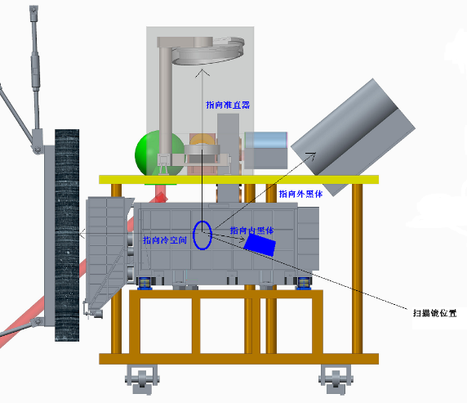
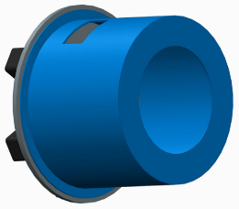
FY-3F/ HIRAS-II Pre-flight calibration
1）Radiometric Calibration
According to the characteristics of large field of view (instantaneous field of view 1°) and small aperture (60mm), the radiometric calibration selection is to use the high-precision low-temperature blackbody and collimator combination method that meets the system aperture and field of view requirements to simultaneously calibrate the 3×3 instantaneous field of view of the system, and the cavity blackbody is placed in the collimator focal plane.The collimator reduces the influence of background radiation and fluctuation on the calibration accuracy by low temperature control.
Collimator
External Calibration Blackbody
Internal Calibration Blackbody
Helium Screen
Scan Mirror
External Blackbody：
Temperature range： 160K-350K
Effective radiation plane ： Φ150mm
Temperature stability： ≤±0.1K/30min
Temperature uniformity： ≤0.2K
Temperature accuracy： ≤0.1K
Emissivity： ε≥0.996

Slide 5
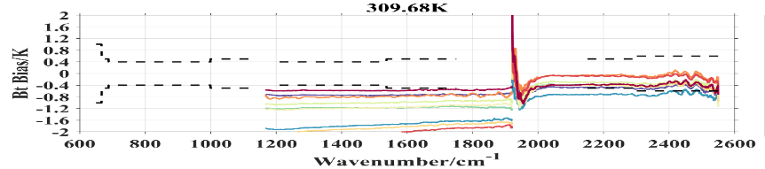
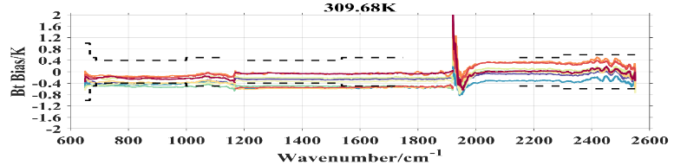
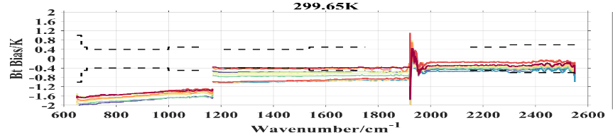
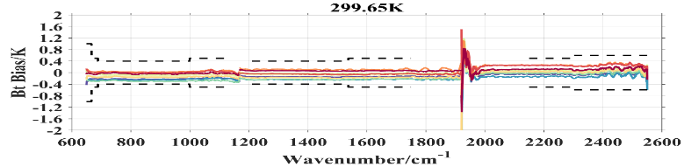
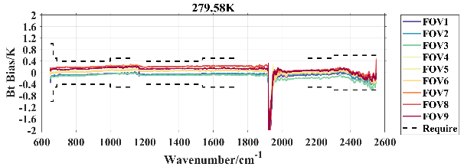
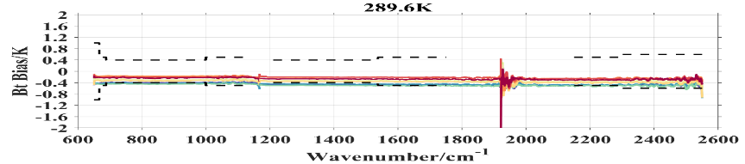
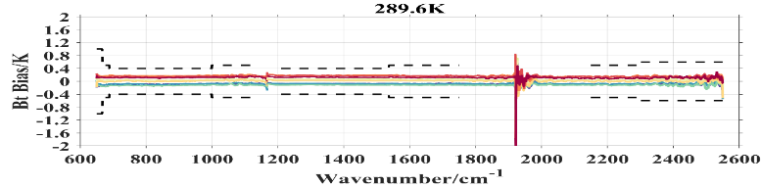
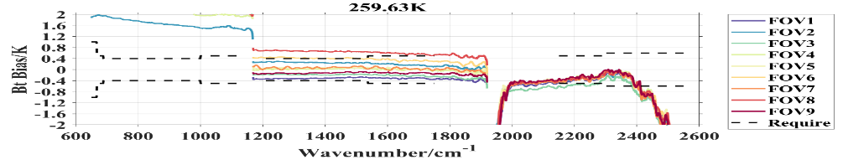
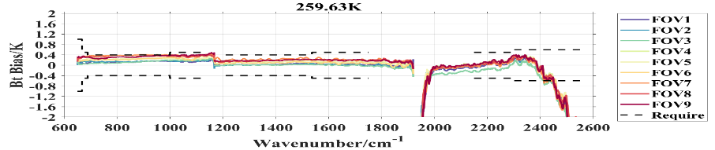
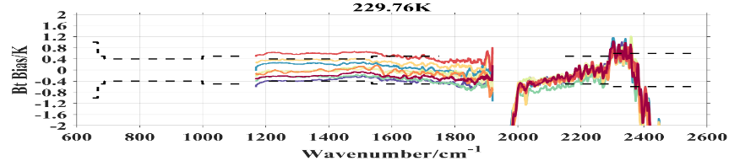
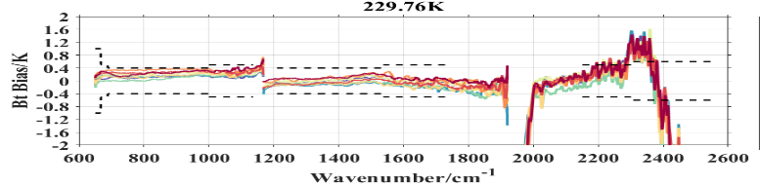
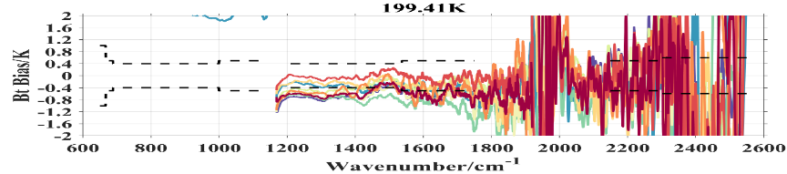
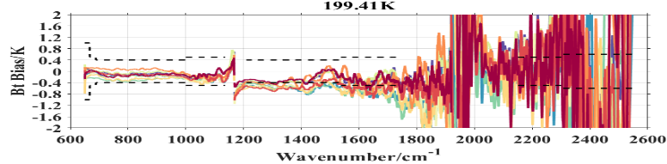
FY-3F/ HIRAS-II Pre-flight calibration
FY-3F/HIRAS-II Radiometric calibration
Pre-launch calibration biases of blackbody at 280K
The LW radiometric calibration biases are better than 0.2K , most channels of MW1 are better than 0.3K, MW2 window area and weak absorption area are better than 0.5K,and a few channels exceed the requirement on orbit.
Before Non-Linearity Correction
After Non-Linearity Correction
LW and MW1 exhibit obvious Non-Linearity characteristics.
• After NL correction, LW and MW channels calibration biases are within 0.5 K.
• MW2 without NL correction, but displays abnormal large bias structure due to weak sigal and large noise for low temperature

Slide 6
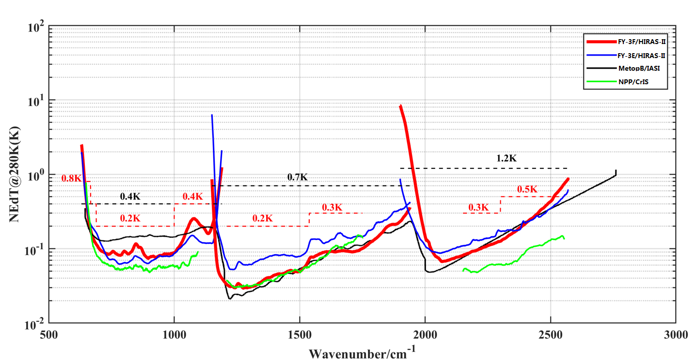
FY-3F/ HIRAS-II Pre-flight calibration
FY-3F/HIRAS-II Noise Performance
Compared to CrIS, IASI and FY-3E/HIRAS-II
Sensitivity of FY-3F/HIRAS-II for MW1 get great improvement from FY-3E/HIRAS-II.

Slide 7
FY-3F/ HIRAS-II Pre-flight calibration
FY-3F/HIRAS-II Spectral calibration
2）Spectral Calibration
Spectral calibration adopts a gas absorption cell + laser as a calibration source, a large field of view collimator to satisfy the optical field of view, and a simultaneous spectral calibration of all detected pixels of the system. The gas absorption cell (different gas or mixed gas) mainly carries out spectral positioning by using multiple standard spectral lines for all the spectral segments, and the laser mainly performs optical off-axis parameter and the instrument line shape under finite optical path difference, the spectral source selection is determined by the positional switching of the rotating mirror in the middle.
FOV | FOV1 | FOV2 | FOV3 | FOV4 | FOV5 | FOV6 | FOV7 | FOV8 | FOV9
LW pre-launch/ppm | 0.32 | 0.21 | 0.42 | -1.05 | 0.32 | 0.11 | 0.95 | -0.42 | 0.42
LW on-orbit/ppm | 0.84 | 0.19 | 2.09 | 1.90 | 3.91 | 2.83 | 0.94 | 1.68 | 1.62
MW1 pre-launch/ppm | 1.46 | 0.62 | -1.69 | -0.15 | 0.54 | 0.77 | 2.23 | 1.08 | -0.15
MW1 on-orbit/ppm | -3.61 | 2.04 | 1.19 | -2.29 | -0.80 | 1.44 | -1.90 | -2.49 | 0.93
MW2 pre-launch/ppm | 1.10 | -0.14 | 1.83 | 0.46 | 1.92 | -0.87 | 1.19 | -0.09 | -0.15
MW2 on-orbit/ppm | -1.50 | -2.06 | -0.65 | -1.26 | 2.69 | -1.69 | -1.72 | -1.70 | -0.64
Blackbody
L_{BB}
Gas cell
window
L₁
τ₁
Gas
L₂
τ₂
Gas cell
window
L₃
τ₃
Interferometer
Spectral calibration biases are within 4 ppm after off-axis parameters adjustment in LW, MW and SW bands.
Spectral calibration biases are within 4 ppm after off-axis parameters adjustment in LW, MW and SW bands.

Slide 8
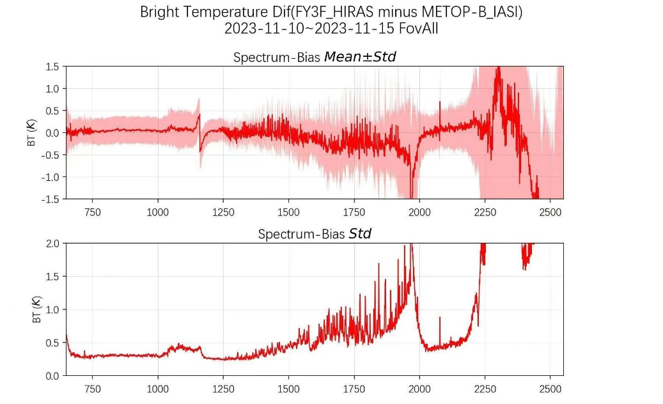
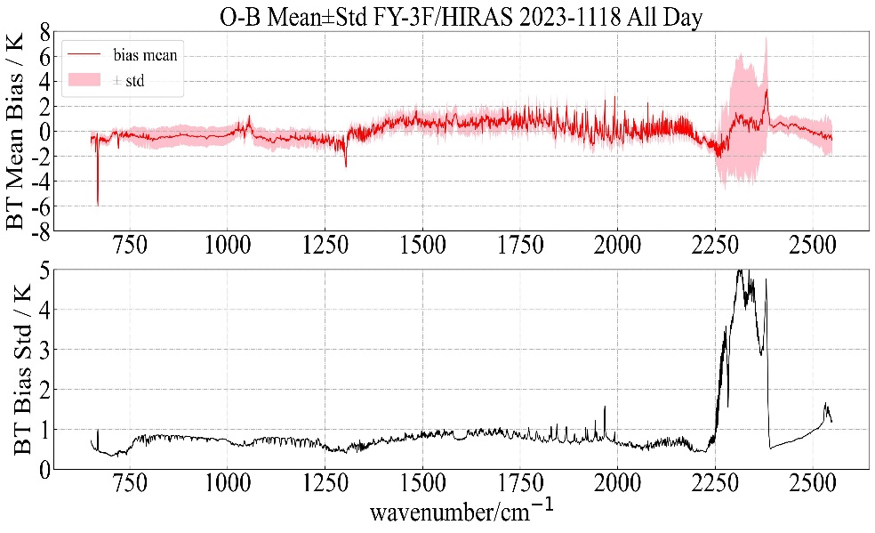
FY-3F/ HIRAS-II –orbit performance
and inter-calibration
FY-3F/HIRAS-II O-B on orbit
FY-3F/HIRAS-II minus Metop-B/IASI on orbit
Perform temperature rise and fall on the blackbody on-orbit.
Based on blackbody temperature and observation data, Derive nonlinear coefficients.
After NL correction, the calibration bias of LW is better than 0.3K, and the std is better than 0.5K;
The calibration bias of MW1 is better than 0.5K, and the std is better than 1K;
MW2 without absorption channel deviation is better than 0.5K.

Slide 9
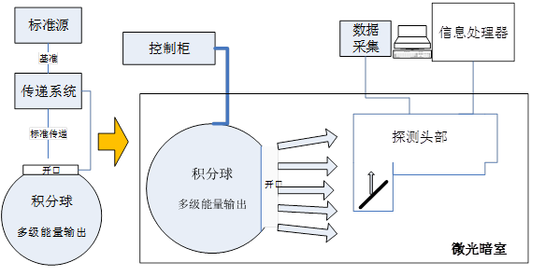
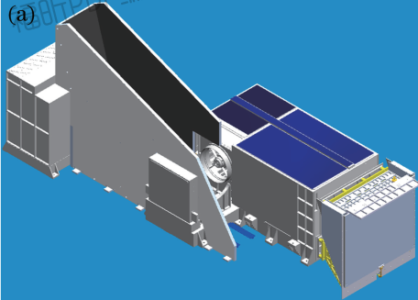
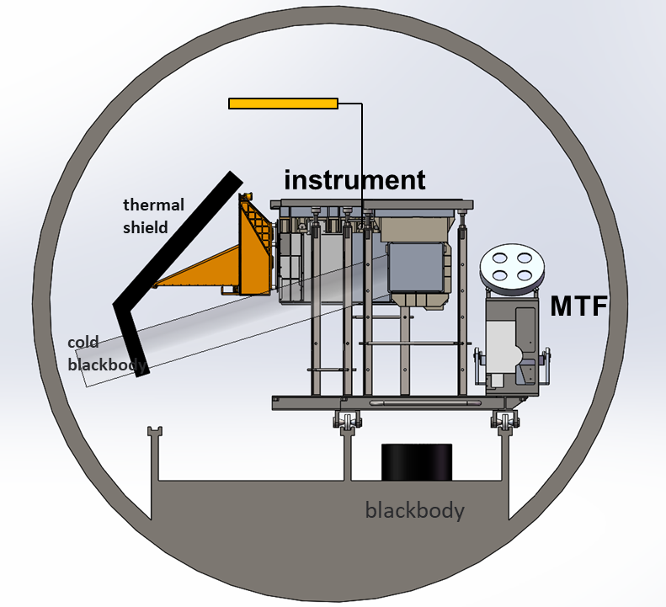
FY-3E/ MERSI-LL Pre-flight calibration
DNB and 1.24um
NIM lamp
DNB bands | Dynamic Range (W/m2/sr) |  |  | SNR (@W/m2/sr) |  |  | Calibration Accuracy
 | Requirement | Measurement |  | Requirement | Measurement |  | Requirement | Measurement
0.7um HGS(9 band) MGS(1 band) LGS(1 band) | 3e-5 | <3e-5 | Y | 200@25.0 | 1280 | Y | 10% | 4.35% | Y
 | 90 | 102 | Y | 7@4e-5 | 13 | Y | 50% | 12.41% | Y
MERSI
Integrating
sphere
Channel | Dynamic Range (W/m² /μm/sr) |  |  | SNR |  |  | Calibration Accuracy
 | Requirement | Measurement |  | Requirement | Measurement
1.24um | 116.051 | 148 | Y | 75 | 170 | Y | 3.28%
The laboratory calibration based on the integrating sphere （1×10^{-6~}143W/（m²·sr）） from the NIM standard
DNB @4e-5 W/m2/sr
SNR >13
Calibration Accuracy <12.4%
Thermal infrared bands
Ch | Dynamic Range(K) |  |  | NEDT（K） |  |  | Calibration Accuracy（K）
um | Requirement | Measurement |  | Requirement | Measurement |  | Requirement | Measurement
3.8 | 186~350 | 355 | Y | 0.25@300 | 0.063 | Y | 0.4@300 | 0.24 | Y
4.05 | 185~380 | 381 | Y | 0.25@300 | 0.063 | Y | 0.4@300 | 0.20 | Y
7.2 | 186~270 | 280 | Y | 0.3@270 | 0.062 | Y | 0.4@270 | 0.22 | Y
8.55 | 185~330 | 340 | Y | 0.25@270 | 0.090 | Y | 0.4@270 | 0.27 | Y
10.8 | 185~345 | 345 | Y | 0.3@300 | 0.226 | Y | 0.4@300 | 0.30 | Y
12.0 | 185~345 | 345 | Y | 0.3@300 | 0.279 | Y | 0.4@300 | 0.33 | Y
The vacuum calibration test based on the blackbody (180-380K) from the NIM standard
NEDT <0.1K (@3.8,4.05,7,2,8.55um)
NEDT <0.28K (@10.8,12um)
2) Calibration Accuracy <0.33K

Slide 10
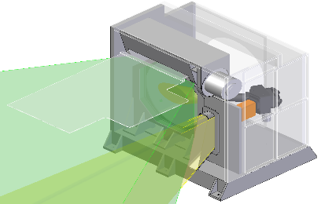
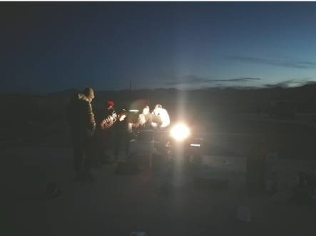
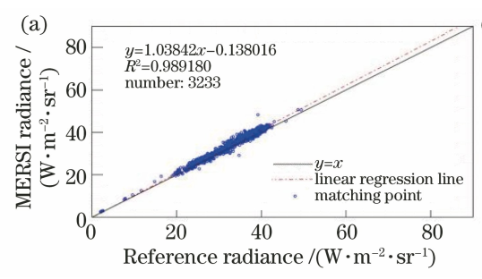
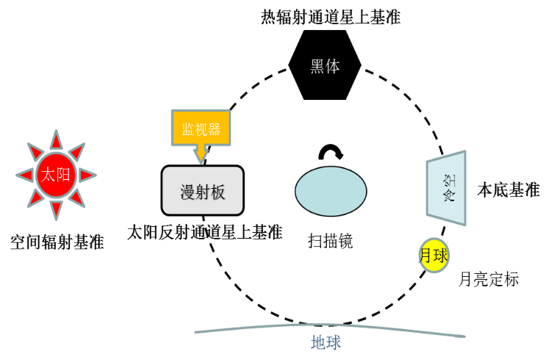
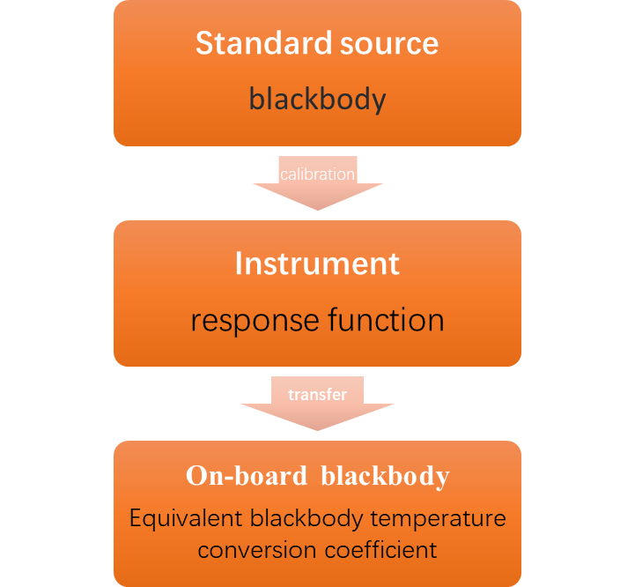
FY-3E/ MERSI-LL on-orbit calibration
DNB
Channel | Dynamic Range(W/m² /sr) |  | SNR |  | Calibration Accuracy
 | Requirement | Measurement | Requirement | Measurement | Requirement | Measurement
0.7um | 3e-5 | <3e-5 | 200@25.0 | 1000 | 10% | HGS bands 20% (site calibration)
 | 90 | 102 | 7@4e-5 | 10 | 50% | LGS bands 1）3.6%（inter-comparison with VIIRS based on the pre-launch calibration coefficients） 2）6.2%（Diffuse Transmission Plate for Onboard Calibrator）
The on-orbit calibration based on the site calibration, onboard calibrator and pre-launch calibration coefficients
1) SNR >10 (HGS) , >1000 (LGS)
2) Calibration Accuracy
>20%(HGS), >3.6%(LGS)
3）Pixel response nonuniformity：<1.8%
Thermal infrared bands
Based on pre-launch calibration coefficients and variable temperature of the on-board blackbody
NEDT <0.75K (@3.8,4.05,7,2,8.55um)
NEDT <0.15K (@10.8,12um)
2) Calibration Accuracy <0.36K
3) Response nonuniformity<2.0%
Channel um | Dynamic Range(K) | NEDT（K） | Calibration Accuracy（K）
3.8 | 355 | 0.05 | \
4.05 | 377 | 0.075 | 0.10
7.2 | 281.5 | 0.02 | 0.23
8.55 | 337.5 | 0.06 | 0.25
10.8 | 345 | 0.13 | 0.36
12.0 | 339 | 0.15 | 0.30

Slide 11
FY-3F/ MERSI-III Pre-flight calibration
FY3F-MERSI: pre-launch calibration and performance
The solar reflective bands
The thermal infrared bands
0.415~2.13um:19 bands
Channel | CWL (μm) | Dynamic Range(W/m²/μm/sr) |  |  | SNR |  |  | Calibration Accuracy
 |  | Requirement | Measurement |  | Requirement | Measurement |  | Requirement | Measurement
1 | 0.47 | 0-642.3 | 674 | Y | 150 | 321 | Y | 5% | 2.8% | Y
2 | 0.55 | 0-582 | 623 | Y | 150 | 365 | Y | 5% | 2.8% | Y
3 | 0.65 | 0-494.9 | 516 | Y | 128 | 336 | Y | 5% | 3.0% | Y
4 | 0.865 | 0-303.2 | 332 | Y | 150 | 308 | Y | 5% | 2.8% | Y
5 | 1.38 | 2-104 | 113 | Y | 150 | 221 | Y | 5% | 4.6% | Y
6 | 1.64 | 0.4-66.5 | 76 | Y | 300 | 422 | Y | 5% | 4.0% | Y
7 | 2.13 | 0.12-27.8 | 34 | Y | 110 | 145 | Y | 5% | 4.0% | Y
8 | 0.412 | 30-162.4 | 178 | Y | 450 | 734 | Y | 5% | 2.8% | Y
9 | 0.443 | 26-127 | 135 | Y | 500 | 1037 | Y | 5% | 2.9% | Y
10 | 0.49 | 22-107 | 121 | Y | 600 | 1010 | Y | 5% | 3.0% | Y
11 | 0.555 | 12-78 | 85 | Y | 600 | 938 | Y | 5% | 2.8% | Y
12 | 0.67 | 9-59 | 65 | Y | 500 | 650 | Y | 5% | 3.5% | Y
13 | 0.709 | 5.8-44 | 49 | Y | 600 | 715 | Y | 5% | 3.1% | Y
14 | 0.746 | 5.3-41 | 47 | Y | 600 | 741 | Y | 5% | 2.9% | Y
15 | 0.865 | 3.4-91.2 | 108 | Y | 600 | 805 | Y | 5% | 3.0% | Y
16 | 0.905 | 6.1-253.5 | 293 | Y | 200 | 392 | Y | 5% | 3.0% | Y
17 | 0.936 | 0-237.3 | 255 | Y | 120 | 442 | Y | 5% | 3.2% | Y
18 | 0.94 | 0-235 | 270 | Y | 250 | 337 | Y | 5% | 3.0% | Y
19 | 1.03 | 5-195 | 233 | Y | 200 | 208 | Y | 5% | 4.3% | Y
Channel | CWL (μm) | Dynamic Range(K) |  |  | NEDT（K） |  |  | Calibration Accuracy（K）
 |  | Requirement | Measurement |  | Requirement | Measurement |  | Requirement | Measurement
20 | 3.8 | 220~350 | 351 | Y | 0.25@300 | 0.04 | Y | 0.4@300 | 0.31 | Y
21 | 4.05 | 220~380 | 382 | Y | 0.25@300 | 0.07 | Y | 0.4@300 | 0.31 | Y
22 | 7.2 | 185~285 | 286 | Y | 0.3@270 | 0.03 | Y | 0.4@270 | 0.31 | Y
23 | 8.55 | 185~330 | 332 | Y | 0.25@270 | 0.05 | Y | 0.4@270 | 0.32 | Y
24 | 10.8 | 185~345 | 349 | Y | 0.3@300 | 0.09 | Y | 0.4@300 | 0.33 | Y
25 | 12.0 | 185~345 | 350 | Y | 0.3@300 | 0.16 | Y | 0.4@300 | 0.34 | Y
The vacuum calibration test based on the blackbody (180-380K) from the NIM standard
NEDT <0.09K (@3.8,4.05,7,2,8.55, 10.8um)
NEDT <0.16K (@12um)
2) Calibration Accuracy <0.35K
The integrating sphere calibration based on the SR4500A spectrometer from the NIM standard
The SNRs at the SWIR bands are better than that for FY3D-MERSI
Calibration Accuracy <3.5%(0.412~0.94um) < 4.6（1-2.13um）

Slide 12
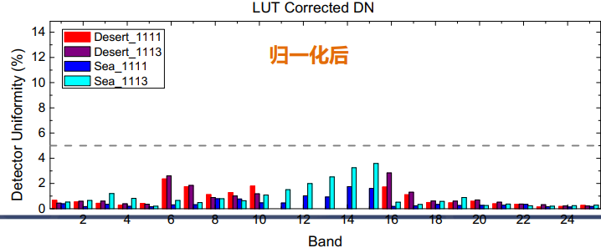
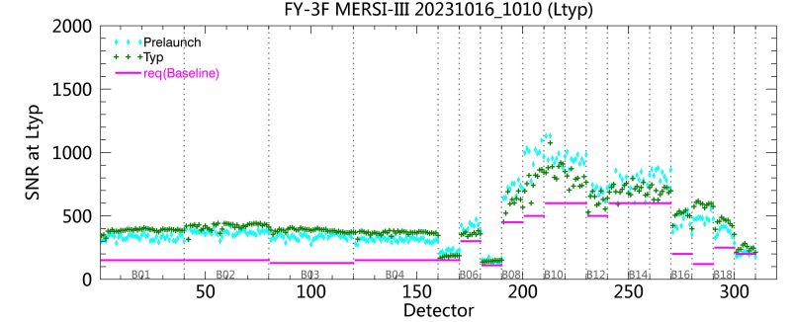
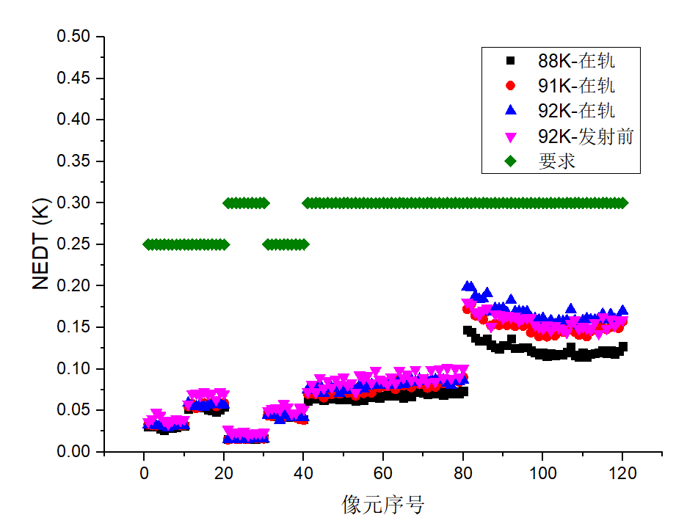

FY-3F/ MERSI-III on-orbit calibration
FY3F-MERSI : on-orbit calibration and performance
The solar reflective bands
response nonuniformity
SNR
The calibration difference between the site calibration, SNO and pre-launch calibration coefficients
Calibration Accuracy
Thermal infrared bands
Channel um | Dynamic Range(K) | Accuracy （K）
3.8 | 352.7 | 0.22
4.05 | 385.3 | 0.01
7.2 | 287.2 | 0.27
8.55 | 330.2 | 0.29
10.8 | 356.5 | 0.12
12.0 | 376.3 | 0.19
Based on pre-launch calibration coefficients and variable temperature of the on-board blackbody
NEDT <0.1K (@3.8,4.05,7,2,8.55um)
NEDT <0.2K (@10.8,12um)
2) Calibration Accuracy <0.29K
3) Response nonuniformity<2.0%
NEDT

Slide 13
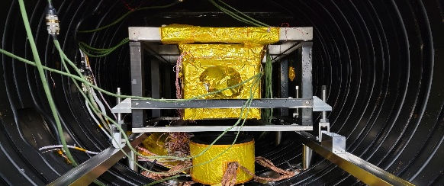
FY-3G/ MERSI-RM Pre-flight calibration
The solar reflective bands
The thermal infrared bands
Ch | CWL (μm) | Dynamic Range(W/m²/μm/sr) |  |  | SNR(@W/m²/μm/sr) |  |  | Calibration Accuracy
 |  | Requirement | Measurement |  | Requirement | Measurement |  | Requirement | Measurement
1 | 0.650 | 0~564 | 610.1 | Y | 150 | 302 | Y | 5% | 3.3% | Y
2 | 0.865 | 0~349 | 403.9 | Y | 150 | 438 | Y | 5% | 3.3% | Y
3 | 0.940 | 0~250 | 265.1 | Y | 300 | 310 | Y | 5% | 3.4% | Y
4 | 1.38 | 2~81 | 87.5 | Y | 150 | 263 | Y | 5% | 3.8% | Y
5 | 1.64 | 0.4~72 | 82.6 | Y | 400 | 401 | Y | 5% | 3.7% | Y
CH | Channel | Dynamic Range(K) |  |  | NEDT（K） |  |  | Calibration Accuracy（K）
 | um | Requirement | Measurement |  | Requirement@300 | Measurement |  | Requirement @300 | Measurement
6 | 3.8 | 186~350 | 352.1 | Y | 0.25 | 0.14 | Y | 0.4 | 0.23 | Y
7 | 10.8 | 185~345 | 350.7 | Y | 0.1 | 0.05 | Y | 0.4 | 0.35 | Y
8 | 12.0 | 185~345 | 351.6 | Y | 0.1 | 0.07 | Y | 0.4 | 0.35 | Y
NIM HTBB
The vacuum calibration test based on the blackbody (180-380K) from the NIM standard
NEDT <0.07K (@10.8,12.0um)
NEDT <0.14K (@3.8um)
2) Calibration Accuracy <0.35K
The integrating sphere calibration based on the SR4500A spectrometer from the NIM standard
SR4500A
MERSI
Integrating
sphere
Integrating
sphere
1)The SNR (@ 1.64, 0.94um) are a little better than the requirement
2)Calibration Accuracy <3.4% (0.65,0.865,0.94um) < 3.8%（1.38,1.64um）

Slide 14
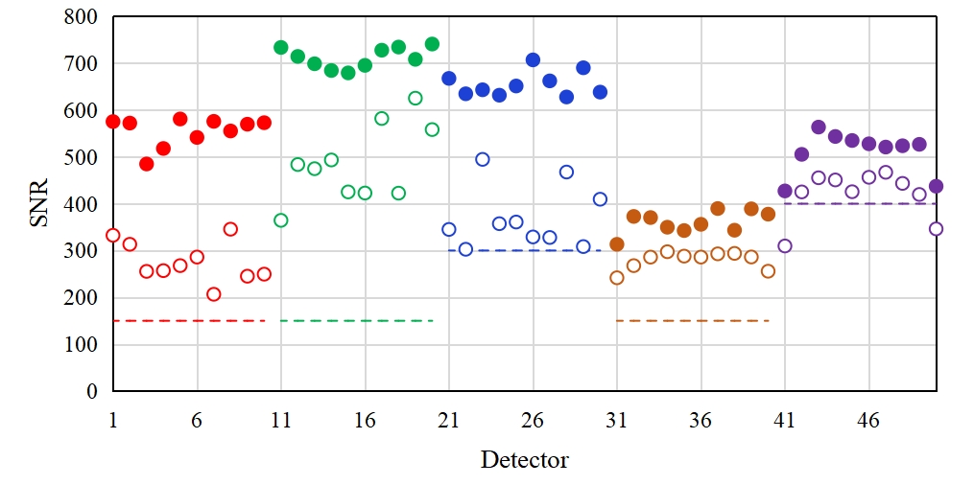
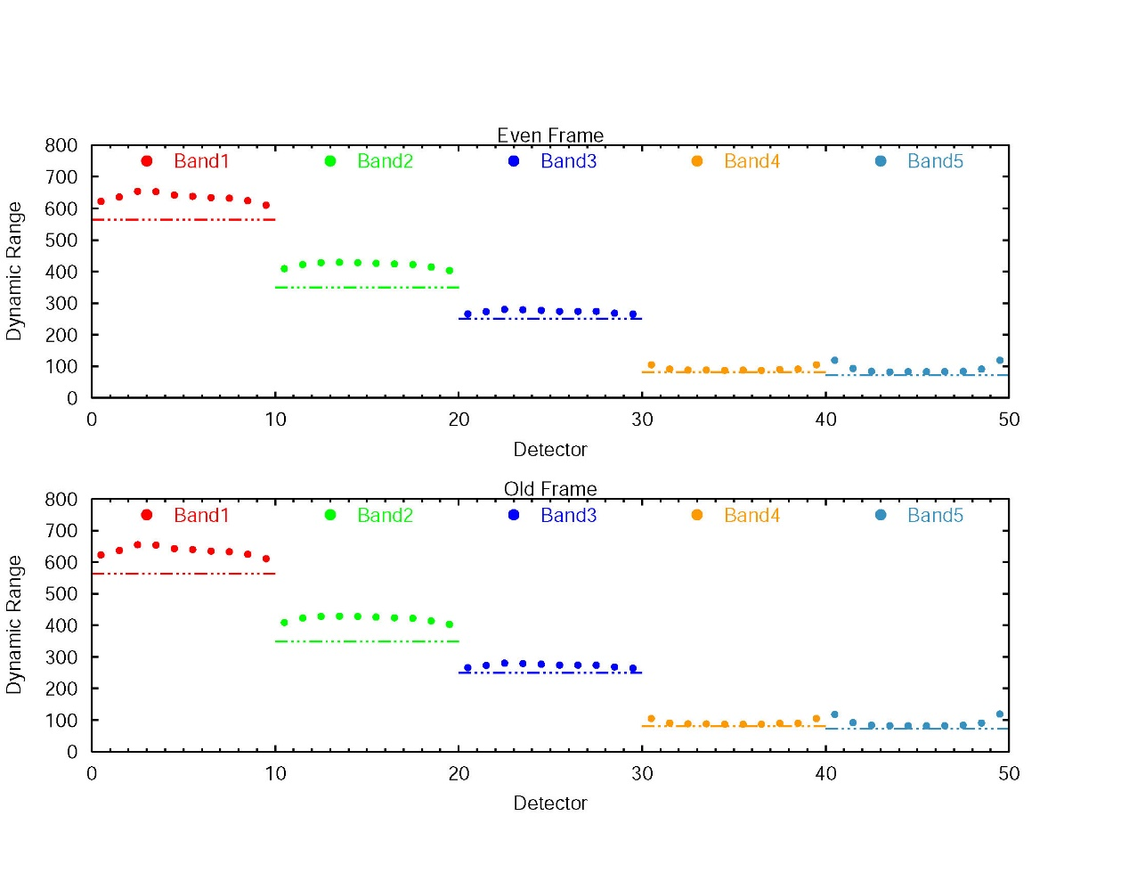
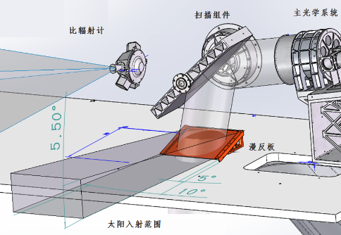
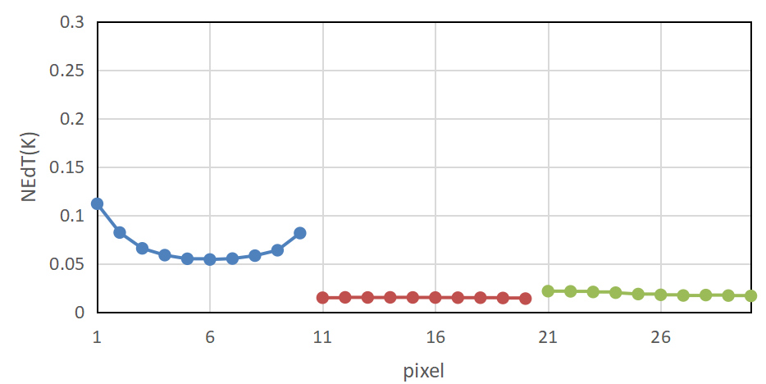

FY-3G/ MERSI-RM on-orbit calibration
The on-orbit calibration based on the site calibration, onboard calibrator and pre-launch calibration coefficients
The solar reflective bands
1) Calibration Accuracy:<4.5%
2）Pixel response nonuniformity：1-4%
A/B
Channel(um) | Accuracy（%）
0.650 | 3.42
0.865 | 4.74
0.940 | 3.25
1.38 | 3.82
1.64 | 2.40
SNR
Dynamic Range
Thermal infrared bands
Based on pre-launch calibration coefficients and variable temperature of the on-board blackbody
1) Calibration Accuracy <0.28K
2) Response nonuniformity<1.0%
NEDT
Channel (um) | Dynamic Range(K) | Accuracy（K）
3.8 | 354.0 | 0.24
10.8 | 351.5 | 0.28
12.0 | 353.0 | 0.06
3）NEDT <0.12K (@3.8,10.8,12um)
NEDT <0.03K (@10.8,12um)

Slide 15
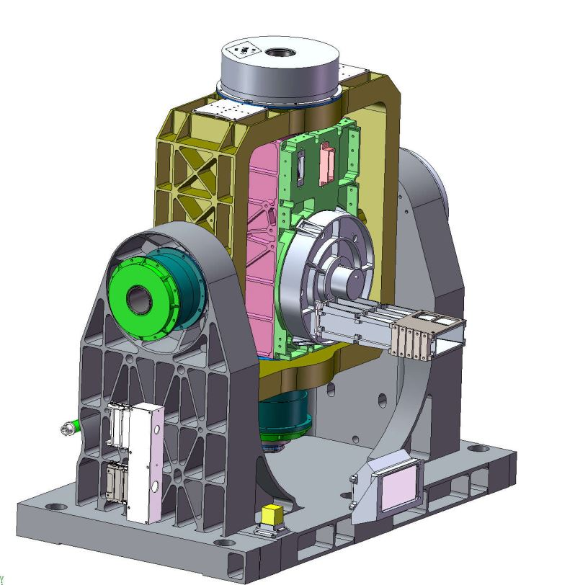
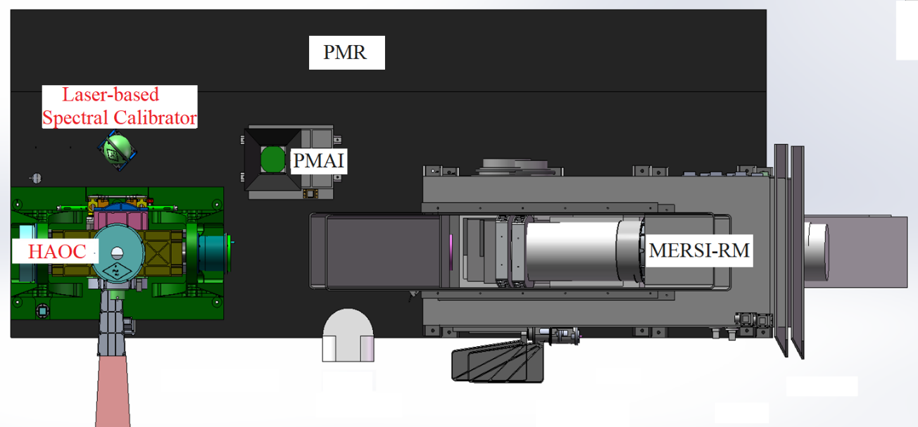
FY-3G/ HAOC
Spectral coverage | 400nm~1060nm
Spectral resolution | 3nm
Spatial resolution | 250m
FOV | 7°
Swath width | 50km
Polarization Sensitivity | ≤1%
2D turntable pointing accuracy | 5″
Ground pointing range | ±30°
Calibration accuracy | < 2%
Using the short-term stability of the instrument to measure the absolute reflectance of the ground, improve the measurement accuracy, and maintain the long-term stability
To cross-calibrate MERSI-RM on orbit
To collect lunar radiation data samples over a large range of moon phase angles
Spectrometer
Mounting Plate
Rotary Encoder
Filter wheels
View / Baffle
DC Motor
Transmissive Diffuser

Slide 16
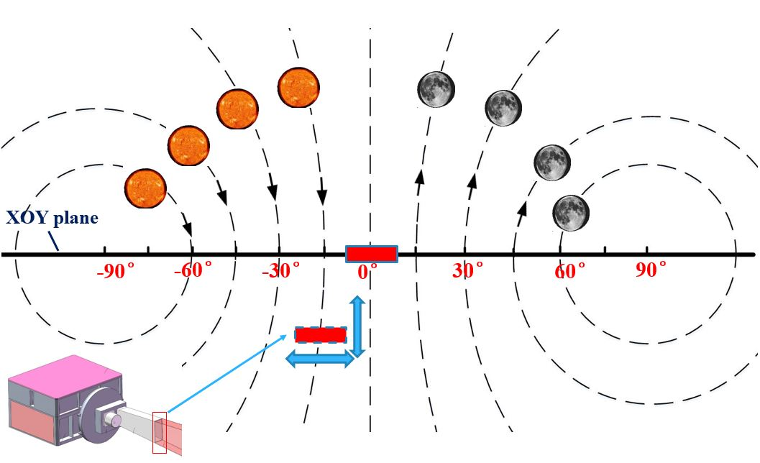
FY-3G/ HAOC
Solar as on-orbit radiation calibration light source
Three solar attenuation filters have attenuation coefficients of 1/4000, 1/25000 and 1/150000 respectively.
Required attenuation coefficient is on the order of 1×10⁻⁵.
the test accuracy of the solar attenuation filters is better than 0.8%.
Uncertainty component | Value / %
Stray light | 0.5
Temperature instability of the filters | 0.1
Instability of the light source | 0.5
Instability of the wide dynamic spectrometer | 0.2
Nonlinearity of the wide dynamic spectrometer | 0.1
Total | 0.78
Observation mode:
Scan the solar disk，the Lunar disk
Scan the solar along the slit
Scan the transmissive diffuser along the slit
Pushbroom imaging

Slide 17
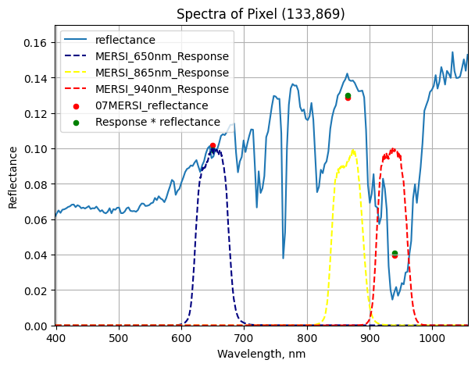
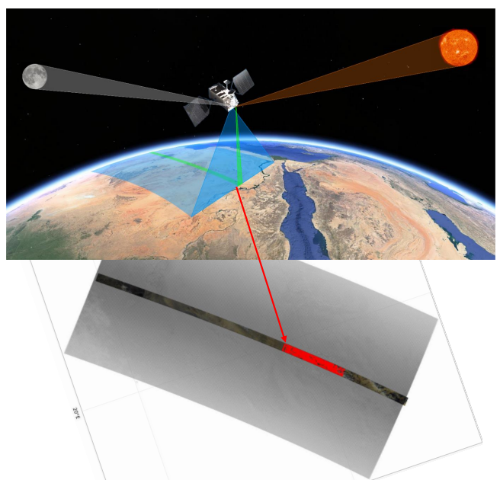
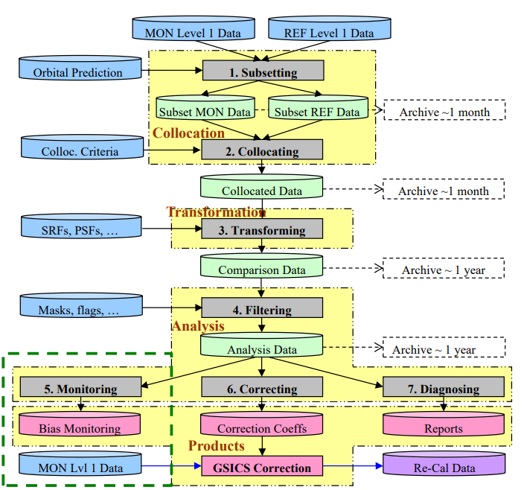
FY-3G/ HAOC inter-calibration
Instrument | MERSI-RM | MERSI-III | HAOC
Channel | Ch1:0.650μm Ch2:0.865μm Ch3:0.940μm Bandwidth:50nm | Ch1:0.47μm Ch2:0.55μm Ch3:0.650μm Ch4:0.865μm Bandwidth:50nm | 0.40μm~1.06μm Bandwidth:3nm

Slide 18
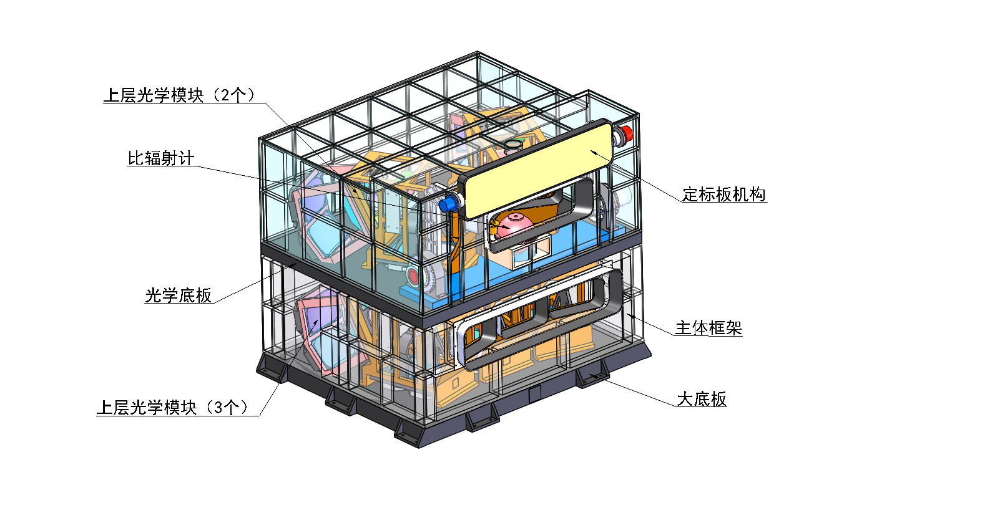
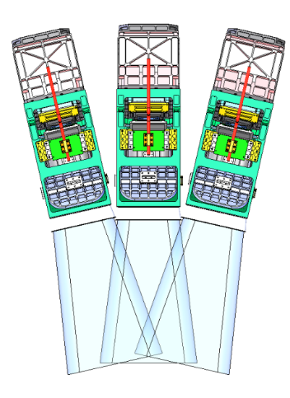
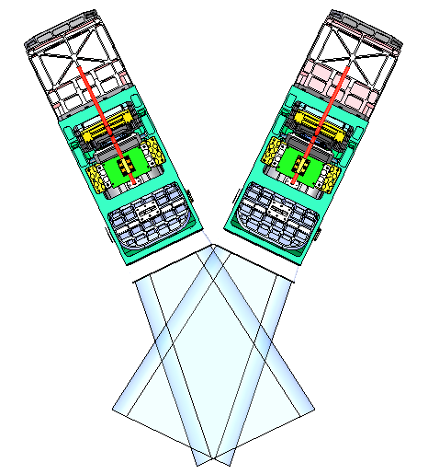
HY-3A/PMRIS(Programmable Medium Resolution Imaging Spectrometer)
Wave range: 0.375~0.91µm,106 selectable channel
1.0 ~ 2.160µm, 4channel
Spectral Resolution: selectable， 5nm,10nm，20nm
Resolution:100m, 200m
Swath: 1000km
Double-layer structure

Slide 19
HY-3A/PMRIS Specification
Bands | Central wavelength（nm） | width（nm） | S/N | 典型辐亮度^{[1]} | 最小输入辐亮度^{[1]} | 最大输入辐亮度^{[1]} | 应 用 对 象
B1 | 385 | 20 | ≥260 | 7.22 | 1.81 | 40.43 | 大气校正、可溶有机物
B2 | 412 | 20 | ≥500 | 7.86 | 1.97 | 35.68 | 叶绿素、CDOM、可溶有机物
B3 | 443 | 20 | ≥500 | 7.02 | 1.76 | 22.58 | 叶绿素、颗粒无机碳、颗粒有机碳、CDOM、总悬浮物、可溶有机物（碳）
B4 | 475 | 15 | ≥500 | 6.19 | 1.55 | 15.24 | 类胡萝卜素
B5 | 490 | 15 | ≥500 | 5.31 | 1.33 | 14.11 | 叶绿素、漫衰减（kd490）、颗粒有机碳、CDOM、PAR、可溶有机物（碳）
B6 | 520 | 20 | ≥500 | 4.58 | 1.15 | 12.09 | 叶绿素、CDOM、可溶有机物（碳）
B7 | 565 | 20 | ≥500 | 3.39 | 0.85 | 10.01 | 叶绿素、漫衰减（kd490）、颗粒无机碳、颗粒有机碳、CDOM、PAR、总悬浮物、可溶有机物（碳）
B8 | 617 | 20 | ≥500 | 2.19 | 0.55 | 9.55 | 总悬浮物、蓝藻
B9 | 640 | 20 | ≥500 | 1.90 | 0.48 | 9.64 | 高浓度泥沙
B10 | 665 | 15 | ≥440 | 1.60 | 0.40 | 9.56 | 荧光基线
B11 | 681 | 10 | ≥340 | 1.45 | 0.36 | 10.14 | 叶绿素、荧光线高度
B12 | 710 | 15 | ≥360 | 1.19 | 0.30 | 10.79 | 高浓度叶绿素、荧光基线、悬浮泥沙
B13 | 744 | 20 | ≥320 | 0.93 | 0.23 | 9.77 | 大气校正、高浓度叶绿素、荧光基线
B14 | 810 | 15 | ≥200 | 0.59 | 0.15 | 8.26 | 水气吸收
B15 | 865 | 40 | ≥230 | 0.45 | 0.11 | 6.3 | 大气校正、颗粒无机碳
B16 | 1020 | 40 | ≥400 | 0.2 | 0.05 | 0.5 | 大气校正、高浓度泥沙
B17 | 1245 | 20 | ≥250 | 0.15 | 0.037 | 0.375 | 大气校正
B18 | 1640 | 40 | ≥180 | 0.088 | 0.02 | 0.2 | 大气校正
B19 | 2135 | 50 | ≥100 | 0.029 | 0.007 | 0.07 | 大气校正

Slide 20
HY-3A/PMRIS 4 different gains
档位 | 动态范围 (mW/cm²/um/sr) | 信噪比1.4%@solar
HG | 0.81≈1.4%@solar | 1307
MG | 3.12≈5.4%@solar | 595.7
LG | 15.44≈26.5%@solar | 402.9
ULG | 59.28≈101.6%@solar | 123
档位 | 档位转换系数
ULG→LG | 3.48
LG→MG | 4.38
MG→HG | 4.95
档位转换动态范围覆盖连续性

Slide 21
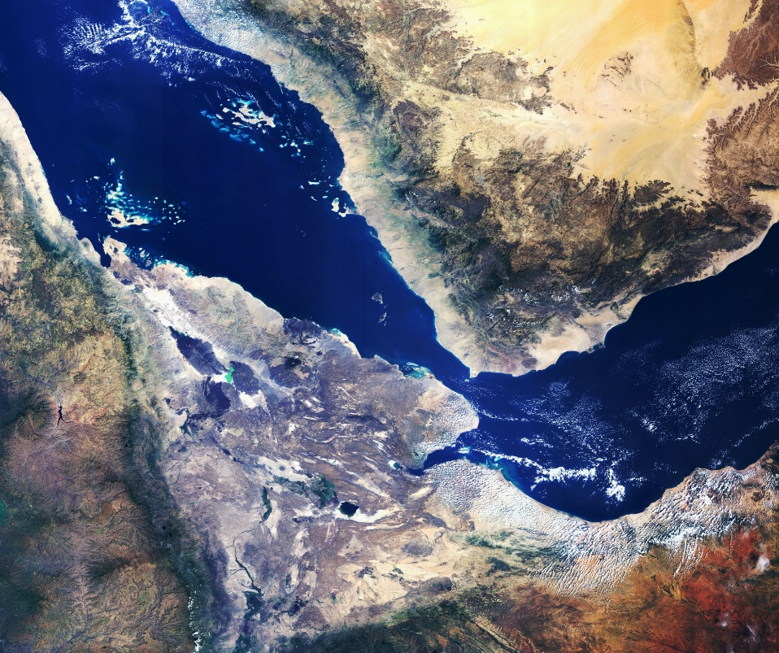
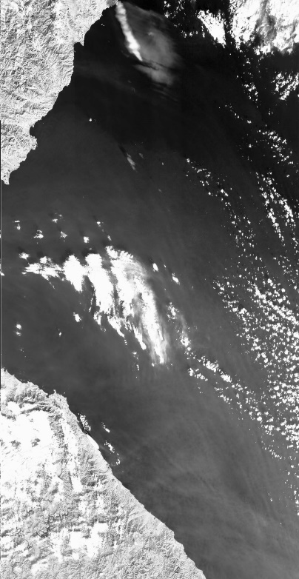
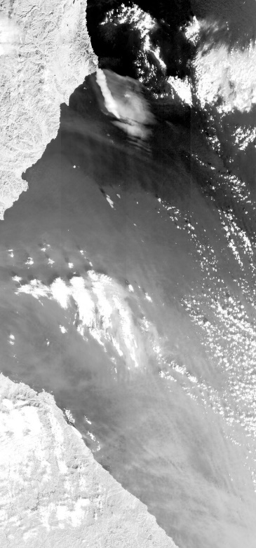
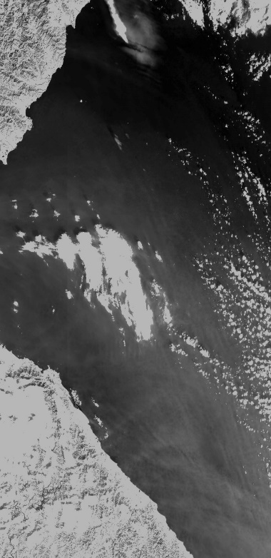
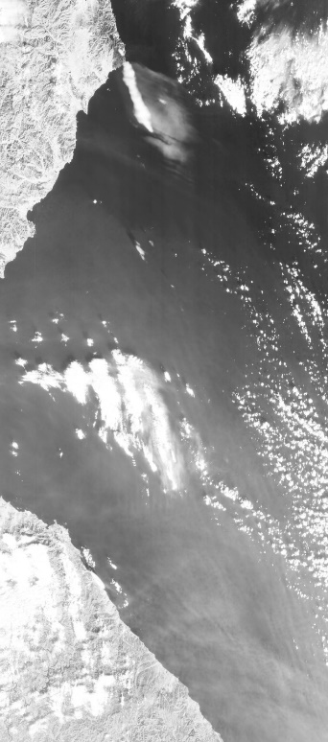
HY-3A/PMRIS on-orbit performance
may be included to GSICS
1245nm
1640nm
1020nm
2135nm

Slide 22

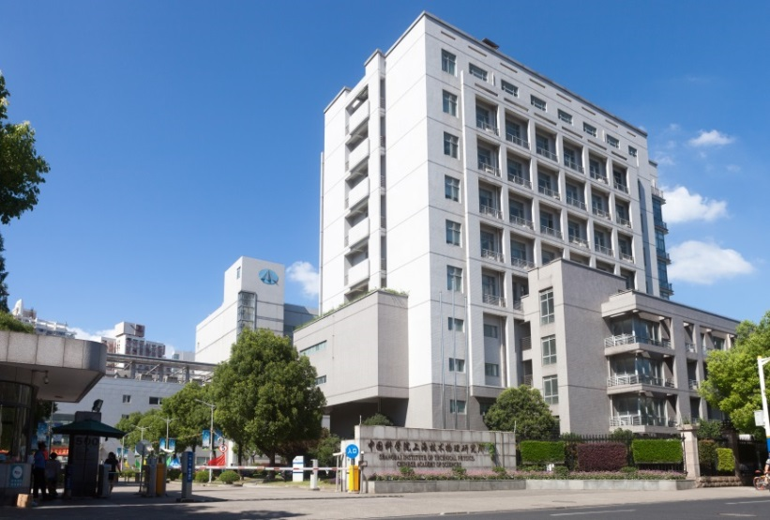

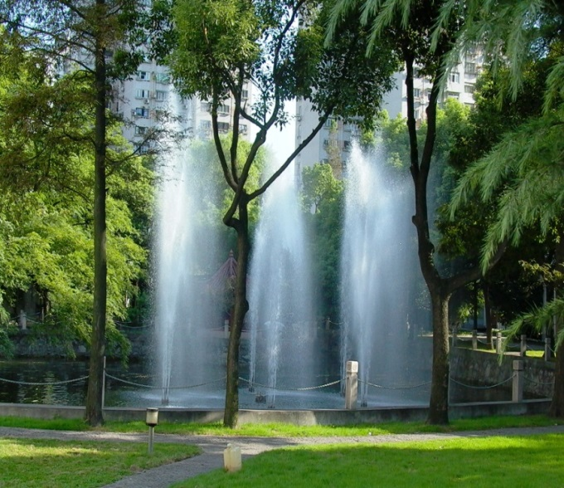


THANKS
Welcom to SITP

