Slide 1
GSICS Agency Report 2024
Jae-Young Byon , Euidong Hwang, Hanbyul Lee, Dohyeong Kim
National Meteorological Satellite Center, Korea Meteorological Administration

Slide 2
Presentation Overview
Summary of Agency’s GSICS Activities, Actions, and Achievements
Support to KMA EP Activities
Support to GDWG and GRWG Activities
Agency’s Calibration Major Updates
Instruments Updates & Planned launches

Slide 3
Summary of KMA’s GSICS Activities, Actions, and Achievements
Current Status of KMA activities
GK2A AMI IR channels
Demo phase of GK2A/AMI IR channels with IASI/CrIS for NRTC and RAC
The evaluation of uncertainty in AMI – IASI inter-calibration is ongoing
GK2A AMI VIS/NIR channels
Lunar calibration, GSICS DCC algorithm, Ray-matching using SNPP, NOAA-20 and -21/VIIRS
Achievements Summary
Update GEO-GEO inter-calibration using Himawari9/AHI in VIS/IR channels.
Calculate re-calibration coefficients for COMS/MI and GK2A/AMI with respect to MetOp/IASI in IR channels.

Slide 4
KMA’s Support to EP Activities
KMA Tasks to support the EP Activities:
Monitor and report on the status of KMA observing system
Personal support
Suggestion new EP member : Jae-Young Byon

Slide 5
KMA’s Support to GDWG Activities
KMA Tasks to support the GDWG Activities:
To set up and operate a GitHub project for GDWG activities
To develop a plotting tool environment in KMA
To review GPRC websites
Overview of the resources and time taken for this support
Hanbyul Lee (new member), 30 days/year

Slide 6
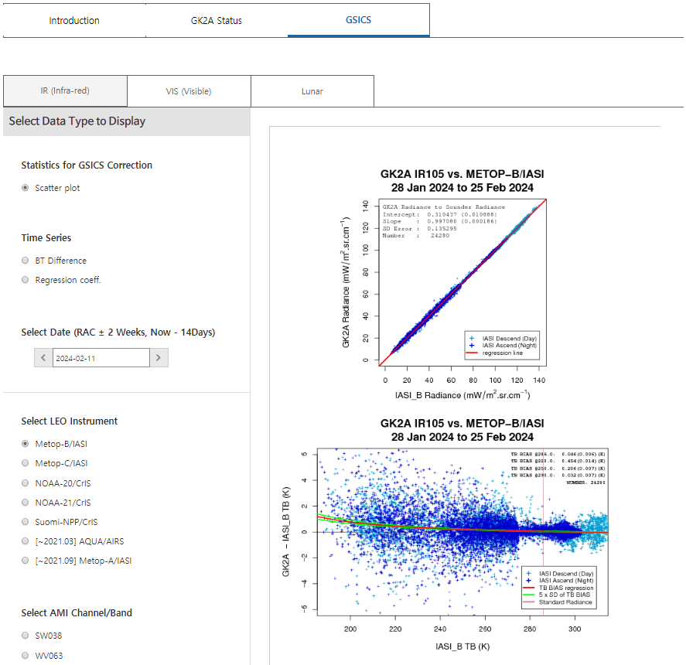
KMA’s Support to GDWG Activities
Updates of monitoring web page
GK2A status page has been added
In addition to NOAA-21/VIIRS and CrIS monitoring page, lunar calibration results have been added
AMI-AHI inter-comparison page will be opened in the second half of 2024.
Landing page:
http://nmsc.kma.go.kr/enhome/html/main/main.do
Event logging:
http://nmsc.kma.go.kr/enhome/html/bbs/listNotice.do?bbsCd=00026
Notes:
.

Slide 7
KMA’s Support to GRWG Activities
KMA Task Summary to support the GRWG Activities:
Monitoring of GEO-LEO using MetOp-B, -C/IASI, SNPP and NOAA-20, -21/CrIS for IR
Application of gap-filling method to inter-calibrate with CrIS
Demo phase for NRTC and RAC data (MetOp-B, -C/IASI, SNPP and NOAA-20/CrIS)
Develop GEO-GEO direct comparison for both IR and VIS channels
Long-term analysis AMI vs AHI (application of SBAF)
Develop and update calibration approaches
Lunar calibration
Ray matching method and GSICS DCC with NOAA-20, -21/VIIRS
Reprocessing of COMS and GK2A data
The long-term data was re-calibrated using MSICC methods
Overview of the resources and time taken for this support
Jae-Young Byon, Hanbyul Lee(VNIR) and Euidong Hwang(IR)

Slide 8
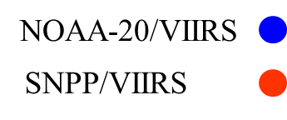
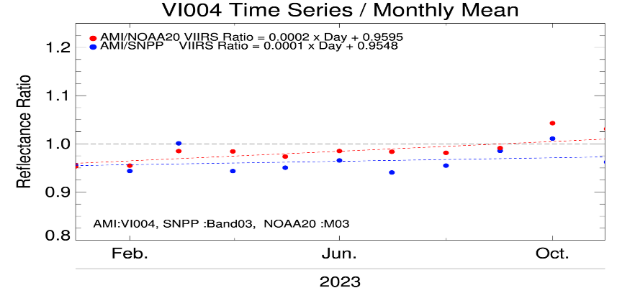
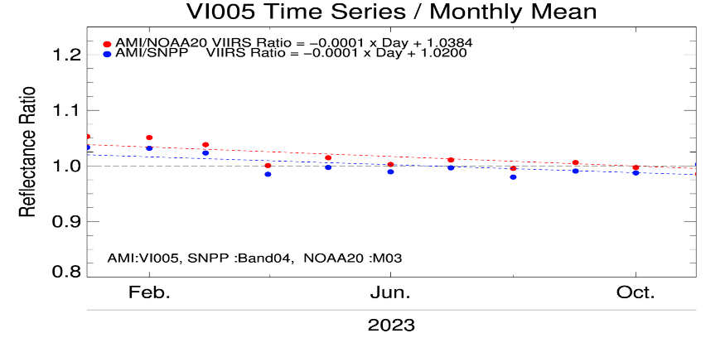
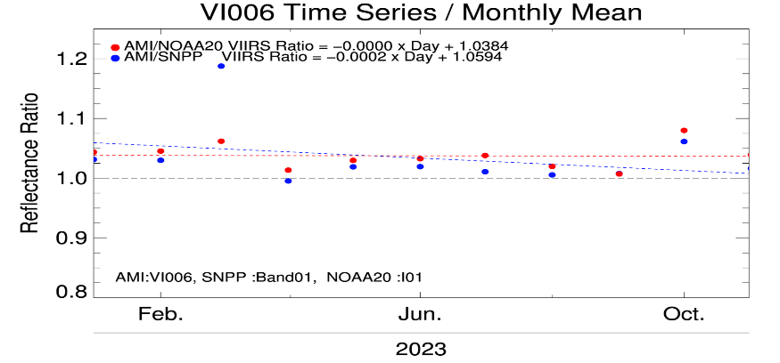
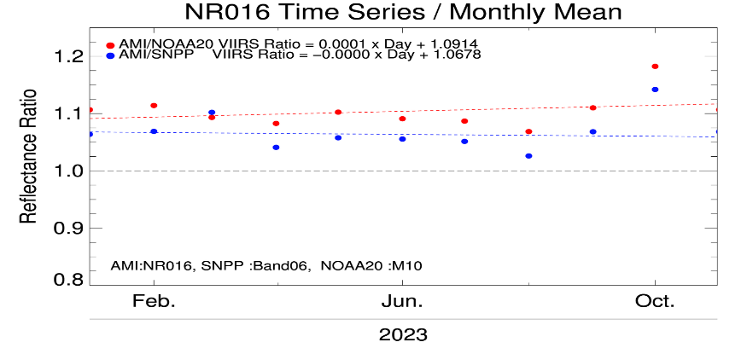
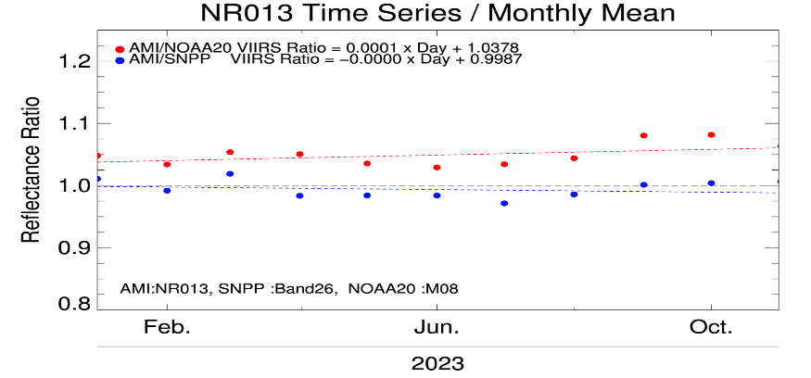
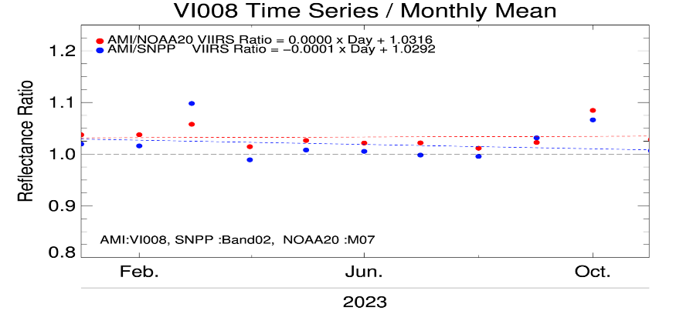
KMA’s Calibration Major Updates (VNIR)
Ray-Matching Method (NOAA-20 and SNPP VIIRS) (Jan. 2023 - Dec. 2023)
Reflectance Ratio = AMI_Ref / LEO_Ref
Reference Satellite | Mean Bias (Uncertainty)
 | VI004 (0.47 μm) | VI005 (0.51 μm) | VI006 (0.64 μm) | VI008 (0.86 μm) | NR013 (1.37 μm) | NR016 (1.61 μm)
NOAA-20/VIIRS | -1.90 (±1.48) | 1.34 (±1.01) | 2.90 (±0.91) | 1.86 (±1.10) | 3.86 (±0.58) | 7.35 (±1.03)
S-NPP/VIIRS | -3.75 (±1.71) | -0.07 (±0.99) | 1.94 (±0.99) | 0.33 (±1.13) | -1.28 (±0.62) | 3.53 (±1.02)
Notes:
This slide shows calibration results for the AMI VIS/NIR channels. Mean bias are mostly less than 5% except for NR016 channel.

Slide 9
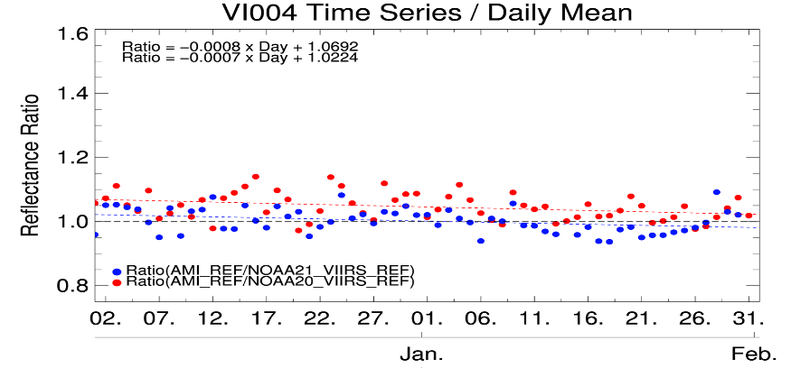
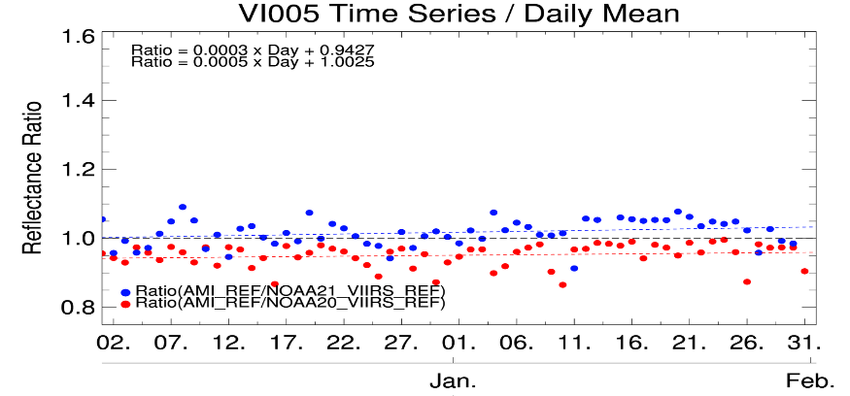
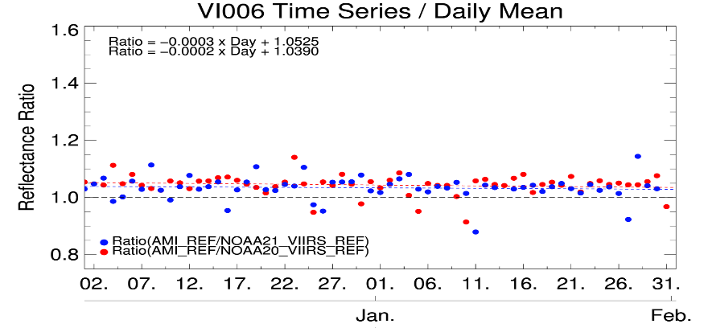
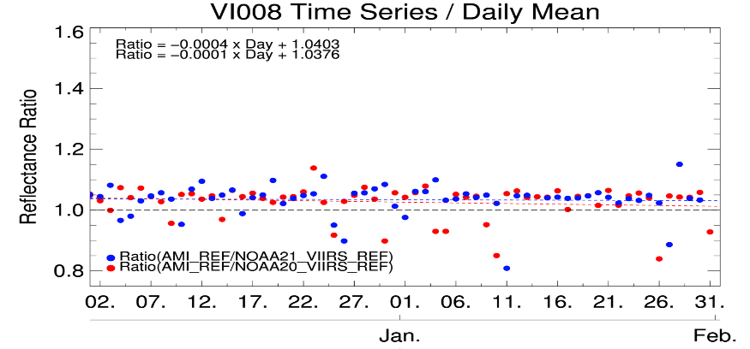
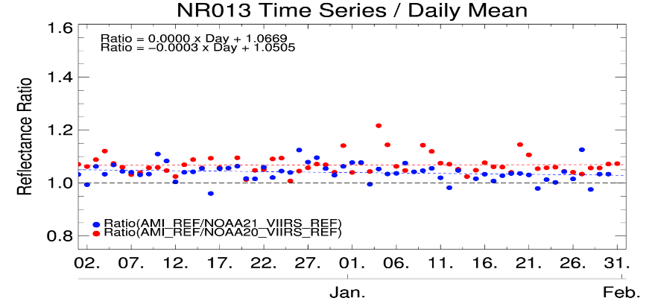
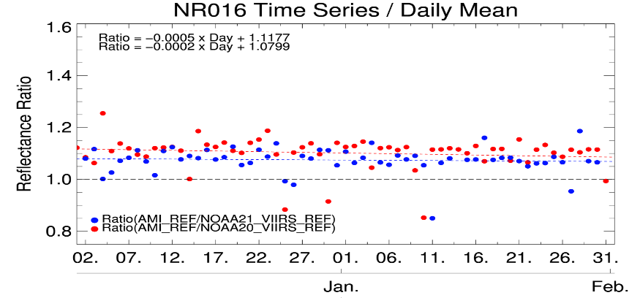
KMA’s Calibration Major Updates (VNIR)
Ray-Matching Method (NOAA-20 and NOAA-21 VIIRS) (Dec. 2023 – Jan. 2024)
Reflectance Ratio = AMI_Ref / LEO_Ref
Reference Satellite | Mean Bias (Uncertainty)
 | VI004 (0.47 μm) | VI005 (0.51 μm) | VI006 (0.64 μm) | VI008 (0.86 μm) | NR013 (1.37 μm) | NR016 (1.61 μm)
NOAA-20/VIIRS | 2.32 (±1.24) | -3.95 (±1.03) | 3.67 (±1.19) | 2.74 (±1.40) | 3.20 (±0.73) | 9.56 (±1.07)
NOAA-21/VIIRS | -2.03 (±1.61) | 2.57 (±1.25) | 2.22 (±1.01) | 2.91 (±1.22) | -2.43 (±0.73) | 6.81 (±0.95)
Notes:
This slide shows calibration results for the AMI VIS/NIR channels. Mean bias are mostly less than 5% except for NR016 channel.

Slide 10
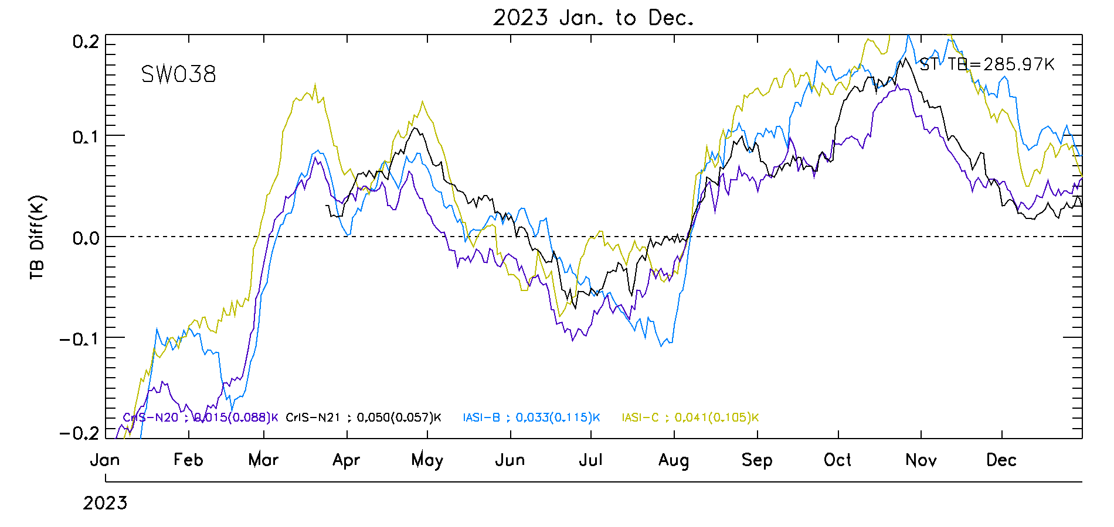
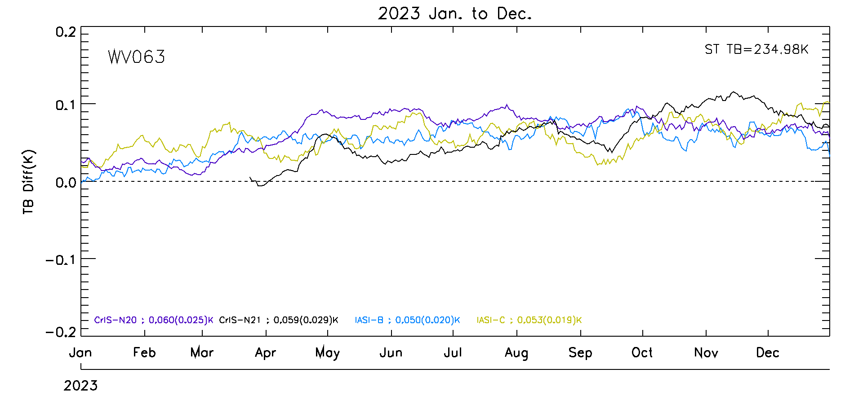
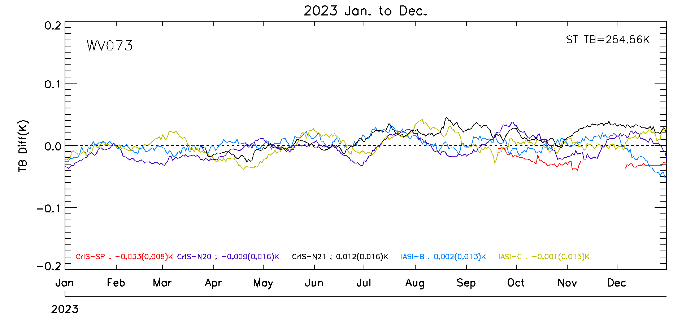
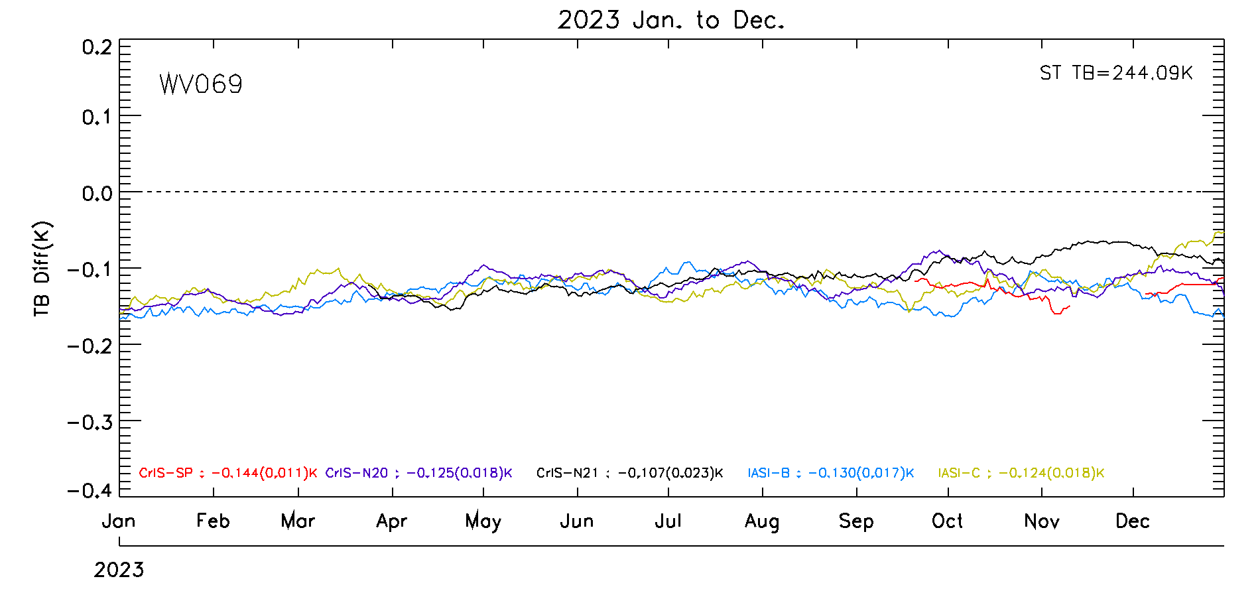
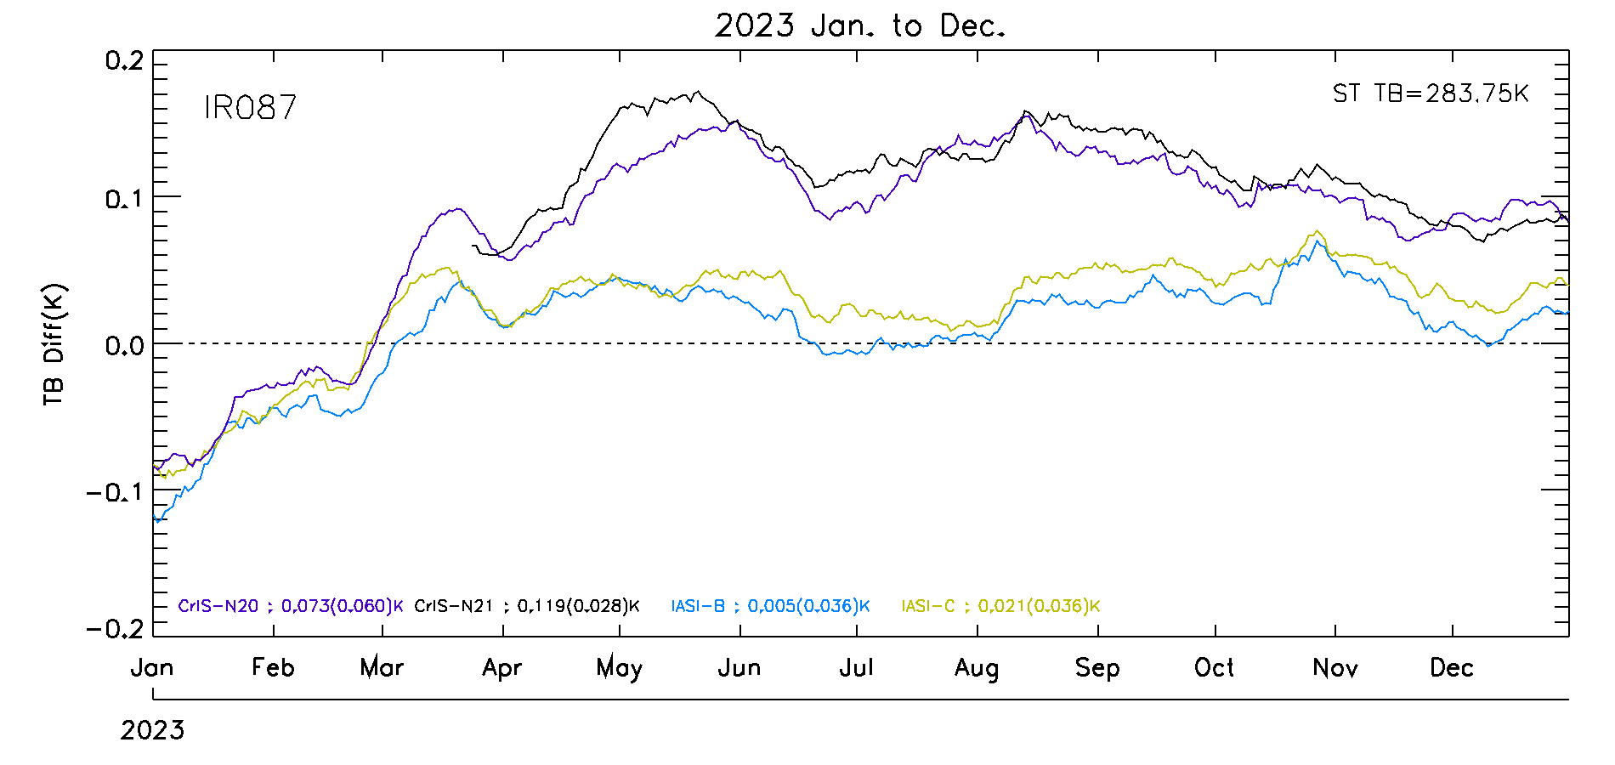
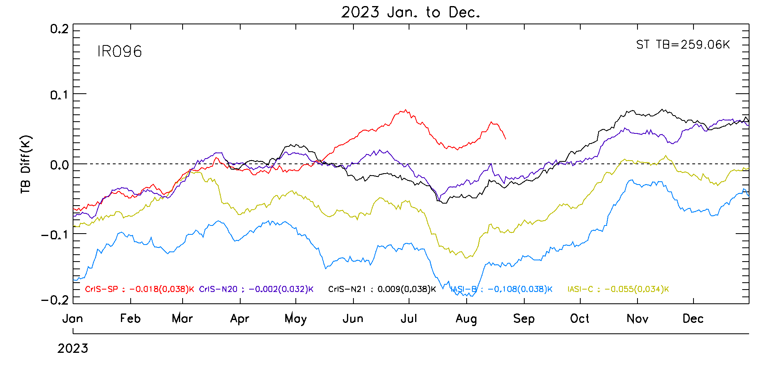
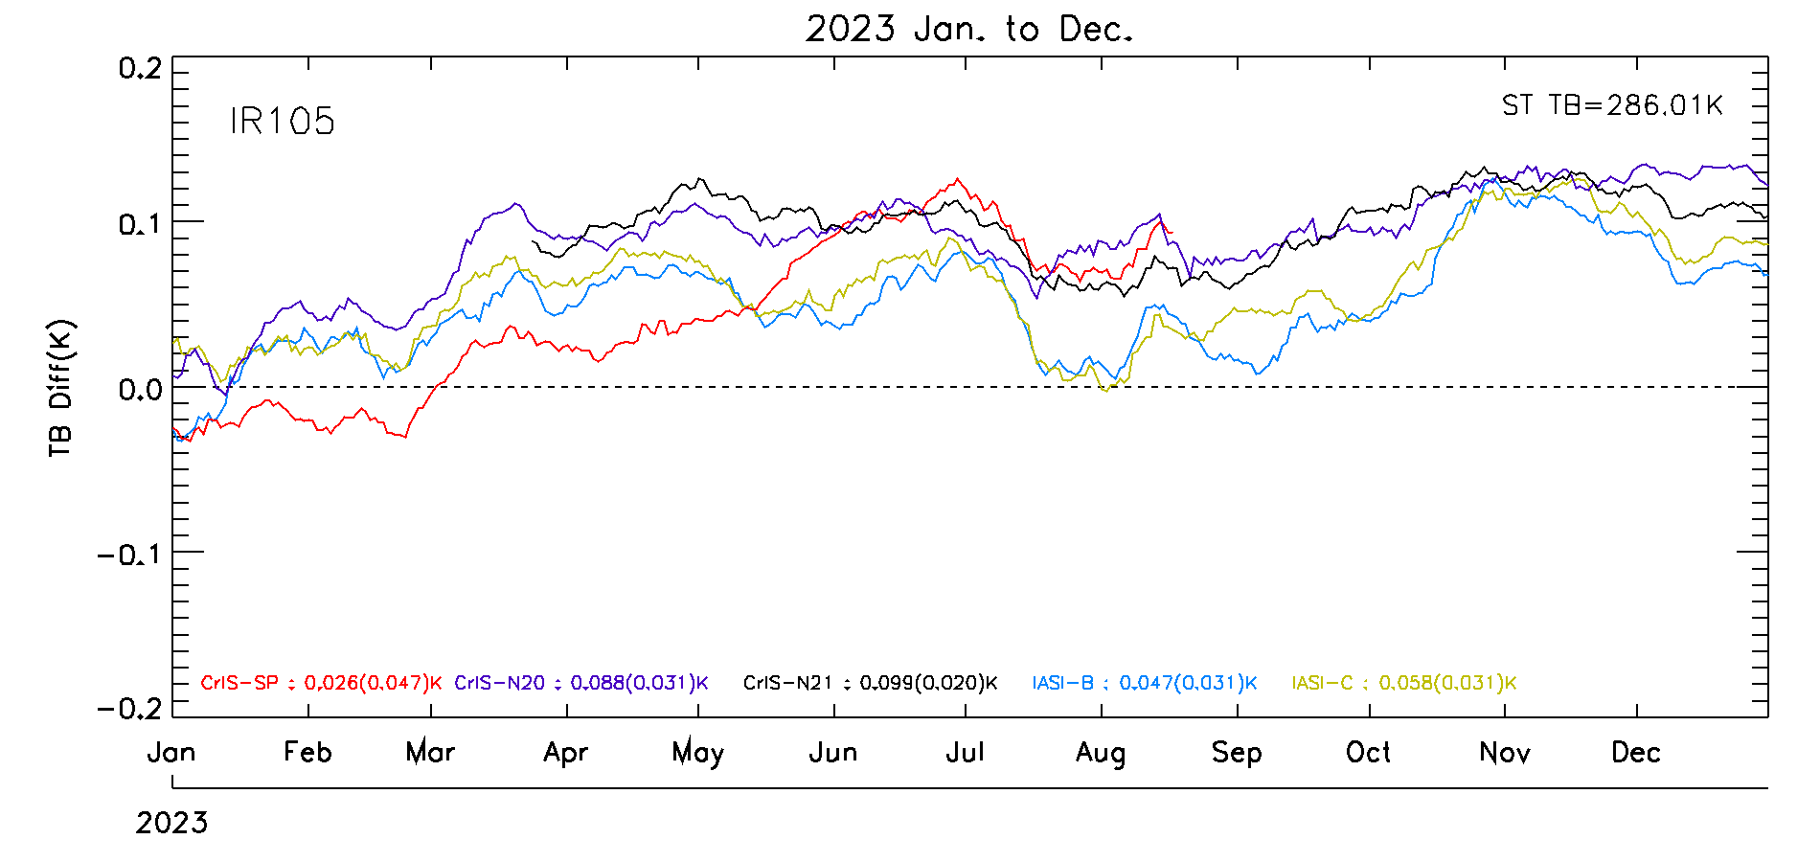
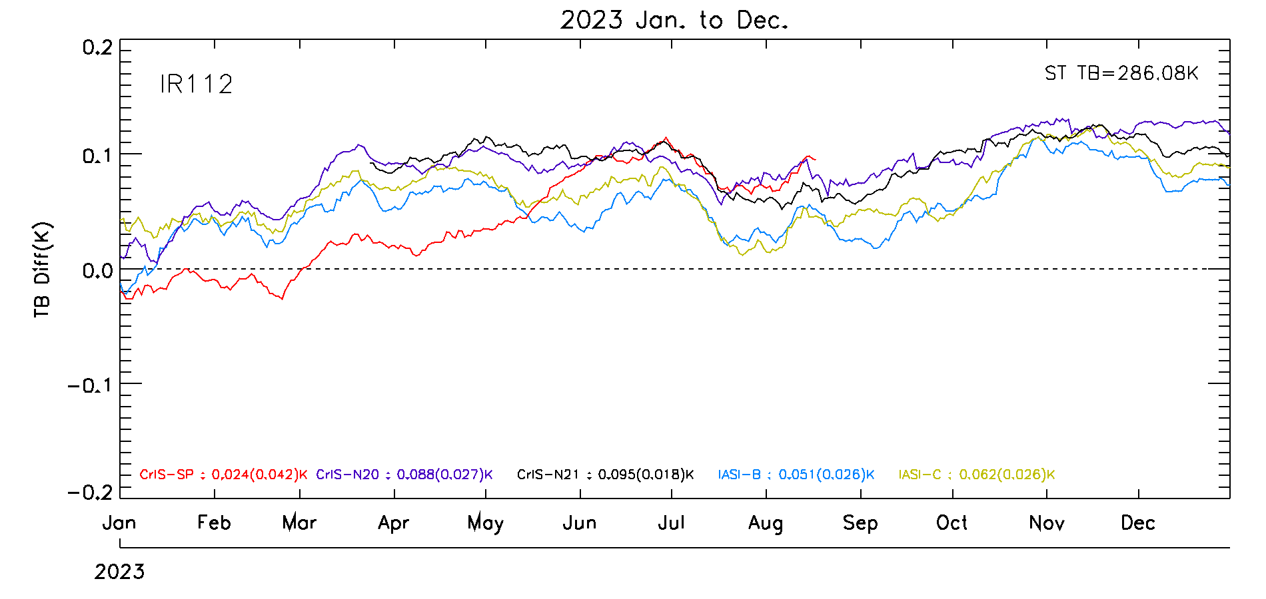
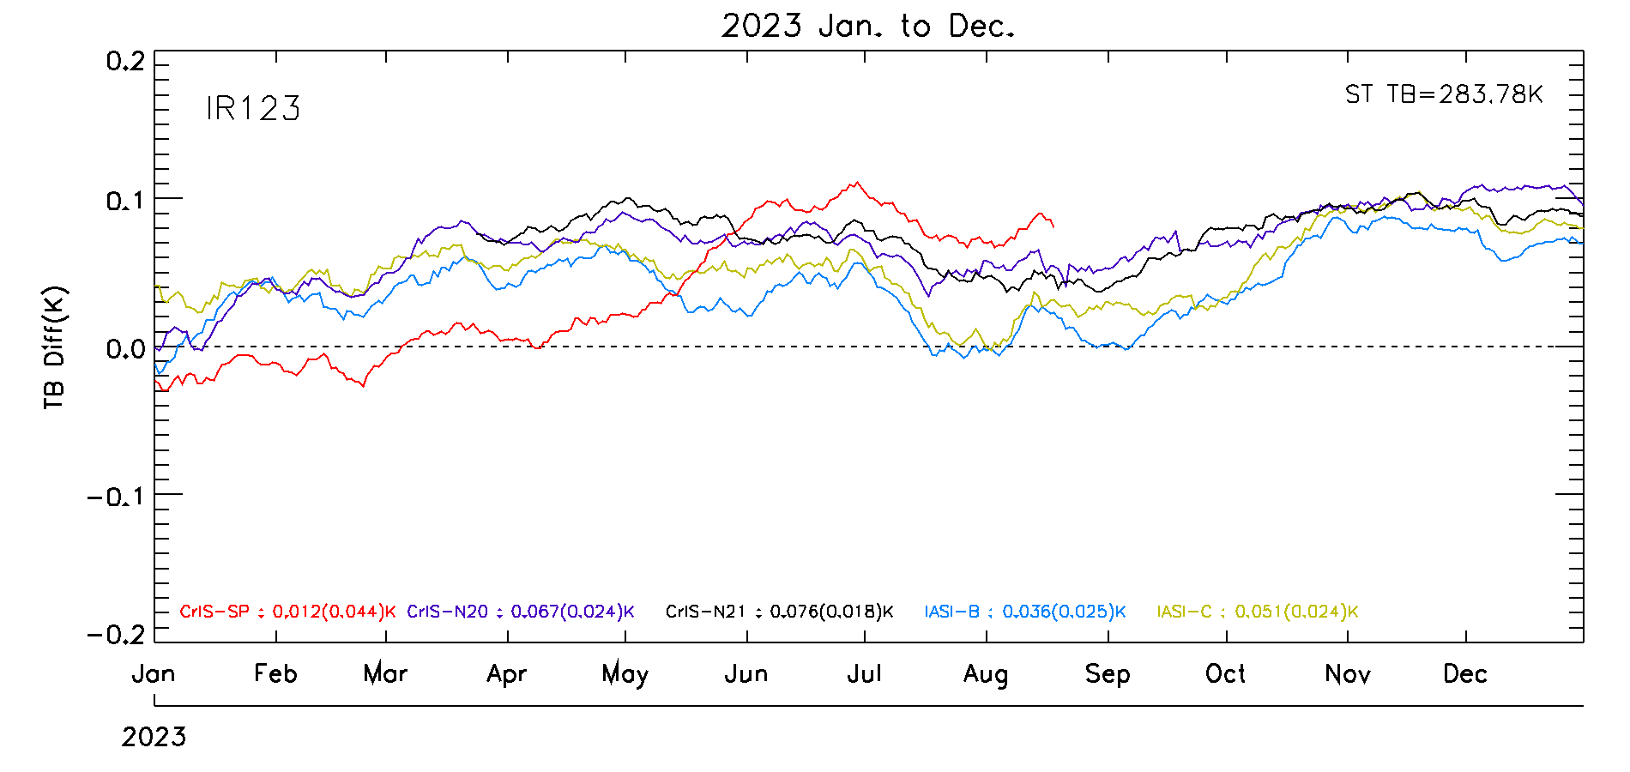
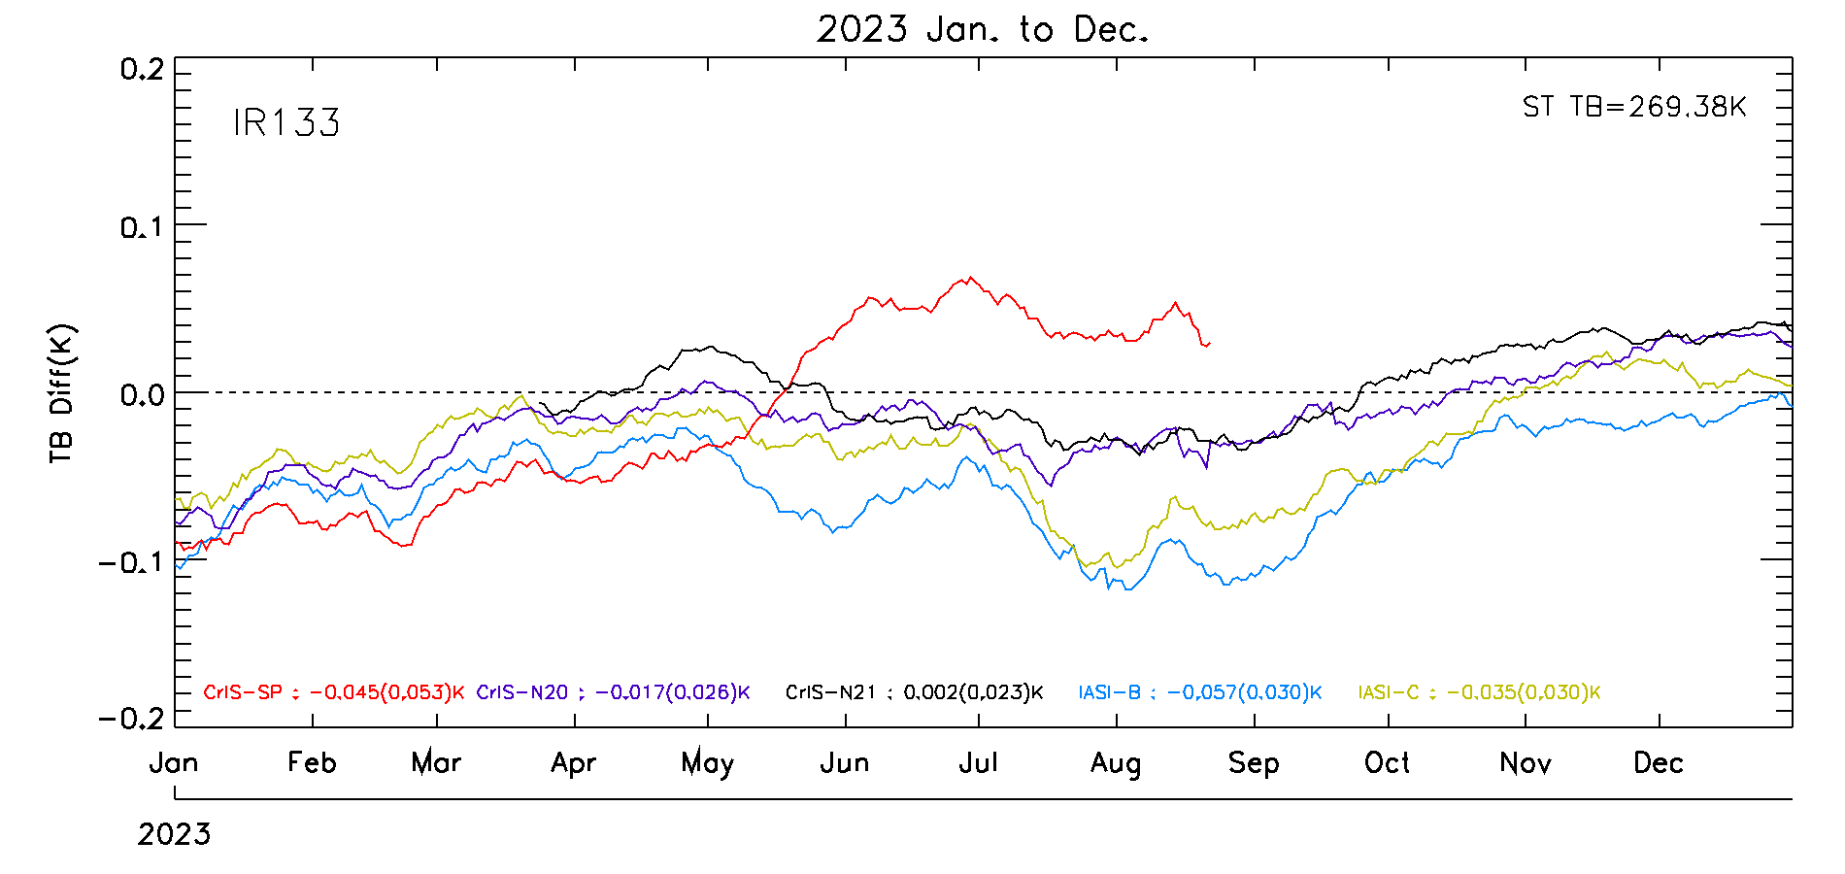
KMA’s Calibration Major Updates (IR)
GEO-LEO using IASI-B, IASI-C, CrIS-NOAA20, CrIS-NOAA21, CrIS-SNPP (CrIS applied gap-filling method for full spectral resolution data) for RAC

Slide 11
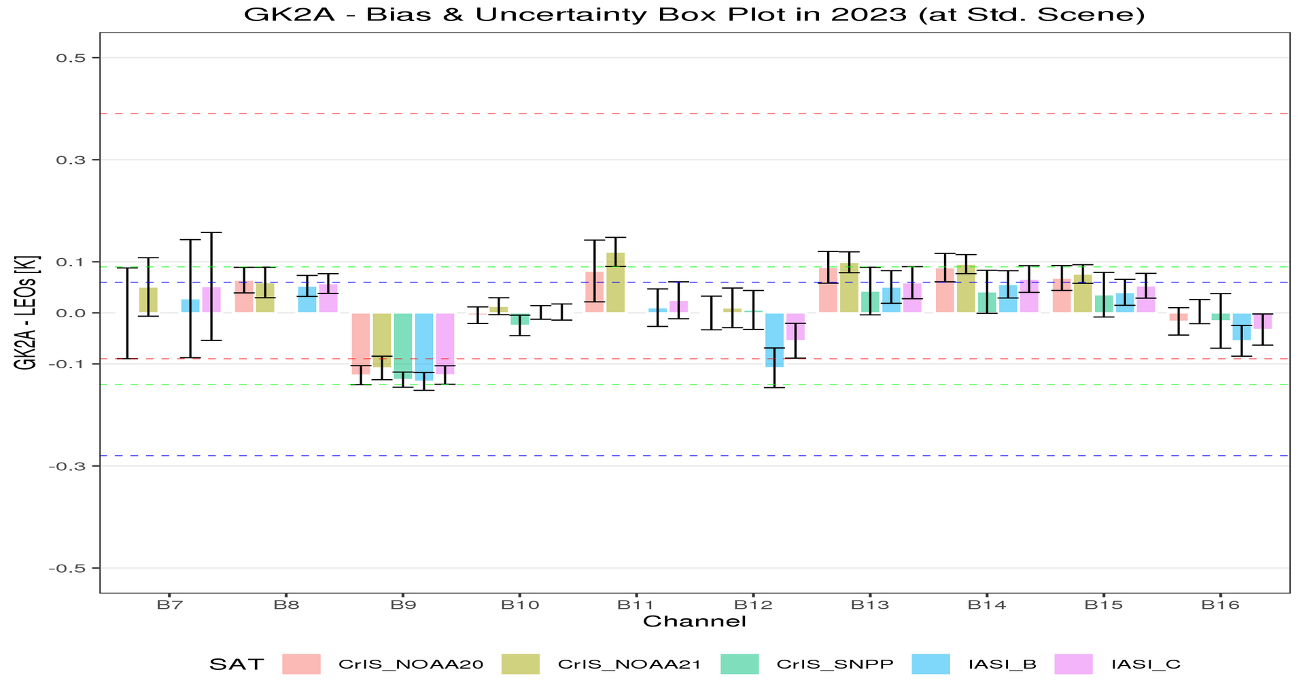
KMA’s Calibration Major Updates (IR)
Statistical Summary of GK2A/AMI IR Calibration Performance in Jan. 2023 - Dec. 2023
NOAA21/CrIS has been added as a reference satellite
GK2A AMI IR channels are stable
GK2A AMI has relatively large negative bias around -0.13K for 6.9µm (WV channel)
SW038 channel has relatively large uncertainty of 0.12 (Metop_B)
SNPP/CrIS failed in LWIR signal processor (Aug. 2023 ~ )
Reference Satellite |  | Bias(Uncertainty)
 |  | SW038 (3.8㎛) | WV063 (6.3㎛) | WV069 (6.9㎛) | WV073 (7.3㎛) | IR087 (8.7㎛) | IR096 (9.6㎛) | IR105 (10.5㎛) | IR112 (11.2㎛) | IR123 (12.3㎛) | IR133 (13.3㎛)
IASI | Metop-B | 0.03 (±0.12) | 0.05 (±0.02) | -0.13 (±0.02) | 0.00 (±0.01) | 0.01 (±0.04) | -0.11 (±0.04) | 0.05 (±0.03) | 0.06 (±0.03) | 0.04 (±0.03) | -0.05 (±0.03)
 | Metop-C | 0.05 (±0.11) | 0.06 (±0.02) | -0.12 (±0.02) | 0.00 (±0.02) | 0.02 (±0.04) | -0.05 (±0.03) | 0.06 (±0.03) | 0.07 (±0.03) | 0.05 (±0.02) | -0.03 (±0.03)
CrIS | S-NPP | - | - | -0.13 (±0.01) | -0.02 (±0.02) | - | 0.01 (±0.04) | 0.04 (±0.05) | 0.04 (±0.04) | 0.04 (±0.04) | -0.02 (±0.05)
 | NOAA-20 | -0.00 (±0.09) | 0.06 (±0.03) | -0.12 (±0.02) | -0.00 (±0.02) | 0.08 (±0.06) | -0.00 (±0.03) | 0.09 (±0.03) | 0.09 (±0.03) | 0.07 (±0.02) | -0.02 (±0.03)
 | NOAA-21 | 0.05 (±0.06) | 0.06 (±0.03) | -0.11 (±0.02) | 0.01 (±0.02) | 0.12 (±0.03) | 0.01 (±0.04) | 0.10 (±0.02) | 0.10 (±0.02) | 0.08 (±0.02) | 0.00 (±0.02)
Standard scene TB(K) |  | 285.9 | 234.9 | 244.1 | 254.5 | 283.7 | 259.1 | 286.1 | 286.0 | 283.8 | 269.4

Slide 12
Planned launches
AMI-II(GK5)
Wavelength(㎛) | GSD(km)
0.47 | 0.5
0.55 | 0.5
0.64 | 0.25
0.86 | 1
1.38 | 2
1.61 | 1
3.9 | 1
6.2 | 2
6.9 | 1
7.3 | 2
8.6 | 2
9.6 | 2
10.4 | 1
11.2 | 2
12.4 | 2
13.3 | 2
0.91 | 1
2.25 | 1
5.1 | 1
GK5/AMI follow-on
AMI follow-on onboard GK5 is planned to be launched in 2031
AMI follow-on will have 18 channels spread over VIS/IR wavelength (some channels improved on spatial resolution)
Channel selection will be determined within this year
Option 1: 2.25 and 5.1 ㎛ channels will be added
Option 2: 0.91, 2.25, and 5.1 ㎛ channels will be added and 0.55 ㎛ will be excluded
GK5/KSEM follow-on
The KSEM follow-on will consist of Proton and Electron Detectors, Charging Monitor, and Magnetometer
Option 2
Option 1

Slide 13
Thank you

Slide 14
KMA’s Personnel supporting GSICS
GSICS EP
Dohyeong Kim
GRWG
Jae-Young Byon(new member), Euidong Hwang and Hanbyul Lee (new member)
GDWG
Hanbyul Lee (new member)
Member | GRWG | GDWG | GEO-LEO | DCC RTM | Moon | GEO-GEO
Jae-Young Byon | Y |  | Y | Y | Y | Y
Euidong Hwang | Y |  | Y |  |  | Y
Hanbyul Lee | Y | Y |  | Y | Y | Y

