Slide 1
GSICS Agency Report
2024
Presenter
Philippe Goryl
European Space Agency

Slide 2
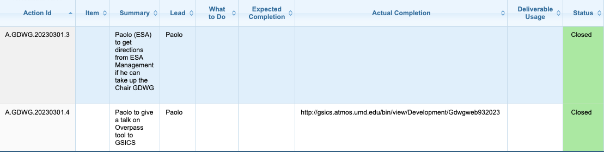
Summary of Agency’s GSICS Activities,
Actions, and Achievements
Actions for ESA
  https://www.star.nesdis.noaa.gov/smcd/GCC/MeetingActions.php

Slide 3
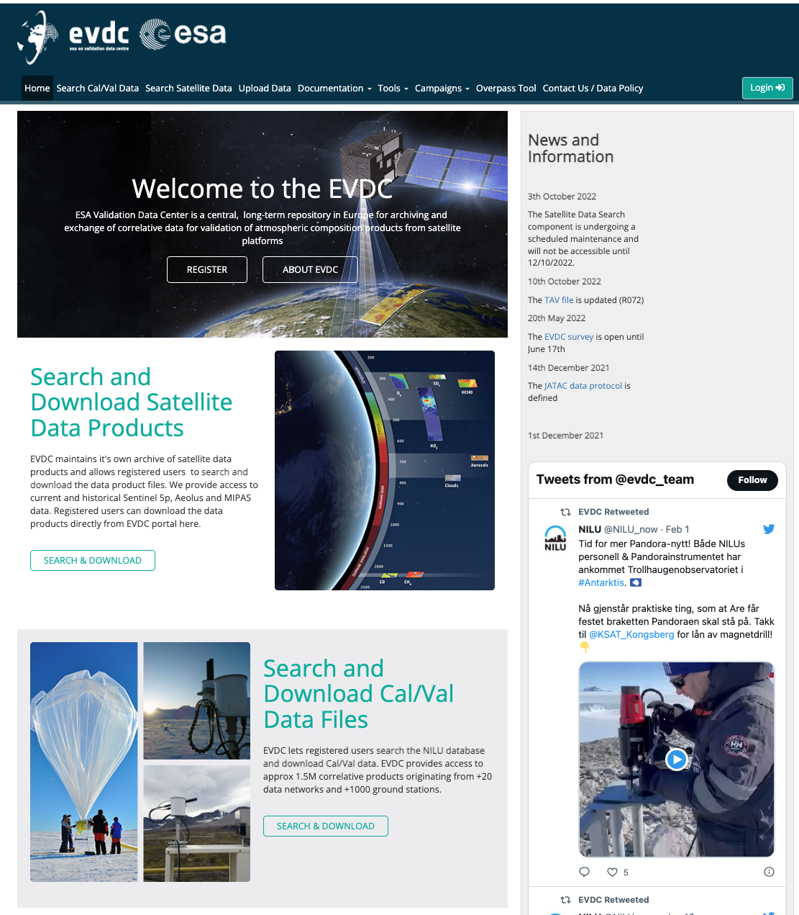
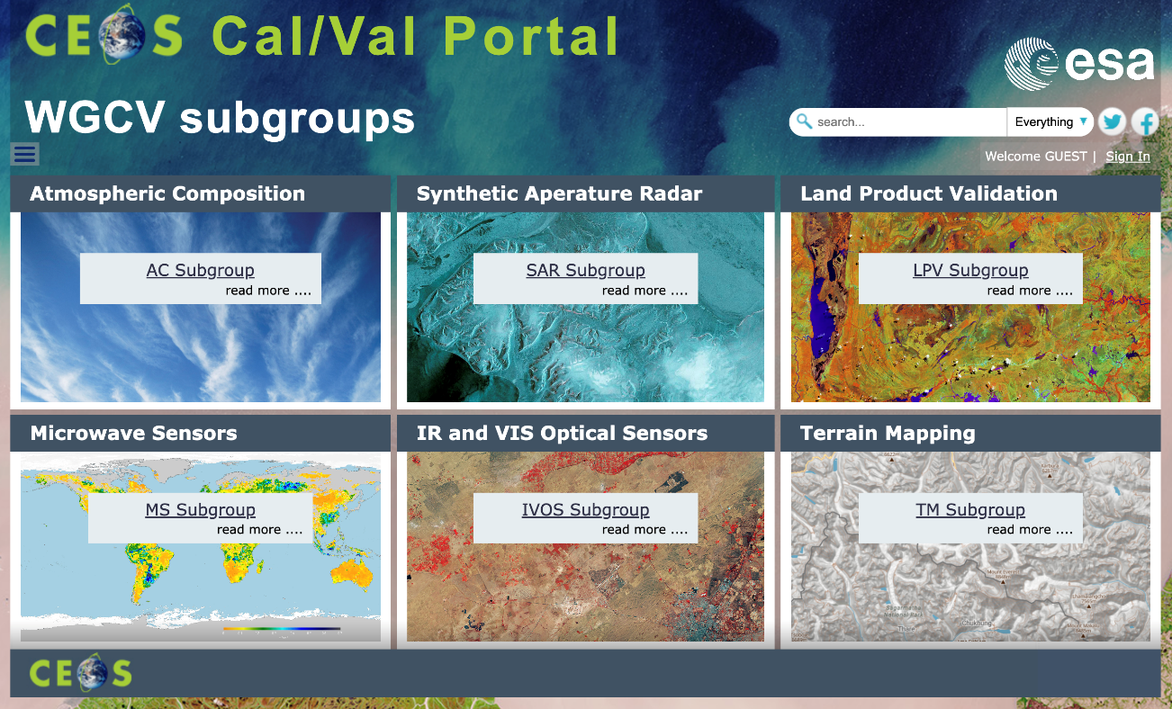
Agency’s Support to GDWG Activities
Status and updates of the main webportals supporting cal/val activities in different domains:
CEOS Cal/Val portal (https://calvalportal.ceos.org/)
ESA Atmospheric Validation Data Centre (EVDC) (https://evdc.esa.int/)
Pi-MEP Salinity (https://www.salinity-pimep.org/)
Quality Assurance for Soil Moisture (https://qa4sm.eu/)
(see P. Castracane presentation GDWG breakout Session 13rd March 09:15 CET)

Slide 4
Agency’s Support to GRWG Activities
GSICS Annual Meeting 11 - 15 March 2024 - ESA contributions​
Session​ | Title ​ | Presenter​ | Date/Time CET​
VIS/NIR (and Lunar Session)​ | TRUTHS status ​ | Thomas August (ESA) ​ | 12.03.2024/afternoon​
VIS/NIR (and Lunar Session)​ | 20+ years harmonized data record of land surface reflectances from SPOT-VGT-1, VGT-2 and Proba-V sensors​ | Iskander Benhadj (VITO)​ | 12.03.2024/afternoon​
VIS/NIR (and Lunar Session)​ | LIME project updates​ | Marc Bouvet (ESA)​ | 12.03.2024/afternoon​
Microwave​ | ESA Passive Microwave Activities​ | Raffaele Crapolicchio (Serco for ESA/ESRIN)​ | 14.03.2024/08:50 ​
UVSN ​ | FDR4ATMOS updates​ | Guenter Lichtenberg (DLR).​ | 13.03.2024/17:30​
Plenary Day 2​ | CEOS/WGCV​ | Philippe Goryl​ | 12.03.2024/11:45​
Space Weather​ | ESA report​ | Hugh Evan​ | 12.03.2024/15:45​

Slide 5
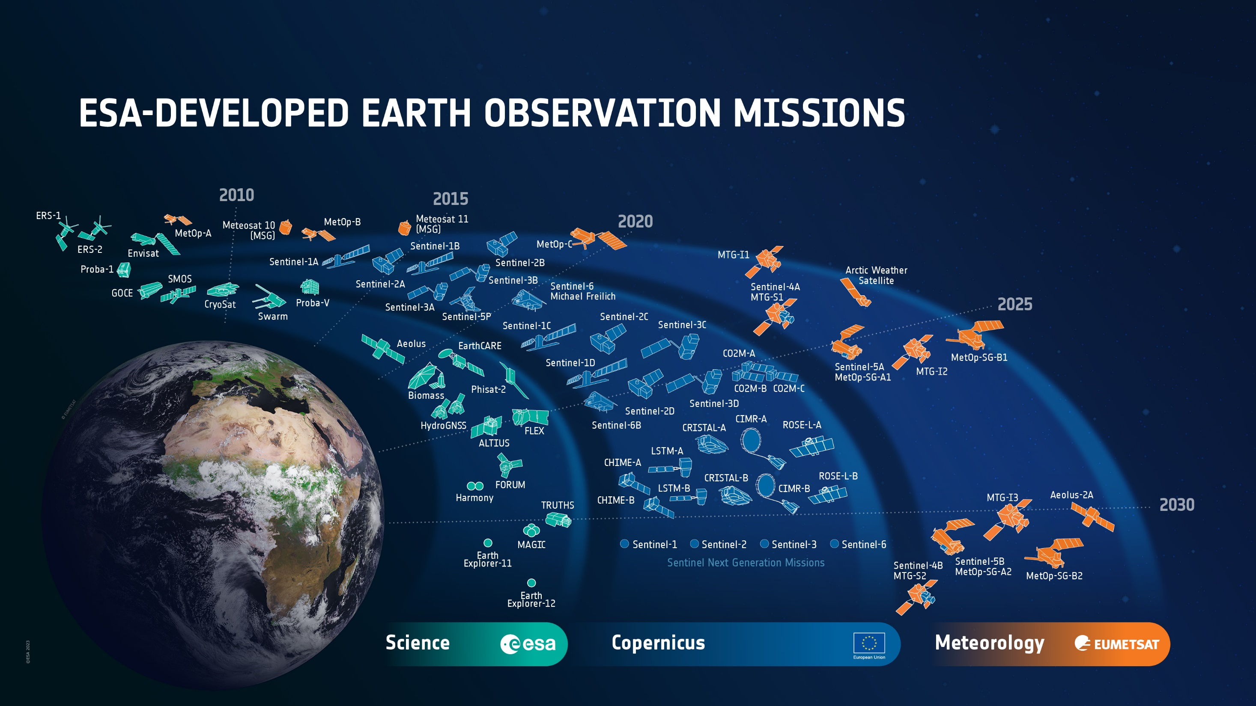
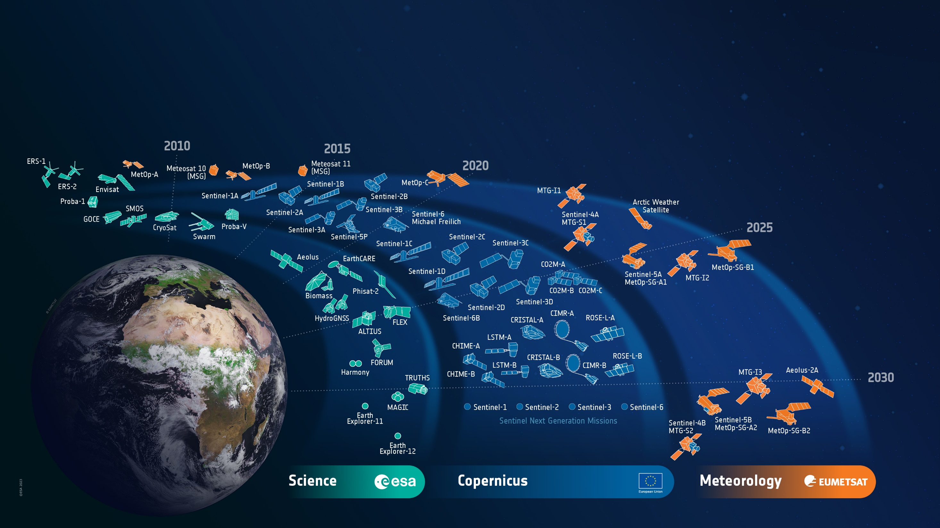
ESA’s Earth Observation Missions
Satellites
Heritage 06
Operational 14
Developing 39
Preparing 19
Total 78
World-class Earth Observation systems developed with European and global partners to address scientific & societal challenges
5
Notes:
D/EOP has three main lines of activities: Earth Science – Copernicus – Meteorology, with
7 Missions (13 satellites) heritage data:
•6 missions (6 satellites) under Science (ERS-1, ERS-2, Envisat / Earth Explorer 1: GOCE / Earthwatch:Proba-1, Proba-V)
•0 under Copernicus ()
•1 mission (7 satellites) under Meteorology (Meteosat1 to 7) NOT counted as part of heritage
9 Missions (14 satellites) in operation:
•5 missions (7 satellites) under Science (Earth Explorers 2 to 5: SMOS, CryoSat, Swarm (Alpha, Bravo, Charlie), Aeolus-1 / Earthwatch: Proba-v Companion Cubesat)
•5 missions (87 satellites) under Copernicus (Sentinels: S-1 A&B, S-2 A&B, S-3 A&B, S-5p, S-6 Michael Freilich)
•0 under Meteorology since operated by Eumetsat (Meteosat-10-11 / MeteosatThird Generation (MTG) I1 / MetOp-A, MetOp-B,MetOp-C )
24 Missions (39 satellites) under development
•8 Missions (10 9 satellites) under Science (Earth Explorers 6 to 10: EarthCARE, Biomass, FLEX, FORUM, HARMONY / Scout-1CubeMap& Scout-2 HydroGNNSx2 / Earthwatch: TRUTHS, ALTIUS)
•12 Missions (24 satellites) under Copernicus (Sentinels: S-1 C&D, S-2 C&D, S-3 C&D, S-4 A&B, S-5 A&B&C, S-6 B / Sentinels Expansion Missions: CO2M A&B, CRISTAL A&B, CIMR A&B, LST A&B, CHIME A&B, ROSE-L A&B)
•5 Missions (6 satellites) under Meteorology (Aeolus-2 / MeteosatThird Generation (MTG) IMAGER-2 & SOUNDER-1 / MetOpSecond Generation (MetOp-SG) A1, B1 / Arctic Weather Satellite)
9 Missions (19 satellites) under preparation
•4 missions (9 satellites) under Science (EE11 (4 candidates), NGGM(2 satellites)/MAGIC(4 satellites of which 2 lead by ESA), Daedalus)
•5 missions (10 satellites) under Copernicus (Sentinels Next Generation: S-1 NG A&B, S-2 NG A&B, S-3 NG A&B (OPT), S-3 NG A&B (TOPO), S-6 NG A&B)
•0 mission (0 satellite) under Meteorology ()

Slide 6
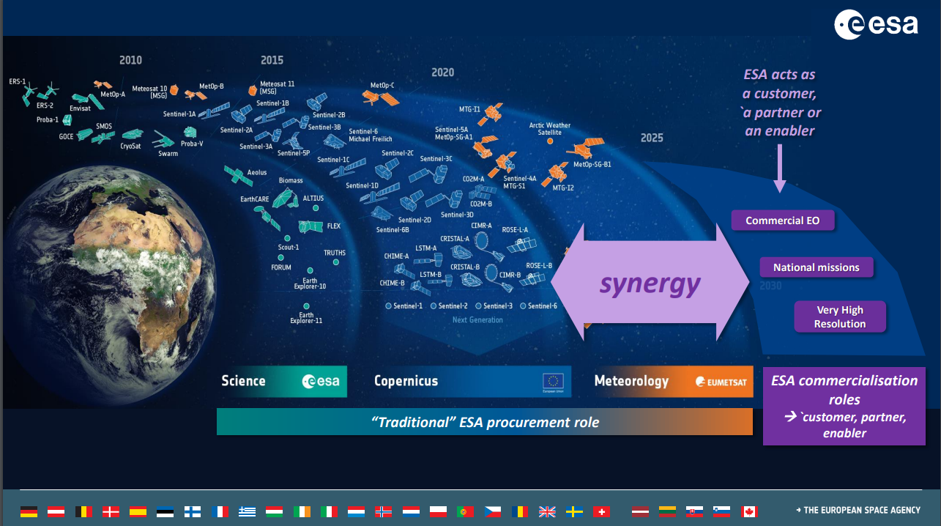

Slide 7
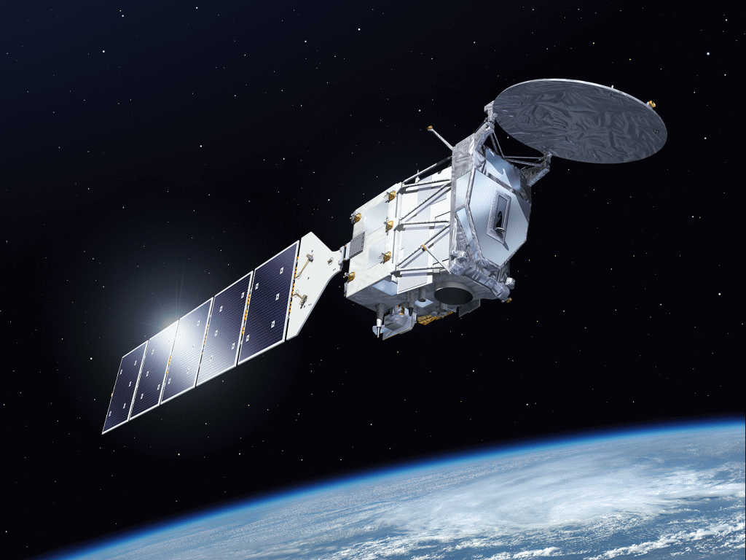
EarthCARE: Earth Cloud, Aerosol and Radiation Explorer
Linking Clouds, Aerosol and Radiation
Science: Impact of Clouds and Aerosols on Radiation
Observations:
Cloud profiles (ice, liquid, mixed), cloud coverage, precipitation
Aerosol profiles
Broad-band Solar & Thermal Radiation
Satellite and Payload
Sun-sync. orbit at 393 km, 14:00 hours descending node
25 days repeat cycle
UV Lidar with high spectral resolution receiver
W-band Cloud Radar with Doppler (contribution JAXA)
Imager and Broad-Band Radiometer
Launch 2024 – lifetime 3 +1 years
Earth Explorer Mission implemented in
cooperation with JAXA
Notes:
Clouds → most significant unknown w.r.t. radiation, feedback with climate change – change of cloud occurrence, height etc., → feedback on radiative effect
Aerosol direct effect (radiation), indirect effect on cloud formation/life cycle (condensation nuclei)
Therefore, need observations! A-Train (CloudSat, CALIPSO, CERES) → EarthCARE → NASA AOS (ACCP)

Slide 8
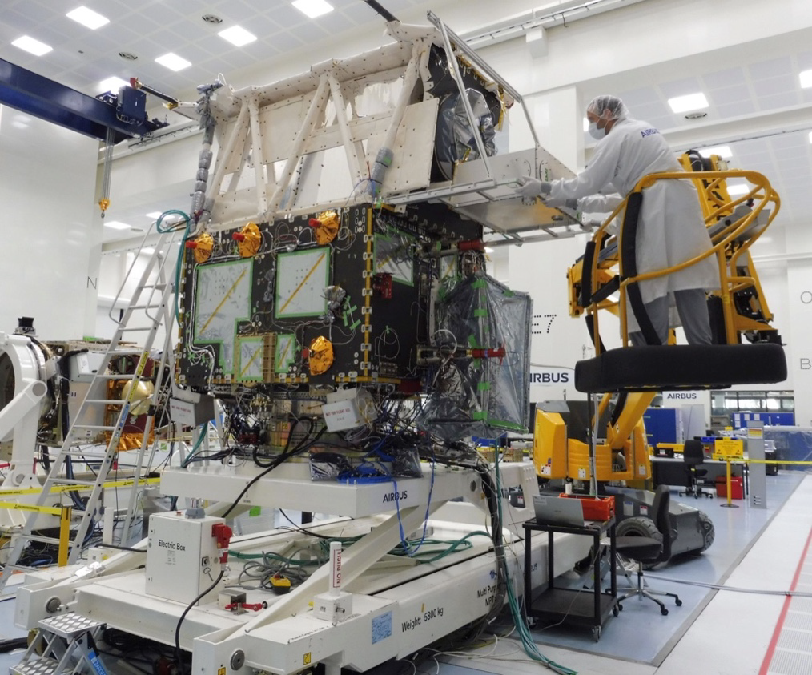
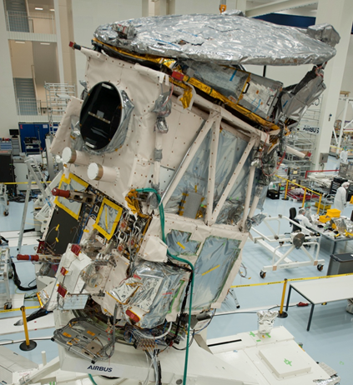
Cloud Profiling Radar (CPR) - JAXA
94 GHz Doppler, 2.5 m dish (folded in photograph)
Level 1: Reflectivity and Doppler profiles
Atmospheric Lidar (ATLID)
High-Spectral Resolution Lidar (HSRL), λ=355nm
Two redundant transmit telescopes & 60 cm receive tel.
3 receive channels: molecular, particular, depolarization
Level 1: attenuated backscatter profiles
Multi-Spectral Imager (MSI)
pushbroom, 4 solar + 3 TIR channels
Level 1: TOA radiances and brightness temperatures
Broad-Band Radiometer (BBR)
2 Channels: Solar + Thermal; 3 fixed FoV
Level 2: TOA solar and thermal radiances & fluxes
Photos courtesy Airbus

Slide 9
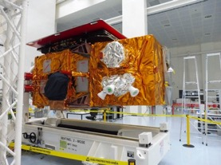

Copernicus Sentinel-2
S2C launch planned on 09 September 2024.
S2C will replace S2A.
S2A will remain in orbit, in standby mode.
A radiometric cross-calibration (in tandem configuration) will be performed between S2C-S2A and S2A-S2B, allowing a fine radiometric characterisation of the whole constellation.
2014 | 2015 | 2016 | 2017 | 2018 | 2019 | 2020 | 2021 | 2022 | 2023 | 2024 | 2025 | 2026 | 2027 | 2028 | 2029 | 2030 | 2031 | 2032 | 2033 | 2034 | 2035
Sentinel-2A
Sentinel-2B
Sentinel-2C
Sentinel-2D
Sentinel-2A NG
Sentinel-2B NG
Today

Slide 10
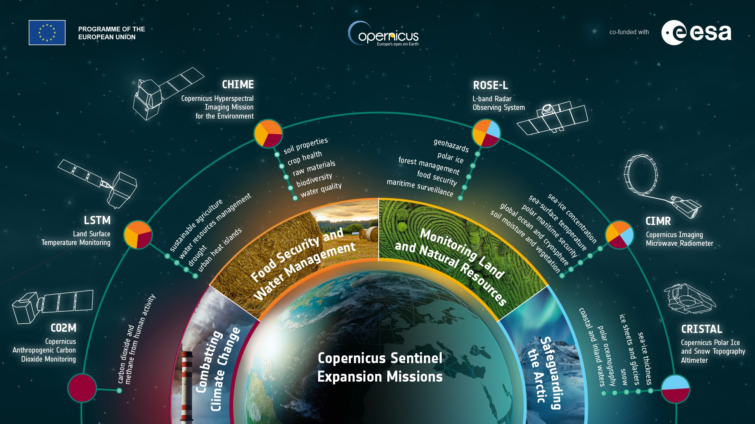


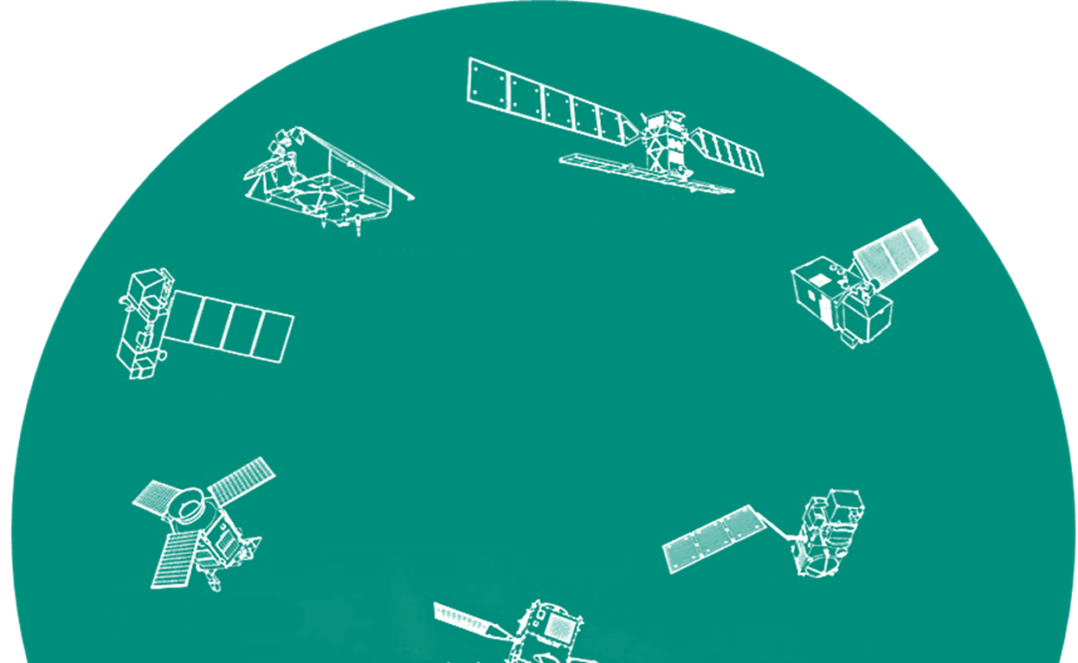
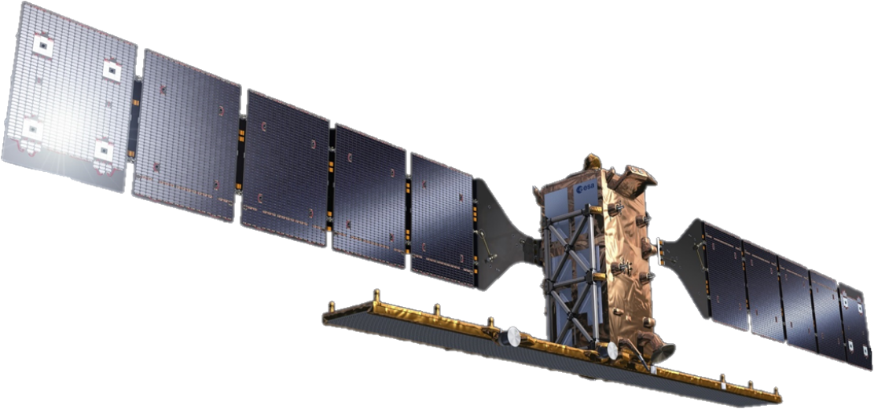
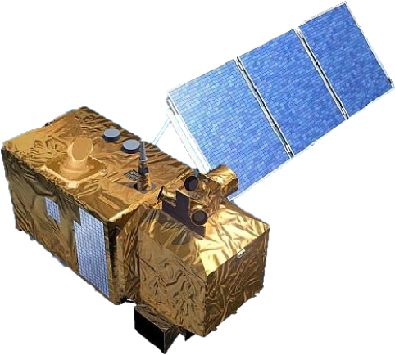
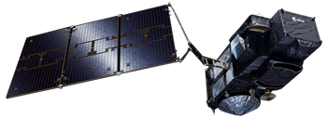
Copernicus Space Evolution
Sentinel-1 NG
Sentinel-2 NG
+ Next Generation Sentinels for data continuation and enhanced observations
Strengthening Copernicus
Space Component with
Sentinel-3
TOPO/OPT NG
10
Notes:
(→ next slide) Beyond the forementioned examples where the availability of free, open and operational Copernicus Sentinel data is of essential importance, the Sentinel satellites also provide key operational data in support of the European CAP, in particular in support of the modernization and simplification of the CAP under the new EU Green Deal.
To guarantee data continuation and enhance the capabilities of the Copernicus Sentinels, ESA is currently developing a range of new Sentinel missions addressing climate and very importantly, food security issues, pushing further the EO capabilities by for example increasing the resolution for thermal observations by a factor 400 down to 50 meters. ESA also cooperates with the emerging New Space companies to create synergies with their innovative and often very high-resolution capabilities.
Furthermore, ESA will continue to collaborate with FAO, IFAD and WFP as well as with many countries around to the world to leverage the independent and global information provided by EO for digital and evidence-based solutions leading to a more food secure world. Just signed a letter of Intend with IFAD for intensifying our collaboration. (→ go to next slide)
Beyond the expansion mission, Copernicus will also evolve into a next generation of Sentinel satellites to ensure data continuation and enhanced observations for the decades to come.
Sentinels 1 NG and 3 TOPO have been funded at CM22
Next Generation Sentinels
Sentinel-1 NG
Sentinel-2 NG
Sentinel-3 Topo NG
Sentinel-3 Opt NG

Slide 11
ESA - Reprocessing
Completed:
1 - ERS-1/-2 RA/MWR and Envisat RA-2/MWR instruments under the FDR4ALT project generating FDRs and TDPs spanning the archives from 1991 to 2012 (Release Q1/2024). Enhanced Calibration and Algorithms improvements ensure top-notch data quality, Long-Term Consistency: fundamental data records maintain accuracy over extended periods, facilitating trend detection and analysis of subtle variations in sea levels, ice cover, and atmospheric conditions, Thematic Data Products offer insights into various Earth system components: inland waters, ocean and coastal topography, ocean waves, land ice focusing on Greenland and Antarctica, sea ice for Arctic and Antarctic regions.Uncertainty-Quantified Observations for robust and reliable scientific analysis.
2 - FDR4ATMOS project produced a harmonized FDR for UV-VIS-NIR spectral regions targeting O3, NO2, SO2, and clouds from ENVISAT/SCIAMACHY and ERS-2/GOME (Release Q2/2024). Uncertainty-Quantified observations provided.
3 - New ENVISAT/SCIAMACHY mission datasets (L1v10 and L2v7.1) in NetCDF format, solving radiance problems in UV, correcting erroneous O3 trend, and providing a specific SCIAMACHY lunar dataset. (Release Q2/2024)
Upcoming:
1 - ENVISAT/MIPAS special modes data reprocessing (~4000 orbits) to address anomalies caused by Envisat CFI software v5.9 malfunctioning. (Project start planned in Q2/2024). Exploring conversion of MIPAS Level 1 data to netCDF format (currently in ENVISAT format).
2 - FDR4ALT and FDR4ATMOS follow-on projects (2024-2026) aimed at further improving and consolidating FDRs/TDPs. Considering possible extensions involving GOME-2 Metop-A/B/C and SARAL/ALtiKa. Additionally, there are plans for a GOME-2/SCIAMACHY lunar FDR.
3 - CRYOSAT
  Ocean Baseline D reprocessing start (Q4 2024, with TTO Q2 2024). Main improvements: Update to latest SAMOSA physical retracker and dedicated SAR SSB computation, Update of several geophysical corrections and static AUX files, Fix SAR and SARIn bias and errors
  Cryo-TEMPO Baseline C thematic products. Main improvements: Land Ice: improved slope correction / relocation algorithm, Sea Ice & Polar Ocean: update to physical retrackers, NRT product provision, , new snow climatology, release of Antarctic products, Coastal Ocean: added SARIn observations, release of North Atlantic product (only Med Sea so far), Inland Water: update to physical reatracker, new lakes & rivers in USA, Canada and Sweden, Release and reprocessing of summer sea ice freeboard product

Slide 12
ESA - Reprocessing
Upcoming - SMOS
4th SMOS Mission reprocessing campaign will start in Q3-2024 at Level 1. The new dataset contains the following improvements:
  Improvements in the image reconstruction with better characterization of the synthetic scene
  Reduction of Brightness Temperature spatial biases
  Improvements in the estimation of the Sun Brightness Temperature
Level 2 reprocessing will follow Level 1 in Q1-2025.
  For Soil Moisture the new dataset contains the following improvements:
    Better characterization of the land cover using ESA CCI dataset
    Better characterization of forest area using ALOS-2 Palsar 2 dataset
    L-vod initialization based on vegetation parameters derived from GEDI/ICESAT-2 dataset
    RFI additional screening based on L1 flags
  For Sea Surface Salinity the new dataset contains the following improvements:
    Reduction of the seasonal and latitudinal biases
    Introduction of Ice Contamination Correction to improve sea surface salinity retrieval at high latitude.
    Revised sea water dielectric constant (cold waters)
    Improvements in the quality flags

