Slide 1
GSICS Agency Report 2024
Heikki Pohjola
WMO

Slide 2
WMO Unified Data Policy and Satellite Data
New WMO Unified Data Policy (Res. 1) was approved by WMO members in 2021 replacing the old Res 40 (weather), 25(hydrology) and 60 (climate)
Two main categories of data:
Core (shall be exchanged)
Recommended (should be exchanged)
The policy is addressed to national governments of WMO Members and cannot dictate private sector entities
Exchange of core data is considered mandatory, irrespective of data origin
 | 2

Slide 3
2023 WMO Core Satellite Data Workshop 5-7 December 2023, Geneva, Switzerland
The workshop representing satellite operators and NWP centres globally
Objectives
To agree an initial list of ‘core’ and ‘recommended’ satellite data for global NWP, based on the preparatory work by WMO
To review the current data policies of satellite operators, which are not entirely aligned with the proposed list of core satellite data
Outcome in the workshop statement adopted to the WIGOS Manual
Seeking endorsement from INFCOM-3 in April followed by Executive Council in June, and finally WMO Congress for the decision by WMO members
Next step to prepare ‘core’ and ‘recommended’ satellite data for other application areas: Nowcasting, hydrology, climate monitoring
More detailed status update will be presented in CGMS-52
 | 3

Slide 4
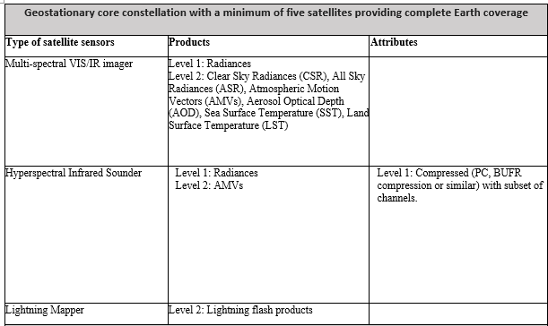
WMO Core satellite data
 | 4

Slide 5
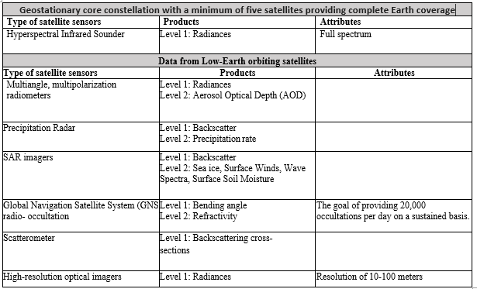
WMO Recommended satellite data
 | 5

Slide 6
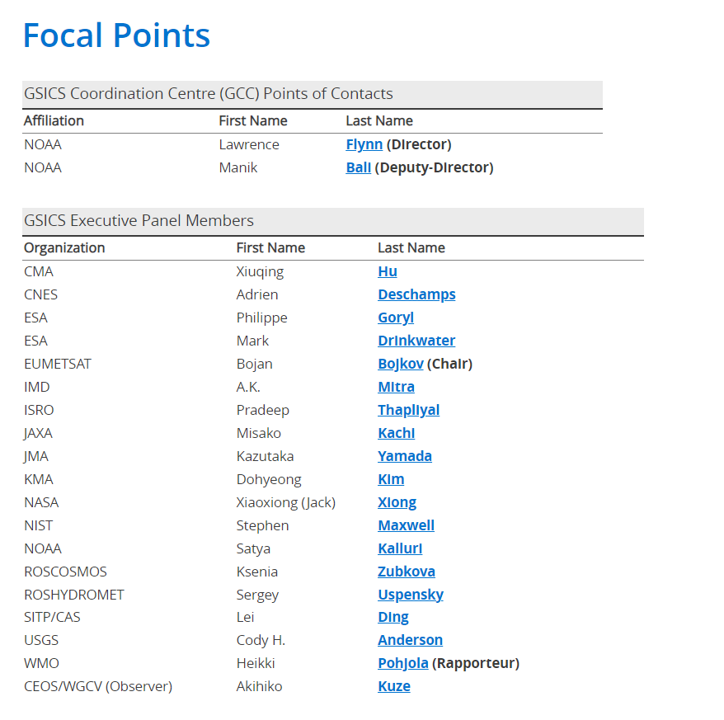
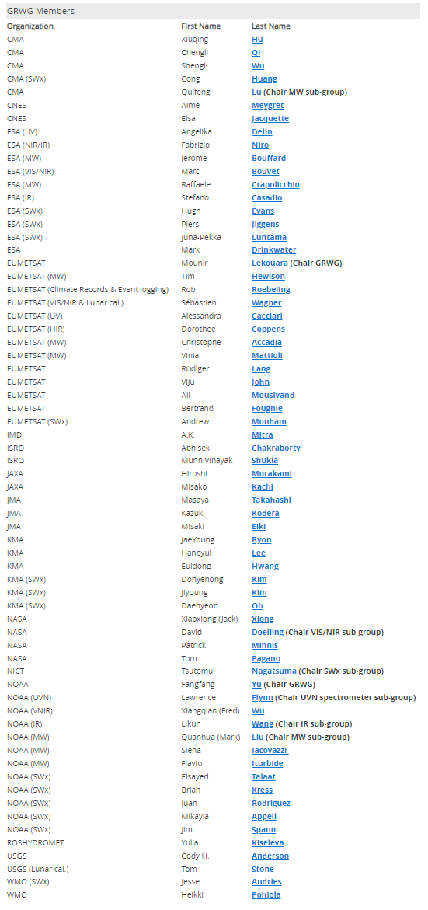
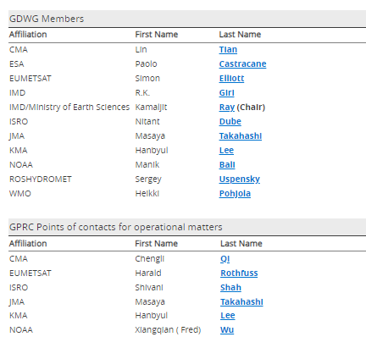
WMO GSICS website
GSICS website hosting service provider for https://gsics.wmo.int/ was changed at WMO with no effect on website functionality
No progress in redesigning the website (WMO action under EP)
WMO GSICS website includes
GSICS structure
Documents
Focal points
WMO will contact agencies to clarify situation with their agency focal points (WMO action under EP)
EP mailing list: gsics-ep@groups.wmo.int
 | 6

Slide 7
Thank you!

Slide 8
Back up slides

Slide 9
WMO Core satellite data
 | 9

Slide 10
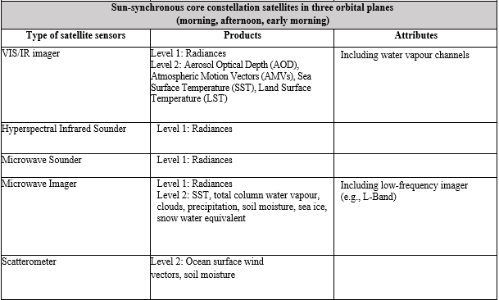
WMO Core satellite data
 | 10

Slide 11
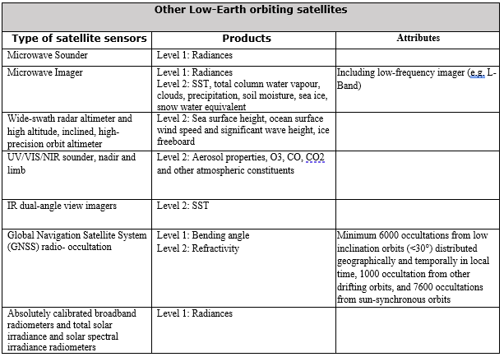
WMO Core satellite data
 | 11

Slide 12
WMO Recommended satellite data
 | 12

