Slide 1

GSICS Agency Report 2024
(NASA)
Jack Xiong
NASA Goddard Space Flight Center, Greenbelt, MD 20771, USA
Xiaoxiong.Xiong-1@NASA.GOV

Slide 2
Key contributors:
Steve Platnick, Kurt Thome, Ed Kim, Jeremy Werdell, Sachidananda Babu (NASA/GSFC)
Dave Doelling, Yolanda Shea, Rajendra Bhatt (NASA/LaRC)
Tom Pagano, Steve Broberg, Rob Rosenberg (NASA/JPL)
Peter Pilewskie, Erik Richard (U. of Colorado/LASP)
Dave Tobin (U. of Wisconsin)

Slide 3
Presentation Overview
Summary of Agency’s GSICS Activities, Actions, and Achievements
Agency’s Support to EP Activities
Agency’s Support to GDWG Activities
Agency’s Support to GRWG Activities
Agency’s Instruments Updates & Planned launches that are relevant to GSICS
Agency’s Calibration Major Updates
Back-up Slides

Slide 4
Summary of Agency’s GSICS Activities, Actions, and Achievements
Activities and Achievements:
  Improvements of pre- and post-launch calibration, including developments of new calibration methodologies and techniques (GSFC, LaRC, JPL)
    Sensors on Terra, Aqua, Aura, OCO-2, PACE, Landsat 8/9, SNPP, NOAA-20/21, JPSS-3/4, and GOES-R series, DSCOVR-EPIC, …
    Sensors on ISS, such as ECOSTRESS, OCO-3, EMIT, and CPF, …
  Enhancements of lunar calibration, including radiometric/spatial characterization, crosstalk assessments, and calibration inter-comparisons (GSFC, JPL)
    MODIS, VIIRS, ABI, OLI, OCI, OCO-2/3, …
  Advancements of testing equipment and new capability (GSFC)
    GLAMR (Goddard Laser for Absolute Measurement of Radiance), …
    BRDF Characterization Facility, …

Slide 5
Agency’s GSICS Activities, Actions, and Achievements – cont’d
Activities and Achievements:
  Expansions of calibration tools (LaRC)
    LASICS (Langley Automated Sensor Inter-calibration System) tools: open access tools for satellite imager inter-calibration that can provide spatial and temporal matching for satellite pairs and PICS
  Continuing efforts and improvements on sensor calibration stability monitoring and inter-comparisons (GSFC/LaRC/JPL)
    Approaches: SNO, Dome C, desert PICS, DCC, and Moon
  Documentation
    ATBD updates, technical memos, conference proceedings, and journal papers, …
Actions:
  None

Slide 6
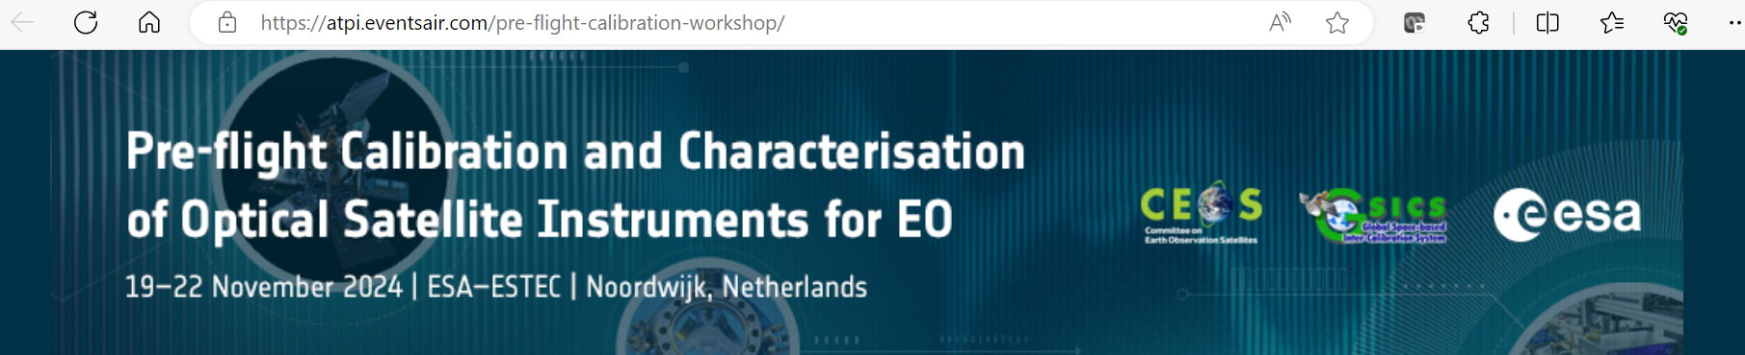
Agency’s Support to EP Activities
Recent Support to GSICS EP and GCC Activities
  GSICS State of Observing System Report and Quarterly Newsletter
  Coordination with CEOS/WGCV/IVOS
    Joint Lunar Calibration Workshop, Darmstadt, Germany, 4-8 December 2023
    Joint Workshop on Pre-flight Calibration and Characterisation of Optical Satellite Instruments for Earth Observation, ESTEC, Noordwijk, Netherlands, 19 - 22 November 2024
    CEOS WGCV/GSICS SITSat Task Team

Slide 7
Agency’s Support to GDWG Activities
Not Applicable

Slide 8
Agency’s Support to GRWG Activities
Tasks NASA Supports
  Sensor calibration traceability, uncertainty, and consistency (pre- and post-launch)
  Inter-comparison and long-term stability monitoring methodologies (SNO, DCC, Dome C, desert PICS, RadCaTS, LandNet, LEO-GEO-LEO, GEO-LEO-GEO, …)
  Lunar calibration inter-comparisons
  Inter-comparisons with GSICS reference sensors (MODIS, VIIRS, AIRS, CrIS, and IASI)
  Inter-calibration opportunities and strategies of CPF with GSICS member sensors
Resources and Effort
  No dedicated resources for support to GSICS related activities

Slide 9
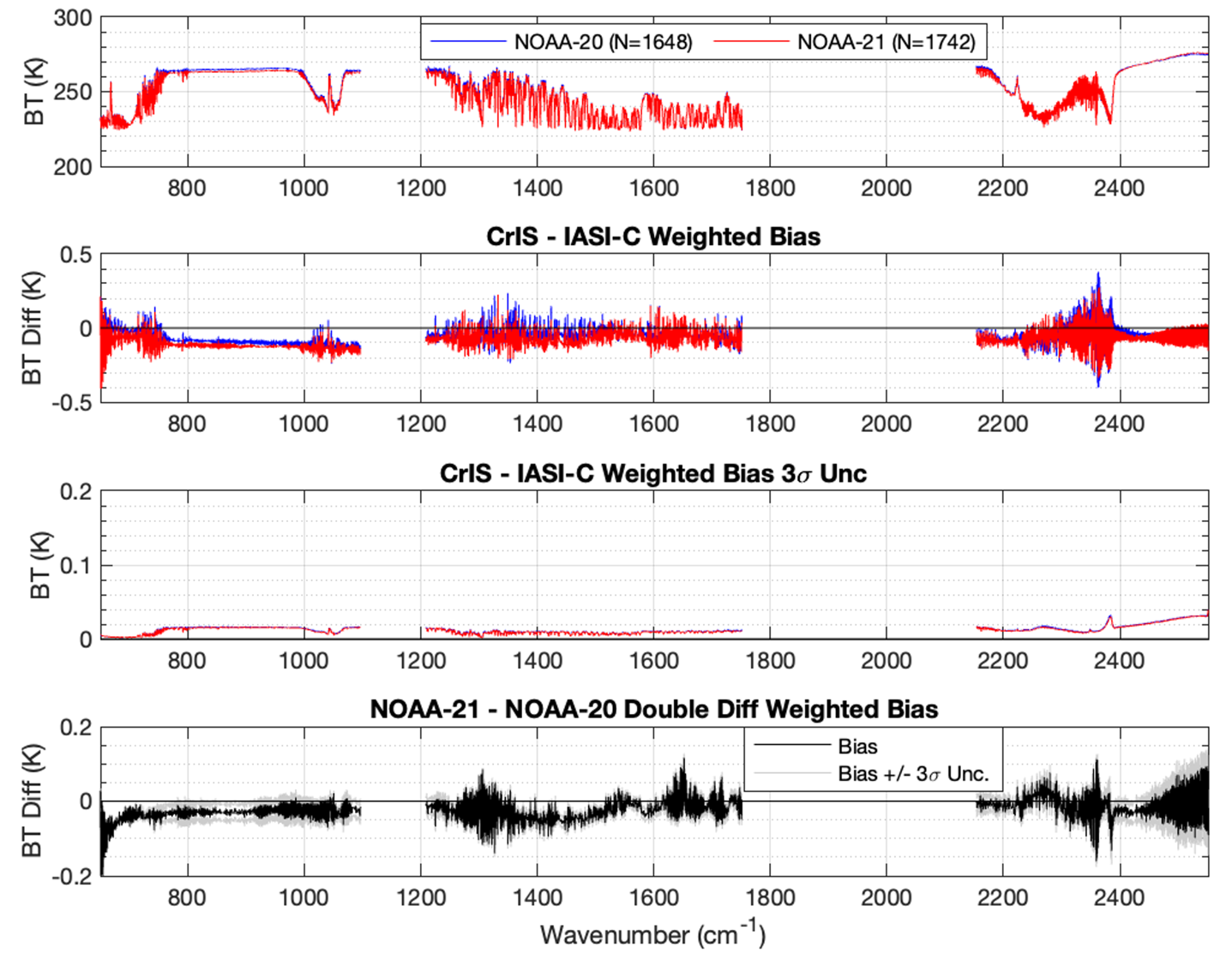
Agency’s Support to GRWG Activities – cont’d
NOAA-21 CrIS Post-launch Assessments
Using SNO-based comparisons with Metop-C IASI and NOAA-20 CrIS
Results support the use of NOAA-21 CrIS as a GSICS IR Reference sensor.
SNO Methodology following Loveless et al. 2023
More details in Tobin’s talk (Wed)

Slide 10
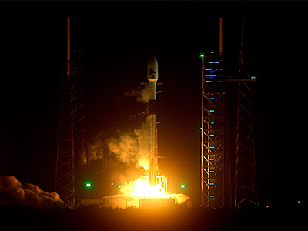
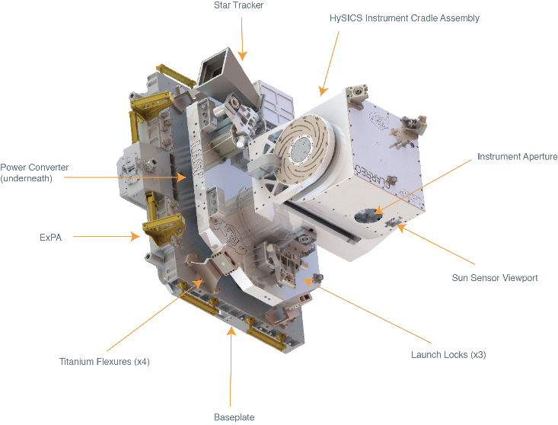
Agency’s Instruments Updates & Planned Launches (Relevant to GSICS)
Current Fleet
  Landsat 7/8/9, Terra, Aqua, Aura, S-NPP, GPM, OCO-2, SMAP, Sentinel-6, SWOT
  Instruments on ISS: ECOSTRESS, EMIT, OCO-3, TSIS-1, LIS
Recent Launches (2023-2024)
  TROPICS (4), TEMPO, PACE
Planned Launches (2024-2025)
  NISAR, PREFIRE (2), GOES-U, MAIA, TSIS-2
Planned Launches (2026)
  CPF, Sentinel-6B, …
PACE Launch (2/8/24)
See backup slides for select new missions/instruments
CPF HySICS

Slide 12
Agency’s Calibration Major Updates
MODIS C7 L1B reprocessing in 2024
  Calibration strategies to address MODIS (Terra/Aqua) orbit drifting
AIRS V8 L1B/L1C release in 2024
  AIRS L1B and L1C product accuracies to be preserved during the drifting orbit
OCO-3 B11 reprocessing (new calibration accepted Feb 2024, L2 expected Dec 2024)
VIIRS (NOAA-21) L1B reprocessing in 2024
  Use of TSIS solar spectra, DNB MG/HG RSR, on-orbit screen parameters
J3 spacecraft I&T (ongoing) and J4 VIIRS TVAC (completed Jan 2024)
CPF instrument characterization and initial payload integration completed (2023)
PACE OCI initial CAL/VAL (launched on Feb 8, 2024, first image in late March)

Slide 13
Additional Slides Not Presented
Agency’s GSICS related research activities
  See presentations in break-out sessions
Agency’s Reprocessing Activities, if any
  See Agency’s Calibration Major Updates (slide 10)
Introduce/Confirm the Agency’s Personnel Supporting GSICS – see next slide
  Focal Points of EP members and GCC PoCs
  GRWG members/GDWG members/GPRC PoCs
  Other Key Agency Personal
Agency’s GSICS activities to be discussed in this joint meeting
  Agenda items that are especially of interest to your agency
  Agency’s activities that may be of interest to the GSICS community

Slide 14
Introduce/Confirm the Agency’s Personnel Supporting GSICS
EP Members
  Jack Xiong (GSFC)
GRWG Members
  GSFC MODIS and VIIRS Cal Teams: Jack Xiong (lead), Amit Angal, Aisheng Wu, Truman Wilson, Tiejun Chang, and Ning Lei (pre-launch and on-orbit calibration, lunar calibration, calibration inter-comparisons, reference sensor calibration and traceability); PACE Cal Team: Gerhard Meister (lead)
  LaRC CERES Cal Team: Dave Doelling (lead), Ben Scarino, Conor Haney, and Arun Gopalan, Prathana Khakurel (GEO visible channel calibration, DCC, SBAF); CPF Cal Team: Raj Bhatt
  JPL AIRS Cal Team: Tom Pagano (lead), Steve Broberg (IR reference sensor and cross-comparison); OCO/MAIA Cal Team: Rob Rosenberg (lead) (OCO-2 calibration, inter-comparison, MAIA), Graziela Keller (OCO-3 calibration), Vance Haemmerle (lunar)
Other Key Agency Personnel
  Kurt Thome (GSFC): CEOS WGCV, Ed Kim (GSFC): MW instruments

Slide 15
Additional Information on Agency’s Instruments & Planned Launches
LASP TIS-1&2
  TSIS-1 (TIM and SIM) on ISS continues to provide high accuracy measurements (launched 2017)
  TSIS-2 (TIM and SIM) ready for S/C I&T (Sept 2024), launch in 2025
CLARREO Pathfinder (CFP)
  CPF instrument characterization and initial payload integration completed (2023), launch in 2026
Landsat Next
  Landsat Next is currently in Phase A, Landsat Next Instrument, LandIS, proposals under evaluation
Surface Biology and Geology (SBG)
  SBG started Phase A in Feb 2023; Mission System Requirements Review (SRR) completed Nov 2023
  Goal to begin Phase C in Spring 2024, launch dates in 2028 (TIR) and 2029 (VSWIR)
Others
  Earth Venture Continuity (EVC-1) mission: Libera (Earth Radiation Budget) to fly on JPSS-4
  InVEST-20 programs: AGROS, ARCSTONE, ACMES (launch in 2024)
  ESTO CubeSat: SNOOPI, HyTI (launch in 2024)

Slide 16
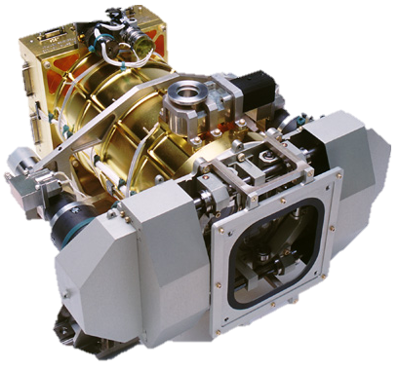
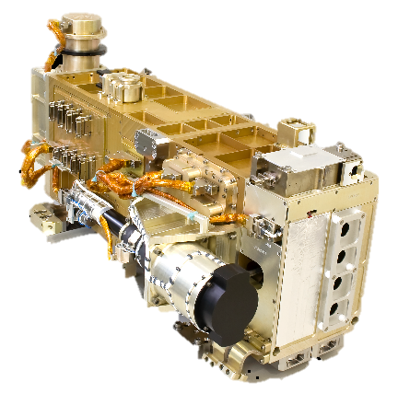
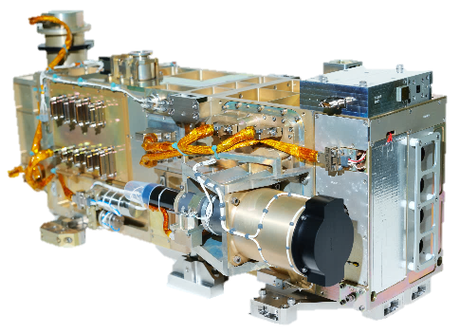
LASP TSIS-1&2 TIM and SIM Instruments
The TSIS-1&2 TIM measures the total solar irradiance (TSI)
  Earth’s predominant energy source
  The TSIS-1 TIM extends the 45-year-long uninterrupted climate-data measurement record of TSI
  TSIS-1 TIM Operations began Jan 2018, continues into Solar Cycle 25
  TSIS-2 on track for launch in early 2025, will continue TSI to the end of the decade
  TSIS-1& 2 SIM measures by the Solar Spectral Irradiance (SSI) from the ultraviolet to the infrared (200 – 2400 nm ; integrated region >96% TSI)
  Identifies the regions of atmosphere that are affected by solar variability and mechanisms of response
  TSIS-1 SIM Operations began Mar 2018, continues into Solar Cycle 25
  TSIS-2 on track for launch in early 2025, will continue SSI to the end of the decade
TIM
TSIS-1 SIM
TSIS-2 SIM

Slide 17
Summary of U. Of Colorado LASP Solar Irradiance Capability
The 17-year SORCE mission ended on February 2020 (Achieved 2 years of overlap with TSIS-1)
TCTE ended in June 2019 (Over 5 years overlap with SORCE, over 1 year overlap with TSIS-1)
TSIS-1 operations on ISS strated in early 2018 (Achieved successful prime mission, currently in extended mission)
  TSIS-1 TIM validates SORCE and TCTE TSI calibration scales (highest accuracy TSI monitor)
  TSIS-1 SIM reduces uncertainties from SORCE SIM (higher accuracy by nearly order of magnitude, higher long term stability)
CSIM & CTIM demonstraton of new, advanced SSI & TSI technology, respectively.
  CSIM ended 3 year mission in Feb 2022 (overlapped with TSIS-1 SIM)
  CTIM launched July 2022 and re-entered in Dec. 2023 (Completed ~1.5 years of overlapping with TSIS-1 TIM)
TSIS-2 instruments built and calibrated ready for S/C int. in Spr. 2024 (On-track for Spr. 2025 Launch readiness)
TSI Instrumentation (in order of mission launch date)
SSI Instrumentation (in order of mission launch date)
Mission/Instrument | Spectral Range | Spectral Resolution (nm) | Stability (%/year) | Uncertainty (%) Pre-launch
SORCE TIM (free flyer) | N/A | N/A | 0.01 | 0.035
TCTE TIM | N/A | N/A | ~0.01 | 0.035
TSIS-1 TIM (ISS) | N/A | N/A | <0.01 | 0.01
CTIM (CubeSat) | N/A | N/A | <0.01 | < 0.01
TSIS-2 TIM (free flyer) | N/A | N/A | <0.01 | 0.01
Mission/Instrument | Spectral Range (nm) | Spectral Resolution (nm) | Stability (%/year) | Uncertainty (%) Pre-launch
SORCE SIM (free flyer) | 200-2400 | 0.25-38 | 0.2 | 3-8
TSIS-1 SIM (ISS) | 200-2400 | 0.25-42 | ≤0.05 | 0.24-0.41
CSIM (CubeSat) | 220-2800 | 0.25-42 | ≤0.1 | 0.3-1
TSIS-2 SIM (free flyer) | 200-2400 | 0.25-42 | ≤0.05 | 0.2-0.4
OWLS (MicroSat) | 115-308 | 1 | ~1 | 3-15

Slide 18
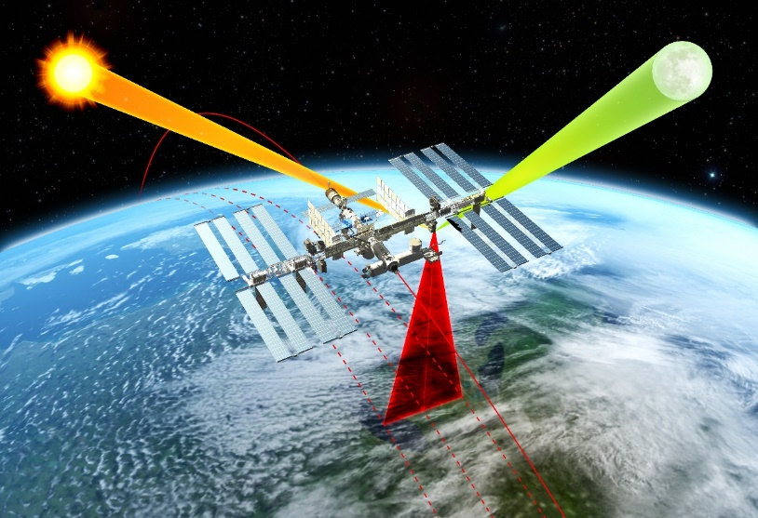
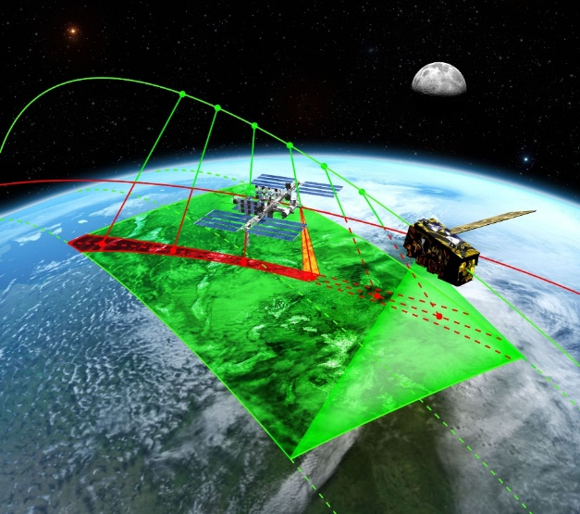
CLARREO Pathfinder (CPF) Science Objectives
Objective #1: High Accuracy SI-Traceable Reflectance Measurements
Objective #2: Inter-Calibration Capabilities
Demonstrate on-orbit calibration ability to reduce reflectance uncertainty by a factor of 5-10 times compared to the best operational sensors on orbit.
Demonstrate ability to transfer calibration to other key RS satellite sensors by inter-calibrating with CERES & VIIRS.
 | Objective #1 | Objective #2
Uncertainty | Spectrally-resolved & broadband reflectance: ≤0.3% (1σ) | Inter-calibration methodology uncertainty: ≤0.3% (1σ)
Data Product | Level 1A: Highest accuracy, best for inter-cal, lunar obs Level 1B: Approx. consistent spectral & spatial sampling, best for science studies using nadir spectra | Level 4: One each for CPF-VIIRS & CPF-CERES inter-cal. Merged data products including all required info for inter-cal analysis
https://clarreo-pathfinder.larc.nasa.gov/

Slide 19
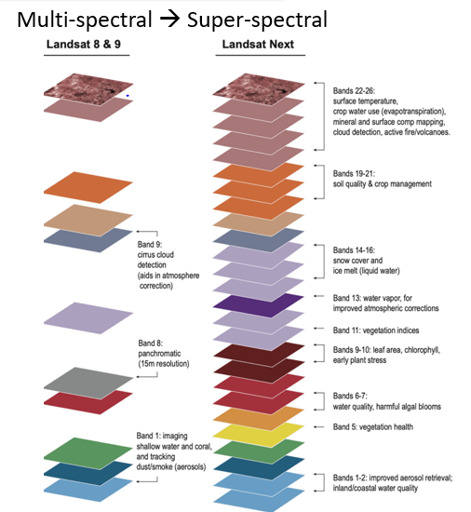
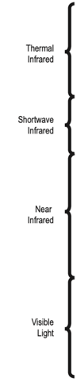
Landsat Next
User need surveys provided a clear set of priorities for Landsat Next requirements to meet emerging needs at breakthrough effectiveness:
Improved Revisit Frequency. Dynamic phenomena (crop health & productivity, water quality, snow/ice state, wildfire) which require ~weekly clear views.
Higher Spatial Resolution. Experience with Sentinel-2 has underscored importance of 10-meter data for monitoring small agricultural fields, forest disturbance, urbanization, and other applications.
Additional spectral bands to support emerging applications in water quality, snow hydrology, soil mapping, and other areas.
Maintaining radiometric quality established by Landsat 8/9
Landsat Next will provide more than twice as many spectral bands, with resolution improved by a factor of 2, and with the repeat coverage of Landsats 8 and 9, combined

Slide 20



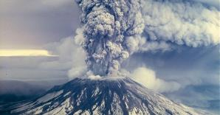
Surface Biology and Geology (SBG)
SBG is key to understanding in five science and applications focus areas
  Functional traits, diversity and health of terrestrial vegetation and inland and near-coastal aquatic ecosystems
  Physiology of primary producers, productivity and stress
  Effects of changing land use on surface energy, water, momentum, and carbon fluxes
  Snow and ice accumulation and melt, surface water availability and management
  Active geological surface changes, natural hazards
Decadal Survey defines the implementation as two sensors: hyperspectral imagery in the VSWIR; multi- or hyperspectral imagery in the thermal IR
SBG is a collaborative mission: activities are underway to harmonize data from multiple missions to improve spatial and temporal coverage
SBG started Phase A on Feb. 27, 2023
Successful Mission System Requirements Review (SRR) held in November 2023
Goal to begin Phase C in Spring 2024
Launch dates: September 2028 (TIR) and June 2029 (VSWIR)

Slide 21
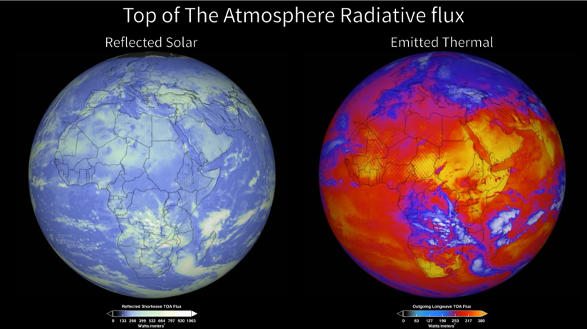
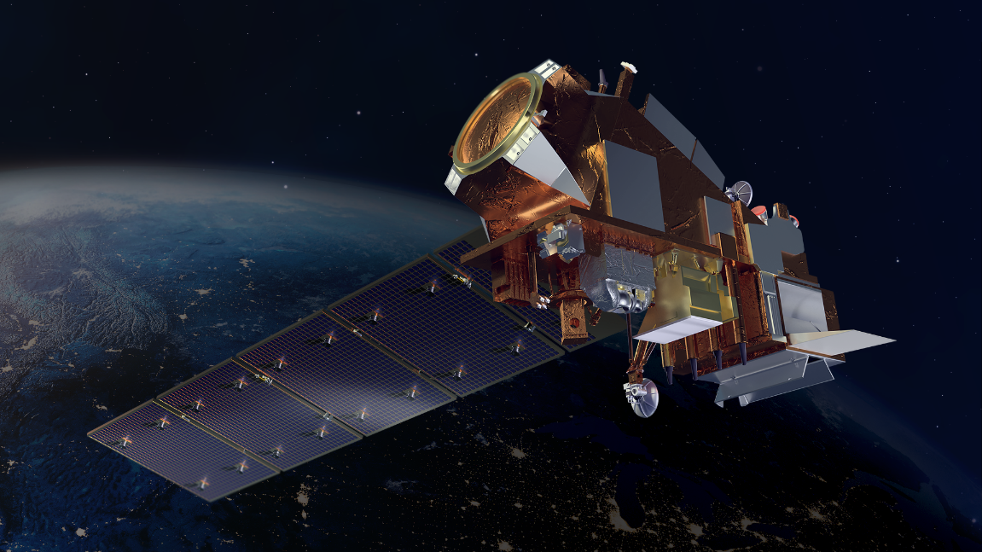
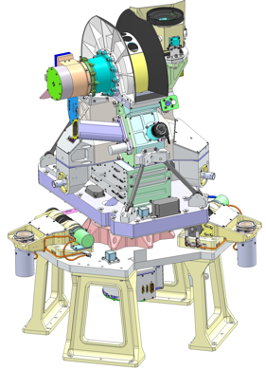
Libera, Earth Venture Continuity-1 Mission
’Li-be-ra, named for the daughter of Ceres in ancient Roman mythology
Outgoing Earth Radiation
Libera continues the 24-year CERES Climate Data Record for the Earth Radiation Budget (ERB).
  Measures reflected solar and emitted terrestrial radiation from Earth
  Provides fundamental climate information about the balance between incoming (from TSIS) and outgoing radiative energy from Earth
  Continuity of this climate record over time reveals the signals of climate change – connects temperature trends to energy flow
  Libera is Innovative:
  Uses state-of-the-art detectors with carbon nanotube technology, the blackest substance on Earth
  Adds a split-shortwave measurement to isolate where energy from the Sun is deposited in the Earth system
  Adds a wide-field-of-view camera to support split
  shortwave science
  Schedule and Milestones:
    Passed Critical Design Review, June 2023
    Delivery: September 2025
    2028 launch on JPSS-4; 5-year mission
Joint Polar Satellite System-4

Slide 22
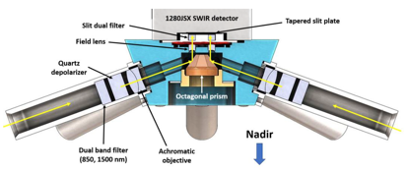
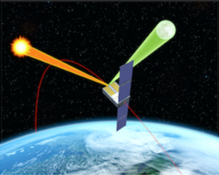
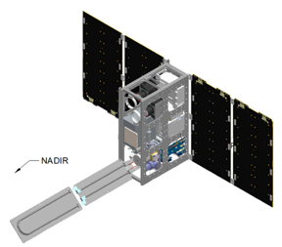
New In-space Validation of Earth Science Technologies (InVEST-20) Programs
The Aerosol Radiometer for Global Observation of the Stratosphere (ARGOS) Instrument
ARGOS will collect limb scattering data of atmospheric aerosols at several wavelengths in multiple viewing directions simultaneously and can be considered as a next generation OMPS limb profiler (launching in 2024)
ARCSTONE: Calibration of Lunar Spectral Reflectance from Space
ARCSTONE, a hyperspectral VSWIR instrument, will provide lunar spectral reflectance measurements with a target accuracy < 0.5% (k=1), sufficient to establish an absolute, on-orbit lunar calibration standard for current and future Earth observing sensors (launching NET August 2024).
Active Cooling for Methane Earth Sensors (ACMES)
The 6U ACMES CubeSat will demonstrate two technologies: an active architecture for thermal control of instruments on small satellites, which aims to reduce radiator size by 70% for a given application; and a filter incidence narrow-band differential absorption infrared spectrometer for the detection of methane sources (launching in 2024 - 2025).

Slide 23
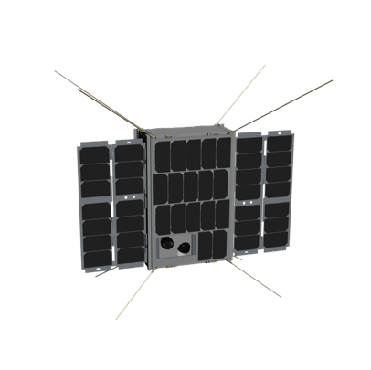
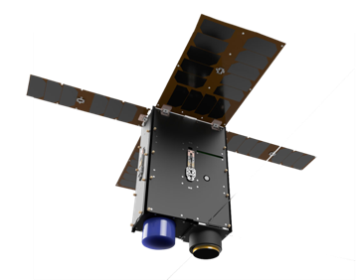
Upcoming ESTO CubeSat Launches
SNOOPI: Signals Of Opportunity P-band Investigation
Launching expected in 2024
Will demonstrate the in-space use of P-band signals from existing telecommunications satellites to measure root zone soil moisture and snow water equivalent from a 6U CubeSat
HyTI: Hyperspectral Thermal Imager
Launching scheduled for 2024
Thermal infrared imager on a 6U CubeSat with high-spatial, spectral, and temporal resolution, using onboard data processing.
Applications range from monitoring volcanic gas fluxes and soil moisture for crop management

