Slide 1

GSICS Agency Report
2024
TAKAHASHI Masaya, KODERA Kazuki
and EIKI Misaki
Japan Meteorological Agency / Meteorological Satellite Center

Slide 2
Summary of JMA GSICS Achievements, Activities, and Actions
Achievements
  GEO-LEO-IR: operational implementation of Himawari-9 AHI vs. Metop-C IASI and NOAA-20 CrIS on Oct. 2023
    Handling of negative radiance data was also updated and RACs were reprocessed back to Sept 2022.
Activities (on AHI)
  Ray-matching inter-cal.: use of low radiance scenes => day-4 VNIR breakout
  Vicarious cal.: input data transition from MODIS to VIIRS => day-4 VNIR breakout
  Lunar cal.: research on unexpected AHI observed irradiance dependence of phase angle (LCWS4)
  IR: revisit to regression method => day-3 IR breakout
Response to open actions
  Action assigned to GDWG (Takahashi) at LCWS4: to find WMO/GSICS guidance on file format, metadata, and version control => day-3 GDWG breakout
  A.GIR.20200319.2: to apply Hui Xu’s CrIS gap-filling method to AHI-CrIS inter-cal for investigating cold scene bias at 3.9µm band
    Gap-filling is not applied, but cold scene bias issue was solved (the action can be closed).

Slide 3
JMA Support to GRWG Activities
VNIR
  Ray-matching (routinely monitored)
    Himawari-8/-9 AHI vs. S-NPP/NOAA-20 VIIRS. Comparison of AHI vs. GCOM-C SGLI is also tested.
  Vicarious calibration (routinely monitored)
    Himawari-8/-9 AHI using Terra/Aqua MODIS L1B and S-NPP/OMPS TCO as inputs for water clouds RT calculation. Transition of MODIS to VIIRS is underway.
  Lunar
    Himawari-8/-9 AHI using GIRO. AHI inter-cal. vs. MODIS, lunar radiance cal., and MTF evaluation were tested before, but recently no updates.
  DCC
    Himawari-8/-9 AHI vs. Aqua MODIS is tested offline.
IR
  GEO-LEO (routinely monitored)
    Himawari-8/-9 AHI vs. Metop-A/-B/-C IASI, Aqua AIRS, S-NPP/NOAA-20 CrIS.
  GEO-GEO
    Himawari-8/-9 AHIs during parallel observation period was investigated.

Slide 4
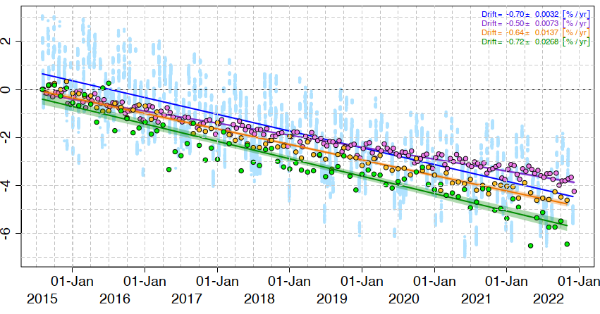
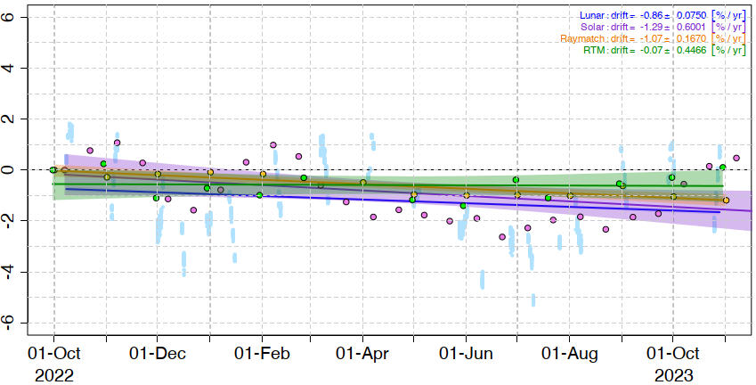
Calibration Trends of Himawari-8/-9 AHI VNIR Bands
B03 (0.64 μm) trend
  Normalized at the first result for each method
Himawari-8 (~7.5 years)
  Similar trends among lunar cal by GIRO, solar cal using solar diffuser observation, ray-matching vs. S-NPP/VIIRS, and vicarious cal by RT simulation using Aqua/MODIS
Himawari-9 (~ 1 year)
  Larger variations compared with Himawari-8 results
Lunar : −0.70 ± 0.003 [%/yr]
Solar : −0.50 ± 0.007 [%/yr]
Raymatch: −0.64 ± 0.014 [%/yr]
RTM : −0.72 ± 0.027 [%/yr]
Relative Calibration Bias (%)
Himawari-8
Lunar : −0.86 ± 0.075 [%/yr]
Solar : −1.29 ± 0.600 [%/yr]
Raymatch: −1.07 ± 0.167 [%/yr]
RTM : −0.07 ± 0.447 [%/yr]
Relative Calibration Bias (%)
Himawari-9

Slide 5
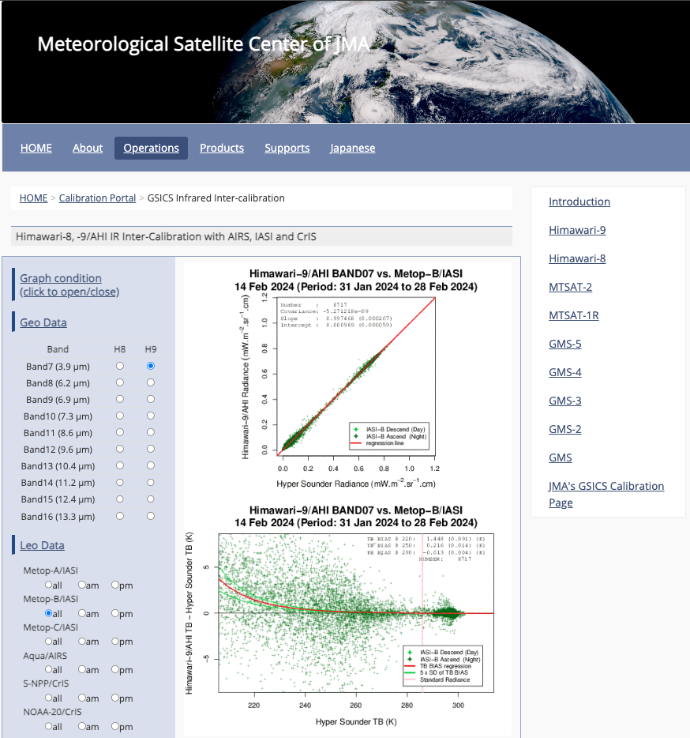
JMA Support to GDWG Activities
Lunar calibration
  LSICS I/O data Convention and versioning
JMA GPRC webpage
  Calibration landing page
    Instrument info (e.g., SRF)
    Event logging
    IR re-calibration info (GMS to MTSAT-2)
  AHI monitoring pages
    VNIR Ray-matching
    VNIR Vicarious cal.
    GEO-LEO-IR

Slide 6
Instruments Updates
Himawari-8 and -9
  Instrument: 16-band VIS/IR imager (AHI: Advanced Himawari Imager)
  Operation
    Himawari-8: 7 Jul. 2015 to 13 Dec. 2022, currently in-orbit standby (backup of Himawari-9)
    Himawari-9: 13 Dec. 2022 to JFY 2029
Himawari-10
  Instruments
    18-band VIS/IR imager (GHMI: Geostationary HiMawari Imager)
    IR sounder (GHMS: Geostationary HiMawari Sounder)
    Space Environment Suite (GFE by NICT)
  Operation: to be started in JFY 2029
Launch

Slide 7
Thanks for your attention!

Slide 8
Additional Slides not Presented
Introduce/Confirm the Agency’s Personnel supporting GSICS

Slide 9
Personnel supporting GSICS
EP
  YAMADA Kazutaka
GRWG
  TAKAHASHI Masaya
  IR, Lunar, GEO-GEO
  KODERA Kazuki
  VNIR Ray-matching, DCC
  EIKI Misaki
  VNIR vicarious calibration (RTM approach using LEO)
GDWG
  TAKAHASHI Masaya
GPRC Points of contacts for operational matters
  TAKAHASHI Masaya

