Slide 1
GSICS Agency Report 2024
Cody Anderson chanderson@usgs.gov
USGS EROS, CEOS WGCV Vice-Chair
Tom Stone tstone@usgs.gov
USGS Flagstaff
U.S. Geological Survey

Slide 2
Support to GRWG Activities
Organizing and co-leading the 4th GSICS/CEOS-IVOS Lunar Calibration Workshop – LCWS4
Details later in the meeting
Contributions to GSICS Lunar Spectral Irradiance Calibration System (LSICS) development
Details later in the meeting

Slide 3
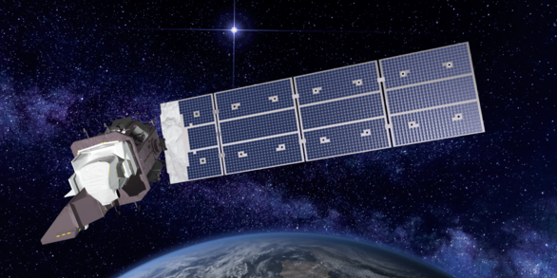
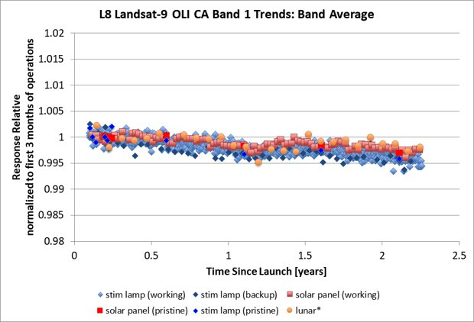
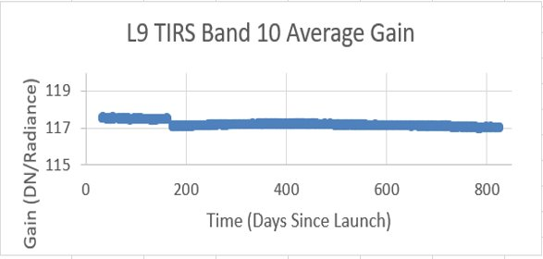
Instruments Updates & Planned launches that are relevant to GSICS
Landsat 9 continues to be stable and in-line with Landsat 8 for both Reflective (Left) and Thermal (Right) Bands
Landsat 9

Slide 4
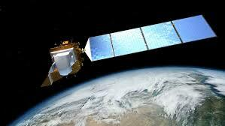
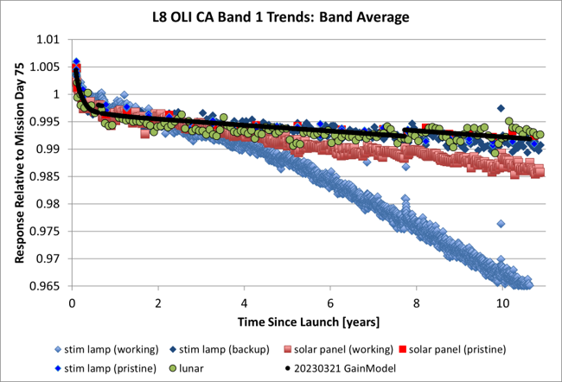
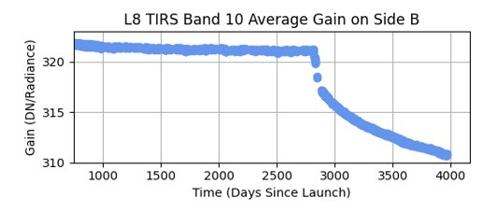
Instruments Updates & Planned launches that are relevant to GSICS
Degradations in Reflective band plot are due to on-board calibrator degradations
Degradations in thermal band plot are due outgassing/condensation which is accounted for with calibration
Landsat 8

Slide 5
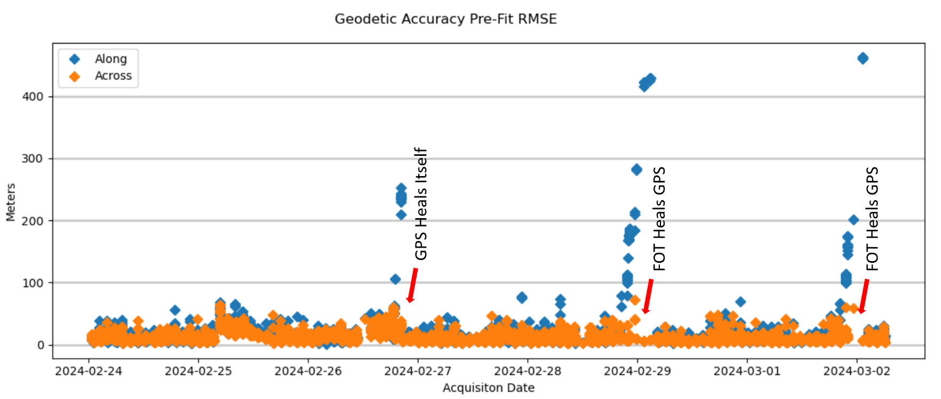
Instruments Updates & Planned launches that are relevant to GSICS
Landsat 8
One on-going issue with L8 is GPS “drop-outs” – 3 within one week in Feb.
These do not affect data quality but require extra effort to process
L9 has a different GPS unit and is not affected, similarly

Slide 6
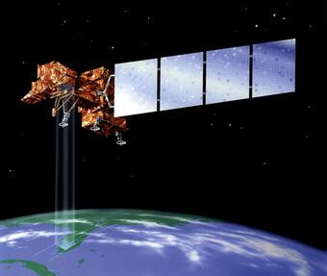
Instruments Updates & Planned launches that are relevant to GSICS
Landsat 7
Nominal Science Mission Ends: April 6, 2022 – Lowered Orbit
Landsat 7 Extended Science Mission: May 5, 2022 – Jan. 19, 2024
With cancellation of OSAM-1, L7 will cease all operations
April 15, 2024 – 25th Anniversary of mission

Slide 7
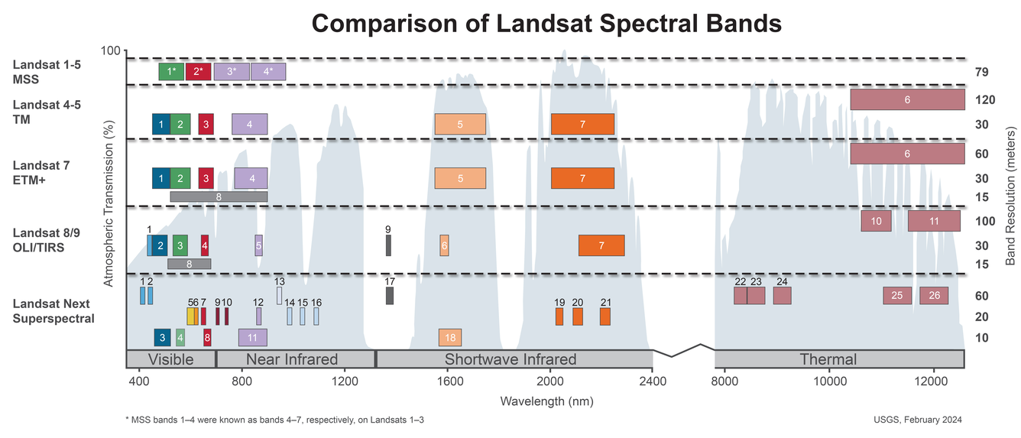
Agency’s Instruments Updates & Planned launches that are relevant to GSICS
Number of spectral bands: 26
Spatial resolution: 10-20 meters (VSWIR),
60 meters (atmospheric/TIR)
Triplet constellation repeat interval: 6 days
Expected launch date: Late 2030

Slide 8
Calibration Major Updates
March 11-14, 2024
Reston, VA
USGS Headquarters
https://www.usgs.gov/calval/jacie-2024-workshop

Slide 9
Calibration Major Updates
JACIE 2024 Workshop by the Numbers
Registered – ~397 (225 In-person)
Exhibits/Booths – 17 (2023 – 9)
Presenters (oral) – 72 (2023 - 49)
Presenters (poster) – 15 (2023 - 6)
Side Meetings (a first at JACIE!)
SAR, HSI, Tools/Assessments (Tues/Wed/Thurs)
Networking event (another first at JACIE!)
Food/drinks will be provided (Mon)
Stakeholders meeting (Monday 11th)
All Agencies attending
Uncertainty Workshop (Friday 15th)
Registered – ~114 (67 In-person)

Slide 10
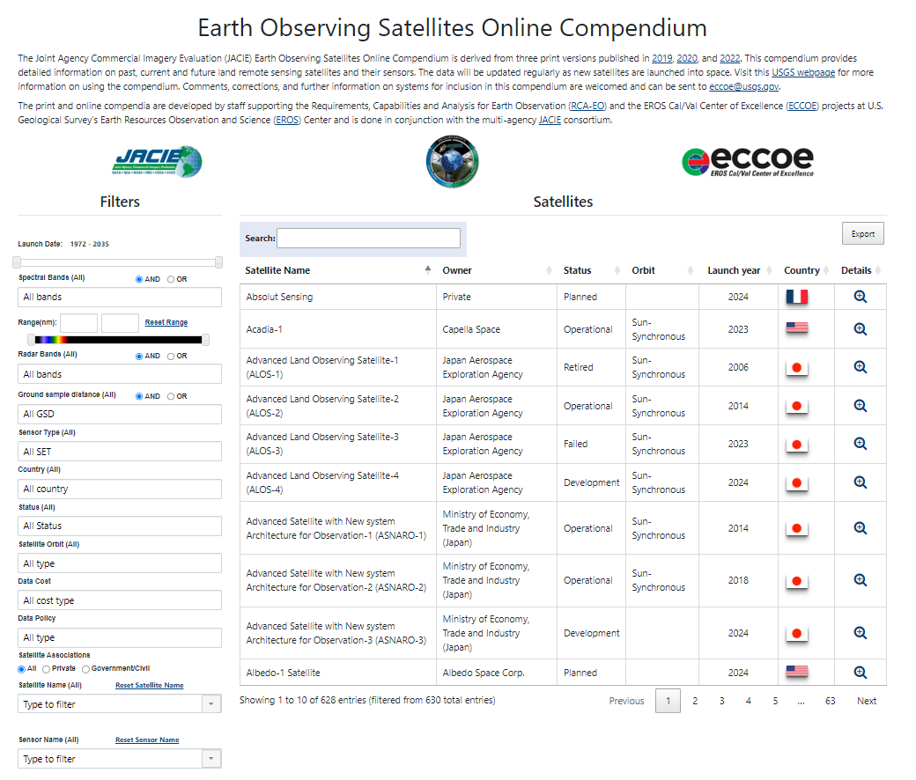
Calibration Major Updates
https://calval.cr.usgs.gov/apps/compendium#

Slide 11
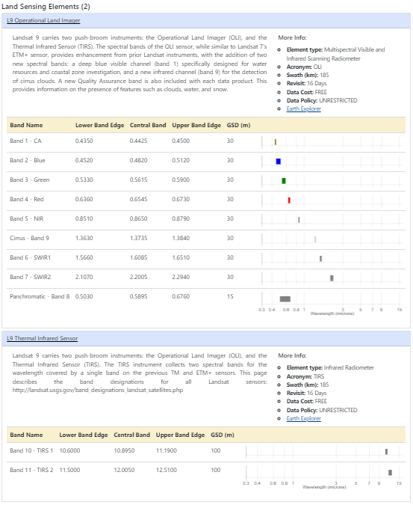
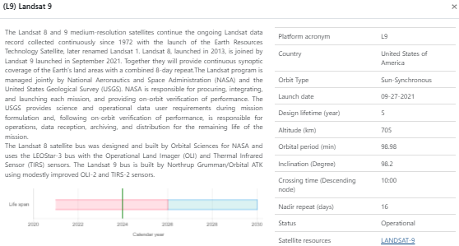
Calibration Major Updates
https://calval.cr.usgs.gov/apps/compendium#

Slide 12
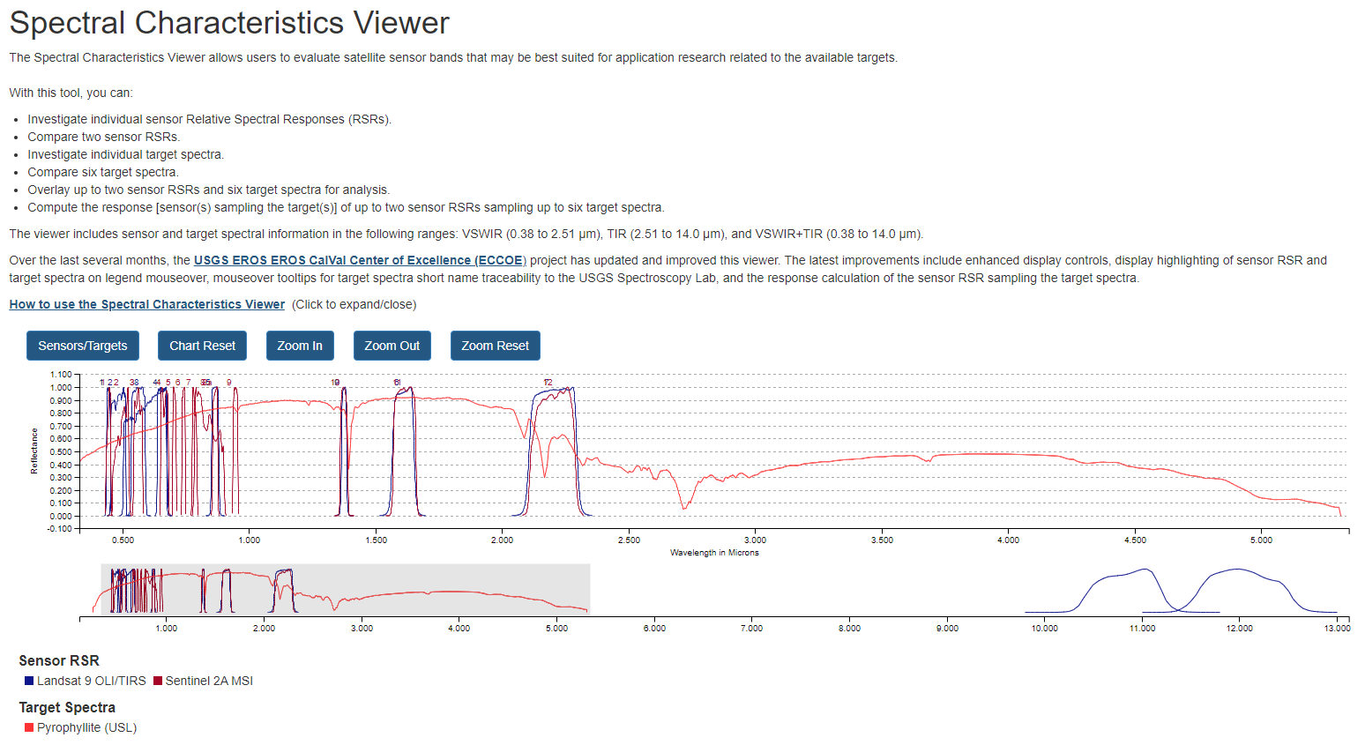
Calibration Major Updates

Slide 13
Calibration Major Updates

Slide 14
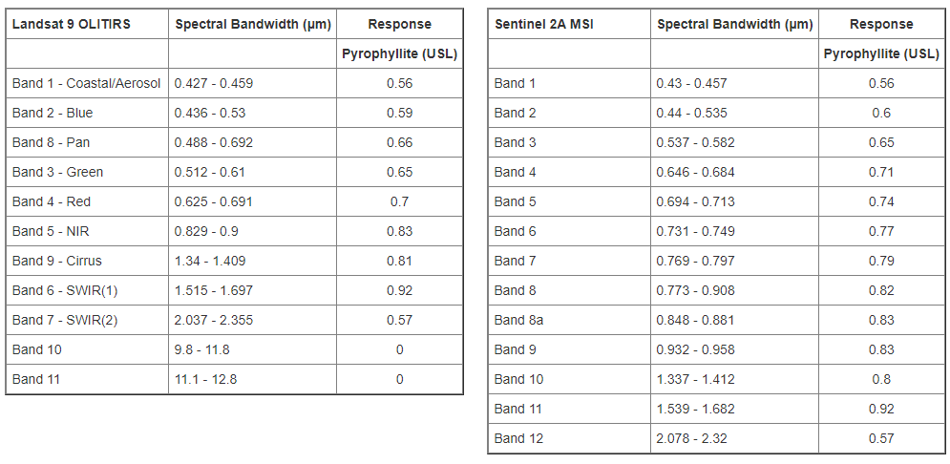
Calibration Major Updates

Slide 15
Summary
Landsat 8 and 9 continue nominal and stable operations
Landsat 7 is being decommissioned
LNext is progressing
Need to make sure GSICS and JACIE aren’t scheduled for the same week next year
Check out the Satellite Compendium
https://calval.cr.usgs.gov/apps/compendium#
Check out the Spectral Characteristics Viewer
https://landsat.usgs.gov/spectral-characteristics-viewer

Slide 16
Additional Slides Not Presented
GSICS related research activities.
Evaluating lunar irradiance measurements derived from nighttime AOD retrievals
Reprocessing Activities
Reprocessing the ROLO dataset — in progress
Personnel Supporting GSICS
EP: Cody Anderson
GRWG: Tom Stone, Cody Anderson
GDWG: none

