Slide 1

GSICS Agency Report
2024
Presenter
Philippe Goryl
CEOS WGCV

Slide 2
Area of Cooperation
WGCV and GSICS share methods and protocols (vicarious calibration)
WGCV and GSICS look for REFERENCE
  SITSat becoming reference from space SI traceable
Joint Organisation of the Pre-Flight Workshop Calibration / Characterisation: https://atpi.eventsair.com/pre-flight-calibration-workshop
Maturity Matrix approach – examples from EDAP and CEOS FRM

Slide 3
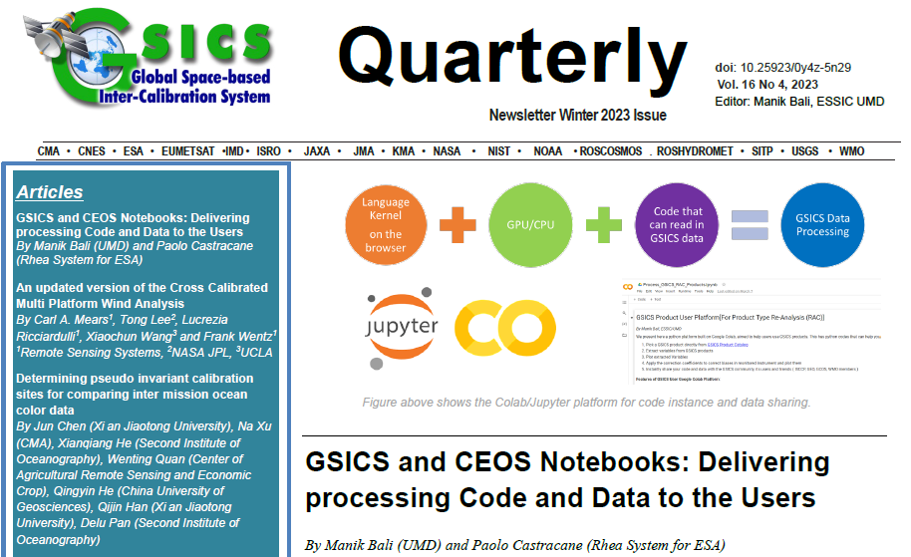
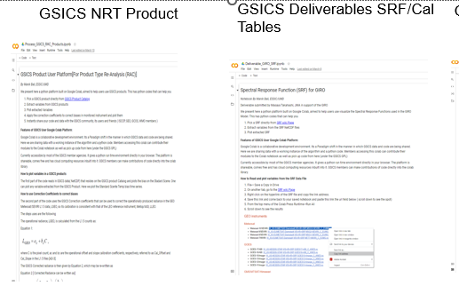
GSICS – CEOS collaboration
GSICS Newsletter: Edited by GSICS Coordination Center is Shared by CEOS on their website
GSICS Notebooks and Notebooks in CoMET Toolkit are shared by ESA. Joint article on Notebooks published by Manik Bali (Vice Chair GDWG) and Paolo Castracane (ESA) in GSICS Quarterly Newsletter V16 No 4 .
Paolo Castracane(ESA) presented the Overpass Tool in the GSICS Data Working Group Webmeeting .
Larry Flynn and Manik Bali are now members of the SITSAT Team.

Slide 4
WGCV Subgroup Updates
6 Sub-Groups
TMSG:
  Held first in-person meeting since re-activation in Iasi, Romania, on occasion of the Geomorphometry 2023 conference
  DEMIX close to finalisation, peer-reviewed publication submitted and final report expected by end 2023
  Active and fruitful cooperation with International Society for Geomorphometry (ISG) developing and implementing new benchmarking method ('wine contest')
  New initiative attempting intercomparison of Ground Control Points (GCP) for global harmonisation of orthorectification proposed: Seeking agencies support!
MSSG:
  Progressing CV-23-05: Retrieval and validation with high winds with combined active-passive microwave measurements and CV-23-06: Retrieval and validation of sea surface atmospheric pressure with microwave remote sensing.
SAR:
  SAR subgroup met at DLR in October 2023, meeting held in conjunction with TerraSARx/Tandem-X science team meeting.
  Space agencies are actively working on sharing of cal/val resources, RFI mitigation, CEOS ARD;
  SAR subgroup announced a new Chair Dirk Geudtner, ESA, and Vice-Chair: Stephane Cote, CSA.

Slide 5
WGCV Subgroup Updates Contd.
LPV :
  LPV is busy with protocol development in the following Focus Areas: Burned Area, Phenology, Vegetation Index, Land Cover, and Global Downward Radiation Product. Also, Soil Moisture has been promoted to Validation Stage 4. CEOS-LPV and GEOGLAM organised a 3 days workshop with aim to develop good practices for validation of crop and crop type maps and related crop area estimation. A peer-reviewed paper on definition of community good practices for accuracy assessment of cropland and crop type maps is in preparation to be published in end of 2023. . A summary of the paper will be also included in the CEOS-LPV good practices protocol for Land Cover, which is currently in preparation. The first version of this protocol is expected to be released in Q4 2023 for internal review within CEOS.
ACSG:
  Joint meeting with ACVC held in October 2023, in Belgium. Discussed on GHGs, Cal/Val synergies, cal/val needs for constellations.
IVOS :
  Meeting held in September 2023, in Germany.
  Discussion on solar irradiance spectrum, identified radiometric, geometric and spatial sites for developing New Space match up database.

Slide 6
Calibration Networks
Calibration Networks | Description | Current Status | Next Steps
RADCalNet | Provides SI-traceable TOA reflectances for post-launch radiometric cal/val of optical sensors. | Current sites: La-Crau (France), Railroad Valley (USA), two sites in Baotou (China), Gobabeb (Namibia) plus new sites expected to join the network. | Continuous collaborative efforts to maintain instrumentation in operation, process and quality control data and communicate with users. Growing user base and data uptake.
SARCalNet | Network of selected curated sites for SAR cal/val. | Dedicated website to collect databases of reference targets, demo data from different missions and relevant documentation is progressing well and will go live early next year. | Form working group for SARCalNet under SAR Subgroup Invite community to submit calibration sites
TIRCalNet | Dedicated to TIR optical sensors cal/val. | CNES in collaboration with NASA/JPL have deployed a JPL field radiometer at La Crau site. | Identify other candidate sites Discuss with partnering agencies on how to collaborate and set up and operate networks (funding for instrumentation, site operation, data analysis, supporting studies, etc.)

Slide 7
TIRCALNet Context
As per CNES WGCV presentation last year:
Several TIR missions operational: ECOSTRESS, ASTER, LANDSAT-8&9, MODIS, VIIRS, SLSTR, SEVIRI…
TIR future missions with higher resolution: TRISHNA, LSTM, SBG
More and more demanding LST accuracy requirements better than 0.1 K for climate studies
Importance of vicarious calibration for the validation of on-board calibration systems (black bodies) or direct calibration
L2 products (temperature & emissivity) validation need
In addition numerous new space TIR companies are about to be launched: ConstellR, Ororatech, Aistech,…

Slide 8
TIRCALNet Objectives
To collect surface temperature and emissivity, and atmospheric data necessary for the simulation of observations by TIR optical sensors and thus verify their radiometric calibration
To increase the number of matchups between in-situ measurements and space sensor observations and reduce the overall uncertainties, and reduce the efforts of individual agencies
To ensure traceability of the space sensor radiometry to the “Système International” (SI)
To support the establishment of the Global Earth Observation System of Systems by providing measurements to verify the radiometric consistency between EO space sensors
The success and experience return from RadCalNet network dedicated to VNIR-SWIR optical sensors cal/val
TIRCALNet should be able to provide TOA Brightness Temperature signals propagated from BOA measurements of ~ 0.5K uncertainty

Slide 9
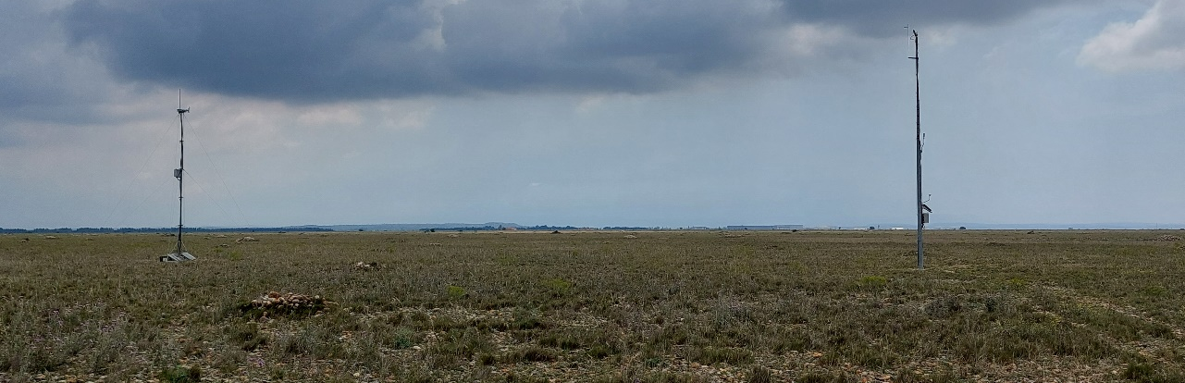
Site Study Objectives
TRISHNA, LSTM, SBG
Existing network for LST
Need for a denser network
  that provides $L_{TOA}$
  with evaluated uncertainty for each site
  with a demanding requirement on TOA
  radiance (0.5K)
Impact of uncertainty sources ?
  Atmosphere
  Emissivity
  Temperature (retrieved from radiometer measurements)
  ⇒ Study on La Crau, Gobabeb, Lake Tahoe and Lake Constance site
9

Slide 10
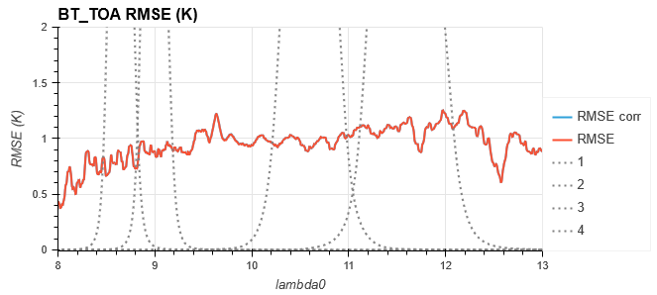
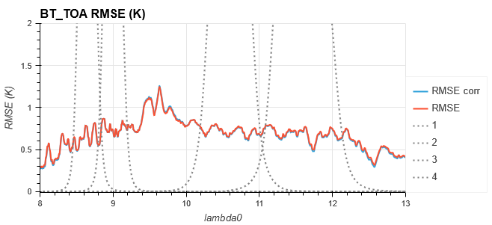
Uncertainty budget : La Crau
  Uncertainty on emissivity at IASI spectral resolution : std 0.02 (+ std 0.01 on mean emissivity)
  Emissivity spectrum : Labed&Stoll91
  JPL radiometer
  Better performance for wet months because of the higher atmosphere contribution (reduce the impact of the emissivity errors on TOA radiance)
Driest month : January
Wettest month : November

Slide 11
Intercomparison Exercises
ACIX: Atmospheric Correction scheme intercomparison
  ACIX-I, ACIX-II completed results available in the cal/val portal. ACIX-III evolving towards hyperspectral using PRISMA and EnMap data.
CMIX: Cloud Masking scheme intercomparison
  CMIX-1 results available. Initiated development of SkyCam - Ground based sky camera network for validation on satellite derived cloud masks.
DEMIX: DEM intercomparison and impact on orthorectification process
  Close to finalisation, peer-reviewed publication submitted and final report expected by end 2023
BRIX: Intercomparison of Biomass algorithm retrieval
  BRIX-2 was closed with two team providing preliminary results
SRIX4VEG: Intercomparison of Surface reflectance for vegetation
  Result of SRIX4Veg I will be presented at 2023 November Workshop. SRIX4VEG II campaign being held in Australia in March 2024
This comparison framework facilitates the understanding and knowledge of the various products from New Space and space agencies allowing better harmonisation between missions.

Slide 12
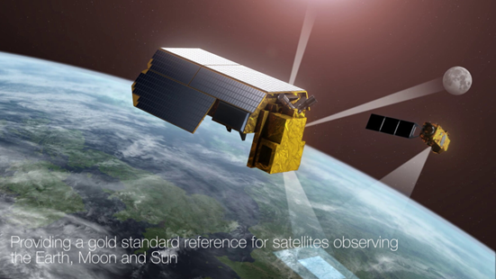
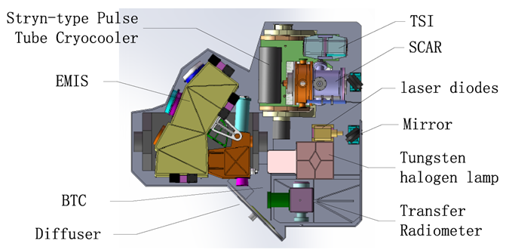
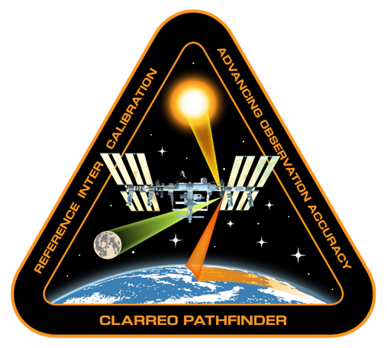
SITSats in Development
CLARREO PATHFINDER-NASA TRUTHS-ESA LIBRA-CMA
Task Team Updates:
Kickoff meeting held in 23 October 2023
Co-leads: Nigel Fox (UKSA) and Yolanda Shea (NASA)
Total Members: 19

Slide 13
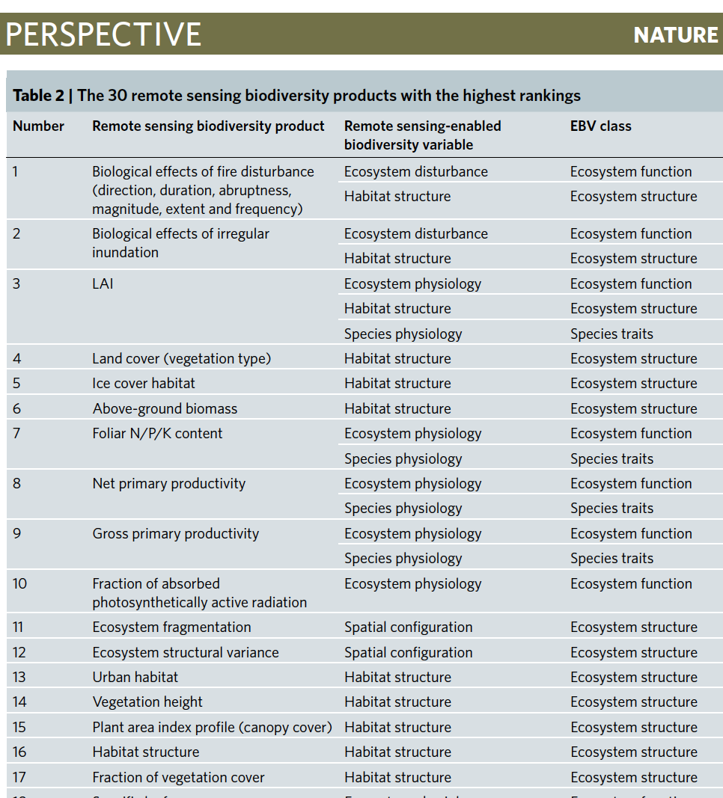

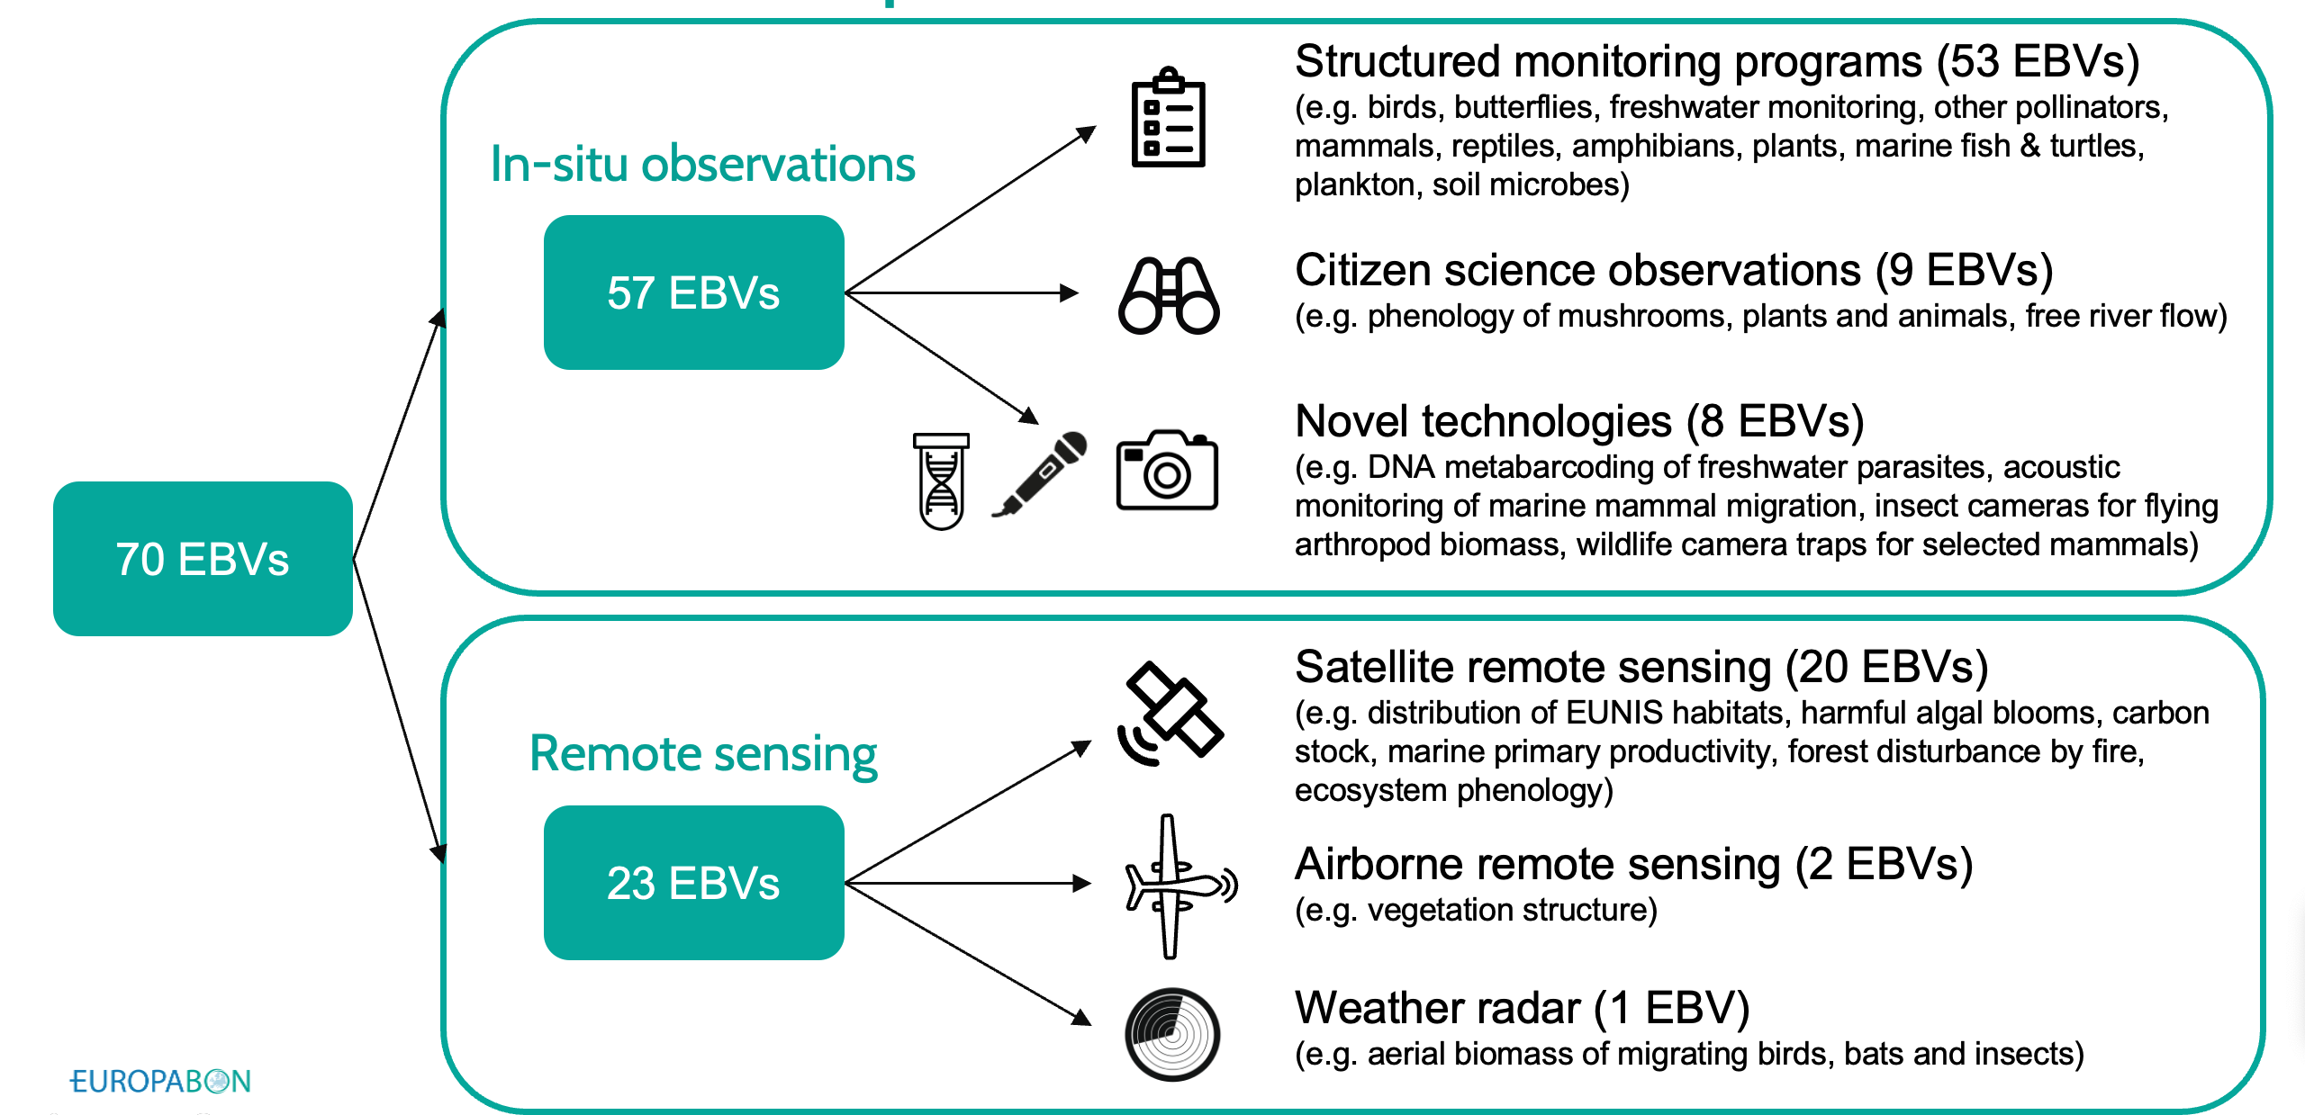
Collaboration with WGCV on EBVs
Support the development of RS-enabled EBVs best practice workflows. (including multi sensor approaches)
For EBVs essentially on ecosystem traits (ecosystem function and structure)
Starting from the variables already addressed by WGCV (e.g., Biomass, fAPAR, LAI)
Development of data quality standards for EBV retrieval algorithms.
Development of scientifically sound validation frameworks (including EBV validation protocols, possibly algorithm intercomparisons)
Support to EBV Cal/Val with sharing/provision of in-situ measurements
(fiducial reference measurements)
Support the integration of future CEOS missions in the EBV workflows (e.g. CHIME, SBG)
CEOS Chair Priority BIODIVERSITY
Europa Biodiversity Observation Network
The EuropaBON project,
Designing an EU-wide framework for monitoring biodiversity
Lumbierres M, Kissling WD (2023) Important first steps towards designing the freshwater,
marine and terrestrial Essential Biodiversity Variable (EBV) workflows for the European Biodiversity
Observation Network. Research Ideas and Outcomes
Skidmore et al., (2021) Priority list of biodiversity metrics to observe from space.
Nature Ecology and Evolution

Slide 14
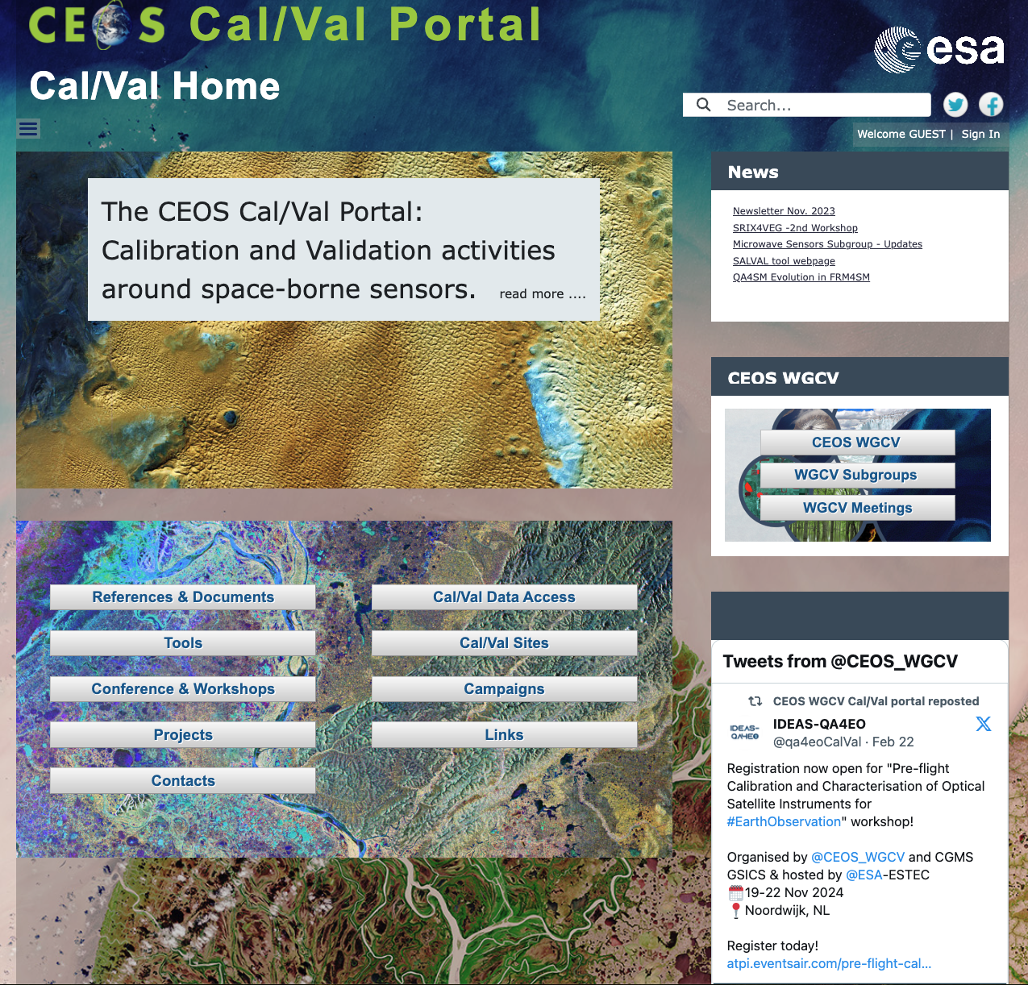
CEOS CALVAL portal Overview - numbers
https://calvalportal.ceos.org
Some numbers: 1st March 2024:
Users
1233 Registered Users
154 CEOS WGCV SAR Subgroup and 3 super-users
50 MTF Members
6 Cal/Val Doc Repository (rights for editing)
21 Terms and Definitions (rights for editing)
- proposal for SITSat group user (with dedicated repository and forum – in progress)
System availability
BC uses Nagios (http://www.nagios.org/) for monitoring the IT services.
The availability of the Cal/Val Portal is close to 100%.
https://calvalportal.ceos.org
Slide 14

Slide 15
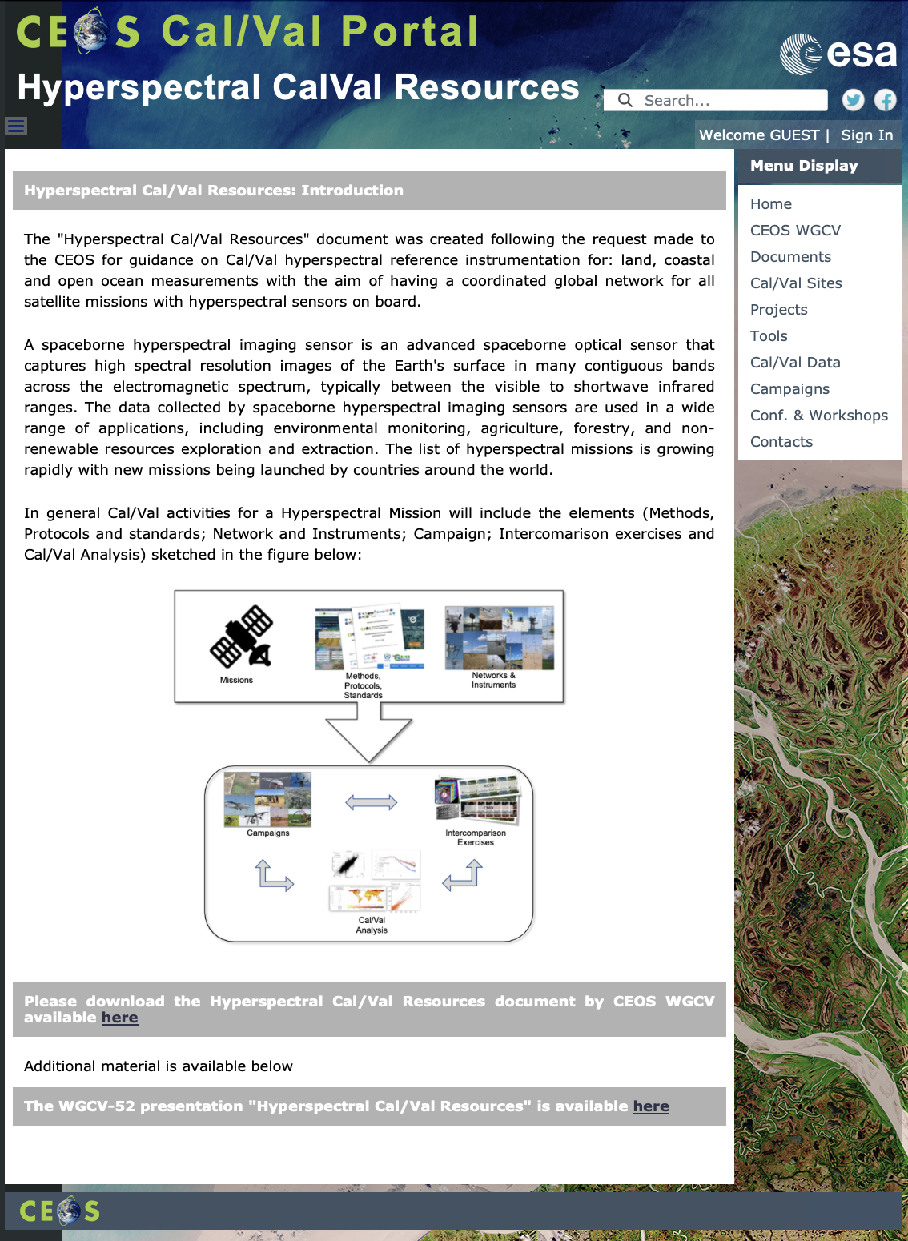
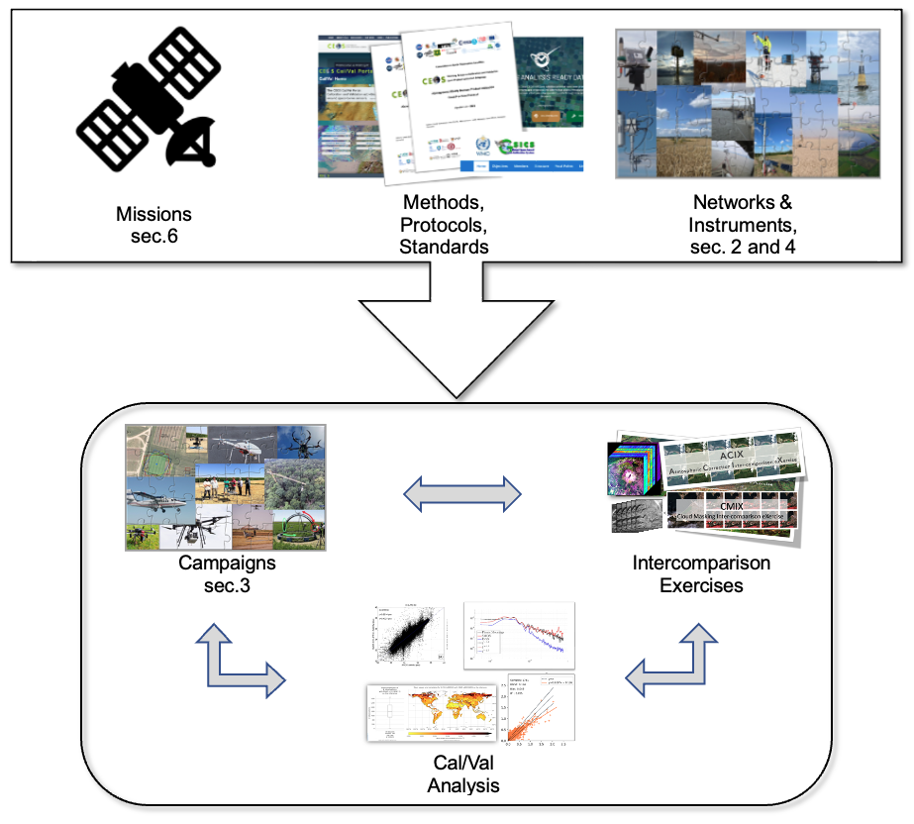
CEOS CALVAL portal Hyperspectral Cal/Val Resources
Hyperspectral Cal/Val Resources
https://calvalportal.ceos.org/web/guest/hyperspectral-calval-resources
Introduction
Networks
Guidelines and Protocols
Campaigns and Inter-comparison Excercise
Instrumentation and Hardware
Mission-Specific Resources
In general Cal/Val activities for Hyperspectral Mission will include the elements sketched in the figure above

Slide 16
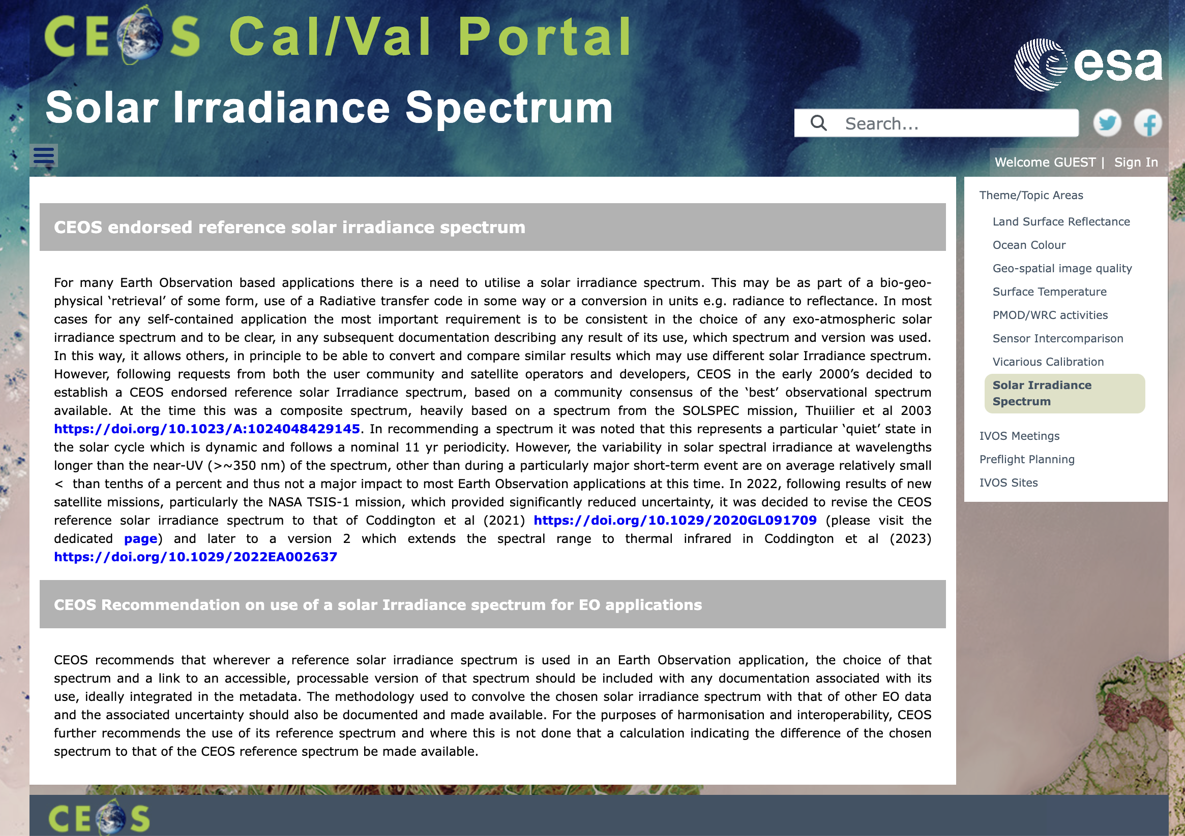
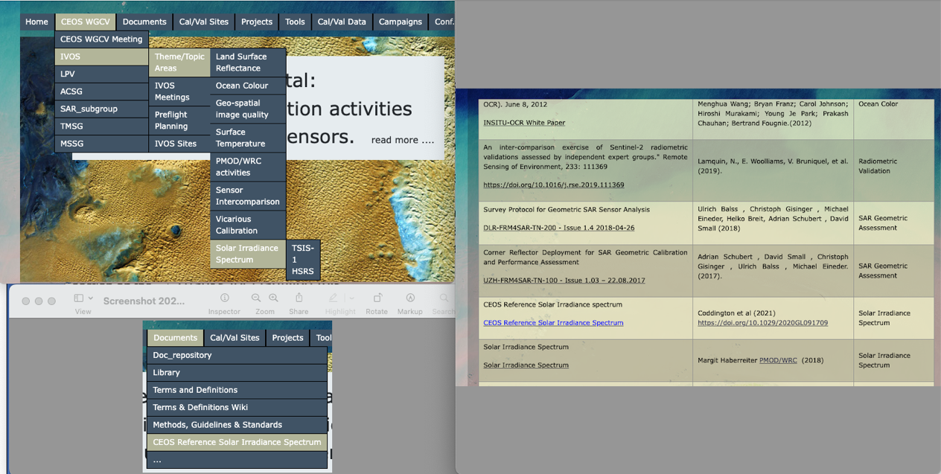
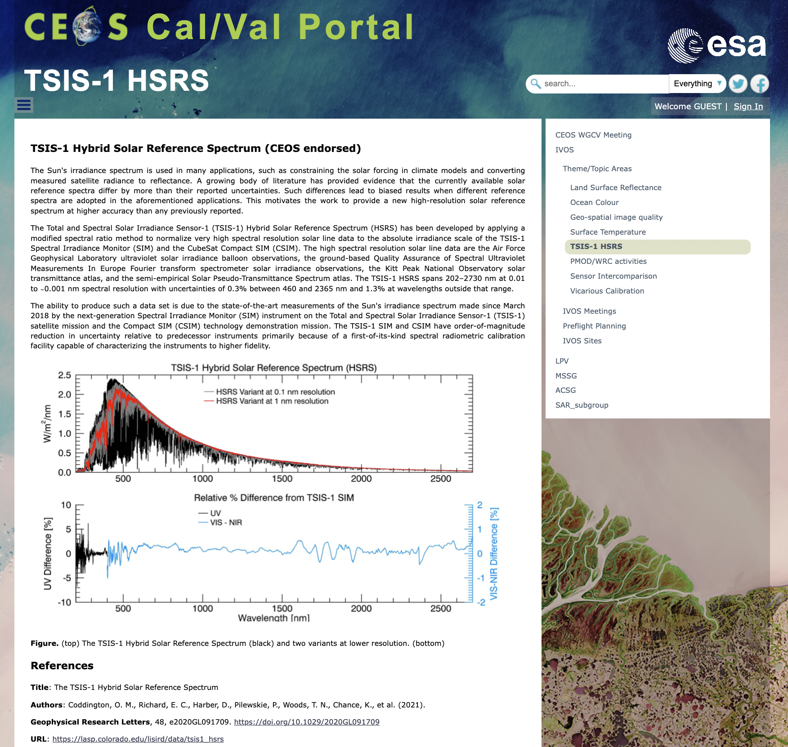
CEOS CALVAL portal Solar Irradiance Spectrum

Slide 17
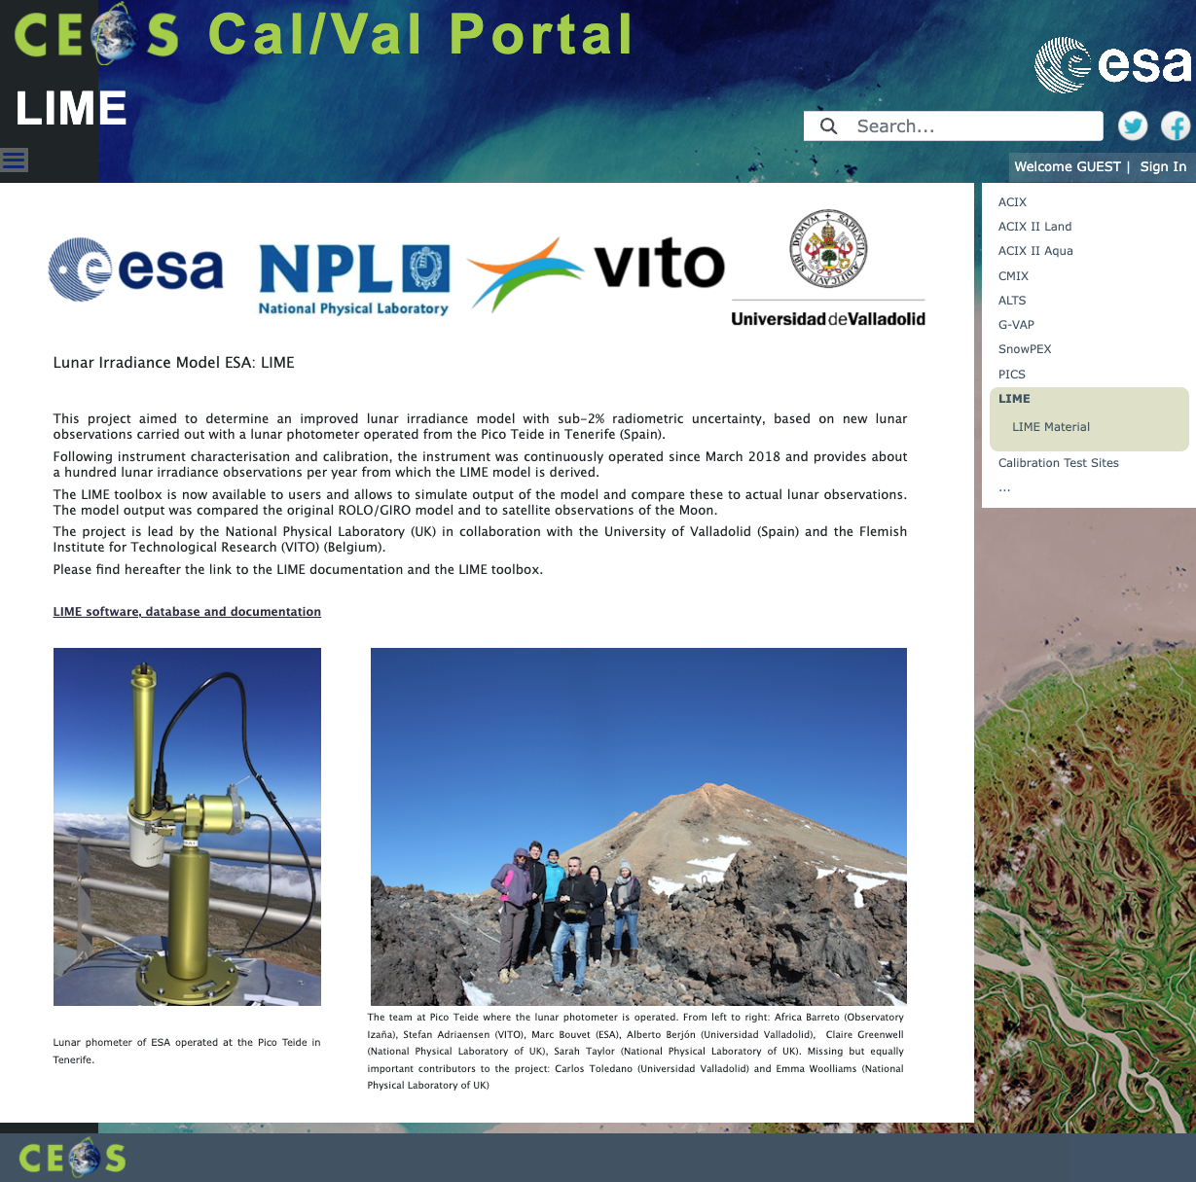
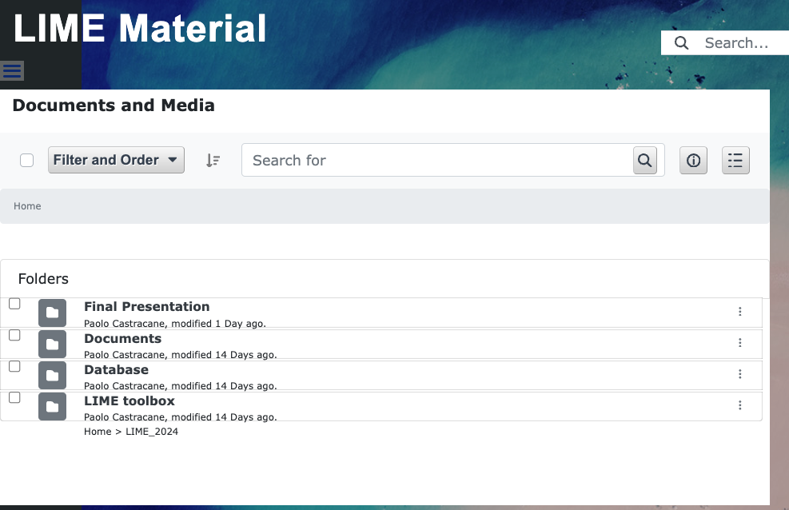
CEOS CALVAL portal LIME update
LIME updates - feb. 2024 with:
Documents: Deliverable documents form the project;
Database;
LIME toolbox: installers for Windows, Mac, Linux and Debian (Ubuntu);
Final Presentations

Slide 18
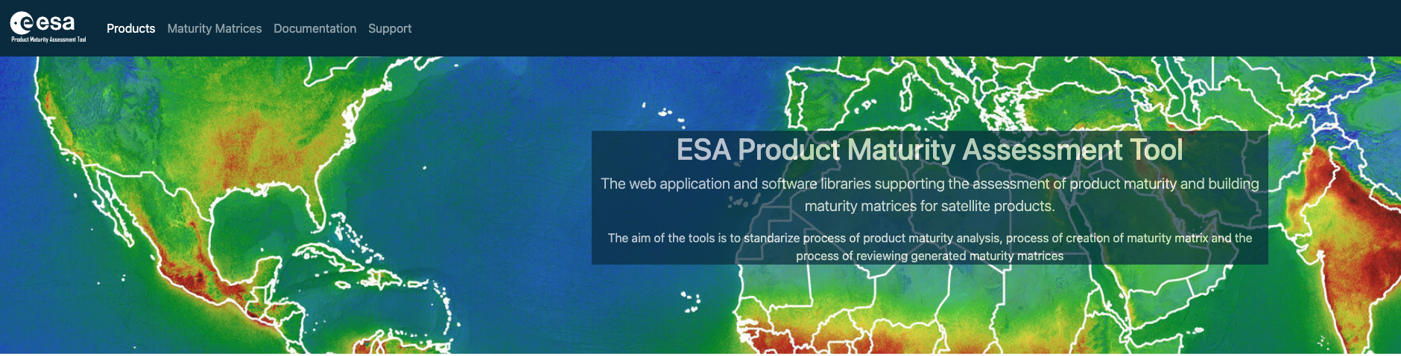
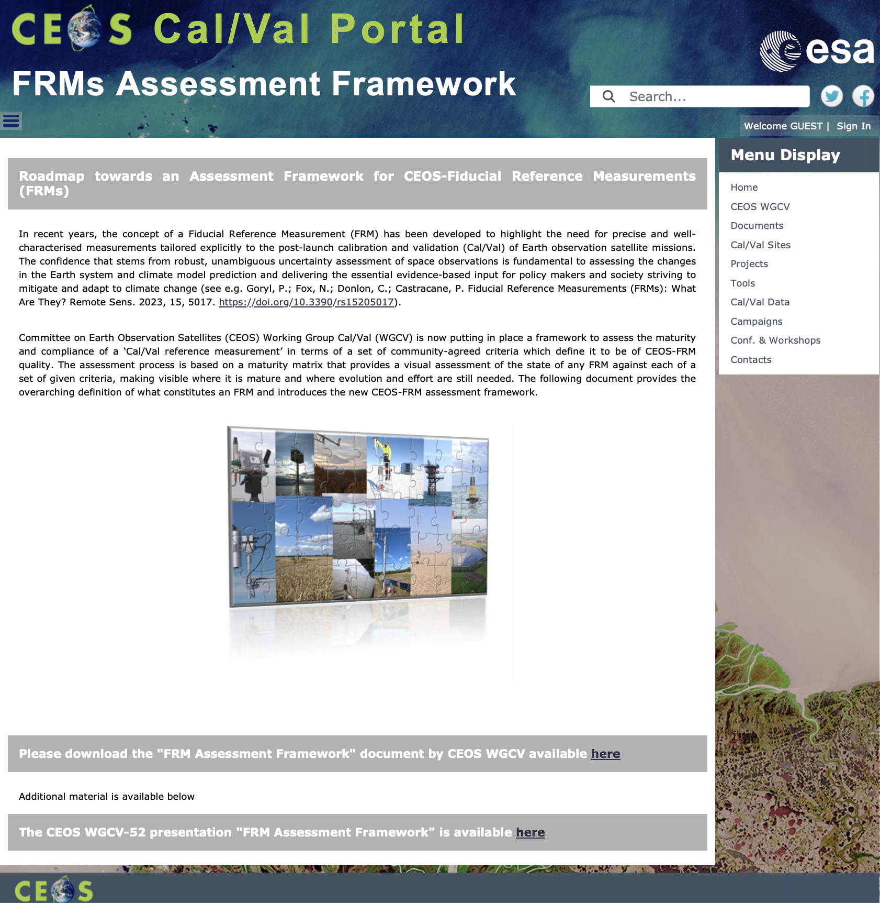
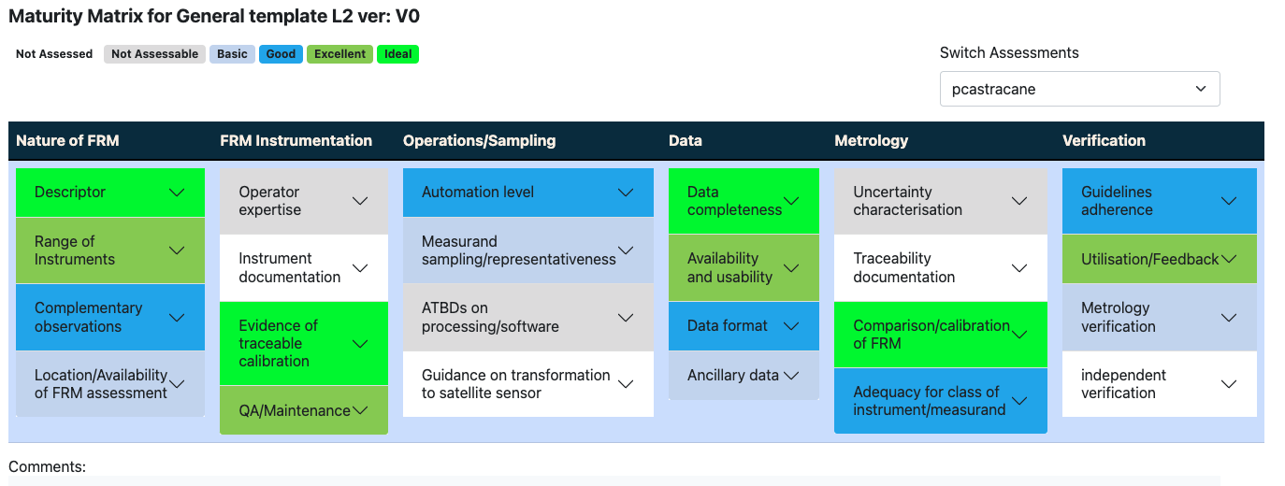

CEOS CALVAL portal FRMs Assessment Framework
Roadmap towards an Assessment Framework for Fiducial Reference Measurements (FRM)
https://calvalportal.ceos.org/web/guest/frms-assessment-framework
The purpose of the document is to propose a roadmap towards an assessment framework to endorse a specific class of measurements as a Fiducial Reference Measurement (FRM).
Background and Objectives
FRM Definition and Principles
FRM Endorsement Process
FRM Maturity Matrix
FRM Overall Classification
CEOS FRM MM –PGN (Pandonia Global Network)
CEOS FRM MM - RadCalNet (Radiometric Calibration Network)
CEOS FRM MM –ICOS (Integrated Carbon Observation System)
CEOS FRM MM - FRM4DOAS (Ground-Based DOAS Air-Quality Observations)
CEOS FRM MM - Brewer Spectrometer Measurements
CEOS FRM MM - Hypernets
CEOS FRM MM – CSIRO (DION)
CEOS FRM MM- BAQUNIN (PREDE-POM LUNAR)
Maturity Matrix Tool
https://mmt.skytek.dev
Dedicated credentials provided for all the selected pilots
Goryl, P.; Fox, N.; Donlon, C.; Castracane, P. Fiducial Reference Measurements (FRMs): What Are They? Remote Sens. 2023, 15, 5017. https://doi.org/10.3390/rs15205017).

Slide 19
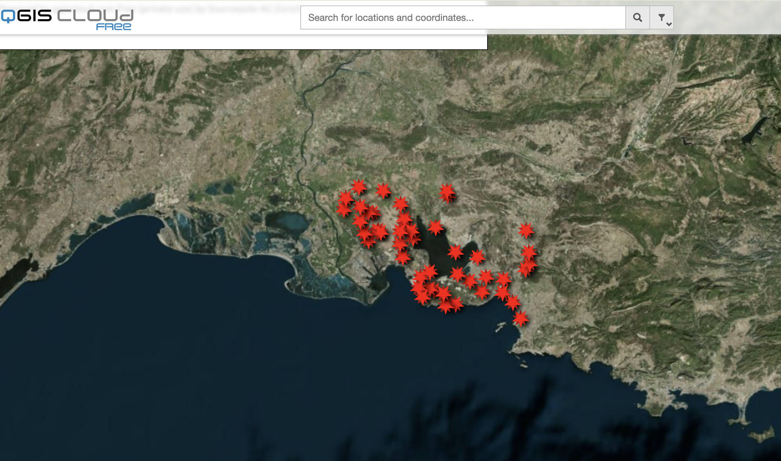
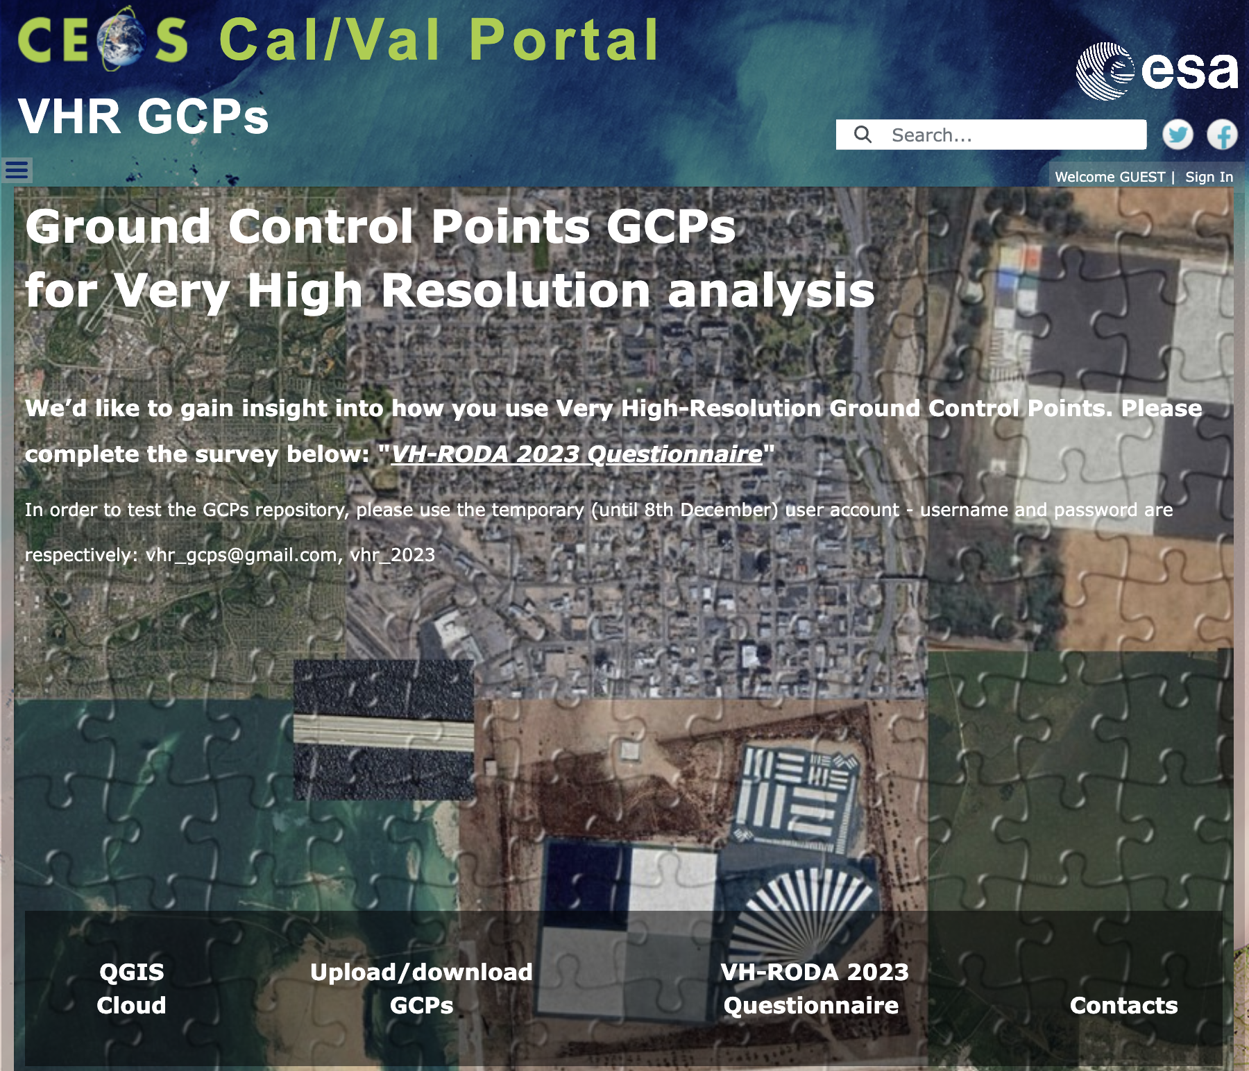
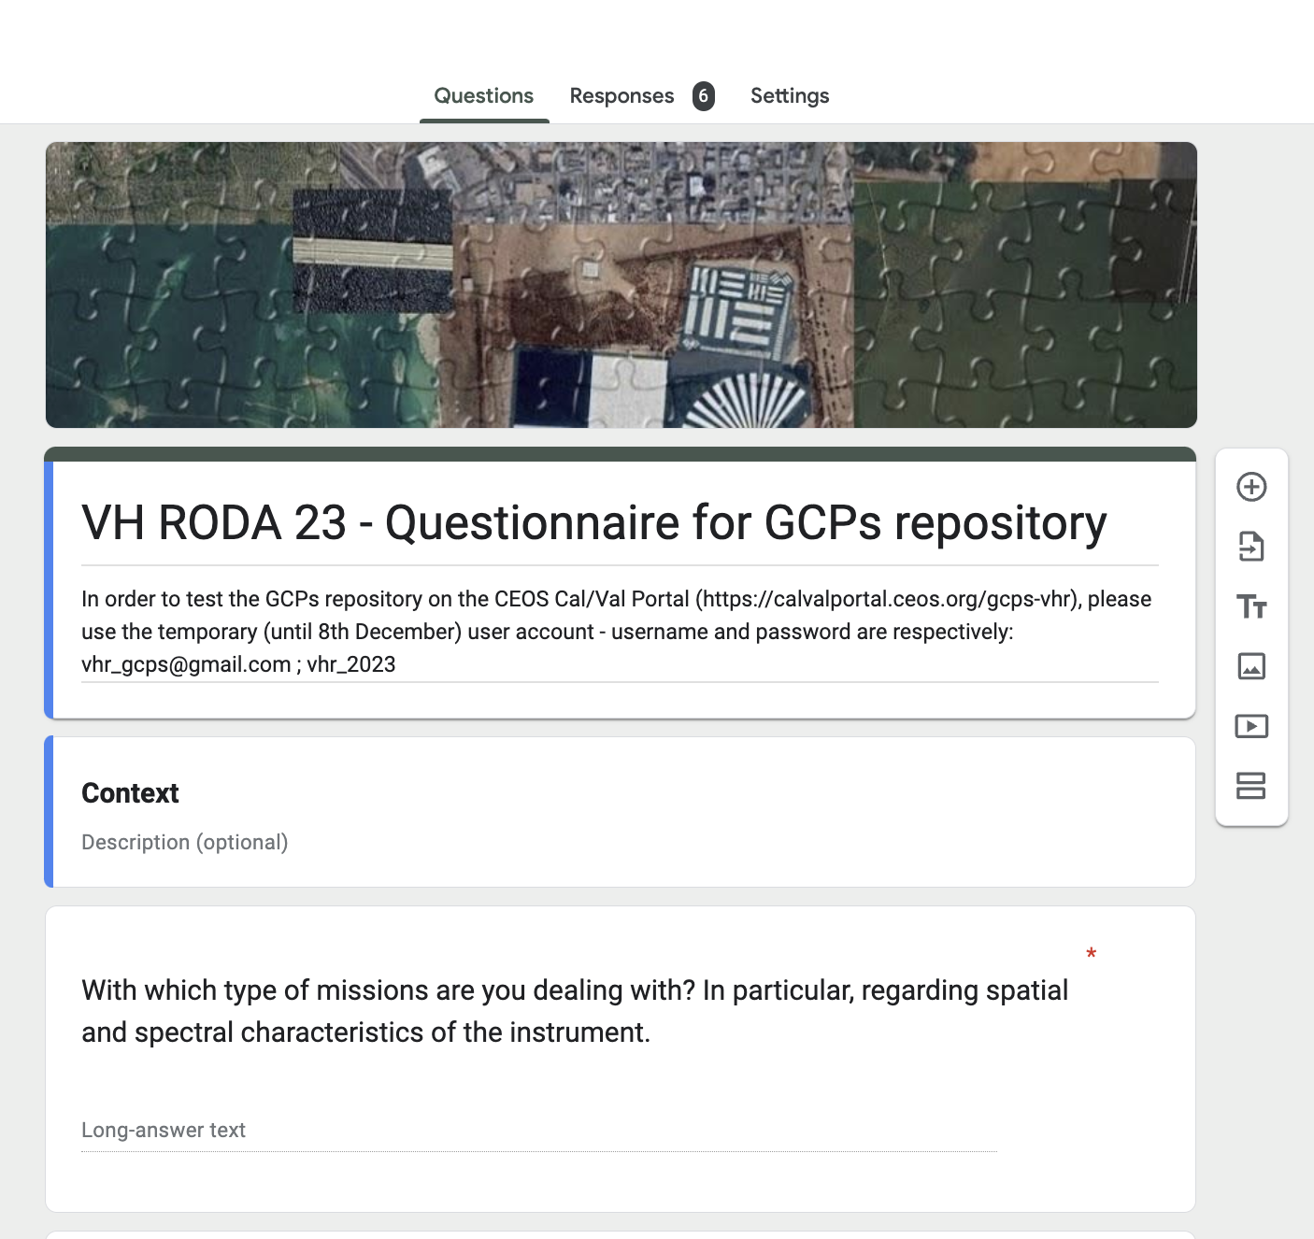
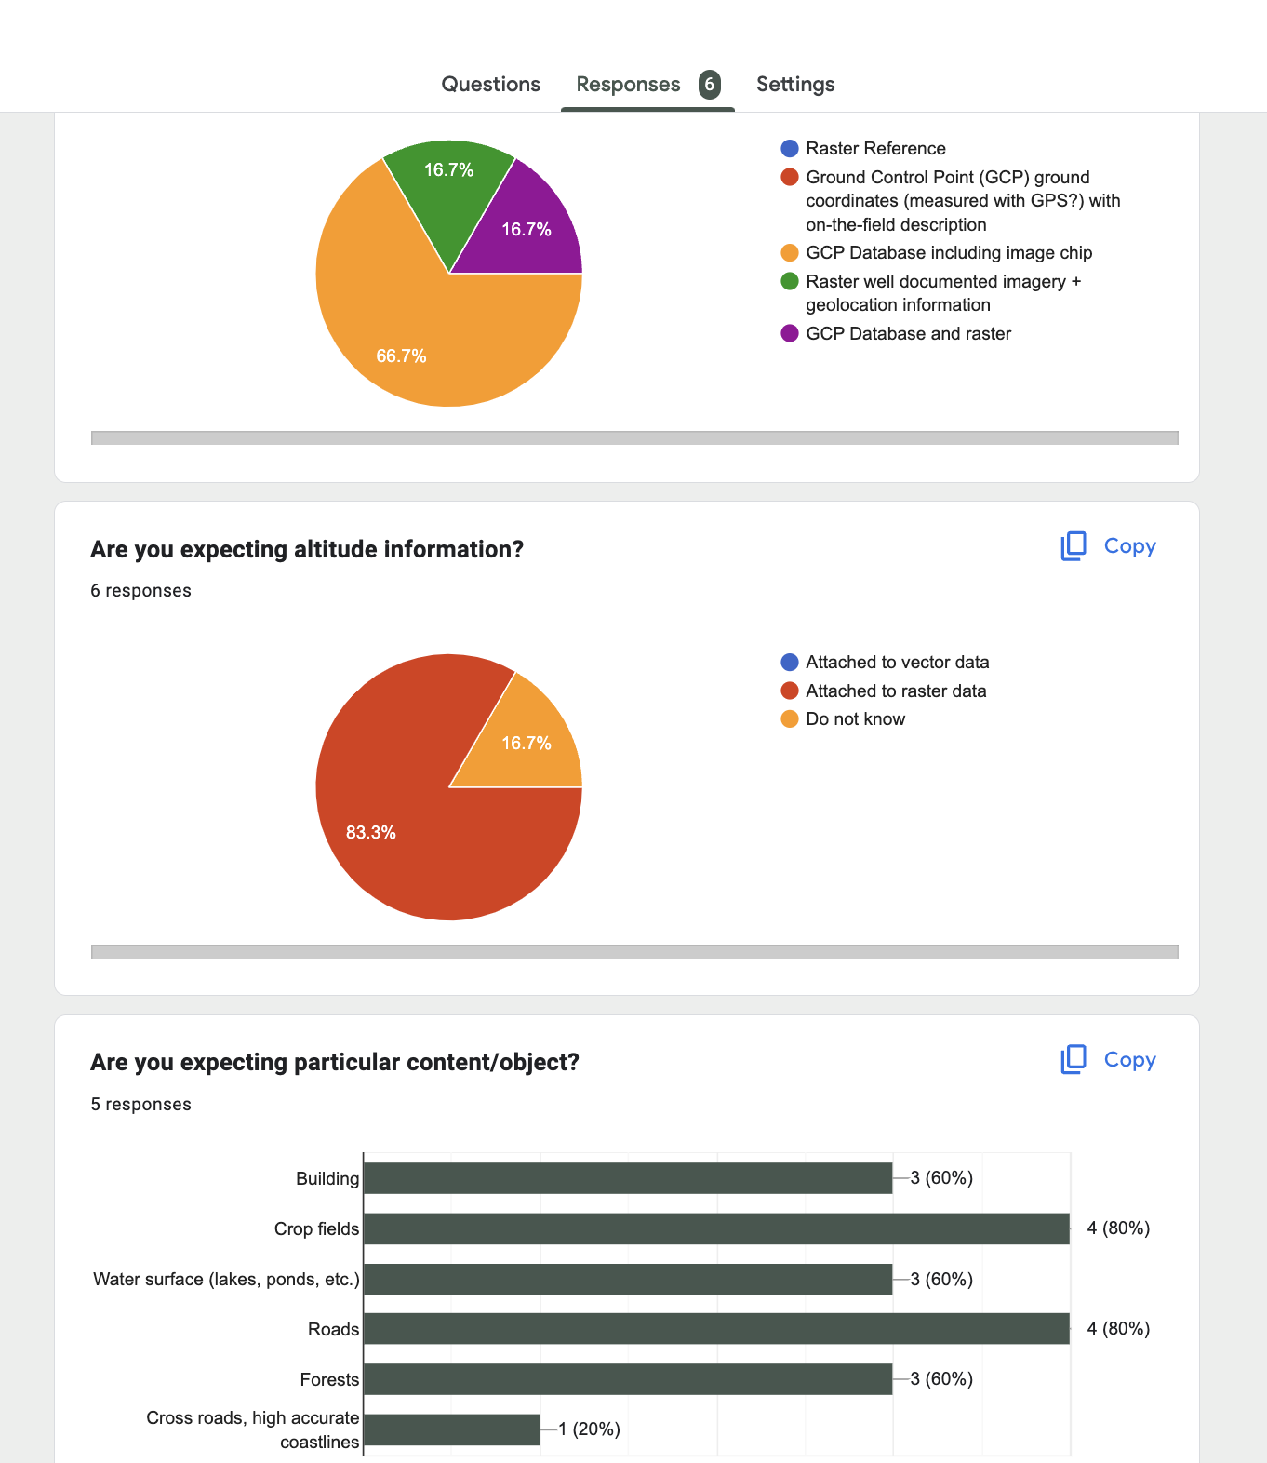
CEOS CALVAL portal GCPs for Very High resolution analysis
Webpage for GCPs for Very High Resolution
QGIS Cloud
Upload/download GCPs
VH-RODA 2023 – Questionnaire
Nov. 2023
- Input from
Sébastien Saunier
Rosario Quirino Iannone

Slide 20
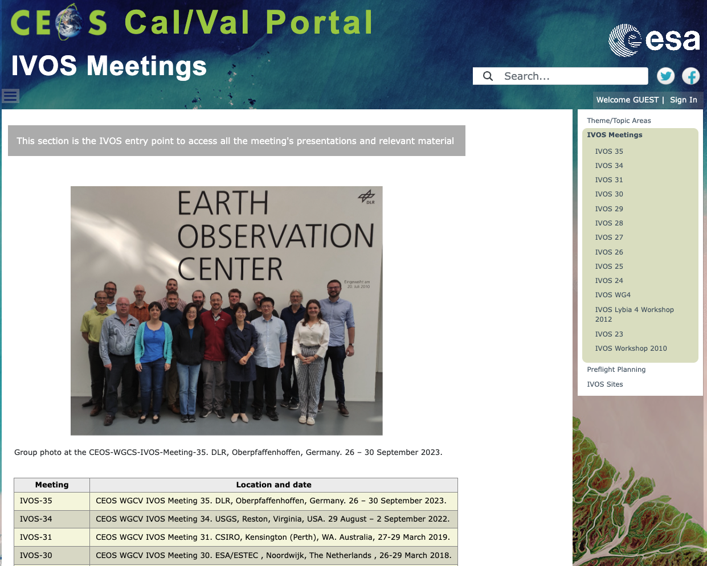
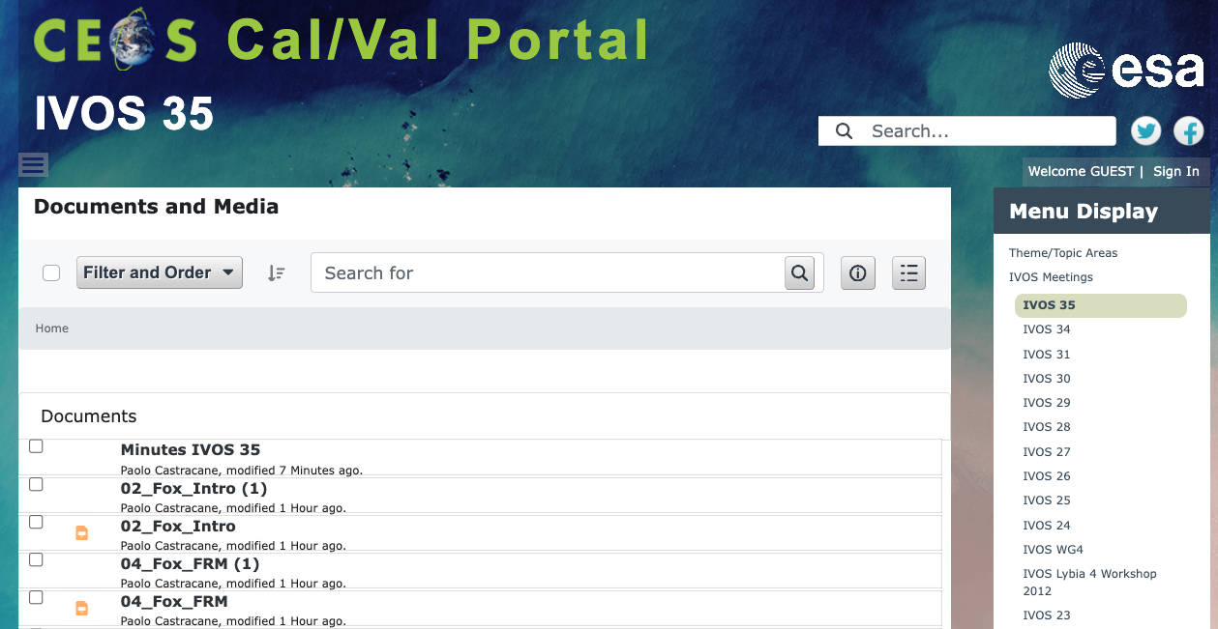
CEOS CALVAL portal IVOS Meetings – IVOS-35
IVOS Meetings
IVOS -35
DLR, Oberpfaffenhoffen, Germany. 26 – 30 Sept. 2023
Presentations
MoM
Now available!

Slide 21

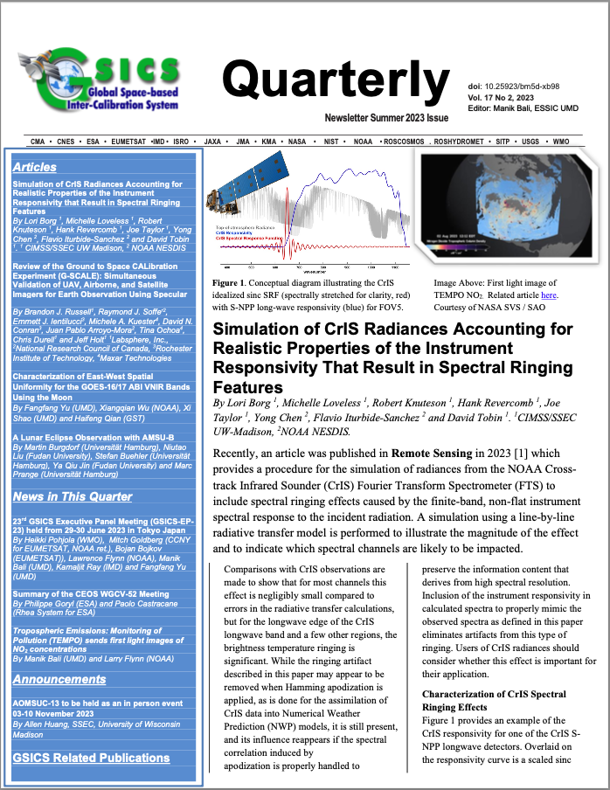
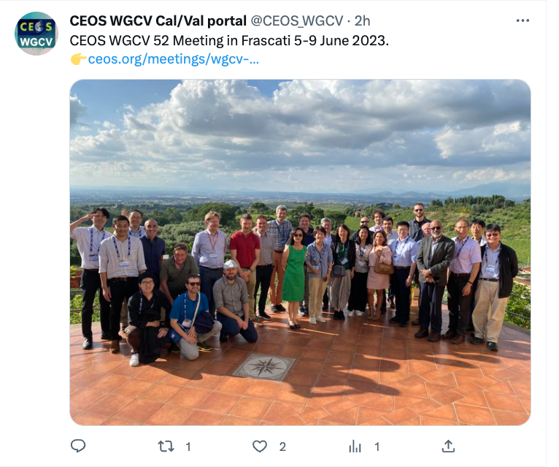
CEOS CALVAL portal Outreach/Newsletter
Newsletter published in Nov 2023
Content Updates for each subgroups
Hyperspectral Cal/Val resouces
FRM Assessmente framwork
Outreach, video tutorials, twitter, contact and support

Slide 22
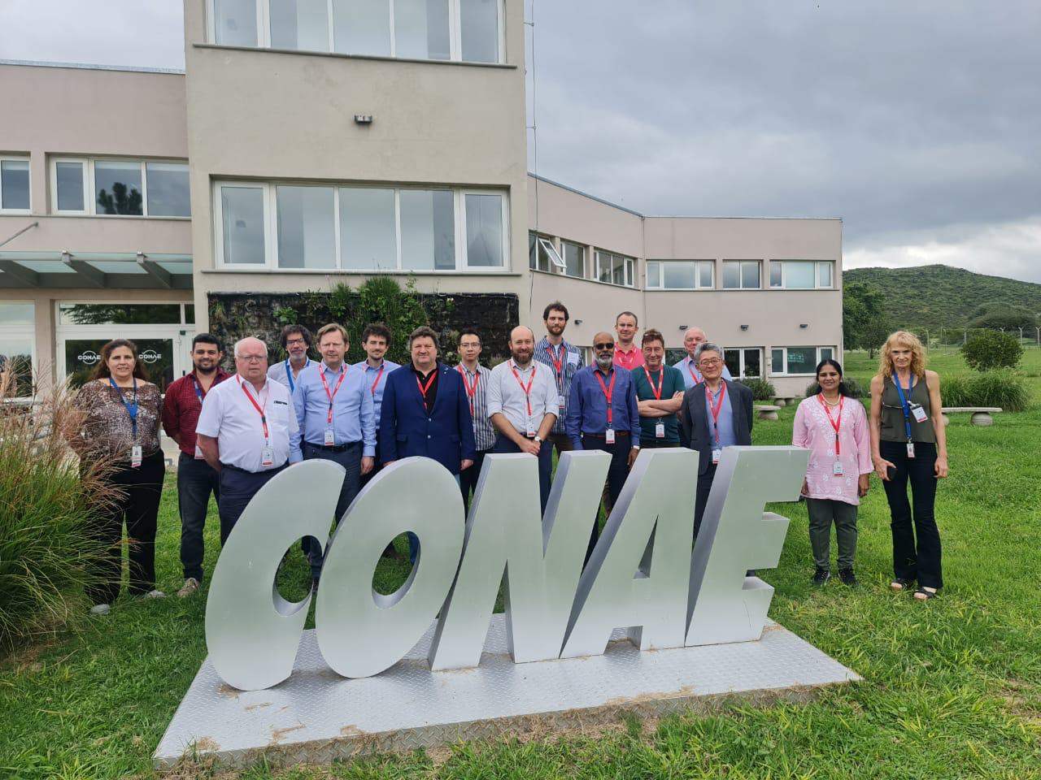
WGCV Plenary Meetings
WGCV-53 took place in Córdoba, Argentina | March 5-8, 2024
Hosted by CONAE
Next WGCV-54
Sioux Falls, USA | Oct 2024
will be a joint meeting with WGISS
Hosted by USGS
  Expression on Uncertainties
  ARD

