Slide 1

GSICS Agency Report
2024
Satya Kalluri Ph.D.
Senior Scientist for NOAA/NESDIS/LEO
Satya.kalluri@noaa.gov
(NOAA EP Member)
US National Oceanic and Atmospheric Administration
(NOAA)

Slide 2
Disclaimer
"The scientific results and conclusions, as well as any views or opinions expressed herein, are those of the authors and do not necessarily reflect those of NOAA or the Department of Commerce.“

Slide 3
Presentation Overview
Summary of Agency’s GSICS Activities, Actions, and Achievements
Agency’s Support to EP Activities
Agency’s Support to GDWG Activities
Agency’s Support to GRWG Activities
Agency’s Instruments Updates & Planned launches that are relevant to GSICS
Agency’s Calibration Major Updates

Slide 4
Activities and Achievements
Reprocessed SNPP SDRs for ATMS, CrIS, OMPS, and VIIRS are available at the NOAA CLASS Archive.^
Populating the ICVS Inter-Sensor Comparison Portal with additional bias products.^
GCC continues to maintain the GSICS Product Catalog and WIKI and publish the GSICS Quarterly.^
Coordinated the development of Lunar Spectral Irradiance Calibration System (LSICS).
Supporting CrIS and VIIRS as reference instruments.
^See note pages for website links.
Notes:
CLASS https://www.avl.class.noaa.gov/saa/products/search?sub_id=0&datatype_family=RPCRISSDR&submit.x=22&submit.y=7
ICVS https://www.star.nesdis.noaa.gov/icvs/comparison_ATMS.php, https://www.star.nesdis.noaa.gov/icvs/GSICS.php
GCC https://www.star.nesdis.noaa.gov/smcd/GCC/index.php

Slide 5
Personnel Supporting GSICS
EP: Satya Kalluri
GCC: L. Flynn, Director & M. Bali, Deputy (UMD)
GRWG: F. Yu, Chair (UMD)
    IR: L. Wang, Chair (UMD)
    MW: F. Iturbide, Co-Chair, S. Iacovazzi (GSTI), C.-Z. Zou, N. Sun (GSTI), H. Yang (UMD)
    SWx: J. Rodriguez, A. Boudouridis, B. Kress
    UVN-S-: L. Flynn Co-Chair, T. Beck, D. Liang (GSTI), Z. Zhang (IMSG), J. Niu (IMSG)
    VNIR: X. Wu, C. Cao, B. Basnet (GSTI), X. Shao (UMD)
GPRC: X. Wu
ICVS: B. Yang, N. Sun (GTSI)
GDWG: M. Bali Vice-Chair (UMD)

Slide 6
Instruments Updates & Planned launches
NOAA-21 SDRs are now at Validated Maturity, and the satellite will become the Primary NOAA afternoon LEO Satellite.
NOAA-20 will be move to 180° away and become Secondary.
GOES-16 is healthy in the 7th year of operation (8th year in orbit).
GOES-17 annual checkout in January 2024 went smoothly.
GOES-18 ABI L1b products achieved Full Validation maturity on in September 2023.
GOES-U/19 is on schedule for launch in May 2024.
EWS-G2 replaced EWS-G1 in October 2023.
JPSS-4 (NOAA-22) is scheduled for launch in 2027.
Notes:
JPSS-4 (NOAA-22) is scheduled for launch in 2027.

Slide 7
Support for EP, GRWG, GDWG & GCC
Satya Kalluri, NOAA LEO Program Scientist, is the new EP Member.
NOAA Continues to support and lead the GCC.
NOAA staff and affiliates
  Are the chair of the GRWG and the vice-chair of the GDWG.
  Are co-chairs of three of the GRWG subgroups.
  Will present fourteen talks in the GRWG and GDWG breakout sessions.
  Are very active participants in the monthly GRWG subgroup and GDWG meetings.
    See the backup slides for members and their interests.

Slide 8
Recent Actions Status
Annual Meeting Actions
A.GWG.20230228.1 | Manik Bali to engage with Copernicus climate archive experts (via Betsy Weatherhead) and NIST data librarians on strategies to provide users with guidance to access best GSICS products for their application | Manik Bali | Initial meeting held with Betsy and follow-ups planned | Ongoing
A.GWG.20230227.2 | Manik Bali (NOAA) to consider the development of tool to interface GSICS Correction coefficients from GSICS Server with Satpy as external calibration coefficients. | Manik Bali | Satpy installed on GSICS Wiki linux instance | Ongoing
A.GDWG.20230301.1 | Manik Bali (NOAA) to add option in tracking tool to label actions as no longer relevant, and ensure a lead is clearly identified for each action | Manik | Implemented | Closed
A.GSW.20230615.1 | Larry Flynn/Manik Bali will assemble background documentation on the GSICS processes and products (Wiki, introductory presentation, GSICS products catalogue etc.) |  | Provided to SW | Closed
A.GDWG.20230904.1 | GDWG to contact the product producers to learn about their views on making their products discoverable in the WIS system on a test basis |  |  | Ongoing
A.GDWG.20230904.2 | GDWG so share lessons learnt with GRWG, Simon and the WIS team. |  |  | Ongoing
Executive Panel Actions
A.GEP.20230630.11 | GCC to organize trimestral status teleconference between EP Chair, WG Chairs and GCC. | GCC | Bojan visited NCWCP | Ongoing
A.GEP.20230630.5 | Prepare proposal for the new space involvement in GSICS. | GCC | Ongoing | Open
A.GEP.20230630.8 | Evaluate ISCCP-NG user feedback, and other user feedback, prioritize and address open issues as actions to subgroups. | GCC/Manik Bali |  | Ongoing

Slide 9
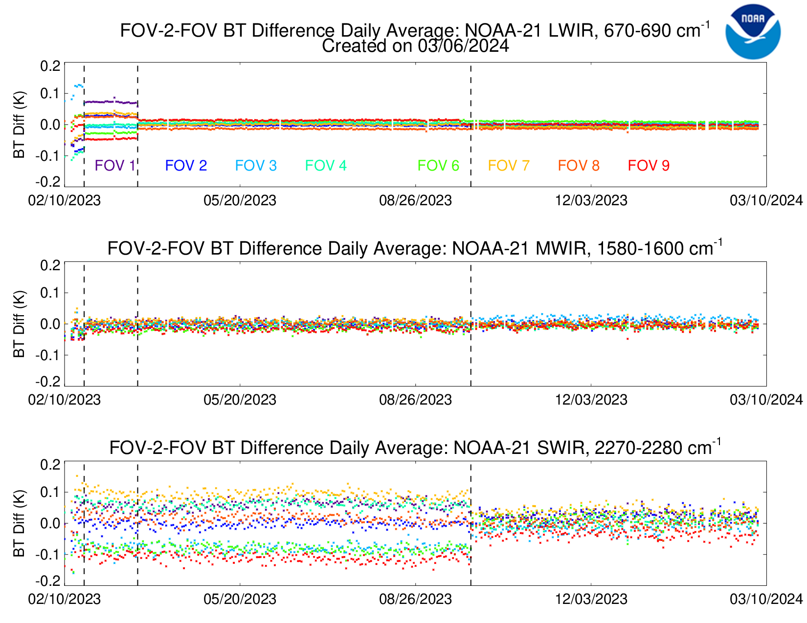
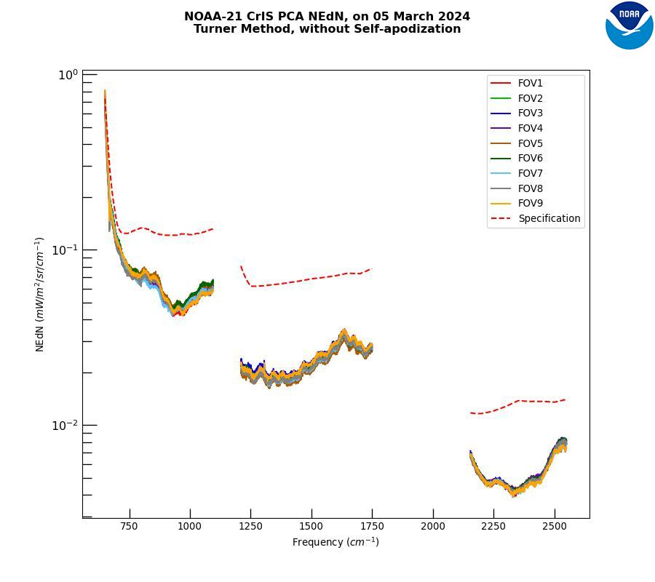
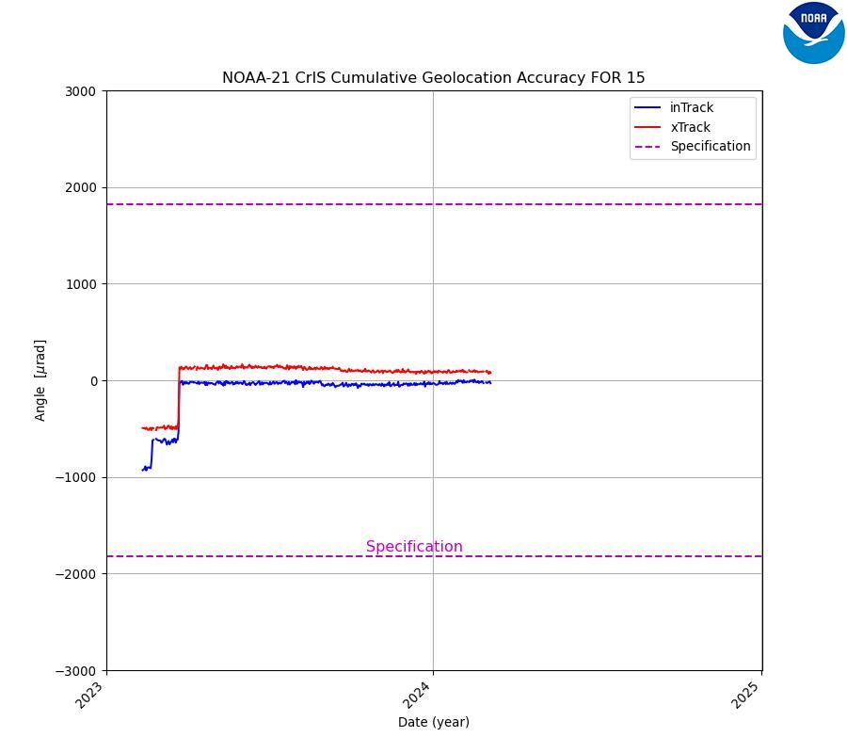
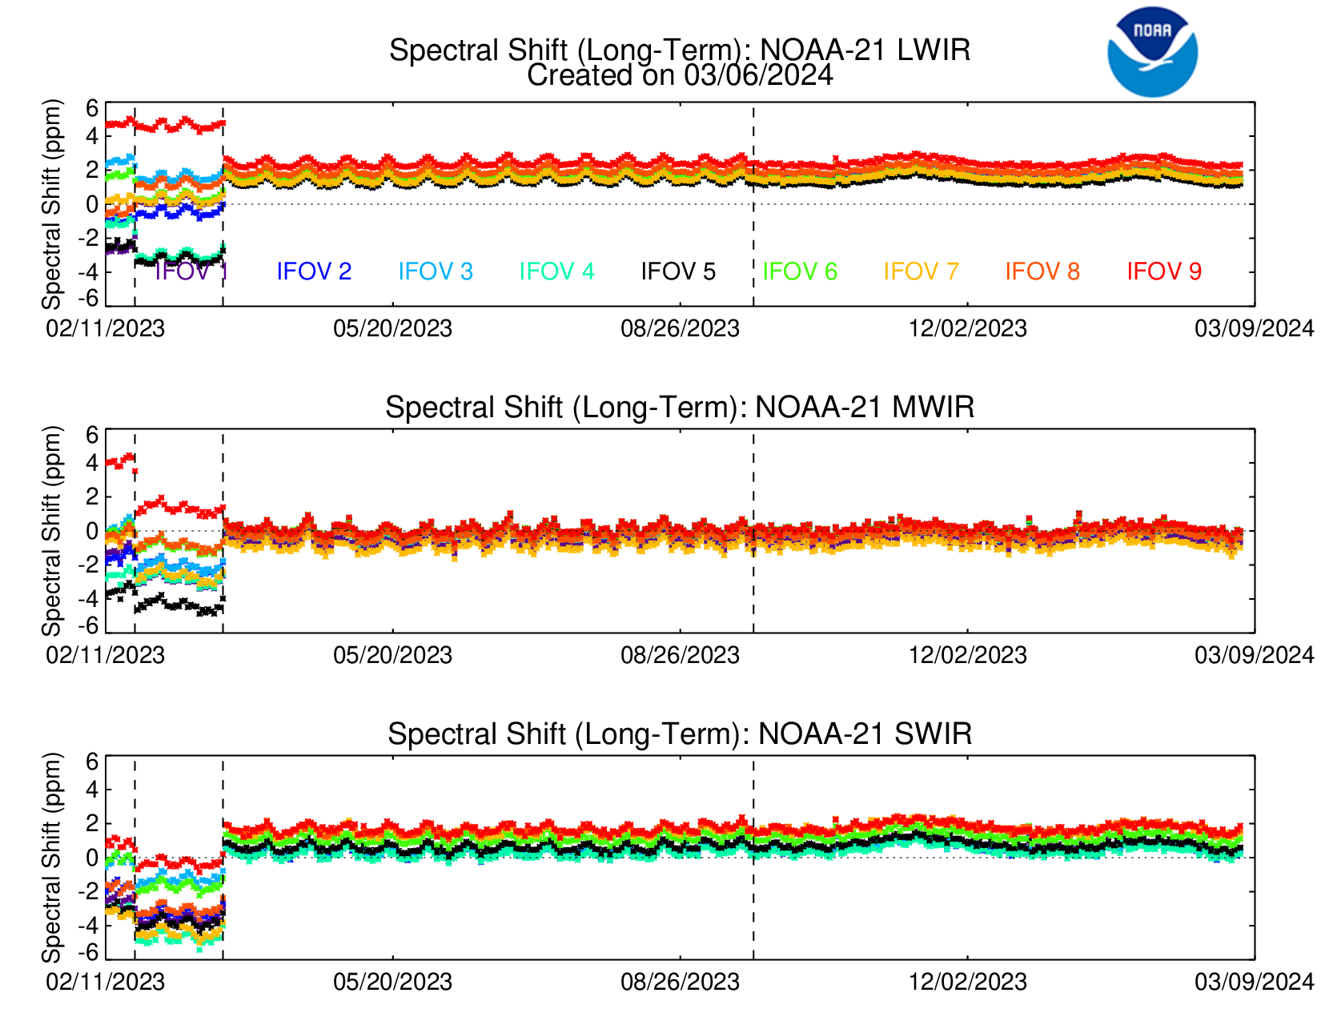
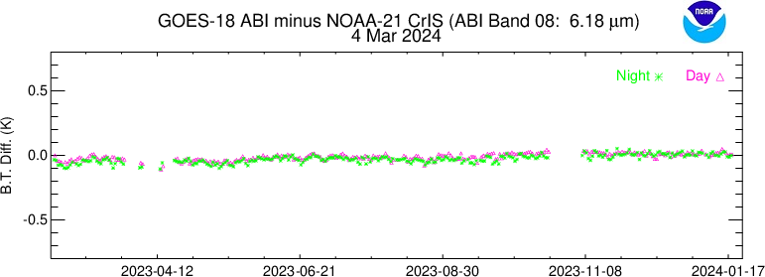
Summary of NOAA-21 CrIS Performance
The NOAA-21 CrIS performance is continuously monitored by the CrIS Cal/Val team, which demonstrates that the NOAA-21 CrIS SDR data quality continues to satisfy the Validated Maturity Requirements in terms of:
  Noise (NEdN) of all FOVs and bands within the specification.
  Radiometric FOV2FOV consistency is within 0.1 K.
  Absolute (and relative) spectral offsets for all three bands are all within ±2 ppm (and ±1 ppm).
  Geolocation meets the requirements for all FORs.
  Inter-comparisons between NOAA-21 CrIS and GOES-18 ABI demonstrate consistent results across all bands (bias within 0.2K).
NOAA-21 CrIS SDR products have been reliably produced by IDPS since first science data on February 10, 2023. No Discrepancy or Risk Reports have been submitted during this period associated with the CrIS SDR Algorithm.
NOAA-21 CrIS is ready for the primary declaration transition scheduled on March 20th, 2024.
Noise
FOV2FOV
Geo. Accuracy
Spectral
CrIS-ABI

Slide 10
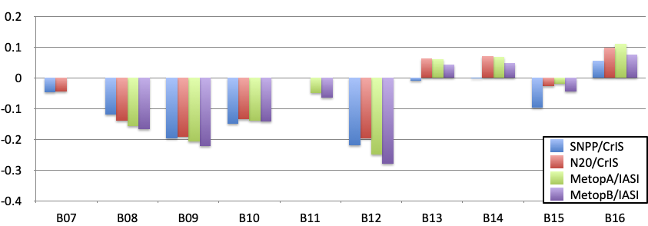
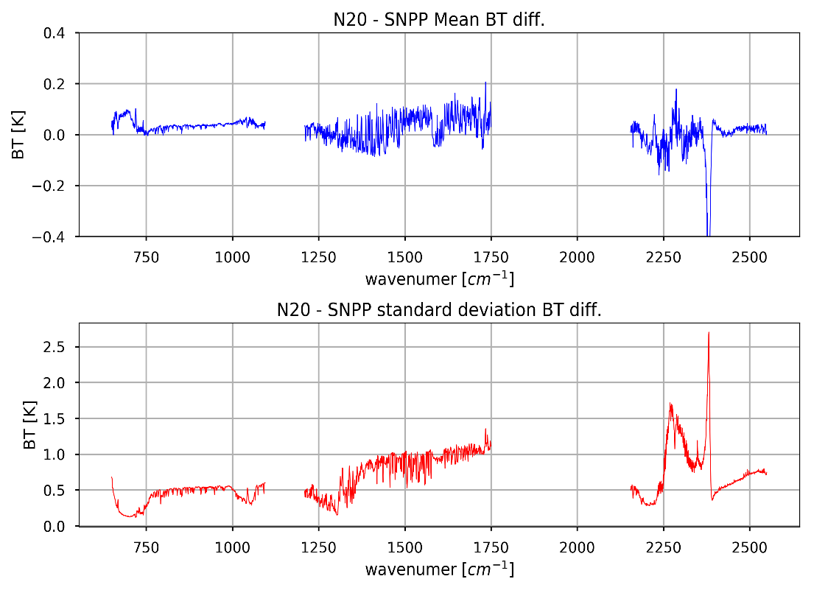
Support for GRWG IR Subgroup
From Arata OKUYAMA of JMA
Likun Wang serves as the chair of GSICS IR working group and coordinate GSICS related activities involving all the participating agencies and support the routine operation of GSICS.
Organizing the Bi-monthly web meetings to cooperate with users and calibration experts within GSICS community.
  FY21 (5 meetings), FY22 (5), FY23(4)
  GSICS wiki
Organizing IR breakout session during the GSICS annual meeting
  FY21 and FY22: Virtual meeting
  FY23: Hybrid meeting at College Park, Maryland
  FY24: Will be hosted at EUMETSAT
Inter-calibration difference between AMI and hyperspectral sounders
SNPP and N20 CrIS differences

Slide 11
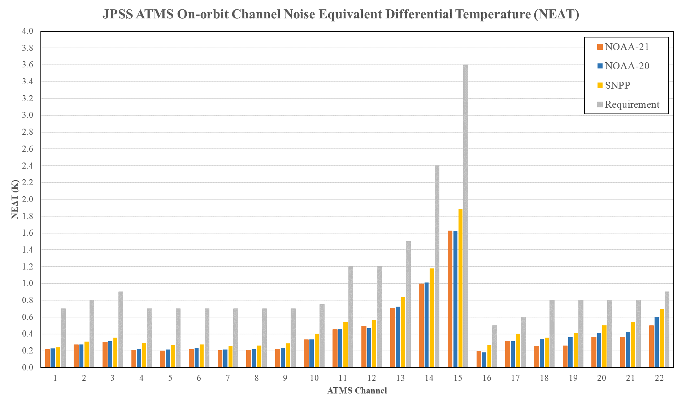
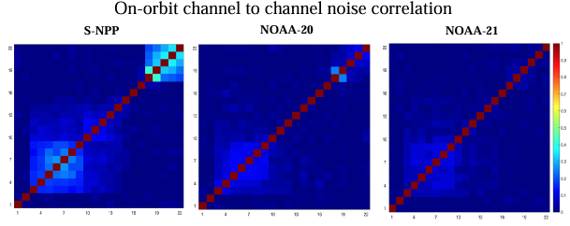
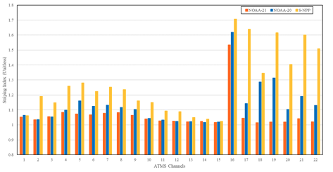
MW Instrument Achievements
NOAA-21 ATMS SDR reached Fully Validated Maturity on 22 June 2023
JPSS ATMS On-orbit Channel Noise Equivalent Differential Temperature (NEΔT)
All NOAA-21 ATMS PLTs have been completed successfully;
NOAA-21 ATMS has the lowest on orbit channel-to-channels noise correlations among S-NPP, NOAA-20, and NOAA-21.
NOAA-21 ATMS channel NE∆Ts are stable and improved G-band performance compared to NOAA-20;
Low noise of NOAA-21 ATMS water vapor channels improves MiRS water vapor EDR performance;
UKMO analysis proved “the NOAA-21 compares very favourably to NOAA-20 … the instrument stability is good too, both in terms of C-B and Nedt”.
NRT instrument health status, performance, and science data quality monitoring details are referred to https://www.star.nesdis.noaa.gov/icvs/status_N21_ATMS.php
On-orbit Channel to Channel Noise Correlation
JPSS ATMS Striping Index (Ratio Between Along- and Cross-Track Variation

Slide 12
NOAA Support to GSICS Microwave (MW) Subgroup Support and Other Activities
NOAA Support for MW Subgroup
  Created a process for and held the MW Subgroup Chair Election
  Played an instrumental role in shifting the Subgroup focus from “technical sharing” to “developing, assessing and maturing methods to achieve data quality and consistency of on-orbit MW sensors to accelerate data usage for weather and climate applications”
Continued MW instrument calibration performance monitoring, maintenance and sustainment for JPSS/ATMS and POES/AMSU-A&MHS
Preparing for QuickSounder ATMS

Slide 13
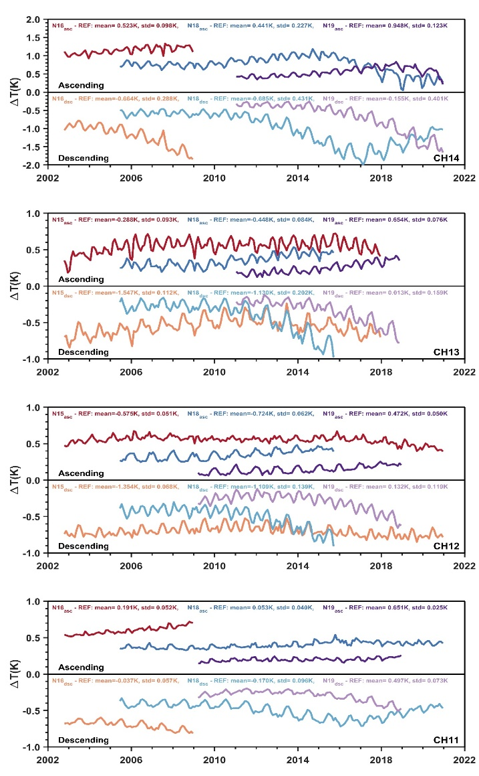
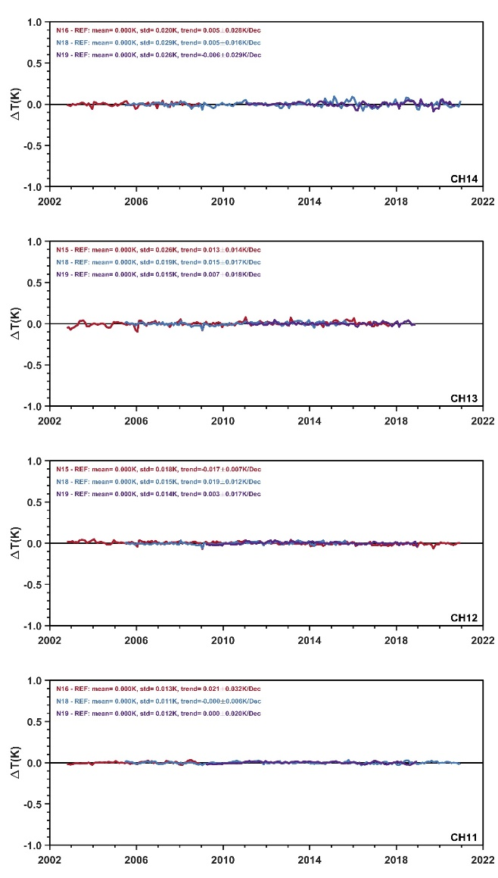
Completed Reprocessing of SNPP Data
Reprocessing: 1) STAR completed transition of reprocessed SNPP SDRs to CLASS for all four instruments, ATMS, CrIS, OMPS, and VIIRS. The reprocessed SNPP SDRs are now available from CLASS for user applications; 2) STAR started to reprocess mission-long SNPP EDRs using the reprocessed SDRs. Theses included but are not limited to ozone, aerosols, cloud products, sea ice surface temperature, polar winds, etc.
Recalibration activities: To develop a updated SSU stratospheric temperature CDRs, STAR recalibrated the AMSU-A stratospheric temperature sounding channels 7-14 onboard legacy satellites NOAA-15, NOAA-16, NOAA-18, and NOAA-19 and their companion ATMS channels onboard SNPP and NOAA-20. This recalibration was to develop consistent observations among these satellites and merge them with SSU historical data to develop longer stratospheric temperature CDRs.
Before recalibration
After recalibration
Inter-satellite difference time series for NOAA-15, NOAA-16, NOAA-18,
NOAA_19, and the reference time series

Slide 14
NOAA VIIRS Update
NOAA-21 VIIRS achieved validated maturity status on 6/23/2023.
  SNPP and NOAA-20 experienced more frequent anomalies as we are entering the solar maximum of 25th solar cycle.
    Reversed solar diffuser degradation observed SNPP and NOAA-20 VIIRS.
    SNPP VIIRS encountered Command Data Processor (CDP) reset on 6/26/2023.
    NOAA-20 VIIRS had a reset anomaly on 9/3/2023.
      Both SNPP and NOAA-20 VIIRS came back to nominal status.
Reprocessing
  SNPP VIIRS V2 reprocessing is completed and transferred to CLASS.
  NOAA-20 and SNPP VGAC (VIIRS Global Area Coverage) data is being archived at NCEI.
The Global Regional Validation Site system (GReVS) site is useful for rapid access and evaluation of VIIRS and other imagery data quality.
  https://ncc.nesdis.noaa.gov/Regional/

Slide 15
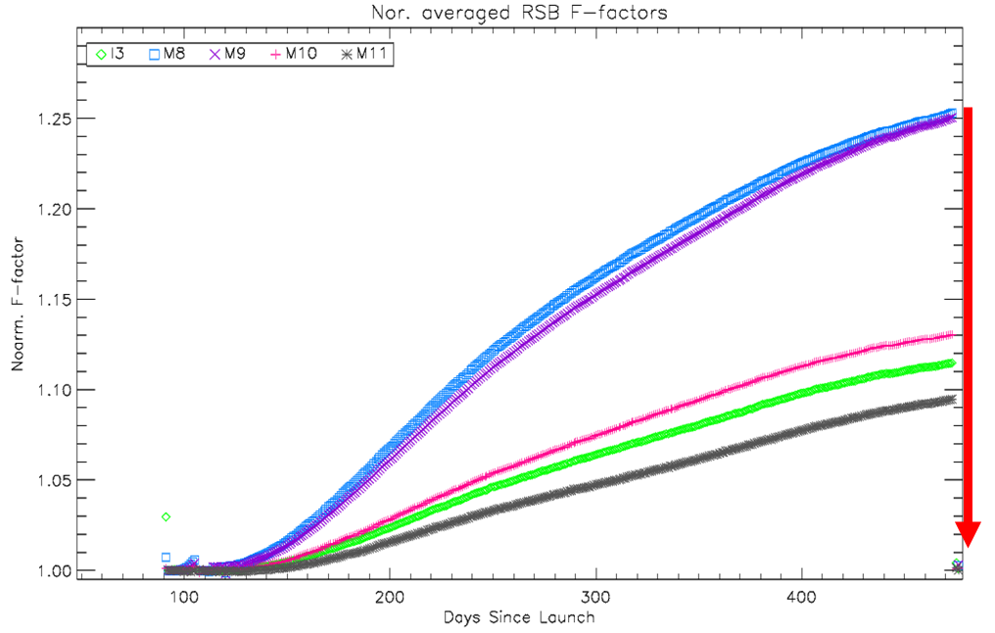
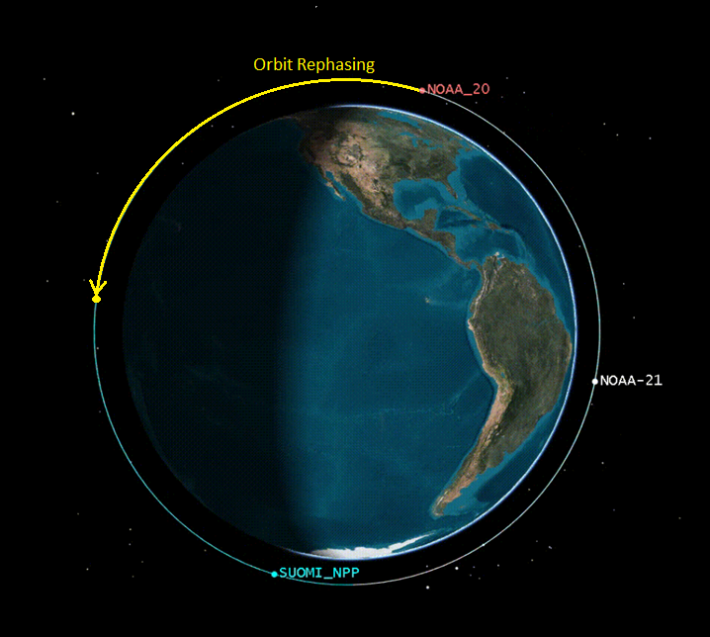
NOAA VIIRS Update
Due to fast SWIR band degradation in NOAA-21 VIIRS, the Mid-Mission Outgassing (MMOG) was successfully performed from 2/26-28/2024.
  Restored to the initial detector responsivity in SWIR (M8-M11, I3) and TEB bands.
Orbit rephasing is planned in April, 2024.
  To make NOAA-21 primary satellite by repositioning NOAA-20 orbit.
MMOG

Slide 16
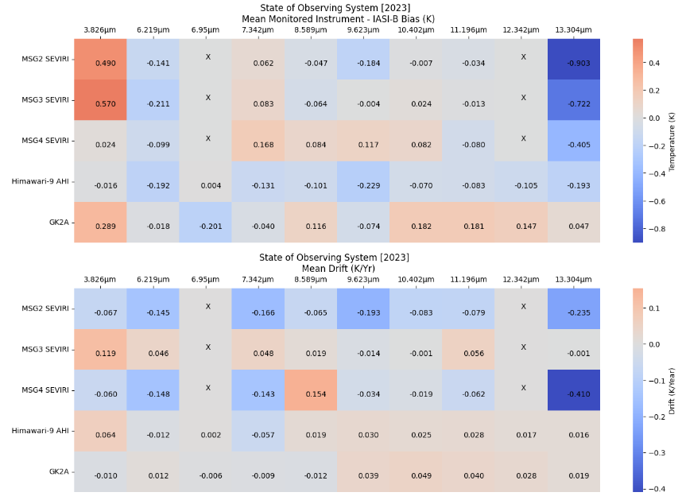
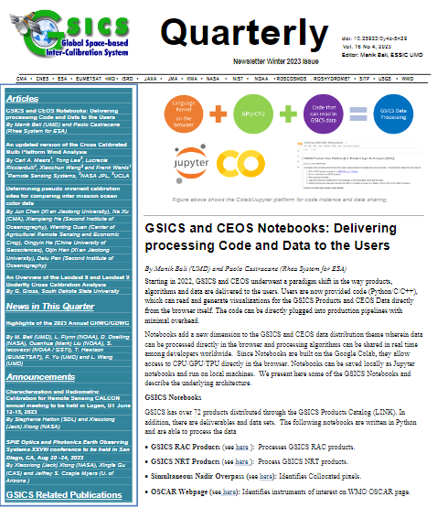
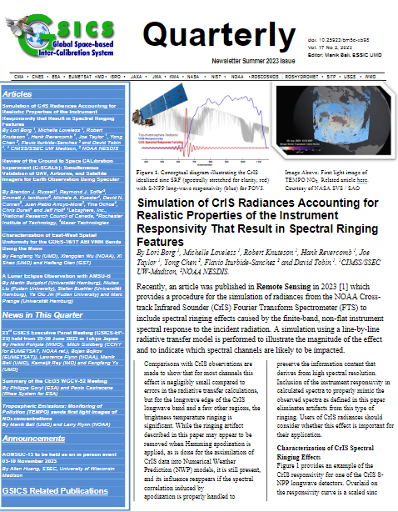
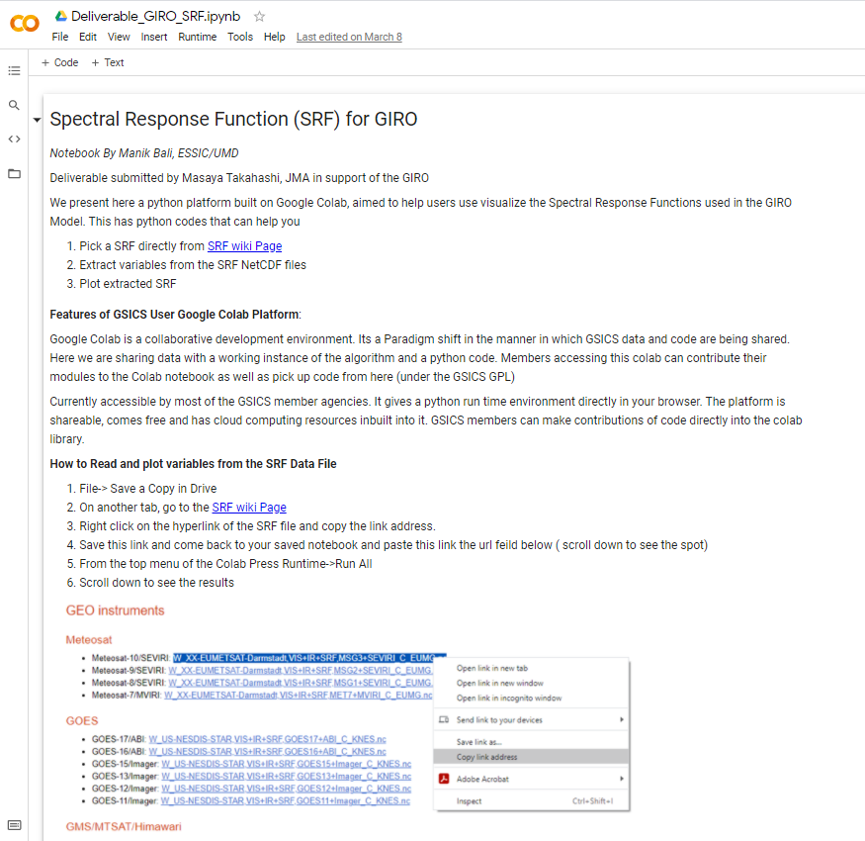
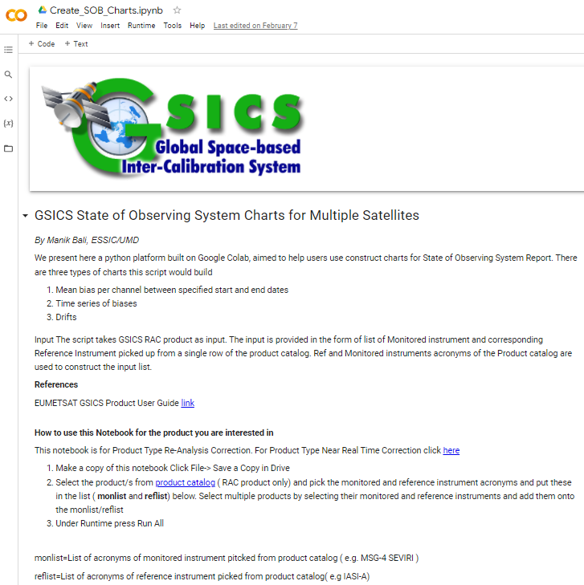
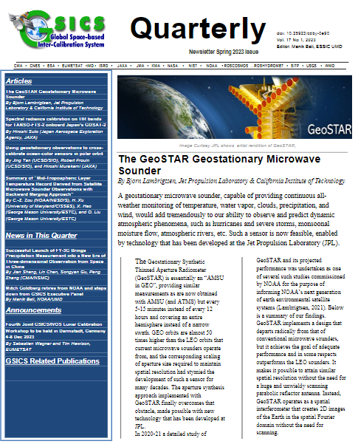
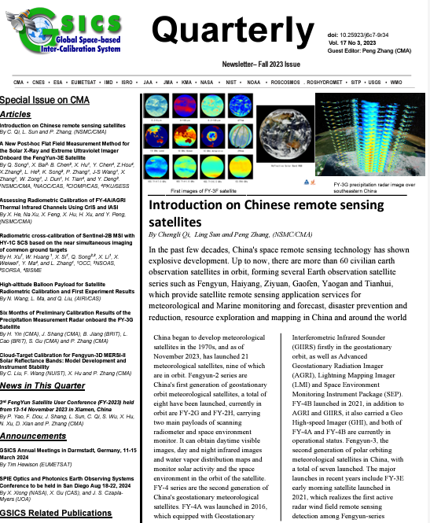
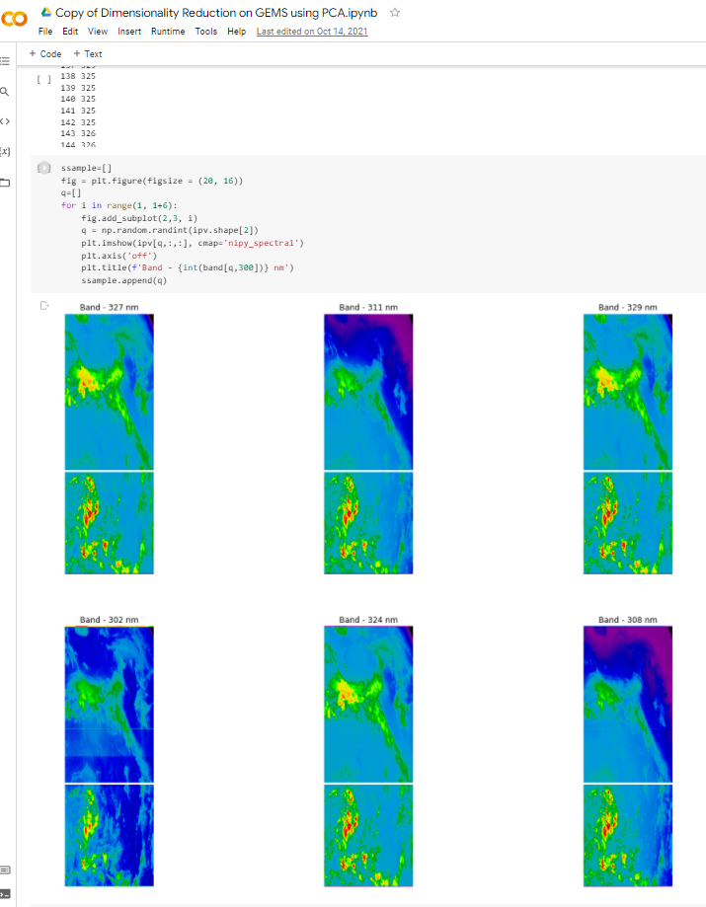
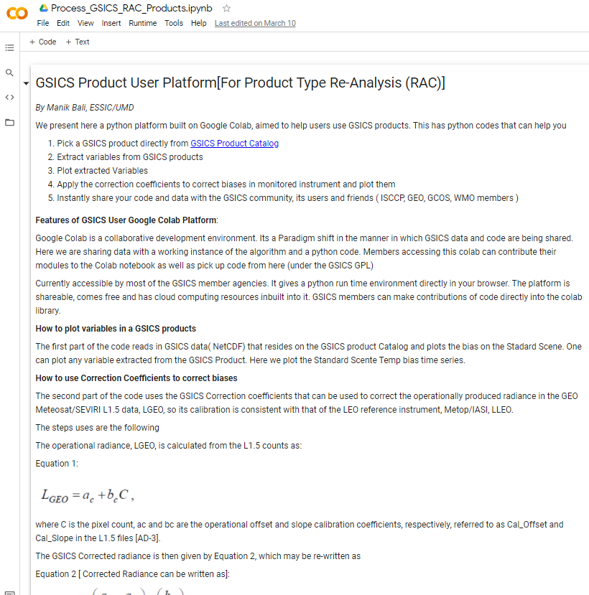
GSICS Coordination Center and GDWG/NOAA
NOAA Hosted the GSICS Annual Meeting 2023 and supported over 20 meetings, GSICS Product Catalog and GSICS Wiki.
NOAA/NASA JPSS instruments continued to compliment IASI and provide references scale measurements to GSICS community.
Automating State of Observing System Report
Developed GSICS Colab Notebooks for the community
State of Observing System
GSICS Notebooks
Suggested Action:
Agencies to host machine readable bias data on GPRC

Slide 17
Calibration Updates – OMPS NM and NP
NOAA-21 OMPS Nadir Mapper and Profiler SDRs are Provisional and the validated maturity review for the SDR is scheduled on March 28, 2024.
POC.: Banghua.Yan@noaa.gov, STAR SCB

Slide 18
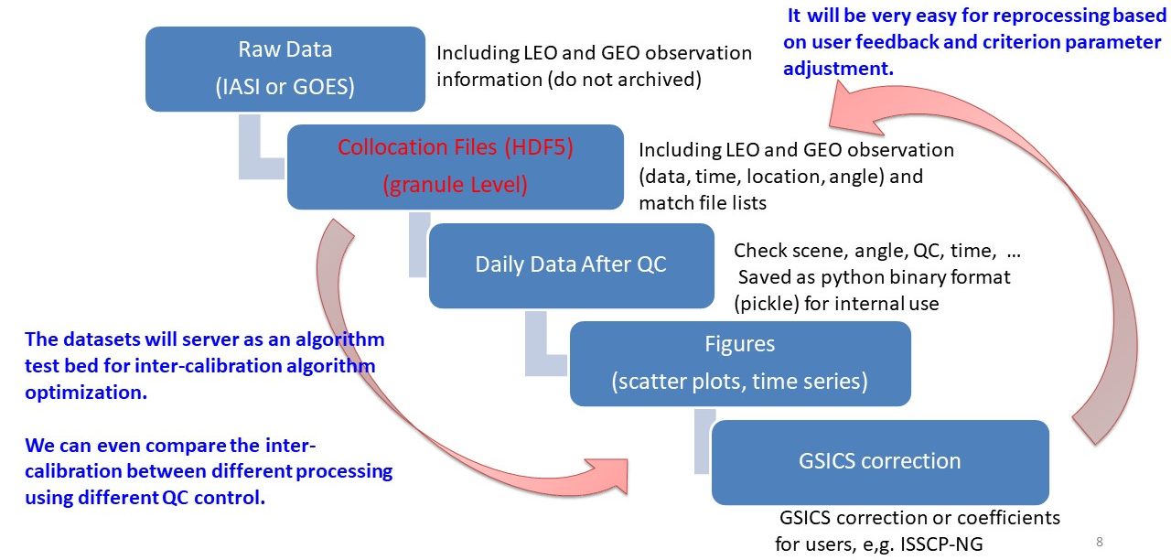
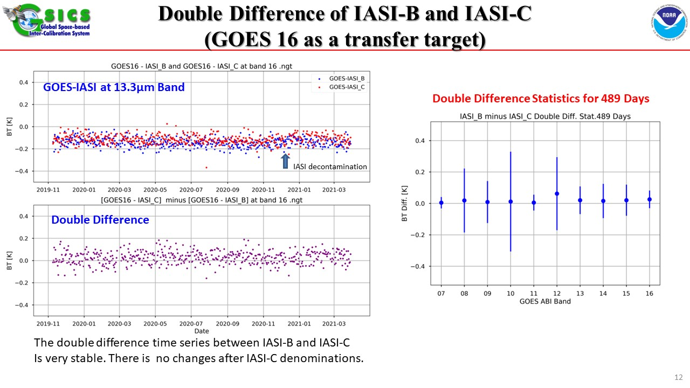
Developing and maintaining NOAA GSICS Inter-Calibration Products
NOAA/STAR Integrated Calibration/Validation System (ICVS) has been operated for many years to provide real-time environmental satellite sensor performance monitoring.
The NOAA GSICS IR inter-calibration products are currently hosted at the ICVS website.
  Status: demonstration
  Instruments: GOES ABI (16, 17) with CrIS (SNPP, N20) and IASI(B, C)
Toward optimizing the GSICS generic inter-calibration algorithm, we use the inter-calibration between GOES ABI and CrIS/IASI as an algorithm test bed.
  Fast and accurate collocation
  Easy reprocessing to test different QA control and GSICS inter-calibration algorithm changes.
  All the intermediate datasets are archived.
Notes:
https://www.star.nesdis.noaa.gov/icvs/GSICS.php

Slide 19
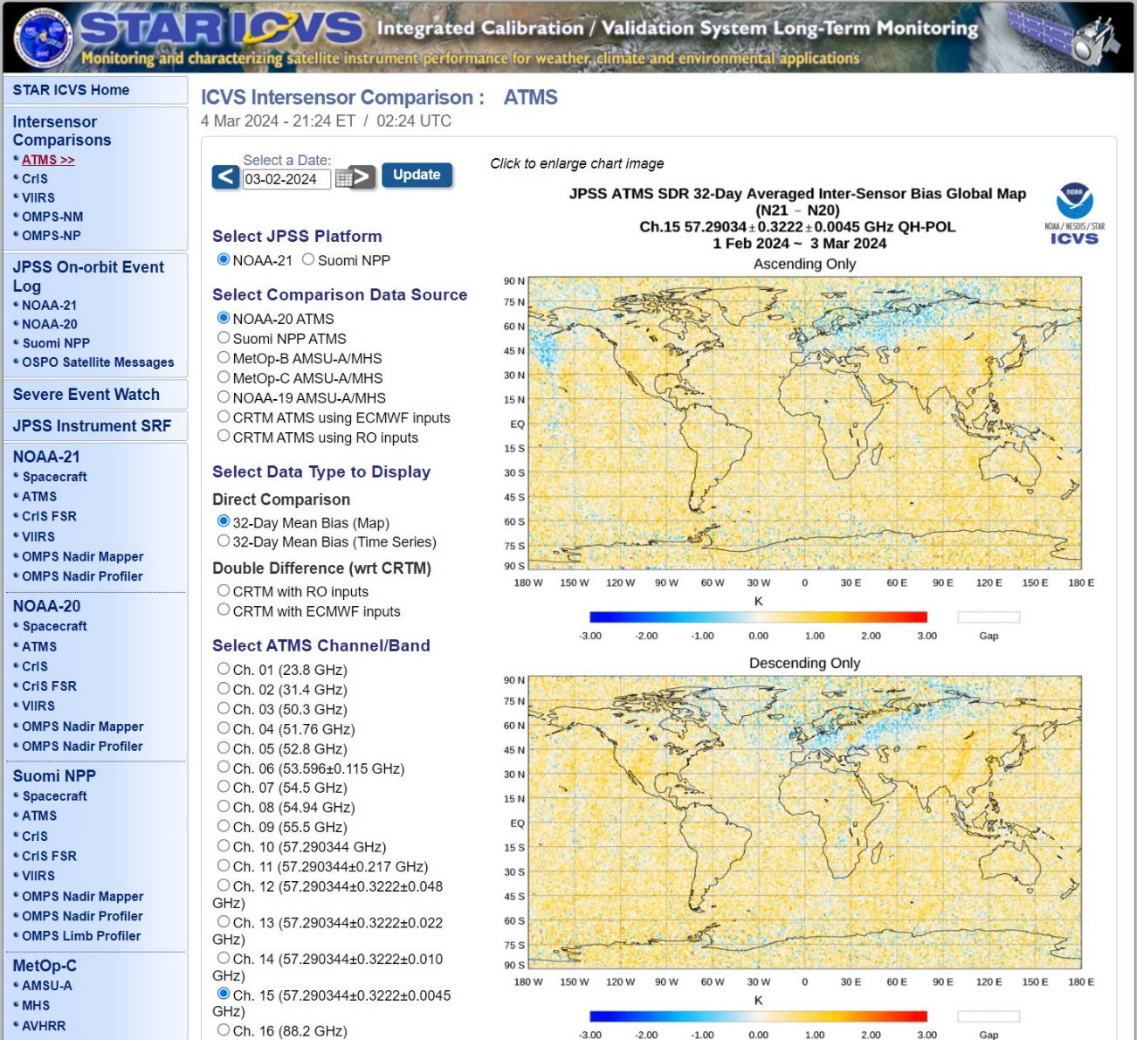
ICVS Inter-Sensor Comparison Portal Beneficial to GSICS
An inter-sensor comparison monitoring tool within the NOAA ICVS framework is operated in a near-real time mode to support JPSS ATMS, CrIS, OMPS, and VIIRS SDR cal/val. Missions.
The inter-sensor comparison products are also beneficial to the GSICS user communities
  LEO-LEO Inter-sensor comparison capabilities, e.g., ATMS-AMSU/MHS, OMPS-VIIRS, OMPS-TropoMI, etc.
  LEO-GEO Inter-sensor comparison capabilities, e.g., CrIS-ABI, VIIRS-ABI, etc.
More examples are accessible in https://www.star.nesdis.noaa.gov/icvs/comparison_ATMS.php
(POCs.: Banghua.Yan@noaa.gov & Ninghai.Sun@noaa.gov)

Slide 20
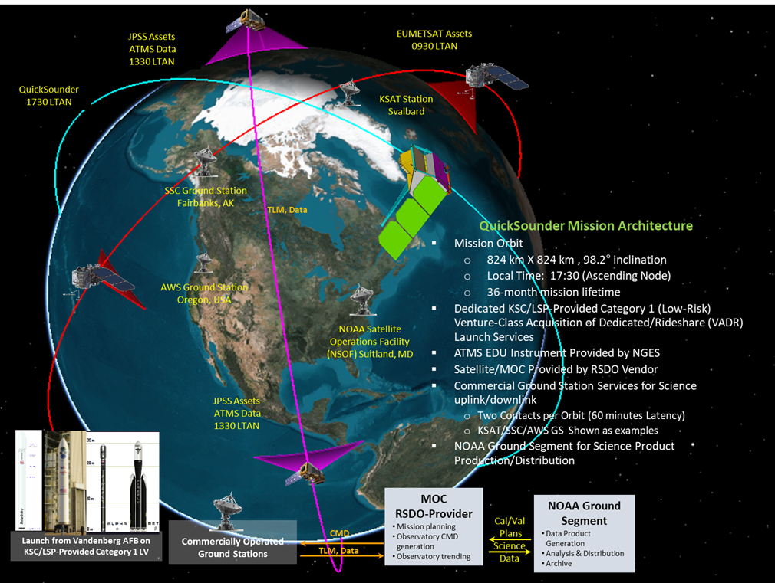
QuickSounder Mission
Flight Segment:
  Commercial small satellite
  Advanced Technology Microwave Sounder (ATMS) Engineering Development Unit (EDU)
Launch Segment:
  Small commercial launch vehicle
Ground Segment:
  Mission Operations: Commercial Service Mission Data Transport: Commercial Service
  Mission Data Processing and Dissemination: NESDIS systems
Expected launch in 2026

Slide 21
Thank you!

