Slide 1
Results from the GSICS Lunar Model Comparison Exercise
Tom Stone – USGS (ROLO)
with contributions from
Sébastien Wagner – EUMETSAT (GIRO)
Hugh Kieffer – Celestial Reasonings (SLIM)
Javier Gatón Herguedas – Univ. de Valladolid (LIME)
Thijs Krijger – Earth Space Solutions (LESSSR)
Toru Kouyama – AIST (SP)
Steve Miller – Colorado State Univ. (MT2009)

Slide 2
Introduction
This is a shortened version of the presentation given at the 4th GSICS/CEOS-IVOS Lunar Calibration Workshop held at EUMETSAT 04-08 December 2023
http://gsics.atmos.umd.edu/pub/Development/LunarCalibrationWS2023/2a_Stone_lunar_model_comparison-rev1.pptx
The GSICS lunar calibration community formulated an exercise with the objective to examine the performance of different lunar models relative to each other.
concept presented at the GSICS 2021 Annual Meeting (virtual) VisNIR session
several follow-on VisNIR SG webmeetings, to define components of the exercise
Methodology: compare model outputs generated for a common set of inputs
specified as photometric geometry points (phase and libration angles) and spectral responses — no corresponding observation times/locations

Slide 3
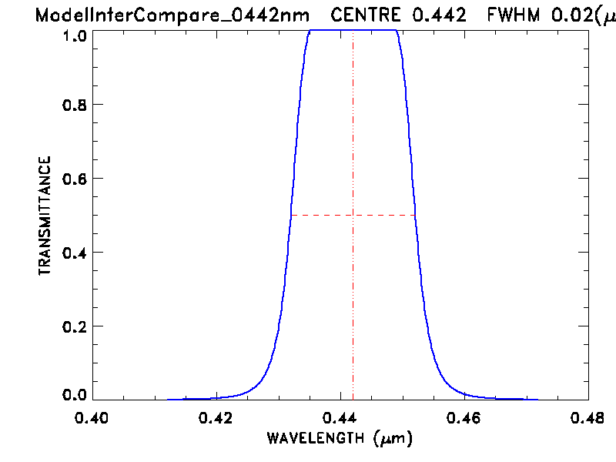
The common inputs
The meeting discussions produced a set of test input parameters, to cover practical ranges of observation geometry (phase angles and librations) and spectral bands.
phase angles: 3°, 5°, 7°, 10°, 15°, 25°, 40°, 55°, 70°, 90°, both before and after Full Moon
libration grid: viewer longitude = 0°, ±4°, ±8°, ±12°, viewer latitude = 0°, ±4°, ±8°
All geometry combinations gives 700 total points
112 are not possible: the phase angle cannot be smaller than the angular difference between the sub-solar and sub-viewer points on the Moon
spectral bands: 8 typical remote sensing channels
442, 550, 670, 765, 870, 1380, 1640, 2350 nm
spectral response functions: synthetic (EUMETSAT)
20 nm FWHM, flat-topped, Gaussian-edged
The final input geometry grid and spectral response files were sent to the lunar modeling community 24 April 2023.

Slide 4
The models
Model outputs were contributed by 7 lunar modelers.
Models listed in roughly chronological order of development, with contact names and affiliations:
ROLO (2003), PoC: Tom Stone, USGS
CLIMES (Miller-Turner, 2009), PoC: Steve Miller, Colorado State Univ.
Spectral Profiler (SP, 2016), PoC: Toru Kouyama, AIST (Japan)
GIRO (2018), PoC: Seb Wagner, EUMETSAT
SLIM (2019), PoC: Hugh Kieffer, Celestial Reasonings
LIME (2019), PoC: Marc Bouvet, ESA
LESSSR (2020), PoC: Seb Wagner, EUMETSAT
Slides with more detailed model descriptions can be found at the link on slide 2

Slide 5
Presentation of Model Comparison Results
The challenge — how to present results having multiple independent dimensions:
spectral (8 bands)
phase angle (20 samples)
viewer longitude libration (7 samples)
viewer latitude libration (5 samples)
the models (7 instances)
The goal: to allow differences in the model outputs to be identified quickly and clearly using visual graphics.
For this GSICS Annual Meeting presentation, reduced number of slides and plots
spectral plots: negative phase angles only
phase angle plots: 4 spectral bands
libration plots: viewer longitude variations only

Slide 6
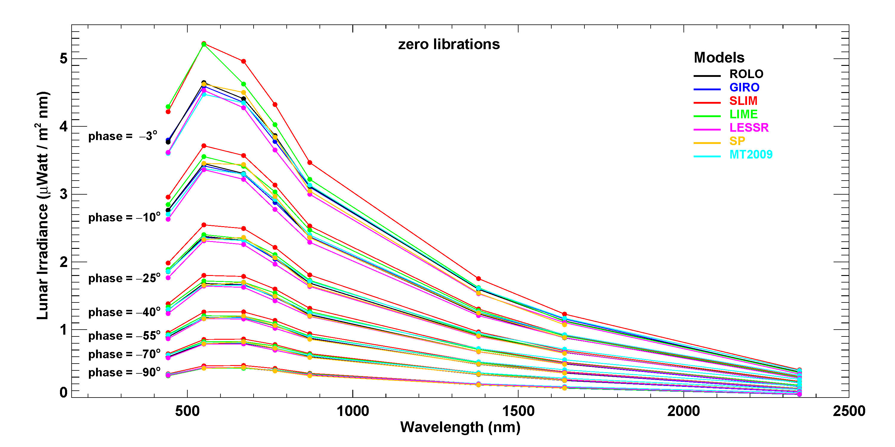
Spectra comparison for selected phase angles
Note: SP model generated 6 bands:
550, 670, 765, 870, 1380, 1640 nm

Slide 7
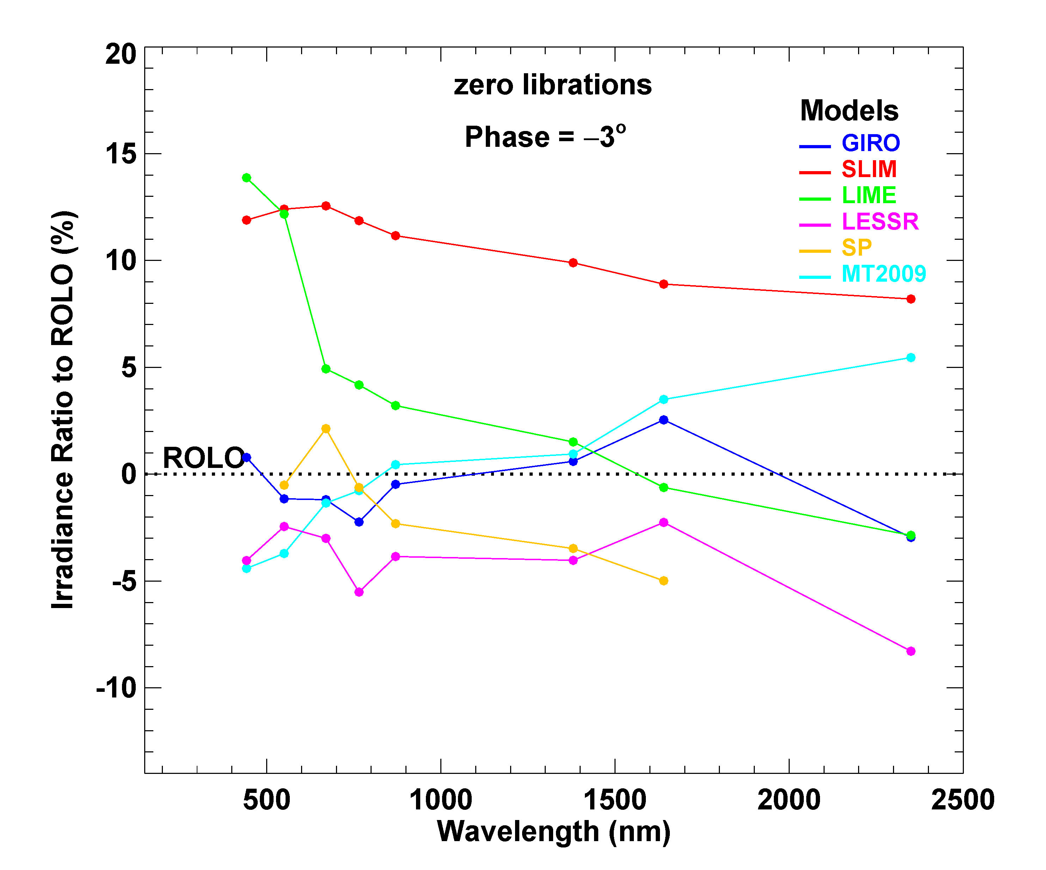
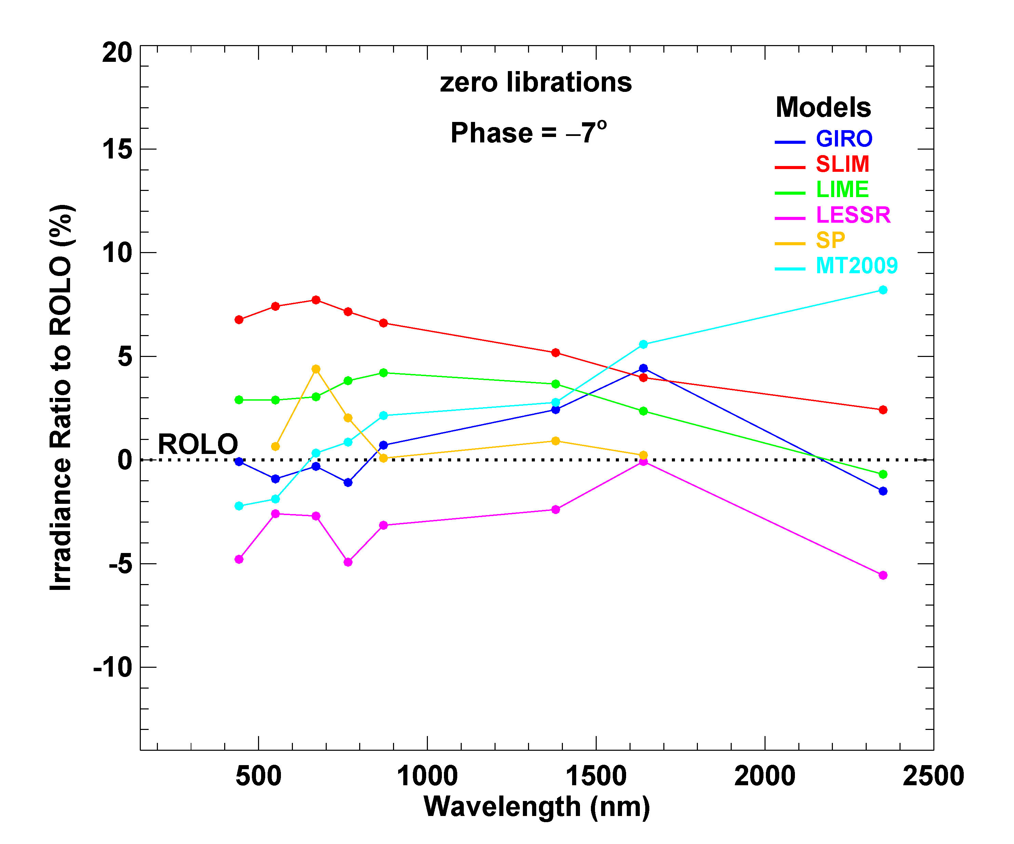
Model-generated irradiances relative to ROLO
Irradiance Ratio = ((model / ROLO) − 1) x 100%

Slide 8
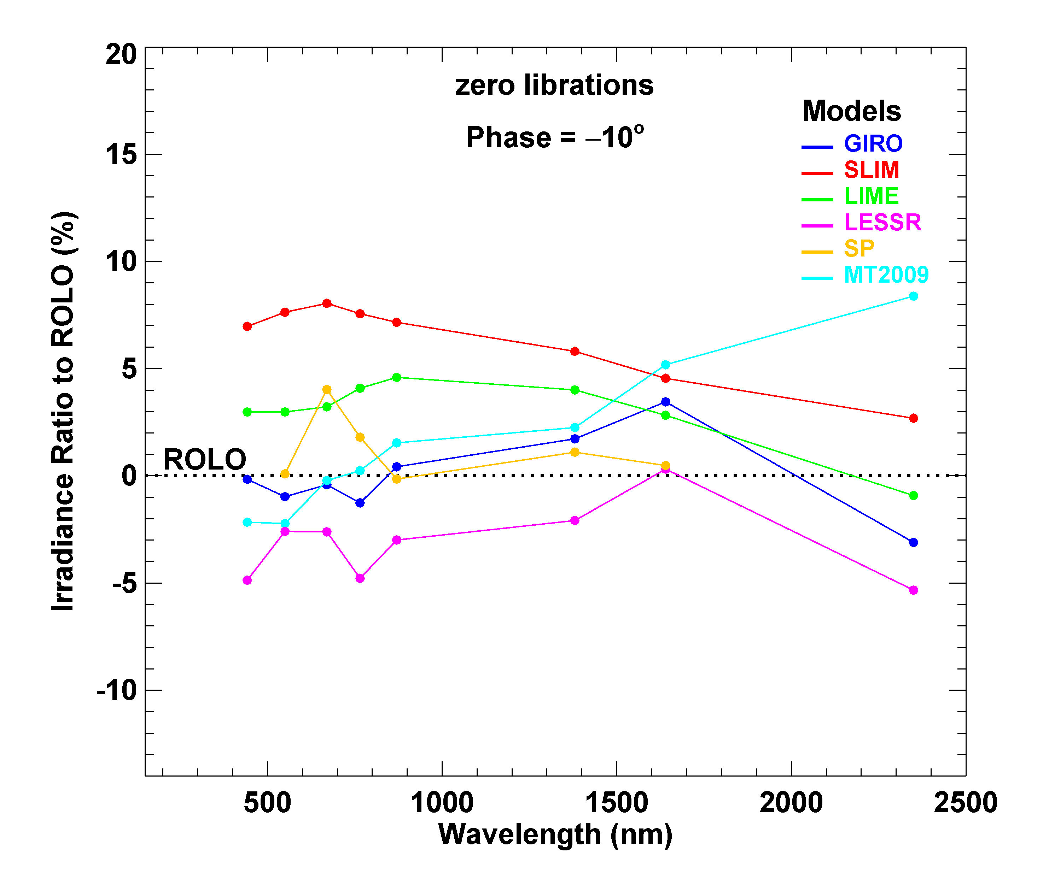
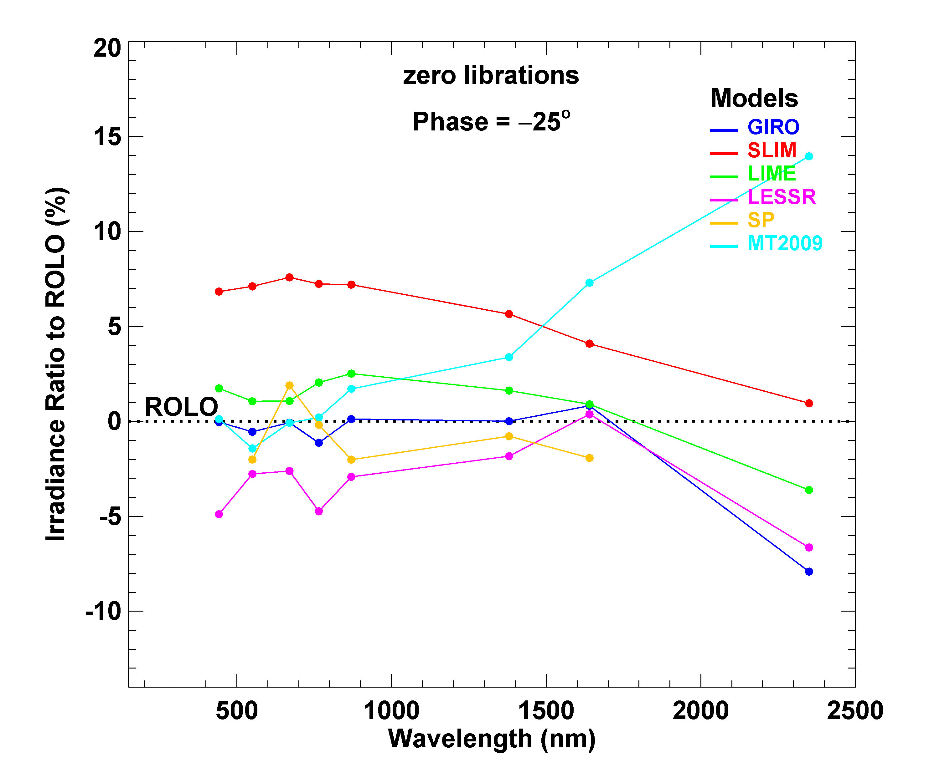
Model-generated irradiances relative to ROLO
Irradiance Ratio = ((model / ROLO) − 1) x 100%

Slide 9
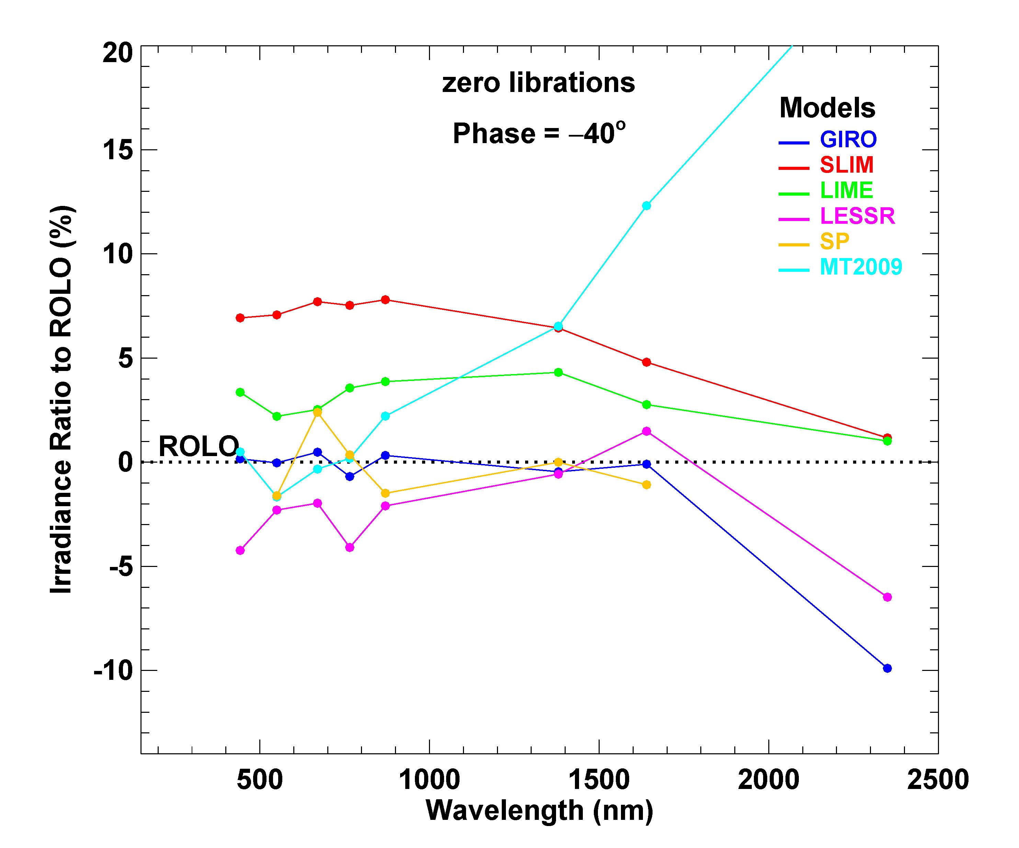
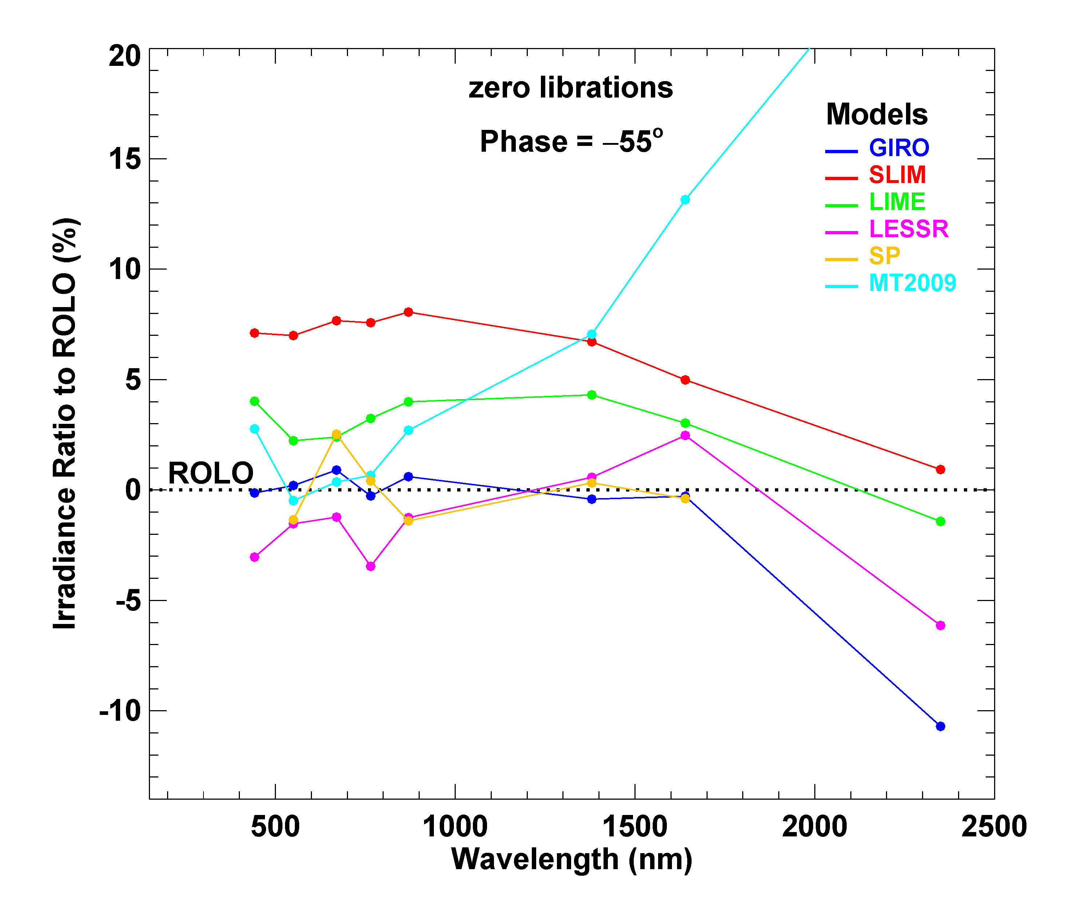
Model-generated irradiances relative to ROLO
Irradiance Ratio = ((model / ROLO) − 1) x 100%

Slide 10
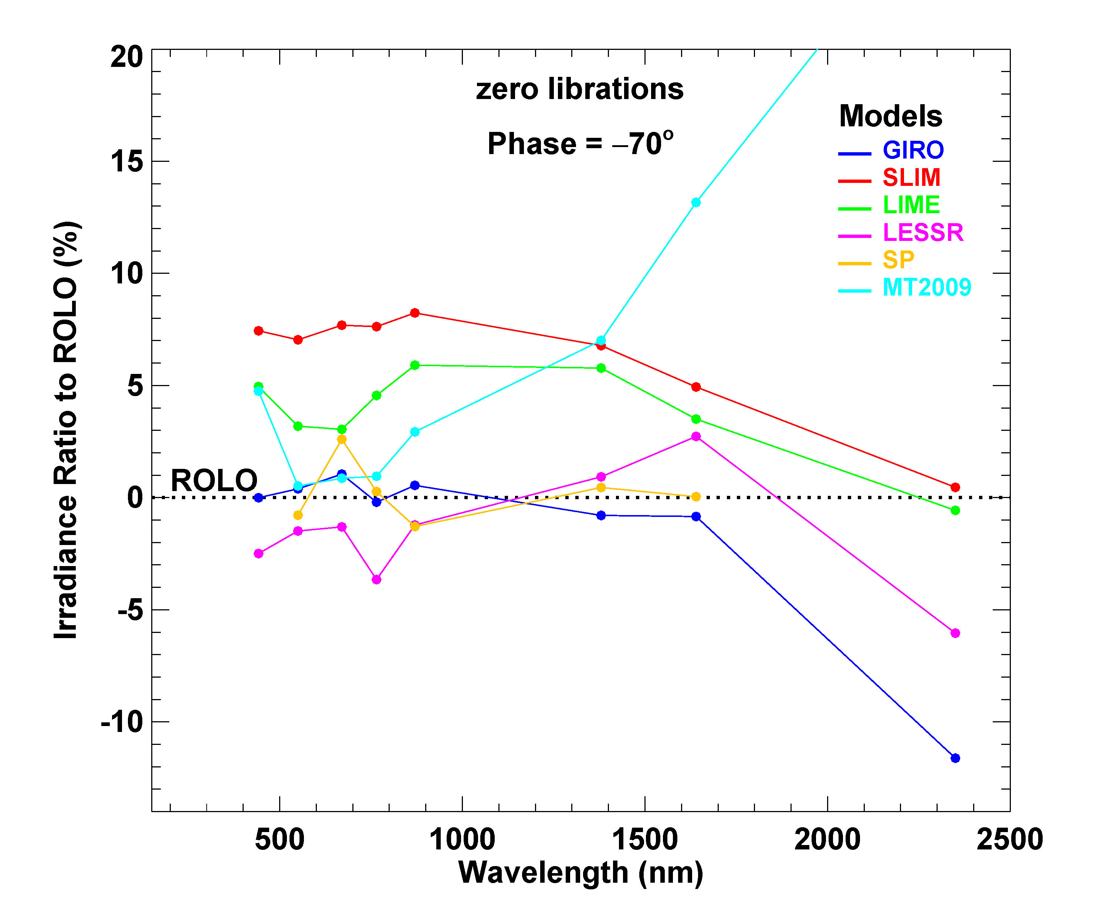
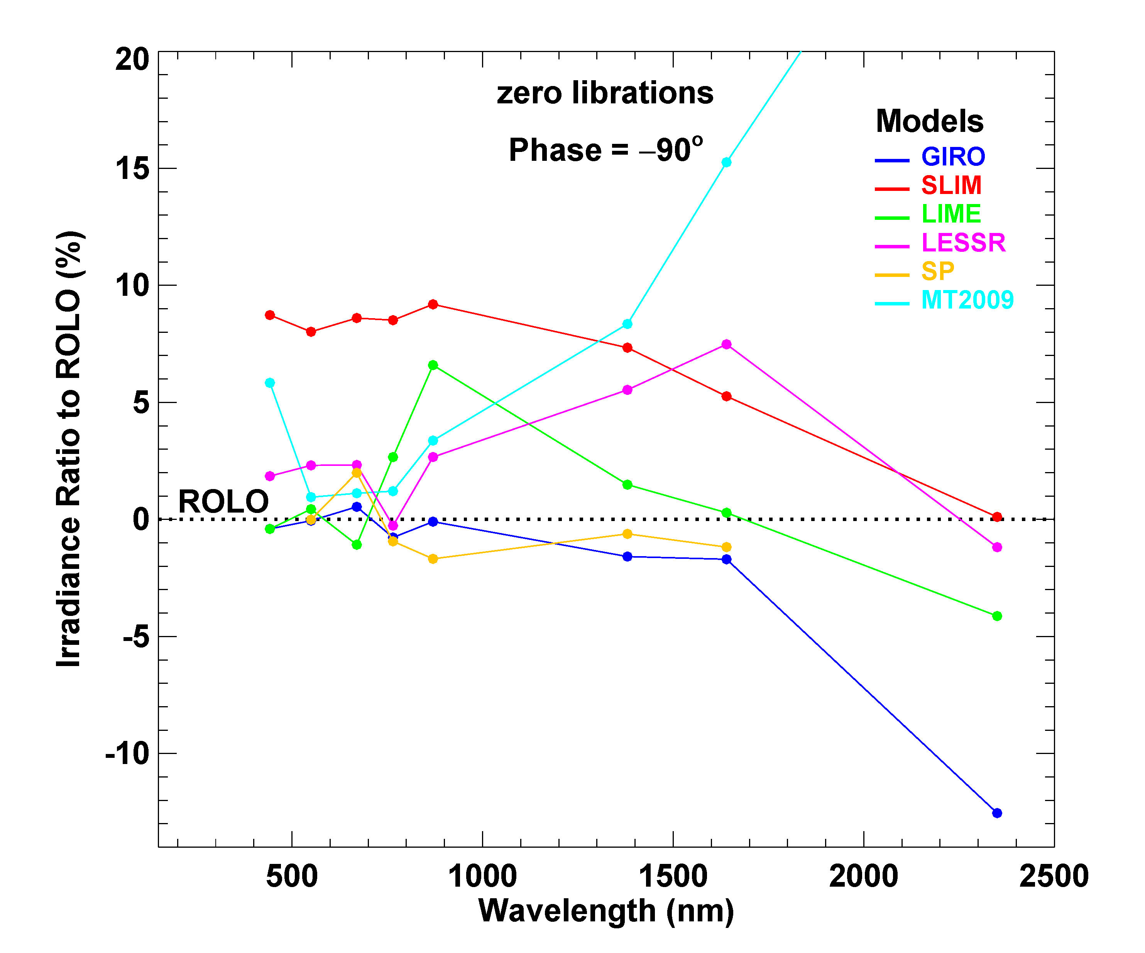
Model-generated irradiances relative to ROLO
Irradiance Ratio = ((model / ROLO) − 1) x 100%

Slide 11
Model Output Comparisons — Variations with Phase Angle
all results shown are for zero viewer librations: φ = θ = 0
phase angle plots for individual spectral bands
waxing / waning differences

Slide 12
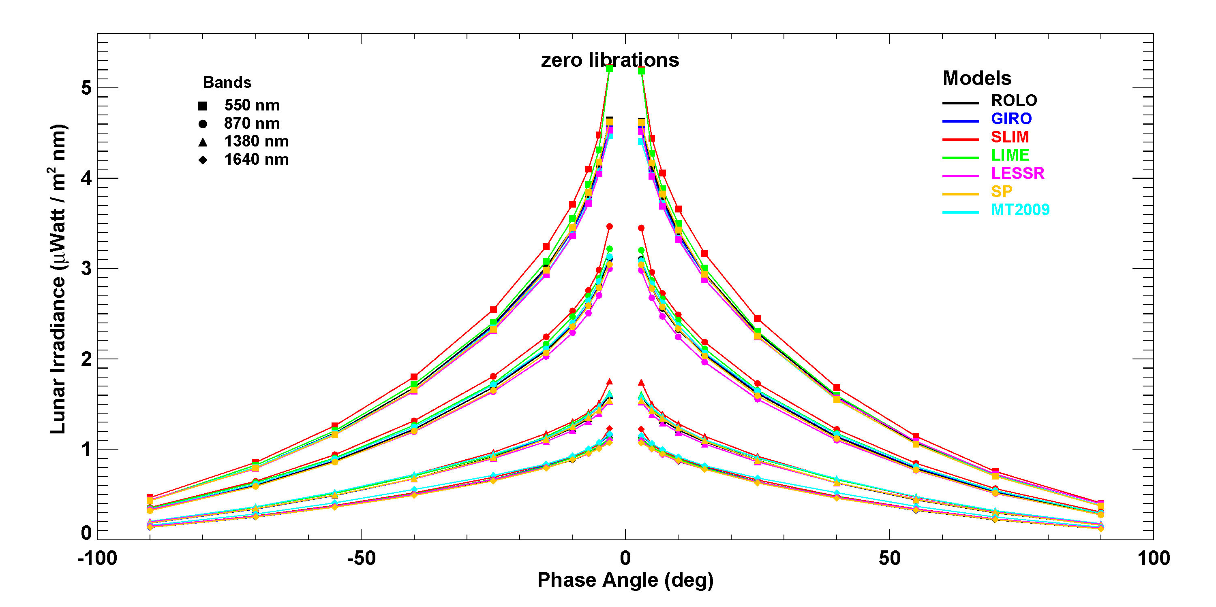
Irradiances vs. phase angle for selected spectral bands

Slide 13
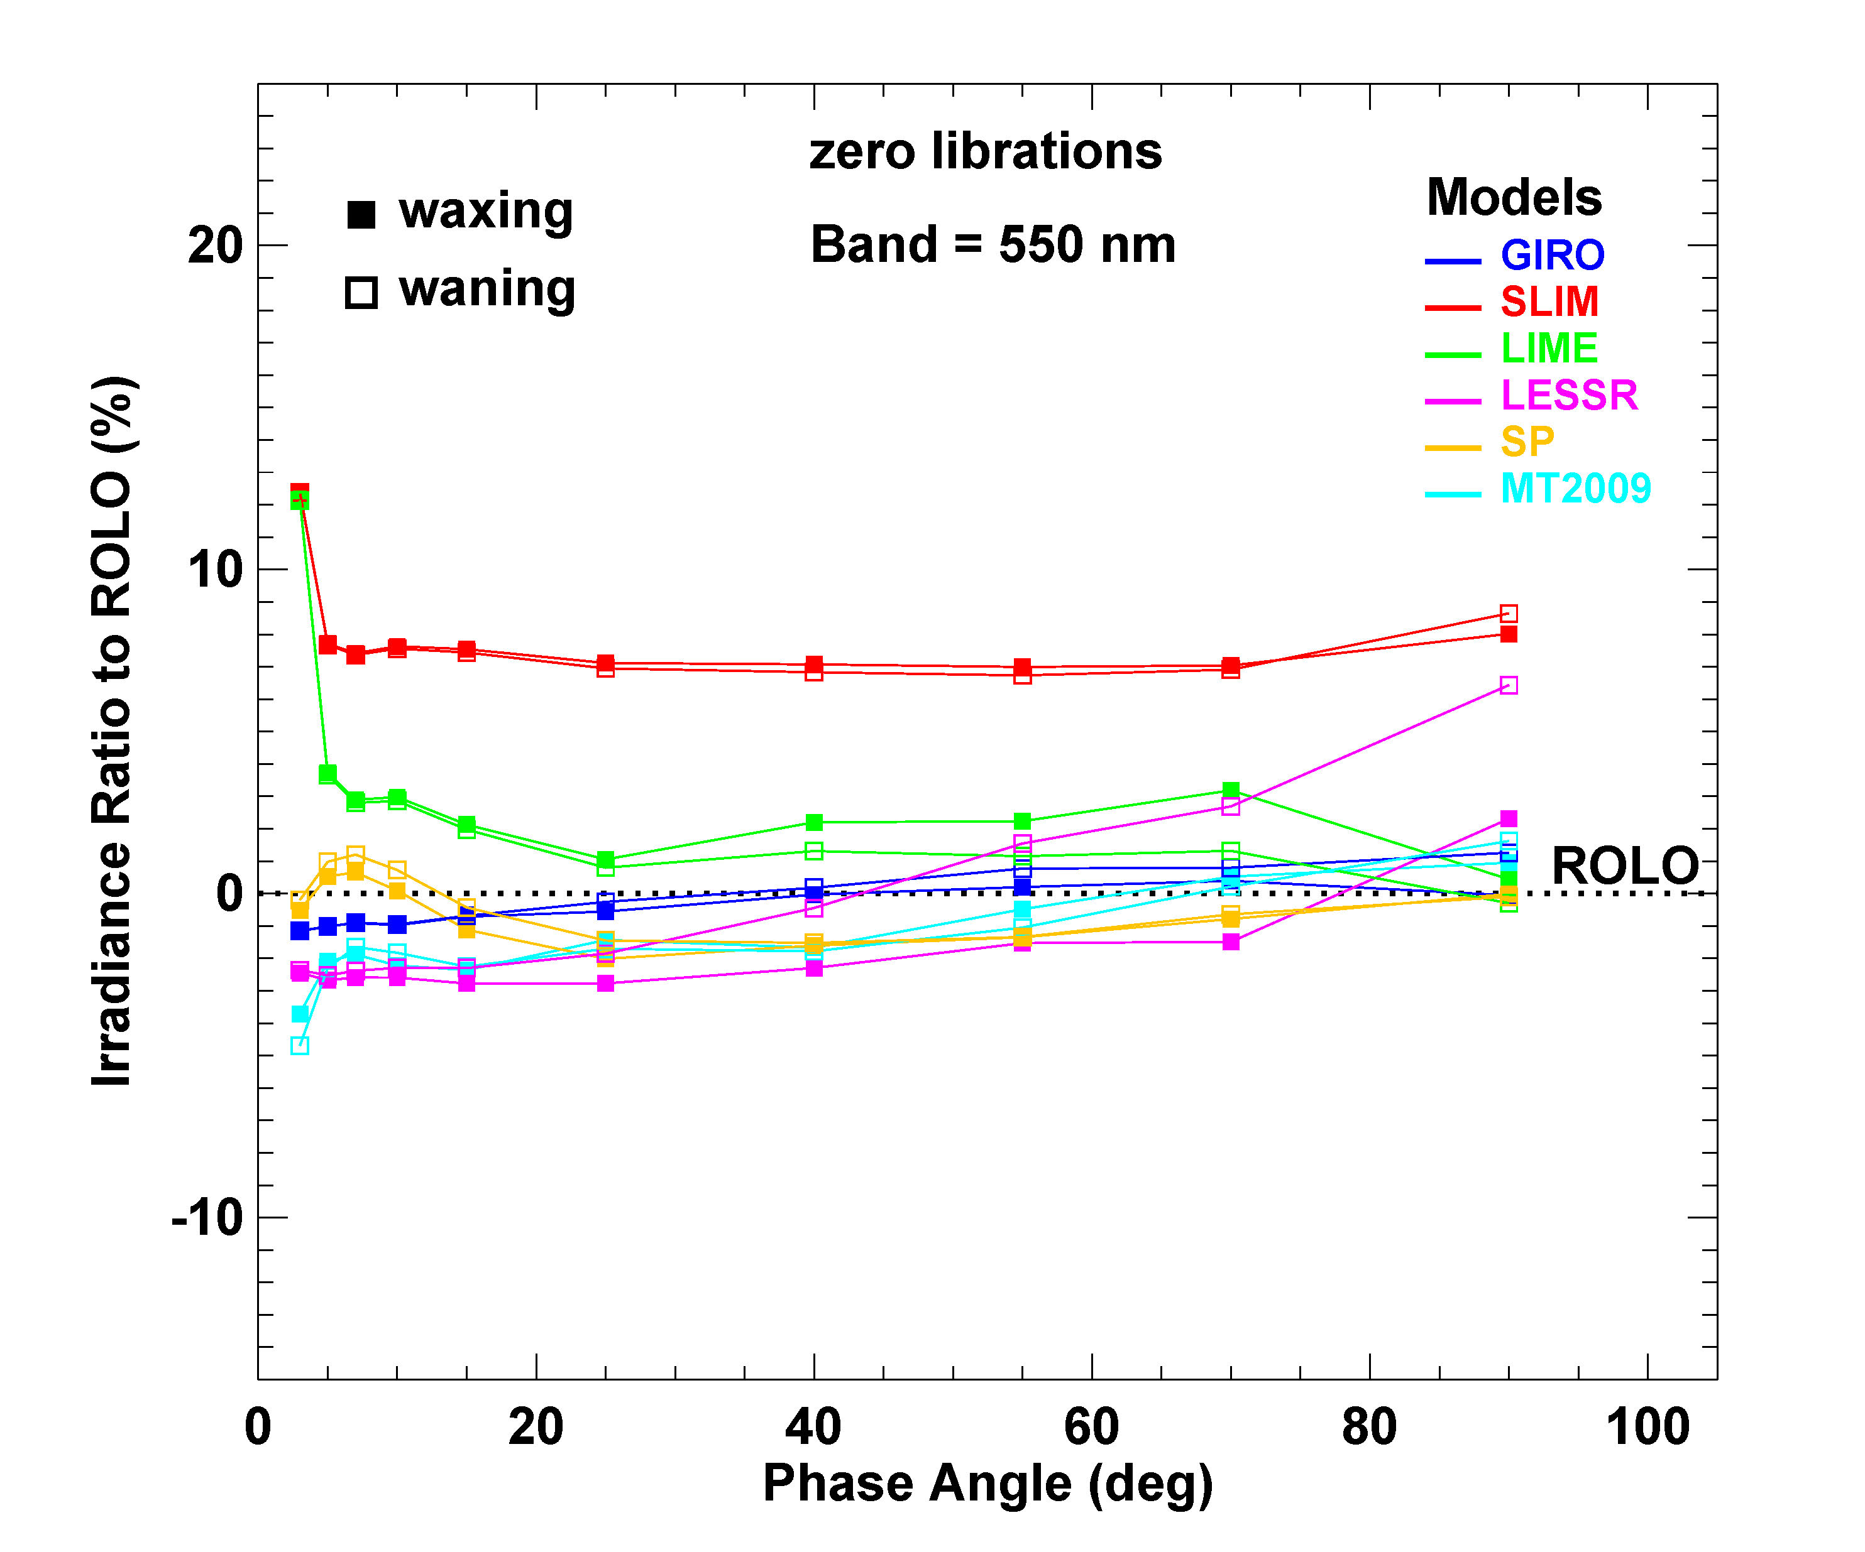
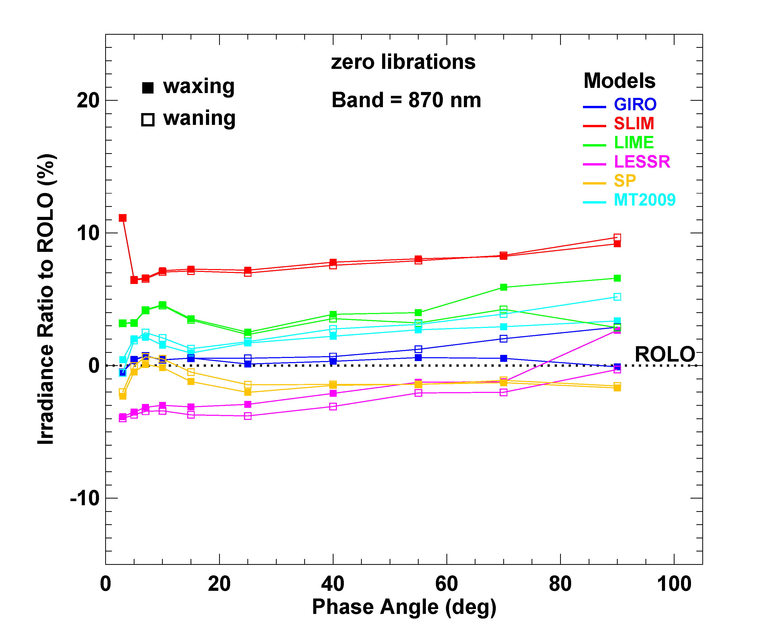
Irradiances relative to ROLO vs. phase angle
Irradiance Ratio = ((model / ROLO) − 1) x 100%

Slide 14
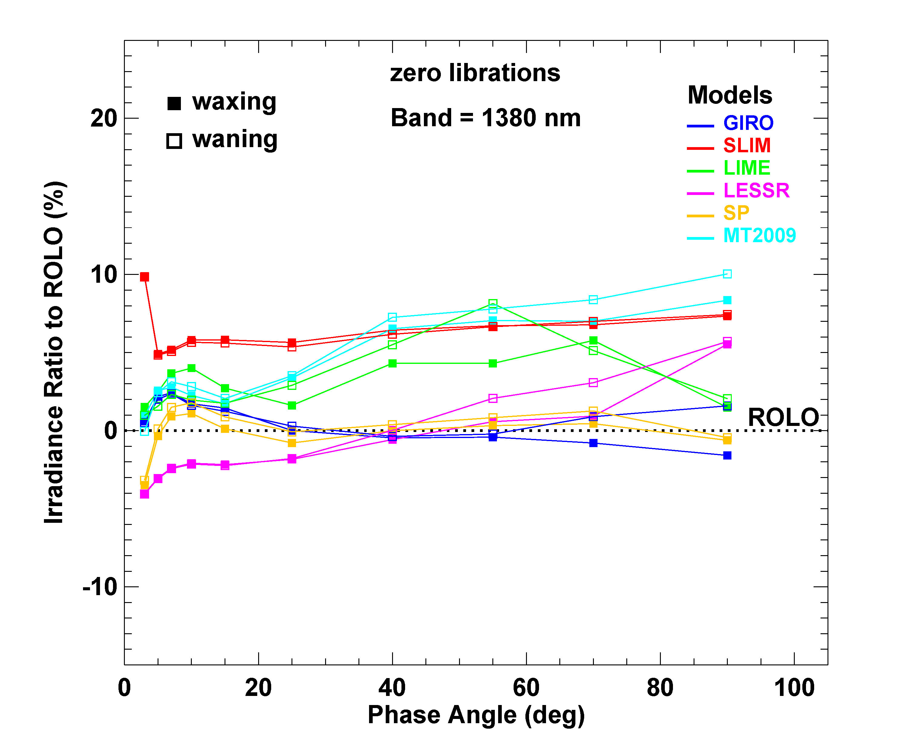
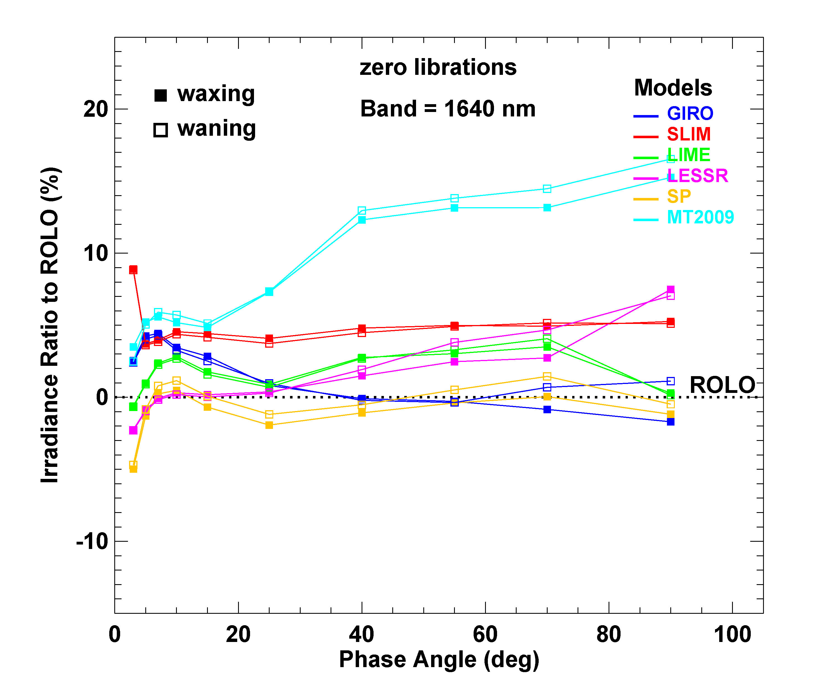
Irradiances relative to ROLO vs. phase angle
Irradiance Ratio = ((model / ROLO) − 1) x 100%

Slide 15
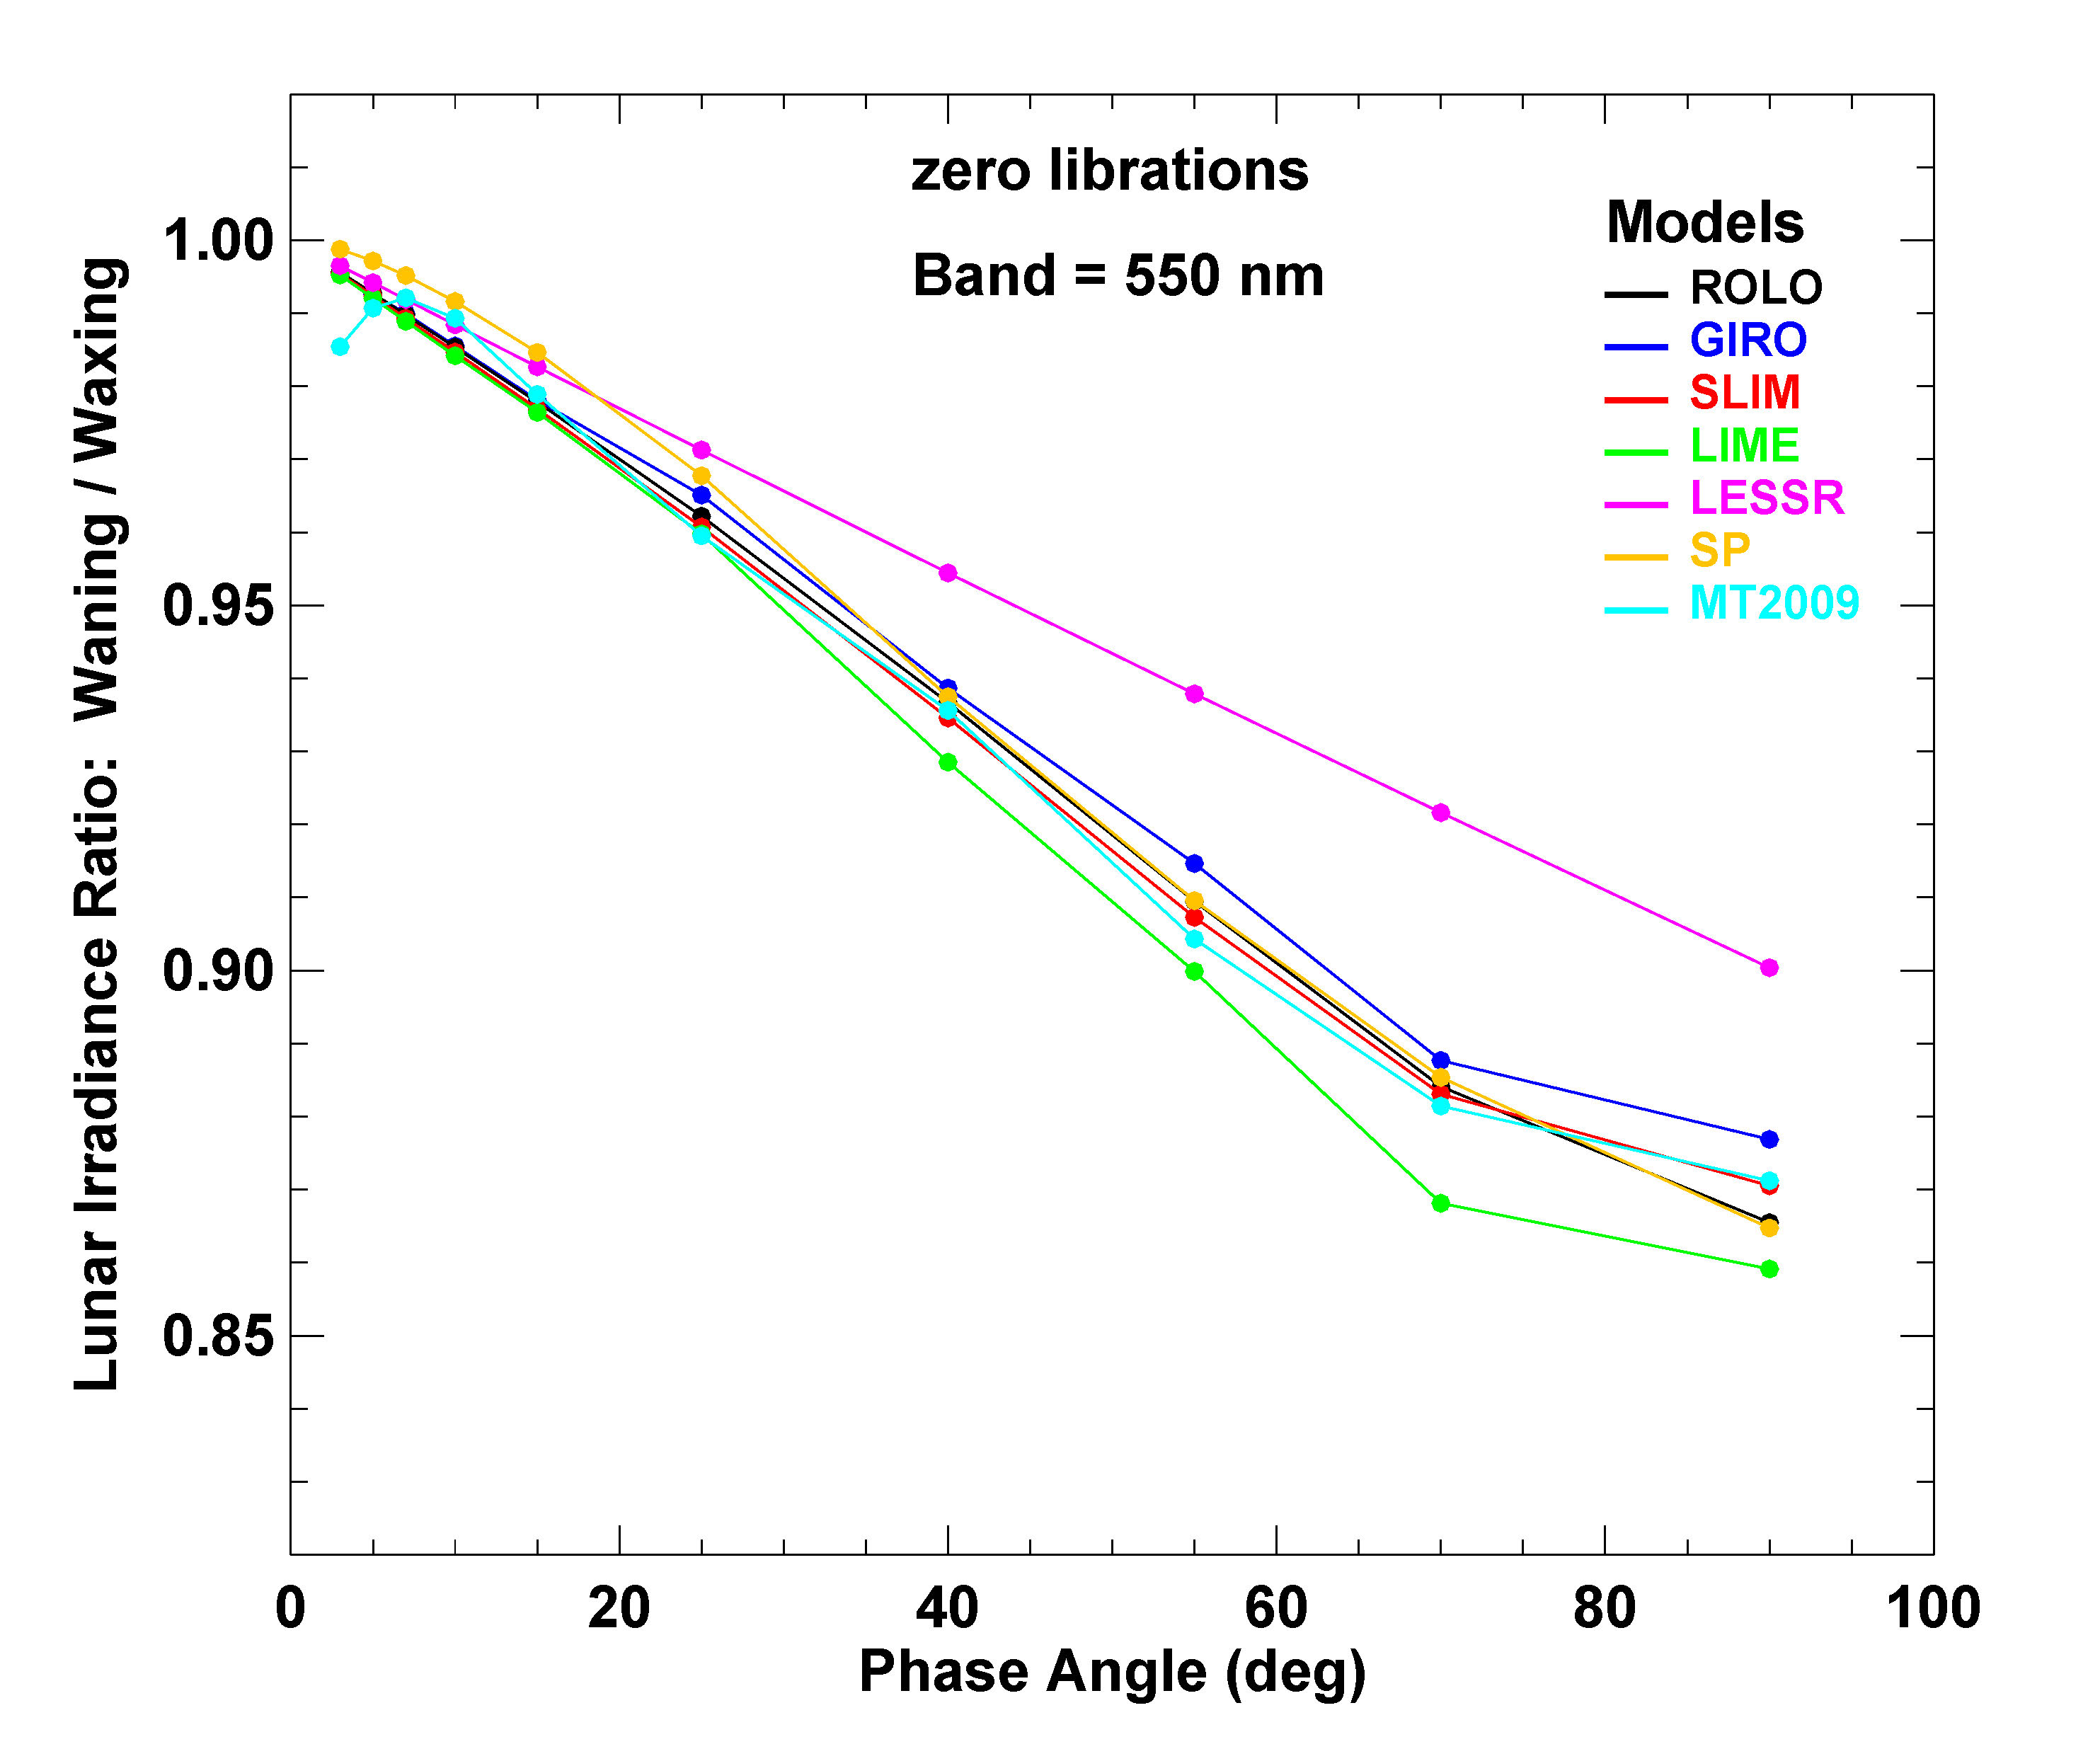
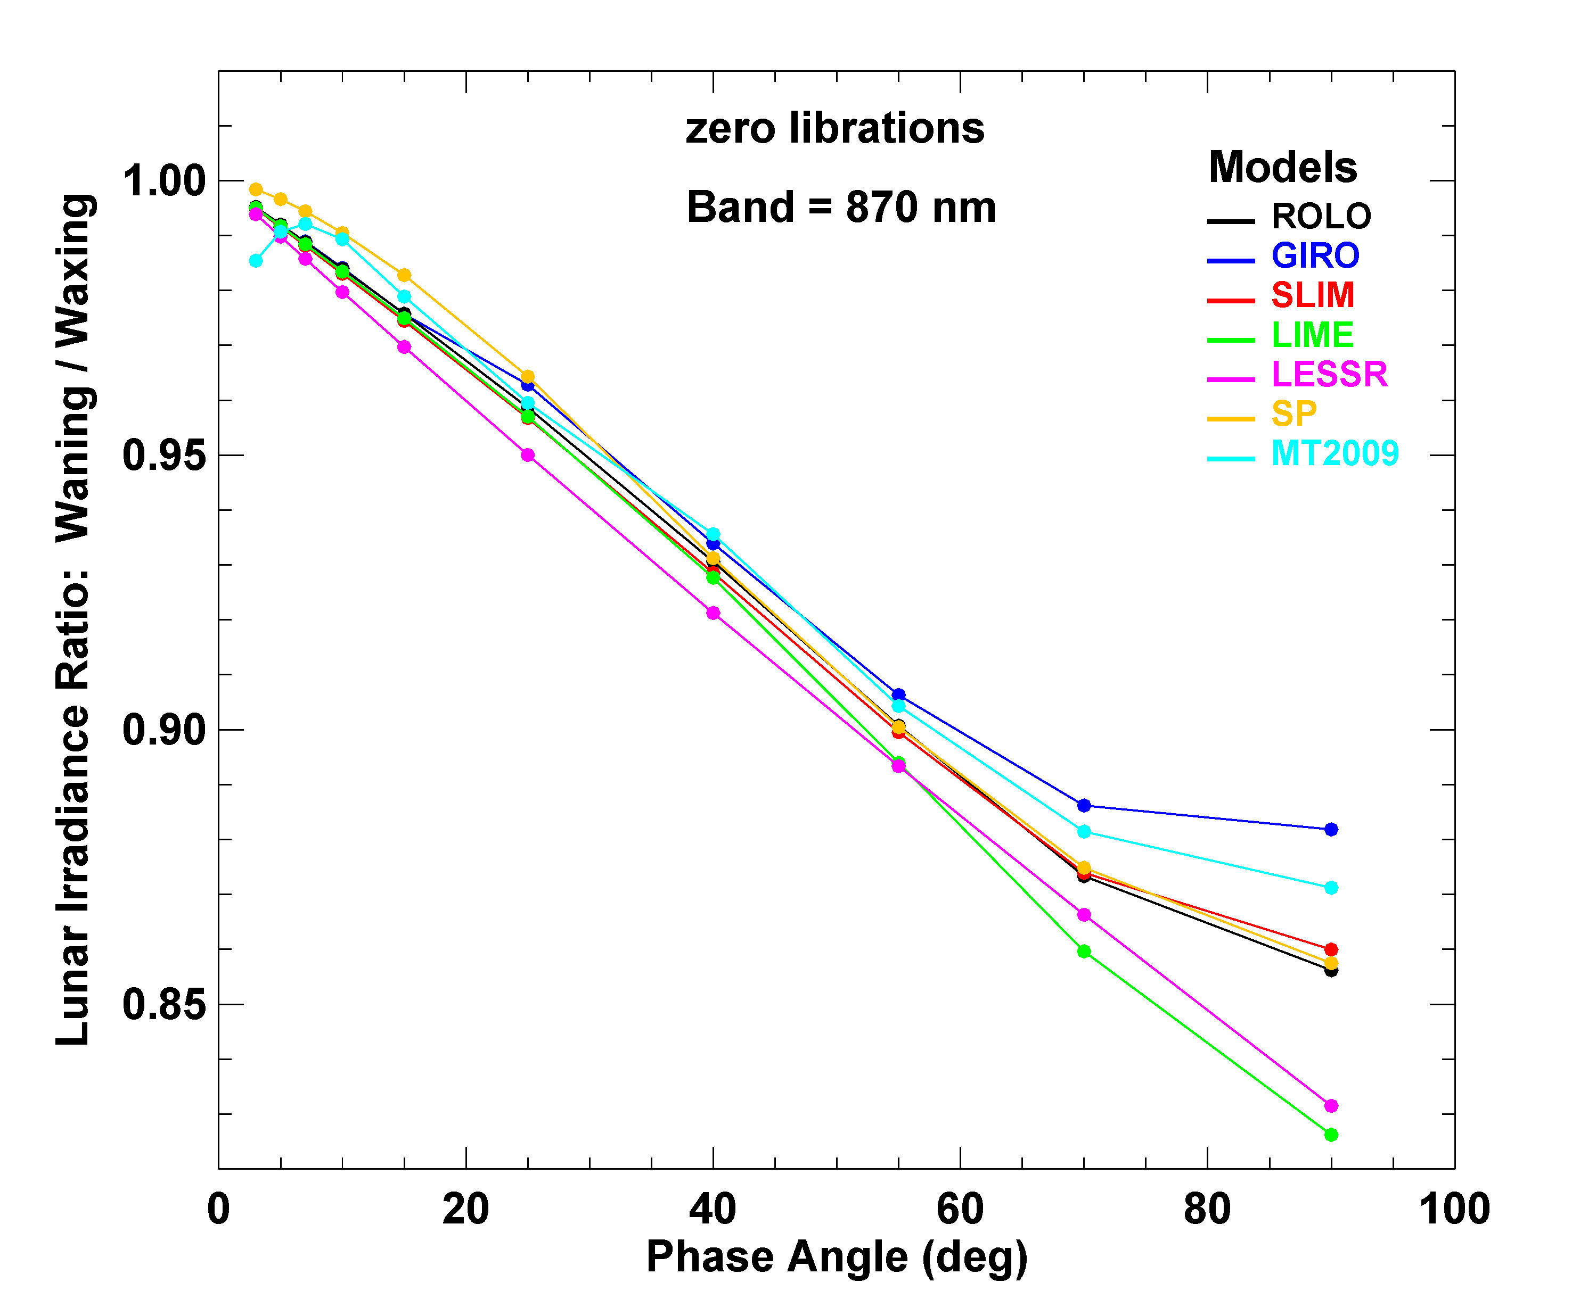
Waning/waxing irradiance ratio vs. phase angle

Slide 16
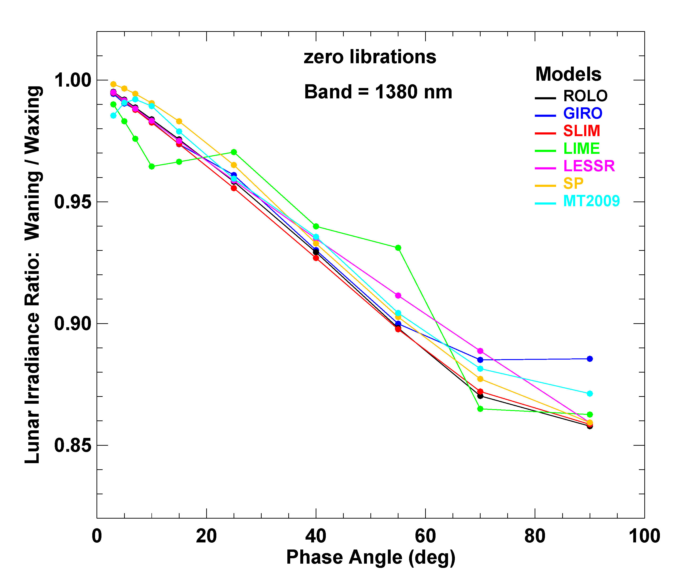
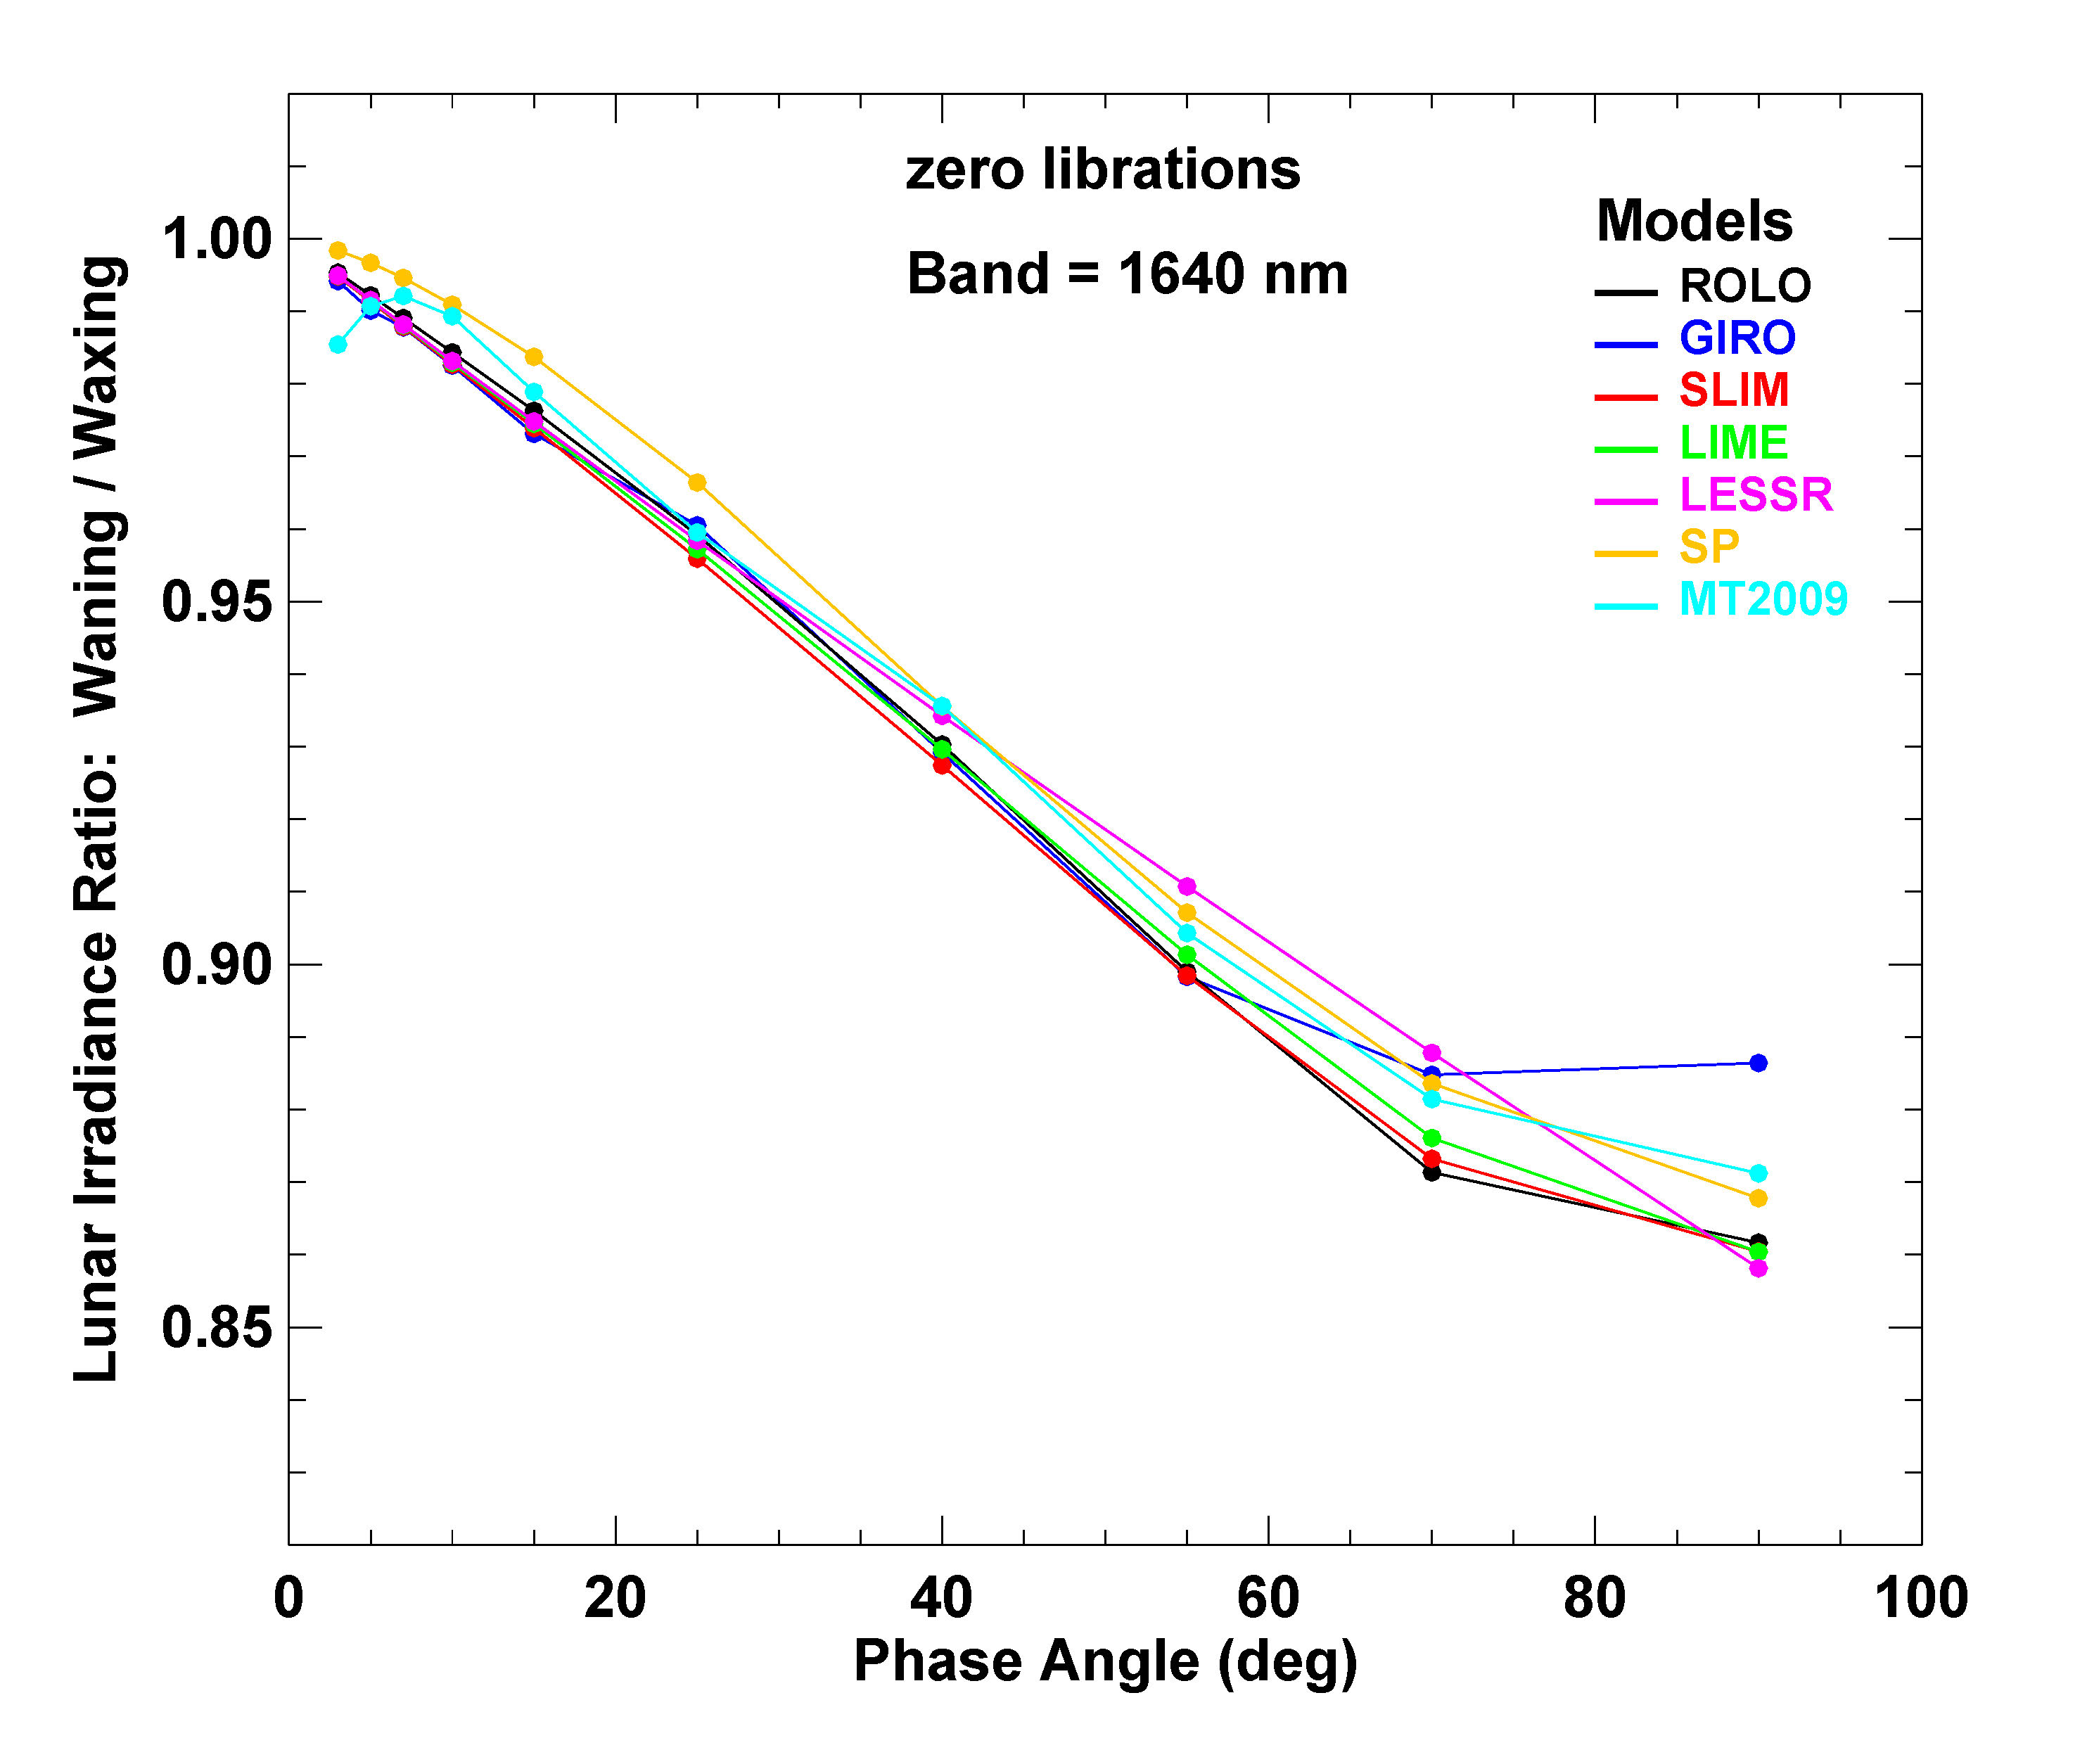
Waning/waxing irradiance ratio vs. phase angle

Slide 17
Model Output Comparisons — Variations with Librations
comparisons shown as irradiance ratio to zero libration: E_{M}(λ,g,Φ,φ,θ) / E_{M}(λ,g,Φ,0,0)
to visualize the libration specifications in the models
additional degrees of freedom → many plots
displays limited to selected bands and/or phase angles
MT model has no libration-dependent terms, therefore no MT results shown

Slide 18
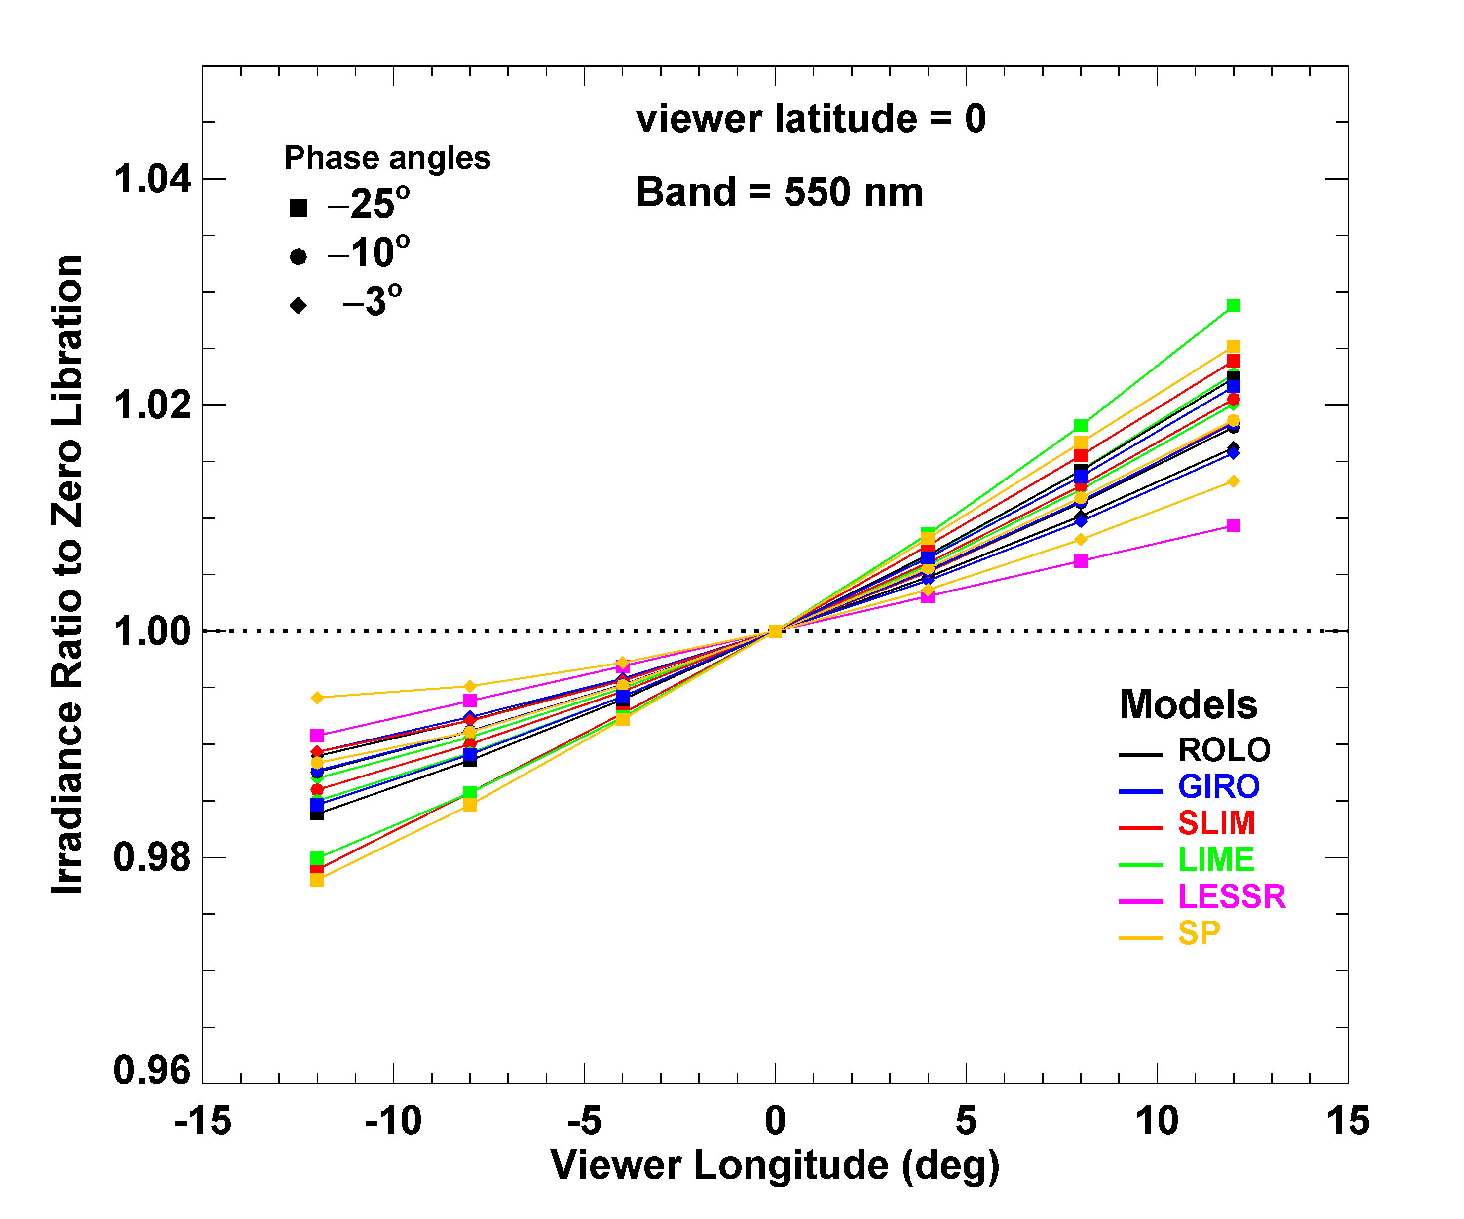
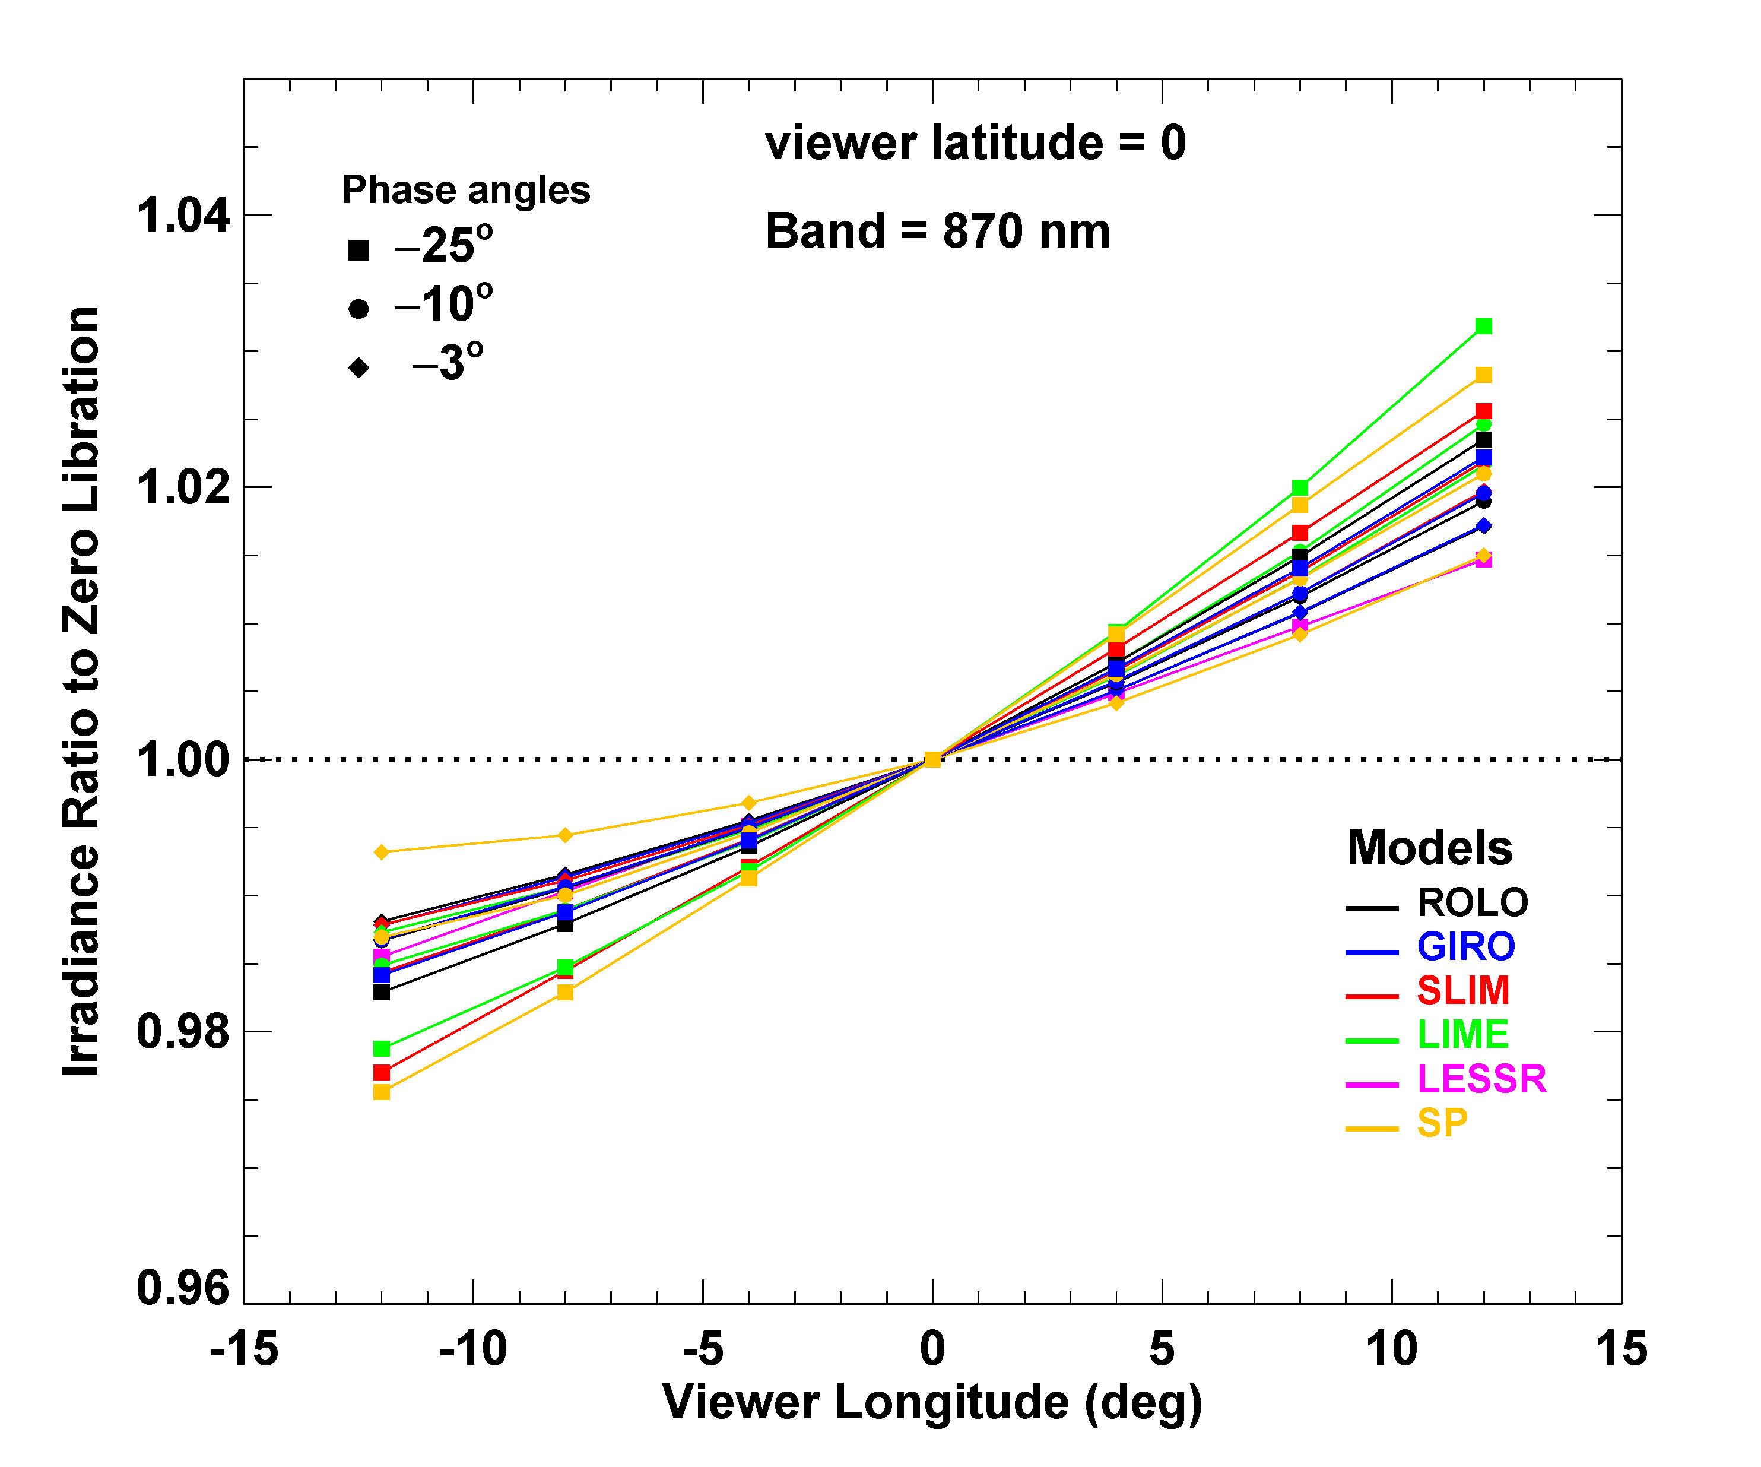
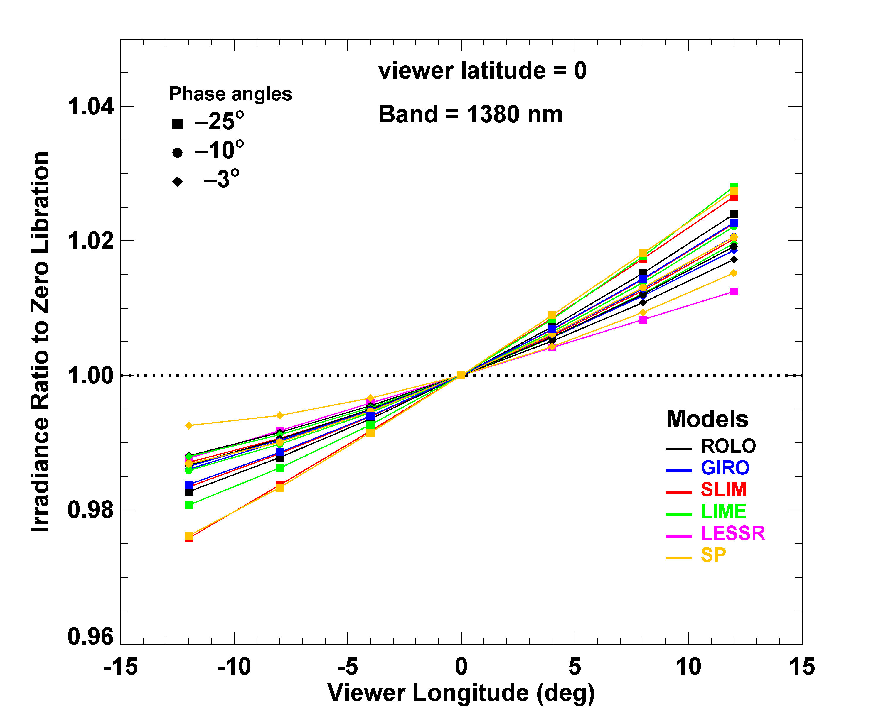
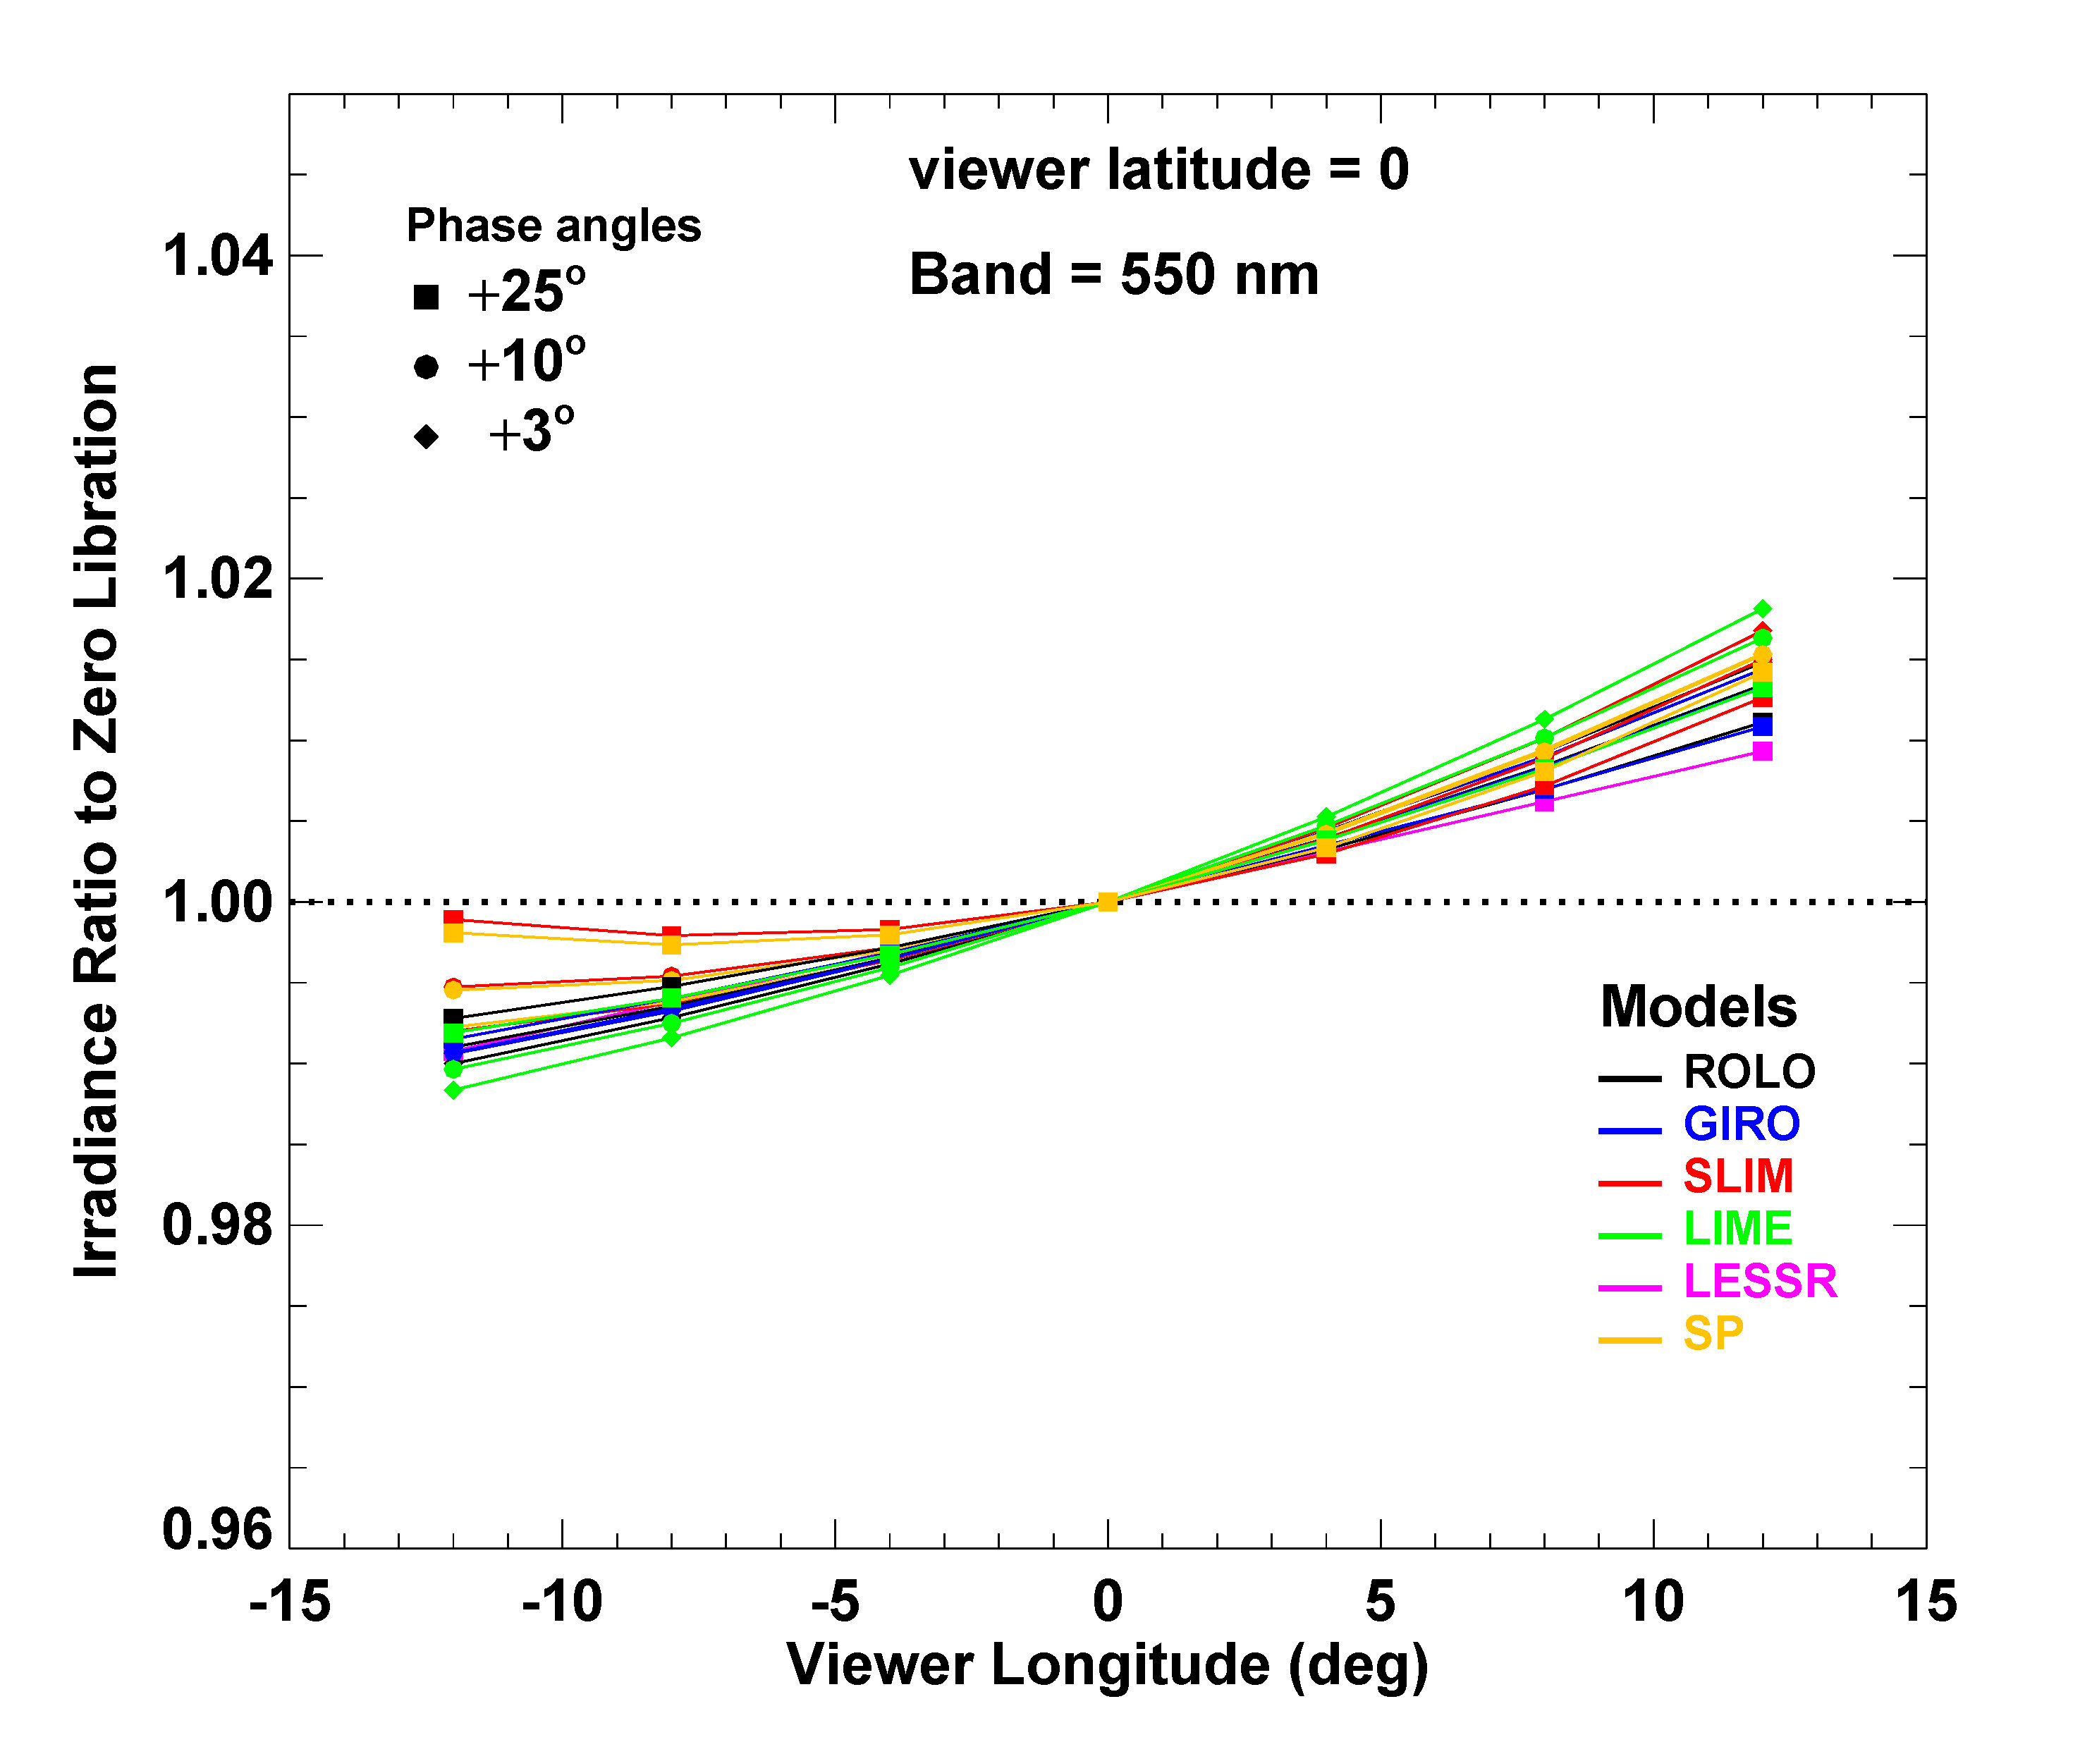
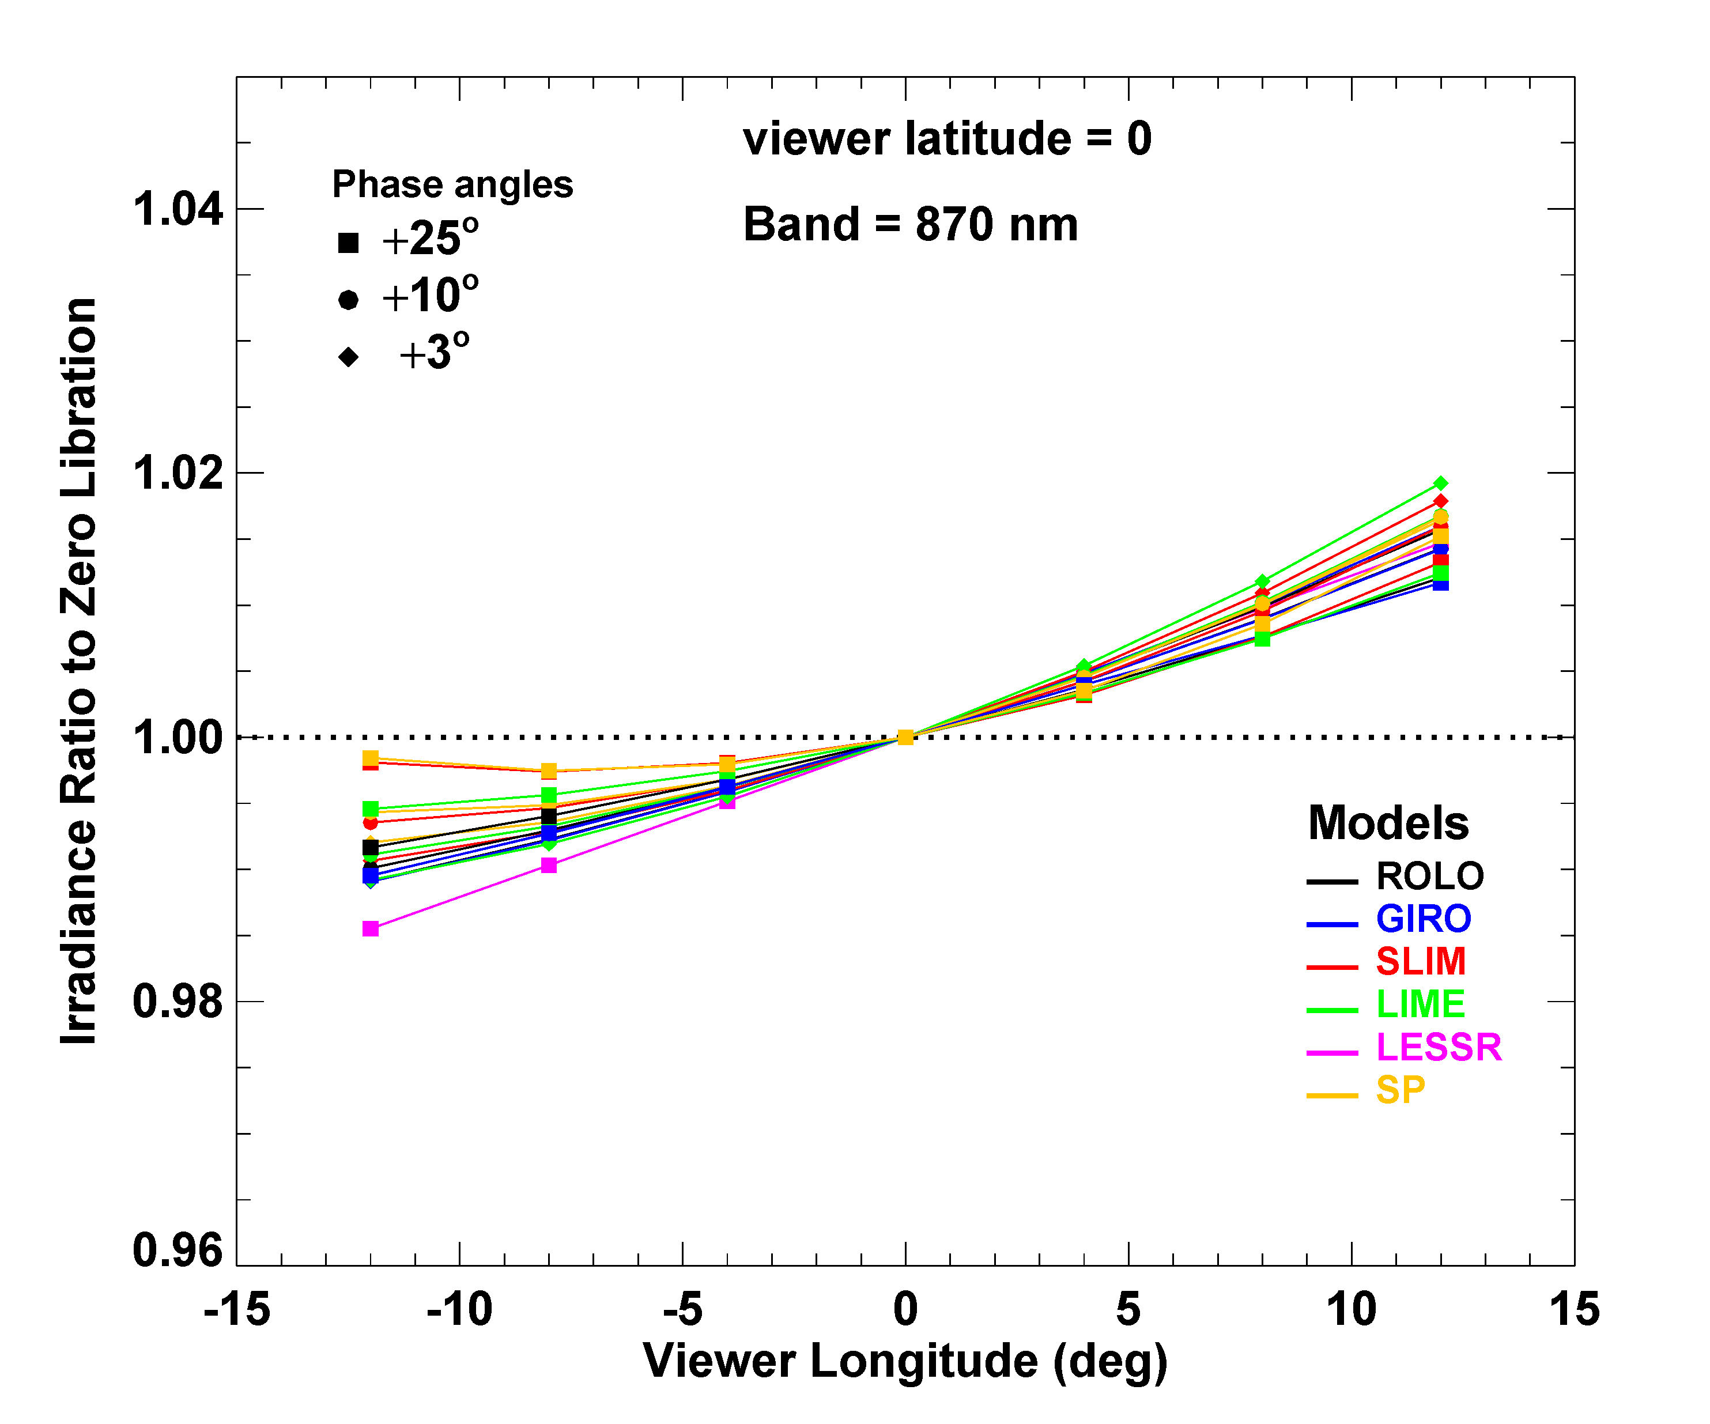
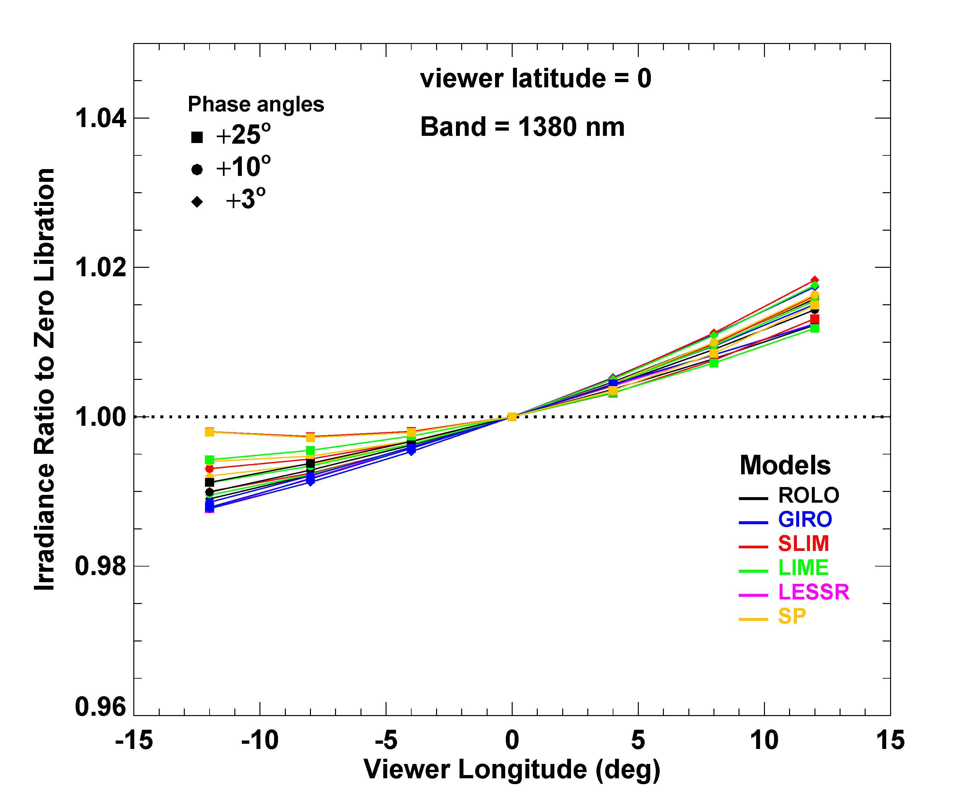

Slide 19
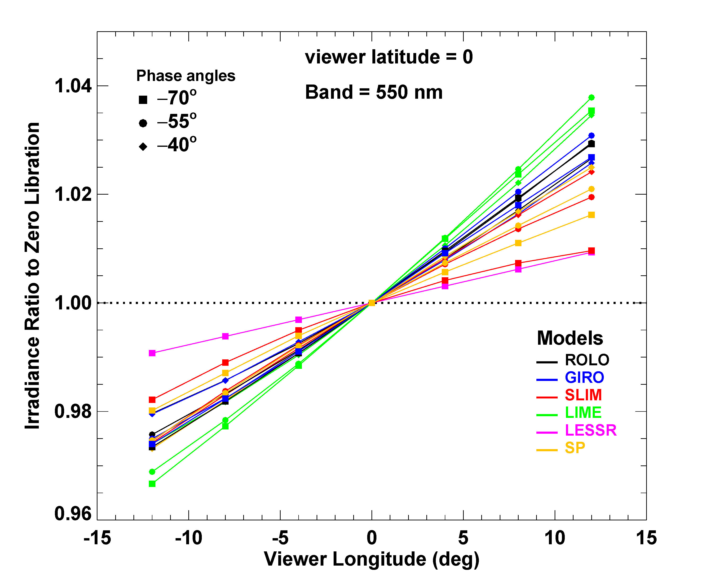
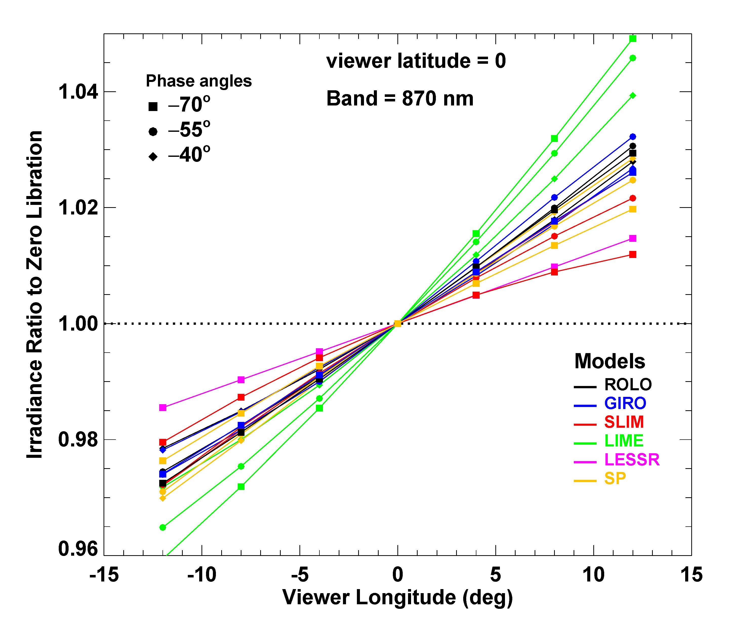
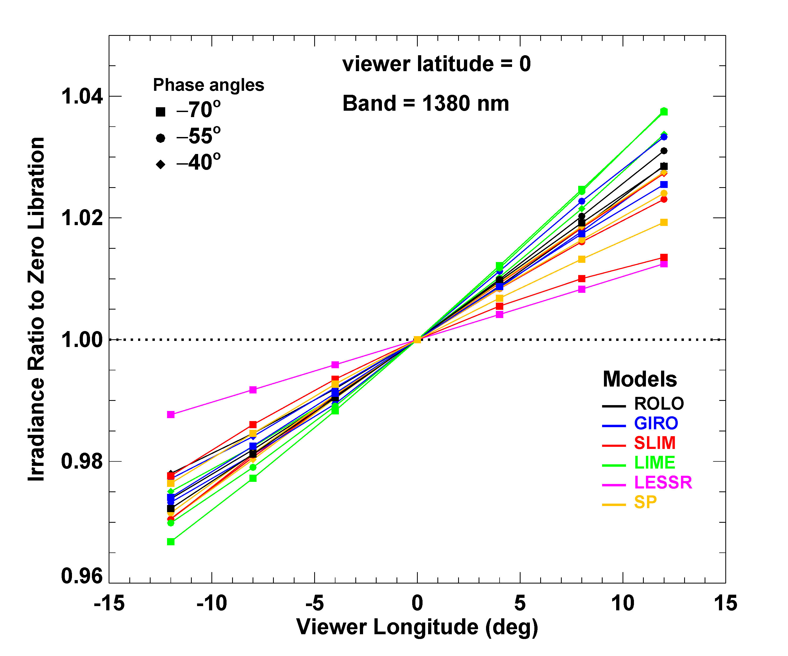
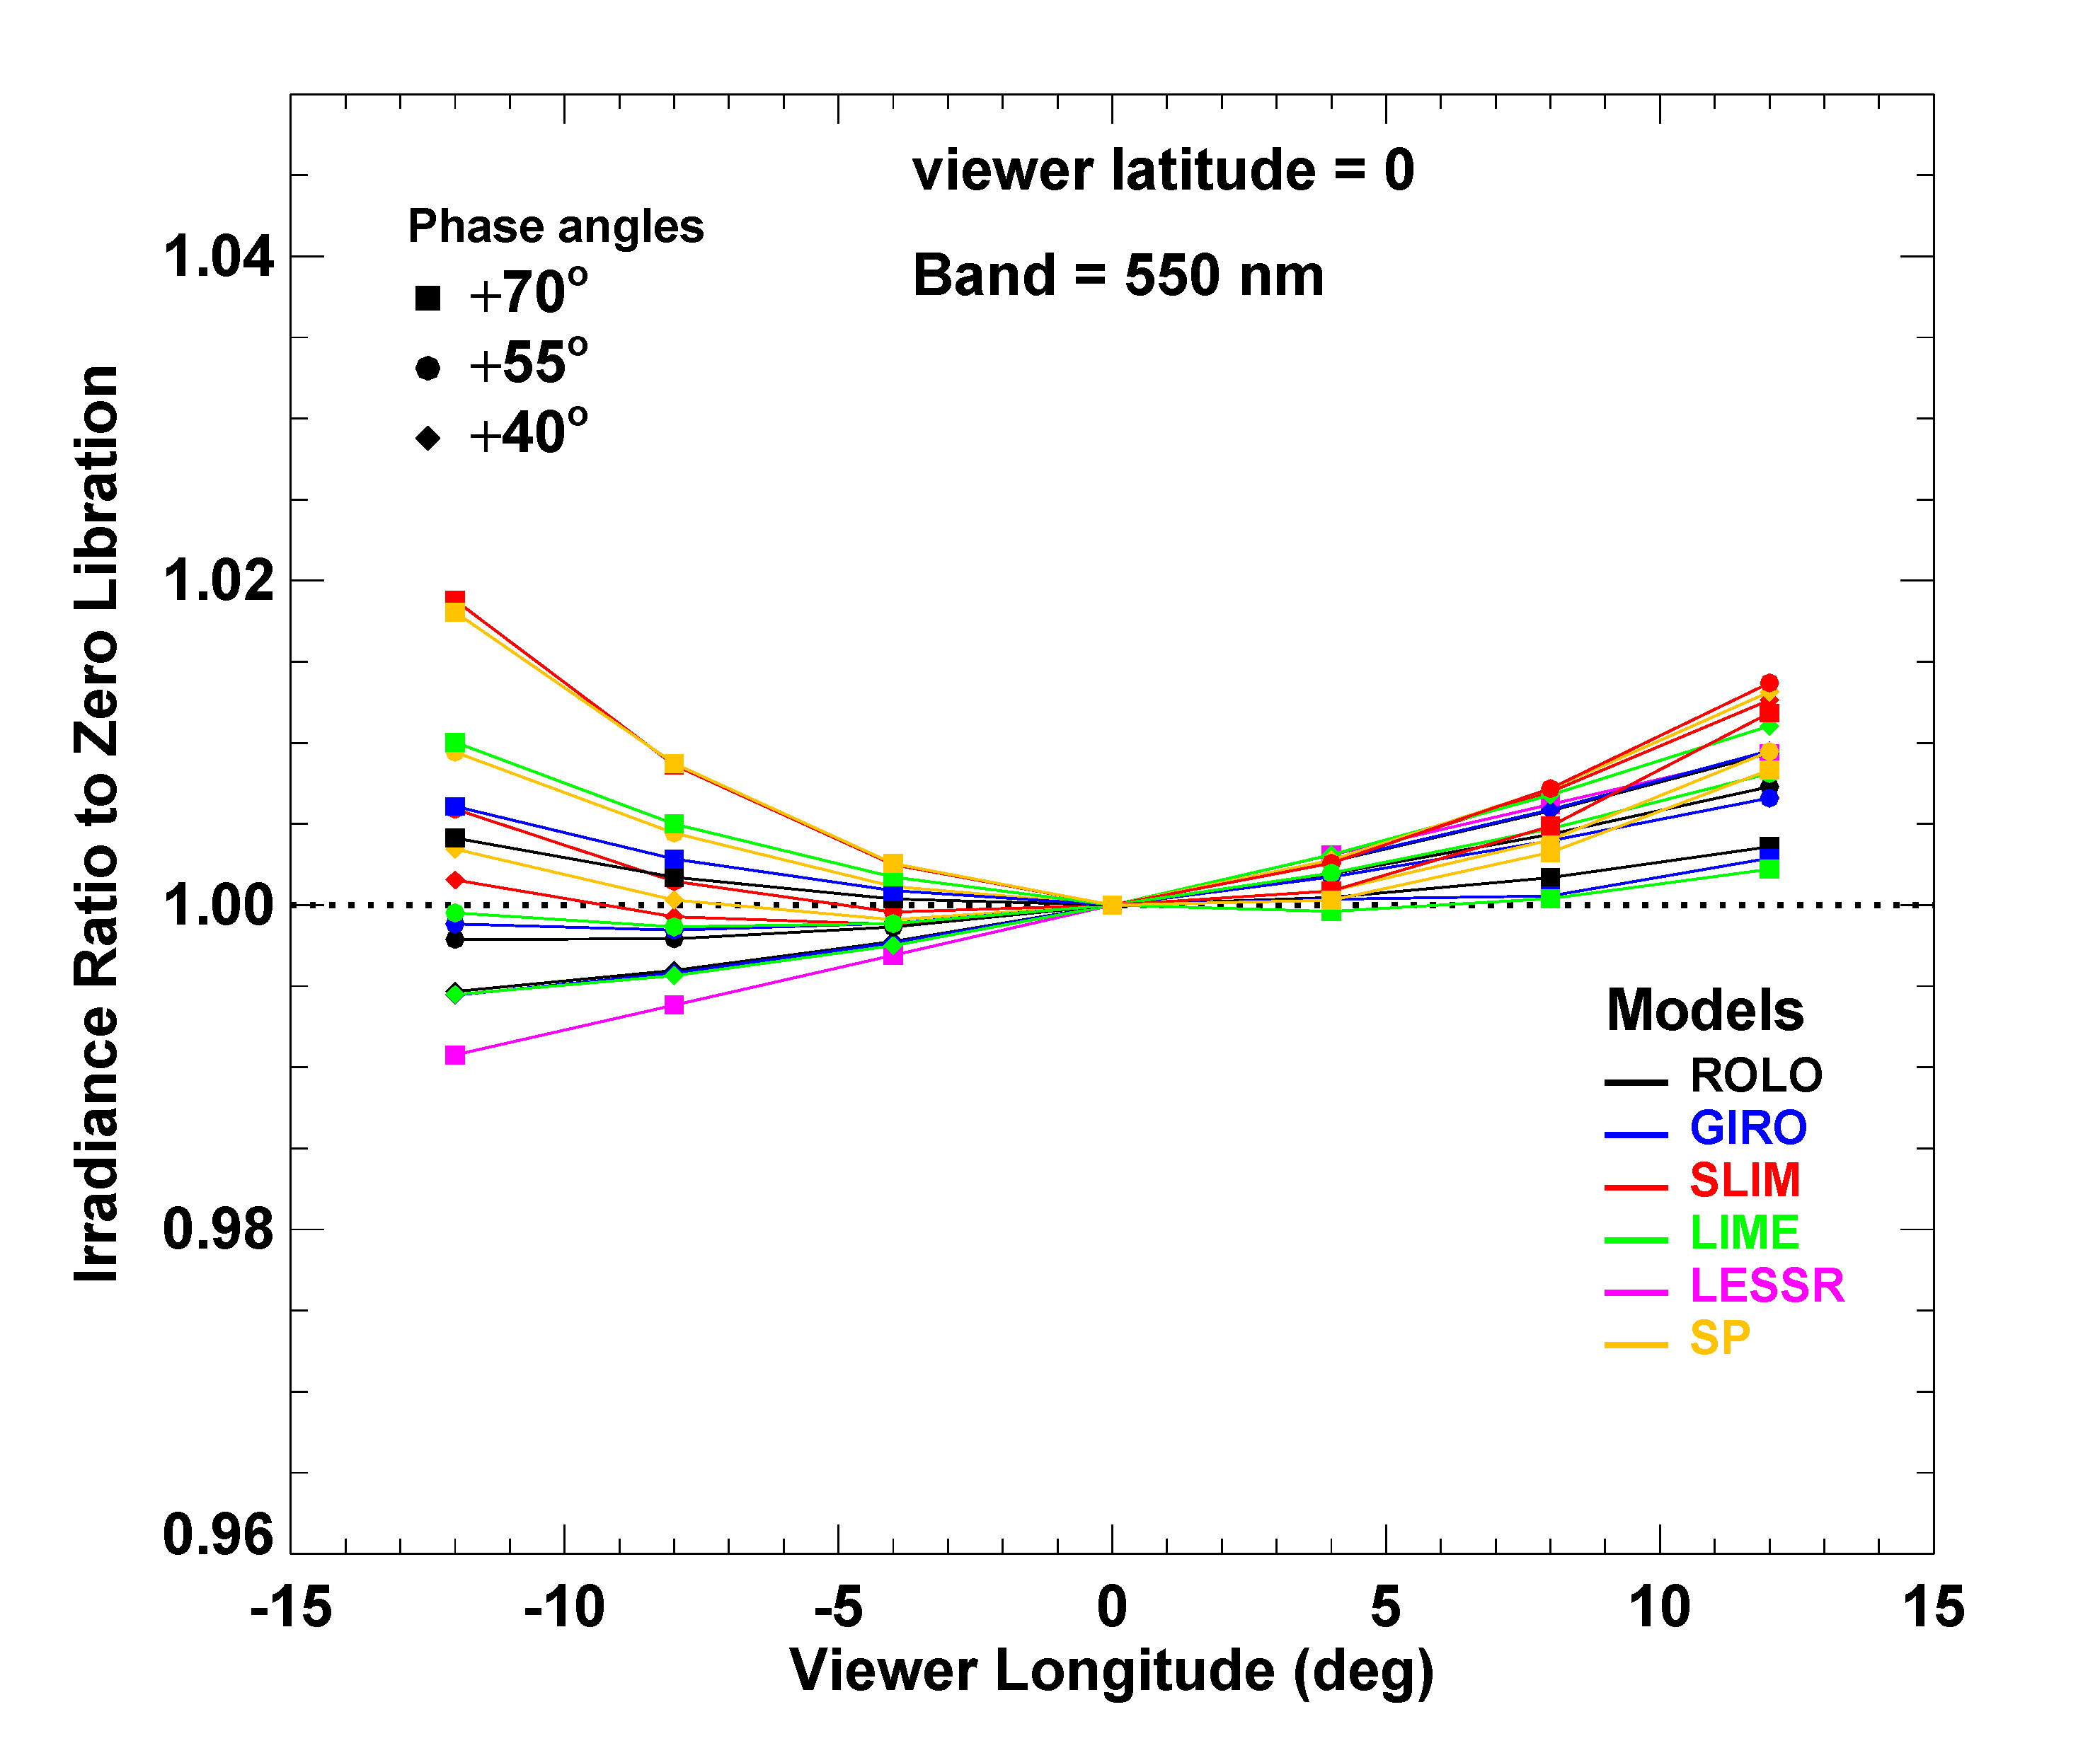
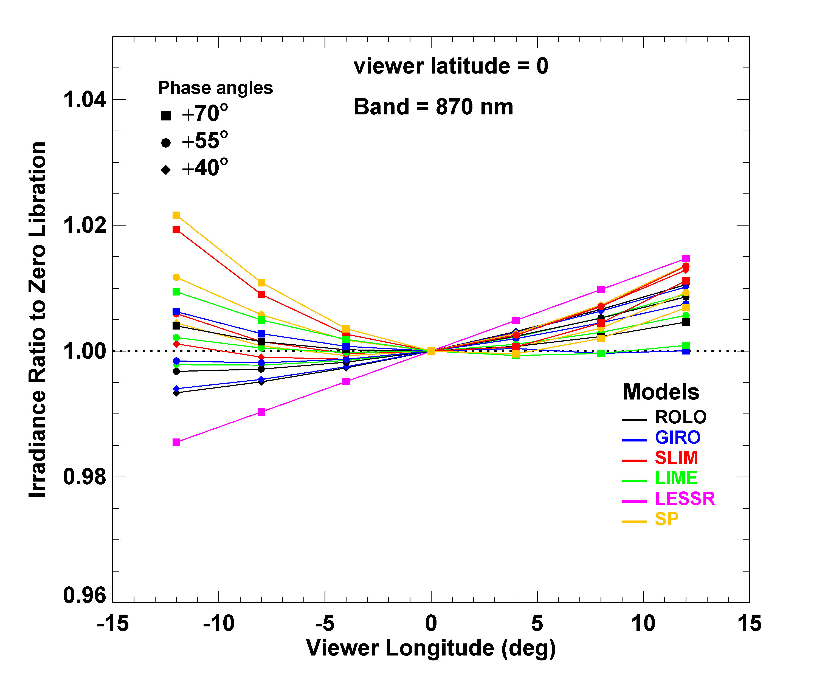

Slide 20
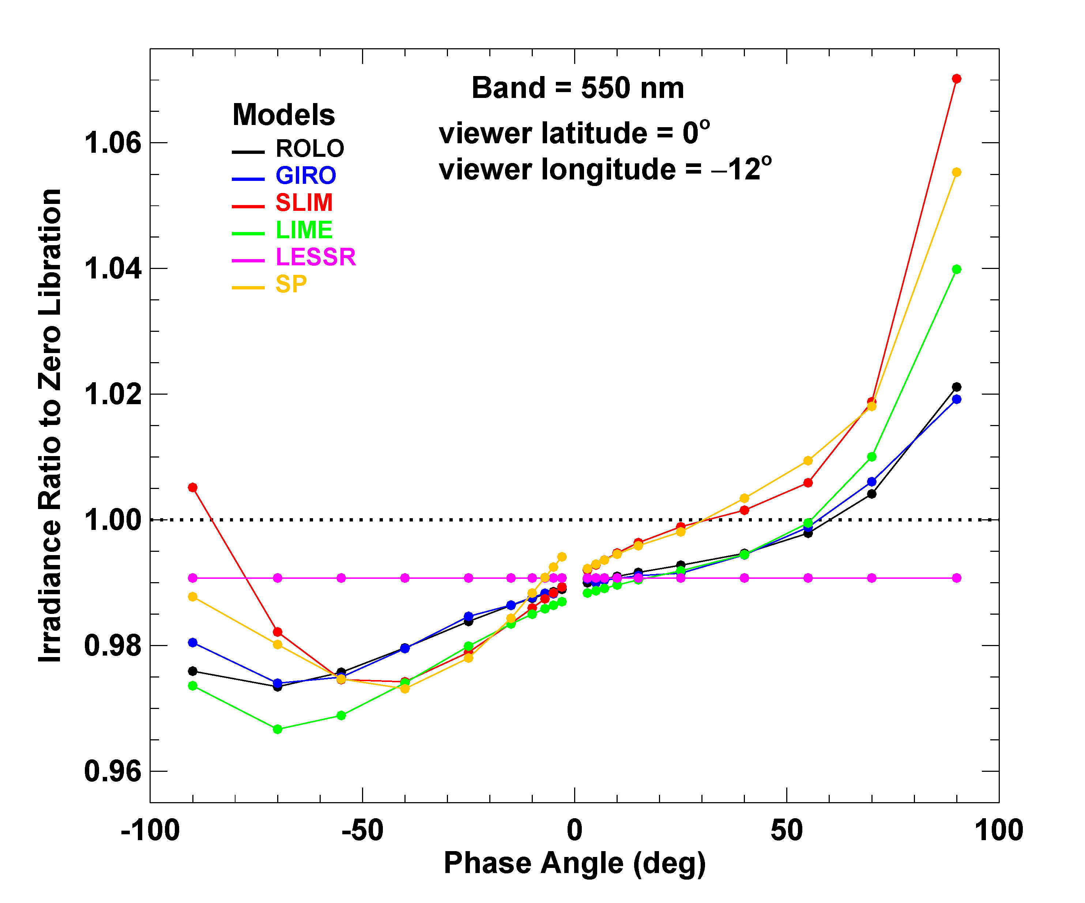
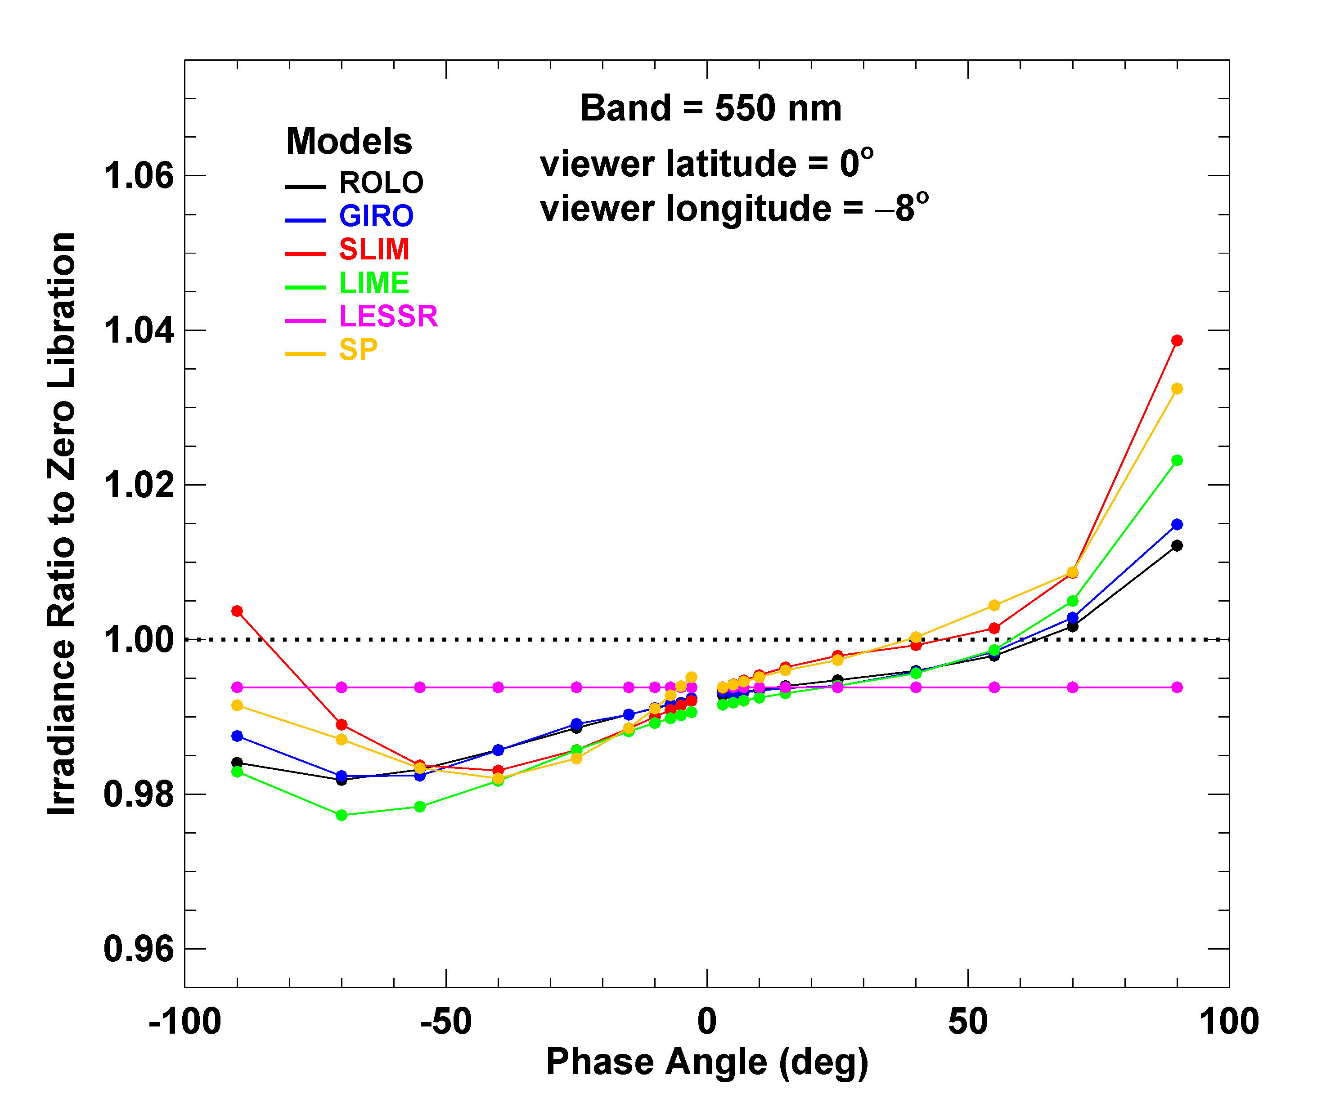
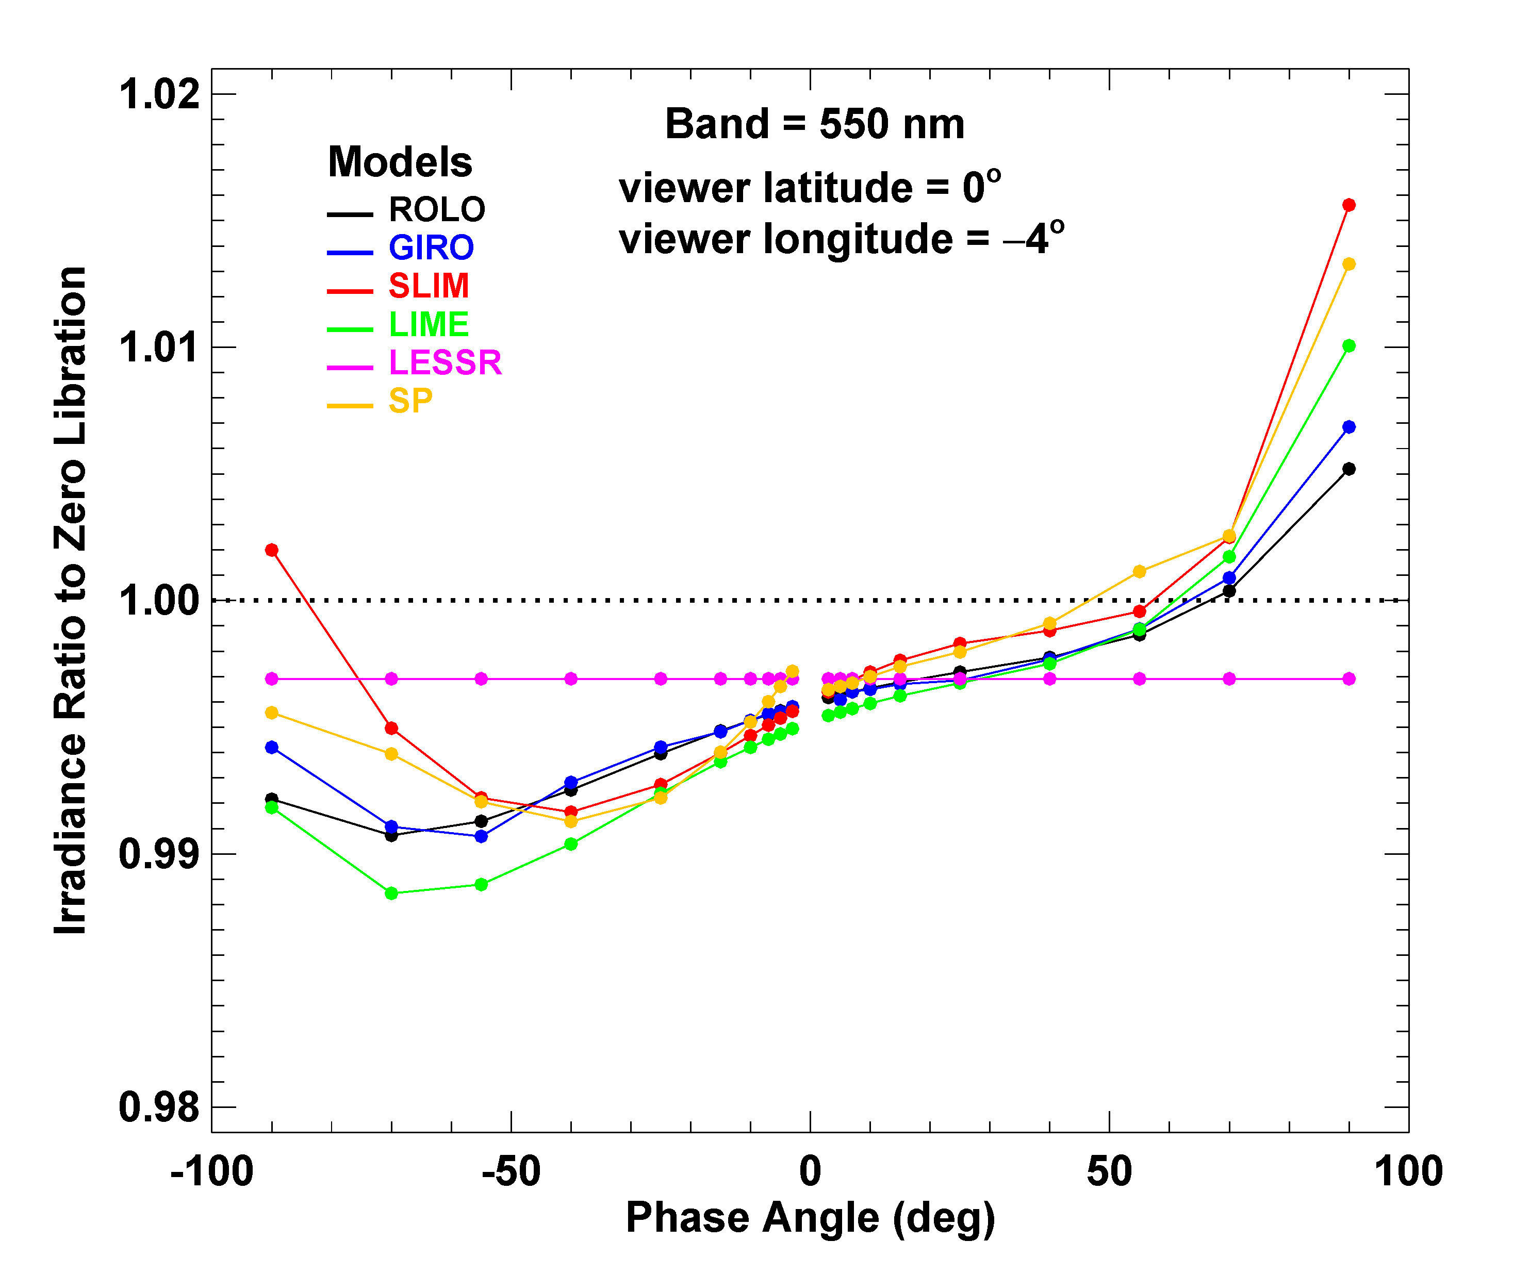
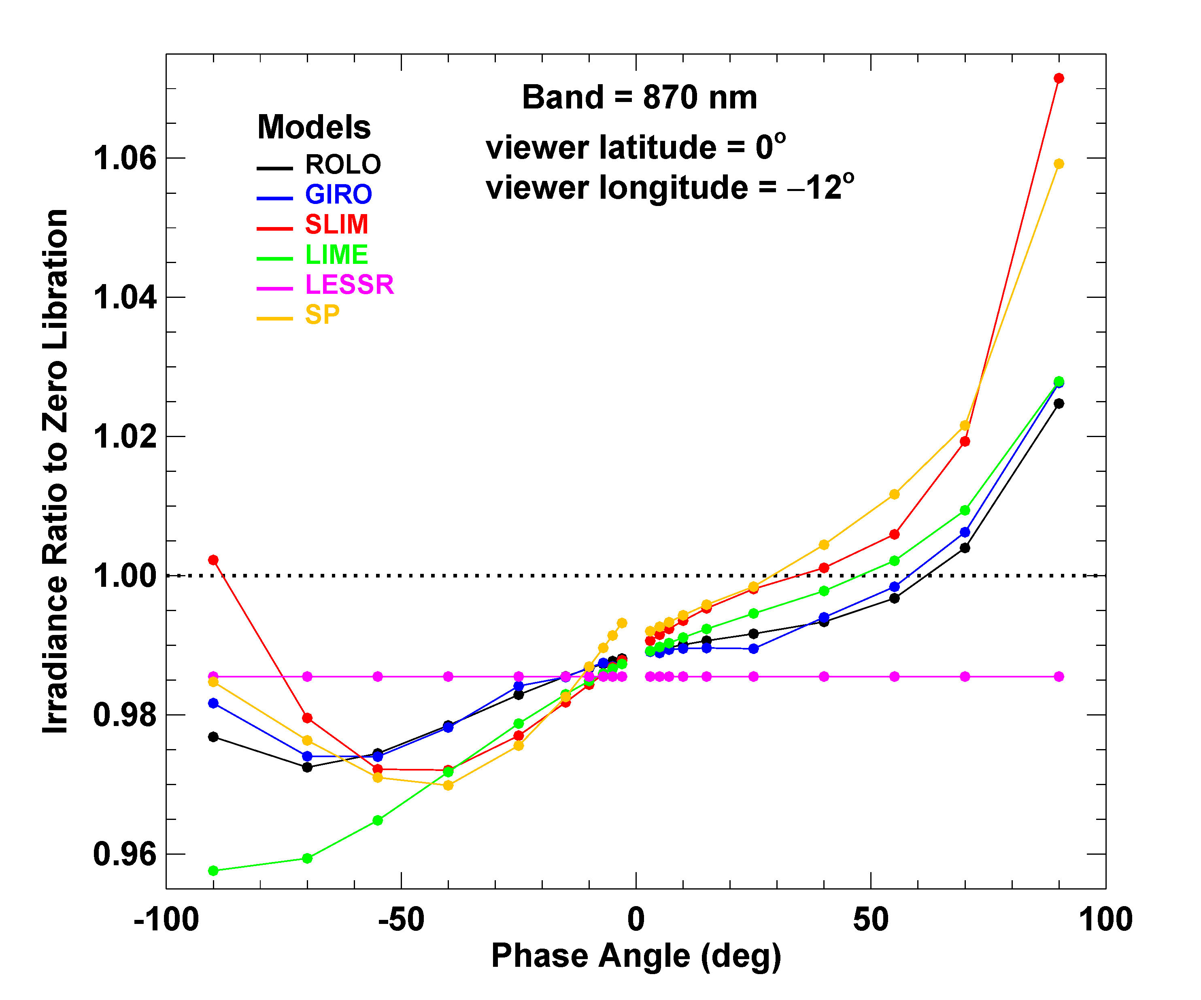
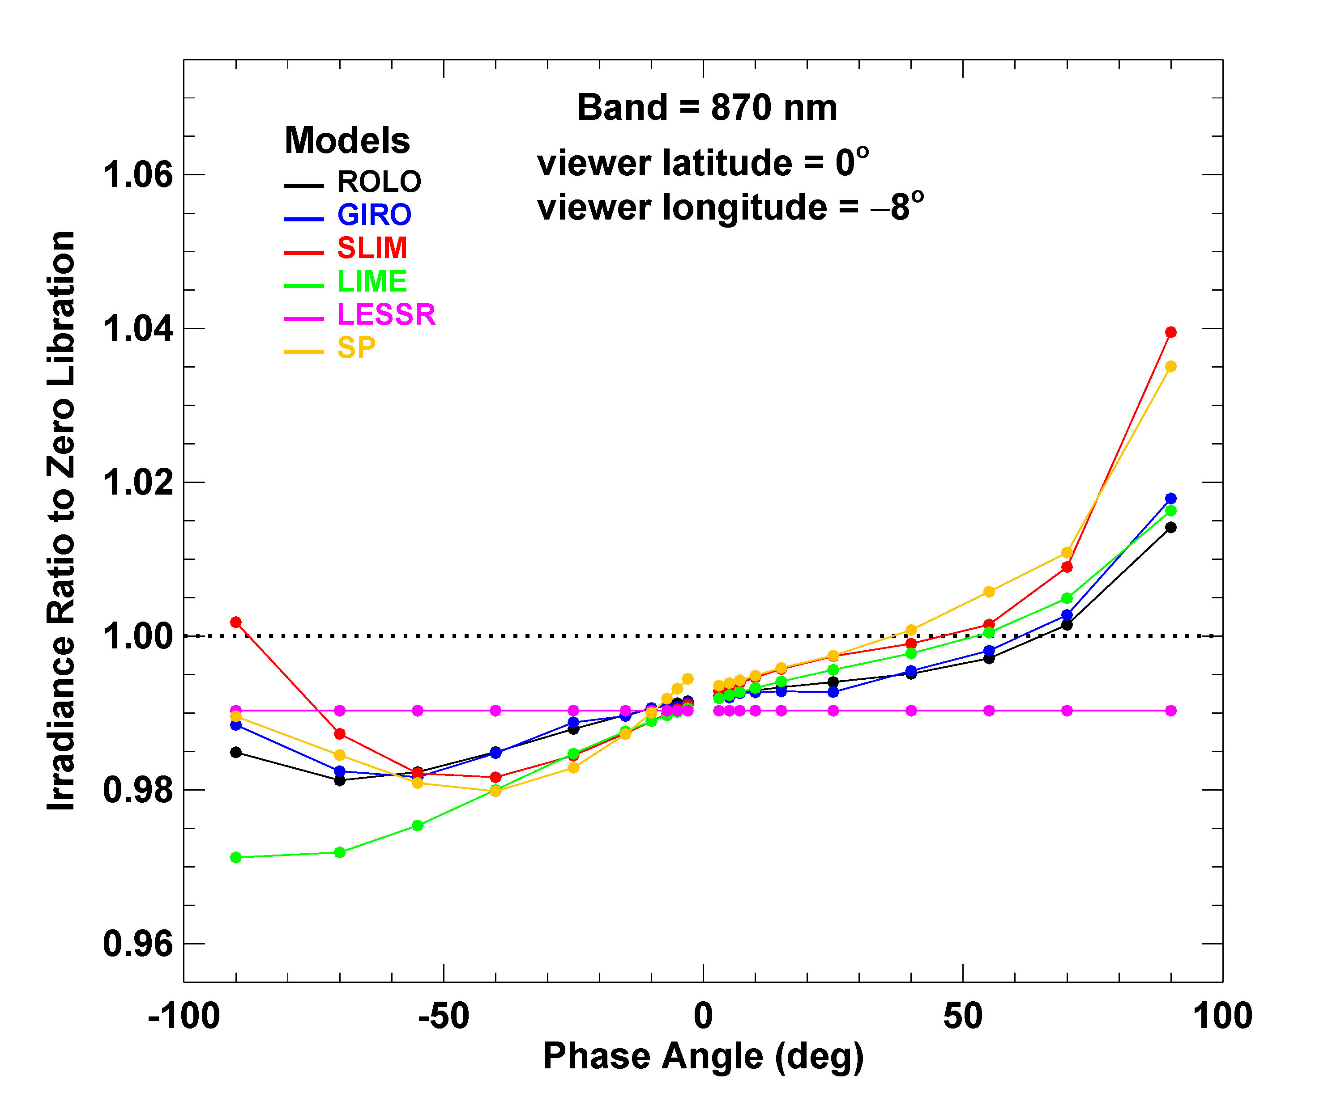
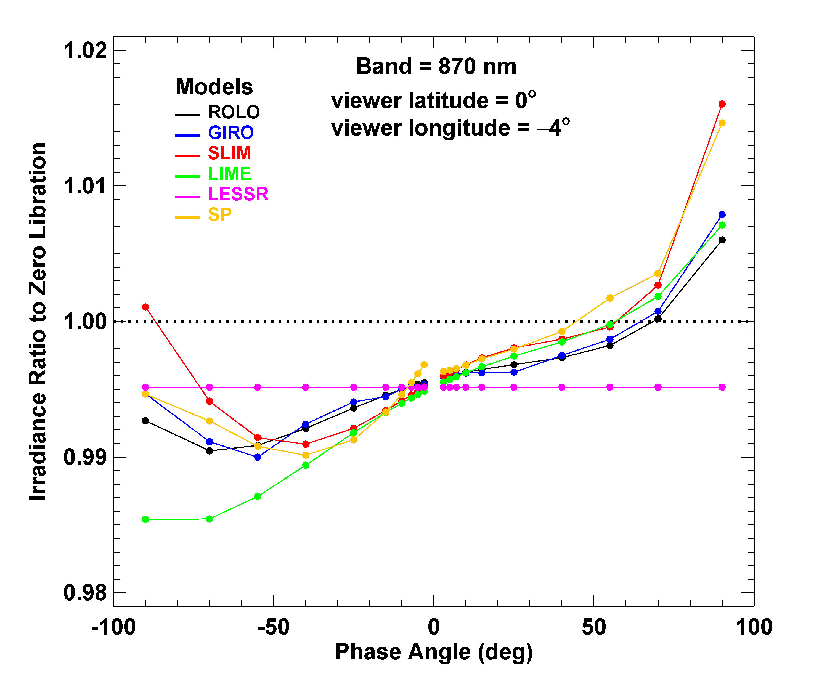

Slide 21
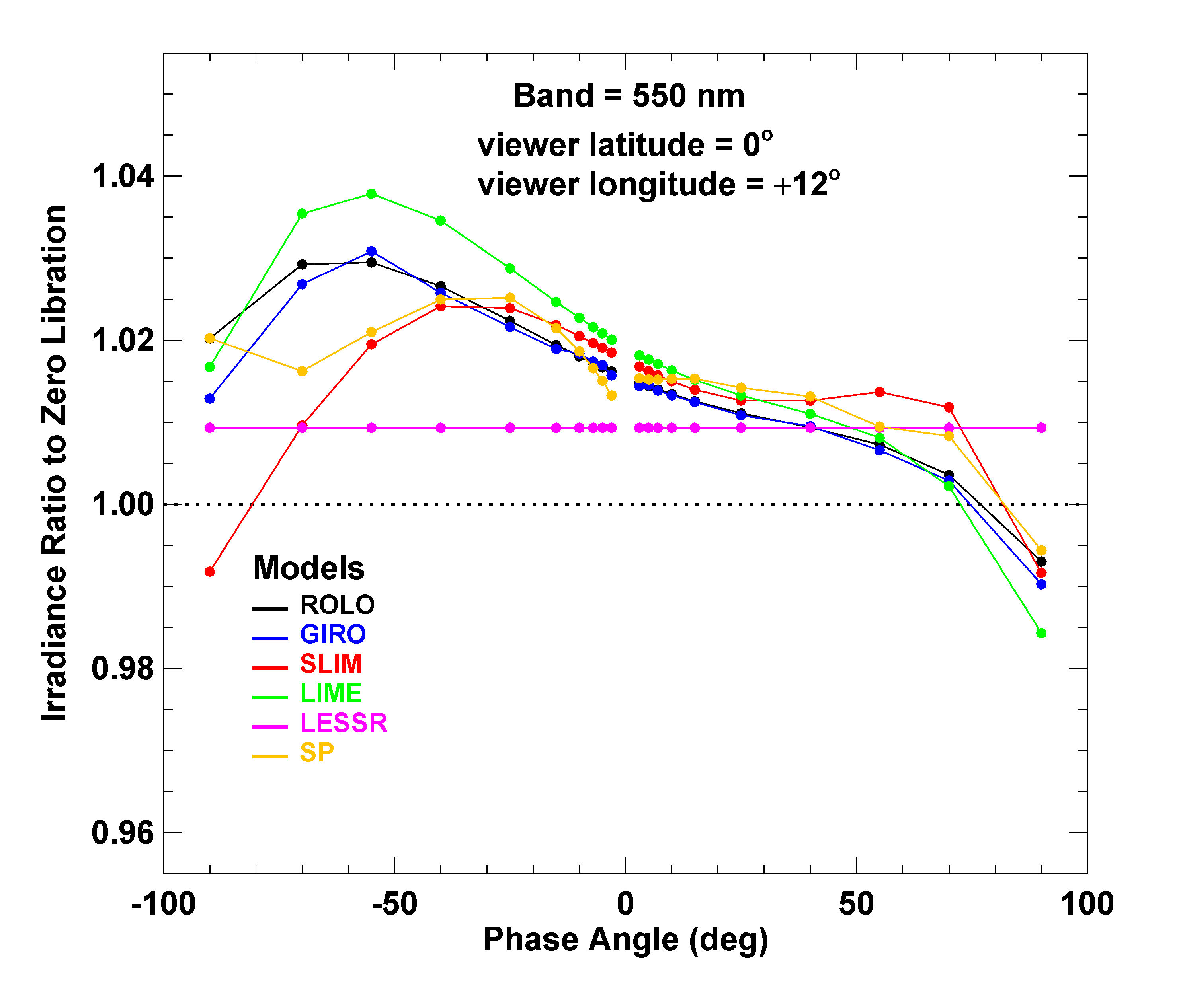
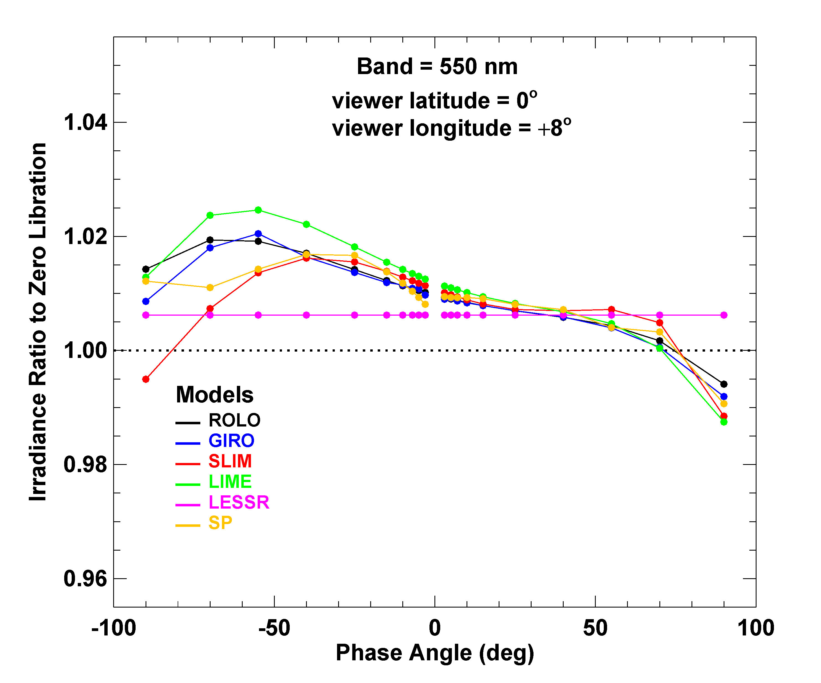
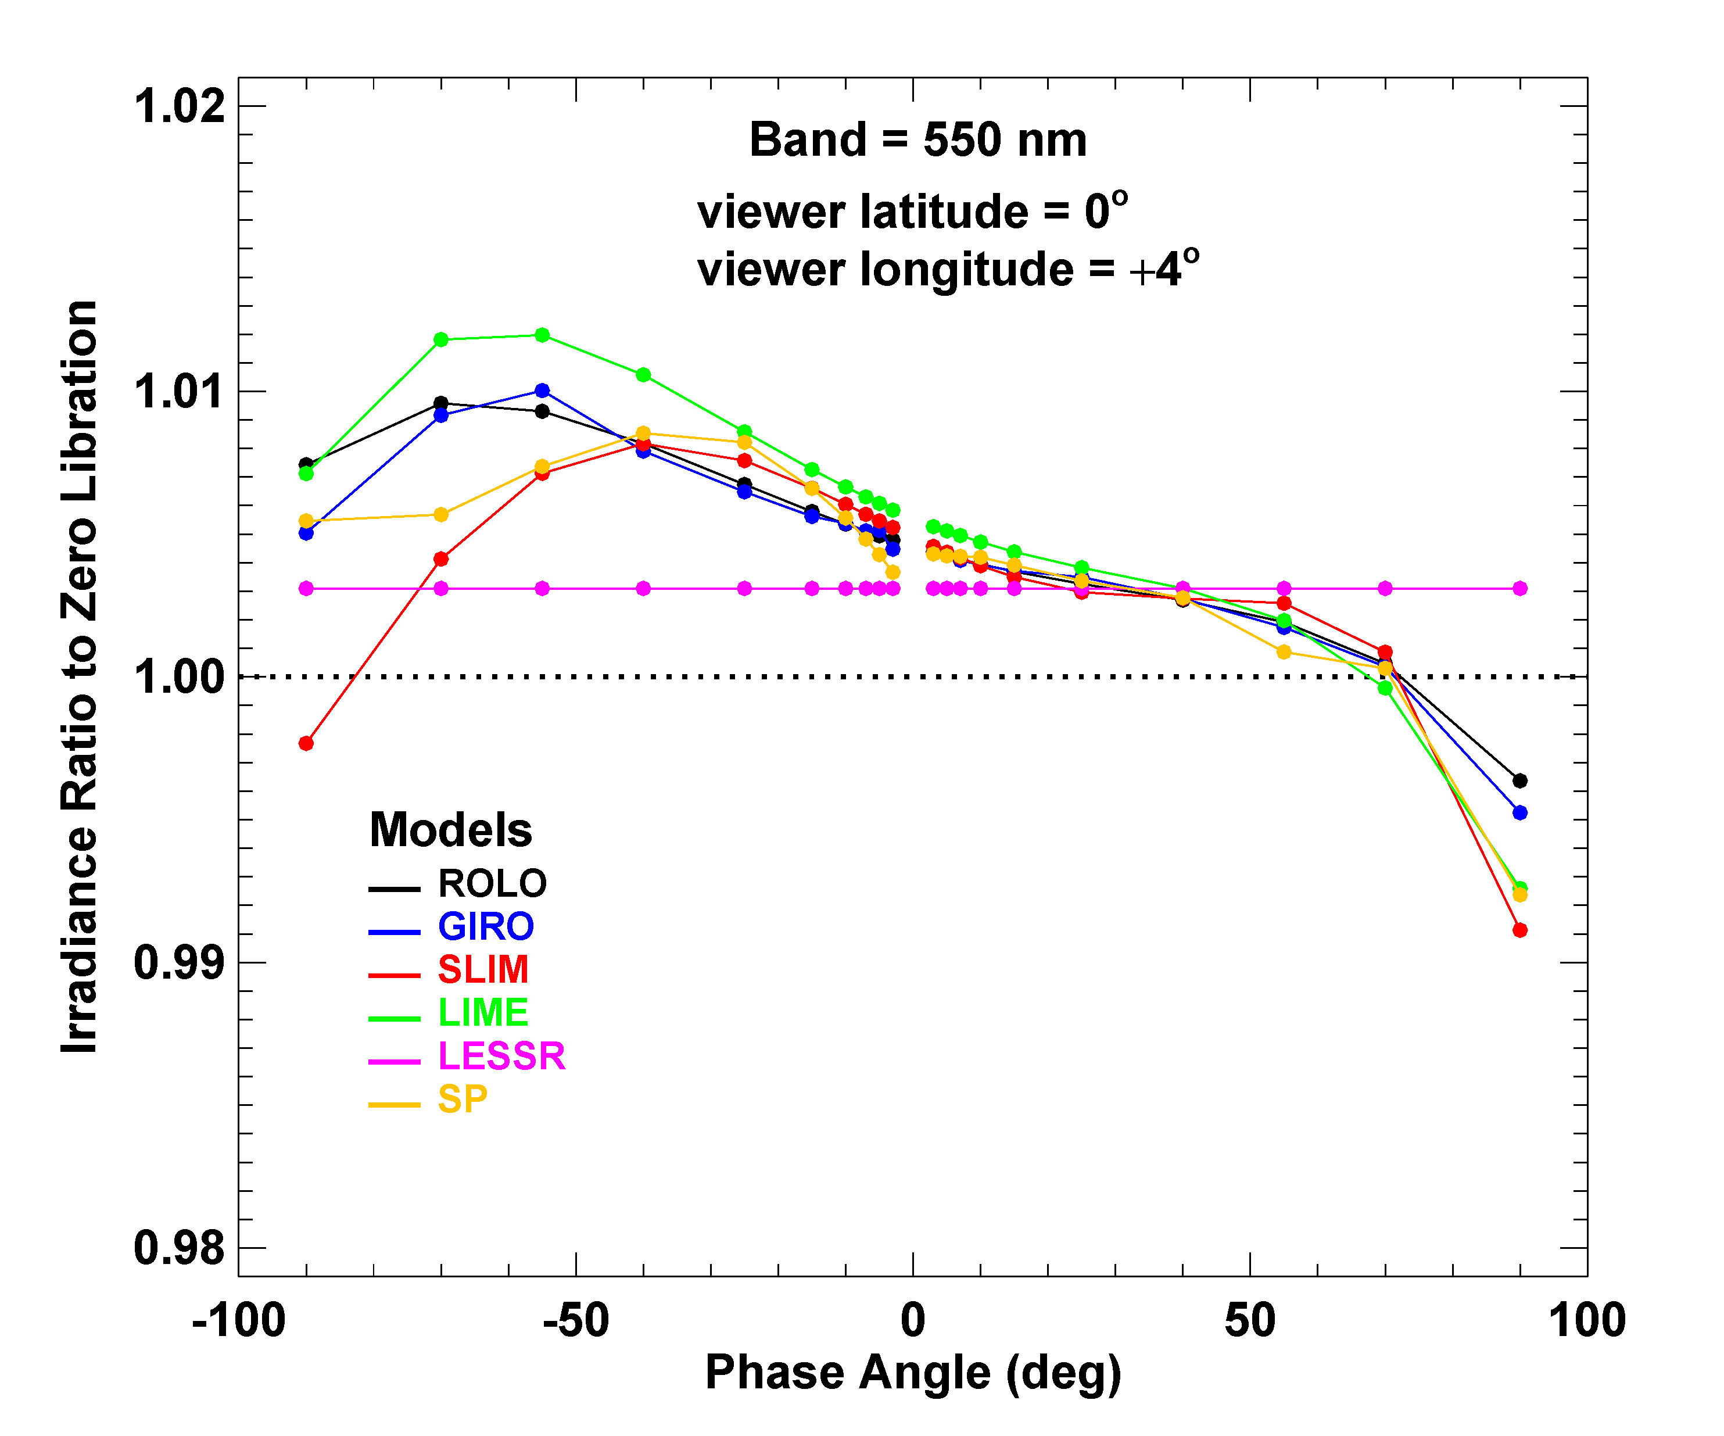
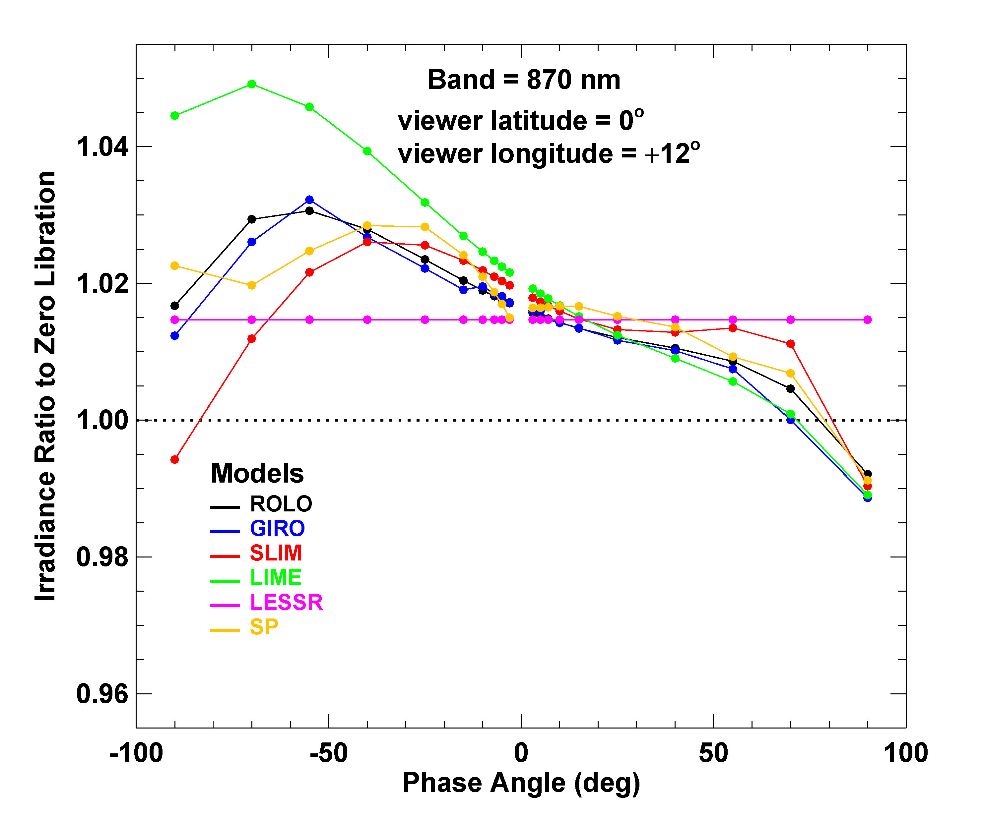
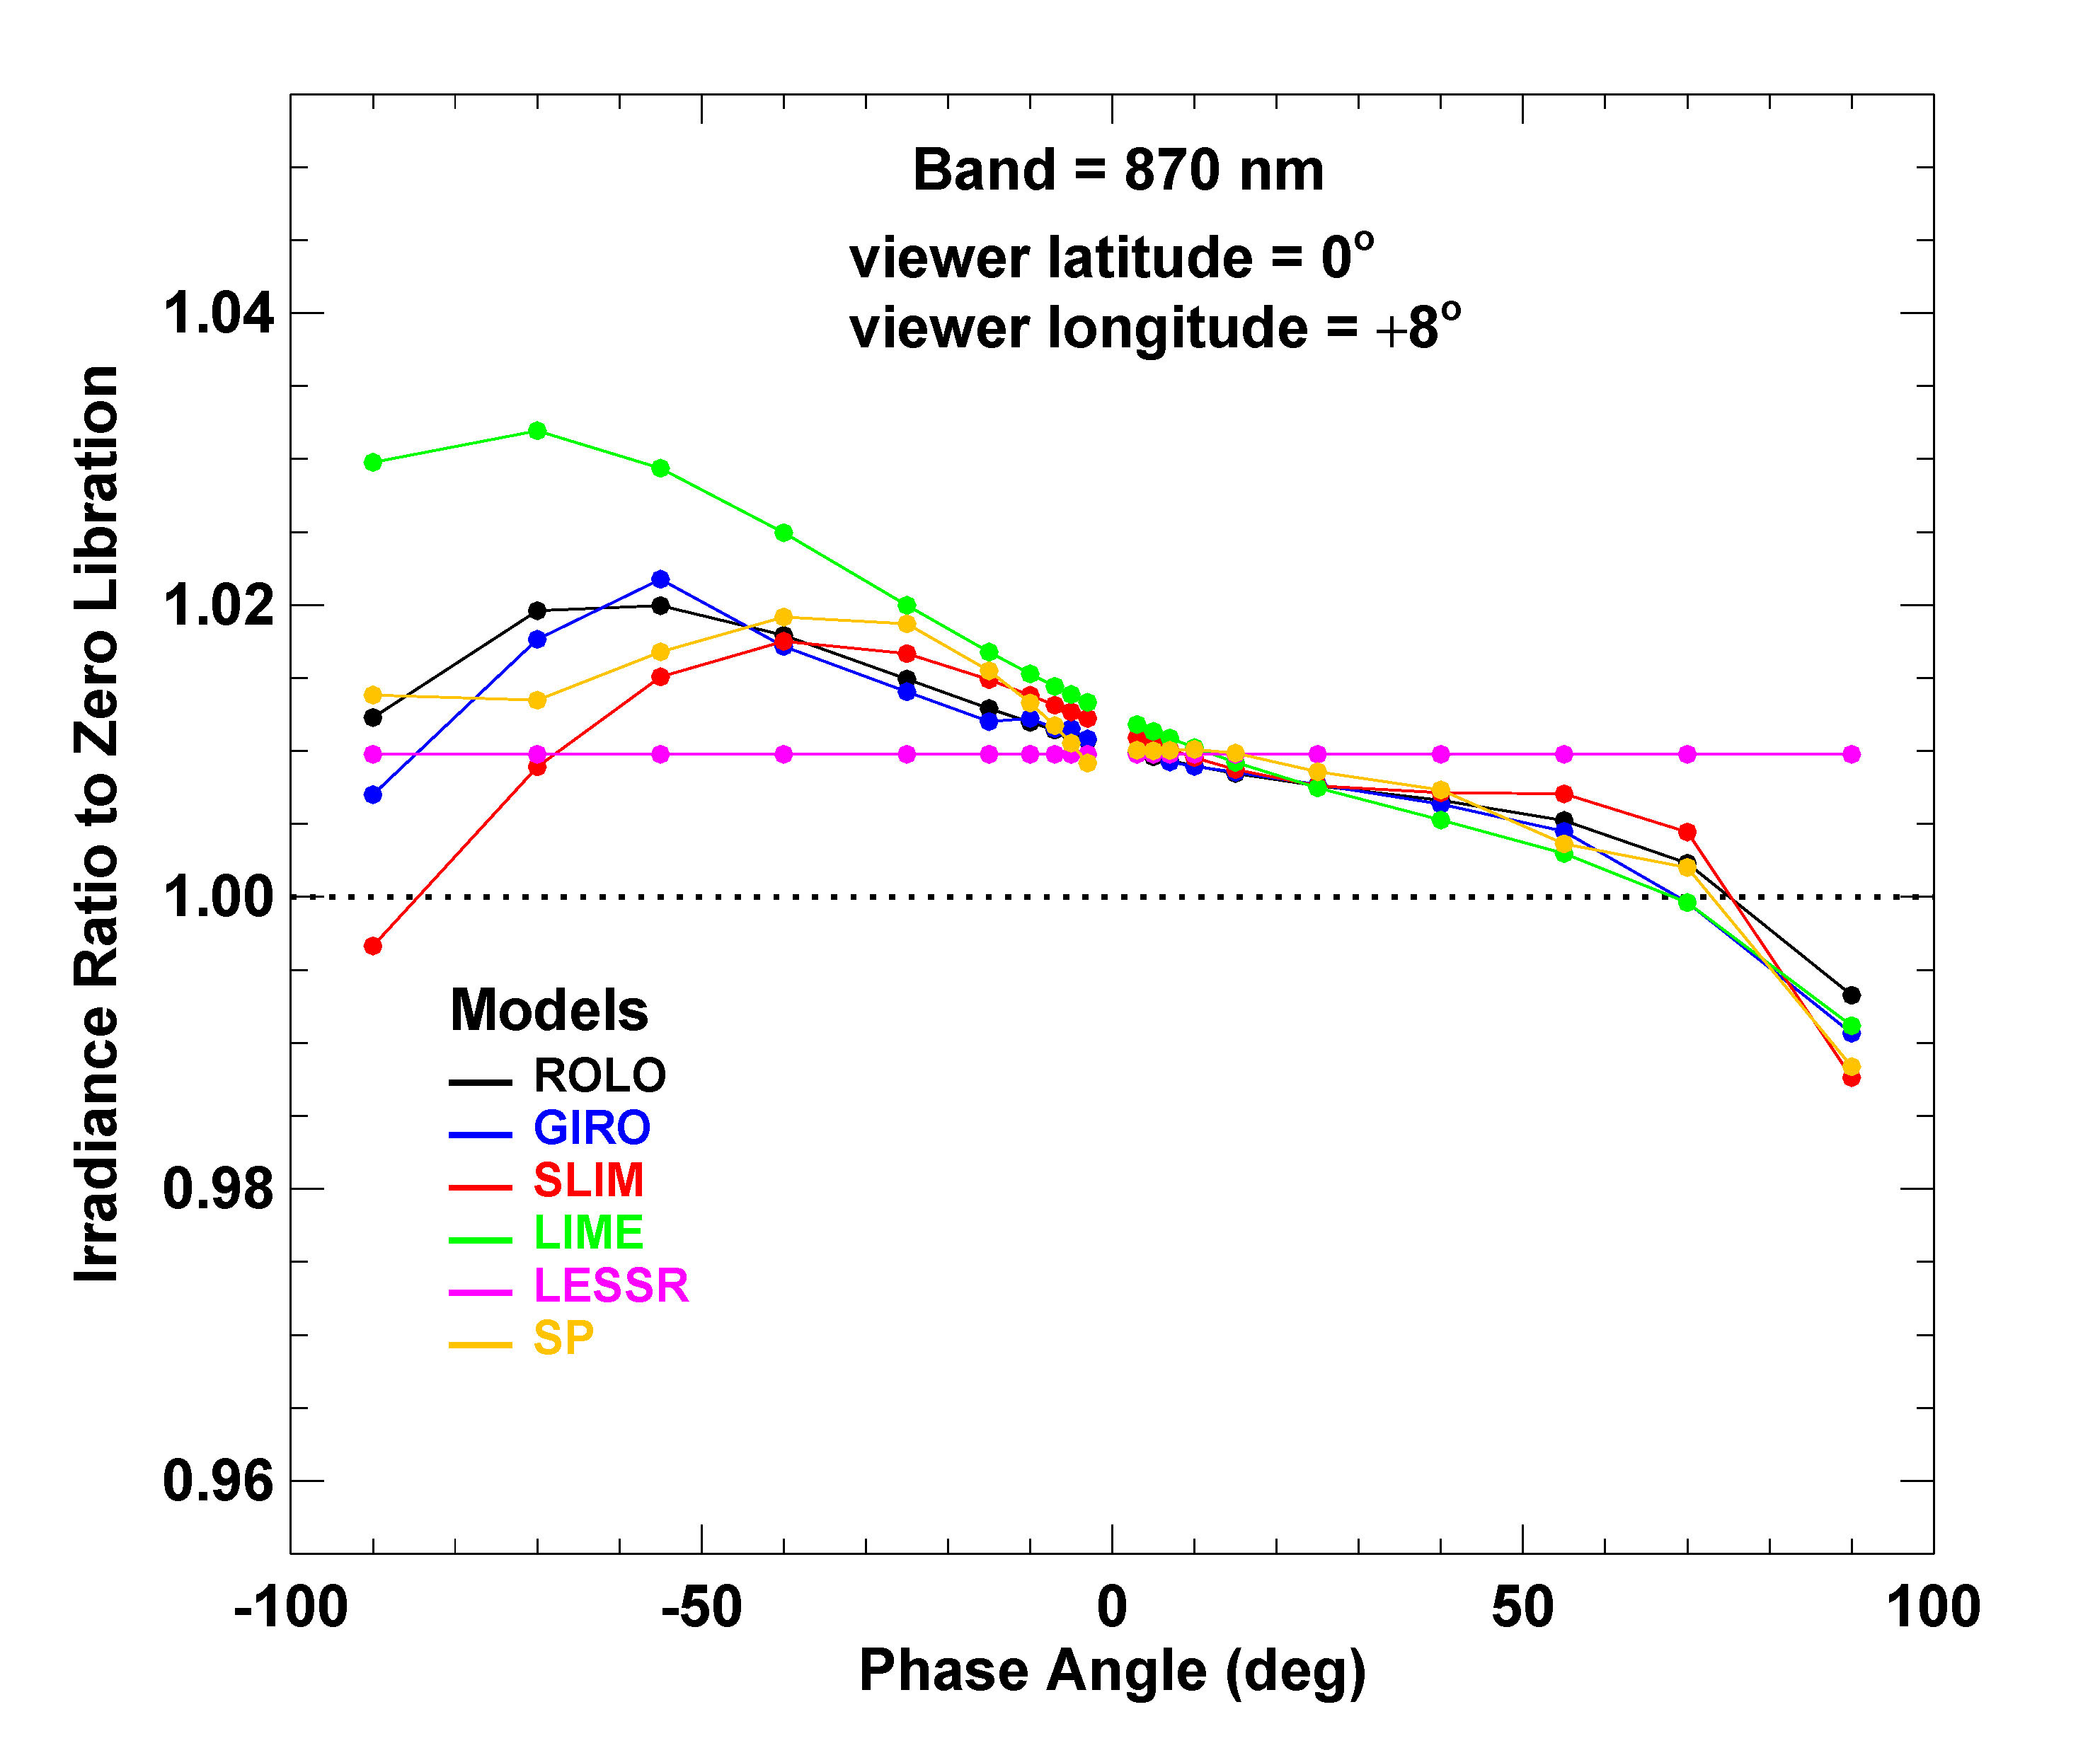
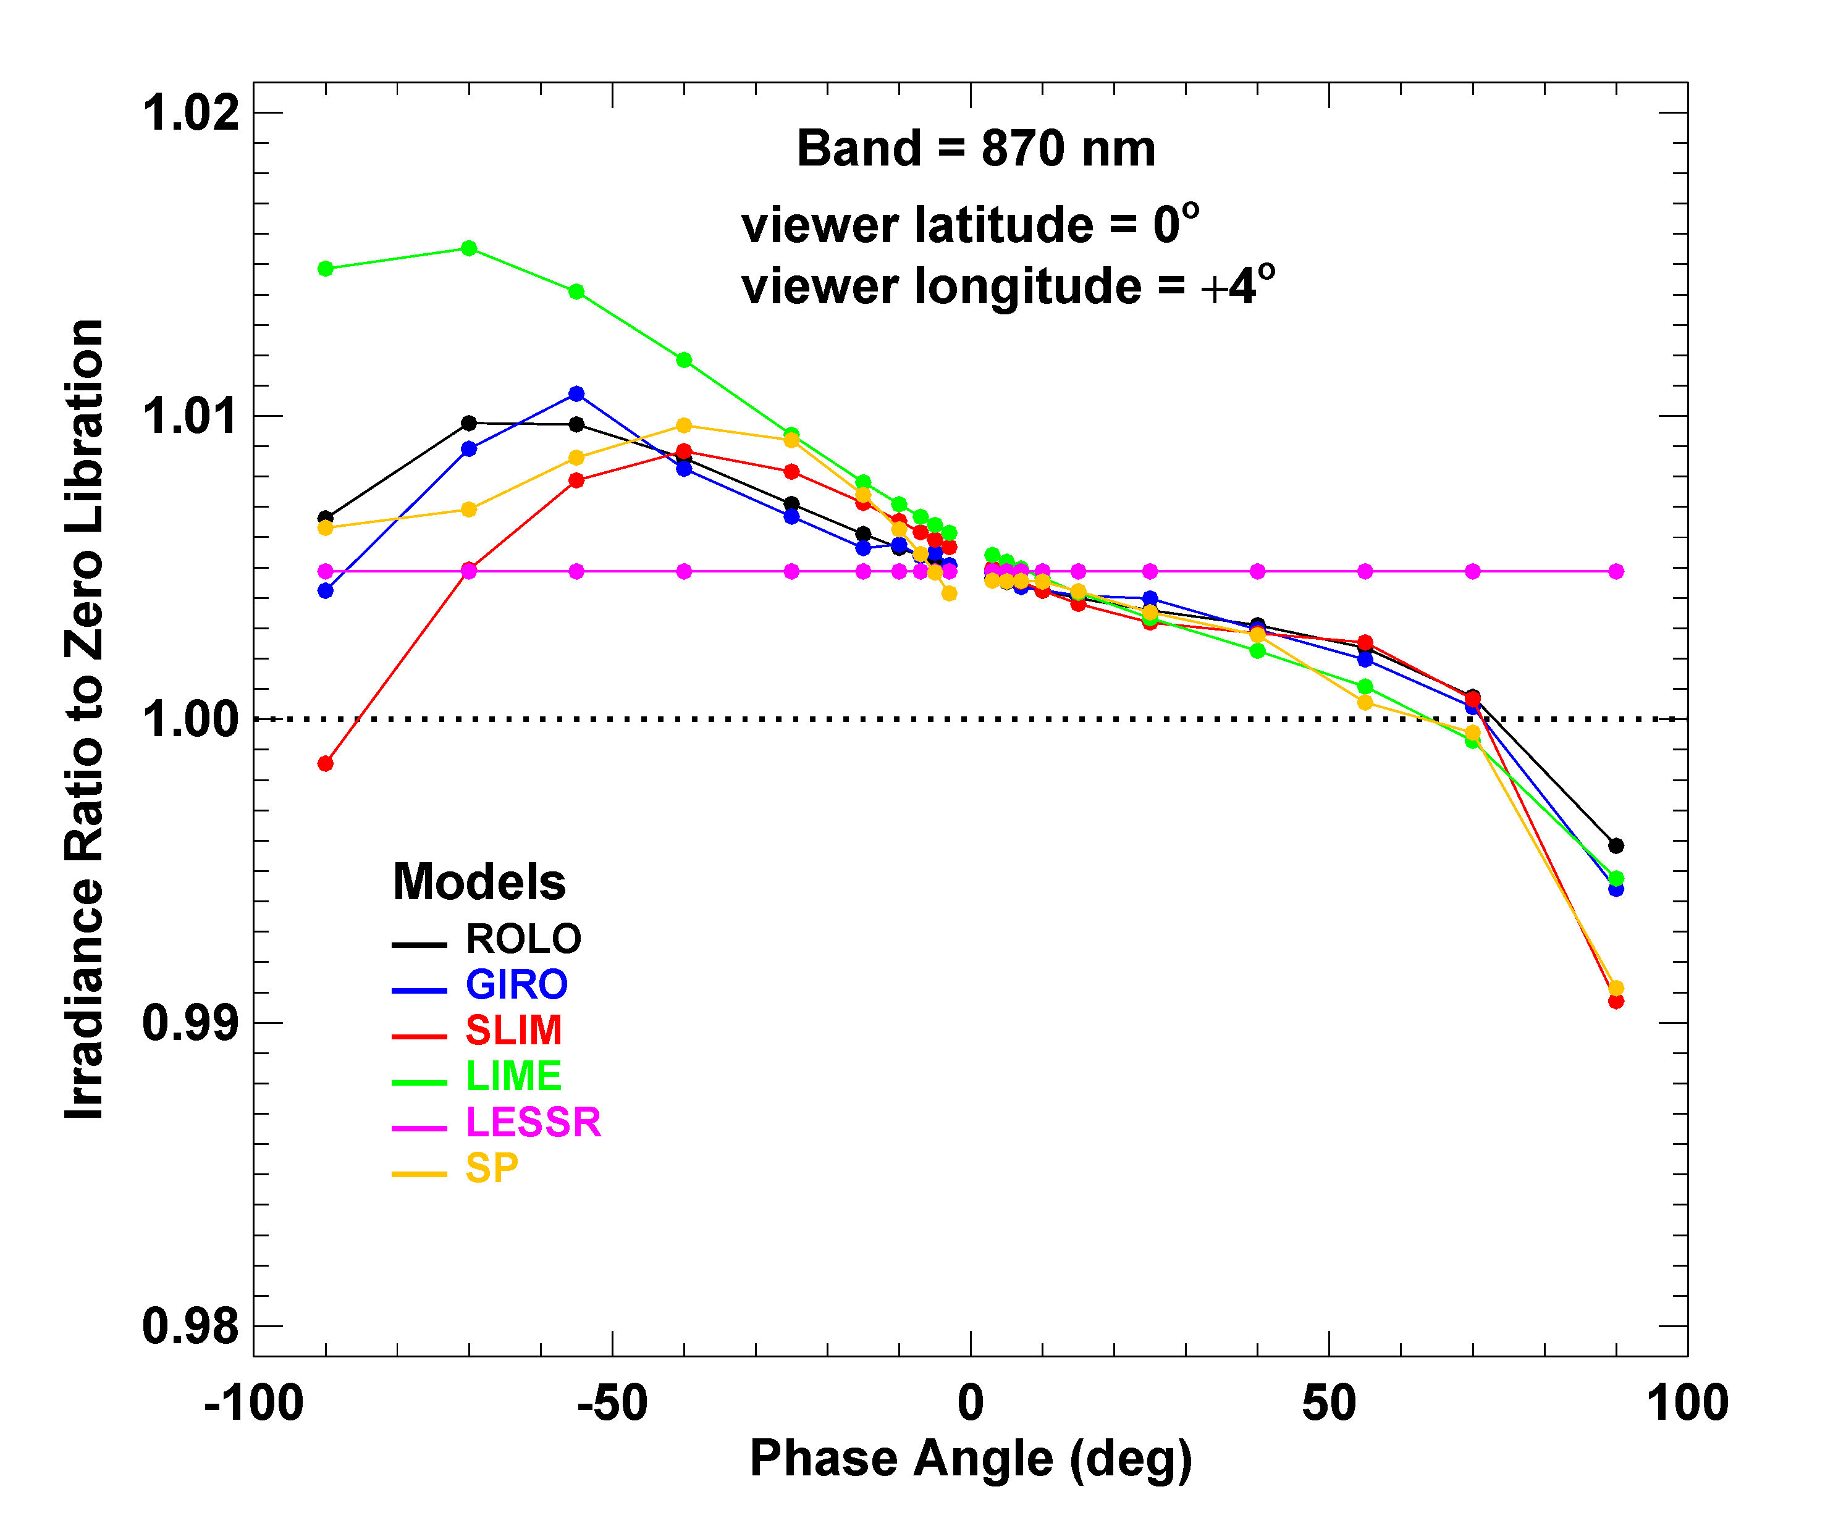

Slide 22
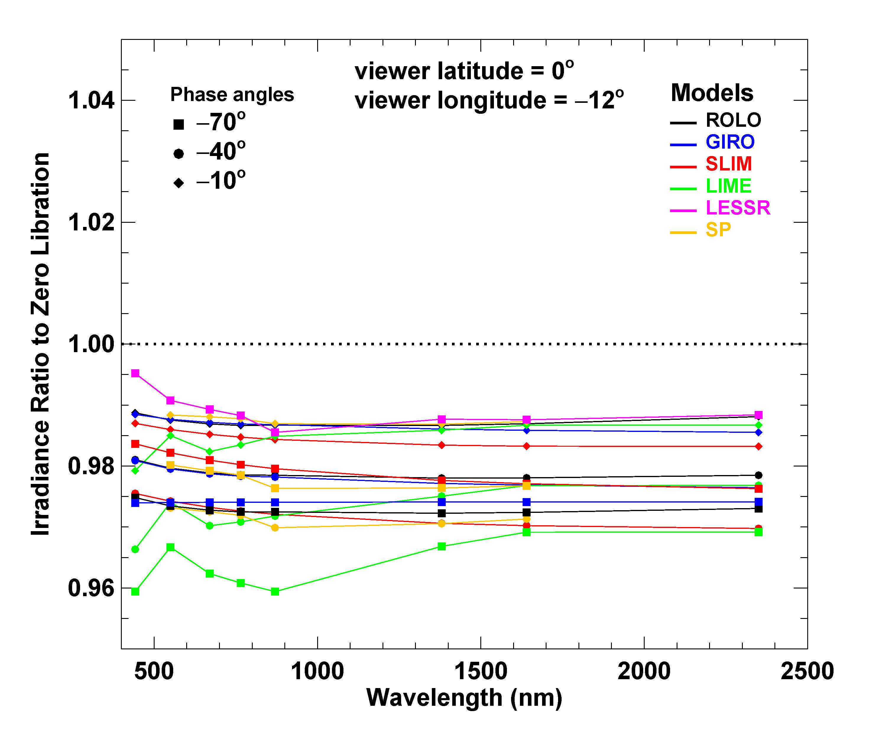
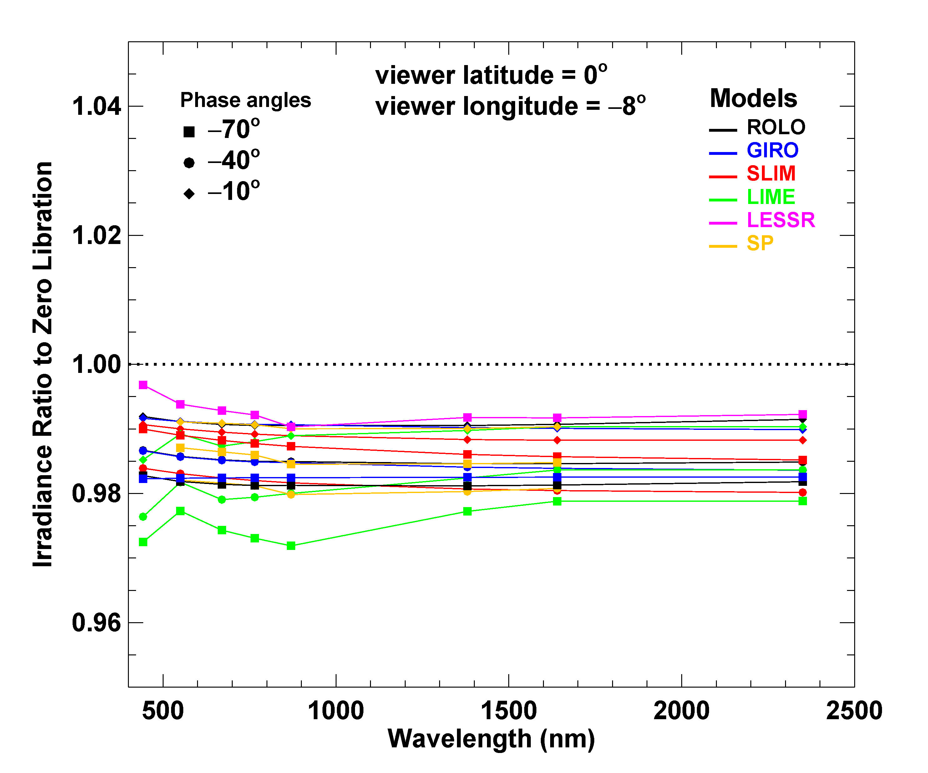
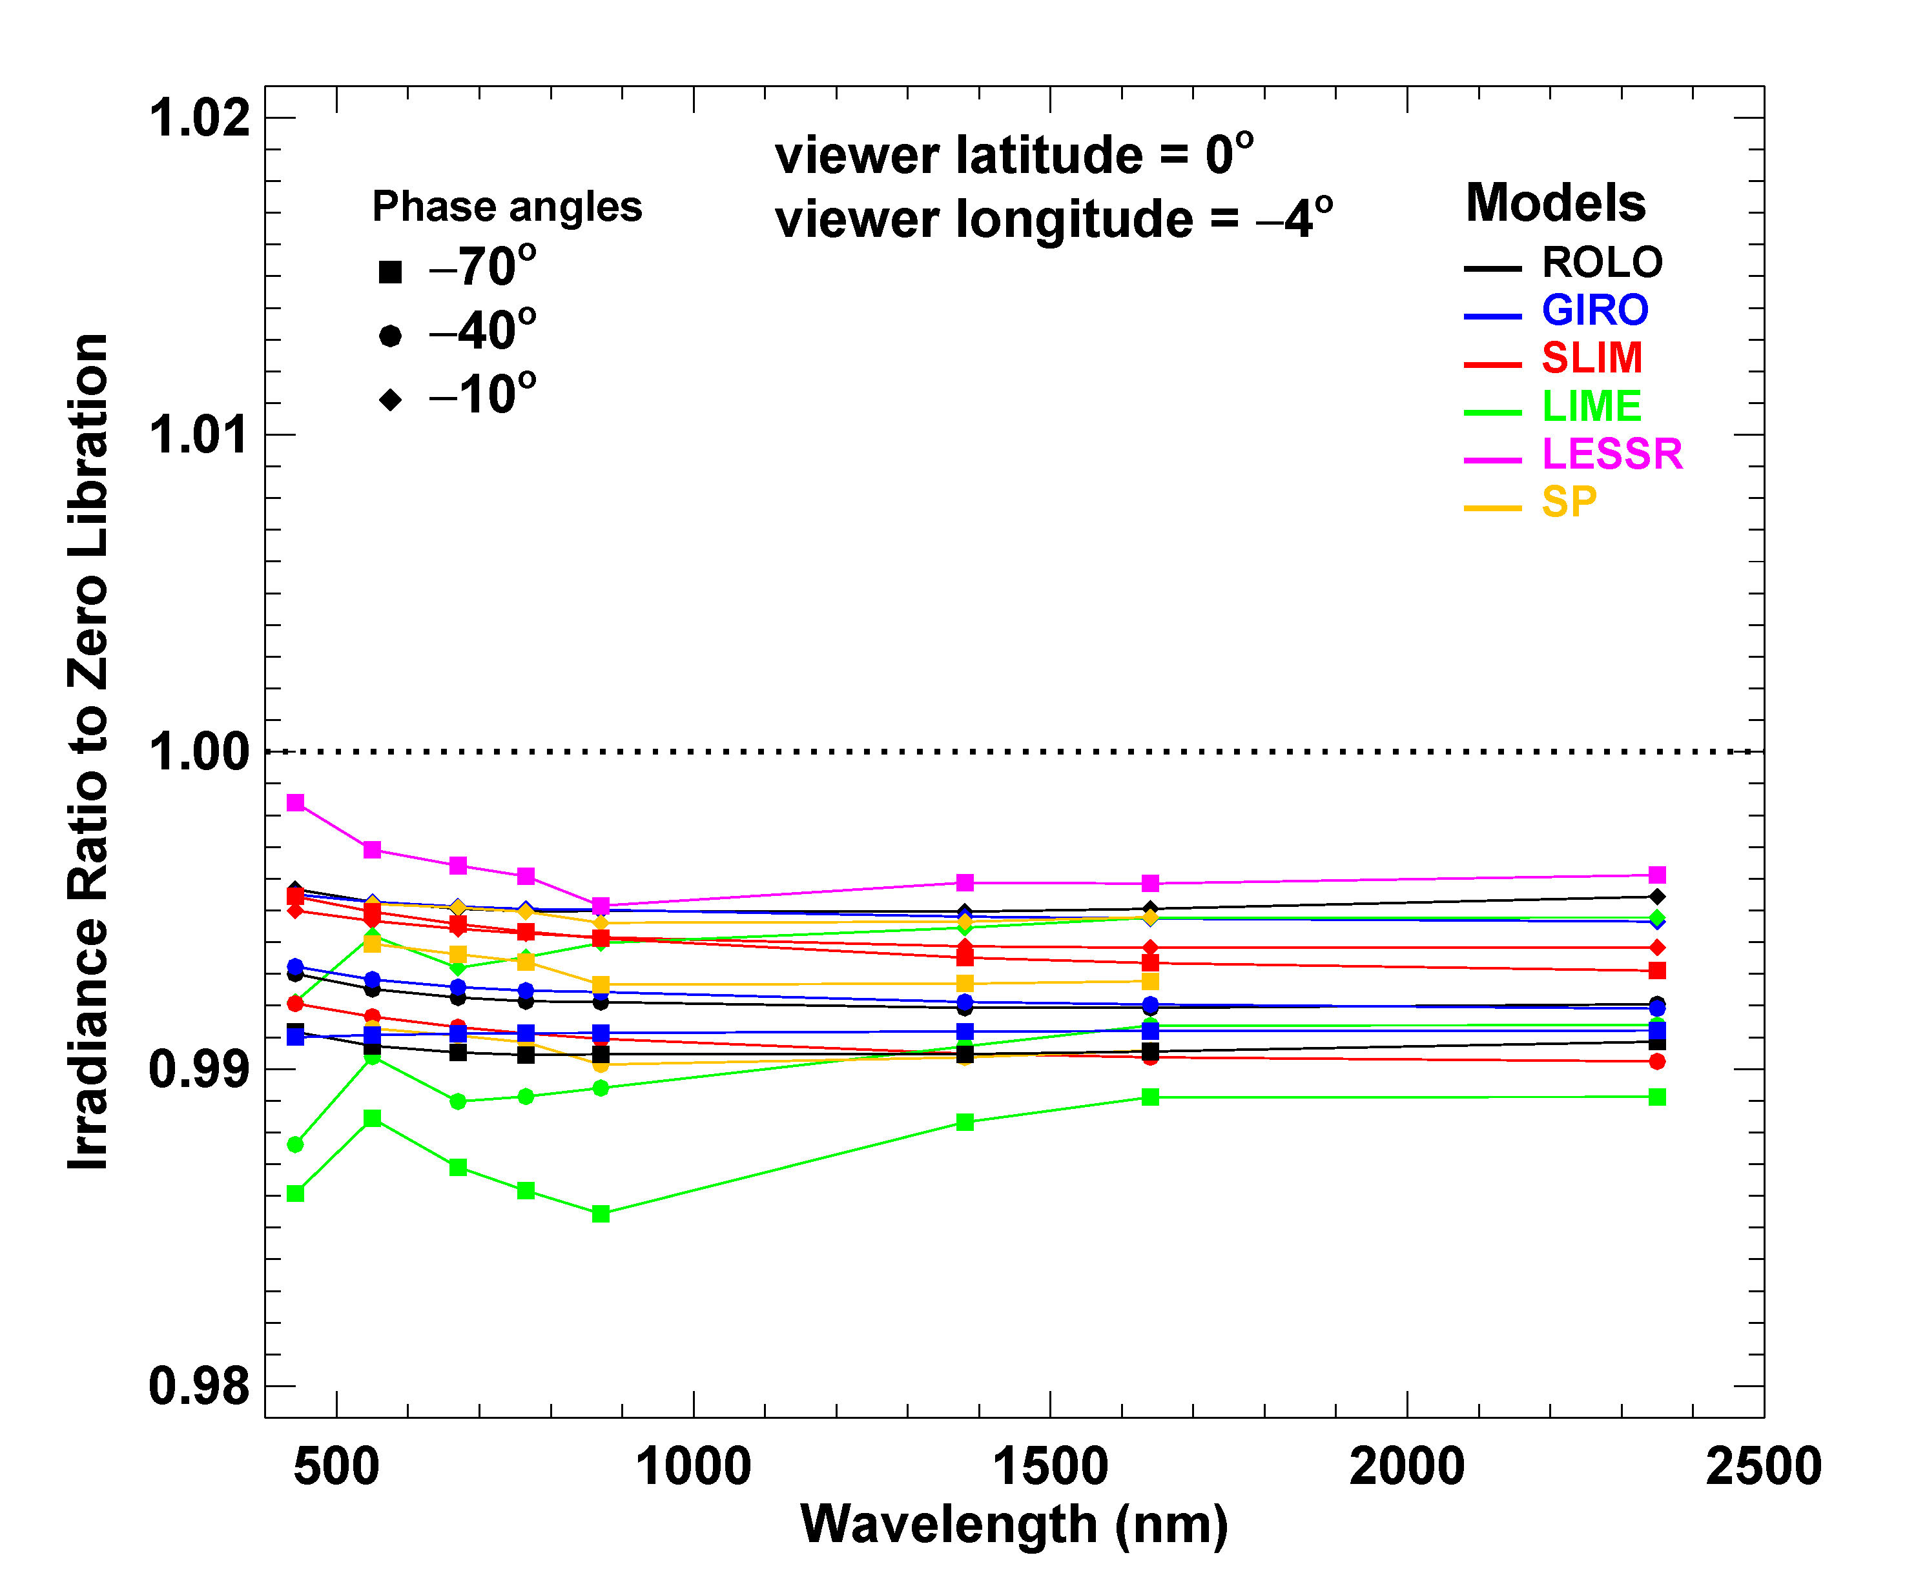
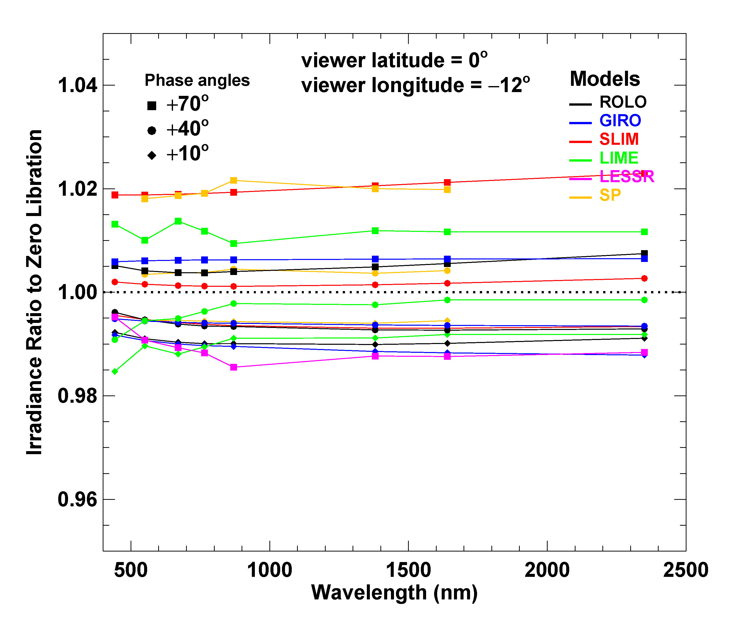
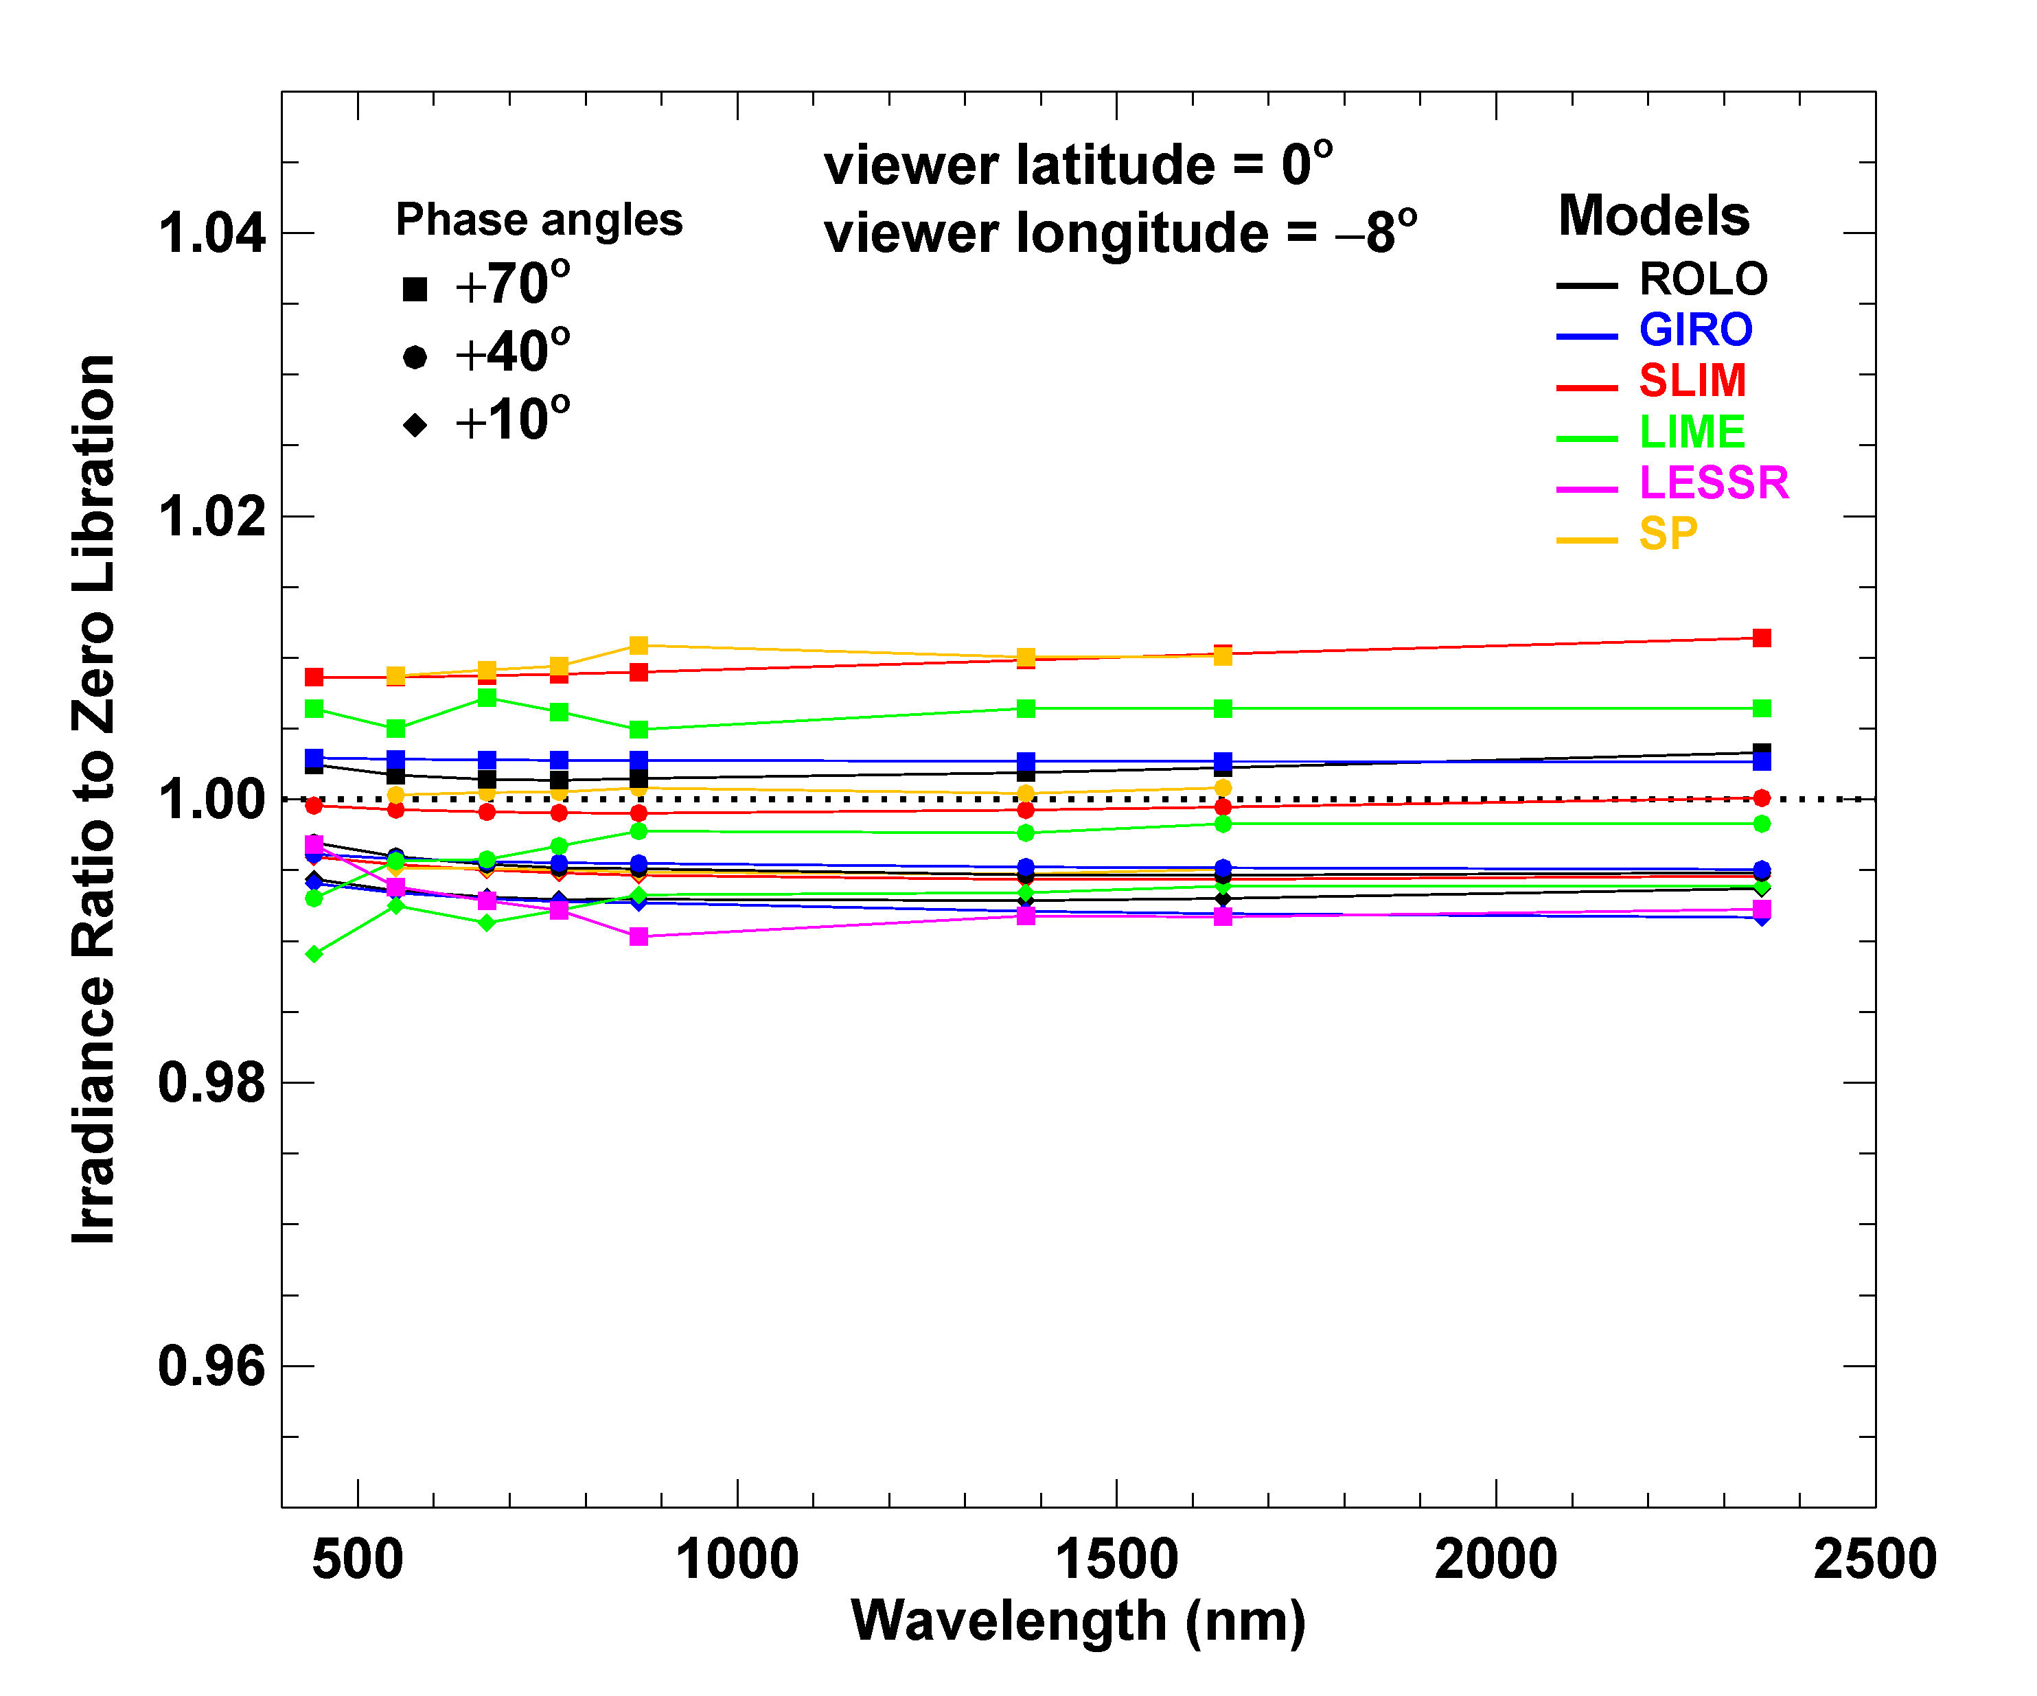
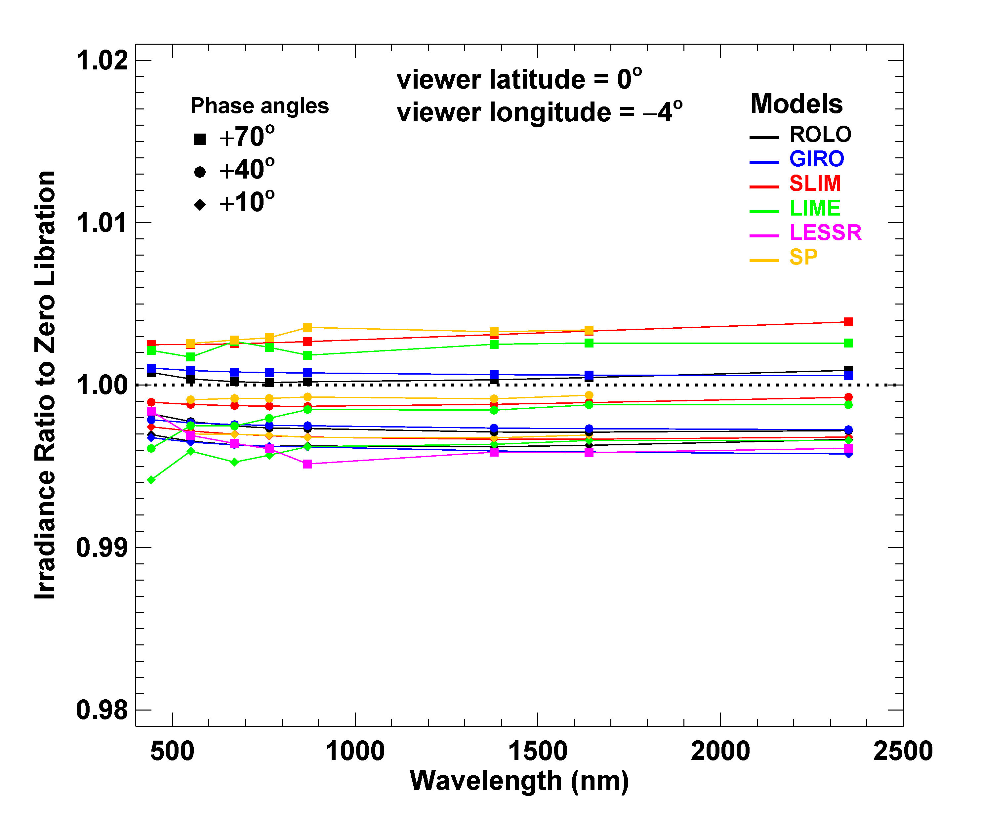

Slide 23
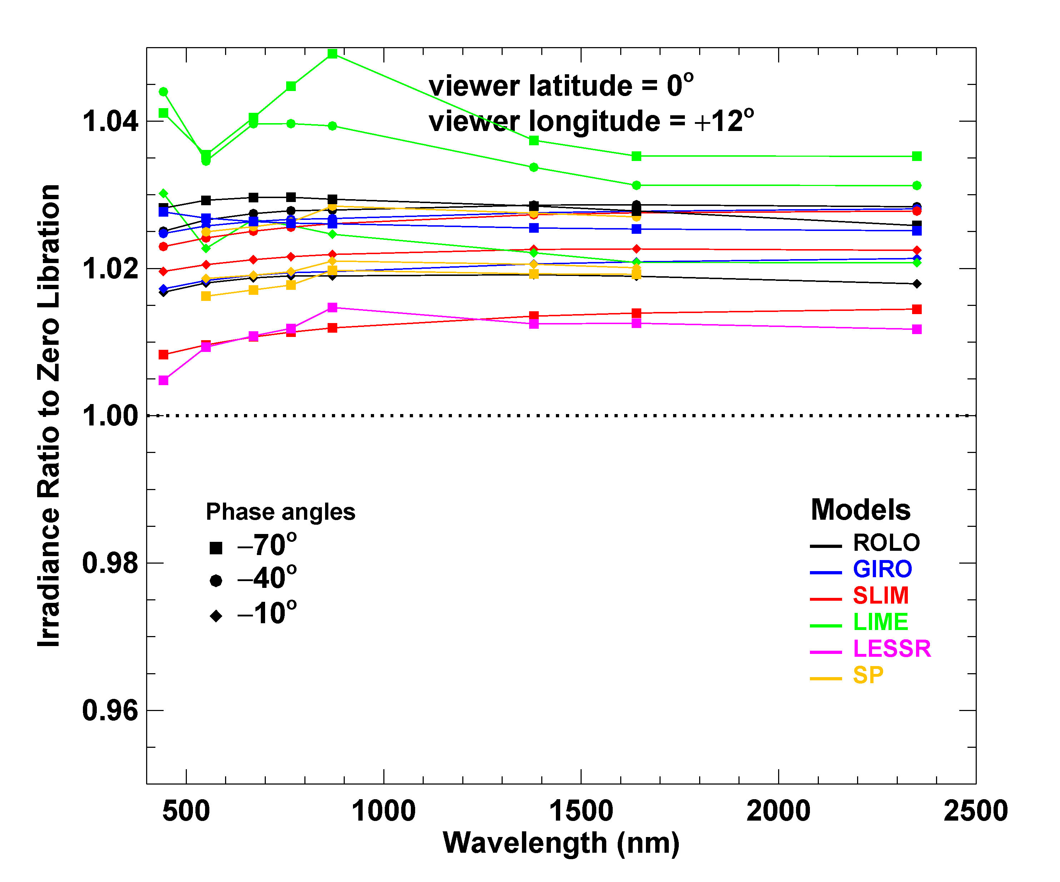
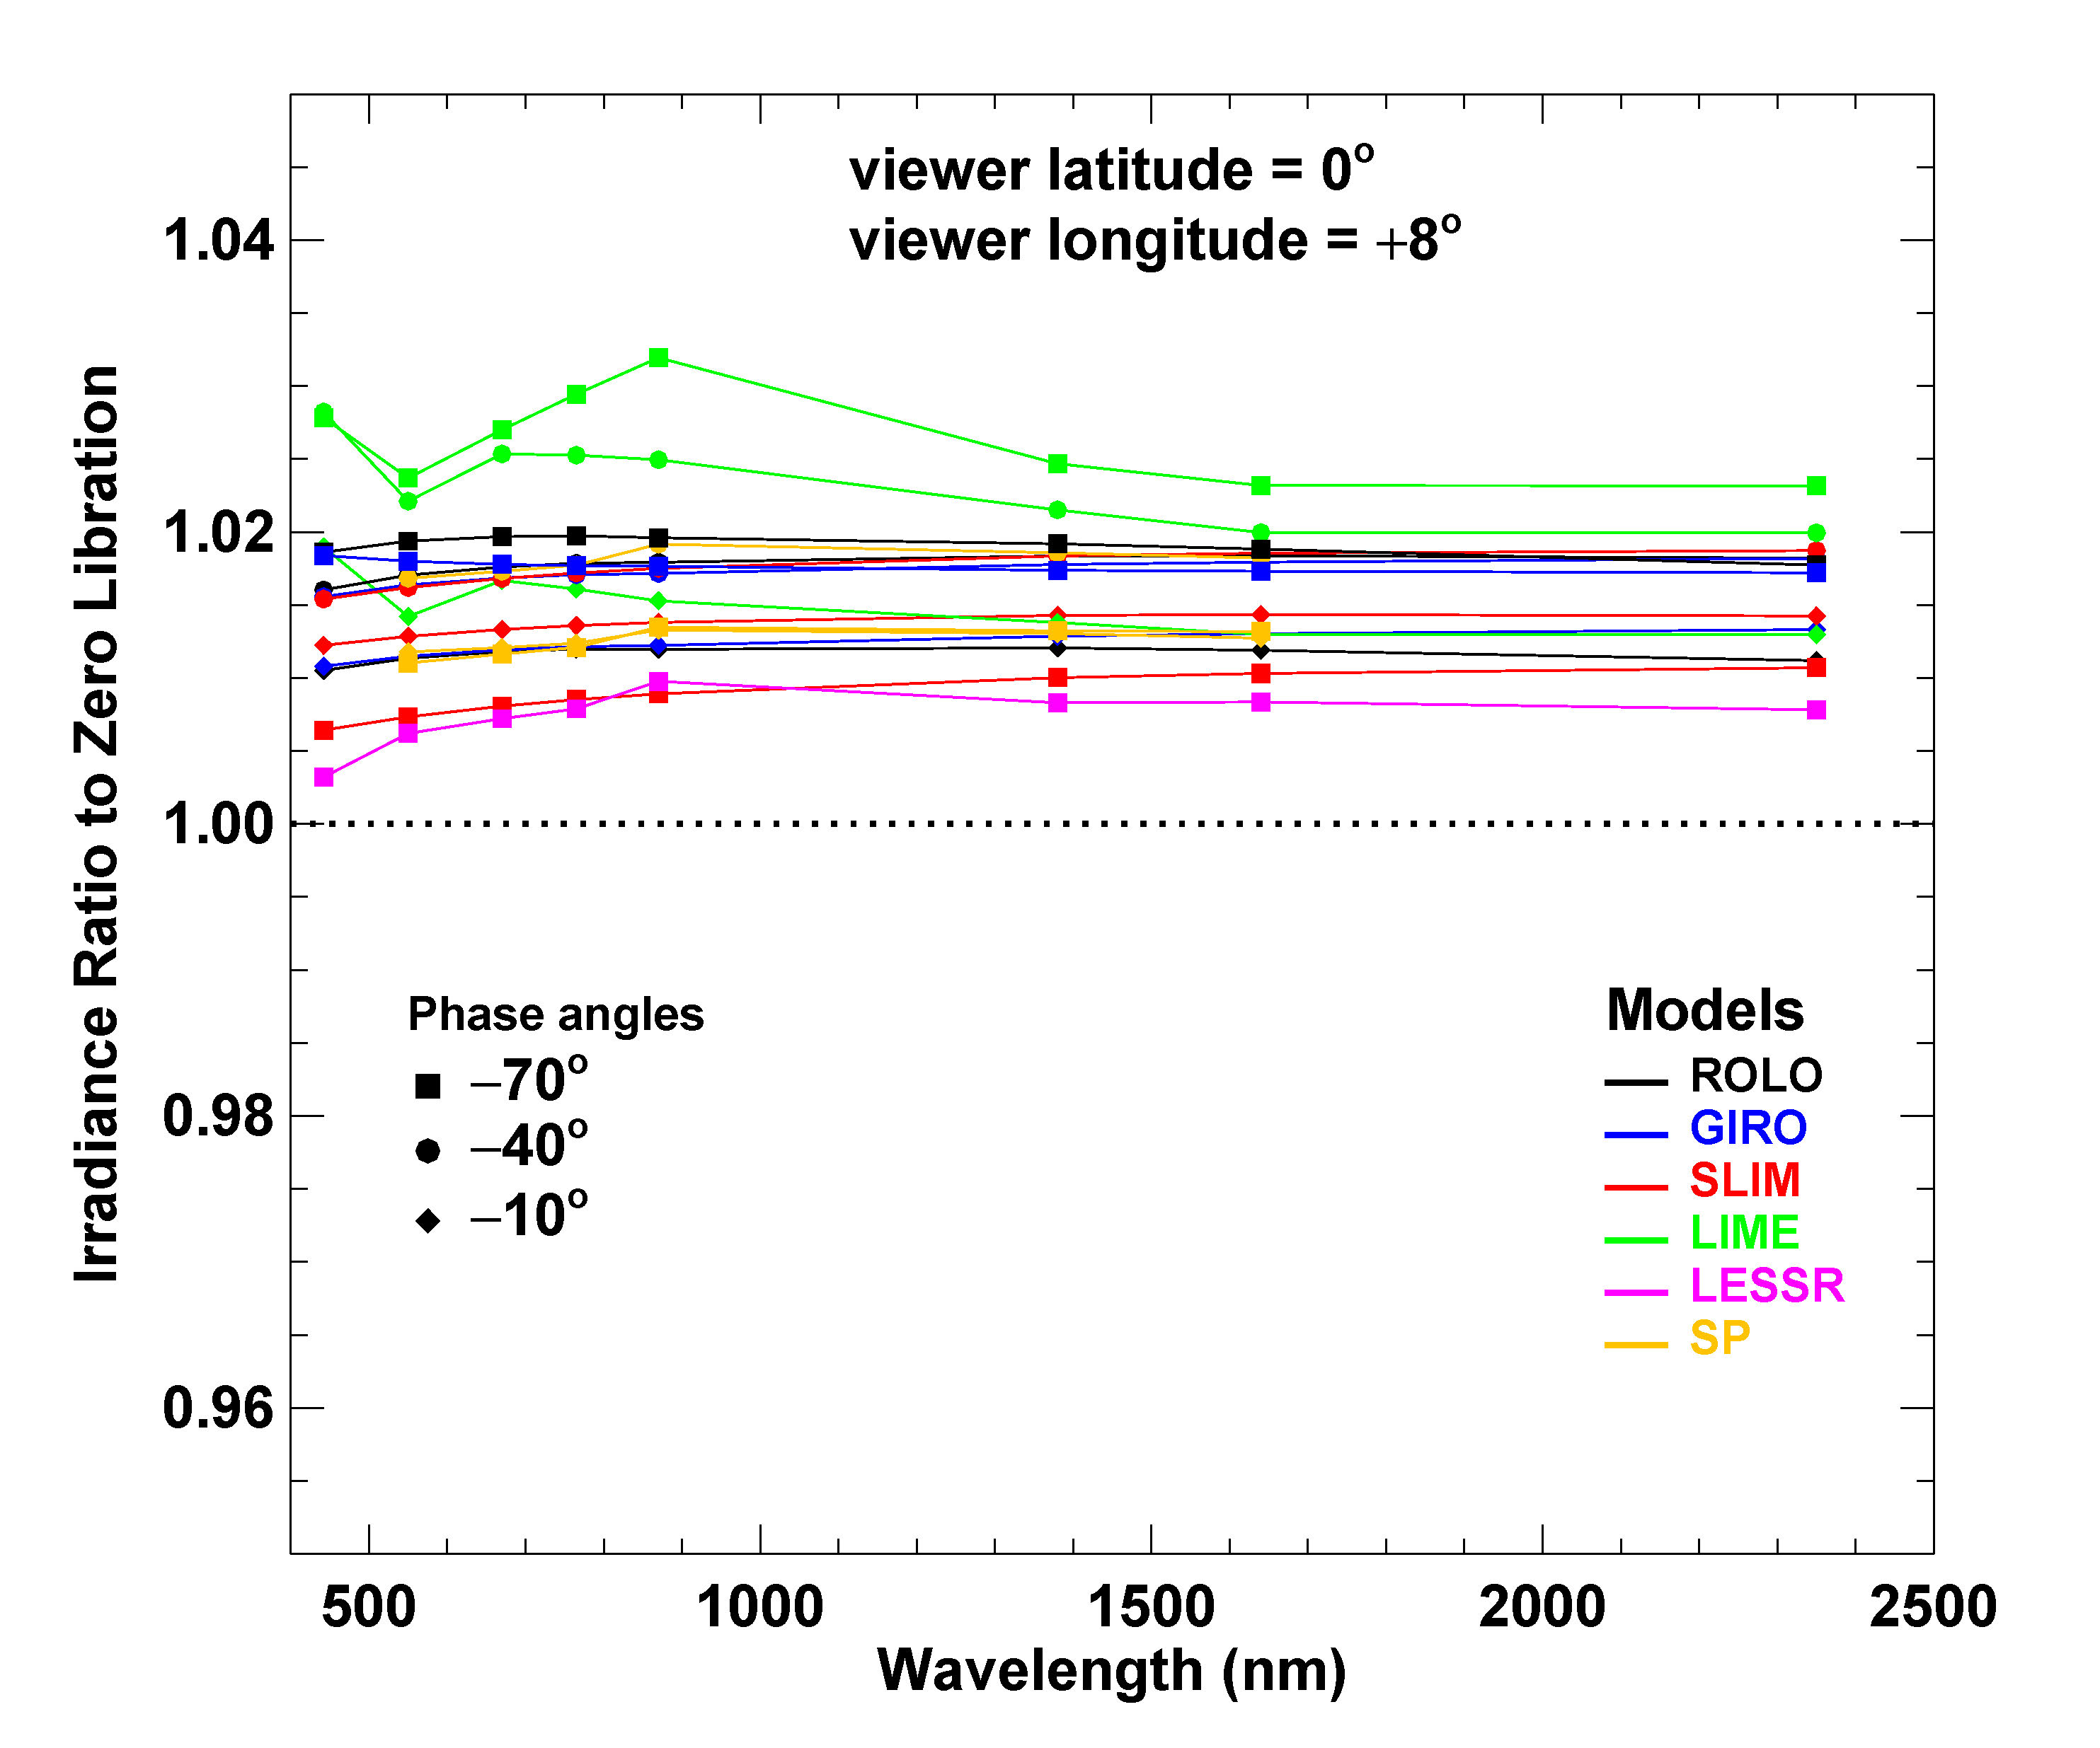

Slide 24
Thank you !
Comments? Questions?

