Slide 1
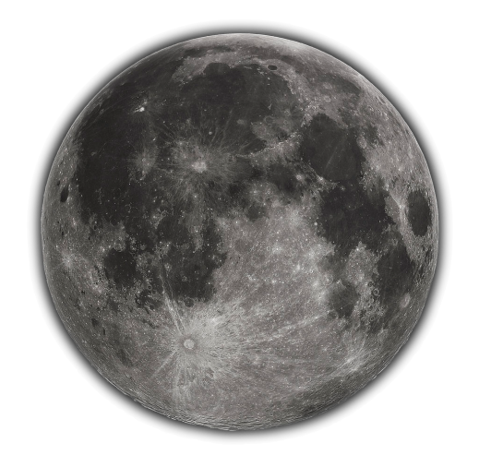
LESSR (v2)
Revisit to lunar model formulation
Thijs Krijger
Study funded by

Slide 2
EUMETSAT / ESA project
Generation Lunar datasets
GOME2
SCIAMACHY → Updated LESSR v1.1
Investigation model formulation (LESSRv2)
Multi-mission lunar model (LESSRv3?)
(see also presentation FDR4ATMOS)

Slide 3
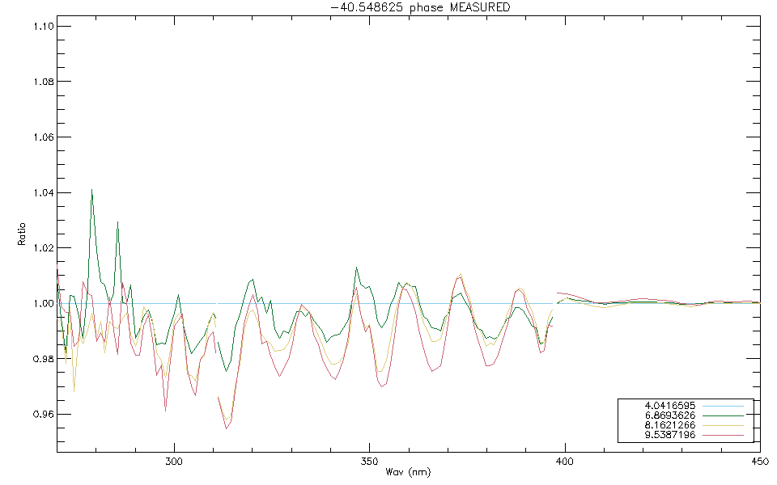
SCIAMACHY V10
New SCIAMACHY (v10) data available
Issue etalon <400nm
ESA investigation on-going before public release
Version v10x (ESS patch) available to EUMETSAT
Presented Lunar workshop (Dec 2023)

Slide 4
GOME2
3 Satellites
METOP-A (2007-2021)
METOP-B (2012- )
METOP-C (2018- )
~1300 independent measurements
Intercalibration
Work just started

Slide 5
LESSR v1.1
Lunar reflectance model
250nm – 2600nm with 5nm resolution
-80° to 20° phase validated
Relative Accuracy: <1.5% 500nm-2600nm (2% up to 300nm)
Complete without need of post-model spectral fits
Strongly reduced implementation error risk
Direct comparisons possible
Based upon
SCIAMACHY dedicated satellite measurements
RELAB on-ground lunar soil measurement
ROLO-inherited formulation
Presented Lunar workshop (Dec 2023)

Slide 6
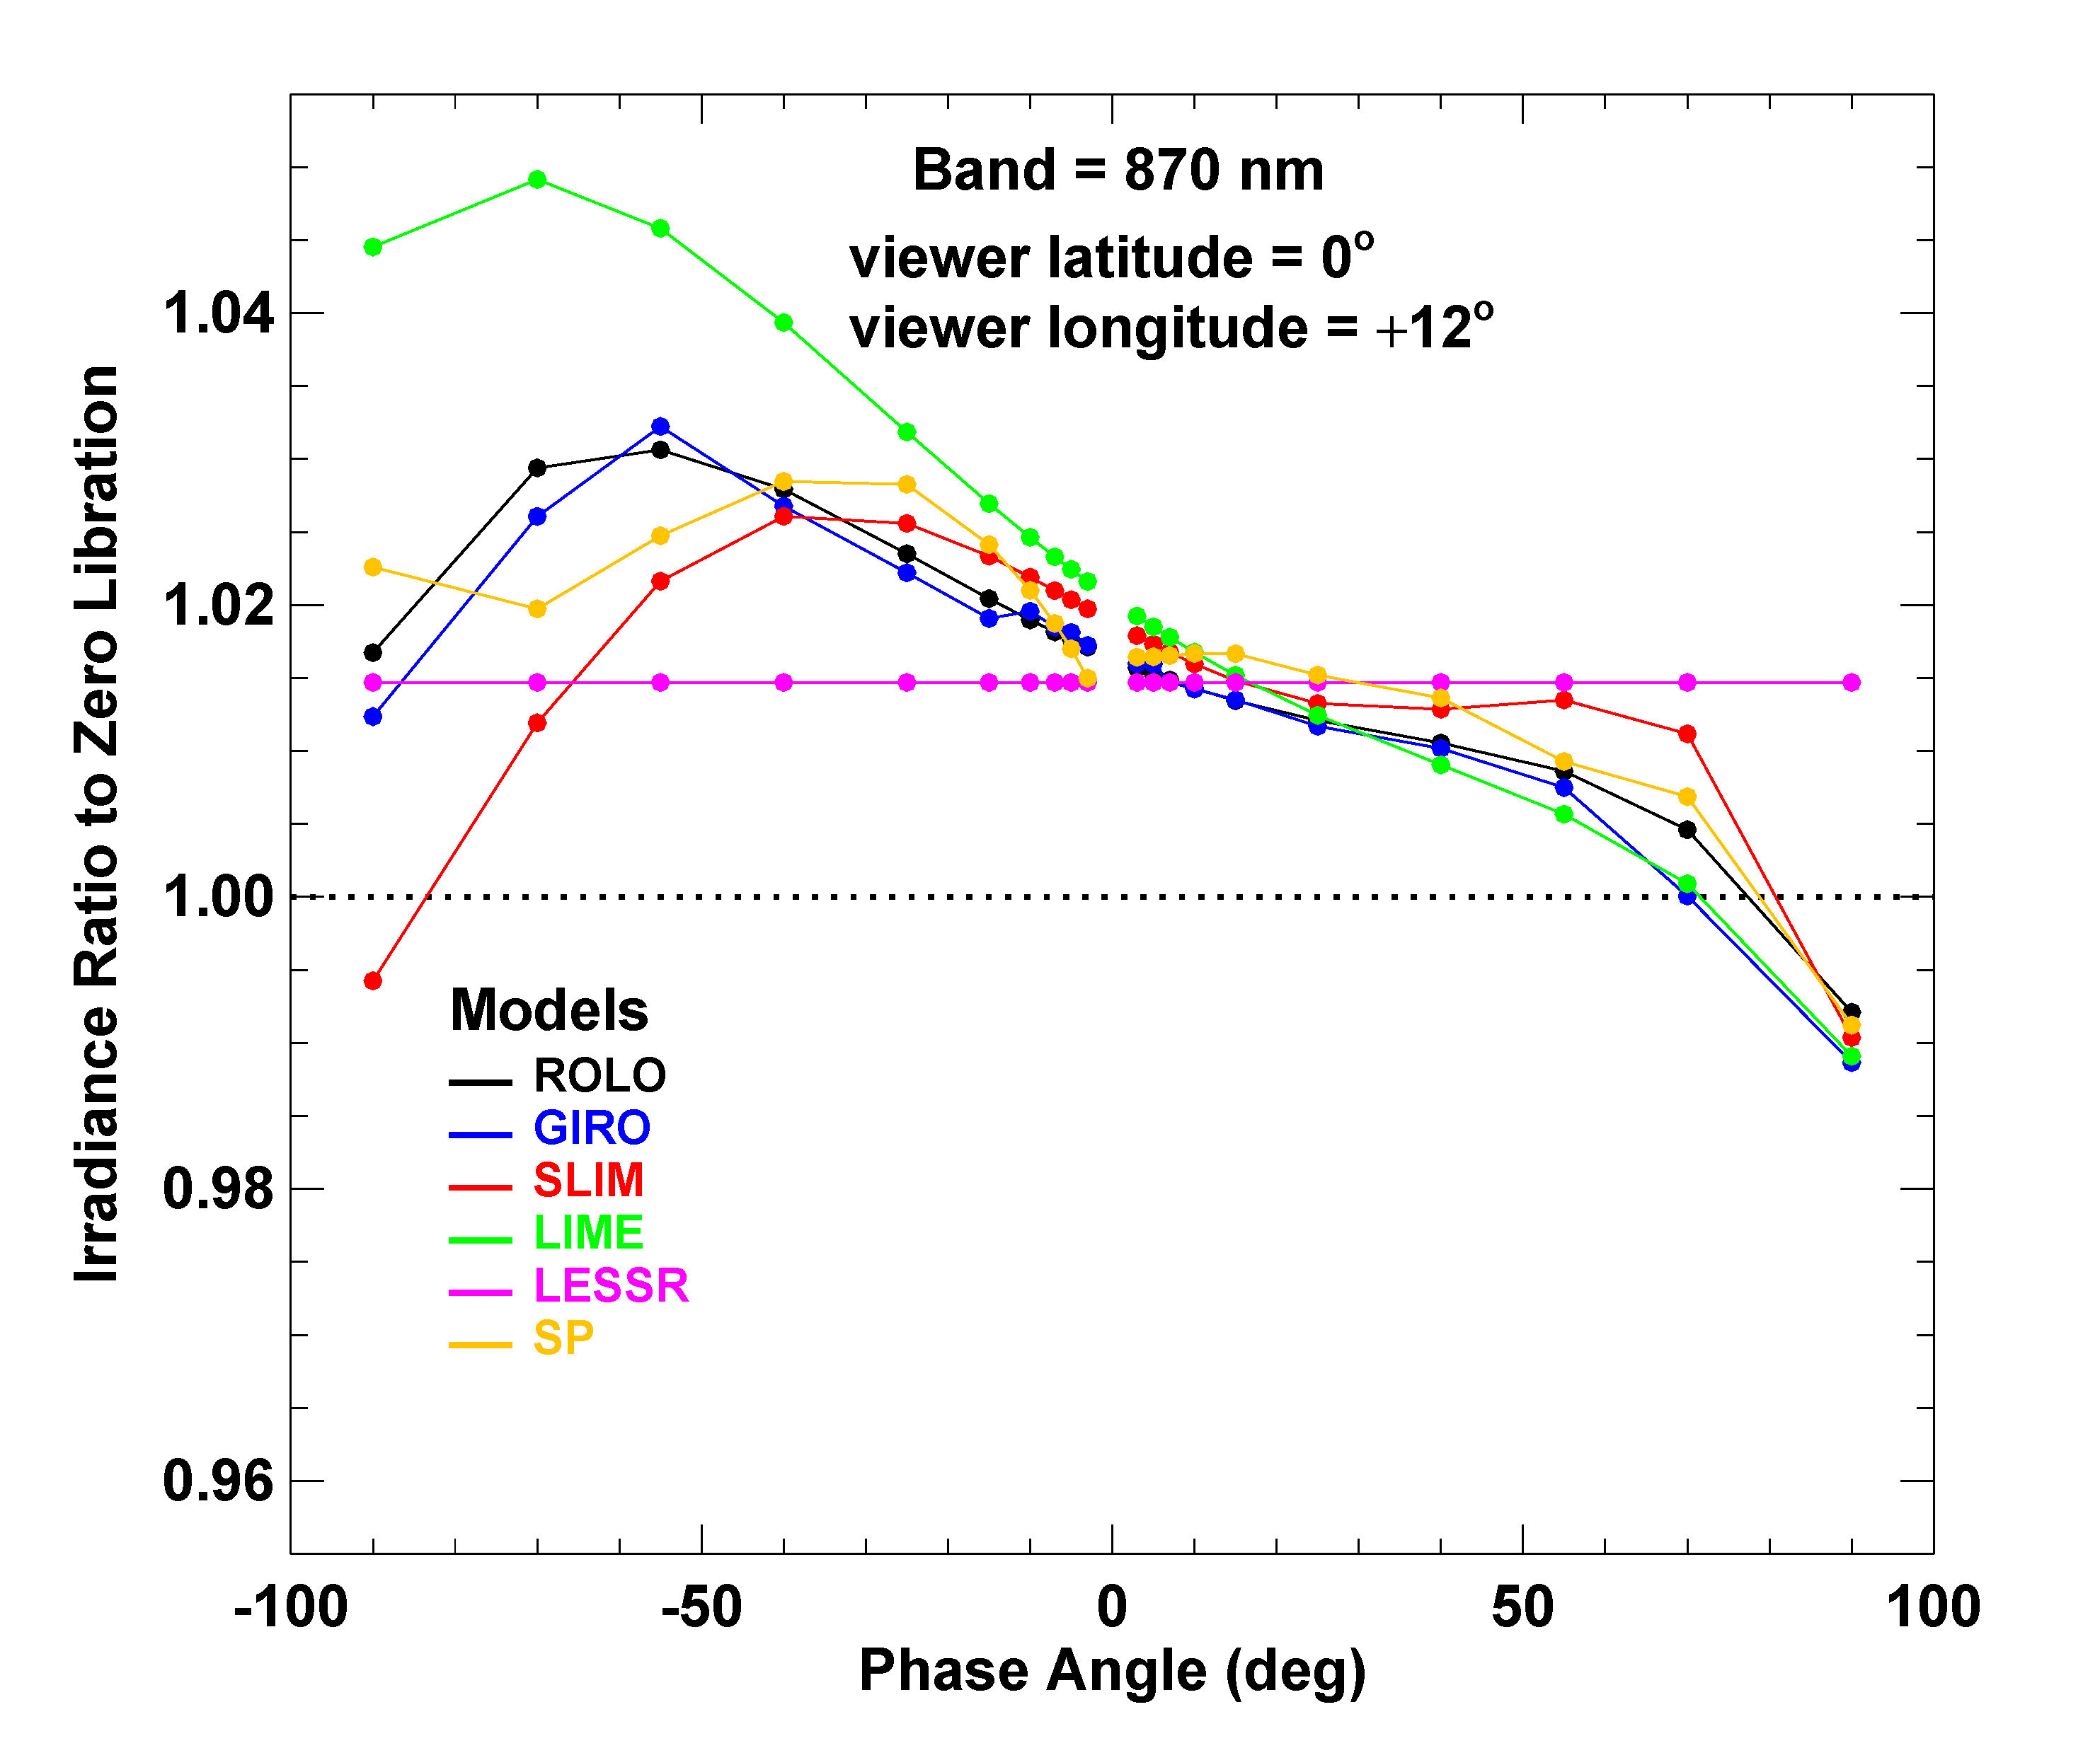
But…
Longitude Libration Dependence
Too low-order Libration dependence
@Stone

Slide 7
Formulation Investigations
Motivation
SLIM 54+ terms
ROLO/GIRO/LIME formulation limited
Relative uncertainties of 3000%
Goals to find formulation (parameter * Basefunctions)
Describe (log of) reflectance measurements (minimal fit residuals)
Valid measurement phase range (fit residuals distributed phase range)
Physical full phase range (force solution physical full phase range)
Avoid overfitting with minimal nmr of basefunctions (Base function Information Content)
Parameter Signal-to-noise > 1 (Parameter Value & Parameter Uncertainty)
Parameter*’BaseFunction expected values’ Minimal uncertainty variance contribution

Slide 8
Basefunction Information Content Iterative Model testing
Requires many models to be tested
Seed overfitted model (Basefunction set)
Remove highly correlated basefunction
Divide measurement (random) into training and validation
Fit model to training set
Determine residual validation measurements vs model
Determine basefunction Information Content via increase of residuals
Determine least significant basefunction of the set
Auto-generation new model with least-significant basefunction
Fit again
Determine least significant basefunction
Auto-generation new model
Etc (but when to stop?)

Slide 9
Parameter Uncertainty Monte Carlo Bootstrap
Take a (reduced) Basefunction Set
Take random sample measurements (same #)
Determine parameters by fitting model
Repeat 1000 times
Uncertainty determined by
Standard Deviation (per parameter)
Drop parameter/basefunction with high relative uncertainty (>>1)
Because zero-assumption
Drop parameter/basefunction with high variance contribution (parameter uncertainty * basefunction impact)^2
Because just adding noise
Repeat till only valid parameters/basefunctions left
Fit model full dataset

Slide 10
Seed Base Functions
Offset (constant)
Sqrt(abs(Phase))^N with N: -3 to 5
Phase^N with N: -3 to 5
For each of Vlat,Vlon,Hlat,Hlon*: X
X^N with N:1 to 2
All X cross-terms
~144 Base-functions
Hlon*=Hlon+Phase-Vlon

Slide 11
Reduction of # Base Functions
Seed Base functions
Information Content Iterative testing
Preselect base functions
Uncertainty Monte Carlo Bootstrapping
Eliminate high relative errors
Eliminate high variance contributions
Manual Iteration

Slide 12
Preliminary Results
Signal to Noise ratio

Slide 13
Relative Uncertainty | Parameter Value | Parameter Uncertainty | Basefunction Impact | Variance Contribution | Basefunction
4.71E-03 | -2.11E+00 | 9.95E-03 | 1.00E+00 | 9.91E-05 | offset
3.20E-02 | -4.82E-03 | 1.54E-04 | 2.01E+02 | 9.60E-04 | sqrt(abs(phase))^3
4.92E-02 | -7.43E-04 | 3.66E-05 | 3.13E+01 | 1.32E-06 | phase
5.80E-02 | 4.08E-04 | 2.36E-05 | 1.29E+03 | 9.32E-04 | abs(phase)^2
6.22E-02 | 3.03E+00 | 1.89E-01 | 3.58E-02 | 4.57E-05 | 1d/abs(phase)
6.64E-02 | -1.51E-06 | 1.00E-07 | 5.69E+04 | 3.26E-05 | abs(phase)^3
8.34E-02 | 1.41E-03 | 1.17E-04 | 3.88E+00 | 2.07E-07 | Vlon
1.01E-01 | -4.58E+00 | 4.61E-01 | 6.19E-03 | 8.16E-06 | 1d/sqrt(abs(phase))^3
1.48E-01 | 2.11E+00 | 3.12E-01 | 1.08E-03 | 1.14E-07 | 1d/abs(phase)^2
1.49E-01 | 8.56E-08 | 1.27E-08 | 5.69E+04 | 5.25E-07 | phase^3
1.53E-01 | -5.88E-07 | 8.97E-08 | 5.41E+03 | 2.35E-07 | phase^2*Vlon
1.66E-01 | -4.15E-05 | 6.88E-06 | 1.32E+02 | 8.23E-07 | phase*Vlon
1.74E-01 | -1.44E-03 | 2.51E-04 | 4.08E+00 | 1.04E-06 | Vlat
1.94E-01 | 1.77E-03 | 3.42E-04 | 1.57E-01 | 2.87E-09 | (Hlon+Phase-Vlon)
2.95E-01 | -2.04E-04 | 6.02E-05 | 5.46E+00 | 1.08E-07 | (Hlon+Phase-Vlon)*phase
3.09E-01 | -2.19E-05 | 6.79E-06 | 1.20E+02 | 6.66E-07 | phase*Vlat
3.57E-01 | 6.53E-05 | 2.33E-05 | 3.04E+01 | 5.02E-07 | Hlat*phase
4.63E-01 | -1.64E-07 | 7.62E-08 | 4.32E+03 | 1.08E-07 | phase^2*Vlat
7.82E-01 | 1.54E-05 | 1.20E-05 | 1.61E+01 | 3.74E-08 | (Vlon*Vlat)
7.97E-01 | 1.32E-03 | 1.05E-03 | 9.89E-01 | 1.08E-06 | Hlat

Slide 14
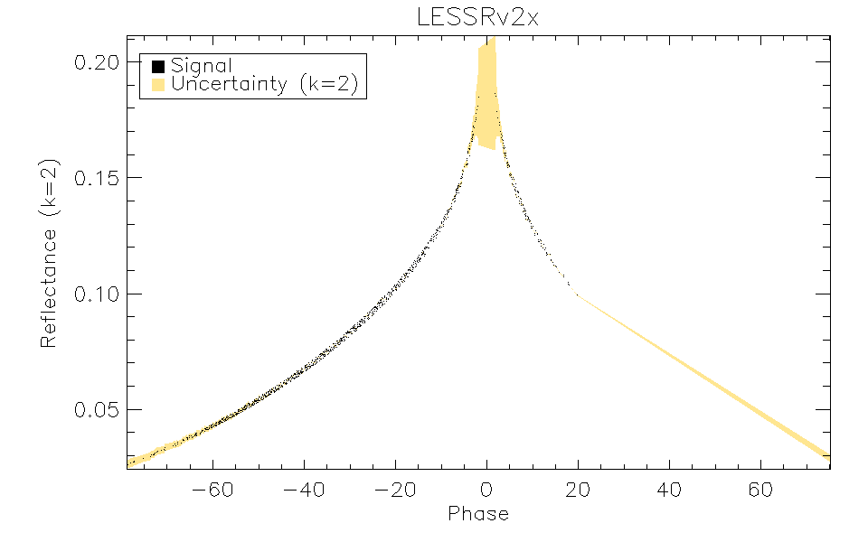
Model uncertainty
σ_{SCIA}

Slide 15
Validation
Local Libration
ROLO

Slide 16
Local Libration
Local Libration removes dependence phase
Select all measurements with 4°phase range
Fit phase polynomial + linear libration
Vlon, Vlat, Hlat, Hlon* (Hlon+Phase-Vlon)
Vlon*Vlat

Slide 17
Small Phase range (local) Libration
Reflectance SCIAV10 (870nm)

Slide 20
Local Libration Dependence

Slide 21
Libration LESSRv2x

Slide 22
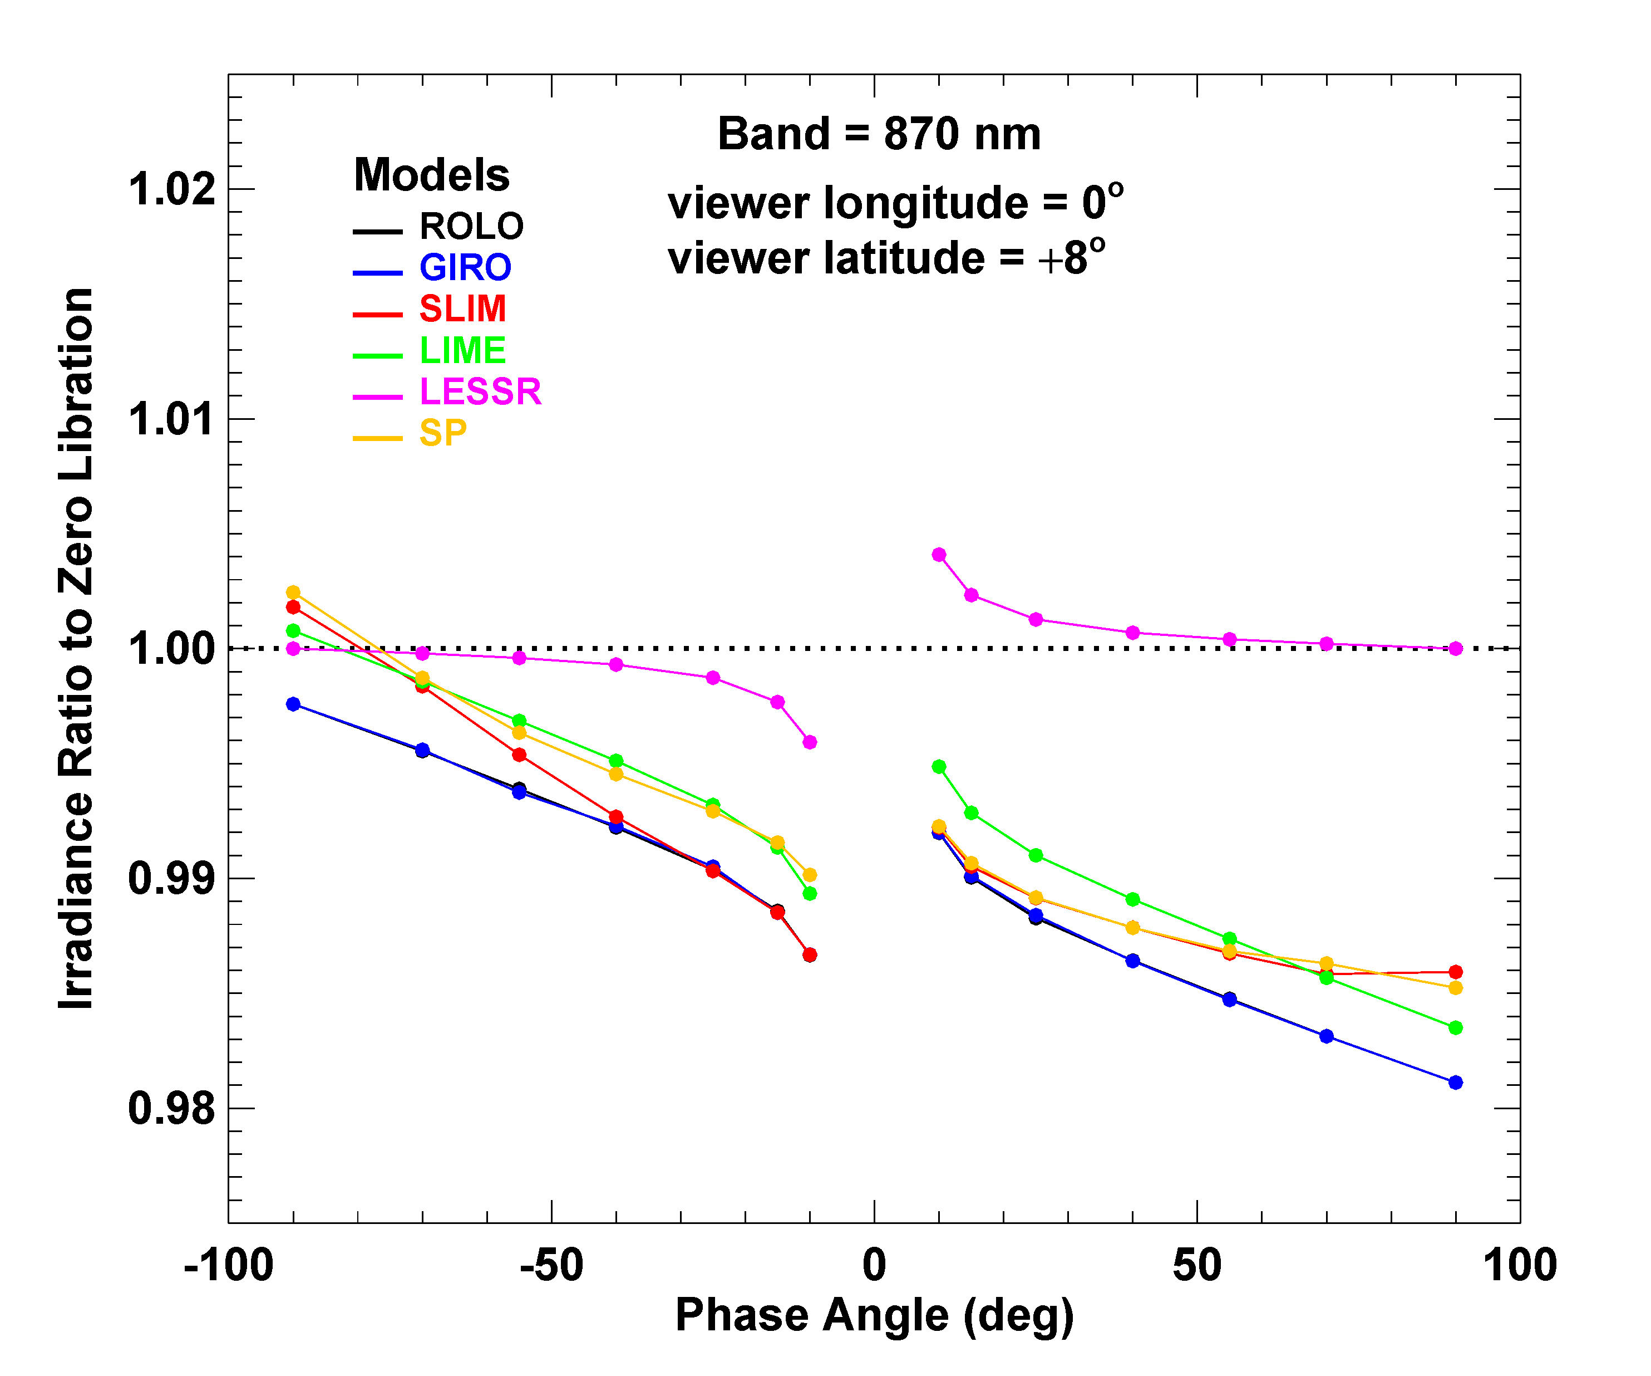
Libration Comparison
No Hlat
@Stone

Slide 23
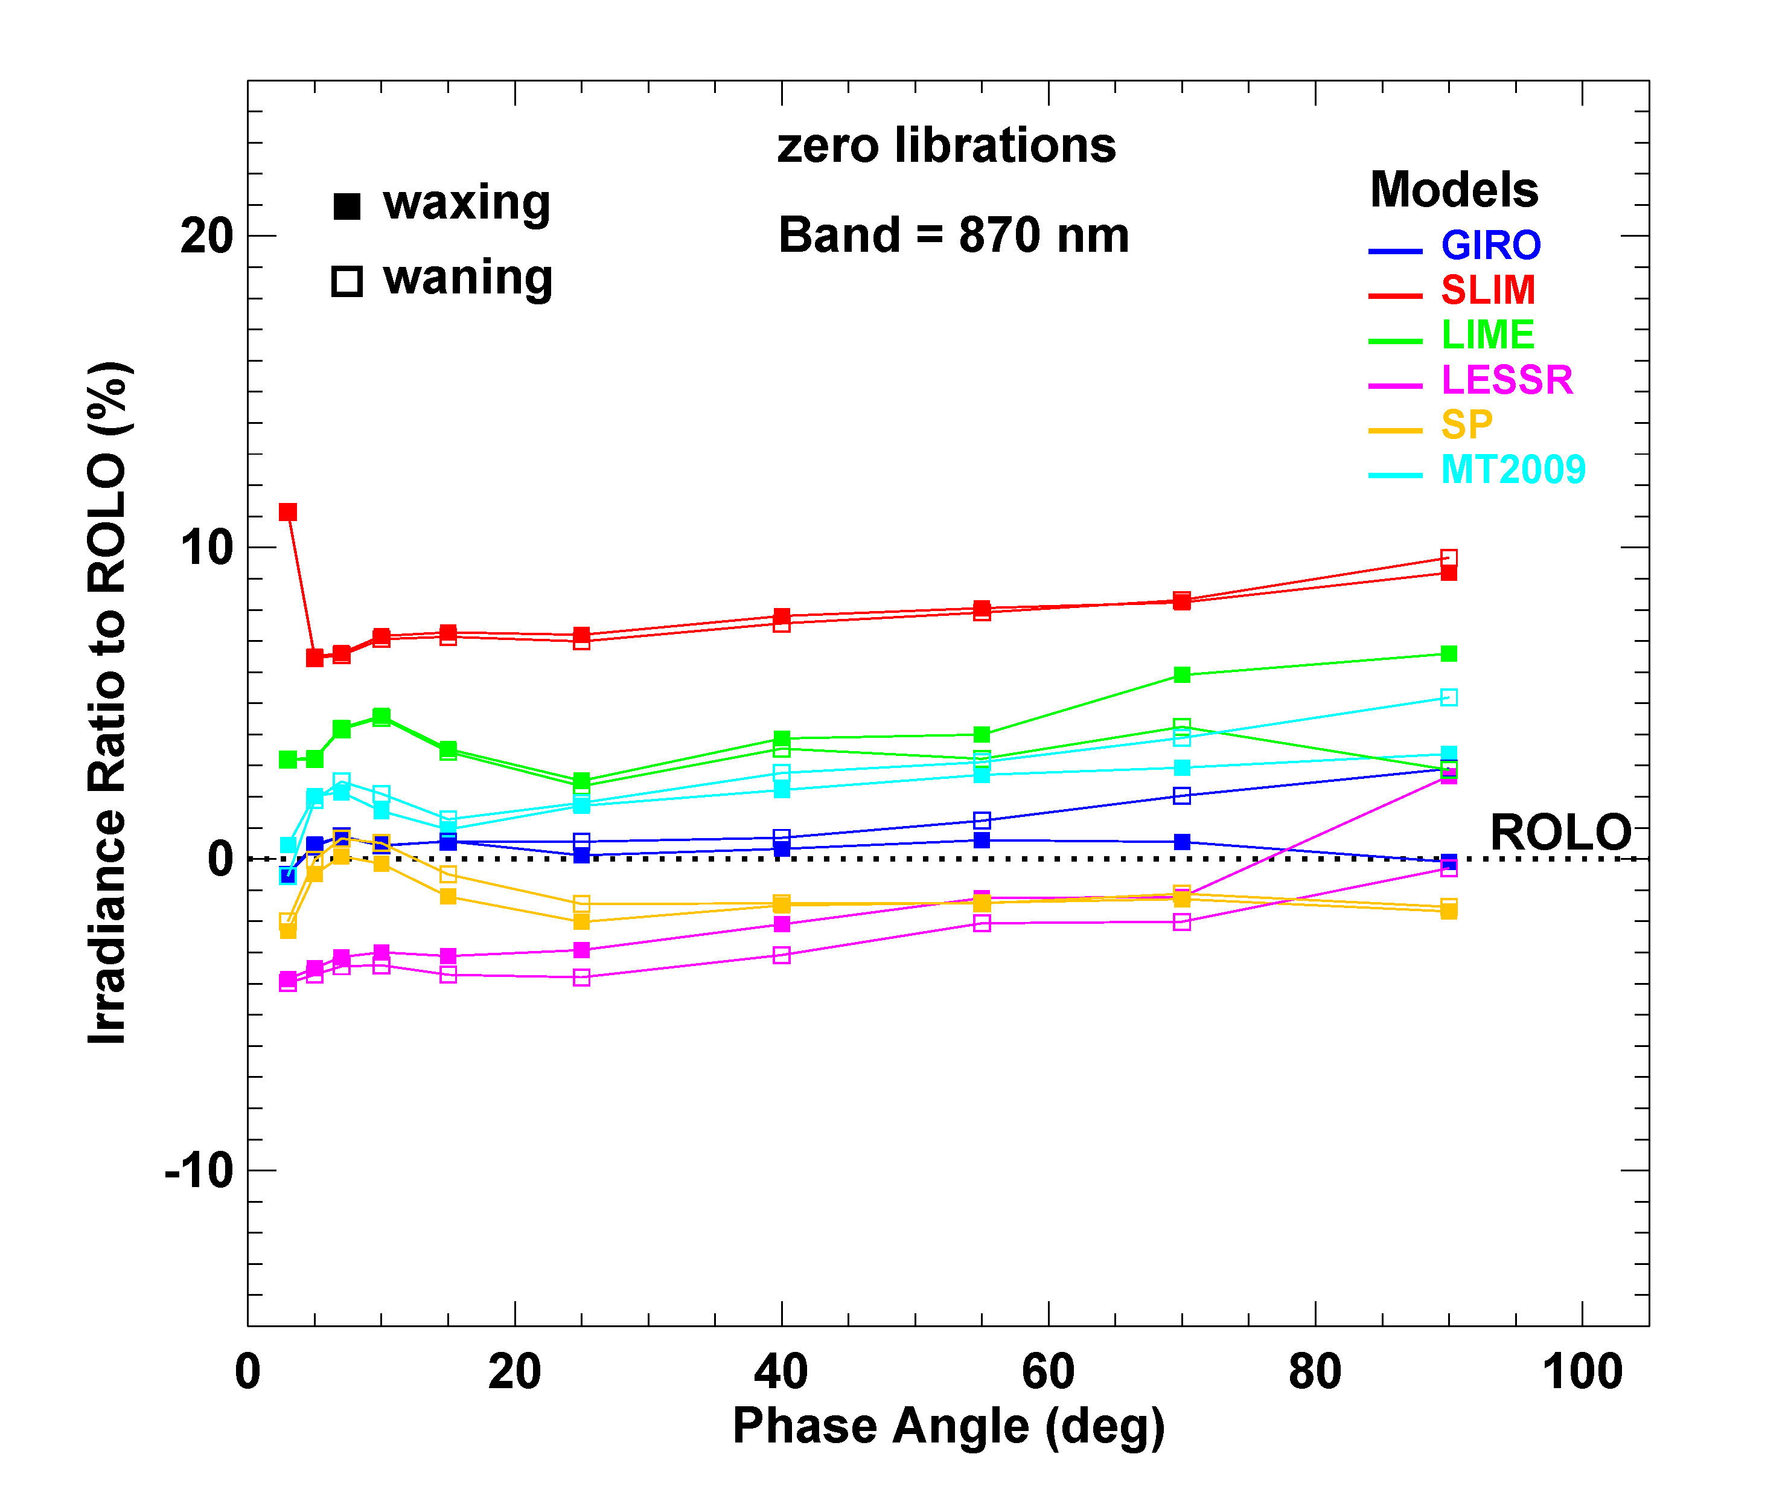
@Stone
LESSR/ROLO
Absolute level similar SLIM

Slide 24
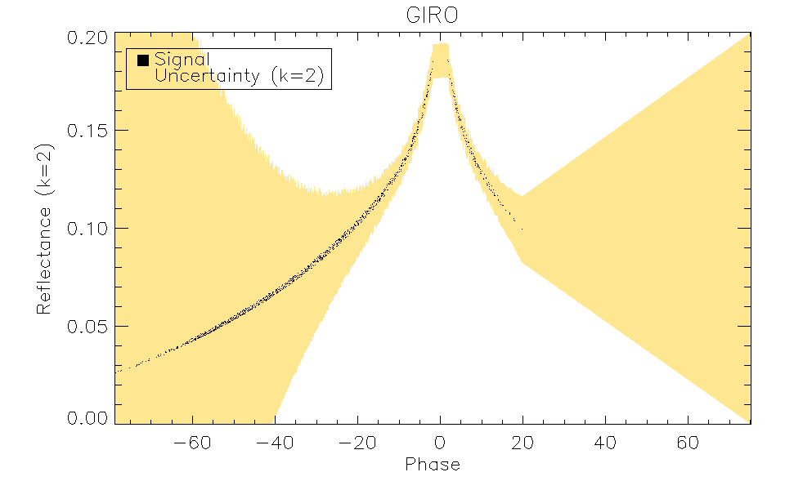
ROLO formulation Local Libration
Fit ROLO formulation (linear parts, non-linear parameters fixed) to SCIAv10

Slide 25
Next steps
Investigate formulation other wavelength
Improve SCIAMACHY uncertainty
LESSRv2
Repeat fit for all wavelengths
Compare SEVERI/OLCI/GIRO/LESSRv1(.1)/LIME
LESSRv3
Include other instruments

Slide 26
Wavelength Slope (Apollo Fit)

Slide 27
Conclusions
Small phase range libration allows formulation validation
Formulation strongly impacts model uncertainties
Using Monte Carlo + Information Content
Reduction of required base functions
Determination uncertainty parameters
LESSRv2 looks extremely promising
GOME2 lunar dataset upcoming

Slide 28
Thank you

