Slide 1
LIME: Lunar Irradiance Model of ESA
Stefan Adriaensen (VITO), Africa Baretto (UVa), Agnieska Bialek (NPL), Marc Bouvet (ESA), Javier Gatón Herguedas (UVa), Chris Maclellan (NPL), Carlos Toledano (UVa), Pieter De Vis​ (NPL), Emma Woolliams (NPL)

Slide 2
The measurements behind the model

Slide 3
Lunar measurements
Top-of-atmosphere irradiance/reflectance from the ground
Langley plot method in high-altitude stations:
  Izaña (2400m asl)
  Teide (3570m asl)
Two instruments:
  Modified version of Cimel 318T radiometer
  ASD Field Spec
Absolute irradiance
Relative reflectance

Slide 4
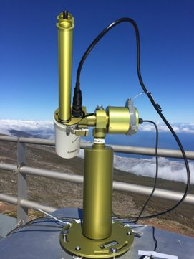
Absolute Irradiance
Cimel 318T – AERONET standard radiometer
Modifications
- Bands: 440, 500, 550, 675, 780, 870, 935, 1020, 1640 nm
    Direct Moon polarization measurements
Calibrated at NPL in absolute irradiance responsivity
Full radiometric characterization: reference plane, linearity, temperature dependence, gains, spectral response function.
Data: 2018-2022 (590 clear nights)

Slide 5
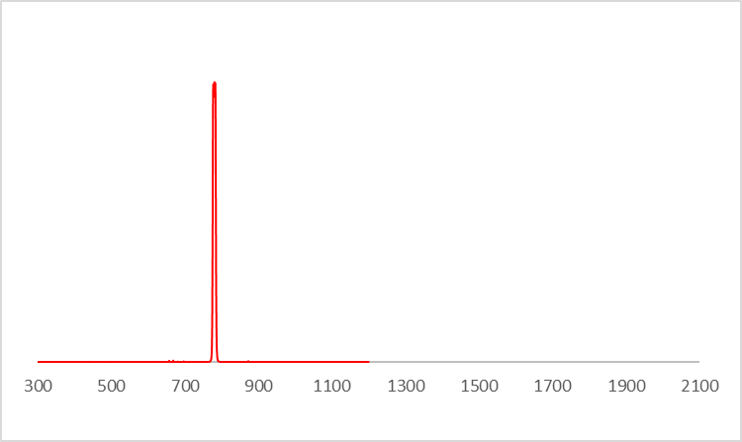
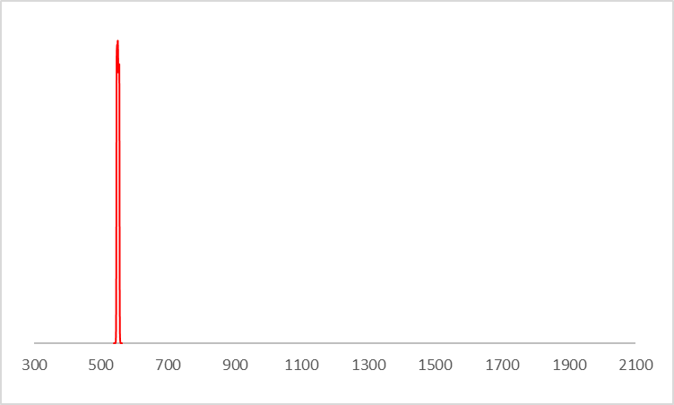
Absolute Irradiance: bands
340
380
440
500
550
675
780
870
936
1020
1640
Si
InGaAs

Slide 6
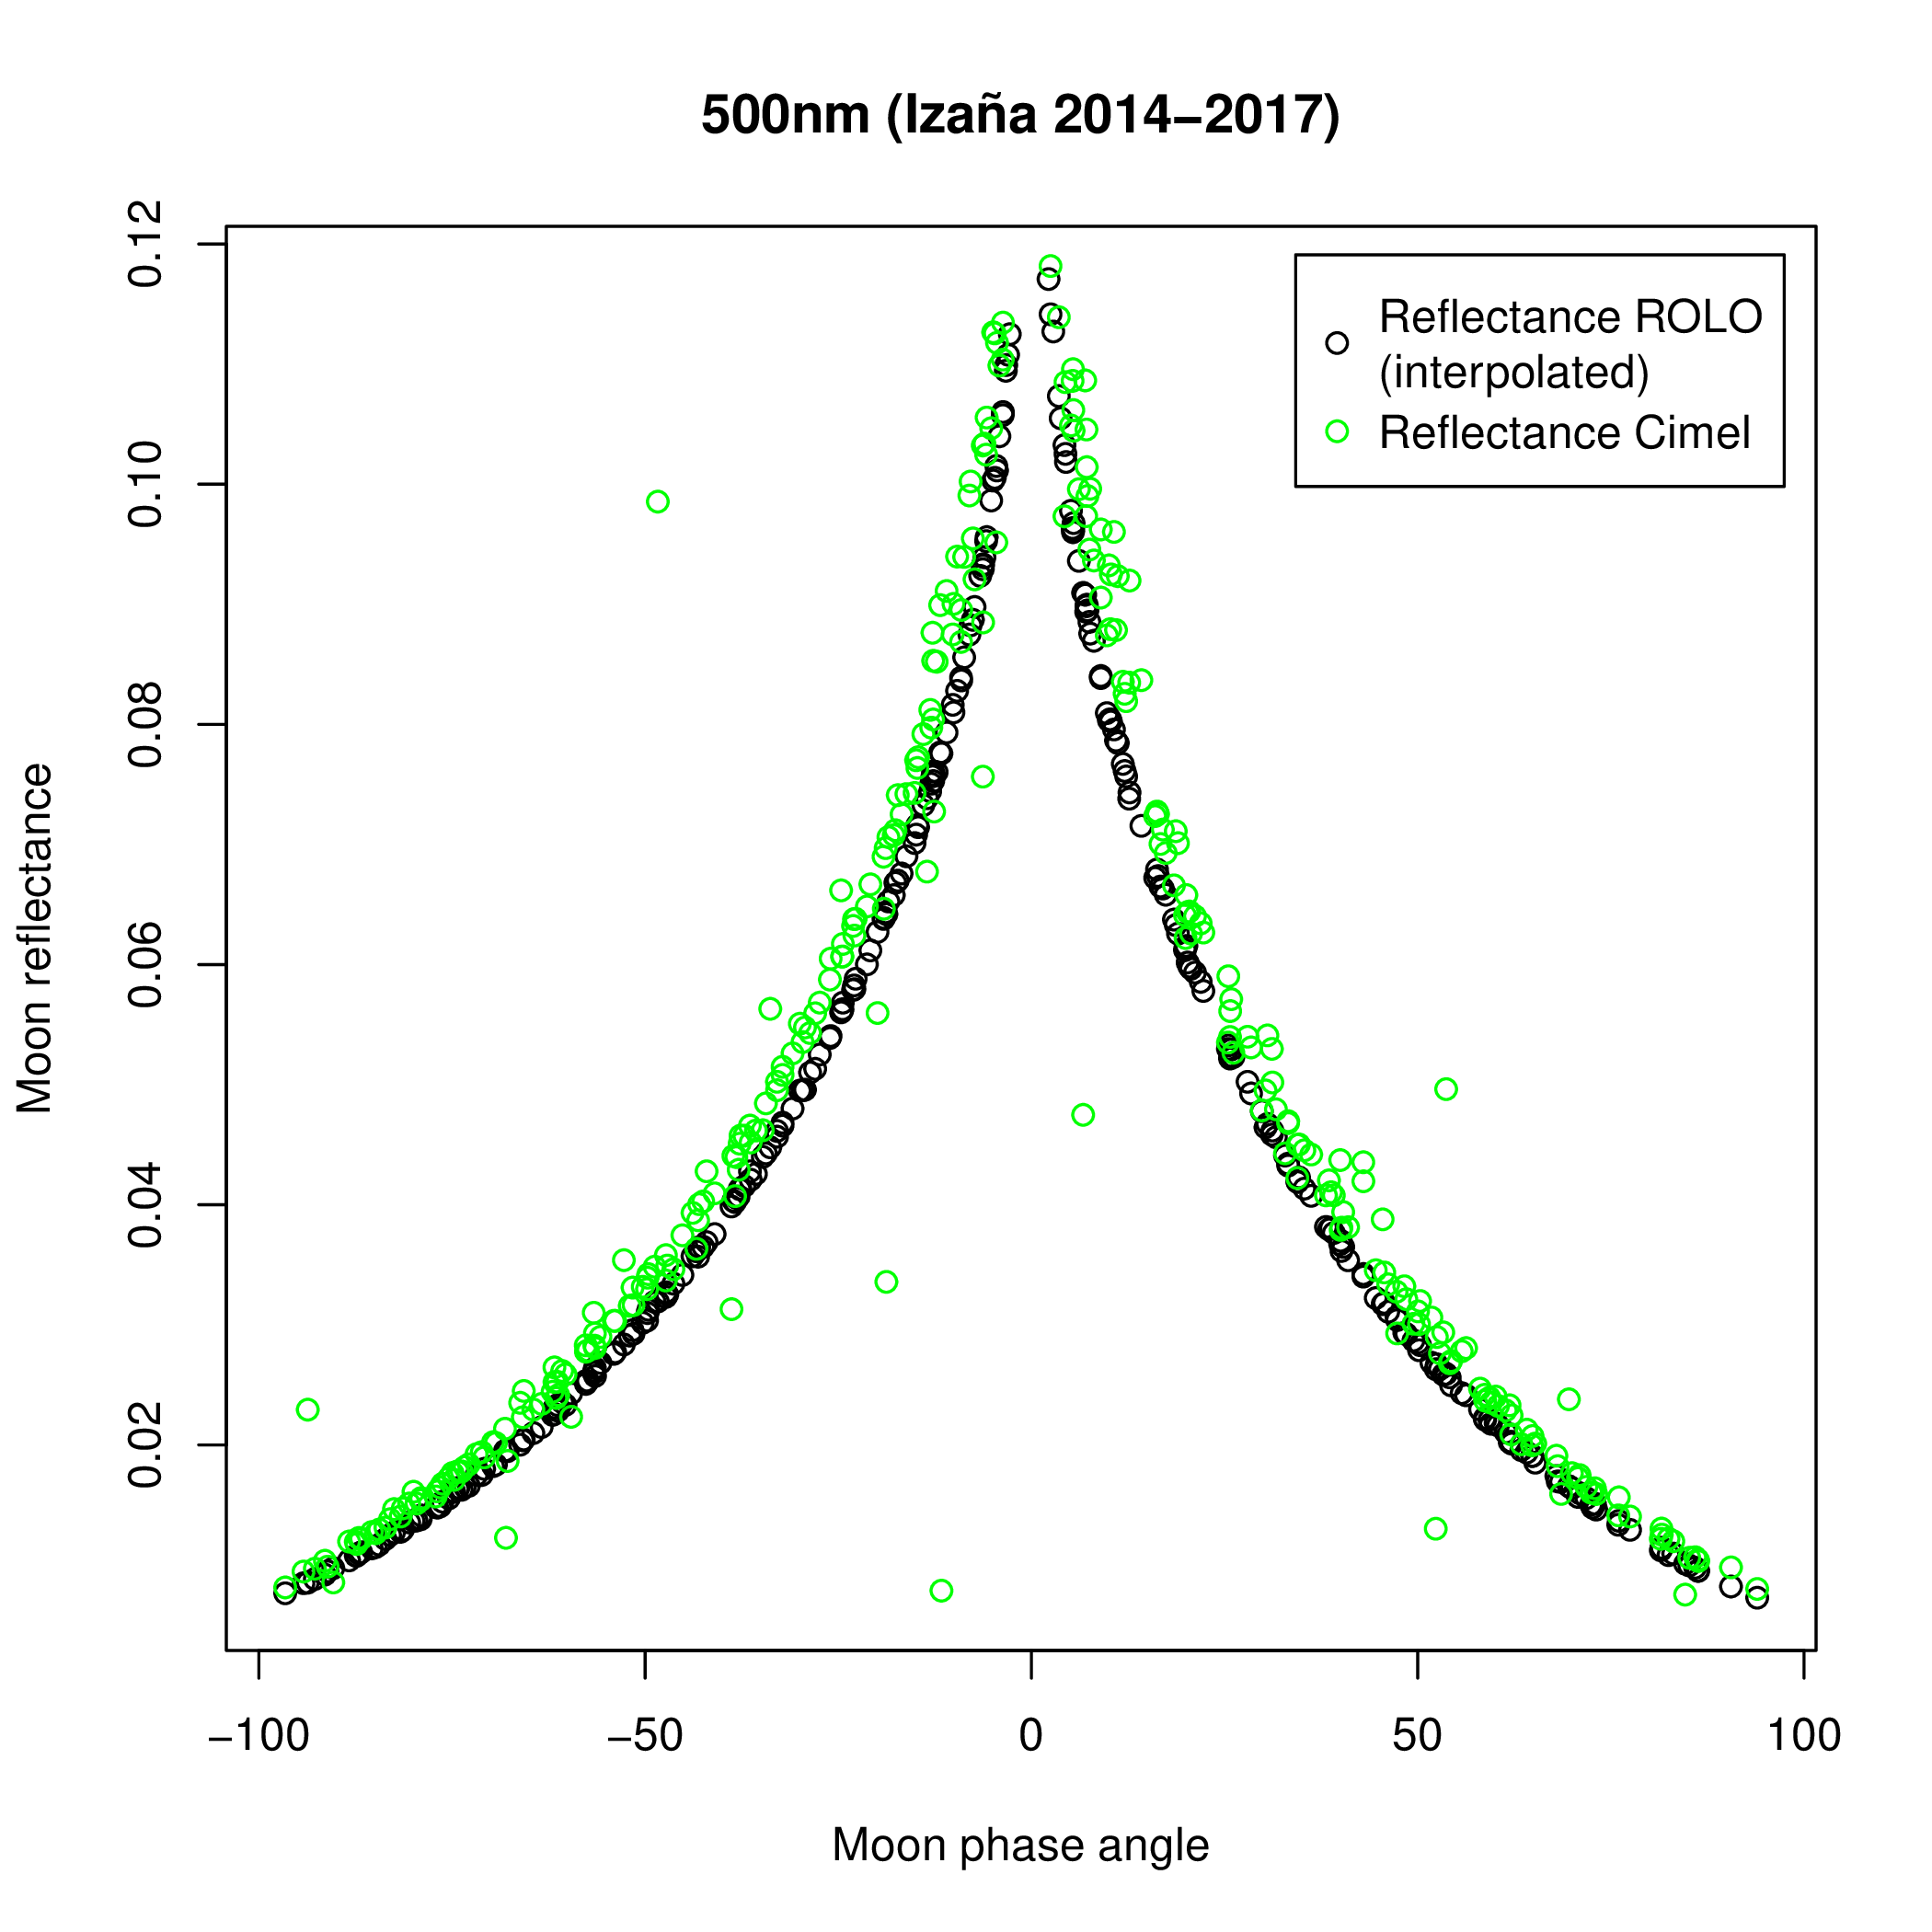
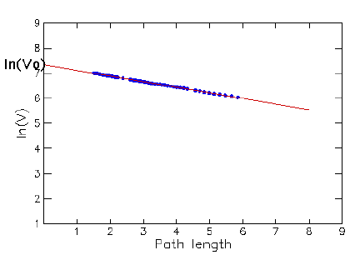
Top-of-atmosphere irradiance determination
Direct Moon irradiance observations (8 bands)
Langley plot method + calibration: TOA
Uncertainty

Slide 7
Moon reflectance
ASD Field Spec 4
Spectral range: 350 – 2500 nm, FWHM 3-16 nm
3 detectors: (350-1000), (1000-1800), (1800-2500 nm)
4 campaigns (April, May, June, September 2022)

Slide 8
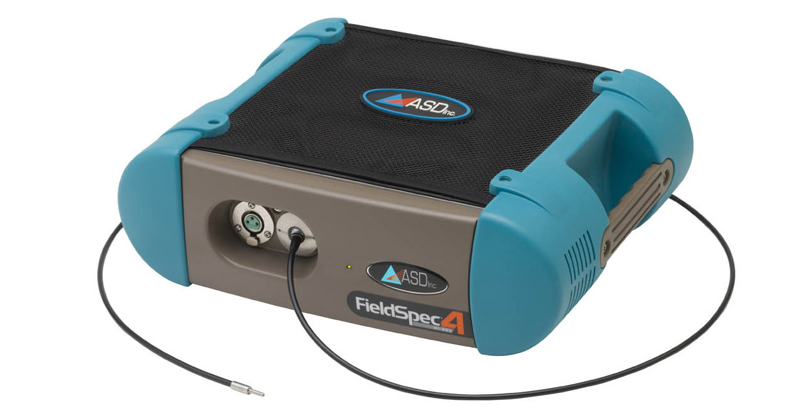
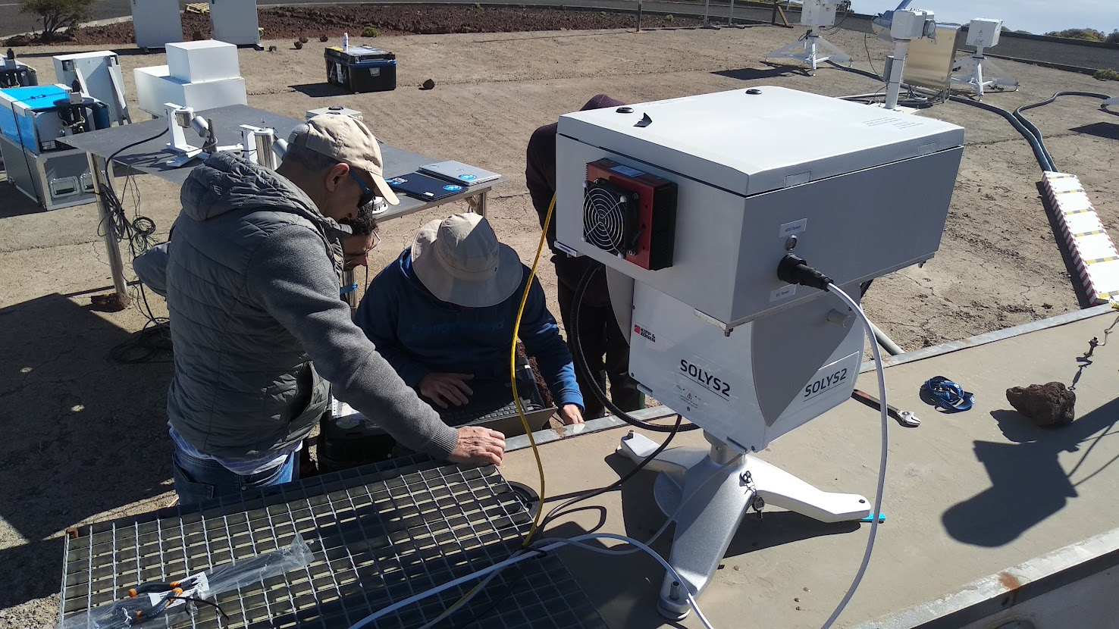
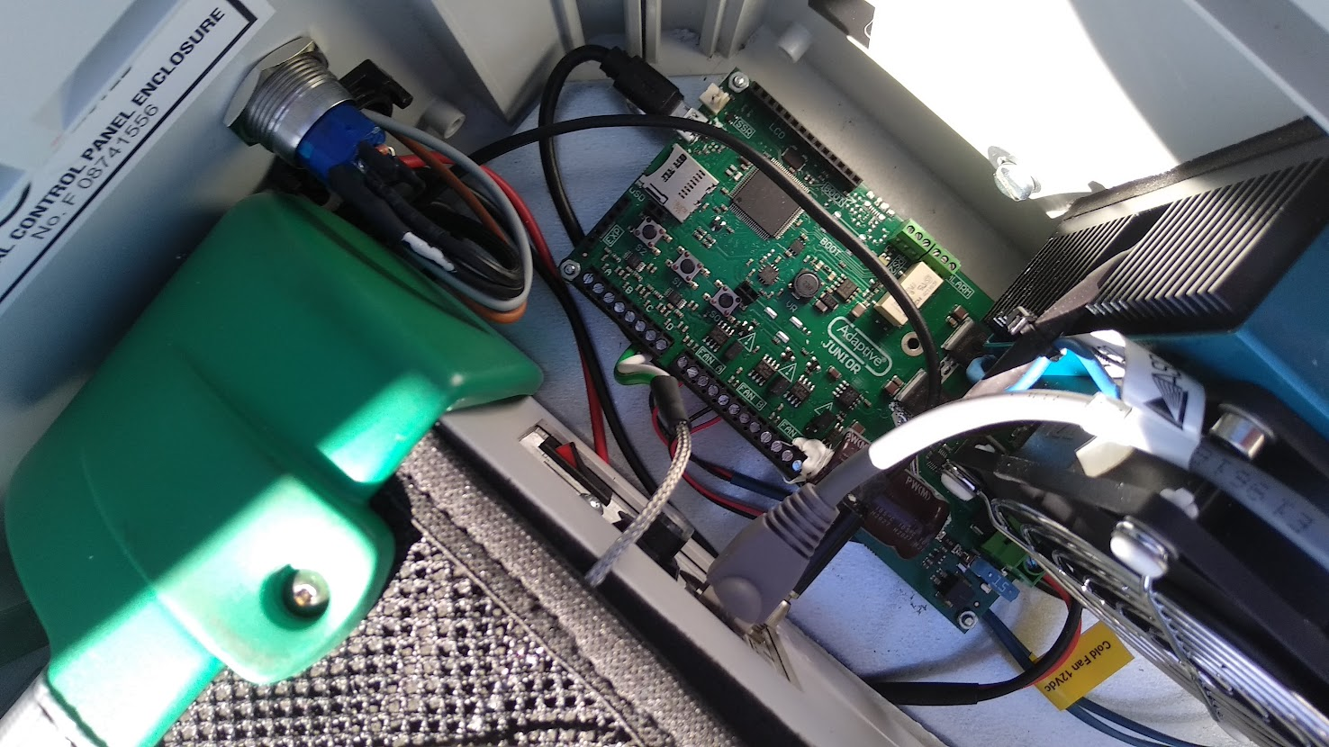
Instrument preparation
Enclosure for ASD spectrometer
Temperature control
Notes:
Christmas wishes
Discussion with VITO >> model requerements and NPL: uncertainty requirements

Slide 9
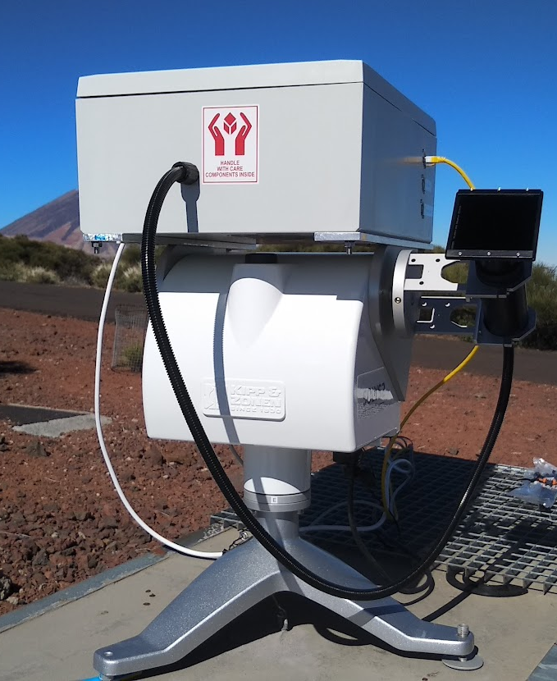
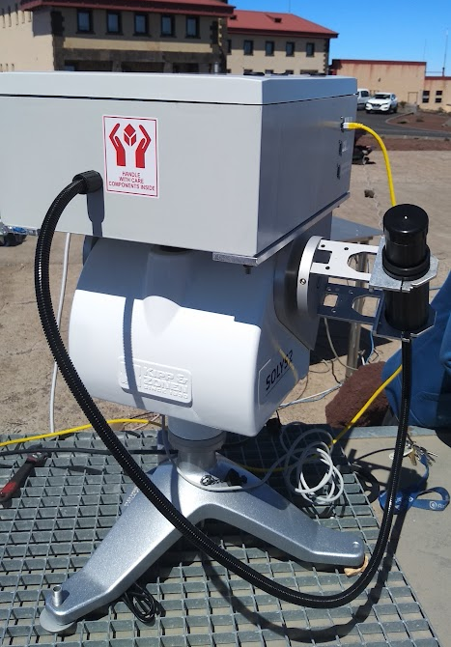
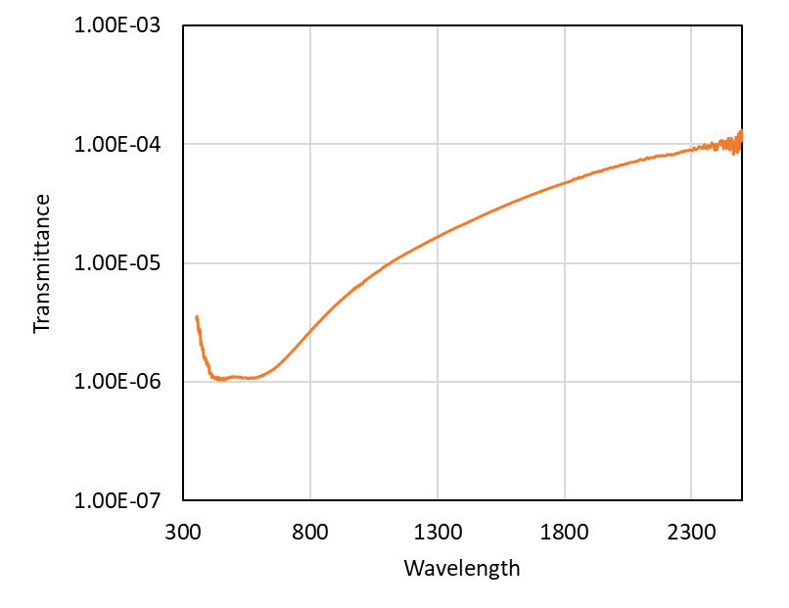
Instrument preparation
Foreoptics for ASD spectrometer: Moon and Sun
ND Filter for SUN measurements
Notes:
Christmas wishes
Discussion with VITO >> model requerements and NPL: uncertainty requirements

Slide 10
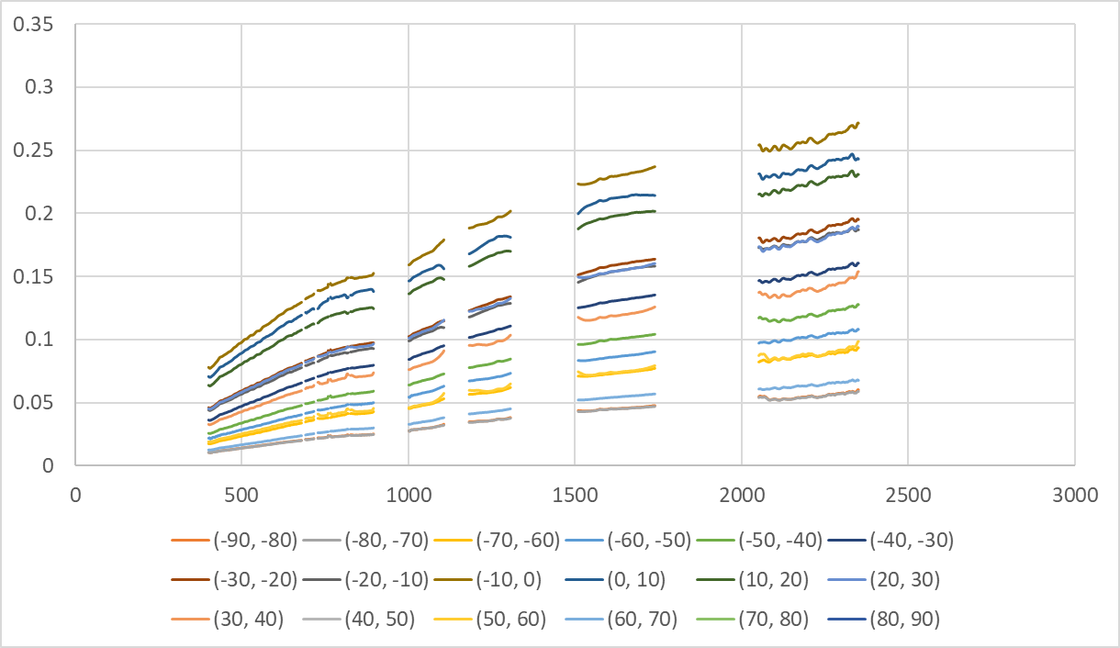
Moon spectral reflectance
10-deg pase angle bins
Reflectance
Wavelength (nm)

Slide 11
The LIME model

Slide 12

Assessing the impact of the LIME modelling capabilities on night aerosol retrieval
D-5: Report on the impact of using the LIME model on the stability and accuracy of aerosol retrieval (day vs. night)
Africa Barreto, Carlos Toledano, Ramiro González, Javier Gatón, David Mateos

Slide 13
Importance of AOD monitoring at night. Scope of the task.
Solar photometry provided reliable information about key aerosol properties to better understand the role of aerosols in the Earth's climate. However, was not able provide day-to-night variations, introducing a bias in climatological studies which is critical for high latitude and polar regions.
CE318-TS appeared in 2016 as an excellent candidate to monitor aerosols in a routine way in the absence of solar radiation using the Moon as light source (reference instrument in the NASA-AERONET network). Drawback in lunar photometry: a precise exo-atmospheric lunar irradiance model is mandatory to derive the AOD at night.
There are different sources of information to estimate extraterrestrial lunar irradiances, i.e. the lunar models, with a decisive impact on the retrieval of AOD:
  Robotic Lunar Observatory (ROLO)
  ROLO implementation for Moon photometry observation (RIMO)
  RIMO Correction Factor (RCF) - Reference
  LIME
SCOPE: In this task we assessed the impact of the improved LIME modelling capabilities in the AOD calculation at night using the RCF model as reference.

Slide 14
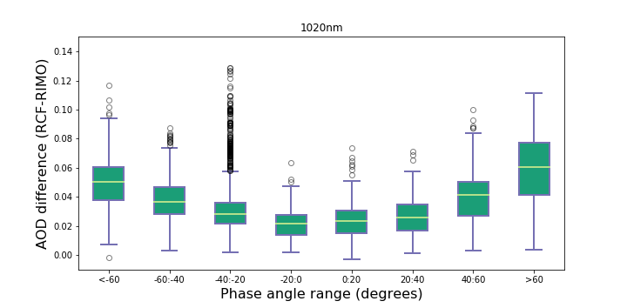
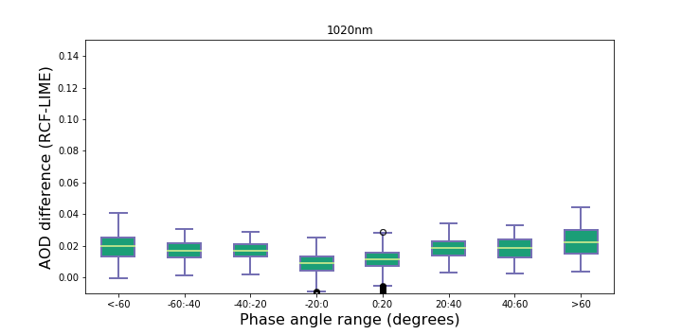
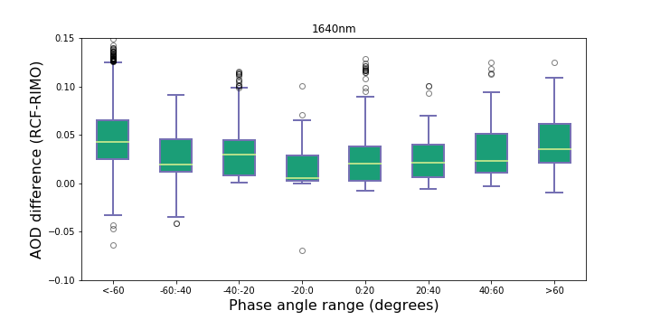
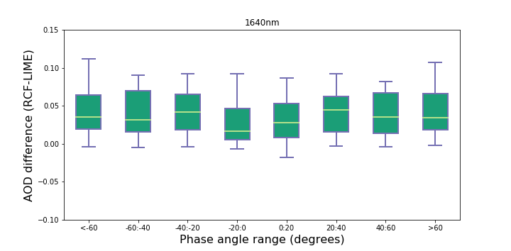
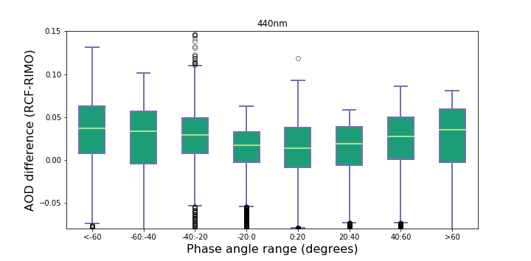
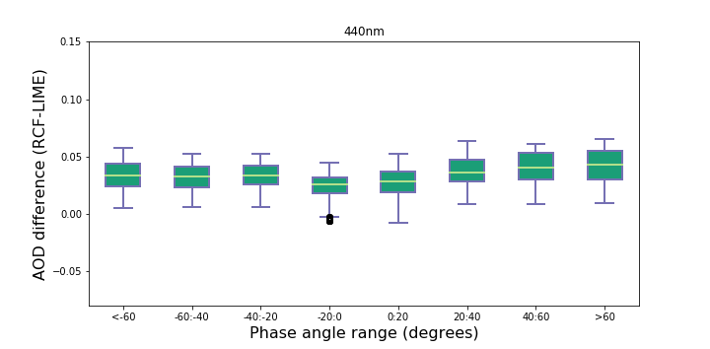
Comparison in terms of AOD difference
RCF vs RIMO
RCF vs LIME
1020 nm (Si)
1020 nm (Si)
Better performance of LIME with regard the lunar phase angle.
Reduction in the average AOD difference associated with the use of the LIME model in relation to the RIMO model in all channels except in 1640 nm.
Higher dispersion of AOD differences in the case of the RIMO model, especially in the 440 nm spectral band.
1640 nm
1640 nm
440 nm
440 nm

Slide 15
Conclusions
The use of the LIME model introduces a substantial improvement in the calculation of AOD at night in comparison to the use of the ROLO/RIMO model.
AOD departures from our references (the AOD retrieved using the RCF model) is quite consistent to the 2% uncertainty limit expected for the LIME model. Some exceptions were found for those Cimel spectral bands measuring with the InGaAs detector (1020i and 1640 nm).
Appreciable problems still exist in the LIME irradiance model:
  Associated to low phase angles (still needed more measurements)
  For InGaAs spectral bands, attributed to the uncertainty in the Gain Factor
RCF was specifically designed to achieve accurate AOD (no SI irradiance calibration). However, the AOD differences LIME vs RCF are a good indication of the model uncertainty and helps monitoring the model performance.

Slide 16
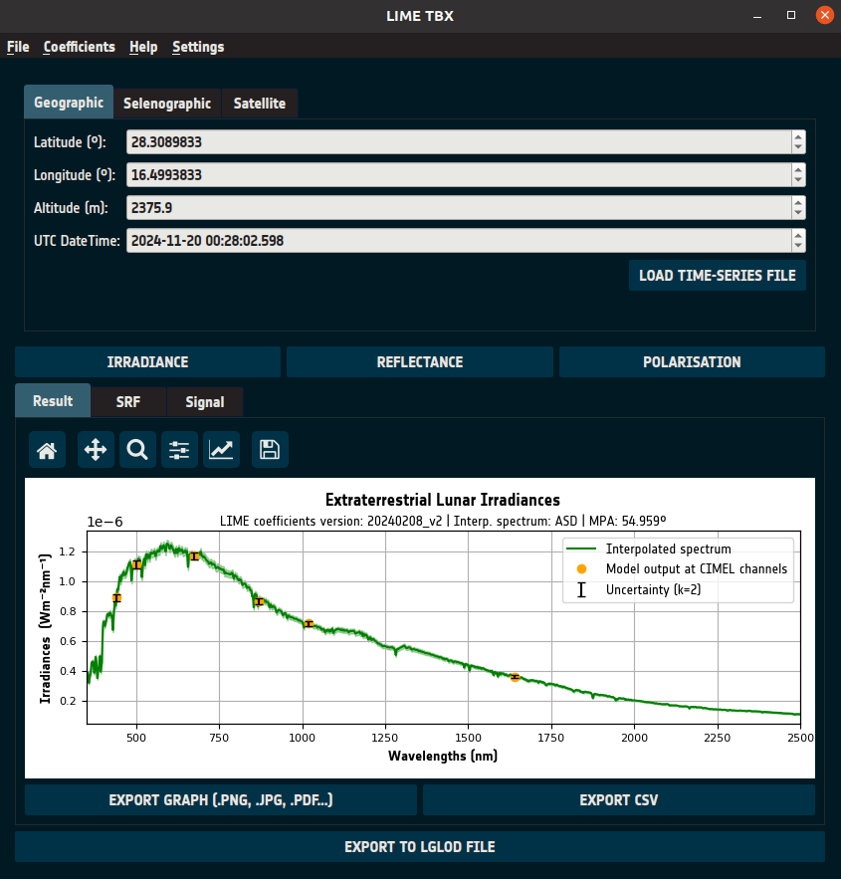
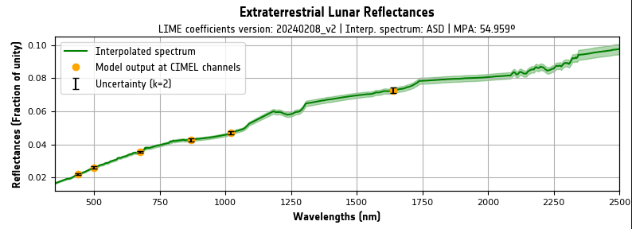
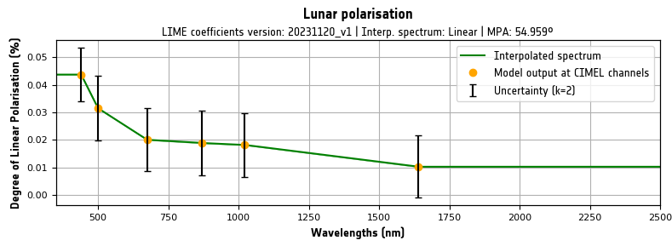
TBX Main Features - Simulation
Simulates:
  Irradiance
  Integrated Irradiance (Signal)
  Reflectance
  Polarisation (DOLP)

Slide 17
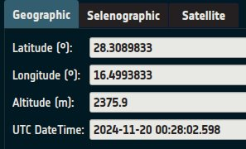
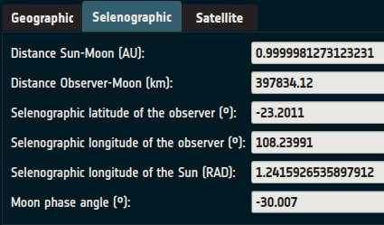
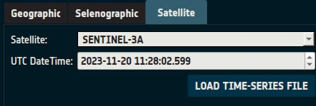
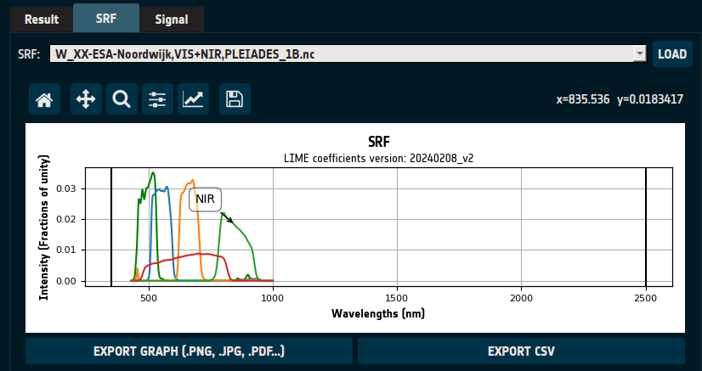
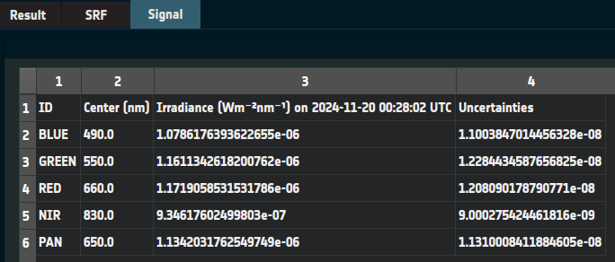
TBX Main Features - Simulation
Input:
  Geographic coordinates & datetime/s
  Selenographic coordinates
  Satellite name & datetime/s
    User may add satellites if they have .tle or .osf files.
  Optional: SRF file in GLOD format

Slide 18
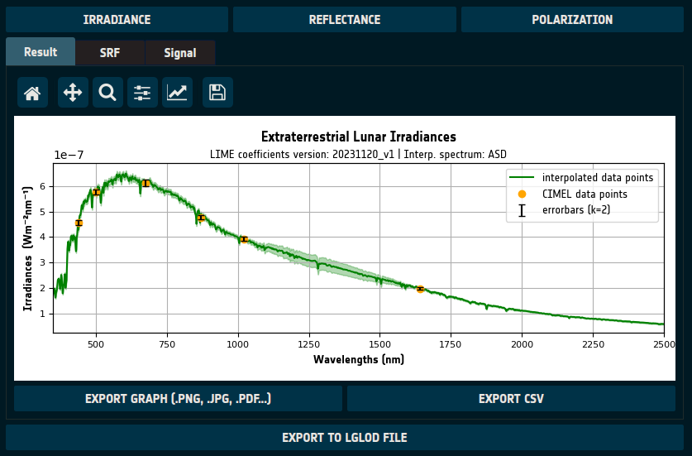
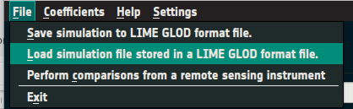
TBX Main Features - Simulation
Output:
  Graph (.png, .jpg, .pdf...)
  CSV file
  NetCDF in LGLOD (LIME-GLOD) format
    Reloadable

Slide 19
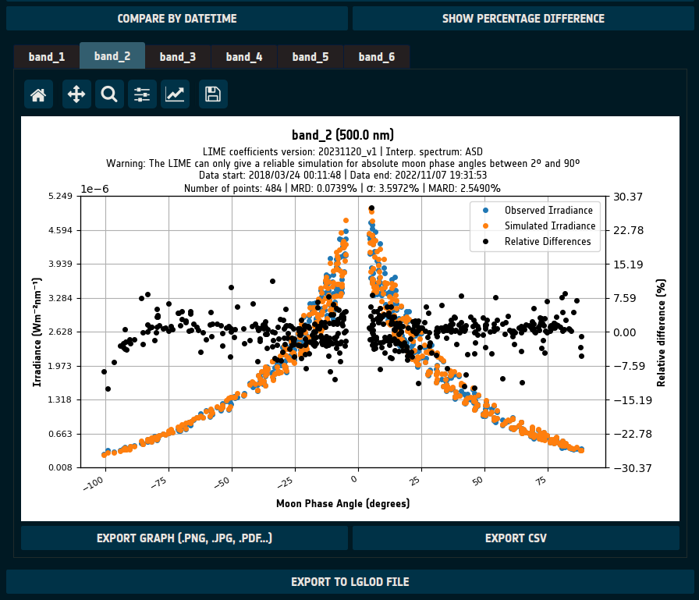
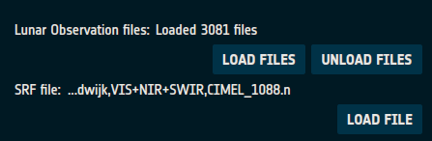
TBX Main Features - Comparison
Irradiance:
  Compare by Moon phase angle (MPA) or datetime
Input:
  Observation files in GLOD format
    Allowing some exceptions
  SRF file in GLOD format
Output:
  CSV file
  Graph (.png, .jpg, .pdf...)
  NetCDF (LGLOD format, reloadable)

