Slide 1
Summary of Alternative Applications of the Moon from LCWS4
Fangfang Yu
University of Maryland
2024-03-12

Slide 2
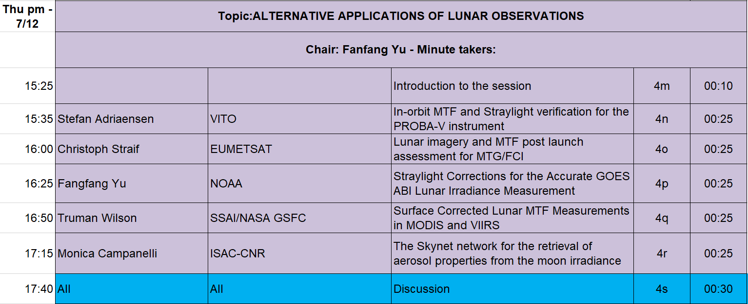
Session Topics
Scope of the session
  Applications of lunar images for instrument characterization, such as MTF, RVS, and aerosol retrieval, etc
Five Talks in this session

Slide 3


MTF with the Moon
Three talks on MTF assessment with different Edge Spread Function (ESF) fitting exercises
  PROBA-V (by Stafen Adriaensen)
  MTF/FCI (by Christoph Straif and Matteo Arico)
  MODIS/VIIRS (by Truman Wilson and Jack Xiong)
Standard procedure
  Lunar image edge selection -> Edge Spread Function (ESF) -> Linear Spread Function (LSF) ->
  Modulation Transfer Function (MTF)
Middle of the Moon, avoid large edge curvature, avoid terminator
Padding for lunar pixel
Subpixel alignment
ESF smoothing
Fitting function
$$LSF\left(x\right)=\frac{d}{dx}ESF(x)$$
$$MTF\left(f\right)=FFT(LSF\left(x\right))$$

Slide 4
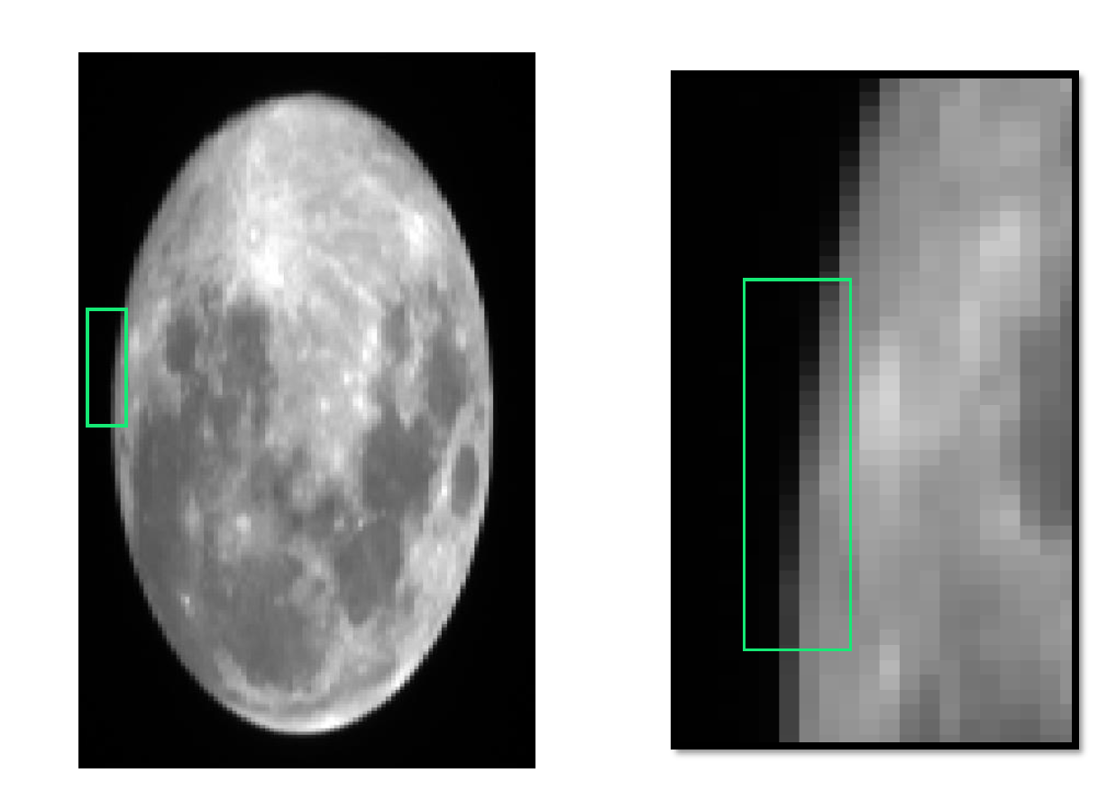
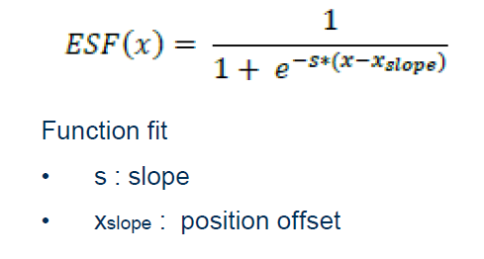
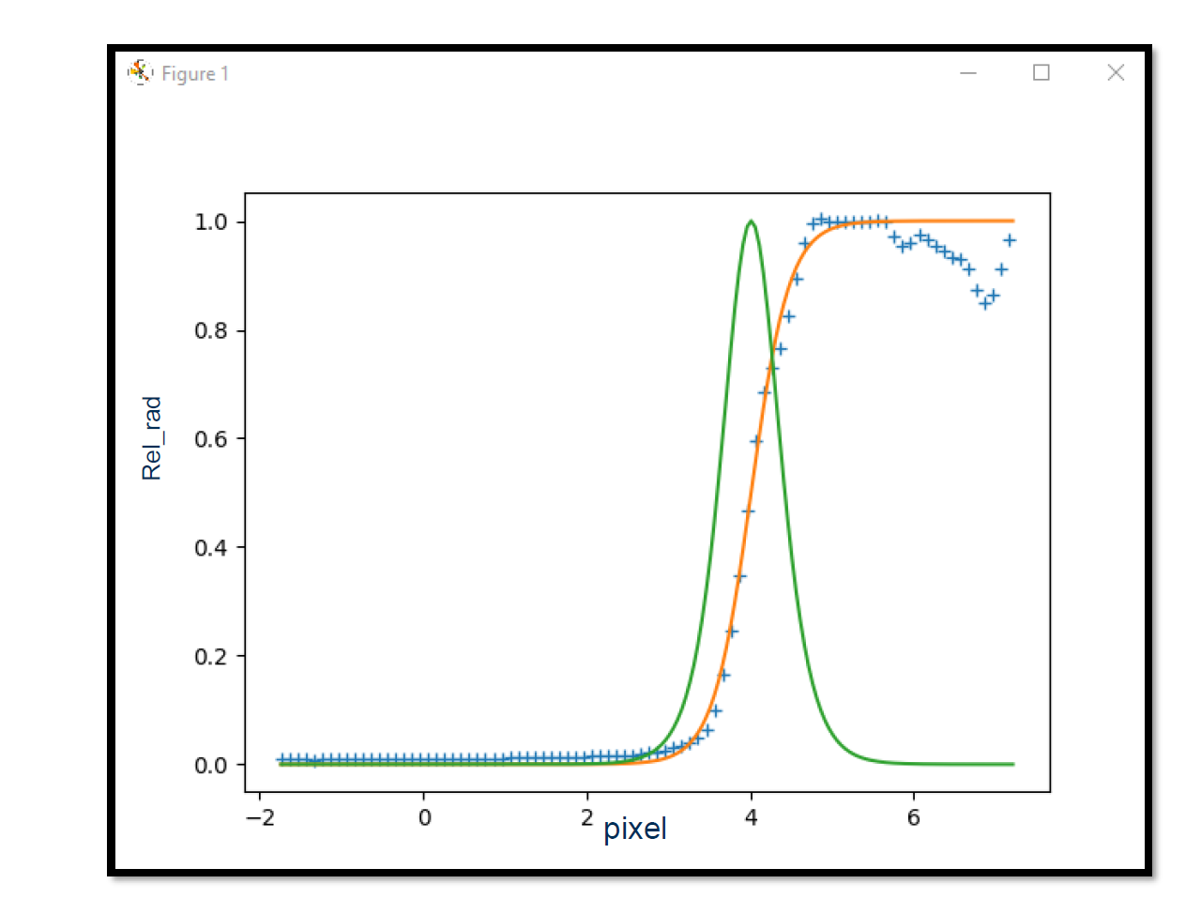
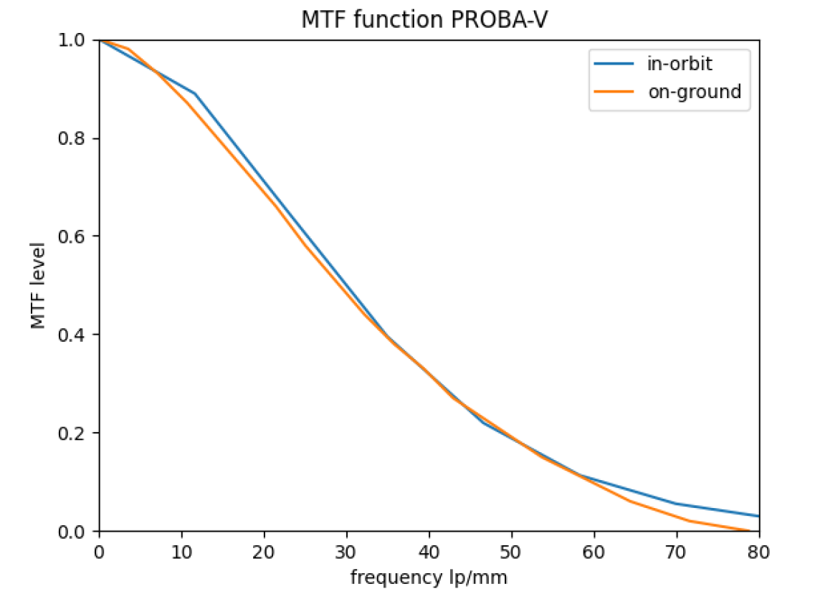
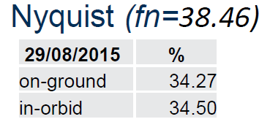
PROBA-V
Edge selection: bright side near the Equator
Normalize to maximum value, close to the edge
ESF fitting function:
Result:
  Comparable to the ground measurements
By S. Adriaensen

Slide 5
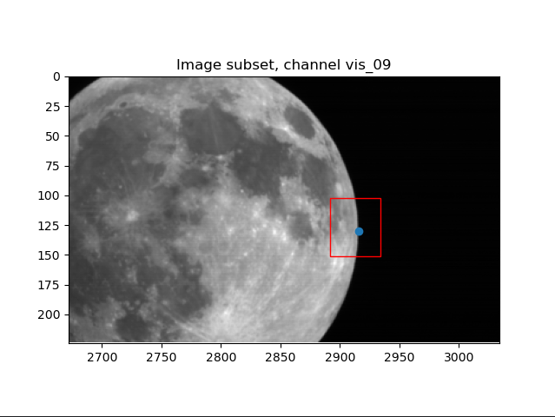
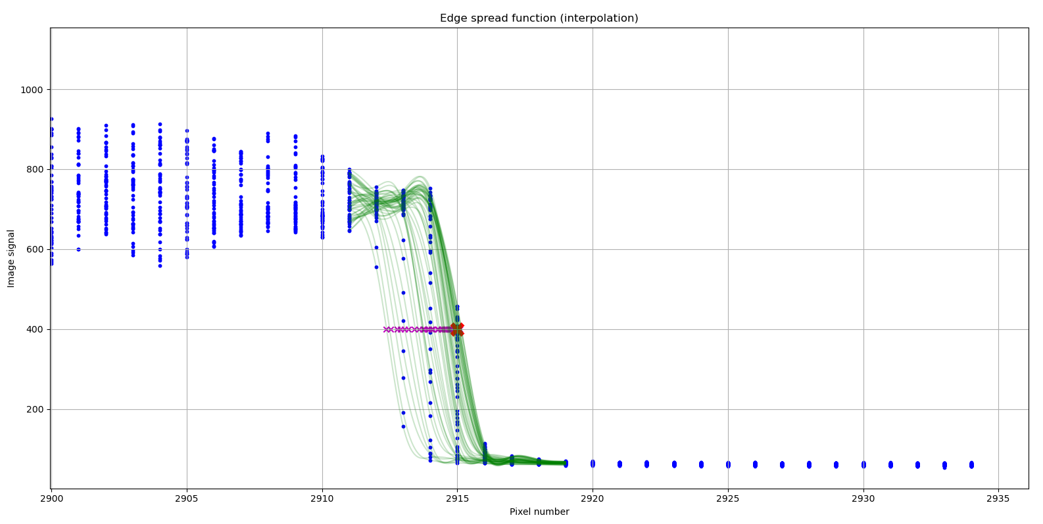
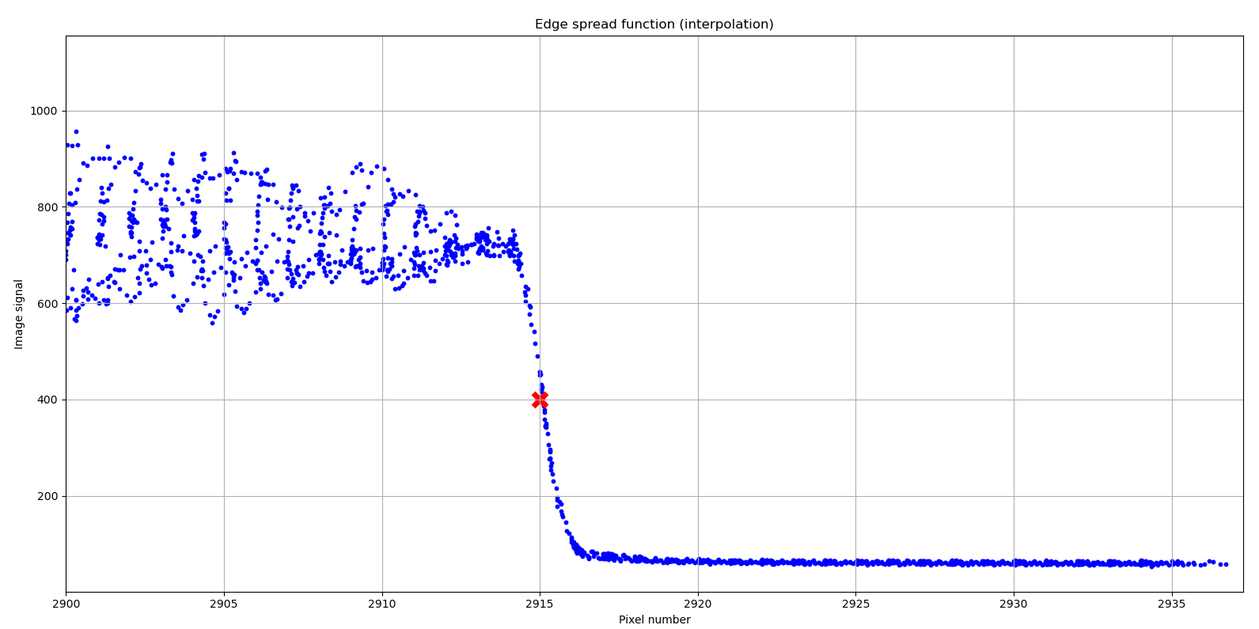
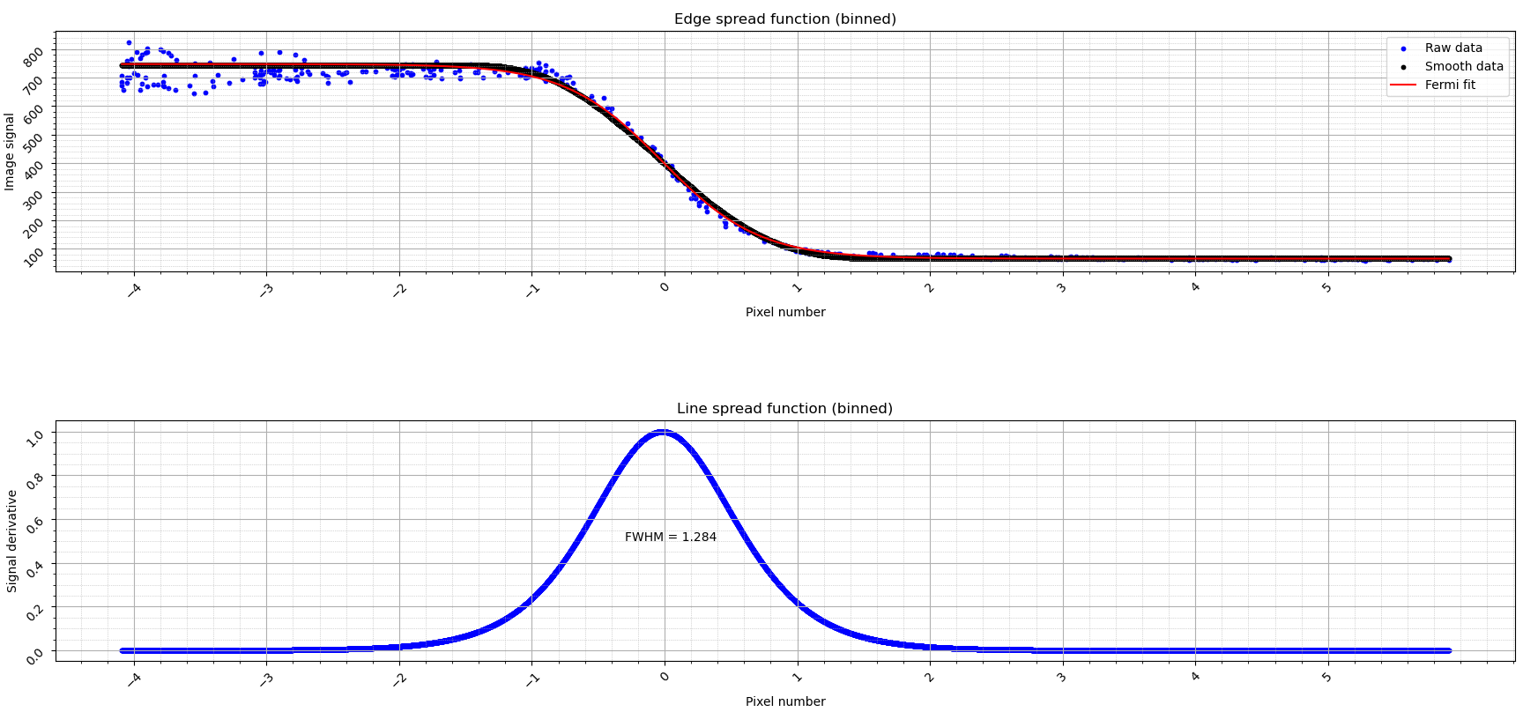
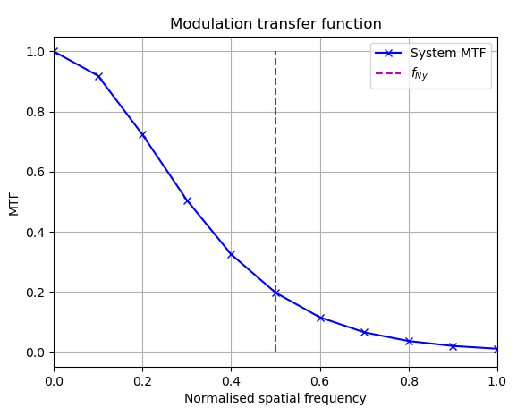
FCI MTF
Edge selection: bright side near the Equator
Sub-pixel alignment
  Spline interpolation for the profiles to align at mid-point
ESF smoothing
  Modified Savitzki-Golay filter
ESF fitting function
  Fermi
By C. Straif and M. Arico

Slide 6
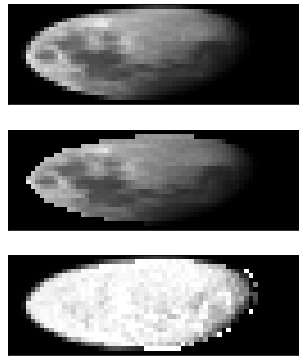
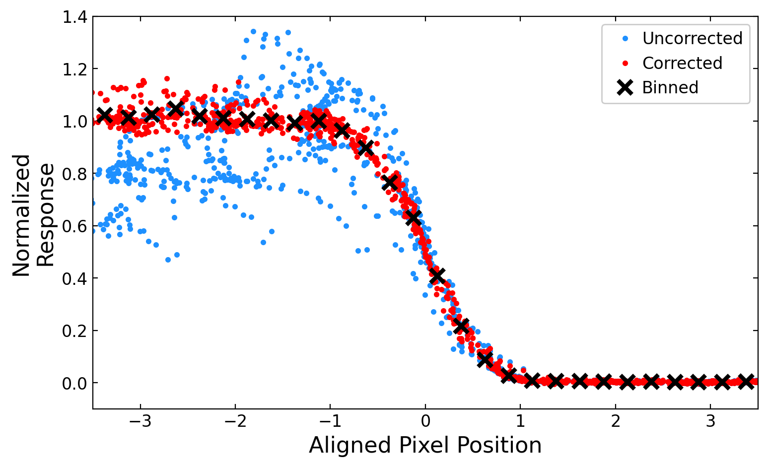
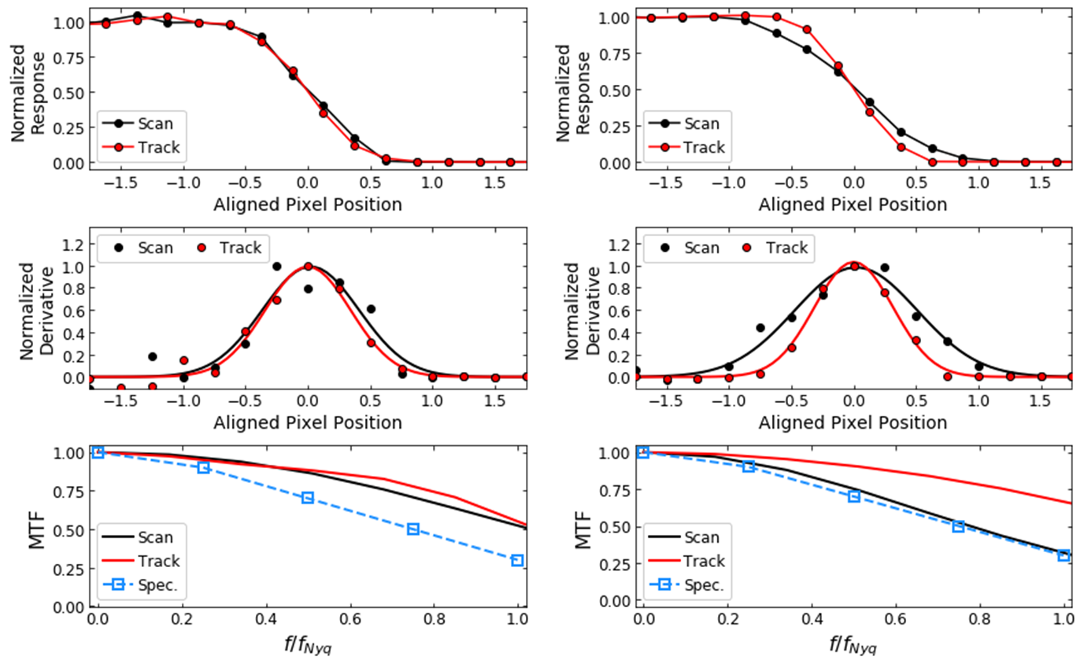
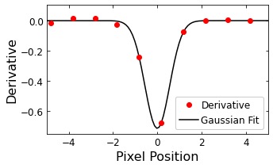
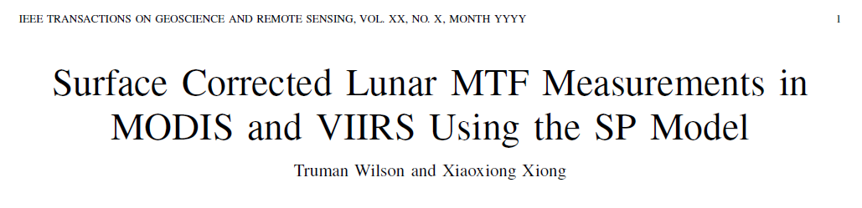
MODIS/VIIRS MTF
Measured Image
Edge selection
  Near the perpendicular edge with respect to the scan/track direction
Padding
  Albedo flattening with SP model
Subpixel alignment
  Edge curvature correction
  Center position from gaussian fit over the derivative of each profile
ESF smoothing
  Binned at 0.25 pixels
Fitting function
  Fermi
Model Projection
Measured/Modeled Ratio
By T. Wilson and J. Xiong

Slide 7
Toward the best practice method for MTF
Best practice for each step, after the exercise results reported in the Xi’an workshop (LCWS2), 6 GEO instruments,
  Lunar Image selection
    Instrument data: L1b or L1alpha, Phase angle -> standard or typical lunar images
  Edge selection
    near middle and avoid edge with large slant angle, avoid terminator
  Edge spread function (ESF)
    Padding lunar pixels to compensate for variable lunar surface reflectance
      Signal-Noise evaluation for screening pixels into the moon, Normalization
      Albedo flattening
    Subpixel alignment
      Edge curvature correction (e.g. MODIS/VIIRS)
      Midpoint (Gaussian fitting, spline interpolation …)
    Smoothing ESF
      Modified Savitzki-Golay filtering, binned average ….
    Fitting function
      Fermi, Cauchy, no-fitting, …
      Instrument dependent fitting?
      Mini pixels for fitting? No issue at the space end. How about the lunar surface?
  Line spread function (LSF)
    Derivative of ESF
  MTF
    FFT
  Evaluation
    Up to 1 Nyquist or go beyond?
    Difference instrument requirement
Recommendation: Continue the exercise.

Slide 8
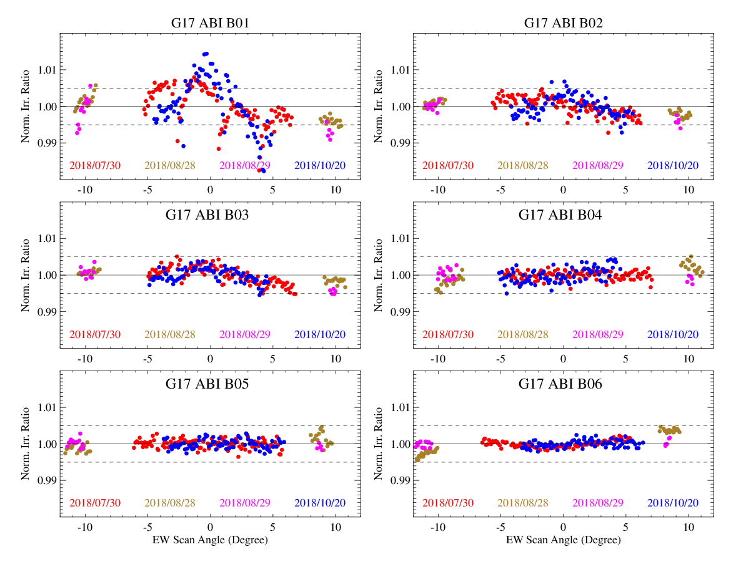
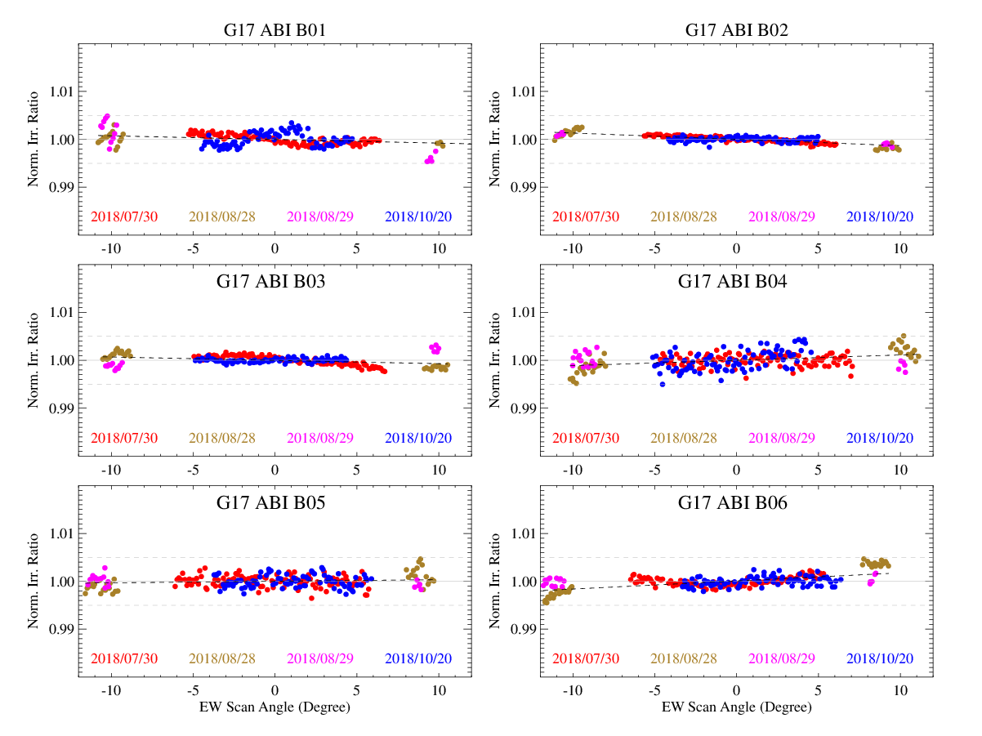

Straylight Corrections
NOAA uses intensively collected lunar images to characterize the response versus scan-angle (RVS) for ABI VNIR bands (B01-B06) in the East-West direction
Some of the ABI B01-B03 lunar images may experience slight straylight impact which is negligible (<0.01% albedo at a typical 40% albedo of the Earth) at sample level. However, the error can be accumulated in lunar image irradiance measurement and result in up to ~1% variation in the response versus scan-angle (RVS) analysis.
Careful straylight correction improved the lunar irradiance measurement accuracy and thus reduced the RVS uncertainty to less than 0.3%.
RVS for G17 VNIR bands (B01-B06)
RVS for G17 VNIR bands, after straylight correction for B01-B03

Slide 9
Some Technical Recommendations
Negligible error at sample level, when accumulated over high spatial resolution lunar image, can become be a significant contribution in the measured irradiance
Straylight correction algorithm is instrument or instrument type dependent
Some common recommendations to reduce straylight impact
  Moon scan schedule: use the scans which is calibrated with un-contaminated spacelook
    e.g. spacelook near the Equator, thus not affected with the possible scattered light near the polar region
  Image collection: the Moon should be collected at least certain distance from the illuminated Earth limb or at the dark side of the Earth
  Data processing of subset lunar images: cover the moon and the vicinity area where lights is scattered or leaking from the Moon, but ensure the area is not too large so as to amplify the potential calibration error in the irradiance values.
  Lunar irradiance measurement: include the lights originated from the Moon.

Slide 10
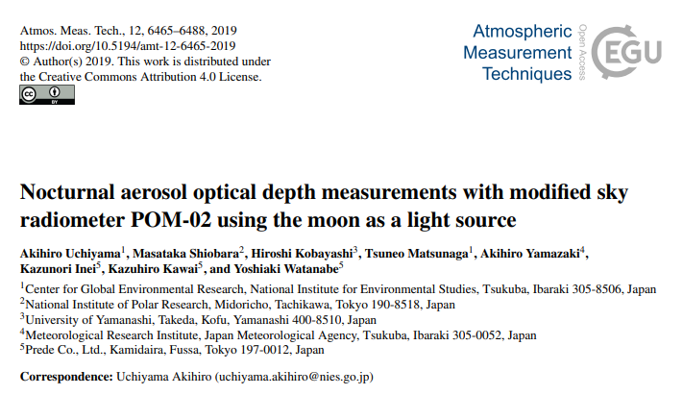
Skynet Network
Skynet network for aerosol retrieval from the moon irradiance (presented by Monica Campanelli, ISAC-CNR, IT)
  Network of sun-sky photometers, POM-02, dedicated to study columnar aerosol properties.
  Langley method was used for the sun and moon measurement calibration by the vendor (Uchiyama et al. 2019, AMT)
Discussion
  The model community showed great interest in the large amount of data
  Most of the POM-2 instruments, although not calibrated during operation, could be good data source for model development.
  Can we use the aerosol data to calibrate the lunar images?
Recommendation
  GDWG to review how to host the new lunar irradiance data such as skynet lunar irradiance data

