Slide 1
Lunar Spectral Irradiance Calibration System (LSICS) development progress update
Bikash Basnet¹, Fangfang Yu² , Thomas C. Stone³, Hugh H. Kieffer⁴, Stephen Maxwell⁵, Sebastien Wagner⁶ , Matthijs Krijger⁷ and Xiangqian (Fred) Wu⁶
1: Global Science & Technology, Inc. Greenbelt, MD 20770, USA
2: ESSIC/CISESS, University of Maryland, College Park, MD, 20740, USA
3: US Geological survey, Flagstaff, AZ, USA
4: Celestial Reasonings, Genoa, NV, USA
5: National Institute of Standards & Technology, Gaithersburg, MD 20899, USA
6: EUMETSAT, Darmstadt, Germany
7: Earth Space Solutions, Netherlands
8: NOAA/NESDIS/STAR, College Park, MD 20740, USA
Acknowledgements: NOAA GOES-R Program and STAR for funding support, GOES-R ABI Calibration Working Group (CWG) team members for their help, and the GSICS community for their continued assistance.
GSICS Annual Meeting, 11-15 March. 2024, Darmstadt, Germany

Slide 2
Outline
Introduction
Background
Framework
Implementation
Geometry module
Lunar Disk Reflectance module
Spectral Irradiance
Discussion
Summary

Slide 3
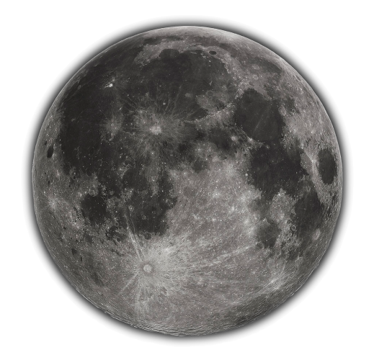
Introduction
Lunar Irradiance model is the critical component of Lunar calibration.
It produces reference model irradiance used for satellite sensors calibration in reflective wavelengths region.
The models based on the RObotic Lunar Observatory (ROLO, 2005) and GSICS implementation of ROLO(GIRO, Eumetsat) has been most widely used until recently.
Recently new Lunar models has been introduced to the community.
H. Kieffer (2022): Multiple-instrument-based spectral irradiance of the Moon(SLIM)
Best Paper for Photo-Optical Instrumentation and Design, JARS 2022.
Improvement over GIRO for higher reflective wavelengths.
The New SCIAMACHY Lunar Model (LESSR), M. Krijger, Earth Space Solutions
LIME, Lunar Irradiance model of ESA, Adriaensen et al.
etc.
GIRO
LIME
ROLO
SP
MT2009
LESSR
SLIM
Participants of Dec 2023
Lunar Calibration Workshop
EUMETSAT

Slide 4
Background
Recognizing some known limitations of existing lunar models, the remote sensing calibration community realized a need to create an improved lunar calibration reference.
Replacement for GIRO
Initial Framework for Implementing a New GSICS Lunar Model was proposed by T. Stone.
Presented with H. Kieffer in the 2023 GSICS Annual Meeting.
Embraced by GSICS community.
This project to foster the application of different lunar models was named Lunar Spectral Irradiance Calibration System (LSICS).
Provides an Framework to work with multiple lunar models.
NOAA embraced the initiative.

Slide 5
LSICS Framework Overview
Modular construction, to allow plug-in modules
interchangeable core lunar disk reflectance module
Interchangeable solar spectrum
Provides Standardized module interface for operation of multiple Lunar models in same system.
Enables comparison of existing models
Initial core disk reflectance module to be a replication of SLIM model
Backward compatibility to GIRO I/O files to be maintained.
Open source(Python)
Community access
Model Definitions
• Operating wavelength set
• Basis function coefficients
Reference Spectra
• Lunar reflectance
• Solar Irradiance
Input Files
• Observation times
• Observer locations
• Sensor SRFs
Lunar Disk Reflectance Module
Operation: compute lunar disk reflectance spectra
• set up basis functions
• reconstruct disk reflectance model
• compute model on operating wave- length set using LOAS parameters
Ingest and Geometry Calculation Module
Operation: compute Lunar Observation Angle Set (LOAS)
• Phase angle (signed)
• Sub-solar longitude and latitude
• Sub-observer longitude and latitude
Spectral Irradiance Module
Operation: produce model irradiances in sensor bands
• Convolve disk reflectance, solar irradiance and SRF
• Apply distance corrections
Intermediate Data Files
• Operating wavelengths
• Disk reflectance spectra
Intermediate Data Files
• Geometry: LOAS
• Spectral: SRF, std units
Final Outputs
• Lunar spectral irradiances for input observations in sensor spectral bands

Slide 6
LSICS Implementation Protocol
Developer delivers the lunar model in terms of detailed algorithm or “pseudo code” or non-python code.
Pseudo-code example: LOAS module
Code example: SLIMv2.1(original IDL package distributed by H. Kieffer)
Implementer codes the model in Python.
The implemented code are then shared via open-source python.
Shared with GSICS community.
Algorithm or Code
Lunar Model developers
Code/ Pseudo-Code
Lunar Model Developers
Open-Source
Implementation stakeholders
Python
Publish

Slide 7
LSICS Implementation Updates
SLIM python version (SLIMpy 1.0) is ready.
Lunar Irradiance values are identical when compared to SLIMv2.1.
To be published in Github.
Three main modules of LSICS has been implemented.
Geometry module.
Lunar Disc Reflectance module (SLIM).
Spectral Irradiance(SI) module.
Tested but not yet finalized
LSICS Specifications for input/intermediate/output files is being finalized with community inputs.
Available in sharepoint (LSICS Specs.xlsx)

Slide 8
SLIM2.1 (in IDL) to SLIMpy
Staring from first version, SLIM underwent several iterations before SLIMv2.1(IDL package) was released and subsequently converted to python version.
NOAA provided active support in testing these difference versions.
The SLIM python version (SLIMpy 1.0) has recently been made ready.
Differs from SLIMv2.1 in geometry module. Uses LSICS geometry module.
SLIMv0
SLIMv1
SLIMv2.1
SLIMpy1.0
IDL Package Received
NetCDF version received
Received
Converted
Tested
Late
Aug’ 22
Nov’ 22
Late
Dec’22
Late
Jan’23
Late
May’23
Early
July’23
Late
Sep’23
Validation
Testing
Queries
Test
All modules completed
Initial Validation

Slide 9
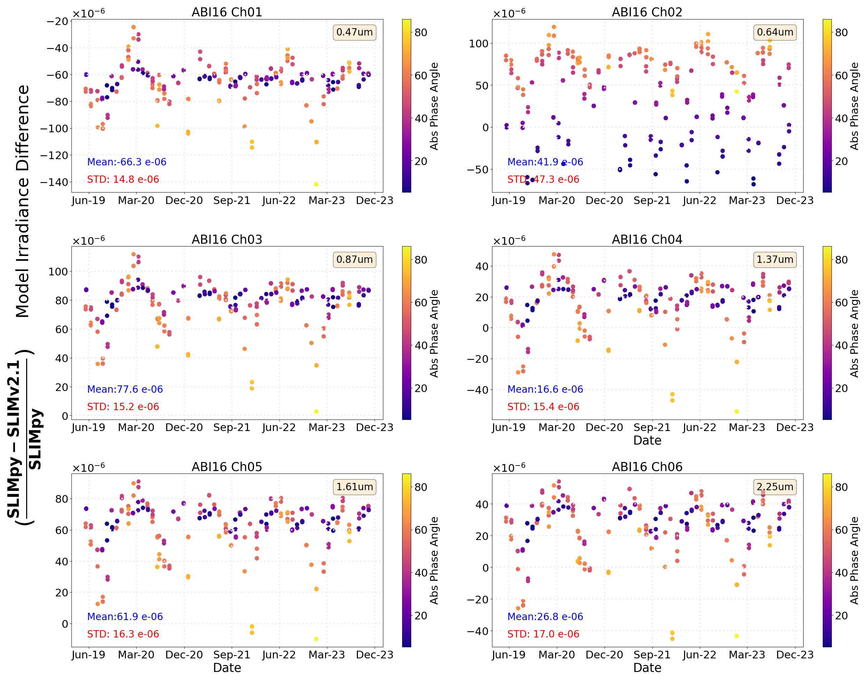
Validation of SLIMpy using G16 ABI
Lunar Irradiance outputs from SLIMpy and SLIMv2.1 were compared.
The irradiance outputs aligns closely for the GOES ABI.
Normalized differences were within machine roundoff errors.

Slide 10
LSICS Geometry Module Validation
Algorithm
Lunar Observation Photometric Geometry Computation
Developed by Tom Stone at USGS for Lunar ROLO model.
Pseudo-Code
Shared by Tom Stone on Sep 19, 2023.
Implementation
The algorithm was implemented to open-source python by NOAA STAR team.
The code was published to GitHub and shared with collaborators for validation.
Tom, Hugh, Steve Maxwell (NIST).
Validation: Comparison was performed between LSICS Lunar Observation Angle Set (LOAS) python module and ROLO and SLIM models for same input geometry.
Results agree within machine roundoff error.
Input Files
• Observation times
• Observer locations
Geometry Calculation Module
Operation: compute Lunar Observation Angle Set (LOAS)
• Phase angle (signed)
• Sub-solar longitude and latitude
• Sub-observer longitude and latitude
Intermediate Data Files
• Geometry: LOAS

Slide 11
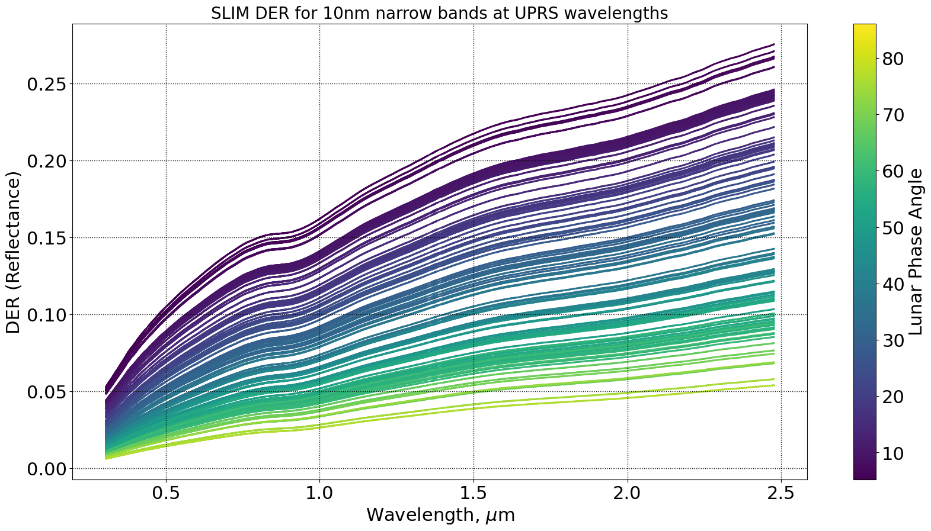
LSICS Disk Reflectance Module
GIRO software provides Disc Equivalent Reflectance (DER) in its output files which was used for testing.
SLIM DER was generated for 2115 wavelength set starting from 300nm and ending at 2481.8nm spaced by λ/1000.
SLIM DER was integrated in the LSICS module.
Model Definitions
• Operating wavelength set
• Basis function coefficients
Lunar Disk Reflectance Module
Operation: compute lunar disk reflectance spectra
• set up basis functions
• reconstruct disk reflectance model
• compute model on operating wave- length set using LOAS parameters
Intermediate Data Files
• Operating wavelengths
• Disk reflectance spectra

Slide 12
LSICS Spectral Irradiance(SI) Module
Reference Spectra
• Lunar reflectance
• Solar Irradiance
SI module executes the conversion from lunar disk reflectance ($R_{disk}$) to spectral irradiance ($E_{moon}$).
Practical computation is a discrete numerical convolution of the disk reflectance spectrum, the solar spectrum ($E_{Sun}$) and SRF ($S_{band}$).
Computing the convolution requires that $R_{disk}$, $E_{Sun}$ and $S_{band}$ are expressed on the same set of wavelengths.
Wavelength set need to be finalized.
Spectral Irradiance Module
Operation: produce model irradiances in sensor bands
• Convolve disk reflectance, solar irradiance and SRF
• Apply distance corrections
Final Outputs
• Lunar spectral irradiances for input observations in sensor spectral bands

Slide 13
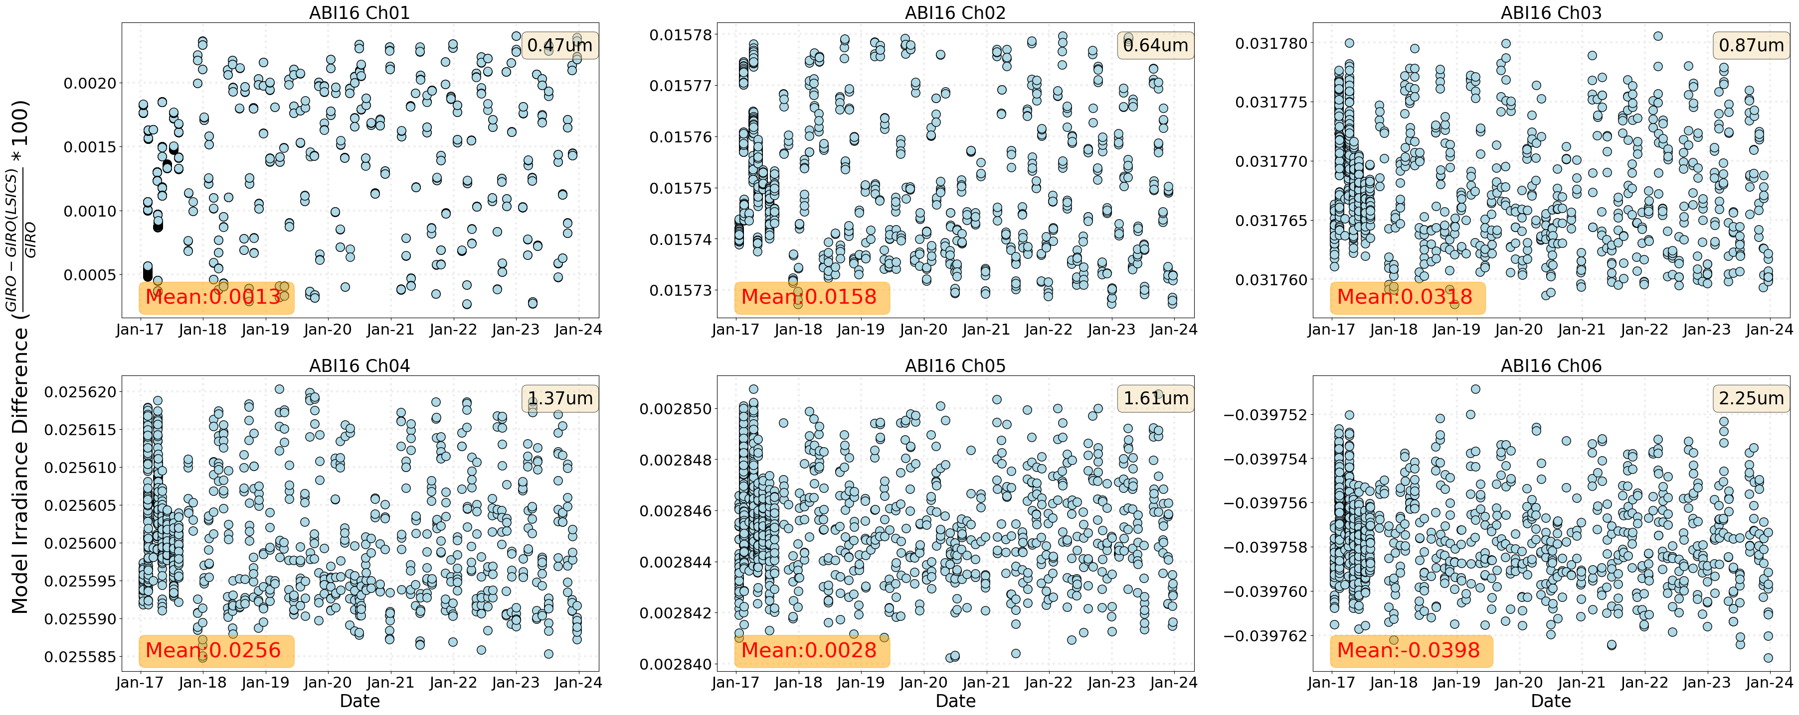
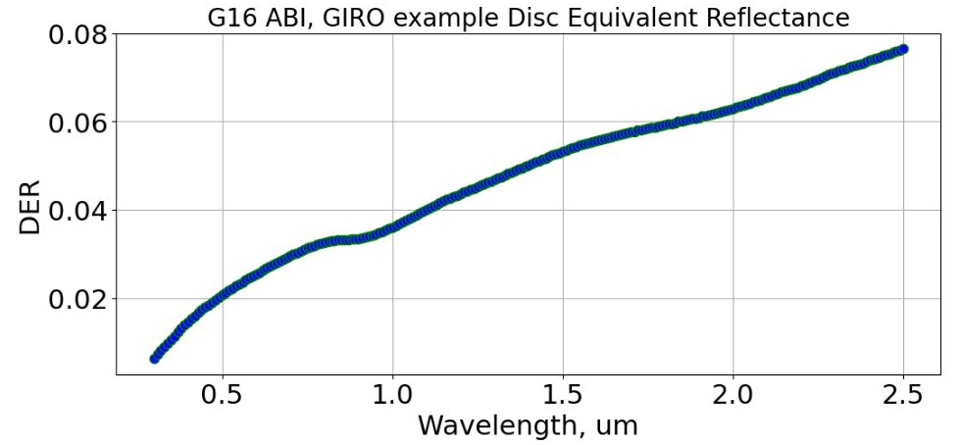
SI module Unit Test using GIRO
Settings
GIRO DER.
Available for ABI Lunar datasets
Resampled to Band SRF
Wehrli Solar Spectrum used by GIRO
Shared by Tom.
Resampled to Band SRF
SRF
GOES-R ABI SRF (NOAA CWG version)
Distance correction performed to get at-sensor model Irradiance
Used GIRO Sun-Moon distance, GIRO Moon-observer distance
Comparison Results, Y-axis:
GIRO: GIRO model at-sensor Lunar Irradiance
GIRO(LSICS): LSICS Spectral Irradiance module following Test Settings above. (At-sensor lunar irradiance)
The GIRO model Irradiance difference is less than 0.04% for all VNIR ABI bands.

Slide 14
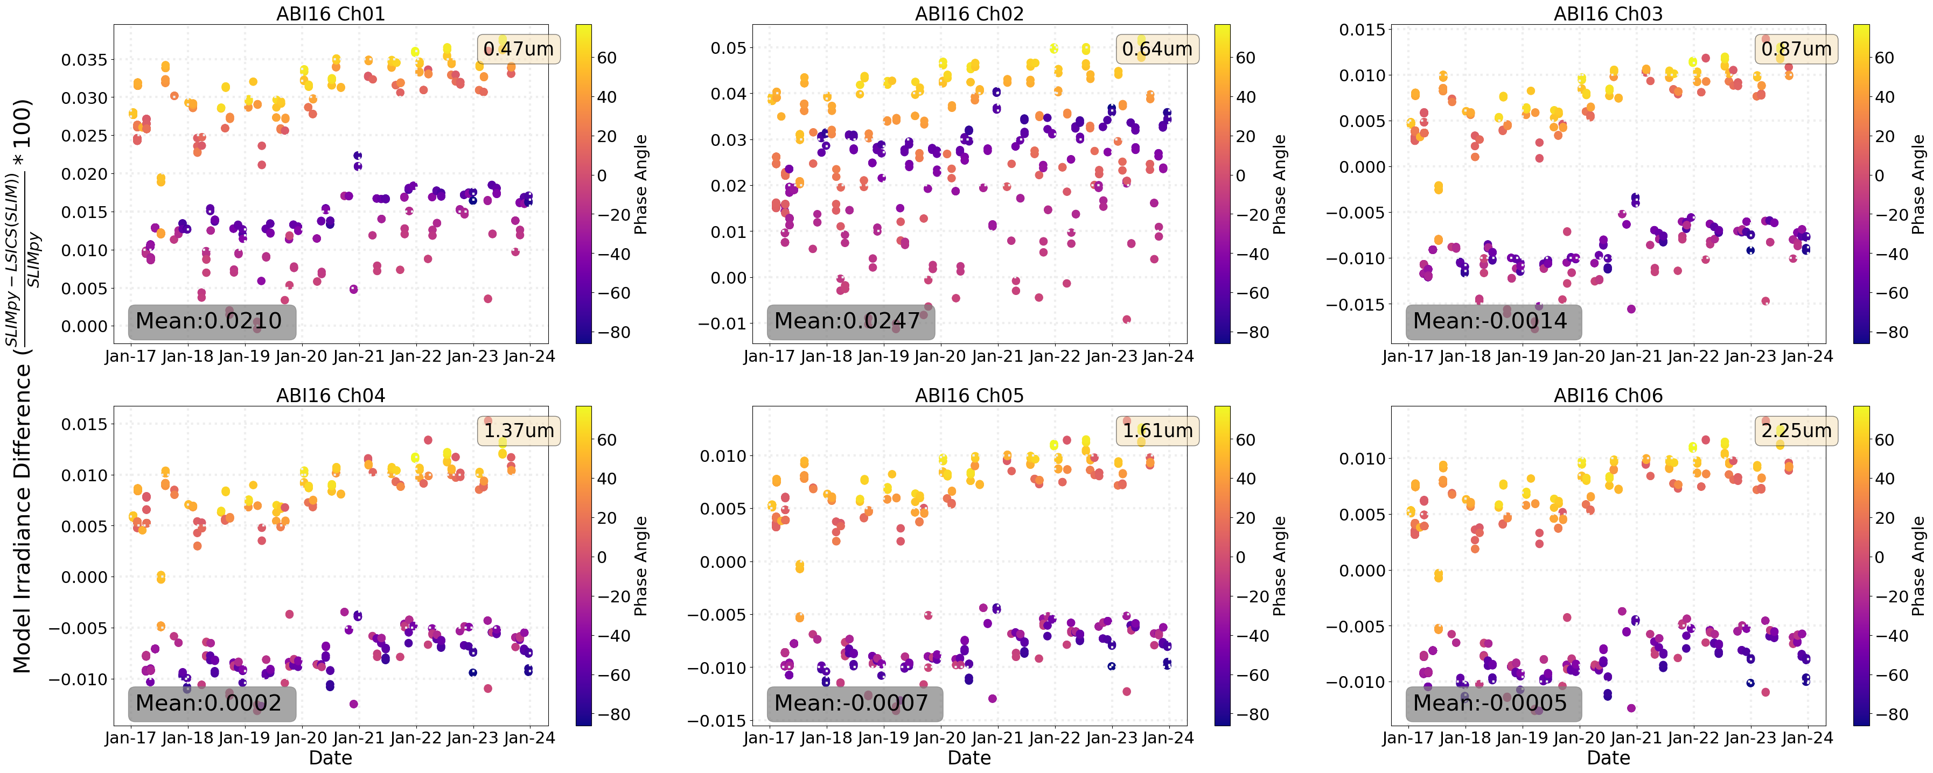
LSICS SLIM Implementation Results
Settings
SLIM DER
At SLIM wavelengths
TSIS Solar Spectrum (SLIMv2.1 version).
Resampled to SLIM wavelengths
SRF
GOES-R ABI SRF (NOAA CWG version)
Resampled to SLIM wavelengths
Comparison Results, Y-axis:
SLIMpy: SLIMpy Model Lunar Irradiance
LSICS(SLIM): LSICS Spectral Irradiance module output using Test settings above, Model Lunar Irradiance
The SLIMpy and LSICS(SLIM) model Irradiance difference is <0.02% for all VNIR ABI bands.

Slide 15
Discussions
LSICS Specification
Follow up from “Specification for a modular lunar spectral irradiance software system, pre-LCSW4 draft” Hugh H. Kieffer
Sharing in Sharepoint has been success so far
concurrent access and edits.
Community inputs and comments are collected.
Next LSICS Lunar Disk Reflectance candidate.
LESSR?
LIME (already in python)?
Improved ROLO?
GitHub license for LSICS distribution.
Currently few modules of LSICS-dev is shared only with collaborators.
Future considerations for copyright and permissions need attention.

Slide 16
Executive Summary
LSICS aims to provide an improved, standardized, modular, and interoperable framework for lunar irradiance calibration.
Initial LSICS core disk module is replication of SLIM model
The initial phase of the project transitioned the SLIM model to Python (SLIMpy 1.0), maintaining its accuracy.
Testing of preliminary implementation of LSICS main modules—Geometry, Lunar Disk Reflectance, and Spectral Irradiance—for SLIM, is ongoing.
Future directions include integrating recently finalized LSICS I/O files specifications.
Integration of other reflectance models is in discussion.
Licensing issues need to be finalized.

Slide 17
Disclaimer
Contents of this presentation is solely the opinions of the authors and does not constitute a statement of policy, decision, or position on behalf of NOAA or the U.S. government.

