Slide 1
Recent Progress of MODIS and VIIRS Lunar Calibration
Truman Wilsonª, Amit Angalª , Jack Xiong^{b}
ªScience Systems and Applications Inc., 10210 Greenbelt Road, Lanham, MD, USA
^{b}Sciences and Exploration Directorate, NASA Goddard Space Flight Center, Greenbelt, MD, USA
GSICS Annual Meeting 2024, Darmstadt, Germany March 11-15, 2024

Slide 2
Outline
Introduction
MODIS RSB lunar calibration
VIIRS RSB lunar calibration
Additional Lunar Observation Applications
Ongoing and Future Efforts
Summary

Slide 3
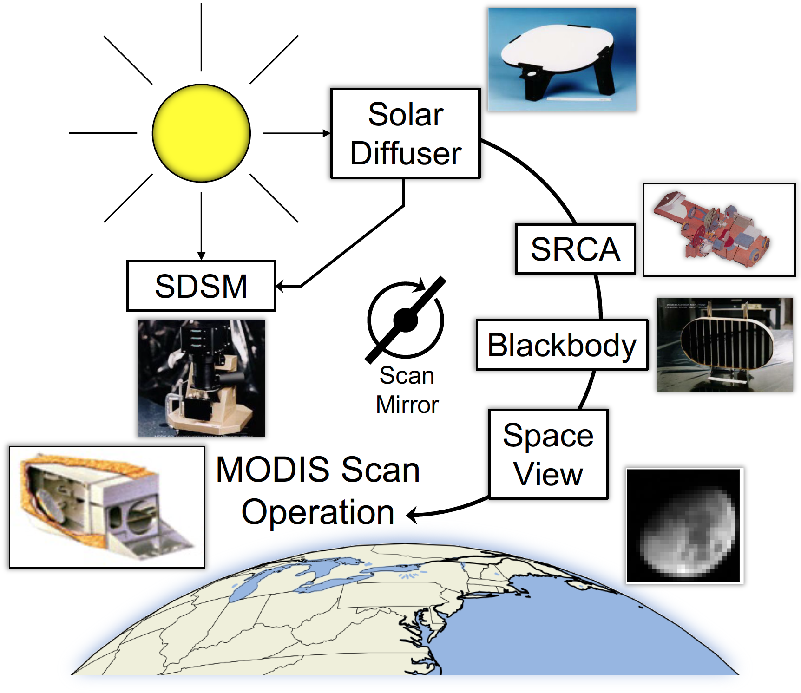
MODIS and VIIRS Lunar Calibration
MODIS and VIIRS share the same calibration strategies
No SRCA in VIIRS
VIIRS SV and SD have the same AOI
Lunar observations are scheduled on a near-monthly basis for a fixed phase angle range.
The Moon is observed through the space-view (SV) port via a spacecraft roll maneuver.
A data section rotation is performed
The Moon as an inter-comparison target:
Observable by many instruments
No overpass time constraints
No atmospheric correction
View-geometry corrections (lunar model).

Slide 4
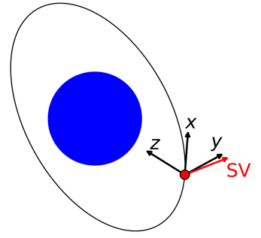
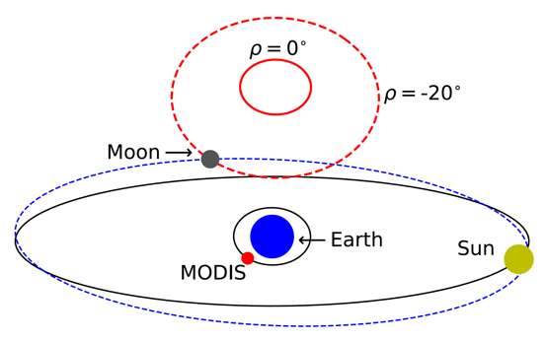
Lunar Observation Geometry
Inst. | Launch Year | Phase Range⁺ | Roll Range | # Events^
Terra | 1999 | 55° to 56° | -20° to 0° | 233
Aqua | 2002 | -55° to -56° | -20° to 0° | 220
SNPP | 2011 | -50.5° to -51.5° | -14° to 0° | 103
N20 | 2017 | -50.5° to -51.5° | -14° to 0° | 52
N21 | 2022 | -50.5° to -51.5° | -14° to 0° | 9
*
*
*
+ Some events fall outside of this range
^ Number of scheduled Moon events as of March 1, 2024.
For MODIS and VIIRS, the Moon is visible in the SV for many scans. Only scans with the full lunar disk visible are used for calibration (below, red).
* VIIRS shows the opposite relationship in roll angle vs SV trace size as its SV is on the opposite side of the y-axis
Track
Terra MODIS Band 1 Lunar Images
Scan

Slide 5
Applications of MODIS and VIIRS Lunar Observations
Reflective Solar Bands (RSB)
Stability Monitoring (MODIS and VIIRS)
RVS characterization (MODIS) and SD degradation adjustment (VIIRS)
Calibration Inter-comparisons (MODIS, VIRS, SeaWiFS, VIIRS, Pleiades, SGLI)
Spatial (MODIS and VIIRS)
Band-to-band registration (BBR) and MTF
Other Applications
Thermal leak and electronic crosstalk characterization (MODIS SWIR bands)
VIIRS Day-Night band (DNB) characterization using the Moon
Thermal Emissive Bands (TEB)
Stability Monitoring (MODIS and VIIRS)
Calibration Inter-comparisons (VIIRS)
Other Applications
Relative calibration for low gain (fire detection) bands (MODIS and VIIRS)
Electronic crosstalk and optical leak characterization (MODIS)
References included in the Appendix

Slide 6
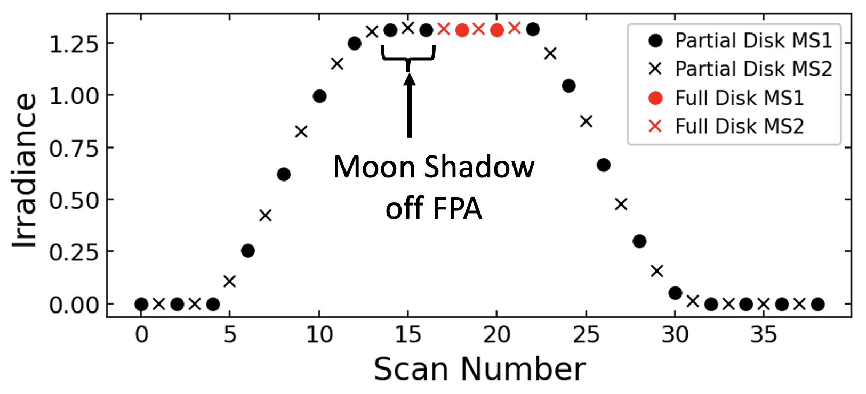
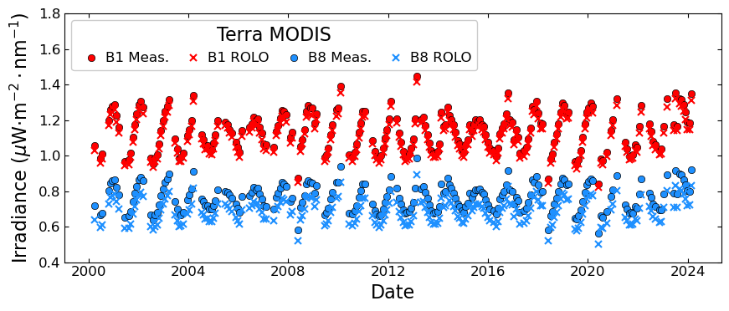
Lunar Calibration Methodology
Lunar irradiance computed using integration of each scan image.
In the current MODIS and VIIRS calculations, only images with the full disk of the Moon on the FPA are used.
Previous MODIS calibrations also used partial images and compensated by applying an oversampling factor.
Variation in the irradiance is mostly caused by view geometry differences between events. This variation can be removed by normalizing to the ROLO model.

Slide 7
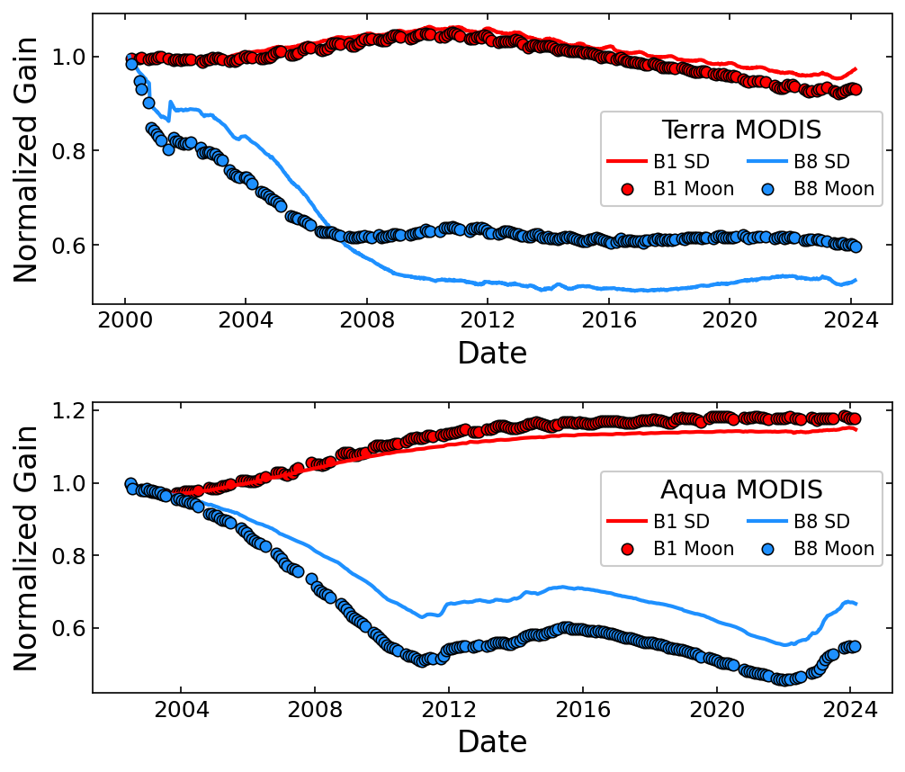
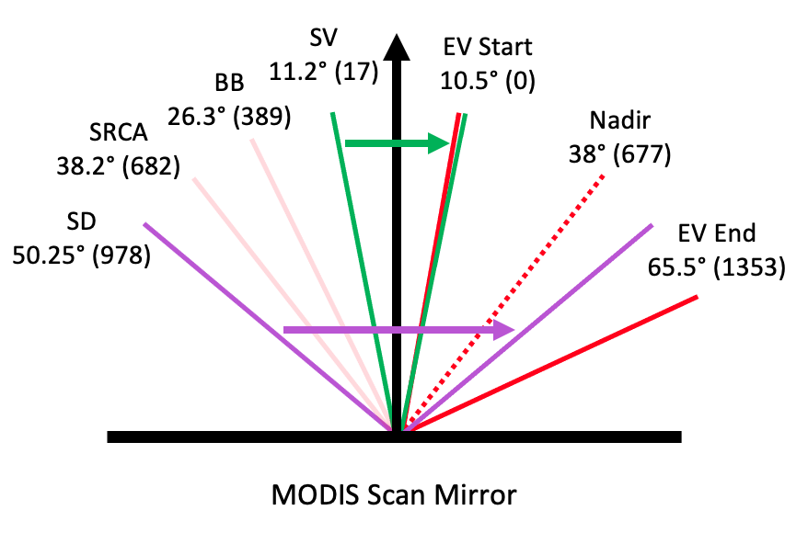
MODIS Lunar Calibration
Moon and SD views at different AOI.
Difference in trending is inferred as a difference in the scan mirror response versus scan angle (RVS).

Slide 8
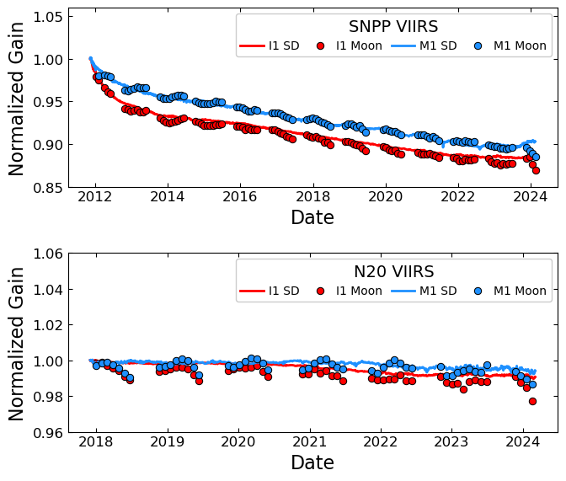
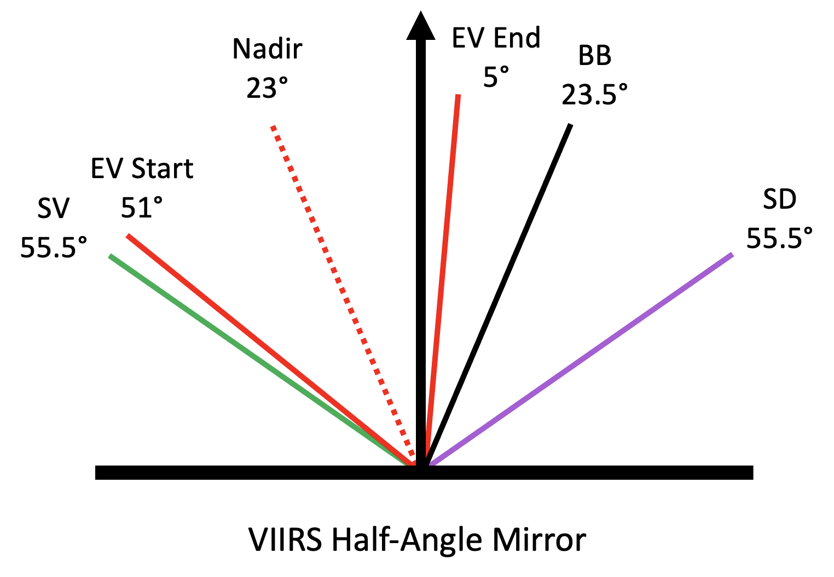
VIIRS Lunar Calibration
Moon and SD views at the same AOI.
Moon can be used to apply correction to the SD trending data.

Slide 9
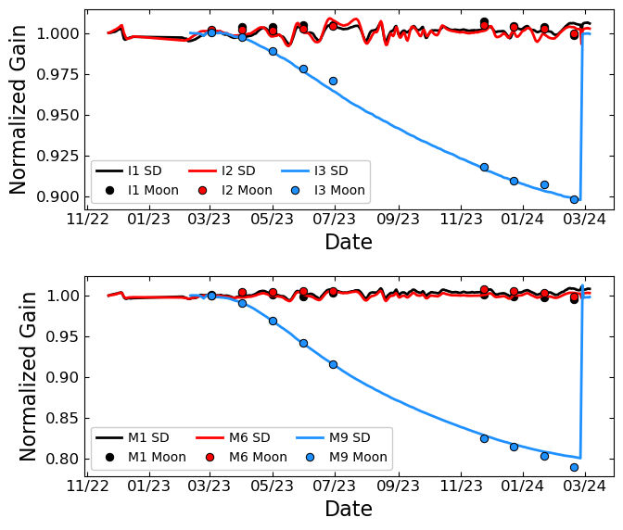
NOAA-21 VIIRS Lunar Calibration
NOAA-21 VIIRS has almost 1 full year of lunar calibration data.
Large gain changes in the SWIR bands were observed and attributed to icing.
A mid-mission outgas (MMOG) has restored the SD gain to near the pre-launch levels.
The next lunar calibration will be in late March 2024.
MMOG
MMOG

Slide 10
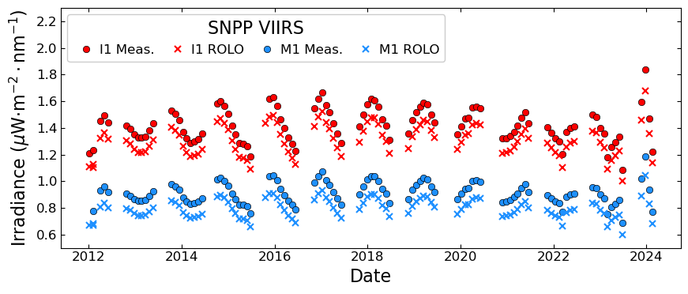
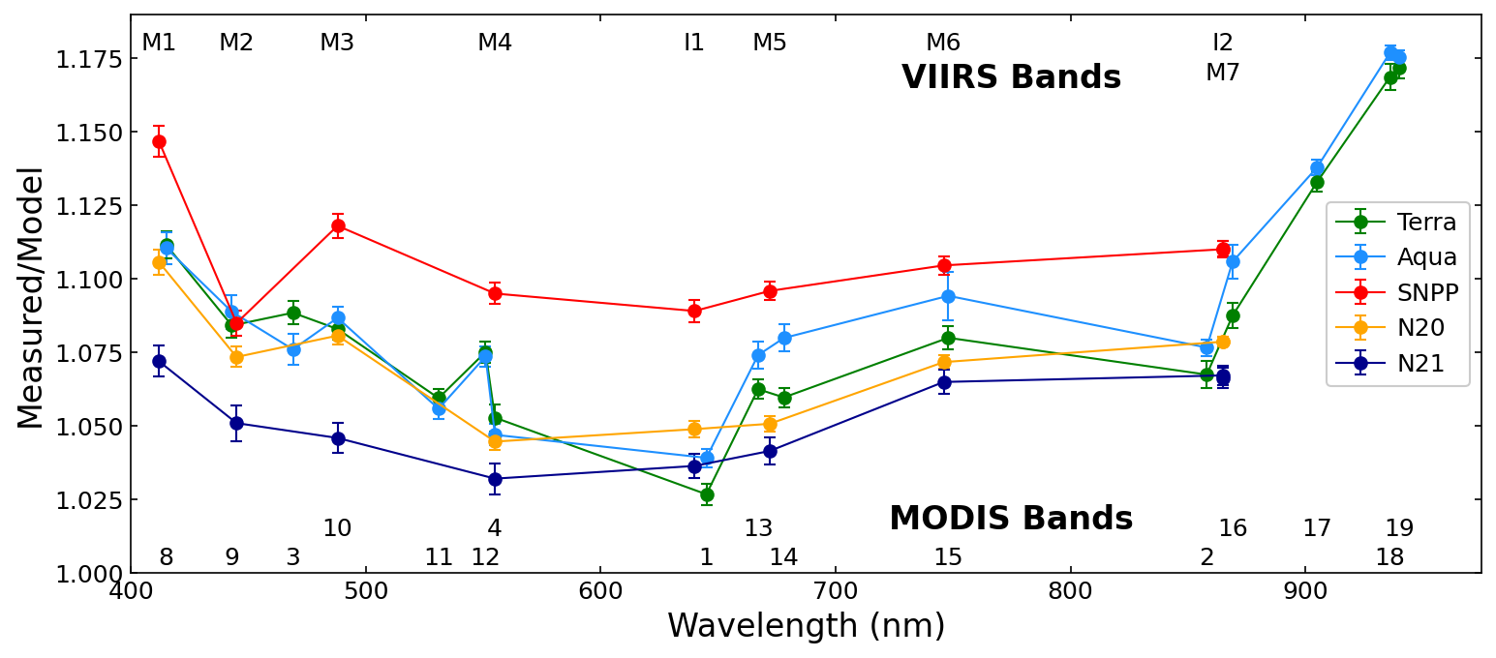
Applications: Calibration Intercomparison
Lunar observations can be used to compare bands across multiple instruments.
The ROLO model is used to account for differences in observation geometry.
Offsets between the measurements and ROLO are nearly constant.
Normalization to ROLO shows some calibration differences between the bands of different instruments as a function of wavelength.
Xiong et al. Remote Sens. 2022, 14, 4754.

Slide 11
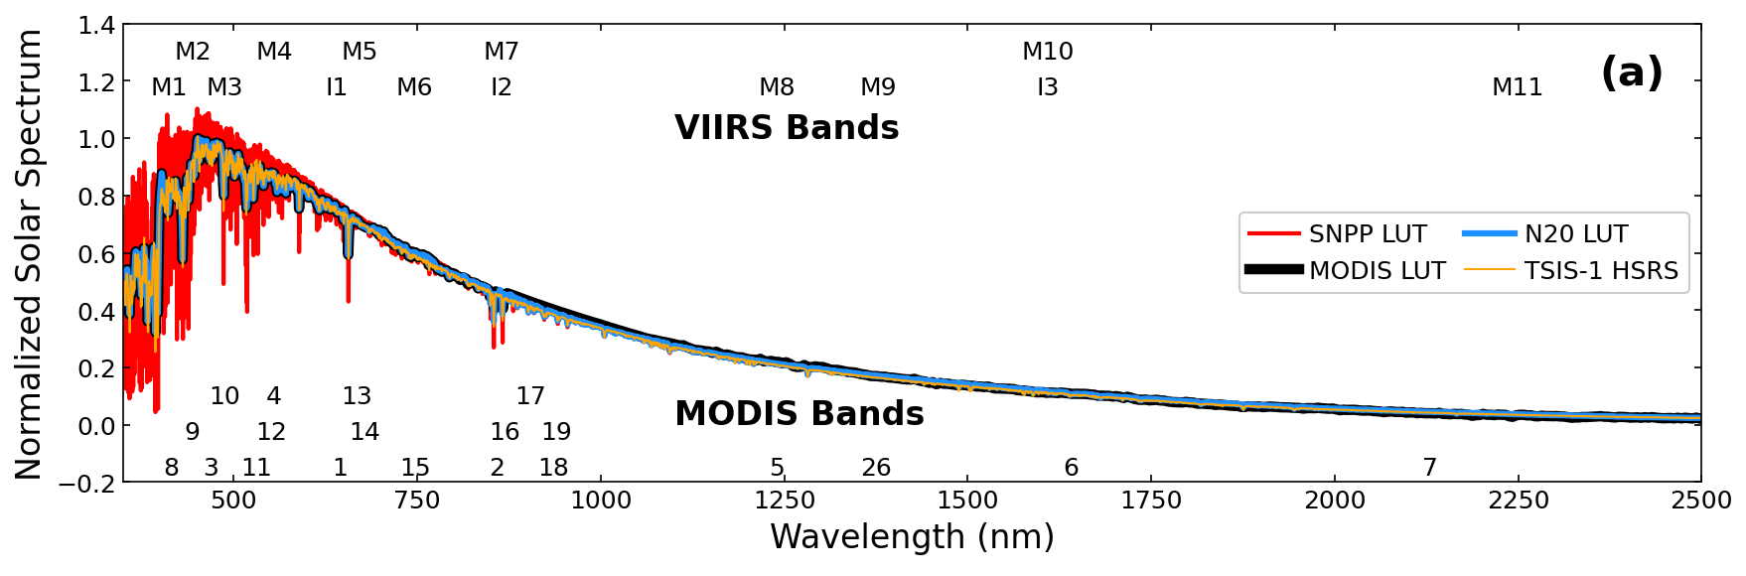
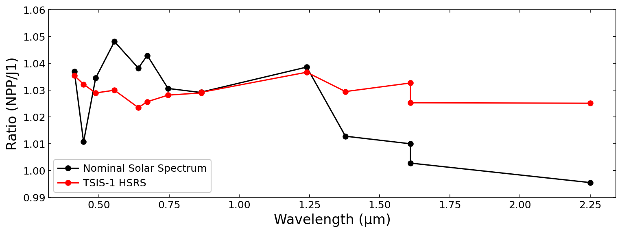
Applications: Calibration Intercomparison
Additional corrections, such as a solar spectrum reference correction are needed for proper comparison.
Example: SNPP uses Kurucz while N20 uses Thuillier. A more consistent calibration intercomparison can be performed by deriving all the calibration data using TSIS-1 HSRS data.
Alternatively, a correction factor can be applied to the ratio with the following equations:
Xiong et al. Remote Sens. 2022, 14, 4754.

Slide 12
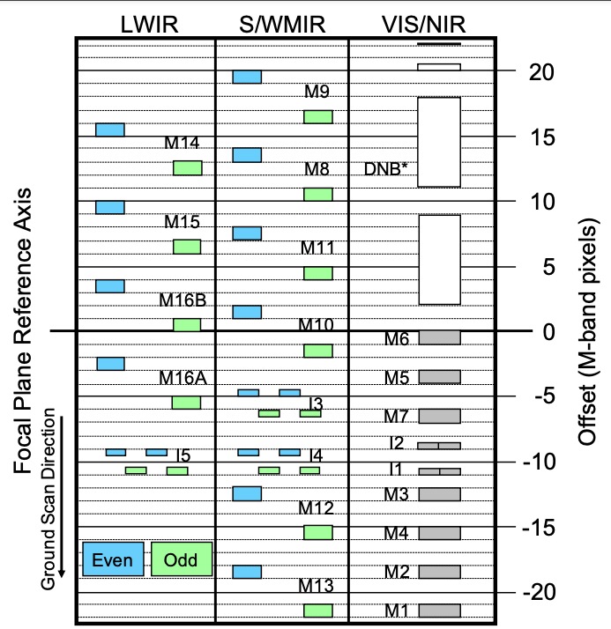
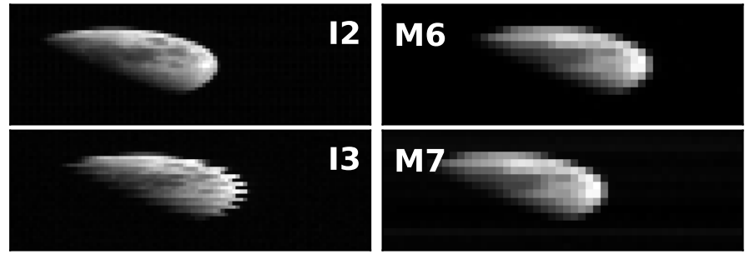
Applications: MODIS and VIIRS Spatial Characterization
VIIRS* Focal Plane Layout
*MODIS has similar spatial offsets
VIIRS unscheduled Moon images showing spatial offsets
Centroids or image X-correlation are used to compute the Band-to-Band Registration (BBR) from the reference band†.
Aqua MODIS Band 8
N20 VIIRS
Band M9
Wilson et al. IEEE TGRS 60, 4702312, 2022.
† Band 1 for MODIS, and I1 for VIIRS

Slide 13
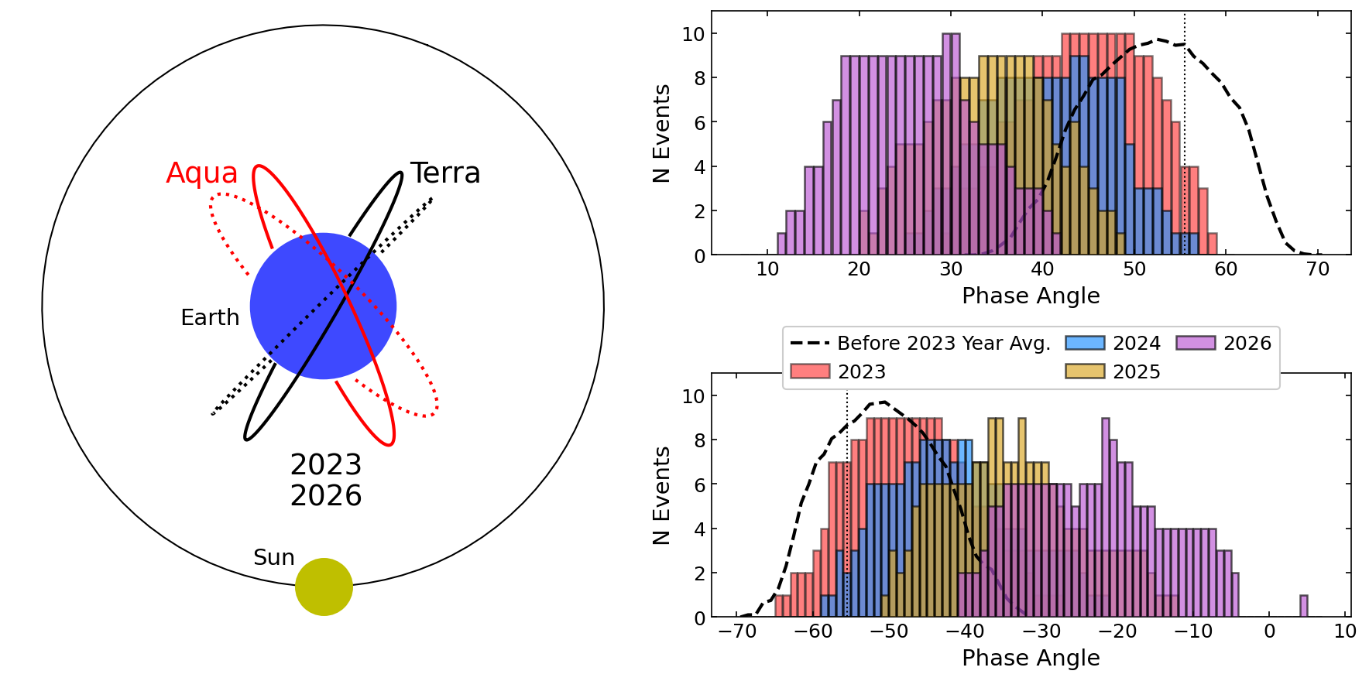
Ongoing and Future Efforts: MODIS Lunar Phase Drift
Terra
Aqua
Orbit simulations provided by Earth Science Mission Operations (ESMO) Flight Dynamics System (FDS) at NASA/GSFC
13

Slide 14
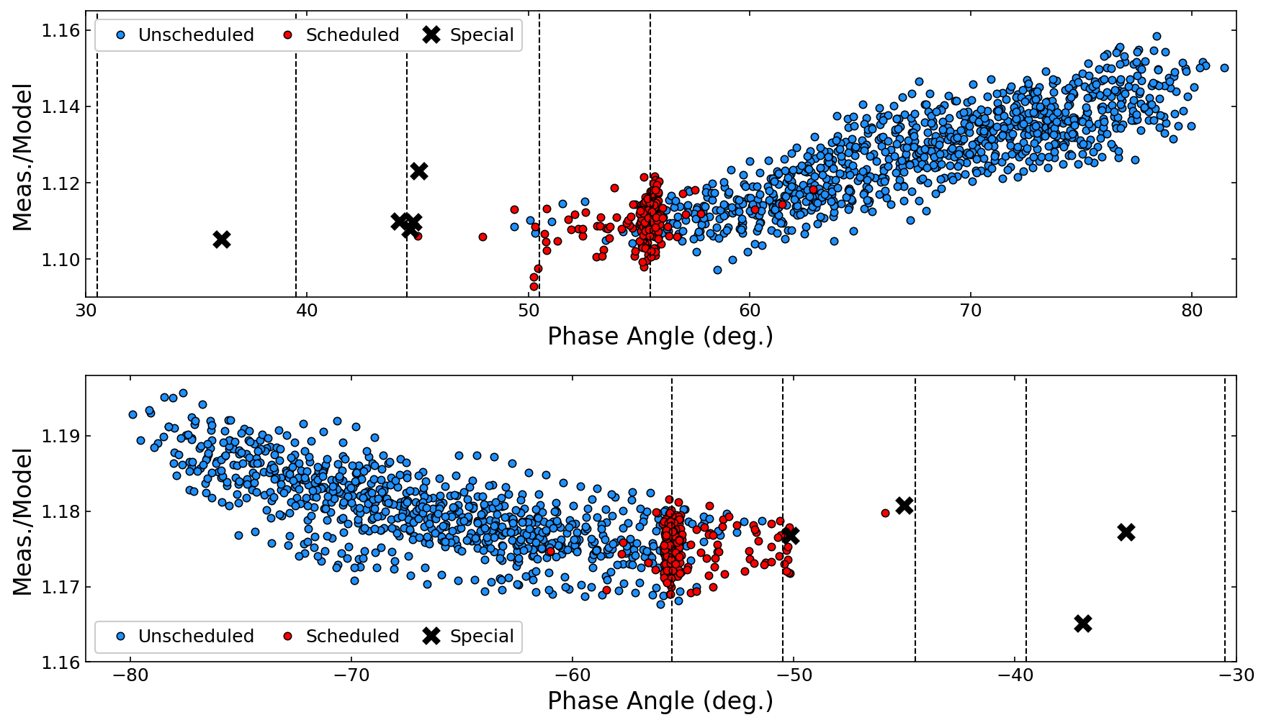
Ongoing and Future Efforts: MODIS Lunar Phase Drift
Terra Band 8
History
Where we’re going
2023
2024
2025
Unscheduled Moon data combined with special Moon data used to determine the expected phase change.
The “special” data collects will continue whenever the opportunity is available.
2026
Where we’ve been
Aqua Band 19
Where we’re going
History
2023
2024
2025
2026
Where we’ve been
Wilson et al. Proc. SPIE 1272917, 2023.
Details also presented at the GSICS Lunar Workshop, Dec. 2023.
14

Slide 15
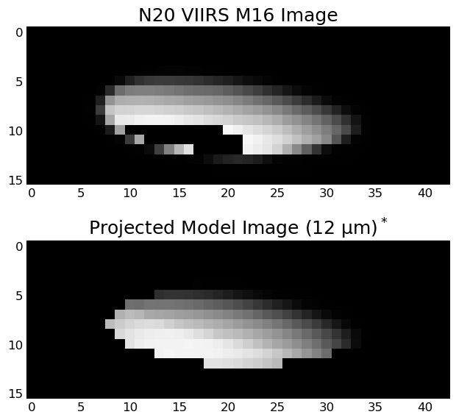
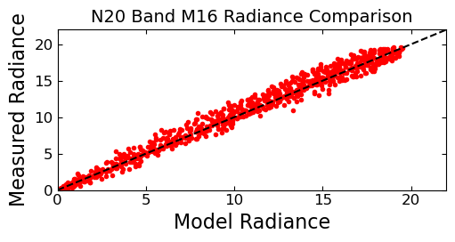
Future Efforts: TEB Lunar Calibration/Intercomparisons
MODIS/VIIRS Thermal Emissive Bands (TEB) also observe the Moon.
High signal levels cause saturation for nearly all TEB.
Pixel-wise comparison can be performed with surface-resolved thermal model of the Moon.
Corrections associated with Sun-Moon and Moon-Instrument distance are not applied below.
*Model data courtesy of Thomas Müller of MPE
See: Müller et al. A&A 650, A38, 2021.

Slide 16
Conclusions
MODIS and VIIRS lunar observations have been implemented successfully into the on-orbit calibration of each instrument.
The MODIS lunar calibration is used to track the scan mirror RVS
The VIIRS lunar calibration is used to adjust the SD F-factor.
NOAA-21 lunar calibrations have begun and have almost 1 full year of lunar calibrations.
Moon observations can also be used for many alternative applications, including instrument intercomparison, spatial calibration, and electronic crosstalk correction.
Future Work:
MODIS orbital drift monitoring and phase dependence correction.
TEB calibration and intercomparison with spatial-resolved thermal models.

Slide 17
Key References
Sun, J.-Q., et.al, “MODIS Reflective Solar Bands On-Orbit Lunar Calibration”, IEEE TGRS, vol. 45(7), 2383-2393, 2007.
Xiong, X, et.al, "Intercomparison of On-Orbit Calibration Consistency Between Terra and Aqua MODIS Reflective Solar Bands Using the Moon," IEEE GRSL, vol. 5( 4), pp. 778-782, 2008.
Xiong, X. and H. Chen, “Using lunar observations to assess Terra MODIS thermal emissive bands calibration,” Proc. SPIE 7807, Earth Observing Systems XV, 78070I, 2010.
Sun, J., et.al, “Evaluation of Radiometric Improvements With Electronic Crosstalk Correction for Terra MODIS Band 27”, IEEE TGRS, vol 52(10), 6497-6507, 2014.
Choi, T., et.al, “On-Orbit Lunar Modulation Transfer Function Measurements for the Moderate Resolution Imaging Spectroradiometer”, IEEE TGRS, vol 53(1), 270-277, 2014.
Wang, Z., et.al, “On-Orbit Characterization of MODIS Modulation Transfer Function Using the Moon”, IEEE TGRS, vol 52(7), 4112-4121, 2014.
Xiong, X., et.al, “Lunar Calibration and Performance for S-NPP VIIRS Reflective Solar Bands”, IEEE TGRS, vol. 54, issue 2, pp. 1052-1061, 2016.
Wilson, T., et.al, "Development and Implementation of an Electronic Crosstalk Correction for Bands 27–30 in Terra MODIS Collection 6", Remote Sensing, vol. 9(6), 569, 2017.
Wang, Z., X. Xiong, J. Fulbright, and N. Lei, "VIIRS day/night band radiometric calibration stability monitoring using the Moon", J. Geophysical Research, vol. 122(11), pp. 5616-5624, 2017.
Wilson, T., and X. Xiong, "Surface Corrected Lunar MTF Measurements in MODIS and VIIRS Using the SP Model," IEEE TGRS, vol. 60, pp. 1-12, Art no. 5110112, 2022
Xiong, X., J. Sun, A. Angal, T. Wilson, "Calibration Inter-Comparison of MODIS and VIIRS Reflective Solar Bands Using Lunar Observations", Remote Sensing Journal, 14 (21), 4754, 2022

Slide 18
Appendix: Lunar Calibration Methodology
MODIS and VIIRS use similar but slightly different equations to compute the lunar irradiance
MODIS
VIIRS
$$I=\frac{1}{N}\frac{\sum_{S,D}^{N}{m_{1}E_{sun}dn_{moon}^{∗}ω}}{πRVS_{SV}}$$
$$I=\frac{1}{N}\frac{\sum_{S,D}^{N}{Fω\sum_{i}{c_{i}dn_{moon}^{i}}}}{RVS_{SV}}$$
N: Number of scans m₁: Calibration coefficient
S,D: Scan, Detector
dn: Background-subtracted signal
RVS: Response versus scan angle
ω: Detector solid angle
E_{sun}: Solar spectral irradiance
N: Number of scans F: F-factor derived from SD data
S,D: Scan, Detector
dn: Background-subtracted signal
RVS: Response Versus Scan Angle
ω: Detector Solid Angle
c_{i}: Calibration Coefficients
The principles of each calculation are the same. Integrate dn times the calibration coefficients, and average over the total number of scans used.

Slide 19
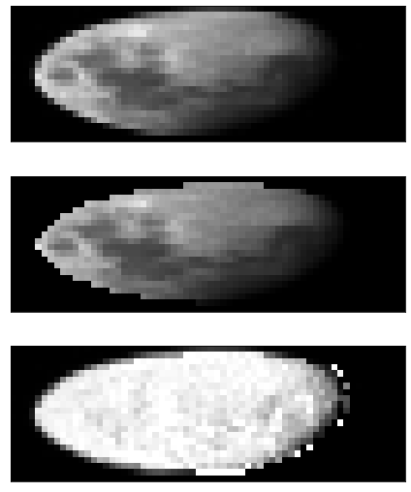
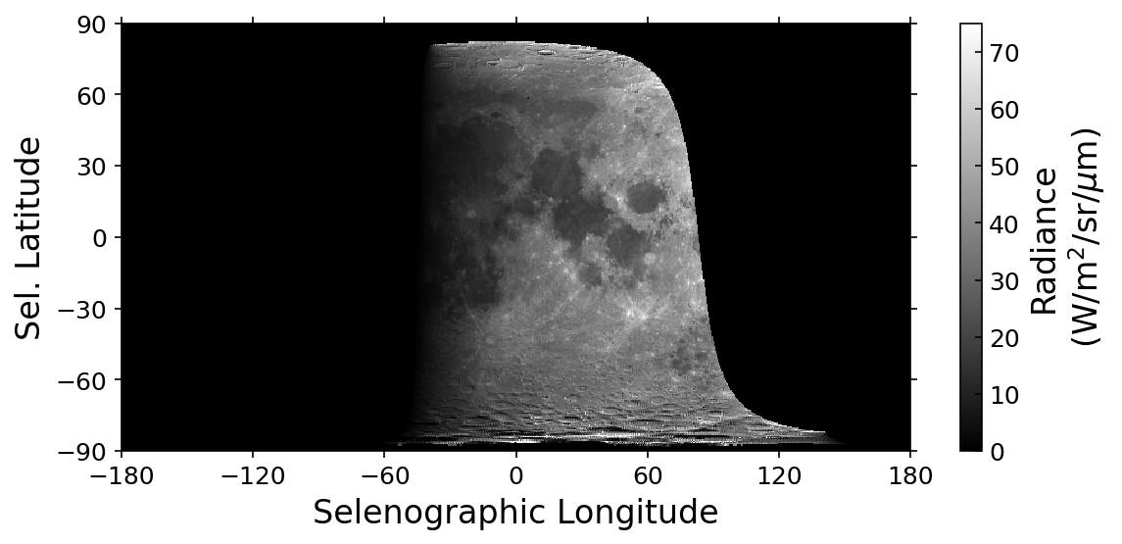
Appendix: MTF Surface Correction with SP Model
SP Model provided by Toru Kouyama of AIST (Japan) in January 2021.
Measured Image
Model Projection
Measured/Modeled Ratio
Model data is projected onto image coordinates using the observation geometry parameters.
Wilson et al. IEEE TGRS 60, 5110112, 2022.

Slide 20
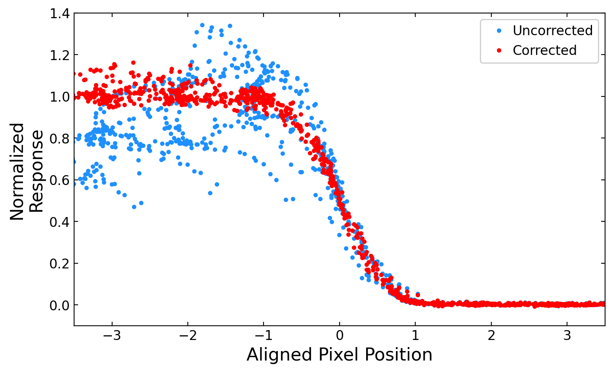
Appendix: MTF Surface Correction with SP Model
Surface correction creates a smooth profile.
MTF derived from FFT of the line spread function.
Terra MODIS Band 1
N20 VIIRS Band M7
Wilson et al. IEEE TGRS 60, 4702312, 2022.

Slide 21
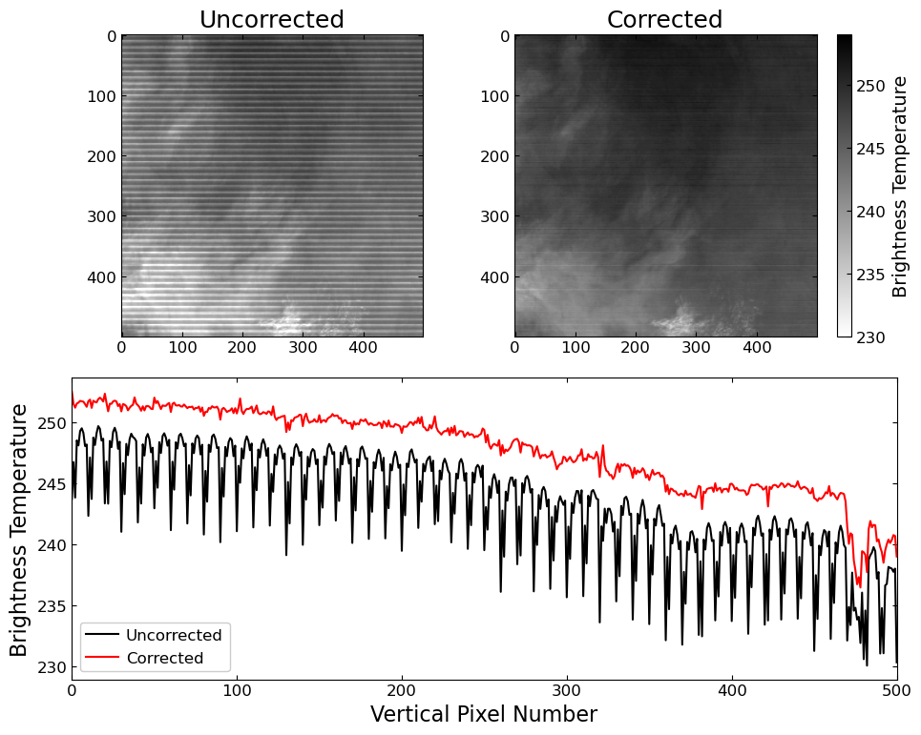
Appendix: MODIS Electronic Crosstalk Characterization
Electronic Crosstalk characterized using known spatial offsets beween lunar images.
Derived correction coefficients are used to correct the Level-1B imagery
Aqua MODIS
Band 27
Sending Bands
Band 27
Band 28
Band 29
Band 30
Chang et al. Proc. SPIE 126851E, 2023.

