Slide 1
S-NPP, N-20, and N-21 VIIRS Reflective Solar Bands
On-orbit Radiometric Calibration Performance
VIIRS Characterization Support Team (VCST), NASA GSFC
(presented by Ning Lei)
March 12, 2024
GSICS Annual Meeting, March 11-15 Darmstadt Germany
1

Slide 2
Outline
VIIRS reflective solar band (RSB) on-orbit radiometric calibration
events and methodology
2. RSB on-orbit calibration performance update
3. Summary
2

Slide 3
Major events/updates since GSICS 2023
Spacecraft Command and Data processor reset (July 26, 2023)
Updated the H_{RTA} model parameter values
S-NPP
Spacecraft Command processor resets (Sep. 29, 2023, Feb. 4, 2024)
VIIRS Command processor reset to resolve a quality flag bit issue (Feb. 20, 2024)
Updated the H_{RTA} model parameter values
Implement de-striping algorithms for VisNIR bands
N-20
Refined the screen transmittance functions, using calibration data collected
on both the yaw maneuver and regular orbits
Second mid-mission outgassing to restore SWIR and thermal emissive bands to at-launch performance levels
SDSM operation frequency changed from one orbit per day to one orbit per week
N-21
3

Slide 4
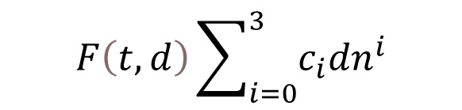
VIIRS RSB on-orbit calibration
Spectral radiance
$$F\left(t,d\right)\sum_{i=0}^{3}{c_{i}{dn}^{i}}$$
on-orbit calibrated
SDSM screen
RTA
SDSM
sunlight
Space view
SD screen
Solar Diffuser (SD)
Solar Diffuser (SD): a calibration source; its BRDF change (H-factor) measured by the SD stability monitor (SDSM)
4

Slide 5
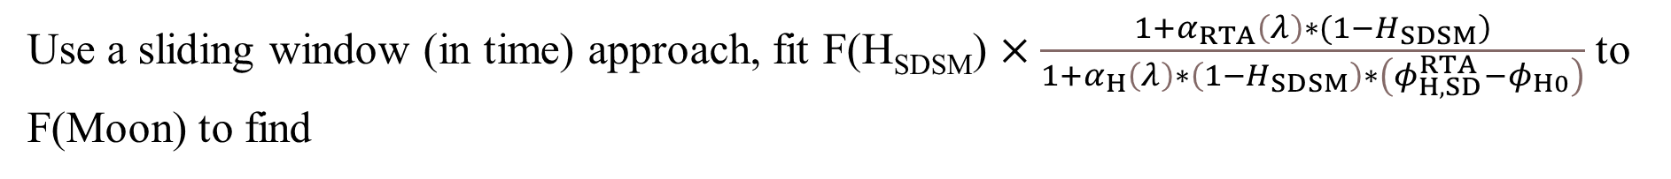
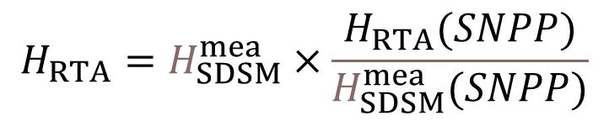
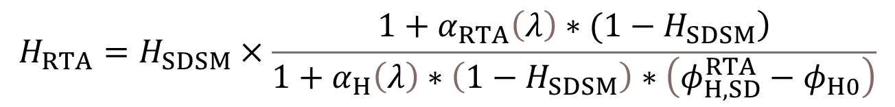

Calculating F(SD) needs H_{RTA}
S-NPP and N-20
$$H_{RTA}=H_{SDSM}×\frac{\left.1+α_{RTA}\left(λ\right)∗(1−H_{SDSM}\right)}{1+α_{H}\left(λ\right)∗\left(1−H_{SDSM}\right)∗\left(φ_{H,SD}^{RTA}−φ_{H0}\right)}$$
Solar azimuth angle
Use a sliding window (in time) approach, fit F(H_{SDSM}) $×\frac{\left.1+α_{RTA}\left(λ\right)∗(1−H_{SDSM}\right)}{1+α_{H}\left(λ\right)∗\left(1−H_{SDSM}\right)∗\left(φ_{H,SD}^{RTA}−φ_{H0}\right)}$ to
F(Moon) to find
$α_{RTA}$
N-21
$$H_{RTA}=H_{SDSM}^{mea}×\frac{H_{RTA}(SNPP)}{H_{SDSM}^{mea}(SNPP)}$$
(Note: once more lunar F-factors are available, we’ll use the methodology for SNPP and N20)
5

Slide 6
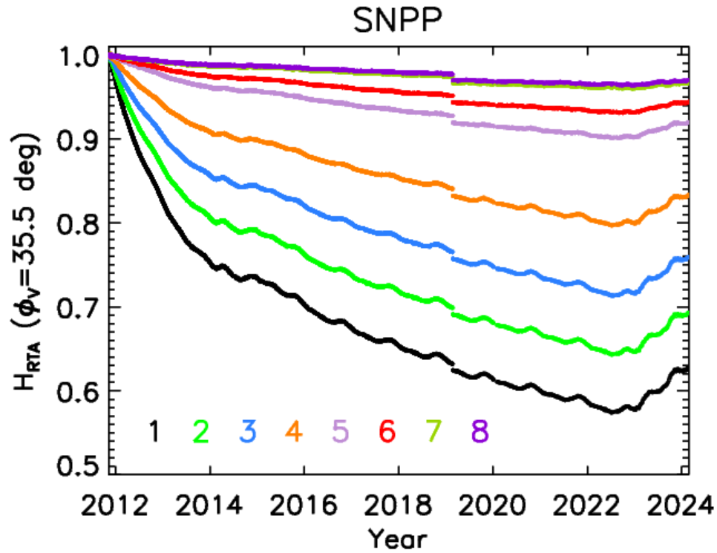
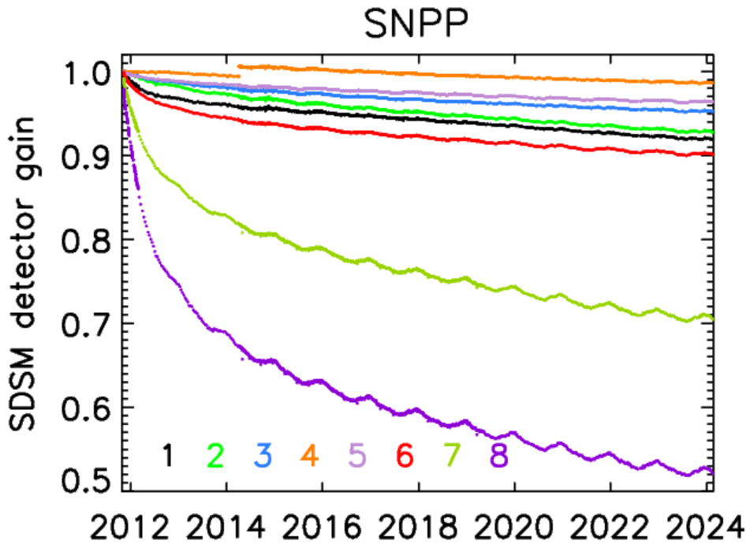
Performance of S-NPP SD and SDSM
Feb. 24, 2019 event
H-factors dropped by about 1% due to the Feb. 24, 2019 event, faster at a shorter wavelength
Recently (~last 1.5 years), H-factors trend upwards, also occurring for N20 and MODIS SDs
SDSM detector gains trend normally; largest decrease for SDSM detector 8 (longest wavelength)—lattice damage from solar bombardment
6

Slide 7
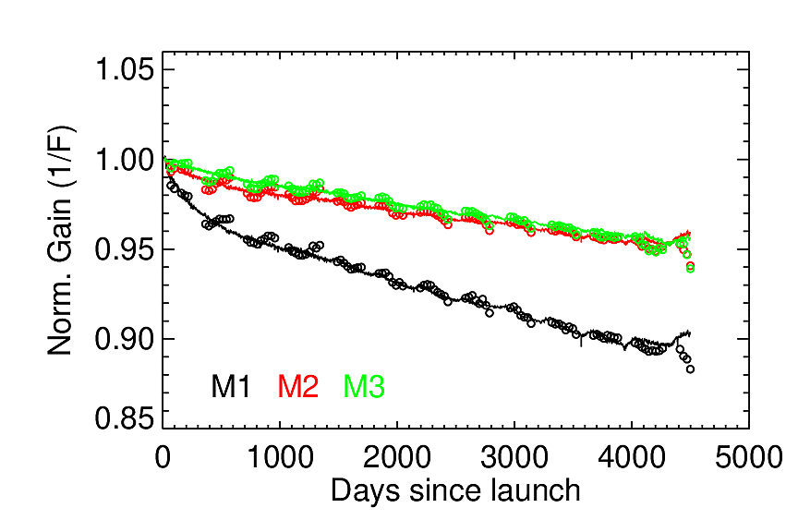
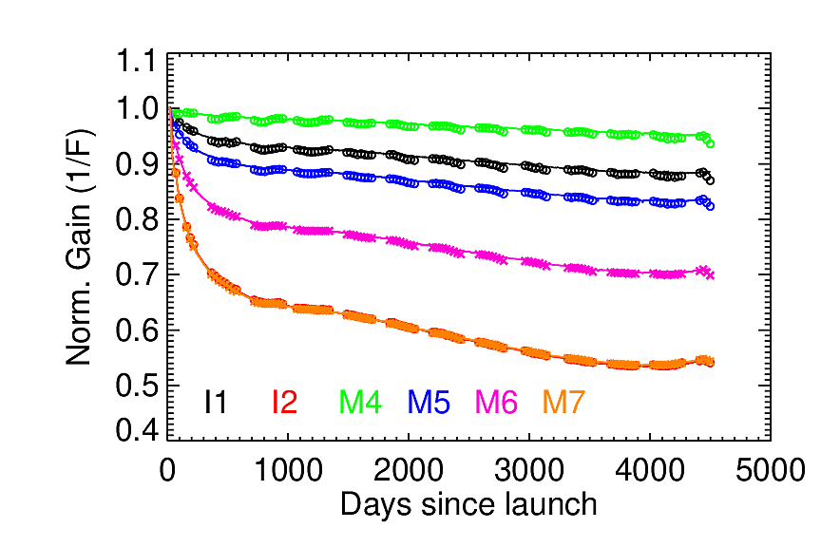
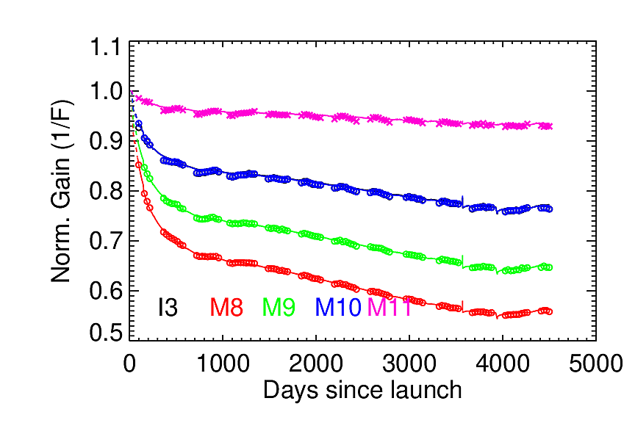
S-NPP RSB F-factors
Solid lines: 1/F(SD); circles: 1/F(moon)
F decreases with time, because of telescope mirror surface tungsten oxide contamination
Over the last 3-4 months, F(SD) diverges from F(moon): need an investigation

Slide 8
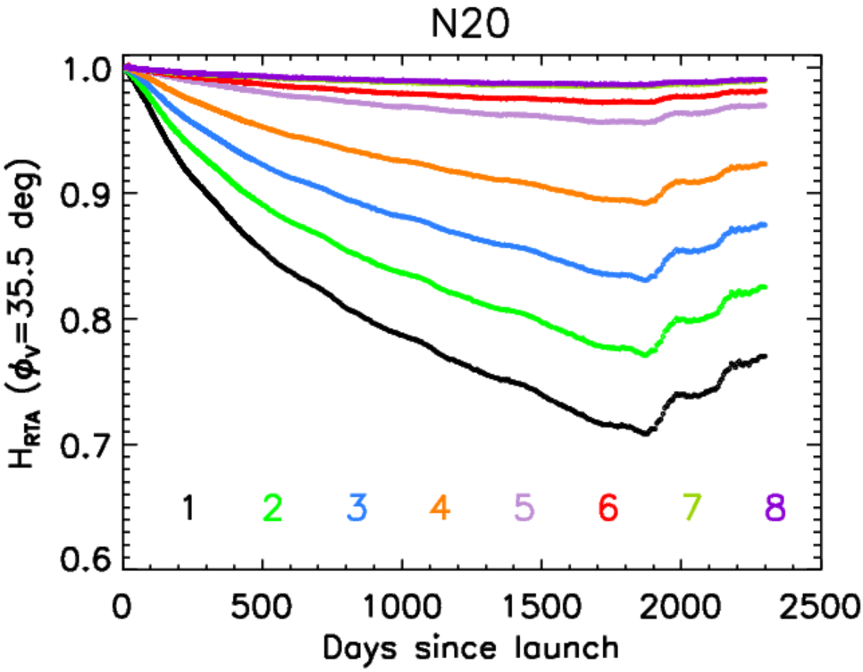
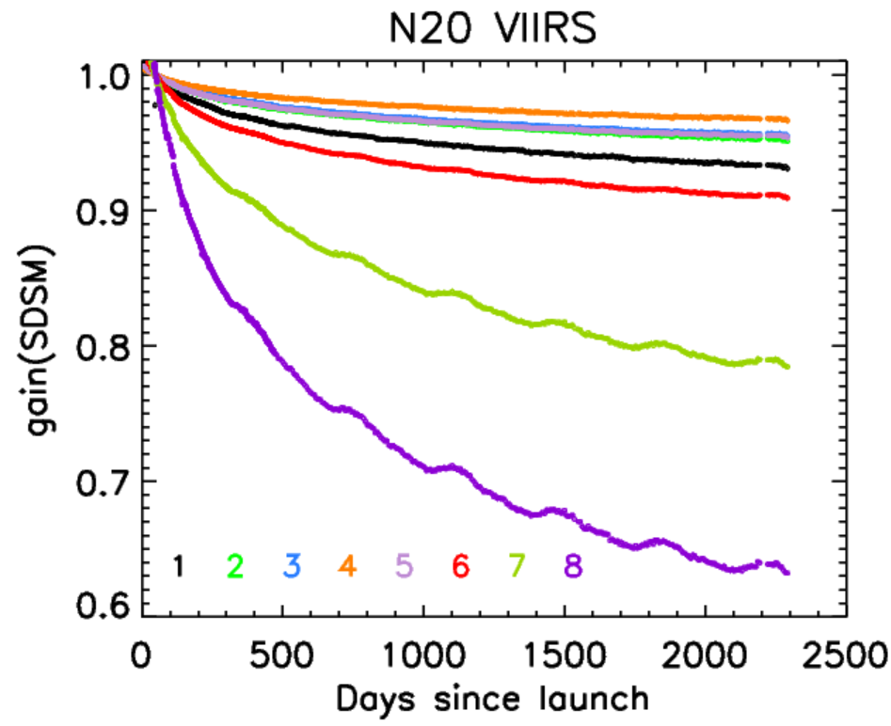
Performance of N-20 SD and SDSM
H-factors decrease at slower rates than S-NPP H-factors
SDSM gains decrease similarly to S-NPP
Notes:
8
SDSM_Hplot_V4aeroX.20150629

Slide 9
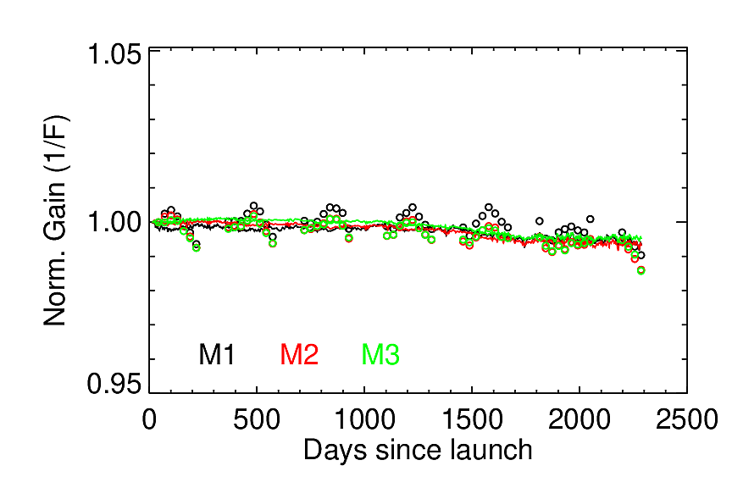
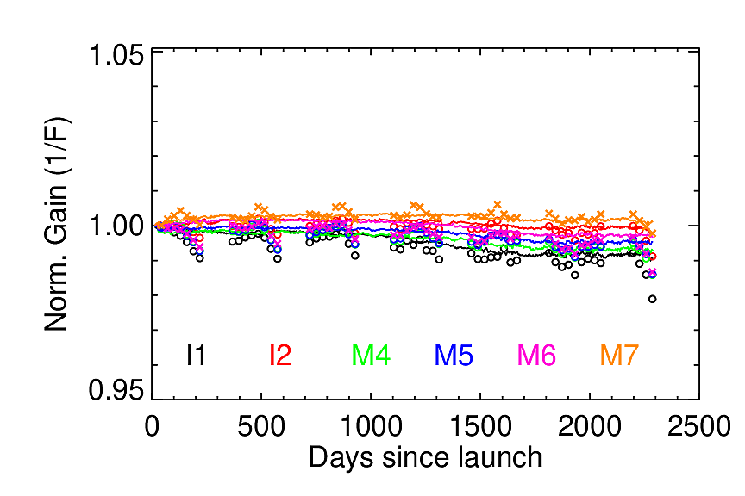
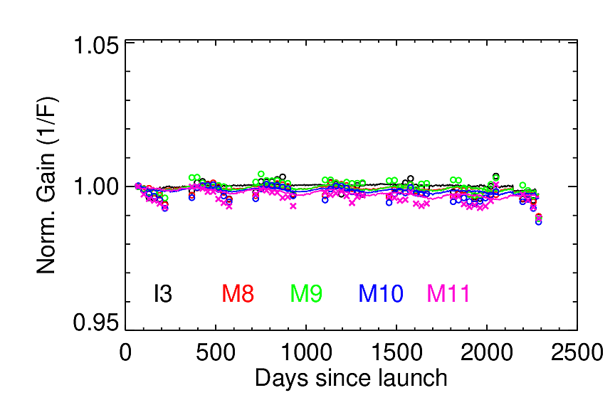
N-20 RSB F-factors
Solid lines: 1/F(SD); circles: 1/F(moon)
F-factors are very stable over mission
Over the last 3-4 months, F(SD) diverges from F(moon): need an investigation

Slide 10
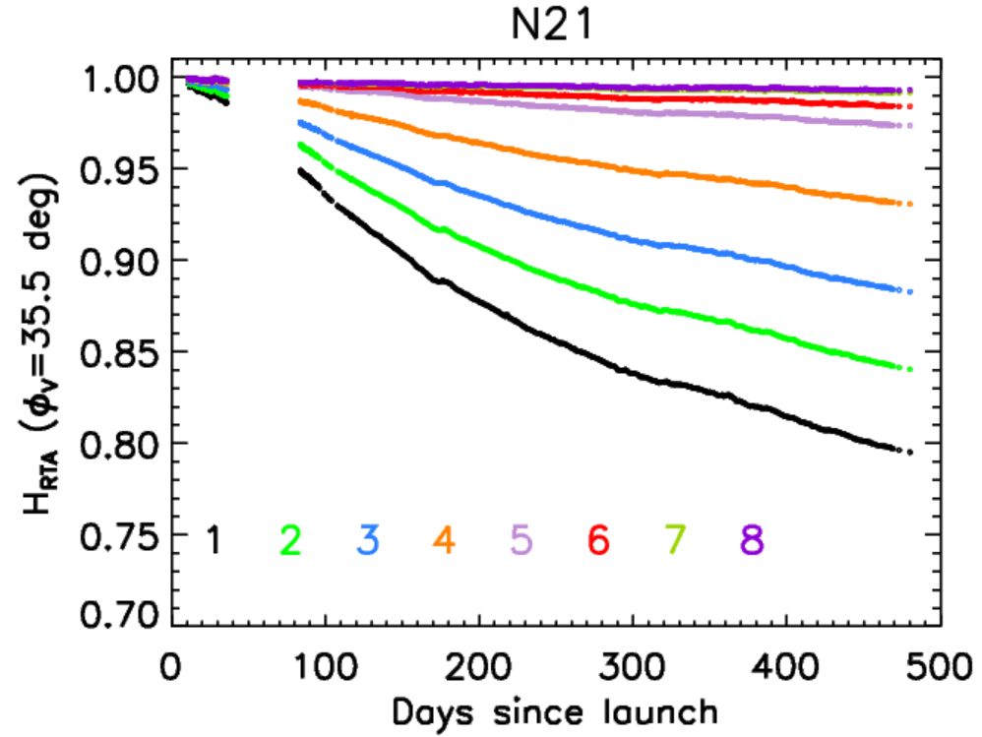
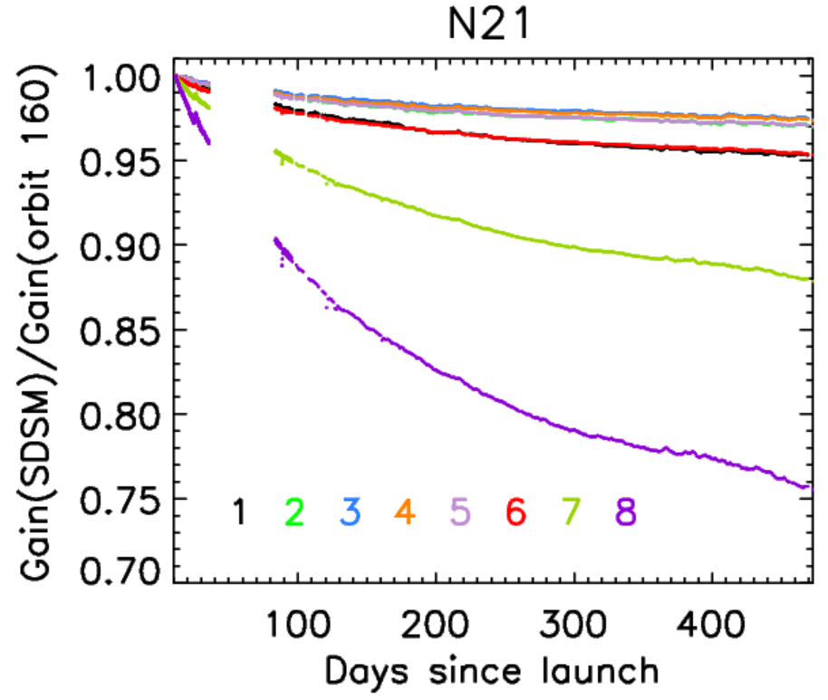
Performance of N-21 SD and SDSM
H-factors decrease faster than N-20, but similarly to S-NPP H-factors
SDSM gains decrease similarly to S-NPP and N-21
Notes:
10
SDSM_Hplot_V4aeroX.20150629

Slide 11
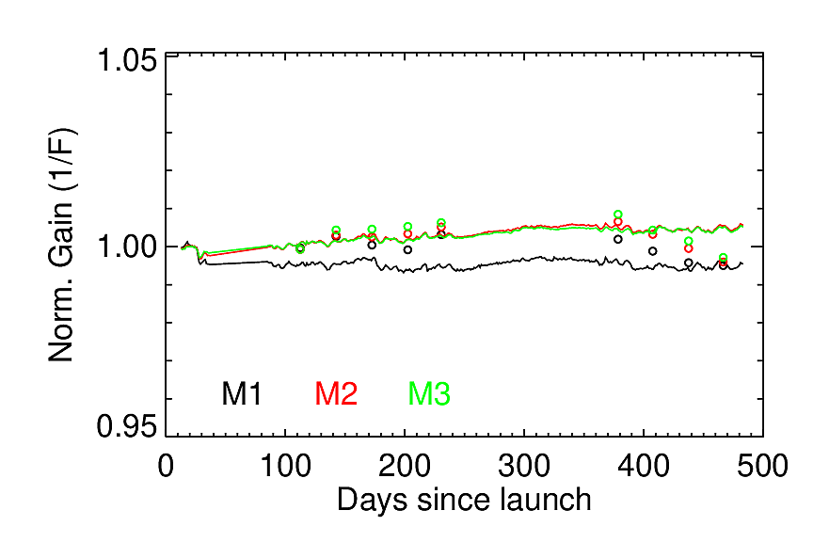
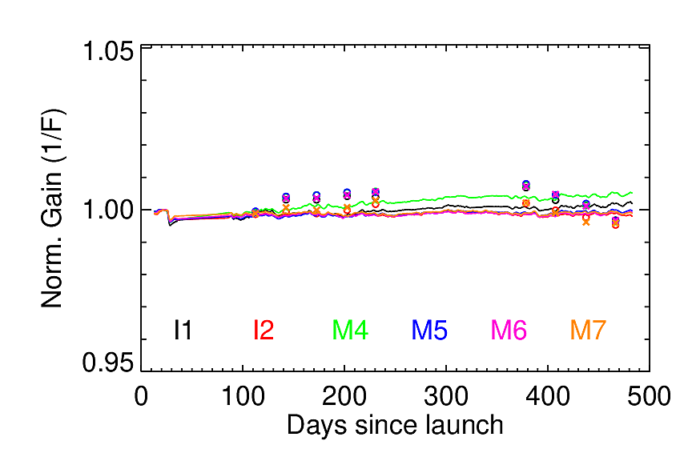
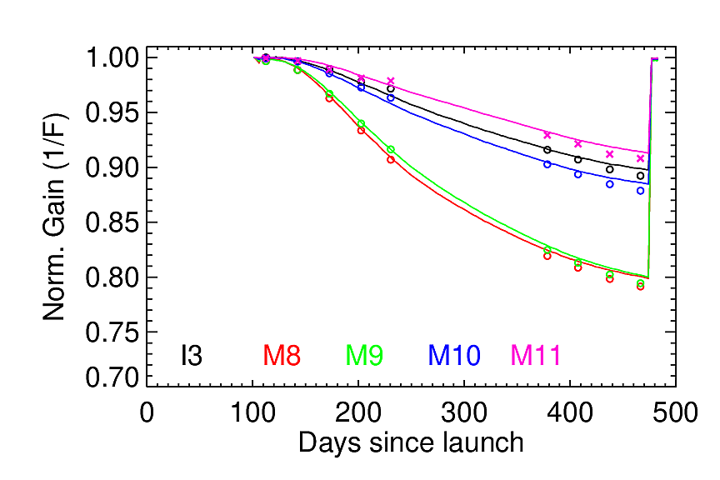
Performance of N-21 RSBs: F-factors
2nd mid-mission outgassing
The VisNIR band SD gains (1/F; solid lines)) are nearly flat and closely follow the respective lunar gains (circles)
2nd mid-mission outgassing return the SWIR band gains to their original values

Slide 12
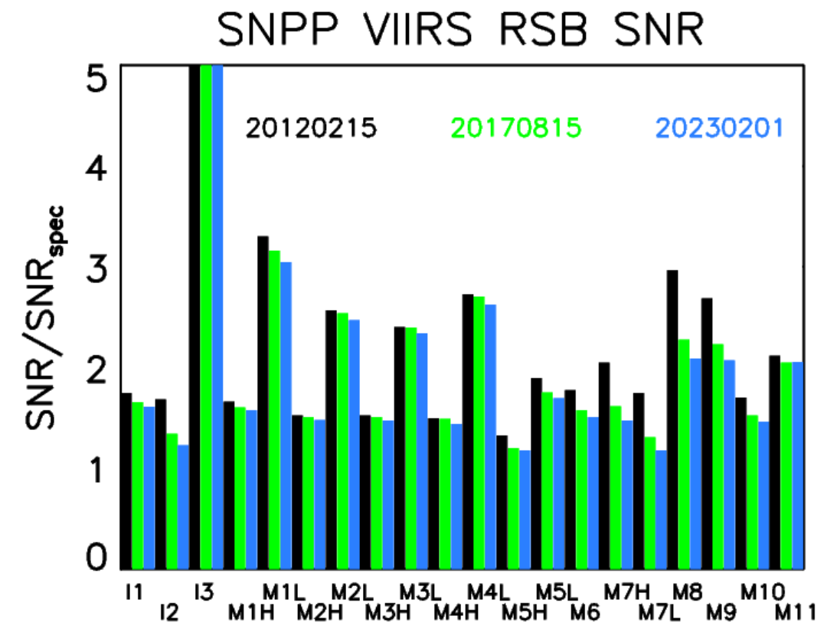
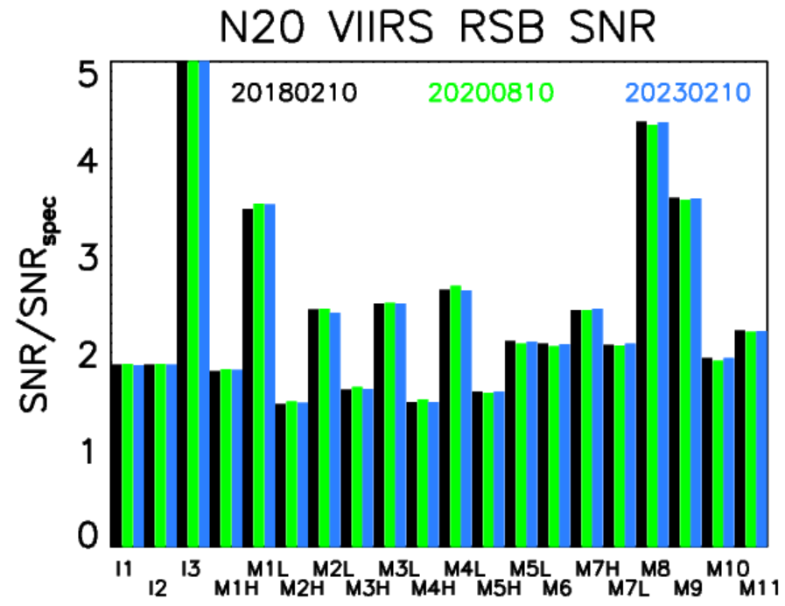
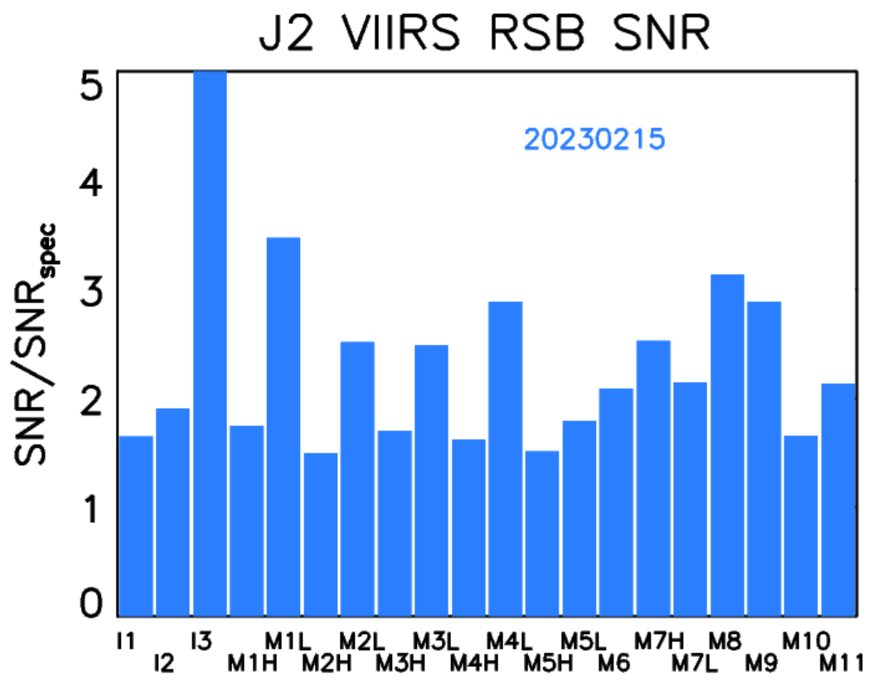
SNRs
All SNRs satisfy requirements, except N-20 I3 band detector 29 (noisy detector)

Slide 13
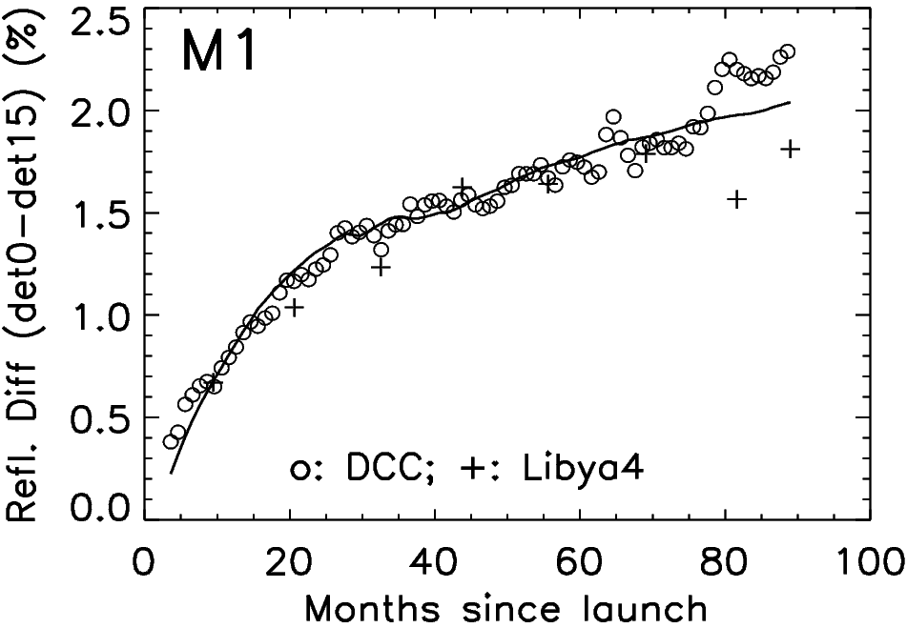

S-NPP and N-20 H-factor SD positional dependence
SD BRDF change factor (H-factor) can depend on SD position
model parameters
$$H_{RTA}\left(λ, t, φ_{H,SD}^{RTA},{\vec{r}}_{d}\right)=$$
$$H_{RTA}\left(H_{SDSM}\left(λ,t\right),φ_{H,SD}^{RTA}\right)×\left[1+c_{d,1}\left(d−d_{mid}\right)+c_{d,2}\left(d−d_{mid}\right)×\left(1−H_{SDSM}\left(λ,t\right)\right)\right]$$
detector array
13

Slide 14
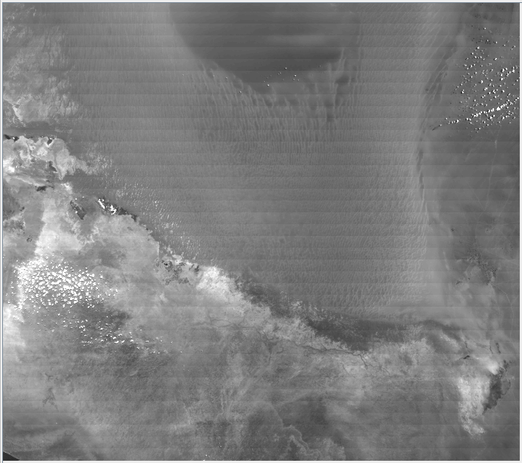
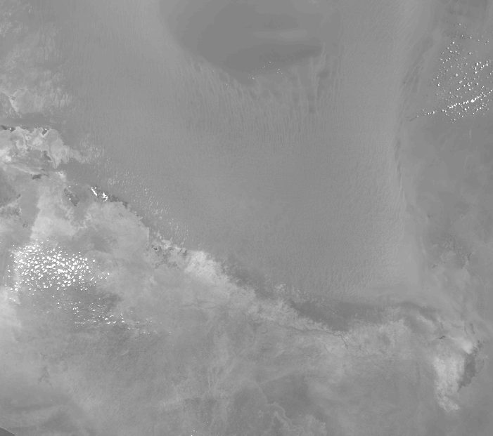
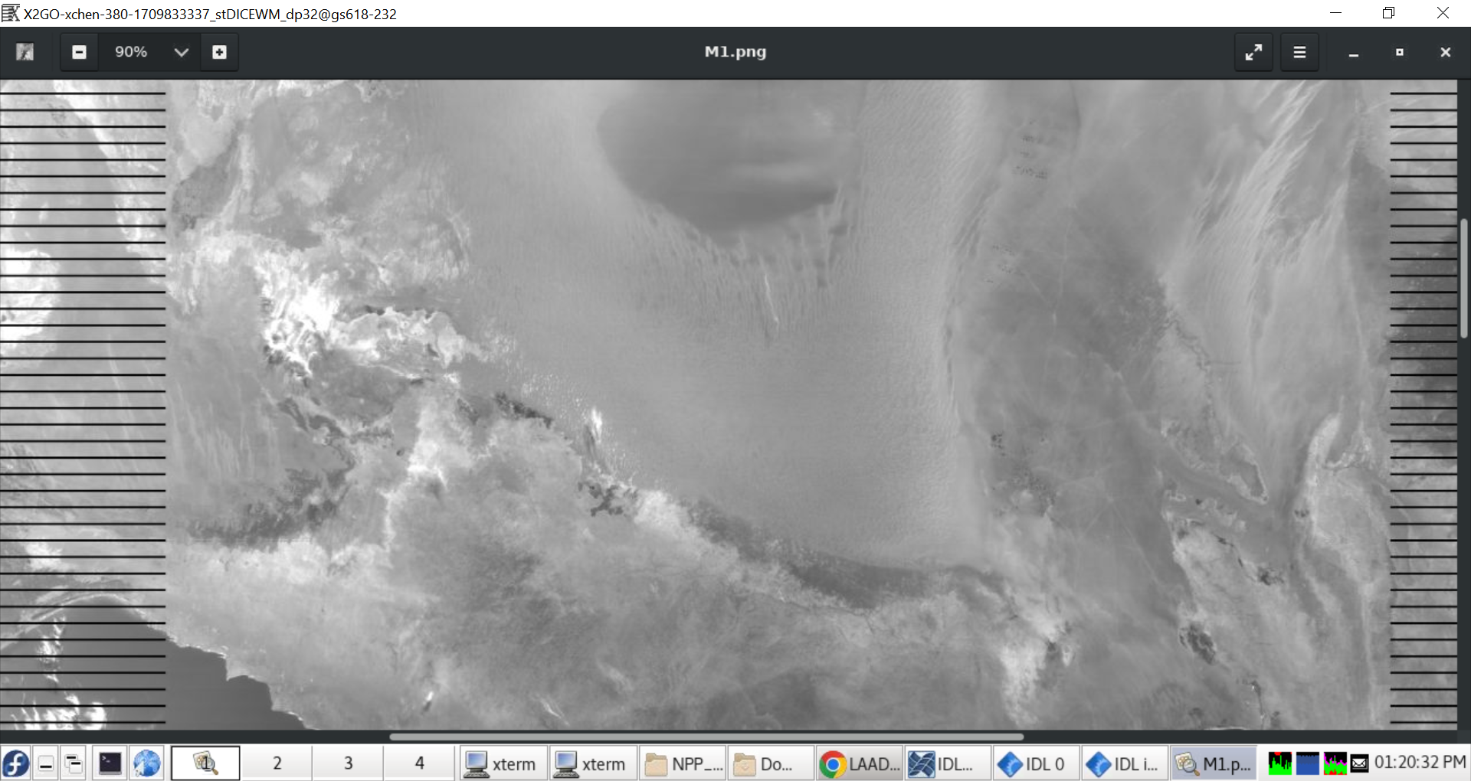
S-NPP TOA reflectance images
2019229
2019229
2024019
M1 striping (C1.1)
M1 striping not seen (C2.0)
M1: no striping seen (C2.0)
H-factor SD positional dependence implemented is still good

Slide 15
Summary
S-NPP, N-20, and N-21 VIIRS RSBs perform normally with SNRs satisfying specifications (except N-20 I3 detector 29) and are expected to be above specifications for the foreseeable future
N-20 and N-21 RSB VisNIR band gains are relatively stable with time whereas S-NPP RSB gains depart from prior trend for some bands since July 2022
S-NPP and N-21 SDs degrade at similar rates, faster than N-20 SD
All three VIIRS instruments SDSM detector gains decrease with similar rates at the same wavelength
De-striping algorithm applied to S-NPP RSBs still works; de-striping algorithms applied to N-20 VisNIR bands recently
Newly derived N-21 VIIRS screen functions significantly improve the accuracy of the retrieved H- and F-factors

