Slide 1
Early Assessment of NOAA21 VIIRS RSB Using Vicarious Techniques
Aisheng Wu¹, Jack Xiong², Amit Angal¹, Qiaozhen Mu¹
¹ SSAI, Lanham, MD 20706, USA
² NASA Goddard Space Flight Center, Greenbelt, MD 20771, USA
GSICS VIS/NIR Annual Meeting, 12 March 2024

Slide 2
Outline
VIIRS RSB
Band | CW (nm) | BW (nm)
M1 | 412 | 20
M2 | 445 | 18
M3 | 488 | 20
M4 | 555 | 20
M5 | 672 | 20
M6 | 746 | 15
M7 | 865 | 39
M8 | 1240 | 20
M9 | 1378 | 15
M10 | 1610 | 60
M11 | 2250 | 50
I1 | 640 | 80
I2 | 865 | 39
I3 | 1610 | 60
Introduction
Methodology
Vicarious approaches (Libya-4, DCC, Dome C and SNO)
Data: NASA SIPS C2 L1B. NOAA21 VIIRS L1B reprocessed over mission in 2023.
Results
Stability and inter-comparison
Summary

Slide 3
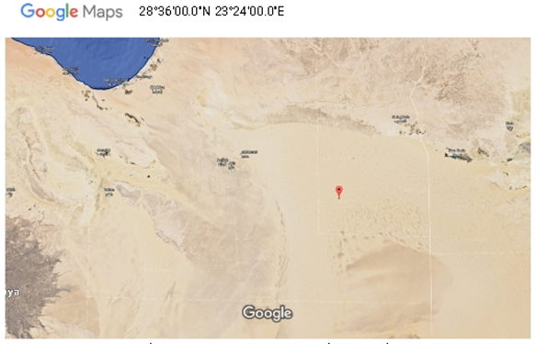
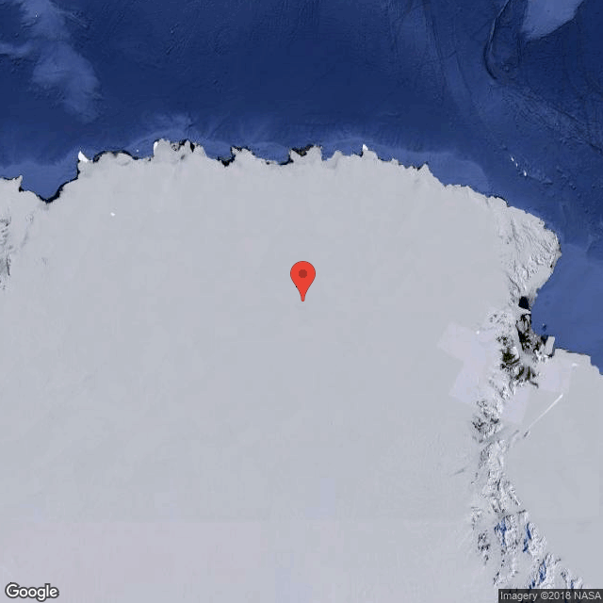
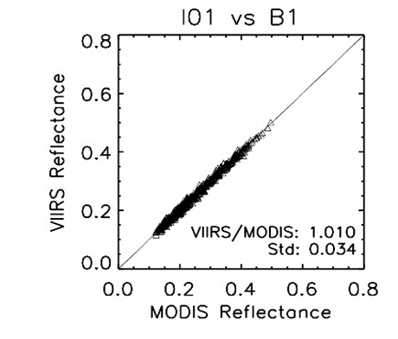
Vicarious approaches
Pseudo-Invariant Calibration Sites (Libya-4, Dome C):
Target area of 25 x 25 km at near-nadir, 16-day repeatable orbits for Libya-4, daily overpasses for Dome C in Antarctic summer.
Semi-empirical (Roujean et al. 1992) (Libya-4) and empirical (Dome C) BRDF correction with coefficients derived from initial years of observation for SNPP VIIRS
DCC approach
DCC pixels collected over western tropical Pacific. The DCC reflectance is determined based on mode/mean using monthly probability distribution functions (PDF).
Simultaneous Nadir Overpasses (SNO)
Aqua MODIS as a transfer radiometer for SNPP/N20/21. SNOs occur in high-latitude (time diff <3 min), once every 3-4 days
Libya 4
25 x 25 km
Dome C
SNO
Pixel-by-pixel from SNO on Oct 8, 2019
3

Slide 4
Vicarious approaches
Impact due to RSR differences among SNPP/N20/N21 VIIRS RSB
Correction is based on SBAF derived using historic SCIAMACHY hyperspectral data. SBAF tool provide by NASA LARC (https://satcorps.larc.nasa.gov/cgi-bin/site/showdoc?mnemonic=SBAF).
It is a sensor, band, and scene-dependent correction. The SBAF correction is up to a few percent depending on band and instrument. For VIIRS M11 (2.25µm), the correction is based MODTRAN simulations due to limitation of SCIAMACHY spectral range.
SBAF correction is well within 1% between N20 and 21 VIIRS VIS/NIR

Slide 5
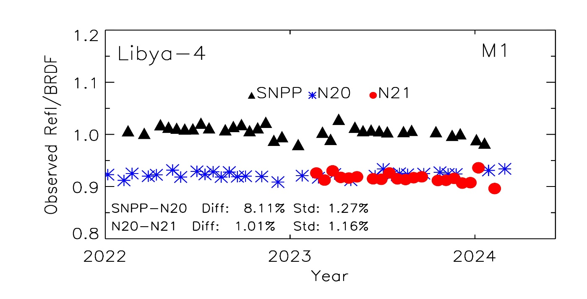
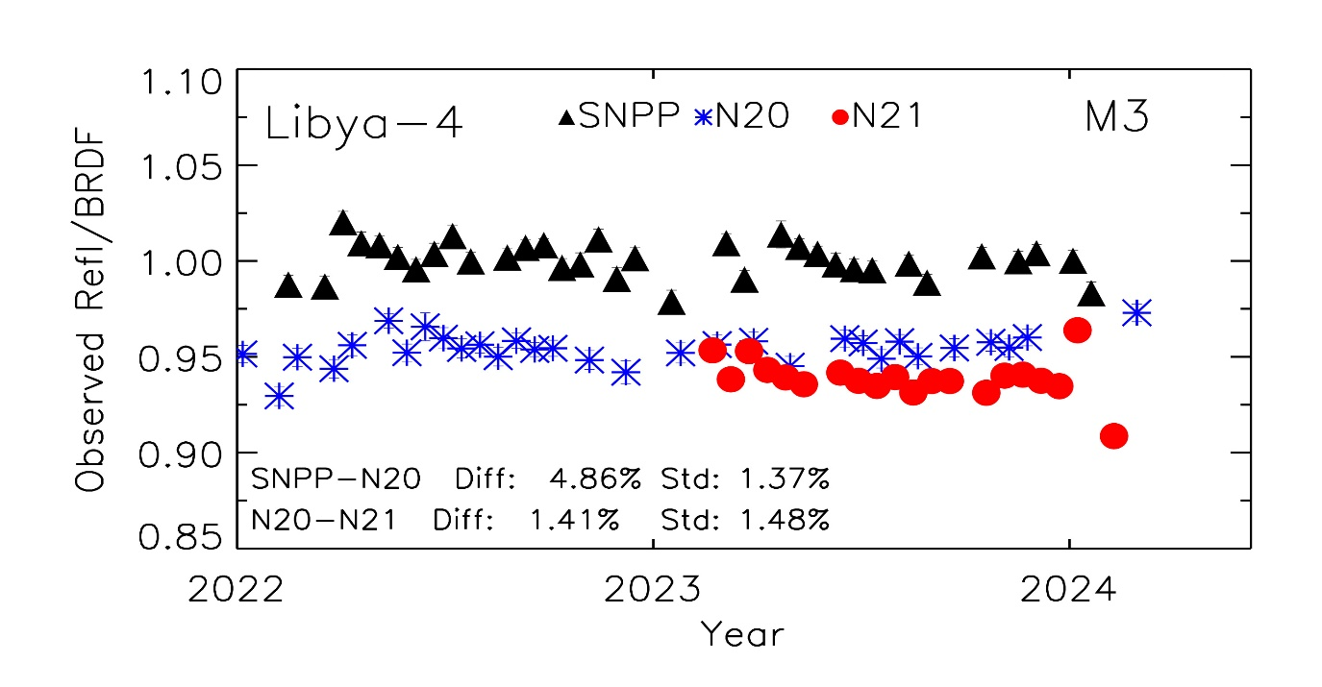
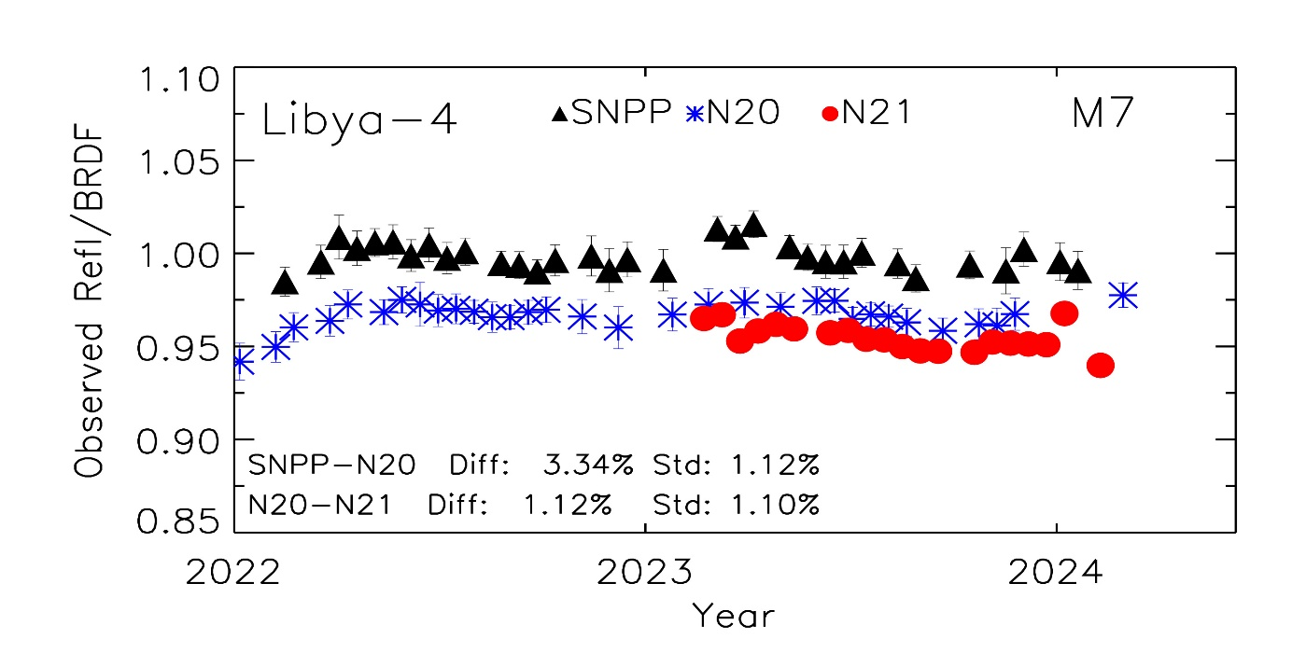
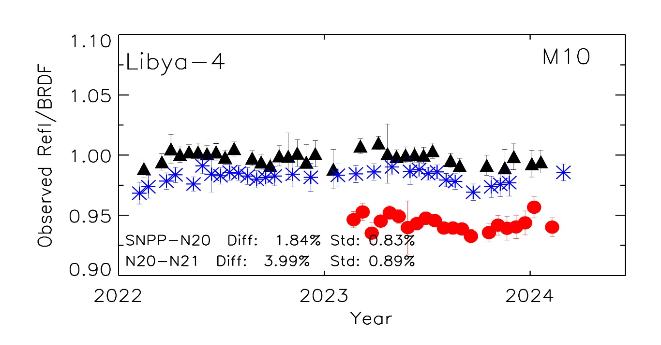
Reflectance trends over Libya-4 site
N20/21 refl consistent
with to within 2% for VIS/NIR
SNPP-based BRDF
5

Slide 6
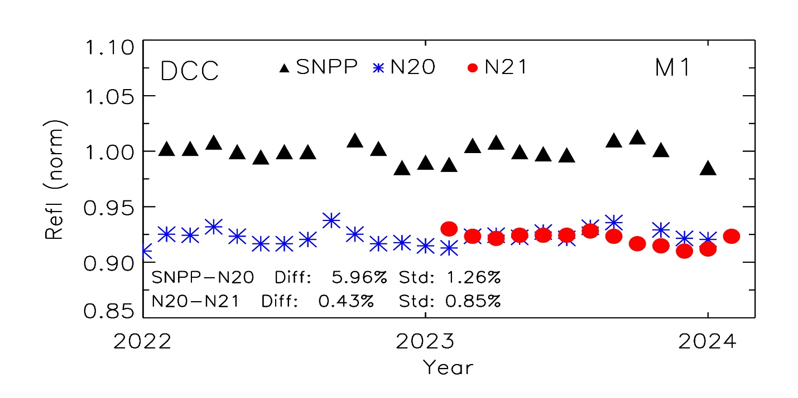
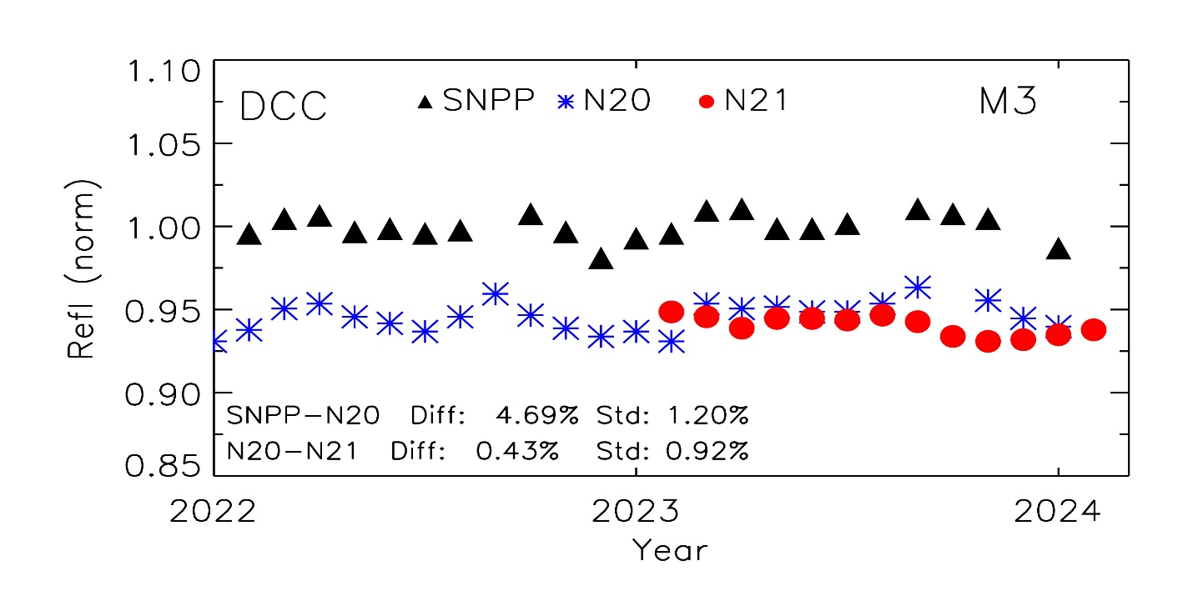
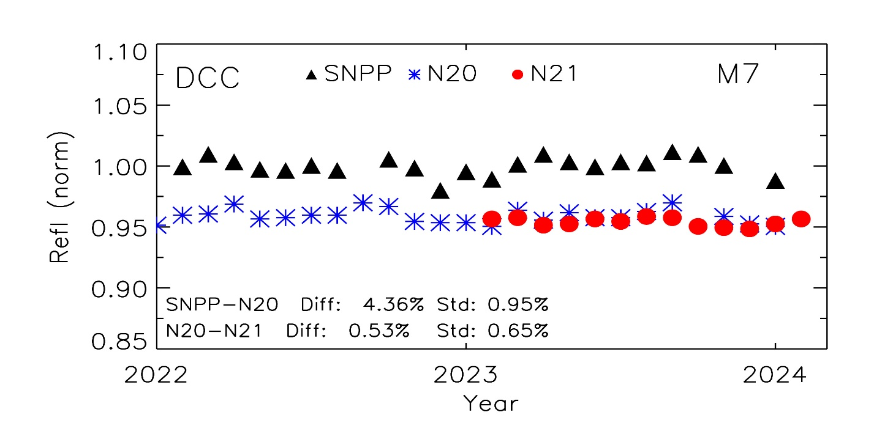
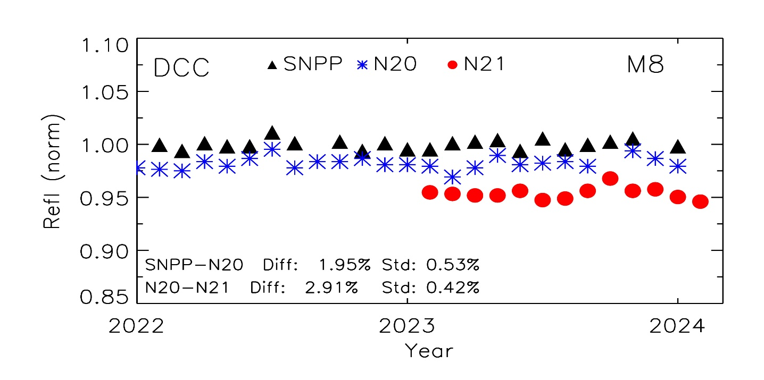
Reflectance trends over DCC
6
6

Slide 7
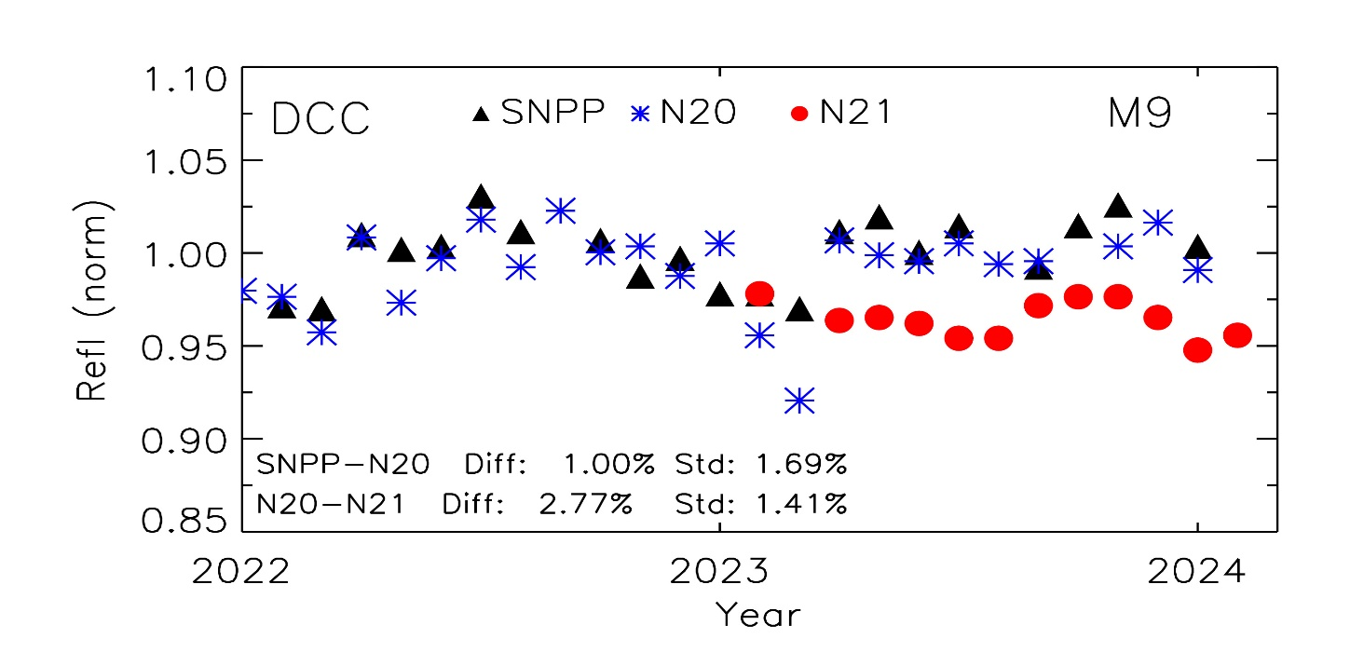
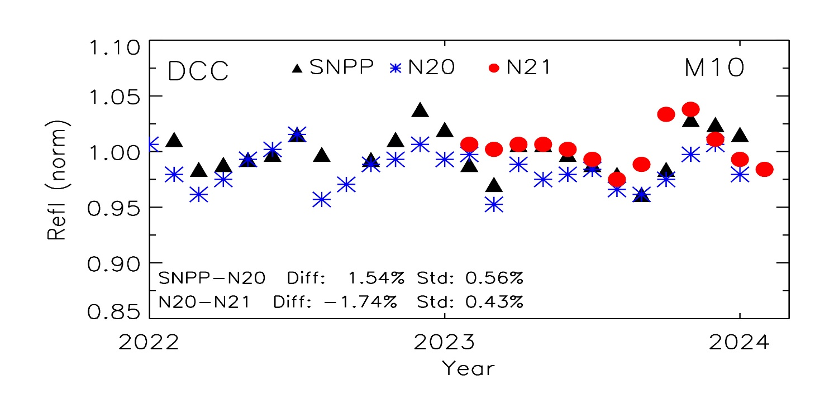
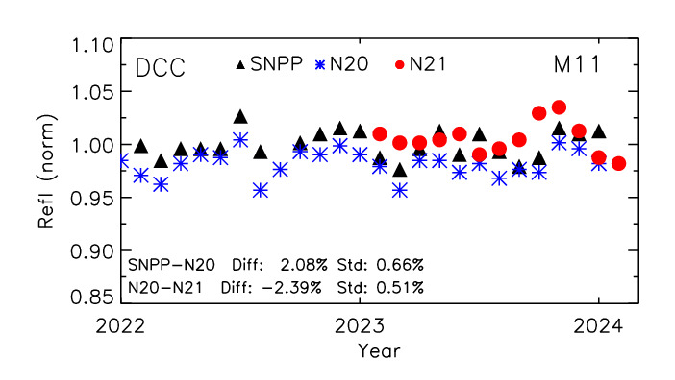
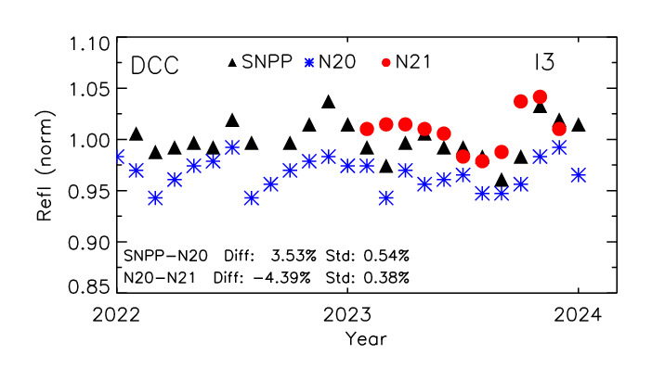
Reflectance trends over DCC
N21 applied one-time upward adjustment of 6.1%
7
7

Slide 8
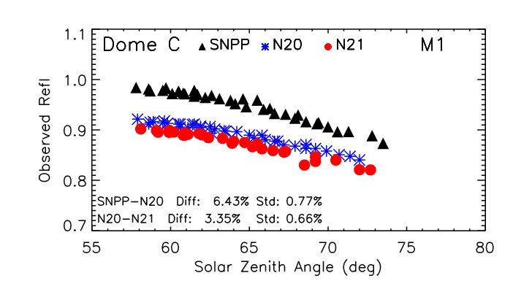
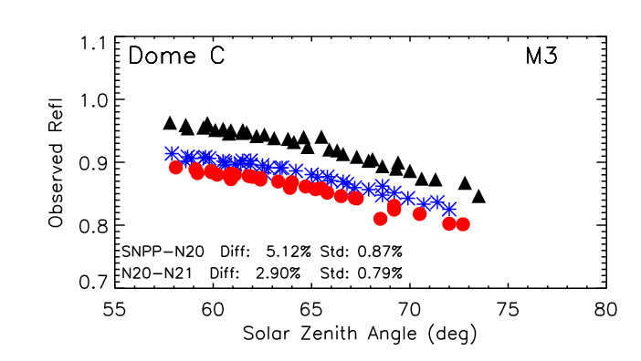
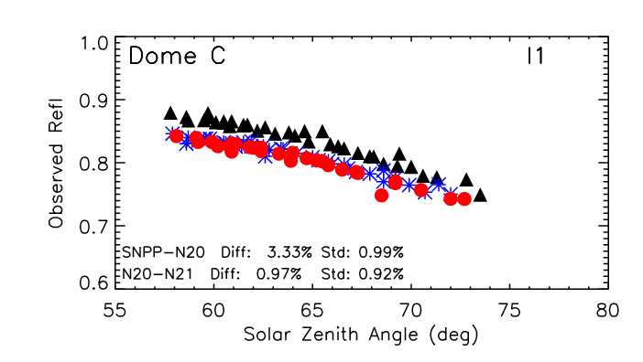
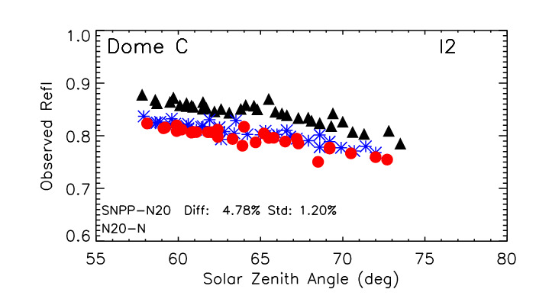
Reflectances over Dome C site
Dome C summer data in 2023-24
8

Slide 9
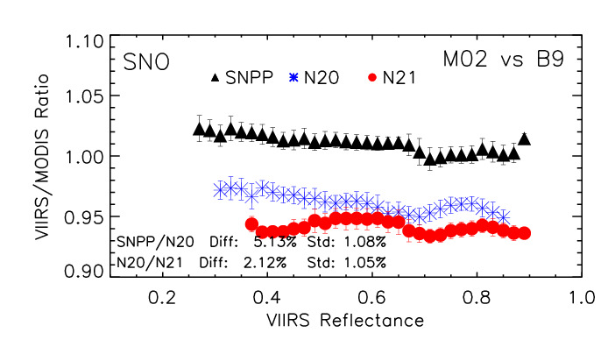
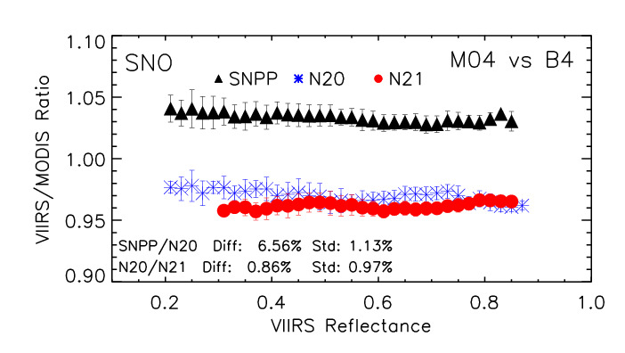
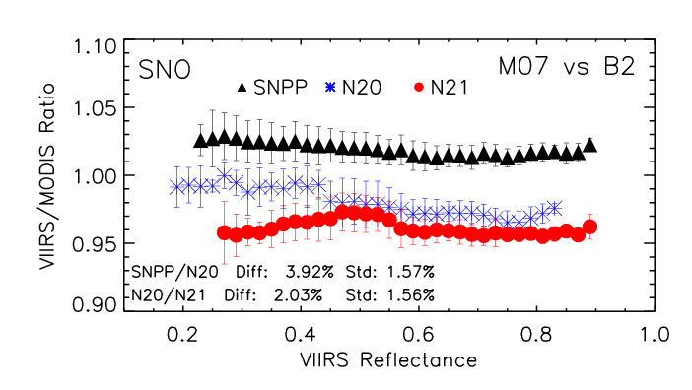
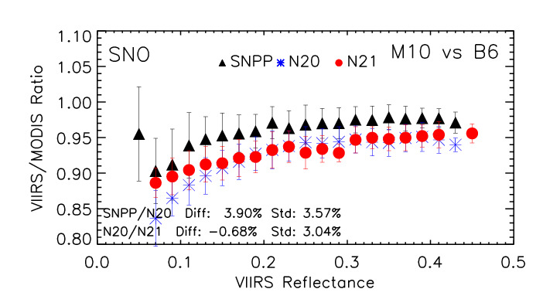
VIIRS/MODIS Reflectance ratios using SNO
Selective SNOs in 2023-24
9

Slide 10
SNPP, NOAA20 and NOAA21 VIIRS RSB comparison
Updated on 03/06/2024
SNPP-N20 (black), N20-N21 (red-VIS/NIR, green-SWIR), Results provided in percentage (%)
Band (µm) | M1 0.41 | M2 0.45 | M3 0.49 | M4 0.56 | M5 0.67 | M7 0.87 | M8 1.24 | M9 1.38 | M10 1.61 | M11 2.25 | I1 0.64 | I2 0.87 | I3 1.61
Libya4 | 7.9 0.9 | 6.2 1.3 | 4.3 1.3 | 3.3 0.9 | 4.5 -0.4 | 2.7 0.9 | 2.4 3.0 |  | 1.8 4.7 | 1.5 2.1* | 2.8 -0.5 | 2.6 0.5 | 3.0 2.3
DCC | 6.7 0.4 | 5.3 0.8 | 5.6 0.4 | 6.8 -1.7 | 5.0 -1.3 | 4.8 0.5 | 1.8 2.5 | 0.6 1.9 | 0.3 2.2 | 1.9 -0.3 | 4.4 1.3 | 5.4 0.1 | 2.5 -0.3
Dome C | 8.1 3.8 | 6.5 4.2 | 4.8 1.4 | 4.7 -1.0 | 5.2 0.4 | 2.2 -1.0 |  |  |  |  | 3.1 -0.9 | 2.4 -1.2
Aqua SNO | 7.3 1.7 | 5.9 2.0 | 3.9 1.6 | 4.6 1.1 | 4.1 -0.1 | 2.1 1.2 | 3.0 1.0 |  | 2.9 3.1 |  | 2.1 0.6 | 2.3 1.2 | 3.8 2.5
*Values shown in the table are based on reflectance, corrected for impact due to RSR differences
An additional correction of 6.1% (based on lunar results) applied to N21 VIIRS M11
10

Slide 11
Summary
Assessment of calibration consistency among SNPP, NOAA20 and 21 VIIRS RSB is based on vicarious approaches (Libya-4 desert, DCC, Dome C and SNO)
While SNPP and NOAA20 have a stability within 2% over the mission, it shows that the NOAA20 reflectances are systematically lower than SNPP by about 4 to 7% for bands M1 to M5 (shortest wavelengths) and 2-4% for the rest bands.
Initial comparison shows that the NOAA21 VIIRS reflectances are consistent with NOAA20 to within 2% for VIS/NIR. For SWIR bands, NOAA21 reflectances are 2-4% lower than NOAA20.
Comparison results indicate that agreement among the different approaches are up to 2.0%, indicating errors due to limitation of each approach.
11

