Slide 1
KMA GDWG Activities 2024
Hanbyul Lee
KMA/NMSC

Slide 2
KMA’s GSICS Corrections
Current Status
Near-Real Time Correction (NRTC)
GK2A / AMI / IR with reference to IASI(Metop-B/-C) and CrIS(S-NPP and NOAA-20) : Demo. phase
COMS / MI / IR with reference to AIRS(Aqua), IASI(Metop-A/-B): Demo. phase
Re-analysis Correction (RAC)
GK2A / AMI / IR with reference to IASI-B/-C and CrIS(S-NPP and NOAA-20/21) : Demo. phase
COMS / MI / IR with reference to IASI-A : Demo. phase
NRTC and RAC Correction Data is available in the EUMETSAT GSICS Server from Jan. 15, 2018
KMA plan to provide MI/AMI IR with reference to NOAA-21 CrIS

Slide 3
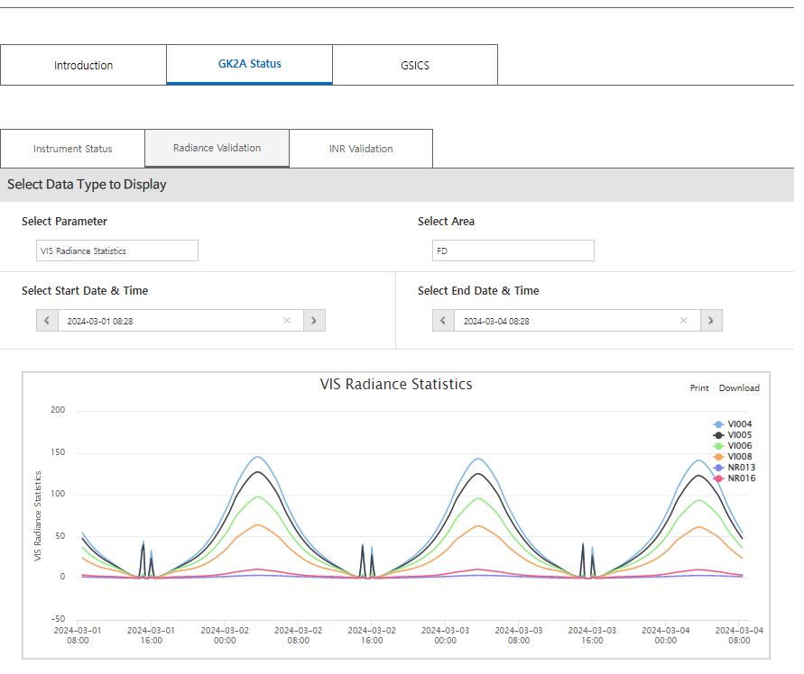
KMA GPRC web pages
Landing page (ACVs)
Introduction
AMI Cal/Val System
GSICS Introduction
Methodology(IR/VIS)
GK2A Status (new)
Instrument Status
Radiance Validation
INR Validation
GSICS
IR
VIS
Lunar
Updates of monitoring web page
GK2A status page has been added
GSICS updates
VIS: NOAA-21/VIIRS, IR: NOAA-20 CrIS , Lunar calibration
AMI-AHI inter-comparison page will be opened in the second half of 2024.
Landing page:
https://nmsc.kma.go.kr/homepage/html/gsics/gsicsIntro.do (Korean, now open)
http://nmsc.kma.go.kr/enhome/html/main/main.do (English, will be updated soon)

Slide 4
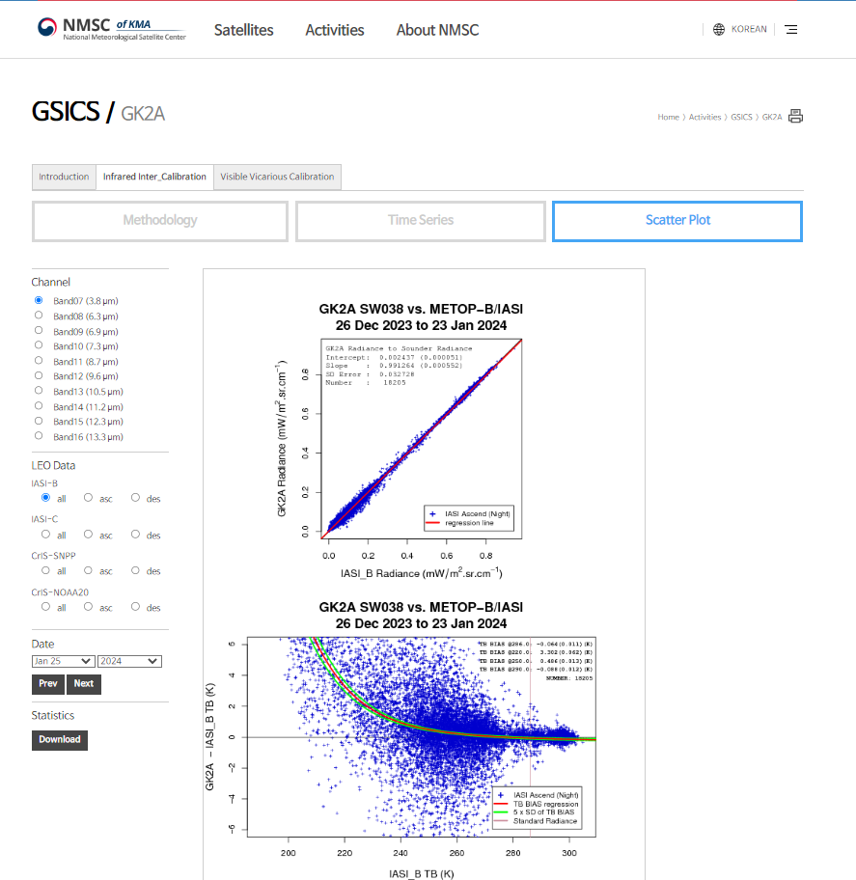
KMA GPRC web pages
Landing page (ACVs)
Introduction
AMI Cal/Val System
GSICS Introduction
Methodology(IR/VIS)
GK2A Status (new)
Instrument Status
Radiance Validation
INR Validation
GSICS
IR
VIS
Lunar
Updates of monitoring web page
GK2A status page has been added
GSICS updates
VIS: NOAA-21/VIIRS, IR: NOAA-21 CrIS , Lunar calibration
AMI-AHI inter-comparison page will be opened in the second half of 2024.
Landing page:
https://nmsc.kma.go.kr/homepage/html/gsics/gsicsIntro.do (Korean, now open)
http://nmsc.kma.go.kr/enhome/html/main/main.do (English, will be updated soon)

Slide 5
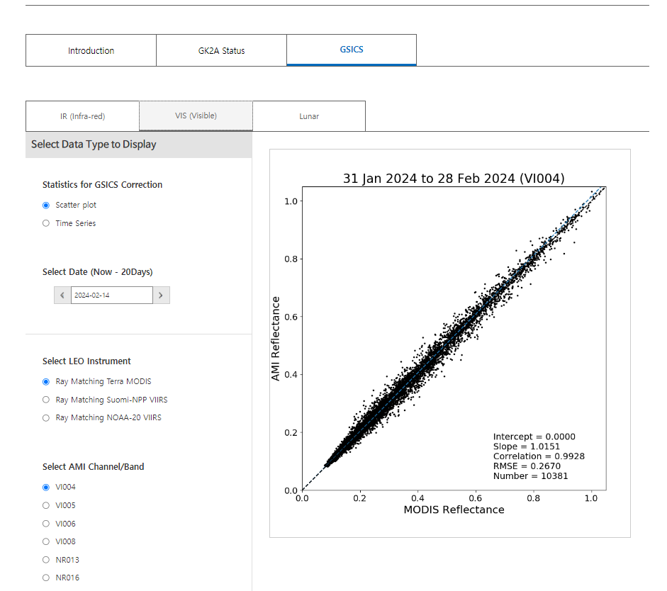
KMA GPRC web pages
Landing page (ACVs)
Introduction
AMI Cal/Val System
GSICS Introduction
Methodology(IR/VIS)
GK2A Status (new)
Instrument Status
Radiance Validation
INR Validation
GSICS
IR
VIS
Lunar
Updates of monitoring web page
GK2A status page has been added
GSICS updates
VIS: NOAA-21/VIIRS, IR: NOAA-21 CrIS , Lunar calibration
AMI-AHI inter-comparison page will be opened in the second half of 2024.
Landing page:
https://nmsc.kma.go.kr/homepage/html/gsics/gsicsIntro.do (Korean, now open)
http://nmsc.kma.go.kr/enhome/html/main/main.do (English, will be updated soon)

Slide 6
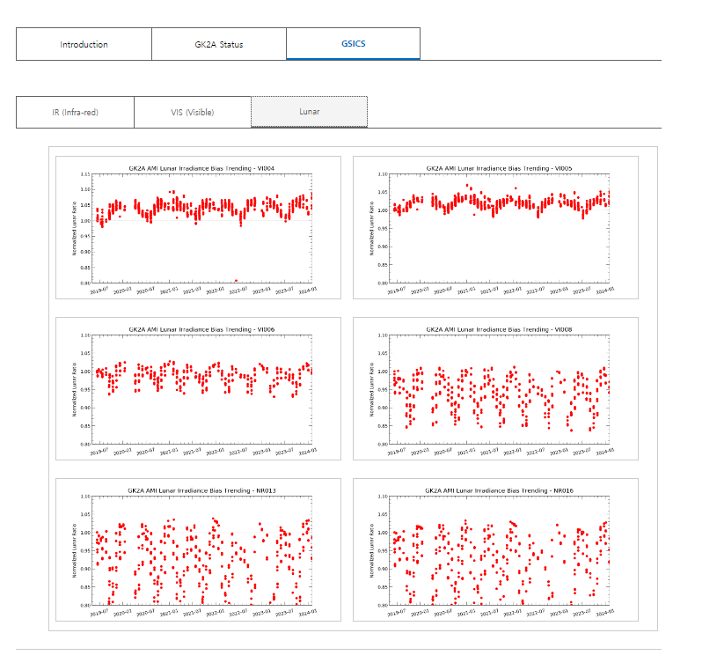
KMA GPRC web pages
Landing page (ACVs)
Introduction
AMI Cal/Val System
GSICS Introduction
Methodology(IR/VIS)
GK2A Status (new)
Instrument Status
Radiance Validation
INR Validation
GSICS
IR
VIS
Lunar
Updates of monitoring web page
GK2A status page has been added
GSICS updates
VIS: NOAA-21/VIIRS, IR: NOAA-21 CrIS , Lunar calibration
AMI-AHI inter-comparison page will be opened in the second half of 2024.
Landing page:
https://nmsc.kma.go.kr/homepage/html/gsics/gsicsIntro.do (Korean, now open)
http://nmsc.kma.go.kr/enhome/html/main/main.do (English, will be updated soon)

Slide 7
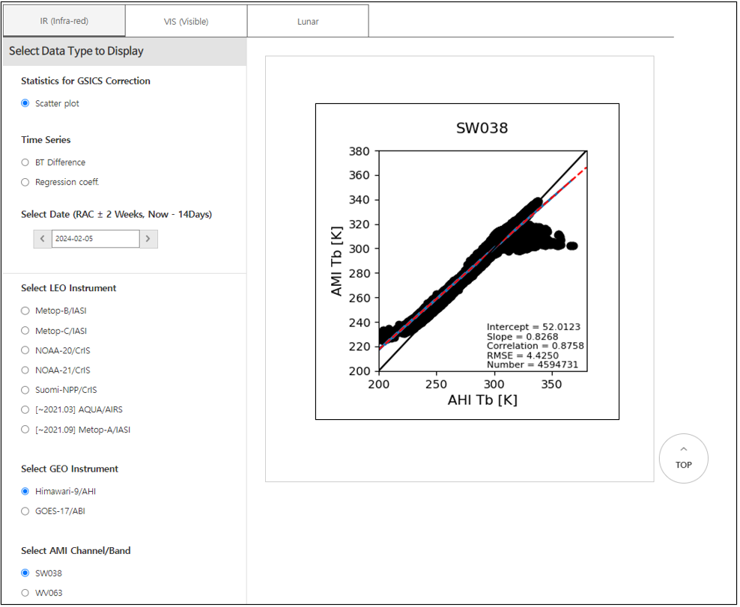
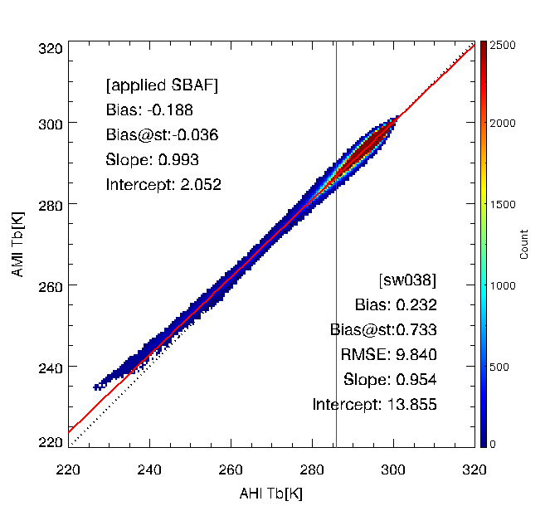
KMA GPRC web pages
Landing page (ACVs)
Introduction
AMI Cal/Val System
GSICS Introduction
Methodology(IR/VIS)
GK2A Status (new)
Instrument Status
Radiance Validation
INR Validation
GSICS
IR(GEO-GEO)
VIS
Lunar
Updates of monitoring web page
GK2A status page has been added
GSICS updates
VIS: NOAA-21/VIIRS, IR: NOAA-21 CrIS , Lunar calibration
AMI-AHI inter-comparison page will be opened in the second half of 2024.
Landing page:
https://nmsc.kma.go.kr/homepage/html/gsics/gsicsIntro.do (Korean, now open)
http://nmsc.kma.go.kr/enhome/html/main/main.do (English, will be updated soon)

Slide 8
KMA’s Personnel supporting GSICS
GRWG
Jaeyoung Byon, and Euidong Hwang
Tae-Hyeong Oh * (*leave of absence)
GDWG
Jaeyoung Byon, Hanbyul Lee (New Member)
Member | GRWG | GDWG | GEO-LEO | DCC RTM | Moon | GEO-GEO
Jaeyoung Byon (Mr.) | Y |  | Y | Y | Y | Y
Euidong Hwang (Mr.) | Y |  | Y
Hanbyul Lee (Ms.) | Y | Y | Y | Y | Y | Y

Slide 9
Thank you

