Slide 1
Challenges for AHI Ray-matching in low radiance scenes
KODERA Kazuki
Meteorological Satellite Center of
Japan Meteorological Agency

Slide 2
Introduction
In JMA, the validation methods for VIS/NIR bands of Himawari-8,-9/AHI.
Implementation routinely: The method comparing with RTM and Ray-matching method
Under development : DCC and Lunar calibration methods
Our implementation of Ray-matching method has some issues for further investigation.
For example,
Using the data : using the resampled data (2km resolution) is suitable?
Stability of validation results : still more variable compared to solar diffuser results.
Regression methods : linear regression is the best way?
Uncertainty analysis : not work on yet
Data amount : getting the stable validations even if using smaller samples than before?
Background
As the preparation toward Himawari-10, the quick validation is important to find out and deal with technical issues during the in orbit test.
Notes:
suitable

Slide 3
Data amount issues
Our implementation issues for using data amount
Need to download the reference data via Internet.
Is it possible to restrict more narrow area and small data size to download…?
Collocating in longer statistics period to get more stabler validation results
Currently, statistics period is 29 days.
Is it possible to get the stable results in short period…?
Goal of this works
To get reliable and stable validation results in short statistics period by using smaller amount of data volume
One of the solutions: utilization of low radiance scenes

Slide 4
Low radiance scenes in Ray-matching
Merit of using low radiance scenes
Low radiance scenes have more collocations than mid/high radiance scenes
enable to get enough amount of data for validation in short period
The issues for using low radiance scenes
The pattern of ratio (=AHI/(VIIRS*SBAF) ) in low radiance scenes is different from that in other radiance scenes
This issue is seen for all VIS/NIR bands.
Current handling the low radiance scenes
Removing these data by TB threshold of 10.4um
B03 vs. I01
B03 vs. I01
removed
low radiance scenes cannot be used as is.
Applying the condition less than 273.15K
Re-consider the handling the low radiance for utilizing these data

Slide 5
JMA implementation
Consideration of collocation conditions
JMA’s current implementation
Himawari-8/9 AHI | Band01 0.47 μm | Band02 0.51 μm | Band03 0.64 μm | Band04 0.86 μm | Band05 1.6 μm | Band06 2.3 μm
SNPP or N20 VIIRS | M3 0.49 μm |  | I1 0.64 μm | M7 0.87 μm | M10 1.6 μm) | M11 2.3 μm
Himawari-8/9 data
The data is not calibrated by solar diffuser on real-time basis.
2km resampled data is used
SNPP,N20/VIIRS data
downloading from NOAA CLASS servers
SBAF
NASA SBAF Tool (B01-05) and calculating radiative transfer model (B06)
“All-sky Tropical Ocean” is selected
(a) Observation time difference | < 5 min.
(b) Satellite zenith angle difference | < 10 deg.
(c) Satellite azimuth angle difference | < 10 deg.
(d) Sun zenith angle difference | < 10 deg.
(e) Sun azimuth angle difference | < 10 deg.
(f) Sun glint angle (AHI only) | > 25 deg.
Brightness temperature @ 10.4 μm (AHI only) | < 273.15 K
(g) STDV of radiance/Mean of radiance | < 0.3
Researching each condition dependence on the ratio : AHI/(VIIRS*SBAF)

Slide 6
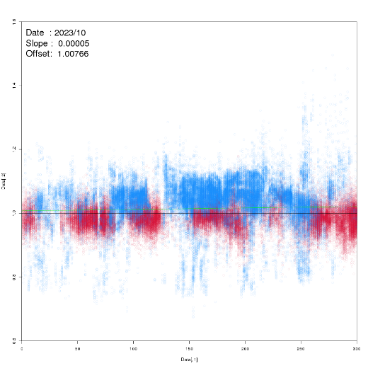
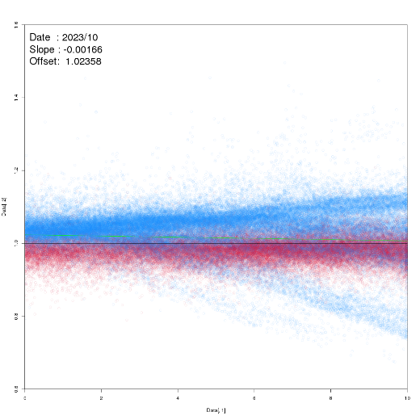
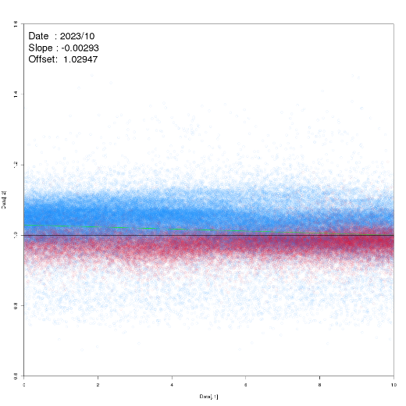
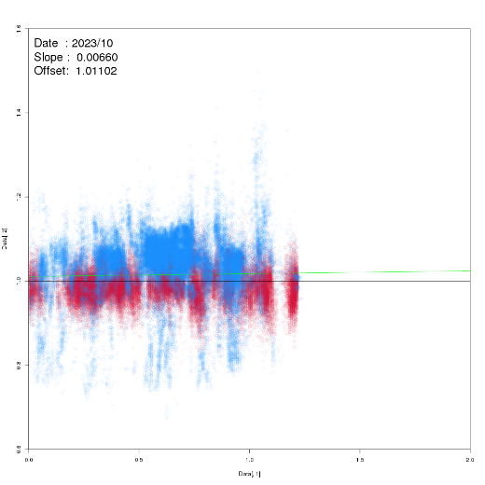
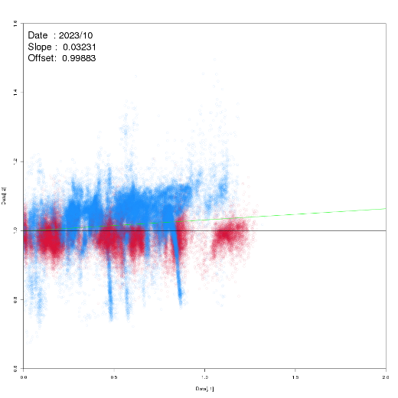
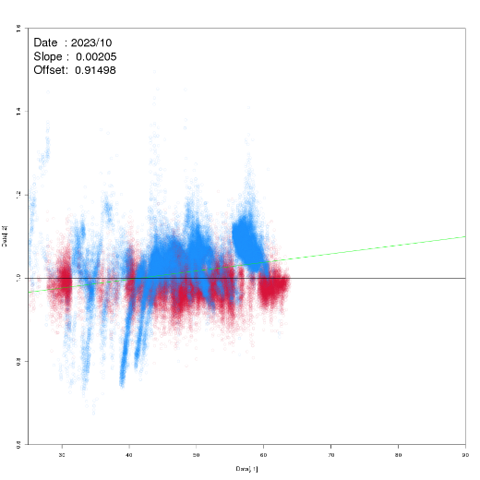
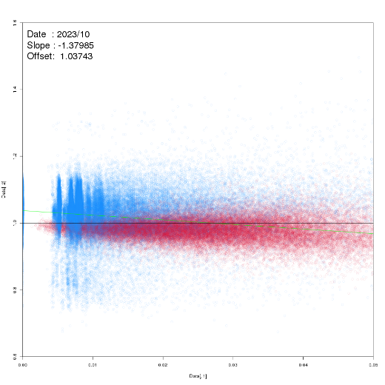
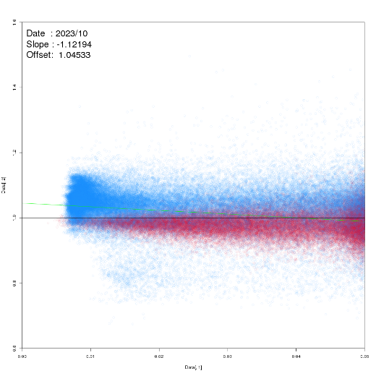
Dependence in current implementation
Monthly statistics period: Oct. 2023
(a) Observation time diff.
(b) Satellite zenith angle diff.
(c) Satellite azimuth angle diff.
(d) Sun zenith angle diff.
1.4
1.4
1.4
1.4
1.2
1.2
1.2
1.2
Raito: AHI/(VIIRS*SBAF)
Raito: AHI/(VIIRS*SBAF)
Raito: AHI/(VIIRS*SBAF)
Raito: AHI/(VIIRS*SBAF)
1.0
1.0
1.0
1.0
0.8
0.8
0.8
0.8
0.6
0.6
Blue: Leo reflectance <= 0.2
Red: Leo reflectance > 0.2
0.6
0.6
0 0.5 1.0 1.5 2.0
0 50 100 150 200 250 300
0 2 4 6 8 10
0 2 4 6 8 10
Time diff. [s]
Angle diff. [deg.]
Angle diff. [deg.]
Angle diff. [deg.]
(e) Sun azimuth angle diff.
(f) Sun-glint angle
(g) Smooth condition for AHI
(g) Smooth condition for VIIRS
1.4
1.4
1.4
1.4
1.2
1.2
1.2
1.2
Raito: AHI/(VIIRS*SBAF)
Raito: AHI/(VIIRS*SBAF)
Raito: AHI/(VIIRS*SBAF)
Raito: AHI/(VIIRS*SBAF)
1.0
1.0
1.0
1.0
0.8
0.8
0.8
0.8
0.6
0.6
0.6
0.6
0 0.5 1.0 1.5 2.0
25 30 40 50 60 70 80 90
0 0.01 0.02 0.03 0.04 0.05
0 0.01 0.02 0.03 0.04 0.05
Angle diff. [deg.]
Angle [deg.]
AHI St.Dev. of Radiance / Ave. of Radiance
VIIRS St.Dev. of Radiance / Ave. of Radiance
SZA diff. and sun-glint angle are promising candidates for improvement

Slide 7
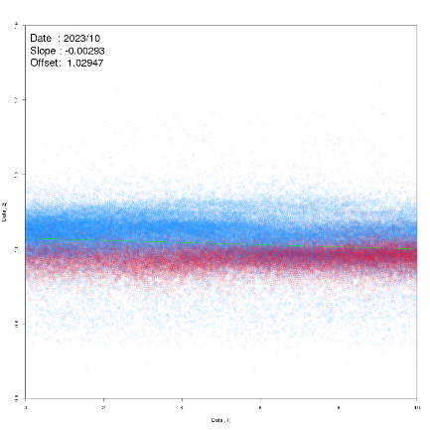
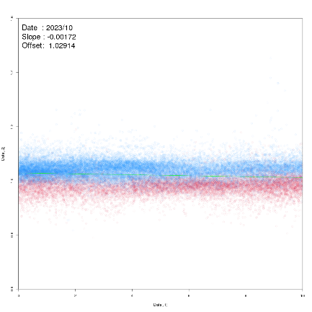
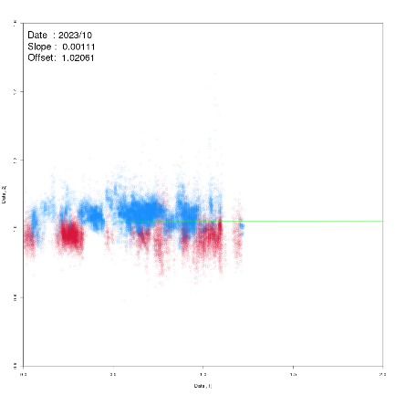
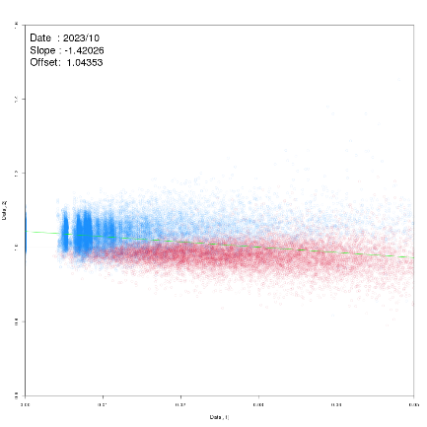
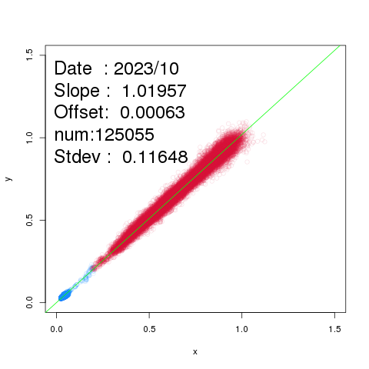
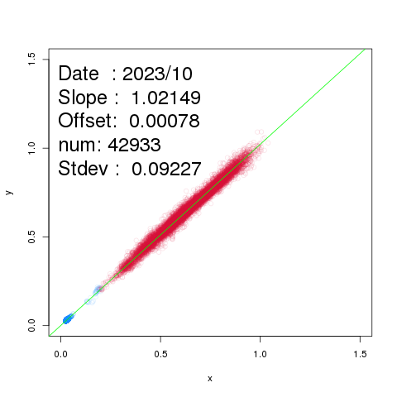
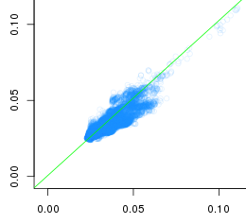
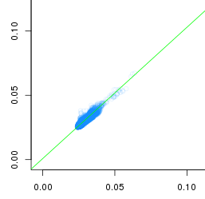
Applying new thresholds
Results by applying new thresholds
SZA<4 deg. and sun-glint angle > 40 deg.
Blue: Leo reflectance <= 0.2
Red: Leo reflectance > 0.2
1.6
(c) Satellite azimuth angle diff.
(d) Sun zenith angle diff.
(g) Smooth condition for AHI
1.4
Before After Before After Before After
Raito: AHI/(VIIRS*SBAF)
1.2
1.0
0.8
0.6
0 2 4 6 8 10 0 2 4 6 8 10 0 0.5 1.0 1.5 2.0 0 0.5 1.0 1.5 2.0 0 0.01 0.02 0.03 0.04 0.05 0 0.01 0.02 0.03 0.04 0.05
Angle diff. [deg.]
Angle diff. [deg.]
Angle diff. [deg.]
Angle diff. [deg.]
AHI St.Dev. of Radiance / ave. of Radiance
Restricting the satellite zenith angle and sun-glint angle indicates:
In the other collocation conditions, some outliers are also removed to some degree
Scatter plots in low radiance scenes became smoother.
Also, effect to other bands and other seasonal results
1.5
Before
After
1.0
AHI reflectance
0.5
0.0
0.0 0.5 1.0 1.5
0.0 0.5 1.0 1.5
VIIRS reflectance
VIIRS reflectance

Slide 8
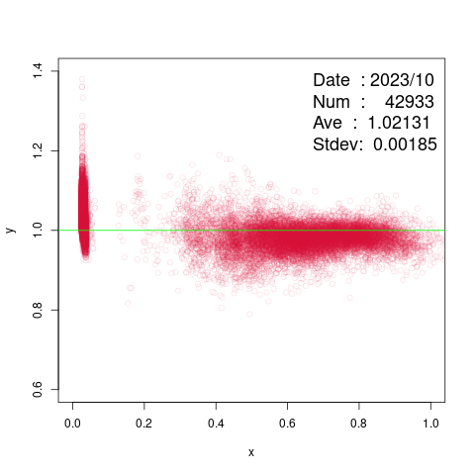
Variations in low radiance scenes
Applying the new threshold makes the smaller variations in low radiance.
Is it difficult to minimize variations in low radiance scenes anymore?
How is the validation in low radiance scenes for other sensors?
AHI in low radiance scenes seems to be good agreement with ABI
On the other hand, are there other factors to need to consider more?
In AHI case,
Due to the sensor
Coherent noise
AHI has the issue of coherent noise. After applying reduction process for noise, the large variability in low radiance scenes is still seen.
It seems that coherent noise has no effect on the larger variation.
Misalignment of collocation condition
Sun glint effect
Others factor
SBAFs
Still larger variation?
Raito: AHI/(VIIRS*SBAF)
VIIRS reflectance
Reference: Fangfang Yu’s presentation
@GSICS monthly web meeting on 05 May 2022

Slide 9
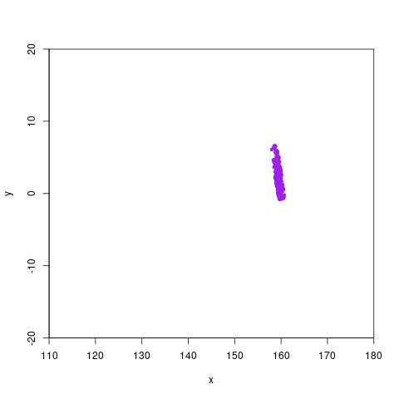
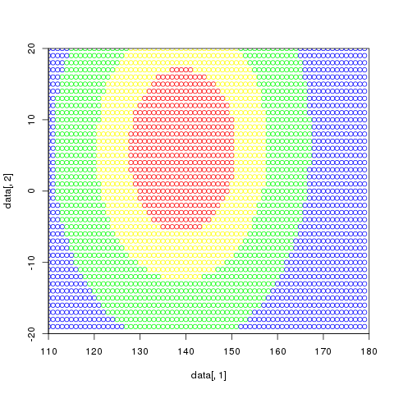
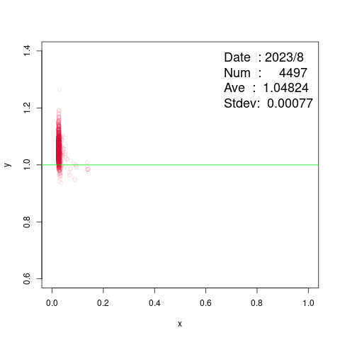
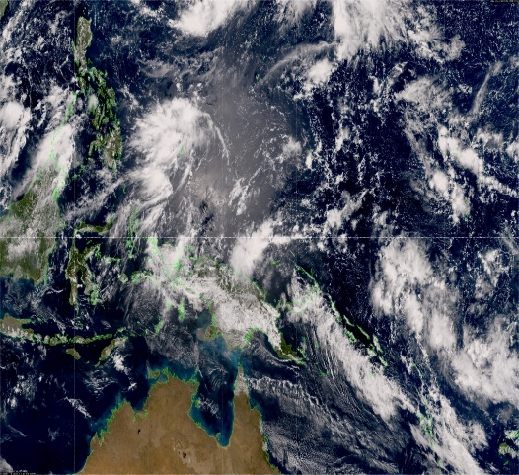
B) Sun-glint
We defined the sun-glint angle to remove sun glint effect
Sun-glint angle new threshold : more than 40 degree
Is this threshold might be examined in more detail.
Forward scattering
sun
satellite
θ
Case study (20 Aug. 2023 0250UTC)
Large variations are seen in low radiance scene.
Collocation points are NOT located in/near sun-glint area.
Sun-glint angle threshold is effective to remove the sun glint area.
0.64um
Geo/(Leo reflectance*SBAF)
Lat
Purple: Collocation points
θ: Sun-glint angle
Red：θ is less than 25 deg.
Yellow：25 deg.<θ<40 deg.
Green：40 deg. <θ< 60 deg.
Blue：θ is more than 60 deg.
Leo reflectance
Sun-glint doesn’t seem to affect to large variations in low radiance scenes.
20 Aug.2023. 0250UTC
Lon
Notes:
Our threshold about sun glint is more than 25 deg.
Removing the sun glint area and collocation points are not located in the sun glint area.
Sun-glint angle is suitable
Handling of sun-glint might be not suitable

Slide 10
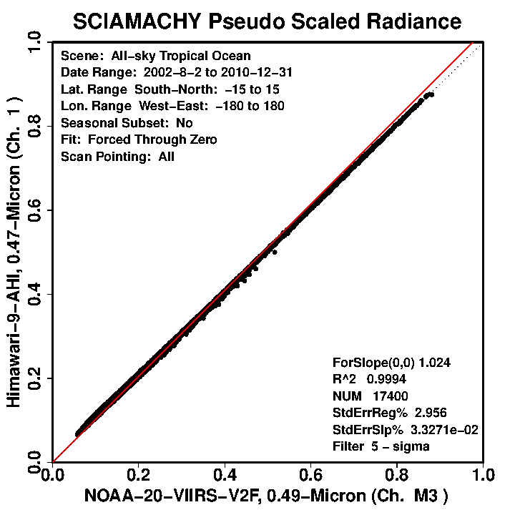
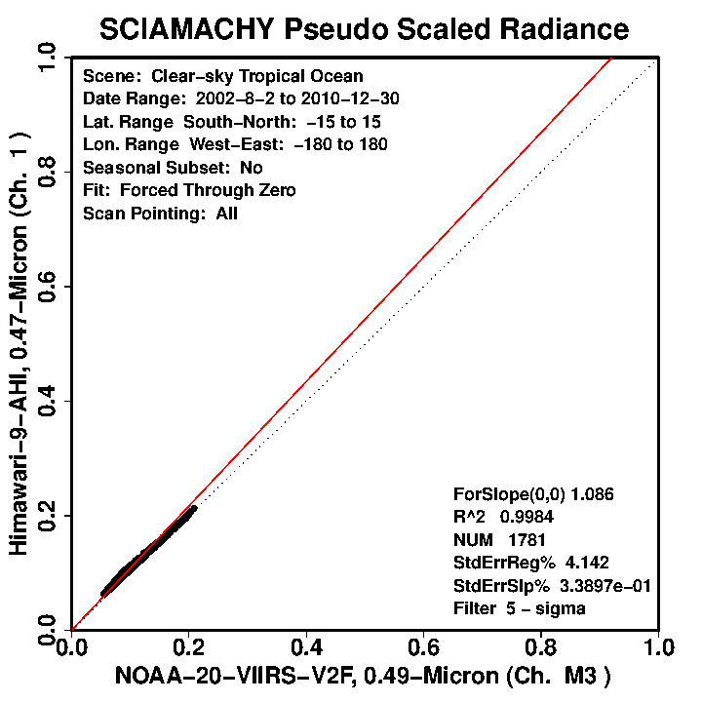
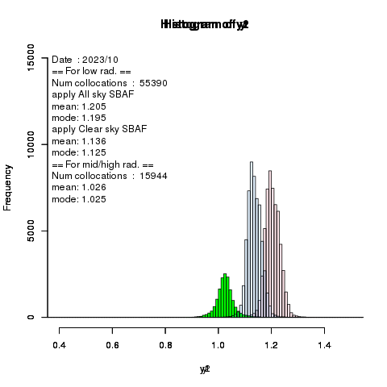
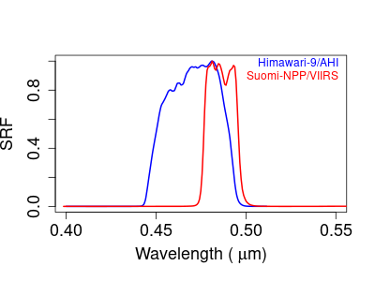
C) SBAFs
Case study ( monthly analysis in Oct. 2023)
Applying “clear sky” SBAFs to low radiance data especially in case of the large difference between SRFs
Vs. N20/VIIRS | B01 | B02 | B03
All Sky Tropical Ocean | 1.024 | 0.962 | 0.997
Clear Sky Tropical Ocean | 1.086 | 0.891 | 1.000
M03 vs. B01 (0.47um)
Green: in mid/high rad. senses
Blue: applying “clear sky” SBAFs to low rad. senses
Red: using “all sky” SBAFs to low rad. senses
Frequency
shift
The peak of low radiance data are better agreement with of mid/high radiance
These may indicate different SBAFs are needed to use for depending on the scenes.
Ratio : AHI/(VIIRS*SBAF)
Notes:
#----------------------------------------------------------------------------
# SBAF比較
#----------------------------------------------------------------------------
#適用後 # 適用前
color<-c("#DC143C20","#1E90FF20")
k<-2
ichan<-3
SBAF_Refl_all<-0.997 #1.024 # 0.962
SBAF_Refl_low<-1.000 #1.086 # 0.891
geoRad <- colloc[[ ichan ]][[ 1 ]]$geoDn * colloc[[ ichan ]][[ 1 ]]$geoCalSlope + colloc[[ ichan ]][[ 1 ]]$geoCalOffset
geoRefl<- geoRad * pi * (colloc[[ ichan ]][[ 1 ]]$sunEarthDist / (ASTRONOMICAL_UNIT/1000))^2 / colloc[[ ichan ]][[ 1 ]]$geoSolIrr / cos( colloc[[ ichan ]][[ 1 ]]$geoSunZen * pi / 180 )
leoRefl<- colloc[[ ichan ]][[1]]$leoFovReflAve
leoRad <- colloc[[ ichan ]][[1]]$leoFovRadAve
x<-leoRefl[ leoRefl <0.2]
y1<-geoRefl[ leoRefl <0.2]/(leoRefl[ leoRefl <0.2]*SBAF_Refl_all)
y <-geoRefl[ leoRefl >=0.2]/(leoRefl[ leoRefl >=0.2]*SBAF_Refl_all)
png("Hist.png")
timecard<-read.csv("TIMECARD.txt",header=F,sep=" ")
res1<-hist(y1,breaks=seq(0,2.0,0.01),col=color[1],xlim=c(0.4,1.5),ylim=c(0,10000))
par(new=T)
res<-hist(y,breaks=seq(0,2.0,0.01),col="green",xlim=c(0.4,1.5),ylim=c(0,10000))
par(new=T)
x<-leoRefl[ leoRefl<0.2 ]
y2<-geoRefl[ leoRefl<0.2 ] / (leoRefl[ leoRefl < 0.2 ]*SBAF_Refl_low)
res2<-hist(y2,breaks=seq(0,2.0,0.01),col=color[2],xlim=c(0.4,1.5),ylim=c(0,10000))
text<-c(sprintf("Date : %s/%s",timecard[1],timecard[2]),
sprintf("== For low rad. =="),
sprintf( "Num collocations : %6d" ,length(y1) ),
sprintf("apply All sky SBAF"),
sprintf("mean:%6.3f",mean(y1)),
sprintf("mode:%6.3f",res1$mids[which.max(res1$counts)]),
sprintf("apply Clear sky SBAF"),
sprintf("mean:%6.3f",mean(y2)),
sprintf("mode:%6.3f",res2$mids[which.max(res2$counts)]),
sprintf("== For mid/high rad. =="),
sprintf( "Num collocations : %6d" ,length(y) ),
sprintf("mean:%6.3f",mean(y)),
sprintf("mode:%6.3f",res$mids[which.max(res$counts)])
)
legend( "topleft", legend=text, x.intersp=-0.5, bty="n",cex=1 )
dev.off()

Slide 11
Summary and future works
Summary
We are working on the improvement of Ray-matching method forward operational start of Himawari-10. As one of them, we are considering the possibility of using the low radiance scenes.
I reviewed the current collocation thresholds. By applying these more restrictive condition, some of the outliers in low radiance scenes are removed.
satellite zenith angle < 4 deg.
sun glint angle > 40 deg.
After applying, the AHI results in low radiance scenes are good agreement with ABI. Is it possible to further reduce the variations in low radiance scenes?
If exits, in AHI case, the effect of sun glint, coherent noise and SBAFs are candidates.
However, I couldn't find the causes in those.
Future works
We continue to consider further improvement on the AHI variations in low radiance scenes by comparing with validation results for other sensors.
Also, working on other issues of Ray-matching for improvement

Slide 12
Back up

Slide 13
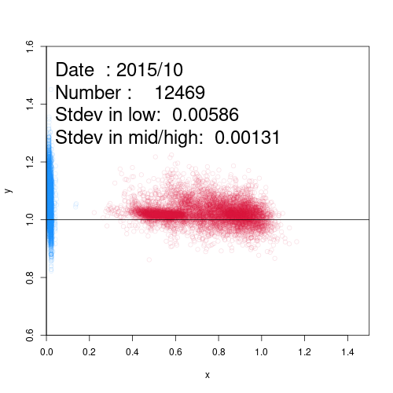
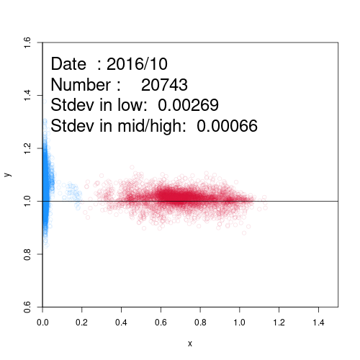
Coherent noise
AHI has the issue of coherent noise.
Before applying
After applying
Case study(1st Oct.2015 and 2016)
Applying the reduction processing on 25 Nov.2015
After that, coherent noise was mitigated.
However, the variabilities in low radiance are still seen.
It seems that less impact to the variability in low radiance.
B04
(0.86um)
Reduction processing on 25 Nov. 2015
B04
(0.86um)
02：50 1st Oct. 2015
02：50 1st Oct. 2016
1.6
1.6
Reference
Griffith(2016) @AOMSUC7
https://www.data.jma.go.jp/mscweb/en/oper/eventlog/20160309_himawari-8_event_en.pdf
1.4
1.4
1.2
1.2
Raito: AHI/(VIIRS*SBAF)
Raito: AHI/(VIIRS*SBAF)
1.0
1.0
0.9
B04
(0.86um)
0.9
B04
(0.86um)
Blue: Leo reflectance <= 0.2
Red: Leo reflectance > 0.2
0.8
0.8
0.0 0.2 0.4 0.6 0.8 1.0 1.2 1.4
0.0 0.2 0.4 0.6 0.8 1.0 1.2 1.4
VIIRS reflectance
VIIRS reflectance
13

Slide 14
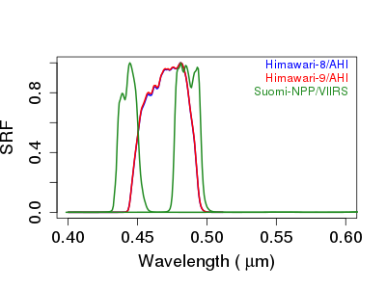
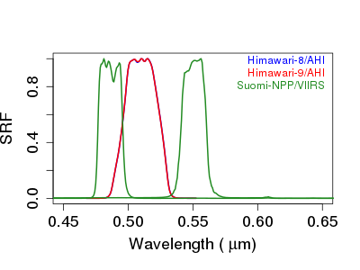
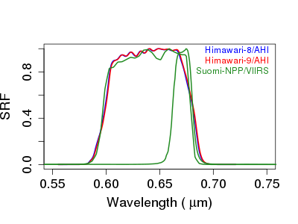
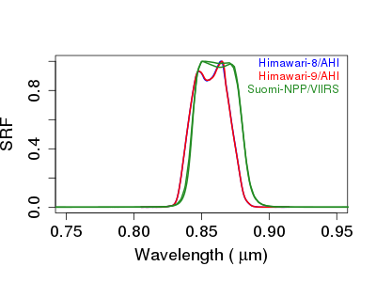
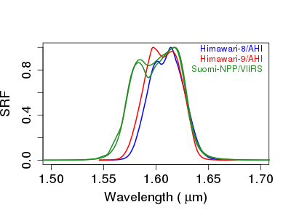
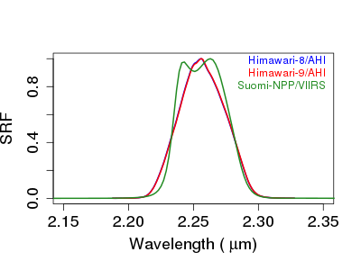
SRF differences (AHI8,AHI9 and NPP/VIIRS)
M2
M3
M3
M4
M5
I1
B01
(0.47μm)
B02
(0.51μm)
B03
(0.64μm)
M7 I2
M10 I3
M11
B04
(0.86μm)
B05
(1.6μm)
B06
(2.3μm)

Slide 15
JMA Ray-matching criteria Table
Table A
Ray-Matching criteria | Ray-Matching threshold
Monitored sensor | Himawari8 and Himawari9 / AHI
Reference sensor and version | SNPP and NOAA20 / VIIRS NOAA
Radiance or reflectance pair regression | Reflectance
SBAF | SCIAMACHY 1st order fit ( for AHI B01~B05) Radiative transfer model ( for AHI B06 ) *Under condition of “All sky tropical ocean”
Latitude Domain | ± 20° latitude of sub-satellite location
Longitude Domain | ± 20° longitude of sub-satellite location
Underlying surface | Targets meeting TB < 273.15K
Spatial grid resolution | AHI 1 pixel vs. average of VIIRS 3x3 pixels (for M band) AHI 1 pixel vs. average of VIIRS 5x5 pixels (for I band) * See the backup slide of “Our implementation details –resolution difference-”
AHI/VIIRS pixel resolution | 2km / 0.75km(M) or 0.375km(I) * We use AHI data resampled to 2km resolution for All VNIR bands.
AHI/VIIRS sub-sampling | 2km / 0.75km(M) or 0.375km(I)
Spatial homogeneity ( STDV of reflectance/Mean of reflectance ) | < 0.3 * See the backup slide of “Our implementation details –spatial homogeneity-” slide.

Slide 16
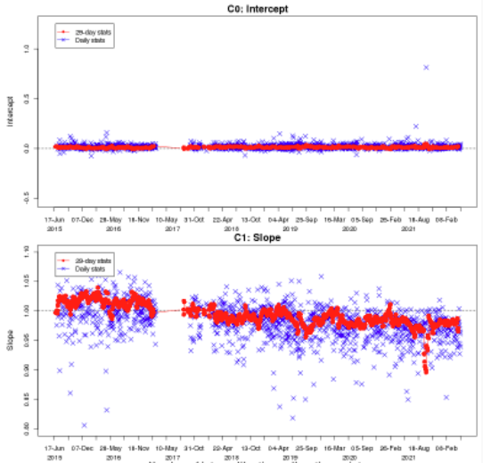
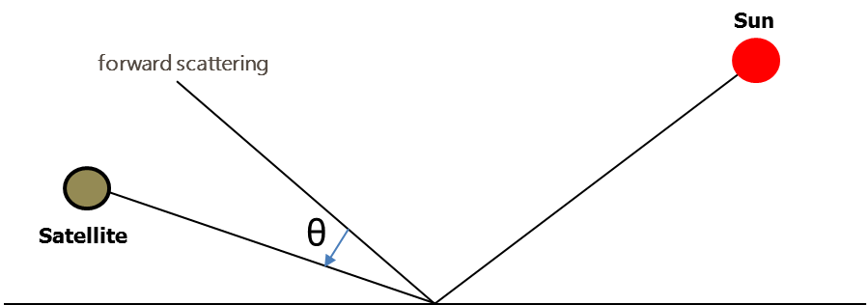
JMA Ray-matching criteria Table
Table A
Table B
Ray-Matching criteria | Ray-Matching threshold
Time matching difference | < 5 minutes
Solar zenith angle (SZA) difference | <10°
View zenith angle (VZA) difference | <10°
Relative azimuthal angle (RAA) difference | <10°
Scattering angle difference | -
Sun glint angle (Scattering angle) | >25°for AHI only
Linear regression, regression through space offset | Linear regression with offset and linear regression via the origin (force-fit regression)
Ray-Matching ATBD 2011 (NASA)​ | Ray-Matching threshold​
Timeline temporal resolution​ | Monthly and daily​
Outlier Filter​ | -
Other criteria​ | -
Temporal regression​ | -​
Intercept
slope
θ： Sun glint angle

Slide 17
Our implementation details – resolution difference -
To considering resolution difference of Input data, our implementation is following way.
Collocating
Matching up AHI 1 pixel with VIIRS 1pixel
Comparison for AHI refl. with VIIRS refl.
Comparing refl. of AHI 1 pixel with average refl. of VIIRS 3x3 pixels in M bands
Input Data we use in ray-matching
AHI : 2km resolution
VIIRS : 0.75km(M) 0.375km(I)
AHI 1 pixel
VIIRS 1 pixel
Match up
Compare
Reflectance of
AHI 1 pixel
Average reflectance
on 3x3 VIIRS M band pixels

Slide 18
Our implementation details – spatial homogeneity -
Pixels in green area are used for checking spatial homogeneity.
The condition of spatial homogeneity check is
STDV of reflectance
Mean of reflectance
< 0.3
AHI data
2km / 1pixel
VIIRS data M bands
0.75km / 1pixel
Spatial homogeneity area

