Slide 1
Transition from MODIS to VIIRS for AHI vicarious calibration
EIKI Misaki
Meteorological Satellite Center of Japan Meteorological Agency

Slide 2
Motivation
Current JMA/MSC vicarious calibration uses MODIS for input data to retrieve parameters.
We try to transfer input data from MODIS to VIIRS.
→Current approach was developed for MODIS
We need to reconsider setting up for VIIRS
We also try to improve the accuracy of this approach.
→Suitable selection of the calculation targets
We need to choose good thresholds

Slide 3
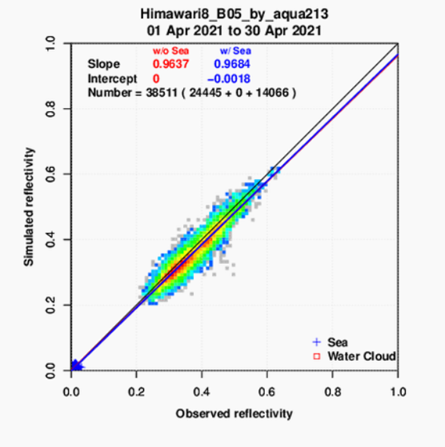
AHI VNIR vicarious calibration
REAP
aerosol
analysis
package
CAPCOM
cloud
analysis
package
MODIS L1B
RSTAR
Radiative transfer calculation
Simulated reflectivity
Aerosol
Atm profile
JRA-3Q (JMA‘s reanalysis data)
Cloud
Ozone
SNPP/OMPS Ozone L3
Water cloud
Sea surface
used in B03-B06(0.64-2.3um)
Radiative transfer calculation using the model "RSTAR" for targets water cloud and sea surface

Slide 4
Transition from MODIS to VIIRS
target of calculation
・Transition input data from MODIS to VIIRS
Aqua and Terra MODIS → SNPP/VIIRS
(We will transition to NOAA-20/VIIRS in the future)
・Improve the accuracy of this approach
→Select thicker and flatter cloud (We now consider good value about cloud parameters)
→ Strict thresholds
(optical thickness and effective radius etc.)
・We change the input data from MODIS to VIIRS and the value of cloud parameters which are inputted radiative transfer calculation
→Compare to current approach
We also need to adapt aerosol analysis package to VIIRS and consider aerosol parameter’s value. This is future task.
flat cloud
(ex. stratocumulus)
small cloud (ex. small cumulus)
→exclusion from calculation

Slide 5
Cloud retrieval package “CAPCOM”
Cloud parameters(optical thickness and effective radius) are obtained from MODIS L1B data using CAPCOM cloud analysis package(Nakajima and Nakajima,1995)
This approach utilizes three MODIS bands,
Band 1(0.645um),Band31(11.03um),Band 7(2.130um) or 20(3.750um)
Band 7 is used for validation of AHI B05 and B06
Band 20 is used for validation of AHI B01, B02, B03, and B04
The thresholds of cloud parameters
optical thickness : 10~100
effective radius : 1~100

Slide 6
Comparative experiment
・Utilize VIIRS for input data
M05(0.67um),M15(10.8um), and M10(1.61um)
・Change the thresholds of optical thickness and effective radius for VIIRS
optical thickness : MODIS 10~100 → VIIRS 25~70
effective radius : MODIS 1~100 → VIIRS 20~35
(These thresholds were studied by predecessor and other thresholds of parameter are also changed )
・Compare to current approach (Aqua/MODIS and Terra/MODIS)
→MODIS L1B C61(MYD02SSH,MOD02SSH)
MYD02SSH and MOD02SSH are 5km subsampled data
・Period：01/02/2023-01/31/2023

Slide 7
Himawari-9/AHI vs. Aqua/MODIS
B01
B02
B03
Himawari-9/AHI | Slope
B01(0.47um) | 0.9987
B02(0.51um) | 1.0508
B03(0.64um) | 1.0633
B04(0.86um) | 1.0330
B05(1.6um) | 1.0275
B06(2.3um) | 1.0715
B04
B05
B06

Slide 8
Himawari-9/AHI vs. Terra/MODIS
B01
B02
B03
Himawari-9/AHI | Slope
B01(0.47um) | 0.9878
B02(0.51um) | 1.0380
B03(0.64um) | 1.0463
B04(0.86um) | 1.0173
B05(1.6um) | 1.0215
B06(2.3um) | 1.0673
B04
B05
B06

Slide 9
Himawari-9/AHI vs. SNPP/VIIRS
B01
B02
B03
Himawari-9/AHI | Slope
B01(0.47um) | 1.0194
B02(0.51um) | 1.0729
B03(0.64um) | 1.0832
B04(0.86um) | 1.0483
B05(1.6um) | 1.0309
B06(2.3um) | 1.0088
B04
B05
B06

Slide 10
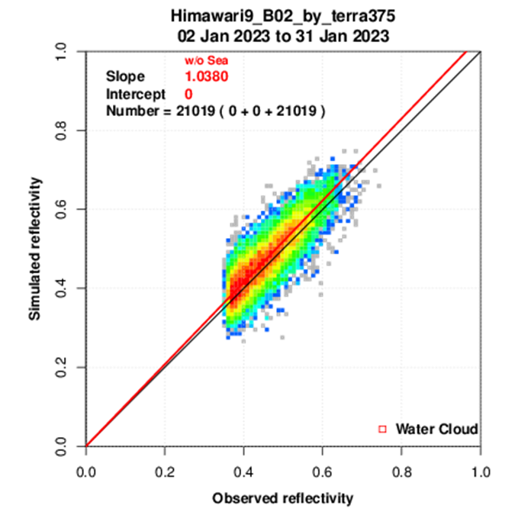
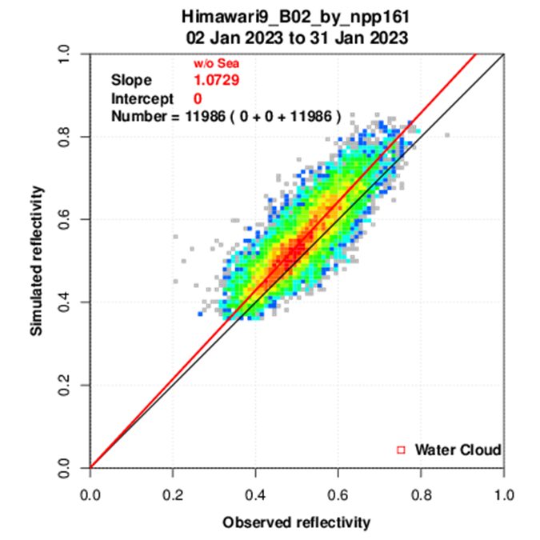
Himawari-9 B02
Aqua/MODIS
Terra/MODIS
SNPP/VIIRS
Slope 1.0508
Slope 1.0380
Slope 1.0729
VIIRS’s slope is larger than MODIS
What is the major cause of this variation? →need to research

Slide 11
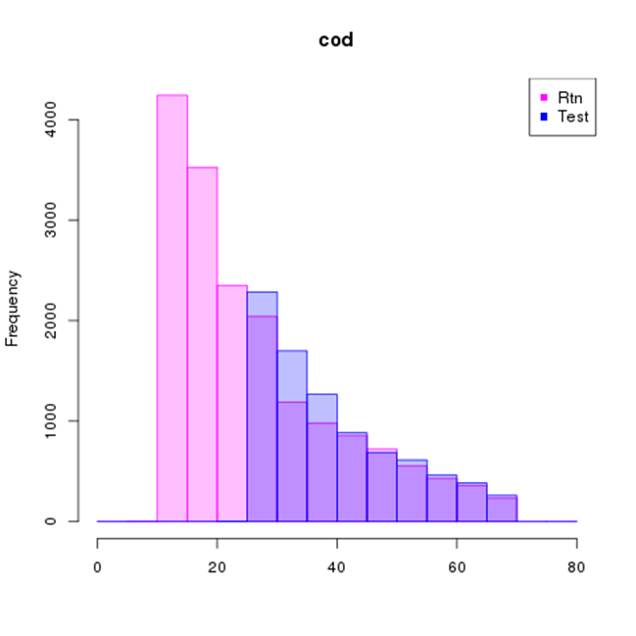
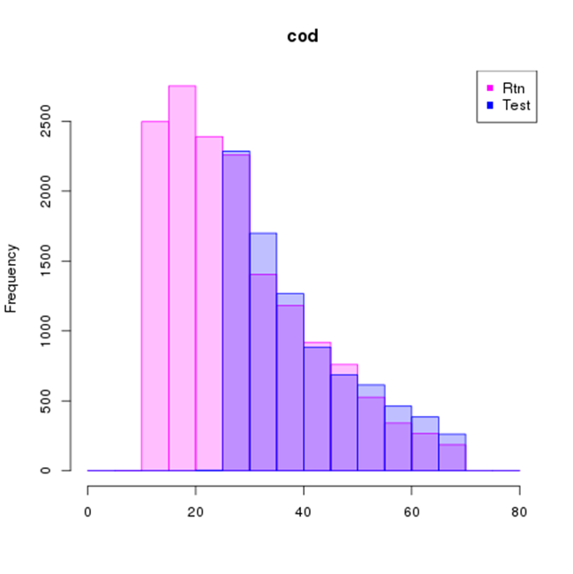
Optical thickness histogram
■ Aqua/MODIS
■ SNPP/VIIRS
■ Terra/MODIS
■ SNPP/VIIRS
MODIS
MODIS
VIIRS
VIIRS
We set up VIIRS’s threshold for optical thickness 25~70 which is inputted radiative transfer calculation
In case of VIIRS, small value of optical thickness is removed → Small cloud is removed
If the threshold for MODIS(10~100) is applied to VIIRS, how does it affect? → Need to research

Slide 12
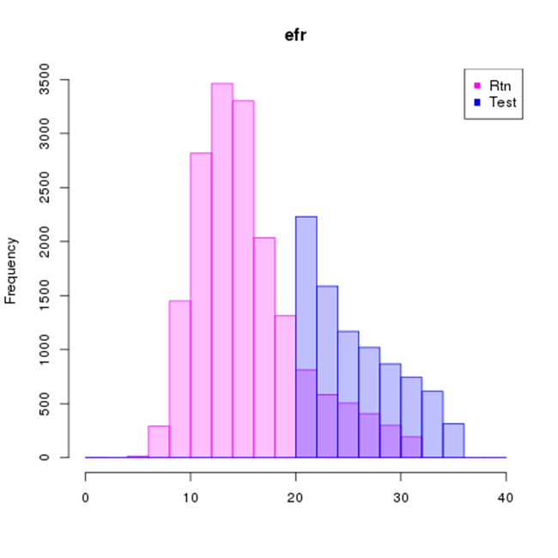
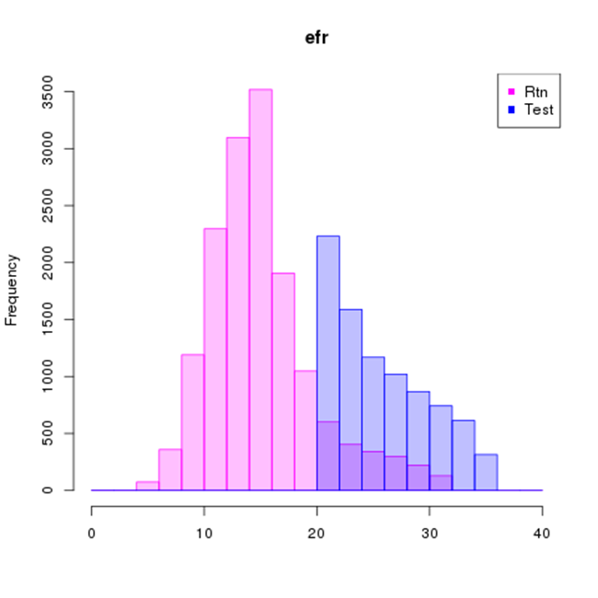
Effective radius histogram
■ Aqua/MODIS
■ SNPP/VIIRS
■ Terra/MODIS
■ SNPP/VIIRS
MODIS
MODIS
VIIRS
VIIRS
We set up VIIRS’s threshold for effective radius 20~35 which is inputted radiative transfer calculation
In case of VIIRS, small value of effective radius is removed → Small cloud is removed
If the threshold for MODIS(1~100) is applied to VIIRS, how does it affect? → Need to research

Slide 13
Summary and Future work
JMA/MSC compares Himawari-9 AHI visible and near-infrared data with radiative transfer calculation to check its calibration accuracy
We try to transfer input data from MODIS to VIIRS and improve the accuracy of this approach
We changed the thresholds of cloud parameters which are used in radiative transfer calculation
Compare to current approach(Aqua/MODIS and Terra/MODIS) and the approach which uses SNPP/VIIRS and changes water cloud’s threshold
SNPP/VIIRS approach’s slope tends to be large
Extend the period of test
Reconsider the water cloud’s thresholds
Transition to VIIRS since SNPP in order
Adaptation REAP to VIIRS

Slide 14
Thank you for your attention

Slide 15
References
RSTAR
Nakajima, T. and M. Tanaka, (1988) Algorithms for radiative intensity calculations in moderately thick atmospheres using a truncation approximation, J. Quant. Spec. Rad. Trans., 40, pp. 51-69
CAPCOM
Nakajima, T.Y. and T. Nakajima, (1995) Wide area determination of cloud microphysical properties from NOAA AVHRR measurement for FIRE and ASTEX regions, J. Atmos. Sci., 52, pp. 4043-4059
REAP
Higurashi, A. and T. Nakajima, (1999) Development of a Two Channel Aerosol Retrieval Algorithm on Global Scale Using NOAA/AVHRR., J. Atmos. Sci., 56, pp. 924-941
Higurashi, A. and T. Nakajima, (2002) Detection of aerosol types over the East China Sea near Japan from four-channel satellite data., Geophys. Res. Lett., 29, pp. 1836-1839

Slide 16
Aerosol retrieval package “REAP”
Aerosol parameters(optical thickness and Angstrom exponent) are obtained from MODIS L1B data using REAP aerosol analysis package(Higurashi and Nakajima,1999)
This approach utilizes three MODIS bands,
Band 1(0.645um)
Band2(0.858um)

