Slide 1



FDR4VGT : 20+ years harmonized data record of land surface reflectances from SPOT-VGT-1, VGT-2 and Proba-V sensors
GSICS Annual Conference, 2024

Slide 2
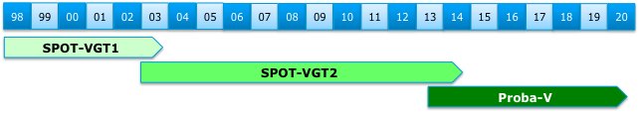
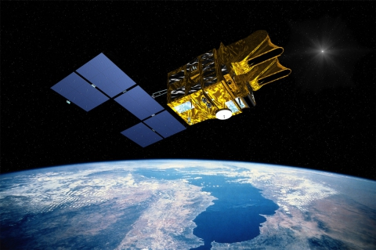
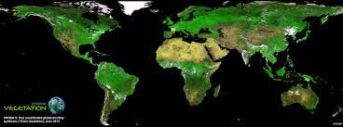
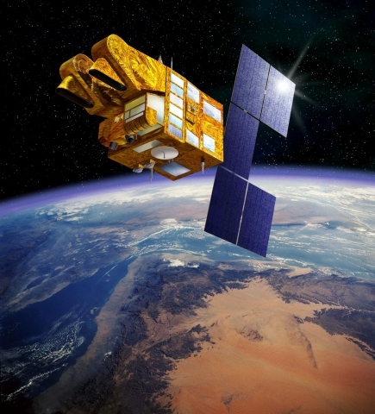
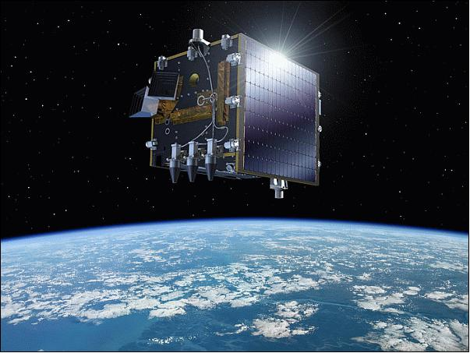
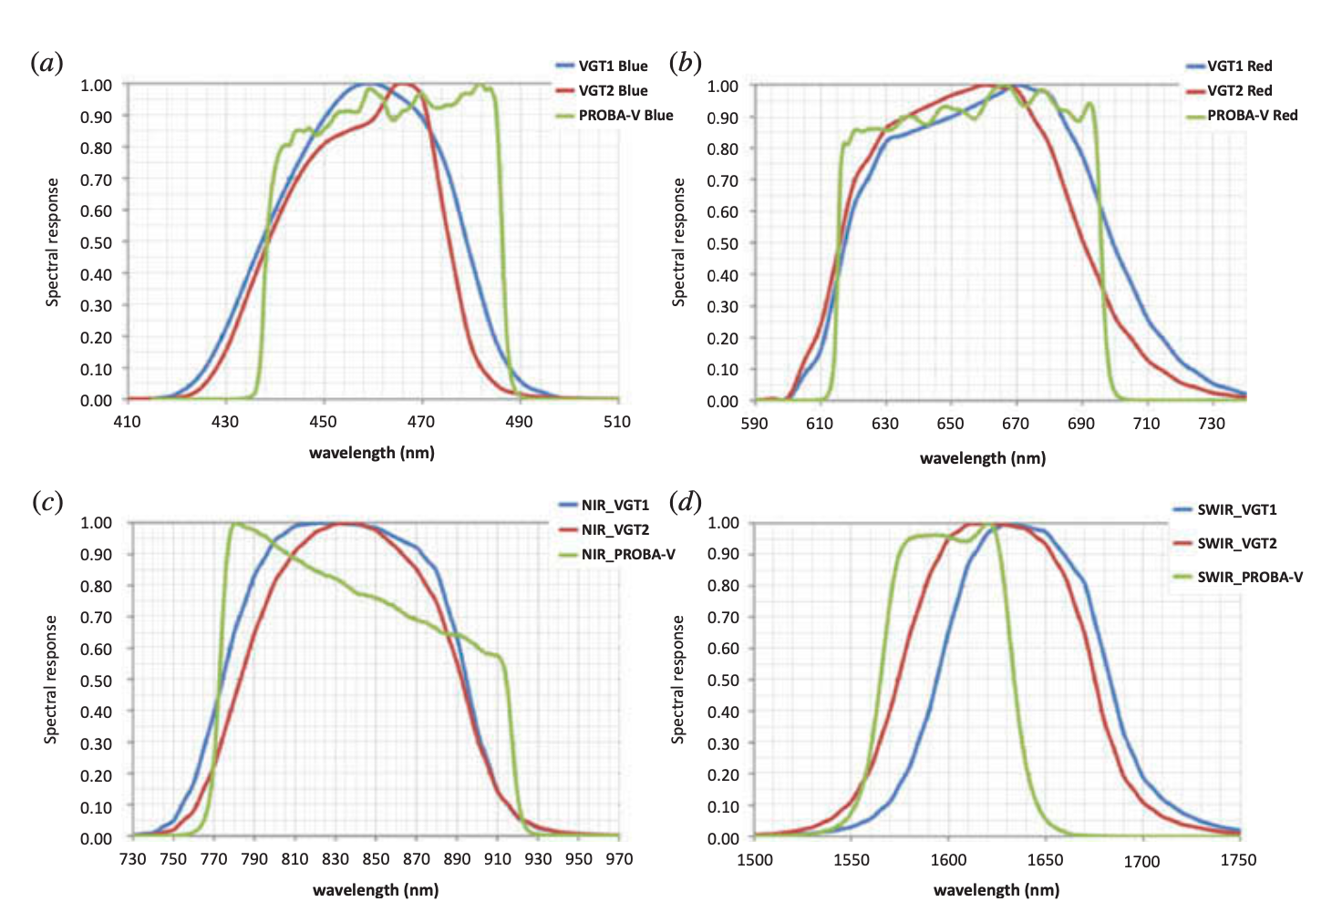


SPOT-VGT1, VGT-2, PROBA-V time series
Bridging the gap to S-3 for Land applications
Sentinel-3B
Sentinel-3A
Global near-daily coverage
Blue, Red, NIR, SWIR bands

Slide 3
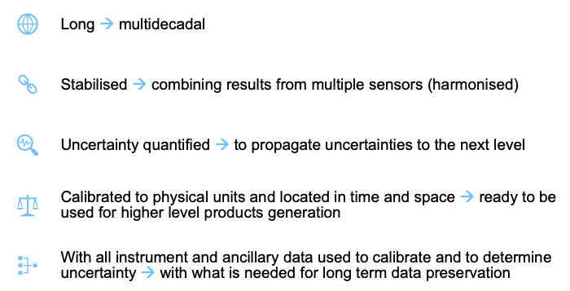


Terminology
A Fundamental Data Record (FDR) is a record, of sufficient duration for its application, of uncertainty-quantified sensor observations calibrated to physical units and located in time and space, together with all ancillary and lower-level instrument data used to calibrate and locate the observations and to estimate uncertainty.
https://qa4eo.org/
Notes:
The term Fundamental Data Record may be applied to records meeting similar standards to an FCDR, but which is either too short to be informative about climate variability and change, or whose contents are relevant for purposes not considered to be climate applications. (Logically, one should define FDR as the baseline concept and add climate-specific requirements to define FCDR, and this may yet be recommended)

Slide 4
FDR4VGT Objectives
Ensuring long-term data preservation and valorisation of SPOT-VGT1, SPOT-VGT-2 and PROBA-V data archives;
Improving consistency, by fully characterising the radiometric, geometric and spectral differences across sensors;
Enhancing harmonisation and temporal stability by quantifying and correcting inter-sensors biases and sensor-induced spurious drifts;
Providing uncertainty estimates at pixel level, ensuring traceability along the full processing chain, starting from raw data;
Generating a temporally stable and harmonised data record of reflectances at TOA and TOC level to be used as input for climate studies.

Slide 5

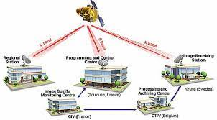
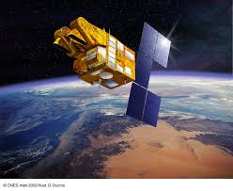

SPOT-VGT Calibration
Image Quality Centre (QIV) at CNES
Processing, Archiving & Distribution at VITO

Slide 6
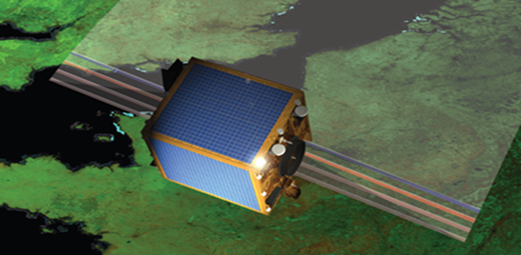
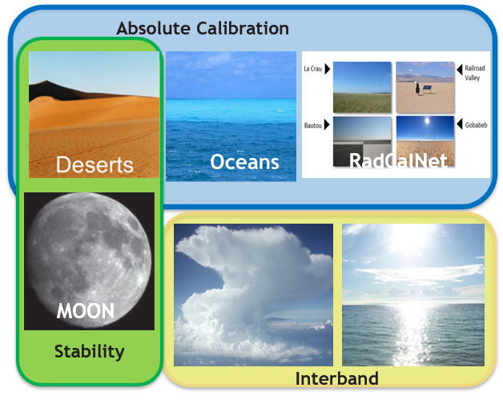
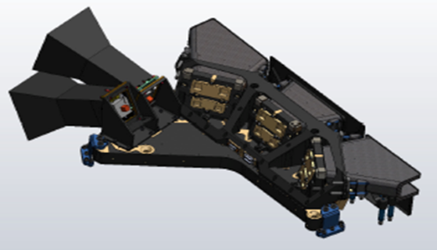
PROBA-V Calibration
Imaging Quality Center (IQC) at VITO
IQC is in charge of the assessment of the PROBA-V performance, the analysis of the image quality, and calibration after launch.
Radiometric Calibration
OSCAR* (Optical Sensor Calibration with simulated Radiances)
*Sterckx et al. IJRS, 2014; Sterckx et al. , TGARS, 2013; Govaerts et al., RSL, 2013; Sterckx et al., RS, 2016

Slide 7
FDR4VGT : Harmonisation
Objective: Secure radiometric consistency between VGT-1, VGT-2 and PROBA-V for the generation of higher level thematic data record.
Harmonisation: All the calibrations of the sensors have been made consistent with (a) reference dataset(s) which can be traced back to known (SI-traceable) reference sources. Each sensor is calibrated to the reference, maintaining its features such that the calibration radiances represent the unique nature of each sensor. Following FIDUCEO, we apply Harmonisation

Slide 8

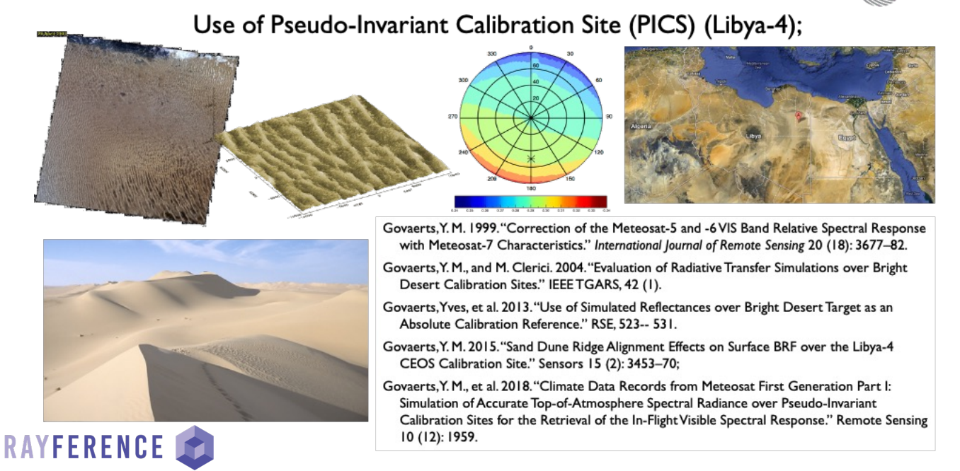
FDR4VGT : Harmonisation

Slide 9
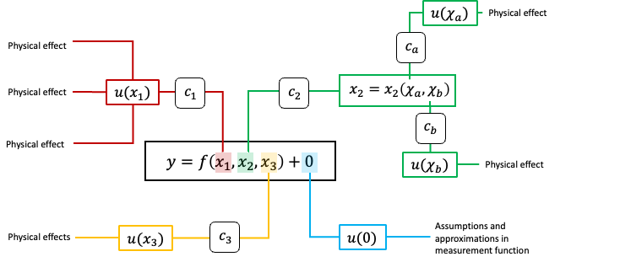
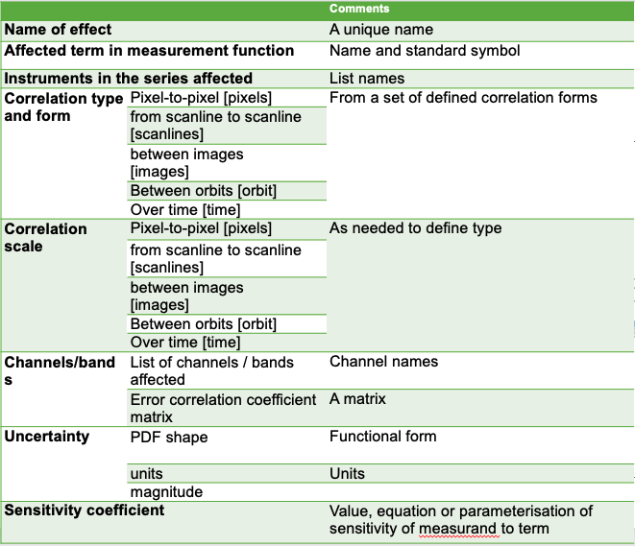



FDR4VGT: Pixel level -uncertainty
FDR4VGT Requirement : Providing uncertainty estimates at pixel level, ensuring traceability along the full processing chain, starting from raw data
Mittaz et al. 2019

Slide 10
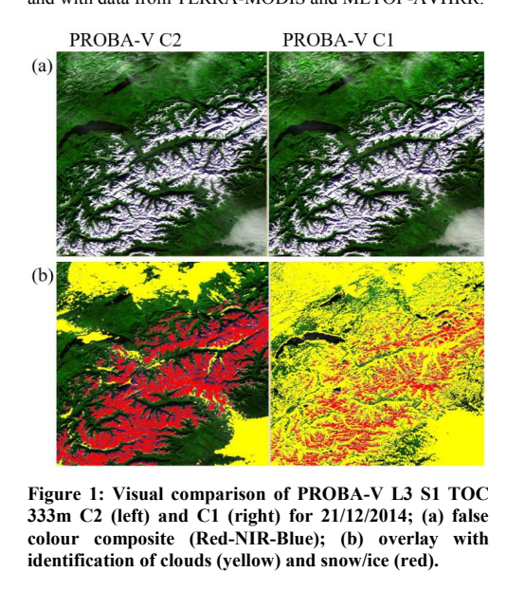
Cloud masking
FDR4VGT Requirements : Development of reliable and consistent cloud masking algorithm
  PROBA-V C2: Multi-Layer Perceptron (MLP)-based Neural Network
  Significant improvements in Cloud Detection
  Transfer learning from PROBA-V to SPOT-VGT1/2

Slide 11
FDR4VGT : L2 –A/C
FDR4VGT Requirements :
  Harmonize A/C between VGT1, VGT2, PROBA-V
  Propagation of uncertainty to L2
Approach:
  SMAC-CL processor
  Ancillary atmospheric data from MERRA-2
  Use FIDUCEO uncertainty propagation

Slide 12
User needs through questionnaire
Questionnaire content
  Data usage (Product level, resolution, frequency,…)
  User satisfaction with current VGT & PROBA-V data quality, format, metadata, status map
  User specific processing (filtering, compositing, A/C, harmonization/homogenization,…)
  Uncertainty information needs
  Additional user needs (metadata, format, others)

Slide 13
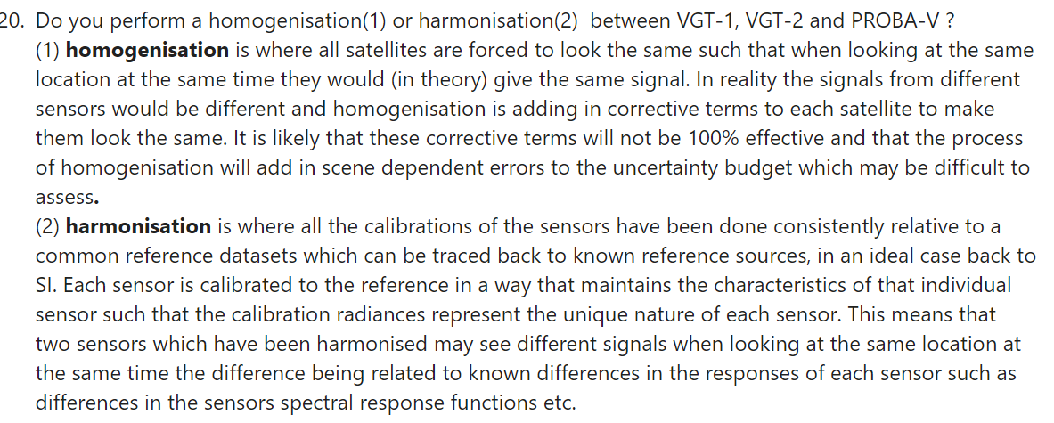
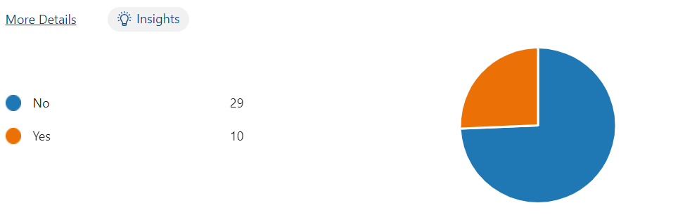
Questionnaire results highlights

Slide 14
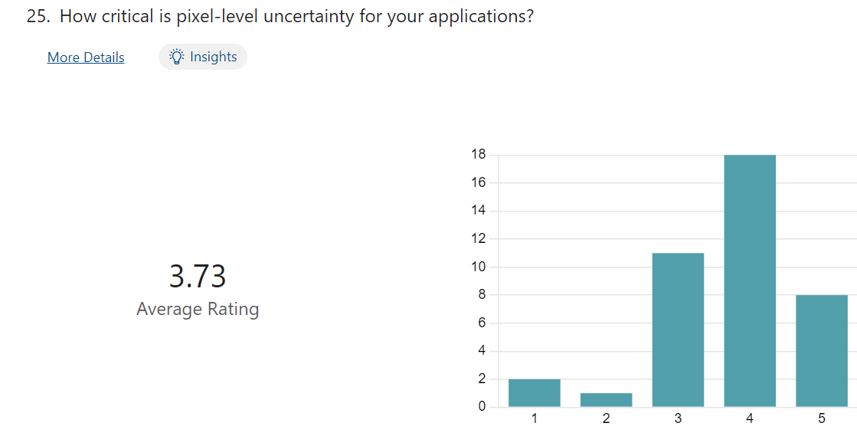
Questionnaire results highlights
Not at all important
Absolutely required

Slide 15
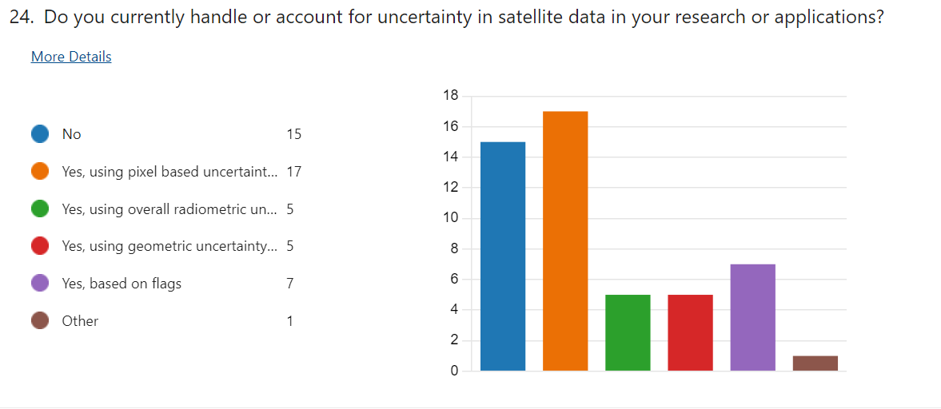
Questionnaire results highlights

Slide 16
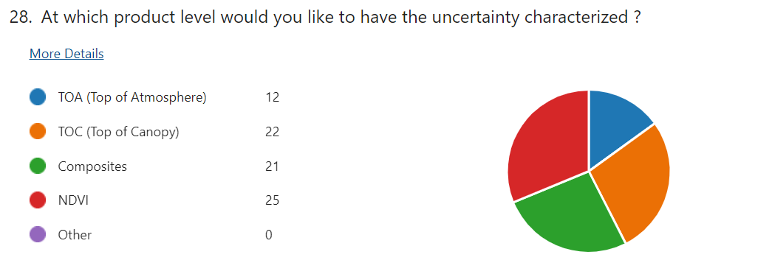
Questionnaire results highlights

Slide 17
Main conclusion user needs
Pixel-level Uncertainty information considered to be very important
Uncertainty information required at different processing levels; propagation of uncertainty up to NDVI & Composites
Clearly demand for improved cloud screening
High interest in cloud probability layer
Consistency with Sentinel-3 should not be overlooked

Slide 18
Implementation Approach
Phase 1 (2024-26) : development of the algorithms for the L1c, L2, L3 data processing and for inter-sensors biases assessment and uncertainties estimation
  KO in January 2024
  VITO: Prime
  Rayference : Uncertainty L1 & definition of radiometric reference
  Uni. Valencia (cloud mask)
  HYGEOS (atmospheric correction) for L2 processing
Phase 2 (2026-28): integration of the prototype algorithm in the target platform and reprocessing/validation of the 20+ years archive.

Slide 19
FDR4VGT
Thanks !

