Slide 1
Update on the MICMICS implementation of the GSICS DCC algorithm
S. Wagner, R. Shanbhag*, A. Mousivand, V. Debaecker*
* Telespazio
GSICS annual meeting 2024

Slide 2
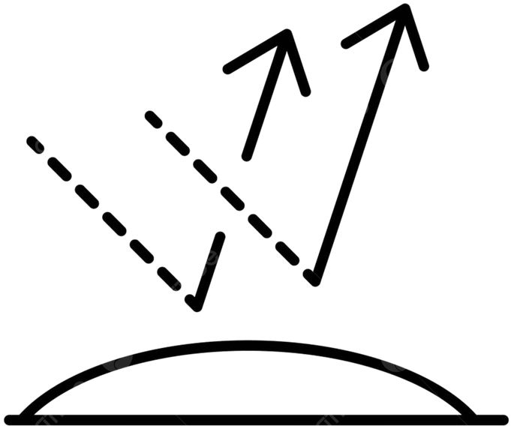
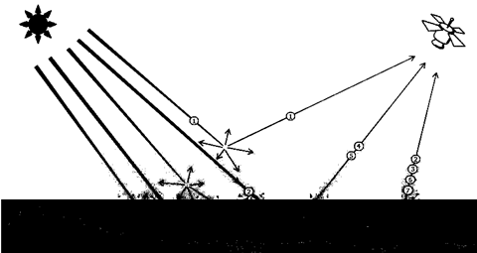
GSICS DCC and MICMICS
Desert Calibration
Desert Inter-Calibration
DCC Inter-Calibration
Lunar Calibration
DCC Calibration
Lunar Inter-Calibration
Imager-Hyperspectral
Inter-Calibration
Rayleigh Calibration
Imager-Imager
Inter-Calibration
FCI
LI
SLSTR
SEVIRI
OLCI
Rayleigh Inter-Calibration
SLSTR
METimage
Ray-Matching
Inter-Calibration
NWP Calibration
FCI
SEVIRI
AVHRR
NWP Inter-Calibration
Inter-Calibration Blender
3MI
METimage
DCC Extraction Module
CLIM
MAP
Sun Glint Inter-Calibration
UVNS
UVN
Lunar Extraction Module
Snow and Ice Inter-Calibration
Subsetter Tool
Radiative Transfer Module
Data-Fusion Tool
#9ba9ea
Colocation Tool
Pre-Colocation Tool

Slide 3
GSICS DCC and MICMICS
Desert Calibration
Desert Inter-Calibration
DCC Inter-Calibration
Lunar Calibration
DCC Calibration
Lunar Inter-Calibration
Imager-Hyperspectral
Inter-Calibration
Rayleigh Calibration
Imager-Imager
Inter-Calibration
FCI
LI
SLSTR
SEVIRI
OLCI
Rayleigh Inter-Calibration
SLSTR
METimage
Ray-Matching
Inter-Calibration
NWP Calibration
FCI
SEVIRI
AVHRR
NWP Inter-Calibration
Inter-Calibration Blender
3MI
METimage
DCC Extraction Module
CLIM
MAP
Sun Glint Inter-Calibration
UVNS
UVN
Lunar Extraction Module
Snow and Ice Inter-Calibration
Subsetter Tool
Radiative Transfer Module
Data-Fusion Tool
#9ba9ea
Colocation Tool
Pre-Colocation Tool

Slide 4
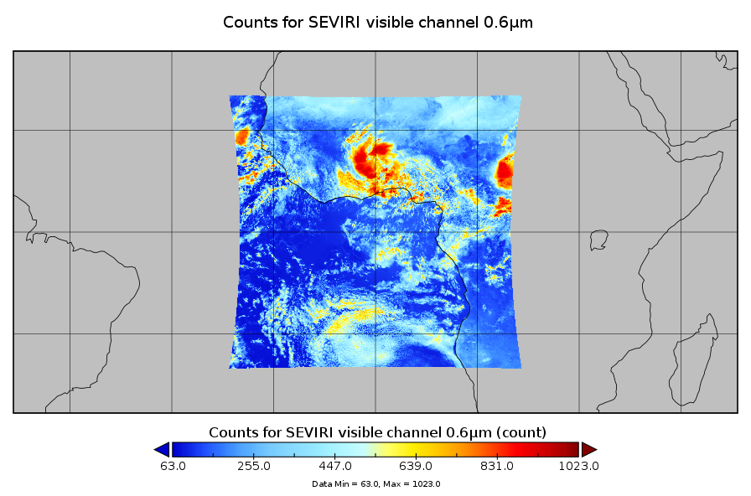
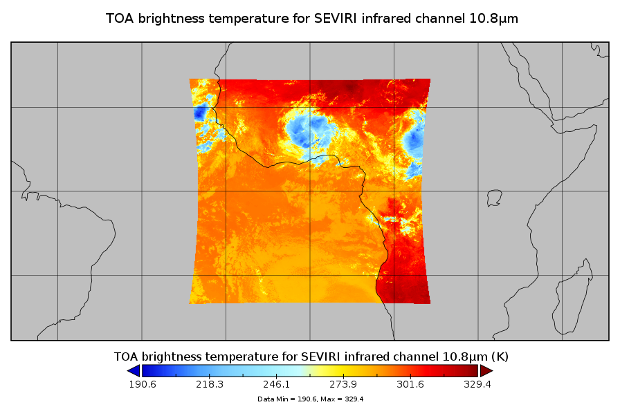
MICMICS DCCICS workflow
Level 1C products
11μm band available ?
Data subsetter
Subsets of L1C products over ROI
DCCXTRM
(DCC extraction)
DCCICS
Yes
GSICS DCC products
GEO imagers such as SEVIRI, FCI
Polar radiometers such as AVHRR, SLSTR, METimage
Inter-Calibration Blender
Calibration Output Database

Slide 5
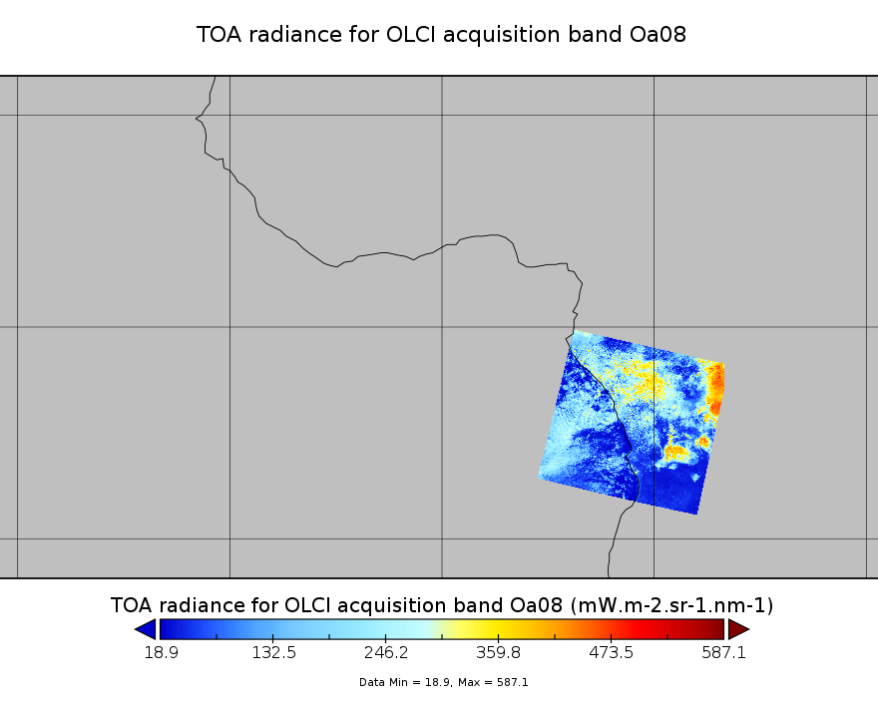
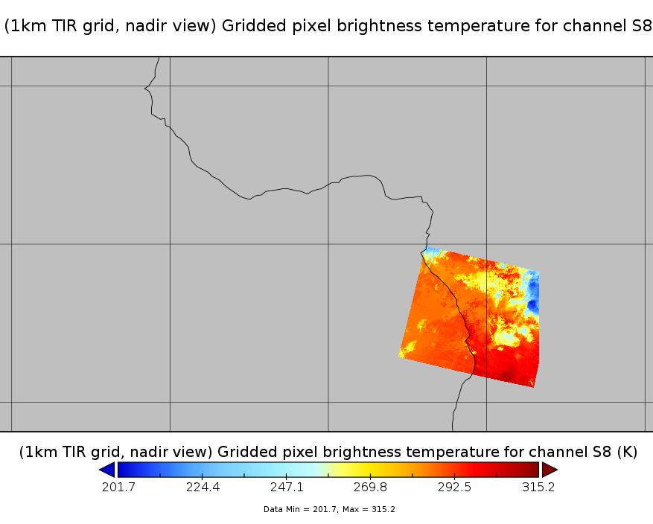
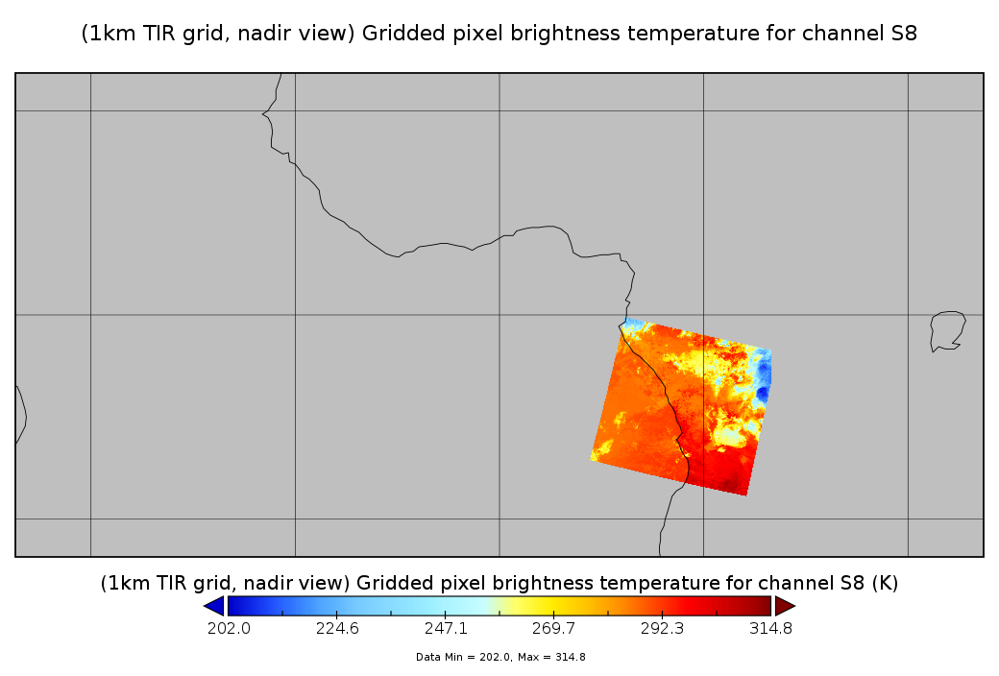
MICMICS DCCICS workflow
Level 1C products
11μm band available ?
Data subsetter
Subsets of L1C products over ROI
DCCXTRM
(DCC extraction)
DCCICS
Data-fused products over ROI
No
GSICS DCC products
Data fusion
(Remapping of IR sensor to monitored instrument grid)
OLCI
SLSTR
SLSTR
GEO imagers such as LI
Polar radiometers such as OLCI, 3MI
Inter-Calibration Blender
Calibration Output Database

Slide 6
Set-up for MSG/SEVIRI
Reference channels
Reference radiance: as per the GSICS ATBD (for Lon 45.5E, same as for Lon 41.5E)
For SWIR, no reference value from VIIRS ➔ based on typical radiance for SEVIRI
Homogeneity test done on all channels (not only on VIS0.6)
SEVIRI channel | VIIRS reference band
VIS0.6 | M5
VIS0.8 | M7
NIR1.6 | M10 (only for SBAF – no ref value)
HRV | M5

Slide 7
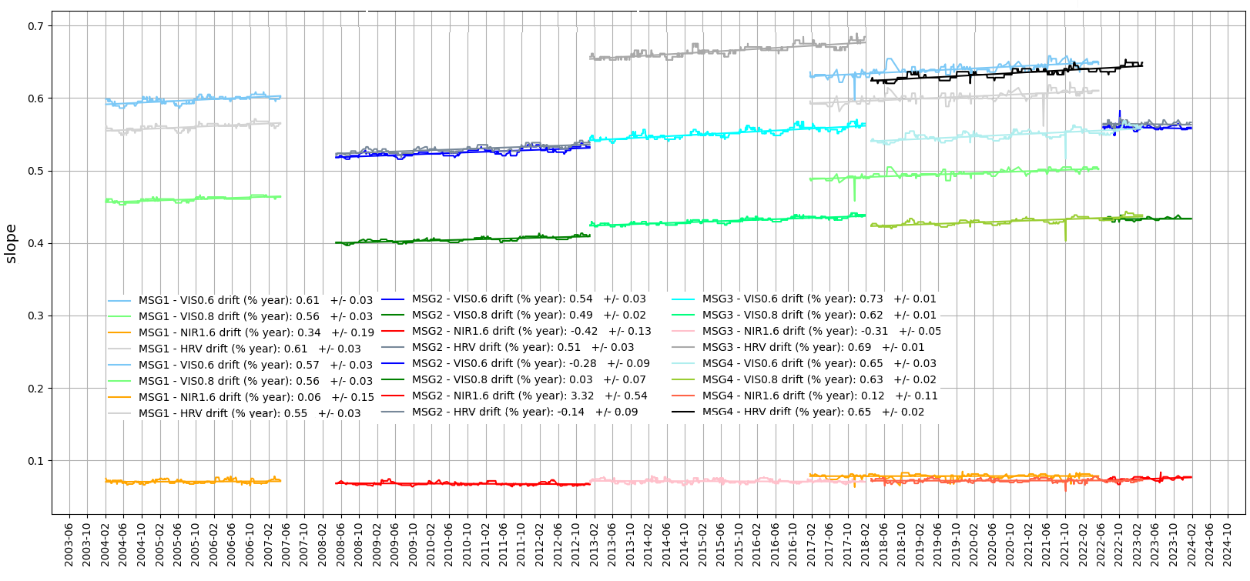
SEVIRI – timeseries – calibration gains

Slide 8
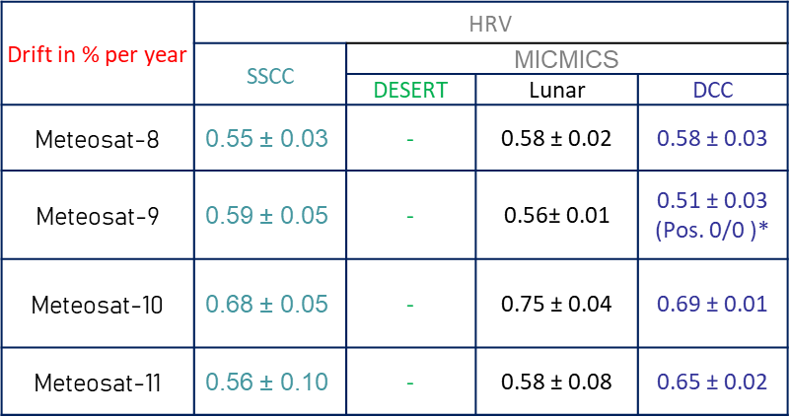
MSG/SEVIRI warm stability radiometric stability

Slide 9
Set-up for OLCI
Reference channels for OLCI
Reference radiance: as per the GSICS ATBD (at Lon 0.0)
Homogeneity test done on all channels (including SLSTR)
Issue of the DCC very cold temperature (SLSTR cold end)
Data filtered using saturation flags
OLCI channel | VIIRS reference band
Oa01 | M1
Oa02 | M1
Oa04 | M3
Oa05 | M4
Oa06 | M4
Oa07 | I1
Oa08 | M5
Oa09 | M5
Oa10 | M5
OLCI channel | VIIRS reference band
Oa11 | M6
Oa12 | M6
Oa13 | M6
Oa14 | M6
Oa15 | M6
Oa16 | I6
Oa18 | M7
Oa19 | M7
Oa21 | M7
Difference in the overpassing time between S3 and NOAA-20
Purpose is to monitor the radiometric stability
Brute force: we extract everything and see what comes out!

Slide 10
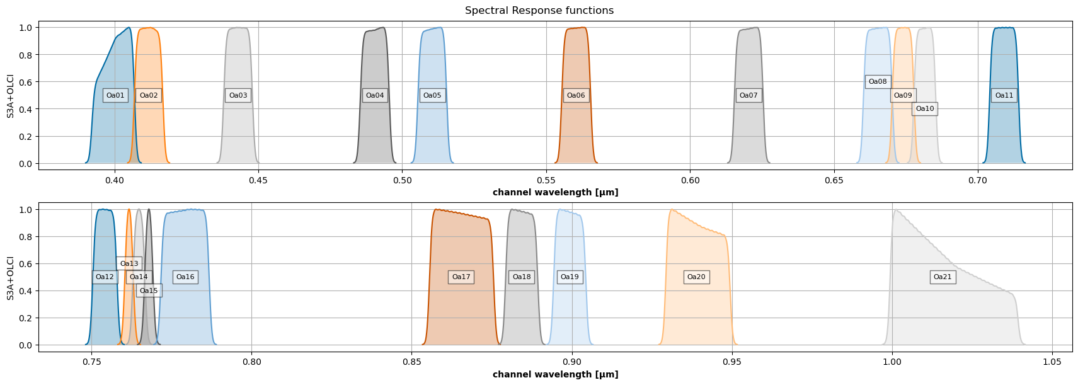
OLCI channels

Slide 11
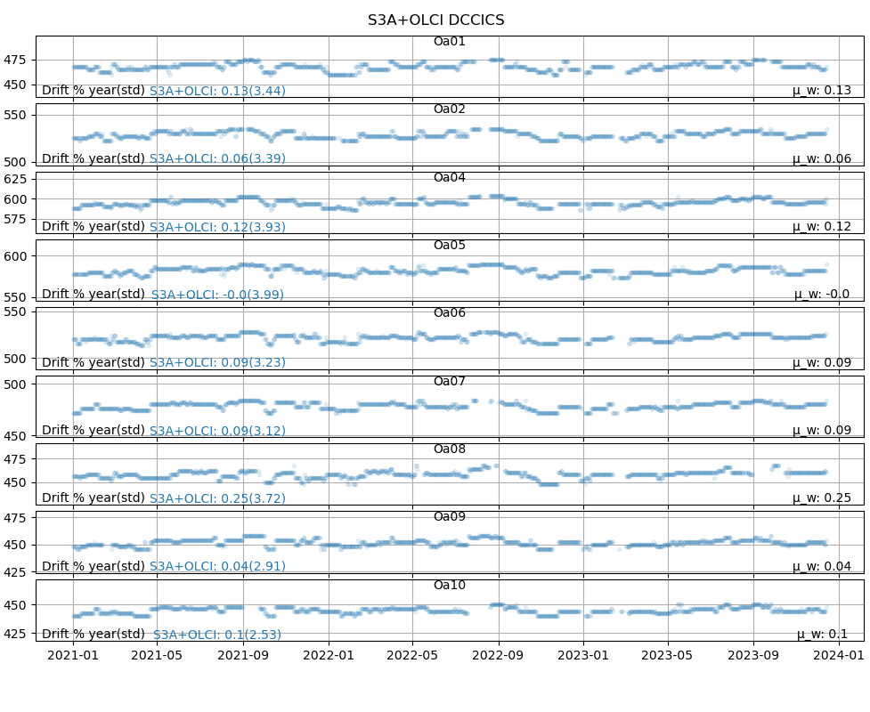
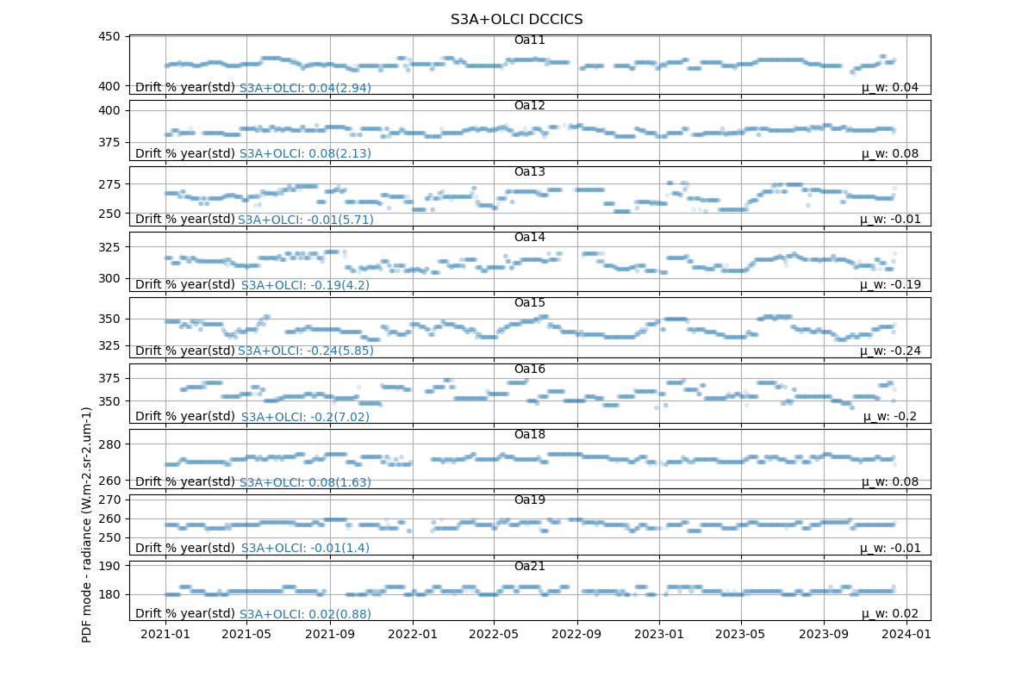
OLCI-A – Timeseries / PDF mode

Slide 12
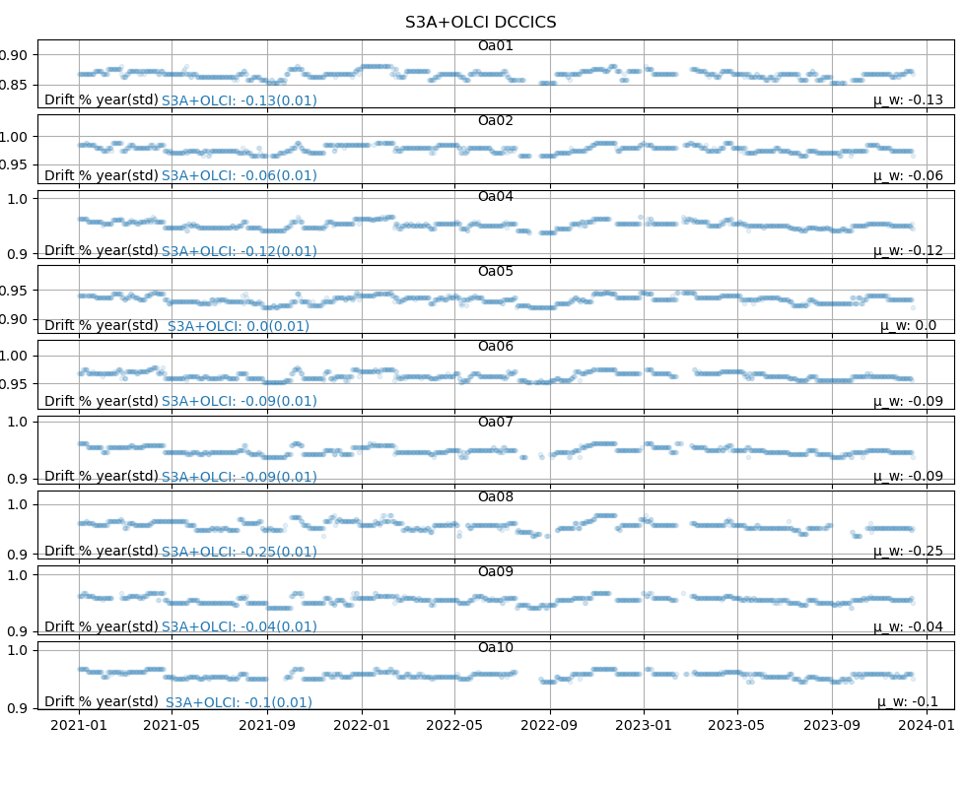
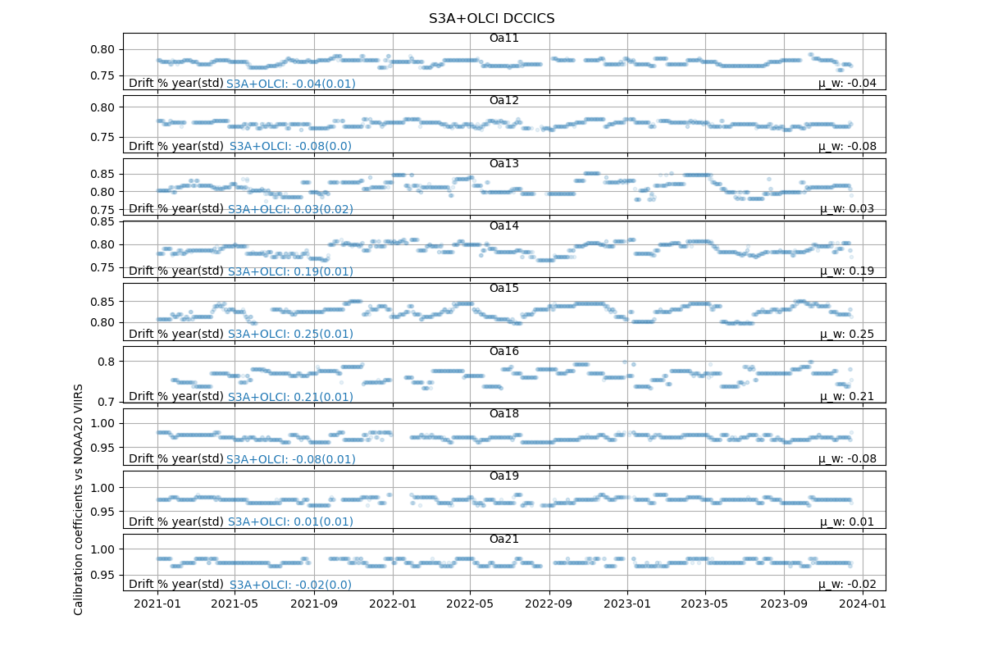
OLCI-A – Timeseries / Correction

Slide 13
Set-up for SLSTR
Reference channels
Reference radiance: as per the GSICS ATBD
Homogeneity test done on all channels (including OLCI)
Remember that SLSTR is for SST, not meant to measure very cold temperatures such as for DCC…
SLSTR channel | VIIRS reference band
S1 | M4
S2 | M5
S3 | M7

Slide 14
SLSTR channels

Slide 15
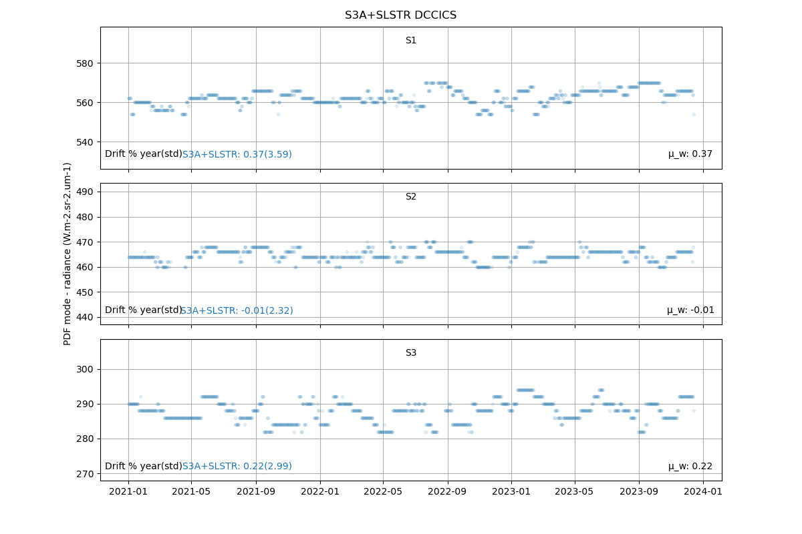
SLSTR-A – Timeseries / PDF mode

Slide 16
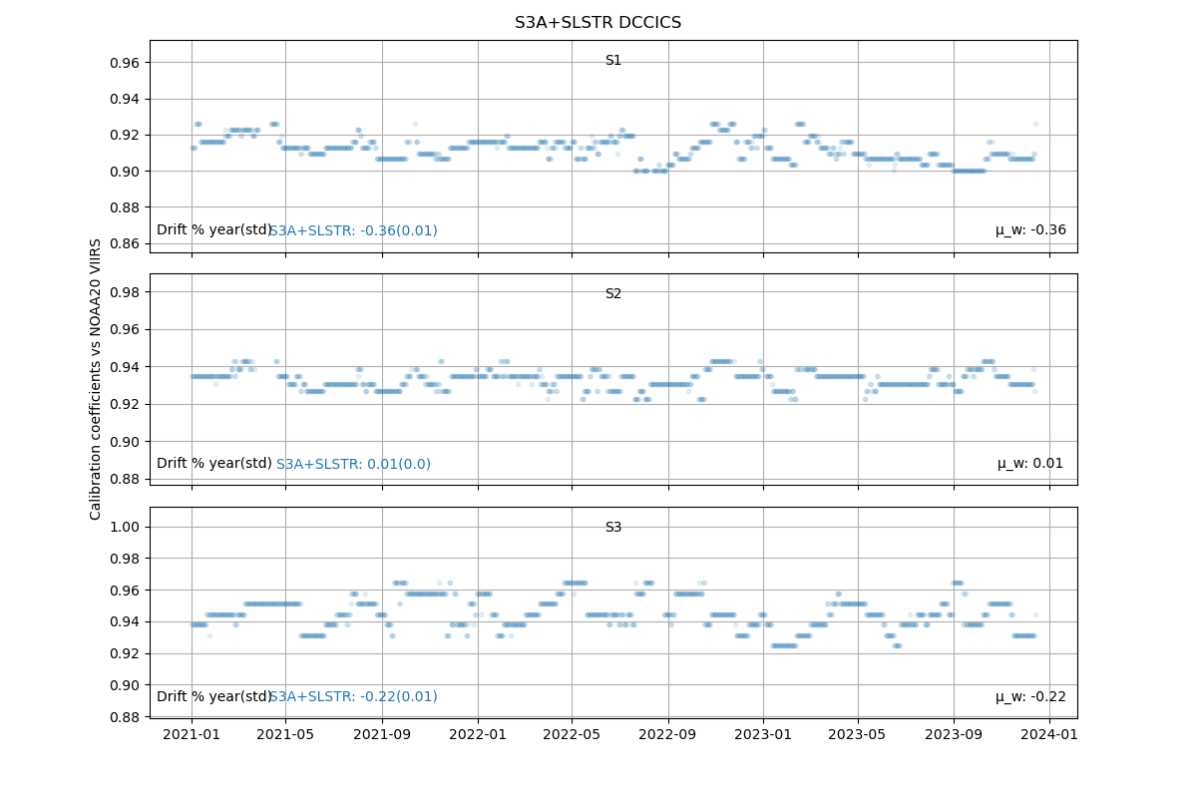
SLSTR-A – Timeseries / Correction

Slide 17
Summary for OLCI-A and SLSTR-A
Drift in % per year | OLCI-A
 | MICMICS
 | DESCS (Obs/Simu) | DCC (Corr)
Oa01 | 0.02 ± 0.01 | -0.13 ± 0.01
Oa02 | 0.02 ± 0.01 | -0.06 ± 0.01
Oa03 | -0.01 ± 0.01
Oa04 | -0.03 ± 0.01 | -0.12 ± 0.01
Oa05 | -0.03 ± 0.01 | 0.0 ± 0.01
Oa06 | -0.05 ± 0.01 | -0.09 ± 0.01
Oa07 | -0.01 ± 0.01 | -0.09 ± 0.01
Oa08 | -0.01 ± 0.01 | -0.25 ± 0.01
Oa09 | 0.01 ± 0.01 | -0.04 ± 0.01
Oa10 | 0.01 ± 0.01 | -0.1 ± 0.01
Drift in % per year | OLCI-A
 | MICMICS
 | DESCS (Obs/Simu) | DCC (Corr)
Oa11 | 0.01 ± 0.01 | -0.04 ± 0.01
Oa12 | 0.01 ± 0.01 | -0.08 ± 0.0
Oa13 |  | 0.03 ± 0.02
Oa14 |  | 0.19 ± 0.01
Oa15 |  | 0.25 ± 0.01
Oa16 | 0.02 ± 0.01 | 0.21 ± 0.01
Oa17 | 0.02 ± 0.01
Oa18 | 0.02 ± 0.01 | -0.08 ± 0.01
Oa19 |  | 0.01 ± 0.01
Oa21 | 0.02 ± 0.01 | -0.02 ± 0.01
Drift in % per year | SLSTR-A
 | S3MPC | MICMICS | MICMICS
 |  | Inter-Band | DESCS | DESICS | DCC
S1 | 0.3 ± 0.2 | 0.36 ± 0.03 | 0.37± 0.01 | 0.4± 0.02 | -0.36 ± 0.01
S2 | 0.2 ± 0.1 | 0.2 ± 0.02 | 0.2± 0.01 | 0.21± 0.01 | 0.01 ± 0.0
S3 | 0.3 ± 0.2 | 0.38 ± 0.02 | 0.36± 0.01 | 0.38± 0.01 | -0.22± 0.01
OLCI:
For OLCI, further work needed on channel selection + reference signal
Complete time series processing is on-going
Further data filtering need to improve DCC extraction
Results are not final…
SLSTR:
Some drift observed for S1, S2 and S3

Slide 18
Conclusion and future work
MICMICS set to extract and process DCC data over specific areas for both LEO and GEOs
Agile system, easy to implement new missions such as MTG/FCI or MTG/LI
NOAA-20 VIIRS set as a new reference
Need to further iterate on selection of bands + reference VIIRS radiance
MICMICS products will replace MODIS products in the demo phase for GEOs ➔ GPPA?
For LEOs, more work needed to derive proper corrections. But promising results for radiometric stability monitoring.

Slide 19
Thank you!
Questions are welcome.

