Slide 1
DCC BRDF netCDF formats and pixel resolution
David Doelling, Conor Haney, Prathana Khakurel, Rajendra Bhatt, Arun Gopalan
GSICS annual meeting, VIS/NIR session,
EUMETSAT, Darmstadt, Germany, March 14, 2024

Slide 2
Pixel resolution impact on DCC identification
The DCC methodology relies on identifying DCC pixels based on the following criteria:
BT_{11µm} < 205 K
Hom_{0.65µm} < 0.03
Hom_{11µm} < 1.0 K
where Hom = spatial homogeneity of 3x3 pixels
Aggregate the VIIRS M band 750-m and Landsat-8 30-m native resolution imagery to lower pixel resolutions
How does the pixel resolution impact the standard DCC identification thresholds?
Is the DCC reflectance PDF shape dependent on pixel resolution?
Can the reference DCC reflectance be transferred to other sensors with differing pixel resolution?

Slide 3
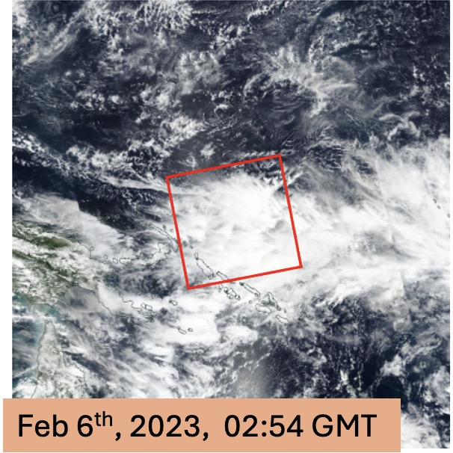
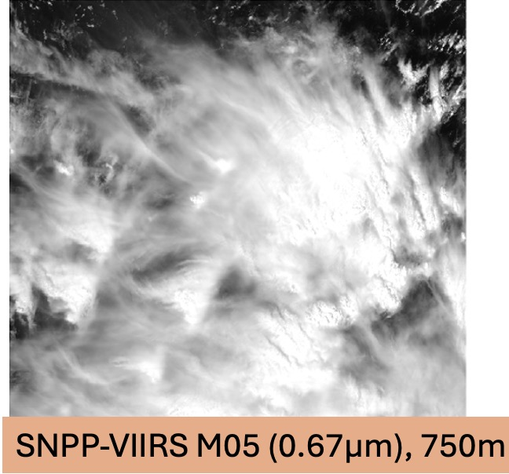
SNPP VIIRS M05 DCC 750-m TSP granule East of Solomon Islands
Himawari-8 0.65µm image

Slide 4
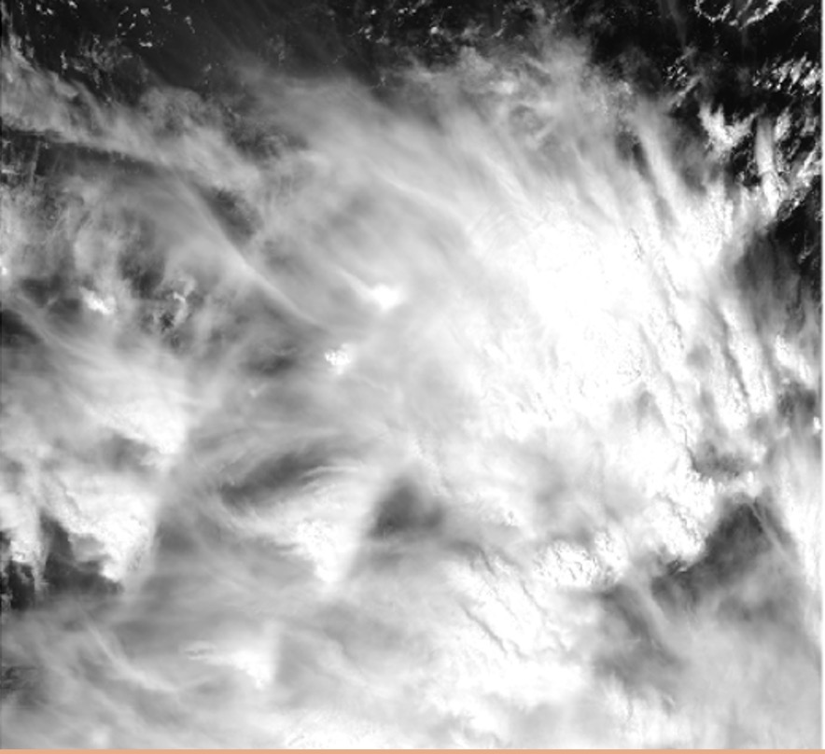
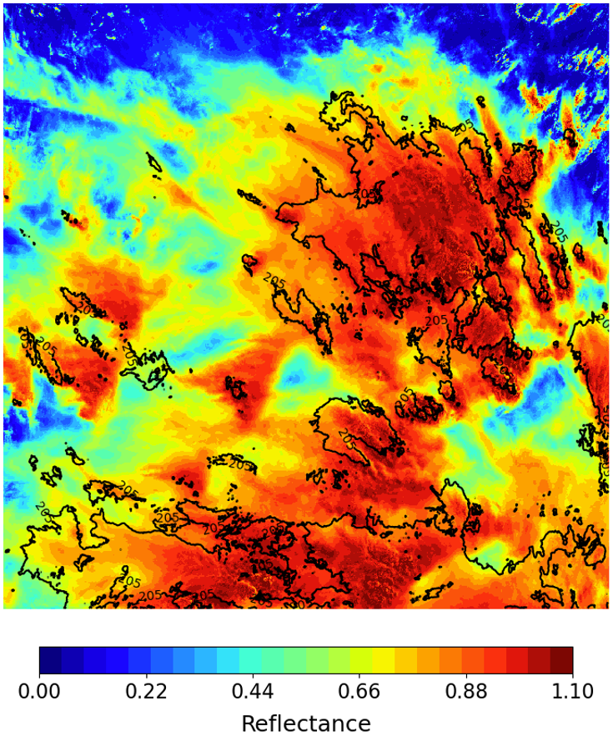
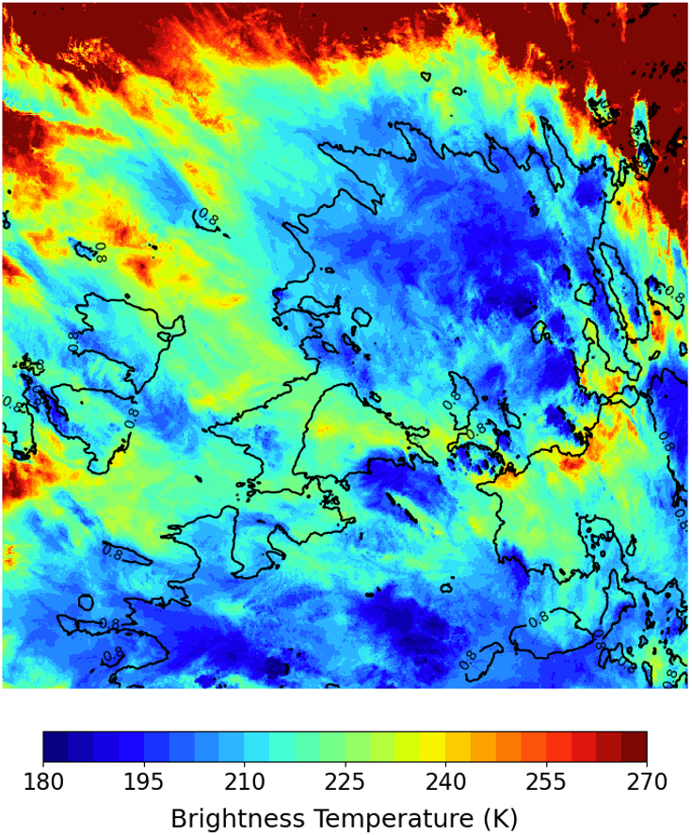
SNPP VIIRS M05 DCC 750-m granule, East of Solomon Islands
SNPP-VIIRS, 750m
M05 0.67µm
M15 11µm BT
205K contour
0.8 ref contour

Slide 5
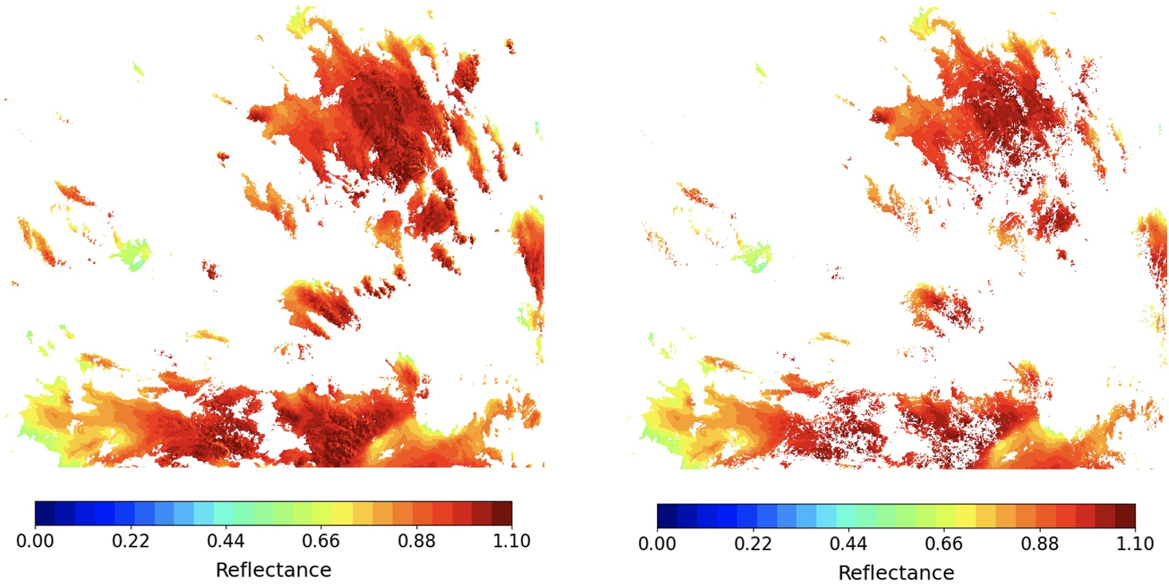
M05 pixel reflectances
M05 pixel reflectances (w/ H_{s} thresholds)
BT_{M15} < 205 K
BT_{M15} < 205 K
H_{M05} < 0.03
SDV_{M15} < 1.0 K
Many overshooting tops are removed

Slide 6
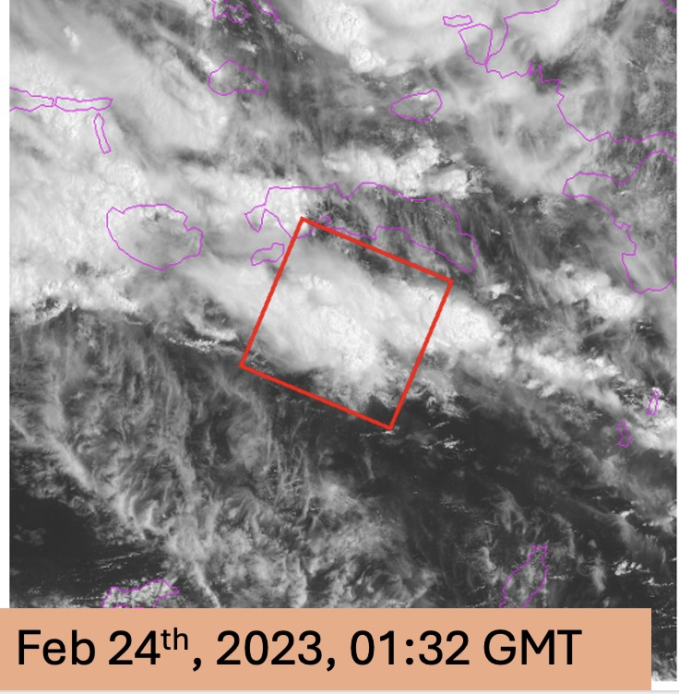
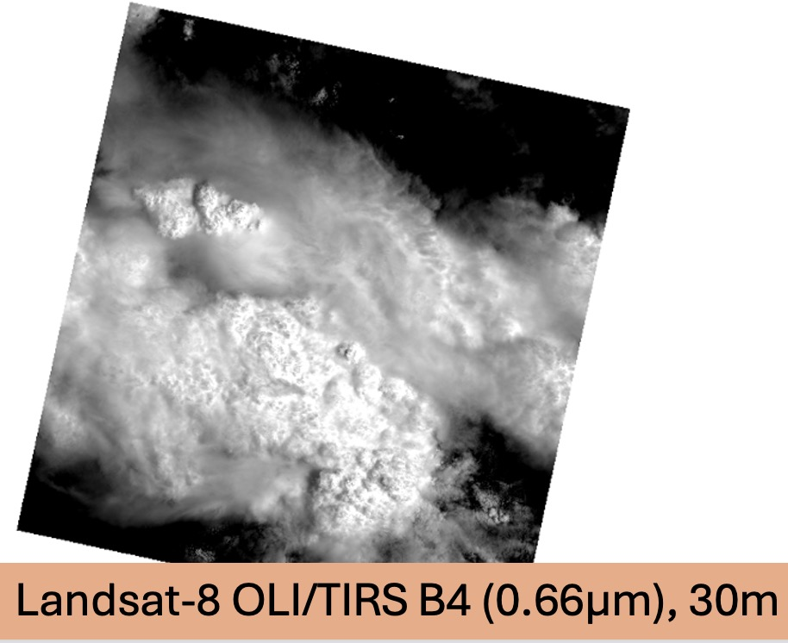
Landsat-8 OLI/TIRS B4 30-m TWP granule Banda Arc, Indonesia

Slide 7
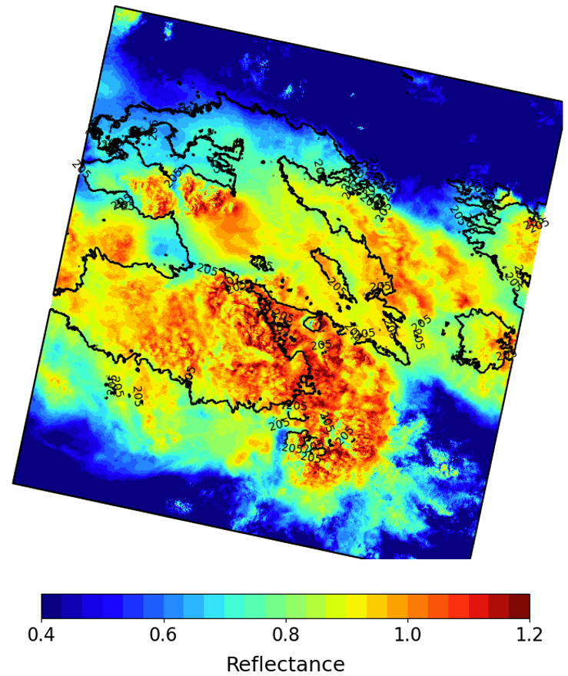
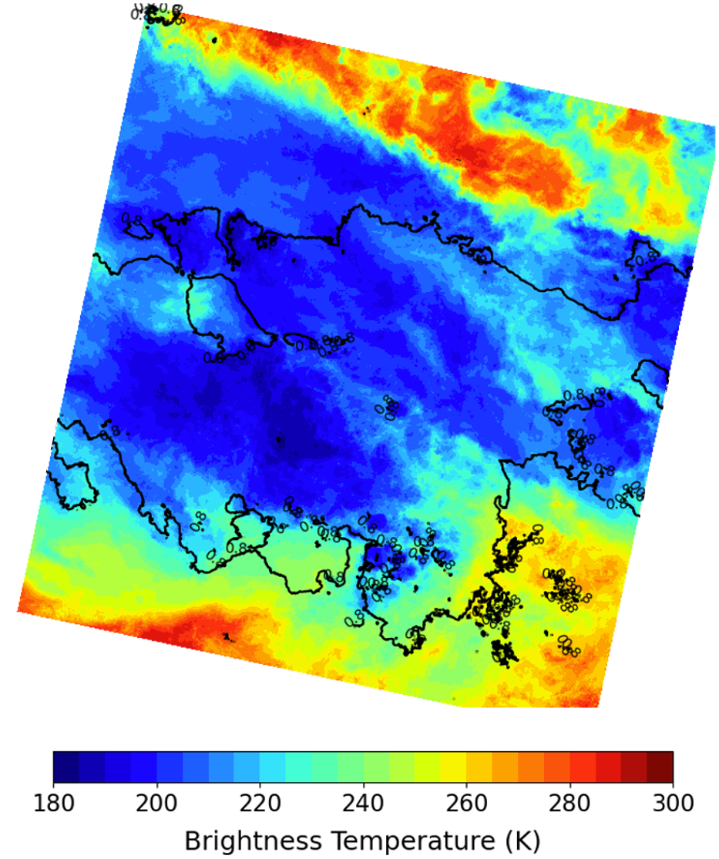
Landsat-8 OLI/TIRS B4 30-m TWP granule Banda Arc, Indonesia
Landsat-8, 30m
OLI B04 0.66µm
TIRS B1 10.8µm BT
205K contour
0.8 ref contour

Slide 8
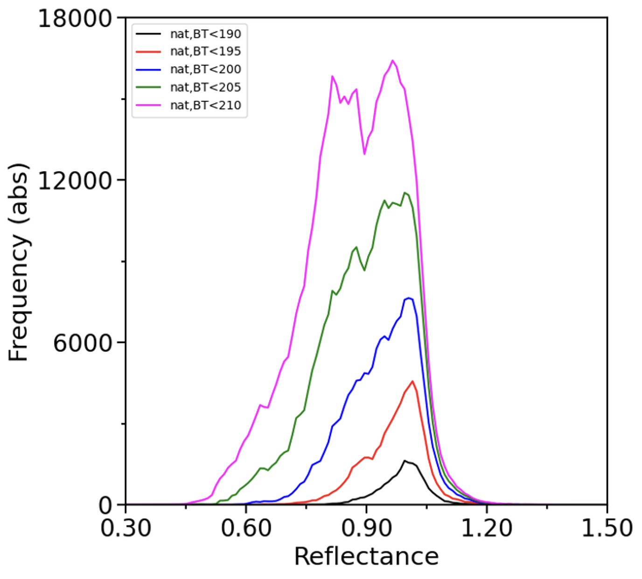
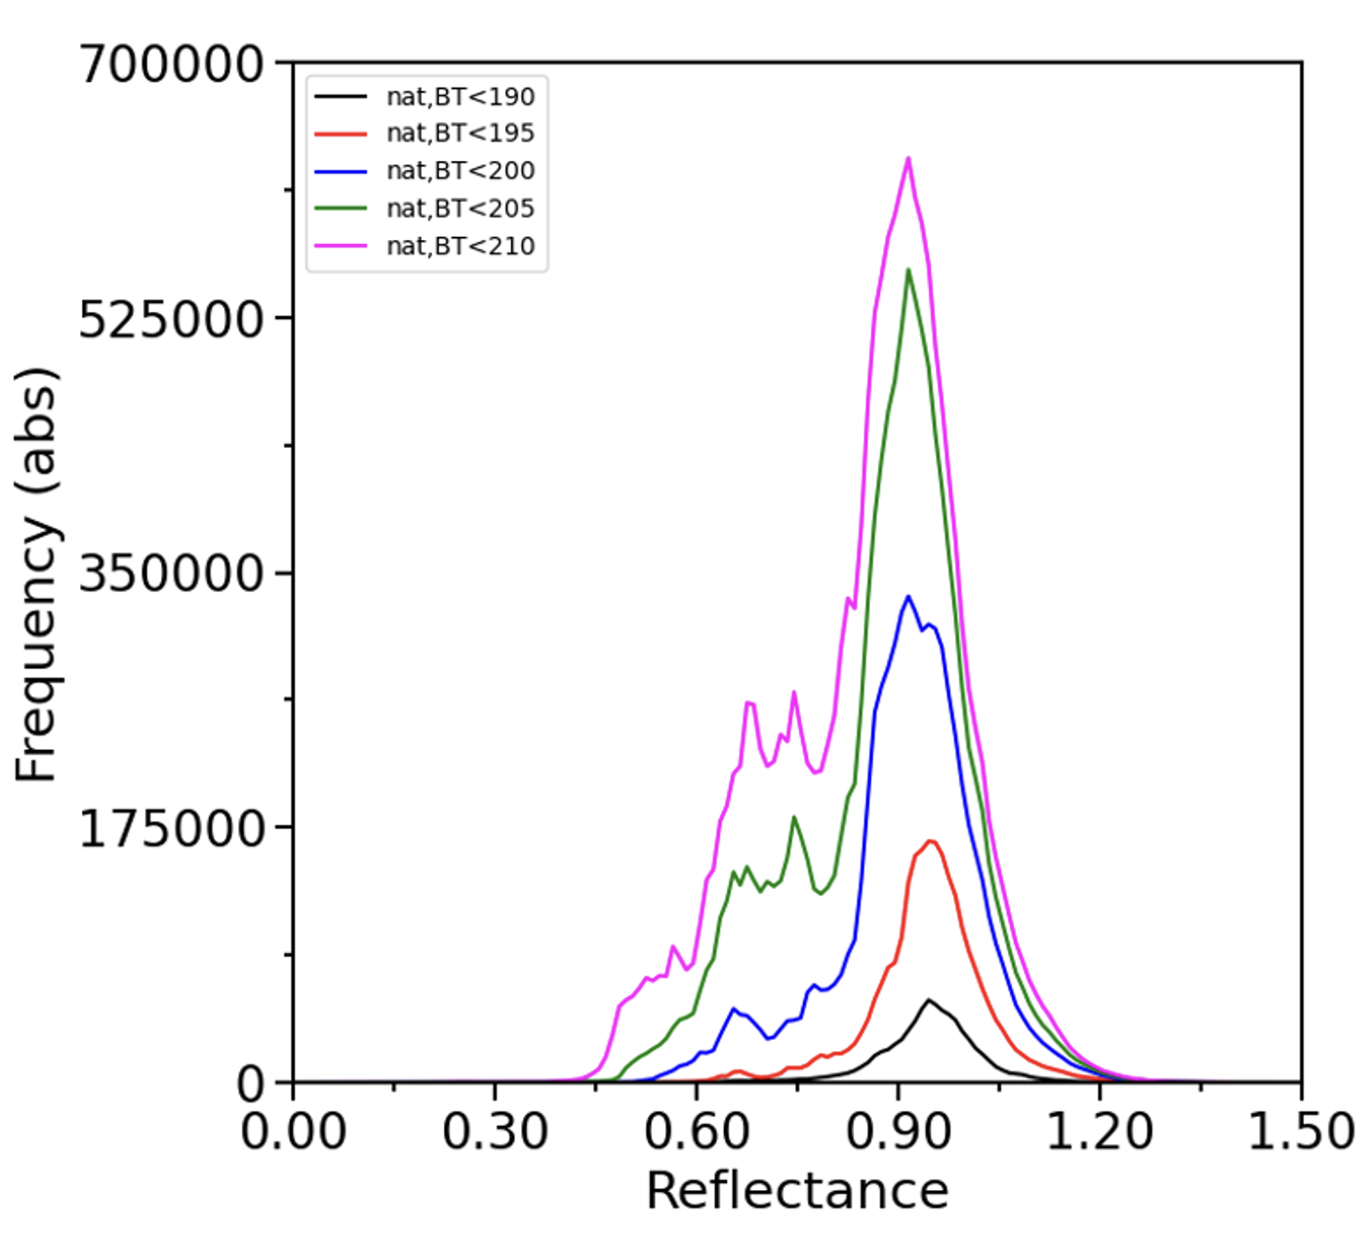
BT Threshold Sensitivity Analysis
SNPP-VIIRS M05, 750m
Landsat 8 OLI/TIRS B4, 30m
BT < 190 K
BT < 195 K
BT < 200 K
BT < 205 K
BT < 210 K
• Decreasing the BT threshold decreases the skewness or darker tail of the PDF
• Increasing the BT threshold increases the frequency of DCC identified pixels

Slide 9
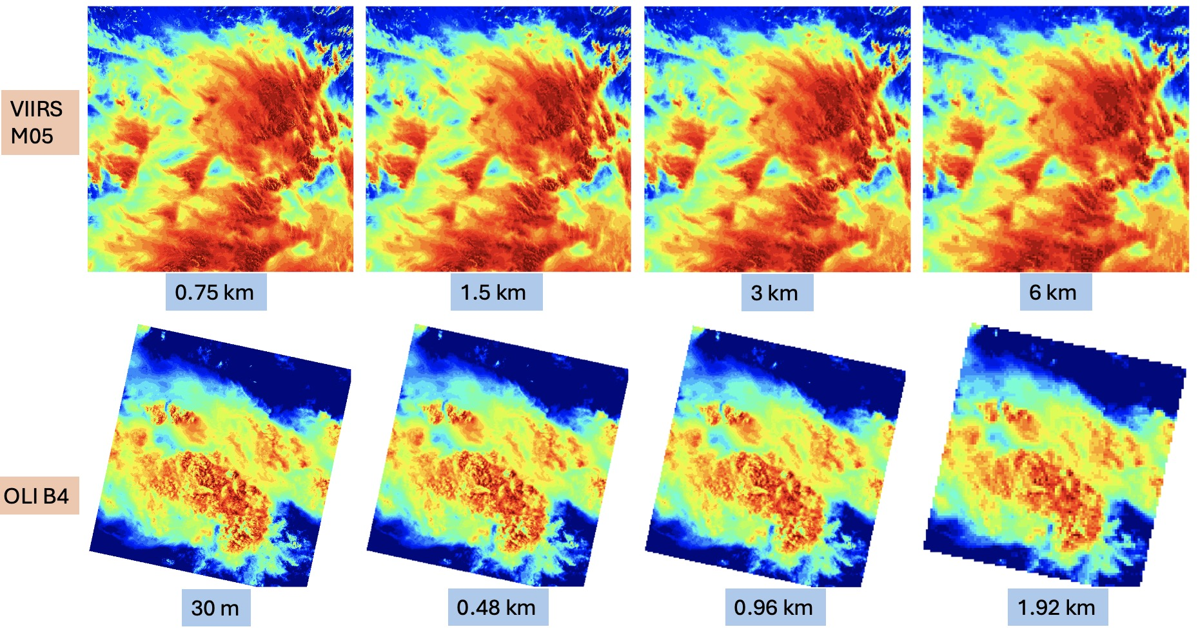
0.65µm reflectance images by pixel resolution

Slide 10
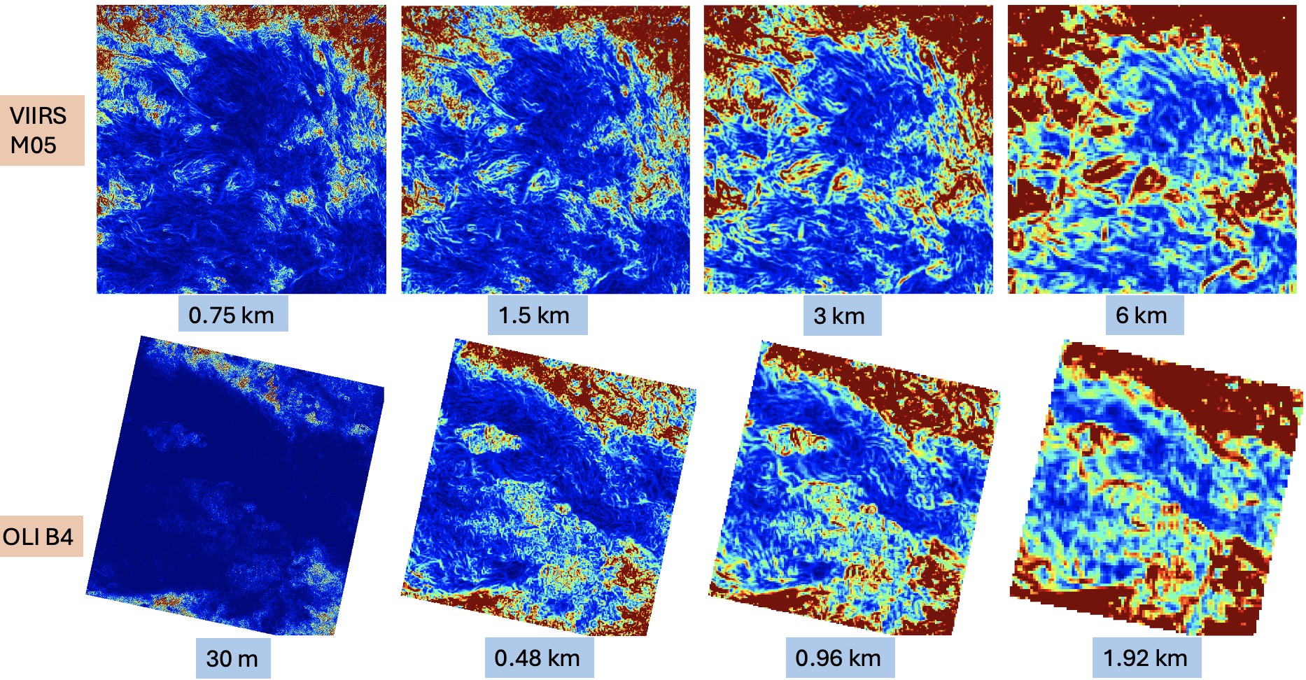
0.65µm reflectance 3x3 homogeneity images by pixel resolution

Slide 11
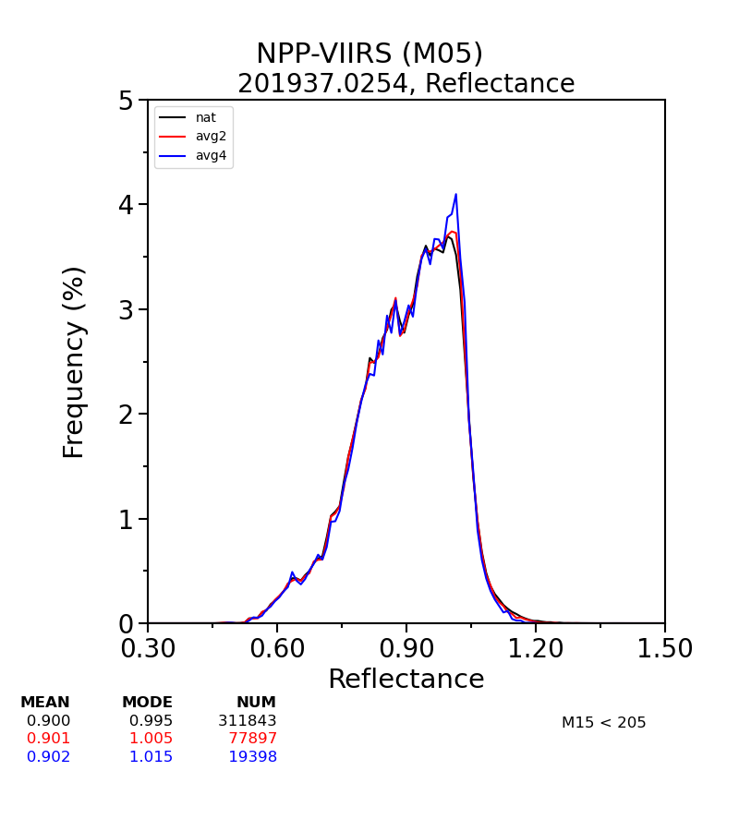
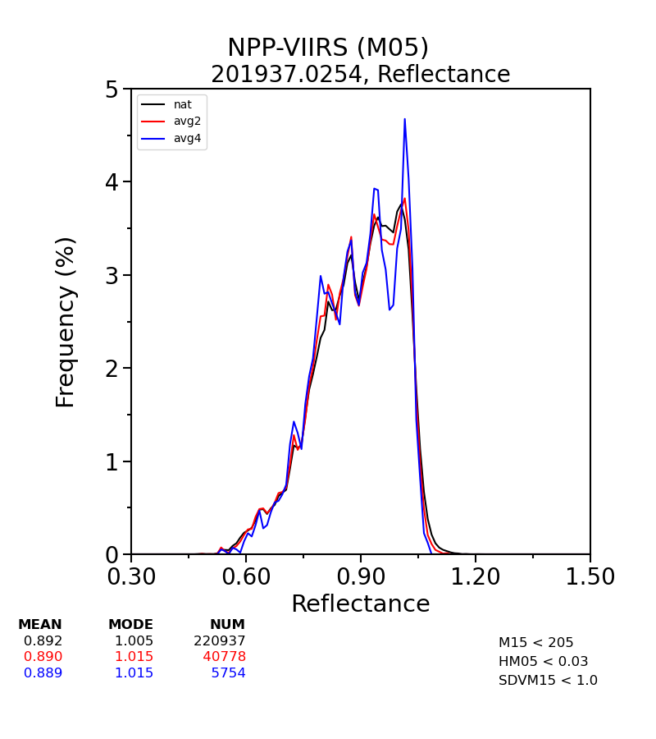
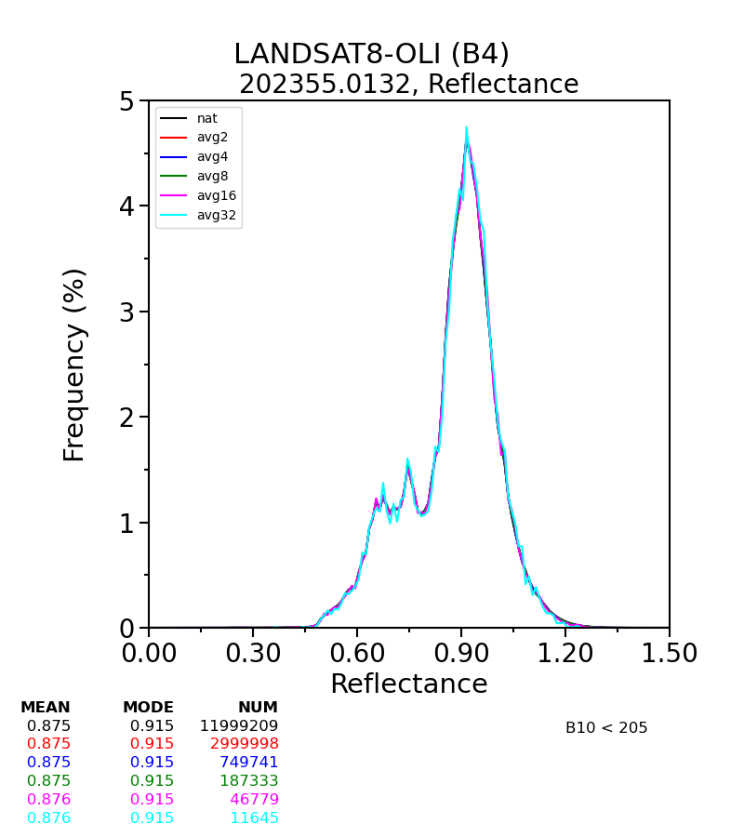
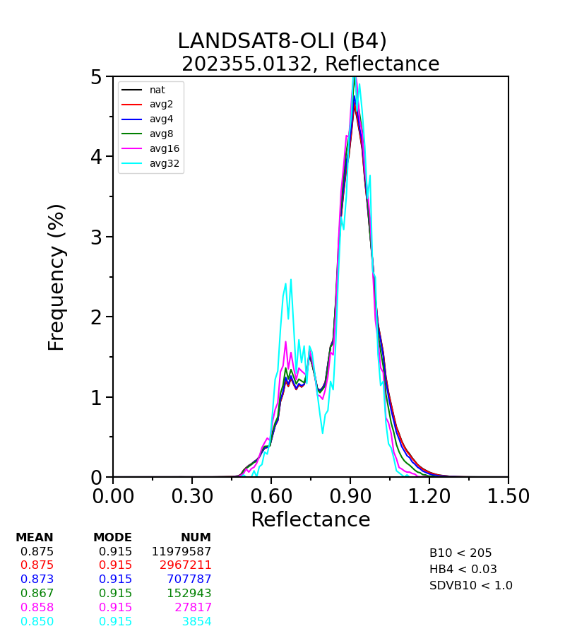
PDF statistics using homogeneity thresholds
VIIRS M05 0.65µm
BT_{11µm}<205K
VIIRS M05 0.65µm
BT_{11µm}<205K, Hom on
OLI B04 0.65µm
BT_{11µm}<205K
OLI B04 0.65µm
BT_{11µm}<205K, Hom on
0.75-km
1.5-km
3.0-km
0.75-km
1.5-km
3.0-km
0.03-km
0.06-km
0.12-km
0.24-km
0.48-km
0.96-km
0.03-km
0.06-km
0.12-km
0.24-km
0.48-km
0.96-km
BT_{11µm}<205K, Hom on | MEAN | MODE | NUM
x1 (0.75km) | 0.892 | 1.005 | 220937
x2 (1.5km) | 0.890 | 1.015 | 40778
x4 (3.0km) | 0.889 | 1.015 | 5754
BT_{11µm}<205K, Hom on | MEAN | MODE | NUM
x1 (0.03km) | 0.875 | 0.915 | 11979587
x2 (0.06km) | 0.875 | 0.915 | 2967211
x4 (0.12km) | 0.873 | 0.915 | 707787
x8 (0.24km) | 0.867 | 0.915 | 152943
x16 (0.48km) | 0.858 | 0.915 | 27817
x32 (0.96km) | 0.850 | 0.915 | 3854
• For these images the homogeneity thresholds or pixel resolution do not significantly change the shape of the PDF

Slide 12
DCC BRDF netCDF files
For visible wavelengths the DCC reflectance is well behaved
Use the Hu DCC BRDF model
For SWIR bands the DCC reflectance is wavelength dependent
Need wavelength specific DCC BRDFs
Empirical DCC reflectance BRDFs are based on angular binned pixel-level DCC identified reflectances
Standardization of DCC BRDFs amongst agencies allows the DCC BRDFs to be shared
Make sure the DCC BRDF netCDF file is self describing for traceability and universal implementation

Slide 13
Terra-MODIS DCC BRDFs for 35°<SZA<40°
# of pixels
Mean Reflectance
Sigma Reflectance
0.65 µm
1.24 µm
1.64 µm

Slide 14
DCC BRDF netCDF parameters
netcdf file:/Users/ddoellin/Desktop/DCC_BRDF_2023/DCC_TERRA_MODIS_ADM_All_Months_TWP.nc { dimensions:
n_channel = 4;
n_sza = 18;
n_month = 13;
n_raa = 18;
n_vza = 11;
group: geometry { variables: float nbin_sza_bound(n_sza=18); :long_name = "solar zenith angle bin boundaries"; :units = "degrees"; :lo_bound = 0.0, 5.0, 10.0, 15.0, 20.0, 25.0, 30.0, 35.0, 40.0, 45.0, 50.0, 55.0, 60.0, 65.0, 70.0, 75.0, 80.0, 85.0; // double :high_bound = 5.0, 10.0, 15.0, 20.0, 25.0, 30.0, 35.0, 40.0, 45.0, 50.0, 55.0, 60.0, 65.0, 70.0, 75.0, 80.0, 85.0, 90.0; //
double float nbin_raa_bound(n_raa=18); :long_name = "relative azimuth angle bin boundaries"; :units = "degrees"; :lo_bound = 0.0, 10.0, 20.0, 30.0, 40.0, 50.0, 60.0, 70.0, 80.0, 90.0, 100.0, 110.0, 120.0, 130.0, 140.0, 150.0, 160.0, 170.0; // double :high_bound = 10.0, 20.0, 30.0, 40.0, 50.0, 60.0, 70.0, 80.0, 90.0, 100.0, 110.0, 120.0, 130.0, 140.0, 150.0, 160.0, 170.0, 180.0; //
double float nbin_vza_bound(n_vza=11); :long_name = "view zenith angle bin boundaries"; :units = "degrees"; :lo_bound = 0.0, 5.0, 10.0, 15.0, 20.0, 25.0, 30.0, 35.0, 40.0, 45.0, 50.0, 55.0, 60.0, 65.0, 70.0, 75.0, 80.0, 85.0; // double :high_bound = 5.0, 10.0, 15.0, 20.0, 25.0, 30.0, 35.0, 40.0, 45.0, 50.0, 55.0, 60.0, 65.0, 70.0, 75.0, 80.0, 85.0, 90.0; //
double float raa_bin_centers(n_raa=18); :centers = 5.0, 15.0, 25.0, 35.0, 45.0, 55.0, 65.0, 75.0, 85.0, 95.0, 105.0, 115.0, 125.0, 135.0, 145.0, 155.0, 165.0, 175.0; // double :long_name = "relative azimuth angle bin centers"; :units = "degrees"; :valid_range = 0.0f, 180.0f; // float :bounds = "raa_bound"; float
vza_bin_centers(n_vza=11); :centers = 2.5, 7.5, 12.5, 17.5, 22.5, 27.5, 32.5, 37.5, 42.5, 47.5, 52.5; //
double :long_name = "view zenith angle bin centers"; :units = "degrees"; :valid_range = 0.0f, 90.0f; // float :bounds = "vza_bound";
float sza_bin_centers(n_sza=18); :long_name = "solar zenith angle bin centers"; :units = "degrees"; :valid_range = 0.0f, 90.0f; //
float :bounds = "sza_bound"; :centers = 2.5, 7.5, 12.5, 17.5, 22.5, 27.5, 32.5, 37.5, 42.5, 47.5, 52.5, 57.5, 62.5, 67.5, 72.5, 77.5, 82.5, 87.5; // double

Slide 15
DCC BRDF netCDF parameters
group: channel_data { variables: String channel_id(n_channel=4);
:channel_names = "B1", "B4", "B6", "B2";
:wavelengths = "1.24um", "1.64um", "2.12um", "1.37um";
String month_id(n_month=13); :months = "January", "February", "March", "April", "May", "June", "July", "August", "September", "October", "November", "December", "Annual";
float channel_brdf_coeff(n_sza=18, n_vza=11, n_raa=18, n_channel=4, n_month=13);
float number_of_pixels(n_sza=18, n_vza=11, n_raa=18, n_channel=4, n_month=13);
float standard_deviation(n_sza=18, n_vza=11, n_raa=18, n_channel=4, n_month=13); :unit = "%"; } //
global attributes:
:title = "DCC BRDF coefficients (TWP)";
:satellite = "TERRA";
:instrument = "MODIS"; :collection = "NASA C7 product";
:DCC_latitude_domain = "±30°";
:DCC_longitude_domain = "95° to 175°"; :DCC_time_range = "Jan 2002 to Dec 2010";
:DCC_temperature_threshold = "<210 K";
:DCC_BT_channel = "B31(11μm)";
:VZA_threshold = "<60°";
:SZA_threshold = "<82°";
:IR_threshold = "<1%";
:VIS_std_threshold = "<3%";
:RAA_threshold = "0° to 180° (0° to 90° as forward scatter)";
:fill_value = -9999.0; // double :created = "2024-01-10 16:15:37";
:author = "Prathana Khakurel";

Slide 16
Conclusions
DCC identification thresholds
Colder BT thresholds reduce the tail of the PDF at the expense of sampling
The spatial homogeneity thresholds remove the overshooting tops and corresponding shadows and partially reduce the PDF tail
Preliminary pixel resolution results
Pixel resolution impacts the homogeneity factor to identify DCC pixels
Pixel resolution seems to have only a slight impact on DCC PDF shape allowing for the potential of DCC inter-calibration across pixel resolutions
DCC BRDF netCDF formats
Make sure all netCDF files are self describing
Allows DCC BRDF to be shared amongst agencies

