Slide 1
Inter-calibration using desert sites
Ali Mousivand, Sebastien Wagner, Rakshith Shanbhag, Mounir Lekouara and Bertrand Fougnie
GSICS annual meeting 2024
14th March 2024, Darmstadt

Slide 2
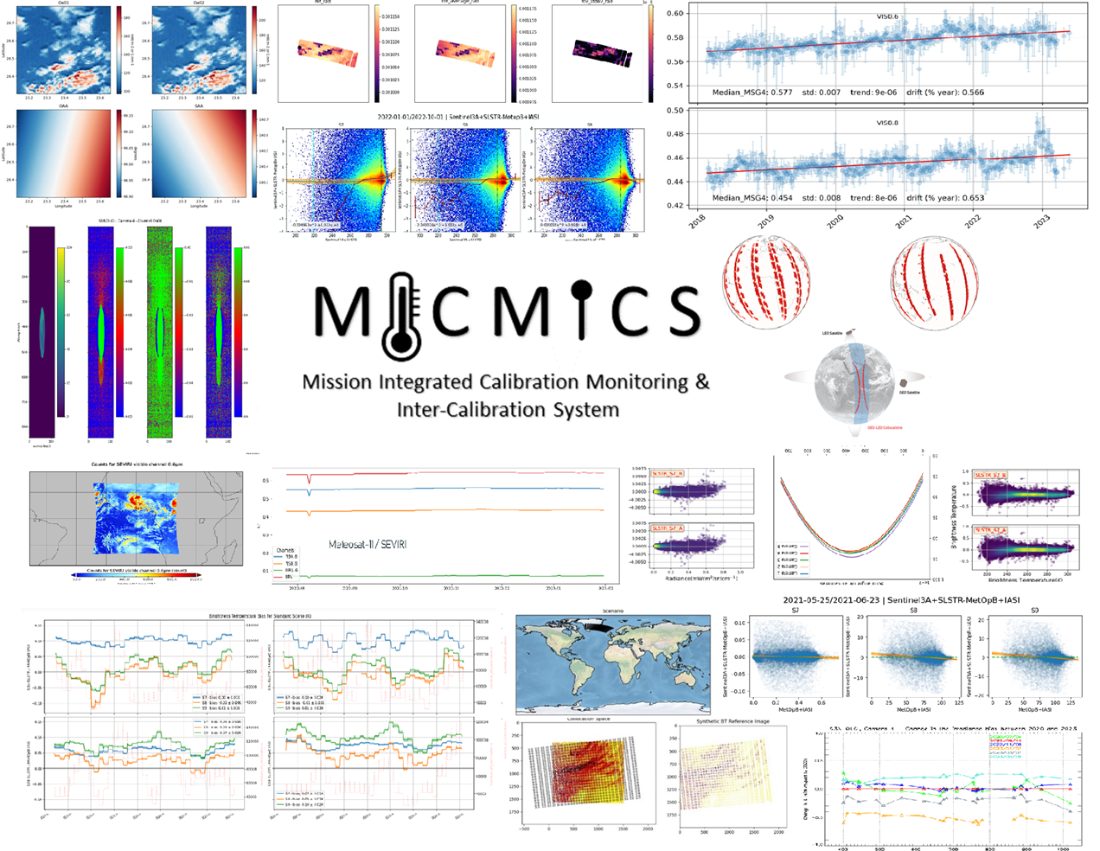
MICMICS (Mission Integrated Calibration Monitoring and Inter-Calibration System)
MICMICS = agile system dedicated to the near-real time monitoring of radiometric performances and inter-calibration
Main assets:
Easy integration of new missions;
Easy integration of new calibration methods;
Inter-operability of the processing modules;
Rationalisation of resources + efforts (including maintenance);
Support the operational generation of GSICS products (and intermediate products such as collocations);
Support generation of Fundamental Climate Data Records;
Status:
The prototype has been extensively tested and validated;
Already supporting the EUMETSAT diagnostics on SEVIRI, AVHRR, OLCI & SLSTR;
Currently used for the FCI and LI commissioning;
Developments are on-going for EPS-SG and CO2M.
Will become the EUM GSICS engine and replace MPSTAR in 2024;

Slide 3
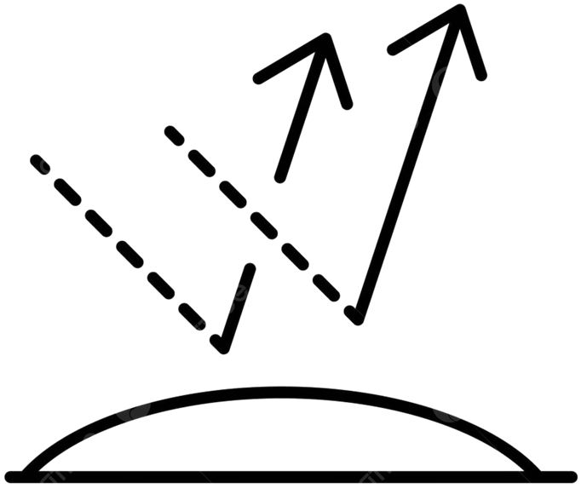
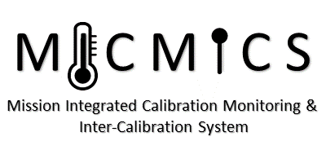
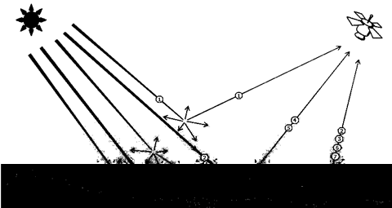
MICMICS workflows
Desert Inter-Calibration
Desert Calibration
Desert Inter-Calibration
Desert Calibration
DCC Inter-Calibration
DCC Inter-Calibration
Lunar Calibration
Lunar Calibration
DCC Calibration
DCC Calibration
Lunar Inter-Calibration
Lunar Inter-Calibration
Imager-Hyperspectral
Inter-Calibration
Imager-Hyperspectral
Inter-Calibration
Rayleigh Calibration
Rayleigh Calibration
LI
FCI
LI
FCI
SLSTR
Imager-Imager
Inter-Calibration
SLSTR
Imager-Imager
Inter-Calibration
Rayleigh Inter-Calibration
SEVIRI
Rayleigh Inter-Calibration
SEVIRI
OLCI
OLCI
SLSTR
SLSTR
METimage
METimage
Ray-Matching
Inter-Calibration
NWP Calibration
Ray-Matching
Inter-Calibration
NWP Calibration
FCI
FCI
AVHRR
SEVIRI
AVHRR
NWP Inter-Calibration
SEVIRI
NWP Inter-Calibration
Inter-Calibration Blender
Inter-Calibration Blender
3MI
3MI
METimage
METimage
CLIM
DCC Extraction Module
CLIM
DCC Extraction Module
Sun Glint Inter-Calibration
MAP
Sun Glint Inter-Calibration
UVN
MAP
UVNS
UVN
UVNS
Snow and Ice Inter-Calibration
Lunar Extraction Module
Snow and Ice Inter-Calibration
Lunar Extraction Module
Radiative Transfer Module
Subsetter Tool
Radiative Transfer Module
Subsetter Tool
#9ba9ea
Data-Fusion Tool
#9ba9ea
Data-Fusion Tool
Colocation Tool
Colocation Tool
Pre-Colocation Tool
Pre-Colocation Tool

Slide 4
DESert Inter-Calibration System (DESICS)
Uses desert Pseudo Invariant Calibration Sites (PICS) to transfer the calibration from a reference instrument to the monitored instrument.
BOA reflectance retrieval
Atmospheric correction: Customised version of the polarized 6SV2.1,
Atmosphere:
Customized Desert Aerosol model over the Sahara and Arabian Peninsula;
US standard atmosphere, scaled with H2O and O3 column;
O3, WV, surface pressure from ECMWF, and AOT550 from CAMS;
TOA reflectance simulation
RTM: customised version of the polarized 6SV2.1
Surface: simulated spectral surface reflectance for monitored instrument
Atmosphere: same as those of BOA reflectance retrieval
Filtering
Apply geometry criteria
| ${SZA}_{ref}−{SZA}_{mon}$| < 2 deg
| ${VZA}_{ref}−{VZA}_{mon}$| < 2 deg
| ${RAA}_{ref}−{RAA}_{mon}$| < 5 deg
SZA<60
Evaluate & Monitor bias:
Estimate the relative calibrations by comparing TOA simulated reflectance against actual measurements
Reference instrument
Monitored instrument
Update Meteo data
Update Meteo data
Outlier removal
Filtering observations by geometry criteria
(∆SZA, ∆VZA, ∆RAA)
Forward RT simulation
Atmospheric correction
Spectrally interpolate BOA reflectance
Simulated BOA reflectance for monitored instrument
Reference BOA reflectance
High resolution spectrum
Simulated TOA reflectance for monitored instrument
Calibration coefficients
Measured TOA reflectance

Slide 5
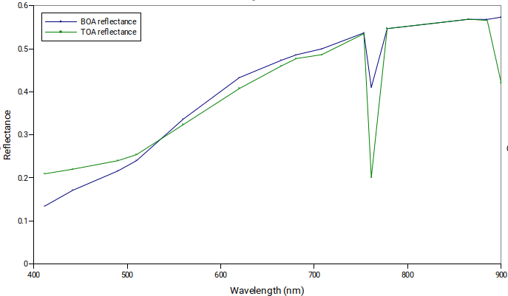
Atmospheric correction
To extract the BOA reflectance for the reference instrument
The customized polarized 6SV2.1 integrated atmospheric correction module is used
SMAC is the frequently used approach by other desert-inter-cal systems
Expected accuracy of SMAC is understood to be 2-3% (similar on 6SV)
6SV is expected to offer similar accuracy if not better
All atmospheric parameters are spatially and temporally interpolated over each target

Slide 6
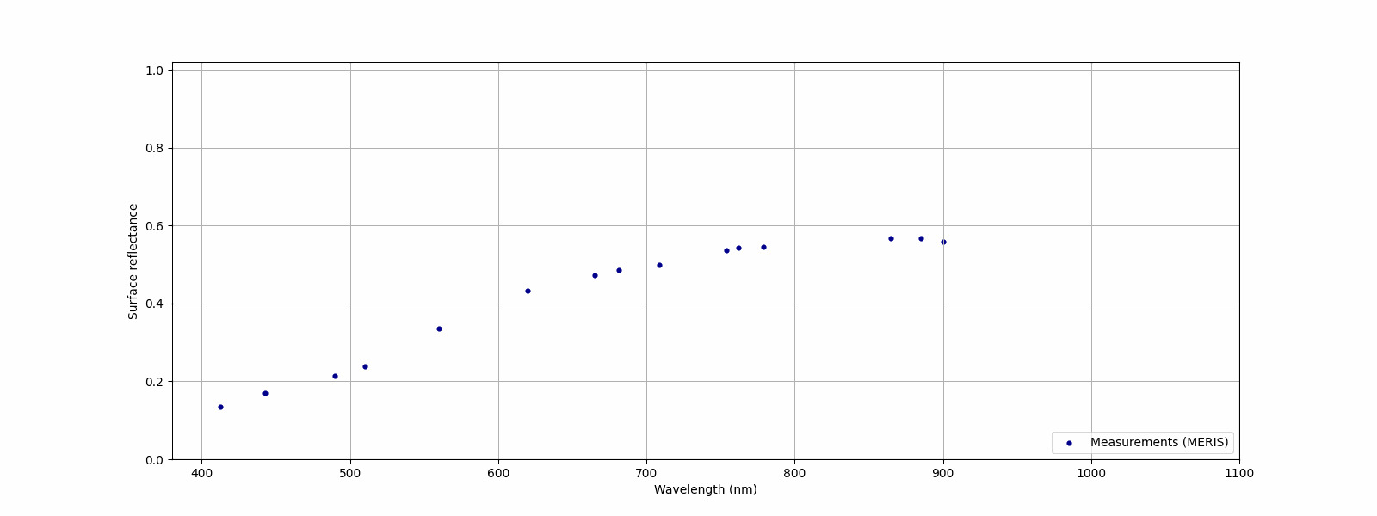
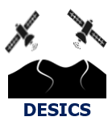
Spectral interpolation
To transfer the reference BOA reflectance to monitored one
Currently, the ρ0 (mean reflectance) parameter of the RPV model BRDF is used
Critical step when there's a disparity in SRF between the reference and monitored instruments
Notes:
ρ0 (mean reflectance), Θ(Asymmetry parameter), k (Minnart parameter), h (hot spot parameter)
Effort is on-going to create a database of Hyperspectral over desert targets using data from DESIS, EnMap

Slide 7
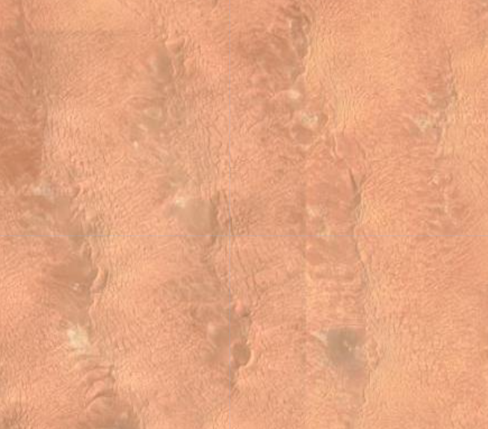
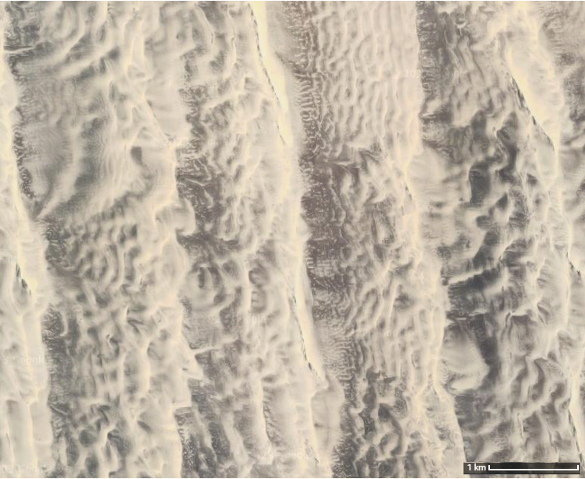
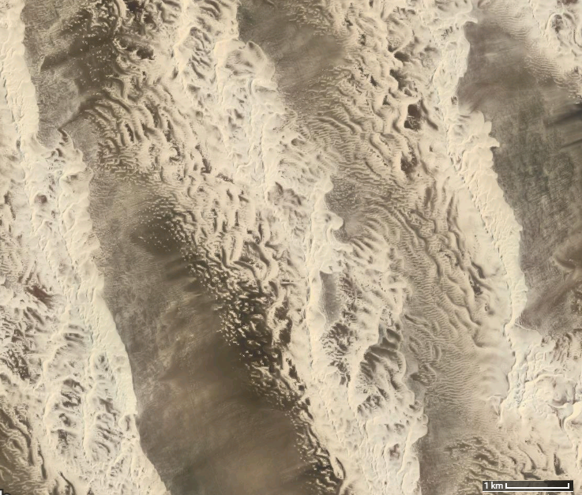
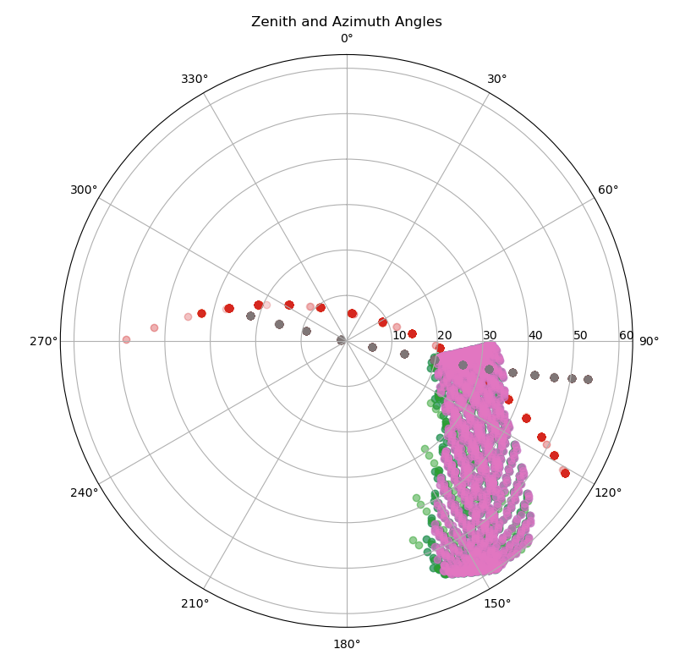
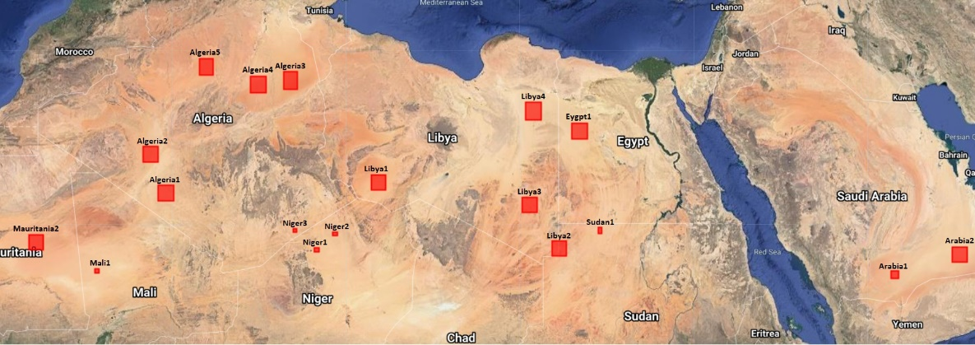
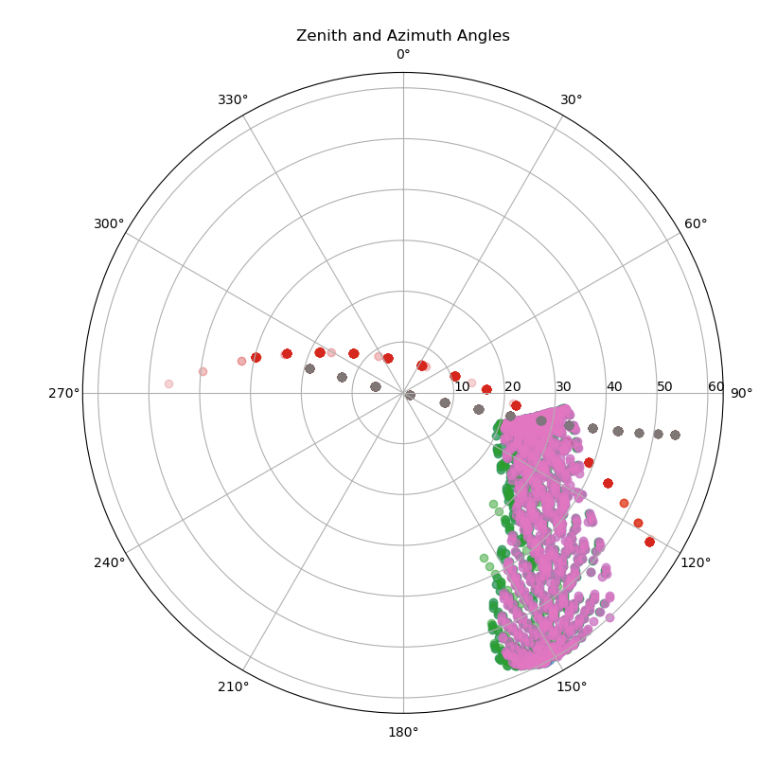
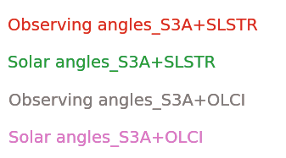
Pseudo Invariant Calibration Sites (PICS)
S3A and S3B SLSTR and MSG4-SEVIRI observations until March 2024
Niger2
S3A SLSTR: 1316
S3B SLSTR: 903
MSG4: 45,577
Algeria5
S3A SLSTR: 1028
S3B SLSTR: 775
MSG4: 40,890
Libya4
S3A SLSTR: 1321
S3B SLSTR: 937
MSG4: 60,235
Egypt1
S3A SLSTR: 1458
S3B SLSTR: 1013
MSG4: 58,140
Sudan1
S3A SLSTR: 1425
S3B SLSTR: 969
MSG4: 52,129
Algeria-5
Libya-4
Six priority one targets: Libya4, Egypt1, Algeria5, Niger2, Sudan1 and Arabia2 (skipped for this analysis)
Total observations:
S3A SLSTR: 6,548
S3B SLSTR: 4,597
MSG4: 256,971

Slide 8
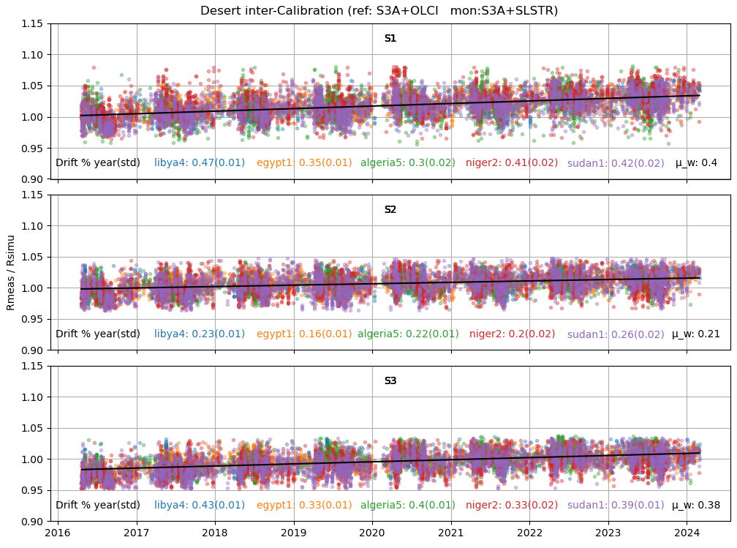
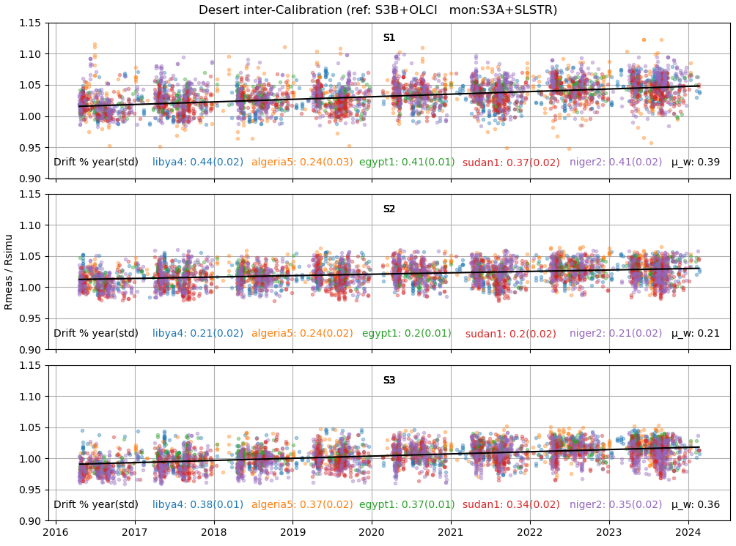
SLSTR-A Desert Inter-calibration (Ref: OLCI-A & OLCI-B)
DESICS

Slide 9
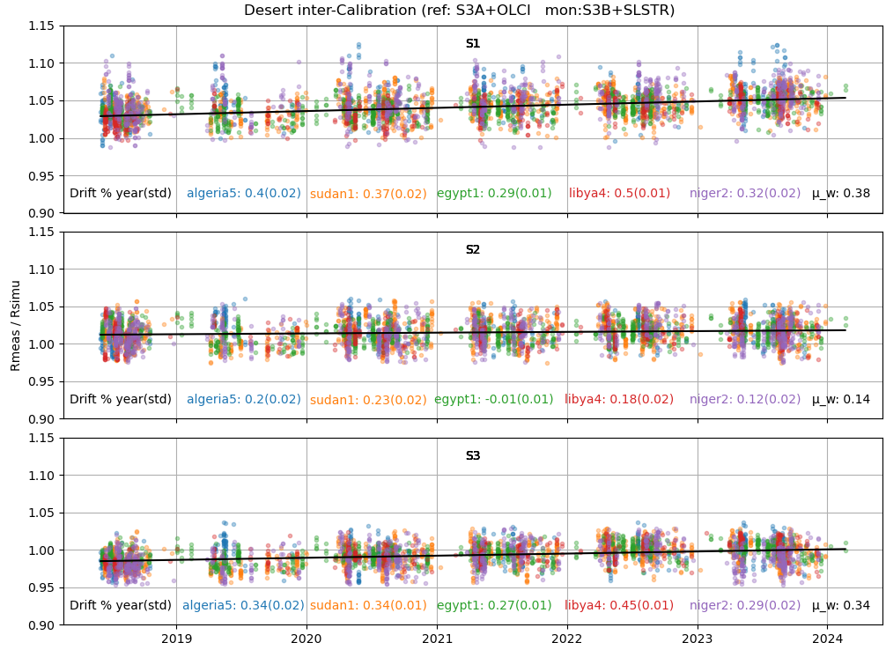
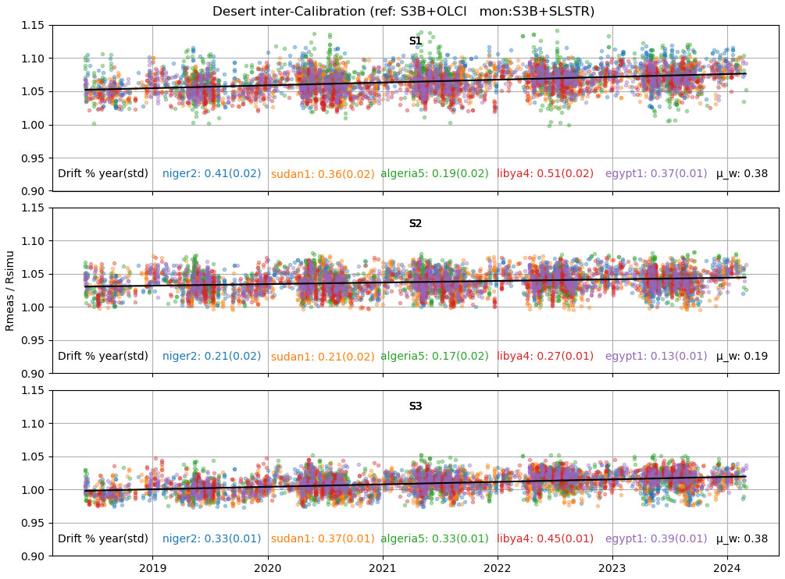
SLSTR-B Desert Inter-calibration (Ref: OLCI-A & OLCI-B)
DESICS

Slide 10
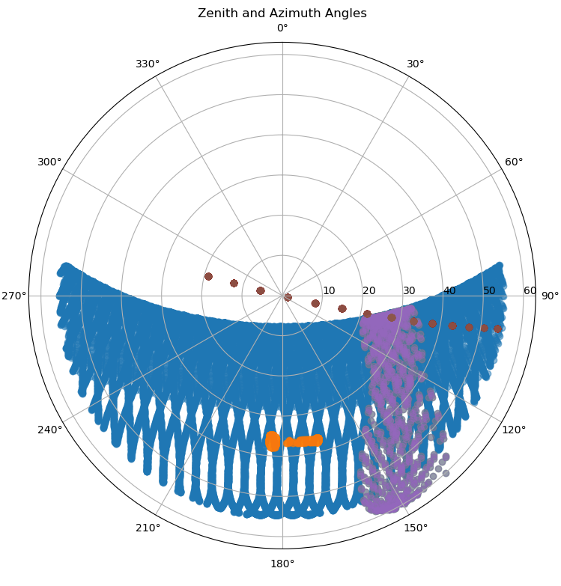
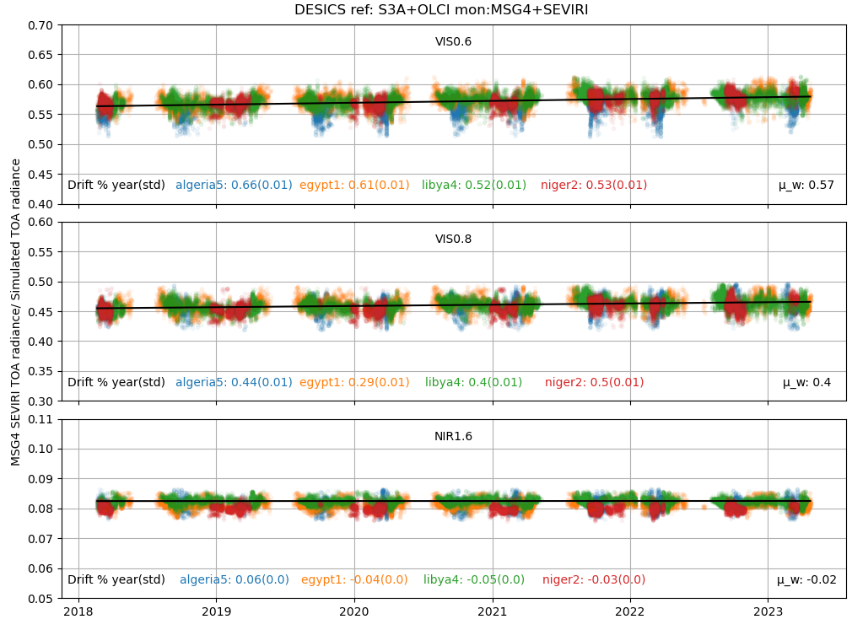
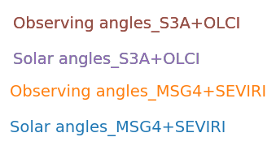
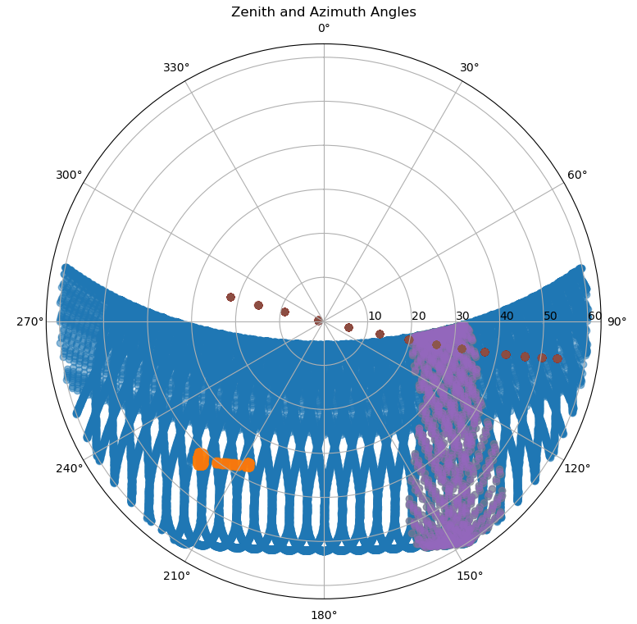
MSG4 SEVIRI Desert Inter-calibration (Ref: OLCI-A)
Algeria-5
Libya-4

Slide 11
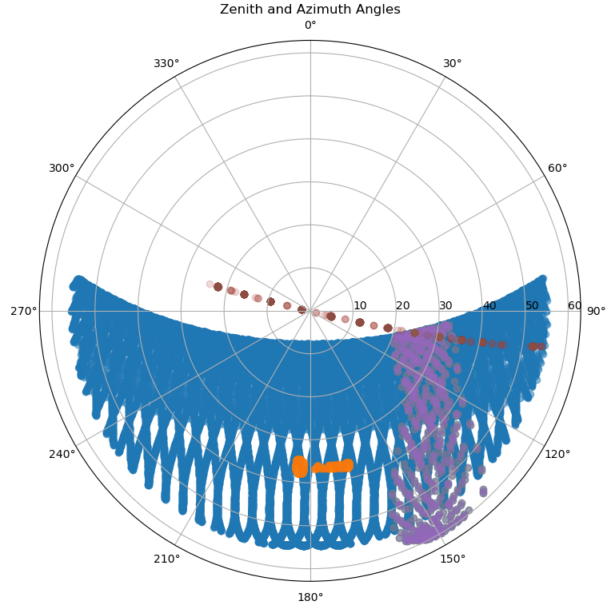
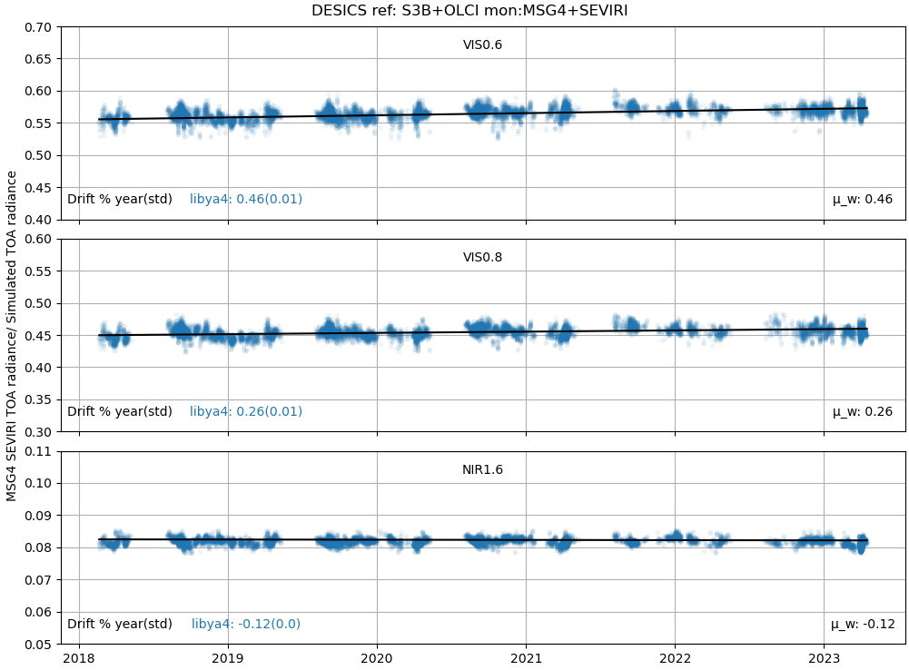
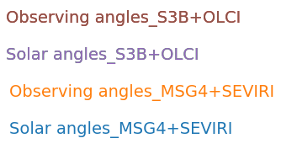
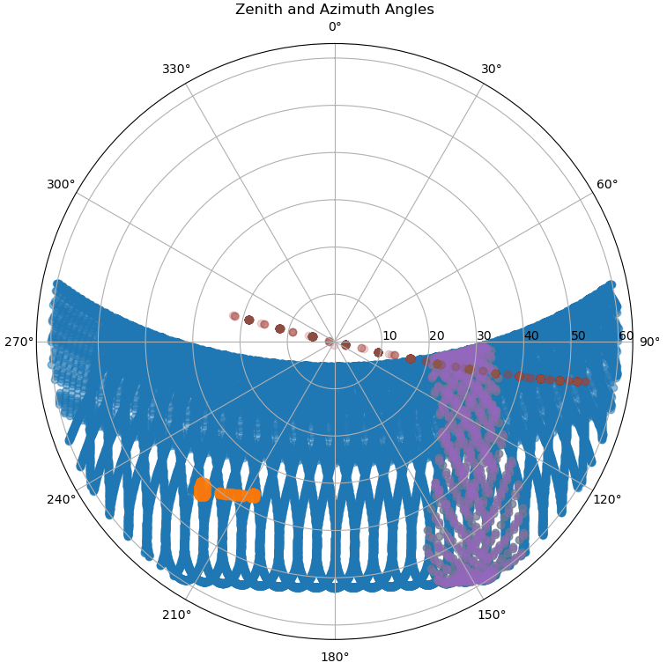
MSG4 SEVIRI Desert Inter-calibration (Ref: OLCI-B)
Algeria-5
Libya-4
Only Libya-4 for OLCI-B

Slide 12
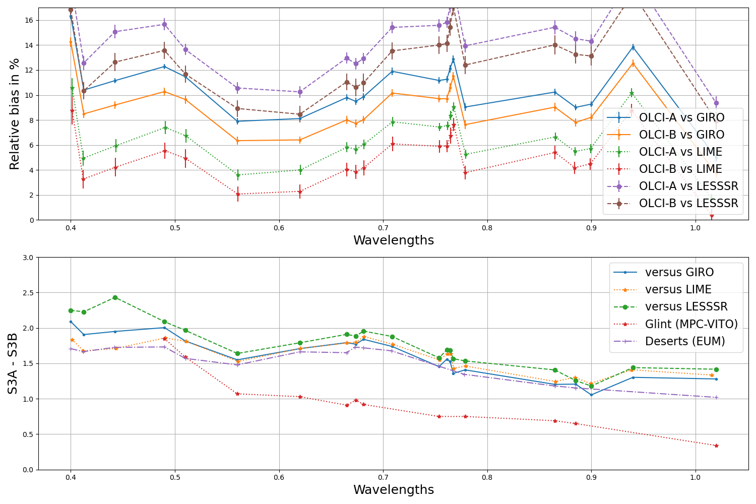
MSG4-SEVIRI inter-calibration with OLCI-A and OLCI-B
A bias between the two?
OLCI channels cover 400nm -1020nm, using OLCI for NIR1.6???

Slide 13
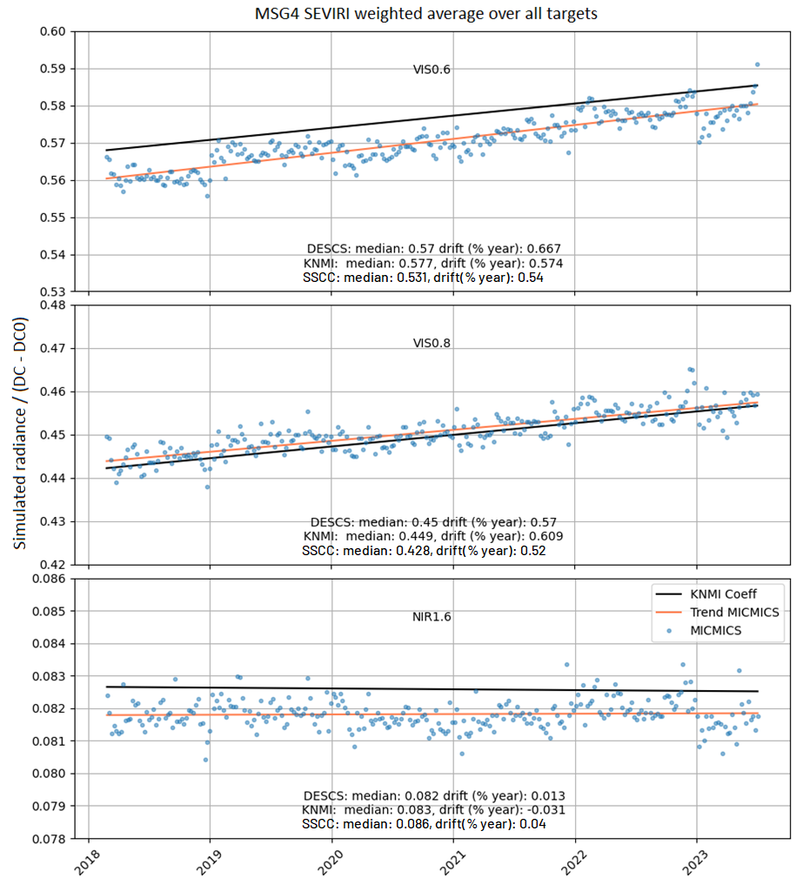
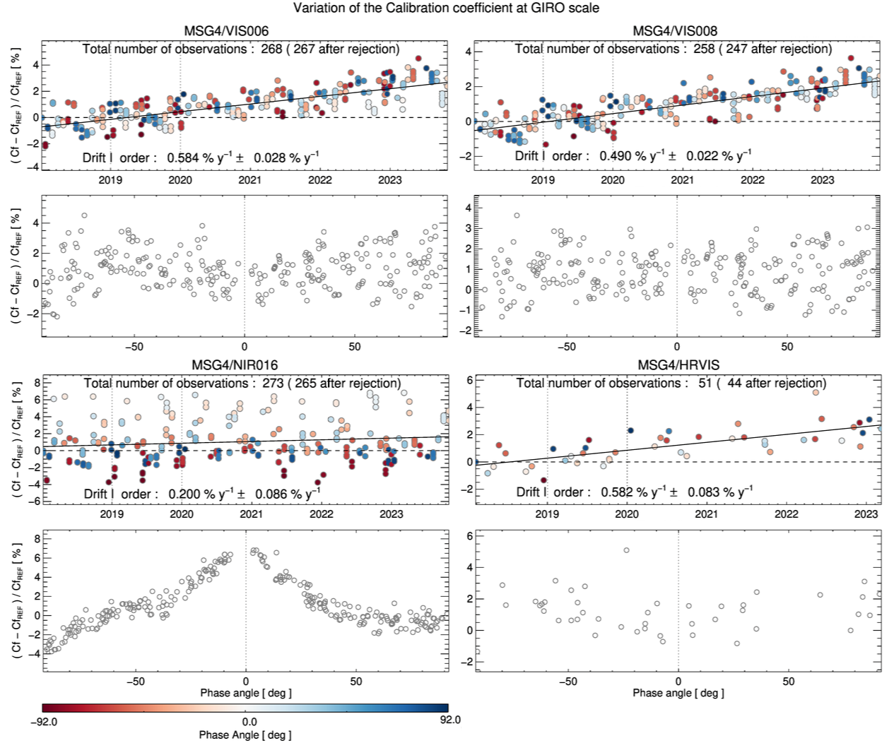
Inter-calibration MSG4-SEVIRI comparison with Lunar and desert
Preliminary results, still promising!

Slide 14
Discussions and conclusions
Why Desert Inter-calibration?
The method offers great potential inter-calibration
Relevant for all spectral bands from VIS to SWIR
Variety of reference instruments can serve as references
All desert targets can be used (no concern regarding BRDF)
Temporal calibration accuracy remains independent of the reference sensor used
Limitation and challenges
Constraints for use as an absolute calibration method
Accuracy is contingent upon factors such as atmospheric correction, calibration of reference instruments, and differences in SRF

Slide 15
Discussions and conclusions
Atmospheric correction
Improving the atmospheric correction model?
Spectral interpolation
Finding the best spectral interpolation method?
Machine learning approach?
Using SBAF?
Use of a continuous spectral database (e.g. from hyperspectral instruments such as EnMap, DESIS) instead of a single reference spectra?
Seeking to develop a methodology with less reliance on user input
Filtering
Time filtering?
Fixed criteria or dynamic?

Slide 16
Thank you!
Questions are welcome.

