Slide 1
GRWG IR Session of GSICS Annual Meeting
Likun Wang
ESSIC/Univ. of Maryland; wlikun@umd.edu
2024 GSICS Annual Meeting, Darmstadt, Germany, EUMETSAT; March 13 2023

Slide 2
Outline
Scope of IR Subgroup
IR Group Activities in FY23
Agenda and Discussion
Future Direction and Plans

Slide 3
Review Scope of the IR Sub-Group
Counterpart of VIS/NIR, Microwave and UV Sub-Groups
  For satellite instrument channels in thermal infrared
  For Hyperspectral instruments
To establish user requirements for inter-calibration
Cooperate with instrument calibration groups
  To communicate relevant information to the users
  To help them understand the root cause of observed biases and develop fixes
Review existing, or develop new inter-calibration
  Algorithms, procedures, corrections, collocation, spectral-gap filling etc.
  Using NWP, ground-based, near-space measurements, etc.
To define and promote calibration standards, tools and datasets, and best practices
  Including selection of inter-calibration reference
Chair: Likun Wang (NOAA affiliation, Since 2018) with the help from Tim Hewison

Slide 4
Four Web Meetings in 2023
The IR group is active as usual. Four web meetings have been organized. 05/04: Inter-calibration imager and Sounder and Angle Effects
  07/06: Hot Land Issue, VIIRS-CrIS and Terrain Corrected Geolocation
  09/07: IR Algorithms Discussion and SSU/AIRS Merge
  11/02: Spectral Band Adjustment and Lunar Calibration
The topics includes inter-calibration algorithms improvements, development of climate data records, and using the moon for IR inter-calibration.
These web meetings are very important to keep the team members communicate and exchange information. We should continue it. Please let new chair know if you or someone you know like to present.

Slide 5
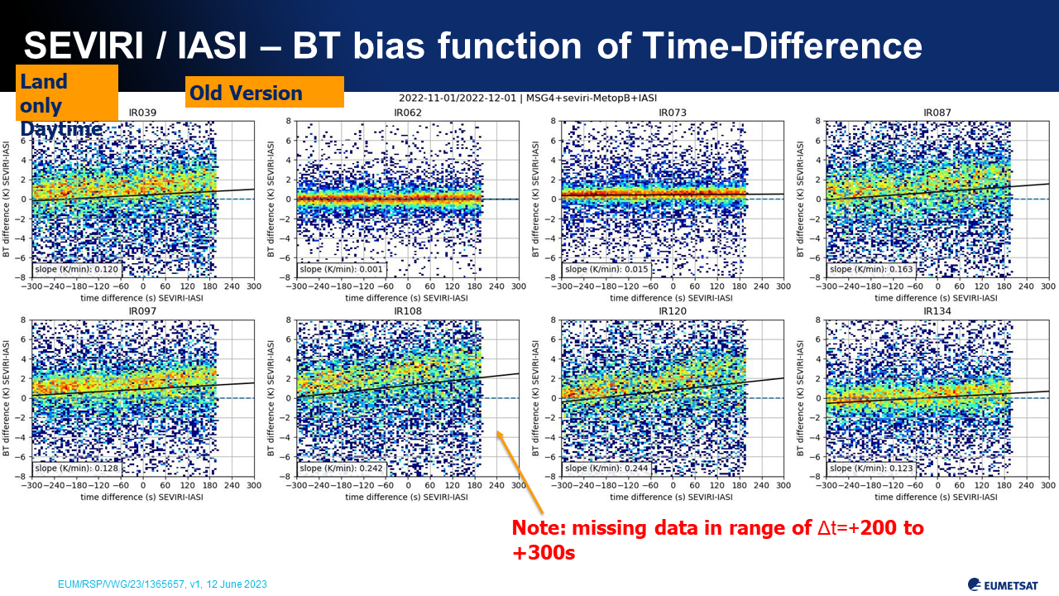
Highlights: GEO-LEO Algorithm Improvements
The IR group is focused on the inter-calibration algorithms improvements for current GEO-LEO inter-calibration. Some issues are under investigation toward the 2nd version of GSICS inter-calibration algorithm.
  Regression
  Hot Land Bias issue
  High viewing angles
  Interpolation between GEO images
  Uncertainty analysis
Several web meetings are organized to respond last year’s actions
  View angle (Likun Wang)
  Hot land Bias (Tim Hewison)
  Uncertainty Analysis (Tim Hewison)
From Tim Hewison

Slide 6
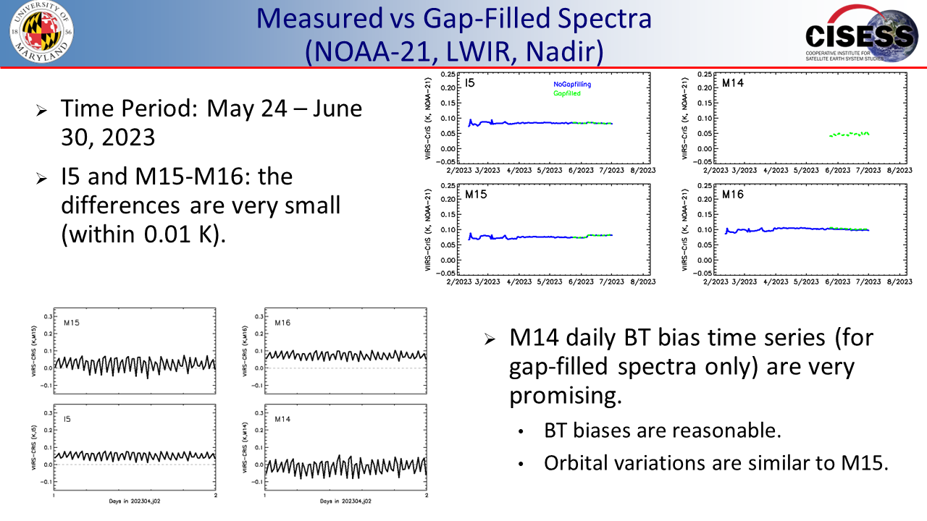
Highlights: Innovative Research
Imager and Sounder inter-calibration on the same platform is continued to be refined and improved.
  Wenhui Wang: CrIS and VIIRS on JPSS satellites
  Di Di: Imager and sounder on FY4
The IR group explore an innovative way to use Moon (Venus) potential stable target to inter-calibrate IR sensors when the Moon was within their FOVs.
  Martin Burgdorf : Venus for IR inter-calibration
Spectral band adjustment is further explored.
  David Doelling : GOES-13 and -16 difference
From Wenhui Wang

Slide 7
IR Session in 2024 GSICS Annual Meeting
8:30 | Welcome Remarks and Review for IR Groups | Likun Wang
8:50 | HIRAS and GIIRS data quality analysis using PC technics and comparisons to IASI | Shin Koyamatsu
9:10 | GOES ABI IR midnight calibration variation detected with GEO-GEO Inter-calibration | Fangfang Yu
9:30 | On-orbit characteristics monitoring and analysis of Fengyun-4 AGRI infrared channels | Xingwei He (remotely)
9:50 | Assessment and Dynamic Correction of Spectral Calibration of FY-3D/HIRAS | Chengli Qi
10:10 | 20 Minutes Coffee Break
10:30 | FY-4B GIIRS / Metop-IASI Inter-comparison | Pierre Dussarrat
10:50 | Thermal radiance model for Moon and Mercury | Kay Wohlfarth (remotely, check)
11:10 | Checking the radiometric stability of CrIS with the Moon | Martin Burgdorf
11:30 | Re-calibration results of COMS/MI and GK2A/AMI | Euidong Hwang
11:50 | Merging of SSU Observations with AIRS toward Extending Stratospheric Temperature Climate Data Records | Likun Wang
12:10 | Improvements in the Current SNO method for Long-Term monitoring of CrIS Inter-sensor Radiometric Biases with ABI within the NOAA ICVS Framework | Xin JIn (remotely)
12:30 | Discussion of GSICS GSICS SOS Reports | All
12:50
 | Lunch Time (1300-1400)
14:00 | Review of Inter-calibration Algorithm issues | Tim Hewison
14:20 | Ongoing GEO-LEO IR algorithm studies - Insights on FCI | Vincent Debaecker
14:40 | Revisit to AHI GEO-LEO-IR Regression | Masaya Takahashi
15:00 | Defining Warm Radiance Scenes and simple model for Parallax Uncertainty | Tim Hewison
15:20 | Summary on Angle errors, parallax, and proposed resolutions | Likun Wang
15:40 | 20 Minutes Coffee Break
 | Group Discussion
16:00 | Algorithms Improvements and the way forward | All
16:30 | Chair Transition and Plan for next year | All
Research topics: New sensor calibration results, climate data records, reprocessing, lunar model
Inter-calibration calibration improvements: regression, angle effects, interpolation GEO, warm scenes, uncertainty analysis
15 minutes for talk and 5 minutes for questions; I will remind you during the talk

Slide 8
Three Discussion
Discussion 1 : GSICS SOS Reports
  12:30 – 12:50
  Hosted by Tim Hewison
Discussion 2: Algorithms Improvements and the way forward
  16:00-16:30
  Hosted by Likun Wang
Discussion 3: Chair Transition and Plan for next year
  16:30-17:00
  Hosted by Likun Wang
  Chengli Qi will step in as a new IR group chair after this meeting

Slide 9
Actions

Slide 10
Status and Future
The GSICS IR group is very energetic in the year of 2023.
Chengli Qi (CMA) will be a new IR group chair
monthly or bi-monthly web meeting
  Plan on Thursday for the first week of each Month
Support more cross-community efforts,
  Dialogue between GSICS with ISSCP-NG, NWP community, CEOS WGVS
Encourage more experts involved in the IR group
  Updates on new instrument, methods, and datasets for the IR group
Share the tools and codes, knowledge Exchange memo
  GitHub or GSICS wiki may be the best host place
Other Items?

