Slide 1
Evaluation of Hyperspectral Infrared Sounder Data with PCA
Shin Koyamatsu & Pierre Dussarrat
Remote Sensing Scientists
GSICS Meeting – 13/03/2024

Slide 2
Agenda
Principal Component Analysis
Instrument: FY-3E / HIRAS-2
Noise Estimation
Anomaly Detection
Harmonisation Experiments
Conclusion

Slide 3
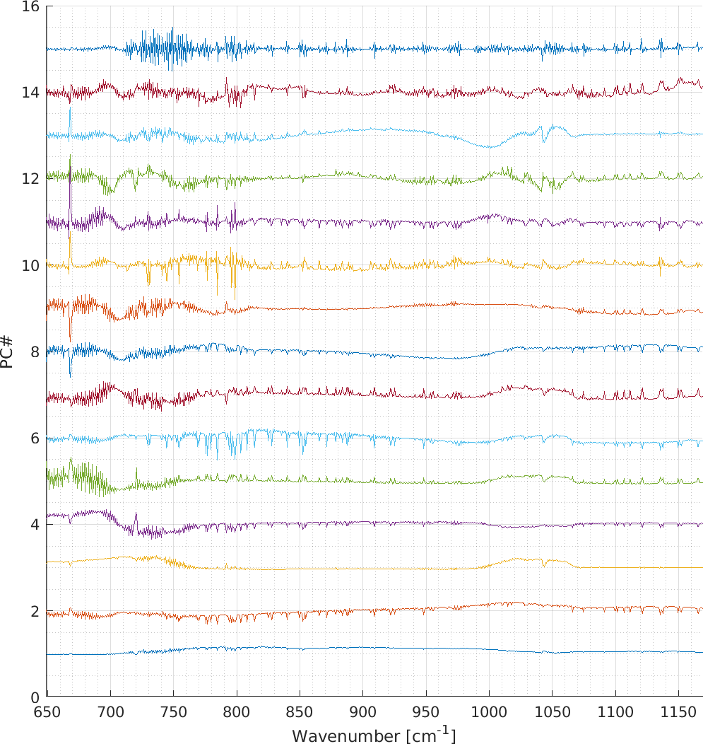
Principal Component Analysis (PCA)
PCA is a popular dimension reduction methodology.
The methodology is data driven; a set of “signals axes” $E=\{E_{i}\}$ called the Principal Components (PC) is chosen as the eigenvectors of the signal covariance:
$C_{x}= \left\langle xx^{⊤}\right\rangle − \left\langle x\right\rangle \left\langle x^{⊤}\right\rangle$
$C_{x} E_{i}=λ_{i} E_{i}$
PCA splits the measurements (the light power spectra $x$) into independent pieces called the Principal Component Scores (PCS).
$PCS(i)=E_{i}^{⊤} (x−\left\langle x\right\rangle )$
Eigenvalues represent variability of PCSs, corresponding to the Signal-to-Noise Ratio if signals are noise-normalized.
https://en.wikipedia.org/wiki/Principal_component_analysis

Slide 4
PCA at EUMETSAT
Dissemination of the PCS
Available to users for METOP-IASI data
Dissemination baseline for MTG-S IRS; The users will use the PCS to reconstruct the radiances on their side
EUMETSAT is studying the interest of PCA for many years.
This presentation provides examples of application of PCA:
Computation of instrumental noise without prior-knowledge of the instrument
Detection of instrumental anomalies
Experiment of data harmonisation
Hultberg, T. et al. "Local or global? How to choose the training set for principal component compression of hyperspectral satellite measurements: a hybrid approach." Sensors, Systems, and Next-Generation Satellites XXI. Vol. 10423. SPIE, 2017.

Slide 5
Agenda
Principal Component Analysis
Instrument: FY-3E / HIRAS-2
Noise Estimation
Anomaly Detection
Harmonisation Experiments
Conclusion

Slide 6
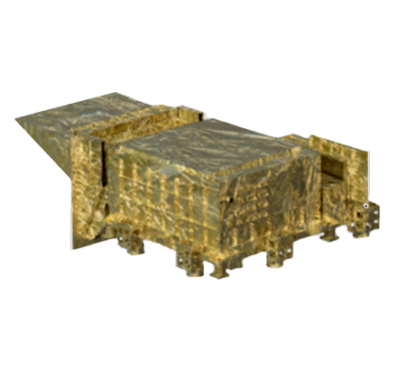
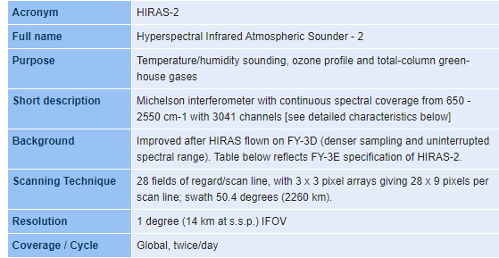
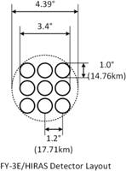
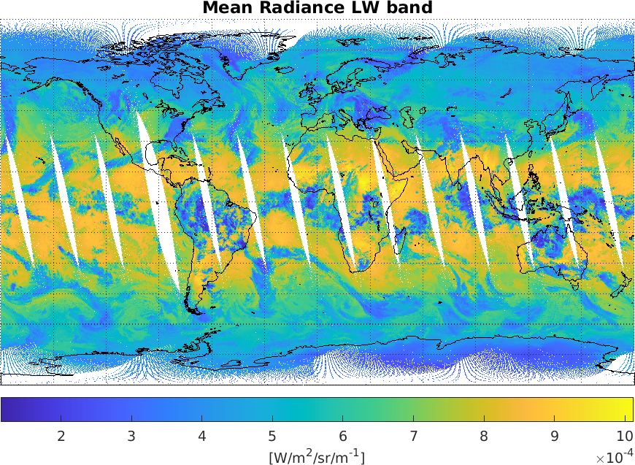
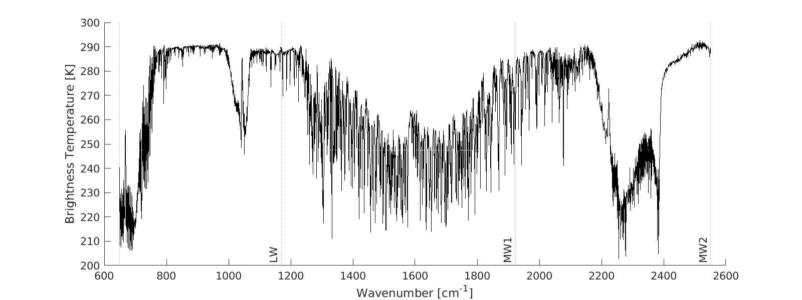
FY-3E / HIRAS-2
Launch: 04 Jul 2021
Orbit: Sun synchronous (ECT 05:40)
Configuration:
28 Fields of Regard (FoR)
3 x 3 pixel arrays (FoV)
3 bands covering 648.75-2551.25 cm⁻¹
GSICS 03/2022: PowerPoint 演示文稿 (umd.edu)

Slide 7
Agenda
Principal Component Analysis
Instrument: FY-3E / HIRAS-2
Noise Estimation
Anomaly Detection
Harmonisation Experiments
Conclusion

Slide 8
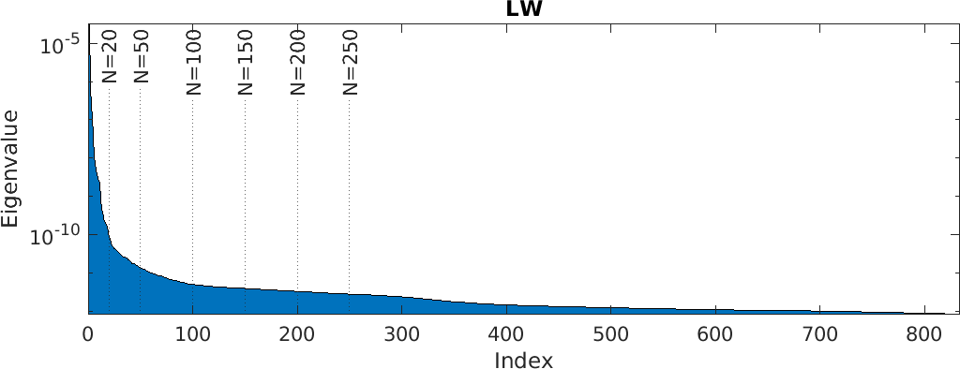
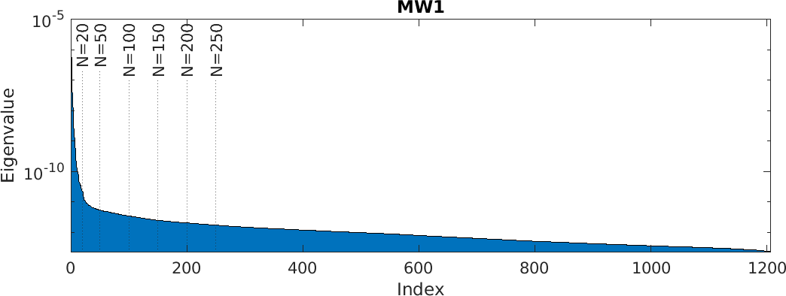
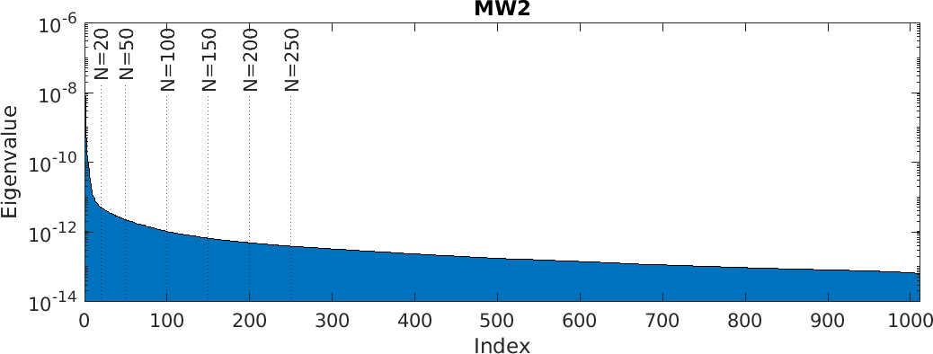
Noise Estimation: Methodology
Eigenvalues of covariance matrix represent the variability of PC scores at the corresponding PC.
Leading PCs contain most of the signal information, and lower PCs contain mostly random noise.
Noise can be estimated by truncating eigenvalues above a certain value at some threshold $N_{thr}$ as:
$$Λ^{′}=\left(\begin{matrix}λ_{1}^{′} & & Ο \\ & ⋱ & \\ Ο & & λ_{N}^{′}\end{matrix}\right), λ_{i}^{′}=\left\{\begin{matrix}\begin{matrix}λ_{N_{thr}} \\ λ_{i}\end{matrix} & \begin{matrix}\left(i=1, 2, ⋯, N_{thr}\right) \\ \left(i>N_{thr}\right)\end{matrix}\end{matrix}\right.$$
Noise covariance is retrieved as: $\boxed{C_{n}=E Λ′{ E}^{⊤}}$
Lee, Lu, et al. "HIRAS noise performance improvement based on principal component analysis." Applied Optics 58.20 (2019): 5506-5515.
Zavyalov, Vladimir, et al. "Noise performance of the CrIS instrument." Journal of Geophysical Research: Atmospheres 118.23 (2013): 13-108.

Slide 9
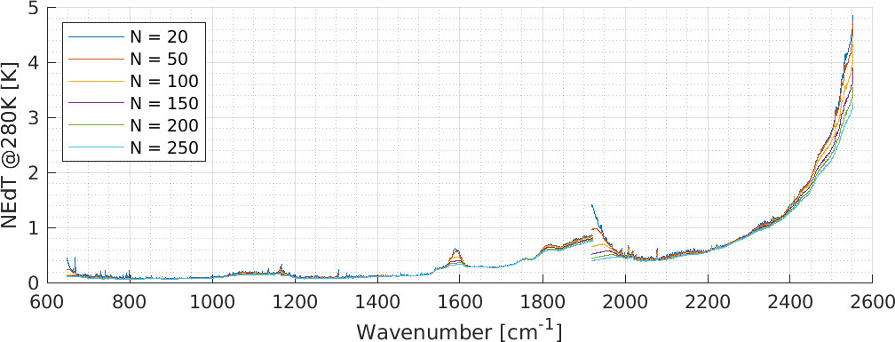
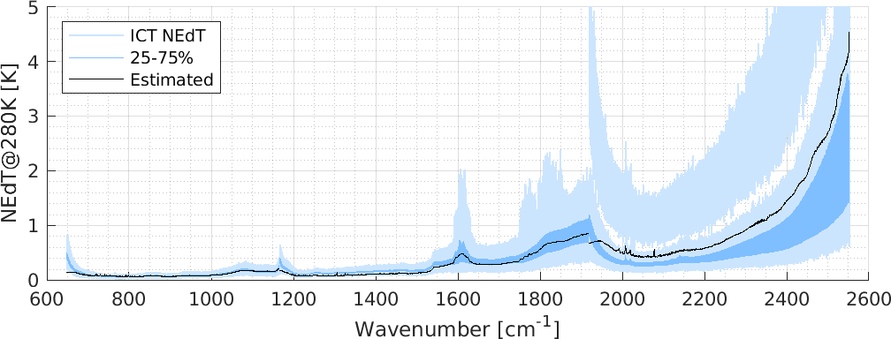
Noise Estimates
Noise was estimated for various thresholds $N_{thr}$
Little sensitivity to $N_{thr}$ across a wide range
Large $N_{thr}$ lead to noise saturation
$N_{thr}=100$ is used for the following analysis.
The estimated noise is in good agreement with the stored values.
$N_{thr}=100$

Slide 10
Agenda
Principal Component Analysis
Instrument: FY-3E / HIRAS-2
Noise Estimation
Anomaly Detection
Harmonisation Experiments
Conclusion

Slide 11
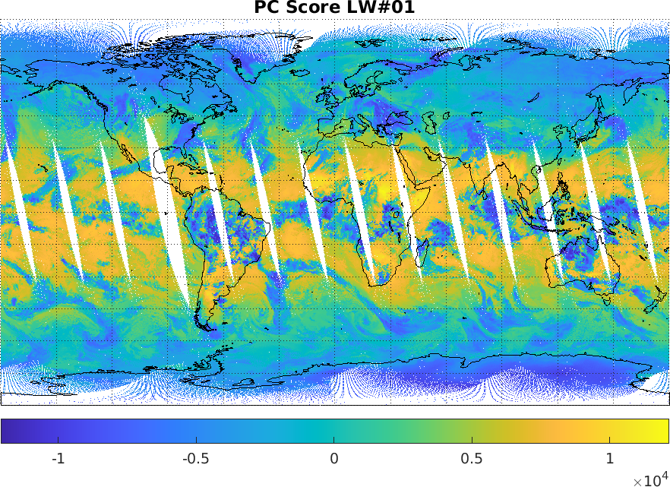
Anomaly Detection
By looking at PC scores, it may be possible to find small anomalies that cannot be noticed from the radiance.
If we look at lower PC scores…

Slide 12
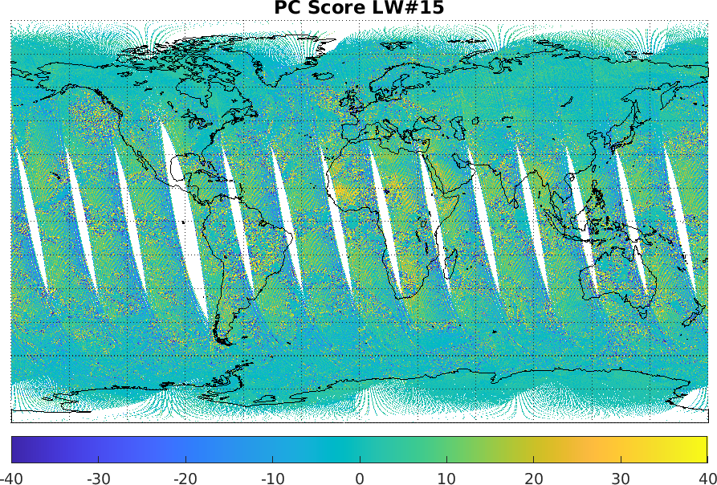
Anomaly Detection
By looking at PC scores, it may be possible to find small anomalies that cannot be noticed from the radiance.
If we look at lower PC scores…

Slide 13
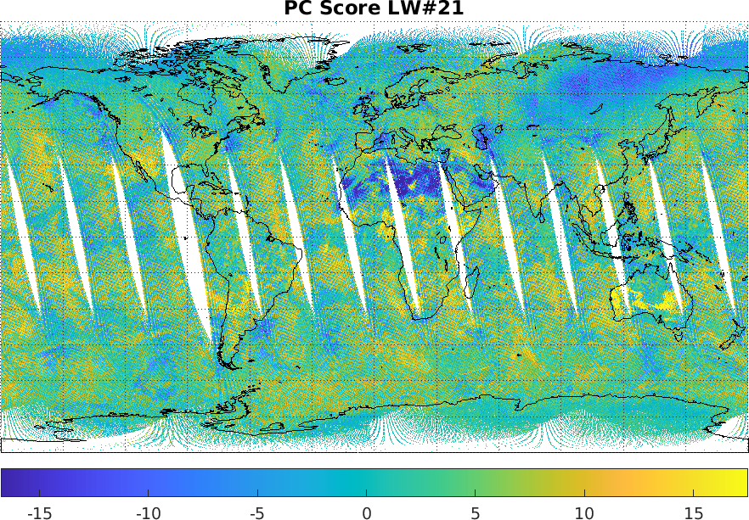
Anomaly Detection
By looking at PC scores, it may be possible to find small anomalies that cannot be noticed from the radiance.
If we look at lower PC scores…

Slide 14
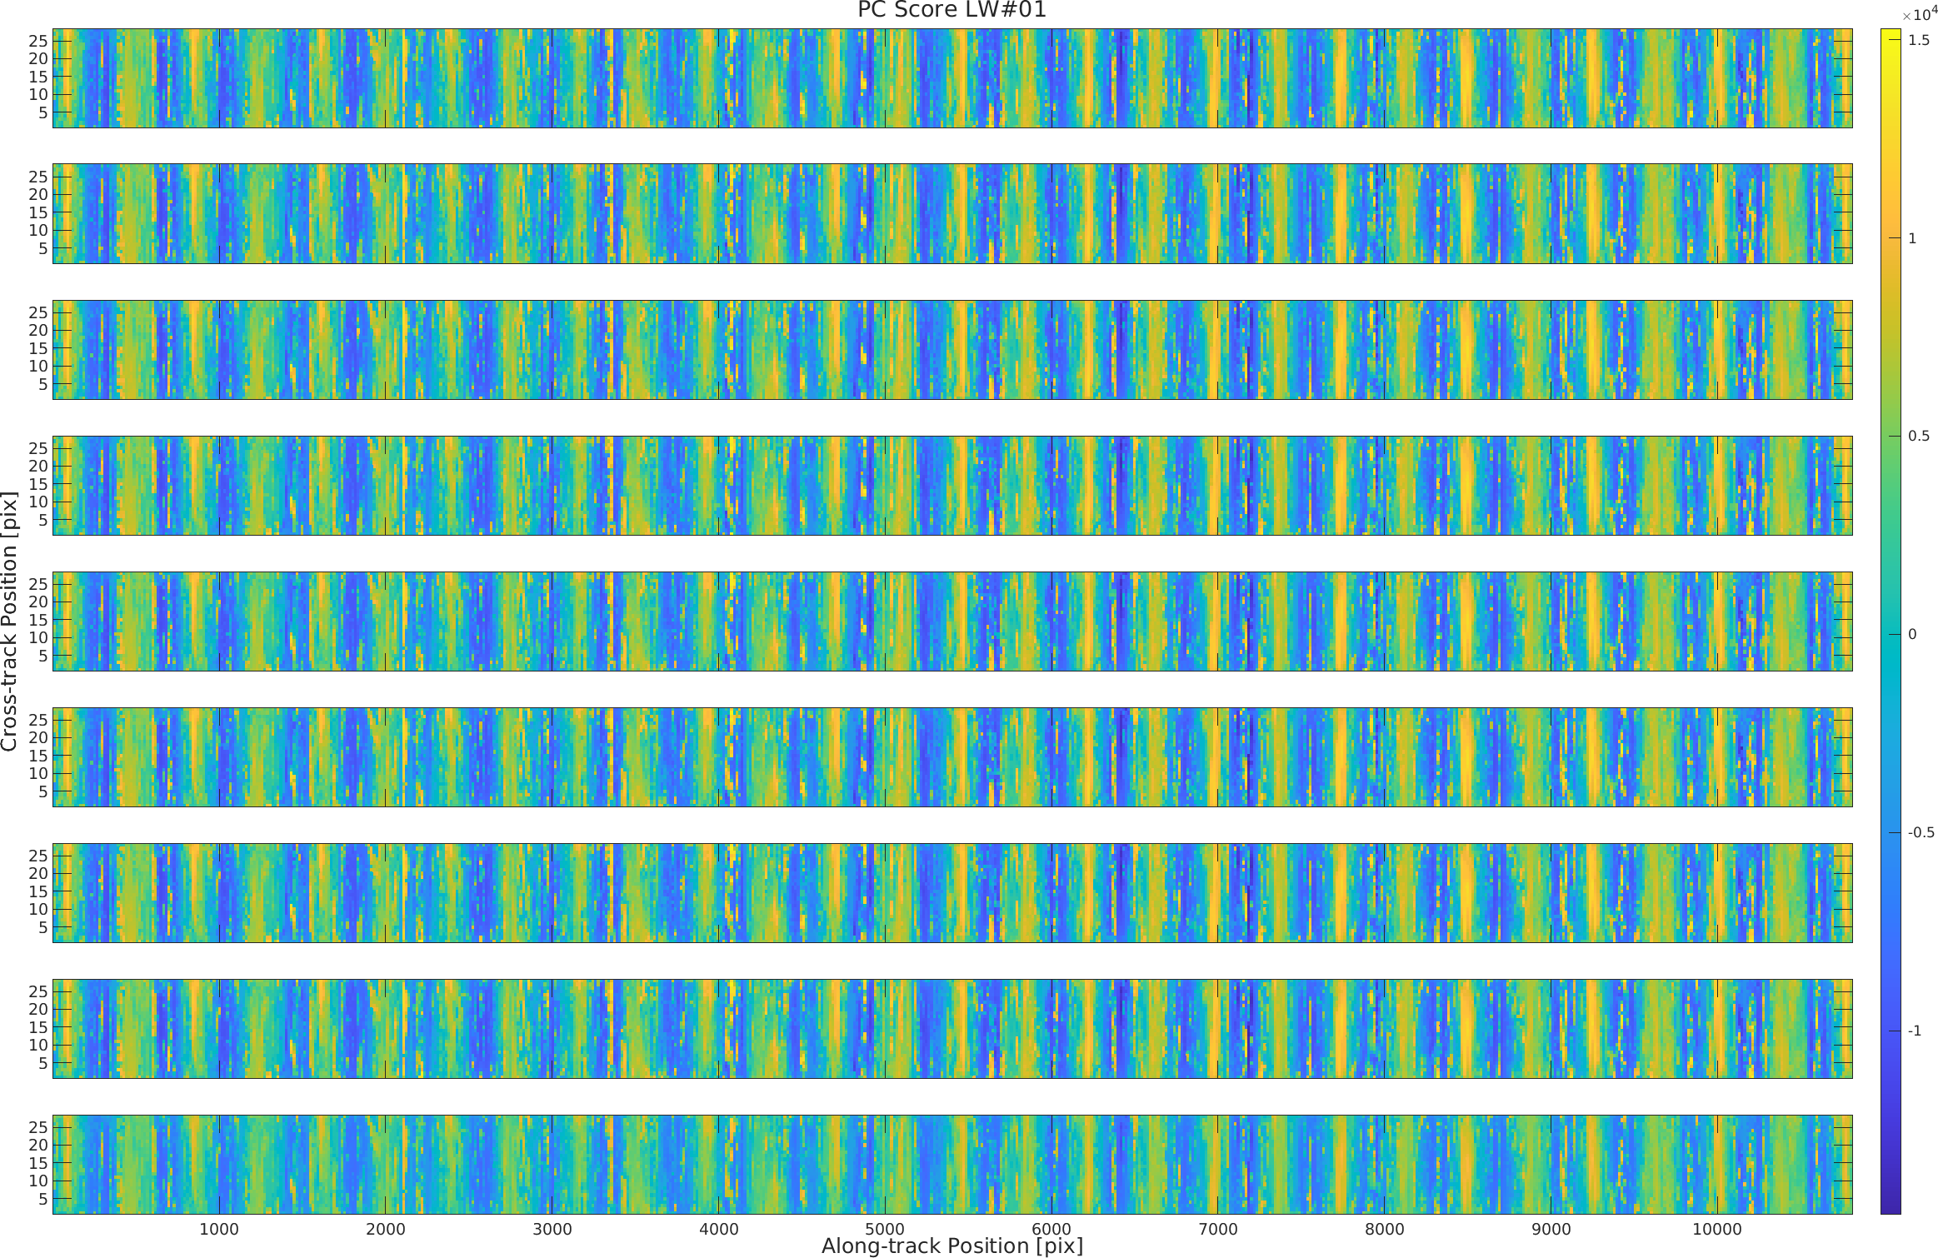
PC Scores per Pixel
FoV 1
FoV 2
FoV 3
FoV 4
FoV 5
FoV 6
FoV 7
FoV 8
FoV 9
Spatial distribution per pixel shows …

Slide 15
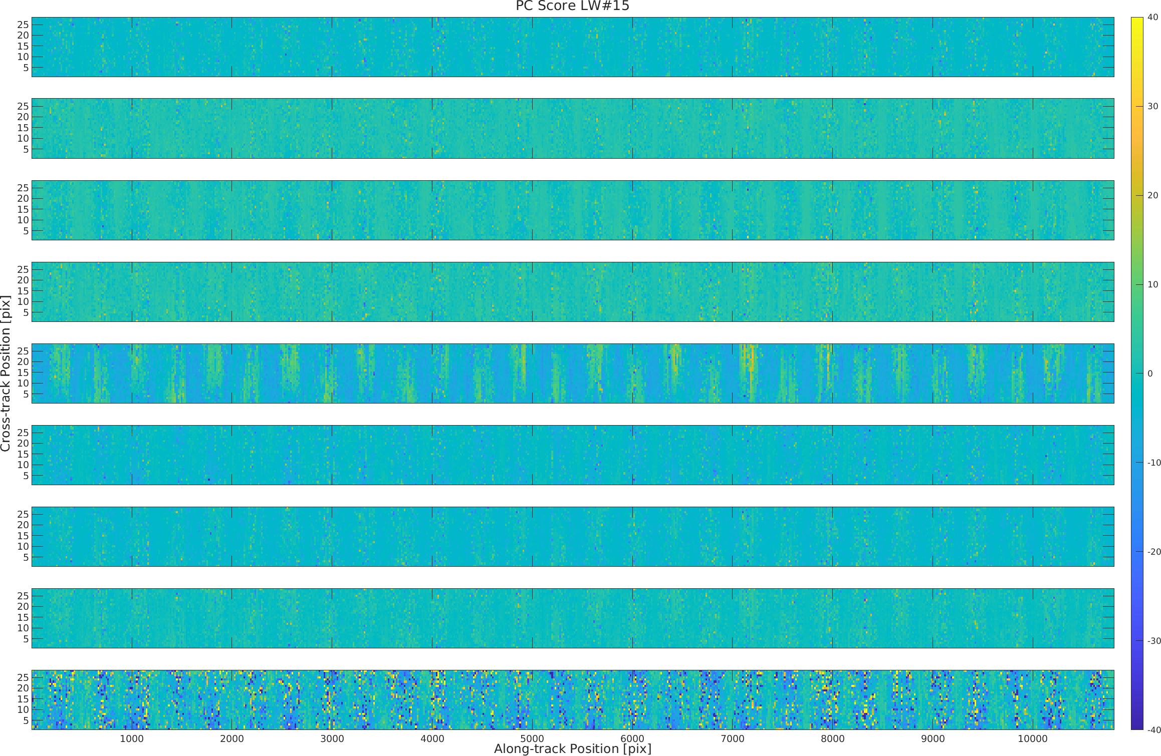
PC Scores per Pixel
FoV 1
FoV 2
FoV 3
FoV 4
FoV 5
FoV 6
FoV 7
FoV 8
FoV 9
Spatial distribution per pixel shows anomalies like
discontinuous distribution
bias between pixels, etc..

Slide 16
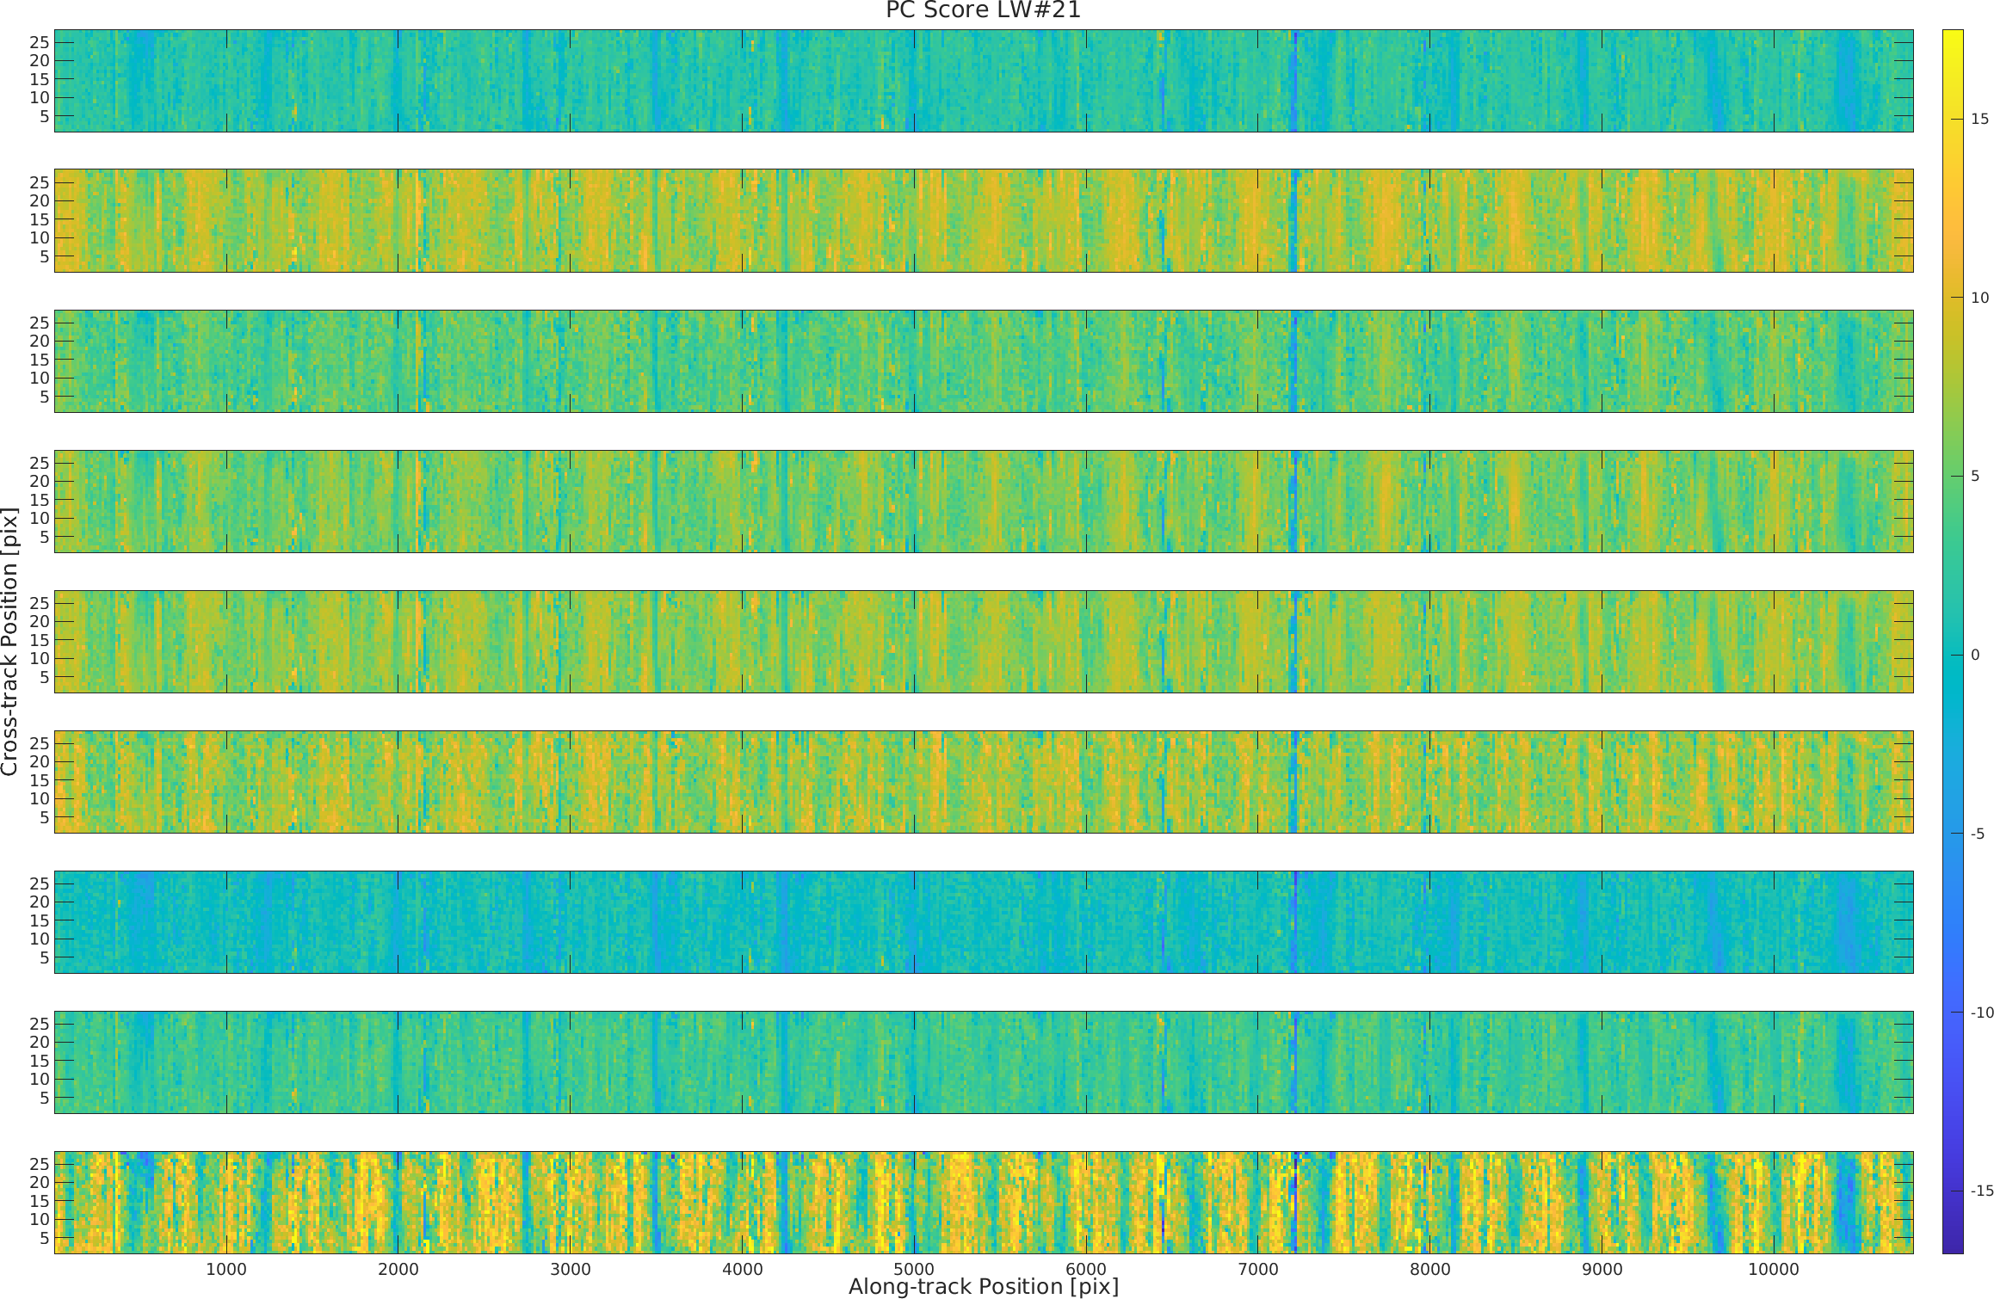
PC Scores per Pixel
FoV 1
FoV 2
FoV 3
FoV 4
FoV 5
FoV 6
FoV 7
FoV 8
FoV 9
Spatial distribution per pixel shows anomalies like
discontinuous distribution
bias between pixels, etc..

Slide 17
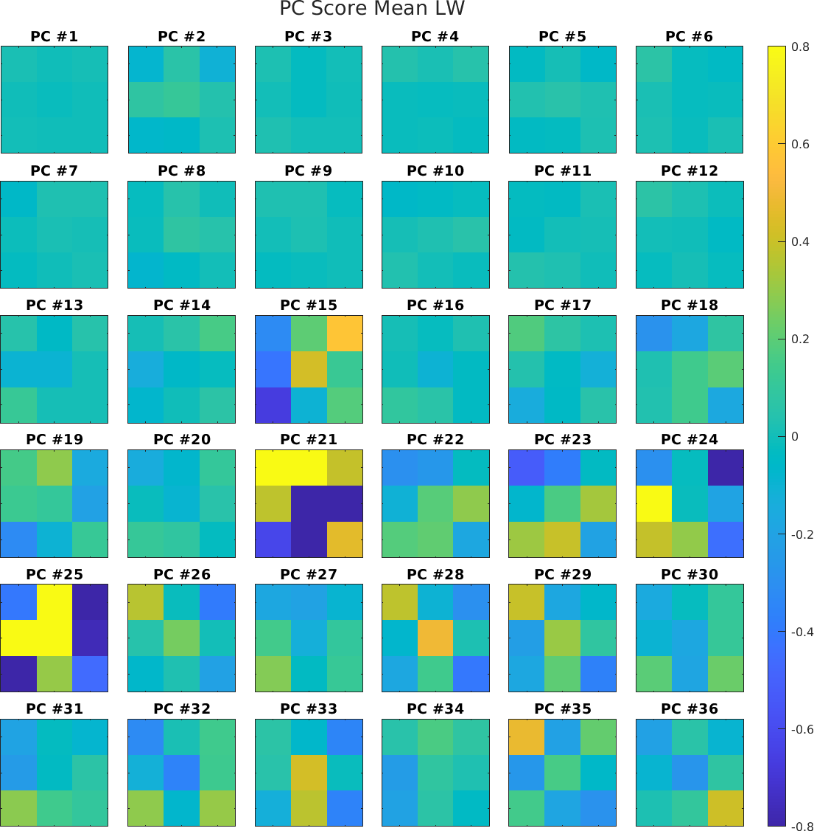
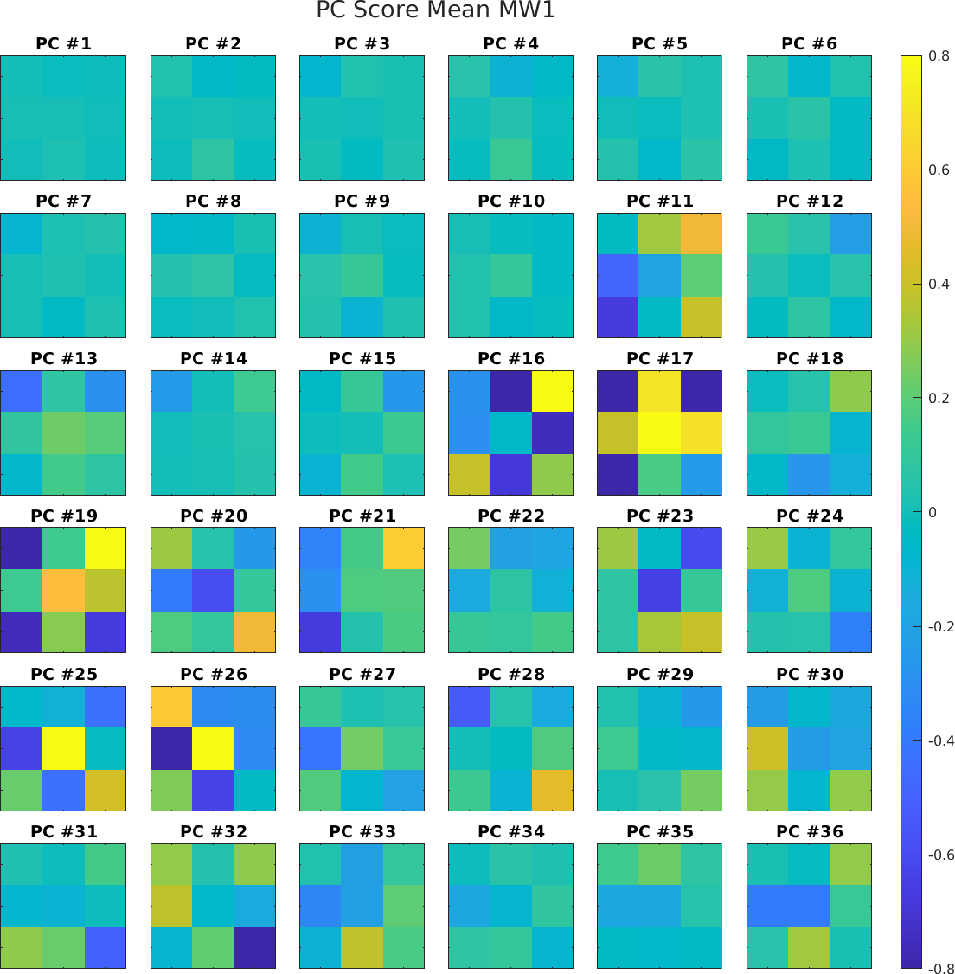
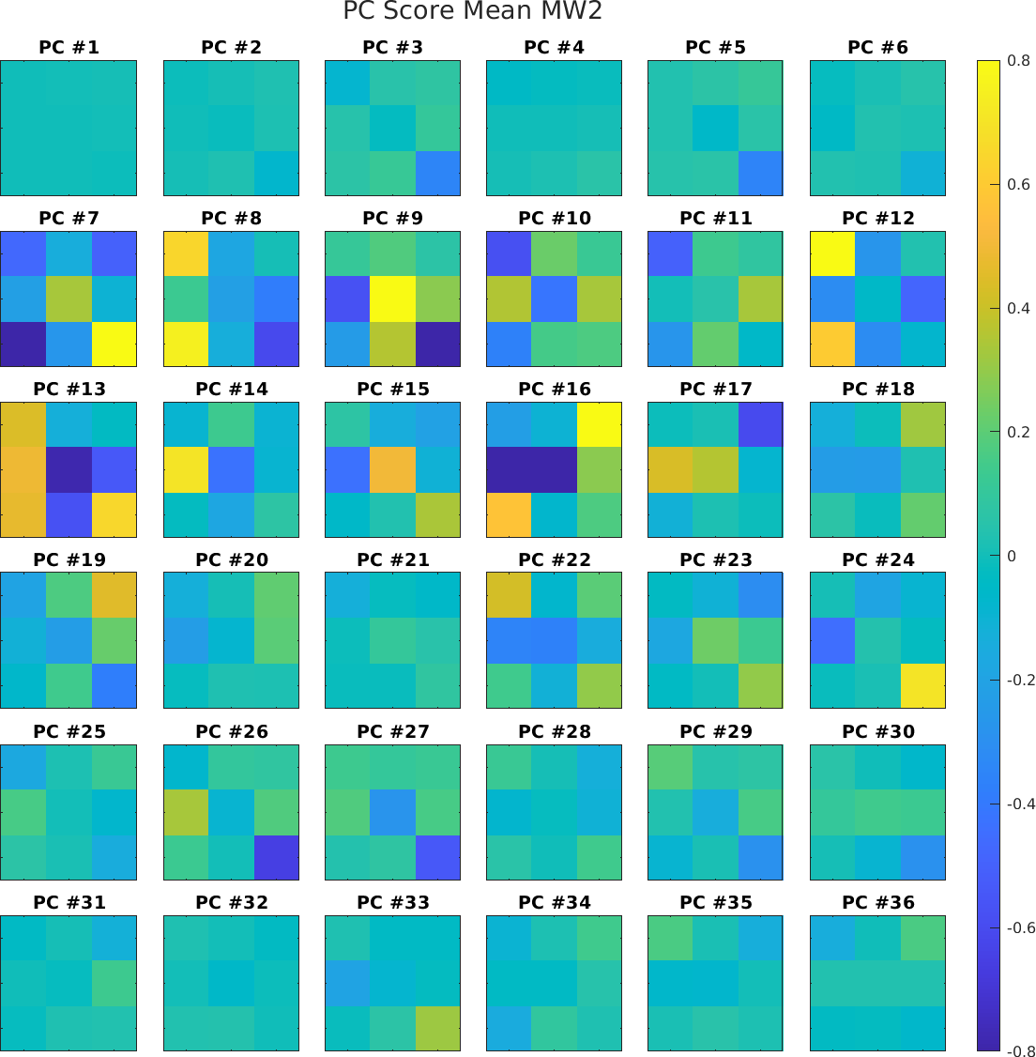
Anomaly Detection
Pixel discrepancies are visible in the PCS averages per pixel.
* PCS averages are normalized by
$$\overline{PCS}\left(k,p\right)=\frac{mean(PCS\left(k,p\right)−{\left\langle PCS\left(k,p\right)\right\rangle }_{p})}{{\left\langle std\left(PCS\left(k,p\right)\right)\right\rangle }_{p}}$$

Slide 18
Agenda
Principal Component Analysis
Instrument: FY-3E / HIRAS-2
Noise Estimation
Anomaly Detection
Harmonisation Experiments
Conclusion

Slide 19
Harmonisation Experiments
We would like to define a new set of PC that favours the directions common to all pixels to remove pixel-dependent instrumental defects.
PCA is performed on each pixel, and PCs obtained for each pixel are used to evaluate their commonality.
By adding the term of “pixel-commonality” to the covariance matrix, both SNR and commonality are maximised simultaneously.
$\left(C_{n}^{−1/2}C_{x}C_{n}^{−1/2}+α\frac{1}{{N_{pix}N}_{PC}}\sum_{p}{\sum_{i=1}^{N_{pc}}{E_{p,i}E_{p,i}^{⊤}}}\right)E_{h,k}=λ_{h,k}E_{h,k}$
In this study, samples are divided into 18 “pixels” according to 9 FoVs and 2 directions of the interferometer scanning.
Hultberg, T. et al. "Removal of instrument artefacts by harmonisation of hyperspectral sensor data from multiple detectors." Sensors, Systems, and Next-Generation Satellites XXI. Vol. 10423. SPIE, 2017.

Slide 20
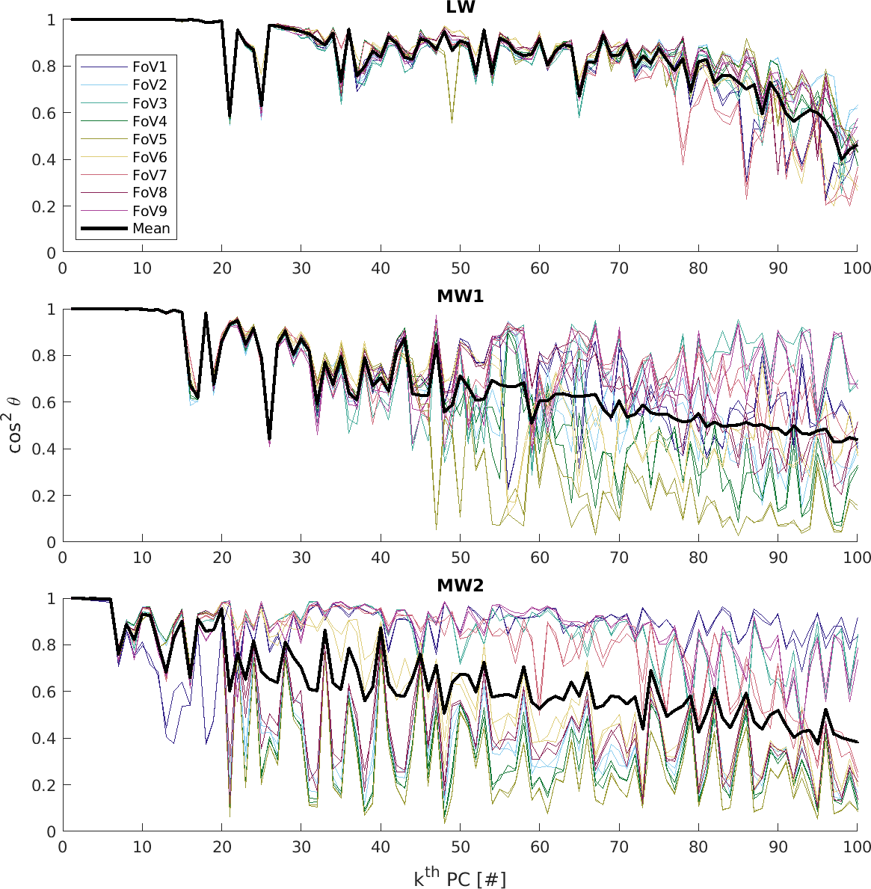
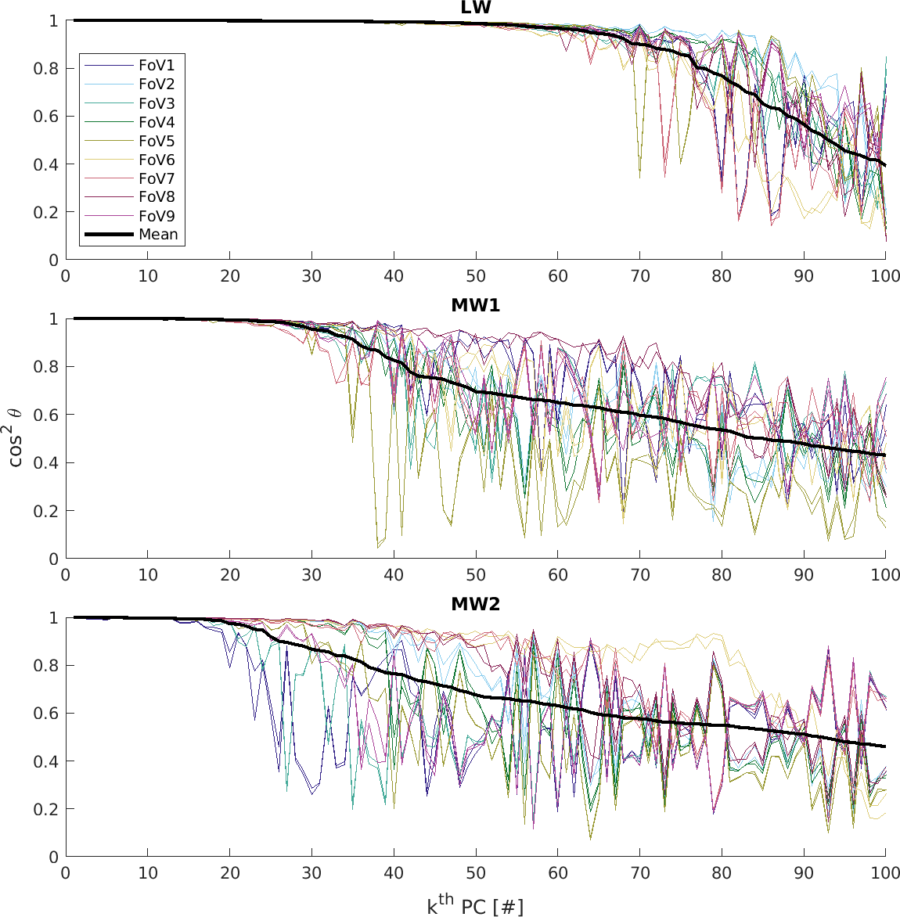
Alignment with Pixel PCs
Some of the standard PCs are poorly aligned with some pixel PCs.
The harmonised PCs are more aligned with pixel PCs.
Angle between k-th PC and PC per pixel $E_{p}$
$$\cos^{2}{θ}=\sum_{i=1}^{N_{pc}}{{\left\|E_{0,k}^{⊤}E_{p,i}\right\|}^{2}}$$
Standard PC
Harmonised PC

Slide 21
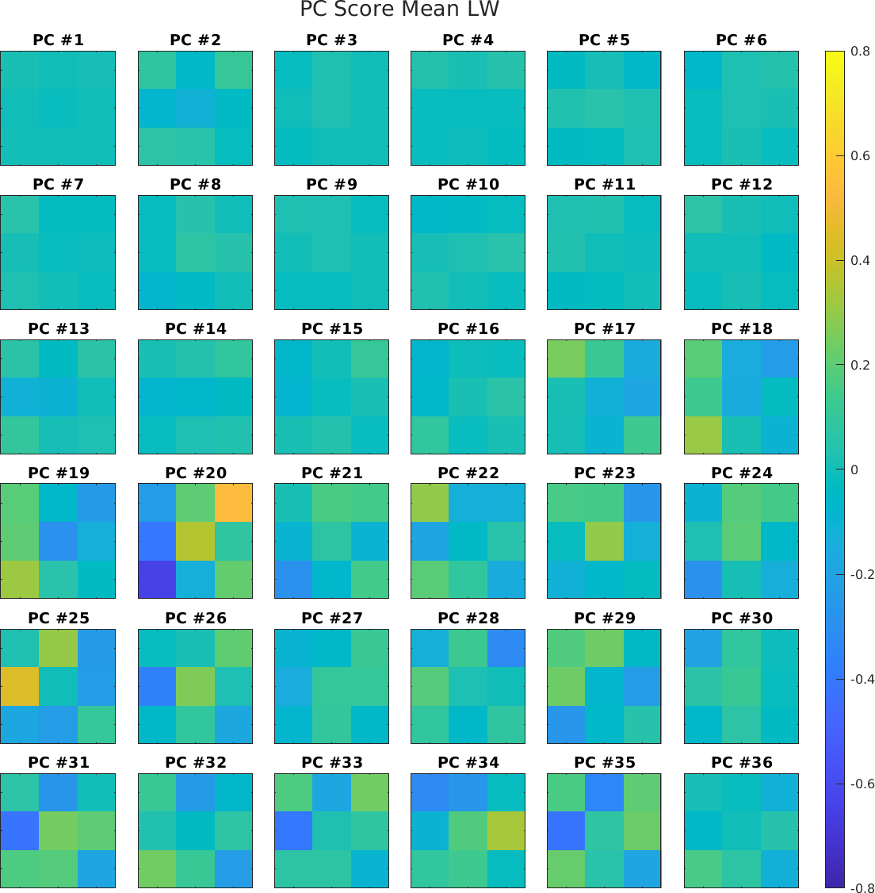
Mitigation of Pixel-Dependent Defects
Bias between pixels as seen at #21 are mitigated in the Harmonised PC.
Noisy distribution at #15 is not removed but appears at lower PC of #20 in the Harmonised PC.
Standard PC
Harmonised PC

Slide 22
Agenda
Principal Component Analysis
Instrument: FY-3E / HIRAS-2
Noise Estimation
Anomaly Detection
Harmonisation Experiments
Conclusion

Slide 23
Conclusions
The noise of HIRAS-2 instrument was estimated by using PCA, a data driven method.
We confirmed that the distribution and statistics of PC scores can be used to detect instrument anomalies.
EUMETSAT will use such technics during the commissioning of Metop-SG IASI-NG and MTG-S IRS
The anomalies could be mitigated by harmonization method, which evaluates the SNR and pixel-commonality simultaneously.

Slide 24
Thank you!
Questions are welcome.

