Slide 1
GOES ABI IR Midnight Calibration Variations Detected with GEO-GEO: Early Analysis
Fangfang Yu¹, Xiangqian Wu², Haifeng Qian³ and Hui Xu³
1: University of Maryland, College Park, MD
2: NOAA/NESDIS/STAR, College Park, MD
3: GST, Inc., Greenbelt, MD
With contributions from the GOES-R Calibration Working Group (CWG) Team
GSICS Annual Meeting, 11-15 March 2024, Darmstadt, Germany

Slide 2
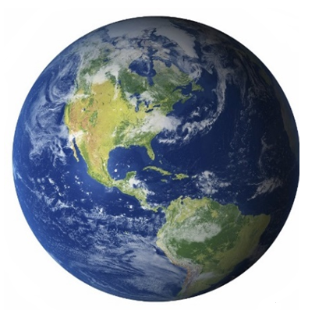
Introduction
Three of the four GOES-R fleet satellites have been launched since November 2016
GOES-16: Launched on 11/19/2016, serving as GOES-East since 12/18/2017
GOES-17 : Launched on 03/01/2018 and served as GOES-West between 02/12/2019 – 01/04/2023
GOES-18: Launched on 03/01/2022, serving as GOES-West since 01/04/2023
GOES-U (GOES-19) is scheduled to be launched in the summer of 2024
GEO Orbit
GEO Orbit
 | Launch Date | L1b satellite nadir | Actual Satellite Nadir | Operational Duration
G16 | 11/19/2016 | 75ºW (GOES-East) | 75.2ºW | 12/18/2017 -
G17 | 03/01/2018 | 137ºW (GOES-West) | 137.2ºW/137.3ºW | 2/12/2019 – 01/04/2023
G18 | 03/01/2022 | 137ºW (GOES-West) | 137.0ºW | 01/04/2023 -
GOES-West
(~137ºW)
G17 was nudged from 137.2W to 137.3W in July 2022
GOES-East
(75.2ºW)

Slide 3
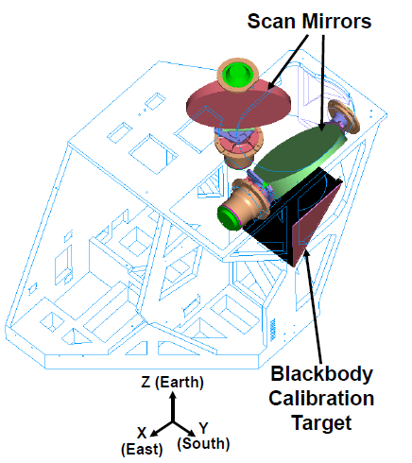
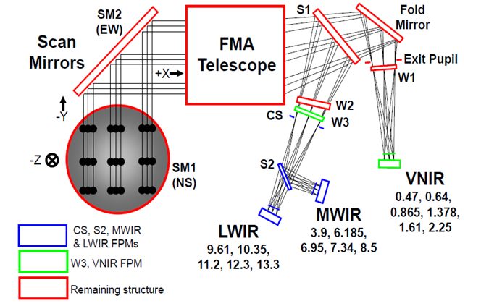
ABI Instrument and IR Bands
Two independent orthogonal scan mirrors
A total of 16 bands
six visible and near-infrared (VNIR) at one focal plane module (FPM)
Calibration targets: solar diffuser and space
10 infrared (IR) bands at two FPMs
Calibration targets: Internal Calibration Target (ICT) and space
Band No. | Central Wavelength (µm) | FPM | Descriptive name
B07 | 3.9 | MWIR | Shortwave window
B08 | 6.2 | MWIR | Upper-level water vapor
B09 | 6.9 | MWIR | Midlevel water vapor
B10 | 7.3 | MWIR | Lower/midlevel water vapor
B11 | 8.4 | MWIR | Cloud-top phase
B12 | 9.6 | LWIR | Ozone
B13 | 10.3 | LWIR | Clean longwave window
B14 | 11.2 | LWIR | Longwave window
B15 | 12.3 | LWIR | Dirty longwave window
B16 | 13.3 | LWIR | CO₂
ABI Optical Architecture
Figures from GOES-R Series Data Book, NASA 2019

Slide 4
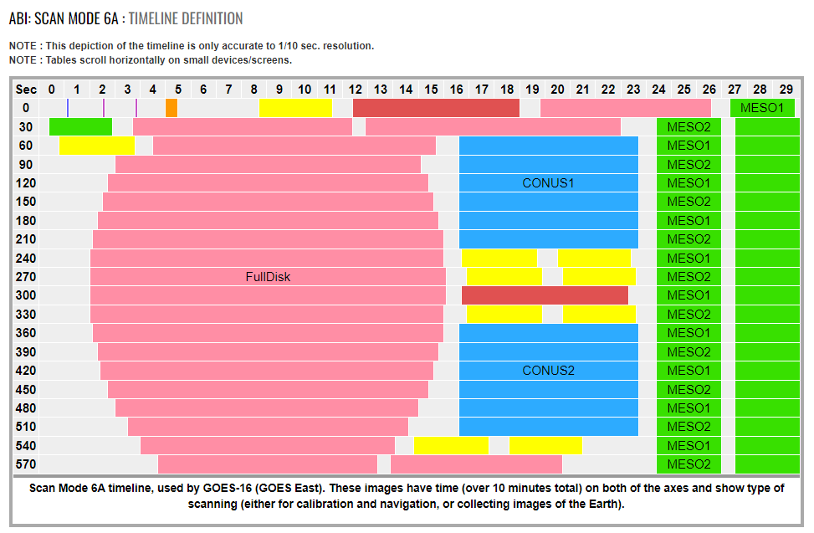
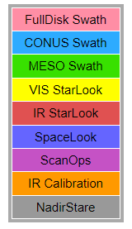
ABI Earth Scans
ABI scan mode is configurable
The current default is a 10-minute flex mode
One timeline = Earth scans + radiometric calibration target scans (space look and ICT look) + geometric calibration target scans (star)
Earth scans in a timeline include one FD image and mode-dependent CONUS and MESO images
FD: fixed location
CONUS: fixed location
MESO
Nominal operational timeline

Slide 5
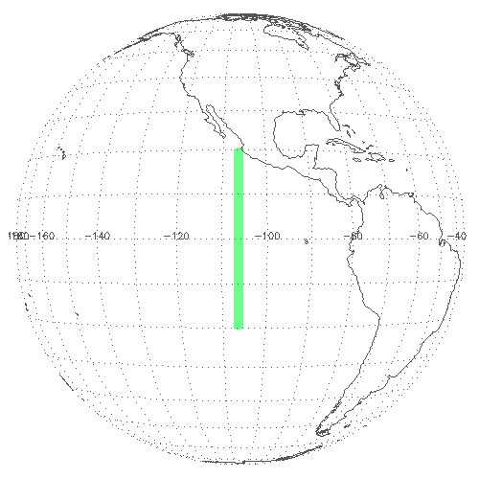
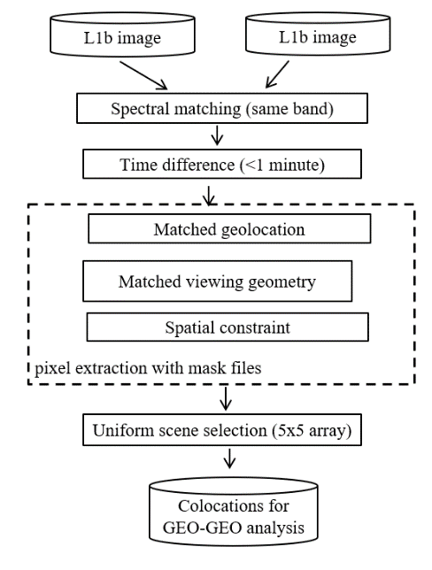
GEO-GEO at NOAA: Matched at ABI Pixel
Co-location criteria
- 20° < Lat < 20° (ocean only, no land: to avoid thermal BRDF impact observed over land)
Time difference < 1 minute (actually difference is within a few seconds)
Cos(View zenith angle) difference < 2%
Uniform selection with 5 x 5 arrays: to reduce parallax impact
Criteria: T_{b} STD < threshold. Thresholds used in this study are given in the Table below (Unit: K @ 300 K)
 | B07 | B08 | B09 | B10 | B11 | B12 | B13 | B14 | B15 | B16
 | 0.74 | 0.13 | 0.15 | 0.23 | 0.19 | 0.18 | 0.28 | 0.19 | 0.22 | 0.34

Slide 6
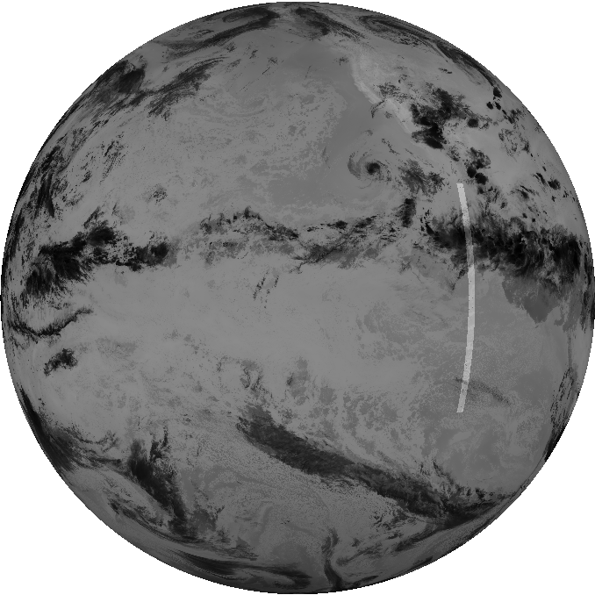
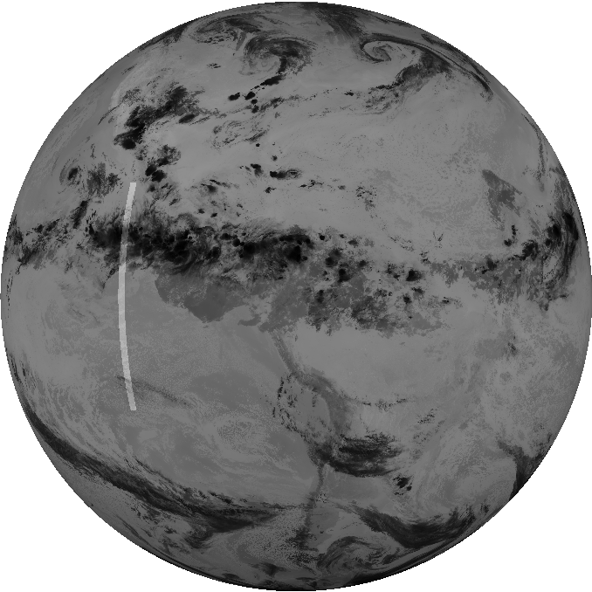
GOES-East (G16) vs. GOES-West (G18)
GOES-16 (GOES-East) vs. GOES-18 (GOES-West)
One year study period of 2023/01/01 – 2023/12/31 at every 10-minute resolution
GOES-West
GOES-East

Slide 7
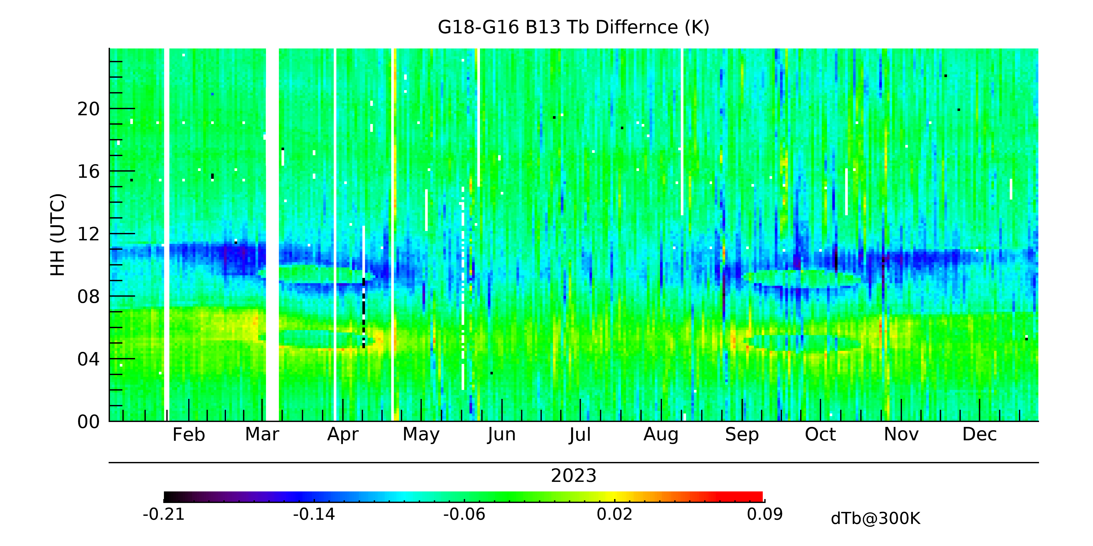
Time-Series of Long-term Monitoring: B13 as an Example
G18 vs. G16: Midnight Calibration Variations
G18 satellite midnight
G16 satellite midnight
The 24-hour long-term 2D monitoring is unique to detect daily and seasonal calibration variations:
Small midnight calibration variations at both satellites, shaping “eyes”
Variation is instrument dependent and within only a few tenth of a degree at 300 K.
Slightly colder radiance
G18 B13 data is used for investigation

Slide 8
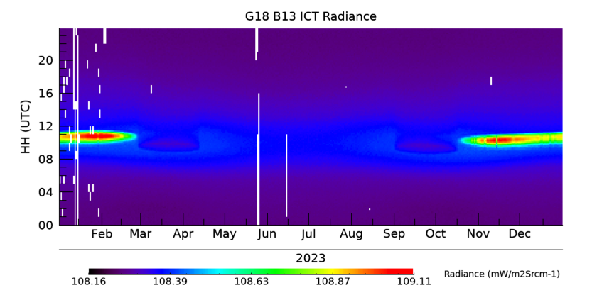
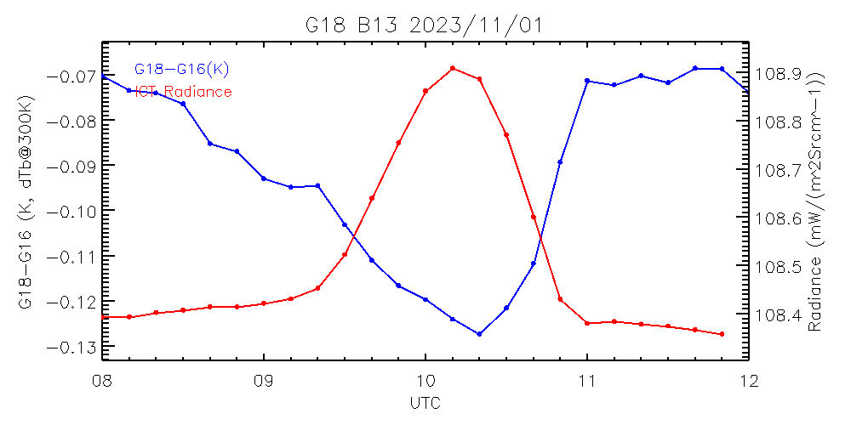
Midnight Variation Around Winter Solstice
G18 satellite midnight
G18 satellite midnight
G16 satellite midnight
Temporal correlation between elevated internal calibration target (ICT) radiance and GEO-GEO bias
Correlation is negative

Slide 9
Midnight Variation around Winter Solstice
07/11 – 07/12: Max PRT – min PRT < 0.1K
01/01 – 01/02: Max PRT – min PRT > ~1.0K
G18 satellite midnight
ABI ICT has 12 PRTs over the blackbody surface, providing weighted temperature for IR calibration
The 12 PRT temperature are generally well controlled most time in a year, except for a short time after midnight around winter solstice
ICT is heated rapidly and unevenly after midnight during this period, which likely causes inaccurate lower ICT count due to latency

Slide 10
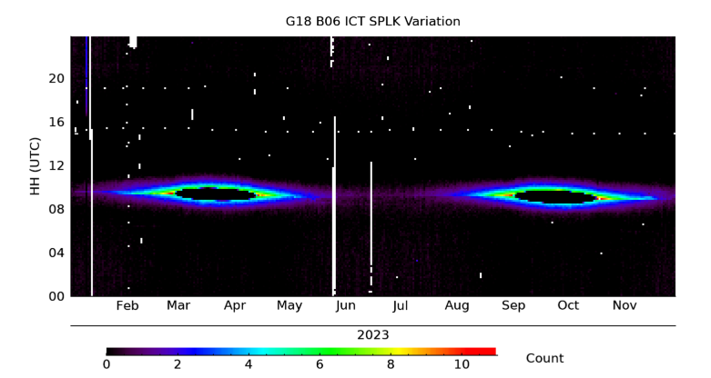
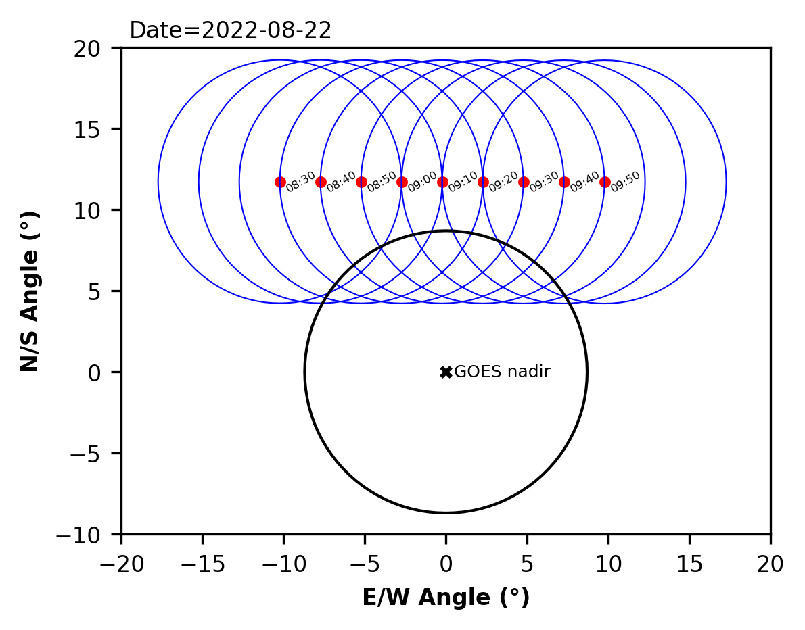
Midnight Variation around Eclipse Seasons – “Eyes”
G18 satellite midnight
Cold GEO-GEO bias occurs around satellite midnight during the eclipse seasons
Seems increasing when the Sun is close to the Earth before and after it is being occluded.
Disappears abruptly as the Sun is behind the Earth.
Possible root cause: scattered light into the spacelook scene used for ICT calibration (aka, ICT SPLK), as shown with the elevated ICT SPLK for the VNIR bands, (e.g. B06), can lead to a lower radiance during the impacted midnight time

Slide 11
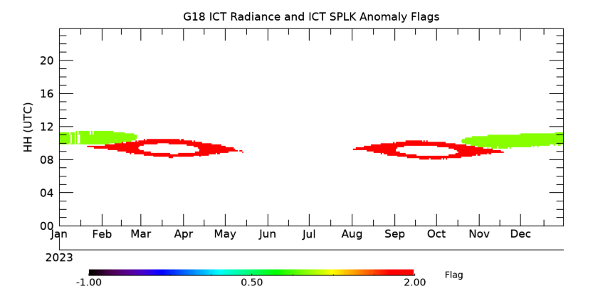
Combined Impacts
ICT Radiance Fluctuation
Elevated B06 ICT SPLK
Occurrence of the ICT radiance fluctuation and elevated B06 ICT SPLK events is highly correlated with GEO-GEO fluctuation time

Slide 12
Summary
Time-series of ABI GEO-GEO inter-comparison, due to its high temporal scale, is sensitive to small change in the radiance difference between the two satellites
A powerful tool to detect possible calibration anomaly
GEO-GEO for GOES-East and GOES-West is able to detect subtle fluctuations around satellite midnight
The midnight fluctuation magnitude is within a few tenth of a degree at 300 K, well within the SPEC
Slightly colder radiance, instrument dependent
Early assessment with one year of G18 B13 data shows two types of midnight variation patterns
Around winter Solstice after midnight: associated with the rapidly and unevenly heated ICT.
Eclipse season midnight, before and after the occlusion times: most likely due to slightly contaminated ICT spacelook when the instrument faces the Sun, which is evidenced with the VNIR ICT SPLK midnight data

Slide 13
Disclaimer
The scientific results and conclusions, as well as any views or opinions expressed herein, are those of the authors and do not necessarily reflect those of NOAA or the Department of Commerce

