Slide 1
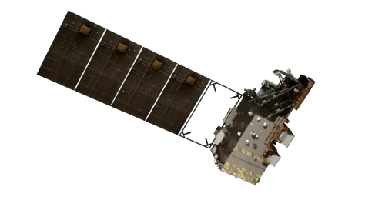
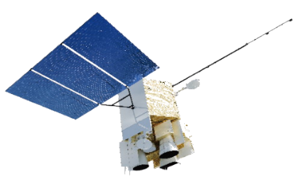
Assessment and Dynamic Correction of Spectral Calibration of FY-3D/HIRAS
Chengli Qi, Junwei Wang, Lu Lee, Xiuqing Hu
National Satellite Meteorological Center (NSMC), CMA

Slide 2
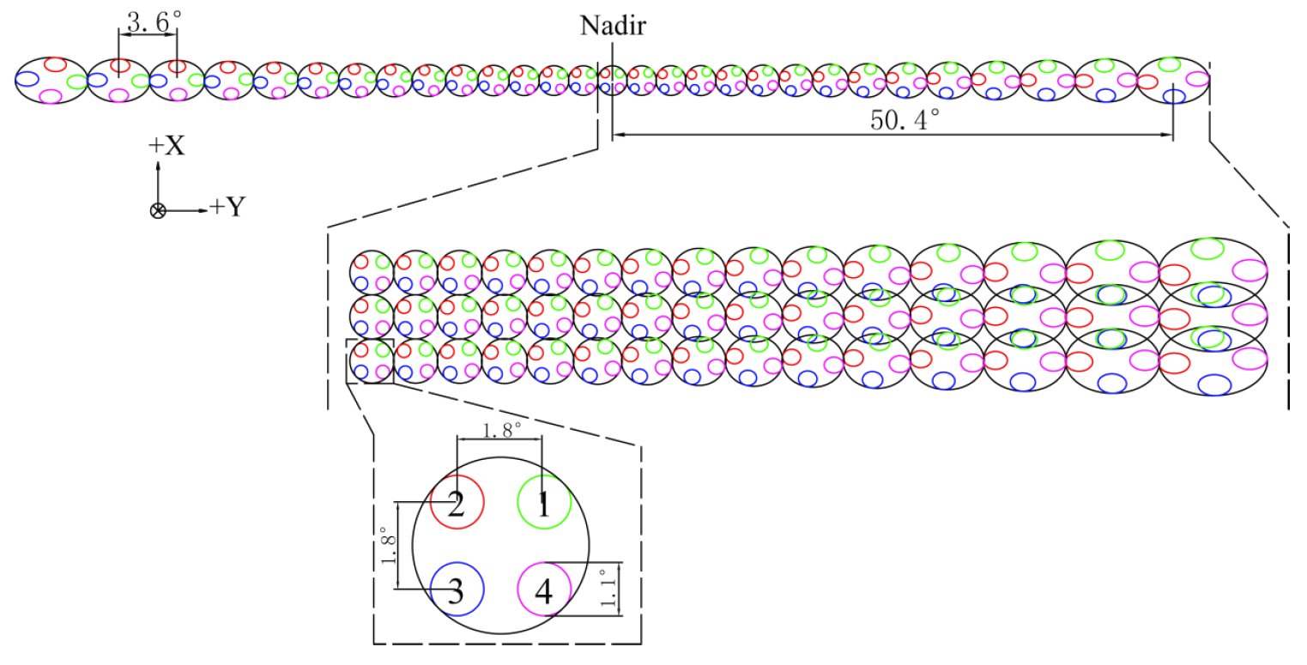
FY-3D/HIRAS overview
HIRAS is an infrared Fourier transform spectrometer(FTS) on board FY-3D satellite
Acronym | HIRAS
Full name | Hyperspectral Infrared Atmospheric Sounder
Short description | Michelson interferometer with three bands, 1370 channels
Spectral range | LWIR: 0.650 - 1136 cm⁻¹ MWIR: 1210 - 1750 cm⁻¹ SWIR: 2155-2550 cm⁻¹
calibration accuracy | 1K, expected 0.7K (radiometric) 10ppm, expected 7ppm(spectral)
Sensitivity* (NEΔT@280K） | LWIR: 0.15~0.4K MWIR: 0.1-0.7K SWIR: 0.3-1.2K
HIRAS Scan Pattern
Swath: 50.4 degrees (2400 km), 29 fields of regards, with 2 x 2 arrays giving 29 x 4 pixels per scan line;
Resolution: 1.1 degree (16 km at nadir)

Slide 3
Assessment of FY-3D/HIRAS spectral accuracy
The spectral accuracy of FY-3D/HIRAS can be assessed by two independent methods
Correlated the observed radiance to the simulated radiance from an accurate forward model over clear ocean samples
Correlated the observed radiance to the radiance from other instrument over SNO samples
HIRAS spectra
Interpolate spectra to a finer grid
(FFT→increase MPD by 0→iFFT)
cross-correlation
reference spectra
transform to HIRAS spectra
(FFT→MPD cut→iFFT)
LWIR: 704-754 cm⁻¹
MWIR: 1264-1314 cm⁻¹
SWIR: 2310-2360 cm⁻¹

Slide 4
Assessment of FY-3D/HIRAS spectral accuracy
Compared with LBLRTM simulation
Compared with Metop-B/C IASI SNO

Slide 5
Operational Spc monitoring results
LW
Lack of ECMWF prediction data in 2019.6~2020.6, data recovered in 2023.
FY-3D/HIRAS experienced volatile silica -gel gas contamination, conduct decontamination once per year.
Spectral bias varies with time and recoveed after decontamination, but the trend pattern are not just same between every year, 3 bands, and 4 detectors.
MW
SW

Slide 6
Operational Spc monitoring results
For start, data of 2022 are selected.

Slide 7
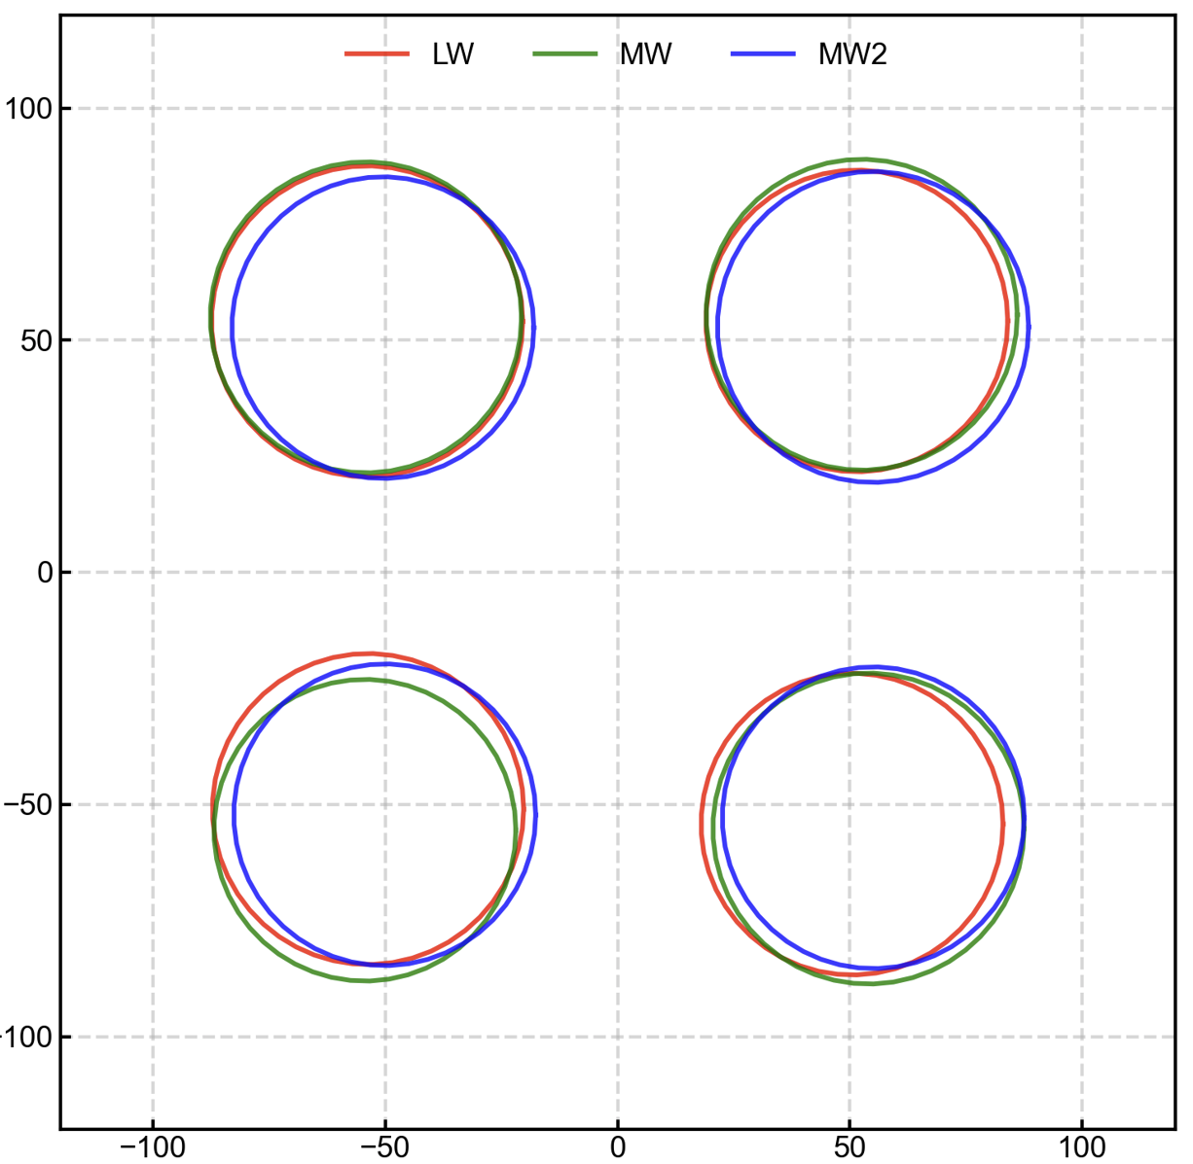
Correction of FY-3D/HIRAS spectral calibration
The accuracy of HIRAS spectral calibration is influenced by various factors, including but not limited to:
misalignment of interferometer optical axis caused by mirror jitters or stationary mirror adjustment
inaccurate geometry of the focal plane detectors
variations in the wavelength of the metrology laser,
issue of the volatile silica gel gas in the path of the
interferometer optical system
Strow et.al (2013)
Δr_{i} is the offset to the nominal detector radial position that causes the shift of i in the observed frequencies
dv/dr_{i} is the sensitivity of the detector frequency to its radial distance from the axis, which can be obtained from pre-launch calibration.

Slide 8
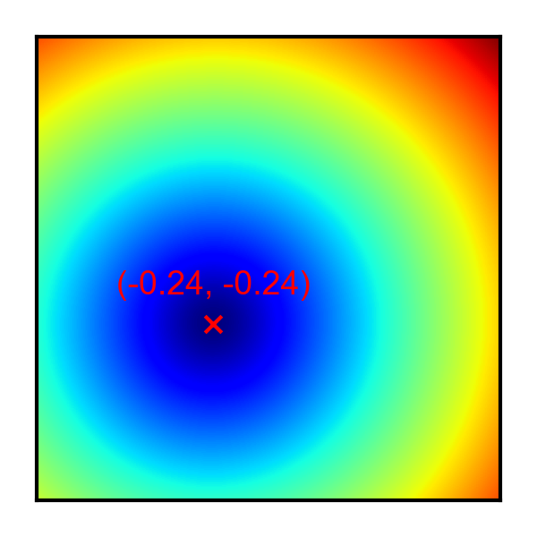
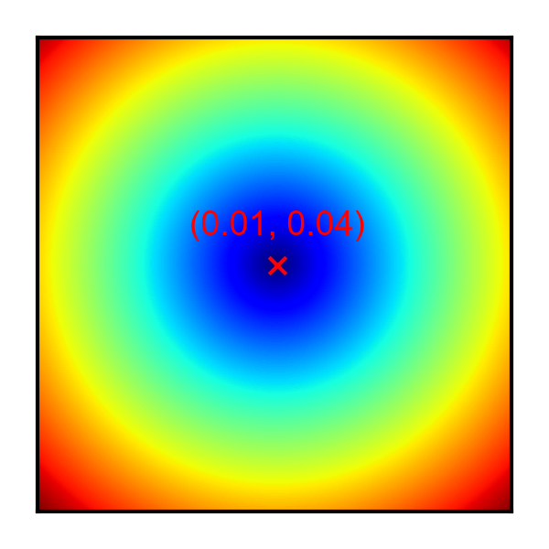
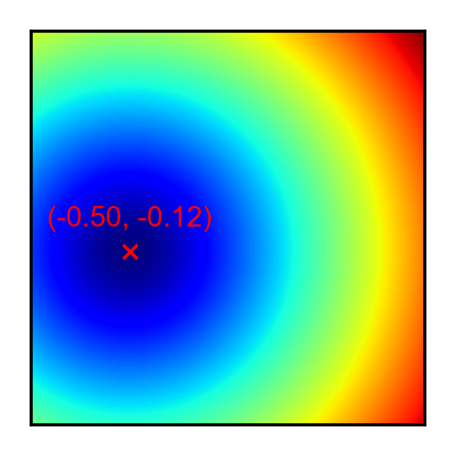
Correction of FY-3D/HIRAS spectral calibration
A two-step approach was used to find the final focal plane configuration.
First, for each band, perturb the optical axis position and calculate the standard deviation of the four detector frequency bias at each new optical axis position. The actual optical axis position can be determined at the point where the standard deviation is minimized.
LW focal plane
MW focal plane
SW focal plane

Slide 9
Correction of FY-3D/HIRAS spectral calibration
HIRAS in-orbit main-tenance begins
Spectral shifts after optical alignment correction
Changes in optical axis offset over time
the residual bias of the four detectors will still exhibit a gradual temporal trend. This is mainly attributed to the silica gel gas that are slowly volatilized from the silica gel material over time.

Slide 10
Correction of FY-3D/HIRAS spectral calibration
Second, the residual bias trend can be fitted with a time-varying quadratic curve. Therefore, the final off-axis parameters for each detector can be dynamically determined by driving the residual bias to zero.

Slide 11
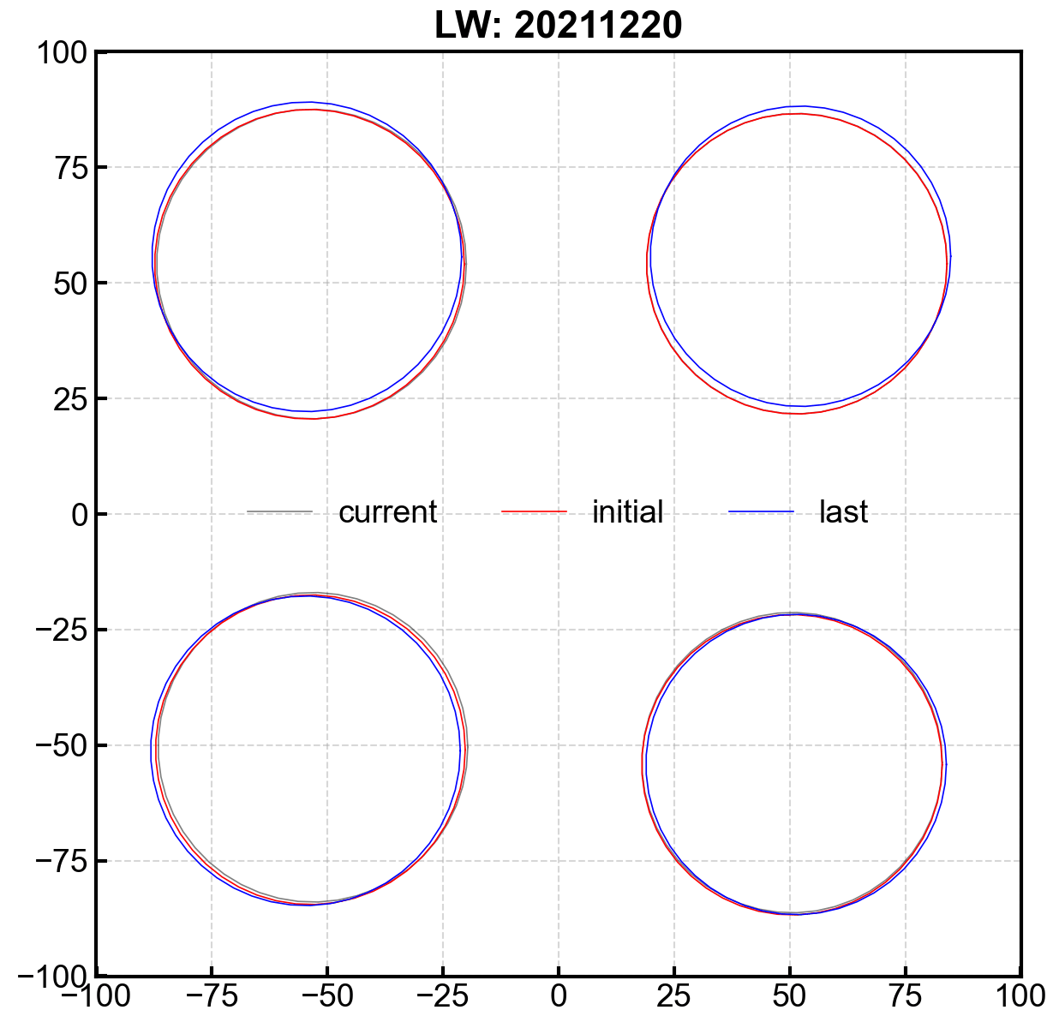
Correction of FY-3D/HIRAS spectral calibration
LWIR
Spectral shift by LBL
After step-1 correction
After step-2 correction
position of the four detectors over time.

Slide 12
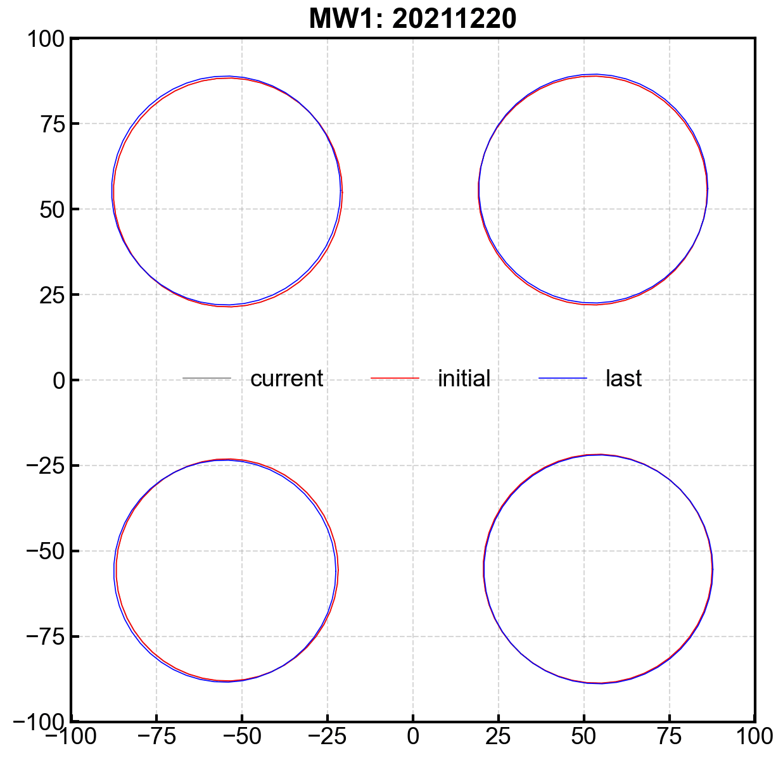
Correction of FY-3D/HIRAS spectral calibration
MWIR
Spectral shift by LBL
After step-1 correction
After step-2 correction
position of the four detectors over time.

Slide 13
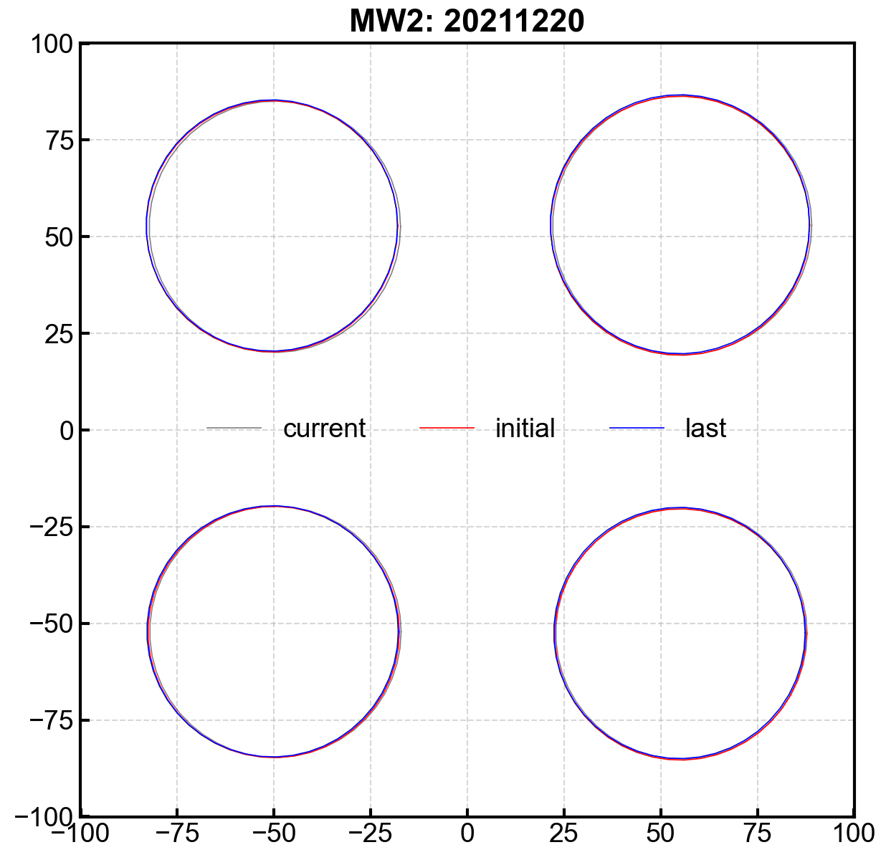
Correction of FY-3D/HIRAS spectral calibration
SWIR
Spectral shift by LBL
After step-1 correction
After step-2 correction
position of the four detectors over time.

Slide 14
Next work
Apply the correction method to the all life time data.
Consider how to correct it in real time processing.
Found out the the influence mechanism of silica gel gas on frequency change with time.
Reprocessing of FY-3D/HIRAS.

Slide 15
Thanks for your attention !

