Slide 1
FY-4B GIIRS-2 / Metop-IASI
Inter-comparison
Pierre Dussarrat & Guillaume Deschamps
Remote Sensing Scientists
GSICS meeting – 13/03/2024

Slide 2
Agenda
Introduction to GIIRS
Colocations with IASI
Radiometric calibration
Spectral calibration
Limbs

Slide 3
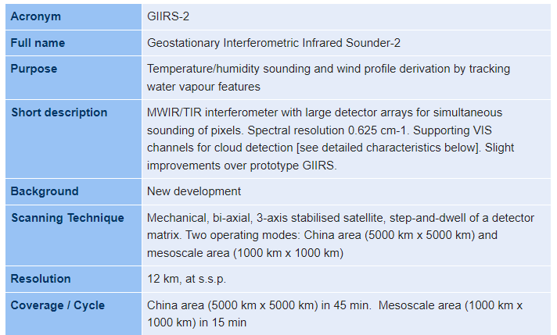
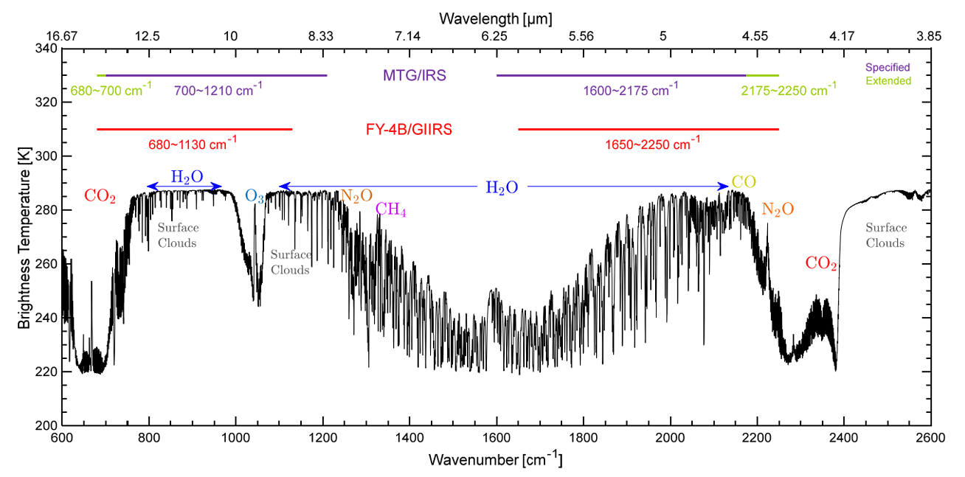
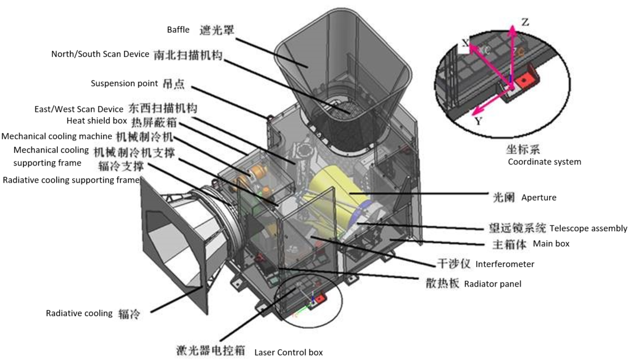
FY-4B / GIIRS-2
https://space.oscar.wmo.int/instruments/view/giirs_2

Slide 4
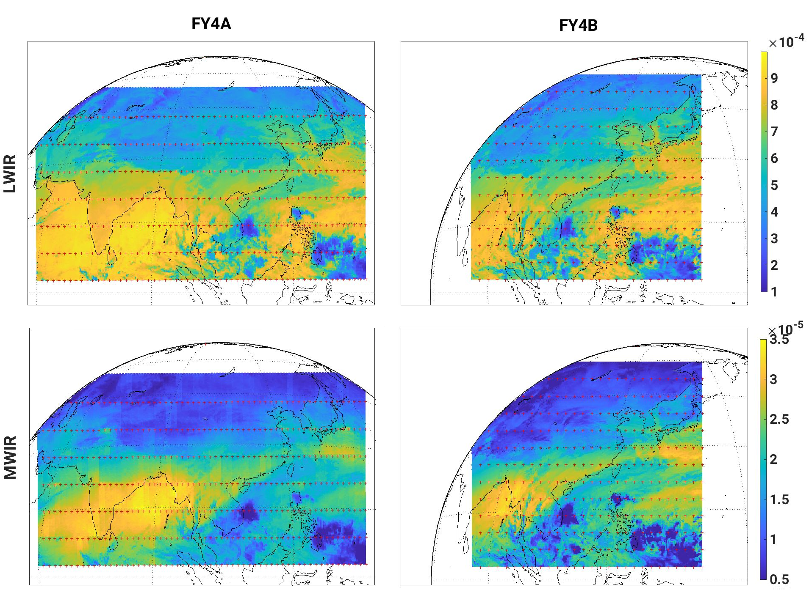
FY-4B / GIIRS-2
FY-4A / GIIRS-1
Launch: 10/12/2016
Geostationary at 104.7°E
FY-4B / GIIRS-2
Launch: 02/06/2021
Geostationary at 133.0°E
Relocation to 105.0°E in 02/2024

Slide 5
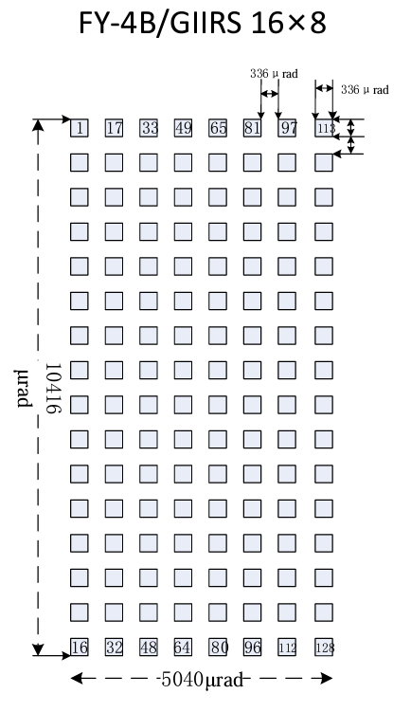
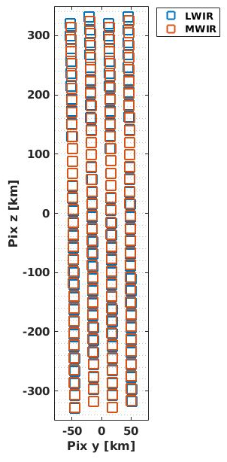
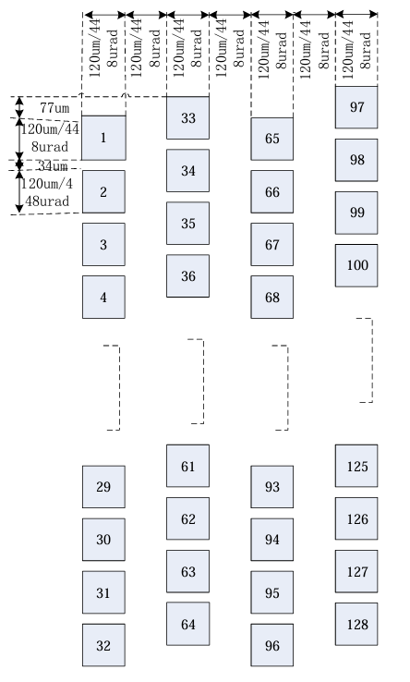
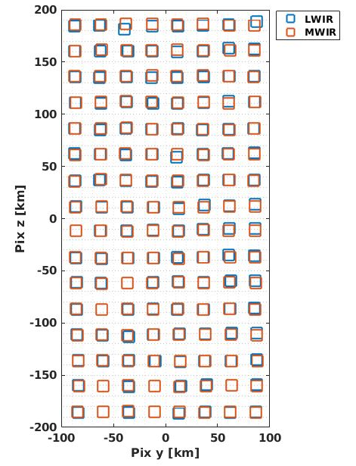
GIIRS Detector Matrix
Pixel matrix change:
FY-4A: 32x4 pixels (16km)
FY-4B: 16x8 pixels (12km)
FY4A
FY4B

Slide 6
Agenda
Introduction to GIIRS
Colocations with IASI
Radiometric calibration
Spectral calibration
Limbs

Slide 7
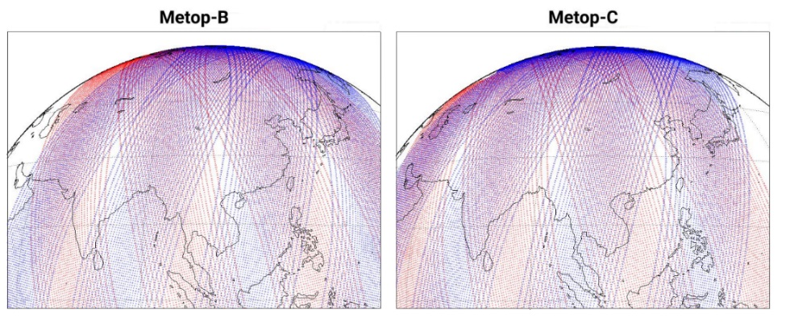
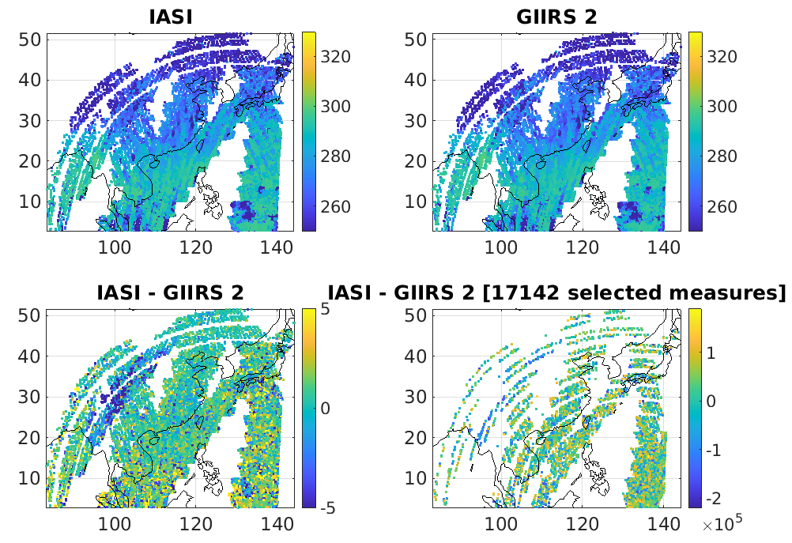
Colocation IASI - GIIRS
Colocations definitions with IASI flybys:
Colocation criteria
$δ$Distance | < 10 km
$δ$ Time | < 10 min
$δ$ Secant | < 0.01
Period | 01/10/2023 → 01/02/2024
Apodisation | Hamming
$δ$ Temperature | $\left|{\left\langle dT_{LW}\right\rangle }_{k}\right|$< 2K $\max_{k}(\left|dT_{LW}\right|)$< 3K
17142 spectra

Slide 8
Agenda
Introduction to GIIRS
Colocations with IASI
Radiometric calibration
Spectral calibration
Limbs

Slide 9
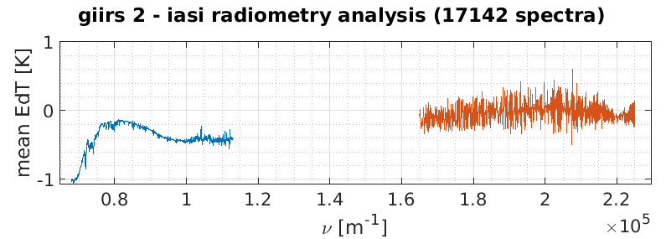
Radiometric calibration
GIIRS radiometric calibration assessment taking IASI and RT-model as references:
Long-wave IR:
Cold bias for low wavenumbers, introduced by the processing update from June 2023, the scan mirror thermal radiation is now accounted improving the calibration stability but producing a bias !
The bias remains function of the scanning angle mirrors and reversed after yaw flips at equinoxes. Believed to be related to a wrong angle dependency of the scanning mirror reflectivity in the calibration equation.
Consistent with CMA results presented to EUM on 08/2023
Giirs 2 @680${cm}^{−1}$– Background [K]
(Chris Burrows / ECMWF)
01/2023
07/2023
Calibration is reversed after yaw flip (03/2023) !

Slide 10
Radiometric calibration
GIIRS radiometric calibration assessment taking IASI and RT-model as references:
Mid-wave IR:
Overall good calibration
Large spikes up to $±$500mK, the spectral responses functions of the GIIRS channels seem highly distorted
Believed to be related to a strong straylight contamination

Slide 11
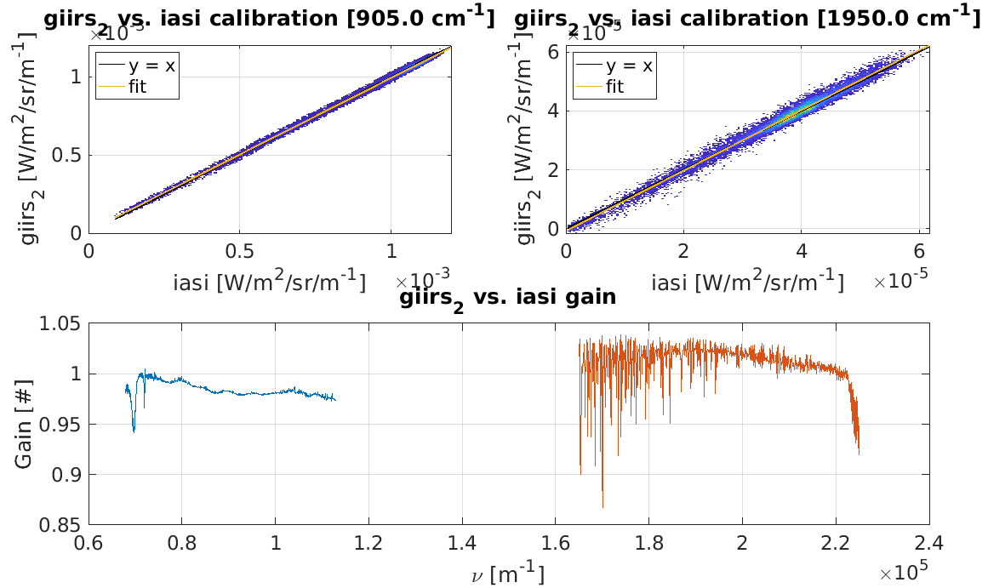
Radiometric calibration
Assessment of the radiometric gain by linear regression between GIIRS-2 and IASI radiances
Long-wave IR:
Gain < 1
Mid-wave IR:
Gain > 1
Believed to be related to some under and over-evaluation of the instrument transmissions in the calibration equation

Slide 12
Agenda
Introduction to GIIRS
Colocations with IASI
Radiometric calibration
Spectral calibration
Limbs

Slide 13
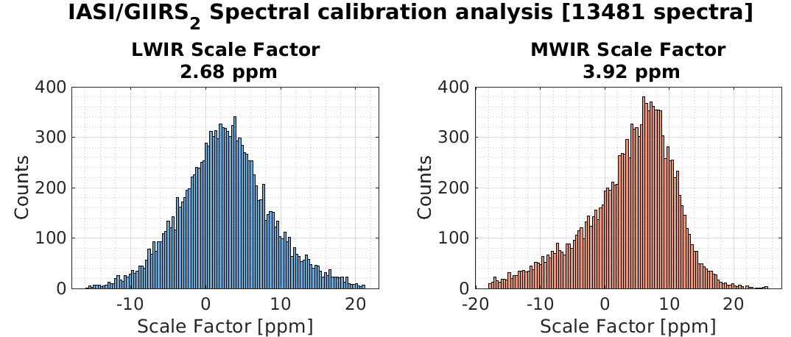
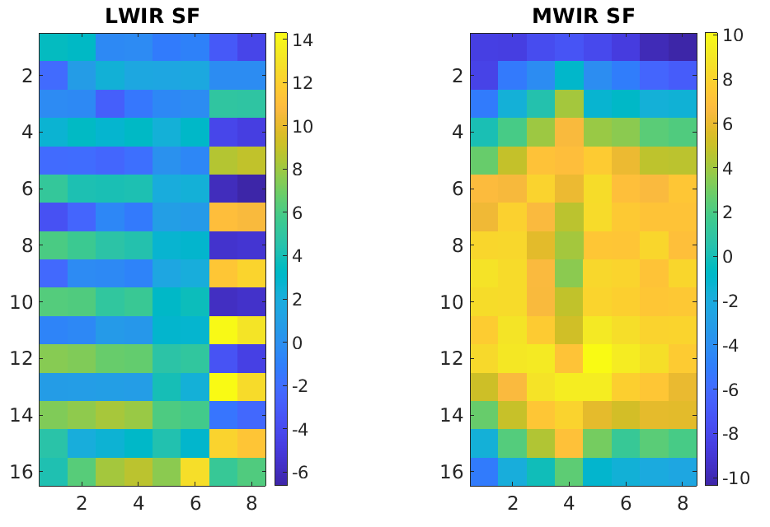
Spectral Calibration
GIIRS spectral calibration assessment taking IASI as reference:
Long-wave IR:
Mostly inside the $±$10ppm requirement
Strong checkerboard pattern
Related to parasite and pixels-dependent clutter signals at interferogram level (CMA results presented on 08/2023)
Mid-wave IR:
Mostly inside the $±$10ppm requirement
Strong diamond shape
Believed to be related to strong straylight contamination
Consistent with CMA results presented to EUM on 08/2023
Spectral calibration per pixel [ppm]

Slide 14
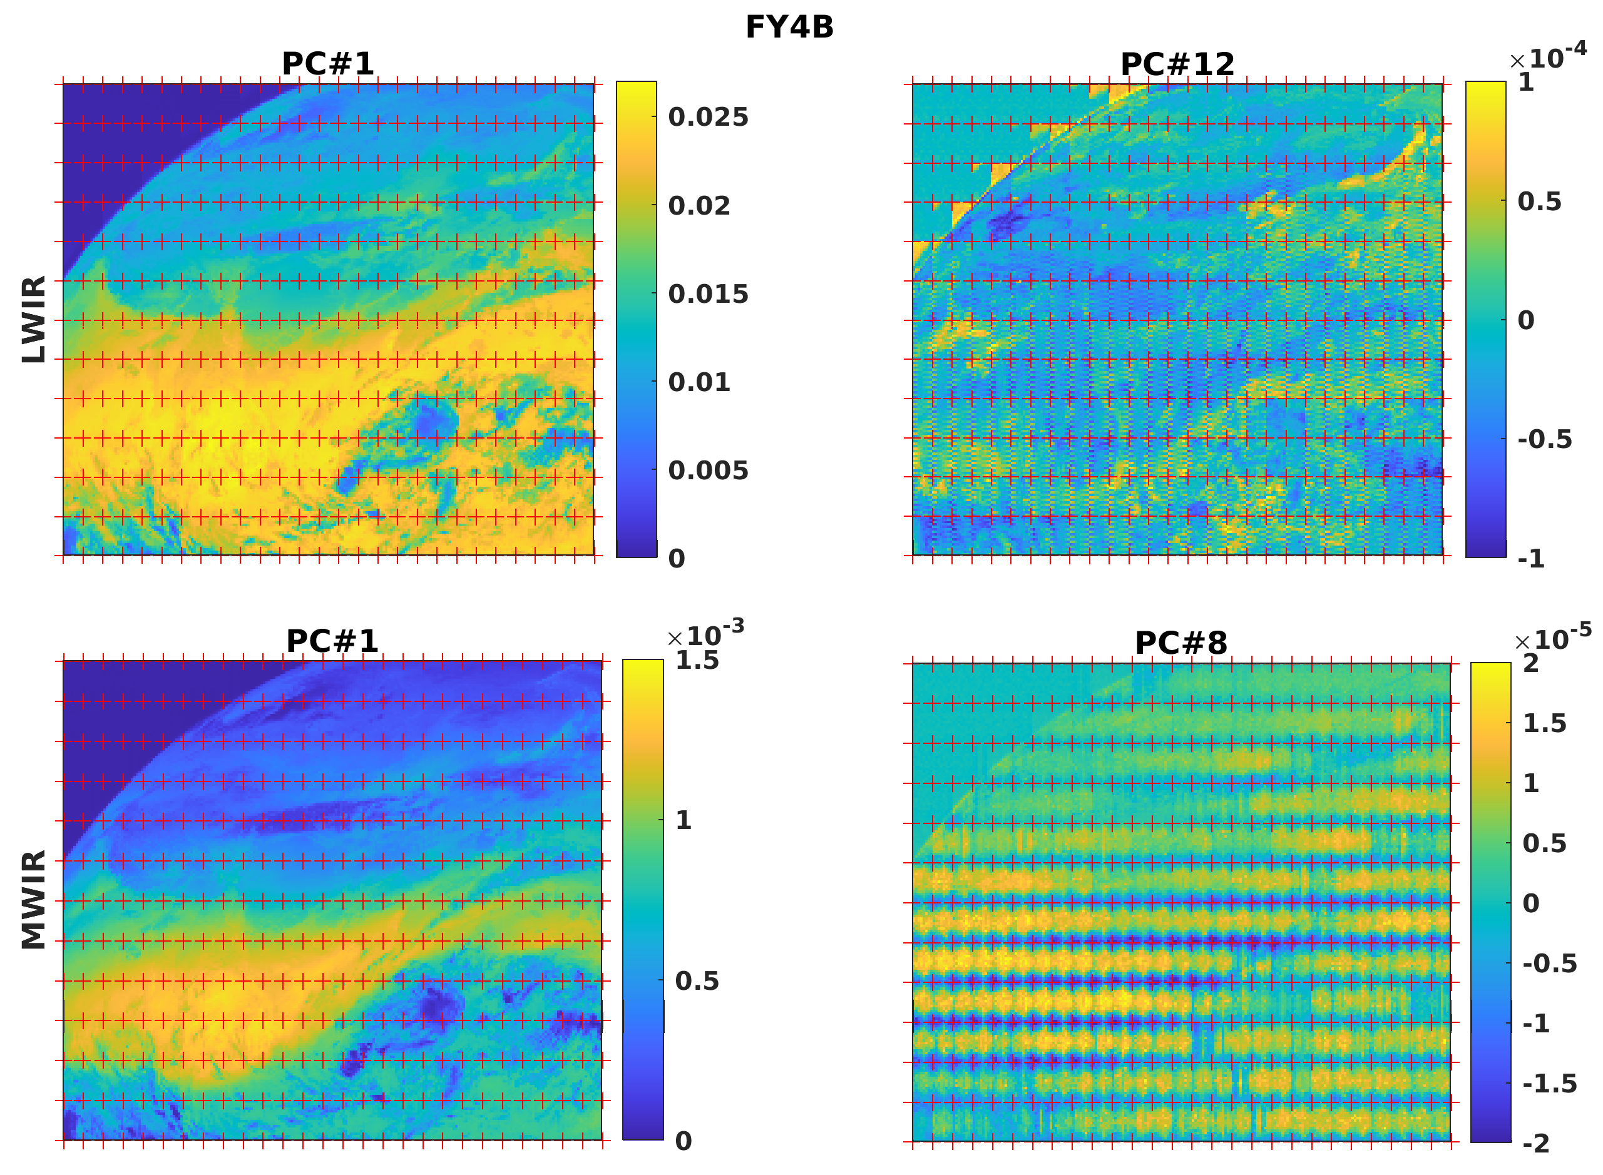
Principal Components Analysis
PCA allows decomposing the signal into independent components ordered by variability amplitude and detecting subtle defects:
PC#12 (LWIR) and #8 (MWIR) can be clearly associated to spectral calibration
These can be monitored outside of the colocation times with IASI to assess the temporal variability of the spectral calibration
See Shin Koyamatsu’ s talk
https://en.wikipedia.org/wiki/Principal_component_analysis
Hultberg, T. et al. "Local or global? How to choose the training set for principal component compression of hyperspectral satellite measurements: a hybrid approach." Sensors, Systems, and Next-Generation Satellites XXI. Vol. 10423. SPIE, 2017.

Slide 15
Agenda
Introduction to GIIRS
Colocations with IASI
Radiometric calibration
Spectral calibration
Limbs

Slide 16
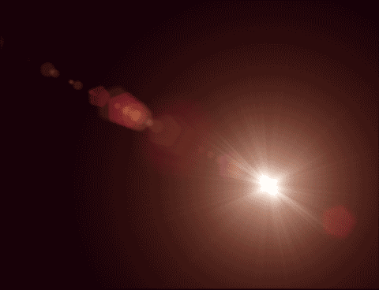
Limbs (01/2023)
Use the limb views to assess:
The background calibration (spectra in space should equal 0)
Potential straylight effects
Great improvements with respect to FY-4A but patterns still visible in both bands.
Believed to be a hint of “flaring” in LWIR band: symmetrical ghosts produces by lens internal reflections.

Slide 17
Conclusions
FY-4B GIIRS-2 data quality is certainly better than FY-4A GIIRS-1
Nonetheless many anomalies remain:
Electronic parasites (spectral calibration LWIR),
Straylight (spectral and radiometric calibration MWIR),
Calibration equation (LWIR and MWIR)
Analysing GIIRS data is a great rehearsal for the EUMETSAT teams
Most of EUMETSAT monitoring modules are ready for MTG-S IRS commissioning

Slide 18
Thank you!
Questions are welcome.

