Slide 1
Re-Calibration result of COMS/MI and GK2A/AMI
2024.03.13.
Euidong Hwang, KMA/NMSC
Notes:
Hello everyone.
I am Euidong Hwang working for national meteorological(미테오로로지컬) satellite center of KMA.
I would like to show about Re-Calibration result of COMS and GK2A

Slide 2
1. Introduction
2. Data
3. Methods
4. Results
5. Summary
1/14
Notes:
today`s my presentation would be like this.

Slide 3
Introduction
KMA has been operating COMS and GK2A satellites to provide stable and continuous satellite data.
COMS : 2011.04. ~ 2020.03., GK2A: 2019.07. ~
Performed the reprocessing on COMS/MI and GK2A/AMI.
The MSICC(Multi-Sensor IR Channel Calibration) algorithm, jointly developed by JMA/EUMETSAT, is used to calculate re-calibration coefficients.
The re-calibration method is based on the GSICS GEO-LEO IR algorithm.
2/14
Notes:
KMA has been operating COMS and GK2A sattellites to provide stable and continuous satellite data since 2011.
As you already know, climate products using satellite data need reprocessing.
because it’s necessary to correct differences between historical satellites.
so,
For the reprocessing of COMS/MI and GK2A/AMI, we used the MSICC algorithm jointly developed by JMA/EUMETSAT.
Furthermore, that method is based on the GSICS GEO-LEO IR algorithm.

Slide 4
Data
 | 2010 | 2011 | 2012 | 2013 | 2014 | 2015 | 2016 | 2017 | 2018 | 2019 | 2020 | 2021 | 2022 | 2023
COMS (GK1) (MI)
GK2A (AMI)
MetOp-A (IASI)
MetOp-B (IASI)
MetOp-C (IASI)
Operation periods
Operation periods
Operation periods
Operation periods
Operation periods
COMS MI
Center wavelength (µm) | Resolution (km)
3.75 | 4
6.75 | 4
10.8 | 4
12.0 | 4
GK2A AMI
Center wavelength (µm) | Resolution (km) | Center wavelength (µm) | Resolution (km) | Center wavelength (µm) | Resolution (km)
3.83 | 2 | 8.56 | 2 | 12.34 | 2
6.21 | 2 | 9.62 | 2 | 13.29 | 2
6.94 | 2 | 10.35 | 2
7.33 | 2 | 11.23 | 2
3/14
Notes:
This slide shows the operational periods of the satellites used in this study.
As seen in the chart, COMS and GK2A were operated concurrently with the MetOp series throughout all periods.
The table below provides information on the common channels of COMS and GK2A.

Slide 5
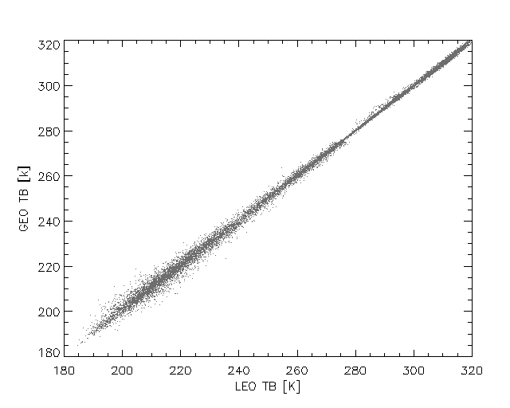
Methods (MSICC algorithm)
Computing of recalibration coefficients
corrected_${Rad}_{GEO}$
= ${Rad}_{GEO} ∗ {Slope}_{daily_coeff}$ + ${Offset}_{daily_coeff}$
GEO and LEO (IASI) satellite data were matched according to the GSICS IR algorithm.
Coefficients were obtained by using the linear regression of the collocated data on ±2days (=5days).
LEO
GEO
Anchoring recalibration coefficients to a prime reference
L`3 = a`2 + b`2 * (a`3 + b`3 * ${Rad}_{GEO}$)
= (a1 – a2 * b1/b2) + b1/b2 * ((a2 – a3 * b2/b3)
+ b2/b3 * (a3 + b3 * ${Rad}_{GEO}$))
= a1 + b1 * ${Rad}_{GEO}$
Anchoring links coefficients with respect to reference satellites and cancels them out, leaving only the prime reference coefficients.
where,
a1 b1 : w.r.t. sat.1 offset and slope (Prime)
a2 b2 : w.r.t. sat.2 correction coefficients
a3 b3 : w.r.t. sat.3 correction coefficients
3/14
Notes:
There are two important steps in the MSICC algorithm, one is to match-up the satellite data and the other is anchoring.
GEO and LEO (IASI) satellite data were matched according to the GSICS IR algorithm.
and then
Coefficients were obtained by using the linear regression of the collocated data on ±2days (=5days).
Anchoring links coefficients with respect to reference satellites and cancels them out.
finally, leaving only the prime reference coefficients.

Slide 6
[Appendix] Re-calibration flow chart
 | IASI-A |  | IASI-B |  | IASI-C
MI | Rad_cor_A |  | Rad_cor_B
 |  | Rad_cor_$B^{A}$
AMI | Rad_cor_A |  | Rad_cor_B |  | Rad_cor_C
 |  |  |  | Rad_cor_$C^{B}$
 |  | Rad_cor_$B^{A}$ |  | Rad_cor_$C^{B^{A}}$
Anchoring
Anchoring
Sensor equivalent radiance
SBAF
Baseline sensor normalized radiance
where,
Rad_cor_A : corrected radiance w.r.t. A
Rad_cor_$B^{A}$ : anchoring A -> B
Rad_cor_$C^{B^{A}}$ : anchoring A -> B -> C
4/14
Notes:
This chart shows the flow of re-calibration.
Row means reference satellite and column means geostationary satellite. Each cell represents the corrected radiance with respect to reference satellite.
Each corrected radiance is linked to the prime reference via anchoring.
Sensor equivalent radiance means the radiance based on the SRFs of each observing sensor.
And, Baseline sensor normalized radiance is the radiance that is adjusted to the SRF of a common sensor by SBAF.

Slide 7
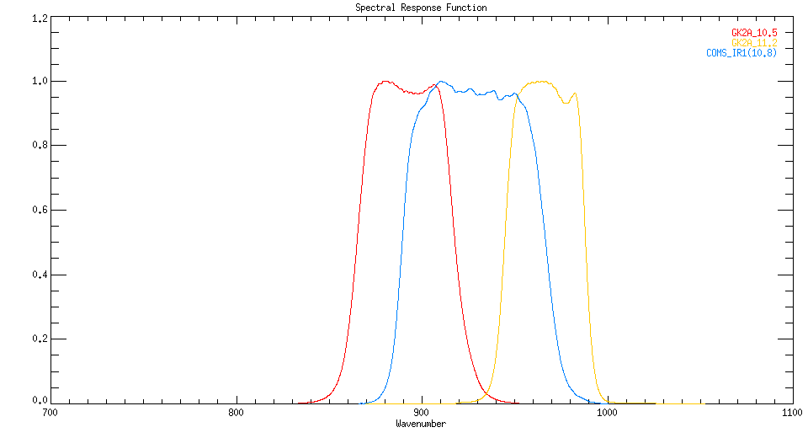
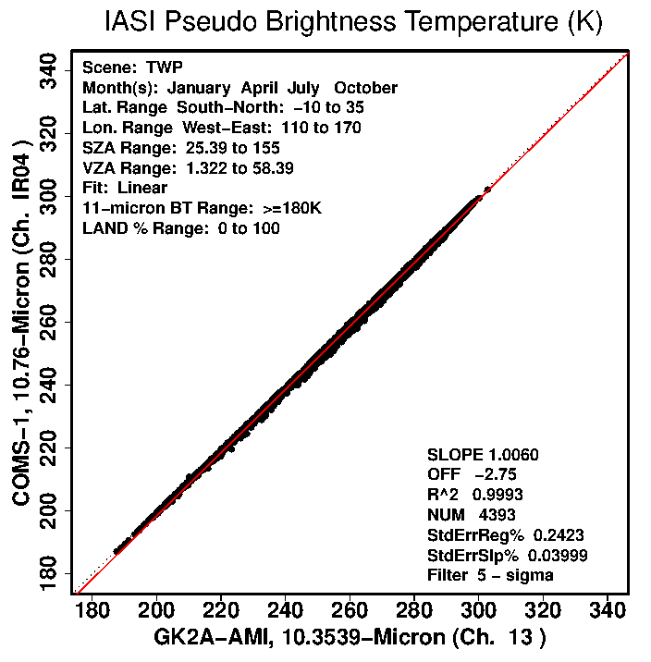
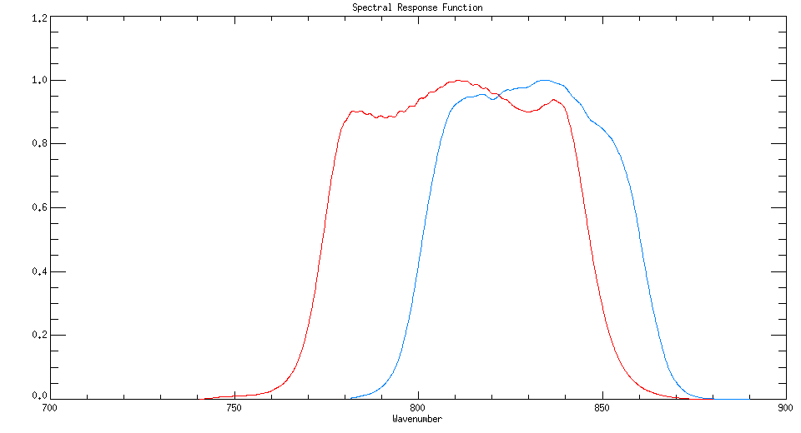
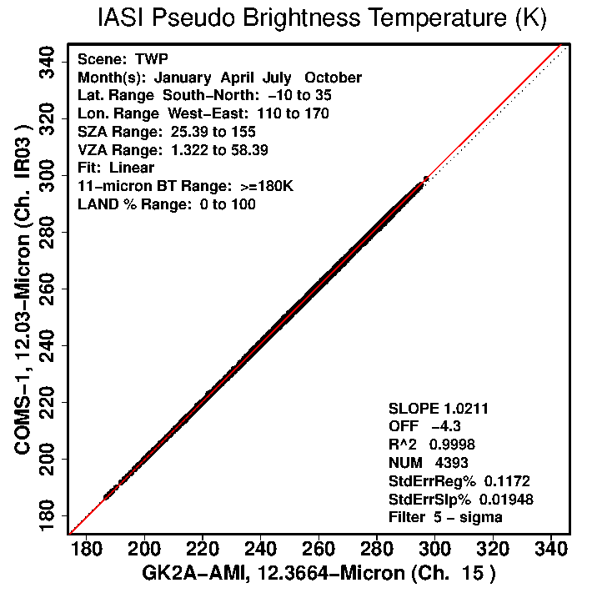
Methods (SRF and SBAF)
GK2A
COMS
IR10.5
IR10.8
IR11.2
NASA LaRC SBAF tool (https://satcorps.larc.nasa.gov/SBAF)
Scene | TWP
Longitude | 110°E ~ 170°E
Latitude | 10°S ~ 35°N
SZA | Defalt
VZA | Defalt
Fit | Linear
GK2A
COMS
IR12.3
IR12.0
Ch | Slope | Offset
IR10.5 | 1.0060 | -2.75
IR12.3 | 1.0211 | -4.3
5/14
Notes:
next slide is the information of SRF and SBAF.
SBAF was calculated using NASA LaRC(Langley research center) SBAF tool.

Slide 8
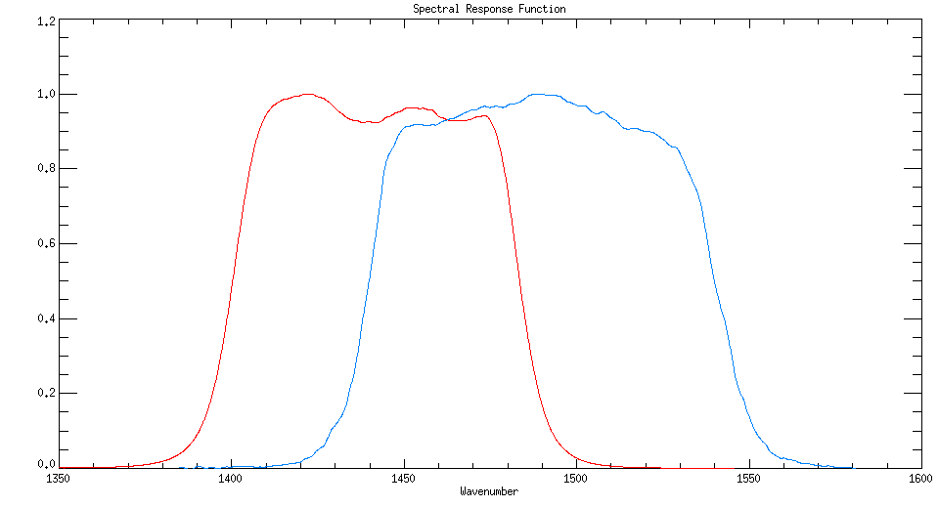
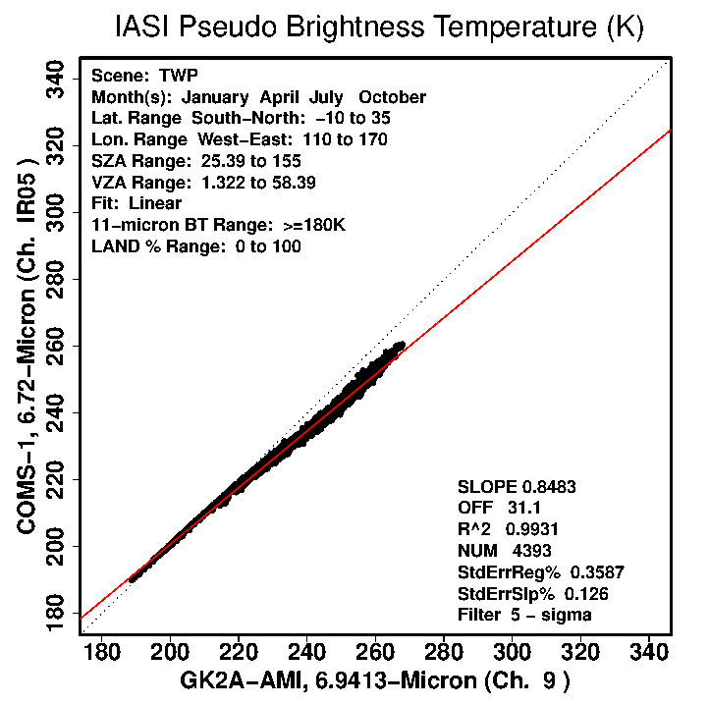
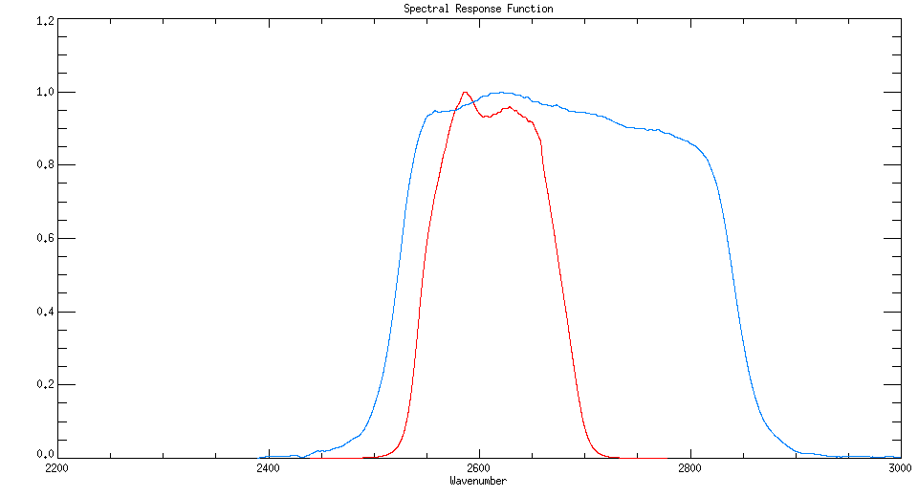
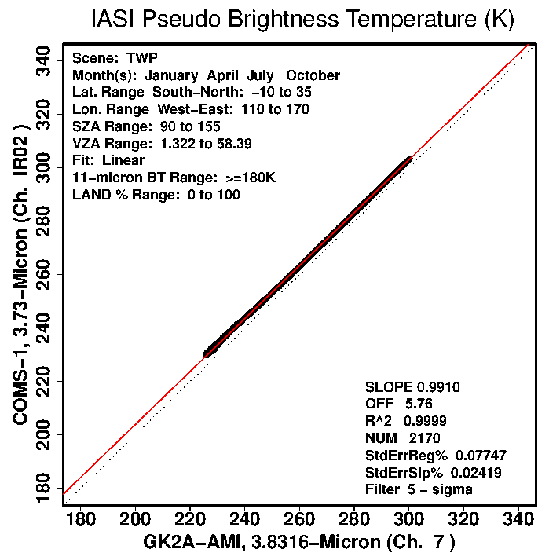
Methods (SRF and SBAF)
GK2A
COMS
WV6.9
WV6.75
NASA LaRC SBAF tool
Scene | TWP
Longitude | 110°E ~ 170°E
Latitude | 10°S ~ 35°N
SZA | Defalt / 90 ~ 155 (SW3.8)
VZA | Defalt
Fit | Linear
SW3.8
SW3.75
Ch | Slope | Offset
WV6.9 | 0.8483 | 31.1
SW3.8 | 0.9910 | 5.76
6/14
Notes:
(For the SW channel, the zenith angle was adjusted to consider only the night time.)

Slide 9
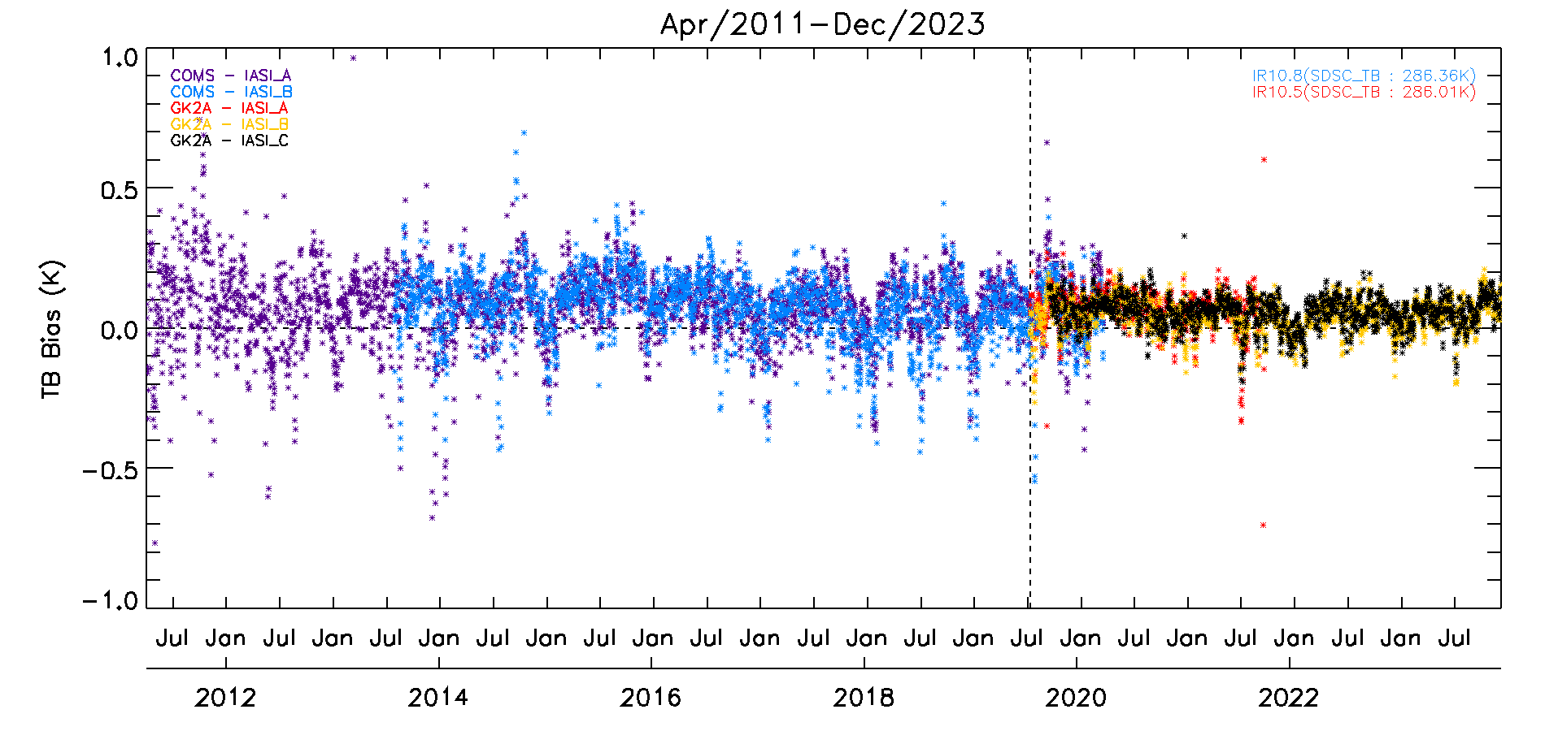
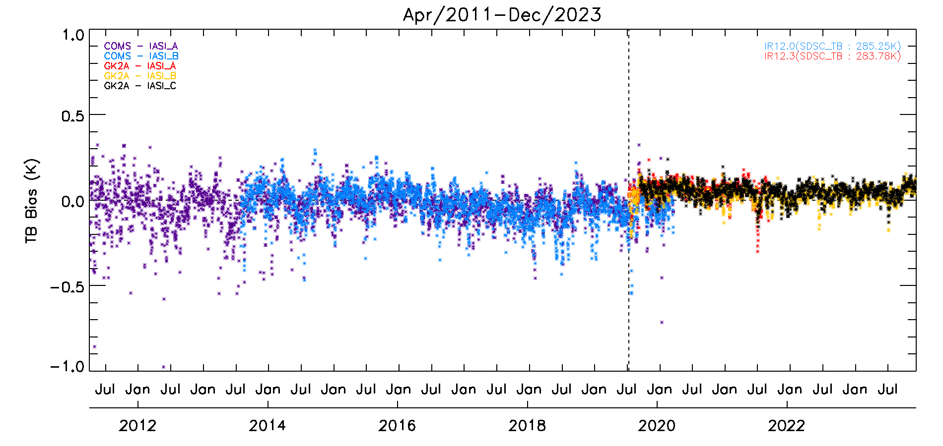
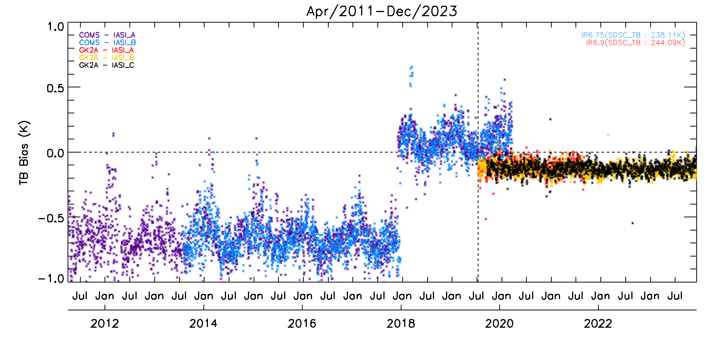
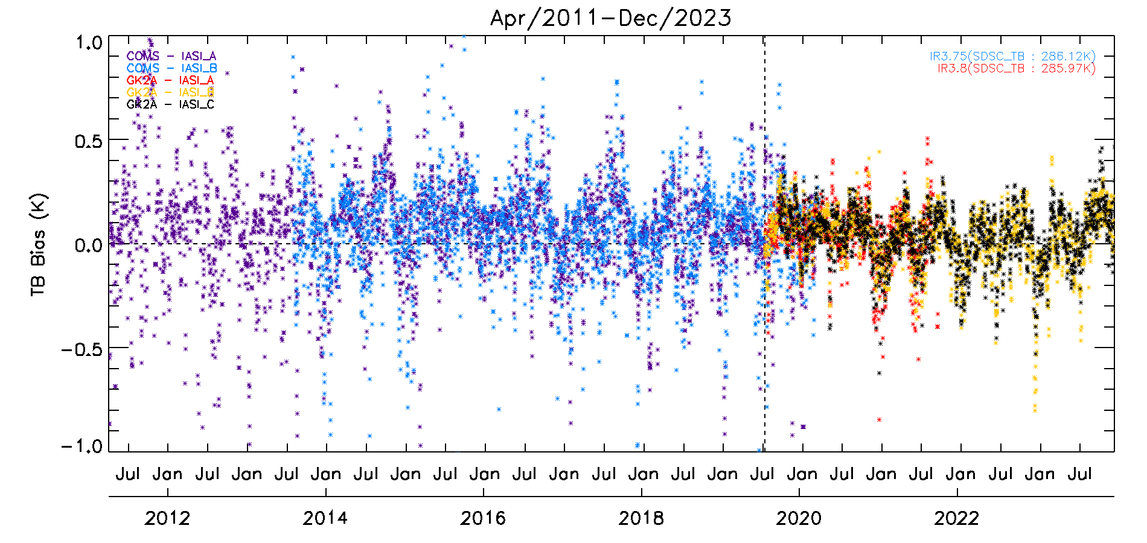
Results (TB bias (GEO TB - LEO TB) @ standard scene TB)
Before
Prime correction
1.0
IR12.3
IR10.5
0.5
-0.5
COMS
GK2A
-1.0
WV6.9
SW3.8
SRF shift
The averaged TB bias of COMS and GK2A is 0.08K, 0.04K for IR10.5, -0.03K, 0.04K for IR12.3, -0.65K/0.09K(before/after shift), -0.12K for WV6.9 and 0.05K, 0.03K for SW3.8, respectively.
7/14
Notes:
I would like to show the results of reprocessing through several types of plots.
One is TB bias at standard scene TB, and the other is time series of mean TB in the domain.
First, this plot is before prime correction results, the bias appears for each channel, and even jumps appear in some channels.
The averaged TB bias of COMS and GK2A is 0.08K, 0.04K for IR10.5, -0.03K, 0.04K for IR12.3, -0.65K and 0.09K for before and after SRF shift, -0.12K for WV6.9 and 0.05K, 0.03K for SW3.8, respectively.

Slide 10
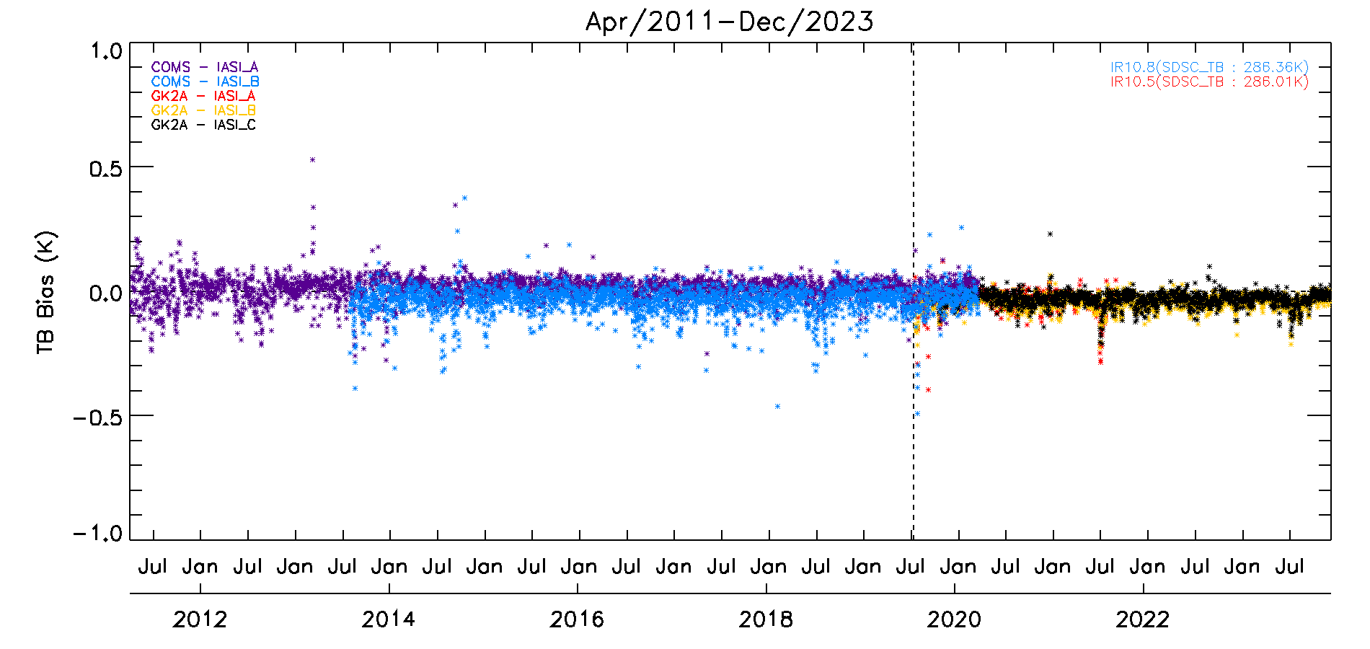
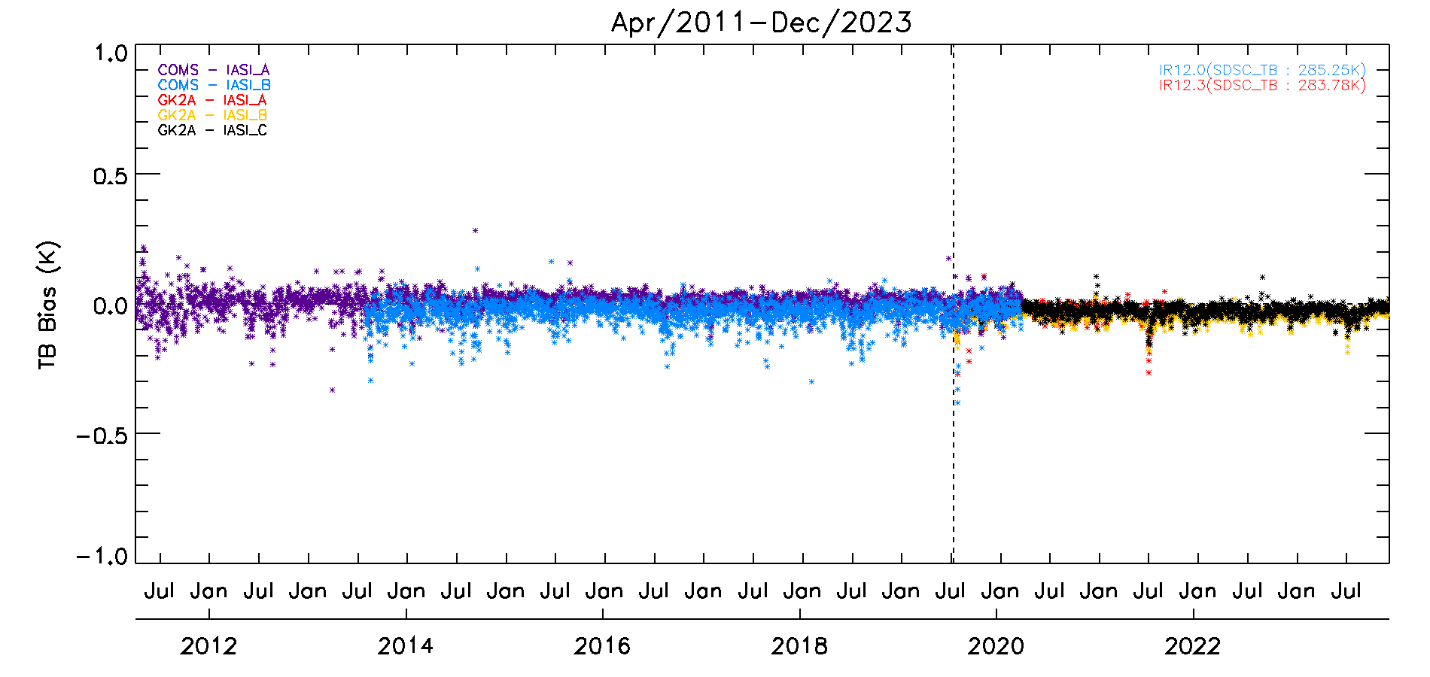
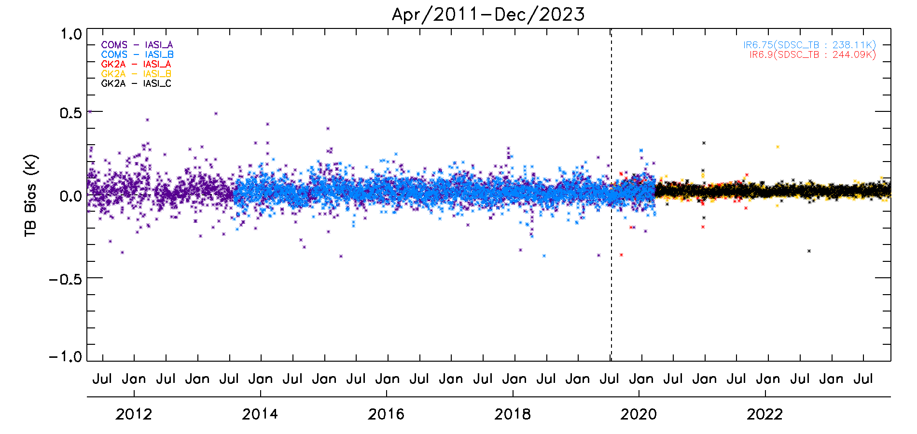
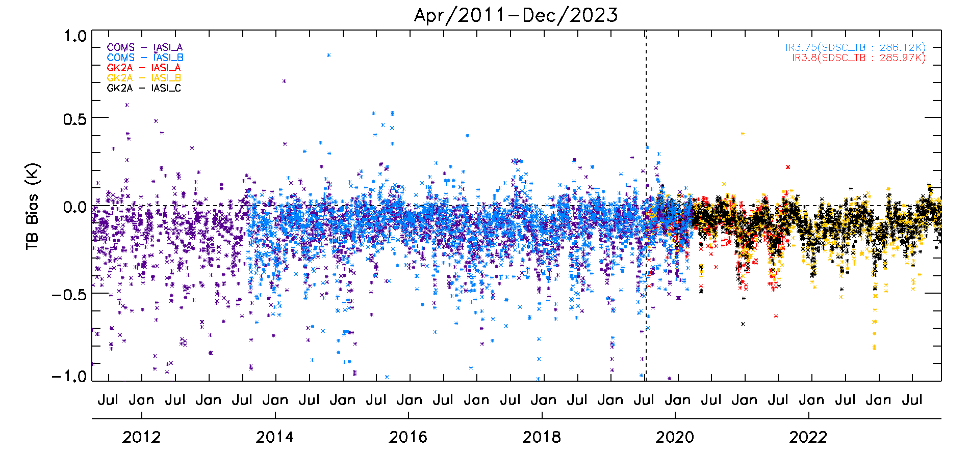
Results (TB bias (Corrected GEO TB - LEO TB) @ standard scene TB)
After
Prime correction
1.0
IR10.5
IR12.3
0.5
-0.5
COMS
GK2A
-1.0
WV6.9
SW3.8
After prime correction, each bias is stable and consistent, with 0.03~0.04K for IR10.5, 0.03K for IR12.3 and 0.02K for WV6.9
SW channel seems to be consistent; however, it has a negative bias of -0.12K
8/14
Notes:
After prime correction, each bias is stable and consistent, with 0.03~0.04K for IR10.5, 0.03K for IR12.3 and 0.02K for WV6.9
SW channel seems to be consistent; however, it has a negative bias of -0.12K

Slide 11
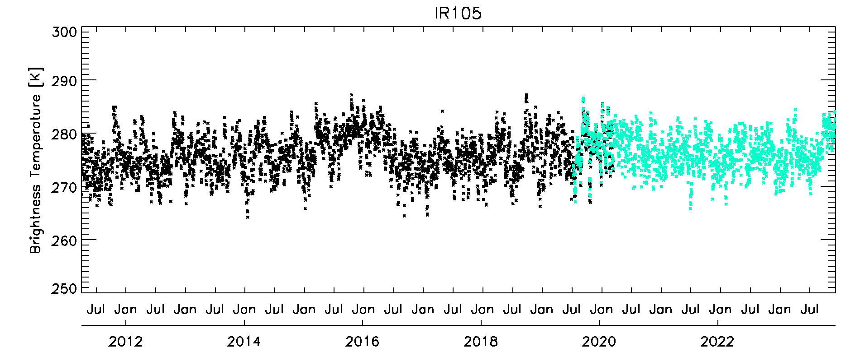
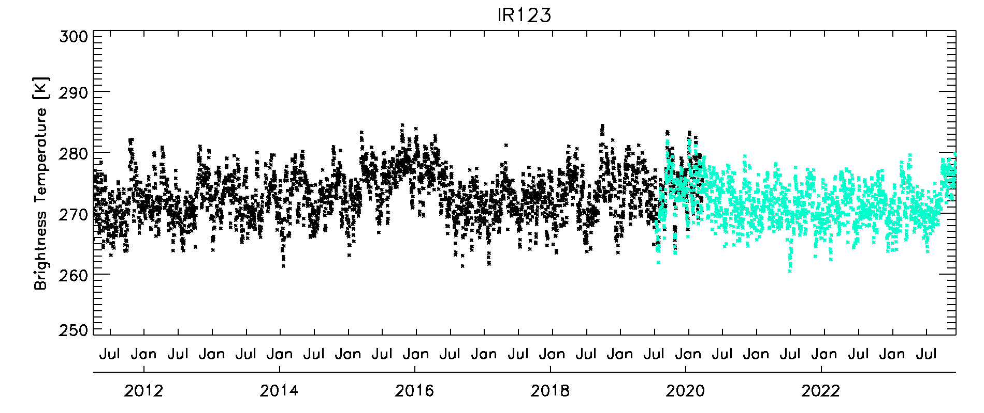
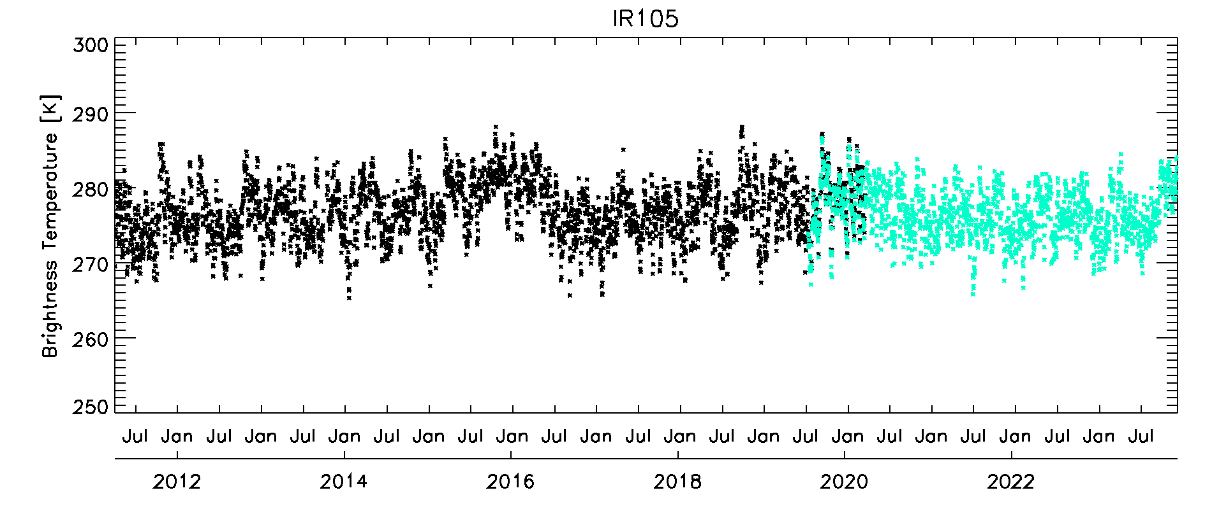
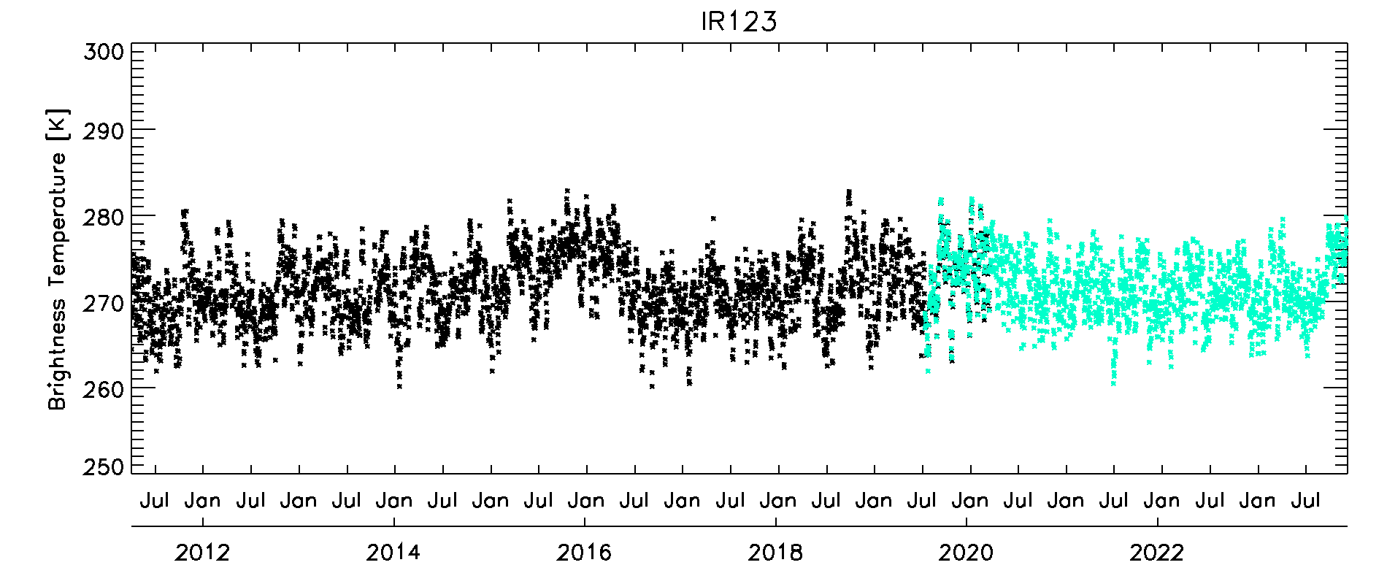
Results (Time series of mean TB in domain)
Original TB
IR105
IR123
COMS
GK2A
Recalibrated TB
(Applying SBAFs)
well consistency
in the window channel
9/14
Notes:
this plot is the time series of mean tb in domain.
The top represents the original TB, and the bottom is the re-calibrated TB.
As seen in this slide, the window channels show consistency both before and after recalibration.

Slide 12
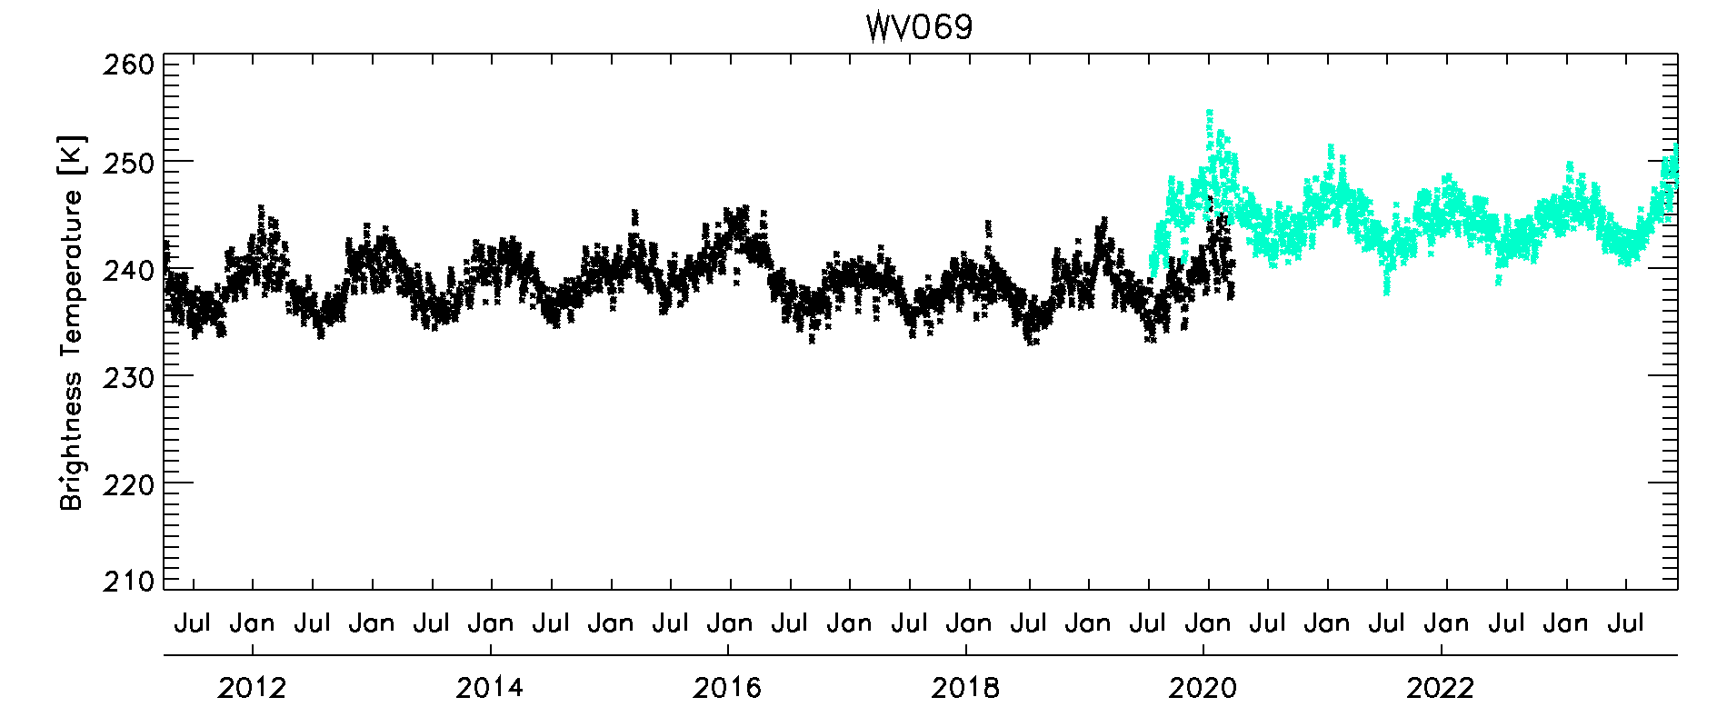
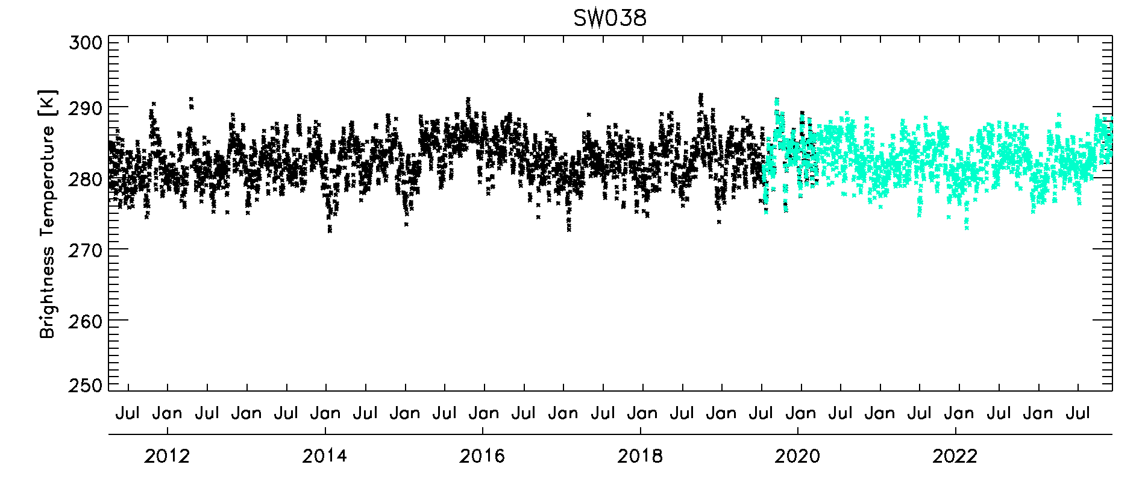
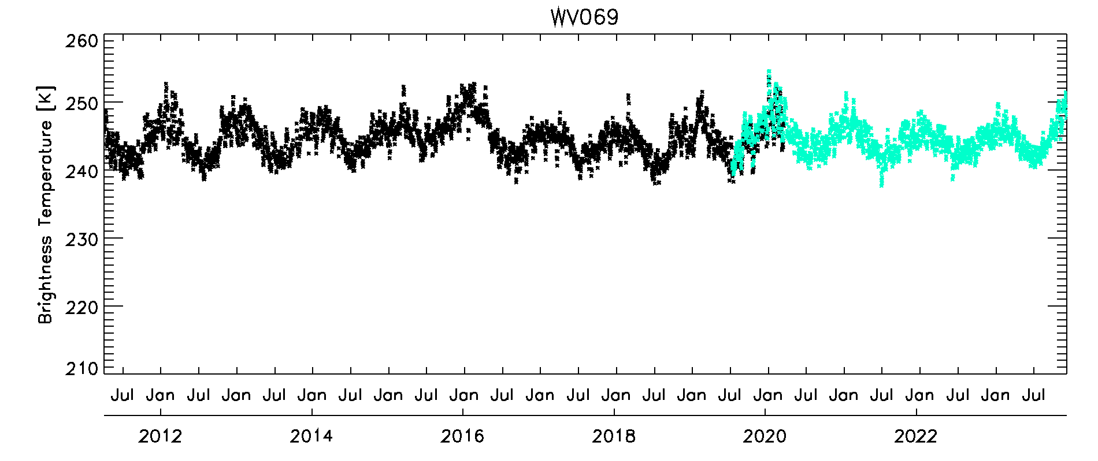
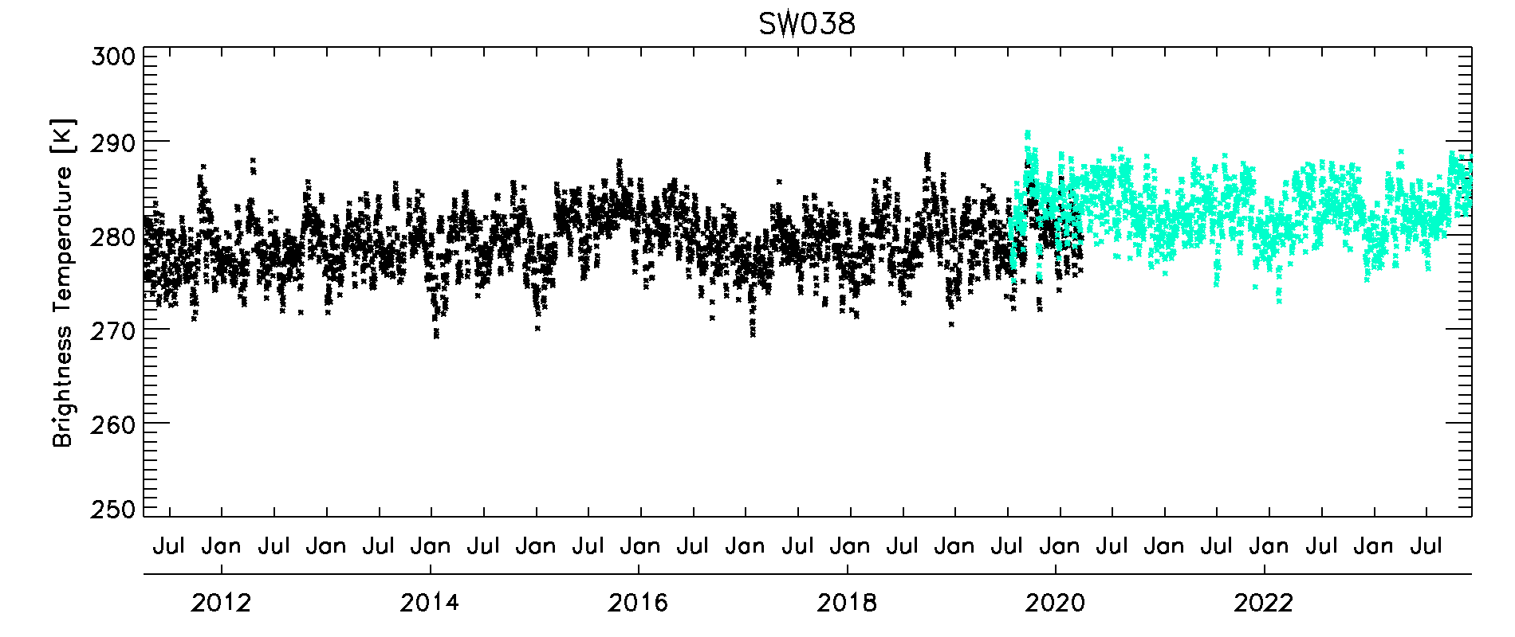
Results (Time series of mean TB in domain)
Original TB
WV069
SW038
COMS
GK2A
Recalibrated TB
(Applying SBAFs)
Reduce
sensor-to-sensor jump
Appeared
sensor-to-sensor jump???
10/14
Notes:
On the other hand, there is something significant about the WV and SW channel.
In the WV channel, you can see that the jump that appeared in the original TB, disappeared in the recalibrated TB.
However, In the SW channel, a jump appeared in the recalibrated TB.

Slide 13
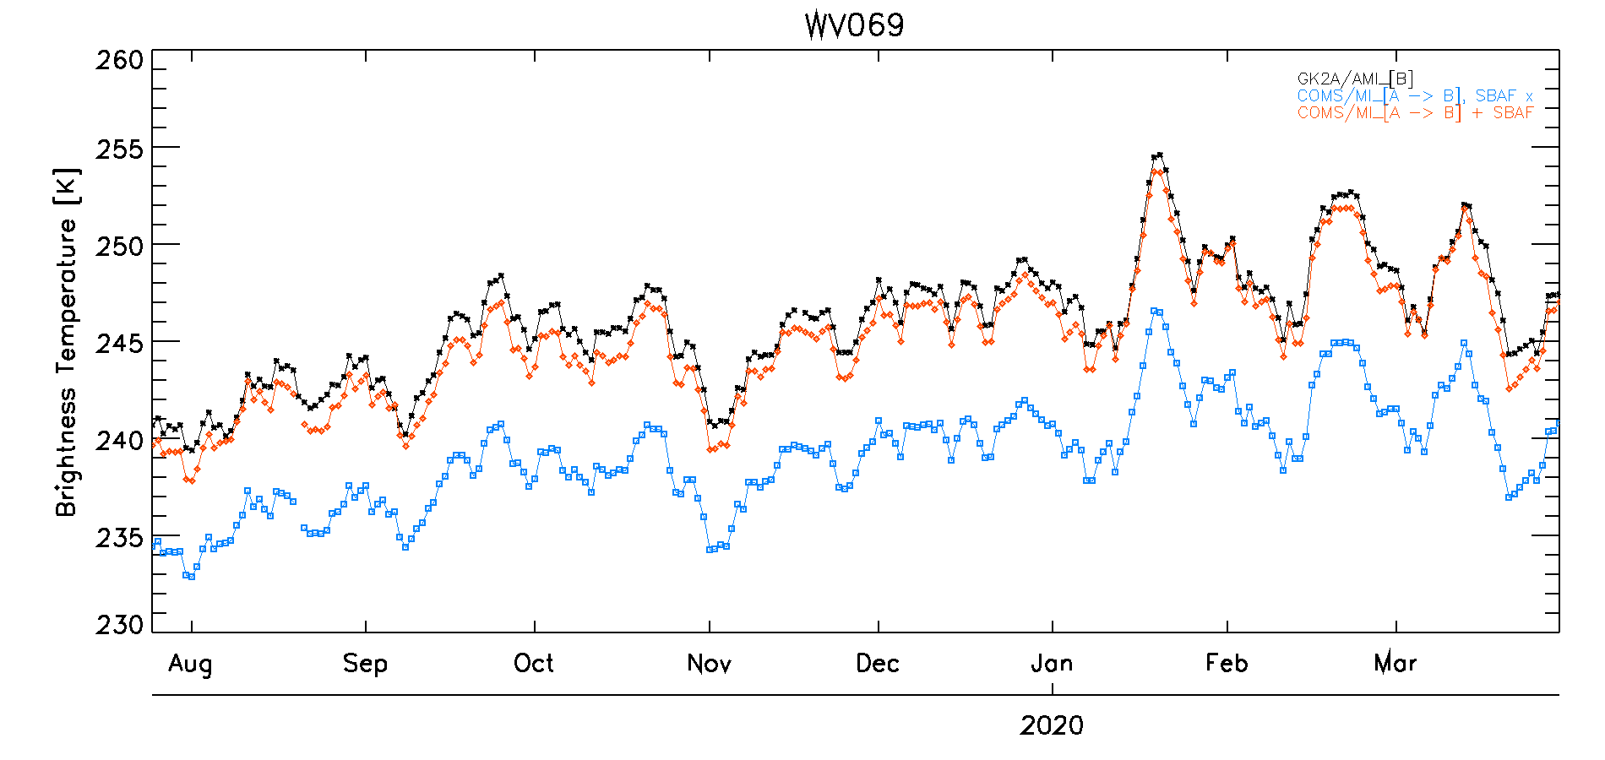
Results (Before & After applying SBAFs (recalibrated data))
COMS+SBAFs and GK2A well consistent, as expected
Applying SBAFs, mean bias of MI/AMI decreases from 0.44K to -0.37K (IR10.5), -1.37K to 0.07K (IR12.3) and 7.03K to 1.03K (WV6.9)
11/14
Notes:
To quantity this, i compared the recalibrated COMS and recalibrated GK2A data in the overlapping period.
The black dot means GK2A, the blue dot is COMS without SBAF, and the red dot is COMS with SBAF.
The figure below shows bias between AMI and MI, the blue dots indicating without SBAF and the red dots is with SBAF.
Applying SBAFs, mean bias of MI/AMI decreases from 0.44K to -0.37K for IR10.5, -1.37K to 0.07K (IR12.3) and 7.03K to 1.03K (WV6.9)

Slide 14
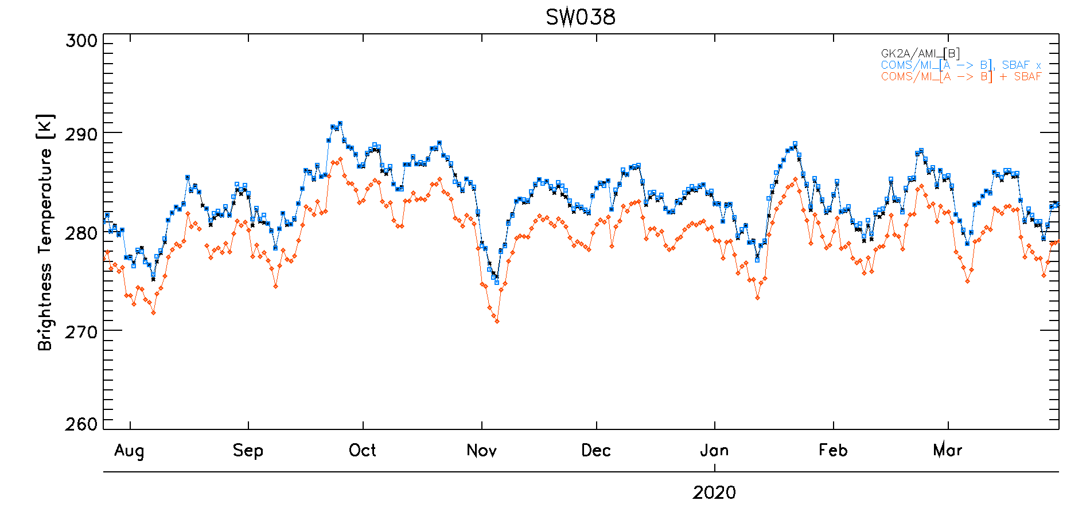
Results (Before & After applying SBAFs (recalibrated data))
???
Conversely, SW channel increases from -0.15K to 3.1K
12/14

Slide 15
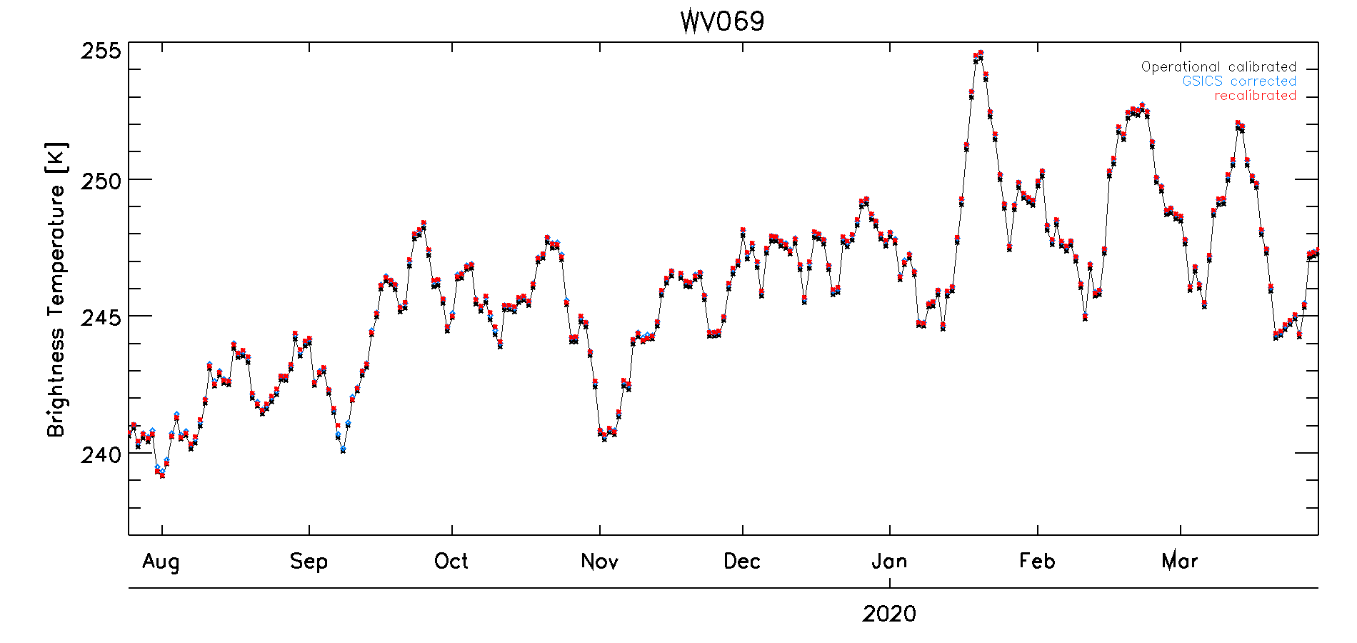
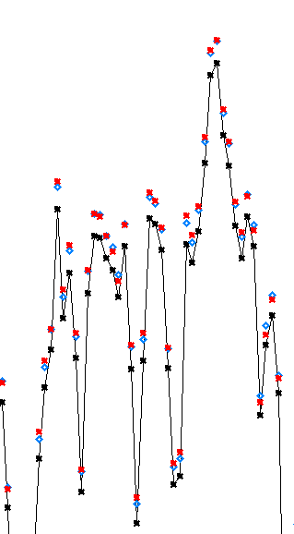
Results (GSICS correction VS recalibrated correction)
(10°S ~ 35°N) x (110°E ~ 170°E) Domain, mean TB @ 12UTC (21KST)
It shows the similarity between the GSICS corrected and recalibrated radiances
IR10.5, IR12.3 and SW also show the same result.
13/14
Notes:
and I also comfirmed the similarity between the GSICS corrected radiances and recalibrated radiances.

Slide 16
Summary
To Calculate recalibration coefficients for COMS and GK2A.
The MSICC(Multi-Sensor IR Channel Calibration) algorithm was applied.
Obtain collocation data for both COMS and GK2A using the common GSICS IR methods.
Re-calibration results show stability and consistency.
Standard scene bias decreases from 0.04K ~ 0.09K to 0.02K ~ 0.04K.
Mean bias of MI/AMI decreases from 0.44K ~ 7.03K to 0.07K ~ 1.03K.
However, SWIR channel shows an unexpected result.
(negative bias of -0.12K and increases mean bias from -0.15K to 3.1K)
There are similarity between the GSICS corrected radiances and the recalibrated radiances.
To provide recalibration coefficients on the KMA/NMSC website in 2024.
14/14
Notes:
I`d like to briefly summarize this presentation.
standard scene bias decrease from a range of 0.04K to 0.09K to a range of 0.02K to 0.04K

Slide 17
Thank you

