Slide 1
Merging of SSU Observations with Infrared Hyperspectral Sounding Measurements toward Extending Stratospheric Temperature Climate Data Records
Likun Wang^{1*} Xianjun Hao² Cheng-Zhi Zou³
Cooperative Institute for Satellite Earth System Studies (CISESS)/Earth System Science Interdisciplinary Center (ESSIC), University of Maryland, College Park, Maryland
George Mason University, Fairfax, Virginia
2. NOAA/NESDIS/Center for Satellite Applications and Research, College Park, Maryland
Email address: wlikun@umd.edu
Disclaimer: The presentation contents are solely the opinions of the authors and do not constitute a statement of policy, decision, or position on behalf of NOAA or the U. S. Government.

Slide 2
Content
NOAA long-term stratospheric temperature satellite observations
Reprocessing efforts for historic Stratospheric Sounding Unit Data
From SSU to AIRS/CrIS hyperspectral data series
  An approach to convert AIRS to equivalent SSU observations
Conclusion and future work

Slide 3
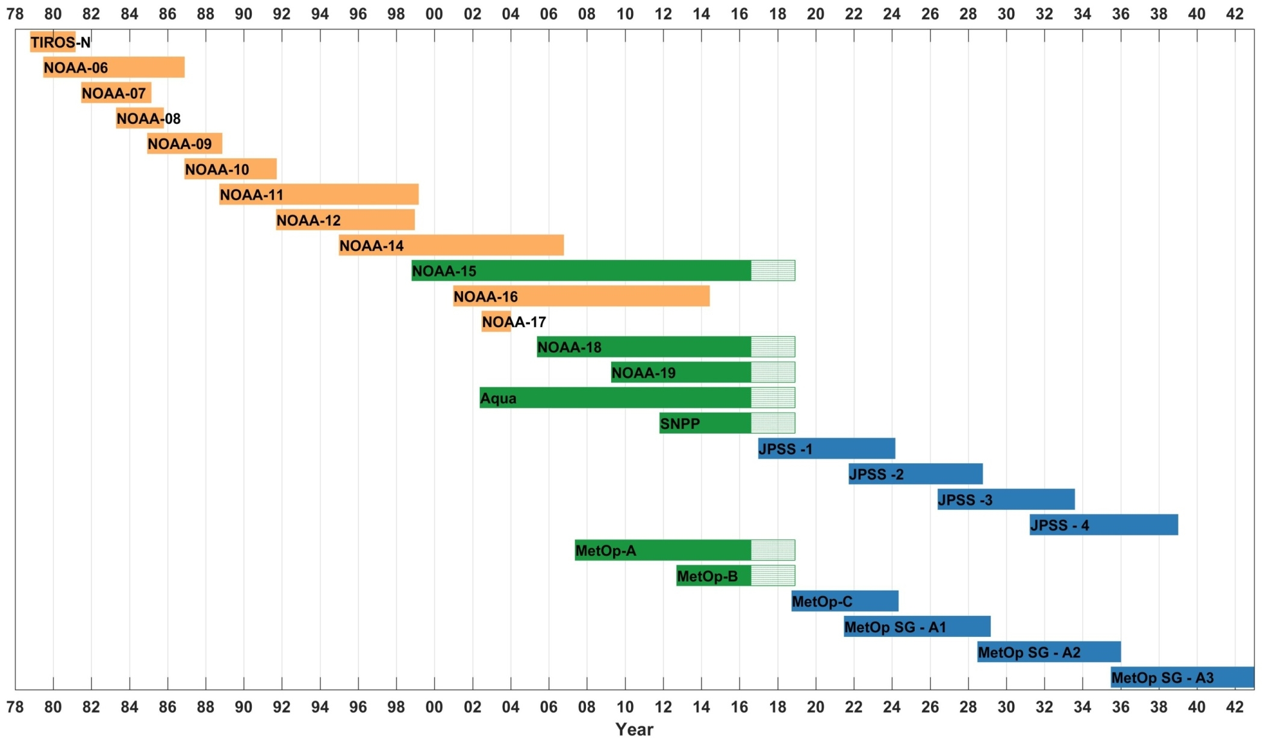
Satellite Series for SSU Related Observations
SSU and its successors are the only means available to provide stratospheric temperature observations with global coverage for long-term monitoring
NOAA satellites have been continuously observing stratosphere for over 40 years
JPSS Program carries the NOAA operational temperature sounding capability into the future
Inter-satellite calibration and satellite merging are needed to develop climate data record for long-term monitoring
Today
MSU
SSU
NOAA/NASA satellites
AMSU-A
AMSU-A
AIRS
ATMS
CrIS
AMSU-A
IASI
EUMETSAT Satellites
MWS
IASI-NG
Notes:
So here is a summary that needs to be deal with in the MSU/AMSU reprocessing. These issues include, but are not limited to, ……….
In this talk, I’ll be focusing on the intersatellite biases and warm target temperature contamination; but also touch a little bit on other problems.

Slide 4
SSU Instruments
One of the TOVS instruments (MSU, HIRS, SSU) onboard NOAA TIROS-N polar-orbiting satellite series from 1978-2006
Supplied by UK Met Office
Infrared radiometer using pressure modulation technique to measure atmospheric radiation from CO₂ 15-μm v₂ band
Three cells of CO₂ gas were placed in the optical path with different pressure which allowed three channels for a single CO₂ band
P(peak)~P(cell)/[CO₂]^{1/2},
SSU channel weighting functions determined by cell pressure values
SSU Channel | 1 | 2 | 3
Channel Peak (hPa) | 15.0 | 5.0 | 1.5

Slide 5
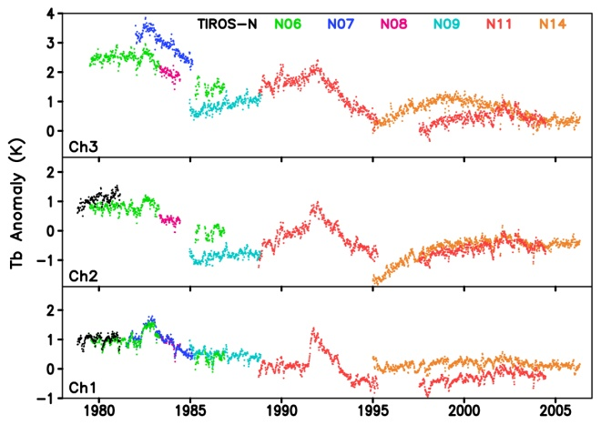
Issues in Raw SSU Dataset
  Insufficient documentation– lost or no record of many calibration parameters
  Bad data from bad calibration (NOAA-7 channel 2)
  Space view anomaly—directly affects level-1c radiances
  Gas leaking in the CO₂ cell→ weighting function variation
  atmospheric CO₂ variations
  limb-effect
  diurnal drift effect→ semi-diurnal tides in the stratosphere
  Residual biases
Global mean anomaly TB time series for each satellite
before adjustment and merging (raw data)
Notes:
SSU time series after removing seasonal cycle
1) Time series are not linked to each other due to the cell pressure problems

Slide 6
NOAA SSU Processing History
Raw SSU data and satellite orbital information were operationally processed at NOAA/NESDIS for each satellite along with other TOVS instruments and saved in operational level-1b files
Operational level-1b files were distributed to world-wide users and archived in NOAA/NCEI Comprehensive Large Array-data Stewardship System (CLASS) ; other centers may also have archives after receiving the data
SSU data were not used in NWP forecasting since NWP models were not high enough to assimilate SSU data in early days
UK Met Office conducted instrument testing and developed its version of SSU time series (Nash and Forrester 1986)
Technical notes available for NOAA operational processing and UKMO instrument testing, but information for instrument calibration was insufficient and sometimes even missing
NOAA/STAR began to develop SSU temperature time series using level-1c radiances derived from operational level-1b data in 2008
STAR released its first version of SSU time series in 2011 (Wang et al. 2012)
Thompson et al. (2012) demonstrated large SSU trend differences between STAR and Met Office versions and between climate model simulations and SSU observations and called for re-investigation of the SSU problems
The SPARC temperature trend group organized a meeting at London in 2013 with participation from both NOAA and Met Office SSU groups to discuss technical issues in SSU processing
STAR recalibrated the SSU raw data using improved information and developed SSU FCDR and Version 2 SSU temperature time series in 2014 (Zou et al. 2014)
STAR merged the SSU V2 data with AMSU-A observations and extended the SSU data to present (Zou and Qian 2016). This version is still being used by the climate community for climate change investigation in the stratosphere
Notes:
In this talk, I’ll be focusing on the intersatellite biases and warm target temperature contamination; but also touch a little bit on other problems.

Slide 7
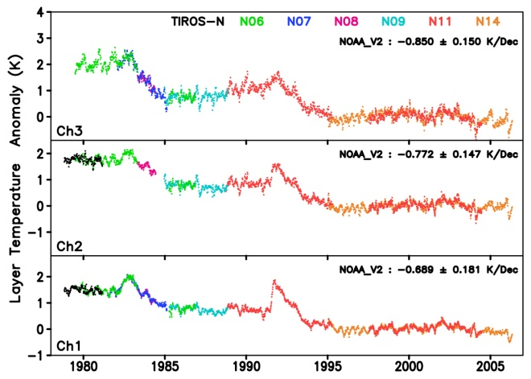
NOAA Version 2.0 SSU Time Series
Before Adjustment and Merging After Adjustment and Merging
Recalibration successfully rehabilitated the SSU data record, making the inconsistent raw SSU time series
with large time-varying biases between satellites before correction (left) to a consistent, well-intercalibrated
and -merged satellite time series suitable for climate change studies after correction (right).
Notes:
In this talk, I’ll be focusing on the intersatellite biases and warm target temperature contamination; but also touch a little bit on other problems.

Slide 8
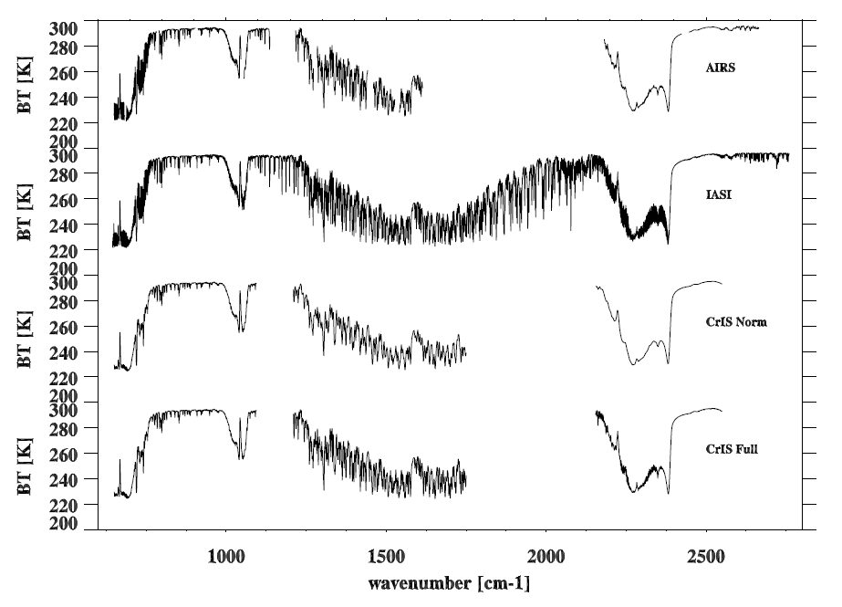
Hyperspectral Instruments: AIRS/IASI/CrIS
AIRS the is key to bridge SSU between JPSS/CrIS
AIRS: 2002-
2378 channels, 9 FOVs/50 km FOR
IASI-A: 2006-
Owing to their hyperspectral nature and accurate radiometric and spectral calibration, AIRS/CrIS/IASI have several longwave and shortwave channels providing 3D measurements of stratospheric temperature with high data quality.
8461 channels, 4 FOVs/50 km FOR
CrIS: 2011-
1305 channels, 9 FOVs/50 km FOR
CrIS: 2014.10-
2211 channels, 9 FOVs/50 km FOR

Slide 9
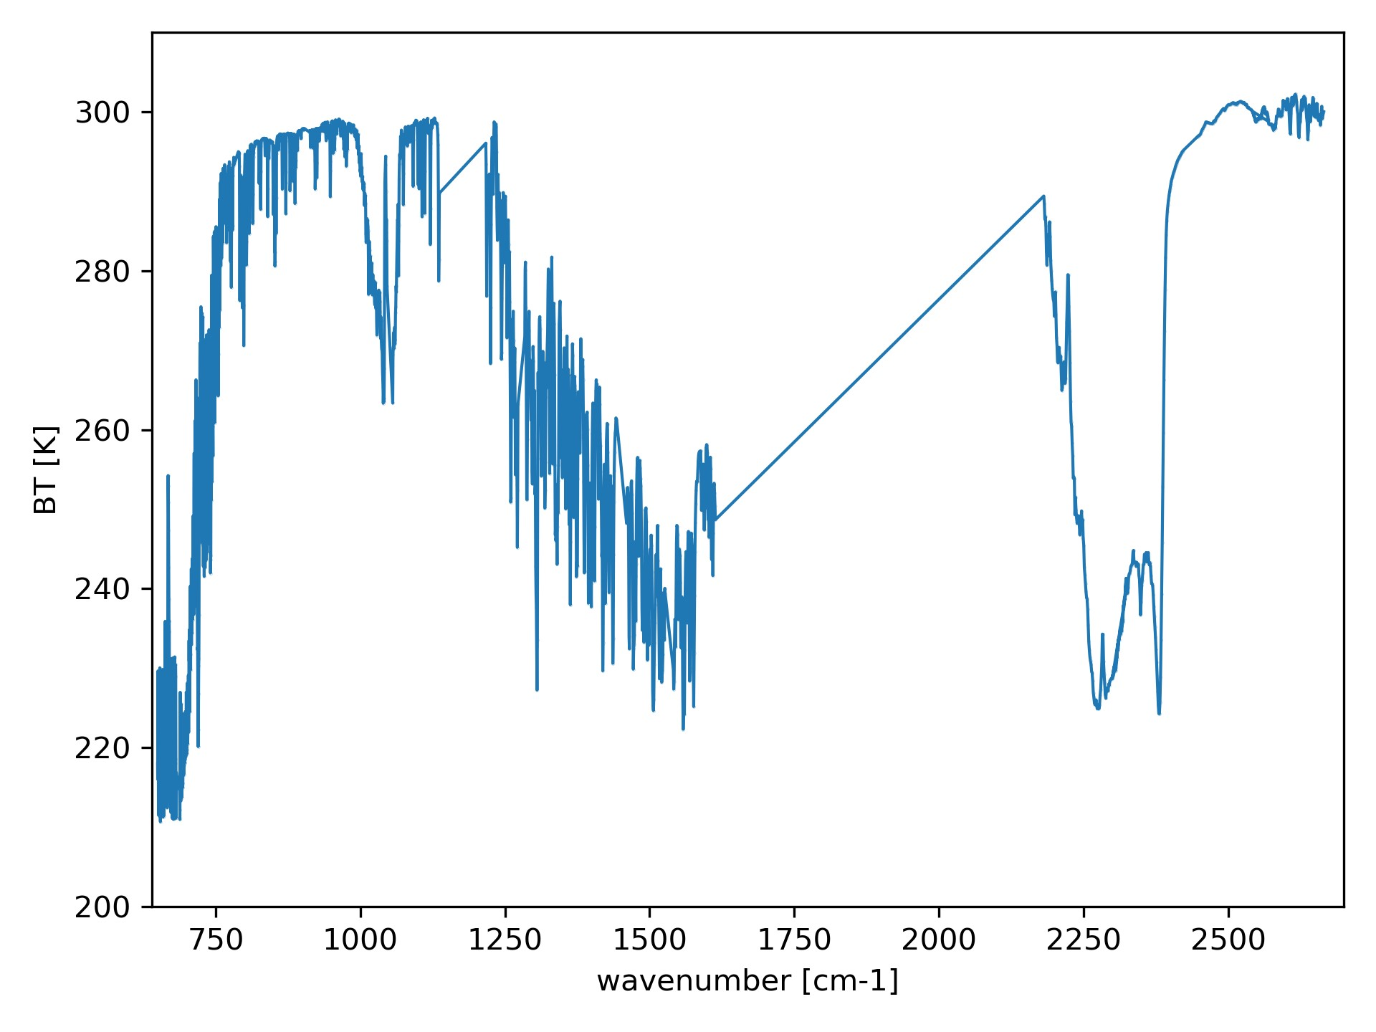
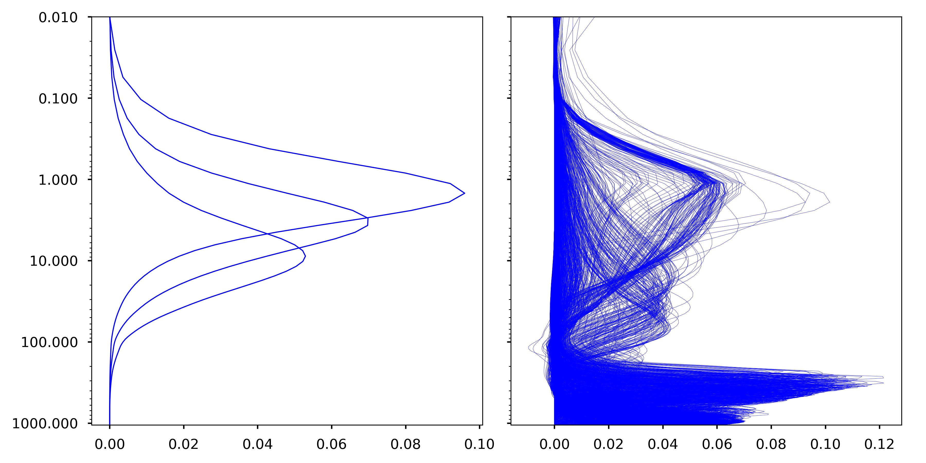
From AIRS to equivalent SSU
AIRS overlapped with SSU during 2002-2006
AIRS/CrIS have enough channels to cover the three SSU channels
Plan to generate equivariant SSU channels from multiple AIRS/CrIS channels
Merge the equivalent SSU channels with the original SSU channels
AIRS Spectrum
SSU Kernels
AIRS Kernels
SSU Ch3
SSU Ch2
SSU Ch1

Slide 10
Problem Definition and Challenges
Linear Regression: select several AIRS channels and use linear regression to combine these channels into SSU
Training Datasets for Regression: wide variability but not redundant
Constrains
  Representativeness: Using weight function as constrains
  Noise:
    Cannot choose too many channels (10-13)
    The coefficients for each channels is less than 0.5
AIRS data
  Level 1B: very noisy but has RTM support
  Level 1C: reconstructed from level 1B but with new spectral grids
  Using Level1C data but choose the spectral channels that both level1C and level1B have common spectral grid
  Longwave channels with high priority

Slide 11

Regression Problems with Constraints
For SSU BT at each channel:
X: AIRS channel BT (LW+SW)
y: SSU channel BT
β: weights for each channels, sum(β_{i}) = 1
For each β_{i,} less than 0.5
$y=\sum_{i}{β_{i}X_{i}}$
The goal is to find an assignment β to that minimizes the cost function:
$$f(β)={\left\|X β −Y\right\|}_{2}^{2}+ λ{\left\|W^{x} β −W^{y}\right\|}_{2}^{2}$$
X: Training Dataset from AIRS selected channels , Y: Training Dataset of SSU BT
W^{x}: Weighting function of AIRS selected channels, W^{y}: Weighting function of SSU
λ: a hyperparameter that controls the balance between BT and weighting function fitting
The problem is solved using CVXPY, a domain-specific language for convex optimization embedded in Python Citing CVXPY — CVXPY 1.3 documentation
Steven Diamond and Stephen Boyd. 2016. CVXPY: a python-embedded modeling language for convex optimization. J. Mach. Learn. Res. 17, 1 (January 2016), 2909–2913. https://doi.org/10.48550/arXiv.1603.00943
Goldberg, M. D., and H. E. Fleming, 1995: An Algorithm to Generate Deep-Layer Temperatures from Microwave Satellite Observations for the Purpose of Monitoring Climate Change. J. Climate, 8, 993–1004, https://doi.org/10.1175/1520-0442(1995)008<0993:AATGDL>2.0.CO;2.

Slide 12
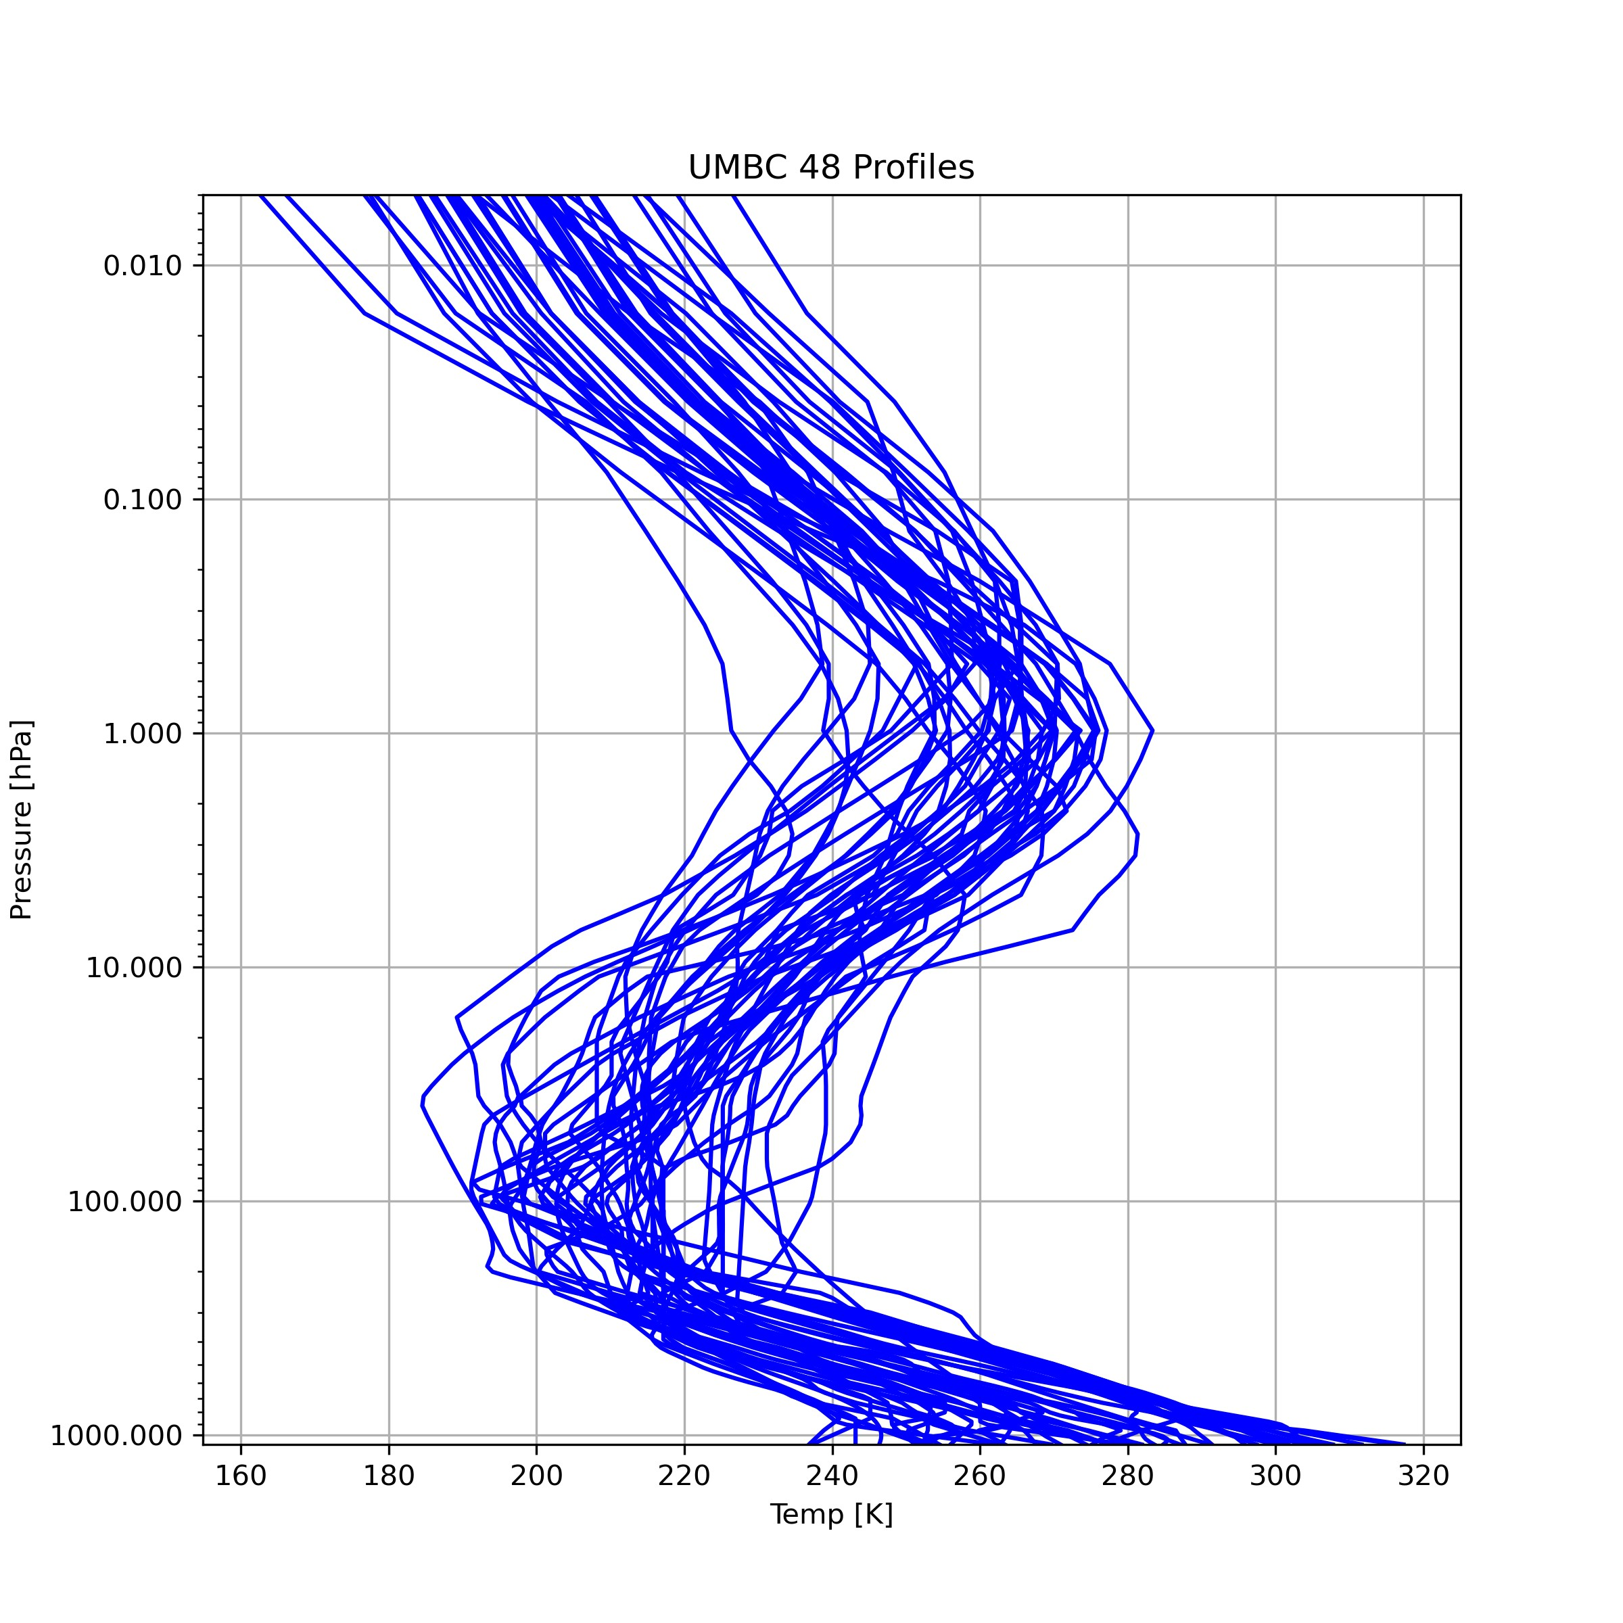
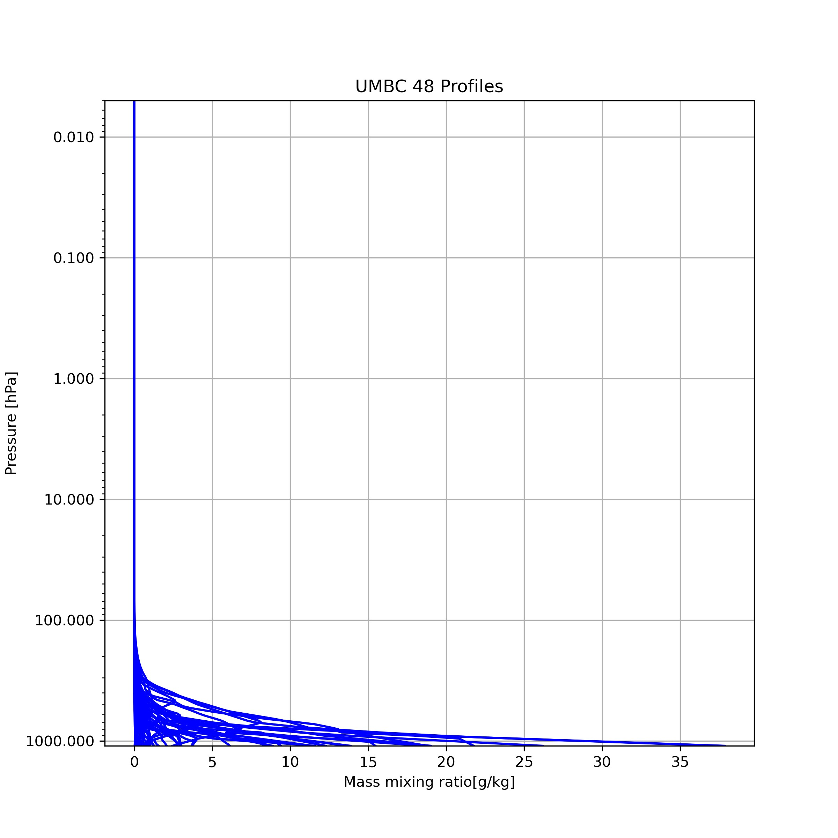
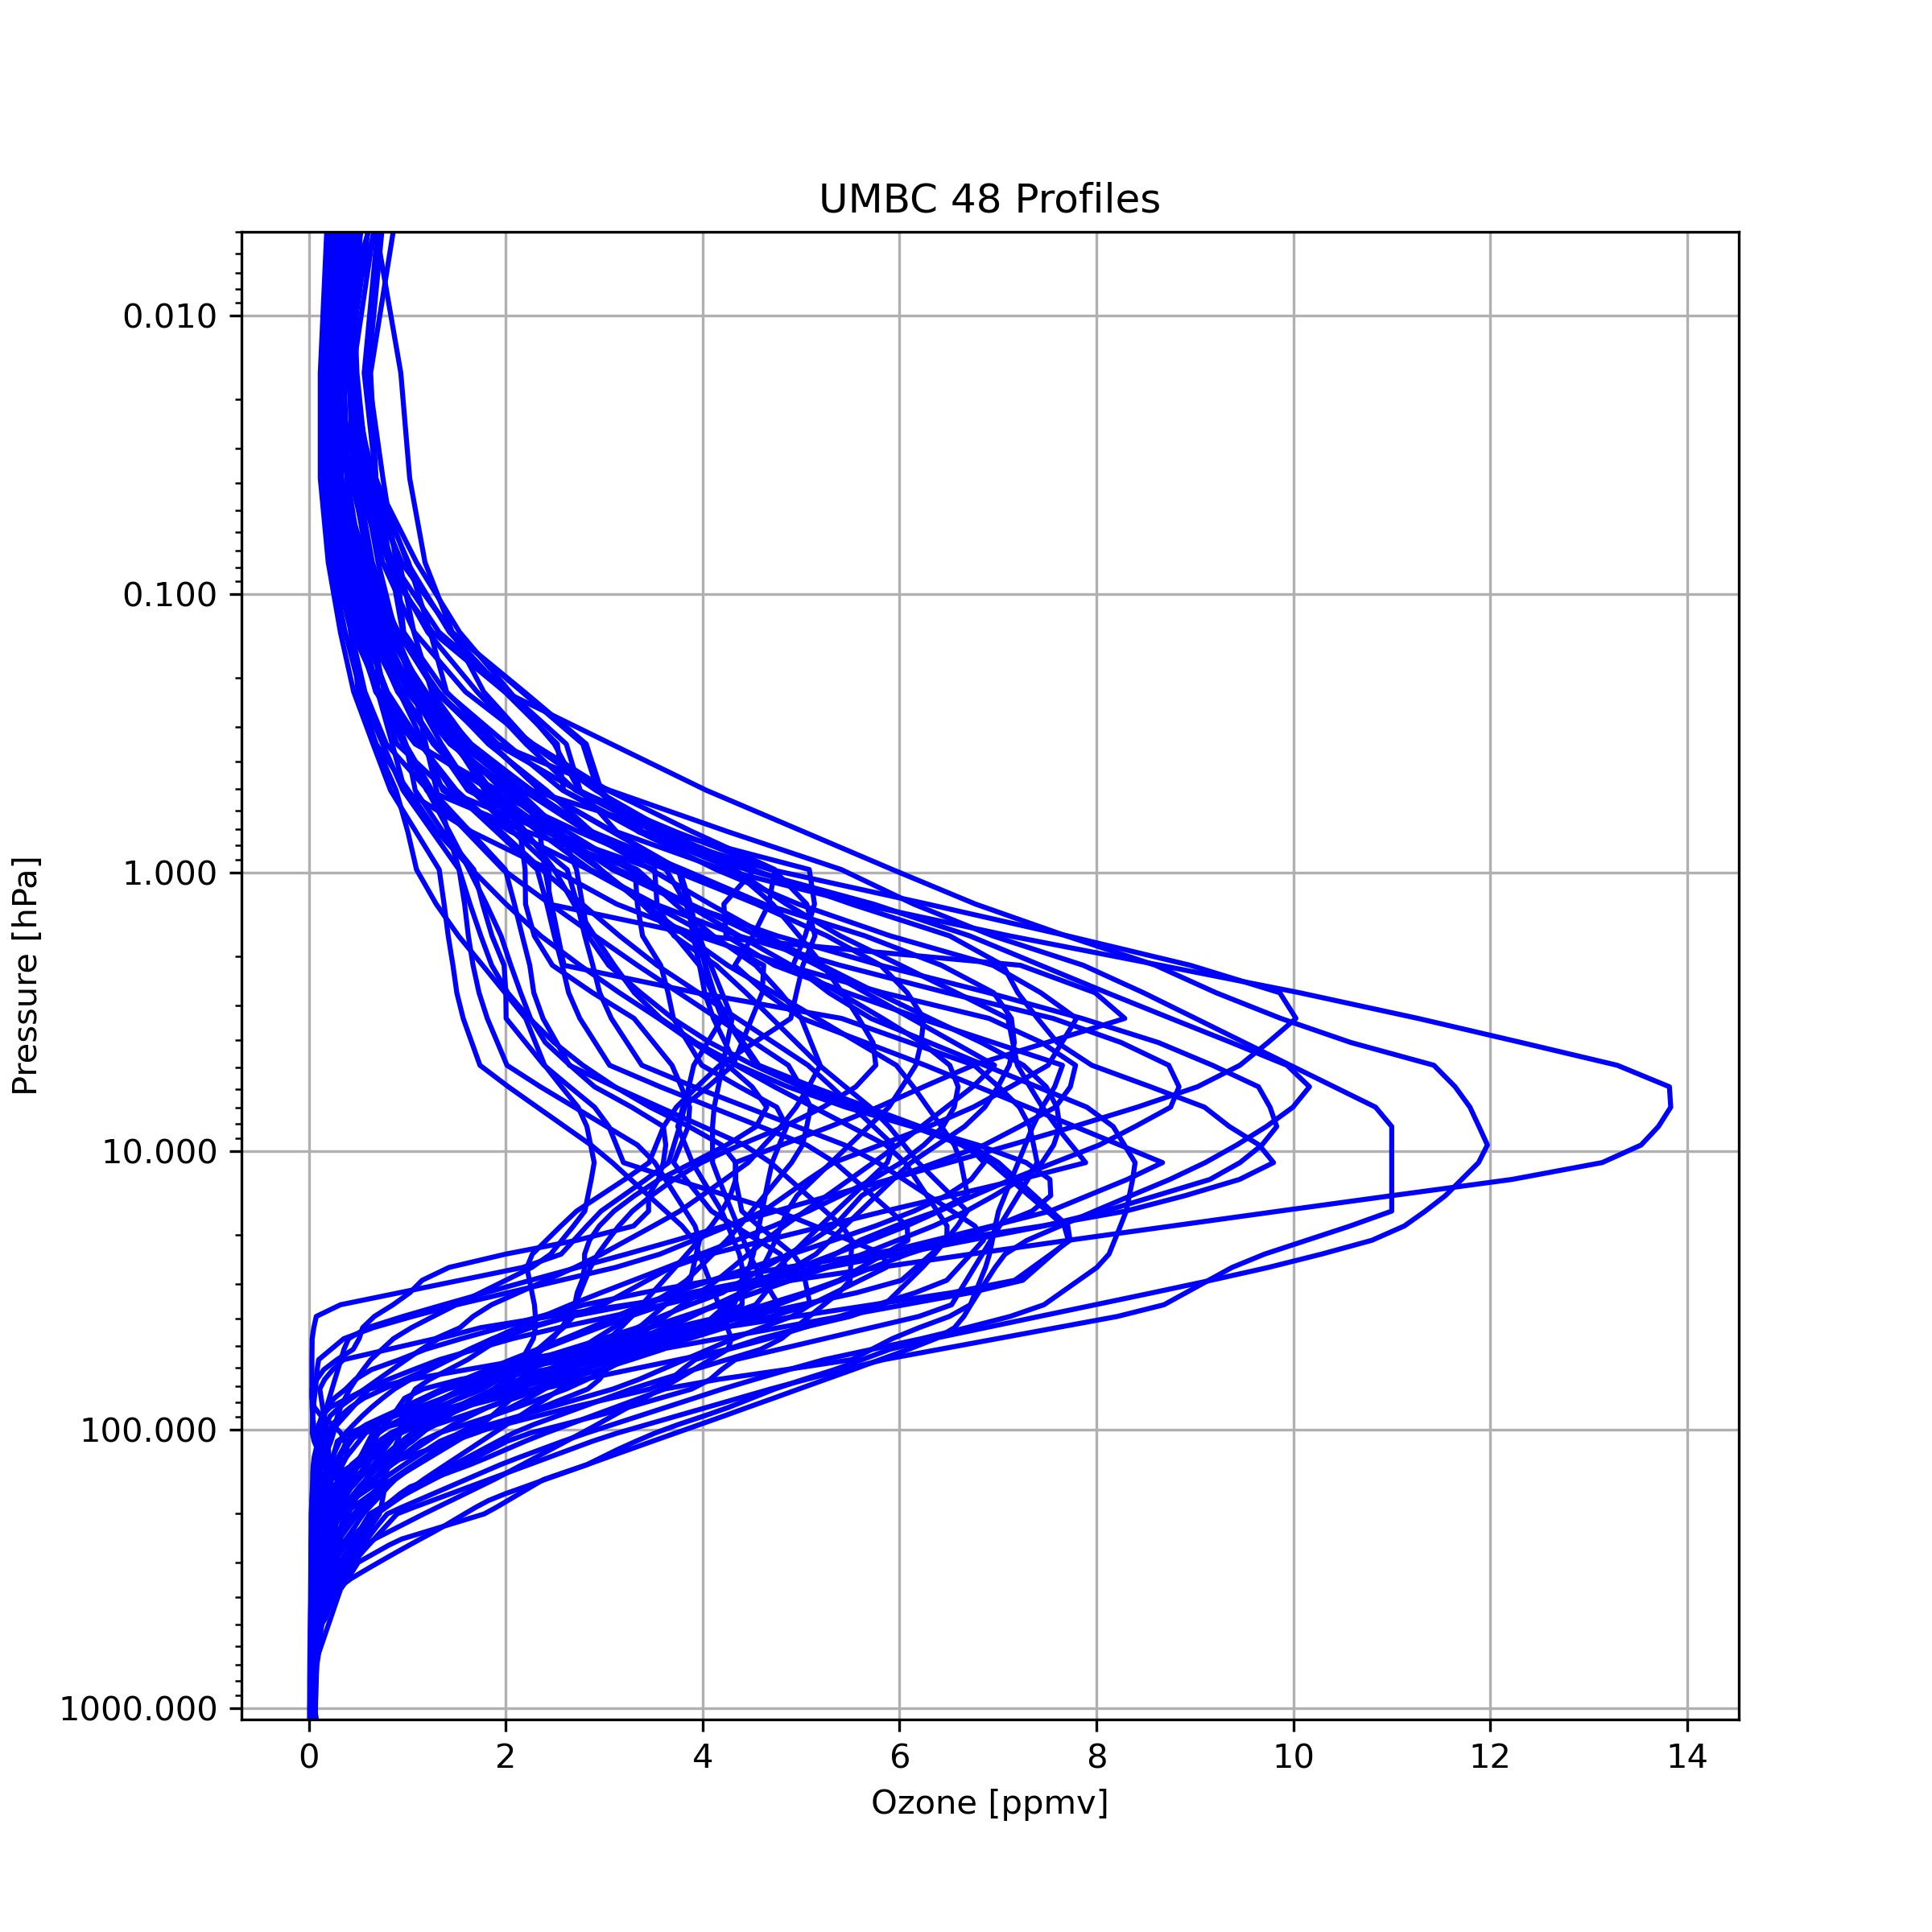
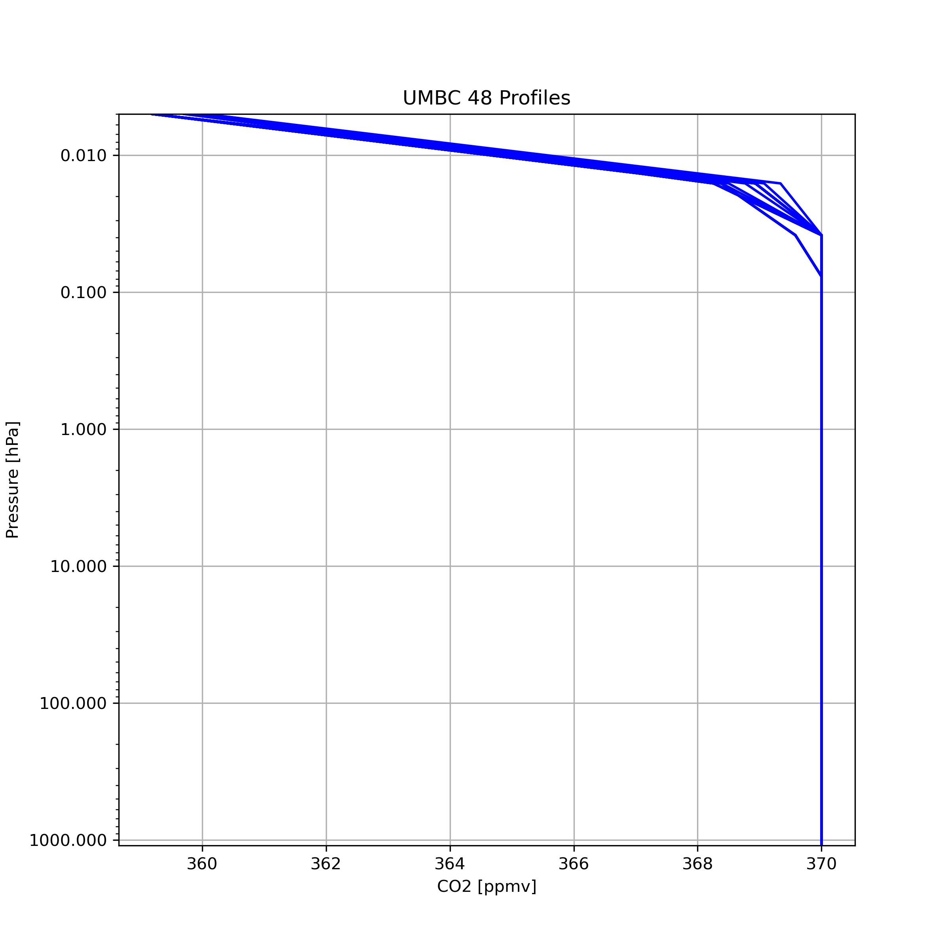
UMBC 48 Atmospheric Profiles
Temperature
Water Vapor
Ozone
CO2
UMBC 48 profiles, which contain typical atmospheric profiles in different location and season, are used for CRTM.
We uses them to simulate both AIRS and SSU observations.

Slide 13
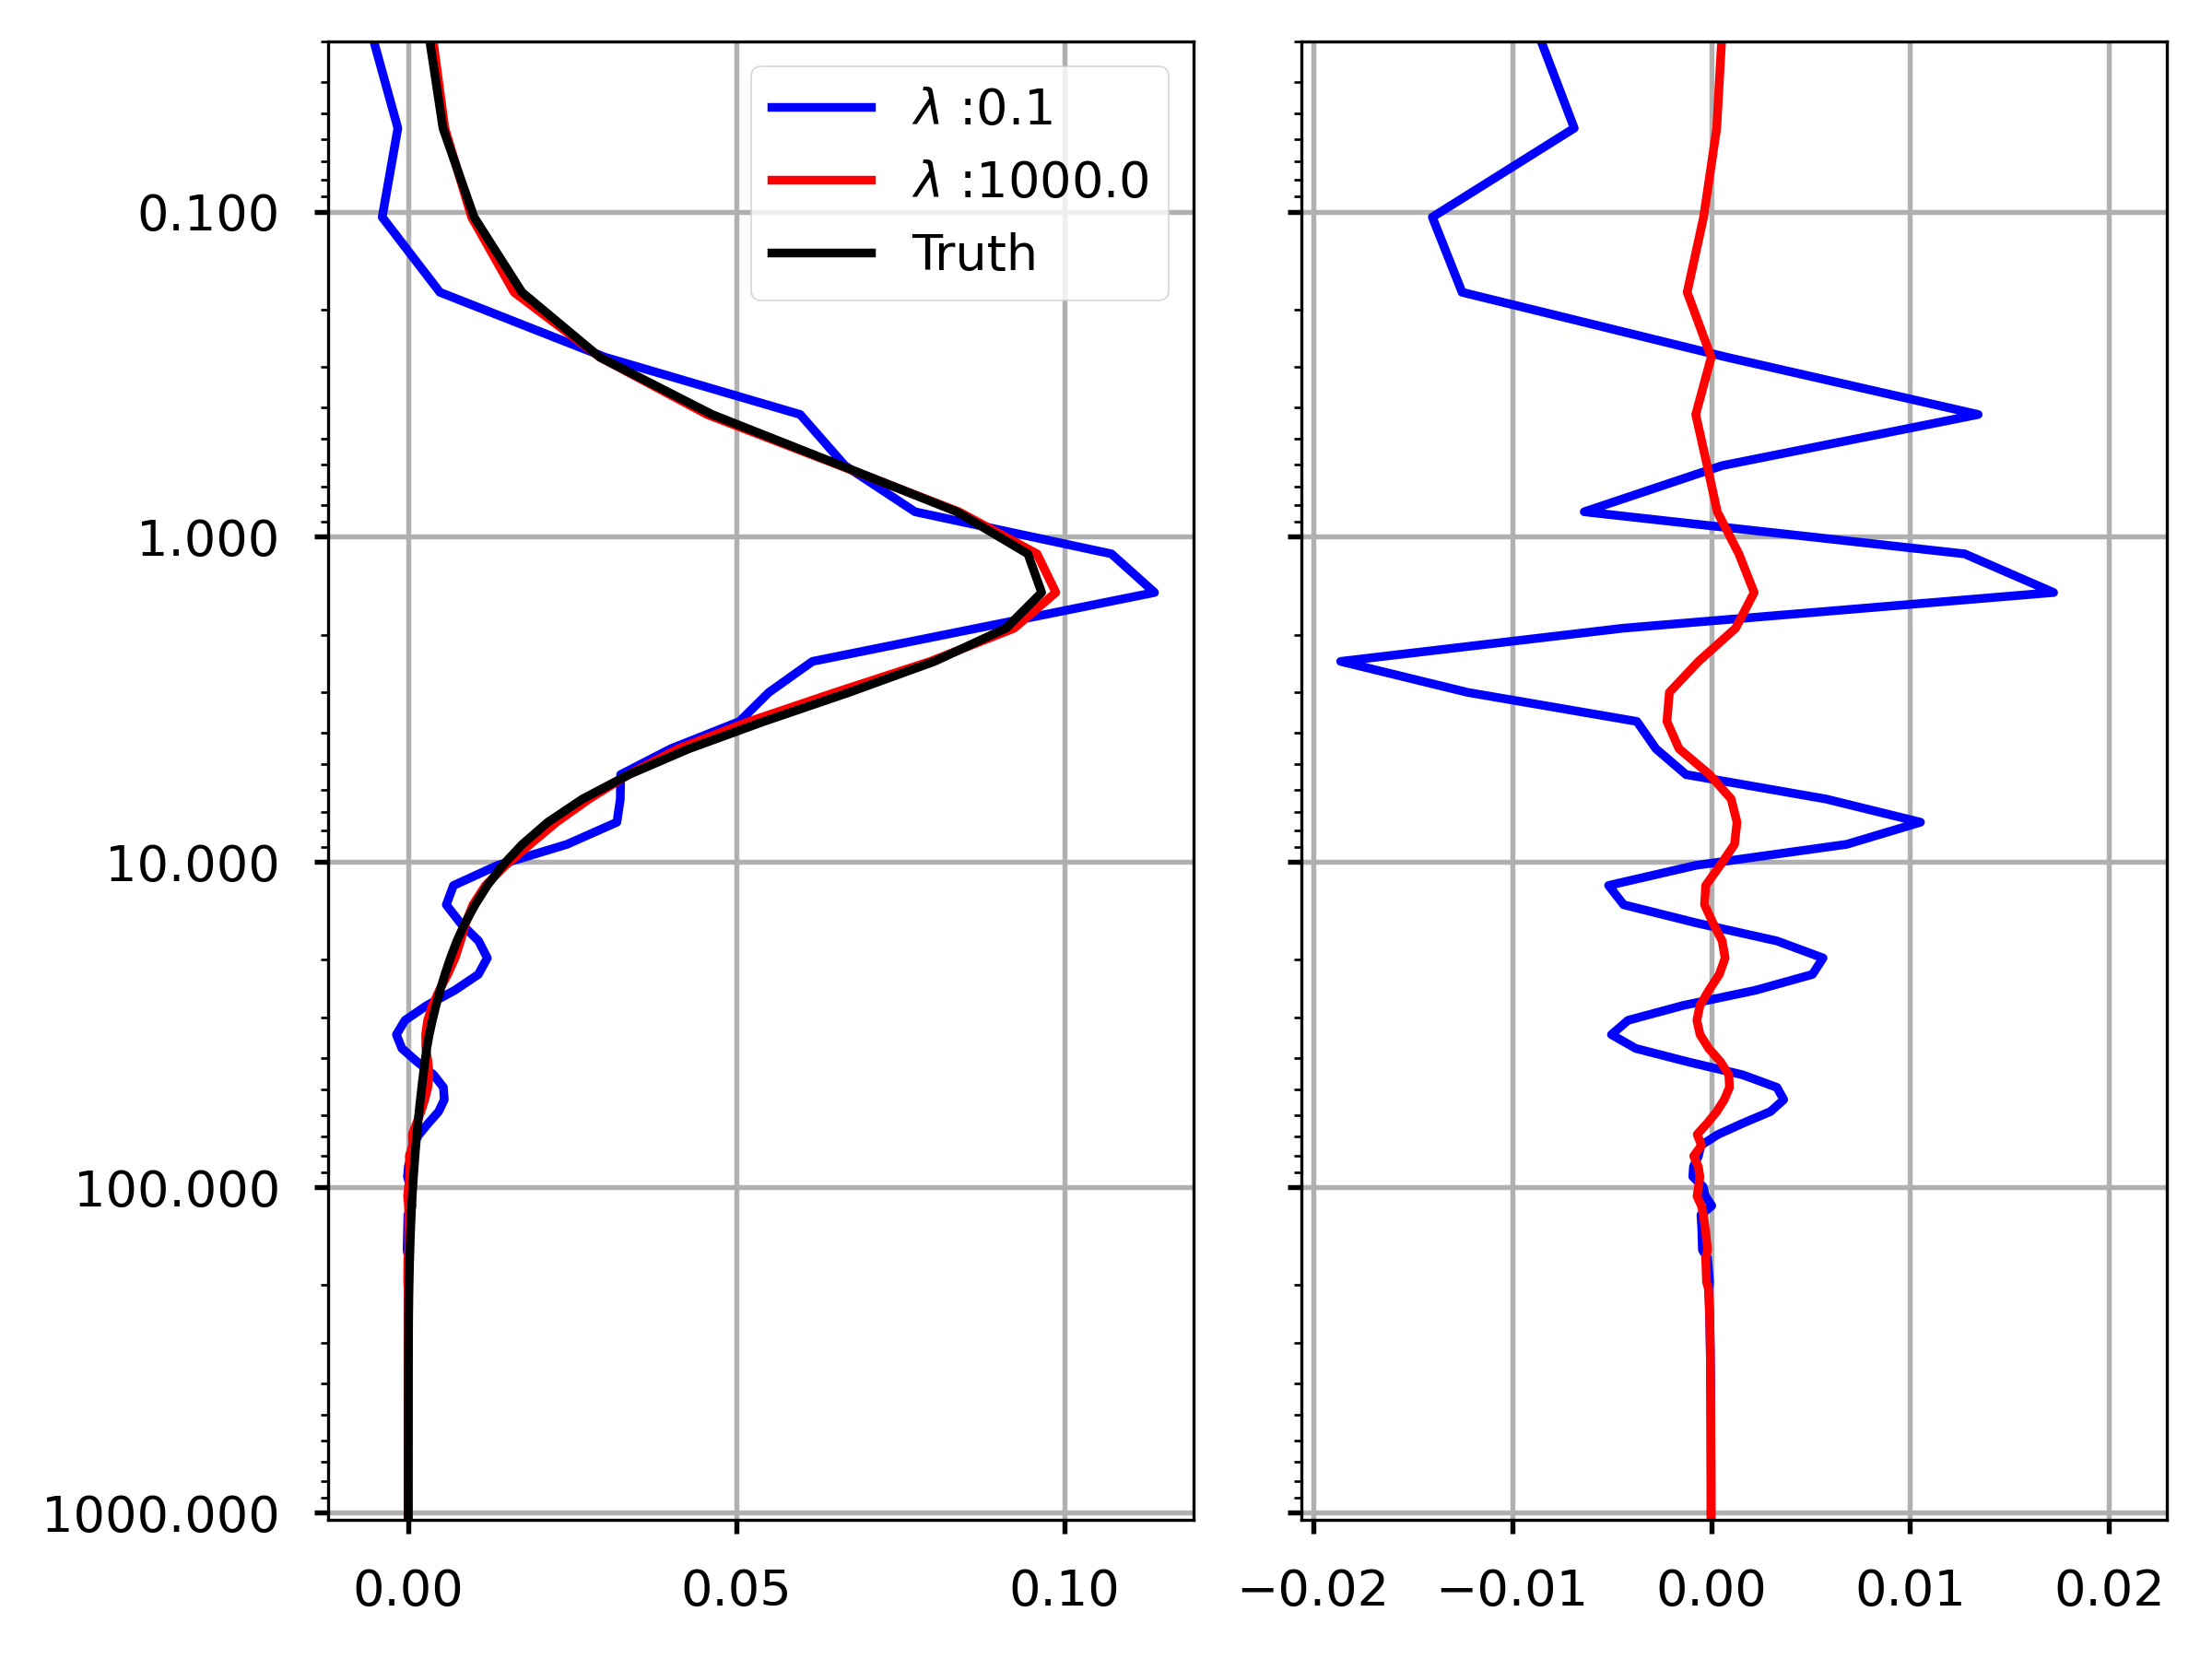
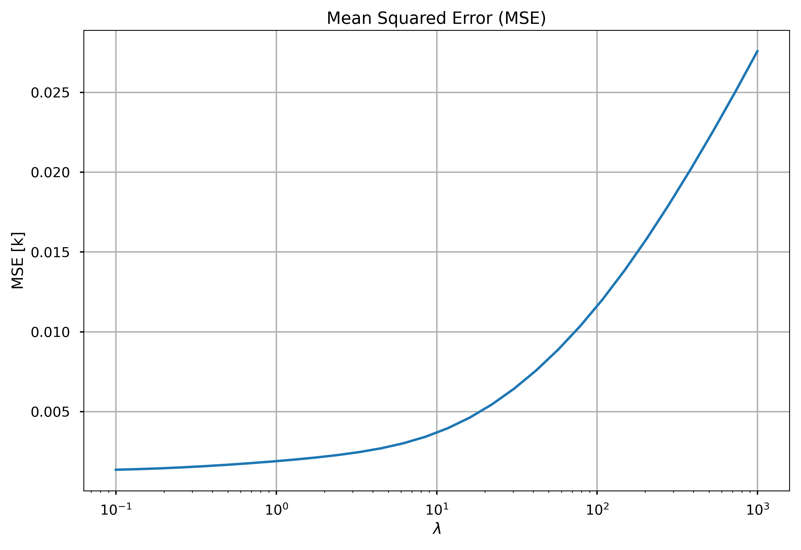
SSU channel 3
The goal is to find an assignment β to that minimizes the cost function:
$$f(β)={\left\|X β −Y\right\|}_{2}^{2}+ λ{\left\|W^{x} β −W^{y}\right\|}_{2}^{2}$$

Slide 14
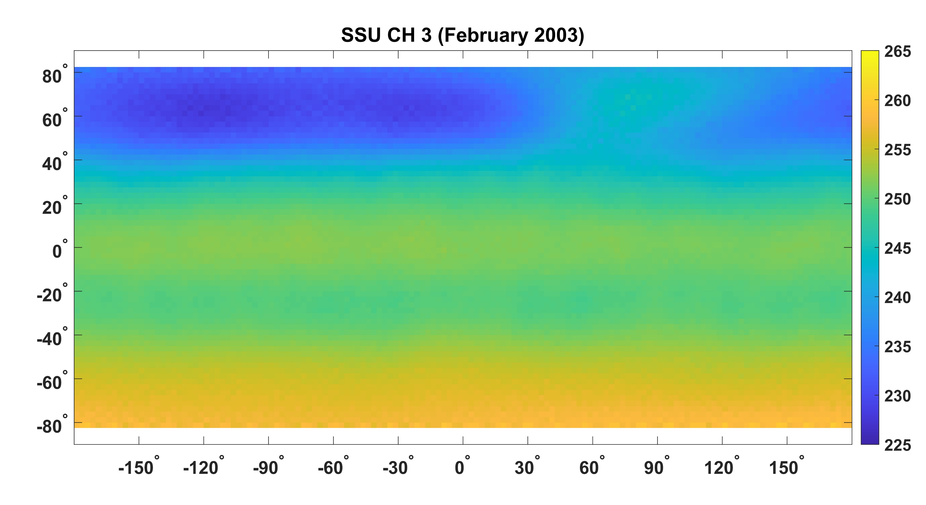
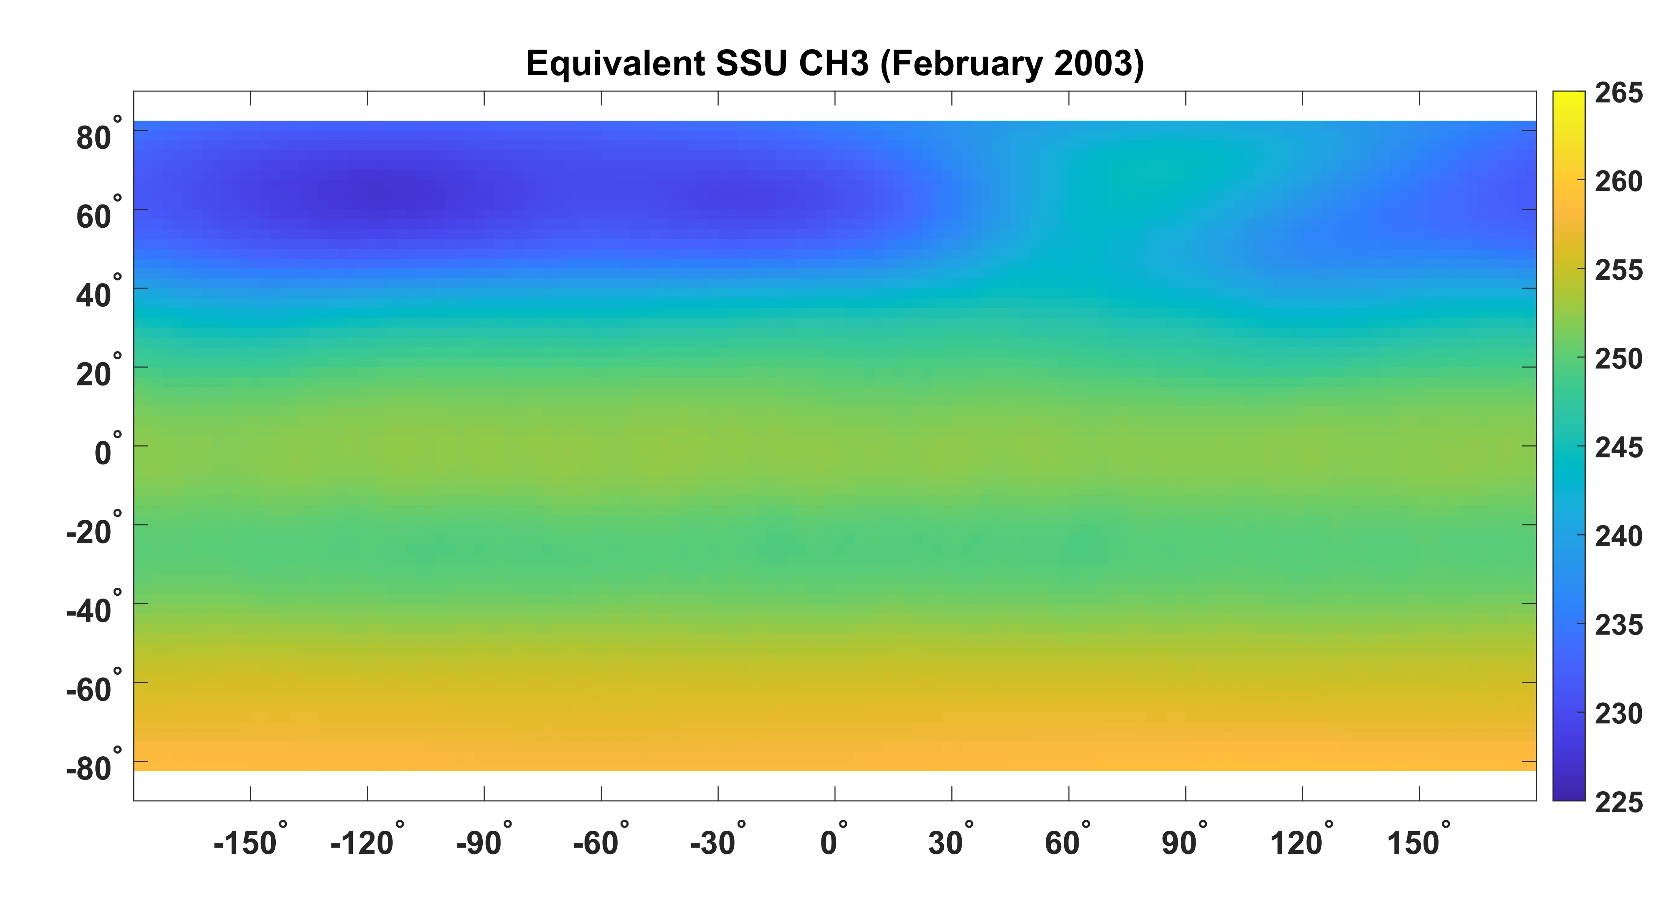
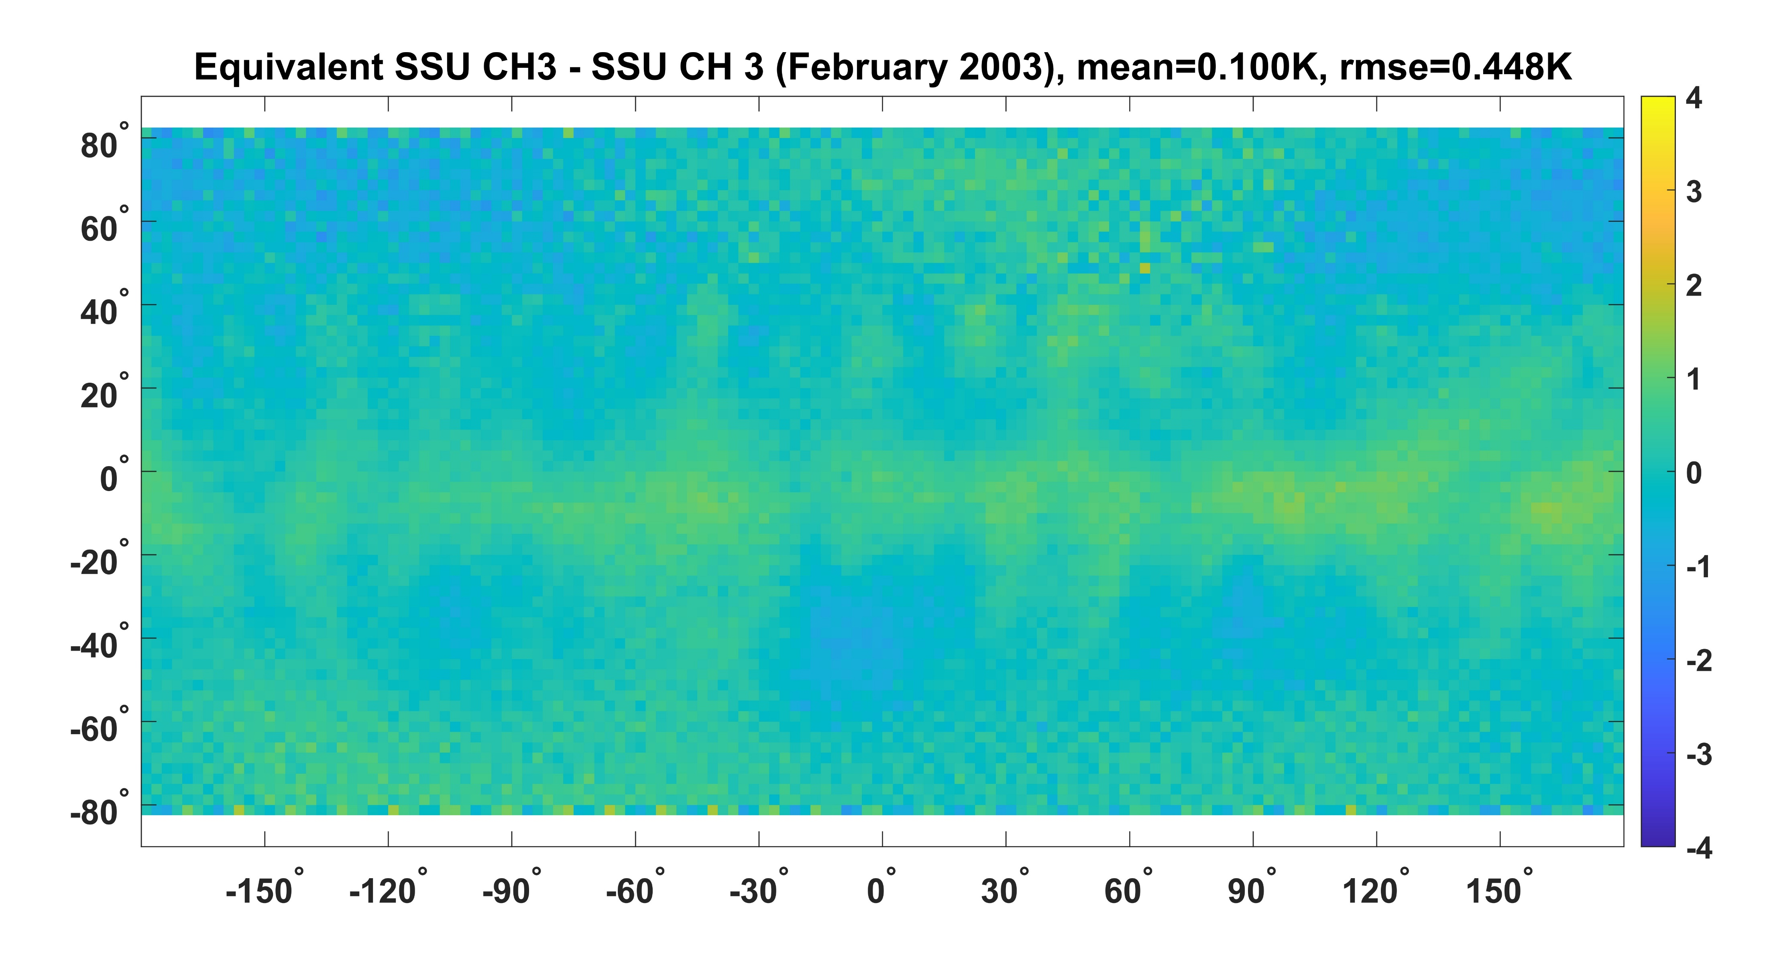
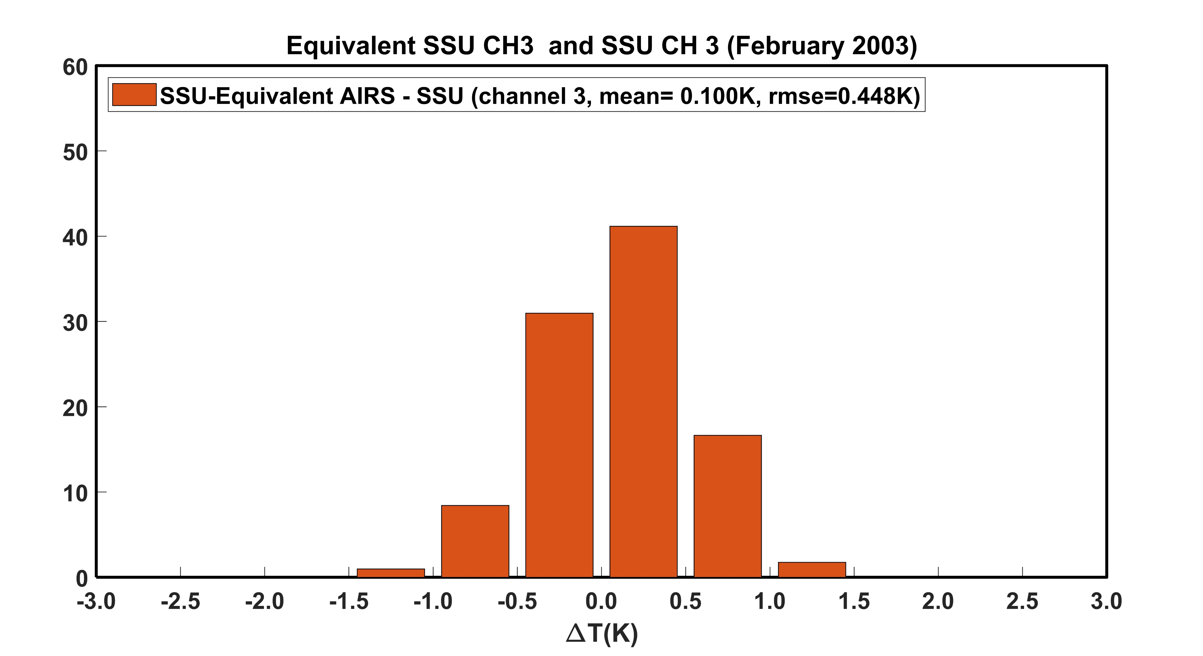

Slide 15
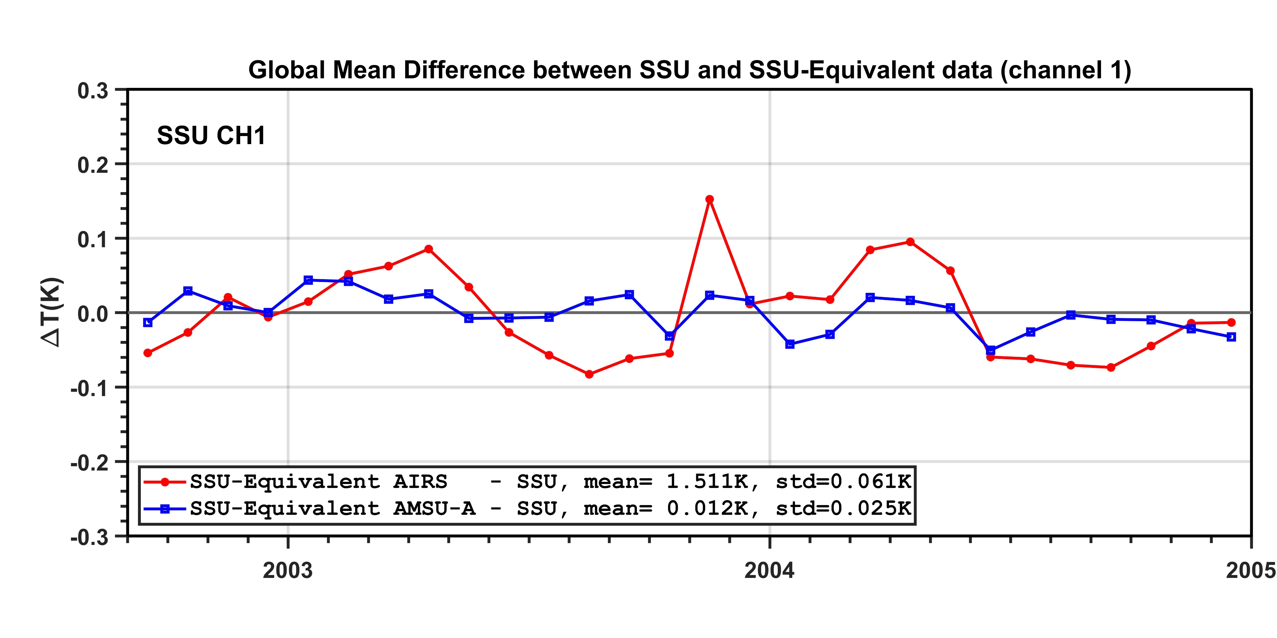
Global Mean Difference, SSU channel 1

Slide 16
Conclusion and Future Work
The efforts has been made to reprocess the SSU data sets for climate data records for stratospheric temperature monitoring in NOAA/NESDIS/STAR.
The AIRS datasets is the key to carry the NOAA operational temperature sounding capability into the future by linking SSU to AIRS/CrIS.
A method is being developed to convert AIRS hyperspectral data into equivalent SSU observations.
  Limited to ~10 channels (avoid noise)
It is under plan to process AIRS data from 2002 to 2005 that are overlapped with NOAA14 SSU

Slide 17
Backup slides

Slide 18
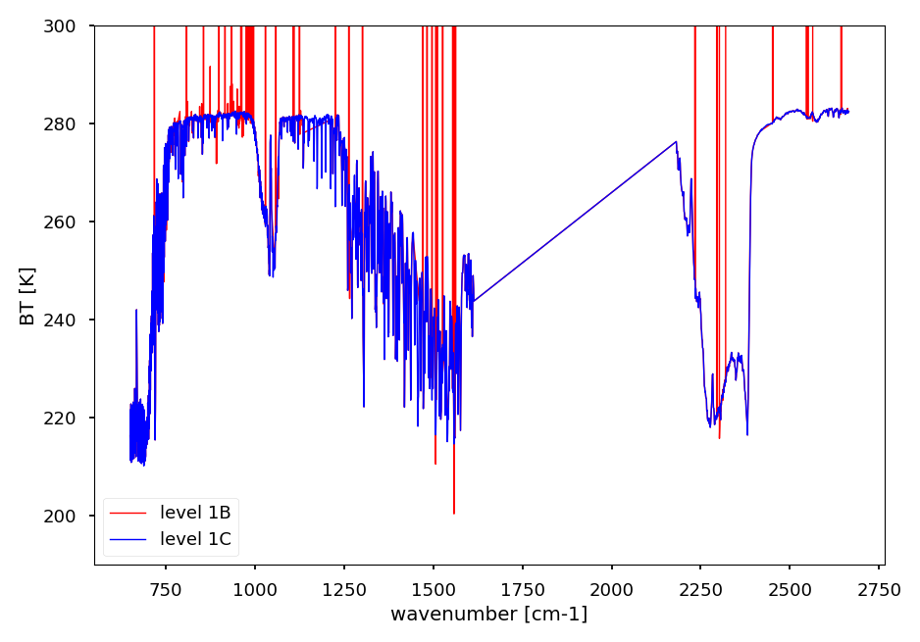

Slide 19
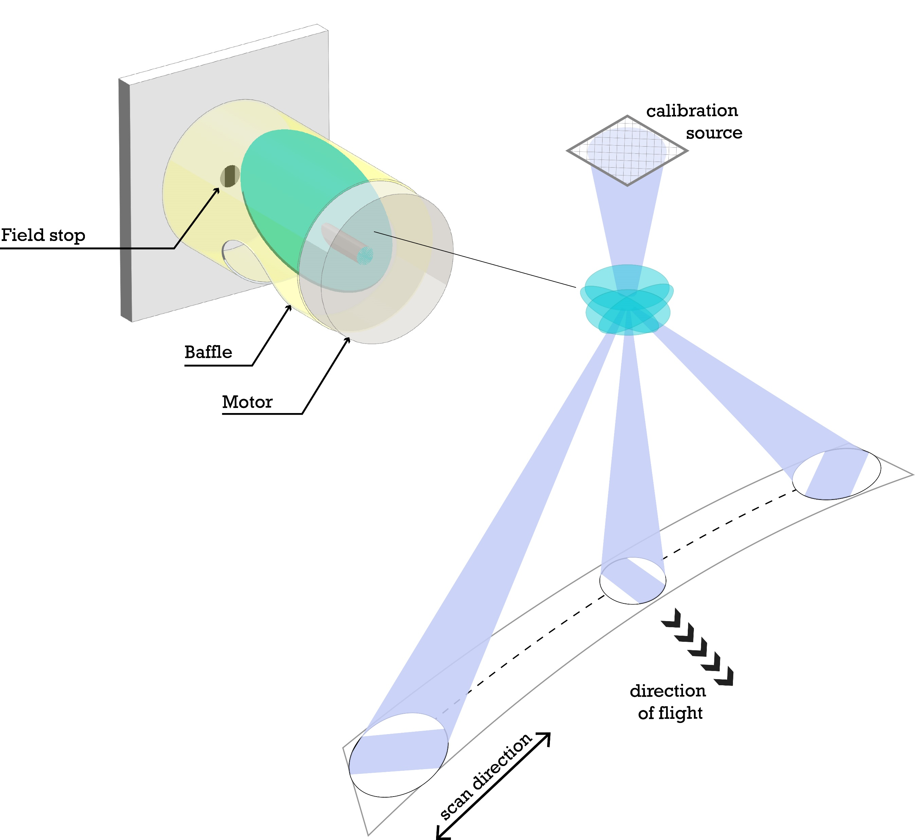
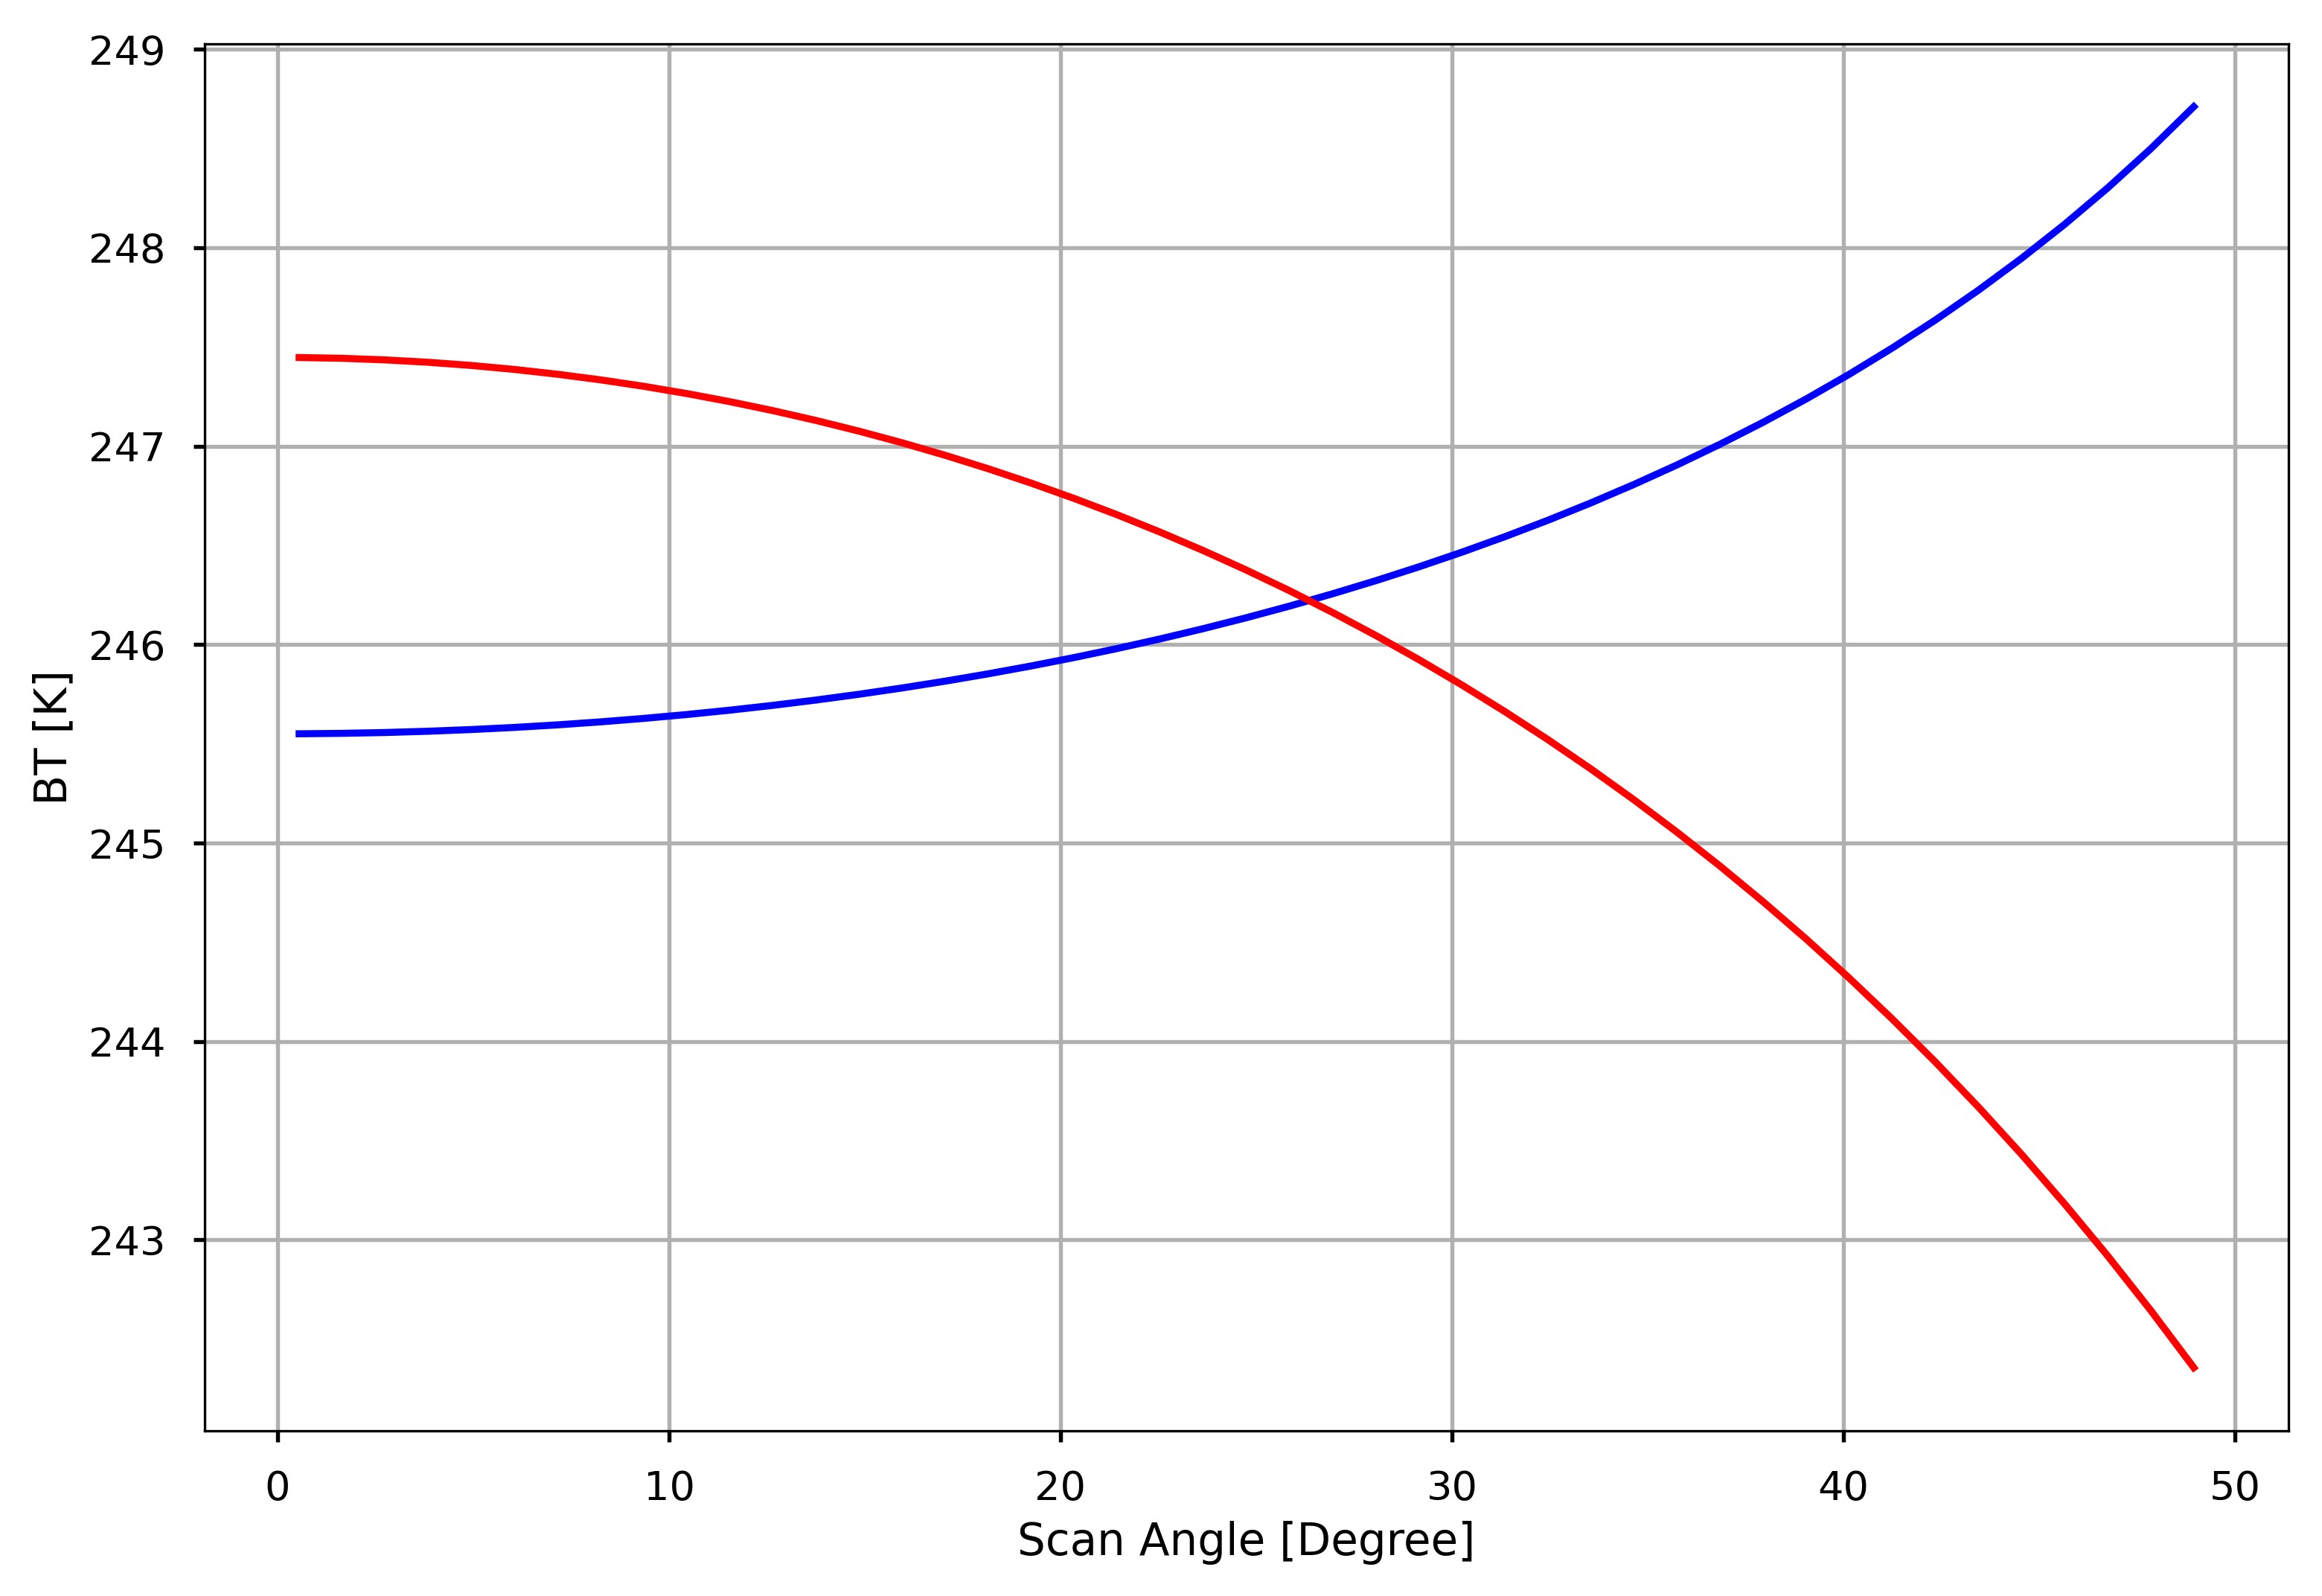
Considering AIRS Scan Pattern
Stratospheric
channel
Tropospheric
channel
From JPL website
1.1 Degree Step angles with 45 steps: 0.55-48.95 Degree

Slide 20
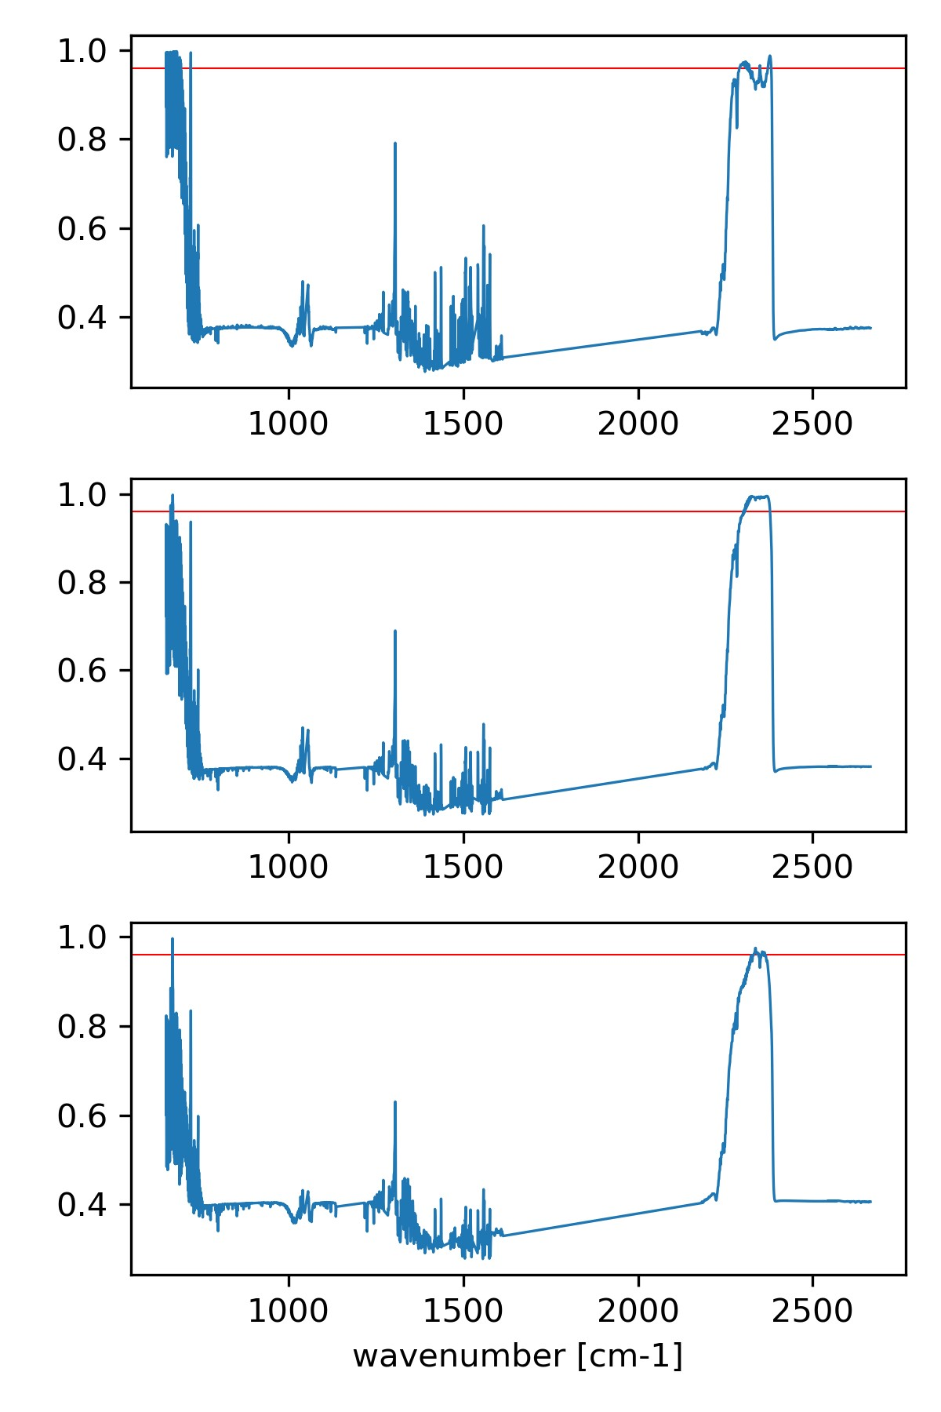
Correlation between AIRS and SSU
48 profiles with 45 different angles: 2160 pairs of SSU and AIRS simulations
SSU cell pressure are fixed as 110, 40, and 15 hPa for SSU channels 1, 2, and 3, respectively. They agree with the SSU CDR data.
The correlation between SSU and AIRS individual channel are calculated.
The threshold 0.96 is used to select AIRS channels.
AIRS has longwave and shortwave channels that sensitive to stratospheric temperature.
0.96
SSU channel 1
0.96
SSU channel 2
0.96
SSU channel 3

Slide 21
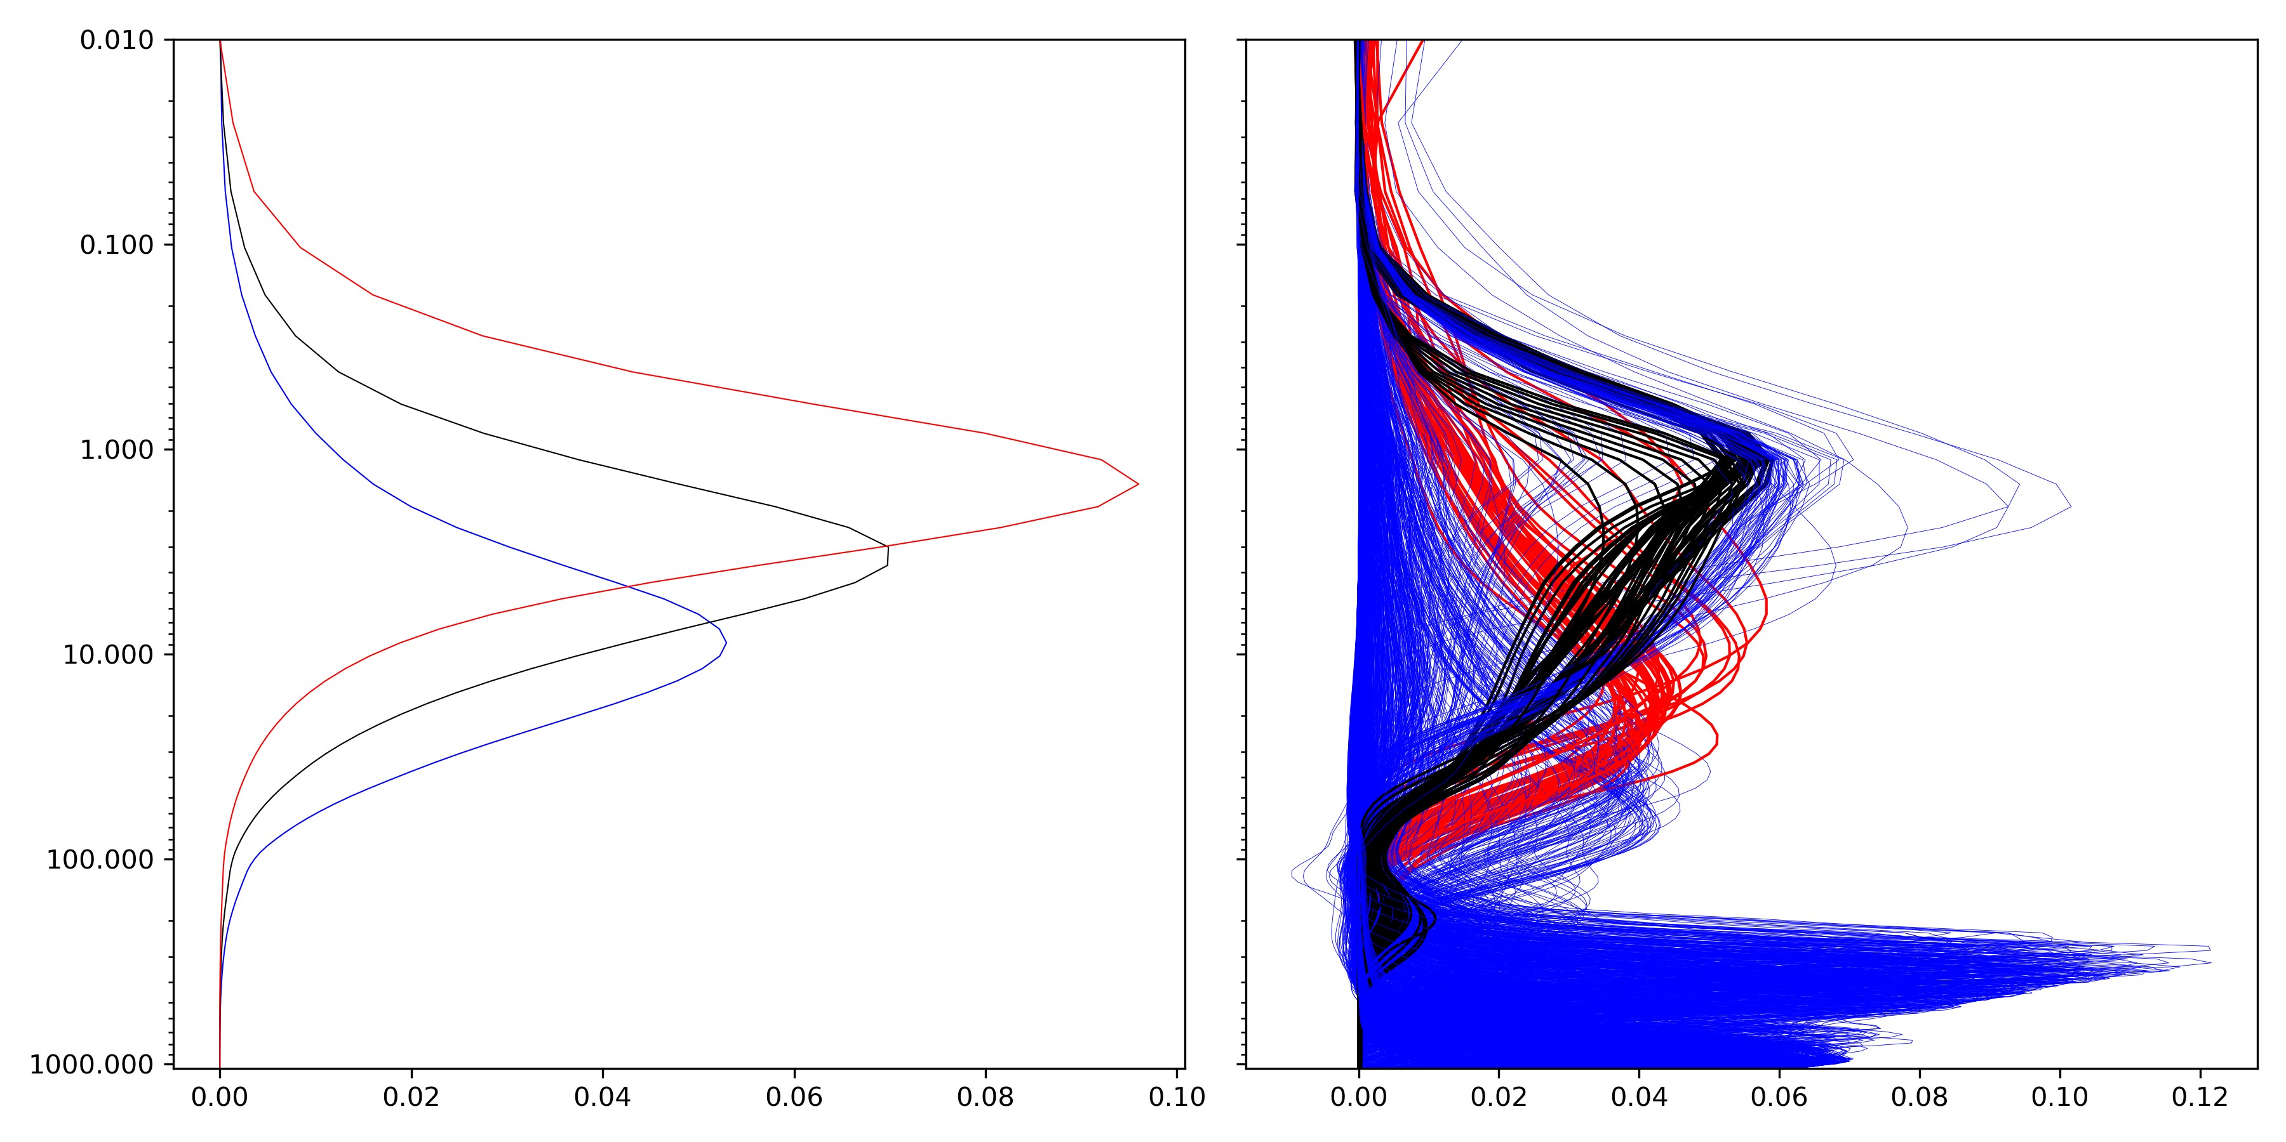
Channel Selection： SSU channel 1 as an example
SW channels
Pressure (hPa)
LW channels
SSU channel 1
Channels in blue color are NOT used.

Slide 22
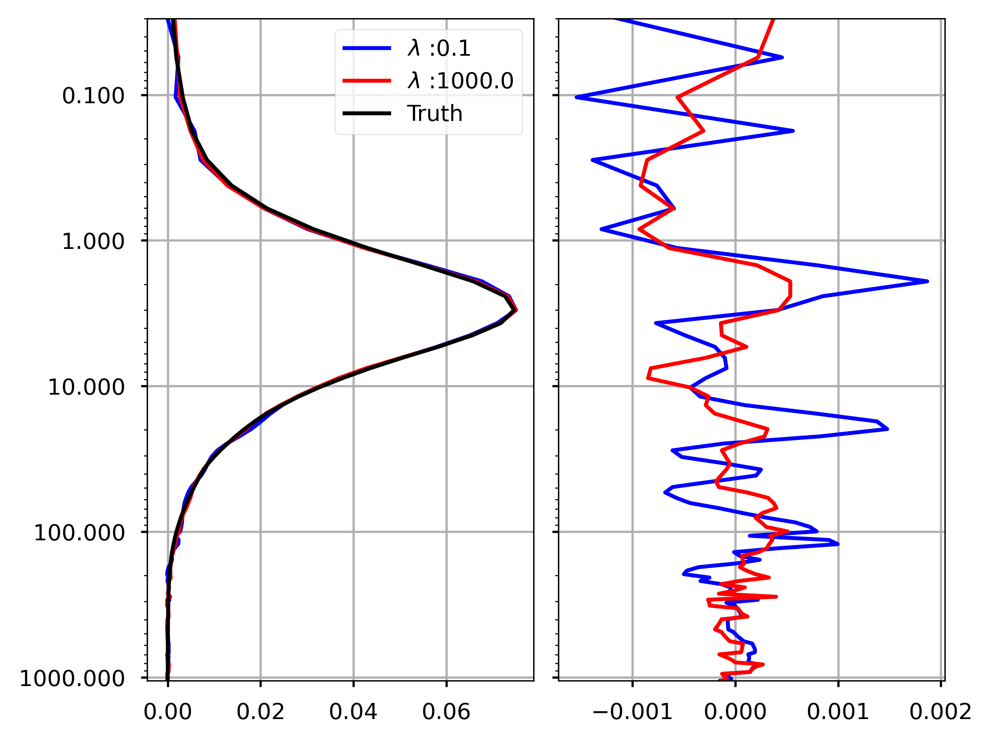
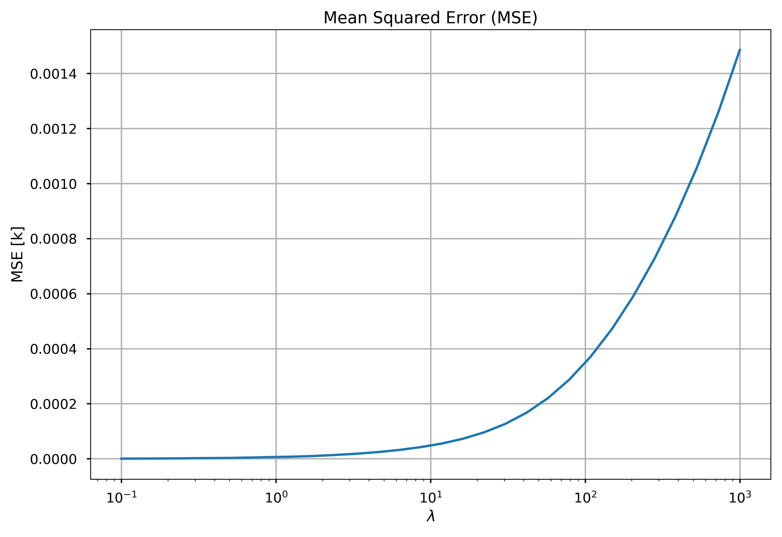
SSU channel 2
The goal is to find an assignment β to that minimizes the cost function:
$$f(β)={\left\|X β −Y\right\|}_{2}^{2}+ λ{\left\|W^{x} β −W^{y}\right\|}_{2}^{2}$$

Slide 23
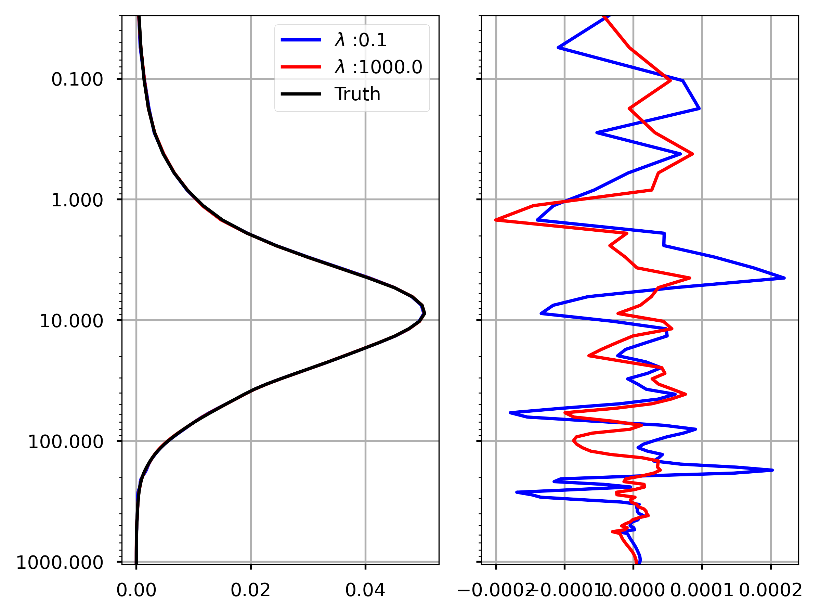
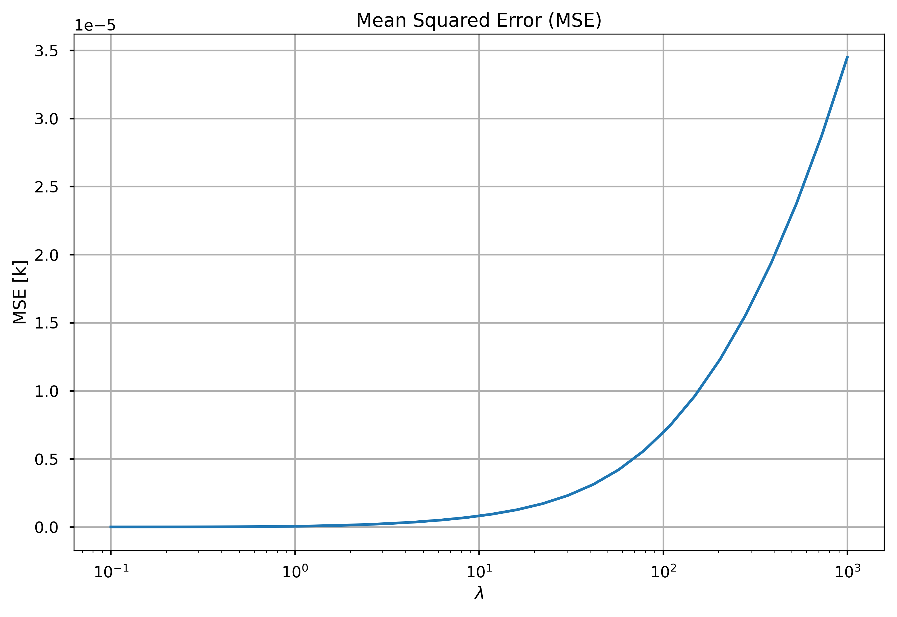
SSU channel 1
The goal is to find an assignment β to that minimizes the cost function:
$$f(β)={\left\|X β −Y\right\|}_{2}^{2}+ λ{\left\|W^{x} β −W^{y}\right\|}_{2}^{2}$$

Slide 24
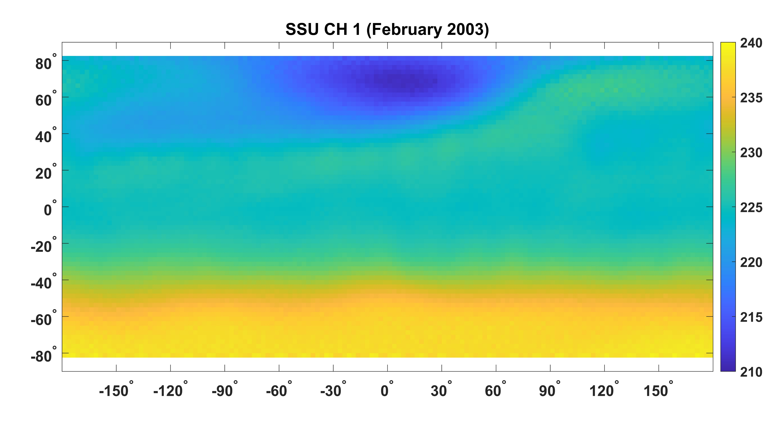
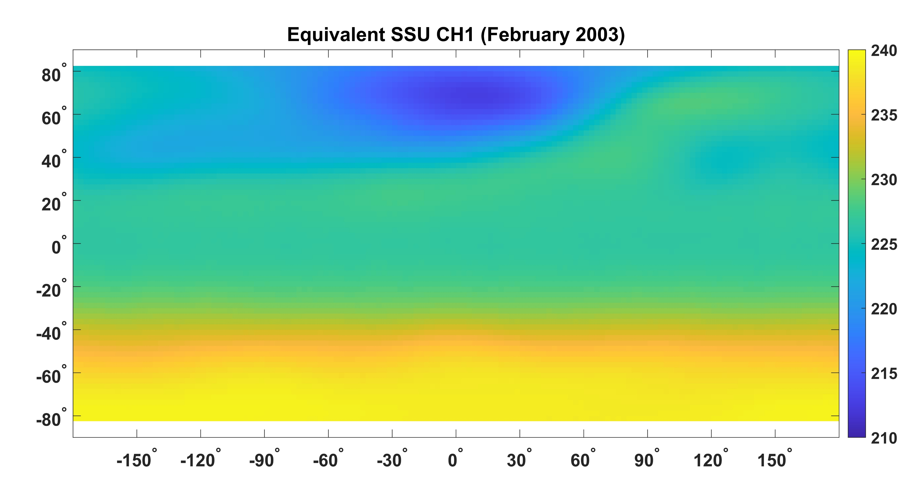
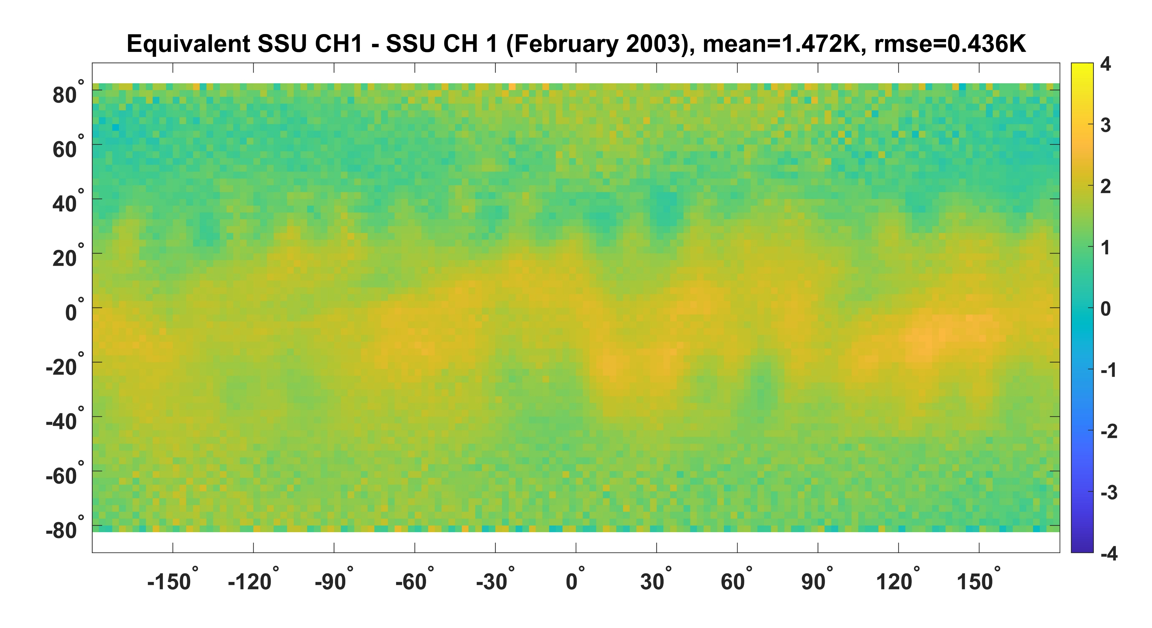
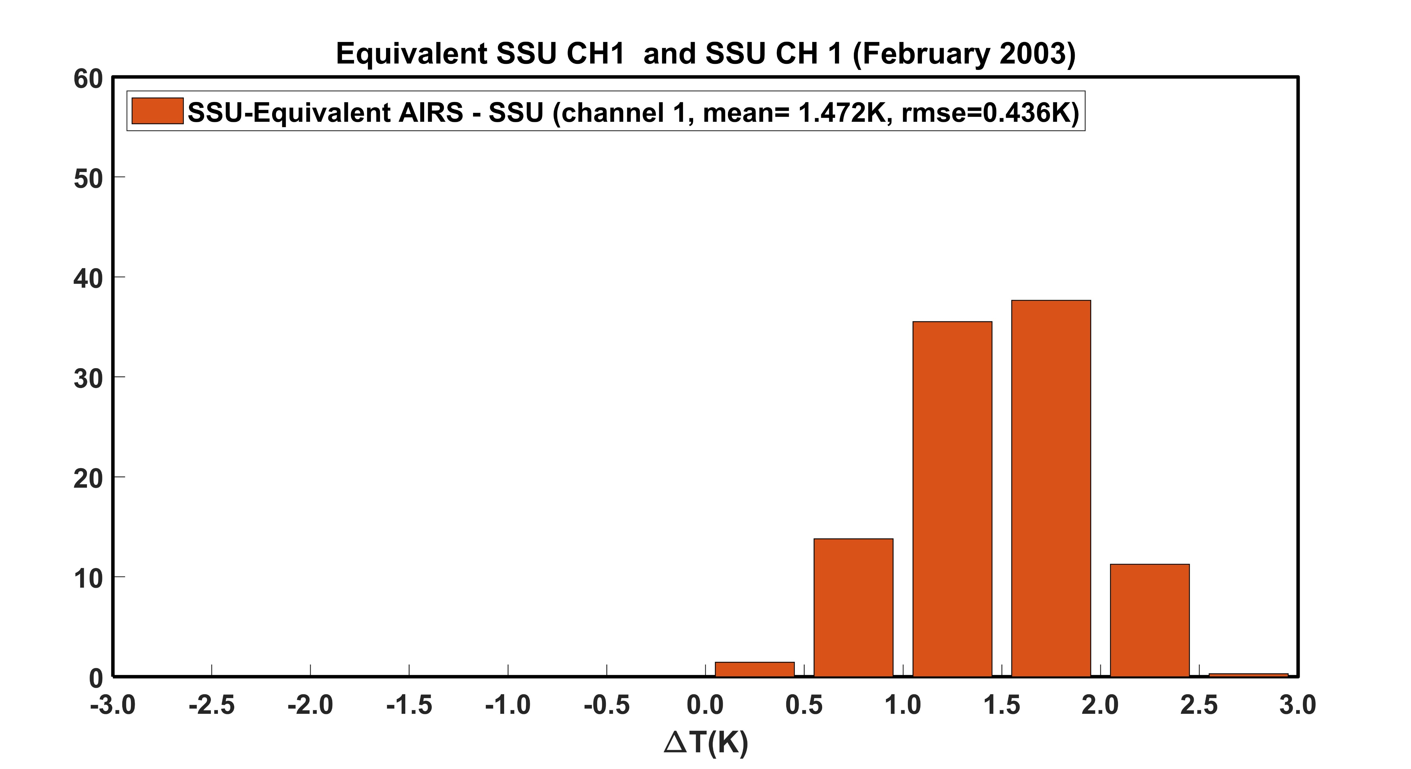

Slide 25
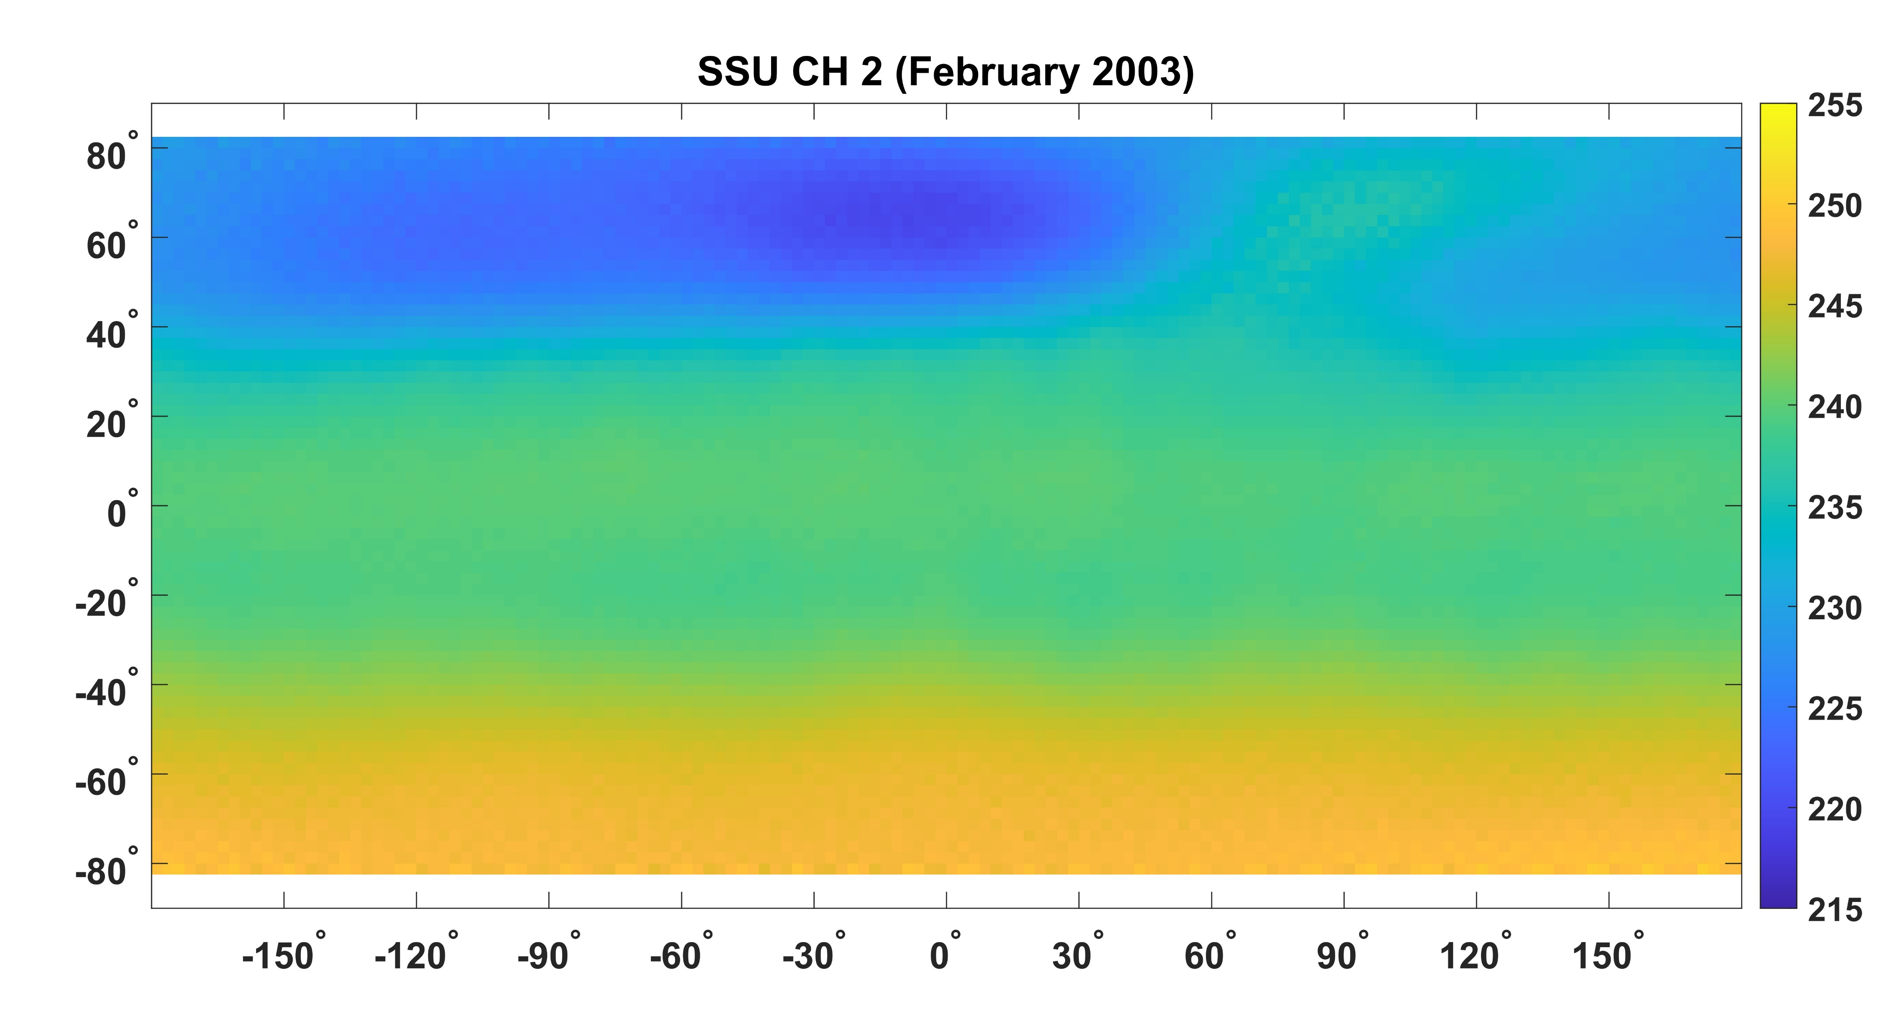
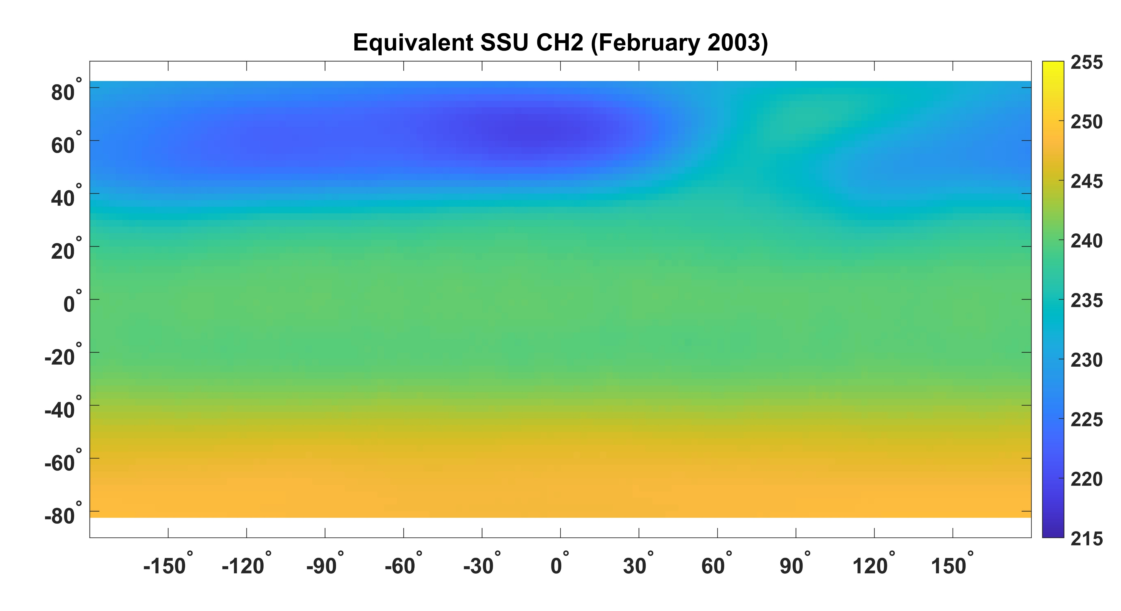
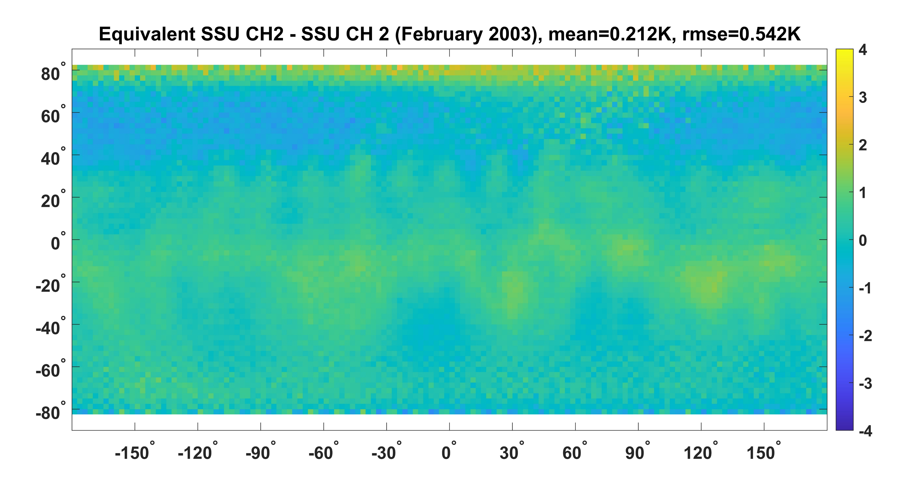
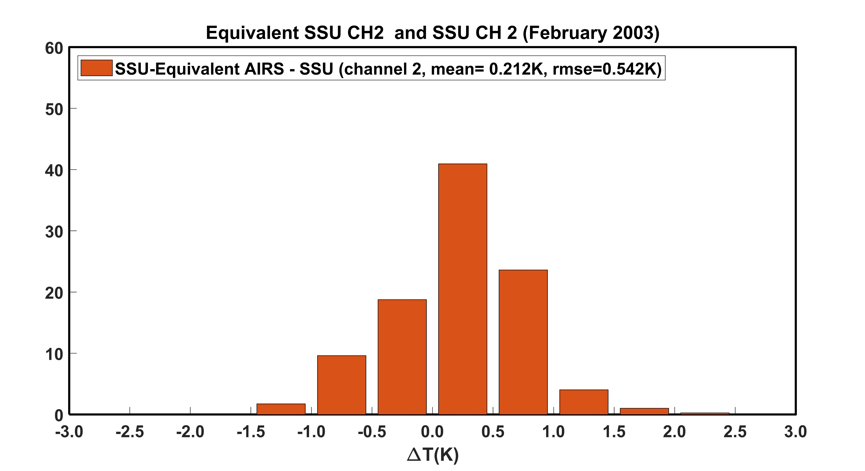

Slide 26
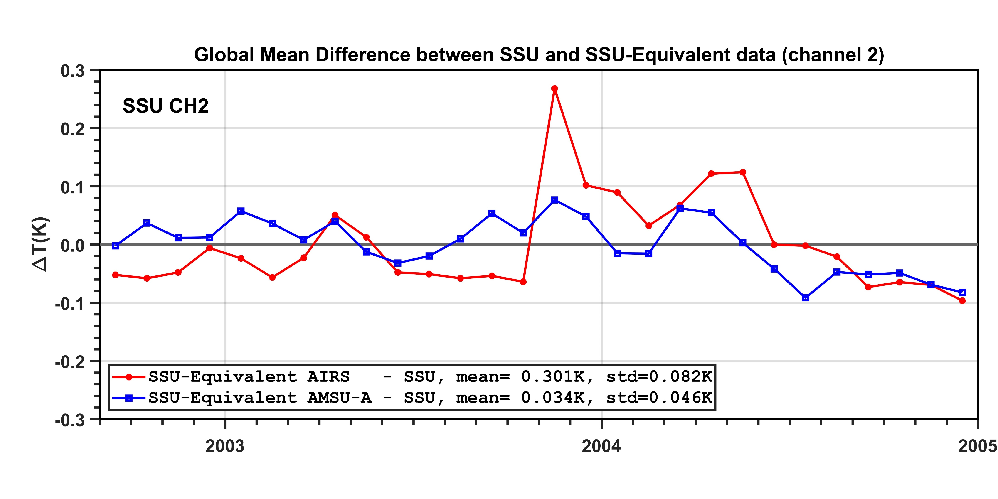
Global Mean Difference, SSU channel 2

Slide 27
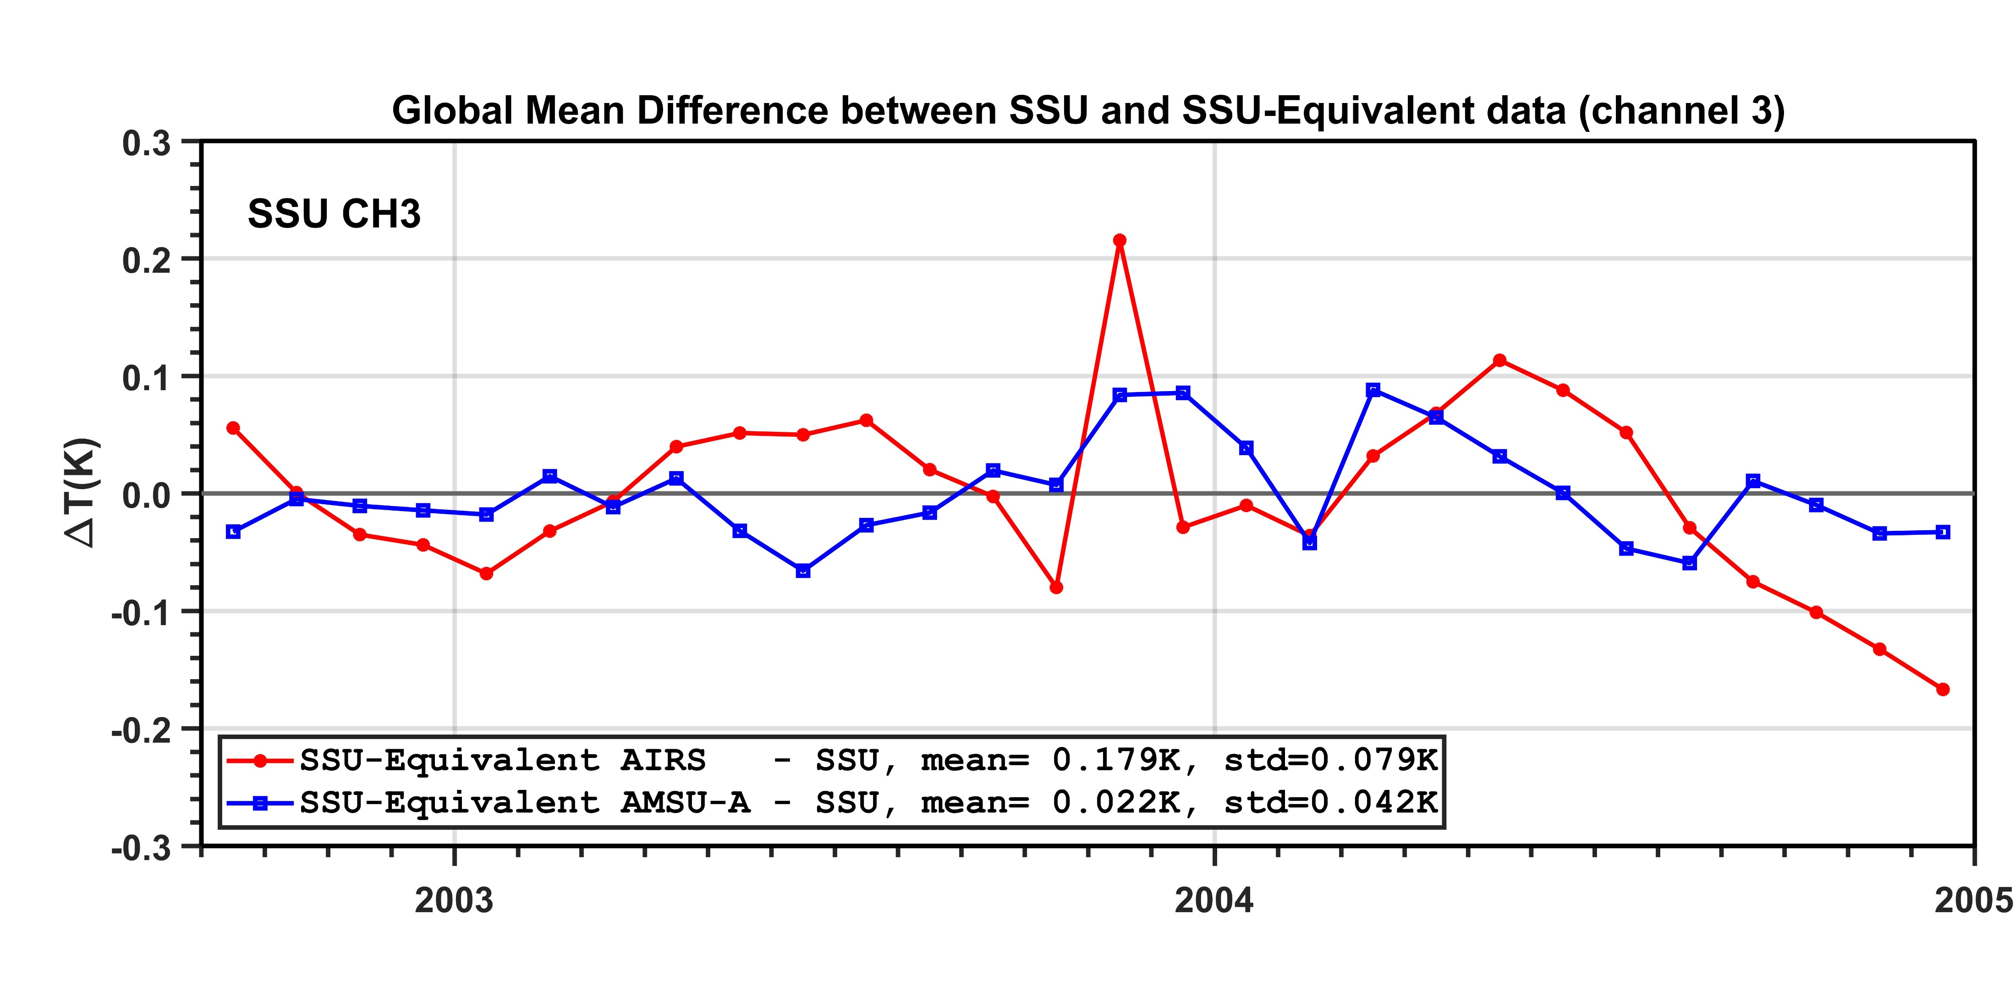
Global Mean Difference, SSU channel 3

