Slide 1
Improving the CrIS-ABI Inter-Comparison Analysis over hot land scenes within the ICVS framework
Global Space-based Inter-Calibration System (GSICS) annual meeting
11-15 March 2024, Darmstadt, Germany
Xin Jin¹, Banghua Yan², Ninghai Sun³
^{1: SSAI, Inc, Lanham, MD, USA}
2: NOAA/NESDIS/STAR, College Park, MD, USA
3: Global Science and Technology, College Park, MD, USA

Slide 2
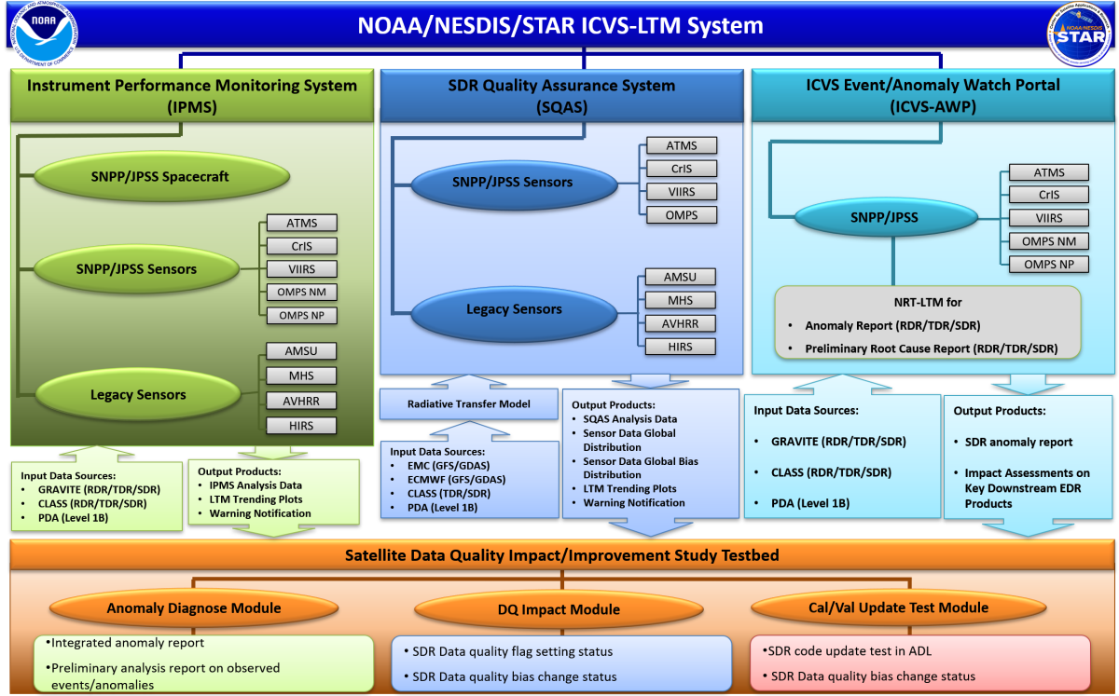
Global Space-based Inter-Calibration System (GSICS) annual meeting
11-15 March 2024, Darmstadt, Germany
Motivations
The Integrated Calibration/Validation System (ICVS), hosted by the NOAA/NESDIS/STAR, is an comprehensive operational framework to monitor weather satellite instrument status and data quality. The inter-comparison between different satellites is a key component of ICVS system.
The inter-comparison between Advanced Baseline Imager (ABI) and Cross-track Infrared Sounder (CrIS) is widely studied and two data collection methods are popular:
the closest time between CrIS and ABI measurements is determined as the simultaneous nadir overpasses (SNO) time;
the brightness temperature (BT) uncertainty of ABI pixels within the CrIS footprints is used as criteria to reduce the uncertainty of CrIS-ABI data pairs.
Current CrIS-ABI SNO methods have difficulties collecting samples over chaotic scenarios
Hot scenes over land are usually removed by current algorithms because the BT uncertainty is scaled up with high temperatures
The performance of IR sensors at hot scenes is important for global temperature monitoring but is hard to get enough samples for calibration and climate study. We need to figure out a method to collect hot scene samples in CrIS-ABI SNO studies
Inter-sensor comparison is part of the SQAS
https://www.star.nesdis.noaa.gov/icvs/index.php
2

Slide 3
Global Space-based Inter-Calibration System (GSICS) annual meeting
11-15 March 2024, Darmstadt, Germany
Data and Methods
Data
Full disk infrared (IR) measurements between 2019 and 2023 from GOES-16 and GOES-17 ABI
S-NPP and JPSS-1 (J01) CrIS hyperspectral infrared spectra
Methods
The SNO between CrIS and ABI is defined as the moment when the spatial distance between J01 and GOES is shorter than 500KM and the temporal difference is shorter than 80 seconds
The ABI full disk measurements just before (t1) and after (t2) the SNO moment are temporally interpolated
The IR radiance of ABI pixels within the CrIS nadir footprints, i.e. the CrIS Field-Of-Regard (FOR) 13~18, is averaged
The CrIS hyperspectral radiance is convolved with ABI spectral response functions after gap filling [Xu et al. 2019]
$R_{geo}(t_{sno})=R_{abi}(t_{1})+\frac{t_{sno}−t_{1}}{t_{2}−t_{1}}·(R_{abi}(t_{2})−R_{abi}(t_{1}))$
$R_{abi}(t_{1})$ and $R_{abi}(t_{2})$ are the mean radiance values of ABI pixels inside of CrIS footprint at $t_{1}$ and $t_{2}$, respectively.
$R_{leo}=\frac{\sum_{v1}^{v2}{R_{cris}\left(v\right)·S\left(v\right)·Δv}}{\sum_{v1}^{v2}{S\left(v\right)·Δv}}$
H. Xu, Y. Chen and L. Wang, "Cross-Track Infrared Sounder Spectral Gap Filling Toward Improving Intercalibration Uncertainties," in IEEE Trans. Geosci. Remote Sens., vol. 57, no. 1, pp. 509-519, Jan. 2019, doi: 10.1109/TGRS.2018.2857833.
3

Slide 4
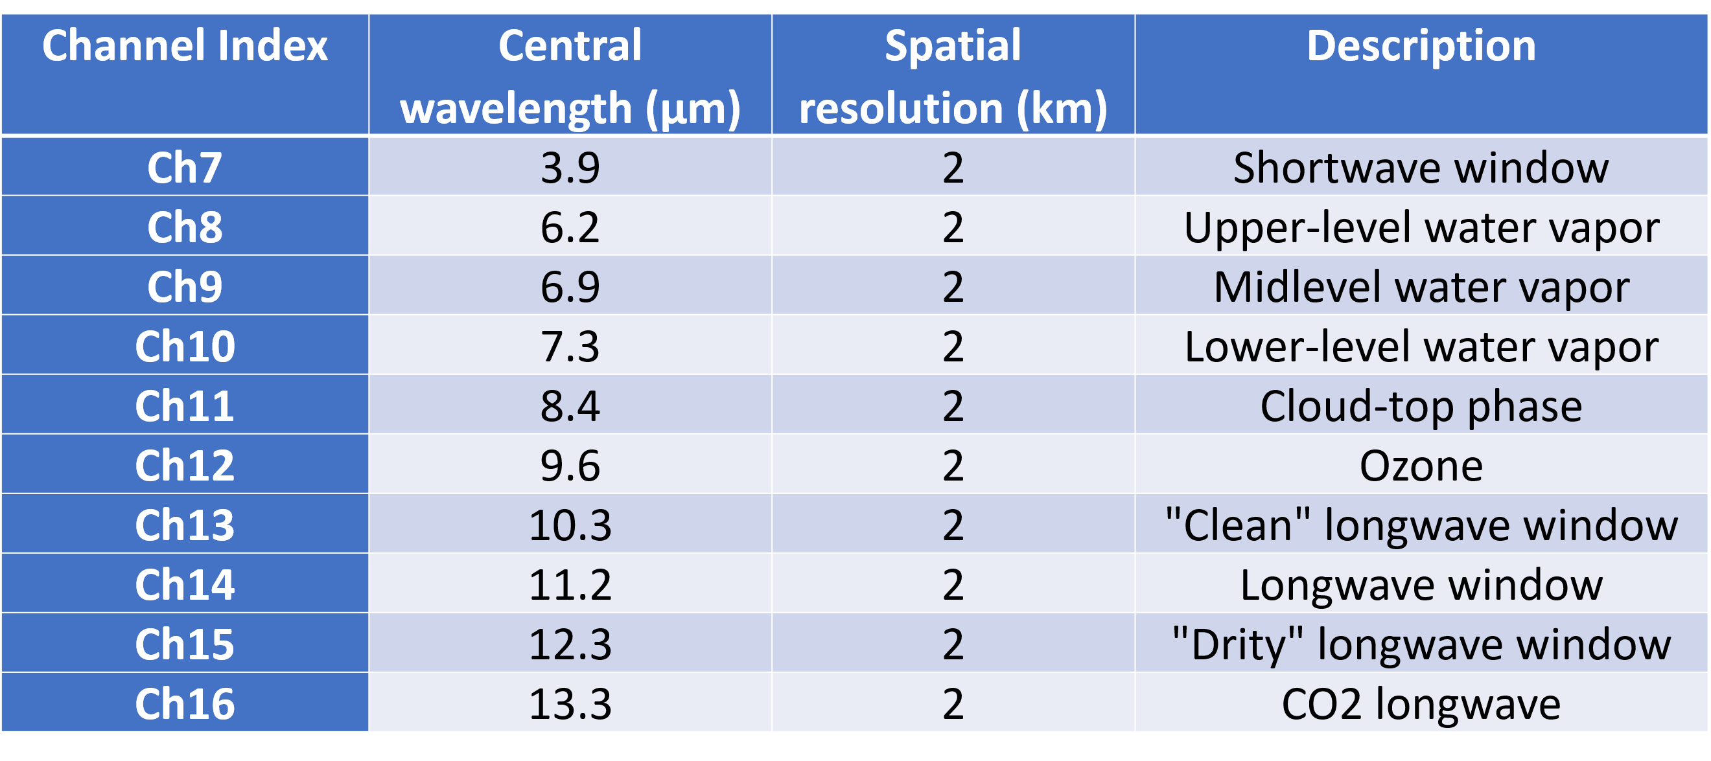
Global Space-based Inter-Calibration System (GSICS) annual meeting
11-15 March 2024, Darmstadt, Germany
Quality Controls
1) Local zenith angle threshold:
$$abs([cos(θ_{leo})/cos(θ_{geo})]−1)<0.02$$
$θ_{leo}$ and $θ_{geo}:$ local zenith angle of LEO and GEO instruments
2) Maximal BT drifting threshold:
$$max⁡(\left|T_{11}−T_{21}\right|,\left|T_{12}−T_{22}\right|,…,\left|T_{1n}−T_{2n}\right|)<10K$$
where $T_{1i}$and $T_{2i}$ represent the i^{th} ABI Ch14 pixel BT within the CrIS footprint at $t_{1}$ and $t_{2}$ respectively
No ABI BT uncertainty index is needed
4

Slide 5
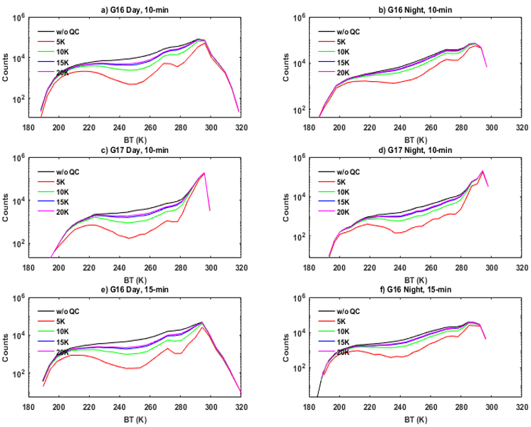
Global Space-based Inter-Calibration System (GSICS) annual meeting
11-15 March 2024, Darmstadt, Germany
Sensitivity Tests in multiple aspects:
Sample numbers vs Maximal BT drifting threshold values
Temporal coverage: 2019~2020
Fig. a & b: GOES-16 Day & Night over land, 10-min interval
Fig. c & d: GOES-17 Day & Night over ocean, 10-min interval
Fig. e & f: GOES-16 Day & Night over land, 15-min interval
5

Slide 6
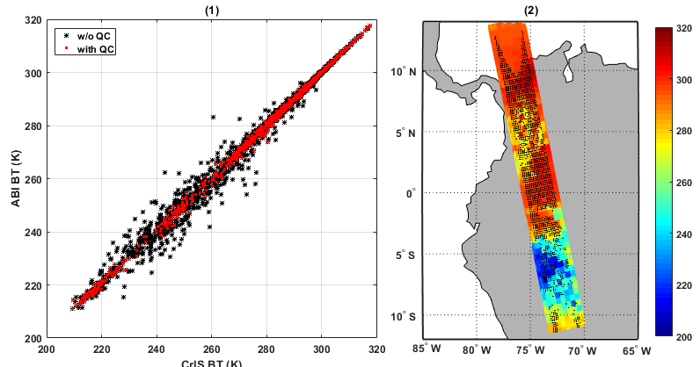
Global Space-based Inter-Calibration System (GSICS) annual meeting
11-15 March 2024, Darmstadt, Germany
An example of CrIS-ABI SNO event over heterogeneous surface
Hot scenes are insensitive to BT threshold QC
Ch14 BT in a G16-ABI and J01 CrIS SNO event on 02/19/2023. The black dots on the right panel represent the SNO samples with QC
6

Slide 7
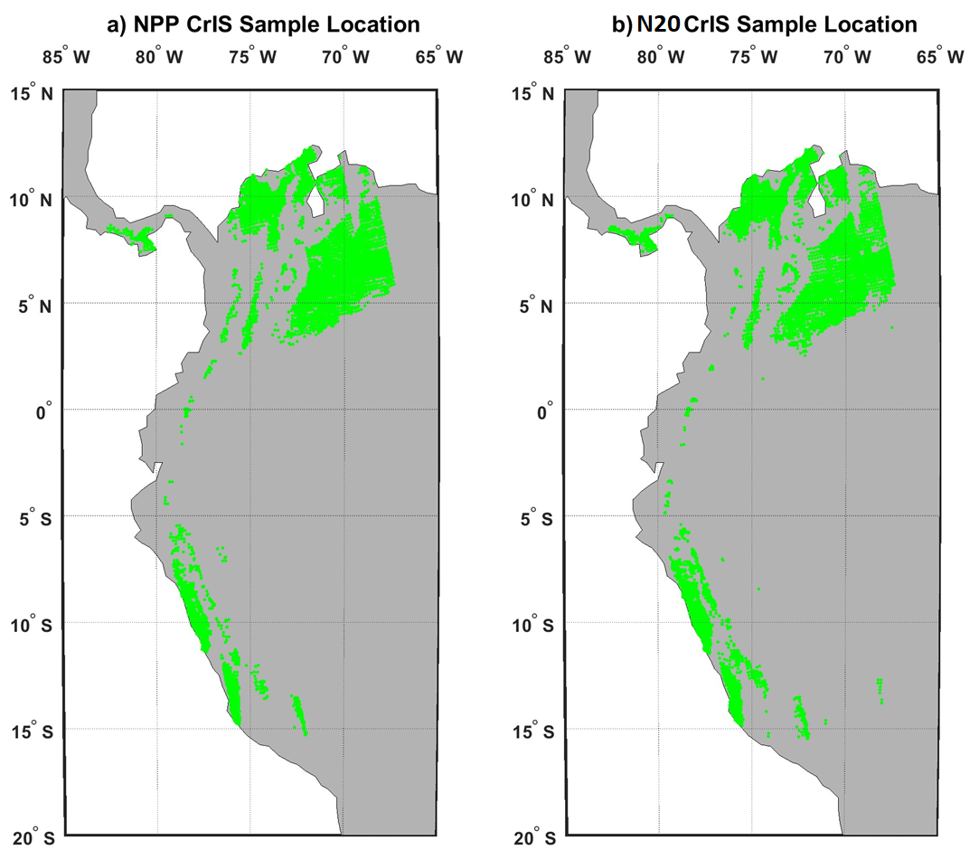
Global Space-based Inter-Calibration System (GSICS) annual meeting
11-15 March 2024, Darmstadt, Germany
Hot pixel locations with the criteria of BT@CH14>305K
temporal coverage: 2019~2023
The green area indicates the location of CrIS-ABI SNO hot pixels used in the following slides
7

Slide 8
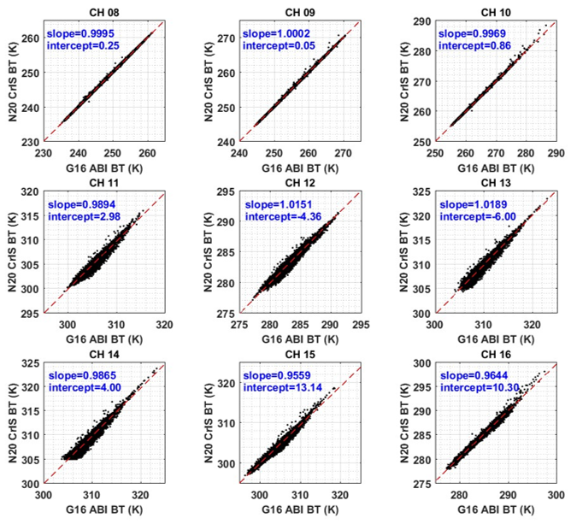
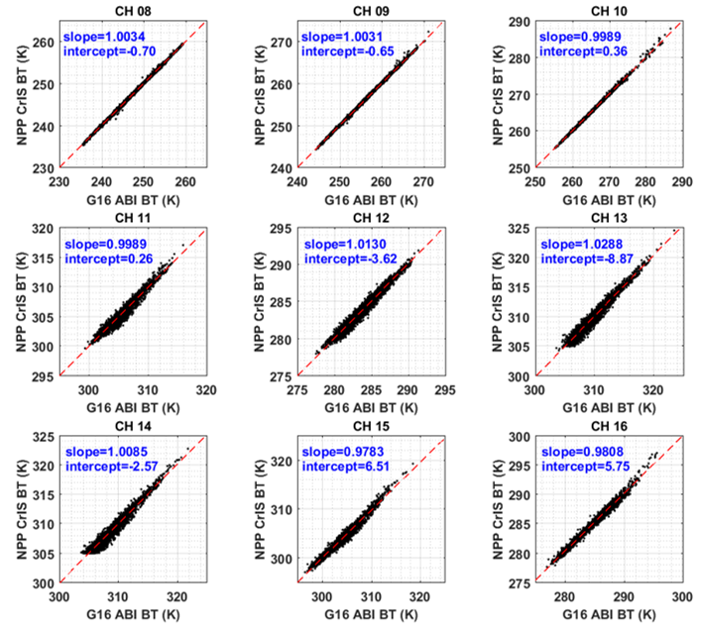
Global Space-based Inter-Calibration System (GSICS) annual meeting
11-15 March 2024, Darmstadt, Germany
CrIS-ABI Hot pixel BT comparison with the criteria of BT@CH14>305K
temporal coverage: 2019~2023
The window channels show stronger nonlinear responses against the scene BT than absorbing channels
Both NPP and J01 CrIS have similar performance when compared with G16 ABI
8

Slide 9
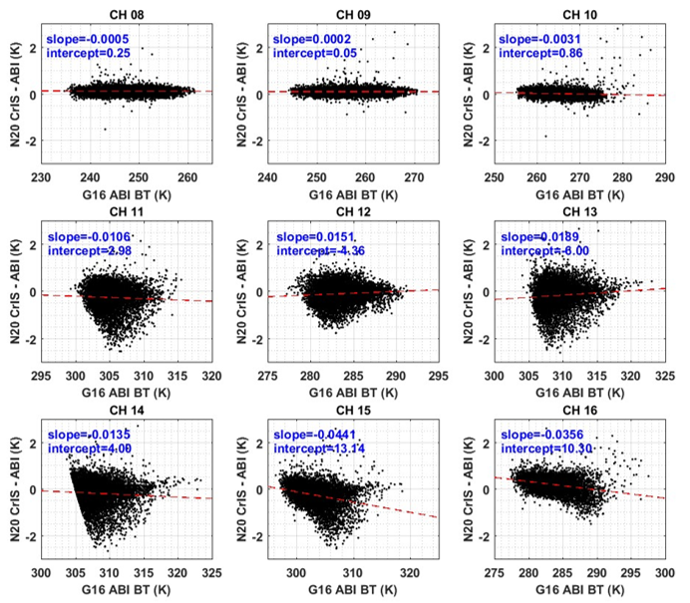
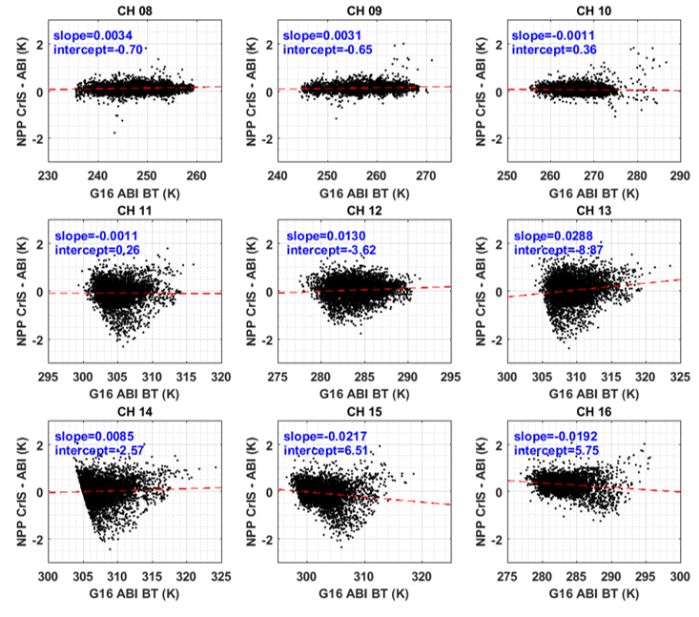
Global Space-based Inter-Calibration System (GSICS) annual meeting
11-15 March 2024, Darmstadt, Germany
CrIS-ABI Hot pixel BT Bias against the Scene BT
temporal coverage: 2019~2023
9

Slide 10
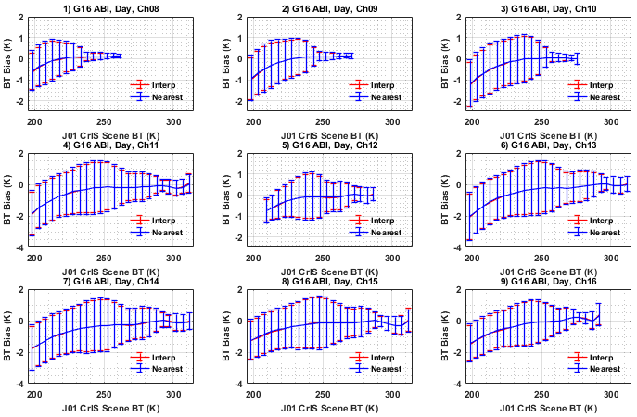
Global Space-based Inter-Calibration System (GSICS) annual meeting
11-15 March 2024, Darmstadt, Germany
The daytime BT bias against scene BT between J01 CrIS and G16 ABI along wider BT range
The ABI BTs derived from linear interpolation are almost the same as those of the direct measurements nearest to the SNO time, but the new method can slightly reduce uncertainties.
10

Slide 11
Global Space-based Inter-Calibration System (GSICS) annual meeting
11-15 March 2024, Darmstadt, Germany
Conclusions
A straightforward quality control method is proposed to collect more hot pixels in CrIS-ABI infrared BT assessments
For hot pixels, the inter-comparison between CrIS and ABI shows obvious non-linear relationship at high scene BTs for the window channels. The BT difference can go higher than 0.5K when window channel scene BT is over 315K. However, the non-linearity response of absorptive channels are insensitive to scene BT variation
The root cause of such a nonlinear response needs to be further investigated. A possible explanation is that the CrIS hyper-spectral resolution is not high enough. The SNO between ABI and IASI is a possible method to investigate the spectral resolution contribution to the nonlinearity.
Other values of the method in this study
The method in this study is also applicable for other LEO-GEO inter-sensor comparison analysis
The method should be applicable for historical GOES measurements whose refresh rate is longer than 15 minutes.
The linear interpolation method to derive GEO datasets for SNO study is insensitive to the full disk refresh rate, no matter it is 10 or 15 minutes.
11

