Slide 1
GSICS State of Observing System (SOS) Reports – Proposed Revisions following 2024 Annual Meeting agenda item 2d discussion Content agreed during discussion in black Items open for further discussion in red
Tim Hewison (EUMETSAT) Manik Bali (UMD@NOAA)
Fangfang Yu (UMD@NOAA)

Slide 2
Discussion from draft minutes
Tim recalled what the SOS report is about: to provide concise summaries of the accuracy of monitored instruments’ calibration with respect to GSICS reference. So far, the status is for the previous year. Tim proposed to revisit the way the info is reported to make it clearer.
D.GWG.2024.2d.1: status shall be given for the previous calendar year in time for annual meetings in Feb/March.
D.GWG.2024.2d.2: We start generating GSICS SOS Reports now and go forward. No need to report previous year at present
D.GWG.2024.2d.3: Agencies may provide the drift rate, if it exists – together with its uncertainty.
Viju commented on the data sampling to establish the drift, as the number of collocations does impact the results.
The way the accuracy is reported shall be revisited. Some information on the reference uncertainties would be needed in the SOS report (for instance the typical difference between IASI and CrIS is very small <~0.15K). It is sufficient to include a link to the counterpart SOS Reports for the reference instruments used.
Generation of the SOS reports:
GPRCs are encouraged to generate GSICS products for all instruments to be monitored. This would also allow the use of tools to automate the generation of the products. E.g. GCC Colab tools to generate instant reports.
Seb commented on possible duplication between the Colab notebooks and the GSICS plotting tools. Do we need to have the two set of tools?
The GSICS plotting tools does not need scripting. At the same time the Colab notebooks allow reading data in different formats that are not covered by the GSICS plotting tool
Tim presented also an example of a heat map table of biases, which allows visual comparison of equivalent channels of multiple instruments in a class.
Tim brought also in the discussion the point on how to give visibility to the SOS report. Manik proposed to link the SOS Reports from the GSICS product catalog for visiblity.
A.GWD.2024.2d.1: Manik Bali to define a format in which the agencies shall provide input for the SOS report.
A.GWD.2024.2d.2: GRWG and GDWG to define a way forward for the generation of the SOS report. [Manik Bali]

Slide 3
State of Observing System Report
Instrument/activity status report
Operational periods
Major events (changes/outages)
Instruments/activities include
GSICS references
Instruments monitored with the GSICS references
Period = Calendar Year
allows time to generate report + more useful for users
Publication
EP chair recommends transfering G-SOS report to document format (open action)
Link from GSICS Product Catalog + Instrument Landing Pages? WMO OSCAR?
On GCC webpage?

Slide 4
State of Observing System Report
Provide the accuracy:
Mean Bias
with respect to GSICS reference(s) of GPRC choice / commonly agreed anchor reference?
Variance (Standard Deviation) over the year
Uncertainty (typical value/median) – typically << variance
Optionally:
Provide the drift rate, if it exists
If multiple references are used, also provide the difference between references with double difference method
For GSICS Reference instruments:
As above, with reference to other reference instruments / anchor reference?

Slide 5
Example SOS Reports
EUMETSAT MSG-2/SEVIRI IR channels wrt IASI-B

Slide 6
Satellite/Instrument Summary - GEO
Hyperlinks on instrument names navigate to the Calibration Landing Page
Satellite (status) |  | Location | Launch date | EO instruments
Meteosat-9 | Op | 45.5°E | 2005-12-21 | SEVIRI | GERB
Meteosat-10 | RSS | 9.5°- 0°E | 2012-07-05 | SEVIRI | GERB
Meteosat-11 | Op | 0 - 9.5°E | 2015-07-15 | SEVIRI | GERB
MTG-I1 | P | 0.0°E | 2022-12-15 | FCI | LI
Satellite Status
 | Op = Operational
 | P = Pre-operational
 | B = Back-up, secondary
 | L = Limited availability
Instrument Status
 |  | Operational (or capable of)
 |  | Operational with limitations (or Standby)
 |  | Operational with Degraded Performance
 |  | Not Operational
 |  | Functional, Turned Off
Major calibration relevant events in 2023
Meteosat-10 & Meteosat-11 Swapped Full Disc – Rapid Scan 2023-03
EUMETSAT User Notification Service
No other events of interest in 2023

Slide 7
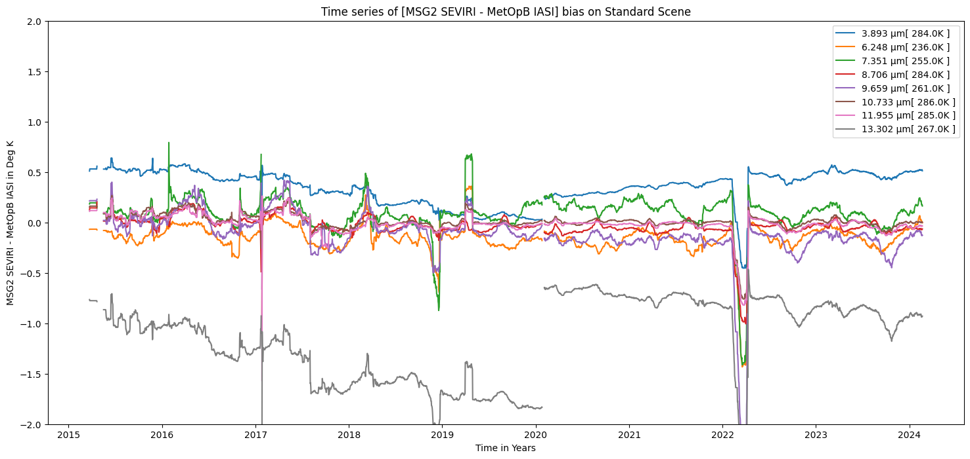
Calibration Performance: Meteosat-9/SEVIRI IR Bands
Statistics over 2023 of bias at standard scenes
from Operational GSICS Re-Analysis Correction
and time series plots over lifetime of product
Calibration is now stable
Instrument Calibration Landing Page: https://www.eumetsat.int/seviri-instrument-status-calibration
Content generated with customised copy of GCC Colab tool
2023-01-01/12-31 | Summary Statistics of [MSG2 SEVIRI - MetOpB IASI]
 | IR3.9 | IR6.3 | IR7.2 | IR8.7 | IR9.7 | IR10.8 | IR12.0 | IR13.4
Standard Scene Temp (K) | 284.0 | 236.0 | 255.0 | 284.0 | 261.0 | 286.0 | 285.0 | 267.0
Tb Bias (K) | 0.49 | -0.14 | +0.06 | -0.04 | -0.18 | -0.01 | -0.03 | -0.90
Std Dev (K) | 0.03 | 0.08 | 0.08 | 0.04 | 0.09 | 0.04 | 0.04 | 0.09
Drift (K/Yr) | -0.07 | -0.14 | -0.17 | -0.06 | -0.19 | -0.08 | -0.08 | -0,24

Slide 8
Example Content of GSICS SOS Report
Table summary stats of Bias wrt Reference over 1 year
Time Series to visualise calibration stability over mission lifetime
(Next slide!)

Slide 9
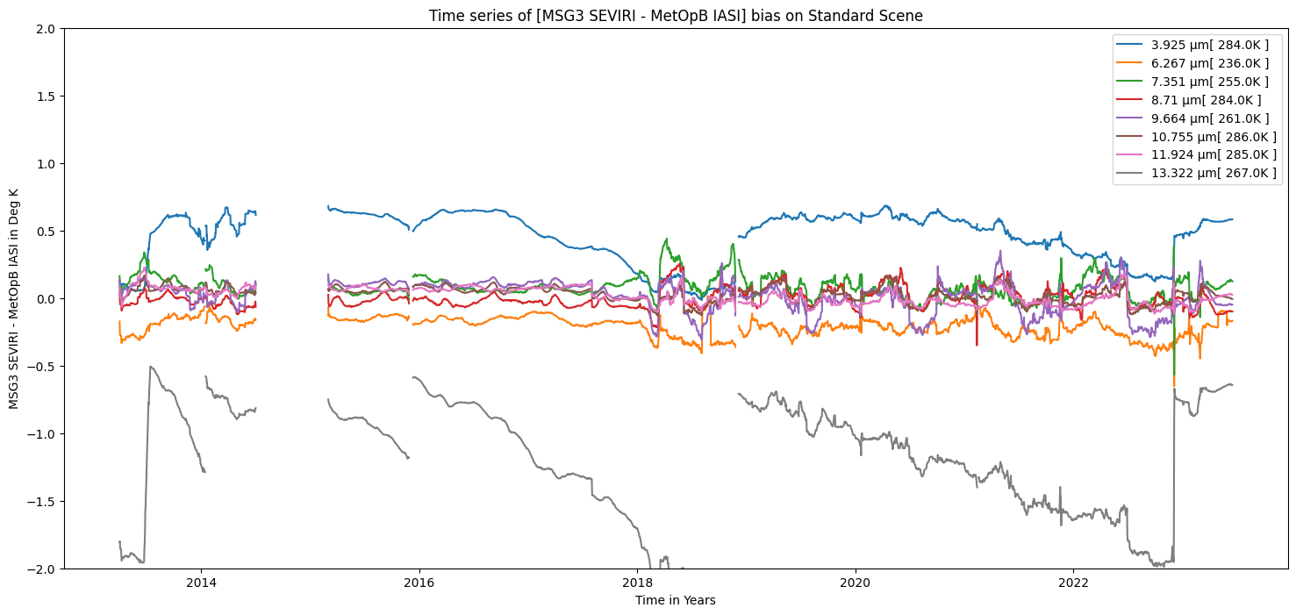
Example – Meteosat-10 over 10 years

Slide 10
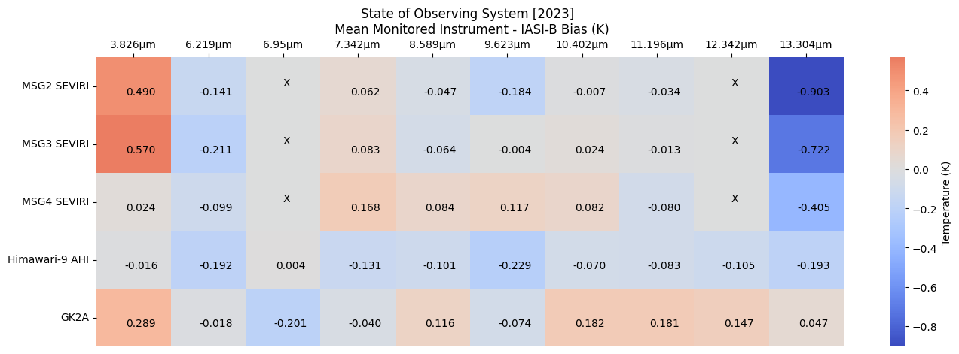
Example Heat Maps to compare common channels of multiple instruments
➔ Format to be refined in IR Sub-Group

Slide 11
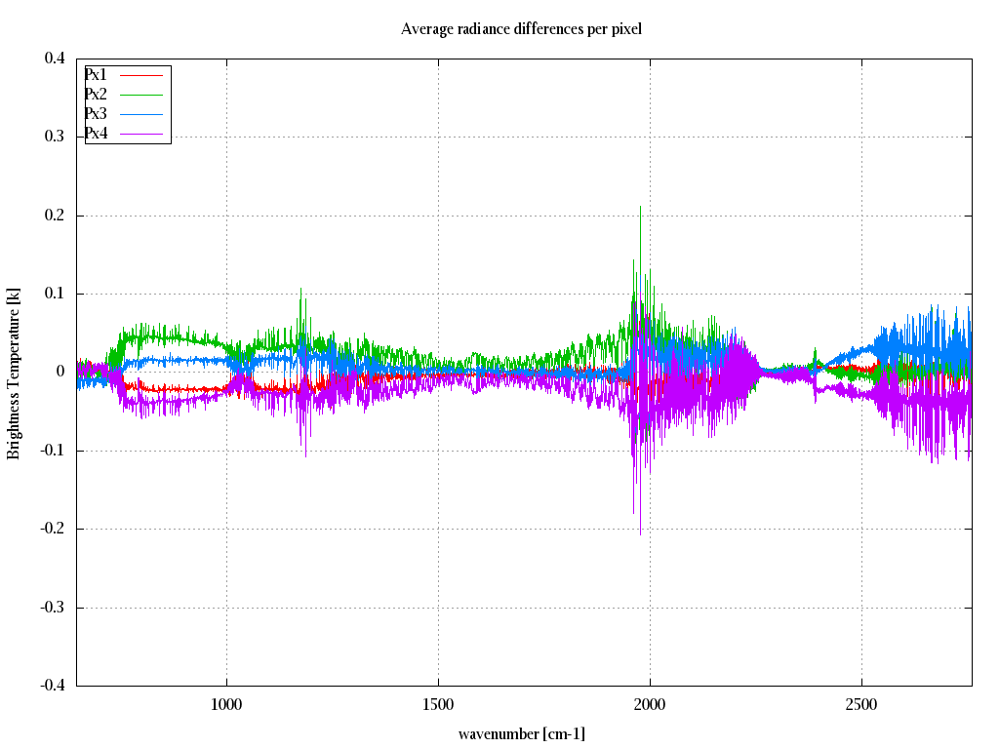
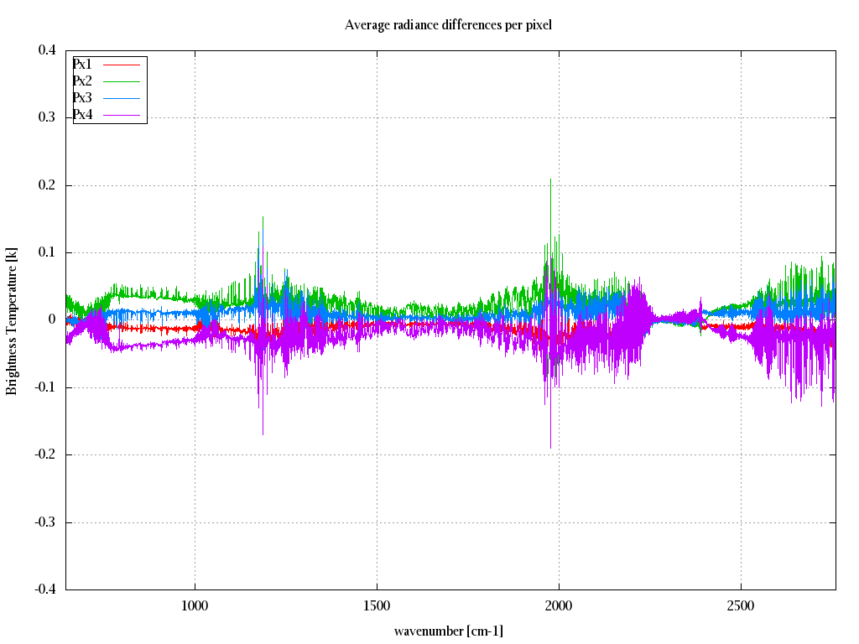
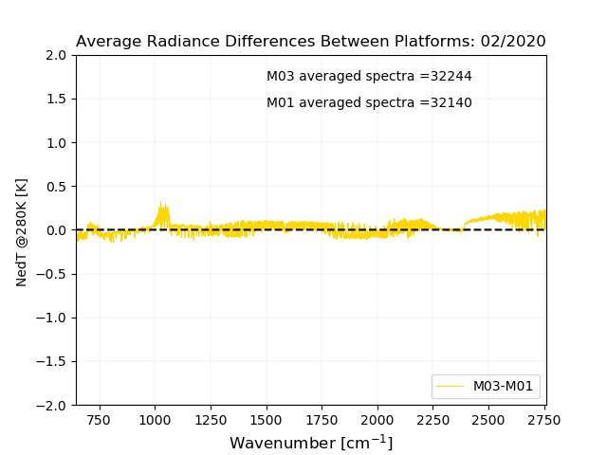
Satellite/Instrument Summary – EPS/ IASI-B and C
Both IASI instruments inter-pixel consistency in 2023 continues to be better than 0.1 K
The noise remains within 0.5K as expected
The consistency between the two instruments is better than 0.1K
IASI-B annual inter-pixel stability
IASI-C annual inter-pixel stability
(IASI-C-IASI-B) for 1 month
0.1K
-0.1K
Instrument Calibration Landing Page:
https://www.eumetsat.int/iasi-instrument-status-calibration

Slide 12
SOS Reports for GSICS Reference Instruments
Still to be agreed:
Common algorithm(s) to compare reference instruments
E.g. SNO, Double Difference from GEO-LEO or NWP, …
Common channels to be reported
E.g. 3 selected channels per spectral band
Standard scene radiances to report biases (e.g. 1976 US Standard Atm + RTM)
Selection of Anchor Reference

Slide 13
Generation of G-SOS Reports
Standardise & Automate where possible!
Encourage GPRCs to generate GSICS products for all instruments to be monitored
Even if they do not need to apply corrections (insignificant biases)
Encourage to use GCC-derived colab tool to generate the charts
Tool available at: http://gsics.atmos.umd.edu/bin/view/Development/Annualmeeting2022
Where not possible, data can be provided to GCC via spreadsheet
In format to be defined by Manik Bali

