Slide 1
Review of GSICS GEO-LEO IR v2 inter-calibration algorithm development
Tim Hewison (EUMETSAT)
+ Many other GSICS contributors over >10 yrs!
GSICS Annual WG Meeting - IR Session 2024-03-12

Slide 2
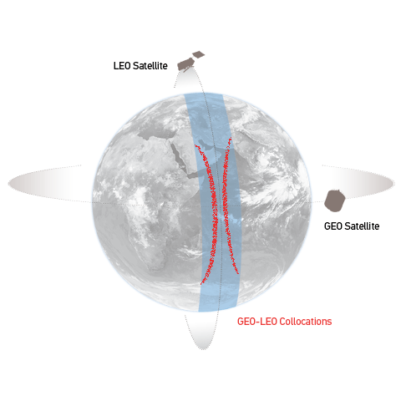
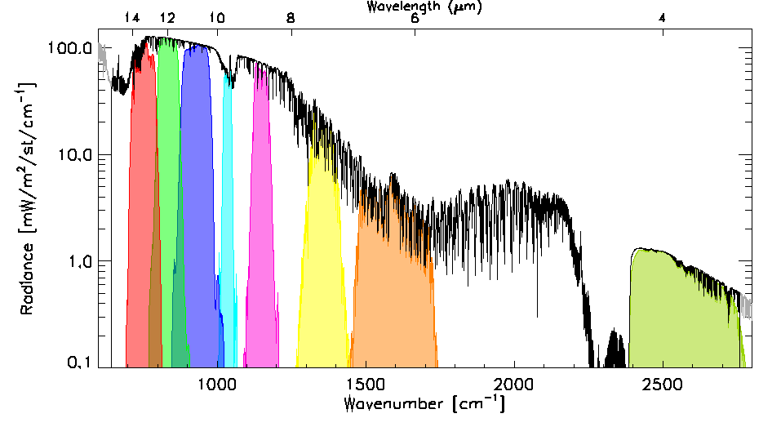
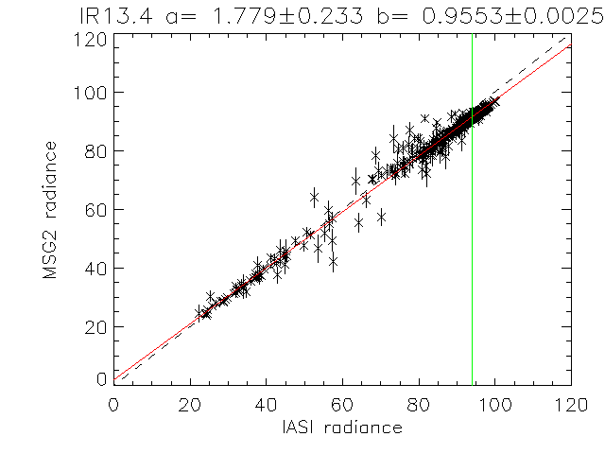
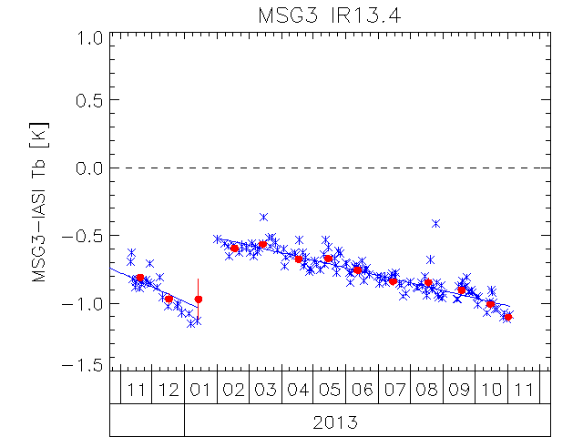
Review: Current GSICS GEO-LEO IR algorithm
Collocate in Space, Time, Angle
Collect Simultaneous Nadir Overpasses (SNOs)
Tie to contemporary reference instrument
with very small uncertainty
Hyperspectral Reference (IASI)
Convolve IASI spectrum with Spectral Response Function (SRF) of monitored instrument
Can diagnose SRF errors
Compare
Apply weighted regression to collocated radiances
Evaluate uncertainties
Generate GSICS Correction
Update daily
Distribute via GSICS Servers
Evaluate & Monitor Bias
Check long-term stability & Decontamination
[mW/m2/sr/cm-1]
[mW/m2/sr/cm-1]

Slide 3
Review: Issues with current GSICS GEO-LEO IR algorithm
Previously, reviewed issues with v1 GSICS GEO-LEO IR algorithm:
Formulation not user friendly
Performance at the Cold End
Hot Land Bias issue
Impact of high viewing angles
Diurnal variation
Need to handle multiple references - including IASI, CrIS, HIRAS, …

Slide 4
Cooperative GEO-LEO IR v2 inter-calibration algorithm development
2023-03 Planned
2023-07 Updated plan:
GPRCs operating GEO imagers to implement proposed algorithm for GEO-LEO IR v2:
CMA, EUMETSAT, ISRO/IMD, JMA, KMA, NOAA
Volunteers agreed to investigate further improvements and report by 2024:
3.9µm channel issue – already addressed (summarised by Likun Wang)
Parallax – Likun Wang (NOAA) – 2023-05-04
Detect and Filter collocations affected by Hot Land issue – KMA + EUM
Formulation of regression algorithm - Fred Wu (NOAA)
Using multiple GEO imagers per LEO overpass – Vincent Debaecker (EUMETSAT) – new!
Multiple References/Diurnal Variations - Pradeep Thapliyal (ISRO), Chengli Qi (CMA)
CMA also to cover in hyperspectral-hyperspectral comparisons
Define Standard Scene Tbs: e.g. 220K, Tb_std, 305K? - Pradeep Thapliyal (ISRO)
Uncertainty Analysis - Tim Hewison (EUMETSAT) – as part of MTG-I1/FCI commissioning
2024-03 – Updates in Green above
Open Issues to be resolved/discussed in red

Slide 5
Related algorithms
GEO-GEO imager-imager
2024-03: FY: GOES ABI IR midnight calibration variation
2024-03: EH: Re-calibration results of COMS/MI and GK2A/AMI
(2024-03: VdB: FCI-SEVIRI)
GEO-GEO hyperspectral-imager
2023-05: DD: FY-4A/AGRI-GIIRS
Radiance dependence
Viewing Zenith Angle dependence
GEO-LEO hyperspectral-hyperspectral
2024-03: PD: FY-4B GIIRS / Metop-IASI Inter-comparison
CMA?
LEO-LEO imager-imager
Extension to VIS/NIR – Ray-matching?

Slide 6
Calibration Correction Model
Issues:
Formulation not user friendly
Performance at the Cold End
Proposals:
2023-03: TH proposed Orthogonal Distance Regression (ODR)
with quadratic term, but forcing offset = zero
2024-03: XJ: Improvements in the Current SNO method for ABI-CrIS ?
2024-03: MT: See agenda item: Revisit to AHI GEO-LEO-IR Regression
Any other ideas?
Way forward?

Slide 7
Extending Dynamic Range – including day-time collocations
Hot Land Issue
2023-07: TH: Ensuring Symmetric Time Sampling critical for daytime!
2024-03: VdB: Interpolating between consecutive GEO images
Issue resolved? Or sufficiently mitigated?
Sun Glint
2024-03: VdB: Impact of Sun Glint mask on FCI-IASI (also for GEO-GEO)
Generalise algorithm?
Gap-filling for 3.8µm channels only trained on night-time data – new!
2024-03: VdB: Issue with FCI-IASI IR3.8 bias in day-time
Re-train with dataset including daytime data?

Slide 8
Impact of high viewing angles
Inconsistent results with SEVIRI Full Disc and Rapid Scan Service
2023-03: TH: Inconsistent results from Full Disc and Rapid Scan Service – see next slide
e.g. due to cloud parallax issues / scan-angle dependence?
2023-09: Not an issue for FCI!
Anyone else?
Terrain Correction
2023-07: LW: Application to LEO-LEO
Issue for GEO-LEO IR?
Parallax
2023-03: TH proposed Parallax mask – reject high VZA + low BT combinations
2023-05: LW: Constrain Relative Azimuth Angle / Use LOS vectors, instead of VZA
2024-03: TH: Simple Model of Parallax Uncertainty
2024-03: LW: Summary on Angle errors, parallax, and proposed resolutions
Way forward?
Ensure no systematic bias introduced by inter-calibration algorithm
Account for additional uncertainty?

Slide 9
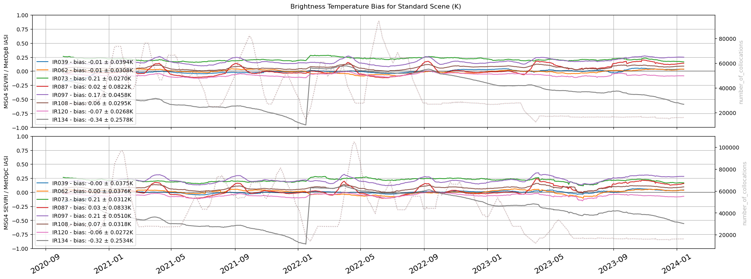
Time series of bias of Meteosat-11/SEVIRI wrt IASI-B/C
Changed from Full Disk to Rapid Scan Service in March 2023
Increase in noise (expected, due to fewer collocations)
Small bias change in IR8.7 and IR13.4 channels

Slide 10
Multiple References/Diurnal Variations
Progress?

Slide 11
Collocation Smoothing Window period
Collocations from multiple days can be combined
When calculating GSICS Correction/bias monitoring
Trade-off between
Response to rapid calibration changes
Uncertainty on correction function/bias
Required level of uncertainty?
2013: Defined 29d for RAC, 14d for NRTC
Based on typical rate of change of GEO calibration
2024-03: VdB Illustration for FCI-IASI
Need to revise for current instruments & v2 algorithm
Iteratively with uncertainty analysis

Slide 12
Reporting & Uncertainty
Definition of biases
2024-03: TH: Standard Scene Tbs
SRF Errors:
2024-03: VdB: Apply Simple SRF Shift to FCI-IASI
SRF retrievals – TBA
Reporting
2024-03: See discussion under agenda item on GSICS SOS Reports
Uncertainty Analysis to be repeated for algorithm revisions
2023-09: TH proposed new approach
Propagating uncertainty on all inter-calibration inputs through calibration equation in near real-time
Will test on FCI-IASI – awaiting sufficient data
Anyone else?

Slide 13
Thank you!
Questions are welcome.

