Slide 1
Ongoing GEO-LEO IR algorithm studies - Insights on FCI
Vincent Debaecker, Tim Hewison , Ali Mousivand, Mounir Lekouara
(EUMETSAT)
2024 GSICS Annual Meeting
Darmstadt, 13.03.2024

Slide 2
Introduction
Results for FCI
  GEO-GEO
  GEO-LEO
On-going studies
  Impact of reducing time window
  Sun-glint masking to apply to day-time
  Temporal Interpolation between GEO images
  Introduction to SRF shifts for FCI (no conclusions)

Slide 3
Results for FCI
Results for FCI
  GEO-GEO
  GEO-LEO
Commissioning phase!
FCI radiances not fully calibrated yet
Many corrections are not yet enabled (e.g. straylight)
Many gaps in the data flow
Demonstration of capability, testing tools, preparing analysis

Slide 4
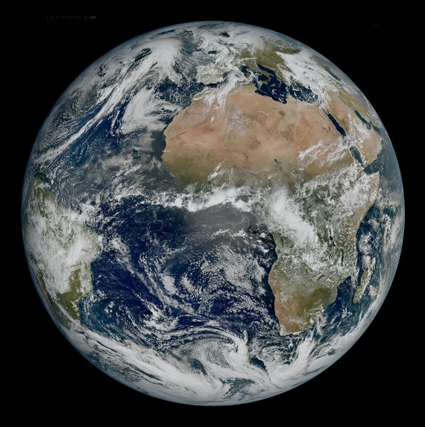
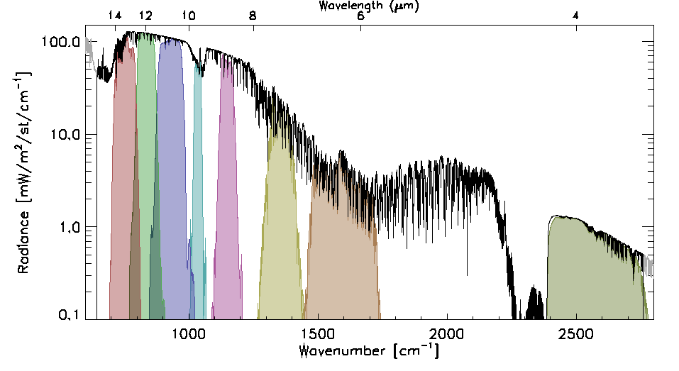
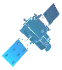
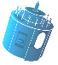
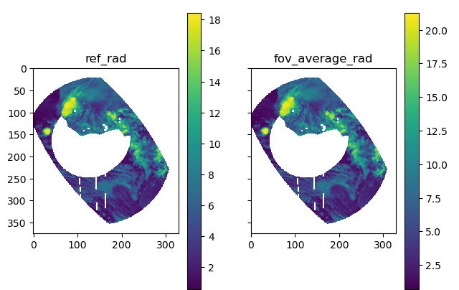
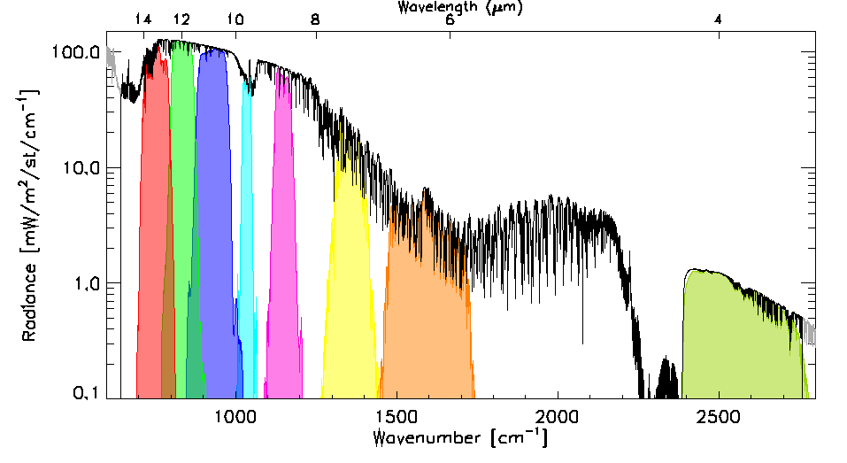
GEO-GEO inter-comparison algorithm: FCI-SEVIRI
Time (1 hour)
Collocate in Space, Time, Angle
  Subset to 30°x30°N/S/E/W (VZA<30°)
  Re-grid GEO images to 15x15 km
  Maximum difference in |dsec(VZA)| < 0.03
  Pixels’ max time difference |dt| < 300s
  Calculate Mean & Variance
Account for Spectral differences
  Apply Spectral Band Adjustment Factors
Filter
  Apply Sun-Glint mask to solar channels
  Tag land/sea/day/night for analysis
Combine
  Collocations within 1 hour windows
Compare
  Weighted regression of radiances
  Evaluate uncertainties
Evaluate & Monitor Bias
  Check medium-term radiometric stability <0.1 % / 24 hr for VIS/NIR
  <0.1 K / 10 min for IR
SEVIRI SRFs
(µ, σ)
|
(µ, σ)
Spectral Band Adjustment Factors
SEVIRI VIS0.6 FCI VIS0.6
FCI SRFs
Notes:
Move grids to top right
Add scatterplot

Slide 5
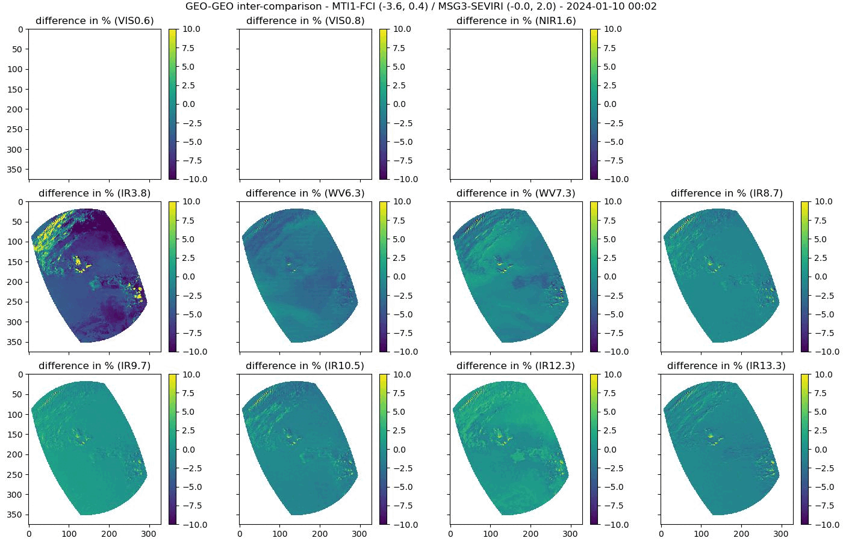
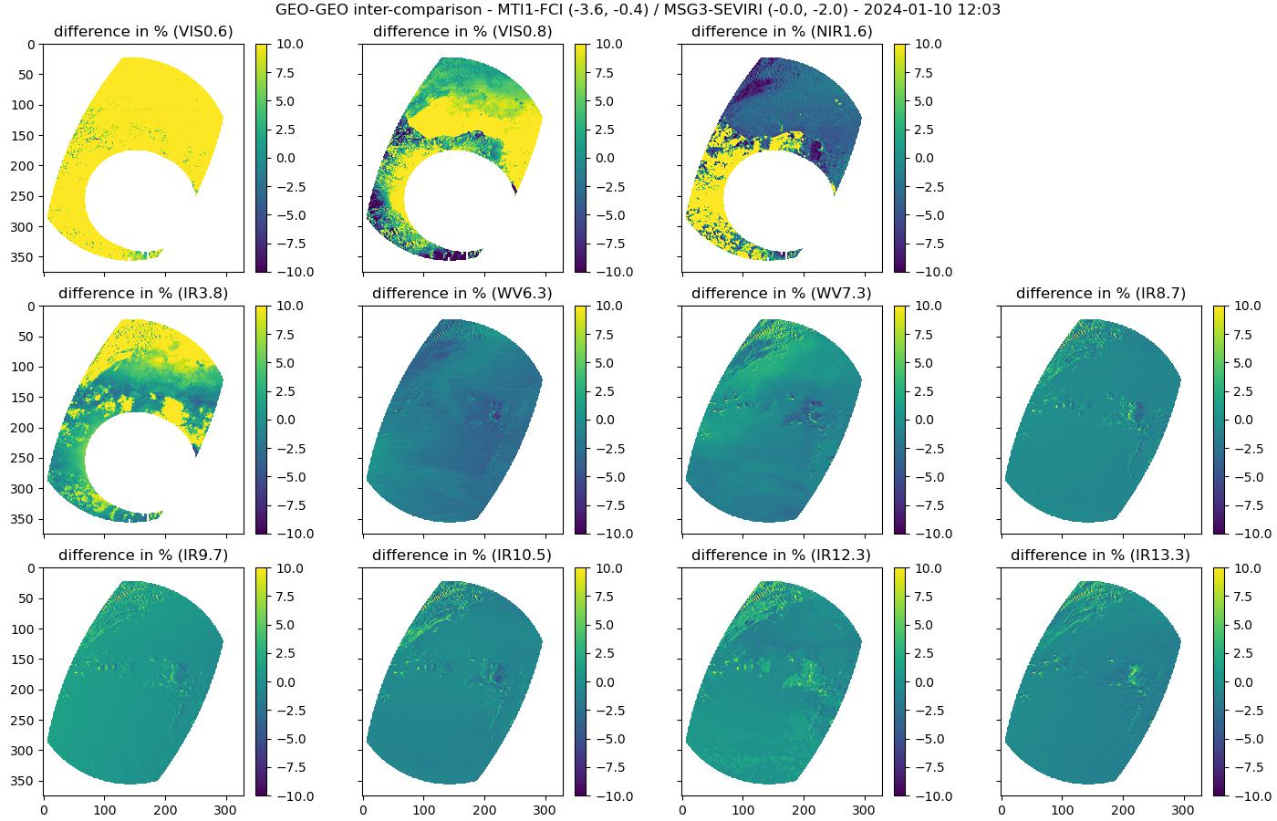

Example GEO-GEO Results – Normalised Differences
FCI VNIR calibration is not yet updated in-flight
SEVIRI VIS0.6/0.8 calibration known to be biased by 10%/ 7%
Other differences/stripes due
to ongoing detector calibration
Target area moves due to satellites’ orbital inclination
Sun glint mask moves with Sun during the day
Differences vary with:
  Time of day
  Land/Water
  Scene radiance
  (clear/cloudy)
  Cloud edge effects
Notes:
Made with http://micmicsdev4:8888/notebooks/FCI/Commissioning/IDPF_IVV_June2023/IIIC_Time_Series.ipynb

Slide 6
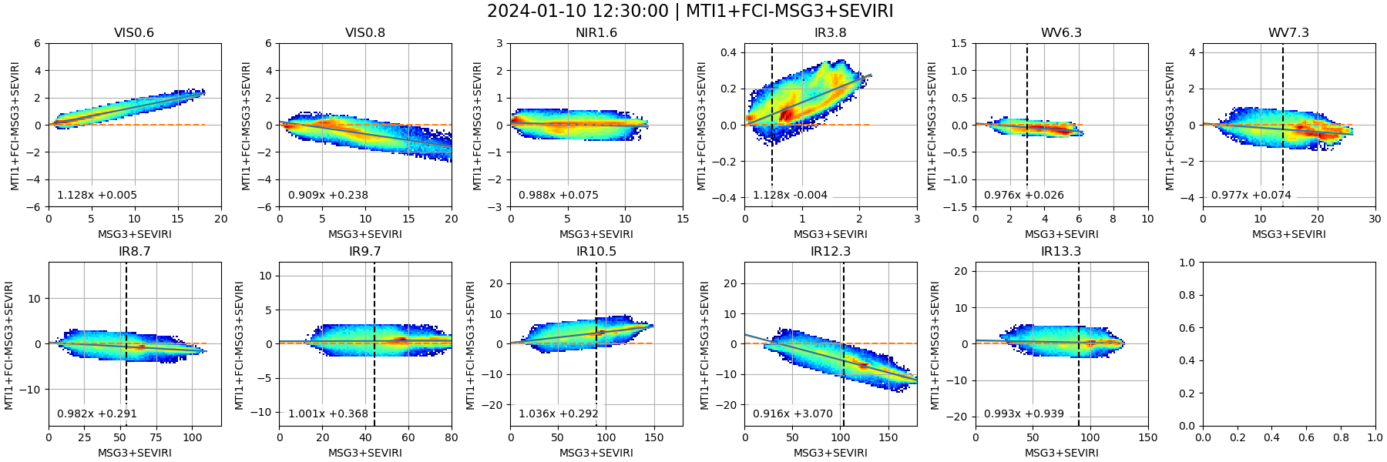
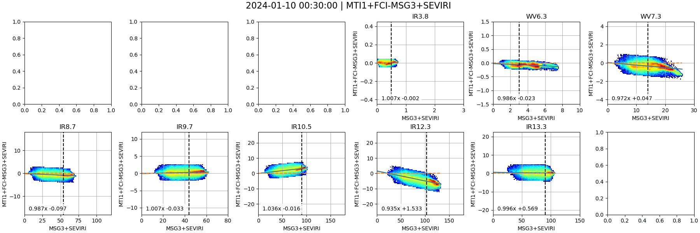
Example GEO-GEO Results – Scatterplots + Regression
day
Daytime (noon): including solar channels
Quick slope/offset assessment (SEVIRI VIS0.6/0.8 calibration known to be biased by 10%/ 7%)
Checking potential non-linearity
Notes:
Scatterplots show relationship between collocated superpixels – e.g. calibration bias, non-linearity
Currently using linear regression to define relationship (under review)
Results sensitive to Spectral Band Adjustment Factors – especially IR3.8 – which may need different SBAFs in daytime and nighttime
Results currently vary during day for some channels – highlighting processing issues
!$ cd /tcenas/proj/calib/results/MICMICS/VAL/COD/products/SATCAL_NRTC_GEOGEO_QLK/Meteosat-12+FCI_Meteosat-10+SEVIRI/v01/2023/08/
!$ convert -delay 20 -loop 0 *20230805*.png 20230805_animation.gif

Slide 7
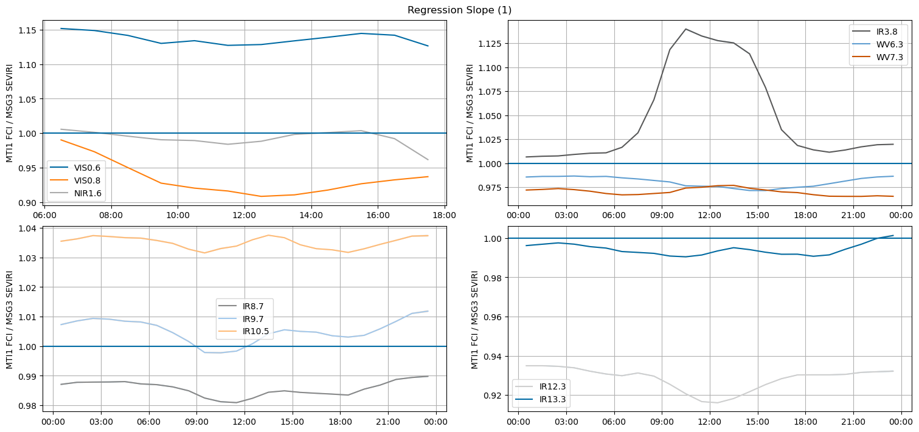
Example GEO-GEO Results – Regression Coefficient
Checking diurnal variations
MTG-I1/FCI-Meteosat-10/SEVIRI 2024-01-10
Based on a single day of collocations
Notes:
VIS/NIR calibration shows large biases – partially explained by SEVIRI calibration – but remains relatively stable during the day
IR channels’ calibration generally in line with SEVIRI – IR3.8 clearly shows different behaviour during the daytime due to sensitivity to solar signal + something in IR8.7+9.7 around sunset
Remaining difference subject to ongoing investigations

Slide 8
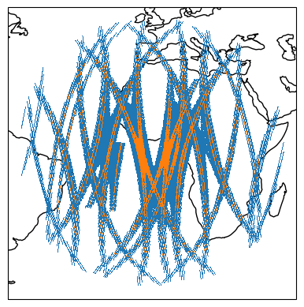
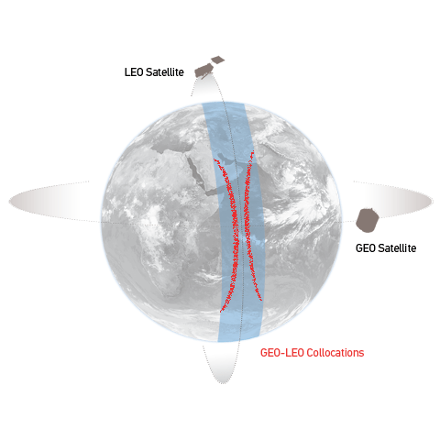
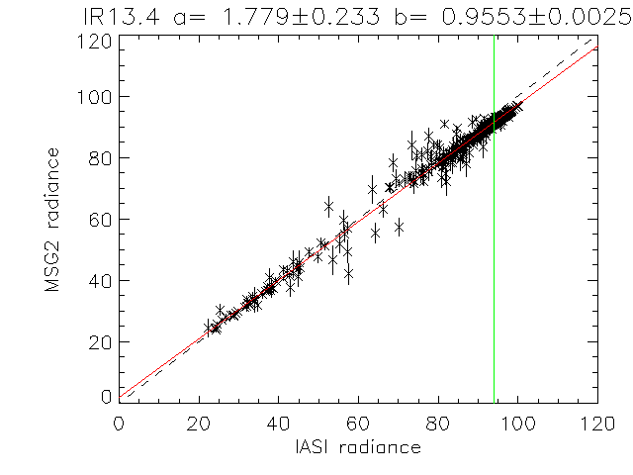
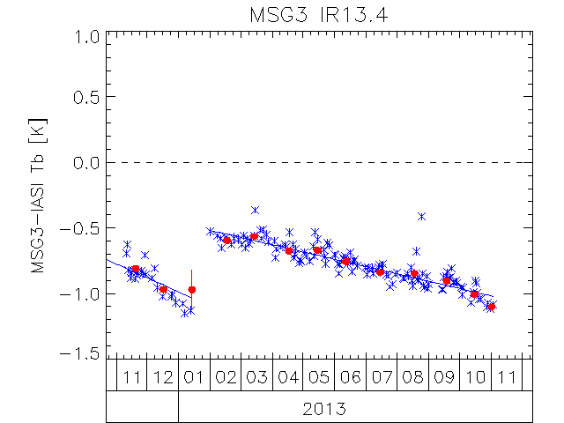

Current GSICS GEO-LEO IR algorithm: FCI-IASI
Collocate in Space, Time, Angle
  Collect Simultaneous Nadir Overpasses (SNOs)
  Maximum difference in |dsec(VZA)| < 0.03
  Pixels’ max time difference |dt| < 300 s
  Night-time data
  Average all FCI pixels in each IASI FoV (+ var.)
Hyperspectral Reference (IASI)
  Convolve IASI spectrum with FCI SRFs
  Can investigate SRF errors
Compare
  Apply weighted regression to collocated radiances
  Evaluate uncertainties
Generate GSICS Correction
  Update daily
  Distribute via GSICS Servers
Evaluate & Monitor Bias
  Verify Radiometric Accuracy Requirement (<0.7 K)
  Check long-term stability (<0.3 K over lifetime)
  Including decontaminations
[mW/m2/sr/cm-1]
[mW/m2/sr/cm-1]
Bias at Standard Scene Radiance (~285K)
Bias at Cold Scene (220K)

Slide 9
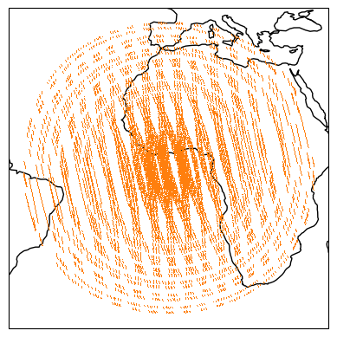
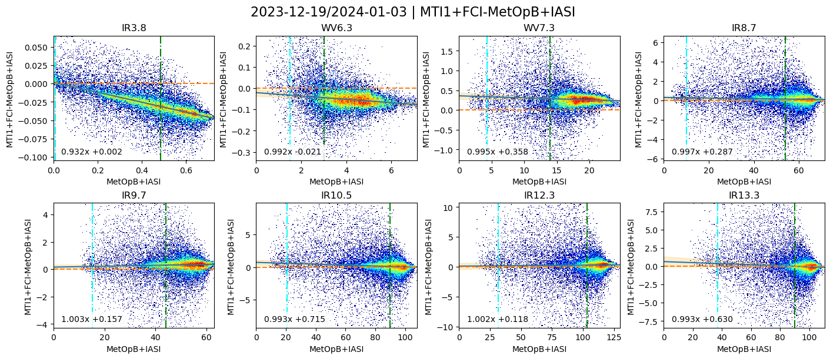
Scatterplot of Collocated Radiances + GSICS Correction
Uncertainties from algorithm inflated by 10x for plotting purposes
ref: IASI B
FCI radiances are not fully calibrated - Many corrections are not yet enabled
Notes:
Radiance-dependent biases in IR3.8, WV7.3, IR13.3 – SRF errors?
SEVIRI MSG3-IASIB - IR3.9 – slope: 1.032, offset: 0.001 -→ explains GEOGEO is flat

Slide 10
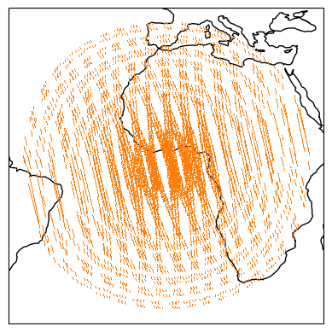
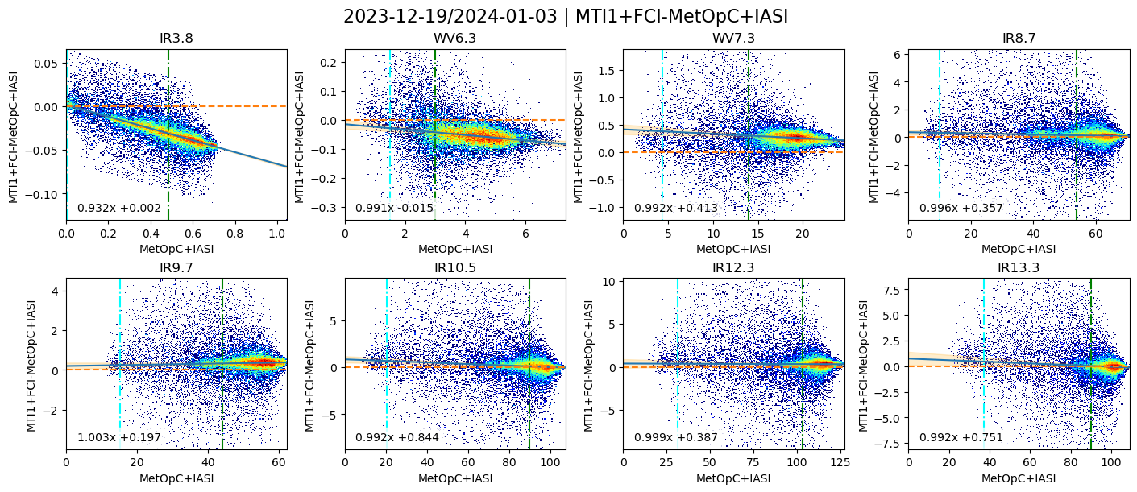
Scatterplot of Collocated Radiances + GSICS Correction
Uncertainties from algorithm inflated by 10x for plotting purposes
ref: IASI C
FCI radiances are not fully calibrated - Many corrections are not yet enabled
Notes:
Radiance-dependent biases in IR3.8, WV7.3, IR13.3 – SRF errors?

Slide 11
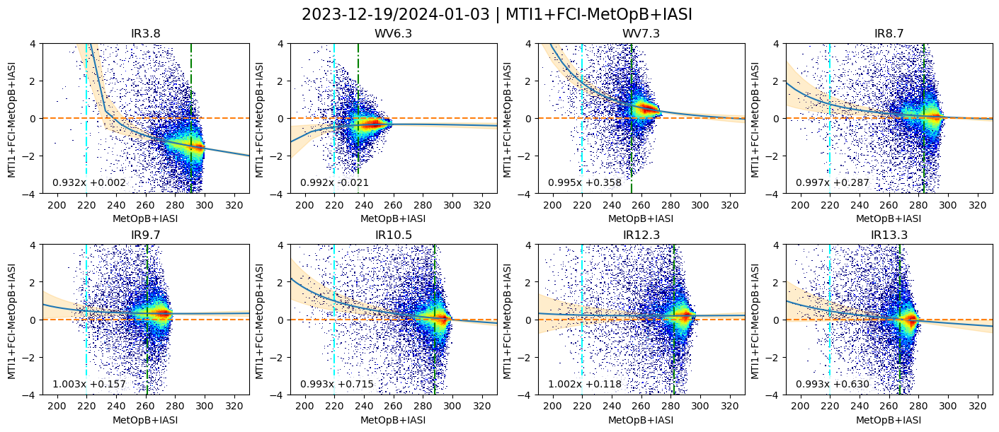
Scatterplot of Collocated BTs + fitted GSICS Correction
Bias Requirement ±0.7K
Uncertainties from algorithm inflated by 10x for plotting purposes
ref: IASI B
FCI radiances are not fully calibrated - Many corrections are not yet enabled
Notes:
Uncertainties are shown multiplied by 10
at extremes of dynamic range appear larger when projected into brightness temperatures
but only 4 days’ data here – will reduce when more data is available, and as more of the dynamic range is filled with more variable cloudiness

Slide 12
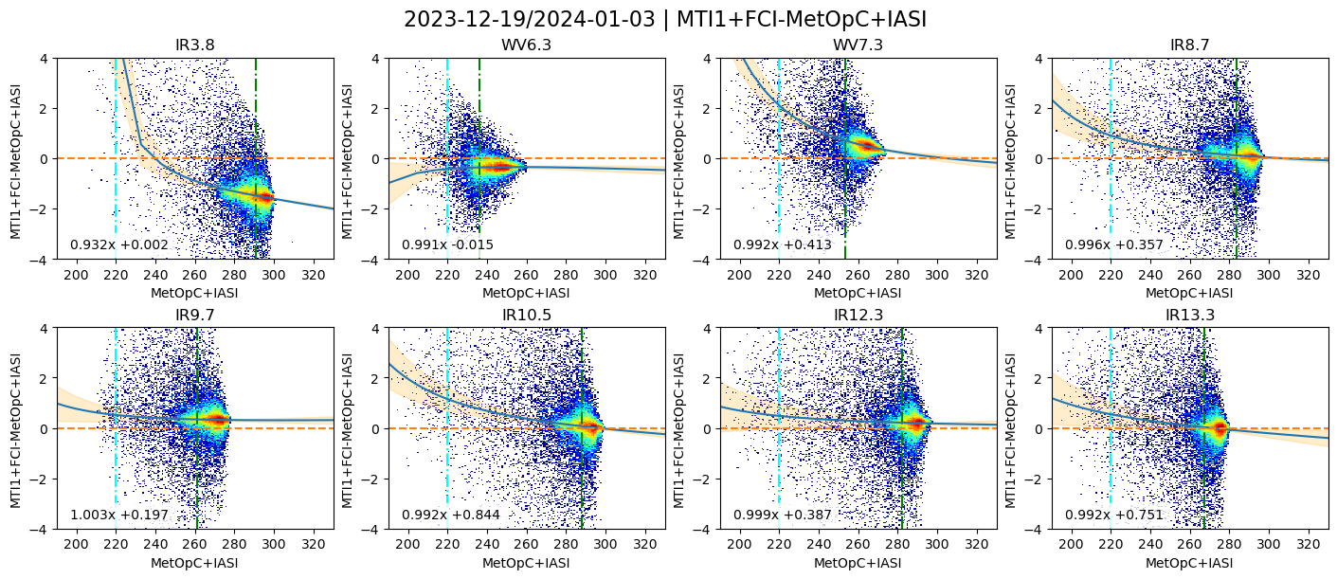
Scatterplot of Collocated BTs + fitted GSICS Correction
Bias Requirement ±0.7K
Uncertainties from algorithm inflated by 10x for plotting purposes
ref: IASI C
FCI radiances are not fully calibrated - Many corrections are not yet enabled
Notes:
Uncertainties are shown multiplied by 10
at extremes of dynamic range appear larger when projected into brightness temperatures
but only 4 days’ data here – will reduce when more data is available, and as more of the dynamic range is filled with more variable cloudiness

Slide 13
On-going studies
Results for FCI
  GEO-GEO
  GEO-LEO
On-going studies
  Impact of reducing time window
  Sun-glint masking to apply to day-time
  Temporal Interpolation between GEO images
  Introduction to SRF shifts for FCI (no conclusions)

Slide 14
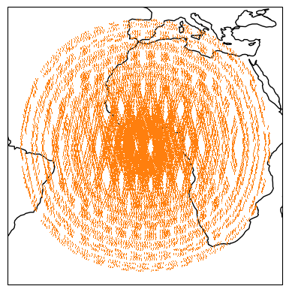
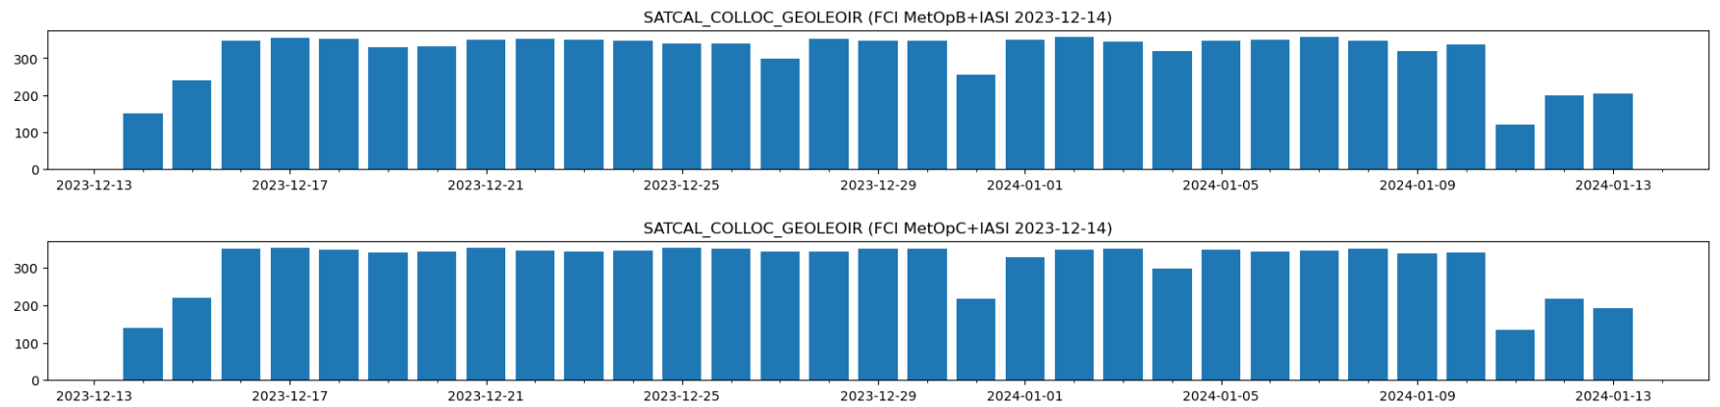
Temporal window size | reduction test
Uncertainties from algorithm inflated by 10x for plotting purposes
Temporal window size – trade off
  Dataset
    FCI L1C / IASI Metop B & C – duration: 1 month
  Collocation module adaptation
    None
  Collocation filtering using nominal criteria
    Maximum difference in |dsec(VZA)| < 0.01
    Pixels’ max time difference |dt| < 300 s
    Maximum viewing zenith angle VZA < 50
    Day and night data

Slide 15
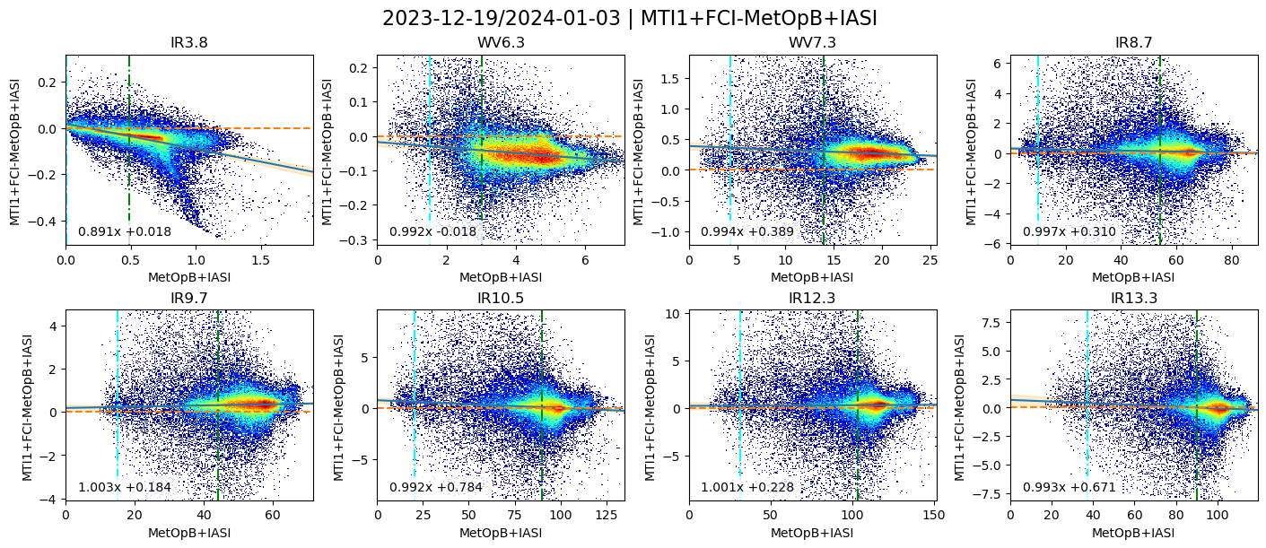
Temporal window size | reduction test
  Current results (day+night – 29 days window)
Uncertainties from algorithm inflated by 10x for plotting purposes
sunglint

Slide 16
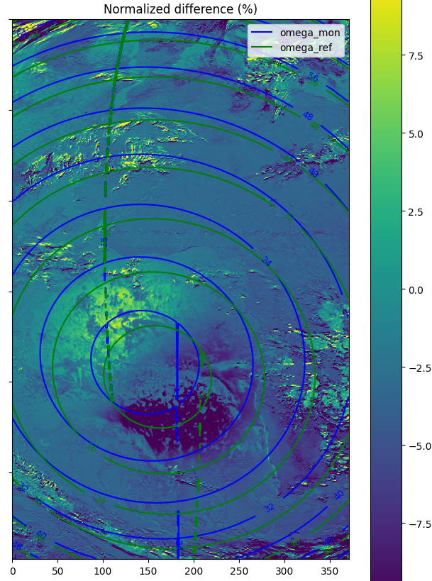
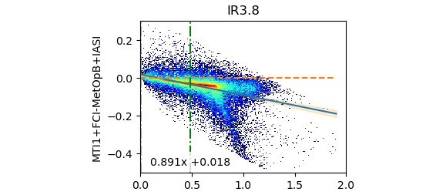
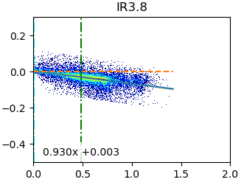
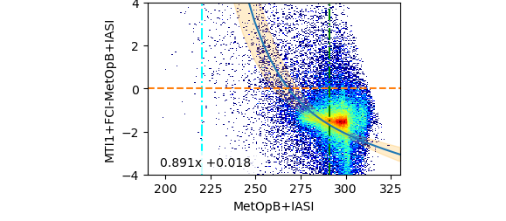
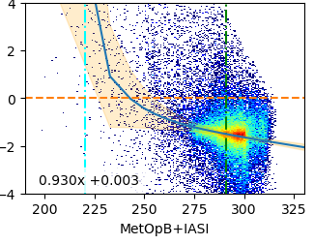
Temporal window size | reduction test
Uncertainties from algorithm inflated by 10x for plotting purposes
Testing sunglint mask (IR3.8 channel)
based simply on a threshold on the sunglint angle
masking
Radiance
Brightness temperature
masking
Sunglint angles of the reference and monitored instruments
Tb_std Bias = -1.685 ± 0.014 K
Tb_std Bias = -1.503 ± 0.006 K

Slide 17
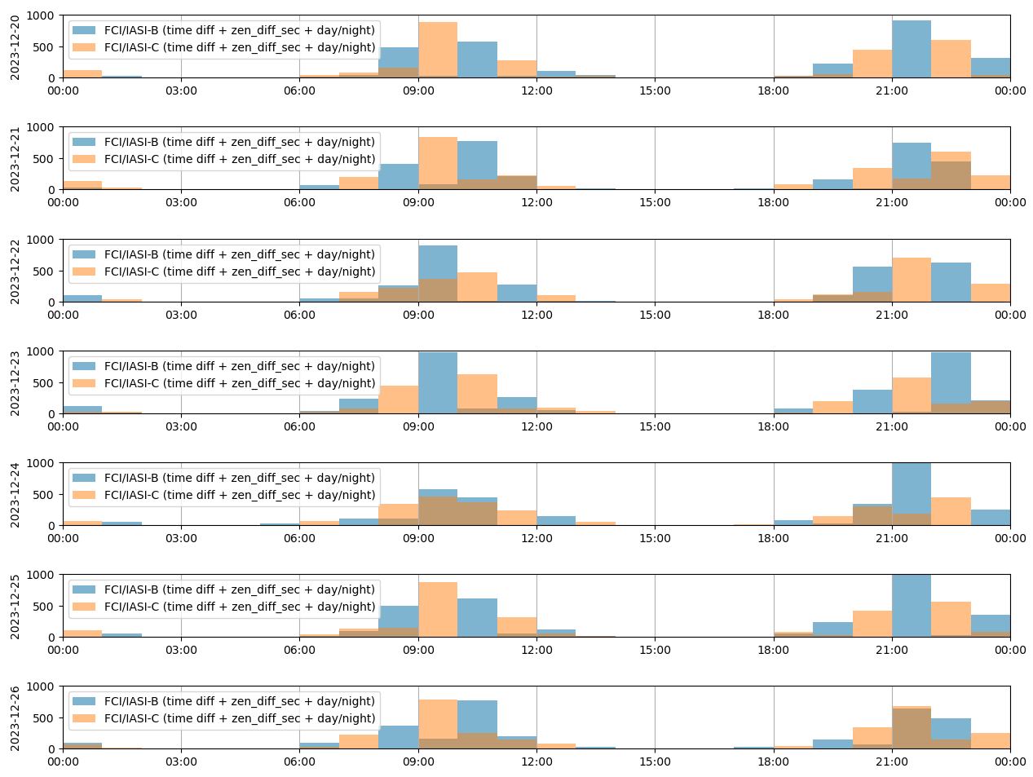
Temporal window size | reduction test
Number of collocations per day
Function of the time of the day
  Getting an idea of the availability of the collocations, on a per day-basis.
  All usual filters applied
  Peaks of collocations around the equatorial crossing local time
  CrIS reference (MSLT: 1:30) will be also used

Slide 18
Temporal window size | reduction test
Uncertainties from algorithm inflated by 10x for plotting purposes
Testing different sizes of time window
31 days
25 days
19 days
13 days
7 days
7 days
For each window:
performing GEOLEO calibration
checking output uncertainty of the Tb bias
1 day
  For a same central date

Slide 19
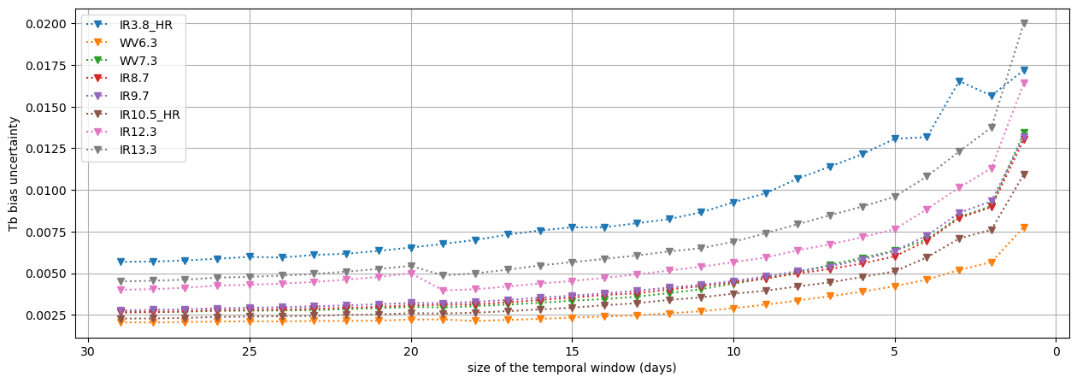
Temporal window size | reduction test
Uncertainties from algorithm inflated by 10x for plotting purposes
Tb bias uncertainty
function of the size of the time window
Future actions:
Need to assess impact on Tb Bias
Other metrics?
To check again with a more stable L1 dataset
Improve the set of collocations
Notes:
Improve the set of collocations (sunglint mask ok, but time interpolation for instance)

Slide 20
On-going studies
Results for FCI
  GEO-GEO
  GEO-LEO
On-going studies
  Impact of reducing time window
  Sun-glint masking to apply to day-time
  Temporal Interpolation between GEO images
  Introduction to SRF shifts for FCI (no conclusions)

Slide 21
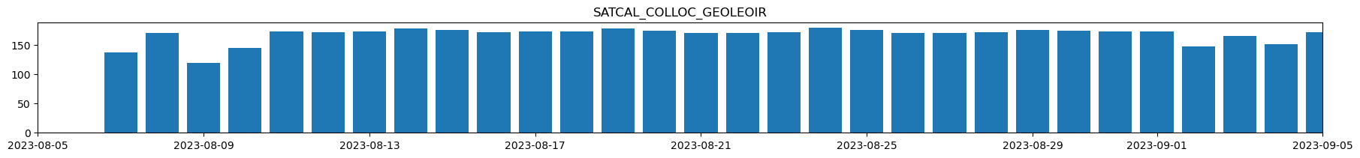
Time interpolation test | GEO-LEO case
Uncertainties from algorithm inflated by 10x for plotting purposes
GEO-LEO time interpolation
  Dataset: SEVIRI MSG3 with IASI MetOp-B - duration: 1 month
  Collocation module adaptation
    Considering 2 GEO passes per collocation– one “before” and one “after” the LEO pass
    Storing 2 values in collocation product:
      “mon”: closest value in time
      “twin”: additional value
  Collocation filtering using nominal criteria
    Maximum difference in |dsec(VZA)| < 0.01
    Pixels’ max time difference |dt| < 300 s (applied on “mon” time)
  Day- and Night-time data

Slide 22
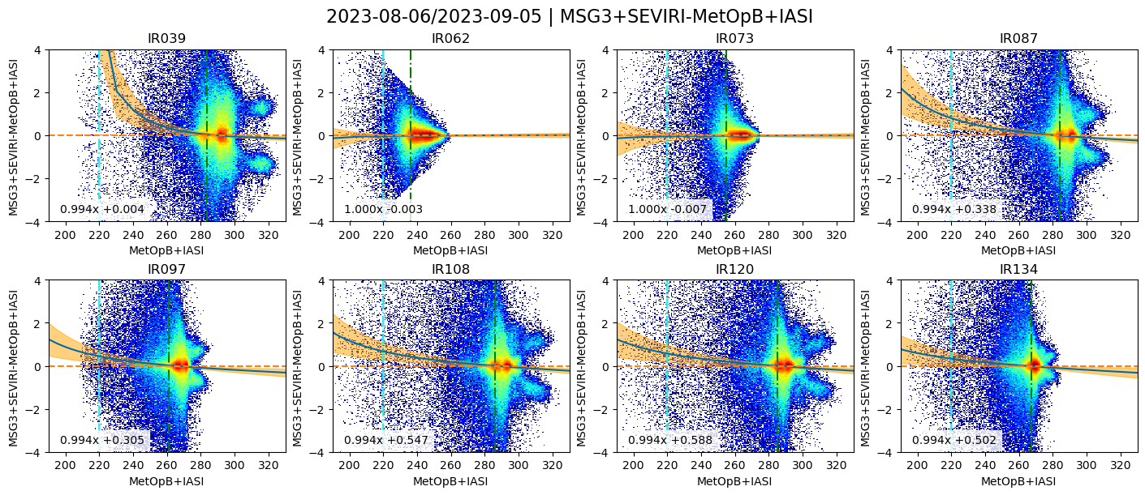
Time interpolation test | GEO-LEO case
Uncertainties from algorithm inflated by 10x for plotting purposes
Verification
  BIAS = Tb difference between the GEO main image and the GEO twin image (15min. Difference)
  day & night - land & sea

Slide 23
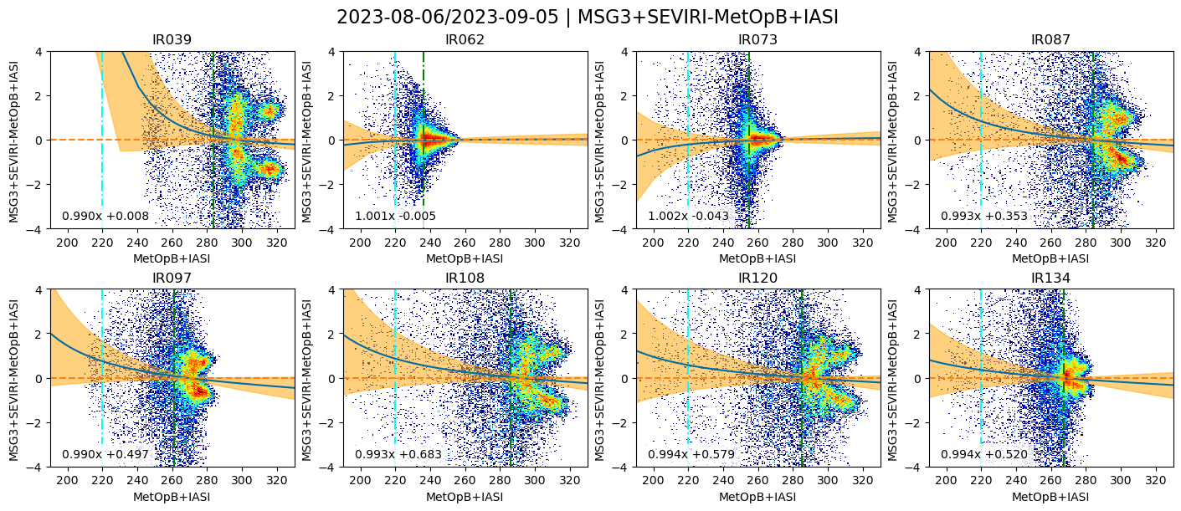
Time interpolation test | GEO-LEO case
Uncertainties from algorithm inflated by 10x for plotting purposes
Verification
  BIAS = Tb difference between the GEO main image and the GEO twin image (15min. Difference)
  daytime - land

Slide 24
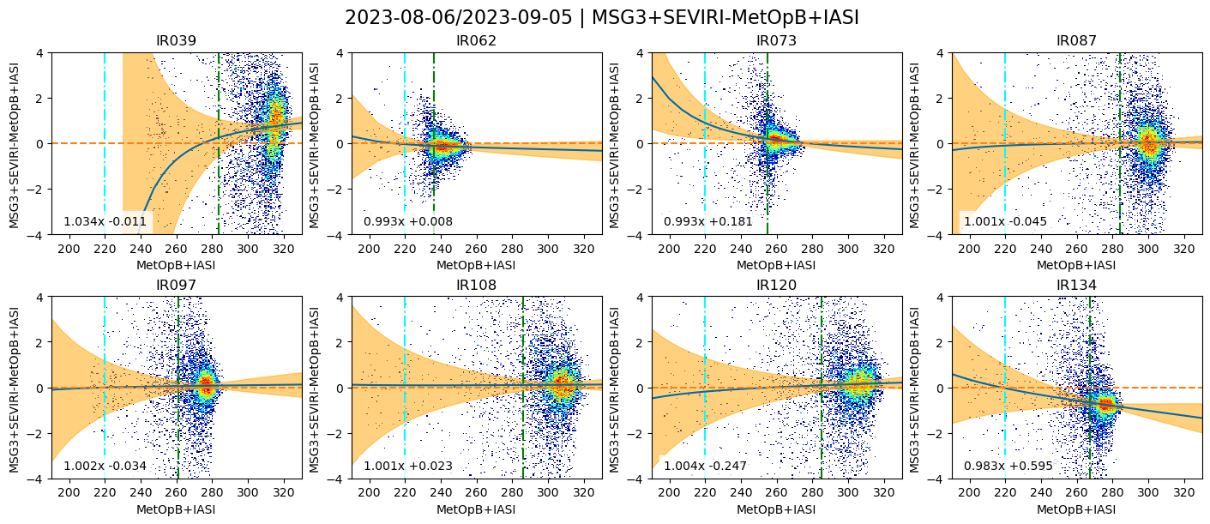
Time interpolation test | GEO-LEO case
Uncertainties from algorithm inflated by 10x for plotting purposes
Interpolation = OFF
  BIAS = GEO Tb – LEO Tb (IASI)
  Day - land

Slide 25
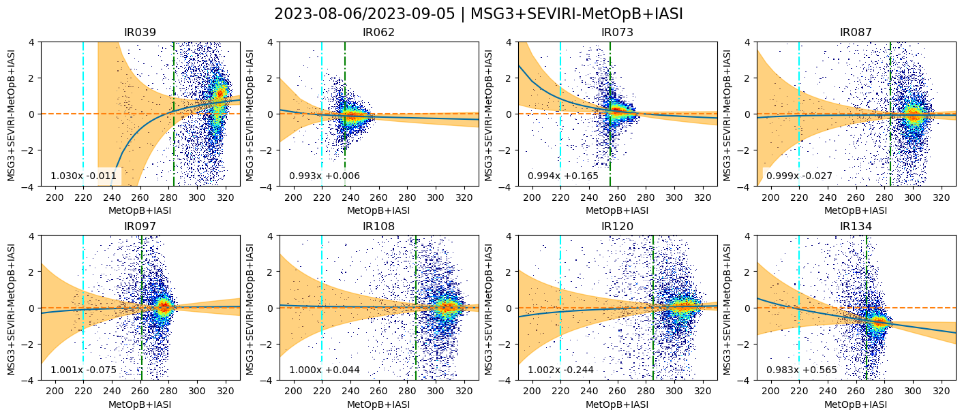
Time interpolation test | GEO-LEO case
Uncertainties from algorithm inflated by 10x for plotting purposes
Interpolation = ON
  BIAS = GEO-GEO time interpolated Tb – LEO Tb (IASI)
  Day - land

Slide 26
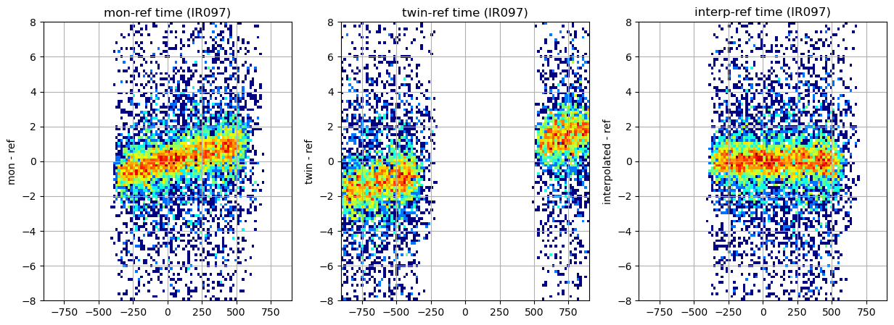
Time interpolation test | GEO-LEO case
Uncertainties from algorithm inflated by 10x for plotting purposes
  Tb BIAS function of the time difference
  ref : reference image (LEO)
  mon : main monitored image (GEO)
  twin : additional image (GEO)
  Day - land

Slide 27
On-going studies
Results for FCI
  GEO-GEO
  GEO-LEO
On-going studies
  Impact of reducing time window
  Sun-glint masking to apply to day-time
  Temporal Interpolation between GEO images
  Introduction to SRF shifts for FCI (no conclusions)

Slide 28
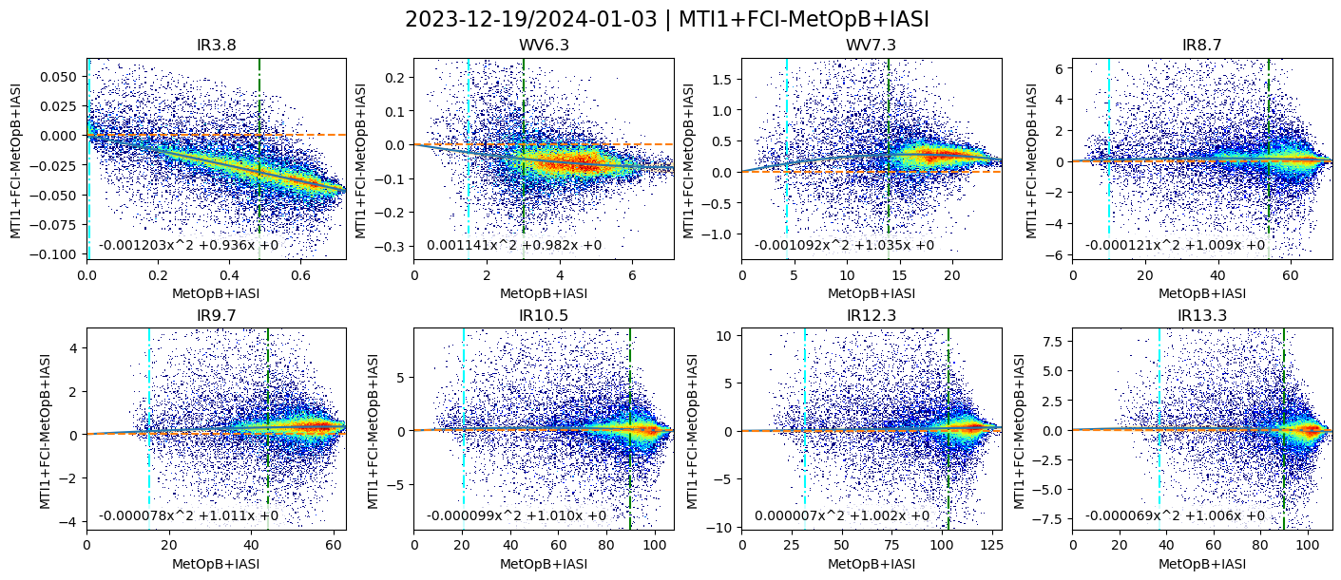
SRF shift test | +10nm shift
Uncertainties from algorithm inflated by 10x for plotting purposes
  SRF Shift Test - Motivation
  Regression not linear for some channels – would like to test the SRF shift - Water Vapor channels mostly

Slide 29
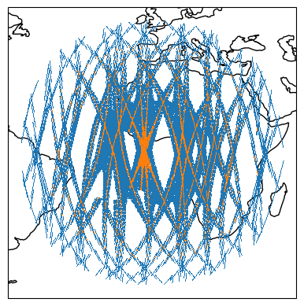
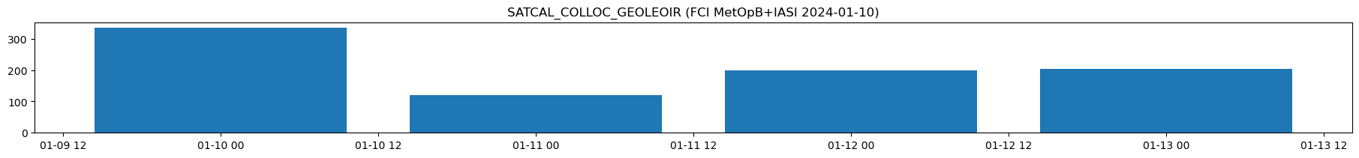
SRF shift test | +10nm shift
Uncertainties from algorithm inflated by 10x for plotting purposes
SRF Shift Test (+10nm)
  Collocation module adaptation
    Creation of “virtual” channels, with a SRF shifted by +10nm
    Adoption of a special naming convention:
      “IR3.8p10nm” -> “IR3.8” “plus” “10nm”
    Shift applied just before convolution with hyperspectral
  Collocation filtering using nominal criteria
    Maximum difference in |dsec(VZA)| < 0.01
    Pixels’ max time difference |dt| < 300 s
    Maximum viewing zenith angle VZA < 50
    Sunglint mask (IR3.8)
  Day- and Night-time data
  Not enough data yet!

Slide 30
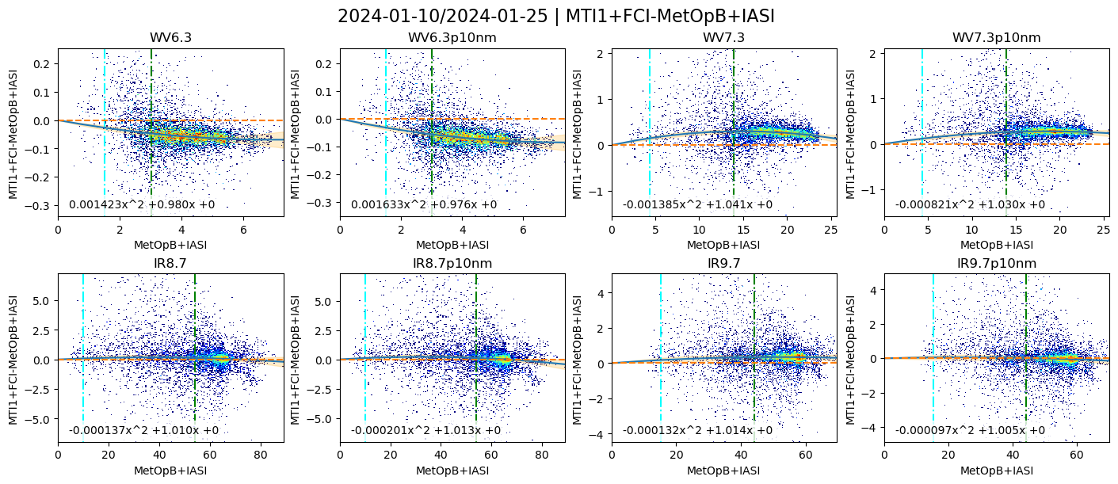
SRF shift test | +10nm shift
Uncertainties from algorithm inflated by 10x for plotting purposes
  SRF shift applied – example of side-by-side results
  Based only on 3 days of data! Analysis shall continue on a larger dataset

Slide 31

Conclusions and Outlook
GEO-GEO inter-comparisons can
  Identify processing artefacts (e.g. striping)
  Identify diurnal calibration variations
  Confirm consistency with SEVIRI
GEO-LEO IR inter-calibration can
  Quantify absolute radiometric calibration (wrt IASI + CrIS)
  Provide radiometric corrections if needed
Impact of reducing time window
  To be repeated on a longer dataset
  Using CrIS as a additional reference is planned
  Improving daytime collocations with time interpolation to be tested with FCI – benefit increased with smaller time windows
  Increasing the number of collocations by mixing different source references (IASI-B, IASI-C, CrIS-20 and CrIS-21) ?
  Simple implementation of sunglint mask in GEO-LEO seems sufficient
SRF shifts for FCI
  Test set-up, waiting for more FCI data
Thank you!
Questions are welcome.

Slide 32
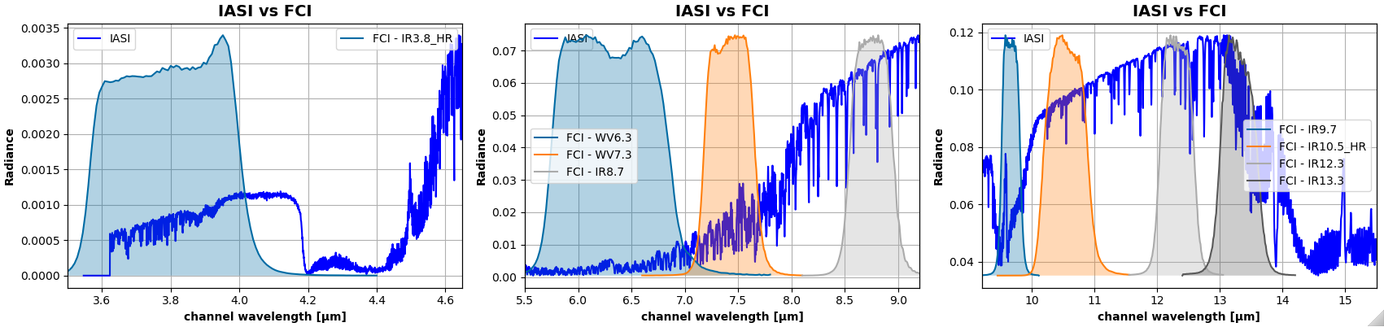
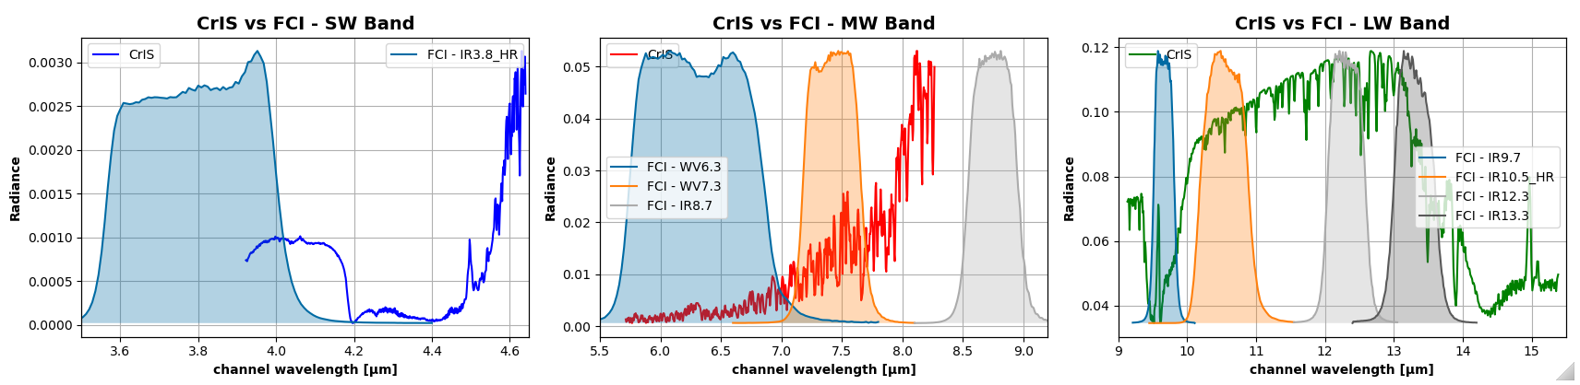
FCI SRFs in regard to IASI and CrIS spectra

