Slide 1
Revisit to AHI GEO-LEO-IR Regression
TAKAHASHI Masaya
Meteorological Satellite Center of Japan Meteorological Agency

Slide 2
Contents
Motivation
Regression Methods
Ordinary least squares (OLS) and reduced major axis (RMA)
Comparison of OLS and RMA for AHI GEO-LEO-IR
Regression Targets
GEO radiance/digital counts vs. LEO radiance
Discussion

Slide 3
Motivation
Current GEO-LEO IR algorithm uses ordinary least squares (OLS) regression for LEO-radiance (X, reference instrument) and GEO-radiance (Y, monitored instrument).
GEO radiance stdv within averaging LEO pixel size is used as weight in the regression.
Reference is assumed to be perfectly calibrated.
JMA’s VNIR vicarious calibration uses Reduced Major Axis (RMA) which considers uncertainties in both X and Y.
Tested for AHI GEO-LEO-IR in 2018, but large difference between OLS and RMA was found particularly in 3.9 μm cold scenes.
Feedback from ISCCP in 2019 (by K. Knapp) and ISCCP-NG in 2023 (by A. Heidinger)
Users have to convert BT to radiance, apply GSICS coefficients, and convert the radiance to BT.
GSICS-corrected BT LUT in MTSAT-2 GEO-LEO-IR is easy to use.
We revisited the regression method and targets (and contents of GEO-LEO-IR) for discussing GEO-LEO-IR v2 algorithm.

Slide 4
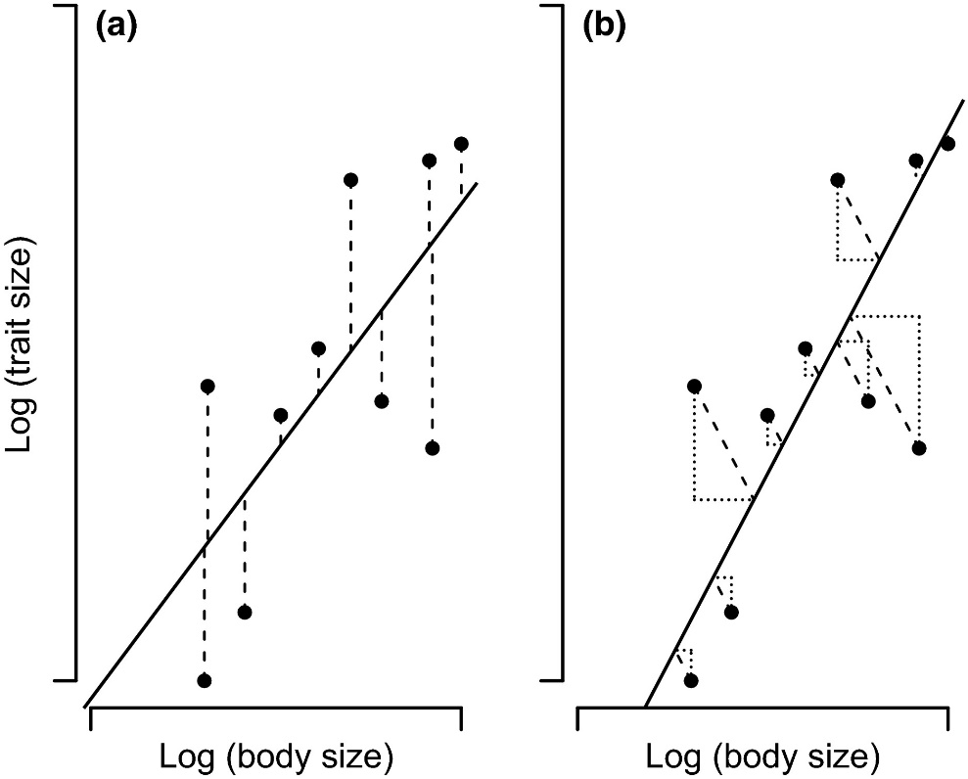
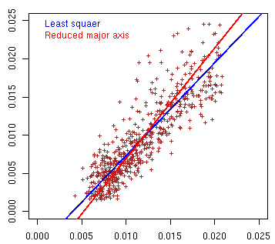
Regression Methods
a) Ordinary least squares (OLS)
No error in X is assumed, minimizing distance is vertical
b) Reduced Major Axis (RMA)
Errors in X and Y are assumed, minimizing distance is diagonal
Radiance vs radiance regression
Himawari-8/AHI (3.9um, Tb < 230K) and Metop-A/IASI
OLS
RMA
GEO Radiance [mW/m²/sr/cm⁻¹]
GEO - LEO
N = 578
January 2016
Kilmer and Rodriguez (2016)
LEO Radiance [mW/m²/sr/cm⁻¹]

Slide 5
Comparison of OLS and RMA
Old comparison prepared for 2018 GSICS Annual Meeting
Himawari-8/AHI B07 (3.9 μm) vs. Metop-A/IASI for Jan 2018
Upper figures: old comparison in 2018
RMA result was not consistent with collocation data plots
Lower figures: new comparison using the latest algorithm (correction of negative radiance handling)
RMA shows consistent result with OLS, and it has slightly smaller bias at cold scenes
The reason is unclear, but the correction of data handling may reduce inconsistency of collocated radiance difference at cold and warm scenes
OLS
RMA
AHI TB - LEO TB [K
LEO TB [K] LEO TB [K]
New comparison using the latest GEO-LEO-IR algorithm
Himawari-9/AHI B07 (3.9 μm) vs. Metop-B/IASI for Feb 2023
OLS
RMA
AHI TB - LEO TB [K
LEO TB [K] LEO TB [K]

Slide 6
Himawari-9/AHI B10 (7.3 μm) TB Biases for Feb 2023
RMA result seems consistent with scatterplots especially at cold scenes
Regression method which accounts for uncertainties of X and Y could be a candidate for v2 algorithm
 | @220 K | @250 K | @ 290 K
OLS | -0.77 to -0.62 K | -0.17 to -0.11 K | 0.13 to 0.16 K
RMA | -0.36 to -0.13 K | -0.10 to -0.03 K | 0.02 to 0.04 K
vs. Metop-B/IASI vs. Metop-C/IASI vs. Aqua/AIRS vs. NOAA-20/CrIS
OLS
RMA

Slide 7
Regression Targets
JMA’s GEO-LEO IR inter-cal info
MTSAT-2 Imager used JMA own implementation
Coefficients from GEO digital counts (DC) to LEO radiance in wavenumber [mW m⁻² sr⁻¹(cm⁻¹)⁻¹]
LUT from GEO digital counts to LEO TB [K] (optional)
Himawari-8/-9 AHI adopts GSICS standard
Coefficients from GEO radiance to LEO radiance in wnum
How to get inter-calibrated AHI rad/TB from GSICS standard info
JMA GEO radiance is based on wavelength [W m⁻² sr⁻¹ μm⁻¹], not wnum
Users have to take the following long process…
Read GEO digital count from AHI L1b (Himawari Standard Data)
Convert DC to radiance in wlen using coefficients in the L1b
Convert radiance in wlen => TB => radiance in wnum
Apply GSICS inter-calibration info to derive LEO radiance in wnum
Convert LEO radiance in wnum => TB => radiance in wlen
GEO DC
In the case of MTSAT-2, LEO rad [WN] is directly derived from GEO DC.
GEO rad
[WL]
LEO rad
[WL]
GEO TB [K]
LEO TB [K]
GEO rad
[WN]
LEO rad
[WN]
GSICS Inter-cal
(standard info)

Slide 8
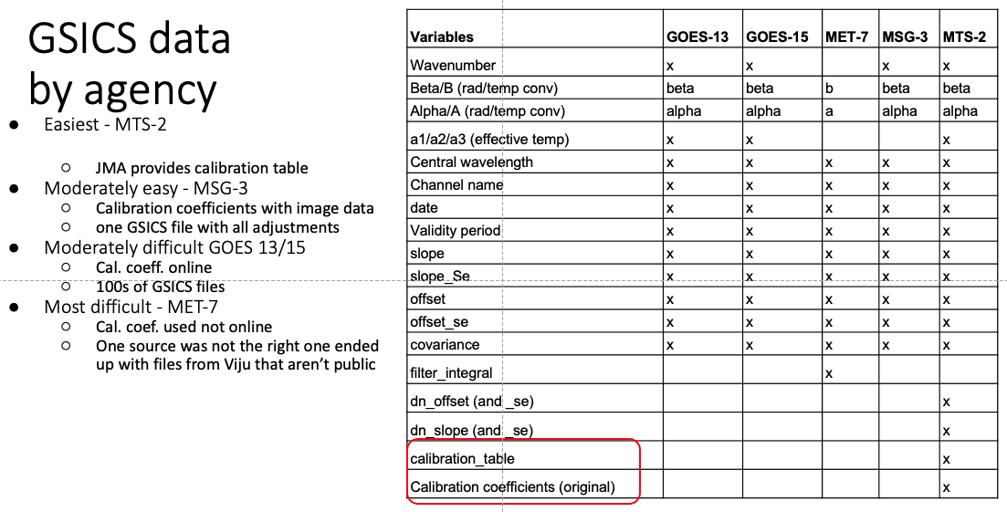
The Way Forward
Feedback from ISCCP (2019) and ISCCP-NG (2023)
Calibration table for GSICS inter-calibration is easy to use
However, it is not practically possible for RAC due to its file size
Having GEO DC vs. LEO rad [wnum or wlen] could be a solution for reducing process for users to derive inter-calibrated radiance/TB
GEO DC
GEO rad
[WL]
LEO rad
[WL]
GEO TB [K]
LEO TB [K]
GEO rad
[WN]
LEO rad
[WN]
GSICS Inter-cal
(standard info)
(Knapp, 2019)

Slide 9
Discussion
Regression method
What is an appropriate regression method for IR inter-calibration?
Current GEO-LEO-IR approach: ordinary least squares (OLS) with weighting?
Reduced major axis (RMA)?
Other methods (incl. linear/polynomial regression equation)?
Regression target
Current GEO-LEO-IR (GEO rad vs. LEO rad in wavenumber) requires users to take lots of steps for getting inter-calibrated GEO radiance.
In particular for GEO radiance in wavelength unit
Does anyone really needs alternative regression target (e.g., GEO DC vs. LEO rad)?
Alternatively, some APIs could cover the messy conversion role :)

Slide 10
Thanks for your attention!

