Slide 1
Defining Standard Scene Tbs for GSICS GEO-LEO IR inter-calibration algorithm
Tim Hewison (EUMETSAT)
GSICS Annual WG Meeting - IR Session 2024-03-14

Slide 2
Definition of additional Standard Scene Radiances - 2023
Current Standard Scene Radiances – used by EUM, JMA,
  1976 US Standard Atmosphere in clear sky over calm sea at nadir
  Calculated by RTTOV
  On the dry side for GEO WV channels
Cold - 220K adopted – used by JMA, NOAA
  ~Cold Cloud Tops
  Same for all channels
  Would 205K be better (DCC threshold)?
Hot – 305K proposed
  To optimise performance over hot land
  Only for window channels
Other?
Considerations for alternative approaches:
Standard Scene radiances should be channel dependent
  and maybe also geographically dependent
  but ideally should be comparable for all GSICS products for a given instrument class
Could be defined based on percentile of observation space
  but ideally should be comparable for all GSICS products for a given instrument class
Can also be used as metric for tuning algorithm trade-offs
  Uncertainty on bias at range of radiances
  Expressed in Brightness Temperatures (channel independent)
Currently:
  EUMETSATuse Tstd
  JMA use Tstd + 220K, 250K, 290K – for all IR channels
  KMA use ?
  ISRO use ?
  CMA use Tstd
  NOAA use 220K, 250K, 290K

Slide 3
2023-03: Proposed metric for tuning algorithm
Proposed metric for tuning algorithm trade-offs
  Uncertainty on bias at range of radiances
  Expressed in Brightness Temperatures (channel independent)
  Standard Scene Radiance
    1976 US Standard Atmosphere in clear sky over calm sea at nadir
    Calculated by RTTOV
    For SEVIRI: Standard Scene Tbs = [284.0, 236.0, 255.0, 284.0, 261.0, 286.0, 285.0, 267.0] K
    On the dry side for GEO WV channels
  Cold - 220K adopted
    ~Cold Cloud Tops
    Same for all channels
    Would 205K be better (DCC threshold)?
  Hot – 305K proposed
    To optimise performance over hot land
    Only for window channels
    Not implemented yet
Plot 2D Histogram (log scale) of collocated radiance + Fit + Uncertainty*10:

Slide 4
Channel Dependent Warm Scene Standard Tb – Attempt #1
For warm standard scene Tb:
Run RTTOV13 for standard tropical profile
  Similar to standard scene radiance using 1976 US Standard Atm
  (Used in current GEO-LEO IR products – although arbitrary)
  Now compare these with observed distribution of collocations:
MTG-I1/FCI | IR3.8 | WV6.3 | WV7.3 | IR8.7 | IR9.7 | IR10.8 | IR12.3 | IR13.3
1976 US Standard Profile | 285.99 | 236.13 | 256.02 | 284.38 | 262.50 | 286.20 | 283.99 | 269.44
Tropical Standard Profile | 298.80 | 243.11 | 261.78 | 295.02 | 270.23 | 296.58 | 292.33 | 276.40

Slide 5
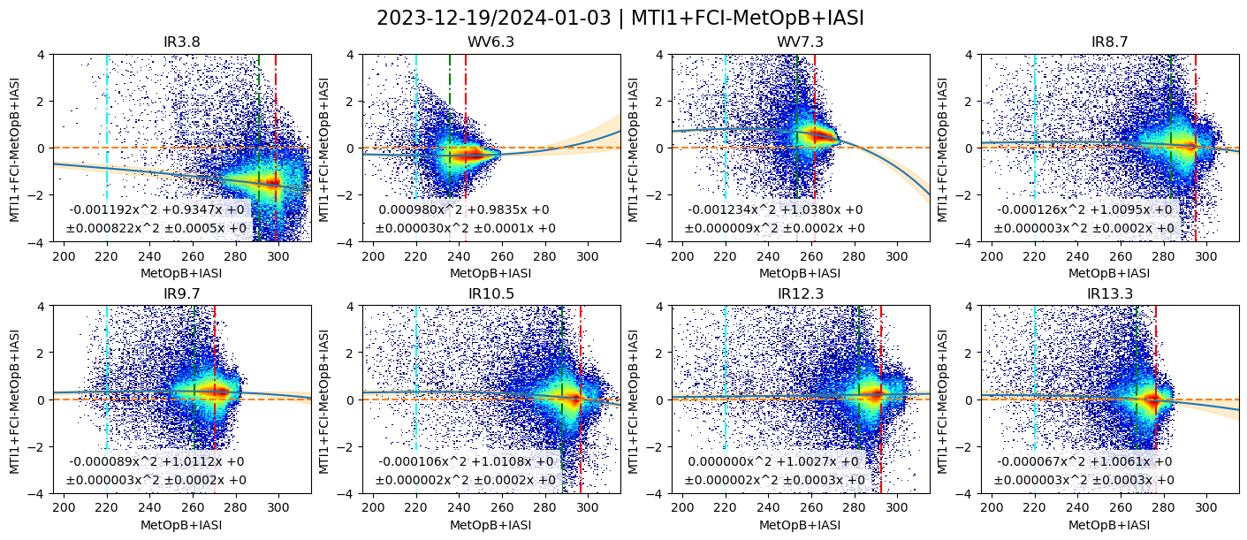
FCI-IASI Day + Night collocations
FCI IR radiances are not yet fully calibrated - straylight correction is not applied yet
Red line = Tropical Standard – Not hot enough for Window channels
+ Not enough humidity for WV channels

Slide 6
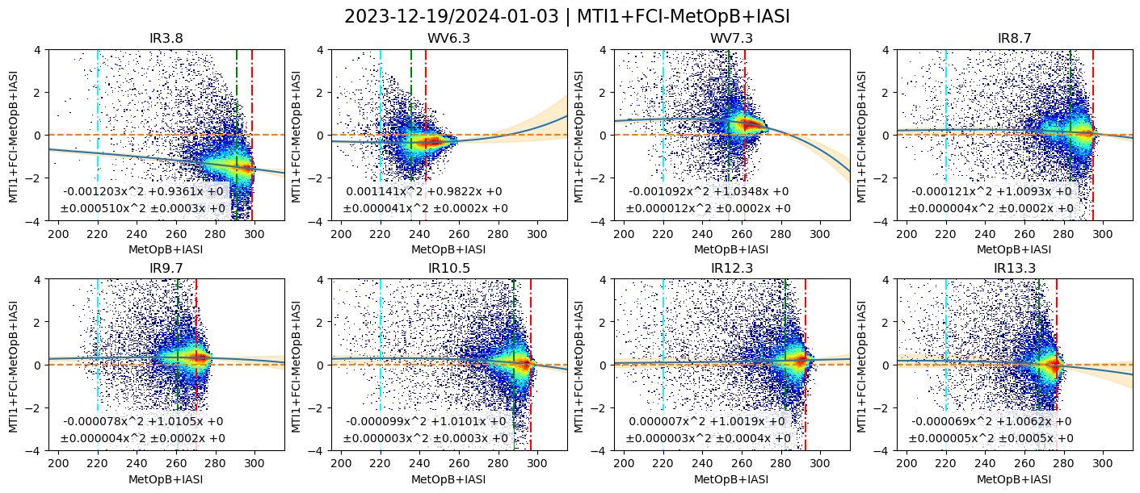
FCI-IASI Night only collocations
FCI IR radiances are not yet fully calibrated - straylight correction is not applied yet
Red line = Tropical Standard – OK for Window channels at night
+ Not enough humidity for WV channels

Slide 7
Channel Dependent Warm Scene Standard Tb – Attempt #2
Just try the 99th Percentile of the observed Collocation Tb
Need to check in NH Summer and Winter
Take mean of Summer+Winter
Round to nearest 10K
Much higher than RTTOV
tropical profile
MTG-I1/FCI | Winter | Winter | Summer | Summer |  | Proposal
 | 99% | 99.50% | 99.00% | 99.50% | Tb_trop
IR3.8 | 311 | 312 | 323 | 325 | 286 | 310
WV6.3 | 255 | 257 | 261 | 262 | 236 | 250
WV7.3 | 271 | 272 | 275 | 275 | 256 | 270
IR8.7 | 302 | 303 | 306 | 308 | 284 | 300
IR9.7 | 280 | 281 | 279 | 280 | 263 | 280
IR10.8 | 304 | 306 | 313 | 315 | 286 | 310
IR12.3 | 302 | 303 | 310 | 312 | 284 | 310
IR13.3 | 282 | 283 | 286 | 287 | 269 | 280

Slide 8
Channel Dependent Cold Scene Standard Tb – Attempt #2
Just try the 1st Percentile of the observed Collocation Tb
Need to check in NH Summer and Winter
Take mean of Summer+Winter
Round to nearest 10K
Much higher than RTTOV
tropical profile
Proposal: 220K
  Consistent with JMA+KMA
  240K for 3.8µm channel?
MTG-I1/FCI | Winter | Winter | Summer | Summer |  | Proposal
 | 0.5% | 1% | 0.5% | 1%
IR3.8 | 224 | 236 | 227 | 244 |  | ? 240
WV6.3 | 211 | 217 | 213 | 219 |  | 220
WV7.3 | 211 | 219 | 213 | 221 |  | 220
IR8.7 | 212 | 221 | 214 | 222 |  | 220
IR9.7 | 219 | 223 | 219 | 224 |  | 220
IR10.8 | 212 | 220 | 213 | 222 |  | 220
IR12.3 | 210 | 218 | 211 | 220 |  | 220
IR13.3 | 210 | 218 | 211 | 219 |  | 220

Slide 9
Thank you!
Questions are welcome.

Slide 10
Cloud Parallax Uncertainty in GSICS GEO-LEO IR inter-calibration algorithm
Tim Hewison (EUMETSAT)
GSICS Annual WG Meeting - IR Session 2024-03-14

Slide 11
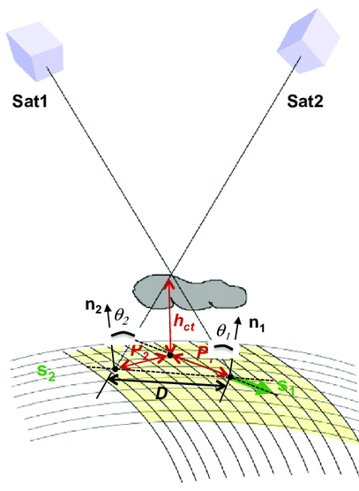

2023 - Spatial Variability/Mismatch – Parallax
Equivalent to spatial offset
Geometrically-defined formula
  Eqn (7) in Hewison, 2013
  Simple Cloud Top Height parameterisation:
    If no CTH retrieval readily available
  CTH = (Tsurf – CTT) / ALR, where
    Tsurf = max (Tb) in surrounding environment
    CTT = Tb(10.8µm) = Cloud Top Temperature
    ALR = Adiabatic Lapse Rate,
      typically -6.5K/km at low latitudes [DOI:10.1134/S0001433806040037]
    For a better model see https://doi.org/10.3390/atmos12020173
Corradini et al. (2016). A Multi-Sensor Approach for Volcanic Ash Cloud Retrieval and Eruption Characterization: The 23 November 2013 Etna Lava Fountain. Remote Sensing. 8. 58. 10.3390/rs8010058.

Slide 12
Simple model for uncertainty due to cloud parallax
Aim:
  To quantify uncertainty (and possible bias) introduced by comparison views of tall clouds observed at different angles
Assumptions:
  Same ground FOV is viewed with similar VZA, but different VAA
  GEO pixels much smaller than LEO FOV used to define collocation
Approximations:
  GEO pixels are square and contiguous
  LEO FOVs are rectangular, extending in x-direction by factor of sec(θ)

Slide 13
Simple model for uncertainty due to cloud parallax
Method:
  Generate Monte Carlo sets
  Of random cloud scenes
  Modelled as tall columns of decreasing temperature
  Evaluate mean Tb for GEO and LEO views averaged over same area (Collocation = LEO FOV)
  Compare average Tb for views along and across scan direction
  (Maximum difference for RAA=90°, but on mean difference = half max?)

Slide 14
Single DCC in FOV – at nadir

Slide 15
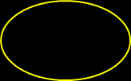
Single DCC in FOV – at nadir and at VZA=45°

Slide 17
Two DCCs in FOV – at nadir and at VZA=45°

Slide 18
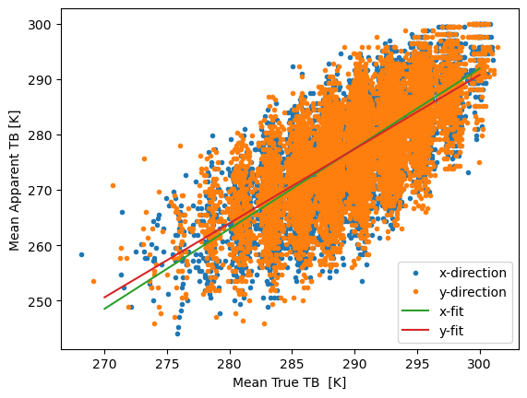
Example Result
n=1e4 Monte Carlo members
Nadir 12x12km/2km
VZA=30° 14x12km/2km
DCC height = 17km
DCC fraction = 10% at nadir
Tb clear = 300K
Tb DCC = 200K
Mean Tb 10K lower at nadir
Mean Tb 23K lower in oblique views
Key Results:
No significant difference in x/y
Std Dev in oblique views ~2x nadir
Mean TB True (nadir view) = +290.118 ± 0.046 K
Mean Apparent TB view on x = +277.621 ± 0.089 K
Mean Apparent TB view on y = +277.540 ± 0.087 K
Mean Apparent TB difference= -0.082 ± 0.084 K
SD TB True (nadir view) = 4.629 K
SD Apparent TB views on x,y= 8.723 , 8.915 K Offset = -1.143 ± 0.041 K Slope = +0.107 ± 0.004

Slide 19
The Statistics
n=1e4 Monte Carlo members
Nadir 12x12km/2km
VZA=30° 14x12km/2km
DCC height = 17km
DCC fraction = 10% at nadir
Tb clear = 300K
Tb DCC = 200K
Supplementary Results:
Apparent Tb depression doubles from VZA=30° -> 45° -> 60°
Apparent Tb STD increases more slowly
 | DCC fraction=10% at nadir
 | True Tb (Nadir) |  | Apparent Tb (VZA)
VZA (°) | Mean | Std Dev | Mean | Std Dev
5 | 290.0 | 5.0 | 290.0 | 5.0
15 | 290.0 | 5.0 | 290.0 | 5.0
30 | 290.1 | 4.6 | 277.6 | 8.8
45 | 290.1 | 4.3 | 267.0 | 10.4
60 | 290.0 | 3.5 | 249.6 | 9.8
 | DCC fraction=5% at nadir
 | True Tb (Nadir) |  | Apparent Tb (VZA)
VZA (°) | Mean | Std Dev | Mean | Std Dev
5 | 295.0 | 3.6 | 295.0 | 3.6
15 | 295.0 | 3.6 | 295.0 | 3.6
30 | 295.0 | 3.3 | 288.1 | 7.0
45 | 295.0 | 3.1 | 281.9 | 9.0
60 | 295.0 | 2.6 | 269.5 | 10.1

Slide 20
Thank you!
Questions are welcome.

