Slide 1
GDWG Report from ESA
GSCIS Data Working Group March 13st - 2024 Paolo Castracane
European Space Agency

Slide 2
Table of Contents
Actions from GSICS 2023
EVDC updates
Pi-MEP Salinity
QA4SM
CEOS Cal/Val Portal activities
GSICS and CEOS WGCV cooperation

Slide 3
Summary of Agency’s GSICS Activities, Actions, and Achievements
Actions for ESA
https://www.star.nesdis.noaa.gov/smcd/GCC/MeetingActions.php

Slide 4
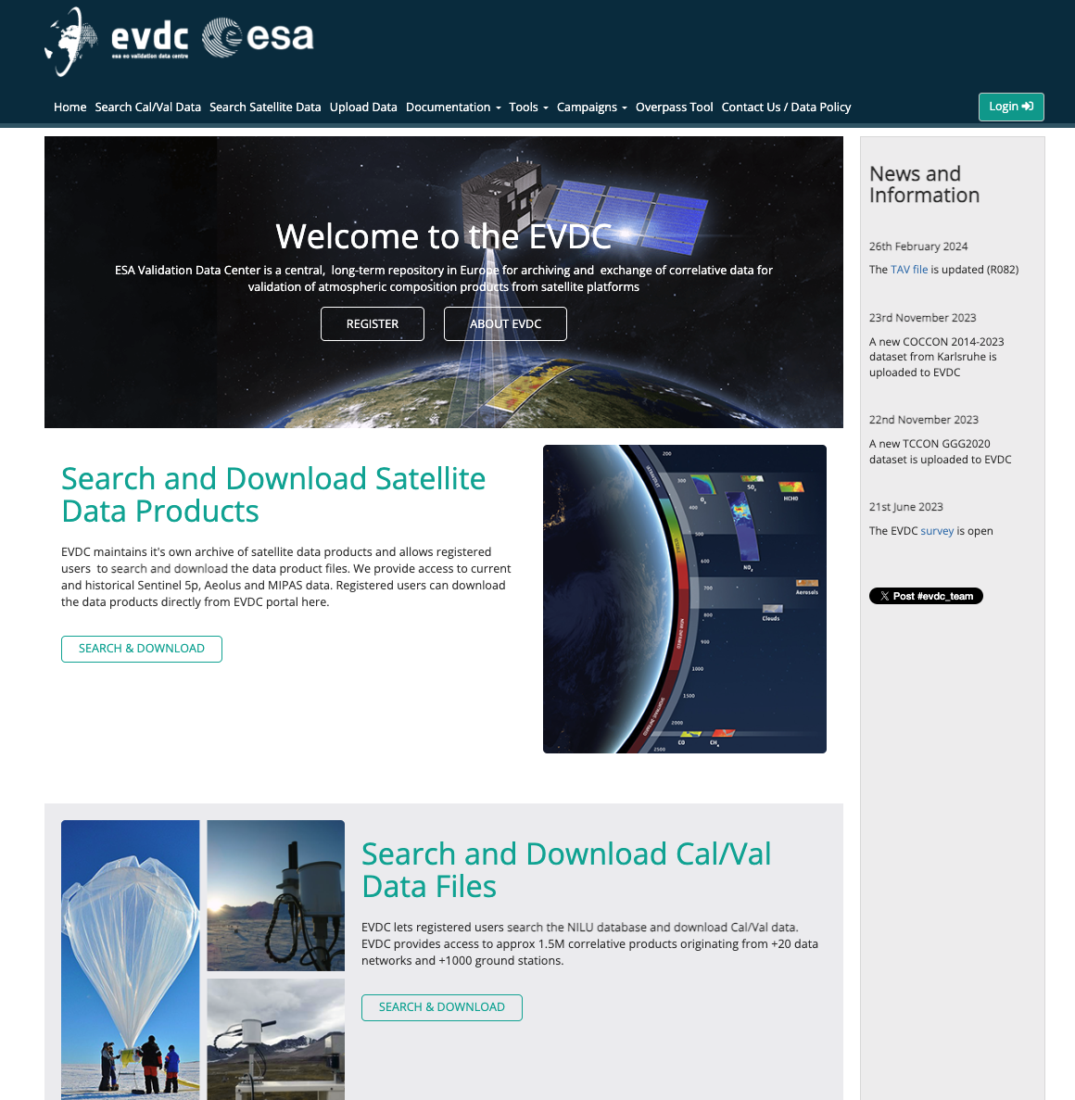
ESA atmospheric Validation Data Center (EVDC)
About EVDC https://evdc.esa.int
EVDC aims to be the main European source of access to the correlative data for validation of atmospheric composition products from satellite platforms.
The EVDC portal offers several tools supporting the user in terms of Cal/Val data query, data upload/download, format conversion (GEOMS conversion routines) and for production of ECMWF parameter’s maps. The EVDC platform also provides an access to satellite data for specific missions, in particular the system supports new atmospheric composition/dynamic missions namely: Sentinel-5P, Aeolus and EarthCARE in the next future.
The portal can be easily expanded to support new campaigns and satellite missions. Data exchange with the EVDC is regulated by a protocol with the aim to ensure data ownership, to prevent re-distribution to third parties and to protect intellectual properties

Slide 5
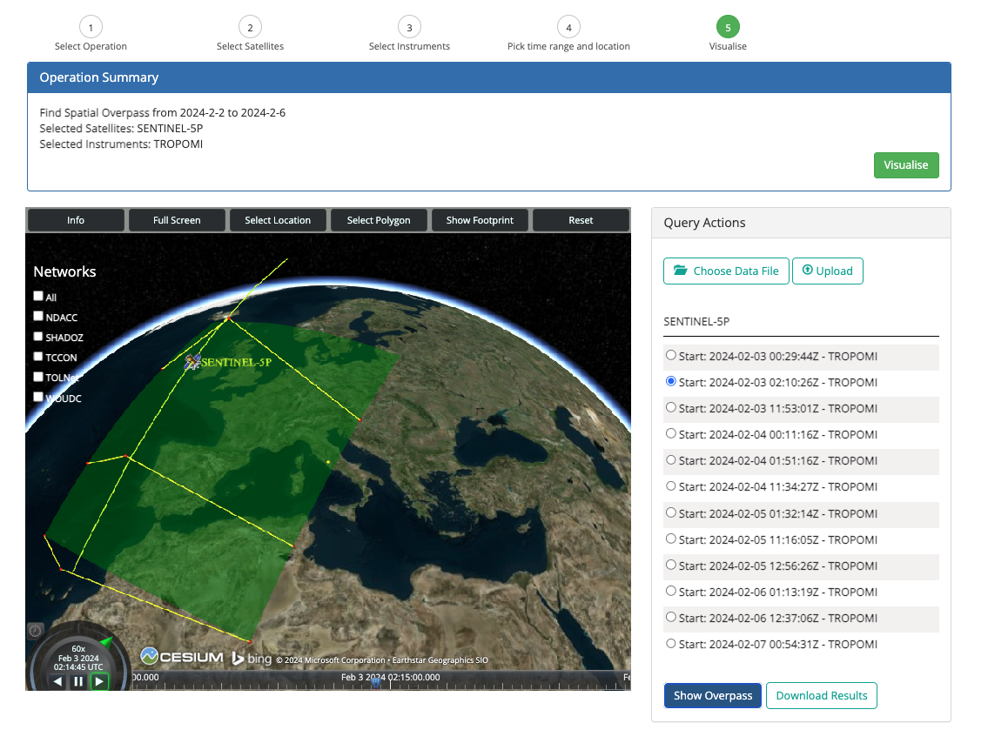
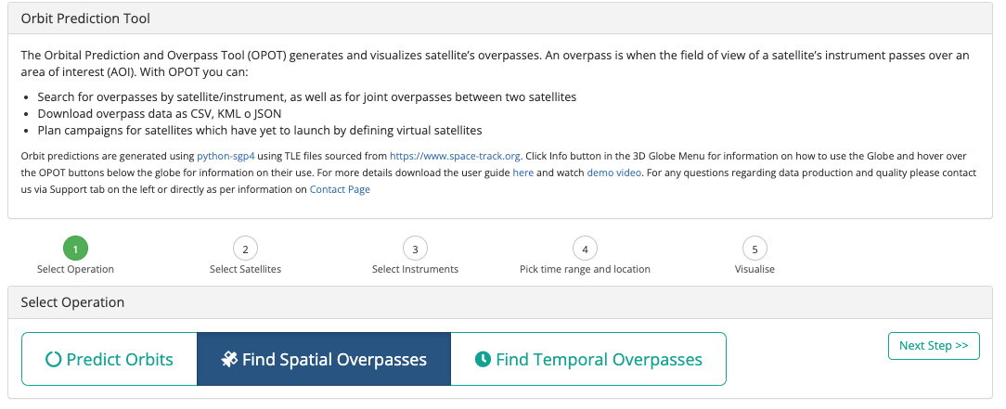
EVDC Overpass Tool
https://evdc.esa.int/orbit/
API distribution – action in progress.

Slide 6
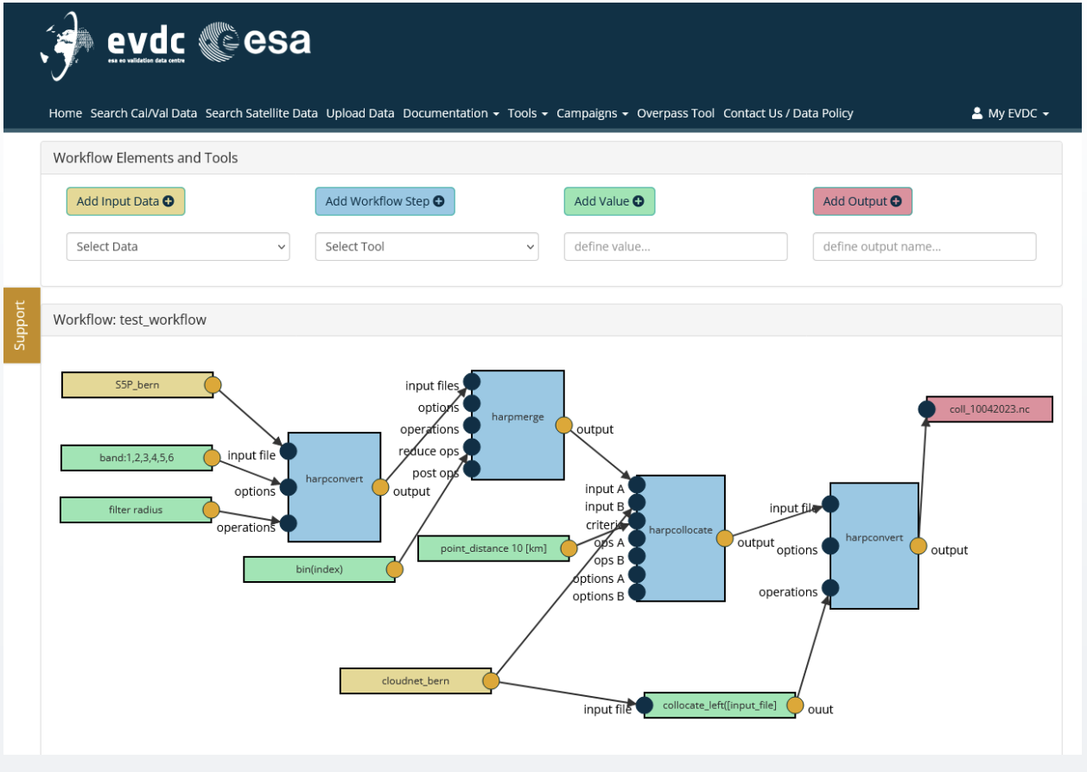
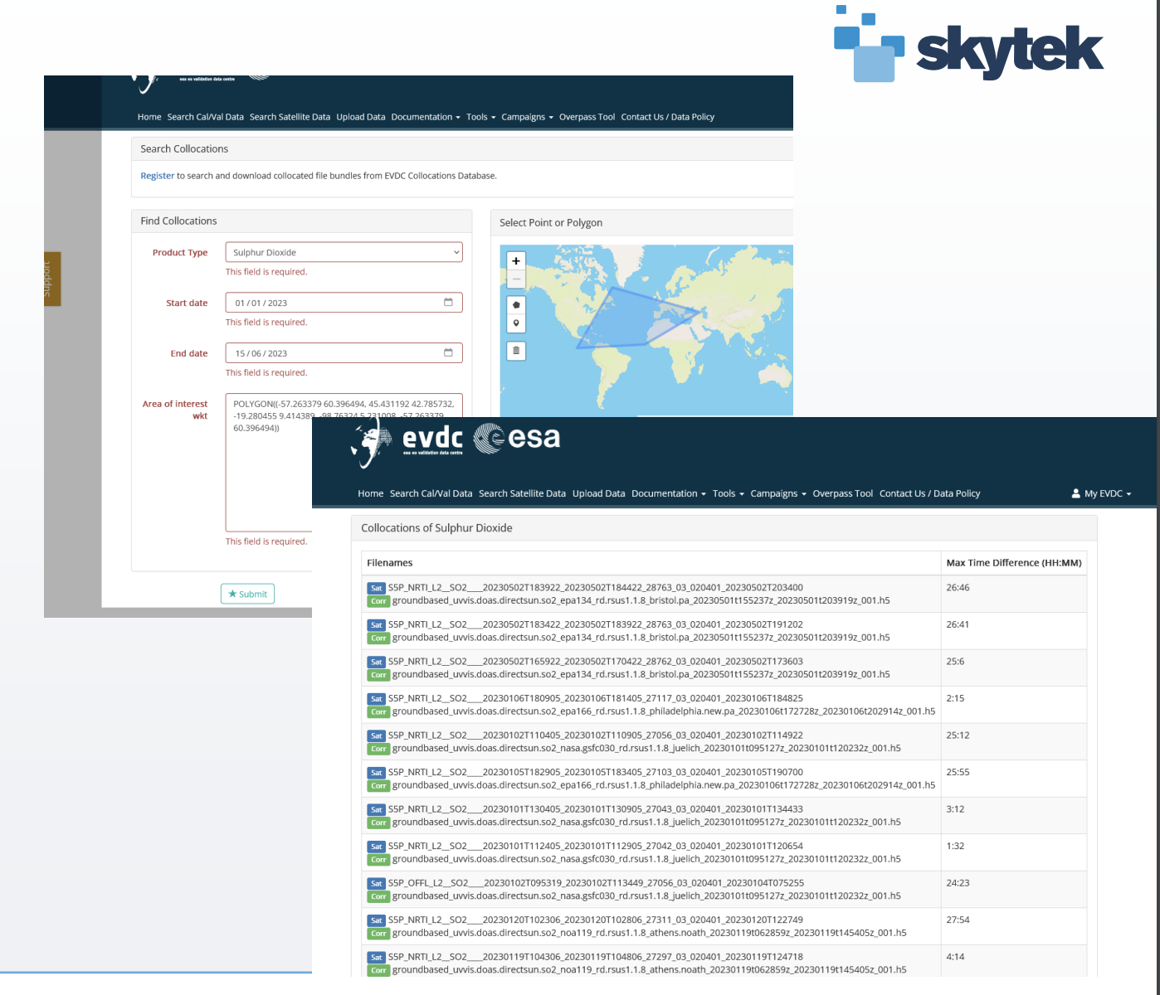
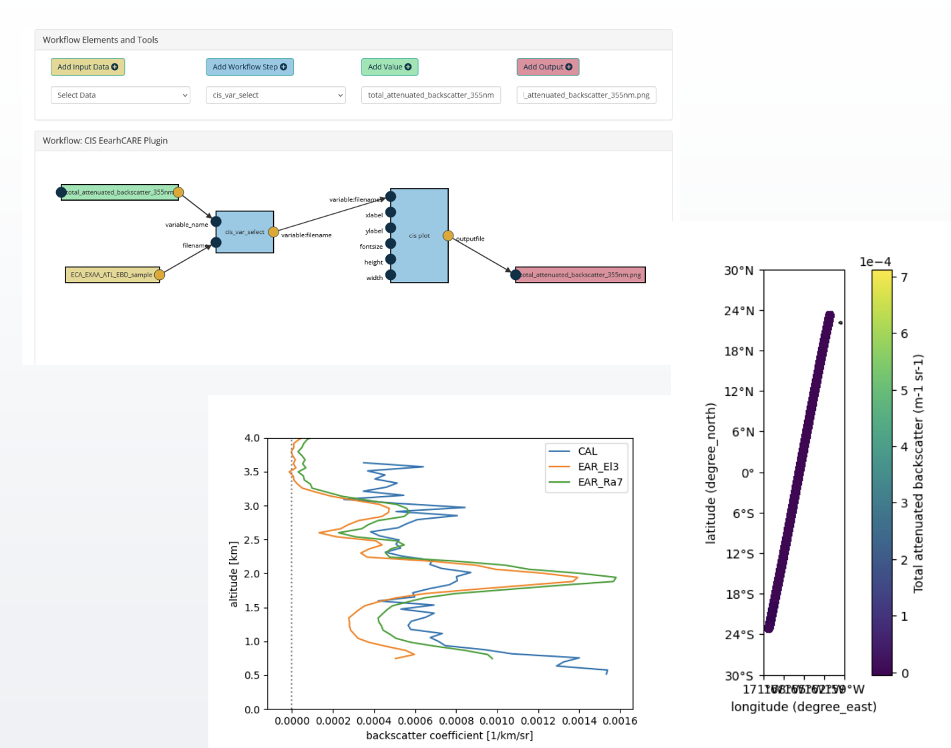
EVDC suite of tools
General suite of tools currently focused on EarthCARE Cal/Val activities
Co-location database for Satellite and corresponding correlative validation data
myWorkflow

Slide 7
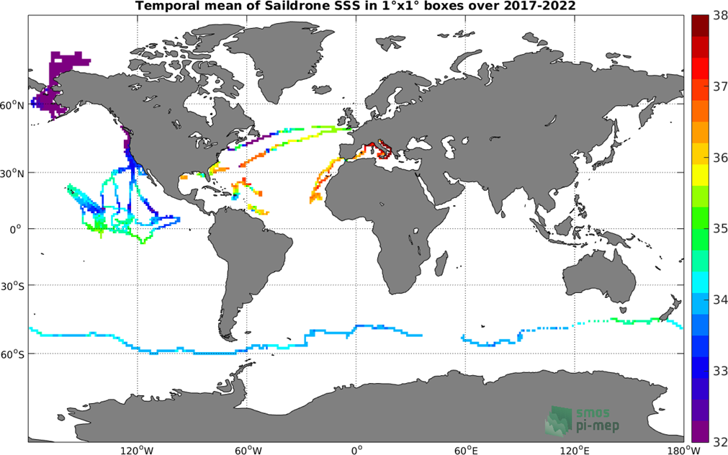
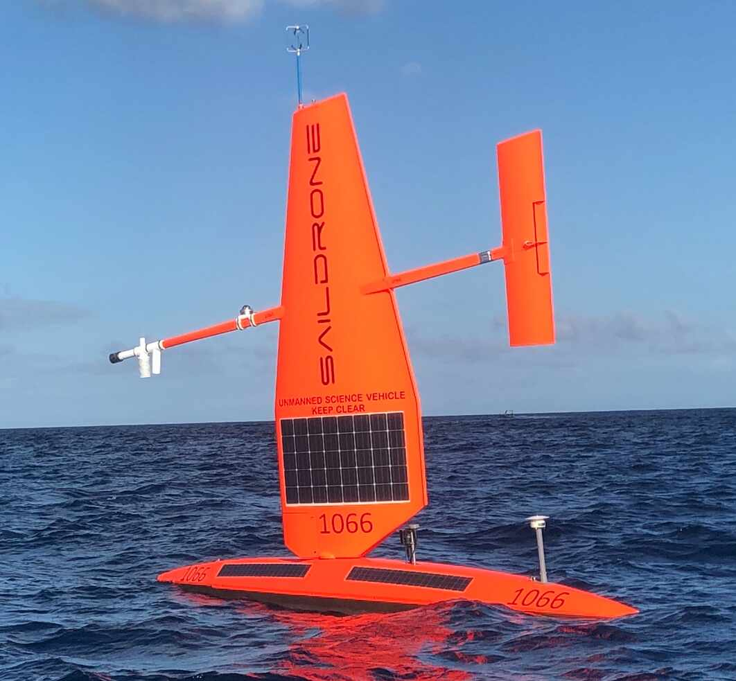
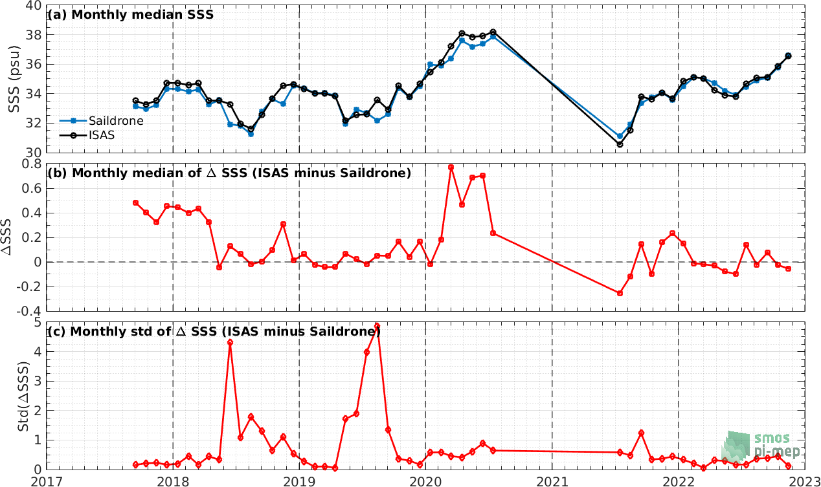
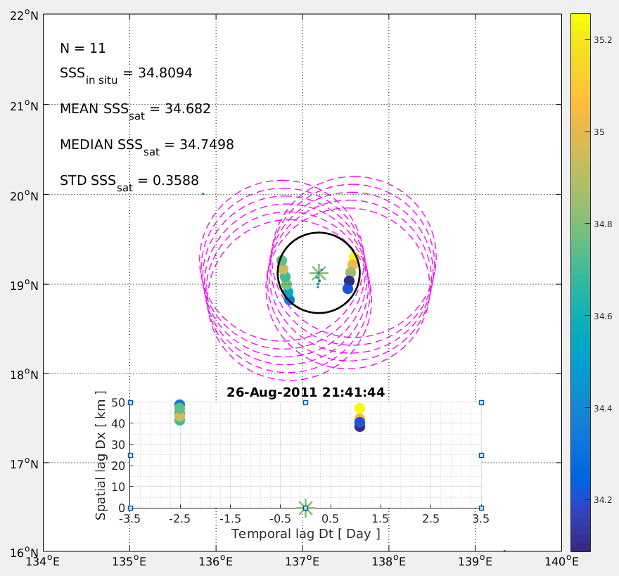
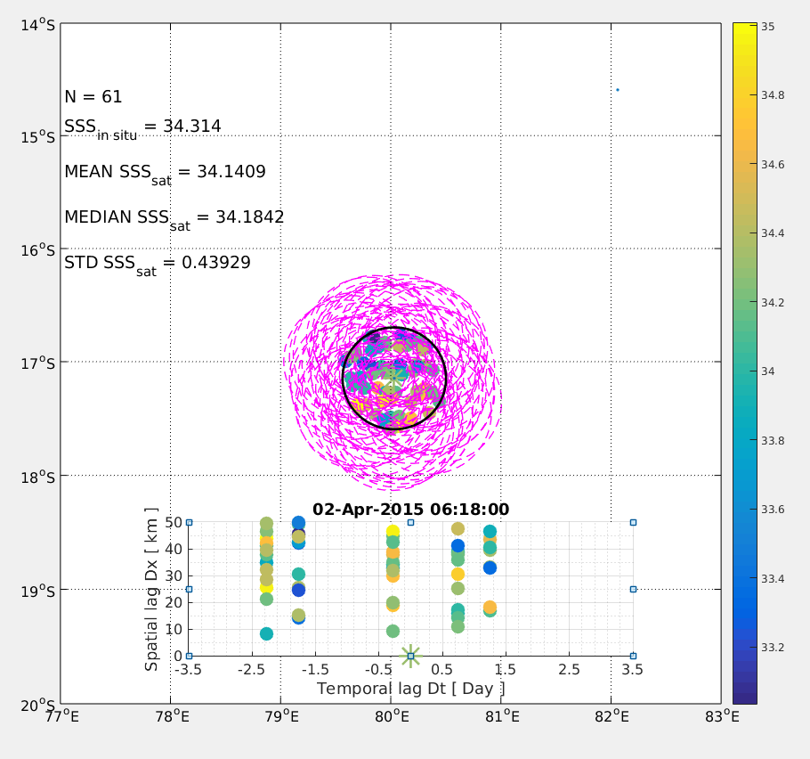
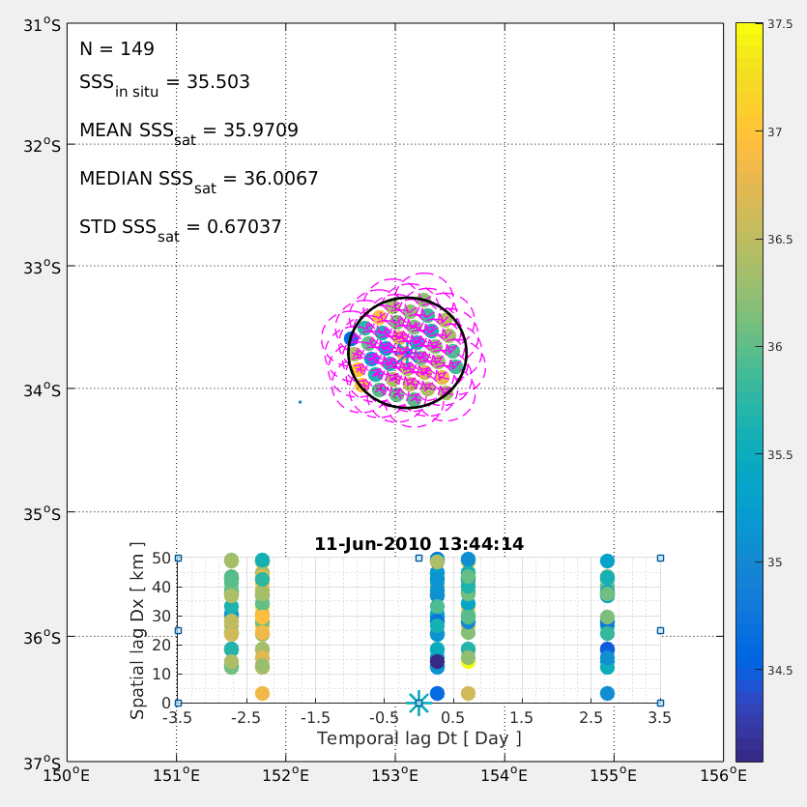
Pilot-Mission Exploitation Platform (Pi-MEP) Salinity
Single web-based environment to visualize, validate, monitor, assess and exploit Satellite Salinity data (SMOS, SMAP, Aquarius). Broad variety of online Tools to extract, inter-compare datasets and compute relevant statistics. Pi-MEP phase-2 (July 2023 – June 2024) SMOS PiMep ->> Salinity PiMep:
Operation
New match-up file and dataset expansion including saildrones
Support to routine QC
Research and Development
Representation errors characterization
“Committed area” identification
Spatial/temporal information content
Exploitation studies
NASA partnership
Roll-out novel NASA MDB criterion and documentation
www.salinity-pimep.org
AQUARIUS
SMAP
SMOS
Argo
Satellite
Temporal mean of Saildrone SSS (upper map), Comparison between Saildrone and ISAS sea surface salinity (lower plots)

Slide 8
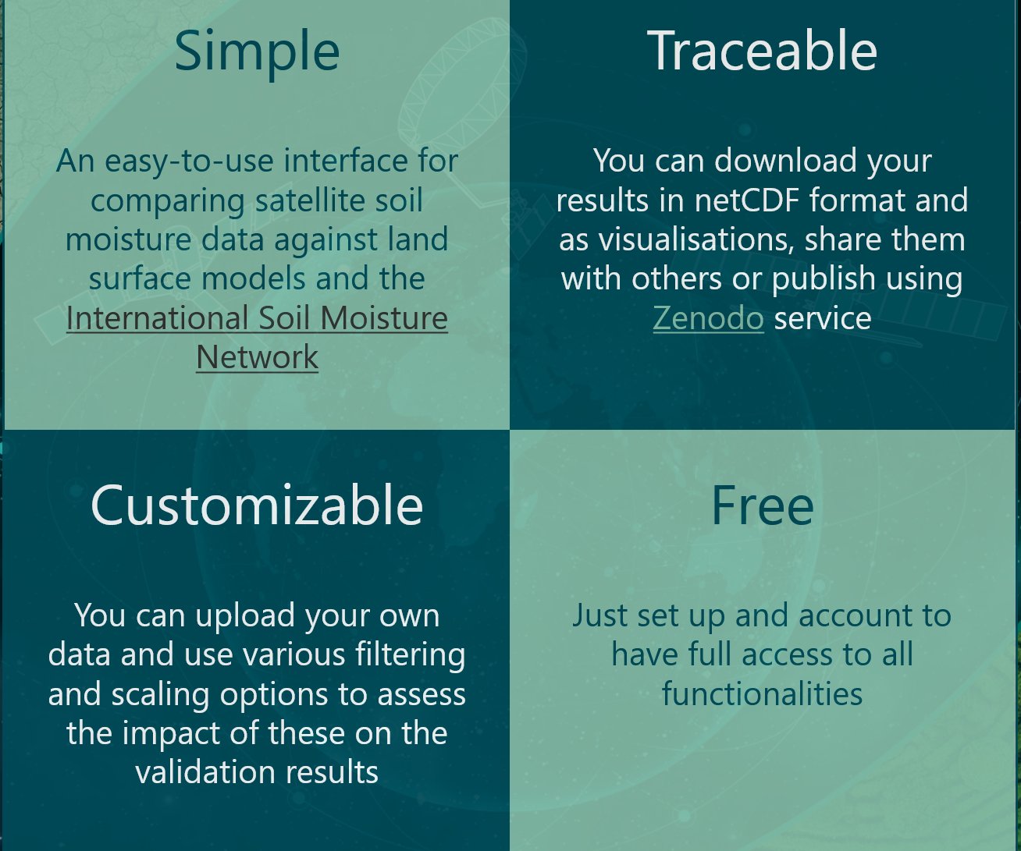
Quality Assurance for Soil Moisture (QA4SM) https://qa4sm.eu
QA4SM = on line validation service, provides a standardized validation system for soil moisture satellite derived measurements vs in situ observation and models. QA4SM platform is maintained and evolved by ESA in the framework of the FRM4SM: Fiducial Reference Measurements for Soil Moisture - Earth Online (esa.int) lead by AWS, TU Vienna and Cesbio.
Next QA4SM release 3 (June 2024) includes:
Spatial Scale Quality Indicator indexes (QIs): describing sub-pixel heterogeneity of land cover, soil texture, biomass, organic carbon content, water body fraction
Temporal scale-related QIs: describing data gap characteristics (quasi-randomly, intermittently, prolonged, …)
Temporally-dynamic QIs: describing seasonal changes in measurement uncertainty
Dataset update for SMOS and SMAP Mission

Slide 9
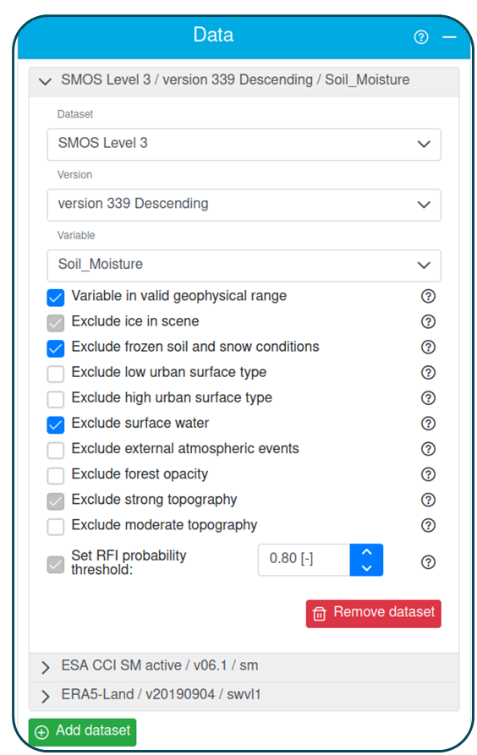
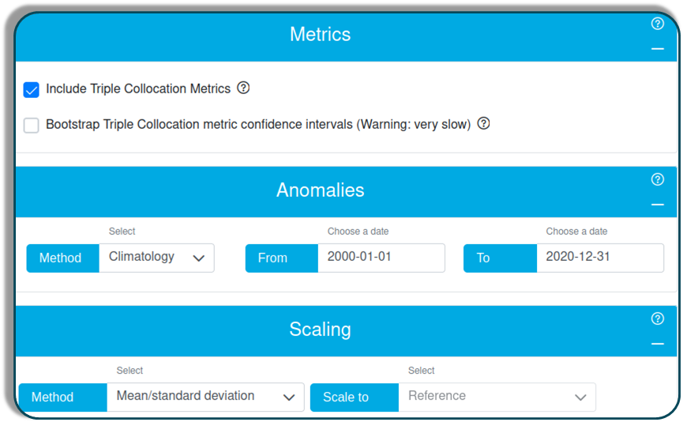
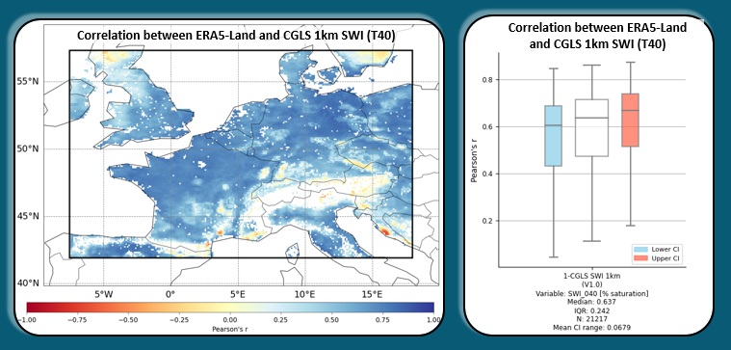
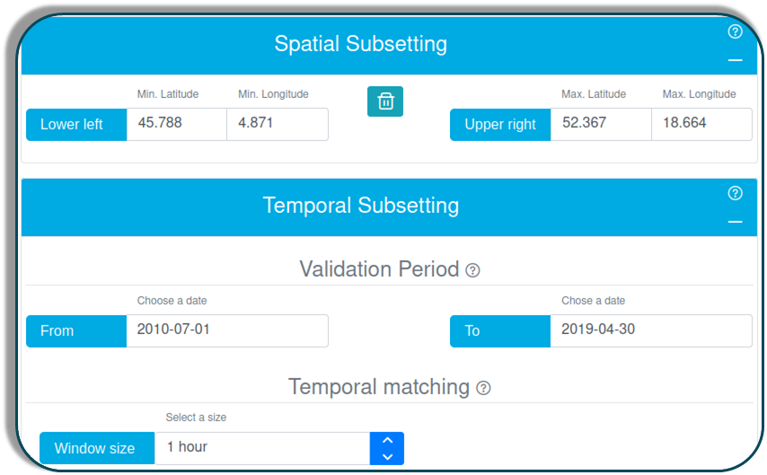
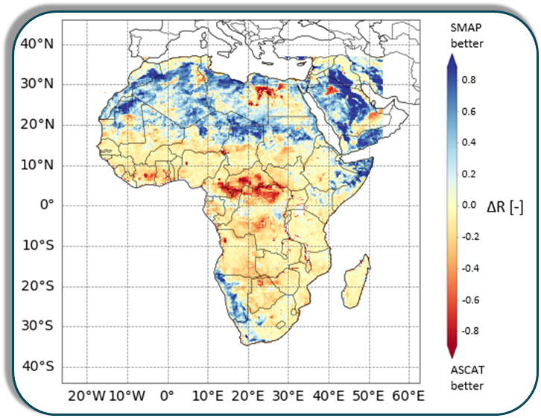
QA4SM Workflow https://qa4sm.eu
1) Data Selection
2) Customize Settings
3) Process, visualize, share & download
Validation metrics ↑ tables, maps, box plots,...
Comparisons →
difference maps, ISMN metadata based comparisons, ...
Temporal / spatial subsets, validation metrics + CIs, anomaly computation, ...
Up to 5 satellites + 1 reference
Public example: Published Validation of ESA CCI (C3S) Soil Moisture with ERA5 https://qa4sm.eu/ui/validation-result/e9a9d43a-deac-4ea5-bbcb-855065fbbeb8

Slide 10
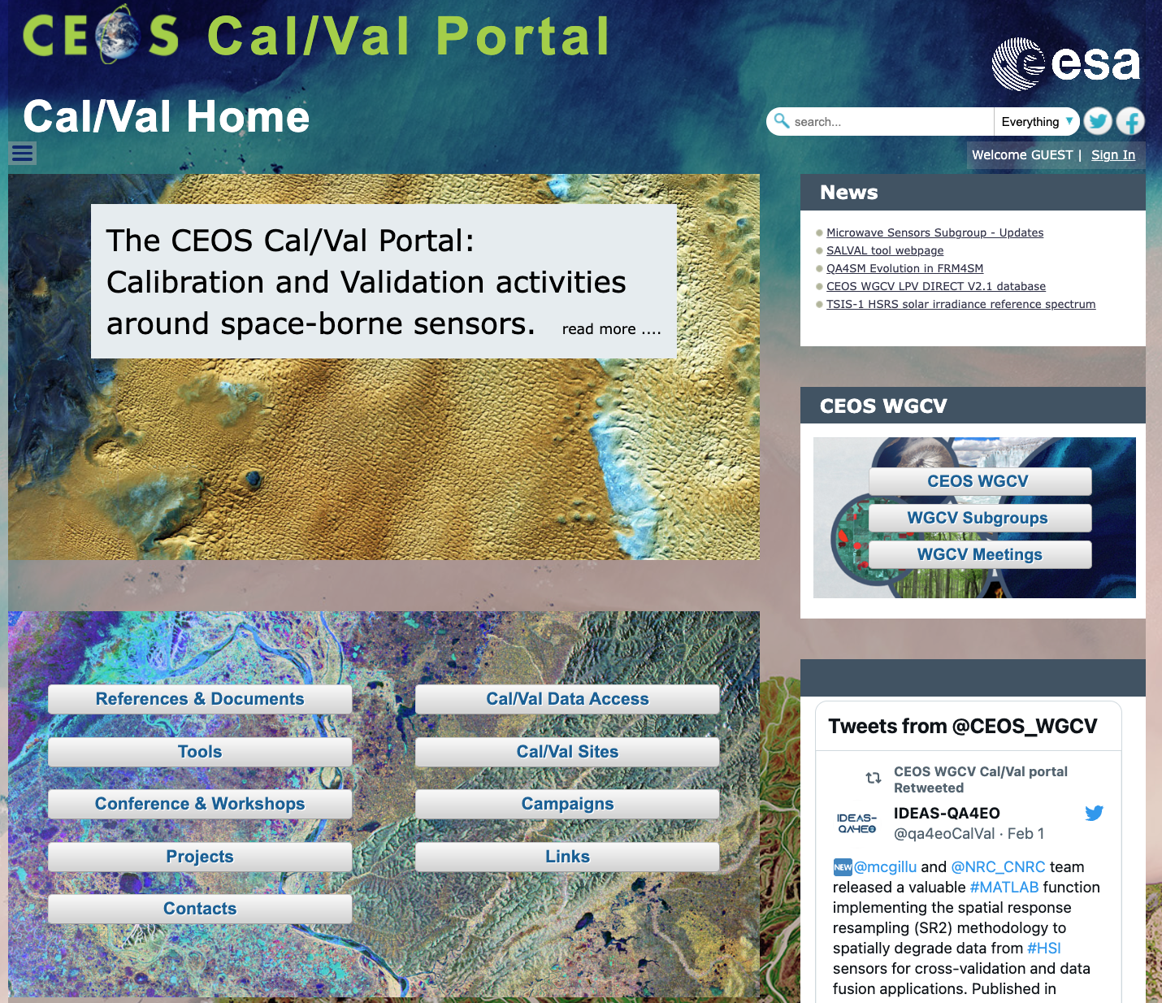
CEOS Cal/Val Portal Overview
https://calvalportal.ceos.org
The CEOS CalVal portal serves as the main forum for exchange and information sharing for the CEOS Working Group on Calibration and Validation (CEOS WGCV).
it provides access to agreed good practices and Cal/Val protocols to the wider Earth Observation community within CEOS and beyond.
It connects users to reference data and networks and provides reliable, up-to-date and user-friendly information useful for Cal/Val tasks, facilitating data interoperability and performance assessment through an operational CEOS coordinated and internationally harmonised Cal/Val infrastructure consistent with QA4EO principles.

Slide 11
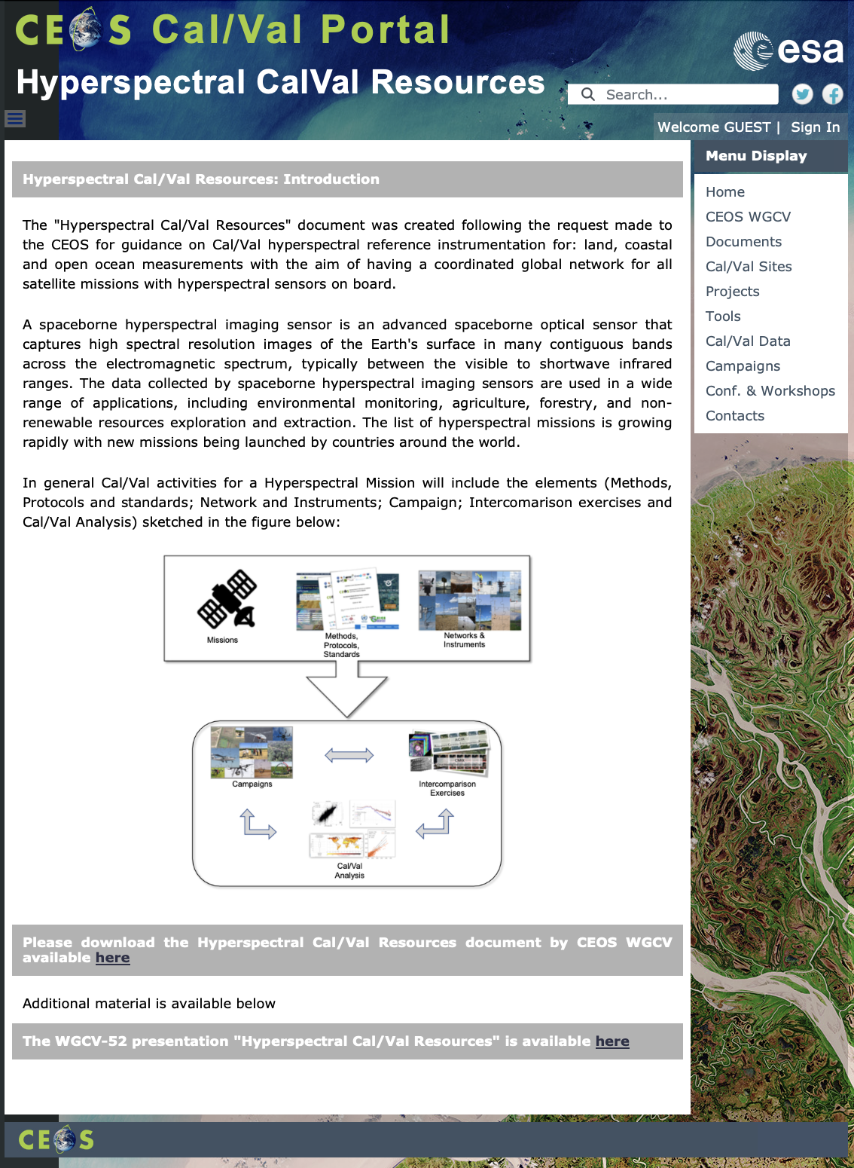
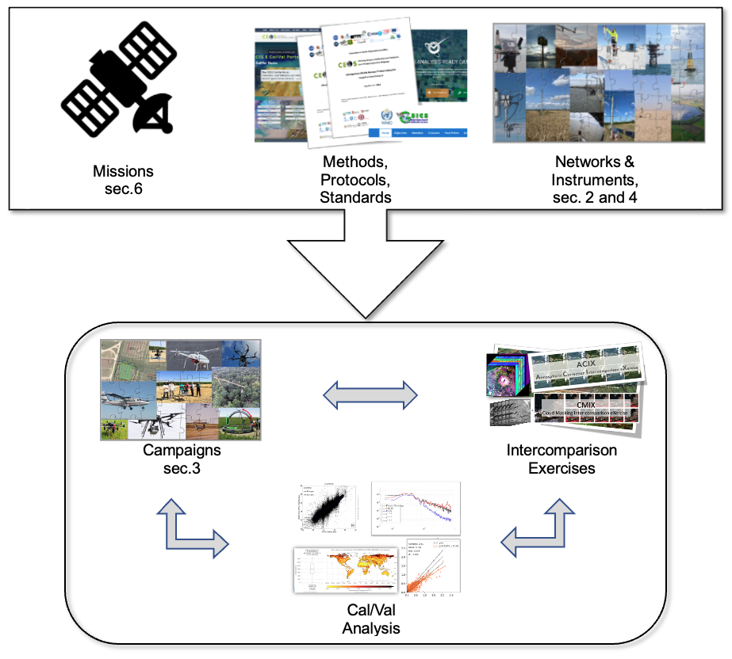
CEOS Cal/Val Portal: Hyperspectral Cal/Val Resouces
Hyperspectral Cal/Val Resources
https://calvalportal.ceos.org/web/guest/hyperspectral-calval-resources
Introduction
Networks
Guidelines and Protocols
Campaigns and Inter-comparison Excercise
Instrumentation and Hardware
Mission-Specific Resources
In general Cal/Val activities for Hyperspectral Mission will include the elements sketched in the figure above

Slide 12
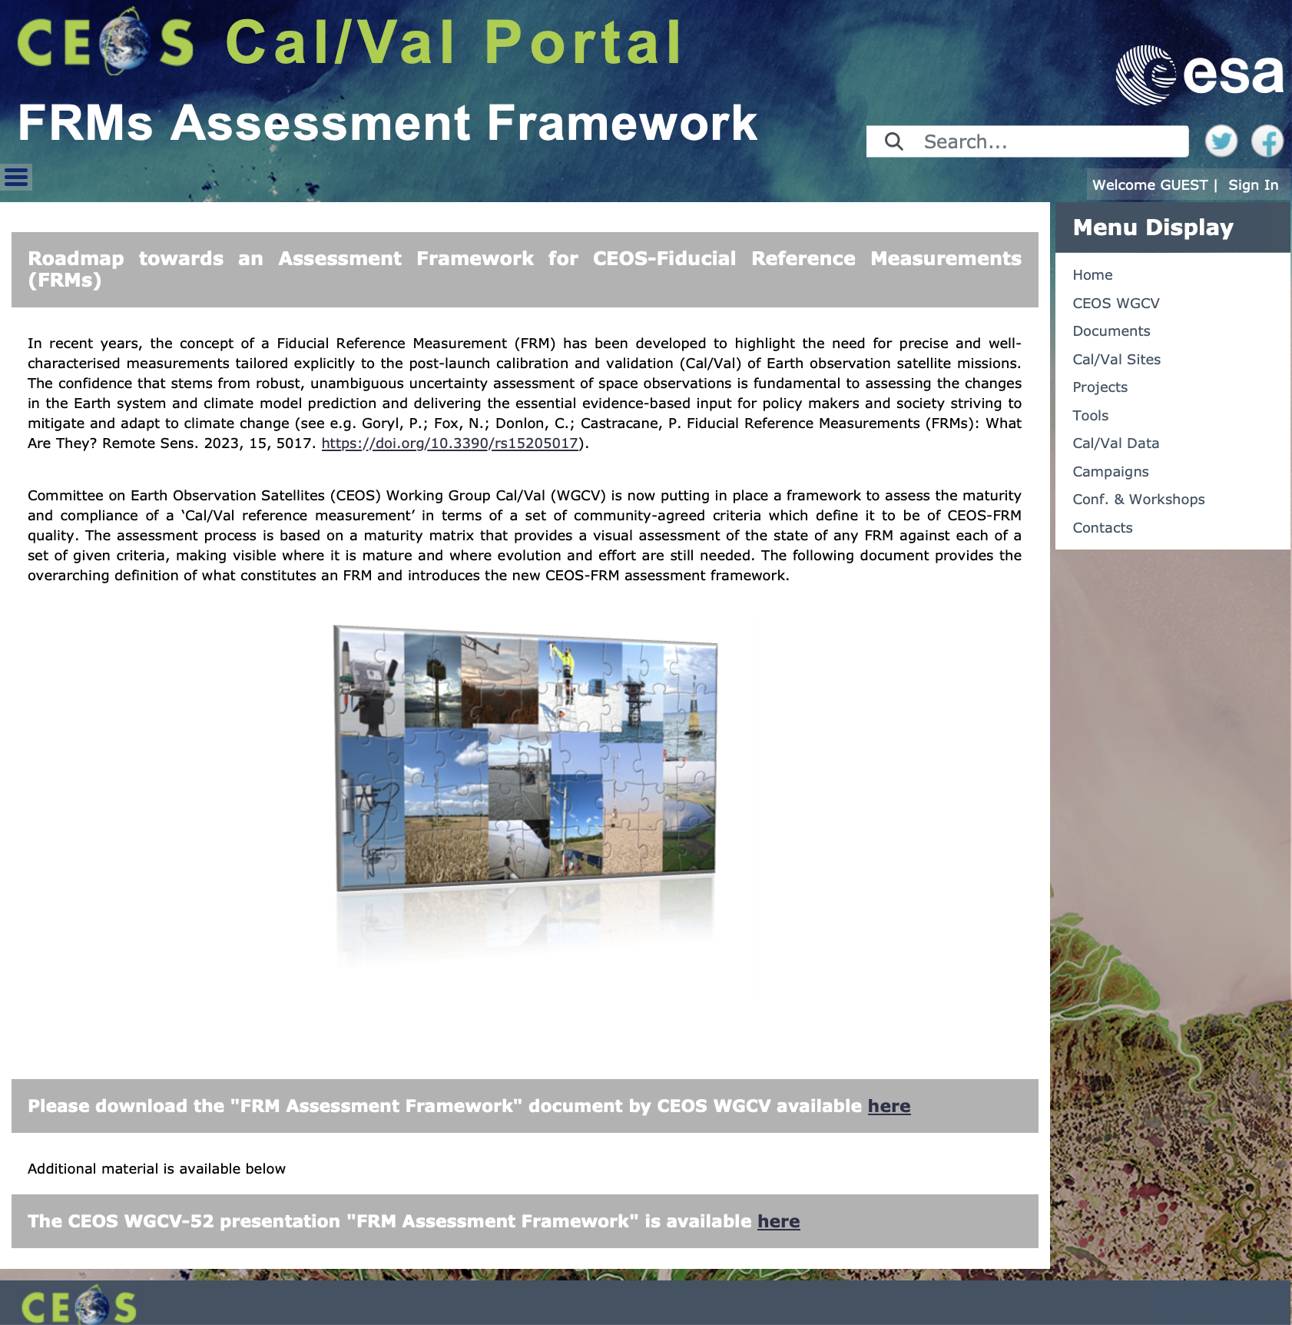
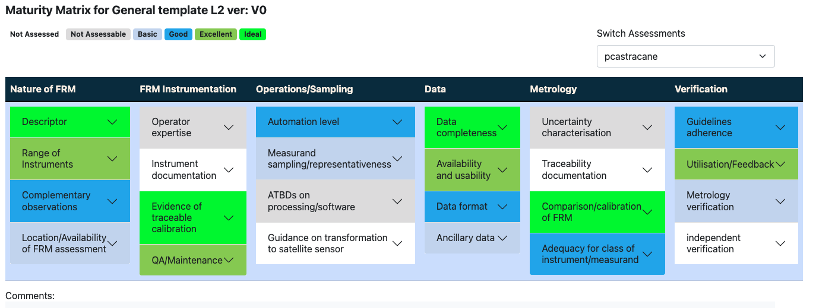
CEOS Cal/Val Portal: FRMs Assessment Framework
Roadmap towards an Assessment Framework for Fiducial Reference Measurements (FRM)
https://calvalportal.ceos.org/web/guest/frms-assessment-framework
The purpose of the document is to propose a roadmap towards an assessment framework to endorse a specific class of measurements as a Fiducial Reference Measurement (FRM).
Background and Objectives
FRM Definition and Principles
FRM Endorsement Process
FRM Maturity Matrix
FRM Overall Classification
CEOS FRM MM –PGN (Pandonia Global Network)
CEOS FRM MM - RadCalNet (Radiometric Calibration Network)
CEOS FRM MM –ICOS (Integrated Carbon Observation System)
CEOS FRM MM - FRM4DOAS (Ground-Based DOAS Air-Quality Observations)
CEOS FRM MM - Brewer Spectrometer Measurements
CEOS FRM MM - Hypernets
CEOS FRM MM – CSIRO (DION)
CEOS FRM MM- BAQUNIN (PREDE-POM LUNAR)
Maturity Matrix Tool
https://mmt.skytek.dev
Dedicated credentials provided for all the selected pilots
Goryl, P.; Fox, N.; Donlon, C.; Castracane, P. Fiducial Reference Measurements (FRMs): What Are They? Remote Sens. 2023, 15, 5017. https://doi.org/10.3390/rs15205017).

Slide 13
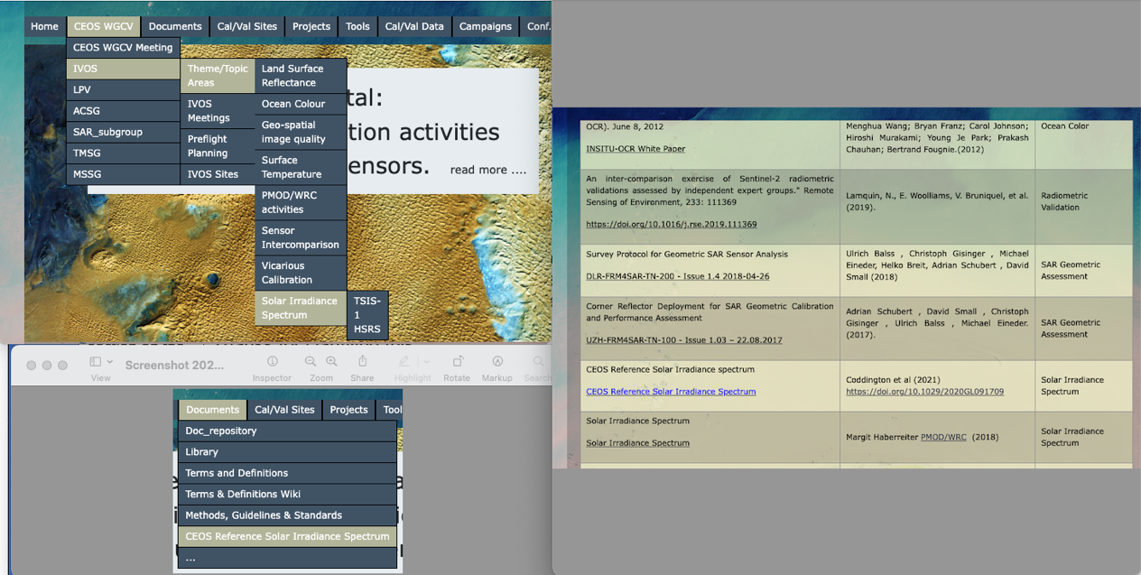
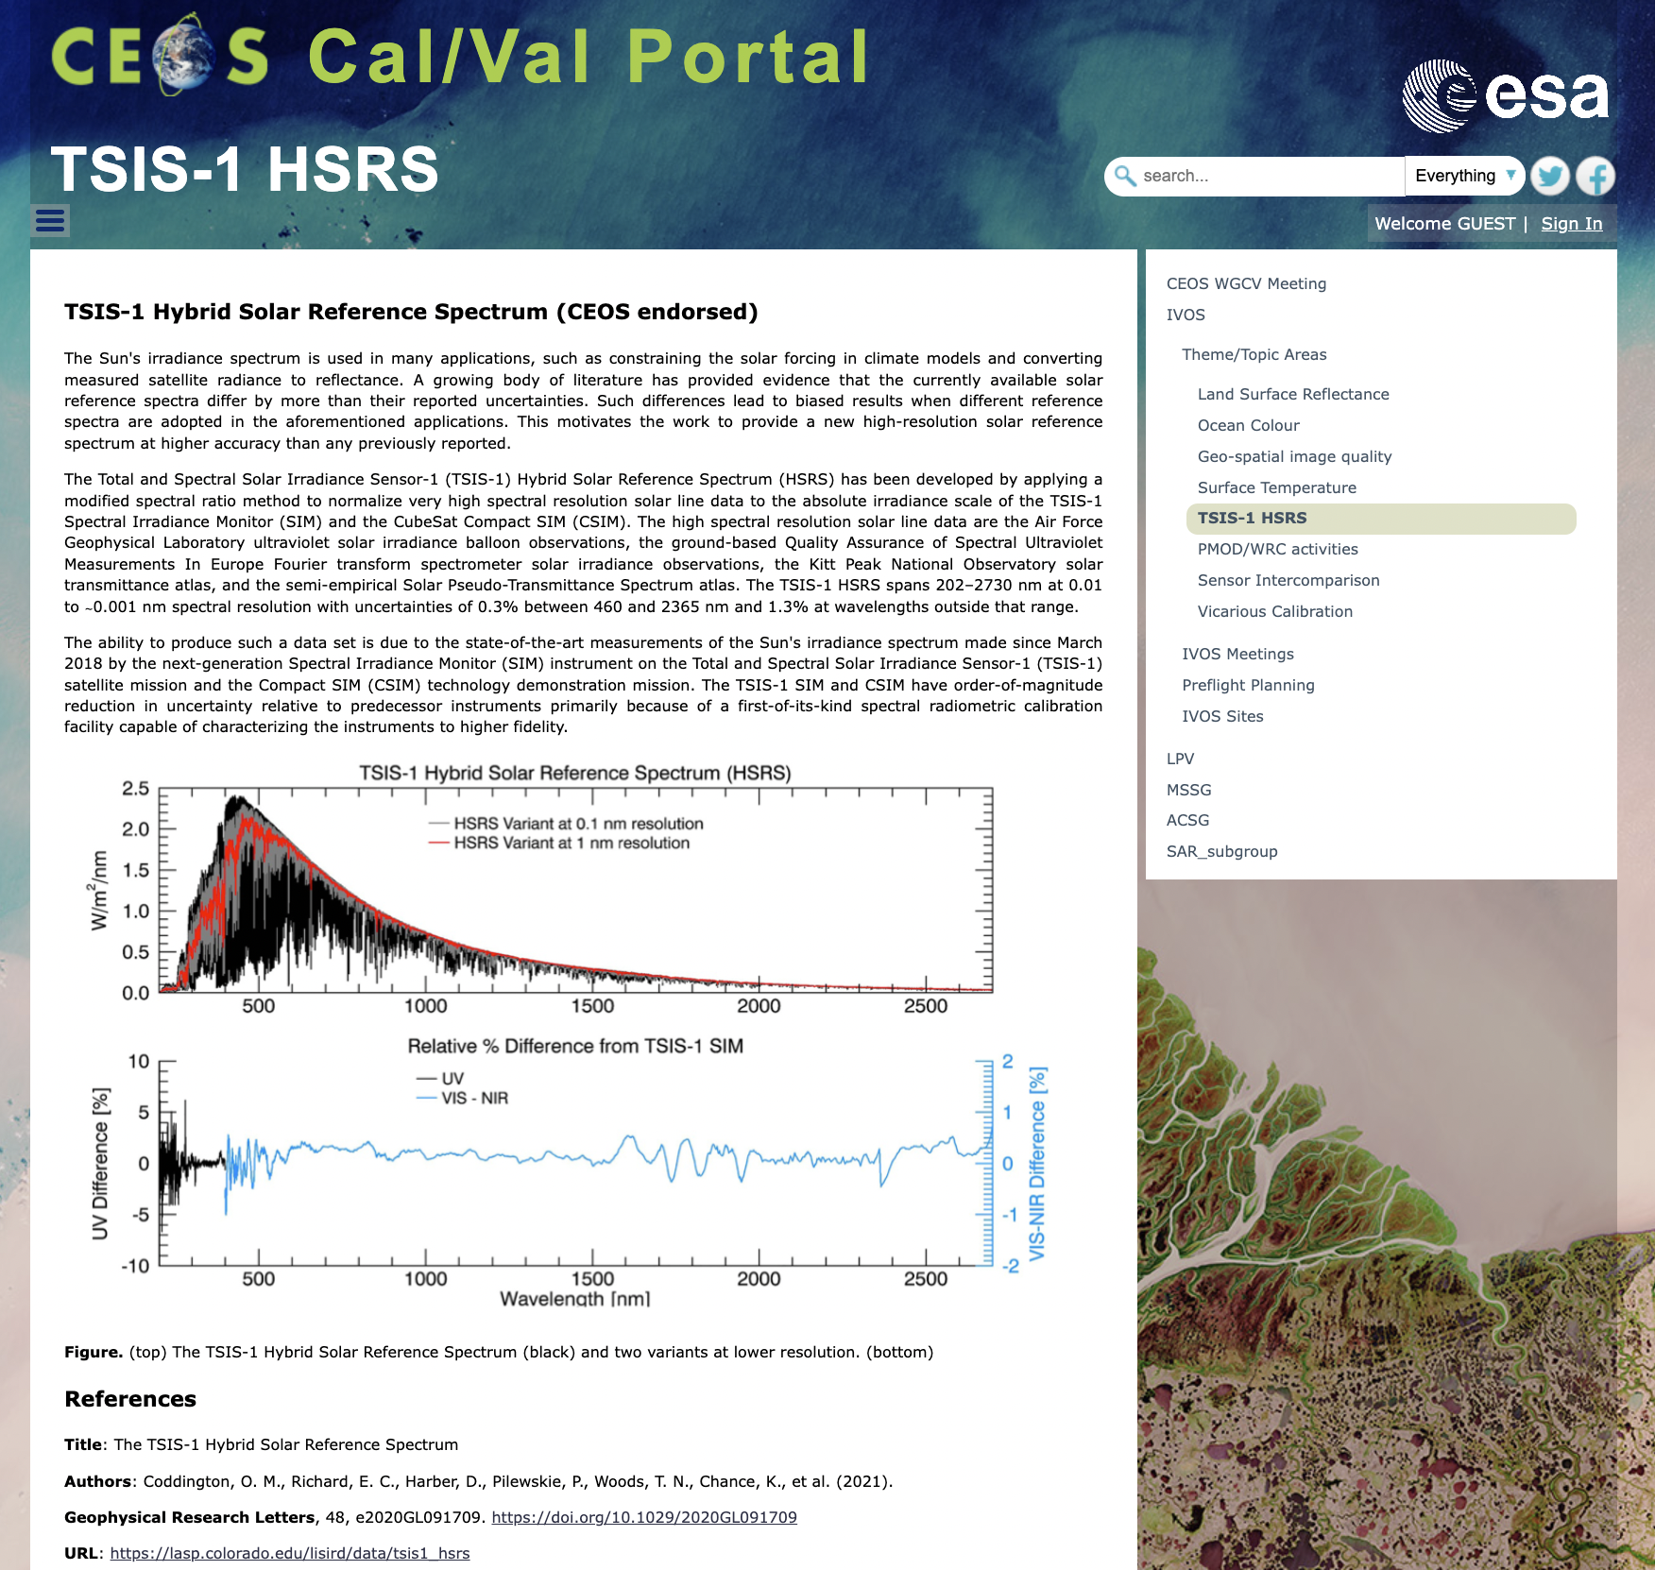
Solar Irradiance Spectrum Reference

Slide 14
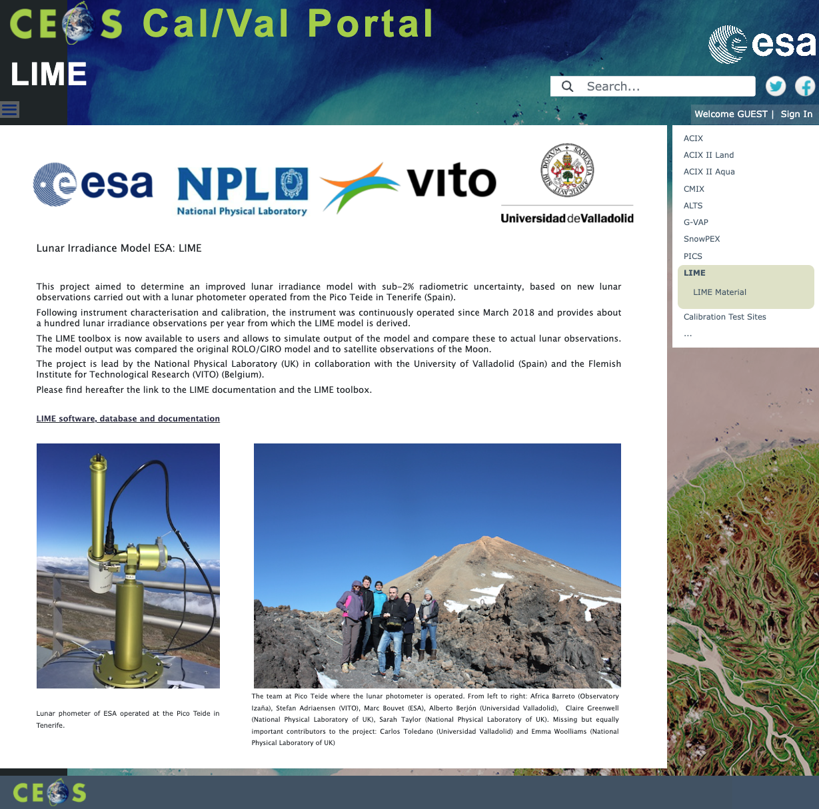
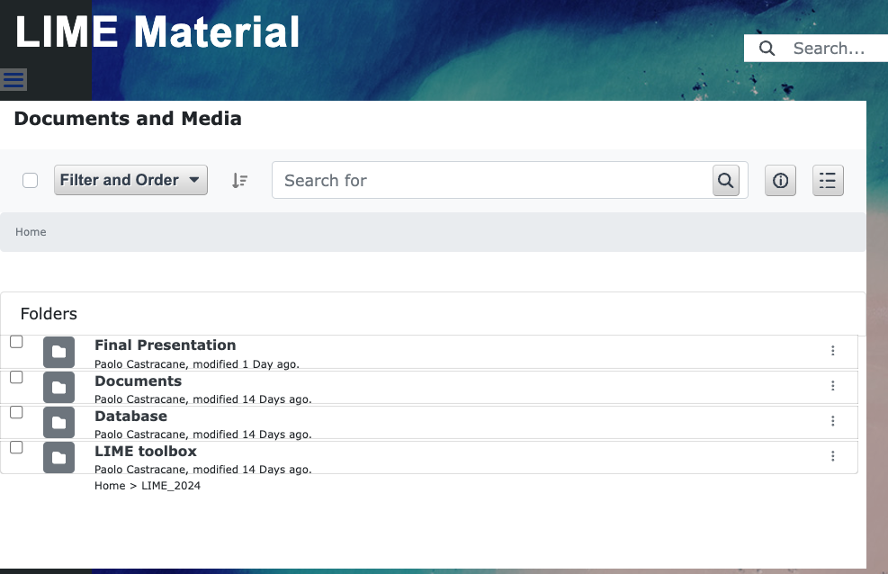
CEOS Cal/Val portal - LIME update
LIME updates - feb. 2024 with:
Documents: Deliverable documents form the project;
Database;
LIME toolbox: installers for Windows, Mac, Linux and Debian (Ubuntu);
Final Presentations

Slide 15
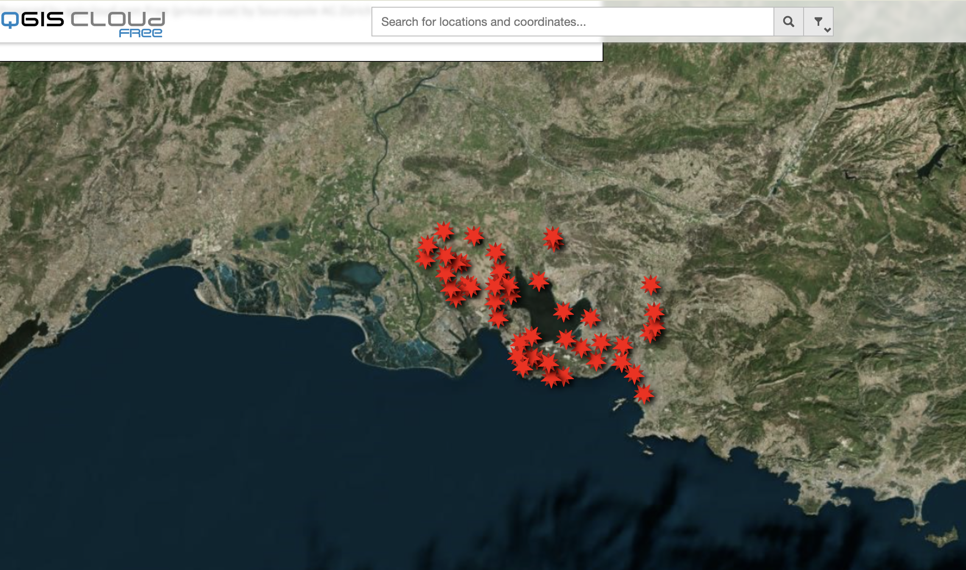
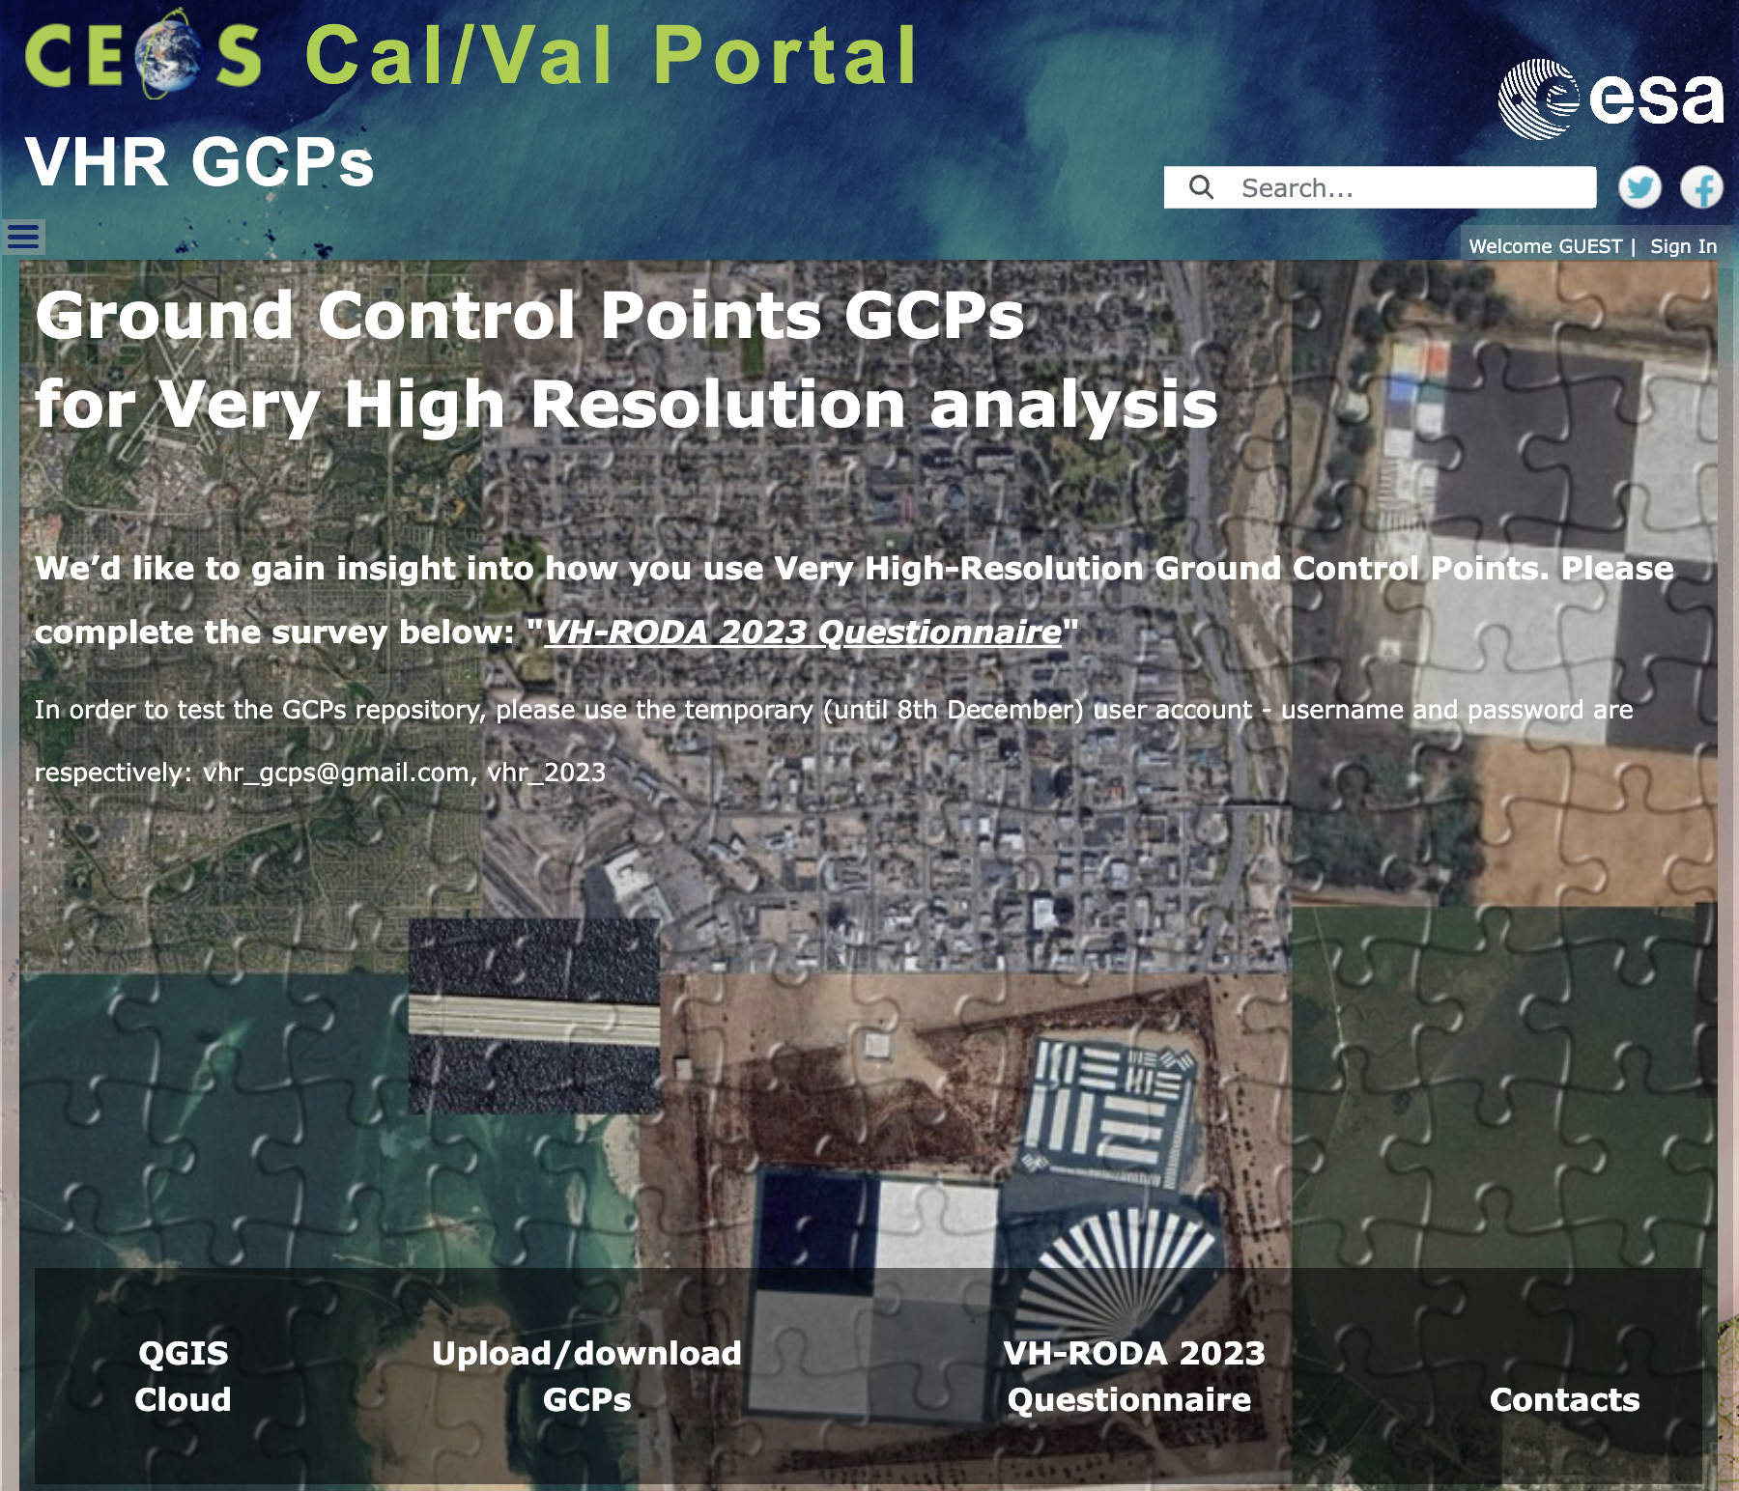
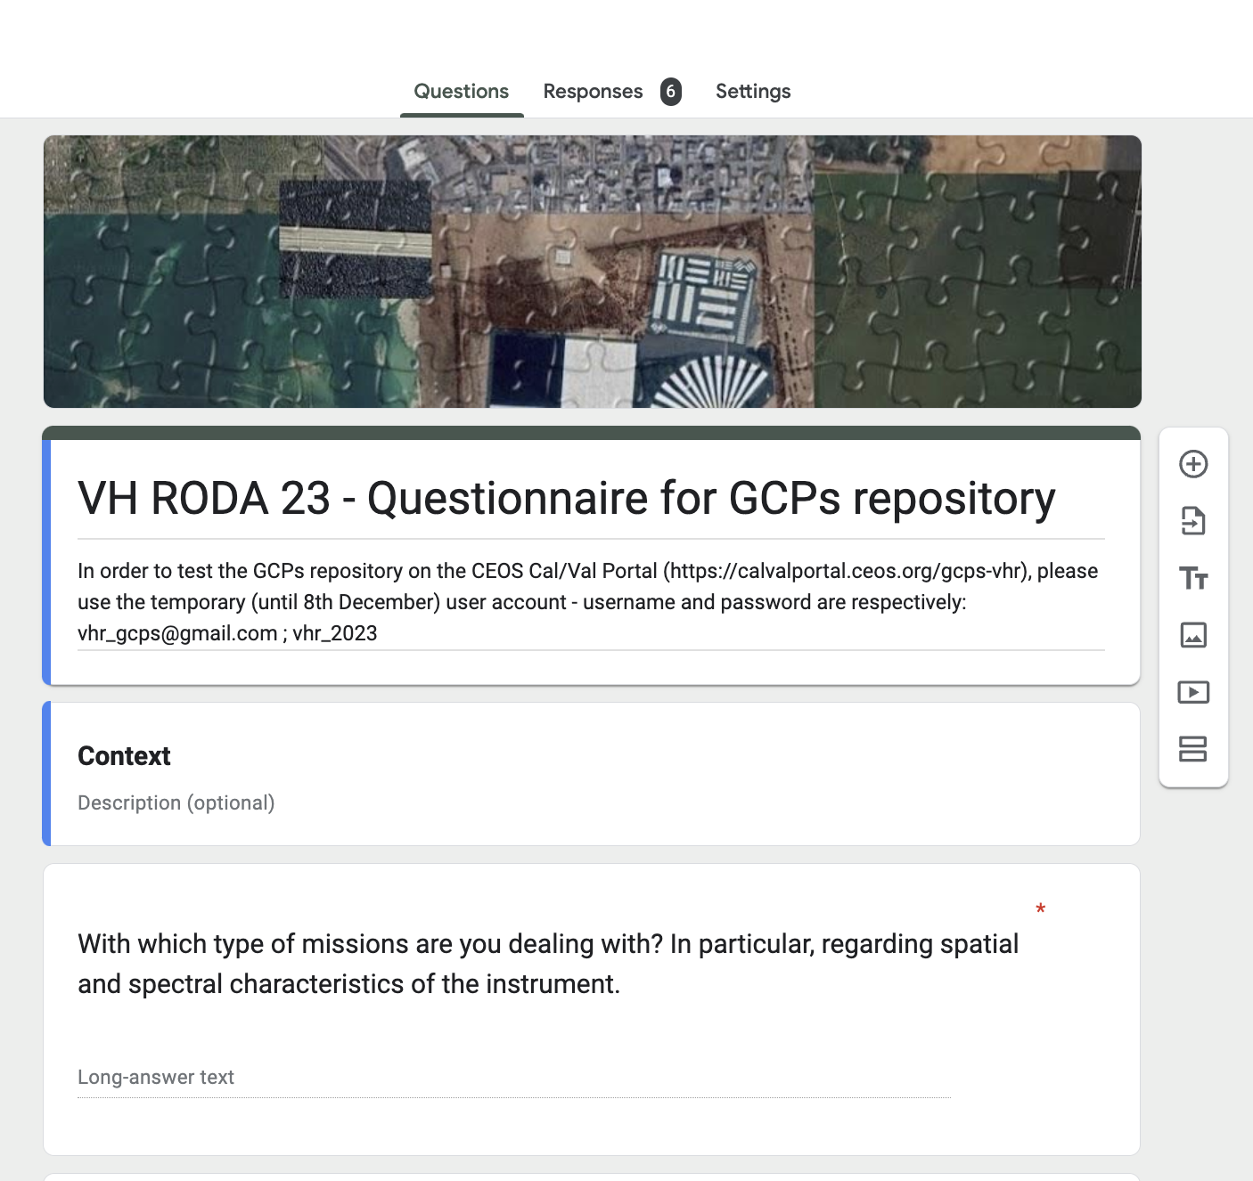
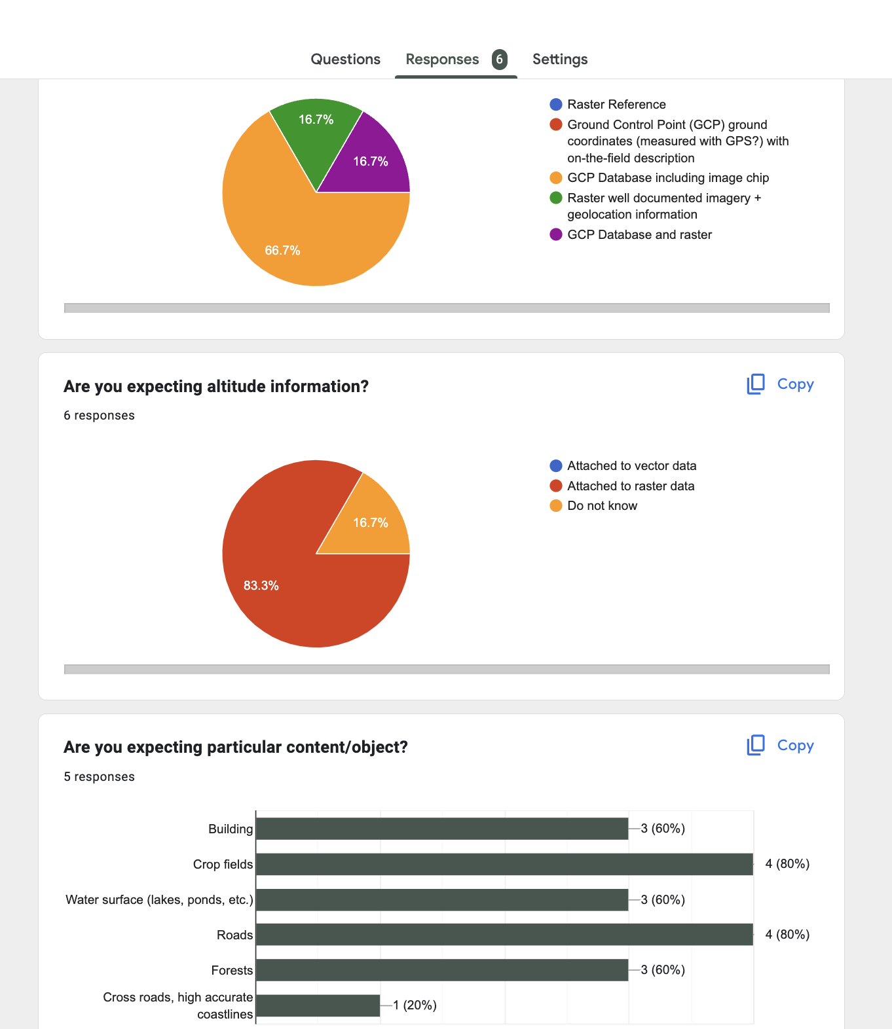
CEOS Cal/Val portal GCPs for Very High-resolution analysis
Webpage for GCPs for Very High Resolution
QGIS Cloud
Upload/download GCPs
VH-RODA 2023 – Questionnaire
Nov. 2023
- Input from
Sébastien Saunier
Rosario Quirino Iannone

Slide 16
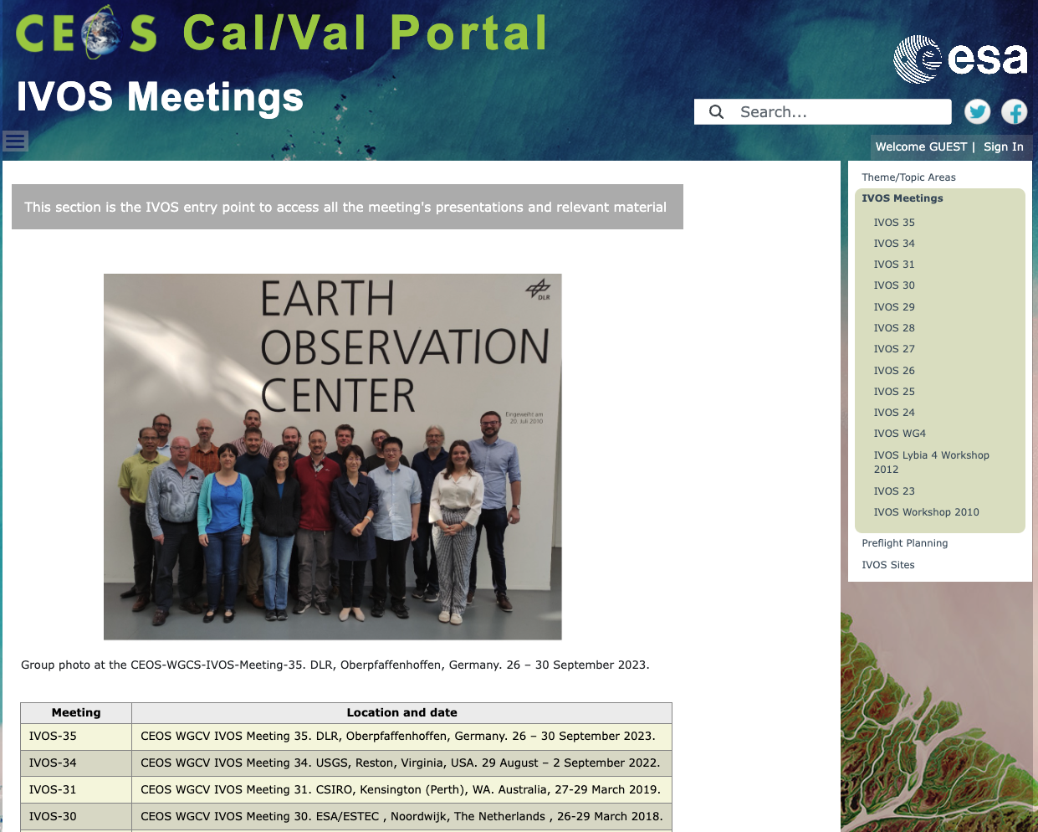
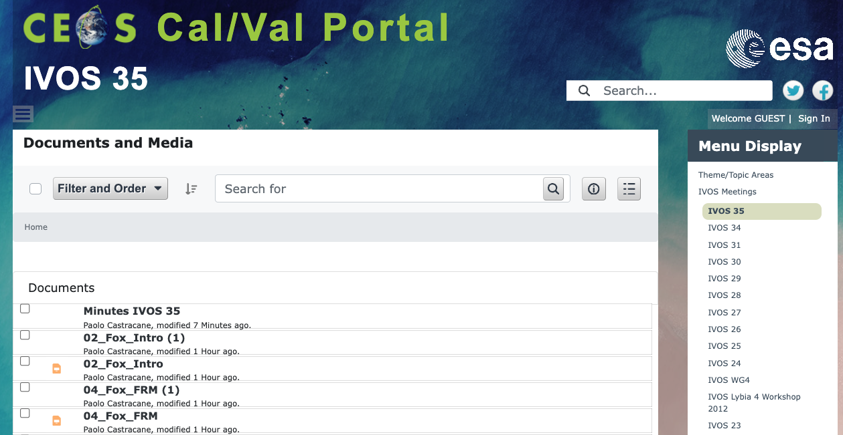
CEOS Cal/Val portal IVOS Meetings – IVOS-35
IVOS Meetings
IVOS -35
DLR, Oberpfaffenhoffen, Germany. 26 – 30 Sept. 2023
Presentations
MoM
Now available!

Slide 17
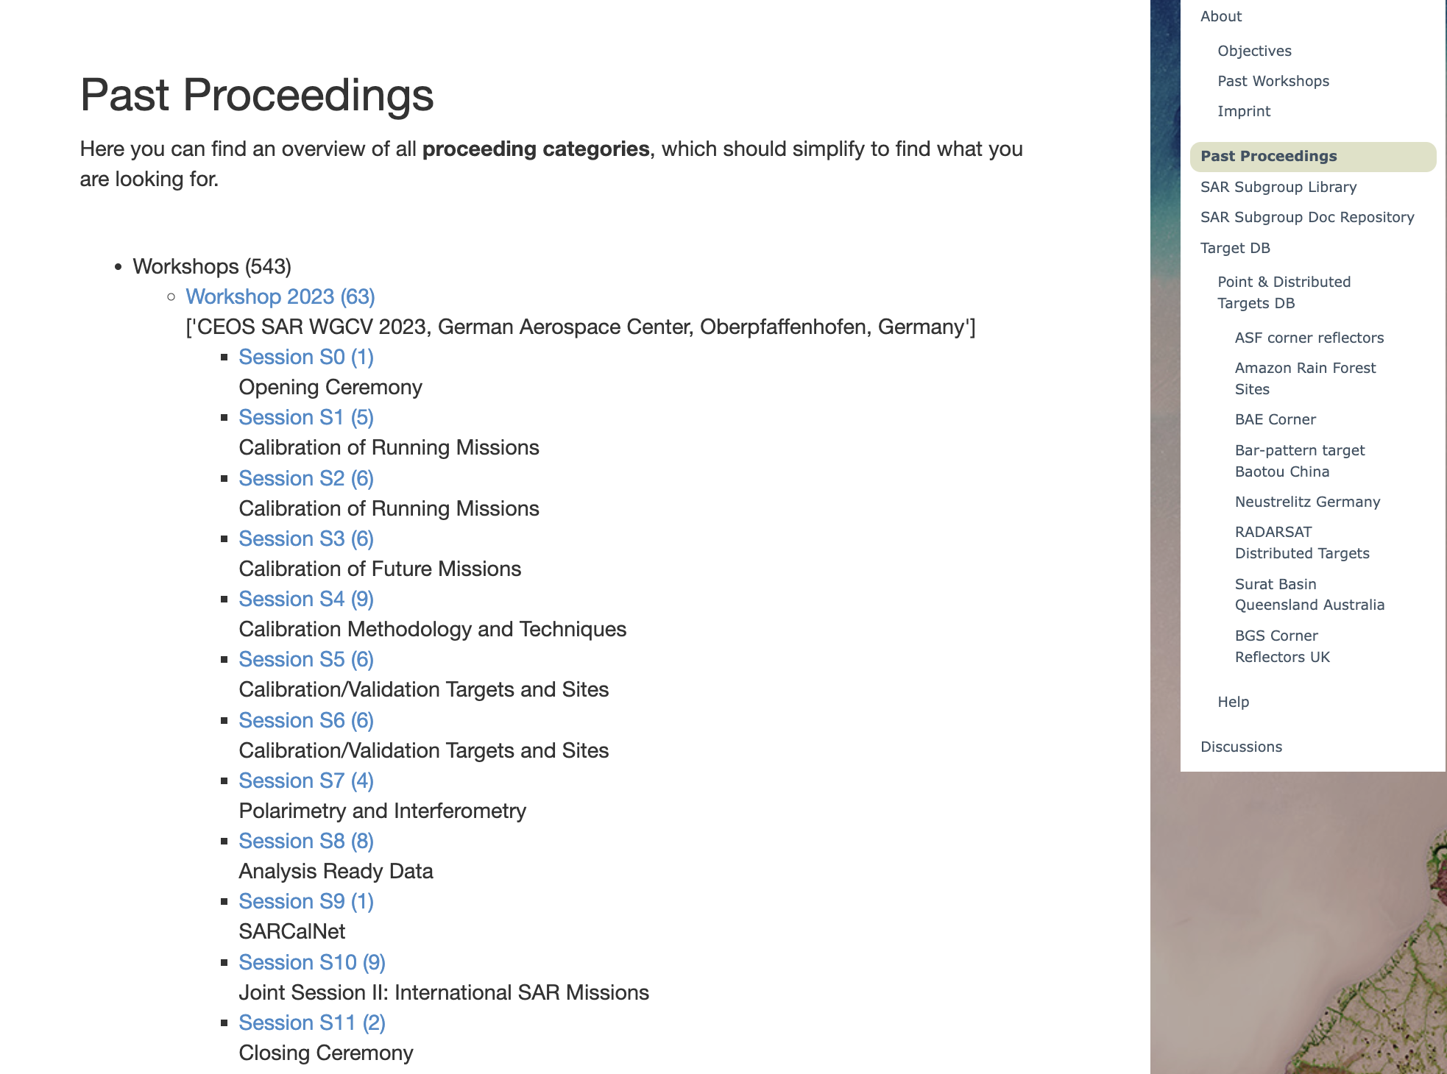
CEOS SAR subgroup

Slide 18
GSICS WGCV Area of cooperation
WGCV and GSICS share methods and protocols (vicarious calibration)
WGCV and GSICS look for REFERENCE
SITSat becoming reference from space SI traceable
Joint Organisation of the Pre-Flight Workshop Calibration / Characterisation: https://atpi.eventsair.com/pre-flight-calibration-workshop
New Space topics
Maturity Matrix approach – examples from EDAP and CEOS FRM
Outreach

Slide 19
Thank you!

