Slide 1
CMA GDWG ANNUAL REPORT 2023
TIAN Lin

Slide 2
Outline
Share Fengyun Satellite Reprocessing Dataset for GSICS
NSMC-GPRC Website Upgrade
Access IASI Data

Slide 3
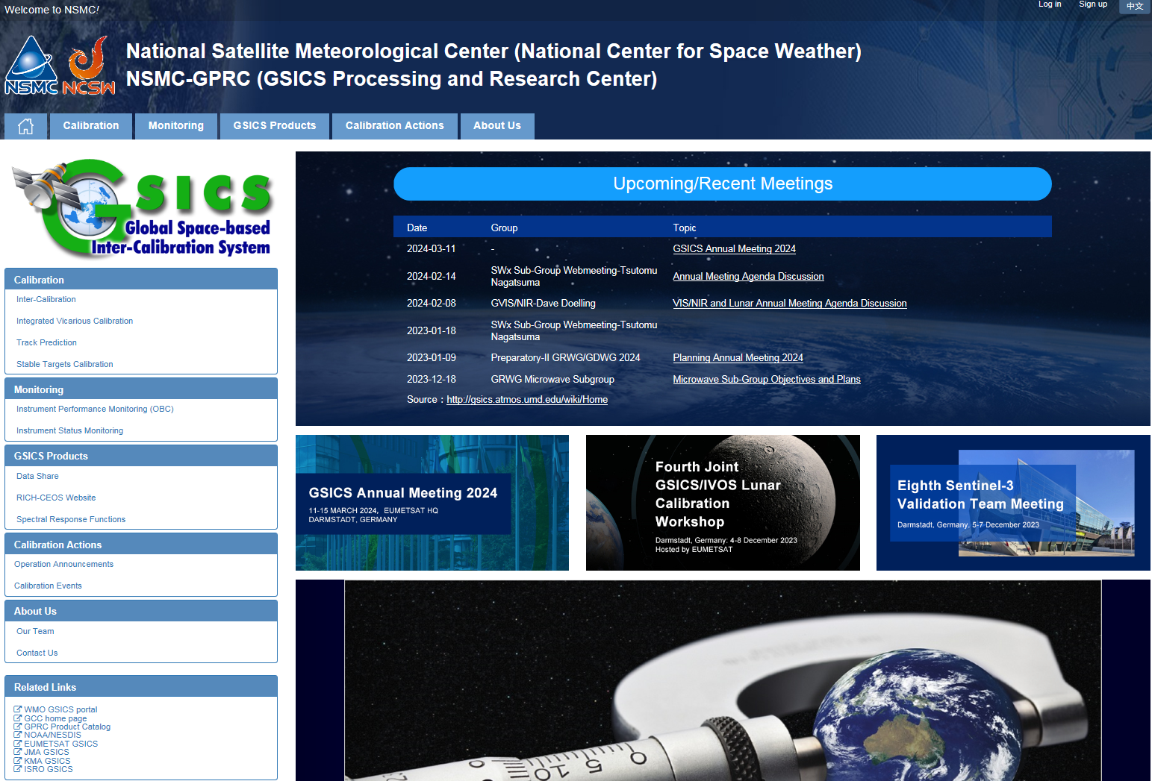
Share Fengyun satellite FCDR for GSICS
Face the action:
Share the Fengyun satellite FCDR for GSICS;
RICH-CEOS website link in NSMC GPRC website.
RetrospectIve Calibration of Historical Chinese Eerth Observation Satellite Data (RICH-CEOS)
Link to RICH-CEOS website

Slide 4
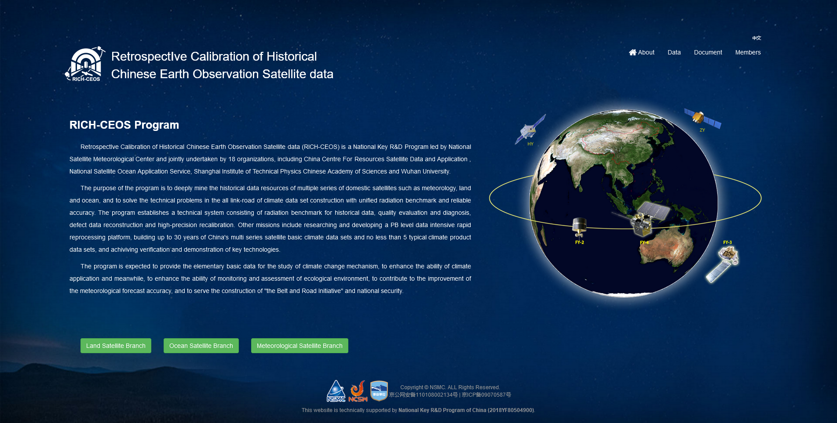
RICH-CEOS Data Website
Up to 30 years of basic climate data of China's multi series satellite such as meteorology, land and ocean.
Climate data sets constructed with unified radiation benchmark and reliable accuracy.
Approximately 300TB data available:
13 primary climate data sets,
9 thematic product data sets,
4 radiation reference data sets.
www.richceos.cn/record/en/index.html

Slide 5
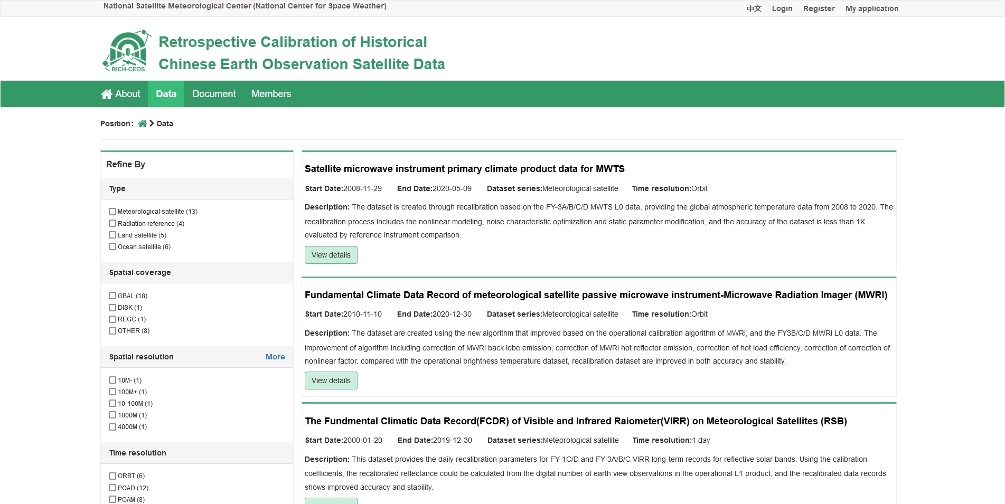
RICH-CEOS Data Website
Step 1: Register with NSMC website and log in with the account.
Step 2: Search data sets you are interested in.
Step 3: Apply for permission from the data set author.
Step 4: Download online data. (dataserver@cma.gov.cn; iusc_nsmc@cma.gov.cn)

Slide 6
Outline
Share Fengyun Satellite Reprocessing Dataset for GSICS
NSMC-GPRC Website Upgrade
Access IASI Data

Slide 7
NSMC-GPRC Website Upgrade
Upgraded in 2023:
Running as an independent website, no longer a subsite of NSMC website (www.nsmc.org.cn);
Newly added meeting information related to GSICS activities;
Bug-fixes, such as fixing dead links.
New page header and navigation bar
Upcoming and recent meeting information from GSICS Wiki
Upcoming conference and workshops information from EUMETSAT
Corrected related links

Slide 8
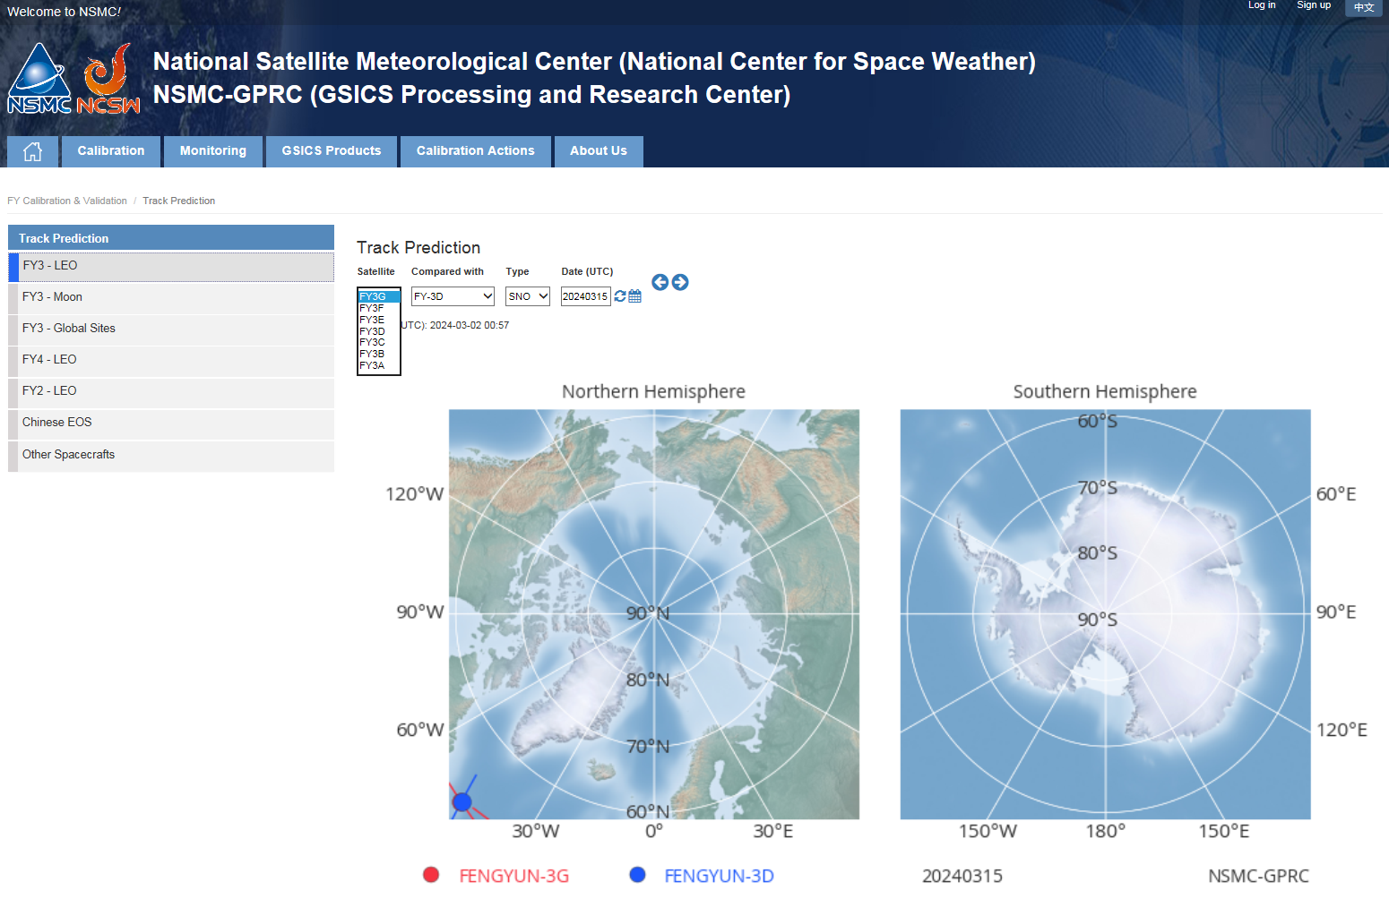
NSMC-GPRC Website Upgrade
Upgraded by 2023/08/31:
Operational orbit prediction results of FY-3E & FY-3F & FY-3G cross with other satellites now available. (http://gsics.nsmc.org.cn/portal/en/fycv/cross.html)
FY-3E & FY-3F & FY-3G crossed with:
JPSS-1
Metop-B
Metop-C
Suomi-NPP
AQUA
TERRA
ENMAP
SENTINEL-1
SENTINEL-2
SENTINEL-5

Slide 9
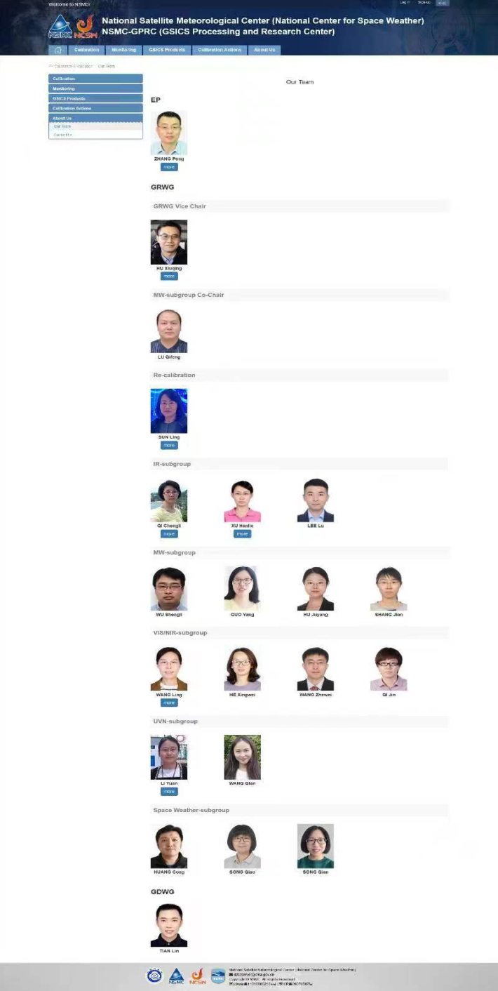
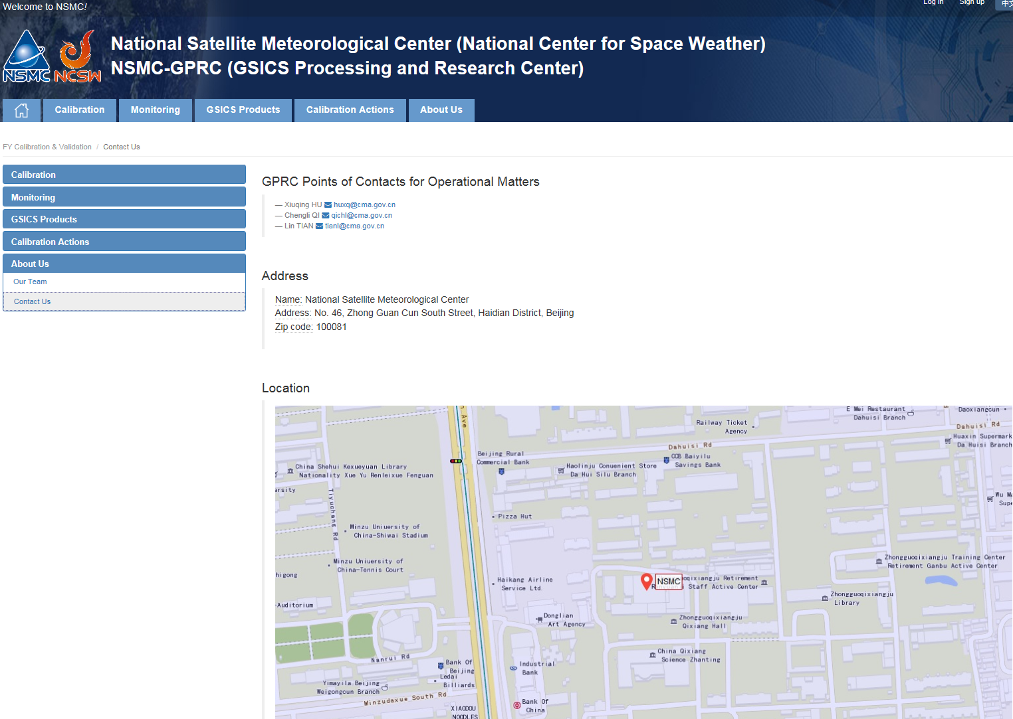
NSMC-GPRC Website Upgrade
Our team:
Our team members’ information;
Contact information for GPRC Operational Matters;

Slide 10
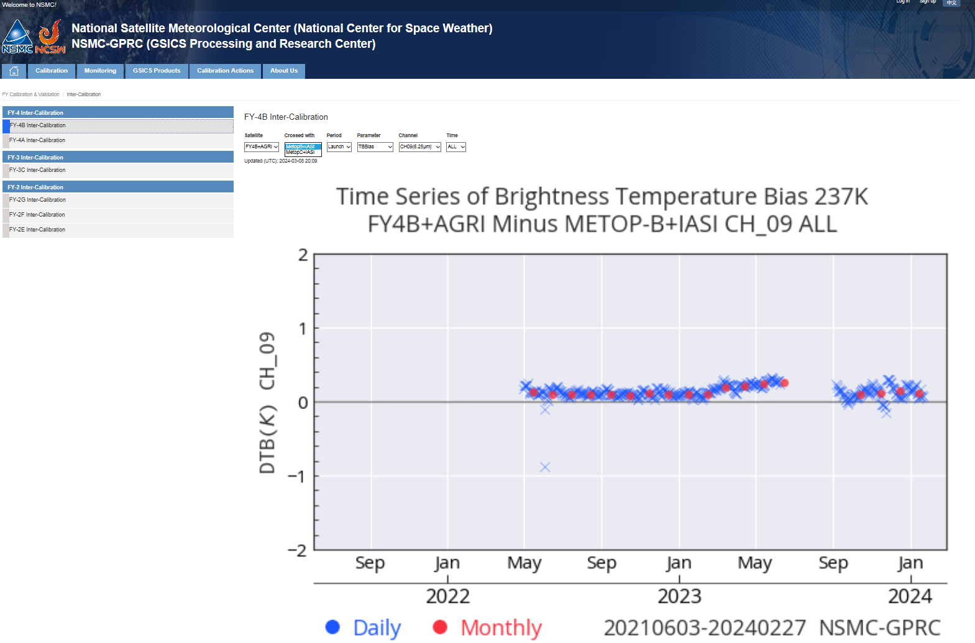
NSMC-GPRC Website Upgrade
Inter-calibration results:
FY-4A & FY-4B compared with Metop-B/IASI & Metop-C/IASI.

Slide 11
Outline
Share Fengyun Satellite Reprocessing Dataset for GSICS
NSMC-GPRC Website Upgrade
Access IASI Data

Slide 12
Communicating with EUMETSAT
Recover IASI data acquisition from EUMETSAT THREDDS website :
The matched METOP-A/B IASI data push have interrupted since 2021;
Eumetsat have kindly helped us to access the matched METOP-B/IASI & METOP-C/IASI data;
The matched data coverage were extended to the coverage of FY-2G, FY-2H, FY-4A and FY-4B satellites (in-orbit FengYun Geostationary satellite);
Then the comparison of Metop-B/IASI & Metop-C/IASI with FY satellite data were recovered.

Slide 13
Thank you for your attention！
Email:
tianl@cma.gov.cn
Notes:
Thank you for your attention. I will stop here. For more information, please visit the following website.
And, if you have any problem, please contact me by email.

