Slide 1
GOSAT and GOSAT-2 update
7.a
Kei SHIOMI (JAXA)
GSICS Annual Meeting 2024, UVN-S Breakout Session, EUMETSAT, Darmstadt / Hybrid, March 13, 2024

Slide 2
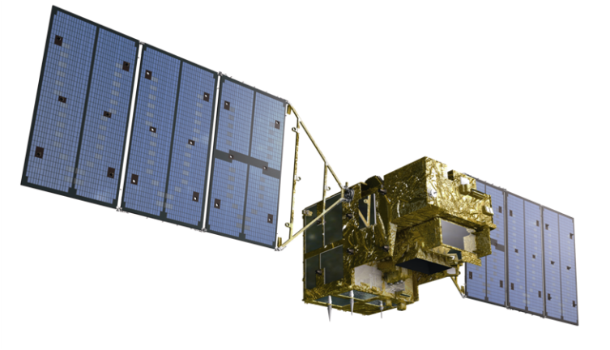
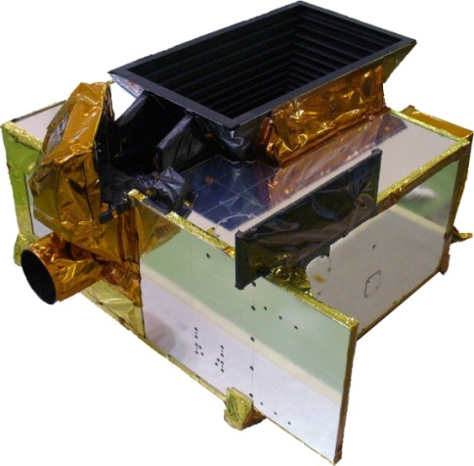
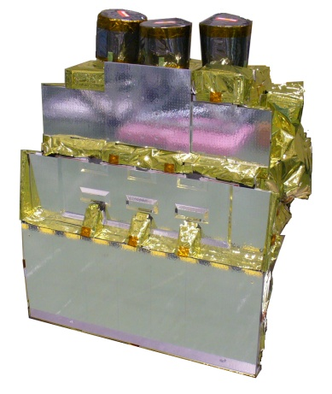
GOSAT and GOSAT-2 satellites
GOSAT (2009~)
GOSAT-2 (2018~)
FTS-2
CAI-2
FTS-2
O2A(0.76μm)
WCO2,CH4(1.6μm)
SCO2, CO (2μm)
2 TIR bands (5-15μm)
High spectral resolution 0.2cm⁻¹
Enhanced pointing mechanisms
FTS
O2A(0.76μm)
WCO2,CH4(1.6μm)
SCO2(2μm)
TIR (5-15μm)
High spectral resolution 0.2cm⁻¹
Pointing mechanism
CAI
UV-SWIR
4 bands linear array
Nadir view
CAI-2
UV-SWIR
10 bands linear array
5 forward view bands, 5 backward view bands

Slide 3
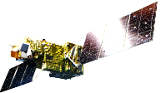
GOSAT and GOSAT-2 status
Long term (15-year Jan. 2024)
calibrated and validated dataset
Satellite Condition
Enough fuel to operate for at least another 10-year
All four batteries are healthy
Level 1 V300.300 (released in March 2023)
Best-estimate radiance spectra using TSIS-HSRS and long-term vicarious-calibration data.
JAXA Level 2 Partial Column product V3
GOSAT (14-year ) and GOSAT-2 (4-year)
Lite (csv format) and HDF with averaging kernels.
Intense target observations
using flexible and
wide angle pointing
Oct30,2024, 5-year operation review.
The operation has been extended.
Calibration
Feb. 2021, anomaly occurred in the solar diffuser plate mechanism. The solar irradiance calibration has been suspended since then, Lunar calibration is normal.
Level 1 V220.221 (scheduled in Mar. 2024)
TIR calibration updated in large-AT angles (V220.220)
SWIR radiometric degradation update (V220.221)
3

Slide 4
Calibration strategy
 | GOSAT (2009~) | GOSAT-2 (2018~)
Relative radiance degradation
Solar diffuser | Backside diffuser is only exposed Once / month | Diffuser is only exposed a few miniues Once /orbit (2018-Feb2021) Suspended due to the shutter trouble
Lunar calibration | 1-2 times / year (2009-2014) Suspended due to the solar paddles rotation stop | 2 times / month Both before and after full moon
Absolute radiance
Vicarious Calibration | Field campaign at Railroad Valley (RRV) playa, Nevada conducted every summer with OCO team | Same as the GOSAT
Inter-comparison
Simultaneous observation with other GHG sensors | Simultaneous observations At RRV target At orbit crossing | Same as the GOSAT
4

Slide 5
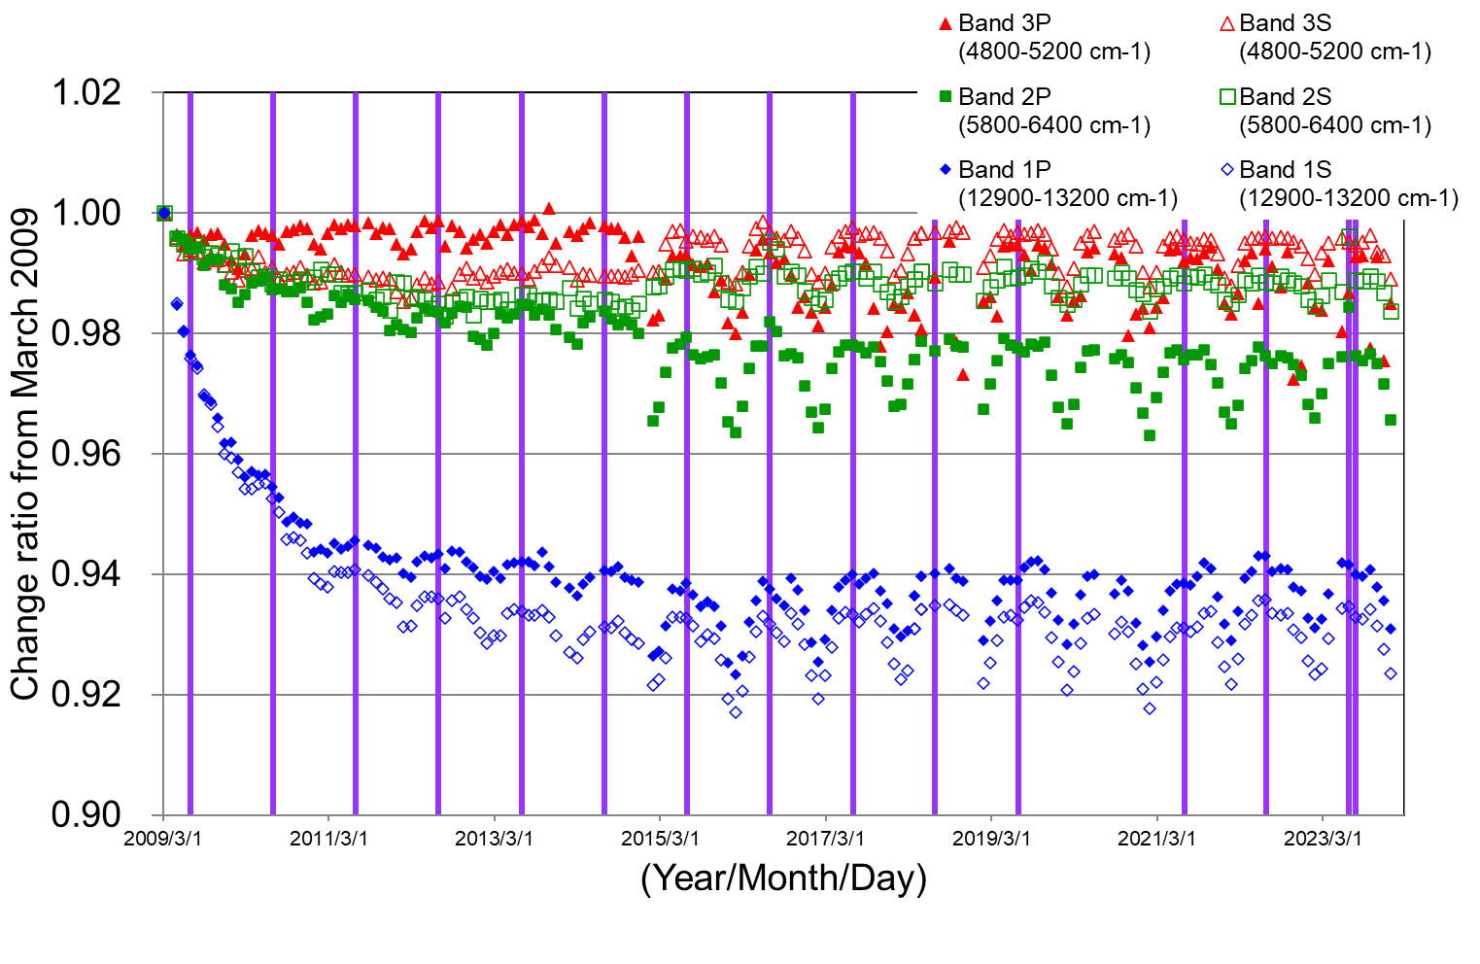
GOSAT solar diffuser calibration as on-orbit main calibrator
GOSAT backside diffuser is exposed only once a month
Over 15 years
High-spectral resolution
Collaborated with TSIS team
The GOSAT radiance degradation curve was estimated from solar diffuser calibration.
This curve will be scaled to the Railroad Valley Vicarious Calibration results over 15 years.
5

Slide 6
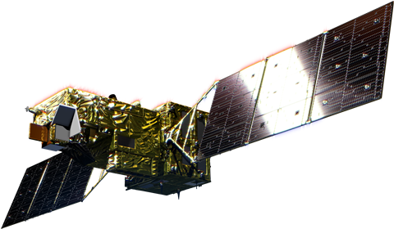
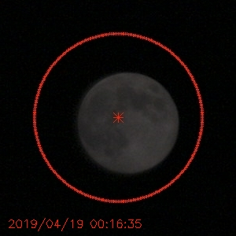
GOSAT-2/FTS-2 lunar calibration as on-orbit main calibrator
GOSAT-2 Lunar Calibrations are operated in two days around full moon (phase angle ~ ±7-8 [deg]).
■day1 : Waxing gibbous moon
Keep looking at the moon, integrate for 4 [sec] per sounding and observes 10-30 soundings.
Used for the evaluation of radiometric degradation.
FTS-2 modulation efficiency depends on orbital ambient temperature, so, we only used the timing② data.
Moon
Moon
integrate 4 [sec] each sounding
FTS-2(band1)
: timing①
■day2 : Waning gibbous moon
FTS-2 footprint
0.77[μm]
0.75[μm]
Moon
The advantage of FTS-2 lunar calibration data
High-frequency observation (almost every month)
Long-term dataset (over 5 years)
phase angle around ±7-8[deg], less lunar polarization (Coyne and Pellicori, 1969, Toledano et al., 2023)
FTS-2(band1~3)
: timing③
FTS-2(band1~3)
: timing②
6

Slide 7
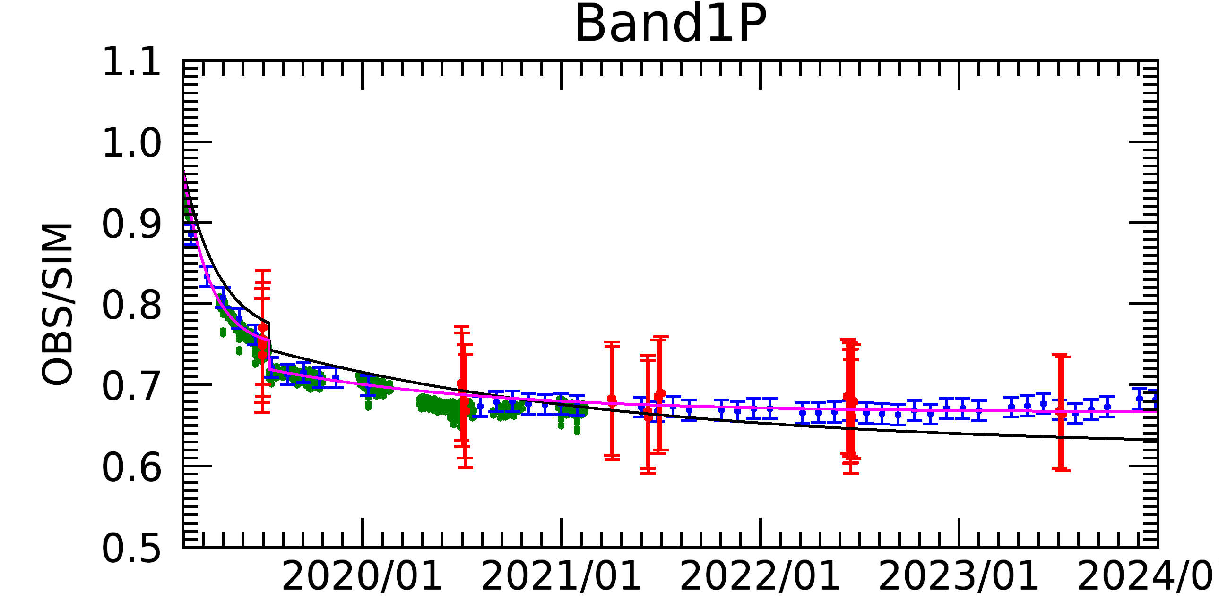
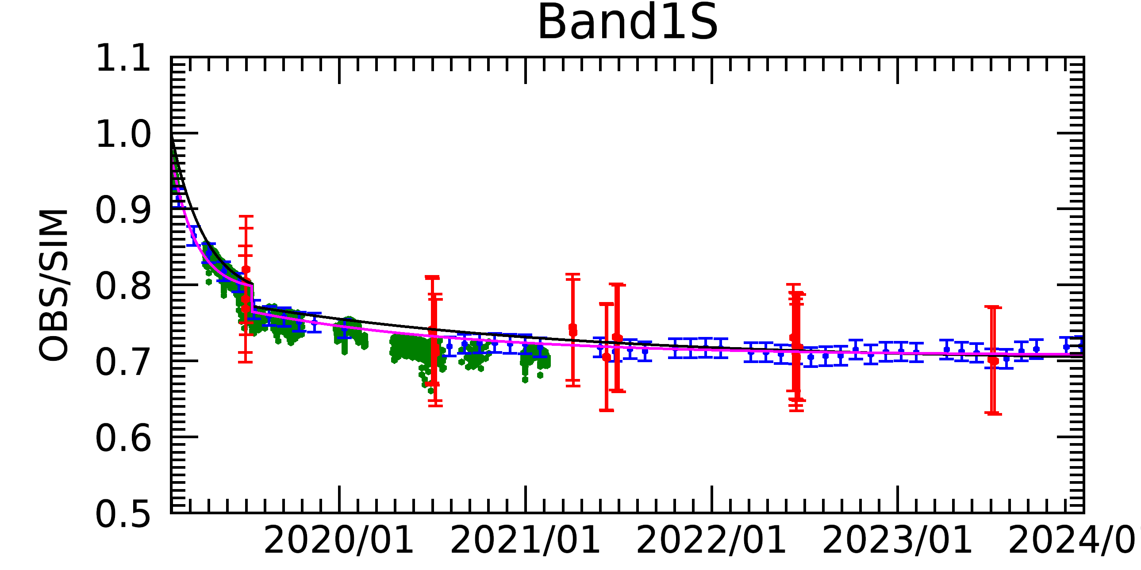
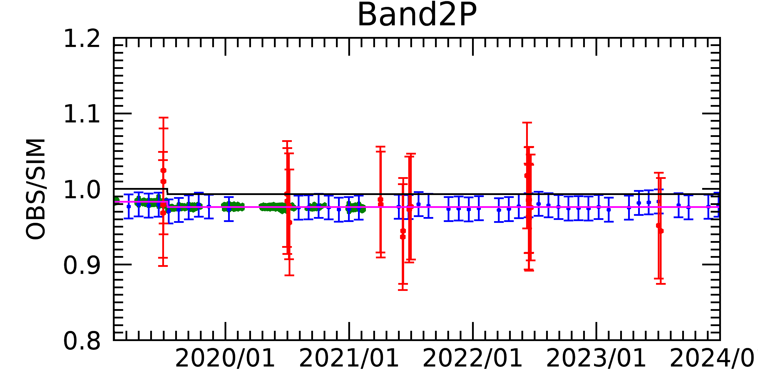
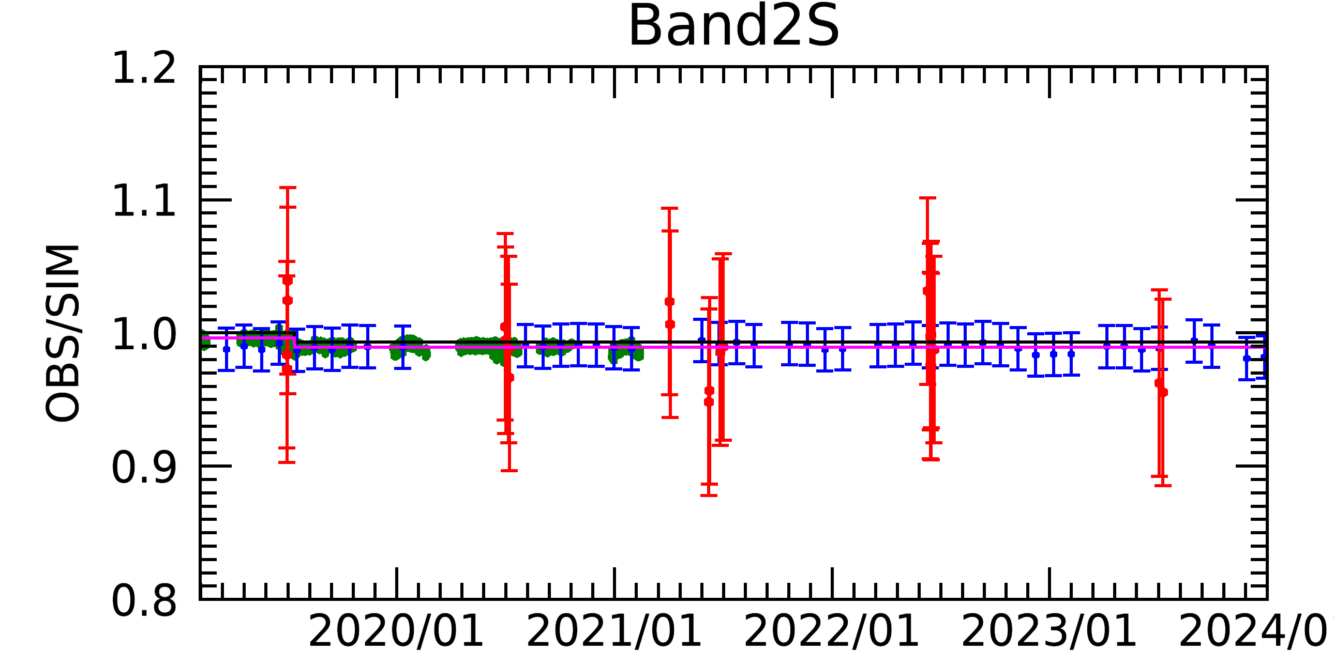
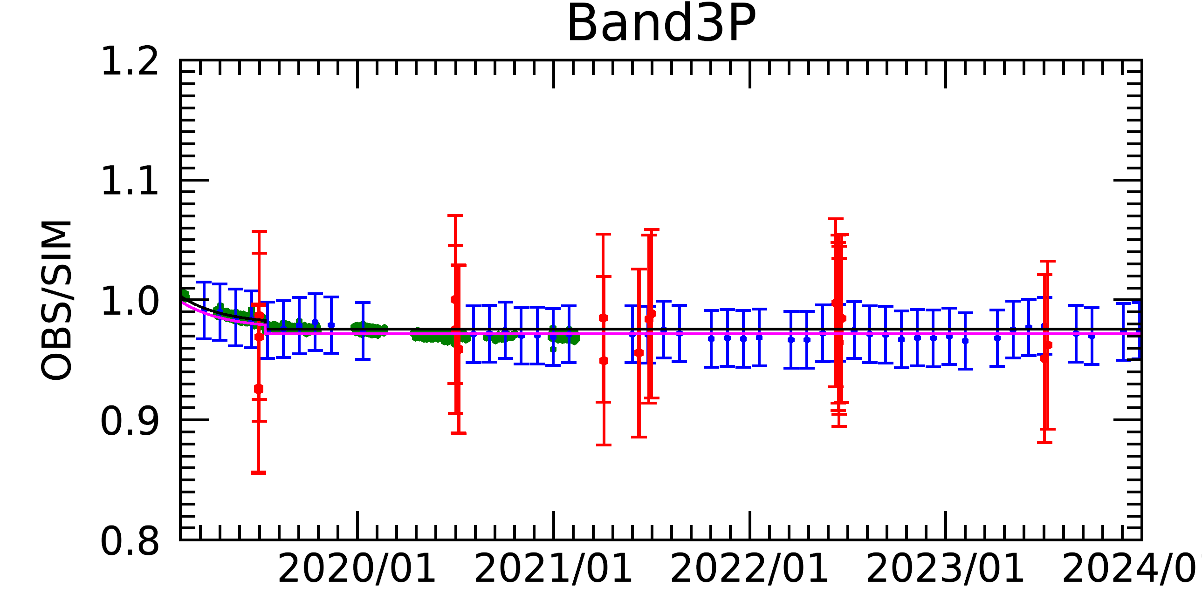
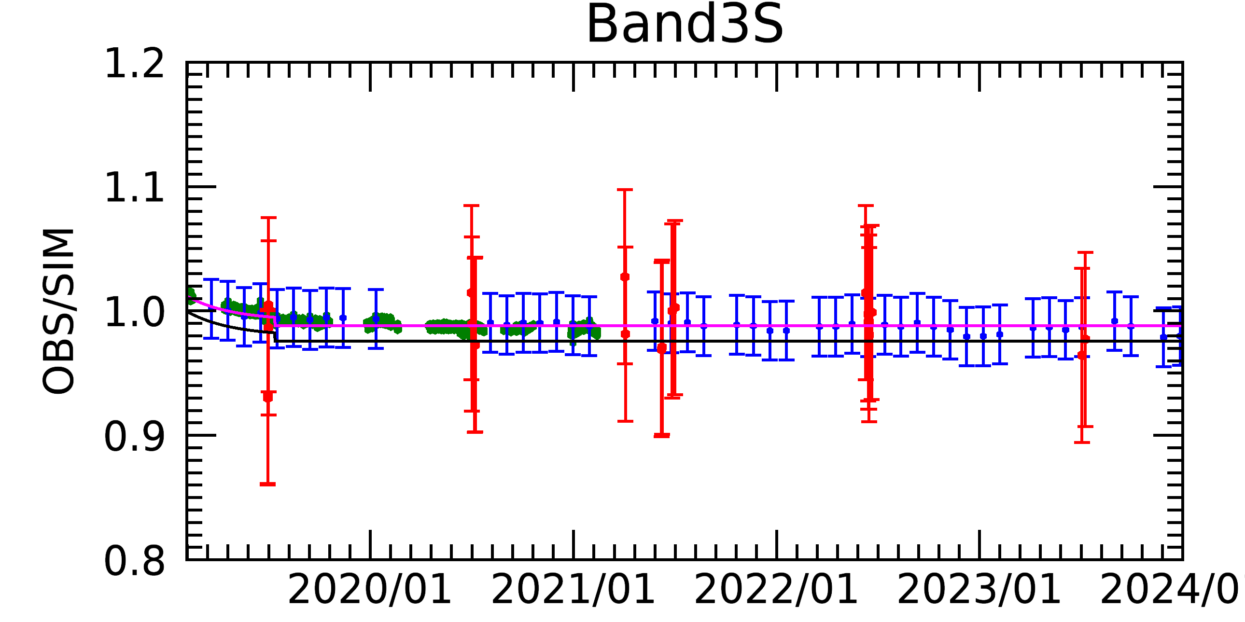
GOSAT/FTS-2 radiance degradation
ーRDF2024 (L1B V220.221) New
ーRDF2020 (L1B V220.220) Old
・Solar diffuser calibration
・Lunar calibration
・RRV vicarious calibration
The GOSAT-2 radiance degradation curve was estimated from solar diffuser calibration before.
New radiance degradation curve was estimated from 5-year lunar calibration.
This curve was scaled to the Railroad Valley vicarious calibration results.

Slide 8
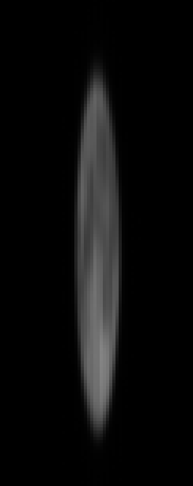
GOSAT-2/CAI-2 lunar calibration
GOSAT-2 Lunar Calibrations are operated in two days around full moon (phase angle ~ ±7-8 [deg]).
■day1 : Waxing gibbous moon
■CAI-2 Lunar Calibration
CAI-2 CT scan
Moon
●Cross Track(CT) Scan in day1 path
・Scanning in the CT direction only once.
・Used for the evaluation of pixel-to-pixel sensitivity difference.
●Along Track(AT) Scan in day2 path
・Scanning in the AT direction 4 times
・Used for the evaluation of radiometric degradation.
Moon
Array detectors
Moon
■day2 : Waning gibbous moon
CAI-2 AT scan
Moon
The advantage of CAI-2 lunar calibration data
High-frequency observation (almost every month)
Long-term dataset (over 5 years)
Array detectors
~12 pixels
8

Slide 9
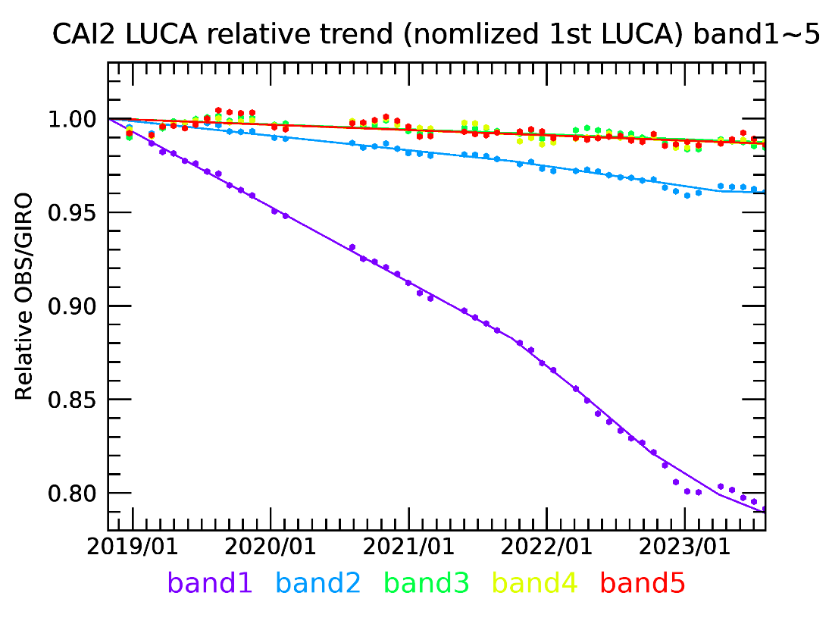
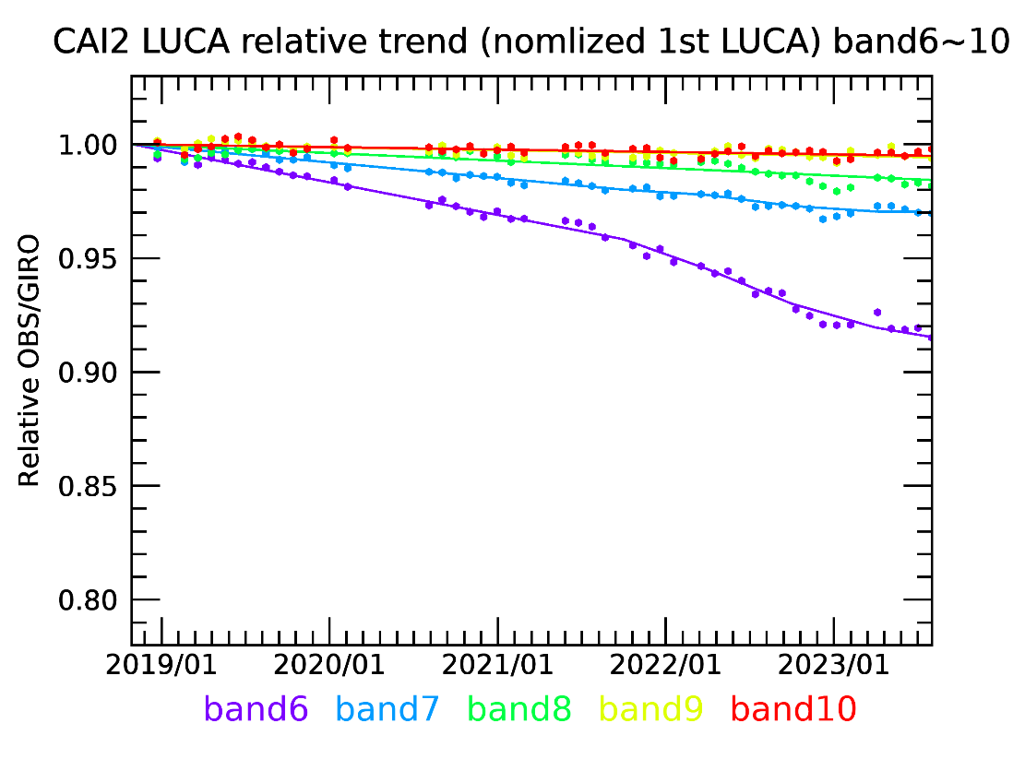
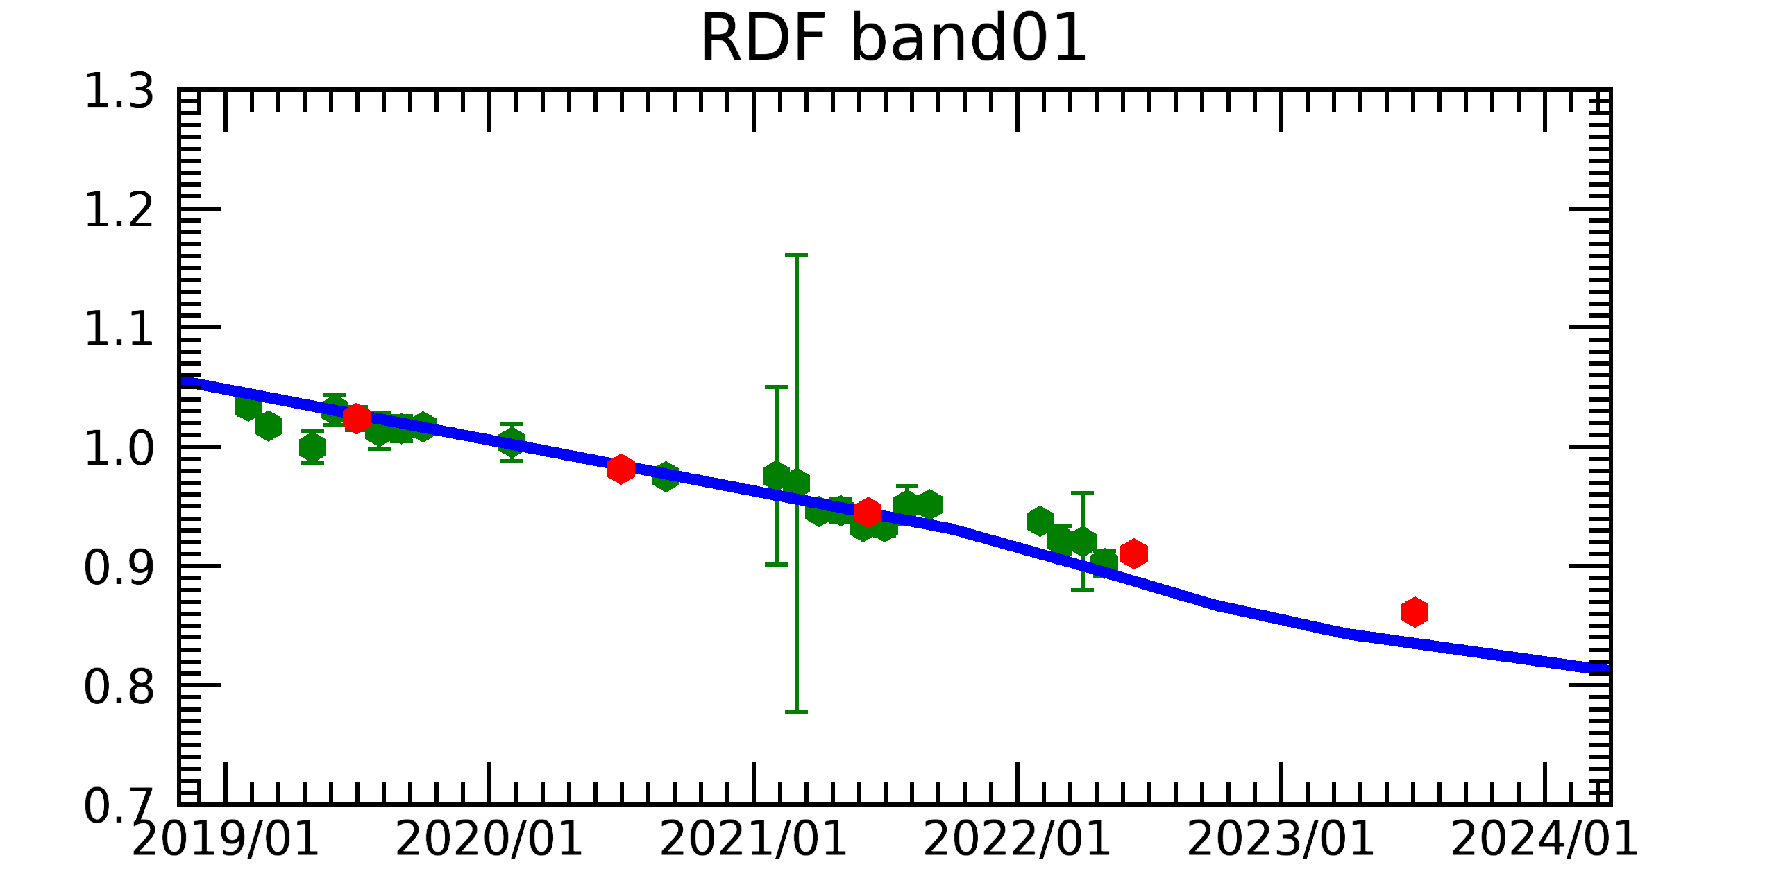
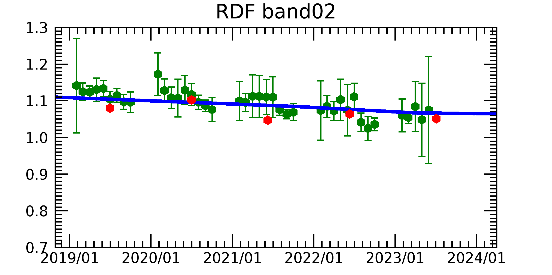
GOSAT-2/CAI-2 radiance degradation
■Radiance degradation curve estimated from Lunar calibration
B01-B05
B06-B10
The shorter wavelength bands have larger degradation.
B02(0.441μm)
B07(0.546μm)
B06(0.377μm)
B01(0.339μm)
■Radiance degradation factor combined with Lunar calibration and Vicarious calibrations
B01(0.339μm)
B02(0.441μm)
Vicarious calibration results that evaluated at the Railroad Valley, USA
Cross-calibration results using other satellite data(ex. VIIRS)
Degradation curve estimated from Lunar Calibration results
OBS/SIM
OBS/SIM
9

Slide 10
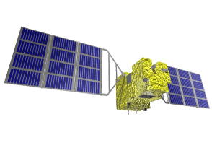
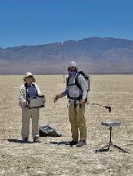
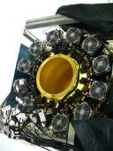
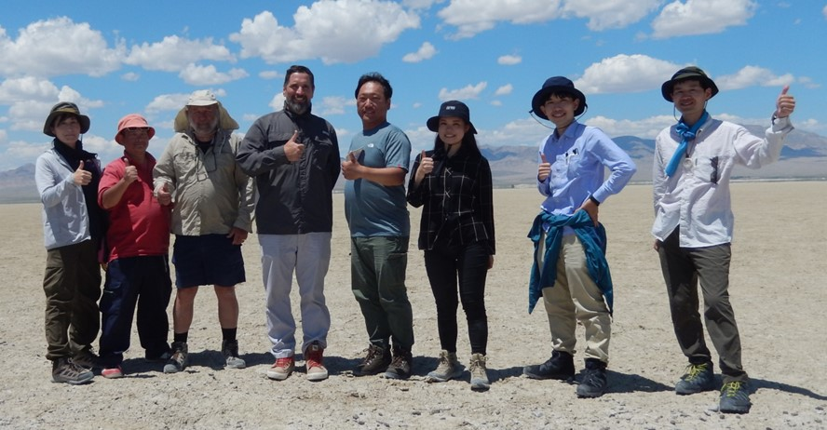
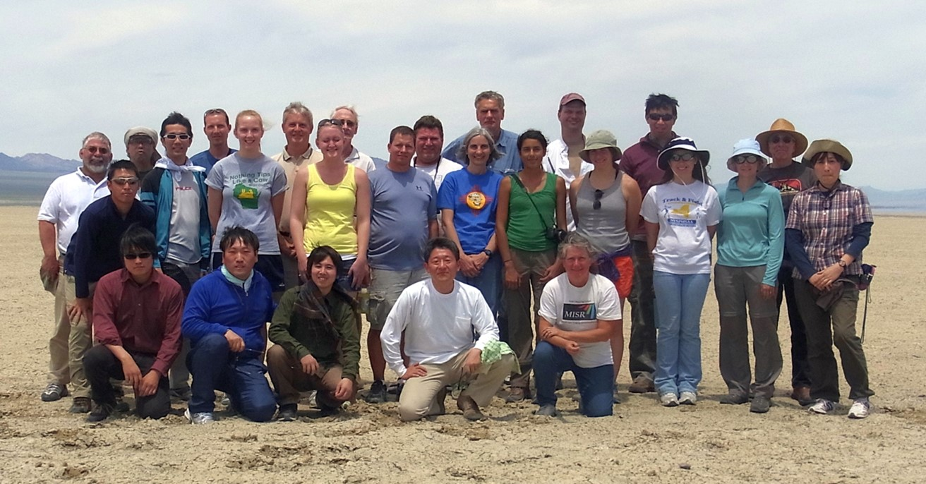
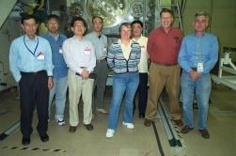
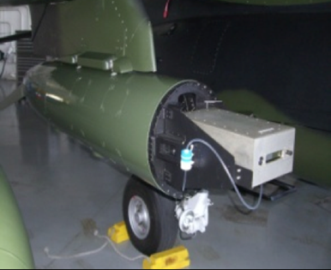
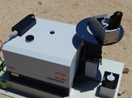
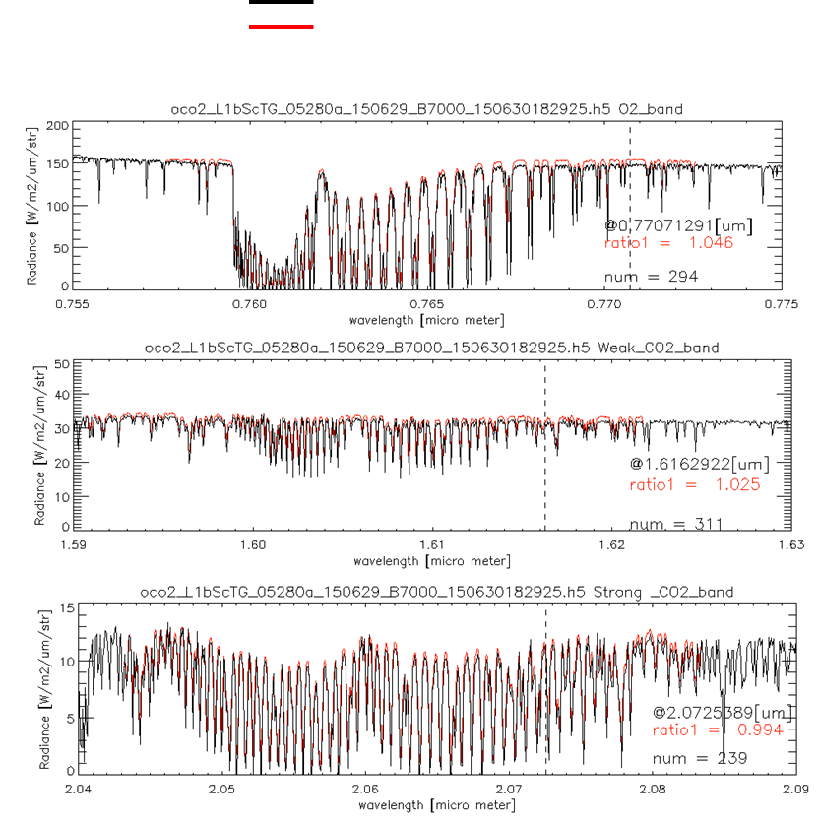
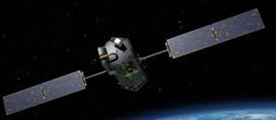
International collaboration for GHG sensors calibration
2008 09 10 11 12 13 14 15 16 17 18 19 20 21 22 23
Radiometric calibration
Prelaunch
X-CAL
Annual Vicarious Calibration at the desert playa in Nevada
CO₂ & CH₄ profile
In situ CO₂ and CH₄ on AJAX
XCO₂ & XCH₄
Column with EM-27 FTS
GOSAT OCO-2
Coincident Target
Calibrated GOSAT and OCO-2 radiance spectra agrees within 5% for all bands.
10

Slide 11
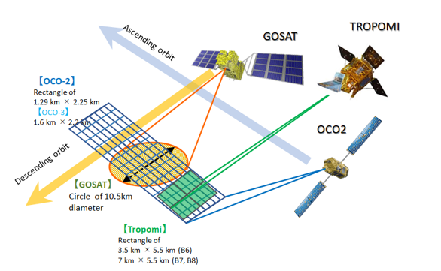
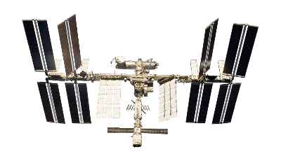
Railroad Valley target by 5 GHG sensors
GOSAT-2
RRV 2022 Summer Campaign schedule
Date | DoW | OCO-2 path | GOSAT path | GOSAT-2 path | TROPOMI InstZA [deg]
8-Jun-22 | Wed |  | no | no | 53.6 | RRV
9-Jun-22 | Thu | 138 | 36 | 72 | 8.1 | RRV
10-Jun-22 | Fri |  | 37 | 73 | 6.9 | RRV
11-Jun-22 | Sat | 136 | no | 74 | 46.3 | RRV
12-Jun-22 | Sun |  | 36 | no | 31.7 | RRV
13-Jun-22 | Mon |  | 37 | no | 46.6 | RRV
Good conditions for all sensors come every 48 days.
 | Nadir footprint size
GOSAT | Circle of 10.5km diameter
GOSAT-2 | Circle of 9.6km diameter
OCO-2 | Rectangle of 1.3 km * 2.3 km
OCO-3 | Rectangle of 1.6 km * 2.2 km
TROPOMI | Rectangle of 3.5 km * 5.5 km (B6) 7 km * 5.5 km (B7, B8)
OCO-3
11

Slide 12
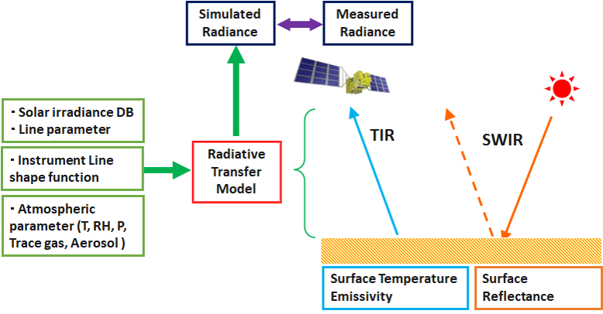
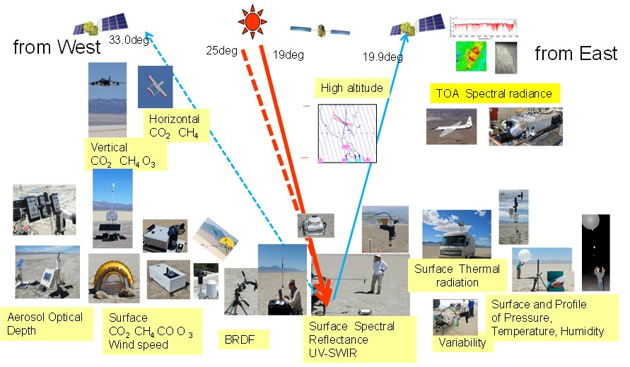
RRV vicarious calibration for GHG sensors
Key parameters
(1) Surface reflectance inhomogeneity correction
(2) Surface BRF correction
(3) Solar database
(4) Atmospheric parameter
We will calculate all 5 sensors for validating radiometric calibration accuracy by the same target.
12

Slide 13
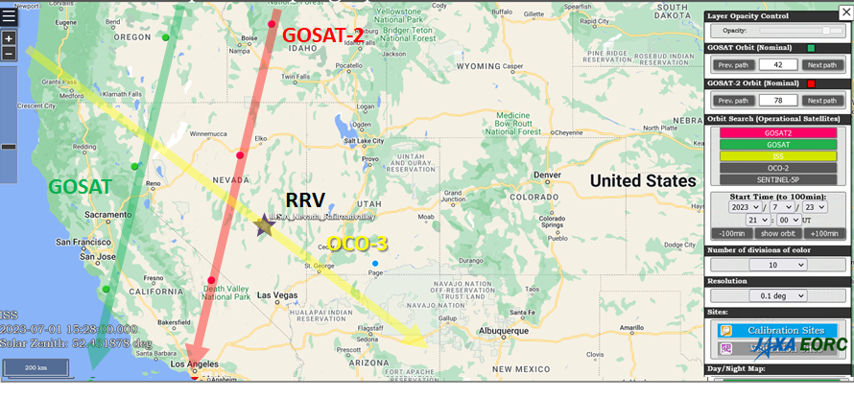
Vicarious calibration for GHG sensors
Jun23,2023
 | GOSAT | GOSAT-2 | OCO-3
Path | 37 | 73
L1 Ver. | V300300 | V220220 | B10
Time | 21:37:05 | 21:10:19 | 18:44
Sat_ZN | 37.35 | 12.92 | 42.82
Sat_AZ | 286.20 | 290.79 | 129.34
Sun_ZN | 28.19 | 23.60 | 19.753
Sun_AZ | 245.89 | 236.57 | 135.42
https://www.eorc.jaxa.jp/GOSAT/GOSAT_Optimization/index.html
Observation
Simulation
GOSAT-2 V220220
OCO-3 V10r
13

Slide 14
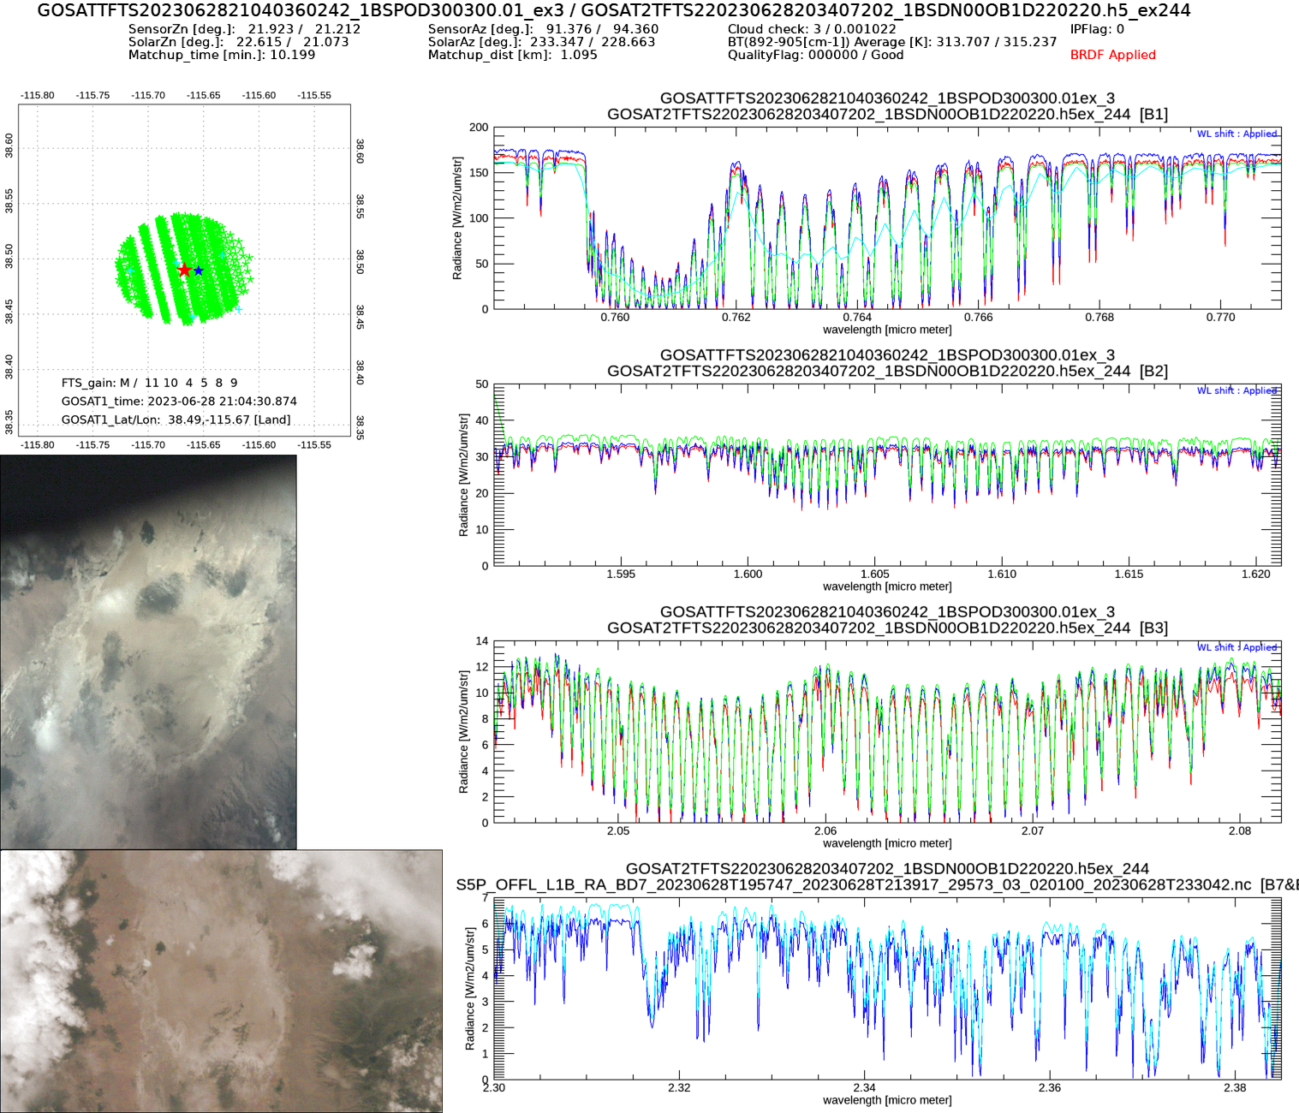
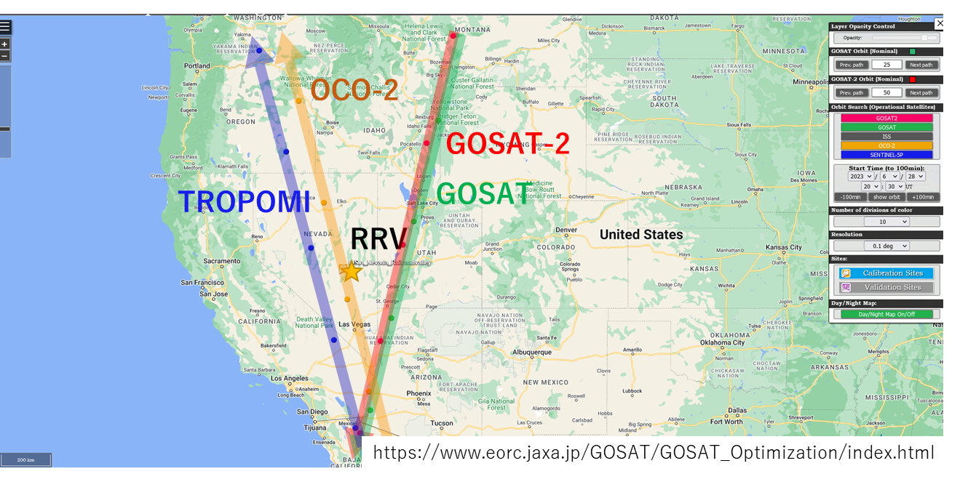
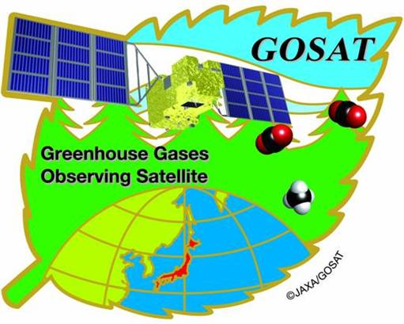
Intercomparison of GHG sensors simultaneous measurements at RRV
BRDF applied
2023/06/28
GOSAT (21:04) V300
GOSAT-2 (20:54) V200
OCO-2 (20:53) B11r
OCO-3
TROPOMI(20:51)
All sensors SatZA=20-23deg
14

Slide 15
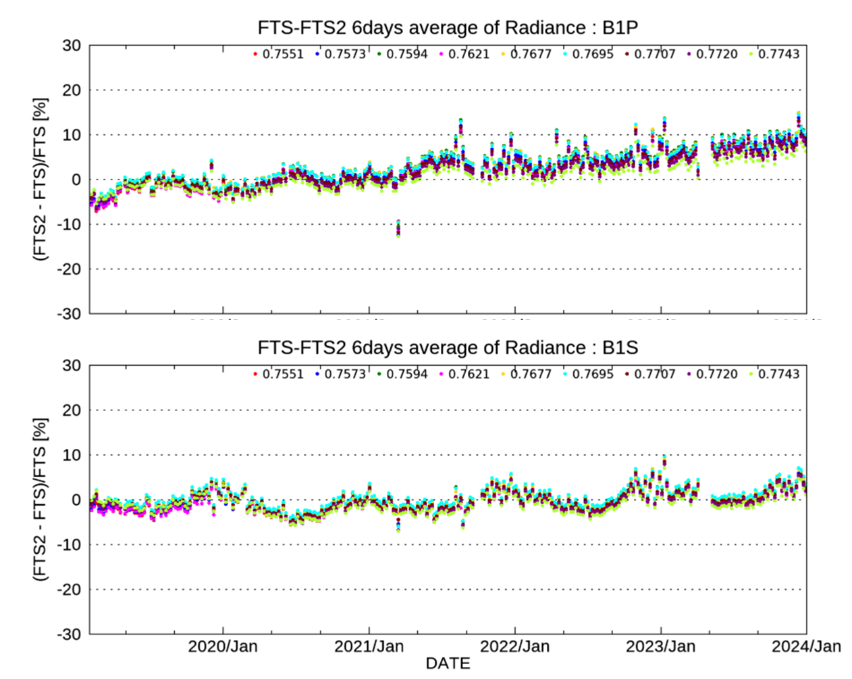
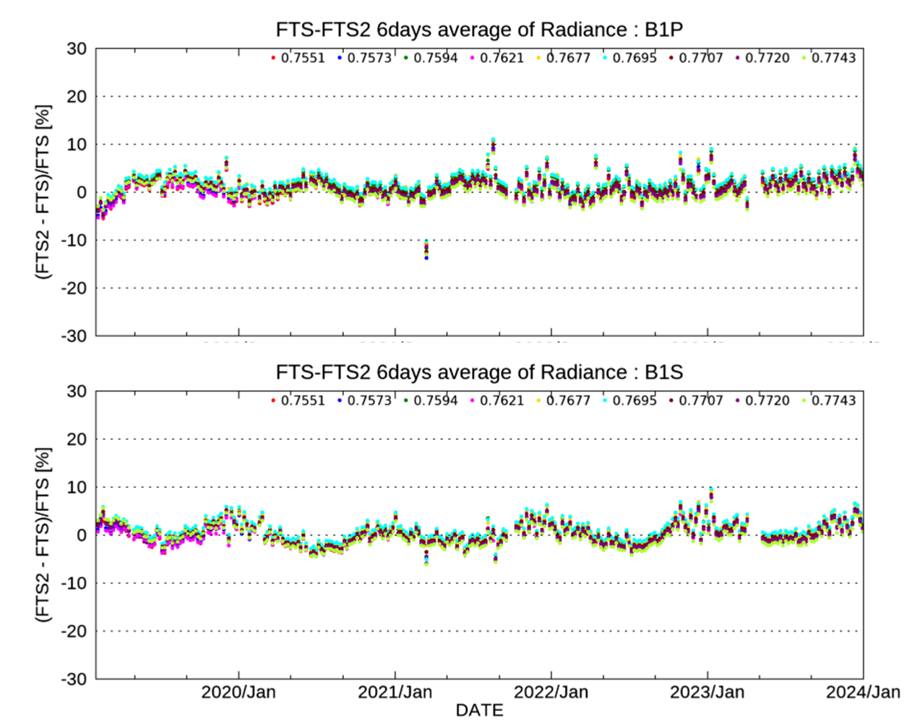
Intercomparison of GOSAT and GOSAT-2 at simultaneous observations
GOSAT-2 FTS-2 V220.220 (Old) minus GOSAT FTS V300
GOSAT-2 FTS-2 V220.221 (New) minus GOSAT FTS V300
GOSAT is well-calibrated in long term. New version of the GOSAT-2 radiance is confirmed to become better during 2019-2023.
15

Slide 16
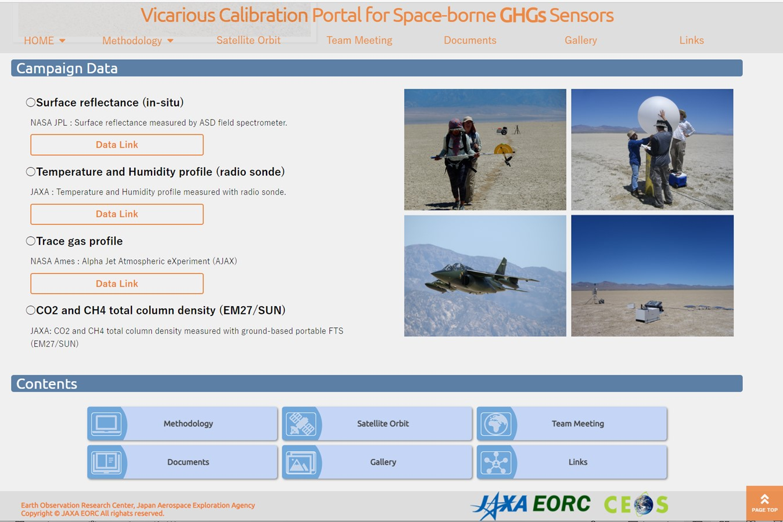
Summary
GOSAT has been operated normally over 15 years since 2009, GOSAT-2 over 5 years since 2018.
GOSAT and GOSAT-2 have been currently operated the on-orbit radiance calibrations by solar diffuser and lunar calibration, respectively.
Vicarious calibration has been conducted at Railroad Valley in collaboration with OCO team and TROPOMI.
https://www.eorc.jaxa.jp/GOSAT/GHGs_Vical/index.html
The Railroad Valley field data are available from VCAL portal site.
VCAL team meeting is held every 3-4 months. Next meeting: 12-13UTC, Friday, April 26, 2024.
RRV Campaign 2024: TEMPO team will be joined. OCO-3 will be back from ISS storage.
16

