Slide 1
2024 Global Space-based Inter-Calibration System (GSICS) Annual Meeting
Current Status of Geostationary Environment Monitoring Spectrometer (GEMS)
Kyunghwa Lee, Jaehoon Jeong, Jeonghyeon Seo, Mijeong Kim, Dongwon Lee
Environmental Satellite Center (ESC)
National Institute of Environmental Research (NIER)
Myoung-Hwan Ahn, Mina Kang, Mijin Eo, Yeeun Lee
Climate and Energy Systems Engineering/Social Economy
Ewha Womans University

Slide 2
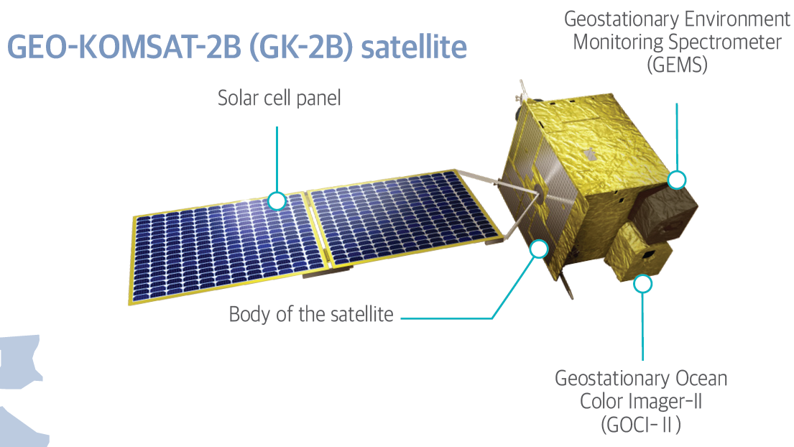
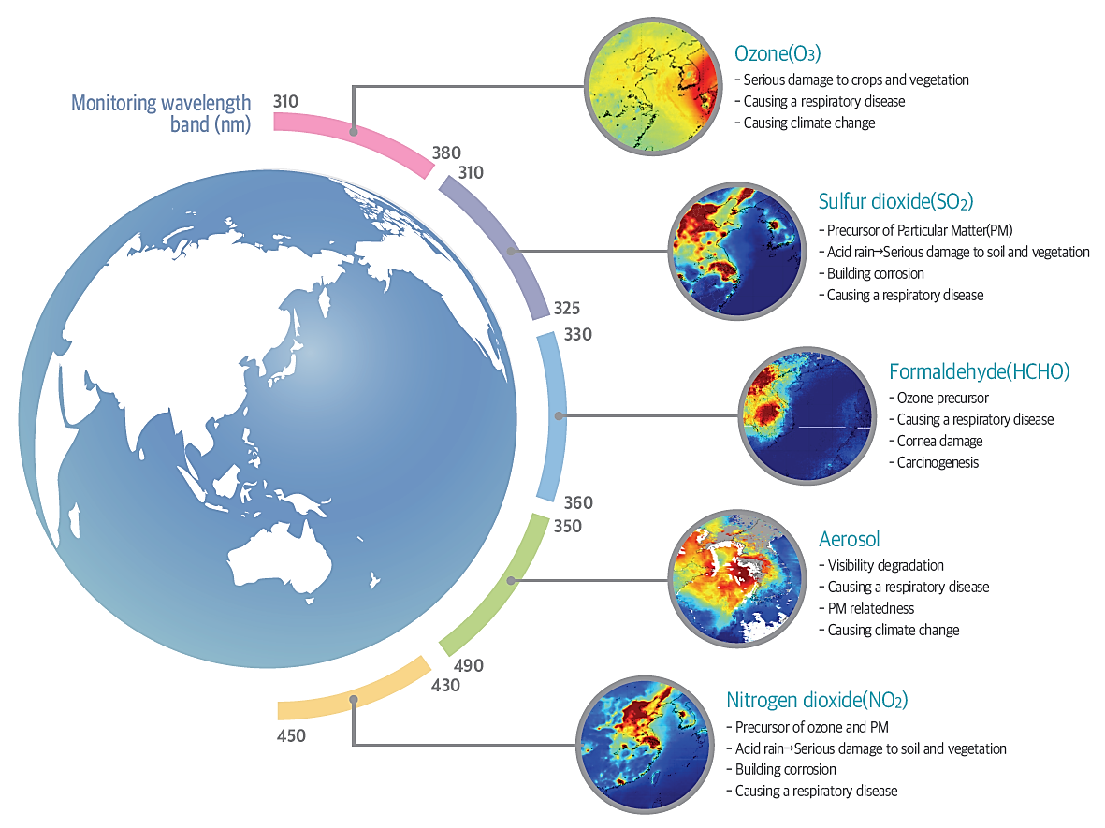
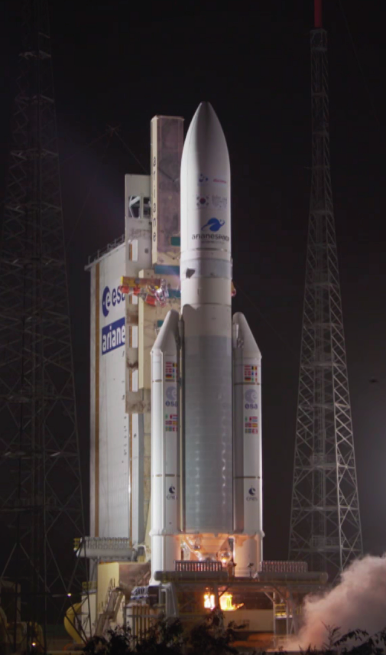
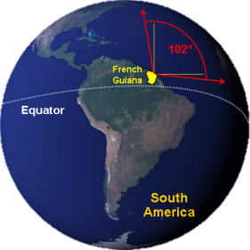
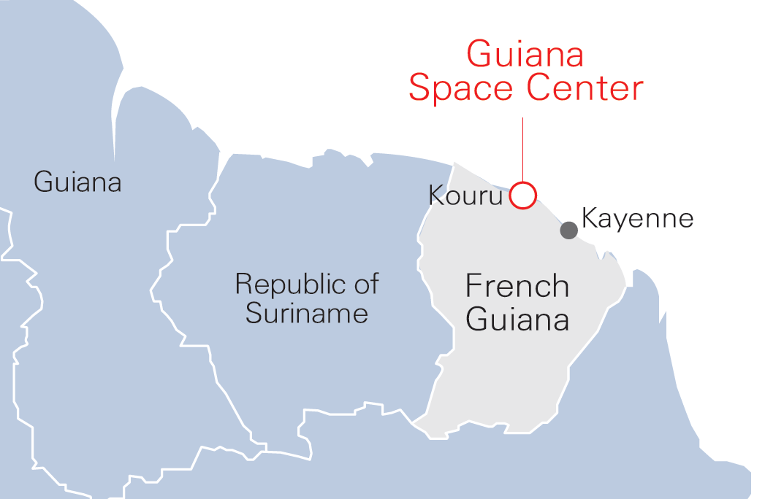
Introduction of GEMS
Launch of the first UV-visible geostationary hyperspectral imager : 18 FEB 2020

Slide 3
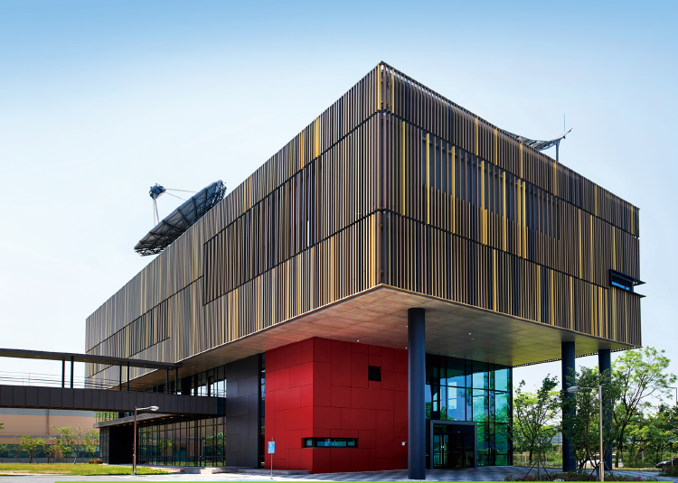
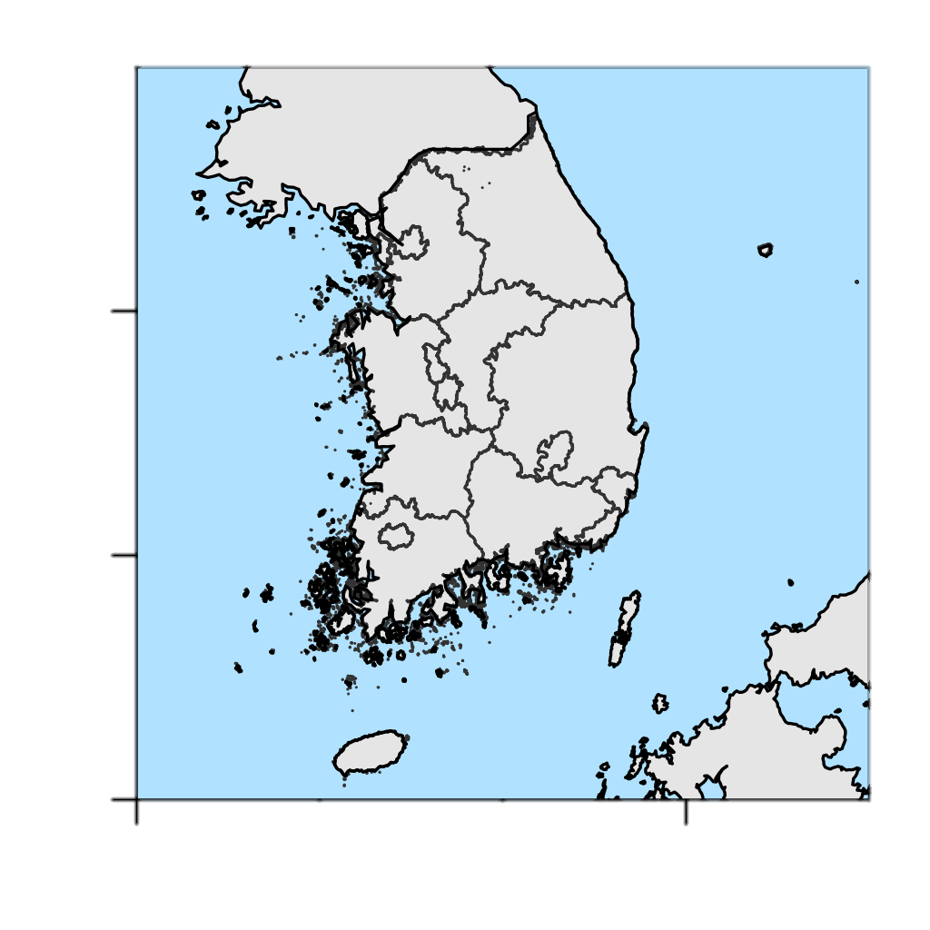
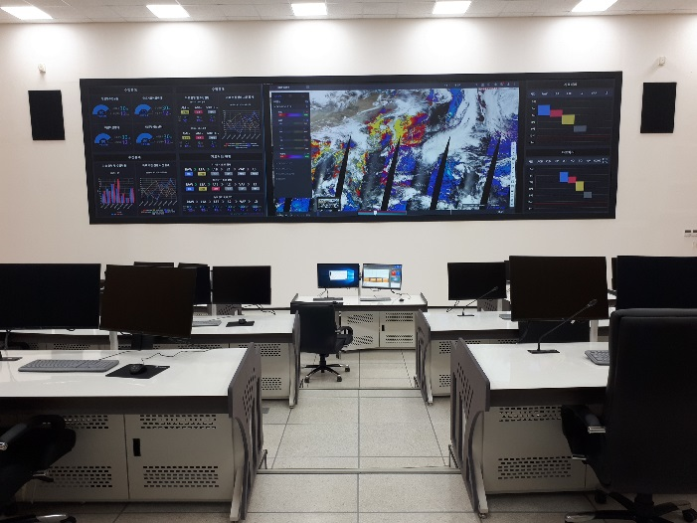
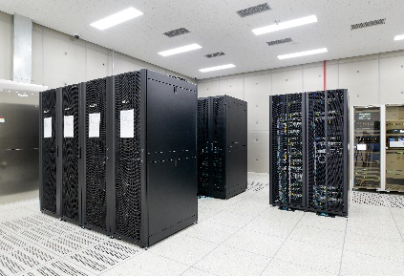
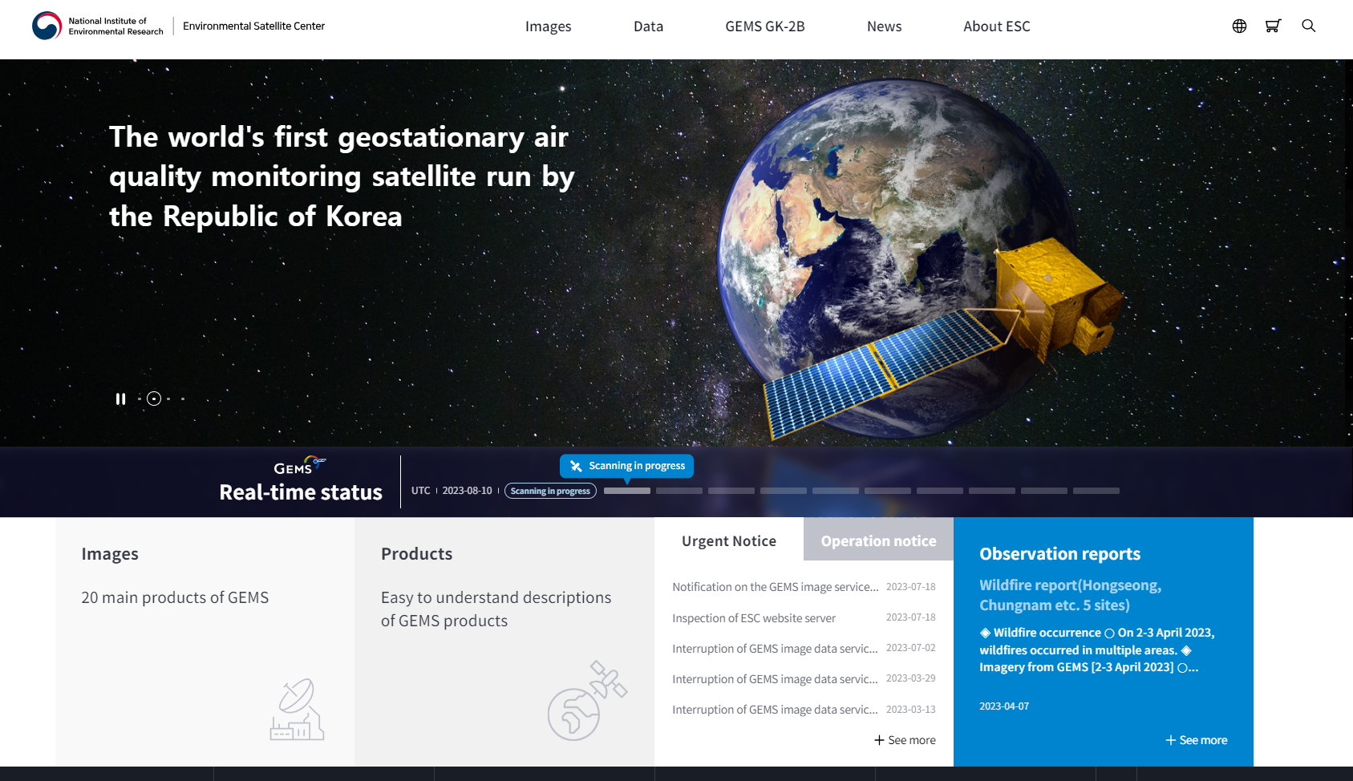
Introduction of ESC
Roles of National Institute of Environmental Research (NIER) for the GEMS operation
Universities
Institutes
ESC
Data processing (L0-L4) & analyzing
Validation
Distribution
Air Quality Forecasting Center
Receiving
Data back-up & archiving
Public service
(http://nesc.nier.go.kr)
Monitoring
Now
LEOP
IN-Orbit Test (IOT)
L2 production / Validation
Distribution of image files
Distribution of NC files
19 Feb. 2020
Launch
8 Mar. 2020
Oct. 2020
Mar. 2021
Jun., Nov., 2022

Slide 4
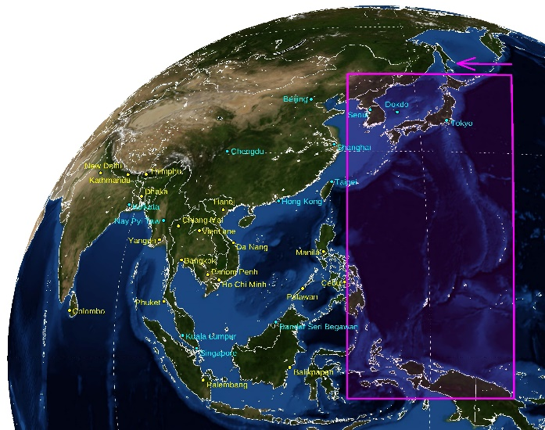
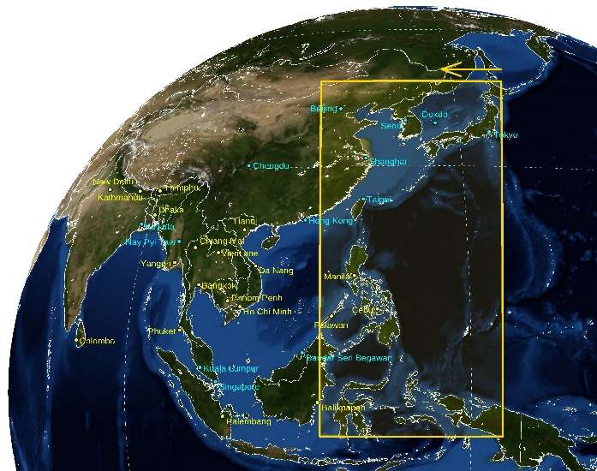
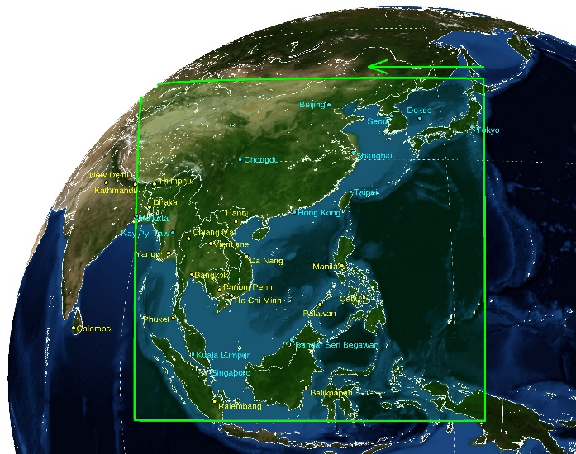
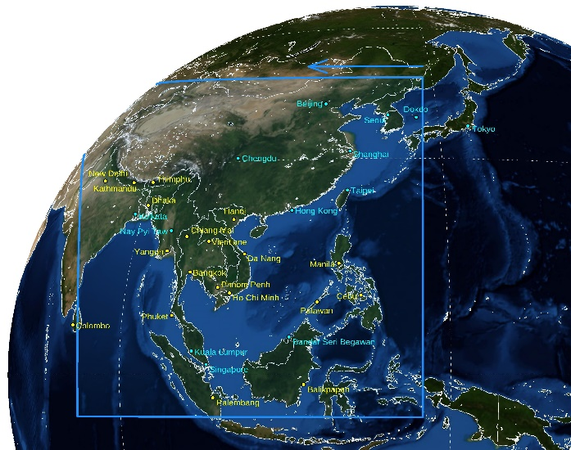
Current status of GEMS
Reschedule of GEMS observation since 1 FEB 2024
Half East
(HE)
Half Korea
(HK)
Full Central
(FC)
Full West
(FW)
+
-
Change
Month | 07:45 | 08:45 | 09:45 | 10:45 | 11:45 | 12:45 | 13:45 | 14:45 | 15:45 | 16:45 | #
1 | - | - | HE | HK | FC | FW | FW | FW | - | - | 6
2 | - | - | HE | HK | FC | FW | FW | FW | FW | - | 7
3 | - | HE | HK | FC | FC | FW | FW | FW | FW | - | 8
4 | HE | HK | FC | FC | FC | FW | FW | FW | FW | FW | 10
5 | HE | HK | FC | FC | FW | FW | FW | FW | FW | FW | 10
6 | HE | HK | FC | FC | FW | FW | FW | FW | FW | FW | 10
7 | HE | HK | FC | FC | FW | FW | FW | FW | FW | FW | 10
8 | HE | HK | FC | FC | FW | FW | FW | FW | FW | FW | 10
9 | HE | HK | FC | FC | FW | FW | FW | FW | FW | FW | 10
10 | - | HE | HK | FC | FC | FW | FW | FW | FW | - | 8
11 | - | - | HE | HK | FC | FW | FW | FW | - | - | 6
12 | - | - | HE | HK | FC | FW | FW | FW | - | - | 6
Month | 07:45 | 08:45 | 09:45 | 10:45 | 11:45 | 12:45 | 13:45 | 14:45 | 15:45 | 16:45 | #
1 | - | - | FC | FC | FC | FC | FW | FW | FW | - | 7
2 | - | HE | FC | FC | FC | FC | FW | FW | FW | - | 8
3 | - | HE | FC | FC | FC | FC | FW | FW | FW | - | 8
4 | HE | HK | FC | FC | FC | FC | FW | FW | FW | FW | 10
5 | HE | HK | FC | FC | FC | FC | FW | FW | FW | FW | 10
6 | - | HK | FC | FC | FC | FC | FW | FW | FW | FW | 9
7 | - | HK | FC | FC | FC | FC | FW | FW | FW | FW | 9
8 | - | HK | FC | FC | FC | FC | FW | FW | FW | FW | 9
9 | - | HK | FC | FC | FC | FC | FW | FW | FW | FW | 9
10 | - | HE | FC | FC | FC | FC | FW | FW | FW | - | 8
11 | - | HE | FC | FC | FC | FC | FW | FW | FW | - | 8
12 | - | - | FC | FC | FC | FC | FW | FW | - | - | 6

Slide 5
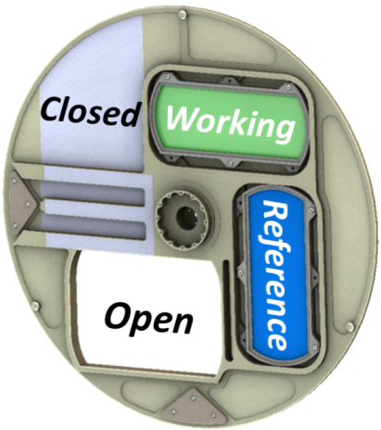
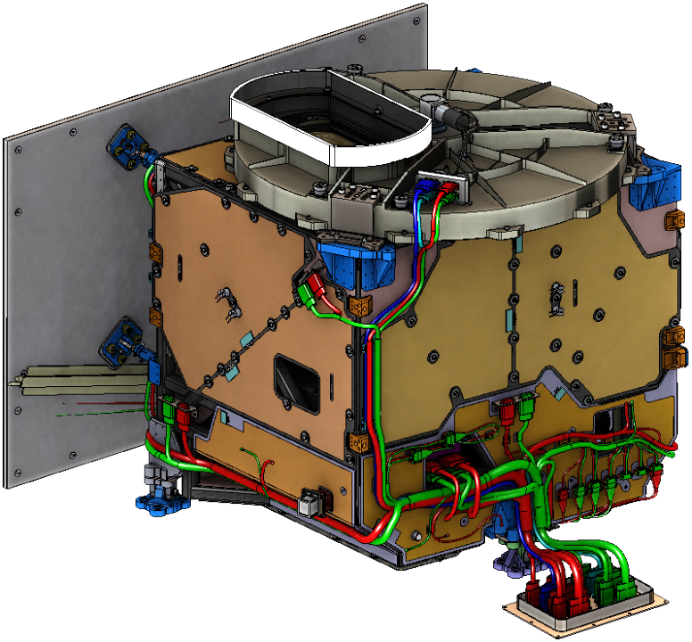
Current status of GEMS
Monitoring and maintaining calibration
Transmissive
Diffusers
Scene Selection Wheel
Observation |  | Frequency | Time | Comments
Earth |  | Avg. 8/day | HH:45min~HH+1hr:15min (duration: 30min) | CMA position: Open Schedule considering SKM, WOL
Solar | WSD | 1/day | Perform before/after local midnight at a sun-diffuser normal angle of 30.5° | CMA position: WD or RD Reschedule after midnight (16-17 UTC) if SKM is overlapped on regular observation time (13-14UTC)
 | RSD | 2/year
Dark | Normal | 2/day (180 images) | Right before/after daytime Earth observation | CMA position: Close Normal: Additional observation after SKM, WOL
 | Solar | 1/day (2 images) | Right before solar observation
 | LED | 1/week (42 images) | Right after LED observation
LED |  | 1/week (17 UTC on Sunday) | After dark imaging and prior to solar calibration | CMA position: Close Observations at multiple integration times
Calibration Mechanism Assembly
Aperture
Radiator Assembly
Thermally-Controlled Composite Structure
WSD: Working solar diffuser
RSD: Reference solar diffuser
CMA: Calibration mechanism assembly
LED: Light emitting diode
CCD: Charge-coupled device (a light-sensitive integrated circuit)
Image credit: Ball

Slide 6
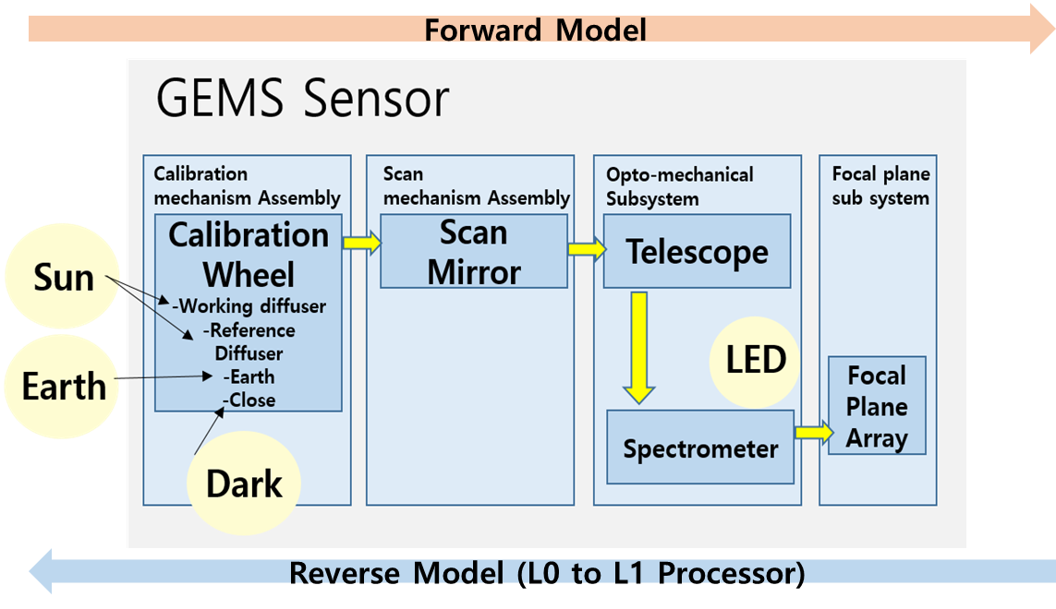
Current status of GEMS
L1 production processes
Done
< Earth Scene>
< Solar Scene >
Proceeding
L0 Input
L1B Output
L1B Output
Co-addition Correction
Spatial Registration
Spatial Registration
Crosstalk Correction
2-Pixel Binning
2-Pixel Binning
Pixel Flagging
L1A Output
L1A Output
Nyquist phase Correction
Spectral Shift Correction
Spectral Shift Correction
Electronic Offset Correction
Diffuser BTDF Correction
Linearity Correction
Radiance Calibration
Irradiance Calibration
Smear Correction
Gain Correction
Stray Light Correction
Integration time Correction
Geometric Calibration
PRNU Correction
Dark Correction

Slide 7
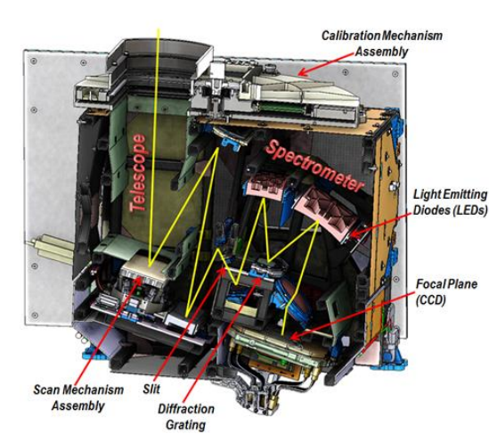
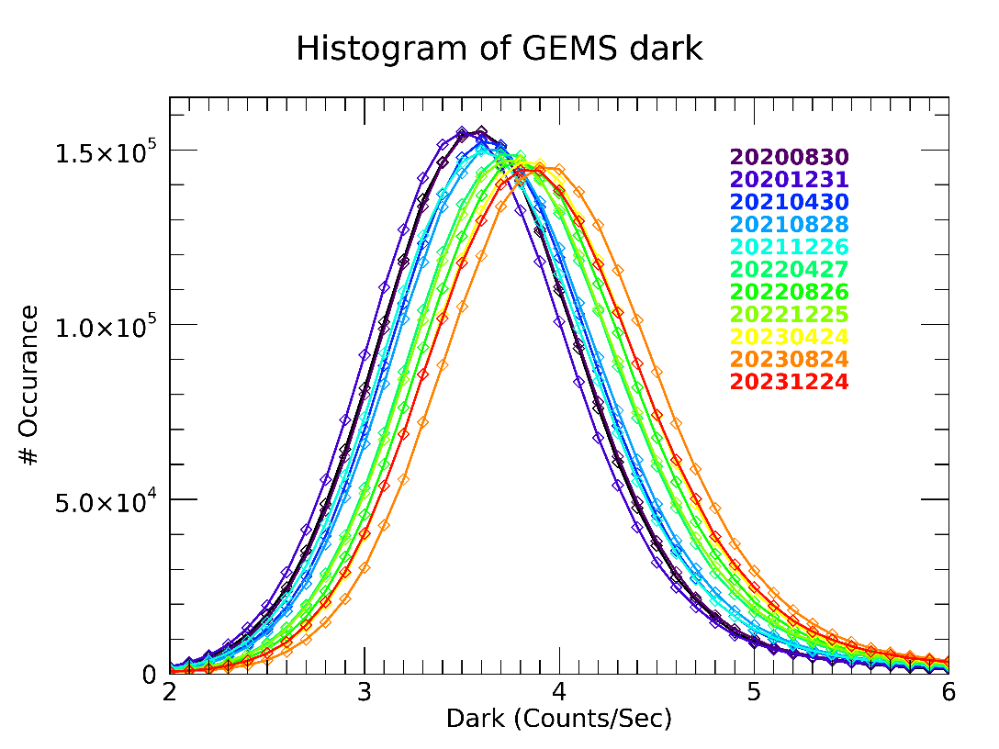
Current status of GEMS
Monitoring long-term GEMS data
☯ Dark current
The pixel-averaged dark current has increased approximately 7.63% for 3.5 years (or 0.005 % per a day)
The half width has increased by about 9.4 %
Common
Courtesy: BATC

Slide 8
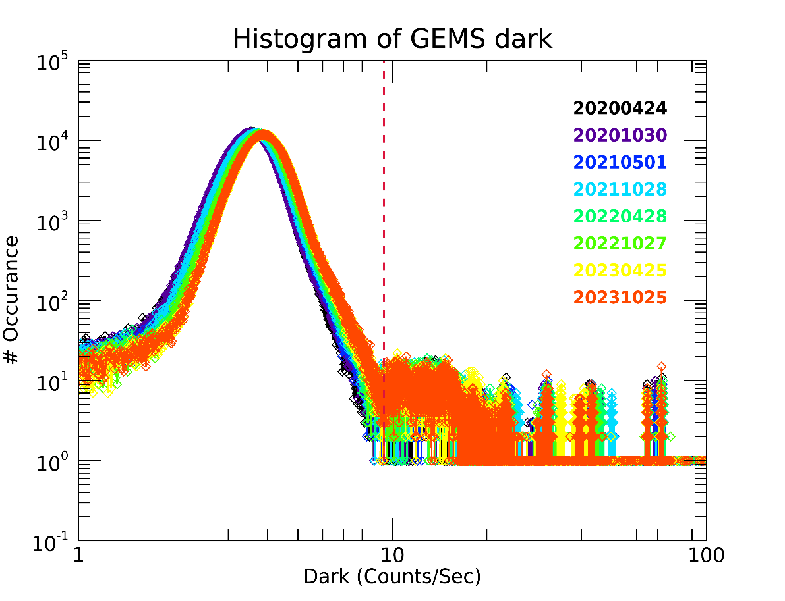
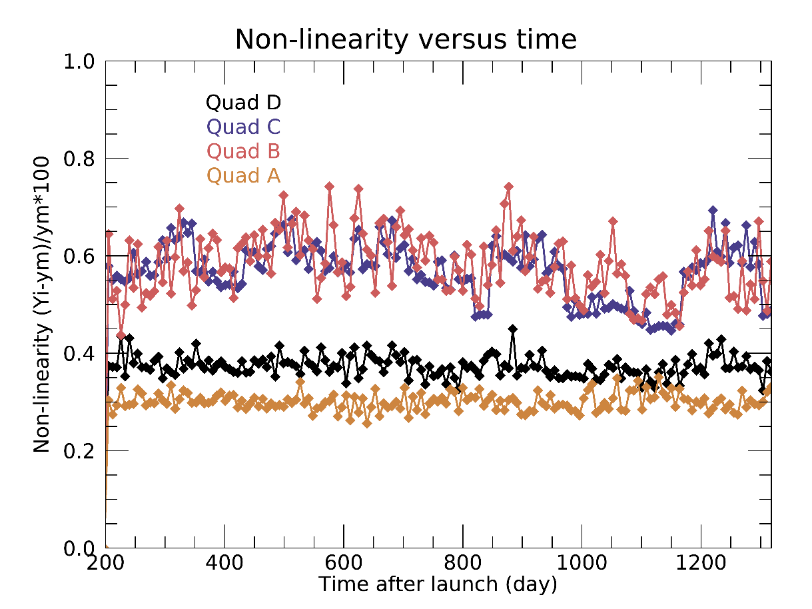
Current status of GEMS
Monitoring long-term GEMS data
☯ Bad pixel
☯ Non-linearity
Hot pixels are continuously increasing with an e-folding time of about 21 years
Cold pixels are consistently maintained
Signal drift is about 0.04 %, caused by the instability of the LED lamp
Time series variance is less than 0.2 % (@CCD full well capacity, 5-95 %)
Hot pixel threshold

Slide 9
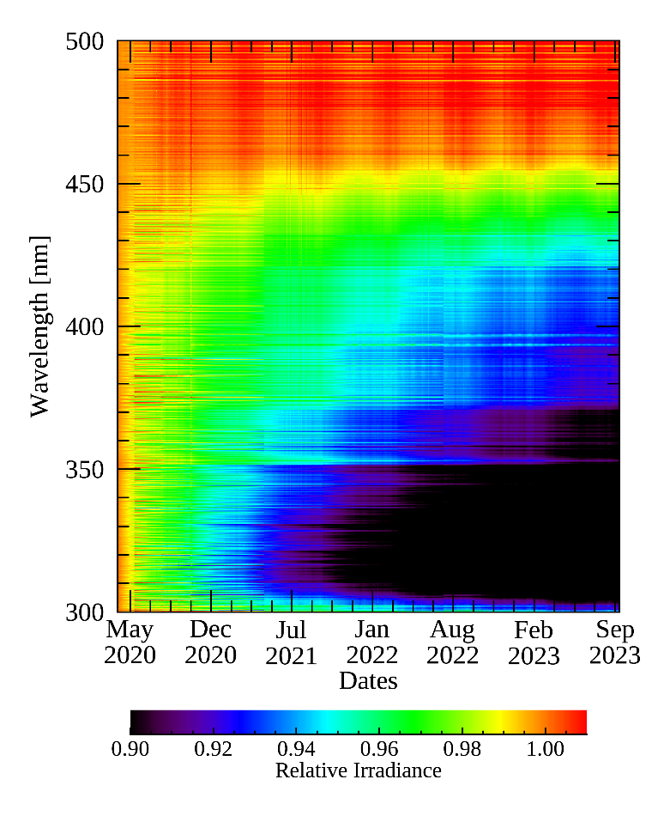
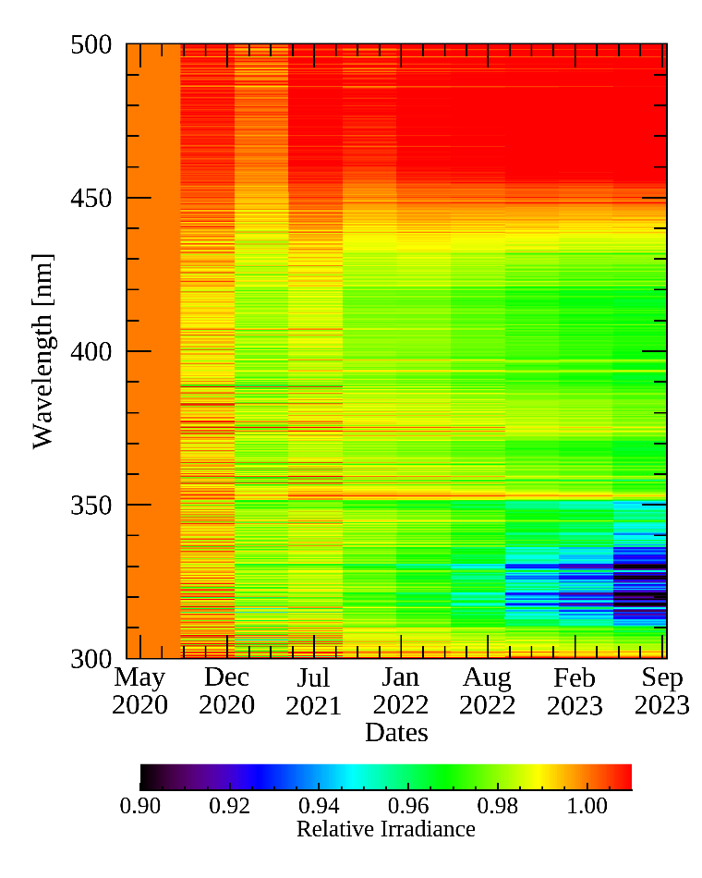
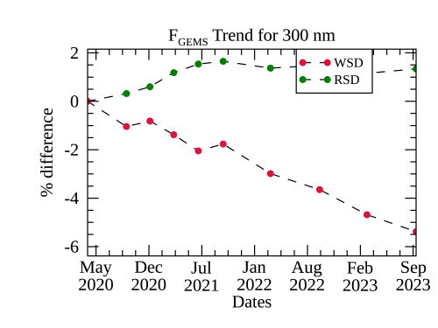
Current status of GEMS
Monitoring long-term GEMS data
☯ Working solar diffuser (WSD) and reference solar diffuser (RSD)
Degradation of the diffuser and throughput occurs as observation time increases
WSD
RSD
1,201 times of exposure
10 times of exposure

Slide 10
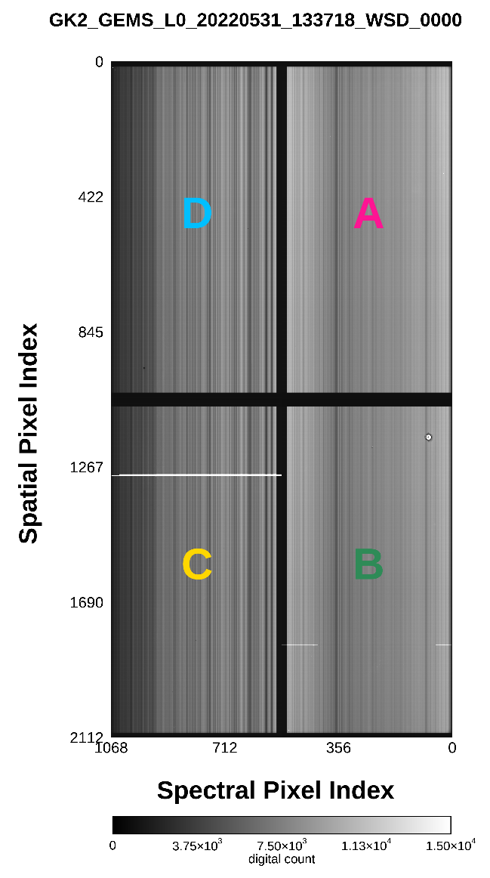
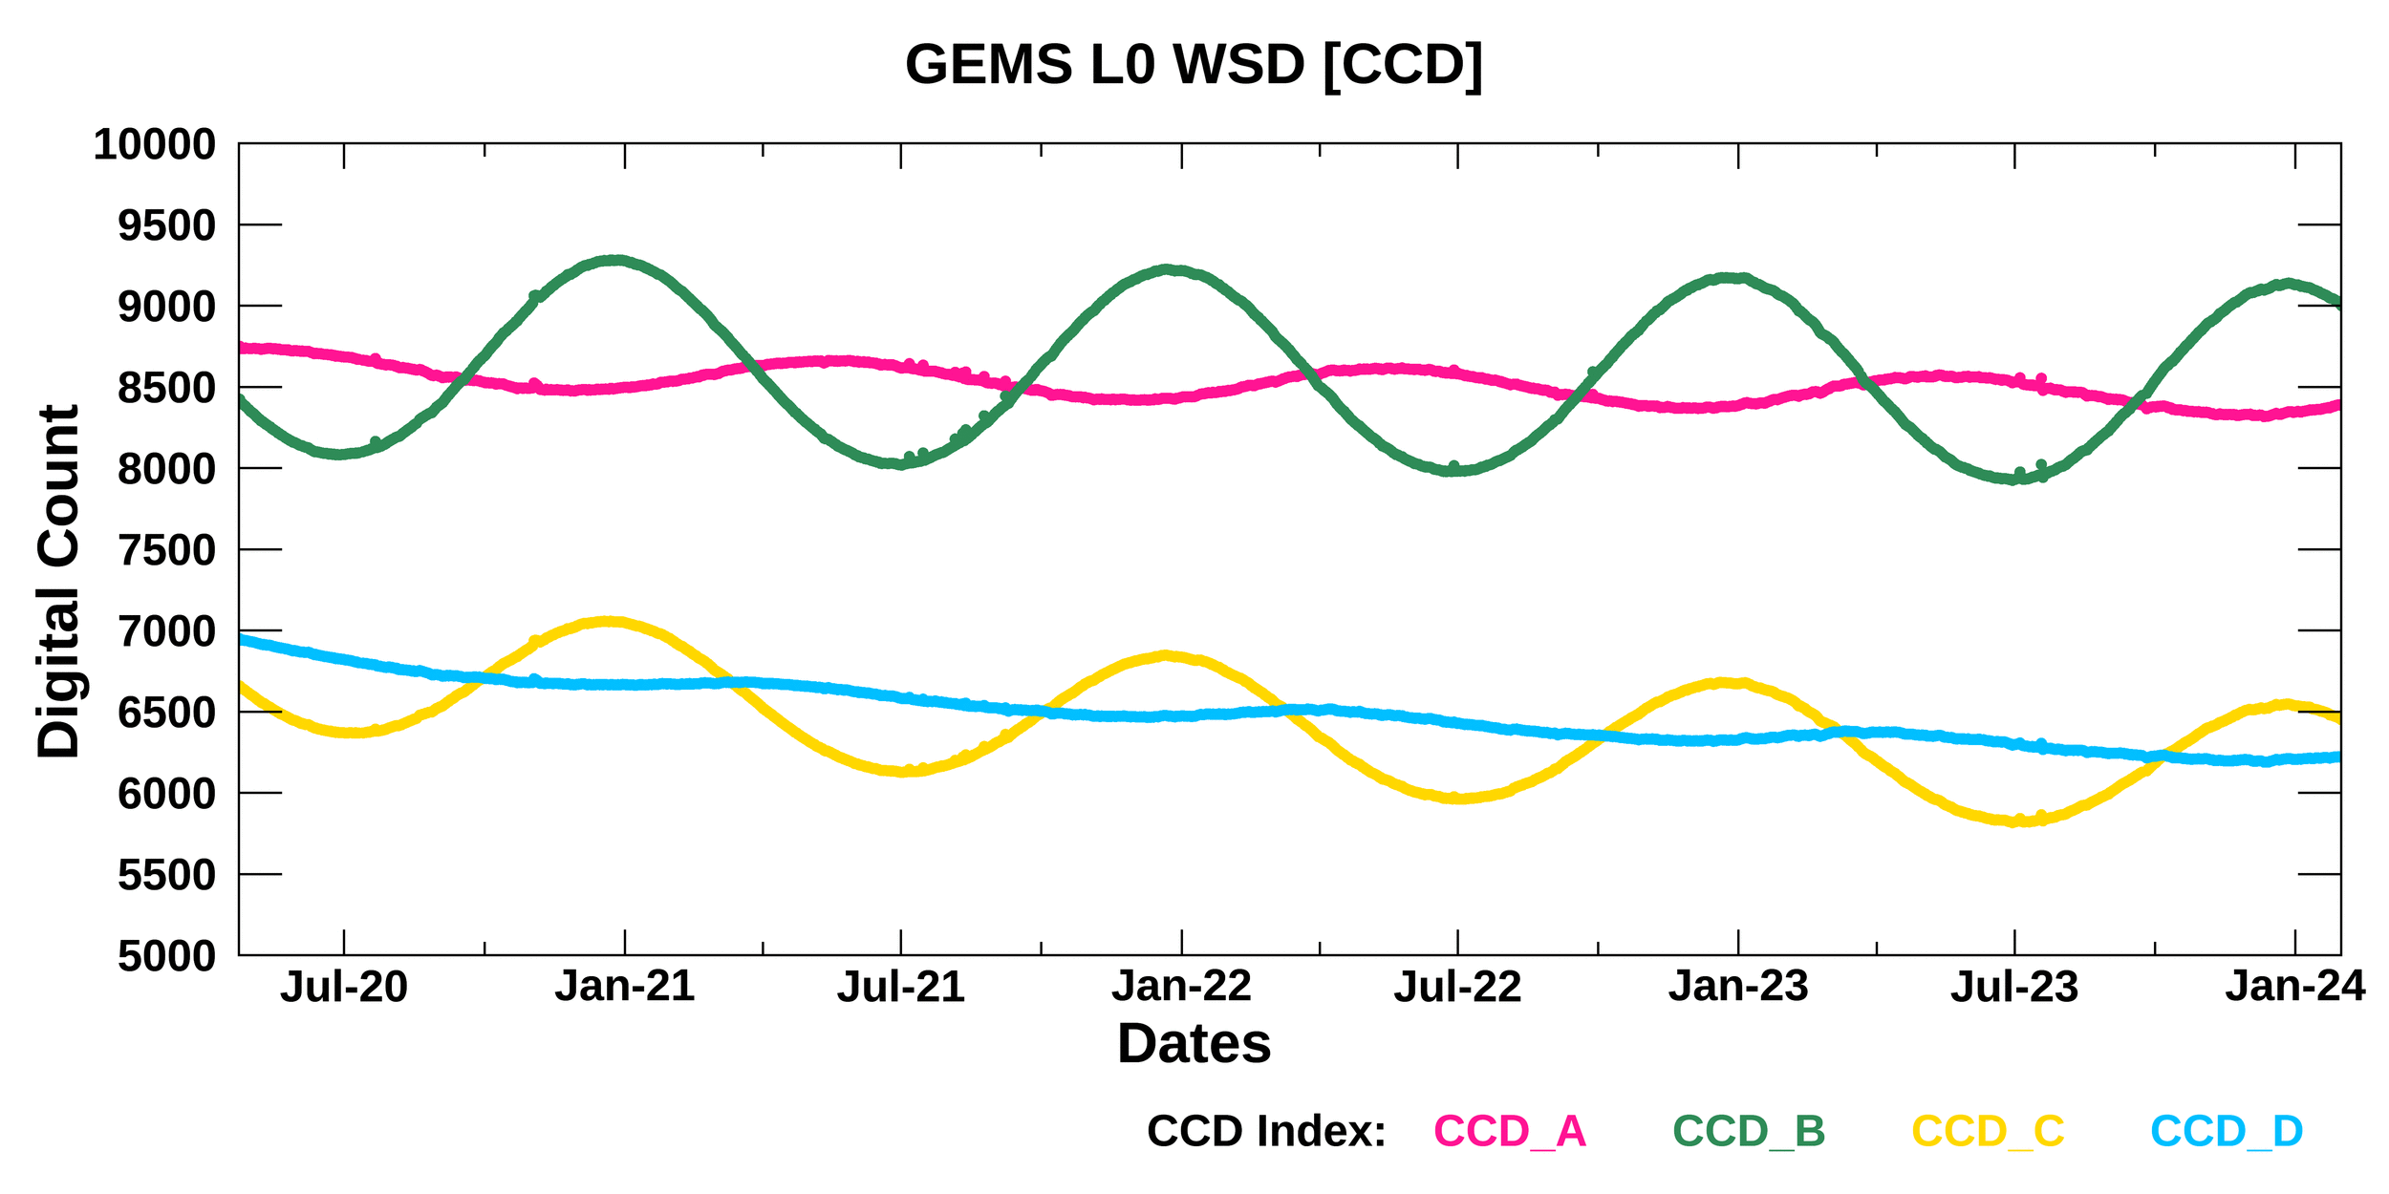
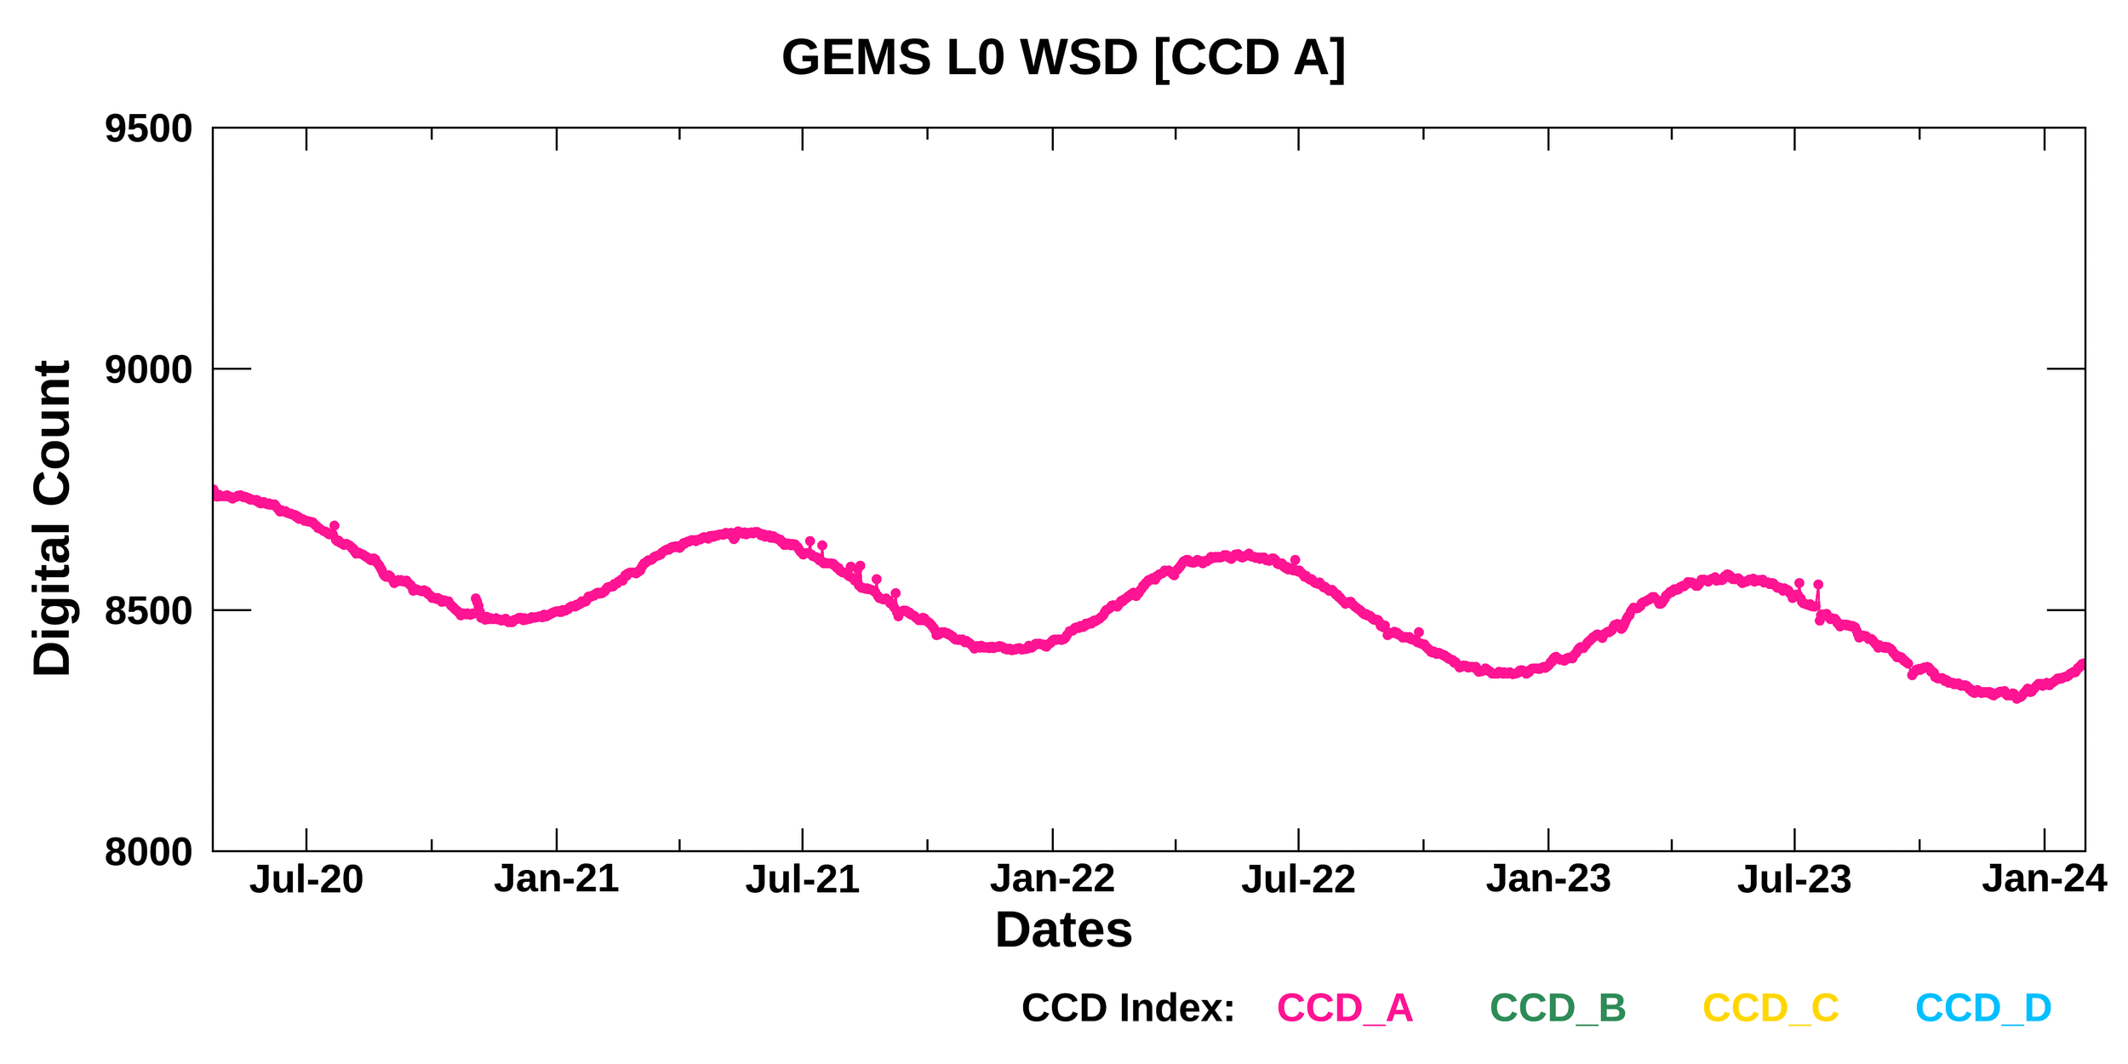
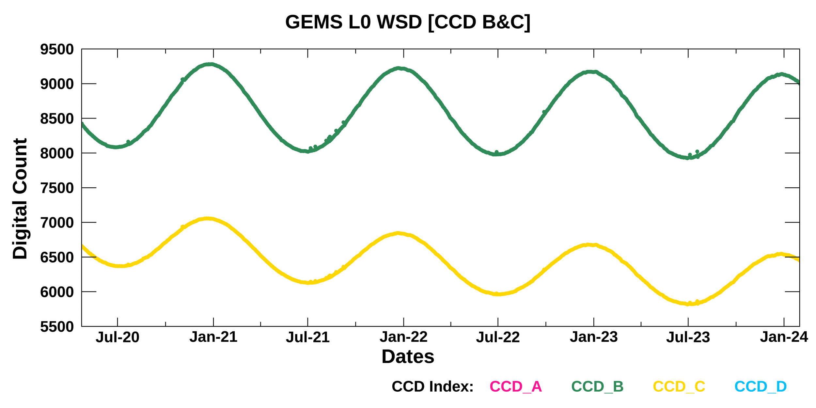
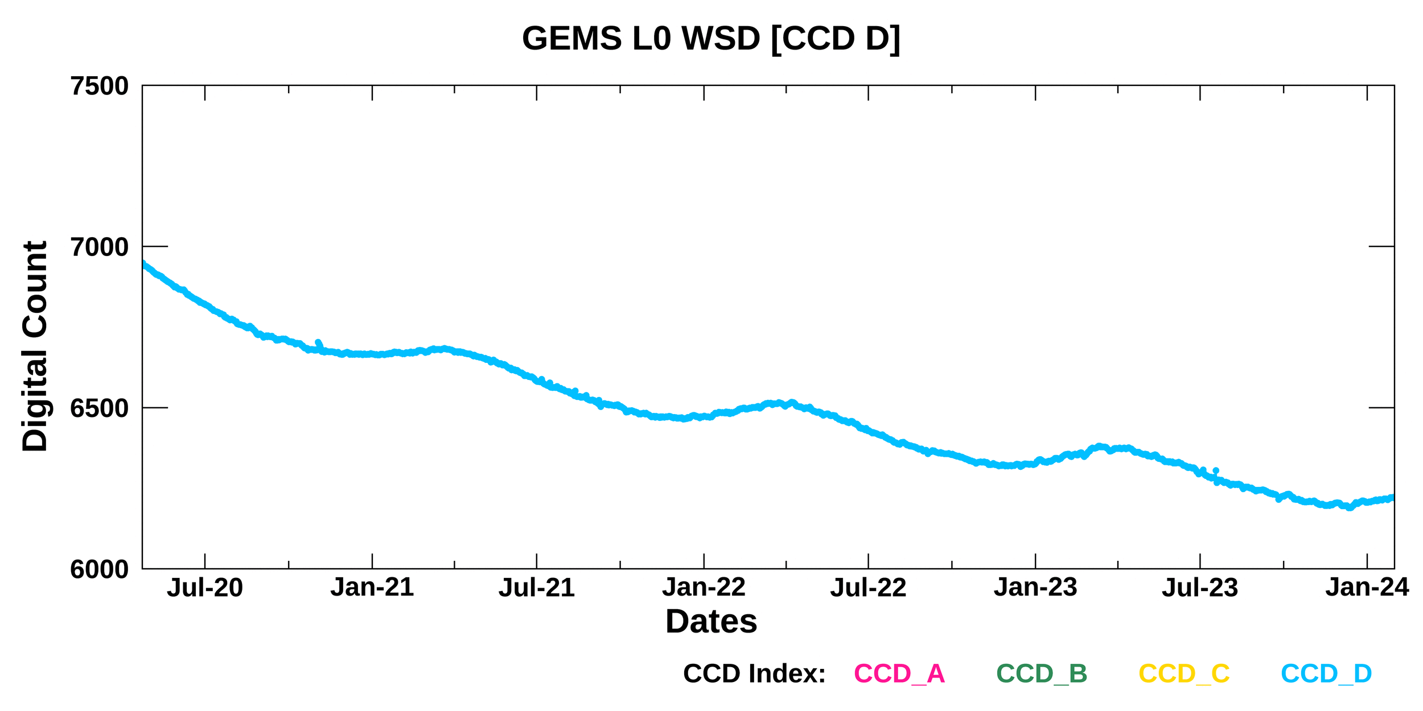
Current status of GEMS
Monitoring long-term GEMS data
☯ WSD (APR 2020 – JAN 2024)
N, 300nm
S, 500nm

Slide 11
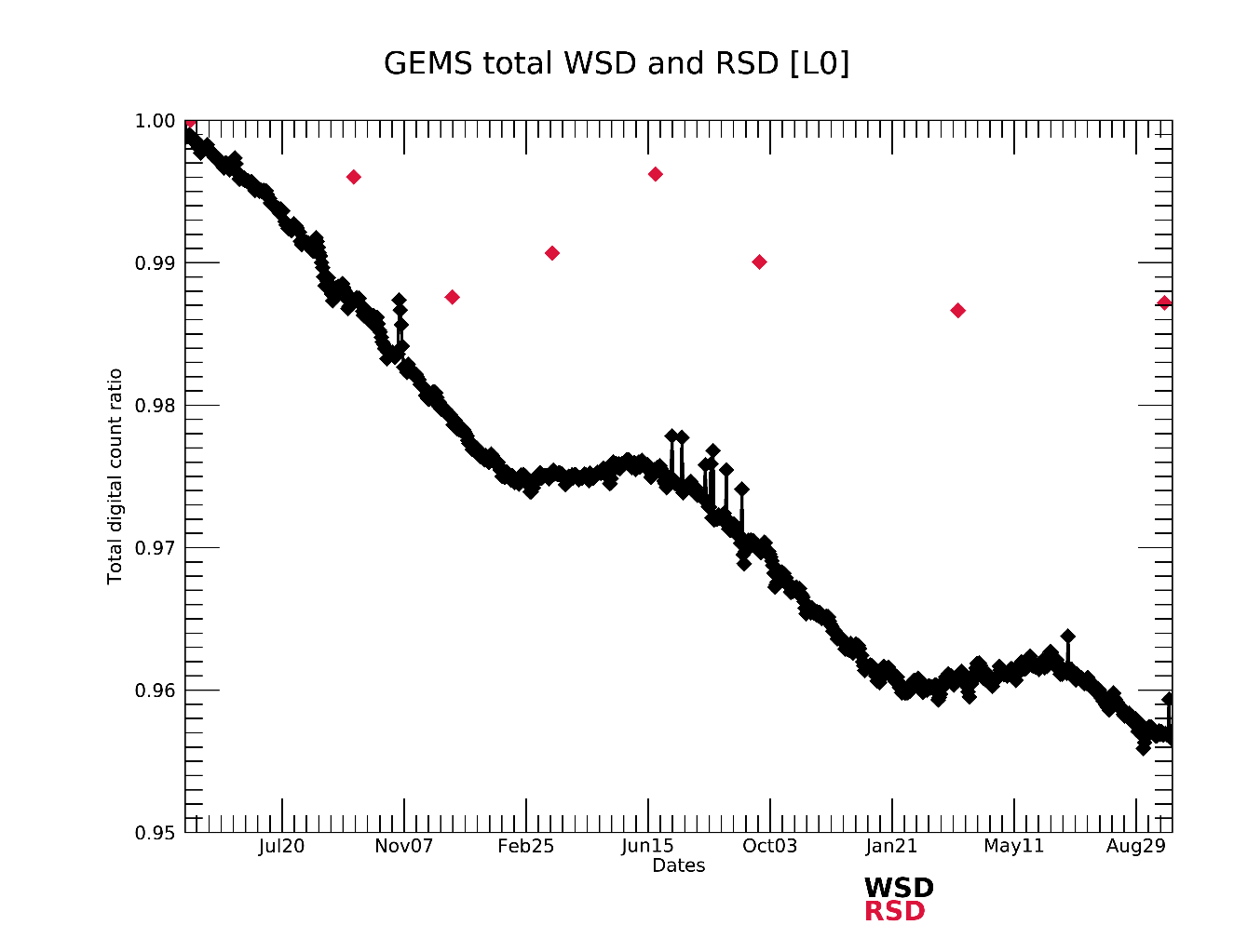
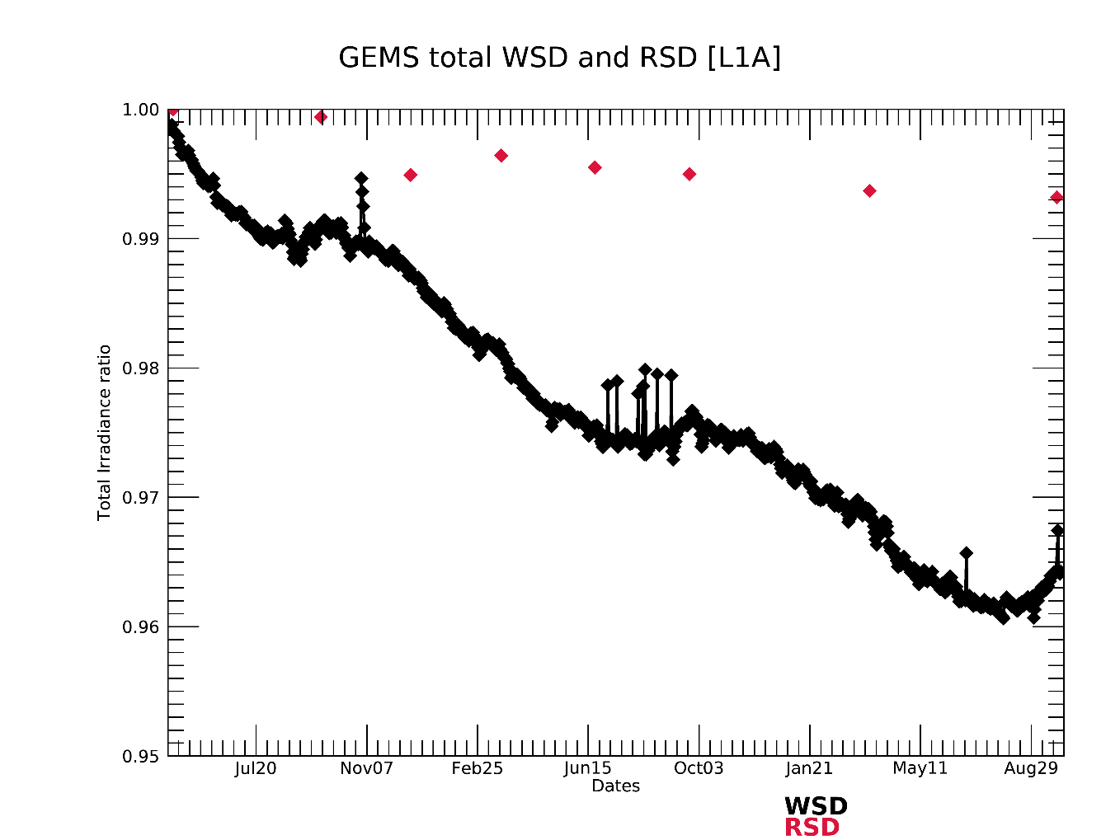
Current status of GEMS
Monitoring long-term GEMS data
☯ Integrated signals over whole CCD for solar irradiance
WSD
RSD
WSD
RSD

Slide 12
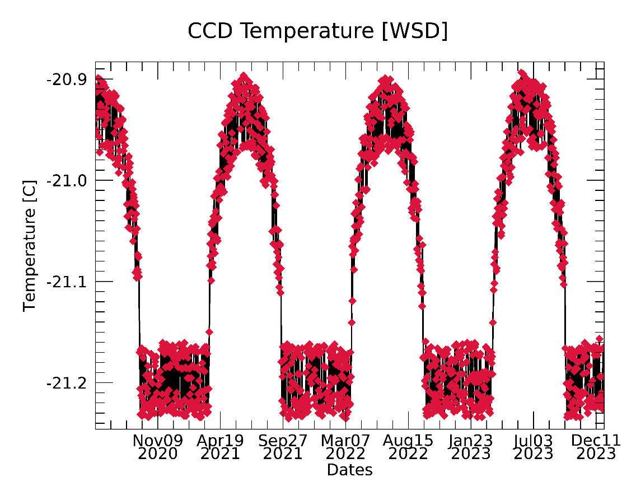
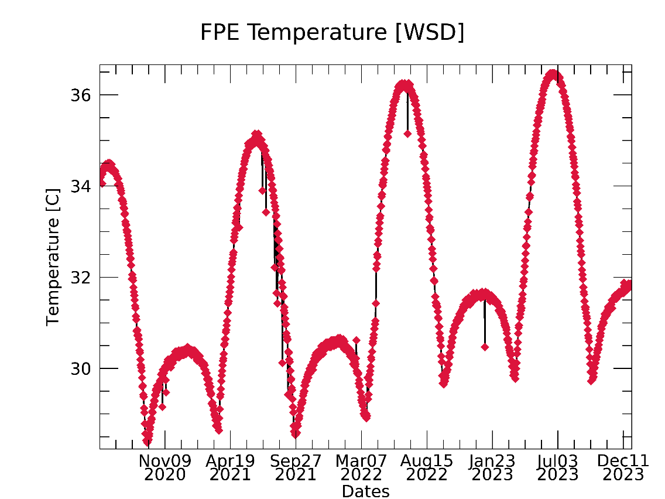
Current status of GEMS
Monitoring long-term GEMS data
☯ Telemetry
Seasonal & stable variability meets requirements
Variability of CCD temperature is < 0.3 °C
Focal plane electronics (FPE) temperature meets the criteria of -35°C to 50°C, but it has gradually increased

Slide 13
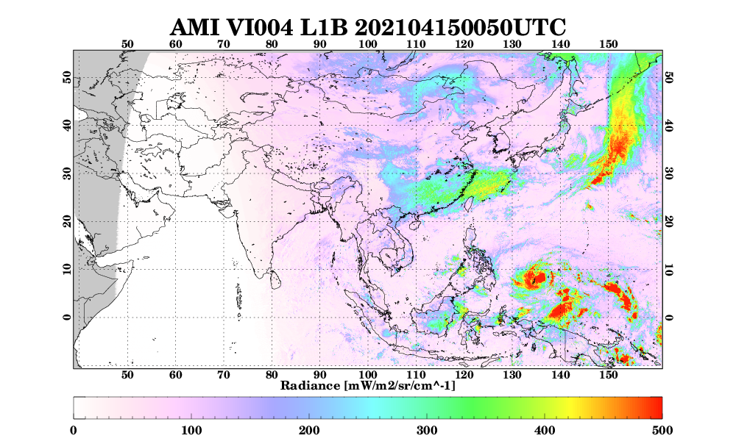
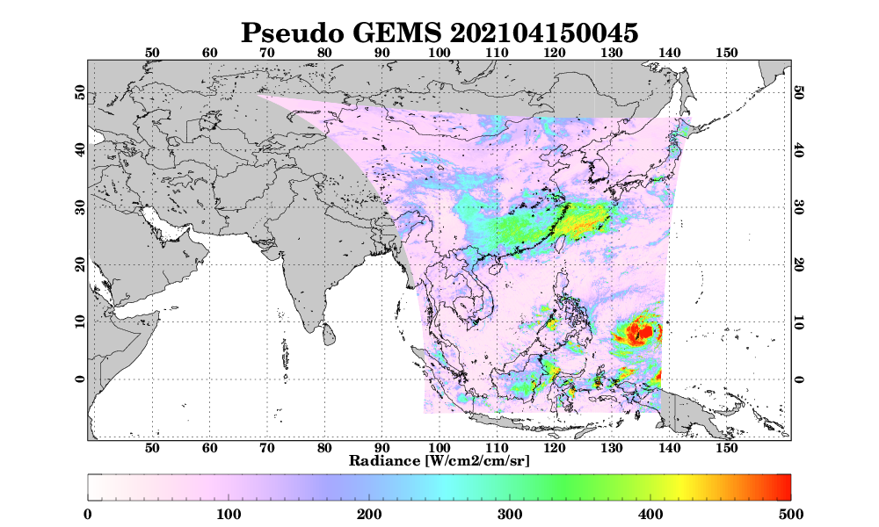
Current status of GEMS
Inter-comparison between GEMS and the Advanced Meteorological Imager (AMI)
☯ Spatiotemporal collocation
Temporal collocation: Using AMI data -10, 0, + 10 min from GEMS observation time
Spatial collocation: AMI 1 km by 1 km → 3.5 km by 8 km (to GEMS domain)

Slide 14
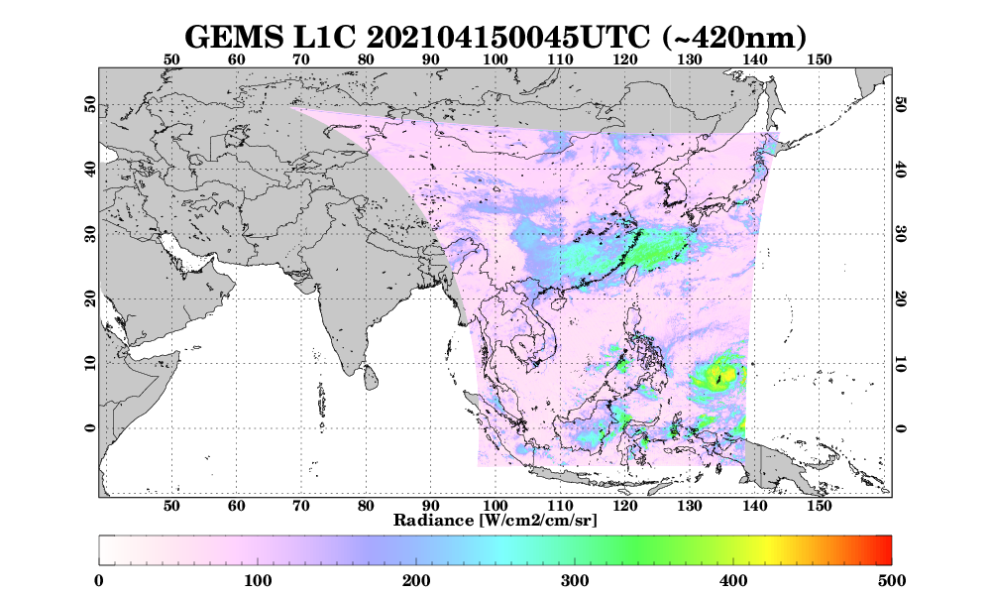
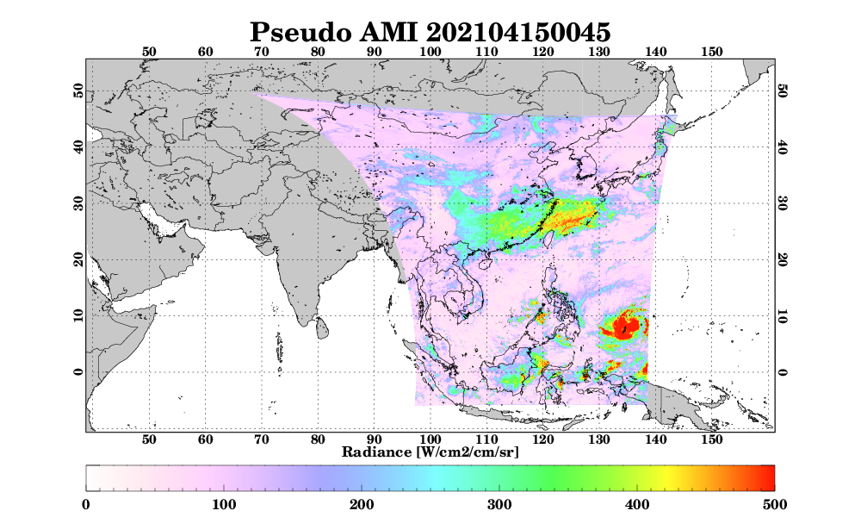
Current status of GEMS
Inter-comparison between GEMS and AMI
☯ Spectral collocation
Collocation of GEMS data using AMI SRF to compare with AMI VIR004 band (central wavelength at 470 nm)
$$L⨂f= \frac{\int_{λ_{i}}^{λ_{f}}{L_{λ}∙f_{λ}} dλ}{\int_{λ_{i}}^{λ_{f}}{f_{λ}} dλ}$$
$L(λ):GEMS spectral data$
$f\left(λ\right):AMI Spectral response function (SRF)$

Slide 15
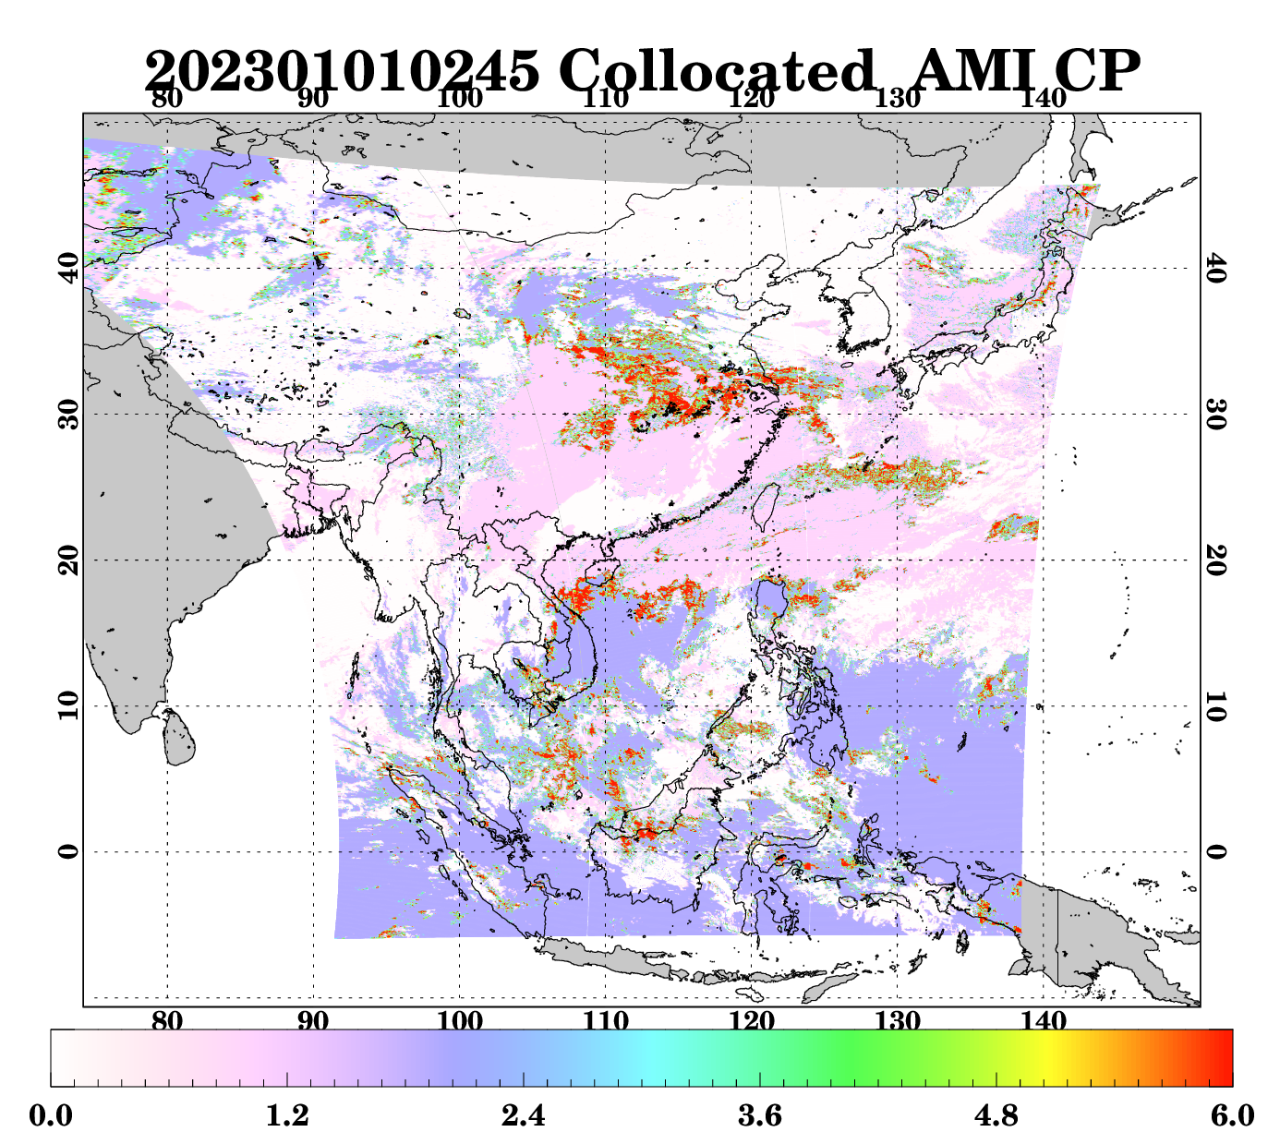
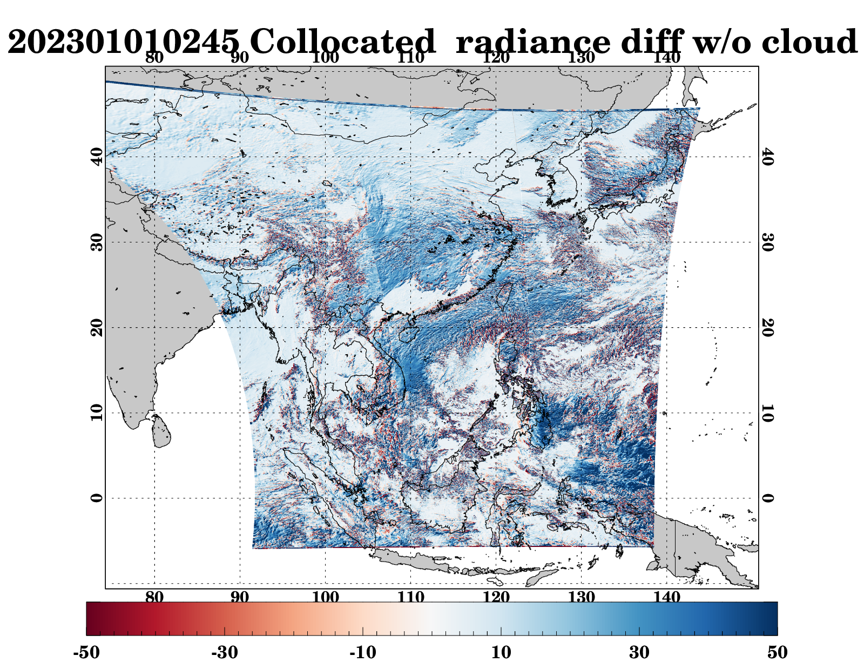
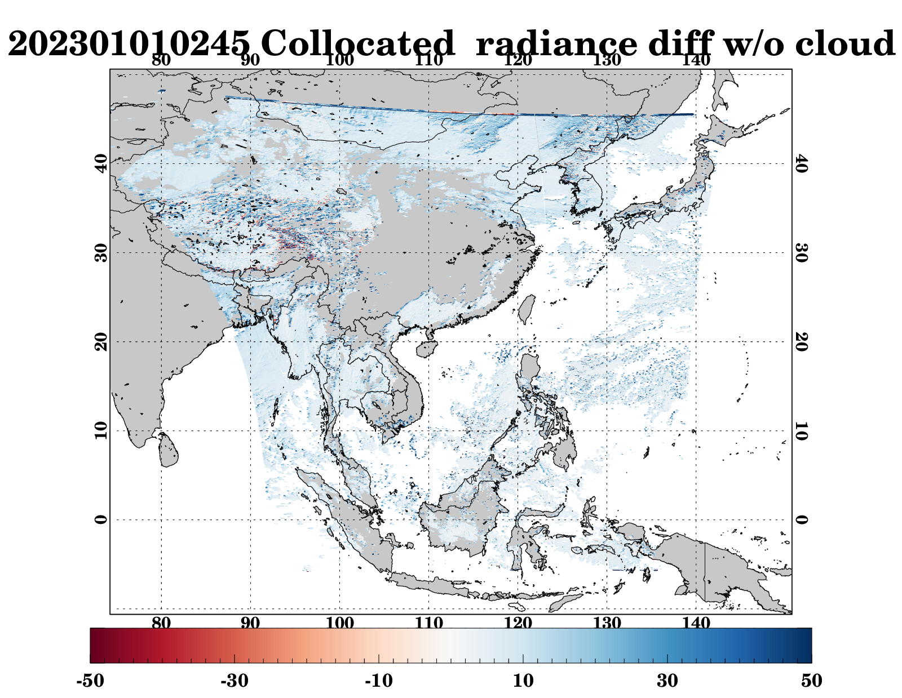
Current status of GEMS
Inter-comparison between GEMS and AMI
☯ Cloud effect removal
Comparison by considering clear pixels using cloud mask
Collocated AMI cloud
Collocated radiance diff. w/ cloud
Collocated radiance diff. w/o cloud
2023.01.01 02:45
2023.01.01 02:45 GEMS - AMI
2023.01.01 02:45 GEMS - AMI

Slide 16
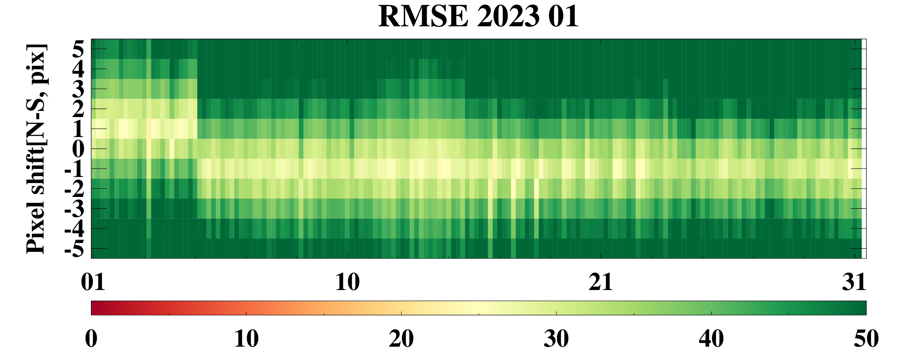
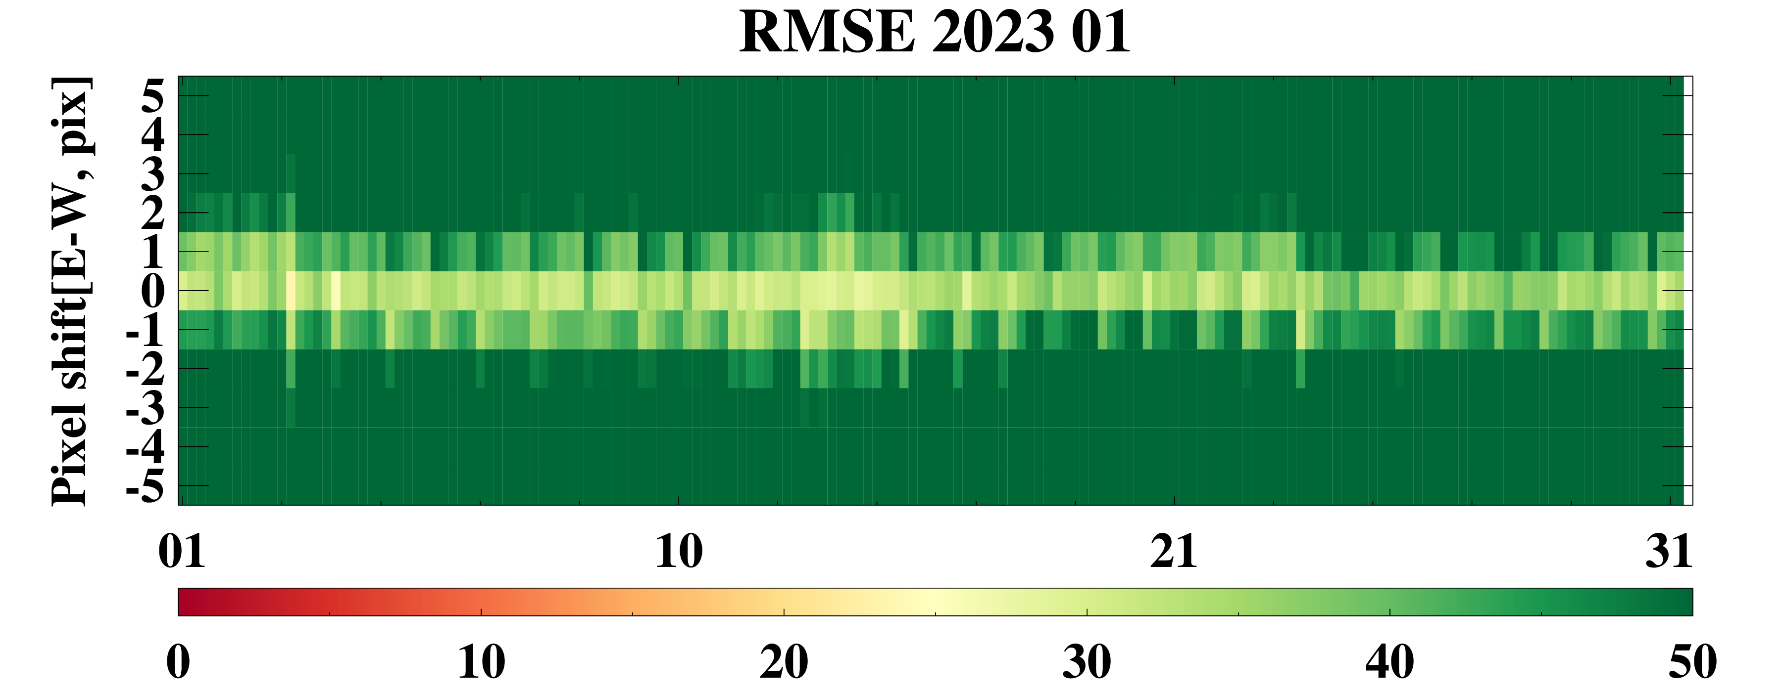
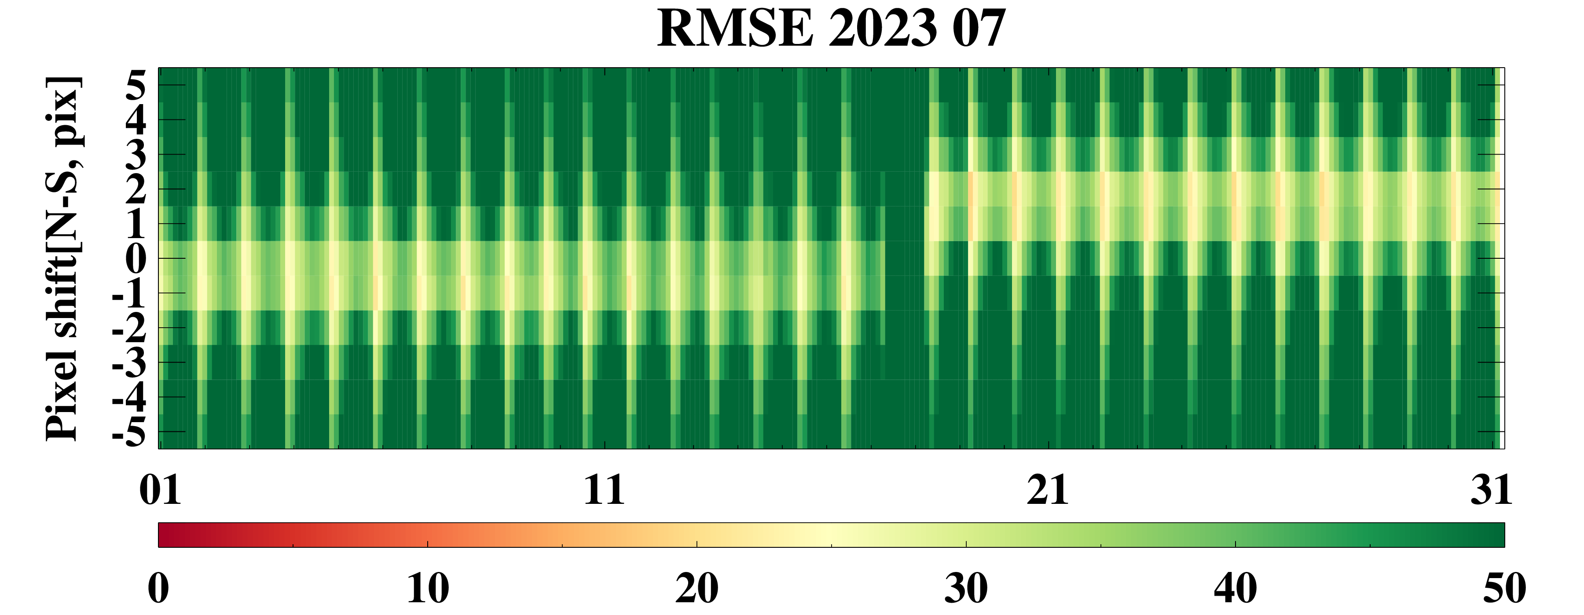
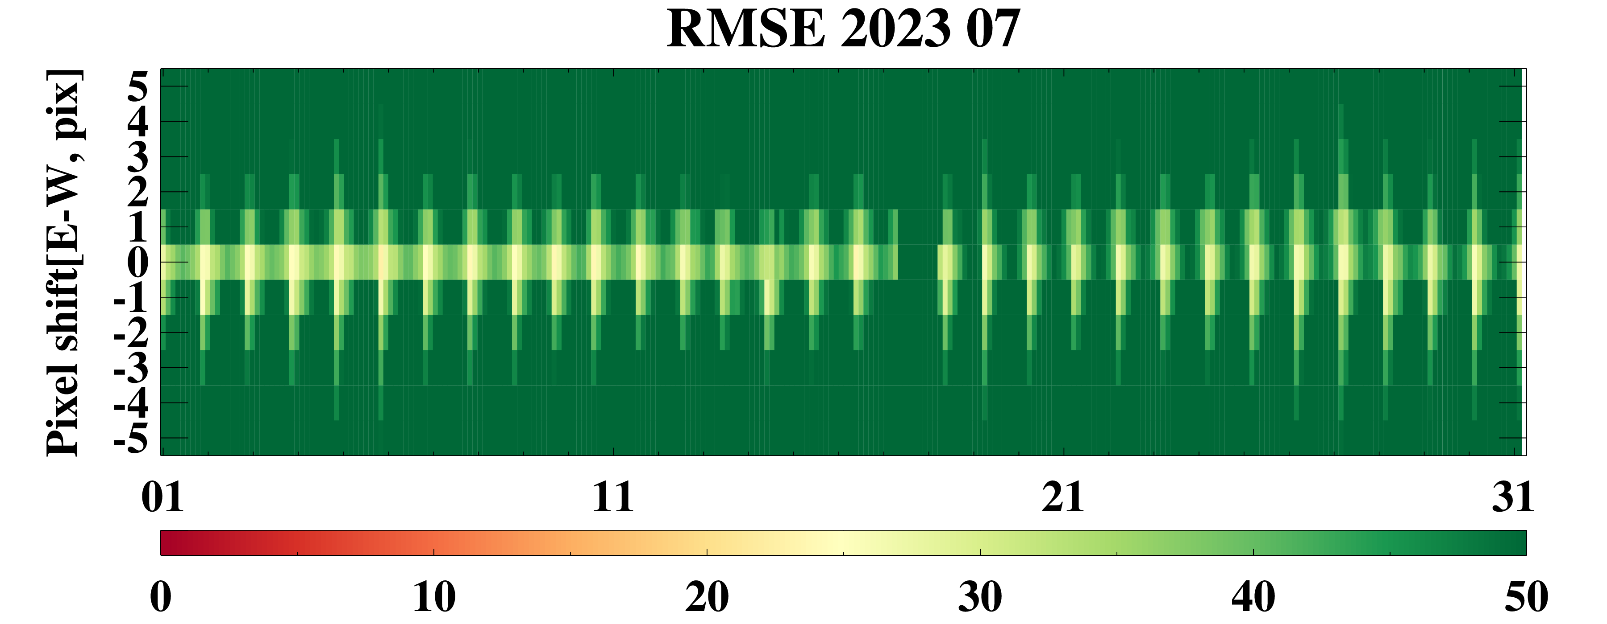
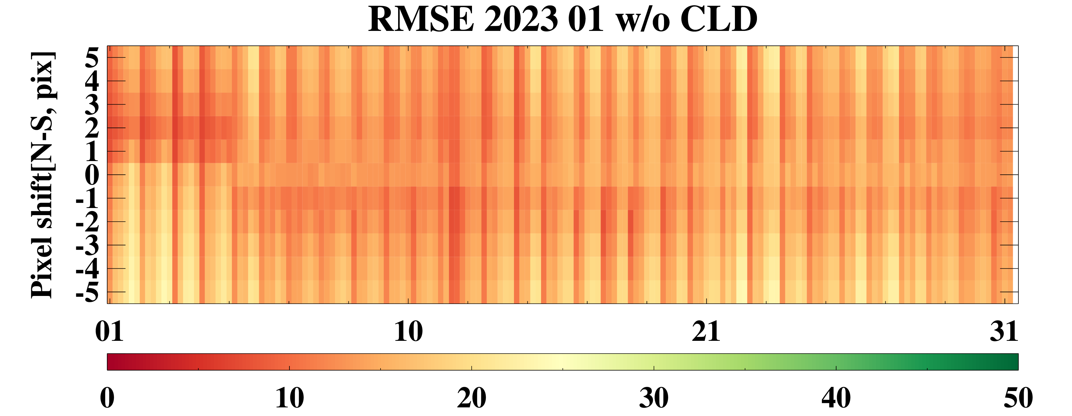
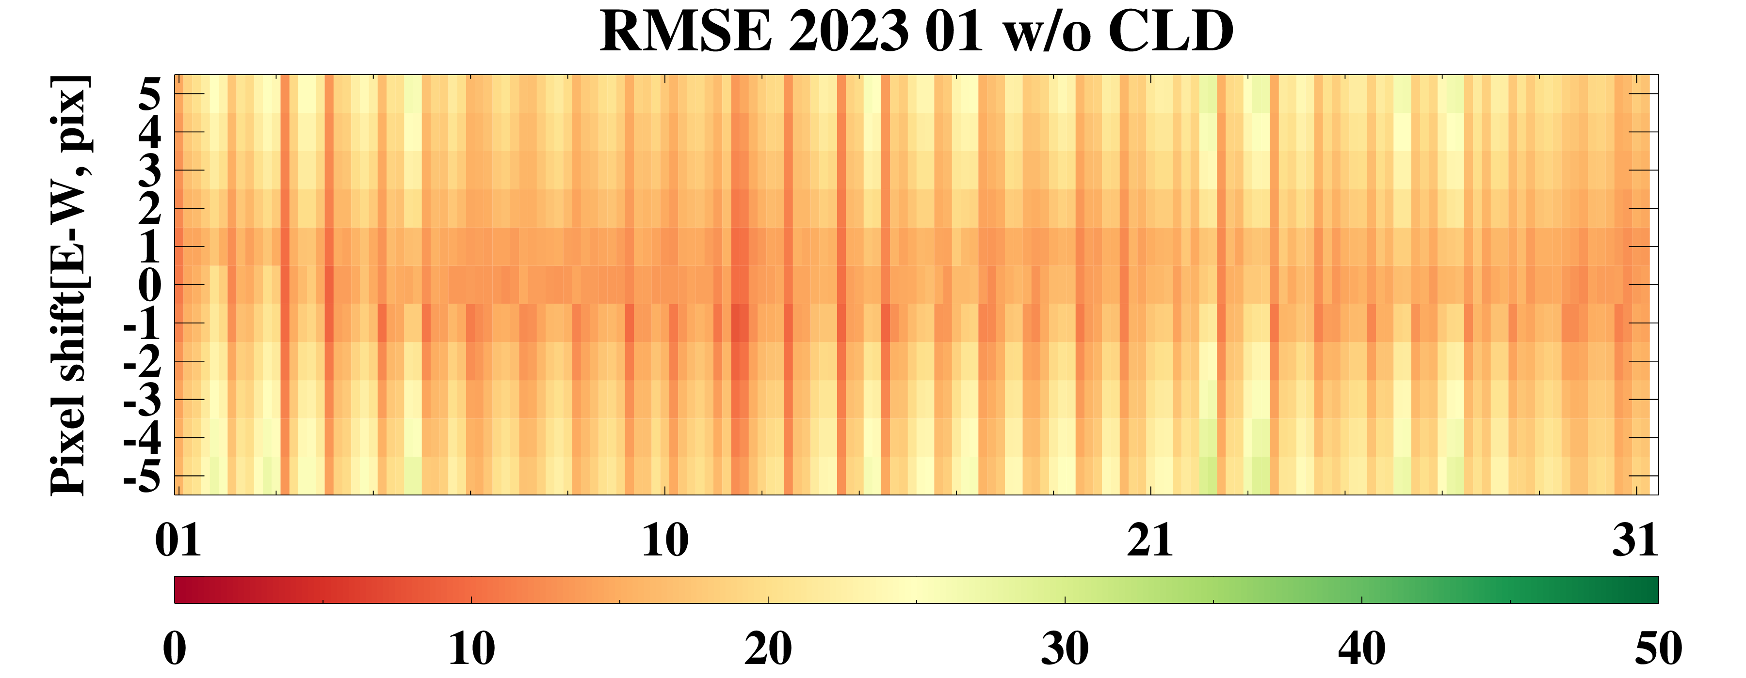
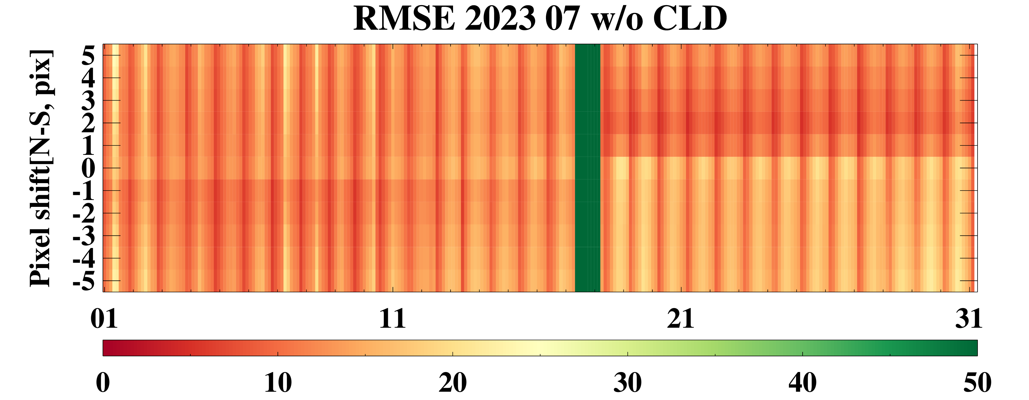
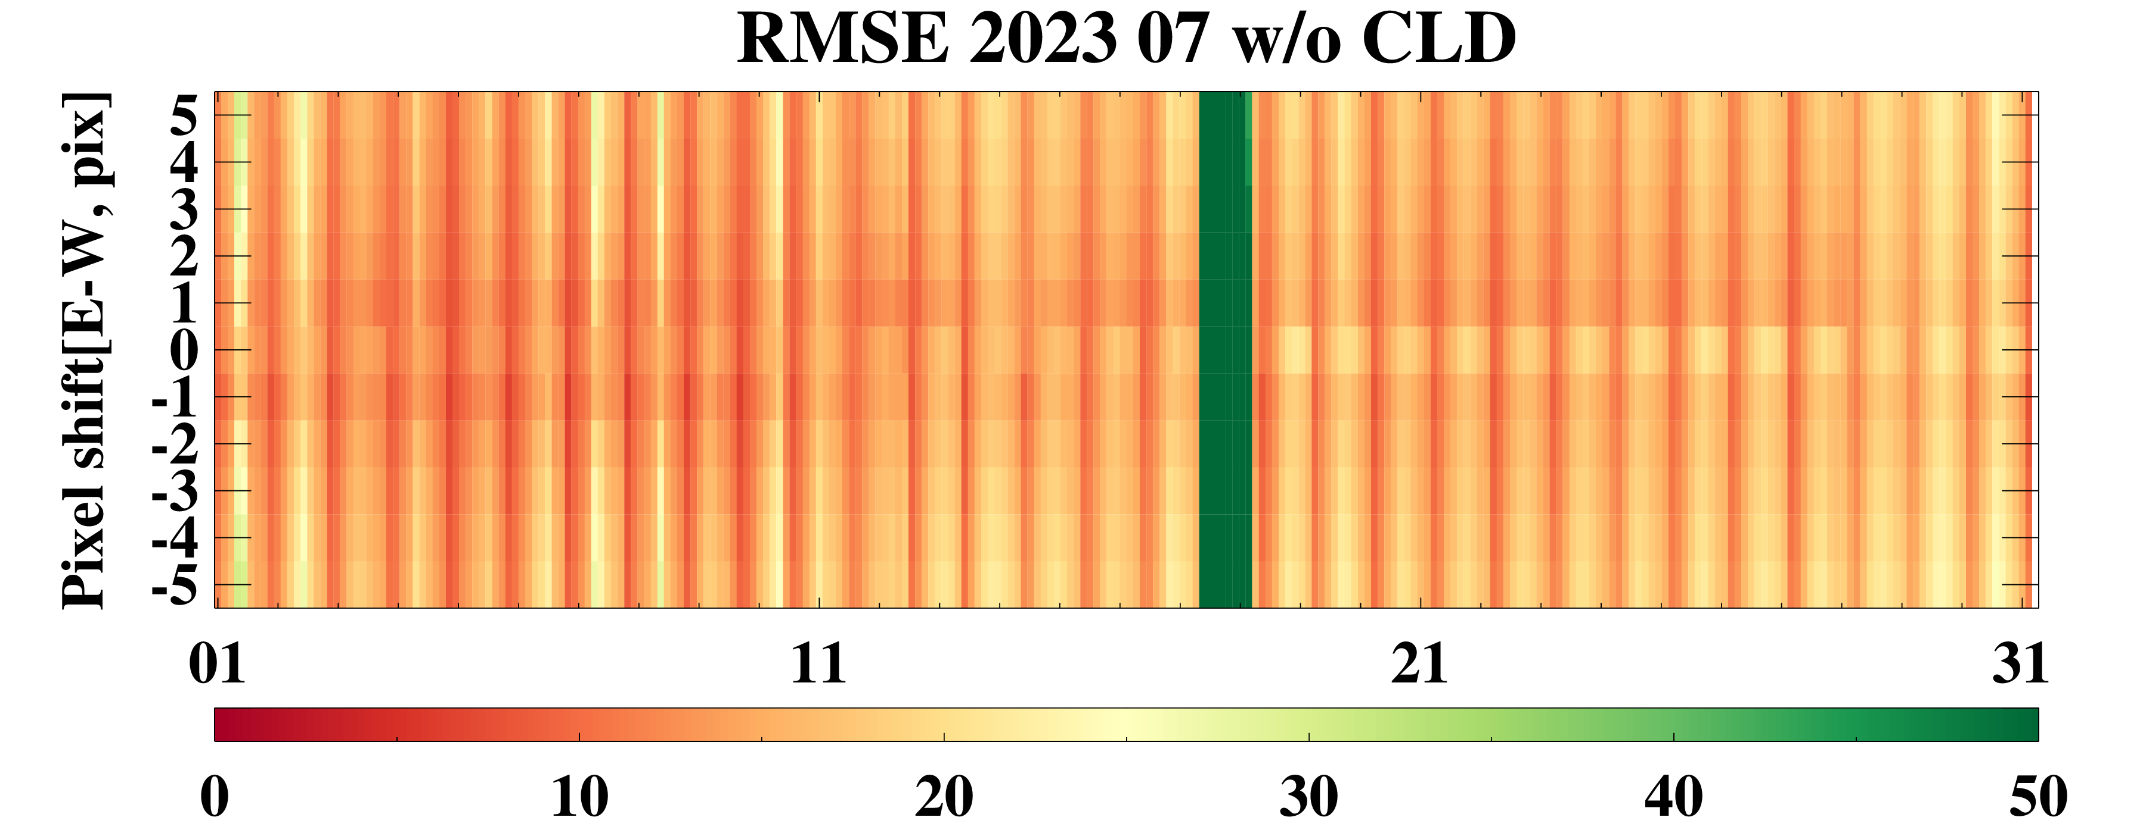
Current status of GEMS
Inter-comparison between GEMS and AMI
☯ Geometric difference
Almost 1-2 pixels difference in RMSE analysis
Sometimes, reversal trend after rebooting GEMS
w/o cloud mask
w/o cloud mask
N-S
E-W
N-S
E-W
w/ cloud mask
w/ cloud mask
N-S
E-W
N-S
E-W
2023.01.04
2023.01.04
2023.07.17
2023.07.17

Slide 17
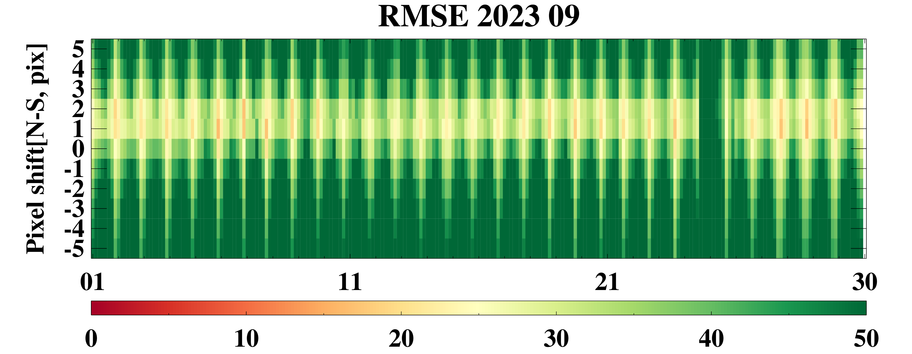
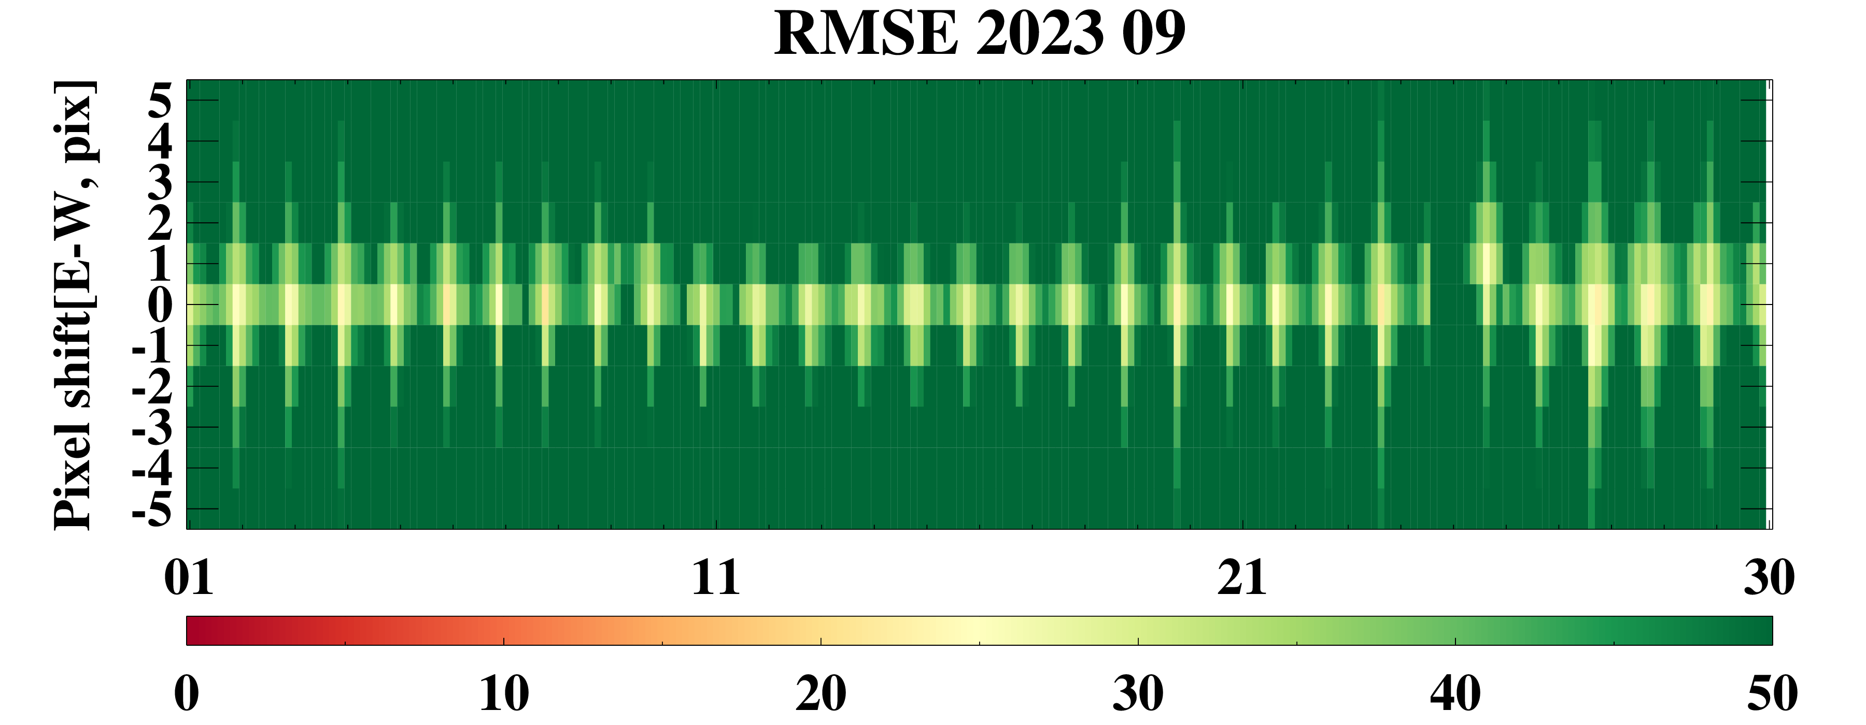
Current status of GEMS
Inter-comparison between GEMS and AMI
☯ Geometric difference
Almost 1-2 pixels difference in RMSE analysis
Sometimes, reversal trend after rebooting GEMS
w/o cloud mask
w/o cloud mask
N-S
E-W
N-S
E-W
w/ cloud mask
w/ cloud mask
N-S
E-W
N-S
E-W
2023.09.24
2023.09.24
2023-12-10
2023-12-10

Slide 18
Current status of GEMS
Inter-comparison between GEMS and AMI
☯ Radiometric difference
Dramatic change in correlation coefficient and bias after rebooting GEMS
w/ cloud mask
2023.01.04
2023.07.17
2023.09.24
2023.12.10

Slide 19
Current status of GEMS
On-going/future work
☯ Bidirectional transmission distribution function (BTDF) update for mitigating diffuser degradation
GEMS irradiance trend ratio before updating BTDF
Spatial index: 50
North
Spatial index: 1,050
Nadir
Spatial index: 1,950
South
500 nm
300 nm
*Relative F_{GEMS} : normalized to F_{GEMS_Apr. 23 2020}

Slide 20
Current status of GEMS
On-going/future work
☯ BTDF update for mitigating diffuser degradation
GEMS irradiance trend ratio after updating BTDF
Spatial index: 50
North
Spatial index: 1,050
Nadir
Spatial index: 1,950
South
500 nm
300 nm
*Relative F_{GEMS} : normalized to F_{GEMS_Apr. 23 2020}

Slide 21
Current status of GEMS
On-going/future work
☯ Stray light correction
Considering ghost signals → bout a 10% reduction in the leftover stray light
Update the stray light distribution matrix using a point spread function (PSF) factor of 1.2
Ghost update
PSF factor (1.2) + Ghost update
☯ Developing an operational system for the inter-comparison between GEMS and other satellites to enhance the precision and reliability of GEMS data.

Slide 22
2024 Global Space-based Inter-Calibration System (GSICS)
Thank you for your attention.

