Slide 1
Status and Calibration Concepts of the CO2M mission
Bernd Sierk, Rüdiger Lang, Josef Gasteiger, Catherine Hayer, Bernd Husemann, Pepe Phillips
EUMETSAT
GSICS, March 13, 2024

Slide 2
Outline
CO2M mission overview
In-flight calibration concept
On-ground calibration concept
CO2I/NO2I instrument specific aspects
  Slit homogenizer and its implications
  Detector effects
Outlook and timeline

Slide 3
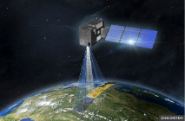
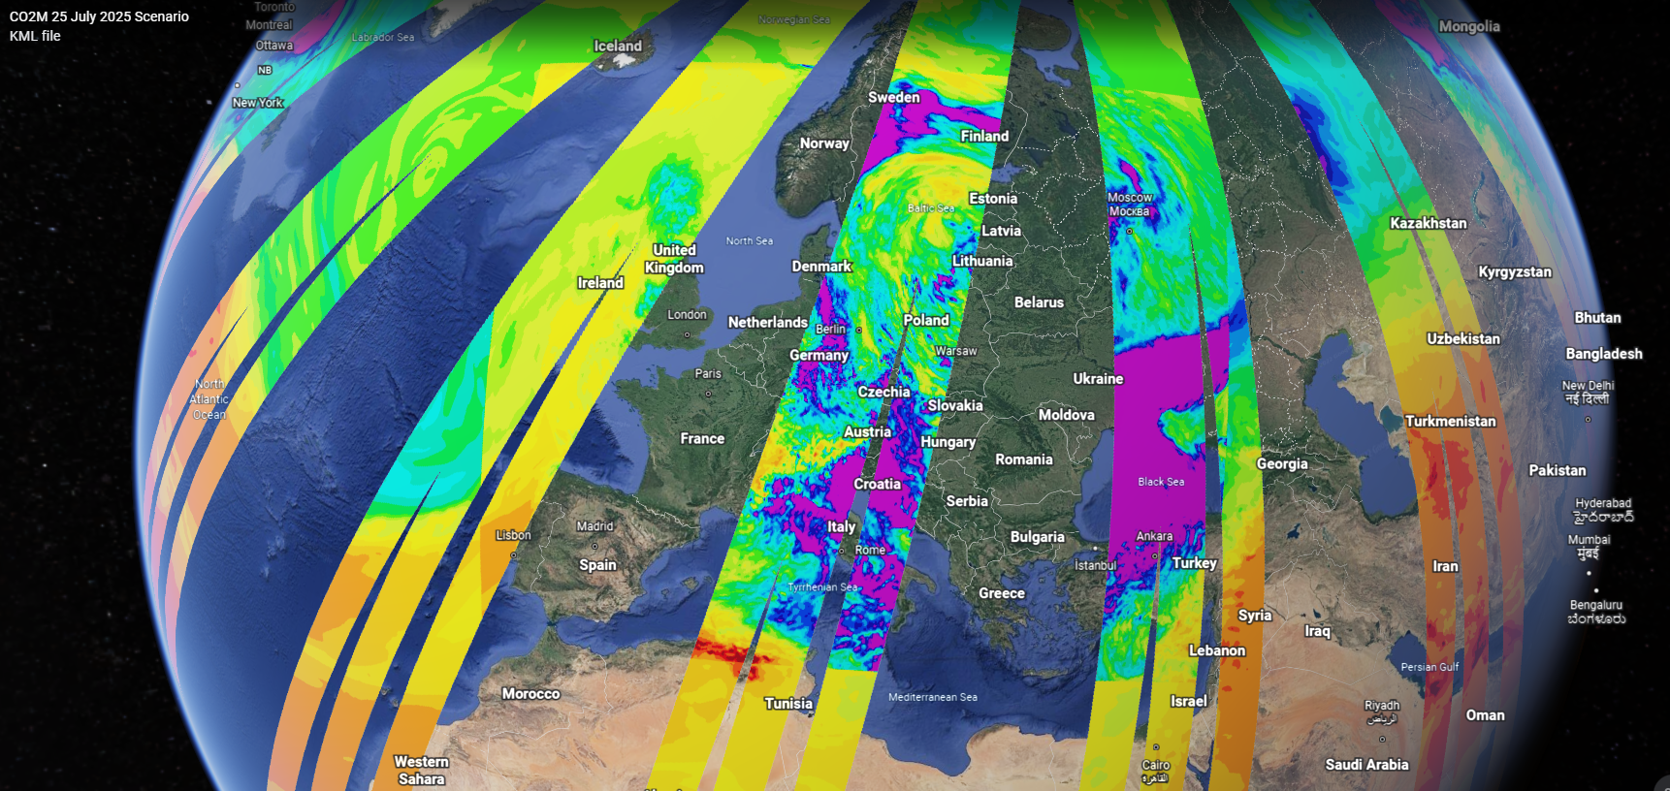
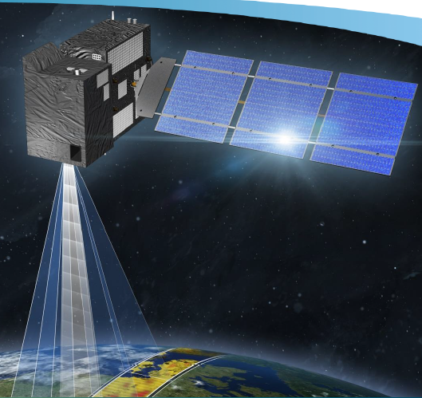

The CO2M greenhouse-gas monitoring constellation
Mission goals
Continuous mapping and monitoring of anthropogenic CO2 emissions
Quantification of biogenic sources and sinks
Provide “actionable information” for policy makers
Three (TBC) satellite missions with each >250 km swath:
Mission prime OHB SE
Payload prime Thales Alenia Space, France
Orbit:
Sun-synchronous orbit 14 5/11
159 orbits repeat cycle (~11 days)
735 km altitude
11:30 LT
Platforms in same orbital plane
Three instruments per platform:
CO2/NO2 push-broom grating spectrometer (CO2I/NO2I)
Multi-Angle Polarimeter (MAP)
Cloud Imager (CLIM)
Product | Spatial resolution | Precision | Bias
CO2 | 4 km² | 0.7 ppm | <0.5 ppm
CH4 | 4 km² | 10 ppb | <5 ppb
NO2 | 4 km² | 1.5x10¹⁵ molec/cm² | <3.5x10¹⁵ molec/cm²
SIF* | 4 km² | 0.7 mW m⁻² sr⁻¹ nm⁻¹ | <0.2 mW m⁻² sr⁻¹ nm⁻¹
Aerosols | 16 km² | 0.05 AOD, 500 m LH | <0.05 AOD, 500 m LH
Clouds | 4 km² | <1% of FOV
CO2M test-data study
Total column CO2 concentrations [ppm]
CO2M three platform constellation
*Solar Induced Fluorescence

Slide 4
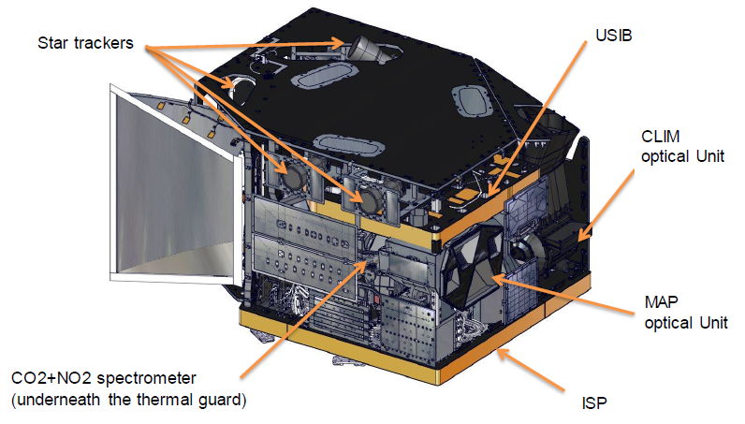
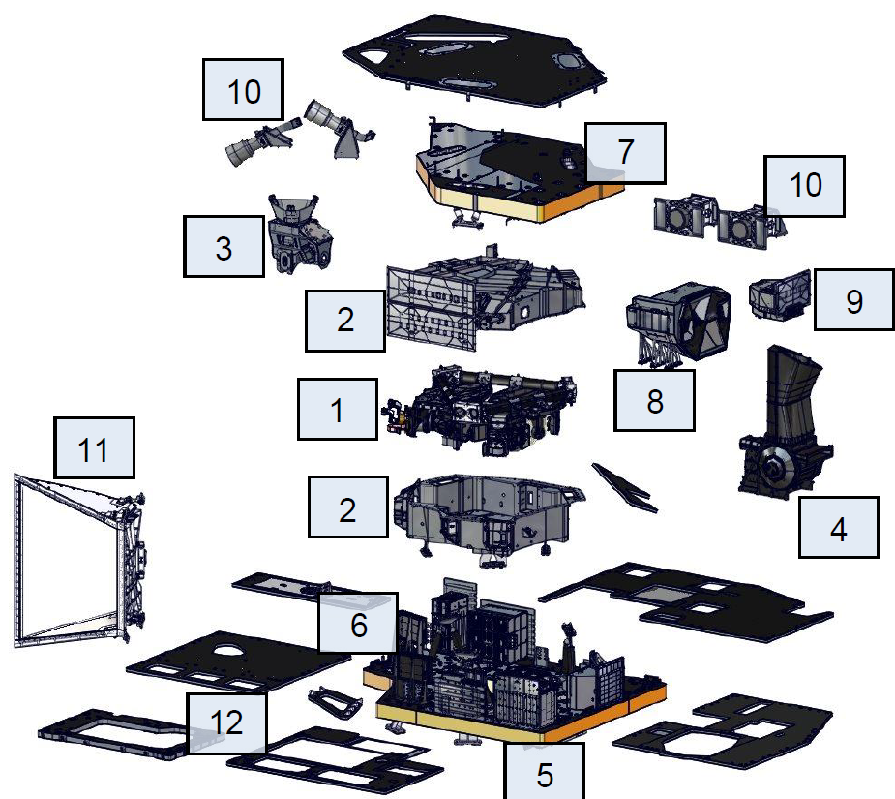
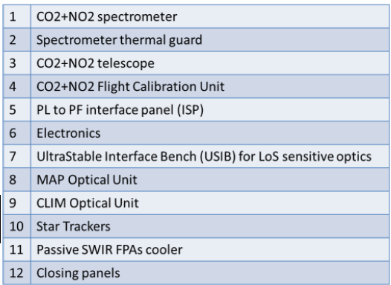
CO2M Payload overview

Slide 5

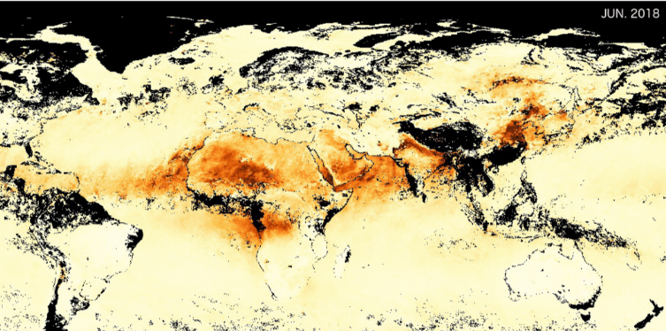
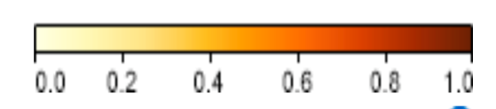
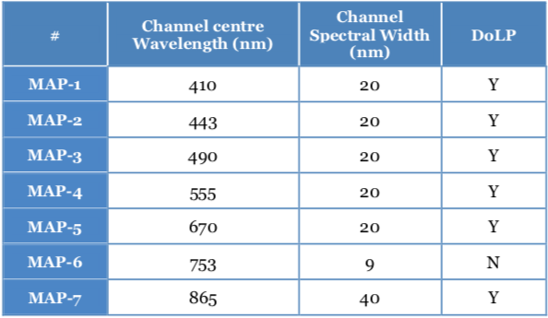
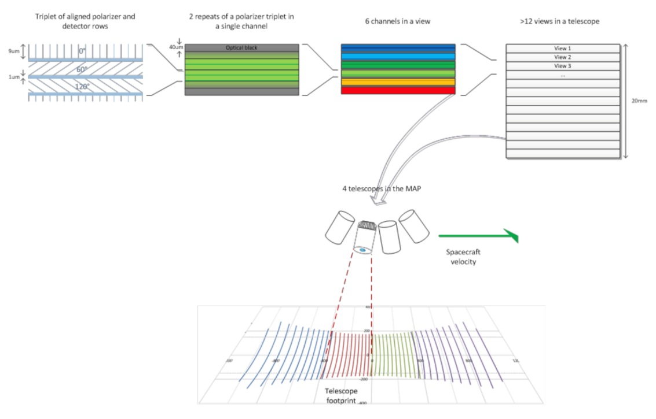
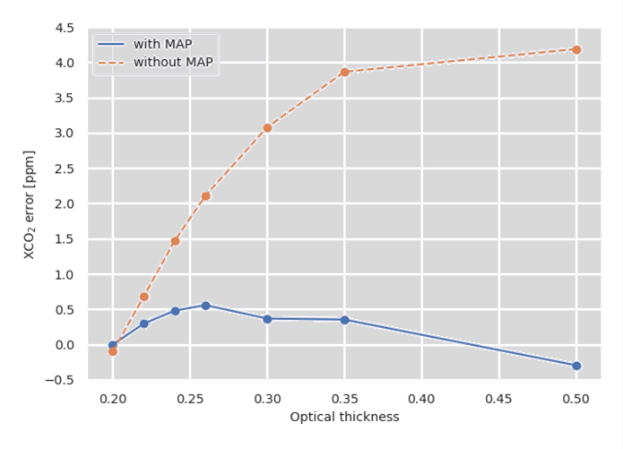
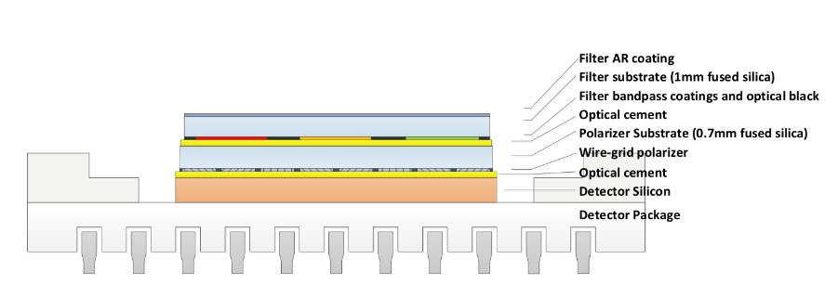
CO2M: Multiple Angle Polarimeter
Aerosol measurements:
Light path correction by measuring effective aerosol parameters
Heritage missions without MAP require bias correction and filtering
Anthropogenic areas in India and China on average AOD>0.3
Higher accuracy CO₂ data (less dependence on bias correction)
More data and more accurate retrievals at high aerosol loading; up to 0.5 AOD
Multi-angle polarimeter (MAP): Pushbroom-imager with
Continuous along track coverage, 47 viewing angles (+/- 60º)
7 spectral bands in VIS and NIR (see table below)
3 polarisation directions (0º, 60º, 120º) sampled by micro-polarizers at detector pixel-level
Spatial resolution: 4x4 km² and sampling <2x2 km²
MODIS AOD, high in India & China
0.0 0.5 1.0
Aerosol Optical Depth (AOD)
Contact @ EUMETSAT: Bernd Husemann
Either 5 views & hyperspectral or
40 views & 6 bands
With MAP
Without MAP
XCO₂ bias (ppm)
Courtesy of TASiUK
Credits: SRON, Utrecht

Slide 6
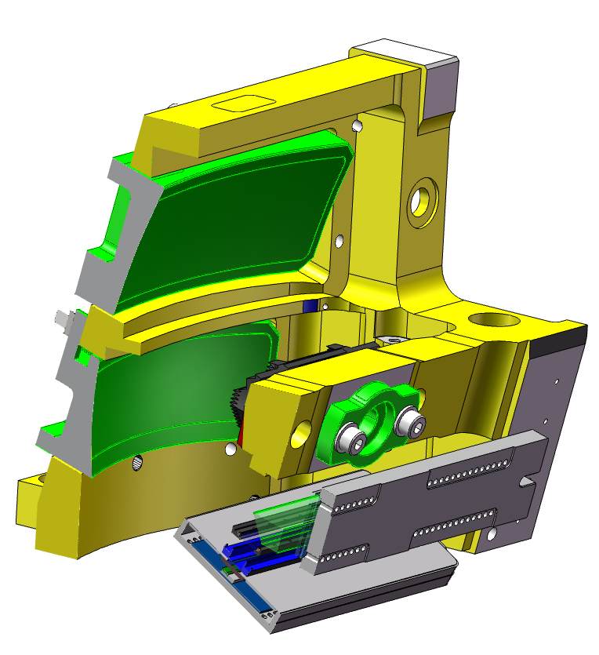
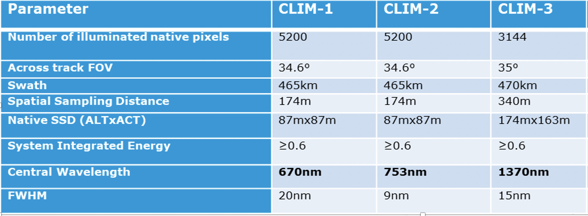
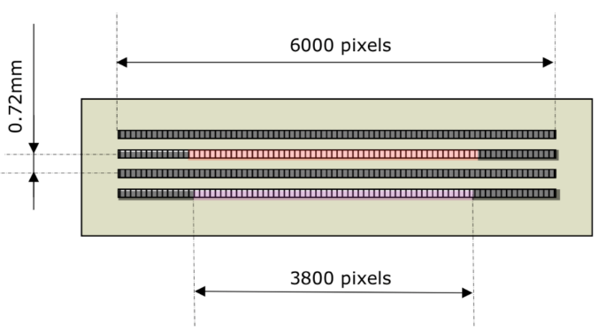
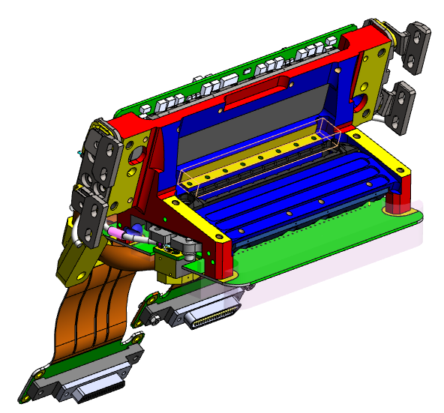
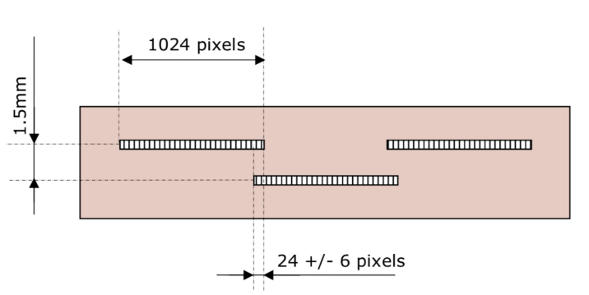
CO2M: Cloud Imager
CO2M requires detection capability for optically thick clouds
low fraction of cloud cover in the range [1%- 5%]
detected in three spectral channels (VIS-NIR-SWIR)
spatially oversampled data.
CLIM instrument (OIP)
Three mirror telescope
F= 110, f/6
Folding mirror for SWIR channel
Spectral filters in front of detectors
2 focal planes: VIS/NIR and SWIR with linear array detectors
Lunar and vicarious calibration
All native samples sent to ground
Contact @ EUMETSAT: Pepe Phillips
25mm
Courtesy of OIP

Slide 7
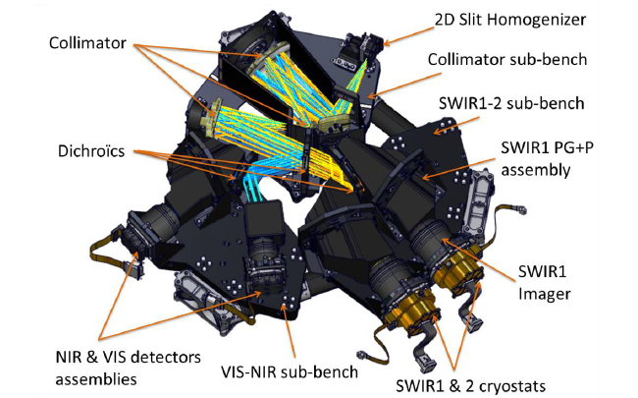
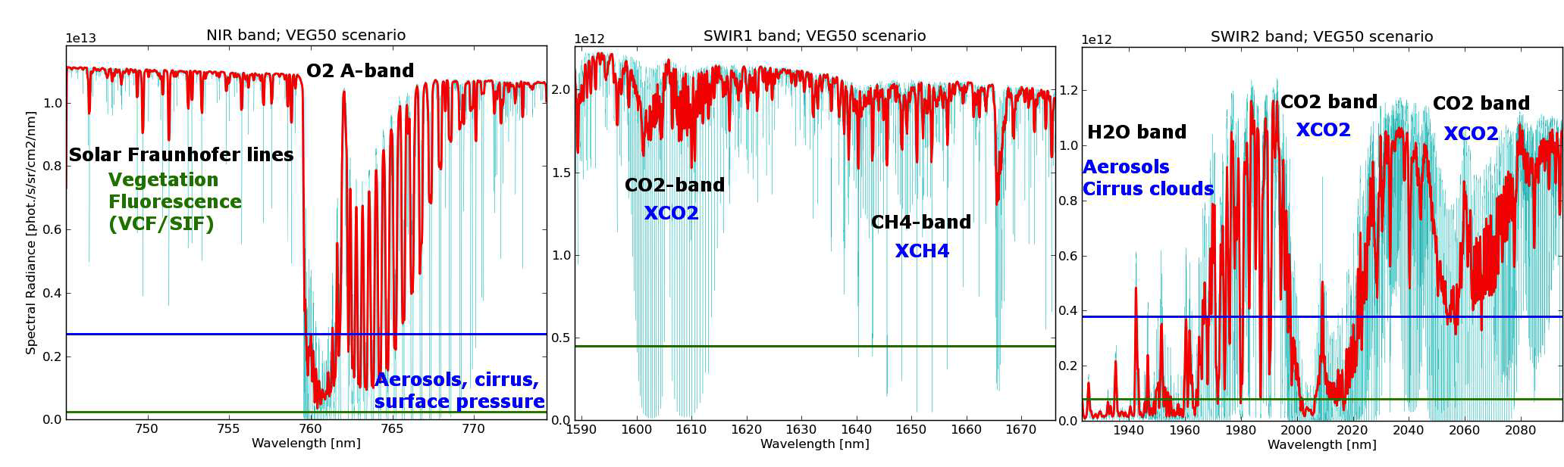
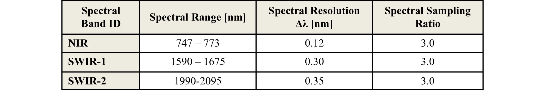
Copernicus CO2M: CO2I/NO2I imaging spectrometer
VIS 405-490 0.35 6.5

Slide 8
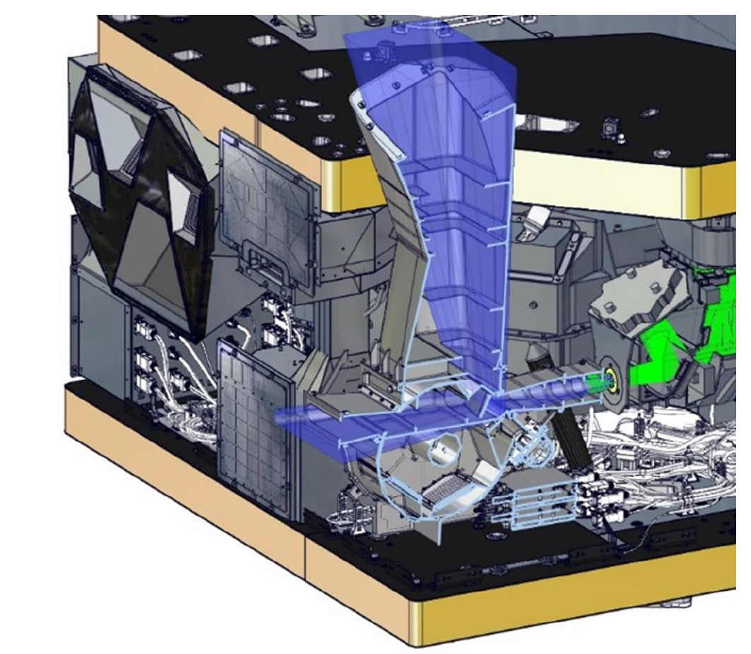
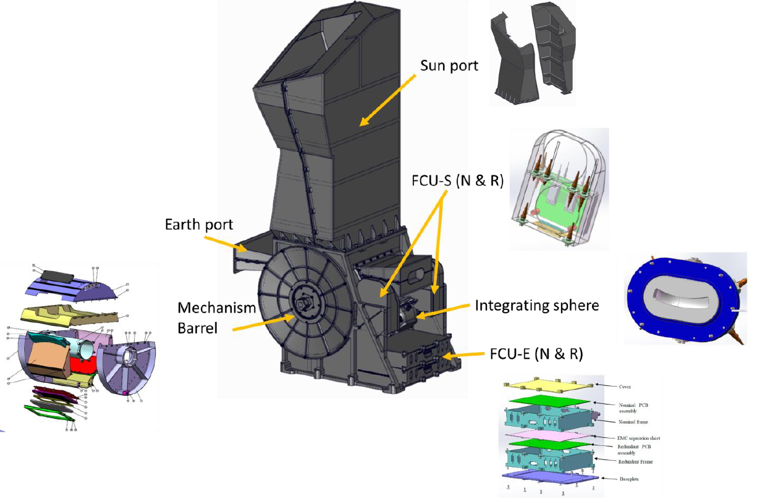
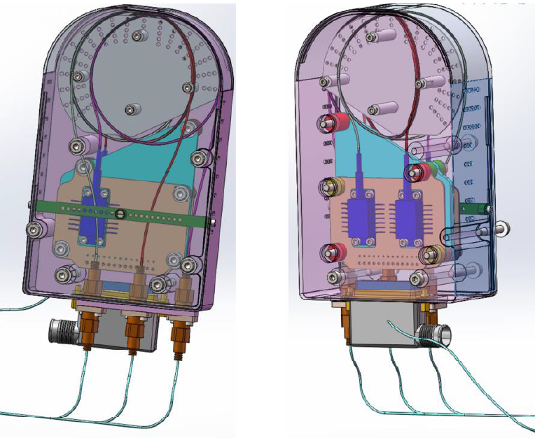
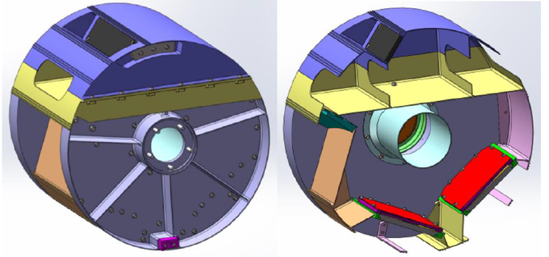
CO2I/NO2I: Flight Calibration Unit
On board calibration sources
“Classical” calibration barrel selecting various light sources
Two reflective diffusers for solar calibration (nominal and reference)
White Light Source (tungsten halogen) for PRNU and detector monitoring
3 laser diodes in butterfly package for ISRF calibration in NIR, SWIR1 and SWIR2

Slide 9
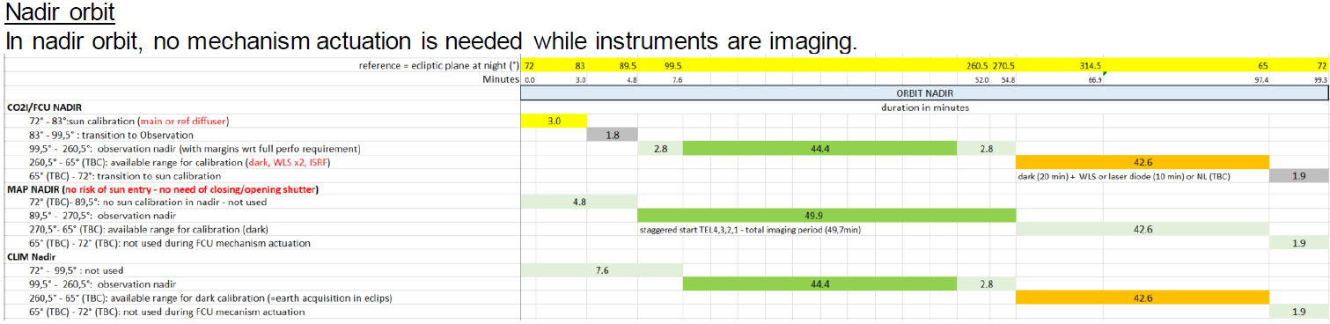
CO2I/NO2I: In-flight calibration
Nadir orbit
Glint orbit

Slide 10
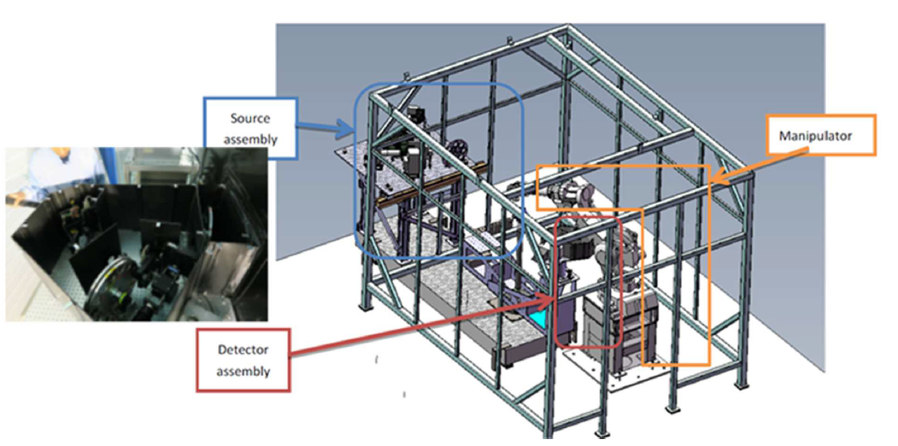
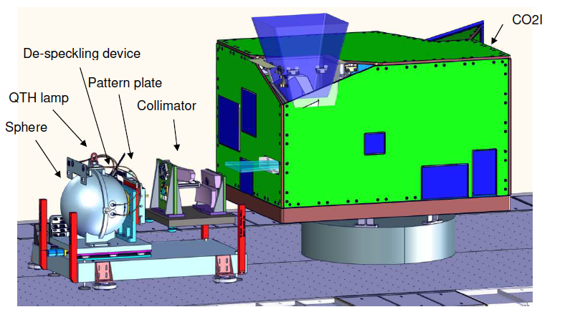
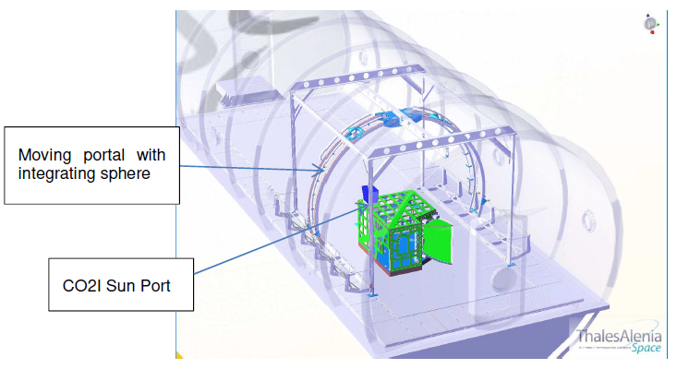
CO2I/NO2I: On-ground calibration
Calibration at sub-system level
Sun diffuser BSDF calibration by CSL
VIS and NIR detectors complete characterization and calibration by Teledyne e2v
SWIR detectors complete characterization and calibration by Lynred
SWIR remanence (memory effect) calibration by TAS using Test Bench 2 (TB2) facility
On-ground calibration…
Radiometric calibration
  Sun diffuser absolute BRDF characterization at CSL (B)
  Integration sphere with light sources traceable to primary standards
  Measurement of instrument transmission and diffuser BRDF
Spectral calibration
  Spectral scale
Geometric calibration
  Instrument LOS characterisation (theodolite sightings)
  Sensitivity to polarization
  Inter-bands and intra-band co-registration
…and characterization
Instrument Spectral Response Function (ISRF)
  All spectral channels, OGSE: Tuneable laser
Straylight characterization
  Measurement of Straylight kernels
  110 spatial and 100 spectral samples down to 1e-7
  Out-of-band and out-of-field SL
  Validation of straylight correction residual for non-uniform scenes

Slide 11
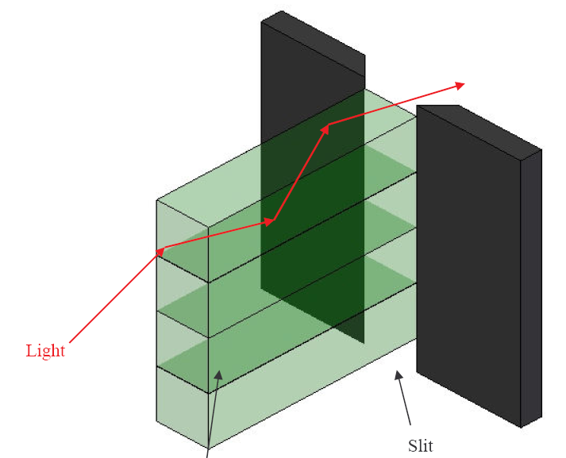
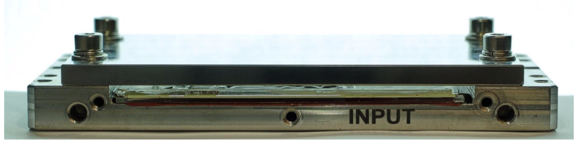
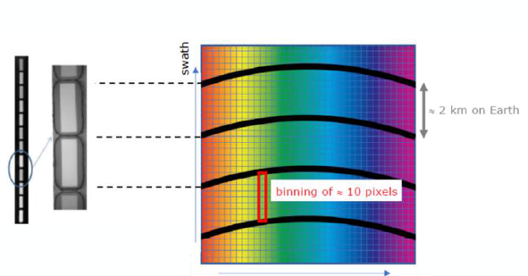
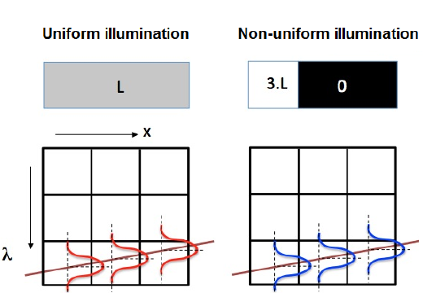

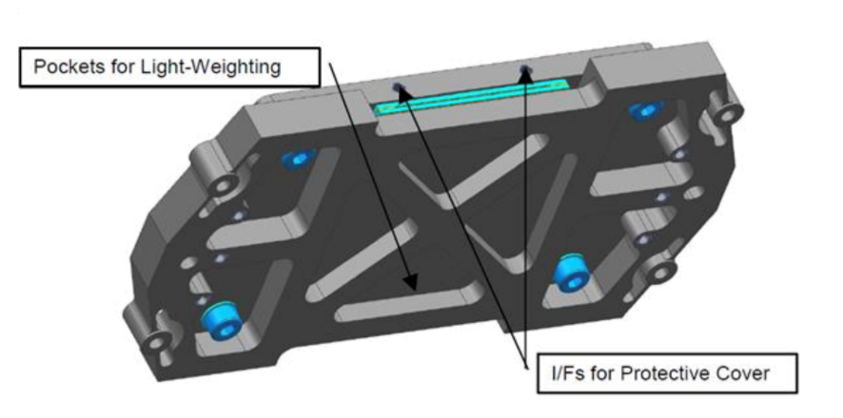
Special features: Fibre-based slit homogeniser
Fiber-based slit homogenizer:
Fiber-based entrance slit made of stacked rectangular multi-mode fibers
Each fiber defines instantaneous FOV and slit width (core dimensions: 319µm x 121 µm)
Homogenization performance in both ALT and ACT directions
Stable ISRF (slit function) independent of ground scene contrast
Quasi-perfect spatial co-registration (between spectral channels): Cladding “stripes” allow for distinction of ACT spatial samples, independent of keystone and smile distortion
Straylight and homogenization measurements with prototype complete
Manufacture of PFM component is on-going
Non-uniform illum. In ACT
Resulting ISRF
Figures courtesy of TASiCH

Slide 12
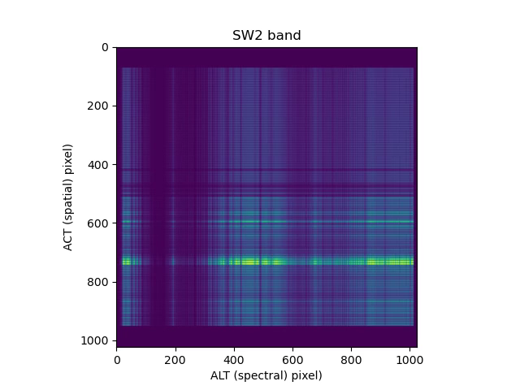
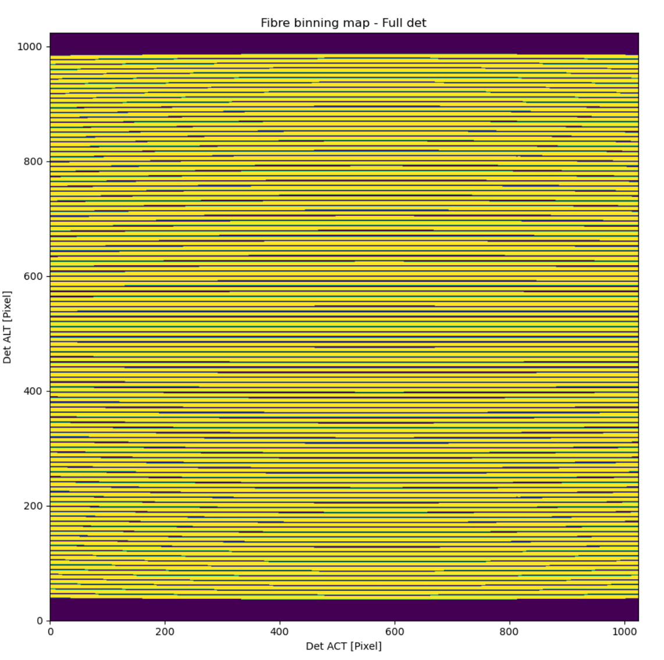
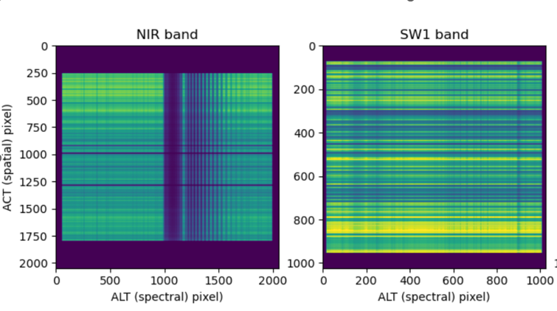
Slit homogenizer and binning strategy
Fibre image map
Fibre projection on FPA measured on ground and in flight with WLS (~15 (VIS, NIR) and 8 (SIR) ACT pixels per fibre)
“Smile” and “keystone” distortion introduce spectral variability of the fibre image position on the detector pixel grid
  “Edge pixels” with fill-factors” <100% (on average 15% for fibre image width of 7.6 pixels)
  Illumination gap (“grey stripes”) of 1.5 pixels (22.5 μm) due to cladding between fibre pair
  ~40 completely shadowed pixels (used for straylight monitoring)
=> The relative contributions of each detector pixel within a binning window is known
Used for “weighted binning” of CKD or “un-binning” (reconstruction of the signal distribution before binning)

Slide 13
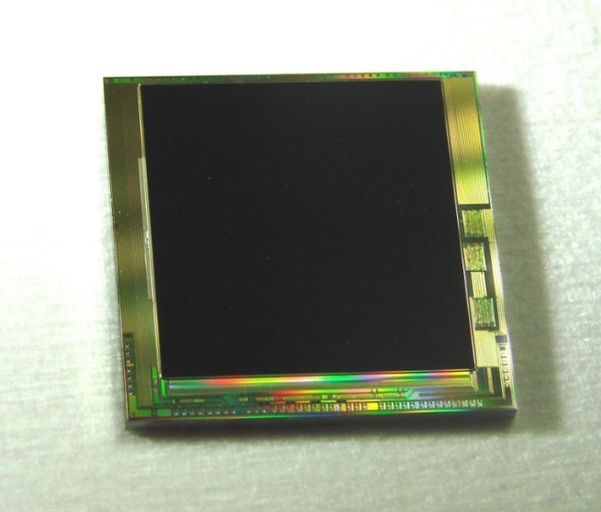
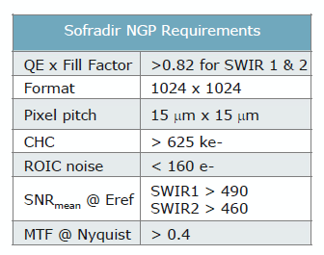
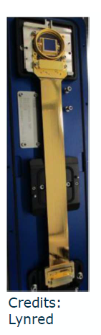
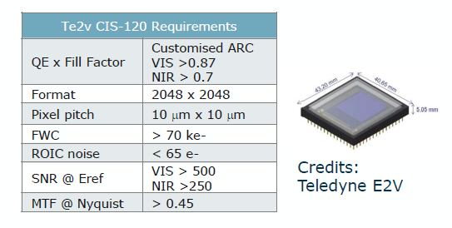
CO2I Design: Detectors
VIS, NIR: Te2v CIS-120
SWIR-1, -2: Lynred NGP
Courtesy of Te2v
Courtesy of Lynred

Slide 14
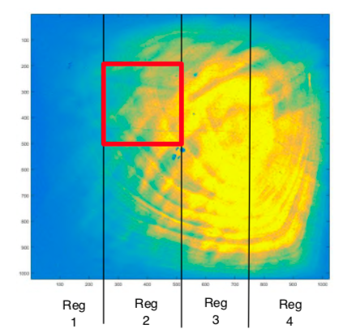
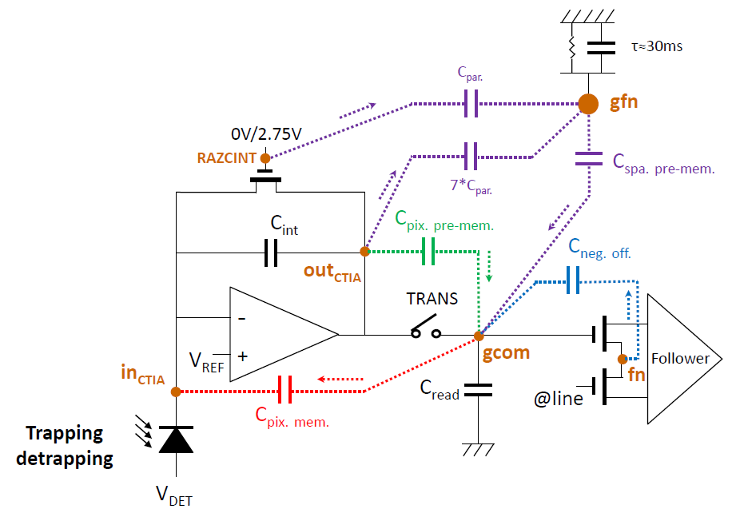
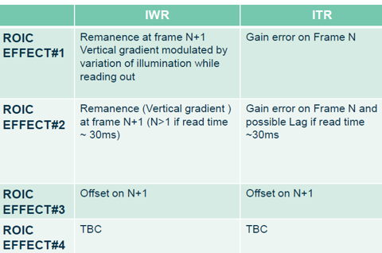
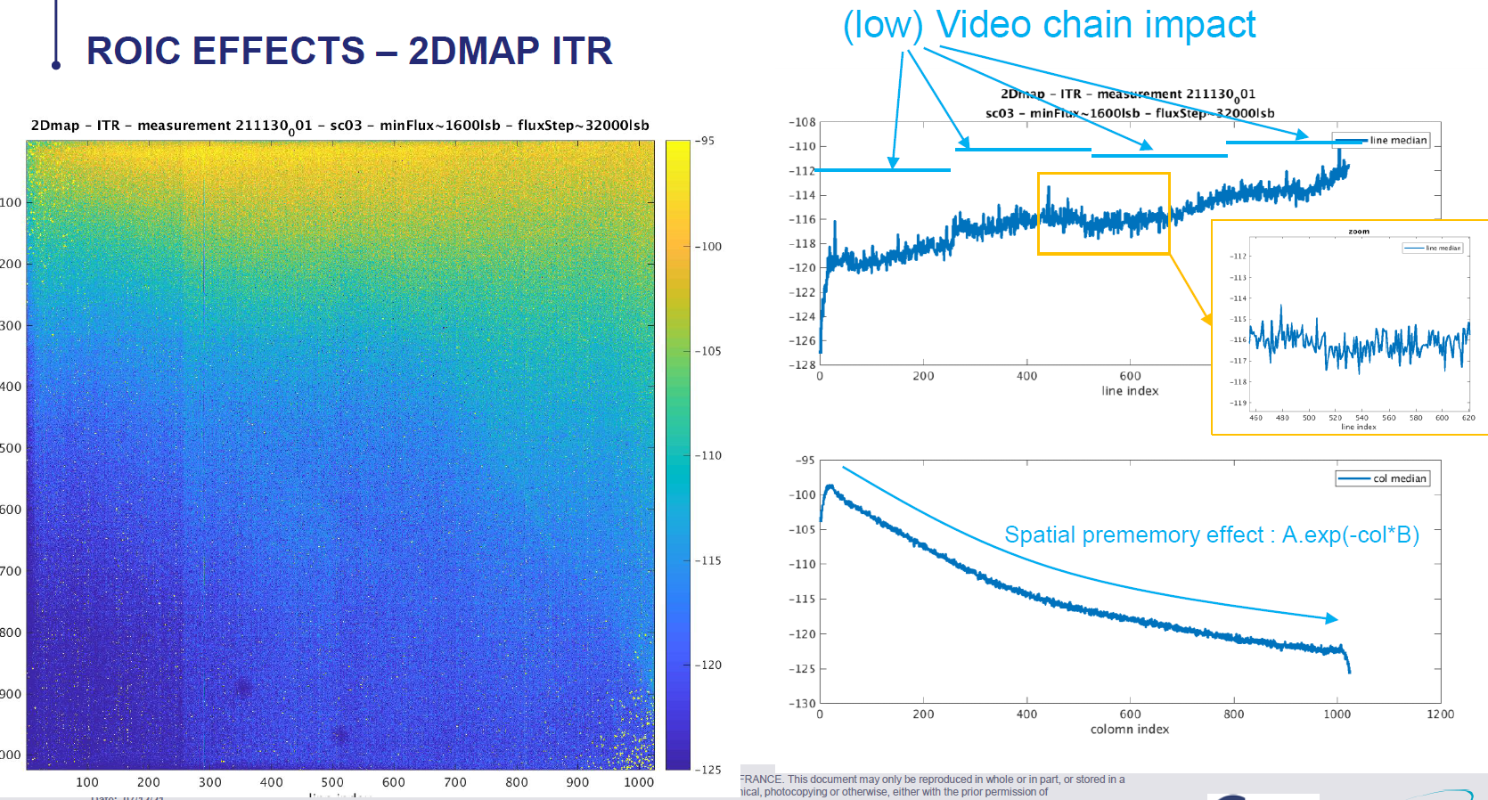
Detector effects: “Remanence” of NGP – ROIC effects
Trapping/de-trapping
Several persistence (remanence) effects have been identified by TAS and Lynred
Signal lag from trapping/de-trapping of charges from defects within MCT lattice
4 different ROIC effects from parasitic capacitances (see list below)
  Acting on different regimes, resp. time scales
    Inter-frame remanence (typically 5 previous frames (N-5) )
    Intra-frame remanence (current frame N)
    give rise to non-linear radiometric error, depending on flux profile (scene)
  play out differently in IWR and ITR modes
  ITR mode eliminates 2 ROIC effects, remaining two depend on global floating node
Correction at L1b possible, but complex
May require in-orbit validation (and possibly re-calibration)
ROIC effects

Slide 15
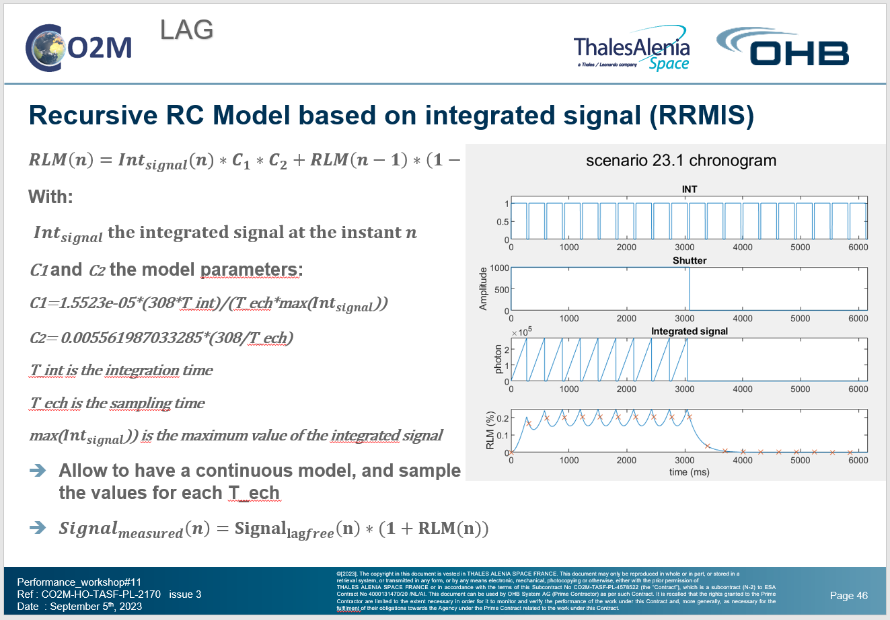
Inter-frame remanence: RRMIS model
Simulation of inter-frame remanence (lag)
TAS developed model of lag effect
Recursive formula describing the effect as a function of temporal charge build-up
Model parameters determined by test measurements (bright-to-dark contrast)
Used to forward-model the effect over realistic scenes
Performed L2-analysis to…
  quantify the impact on XCO₂ retrieval
  estimate the best possible correction performance
  derive calibration requirements

Slide 16
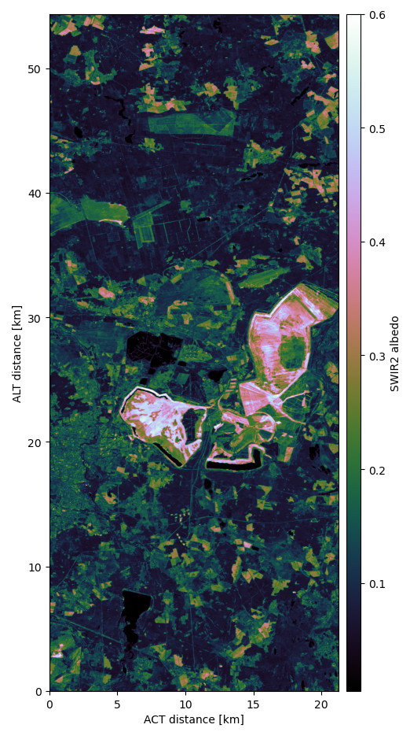
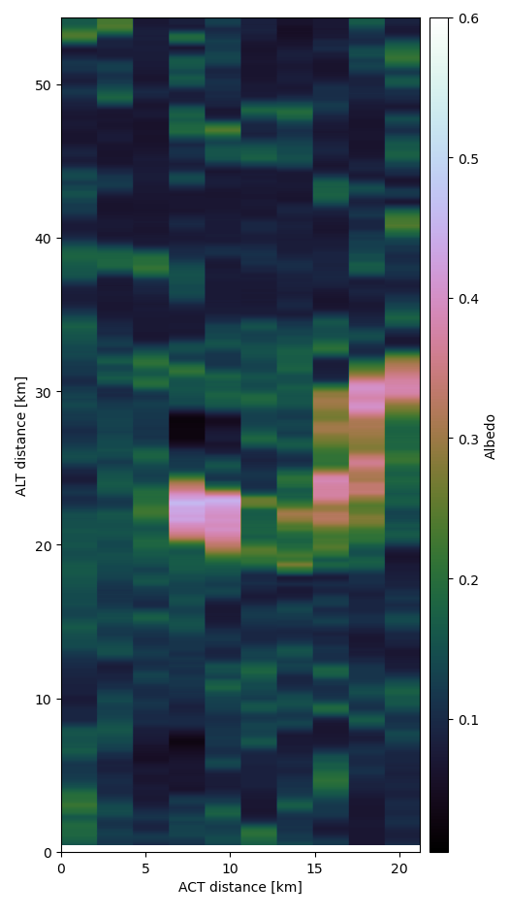
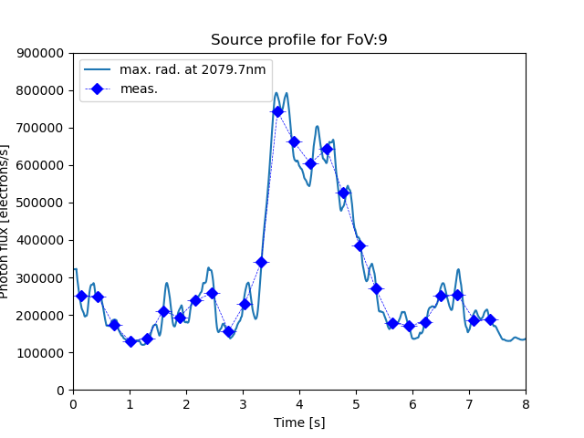
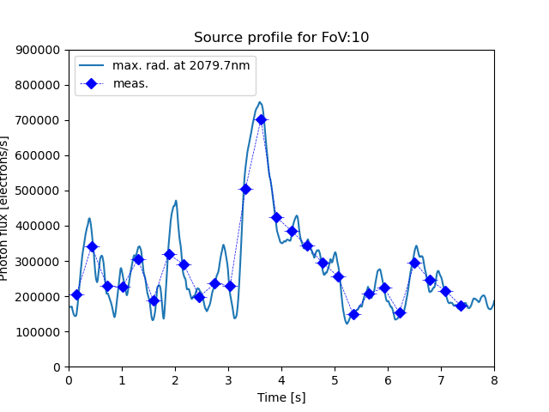
First look at a realistic scene: Sentinel-2
Inter-frame remanence: Simulation setup

Slide 17
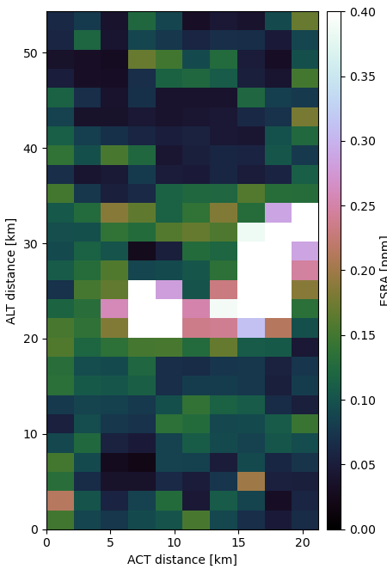
Inter-frame remanence: Impact on Level-2 (XCO2)
min: : 0.016 ppm max: 0.869 ppm
Ave: 0.113 ppm
Req.: 0.4 ppm
Reminder:
This is for uncorrected lag

Slide 18
Summary and Outlook
CO2M mission for monitoring of anthropogenic greenhouse gas emissions
  Multi-instrument payload with combined retrieval of CO2 (and CH4)
    CO2I/NO2! pushbroom imaging spectrometer for measurement of XCO2 and XCH4
    Multi-Angle Polarimeter (MAP for Aerosol measurement
    Cloud Imager (CLIM) for sub-sample cloud flagging/characterisation
CO2I/NO2I “special features”
  Fibre-based slit homogenizer with implications on (un-)binning strategy
  Detector lag/persistence/memory effects require detailed models and corrections
    Development of correction algorithms are on-going, to be implemented in operational L1b processor
CO2M is “on course” for launch in 2026
  Space segment development led by ESA
    Payload CDR kicked of end of March, to be completed in June
  Ground segment development led by EUMETSAT
    Instrument Processing Facility with operational L1 and L2 processor, CDR to be kicked off April

Slide 19
Backup Slides

Slide 20



Binning and detector effects
EBB slit
Pixel Nr.
1
2
3
4
5
6
7
8
Results with EBB and OM spectrometers show residual non-uniformity
    Interference effects for non-uniform scene input
  Non-uniform fibre-output even for uniform scene input
“High Spatial Sampling” (HSS) data provide a measurement residual scene non-uniformity

Slide 21





CO2M Pre-Development: Diffraction gratings
Diffraction gratings (Fraunhofer IOF)
Grism + Prism assemblies, transmission 1st order
operated in Littrow configuration
Photonic sub-wavelength structures
Manufacture: e-beam lithography and reactive ion-etching
NIR: TiO₂ over-coating by applied by ALD
SWIR: Nano-laminate multi-layer coating (alternating stack of Al₂O₃ + TiO₂)
Grooves completely filled by multi-layer coating, enclosed in SiO₂
Measured performance
  Diffraction efficiency > 90%
  Polarisation Sensitivity < 10%
  Low wavefront error and straylight
Courtesy of IOF
Courtesy of IOF

Slide 22



CO₂ emissions from cities and power plants
Credits:
EMPA
From Strandgren et al., AMT, 2020
Cities account for ~70% of global CO₂ emissions
.... and have large reduction potential
CO₂ emissions are concentrated:
90% emitted over less
than 8% of area of Europe
52% from point sources,
primarily power plants
Credits: EMPA, based on TNO-MACC

Slide 23

Overview: CO2M
From Earth Explorer to Copernicus mission candidate
  Anthropogenic CO₂ emission as primary target
  High spatial resolution imaging of point sources (cities, power plants)
  Global coverage at high temporal sampling
  High single sounding precision and accuracy (flux inversion from single over-flights)
  Requirements are driven by point-source detection/monitoring:
    Low-noise retrievals (high SNR of measured radiance)
    Knowledge of plume shape (from NO₂ images)
    Knowledge of cloud and aerosol distribution above scene (from polarimeter measurements)
    ➔Payload with suite of instruments
Mission requirements (XCO₂):
XCO₂ precision: 0.5 – 0.7 ppm
Systematic bias < 0.5 ppm
Spatial resolution 4 km²
Continuously sampled swath width of > 200 km
Revisit around 2–3 days (poleward of 40 deg)
by constellation of N satellites
Orbit equator crossing time 11:30 hrs
Push-broom imaging spectrometer (heritage)

Slide 24


CO2M: The NO₂ imager (NO2I)
Nitrogen dioxide (NO₂) as a tracer for CO₂
  generated in combustion processes at high temperature (coal-fired-power plants, Diesel engines)
  strong correlation between the off-wind plumes of CO₂ and NO₂
Detection of CO₂ point sources requires higher resolution than currently available
CO2M will measure NO₂ column densities at 4 km² resolution
  re-sampled on CO2 grid on the ground
NO2I instrument is implemented as an additional VIS band (sharing telescope and collimator with CO2I
Band | Spectral range [nm] | Spectral resolution | SNR at reference radiance
VIS | 405–490 | 0.6 nm | 500
CO₂ at CO2M resolution
NO₂ at CO2M resolution

Slide 25


Slide 26



Specific aspects of CO2I/NO2I
The fibre-slit – 2DSH
Binning has been (or will be) performed on other (heritage) missions like TropOMI, and Sentinel-5
On CO2I/NO2I the 2DSH “scrambles” spatial information on sub-sample level (<2.2 km) , and provides piece-wise homogenised signal across a fibre image at the focal plane => The signal in each binned pixel is equal and can be infeered for the binned signal
The presence of cladding around fibre cores results in non- (or partially) illuminated detector pixels. The 2DSH is sized to provide for a distance of 1.5 detector pixels between adjacent binning windows, so at least one pixel between them is not illuminated (in the following called “shadowed pixels”)
At the two edges (left and right) of each binning window, the detector pixels are partially illuminated (fill factor <1), determined by the dimensions and positions of the 2DSH, the detector and the optical distortions (in the following called “edge pixels”)
The average binning factor is
- 14.4 in VIS and NIR
- 7.6 in SWIR-1/2

