Slide 1
Current status of GOME-2 and outlook for Sentinel-4 & Sentinel-5
Rasmus Lindstrot
CAM – Atmospheric Chemistry
Nan Hao, Gabriele Poli, Philipp Köhler, Yang Wang, Sebastian Gimeno Garcia, Frank Rüthrich, Vinod Kumar, Myojeong Gu, Praveen Pandey, Malcolm Taberner, Yu Ren, Catherine Hayer, Bernd Sierk, Josef Gasteiger, Leonid Butenko, Malcolm Taberner and Rüdiger Lang
GSICS Annual Meeting, 11-15 March 2024, UVNS subgroup

Slide 2
Agenda
Atmospheric Chemistry (ACh) at EUMETSAT
GOME-2 & Copernicus UVNS spectrometers (Sentinel-4, Sentinel-5, CO2I/NO2I)
GOME-2 on MetOp-B/C
Instrument(s) status
Copernicus UVNS spectrometers
Instruments
Announcement of Opportunity for S4/S5 Cal/Val
ACh Cal/Val tools
ACh GSICS–UVNS priorities

Slide 3
Atmospheric Chemistry (ACh) at EUMETSAT
Within EUMETSAT, the Atmospheric Chemistry (ACh) Competence Area, in close collaboration with the various Programmes, is responsible for all science matters, pre- and post-launch, for all hyperspectral UVNS spectrometers operated by EUMETSAT:
  GOME-2 on Metop
  Copernicus Sentinel-4 on MTG-S
  Copernicus Sentinel-5 on EPS-SG A
  Copernicus CO2/NO2I on CO2M
The ACh scientific roadmap foresees a harmonization of processing elements and the use of common approaches and tools for Cal/Val and monitoring across all these missions - as far as possible.

Slide 4
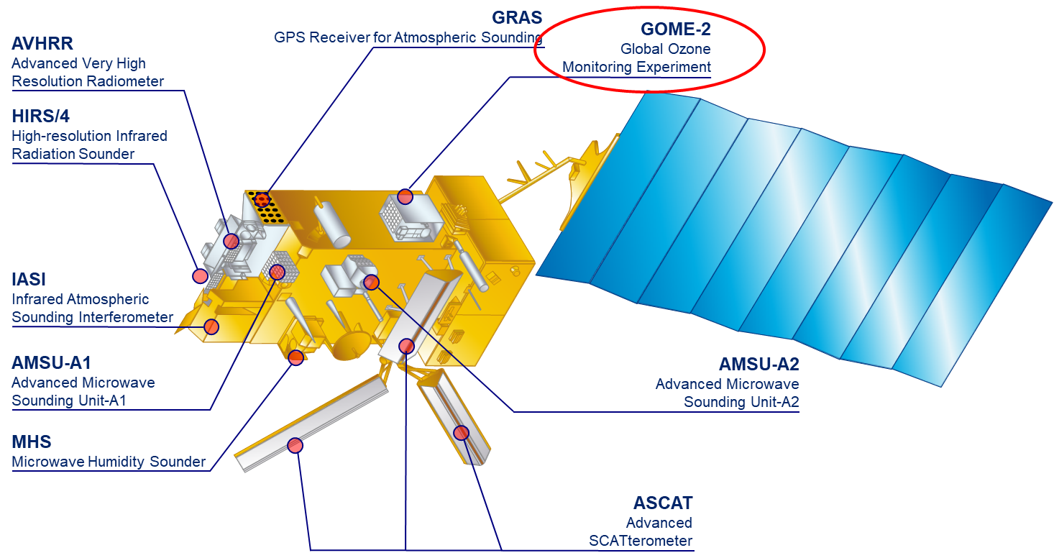
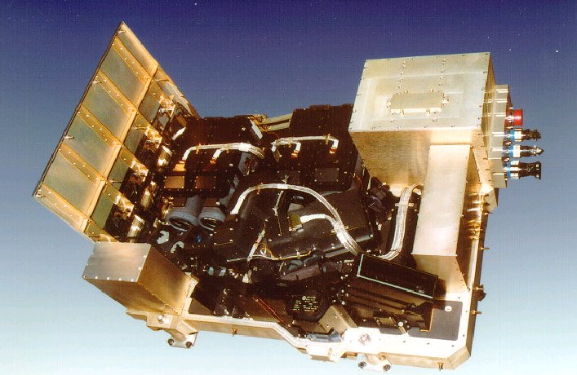
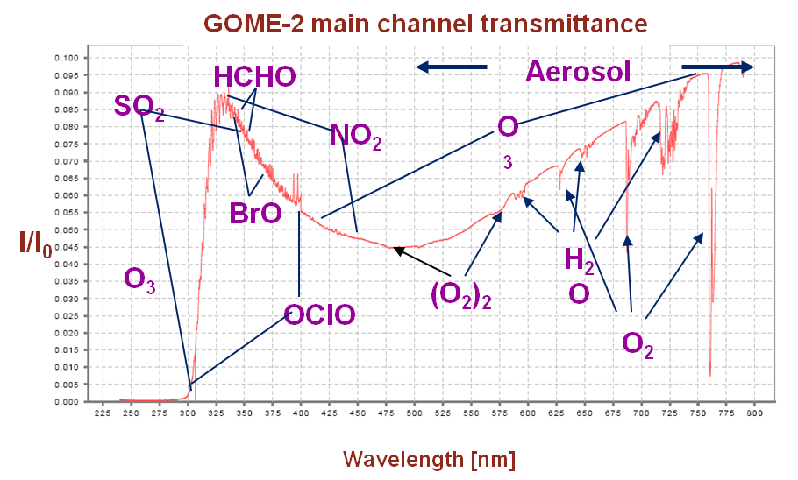
EPS GOME-2
Series of 3 instruments on Metop A/B/C
sun-synchronous orbit, 09:30
412 orbits (29 days) repeat cycle
Global coverage 1.5 days
240 nm to 800 nm
0.25 to 0. 5 nm spectral resolution (FWHM)
4 channels with 4098 energy measurements of polarisation corrected radiances (40 x 80 km²)
2 channels with 512 energy measurements of linear polarised light in perpendicular direction (S/P) (40 x 10 km²)

Slide 5
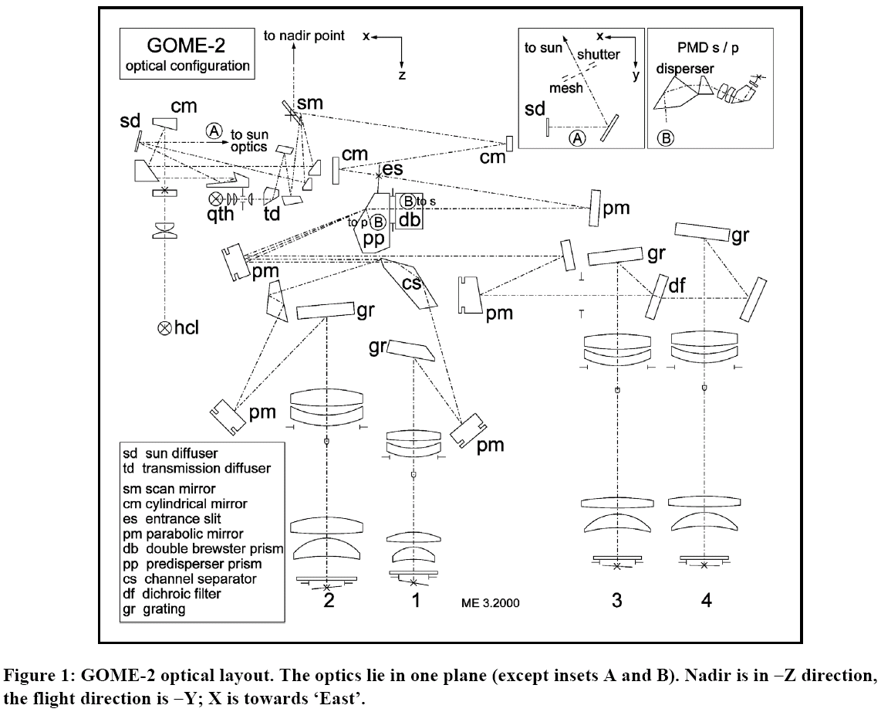
GOME-2 optical layout
Earthshine
Sun I₀ (daily)
Scan Mirror
Solar diffuser
White Light Source
WLS (daily)
Calibration
Unit
Spectral Light Source
SLS (daily)
Common (Earth/Solar/Cal) path

Slide 6
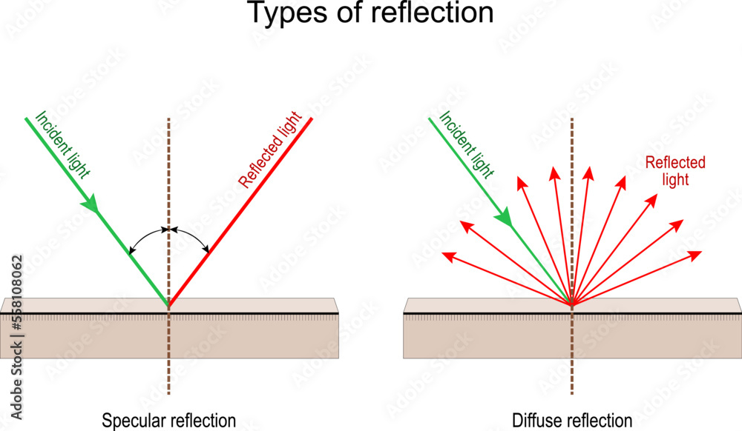
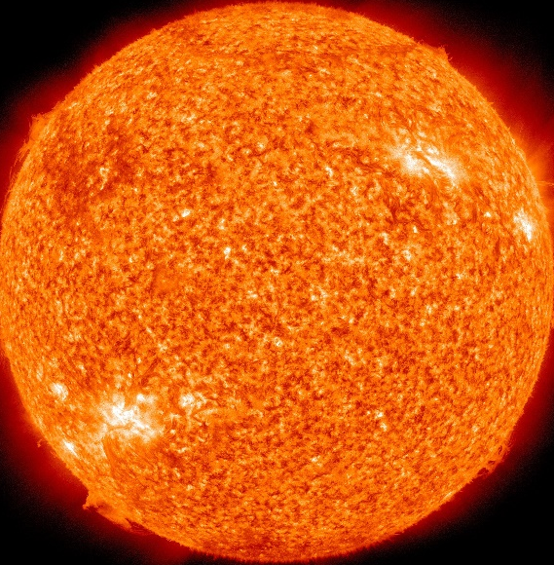
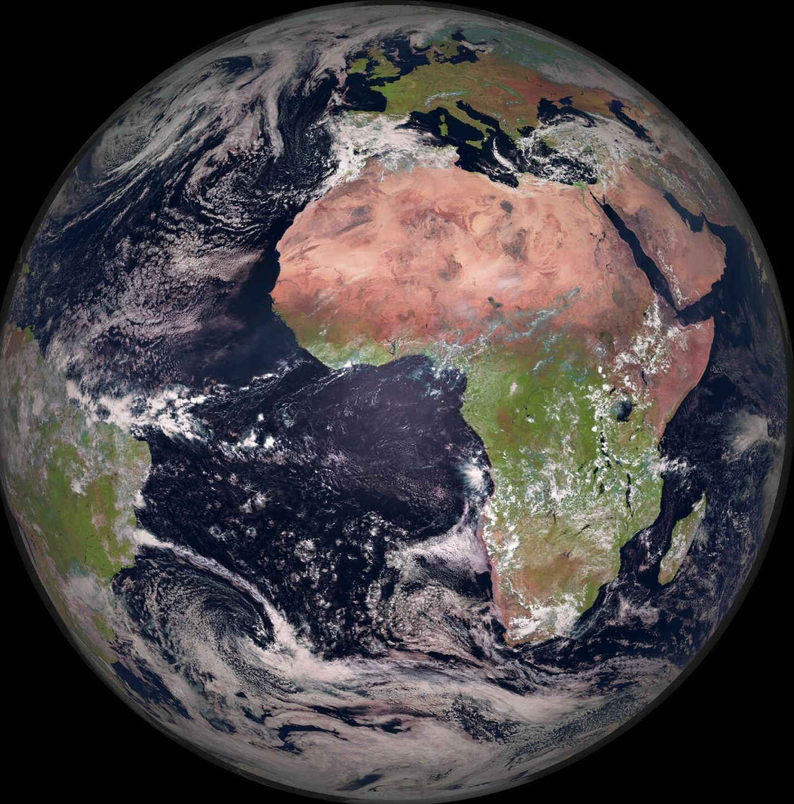
GOME-2 Sun observations
Diffuser
Scanning mirror

Slide 7

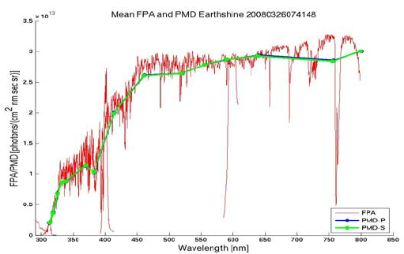
GOME-2 Earth observations

Slide 8
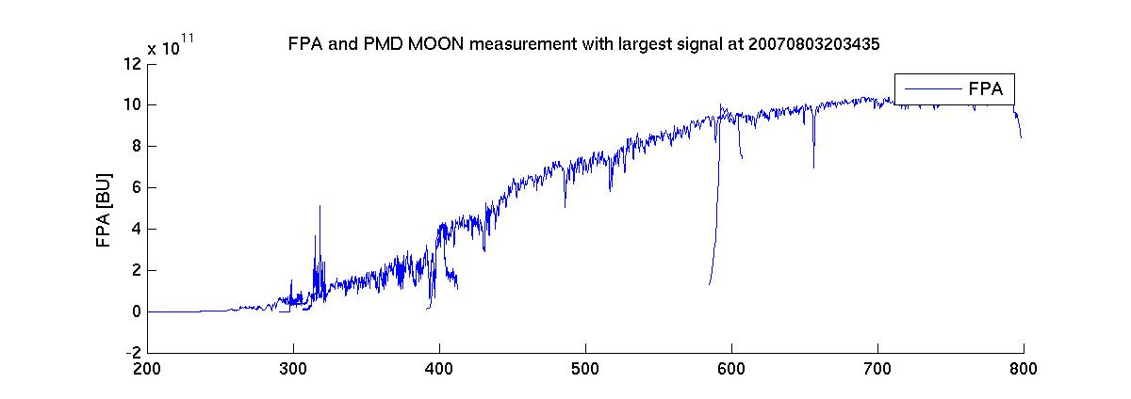
GOME-2 Moon observations
Lunar data is processed in dedicated campaigns, aimed at support of, e.g., SCIAMACHY/GOME-2 intercalibration (FDR4ATMOS, see presentation of G. Lichtenberg, DLR)

Slide 9
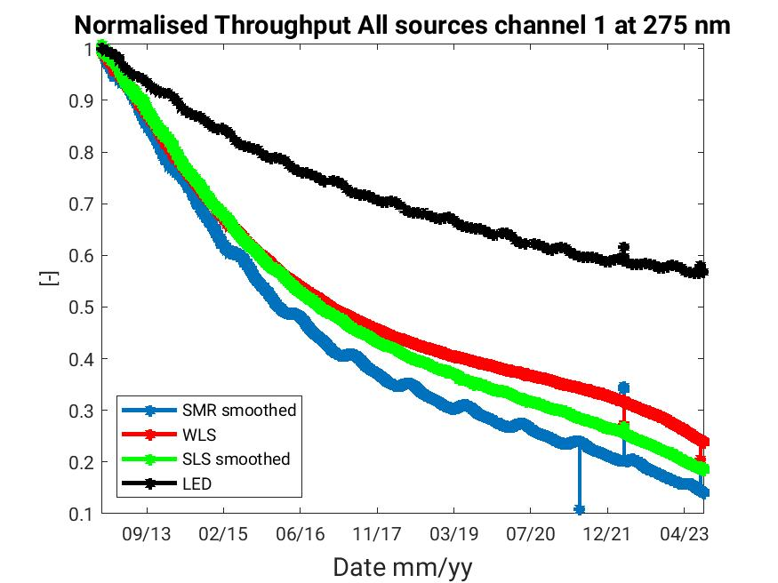
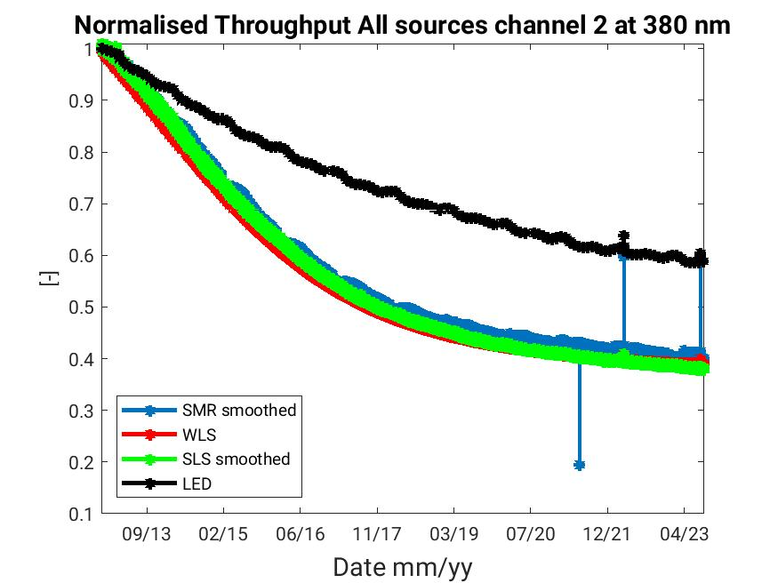
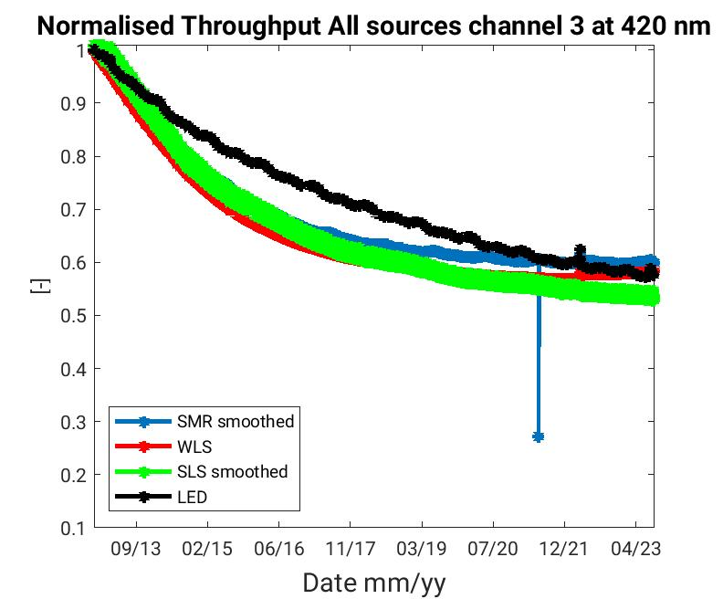
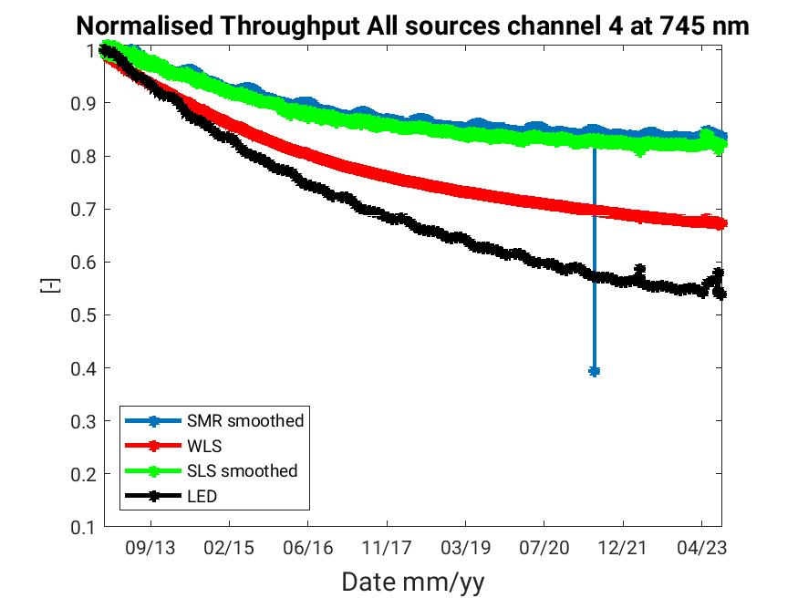
GOME-2 Radiometric degradation
Radiometric degradation is largely similar between the different observations, but differences do exist due to
  Solar diffuser (with angular dependence and its own degradation)
  Scanning mirror angle differences
Operational L1B Earth radiance and Sun irradiance products are not degradation-corrected, as the primary goal is to minimize degradation in reflectance.
Degradation correction factors are available separately for solar irradiance and Earth radiance data.

Slide 10
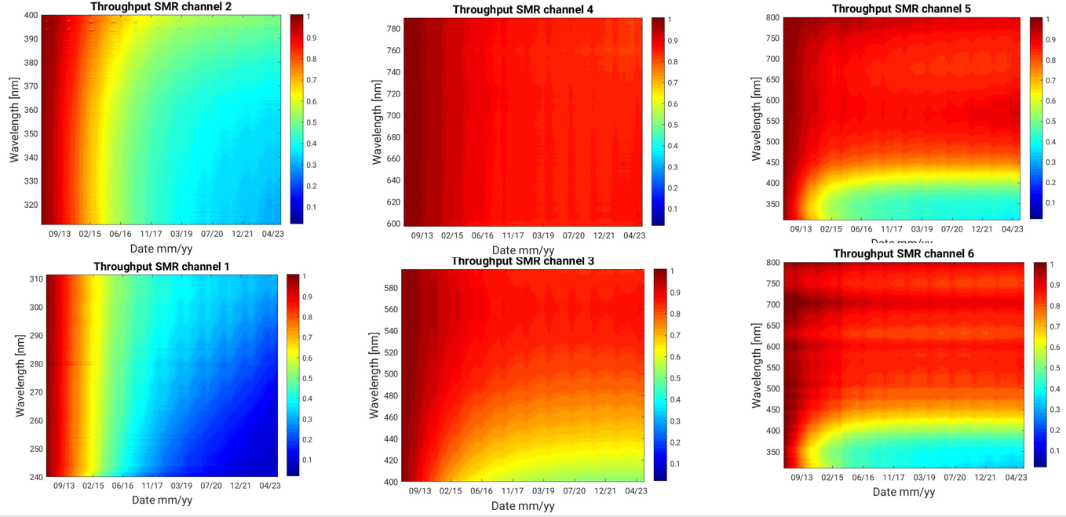
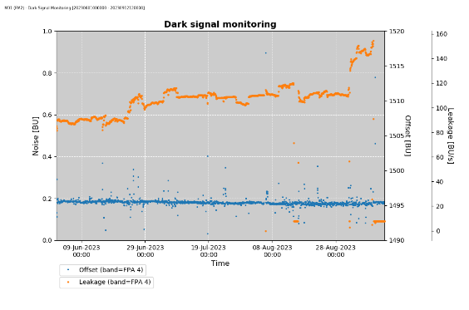
GOME-2 status – MetOp-B
Throughput degradation in progress, especially pronounced in the UV. Stabilizing over time.
This is known since MetOp-A and well under control as it mostly cancels out in reflectance.
Otherwise, the instrument is healthy, except for increased leakage current in band 4, most probably due to detector LED leaking some light. Corrected automatically via dark current calibration.

Slide 11
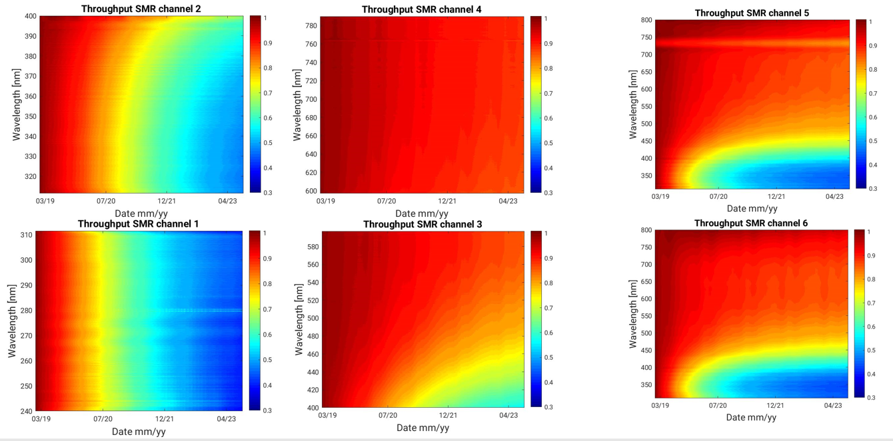
GOME-2 status – MetOp-C
Throughput degradation in progress, especially pronounced in the UV. Stabilizing over time.
This is known since MetOp-A and well under control as it mostly cancels out in reflectance.
Otherwise, the instrument is healthy.

Slide 12
GOME-2 on MetOp-B/-C: outlook
Metop-B
  is starting to drift, resulting in shortening eclipses during 2024 and need for updated measurement timelines to avoid stray light intrusions during dark measurements.
  “Solar gaps” (sun not visible for daily solar calibration) are starting to happen → use solar model derived from simultaneous MetOp-C measurements.
  EoL: 2027/28
4th reprocessing is under way for release in early 2025
  MetOp-A, -B, -C
  Covering full mission lifetime with most recent L0-to-L1 processor version (PPF v7.1.0)

Slide 13
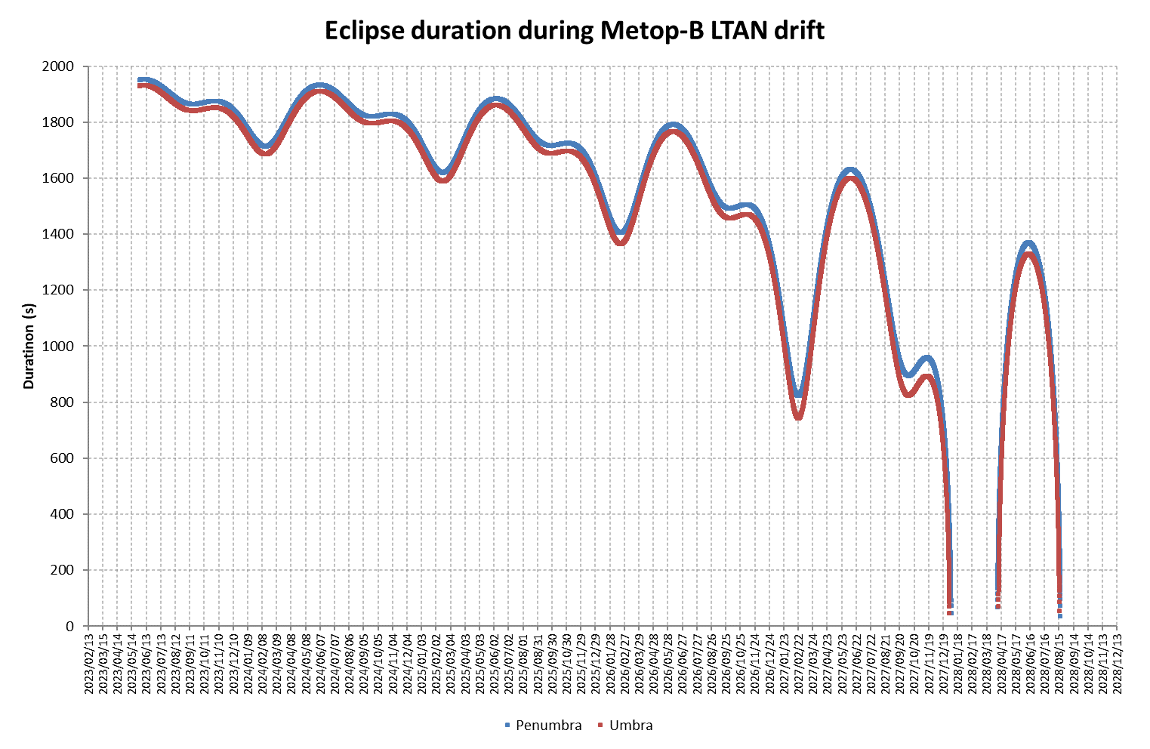
Metop-B GOME-2 dark calibration and impacts of stray light
Metop-B is drifting, resulting in shortening eclipses during 2024
Possible stray light impacts will start in 2024 (green line); updated timelines have been uplinked.
Like Metop-A, will transition in two steps from current Metop-B GTLs to 1350s & then 780s eclipse duration (red line);
Note: if Metop-B is allowed to drift longer than Metop-A there would be seasonal periods of 0 minutes of eclipse. No calibrations at all.

Slide 14
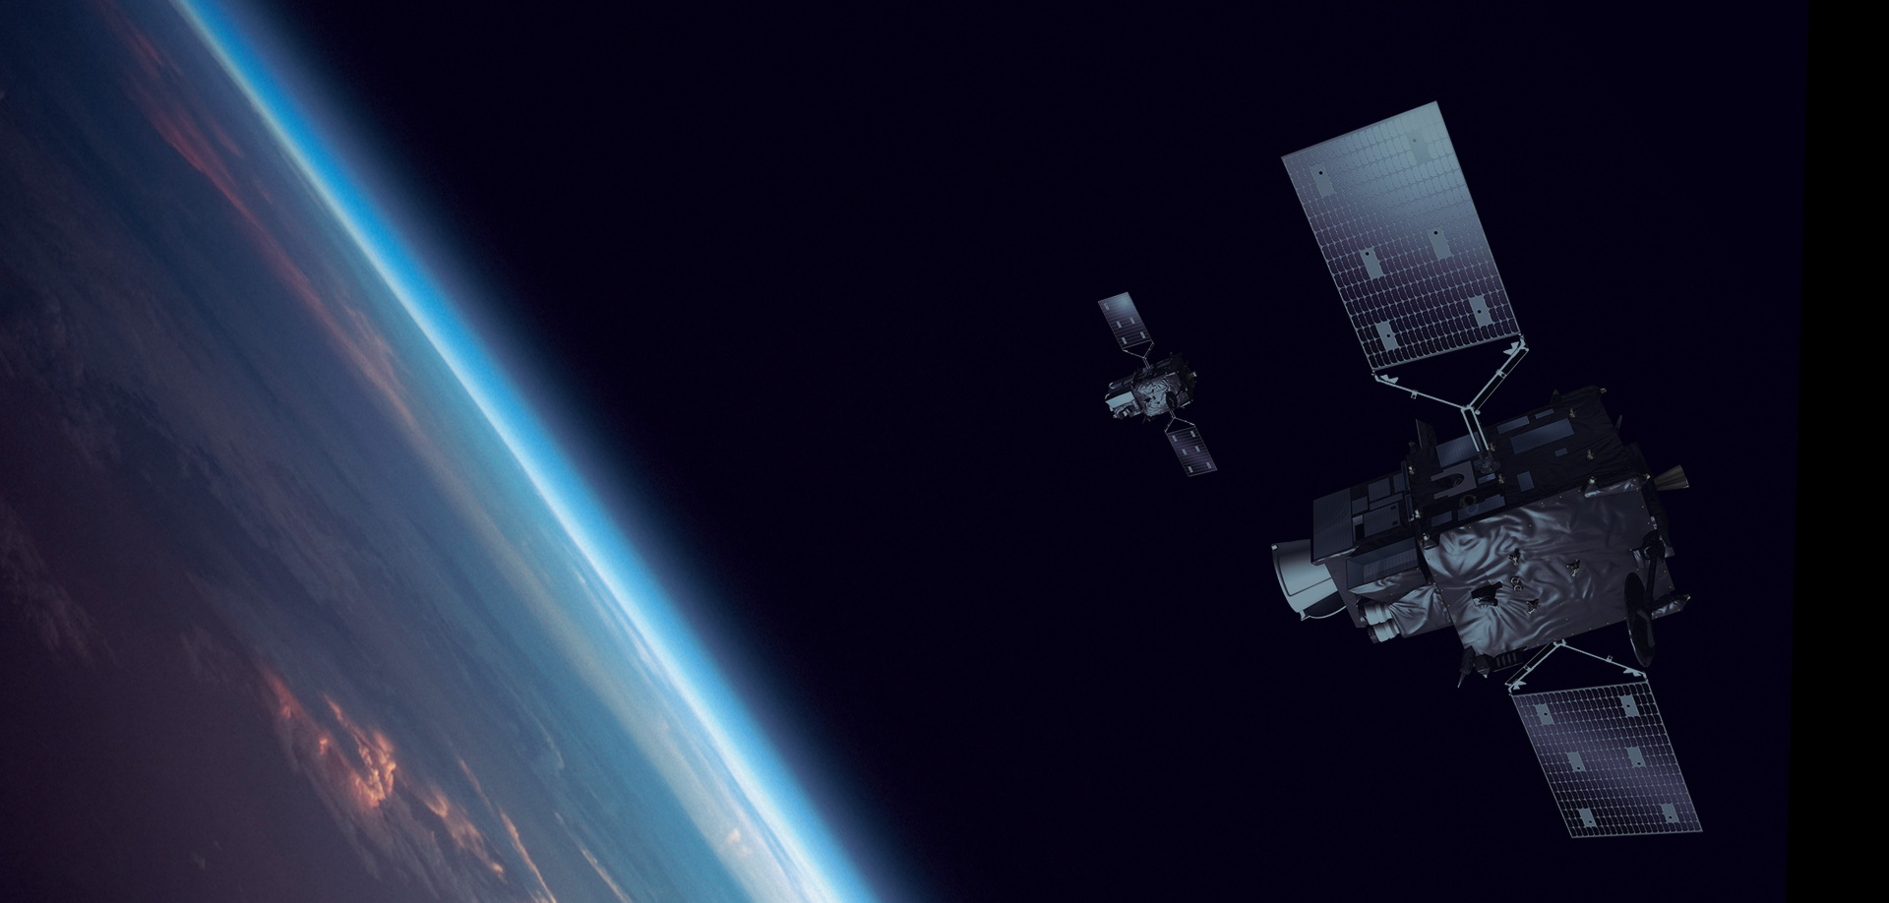
Meteosat Third Generation
Complete constellation consists of three satellites: two imaging satellites and one sounding satellite
MTG-I platforms:
Flexible Combined Imager (FCI)
Lightning Imager (LI)
Launch: 14 December 2022
MTG-S platform:
InfraRed Sounder (IRS)
Copernicus Sentinel-4 (UVN/S4)
Launch: 2025

Slide 15
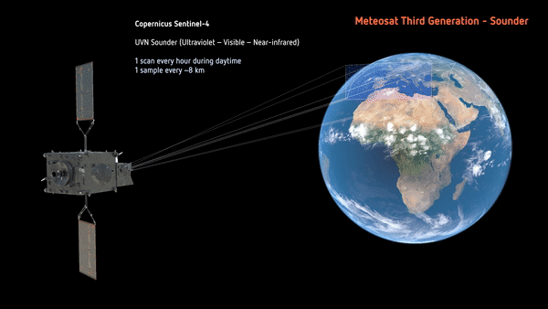
Meteosat Third Generation – Sounder / Copernicus Sentinel-4
Copernicus Sentinel-4 will be the first European Air Quality mission in a geostationary orbit
UVN spectrometer measuring in the ultraviolet (UV: 305–400nm), the visible (VIS: 400–500nm) and the near infrared (NIR: 750–775nm), spatial sampling distance of around 8km.
Observation area from 30 to 65º N in latitude and 30º W to 45º E in longitude. Observation repeat cycle period approximately one hour.
The Sentinel-4 instruments are CFI provided by ESA in the framework of the Copernicus Space Component.

Slide 16
Copernicus Sentinel-4 key characteristics
N/S Field Of View: 3.85°
E/W Field Of Regard: 11.2°
Scanning in E/W direction with hourly frequency
Imaging Spectrometer:
  Telescope + UV-VIS & NIR spectrographs
  Full refractive optics except the scan mirror (23 elements / 19 lenses)
2 silicon CCD detectors cooled to ≈ 215 K
  UV-VIS band: 305 – 500 nm
  NIR band: 750 – 775 nm
On board calibration sources: solar diffusers, White light source, LEDs

Slide 17
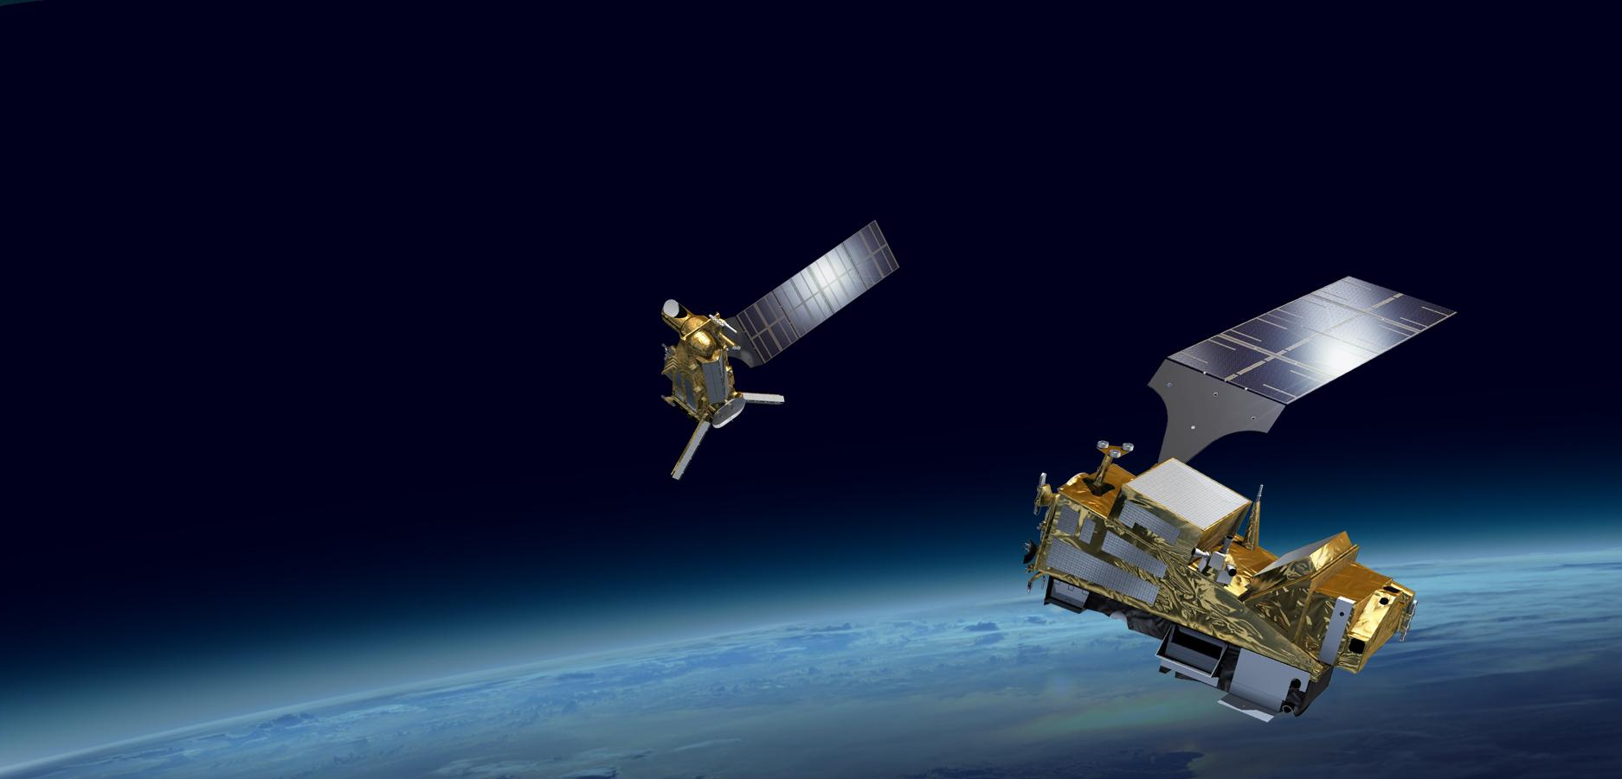
EPS-SG
Complete constellation consists of two satellites: Sounding and Optical Imaging (A) and Microwave imaging and sounding (B)
EPS-SG A platform:
Visible Imfrared Imager (METimage)
Infrared Atmospheric Sounding Interferometer – NG (IASI-NG)
Microwave Sounder (MWS)
Multi-Viewing Multi-Channel Multi-Polarisation Imaging (3MI)
Radio Occultation (RO)
Copernicus Sentinel-5 (UVNS/S5)
Launch: 2025
EPS-SG B platform:
SCA, MWI, ICI, RO, ADCS-4
Launch: 2026

Slide 18
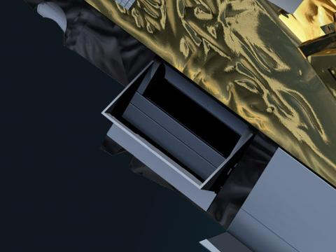

EPS-SG A / Copernicus Sentinel-5
Copernicus Sentinel-5 will provide operational monitoring of trace gas concentrations for atmospheric chemistry and climate applications from a polar orbit, extending the GOME-2 and Copernicus Sentinel-5P missions into the future.
TBW
UVNS spectrometer measuring in
the ultraviolet (UV: 270–370nm),
the visible (VIS: 370–500nm),
the near infrared (NIR: 750–775nm) and
the shortwave infrared (SWIR: 1590-1675nm, 2305-2385nm),
spatial sampling distance of around 7km at nadir.

Slide 19
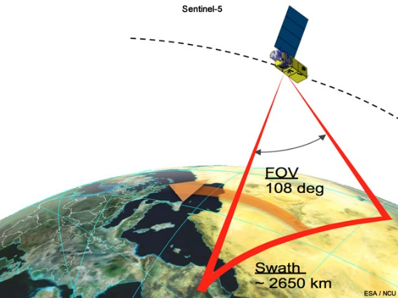
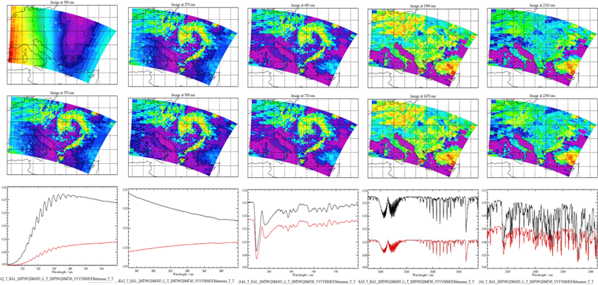
Copernicus Sentinel-5 key characteristics
Type: passive grating imaging spectrometer
Configuration: Push broom staring (non-scanning) in nadir viewing
Swath width: 2 670 km
Spatial sampling: < 50 x < 50 km²(UV1a), 7.5x7.5 km² (all other channels),
Spectral: 5 spectrometers (1 in UV1, 1 in UV2VIS, 1 in NIR, 2 in SWIR)
Radiometric accuracy (absolute): 3%, 6%(SWIR) of the measured earth spectral reflectance.
Design lifetime: 7.5 years
Power Demand: 300 W
Generated data volume: 139 Gbits per full orbit.
On board calibration sources: solar diffusers, White light source, LEDs, SLS

Slide 20
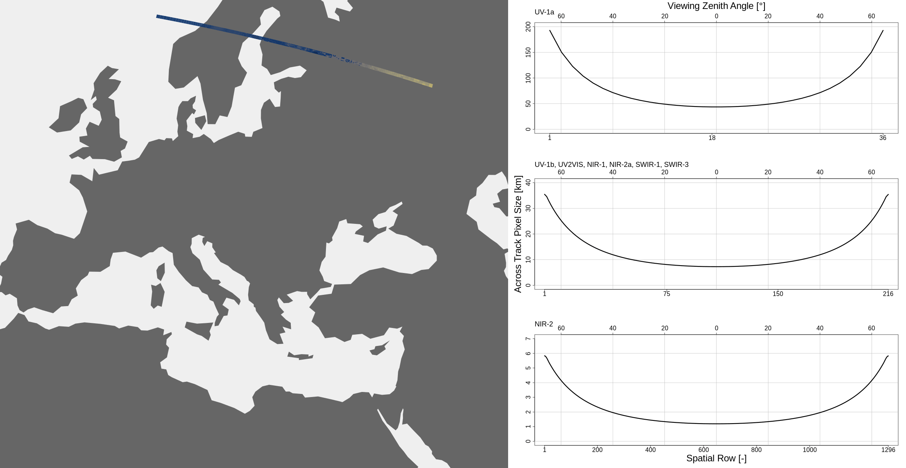
Copernicus Sentinel-5: spatial sampling

Slide 21
Copernicus CO2M: CO2I/NO2I
See presentation of Bernd Sierk

Slide 22
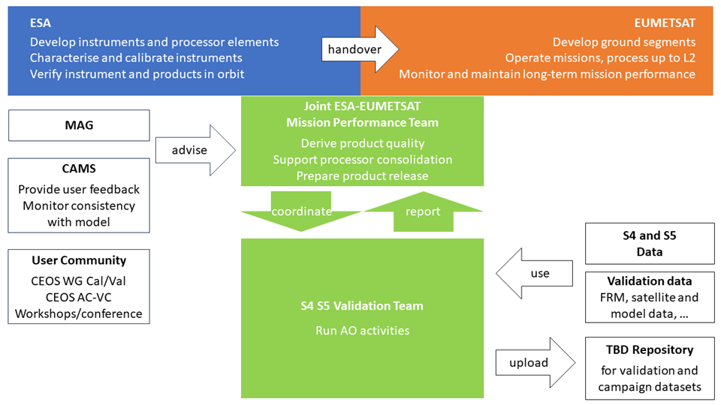
S4/S5 responsibilities during commissioning

Slide 23
Announcement of Opportunity for Cal/Val support
Sentinel-4 and Sentinel-5 Cal/Val Objectives
Assess and establish initial post-launch data quality of mission products
Support consolidation of processors by identifying and fixing bugs in algorithms and processor implementations, by providing a basis for the fine-tuning of algorithm settings, and by identifying and handling potential unexpected post-launch instrument features
Verify that mission products meet performance requirements and can be released to the users
Monitor data quality on long-term operational basis. Support maintenance and evolution of processors throughout mission lifetime
EUMETSAT and ESA/ESTEC are preparing an Announcement of Opportunity (AO) call for the support of Sentinel 4 and 5 Cal/Val, to be published in the first half of 2024.
to trigger & coordinate nationally funded Cal/Val activities
Aiming at Objectives A, B, C
Complementing planned commissioning phase activities verifying PFM instruments, L1b and L2
Complementing long-term Cal/Val activities by EUMETSAT aiming at Objective D

Slide 24
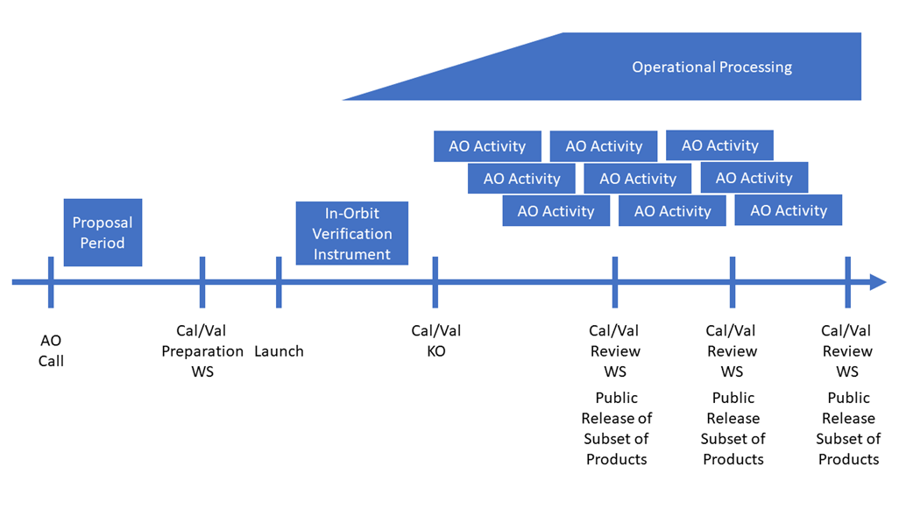
Announcement of Opportunity timeline
Current status:
Documentation (Call text, Cal/Val requirements) under finalization for release in spring 2024.
Cal/Val workshop to take place in Q1 2025

Slide 25
ACh Cal/Val tools
Development ongoing for
  Instrument and product quality monitoring facilities (UVN-STAR, UVNS-STAR, CO2I-STAR), utilizing a number of libraries developed in-house
    Spectral calibration (SPECFUN = Spectral Calibration Framework Utilizing Numerics)
    Other supporting tools (anaLiza, Monalisa, …)
  satpy readers
  Offline calibration processing / in-orbit CKD generation
  UVN/UVNS integration into multi-mission MICMICS framework for radiometric vicarious and inter-calibration activities
  UVN/UVNS integration into multi-mission PIQMICS framework for geolocation verification and monitoring activities

Slide 26
ACh GSICS–UVNS priorities
Solar reference
Performance parameter: Absolute radiometric accuracy of the solar port
Performance target: Signal accuracy and stability / throughput (diffuser) and detector degradation
Resource: Solar reference spectra (high spectral resolution <0.01 nm from 250 to 2500 nm)
Needs: GSICS validation and recommendation
Research target: UV to SWIR
Target
GSICS UVNS contribution: methods, procedures, resources

Slide 27
ACh GSICS–UVNS priorities
Lunar reference
Performance parameter: Absolute radiometric accuracy of the earthshine port
Performance target: Signal accuracy and stability / throughput (diffuser) and detector degradation
Resource: Lunar (polarised) surface reflectance model (high spectral resolution <0.1 nm from 250 to 2500 nm)
Needs: GSICS lunar geometric (phase) and radiometric model (ROLO) / validation and recommendation
Research target: UV to SWIR / polarisation of lunar signal / lunar disk phase model / lunar high spatial resolution surface albedo
Target
GSICS UVNS contribution: methods, procedures, resources

Slide 28
ACh GSICS–UVNS priorities
SNOs
Performance parameter: Absolute radiometric accuracy of the earthshine port
Performance target: Signal absolute and relative accuracy and stability / mission inter-calibration / ISRF monitoring (imager vs spectrometer)
Resource: Simultaneous Nadir Overpass (SNO) database (multi-mission) LEO-LEO / LEO-GEO / GEO-GEO; cross—calibration coefficients
Needs: SNO database maintenance (long-term)
Research target: Expansion of database to provision of derived co-located spectra / images
Target
GSICS UVNS contribution: methods, procedures, resources

Slide 29
Thank you!
Questions are welcome.

