Slide 1

Validation of TSIS-1 HSRS in the range 300 nm to 1700 nm using ground-based SI-traceable spectral solar irradiance measurements
Julian Gröbner¹, Gregor Hülsen¹, Saulius Nevas², and Peter Sperfeld².
¹Physikalisch-Meteorologisches Observatorium Davos und World Radiation Center (PMOD/WRC), Davos Dorf, Switzerland
²Physikalisch-technische Bundesanstalt (PTB), Braunschweig, Germany.
This work has been supported by the European Metrology Program for Innovation and Research (EMPIR) within the joint research project EMPIR 19ENV04 MAPP “Metrology for aerosol optical properties”. The EMPIR is jointly funded by the EMPIR participating countries within EURAMET and the European Union.

Slide 2
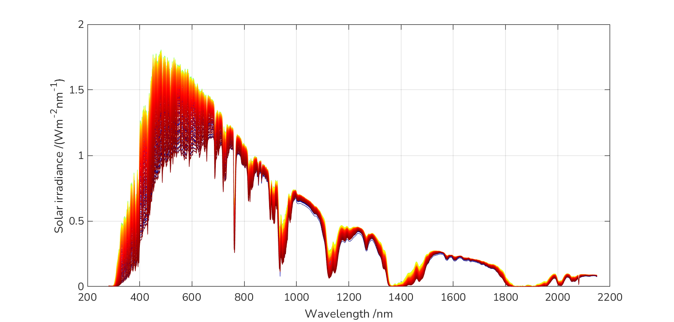



How to get the Top of Atmosphere solar spectrum from ground-based direct solar irradiance measurements?
The langley-plot
Spectral solar irradiance, 13 September 2022
The Beer-Lambert law
$$I(λ)=I_{0}(λ)e^{−τ_{λ}m}$$
$$\log{I(λ)}=\log{I_{0}(λ)}−τ_{λ}m$$
logI₀
The optical depth τ is assumed constant during this period (half-day)
$$y=a−bx$$
The retrieved I₀(λ) represent the solar spectrum at the top of the atmosphere and can be compared to space-based measurements from satellites (in certain spectral bands).
The QASUMEFTS solar spectrum (300 nm to 500 nm):
Gröbner et al., AMT, 2017.

Slide 3
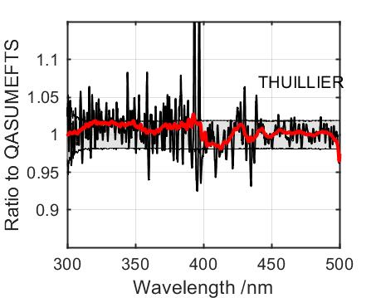
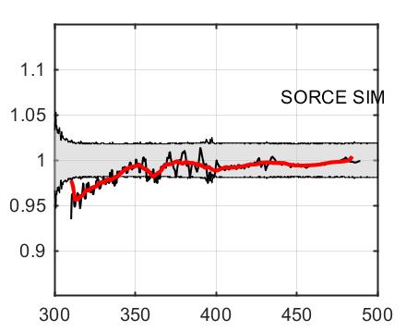
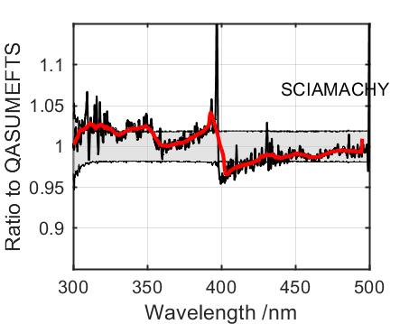
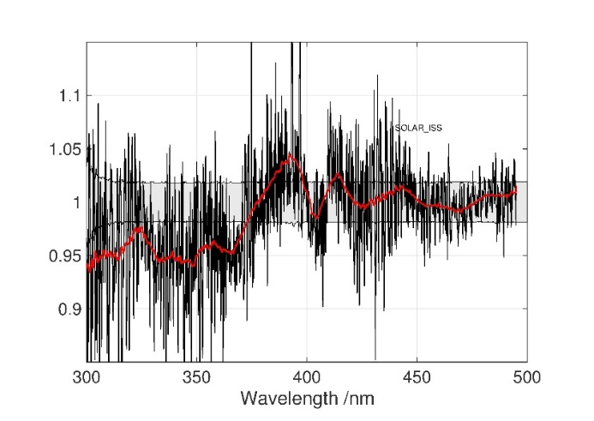
The QASUMEFTS solar spectrum
Derived from ground-based spectral solar measurements at Izana in September 2016.
Using a high resolution FTS and a double-monochromator spectroradiometer.
Spectral range 300 nm to 500 nm.
Expanded relative uncertainties of 2%.
Published Gröbner et al., AMT, 2017.
Comparison to ToA solar spectra:
SOLAR_ISS
Thuillier et al., 2003
Harder et al., 2010
Hilbig et al., 2017
Meftah et al., 2016

Slide 4
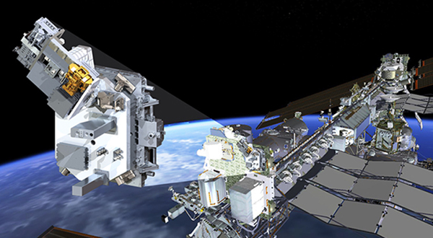
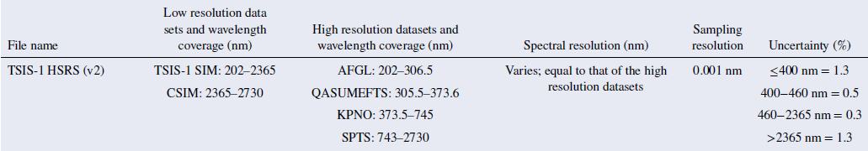
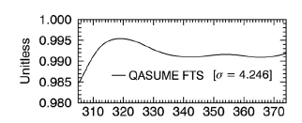
TSIS-1 Hybrid Solar Reference Spectrum (HSRS)
TSIS-1 on the ISS
QASUMEFTS was used to produce TSIS-1 HSRS:
Coddington et al., 2021 (V1.0), 2023 (V2.0)

Slide 5
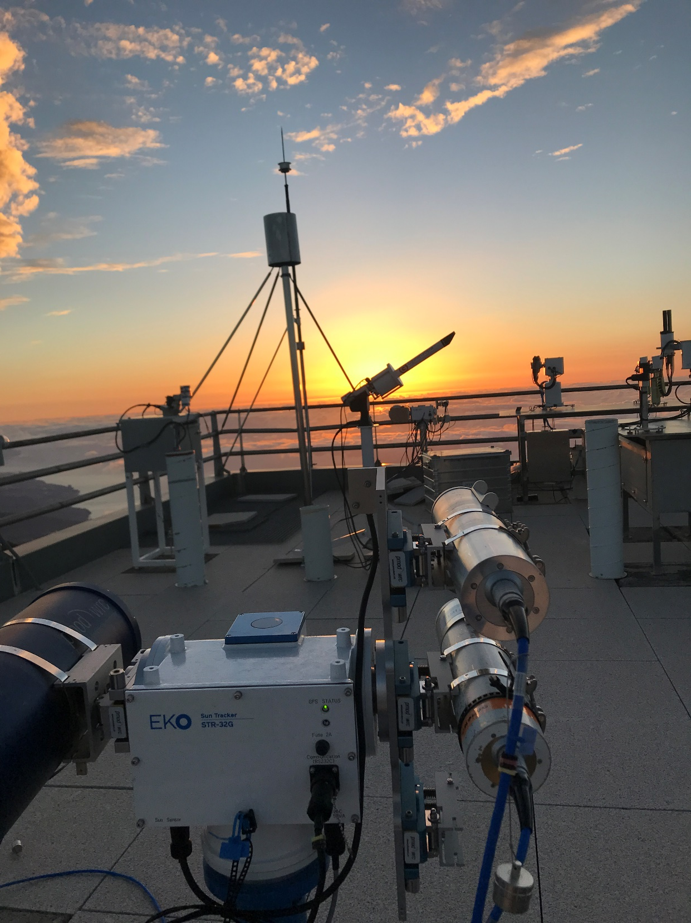
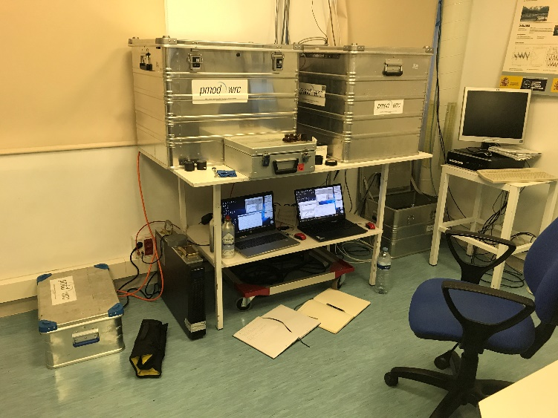
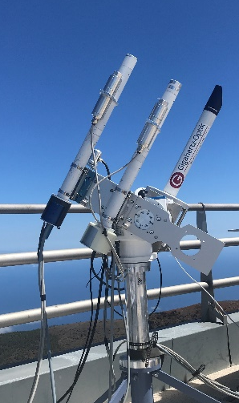
Spectral solar irradiance measurements at the pristine high altitude station Izaña, Tenerife, Canary Islands, Spain
Campaign objectives:
Retrieve Top-of-Atmosphere solar spectra from SI-traceable solar irradiance measurements in the range
300 nm to 1700 nm.
Validate the space-based solar spectrum TSIS-1 HSRS.
QASUME (direct)
7-22 September 2022
~14 clear sky half days

Slide 6
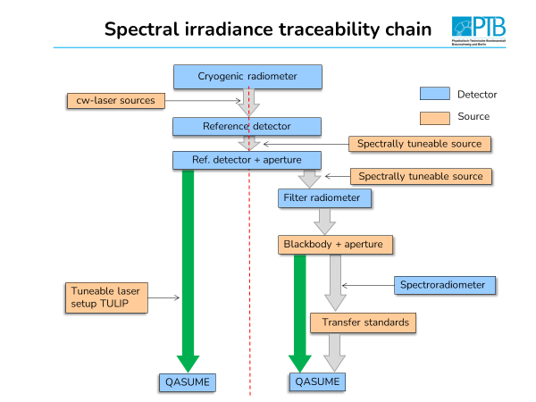
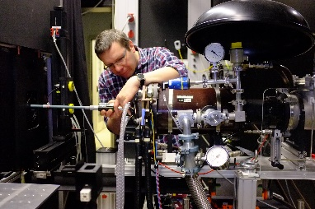
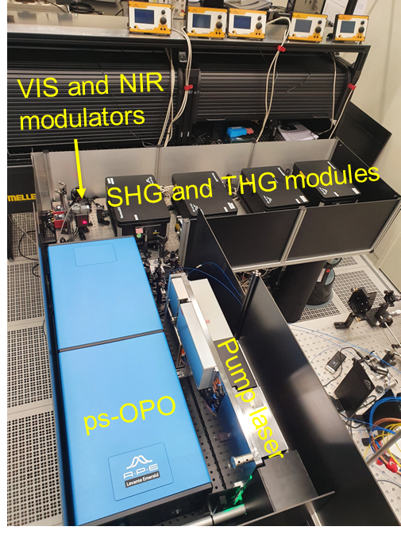
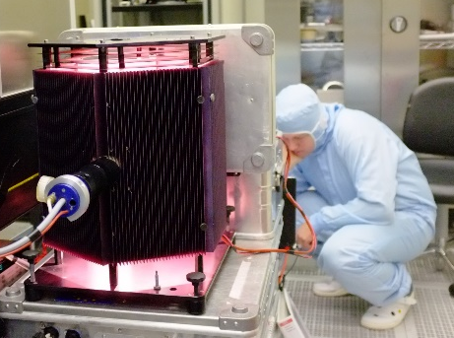
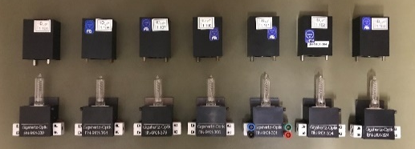

Spectral irradiance measurements are traceable to the primary spectral irradiance standard of PTB
High temperature blackbody
BB3200pg
Tuneable Laser facility
TULIP
QASUME
Portable calibrator with low power lamps
QASUME transfer standards

Slide 7
Spectral irradiance measurements are traceable to the primary spectral irradiance standard of PTB
High temperature blackbody
BB3200pg
QASUME transfer uncertainty U₉₅=1.3%
TULIP
Tuneable Laser facility
TULIP
BB3200pg

Slide 8
Spectral irradiance measurements are traceable to the primary spectral irradiance standard of PTB
Spectral irradiance comparison between TULIP and BB3200pg
Shown are expanded relative measurement uncertainties (k=2).
Gray shaded area: QASUME (< 550 nm)/ QASUME-IR at BB3200pg.
Error bars : QASUME (< 550 nm)/ QASUME-IR at TULIP.
The ambient water vapour variability increased the measurement uncertainty of QASUME-IR between 1360 nm and 1650 nm (estimated).

Slide 9
Top of the Atmosphere solar spectra from QASUME & QASUME-IR using Langley-plots
QASUME (direct)
14 half days
Water vapour absorption
QASUME
QASUME-IR
±1%

Slide 10
Top of Atmosphere solar spectra using Langley plots
Water vapour absorption
Relative standard error of the retrieved ToA solar spectrum ~0.1%

Slide 11
Validation of TSIS-1 HSRS with ground based solar irradiance measurements
U⁹⁵_{QASUME}=1.6%
Agreement with TSIS-HSRS: 1% outside of strong atmospheric absorption bands

Slide 12
Uncertainties of Top of Atmosphere solar spectra QASUME & TSIS-1 HSRS
At wavelengths shorter than 400 nm, the relative uncertainty of QASUME is 0.8% and therefore lower than the one of TSIS-1 HSRS.

Slide 13
Conclusions
The Top of Atmosphere solar spectrum TSIS-1 HSRS was validated with ground based measurements within 0.8% standard relative uncertainties.
In the range 310 nm to 400 nm the uncertainty of the TSIS-1 HSRS solar spectrum could be reduced from 1.3% to 0.8%, based on the QASUME measurements.
Published Gröbner et al., AMT, 2023.

