Slide 1
TEMPO Calibration
Heesung Chong Smithsonian Astrophysical Observatory
Xiong Liu, John Houck, David E. Flittner, James Carr, Weizhen Hou, John E. Davis, Raid M. Suleiman, Kelly Chance, Nischal Mishra, Christopher Chan Miller, Gonzalo González Abad, Brian Baker, James Lasnik, Dennis Nicks, Juseon Bak, Caroline R. Nowlan, Huiqun Wang, Junsung Park, Ewan O’Sullivan, Jean Fitzmaurice, and Laurel Carpenter
March 14, 2024

Slide 2
TEMPO Level 1 Data Products
Version 1 release - Date: February 5, 2024 - Collection name (Validation status): UNVALIDATED - Mini release of data from December 17–23, 2023, and eight days of commissioning observations from August 2023
Version 2 release - Date: February 26, 2024 - Collection name (Validation status): BETA - Continuous data production onward from the release date + Reprocessing ongoing - User Guide available online, Version 1.0 ATBD available upon request (https://www.earthdata.nasa.gov/learn/articles/new-beta-level-1-tempo-products)

Slide 3
TEMPO Level 1 Data Products
Product | Level | Description | Nominal sampling frequency | Validation status
DRK | 1a | Dark exposure | Variable (sampled before the beginning of the other types of exposure) | Beta
RAD | 1b | Geolocated Earth radiances | Once per hour or more frequent (during daylight hours) | Beta
RADT | 1b | Geolocated Earth radiances (twilight) | Variable | Not released yet
IRR | 1b | Solar irradiance (working diffuser) | Once per week | Beta
IRRR | 1b | Solar irradiance (reference diffuser) | Once per 3 months | Beta

Slide 4
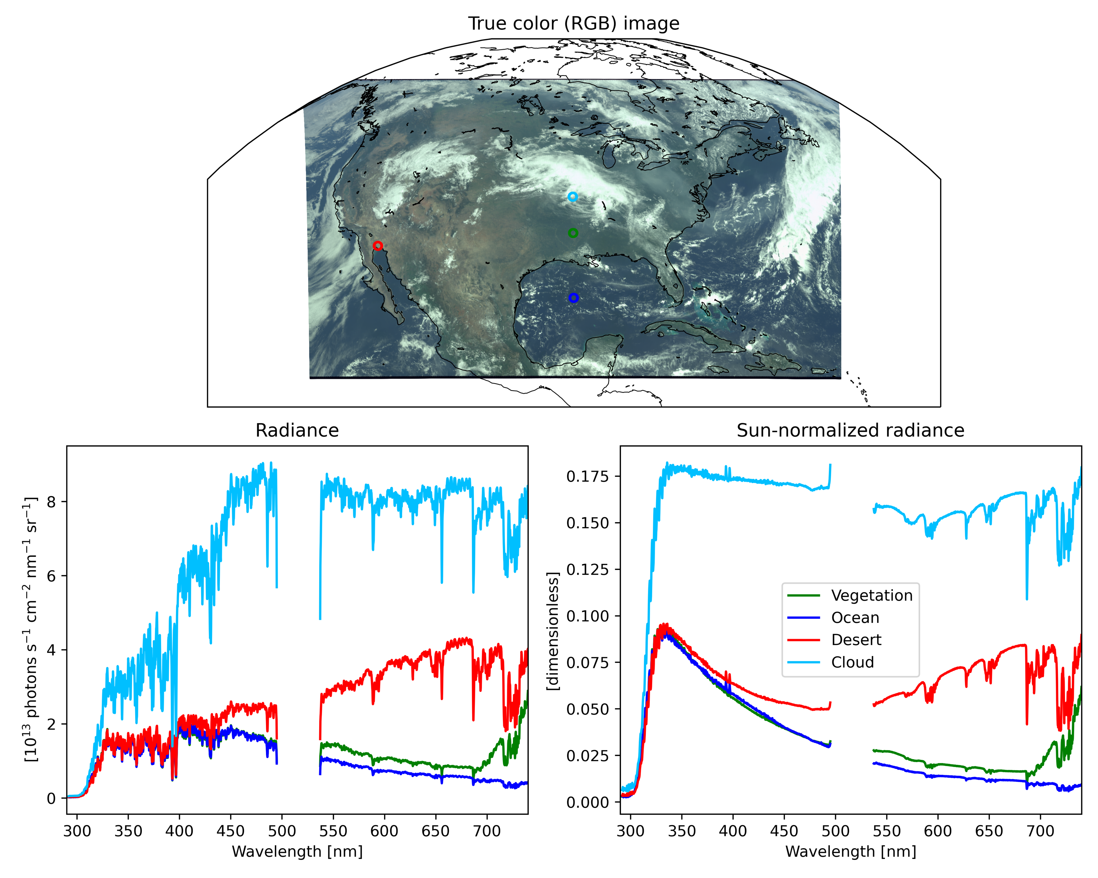
First Earth image from TEMPO
Scan started at 15:12:49 UTC on August 2, 2023

Slide 5
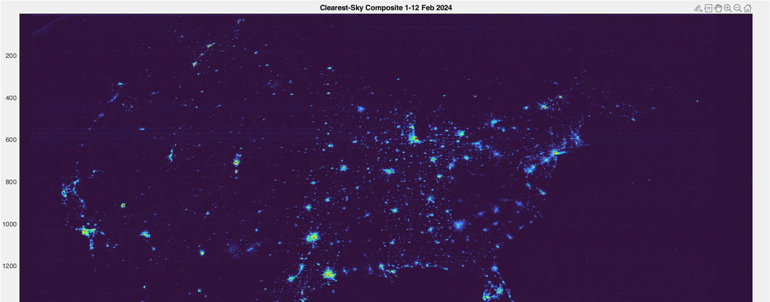
TEMPO city-light image (preliminary)
Clearest-Sky Composite 1–12 February 2024
[Credit: James Carr]
Radiance derivation → Post-processing (de-speckling, de-streaking, etc.) → Composite

Slide 6
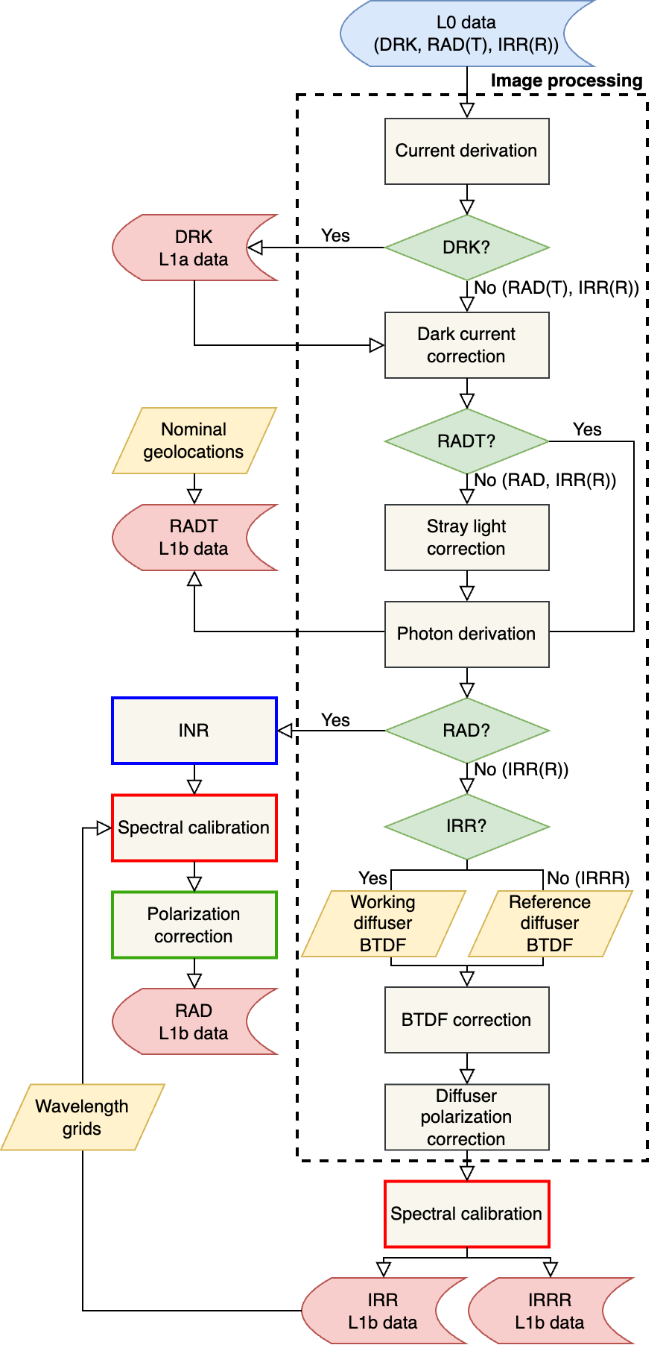
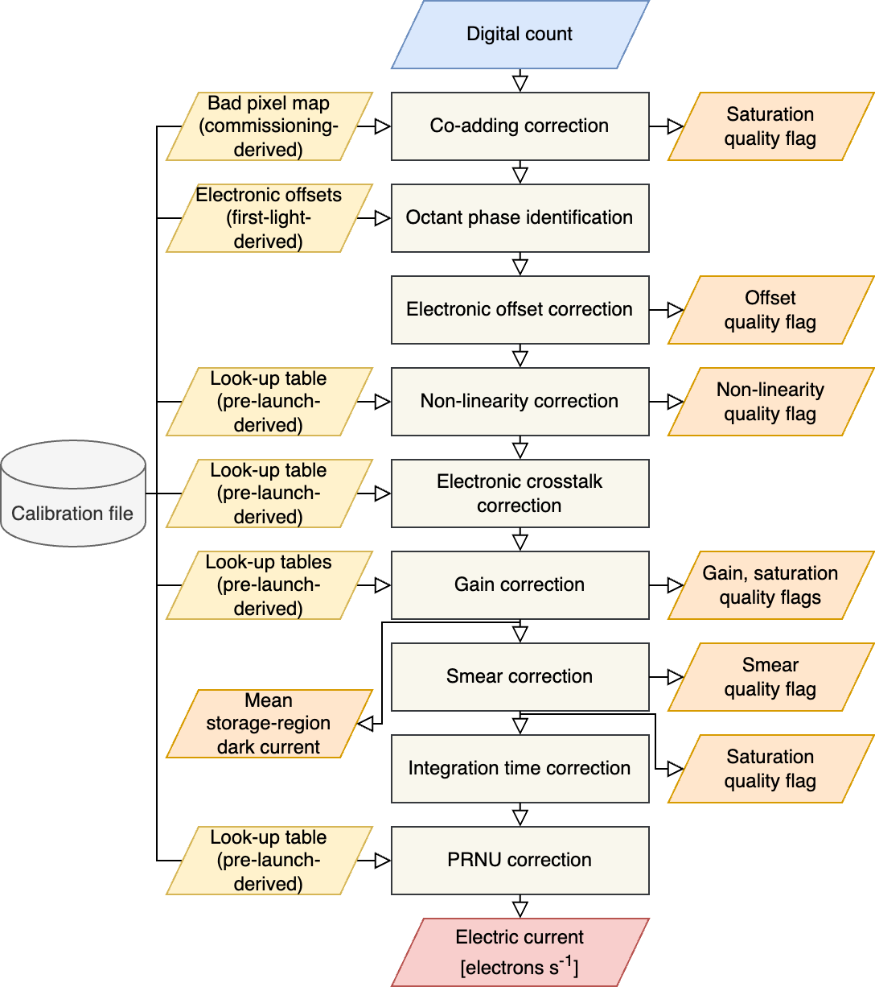
Flow chart
: Turned off in Version 2
: Updated in Version 2

Slide 7
TEMPO Level 1 Data Products
Updates (V01 → V02) - Electronic offset correction (constant offset → row-by-row offset) - Smear correction (smear from overclocked pixels → smear from photoactive pixels) - Diffuser *BTDF correction (elevation angle correction → elevation and scattering angle corrections) - Earthshine radiance wavelengths (static wavelength grids → the latest solar wavelengths) - Solar irradiance wavelengths (changes in spectral fitting configurations)
*BTDF: bidirectional transmittance distribution function

Slide 8
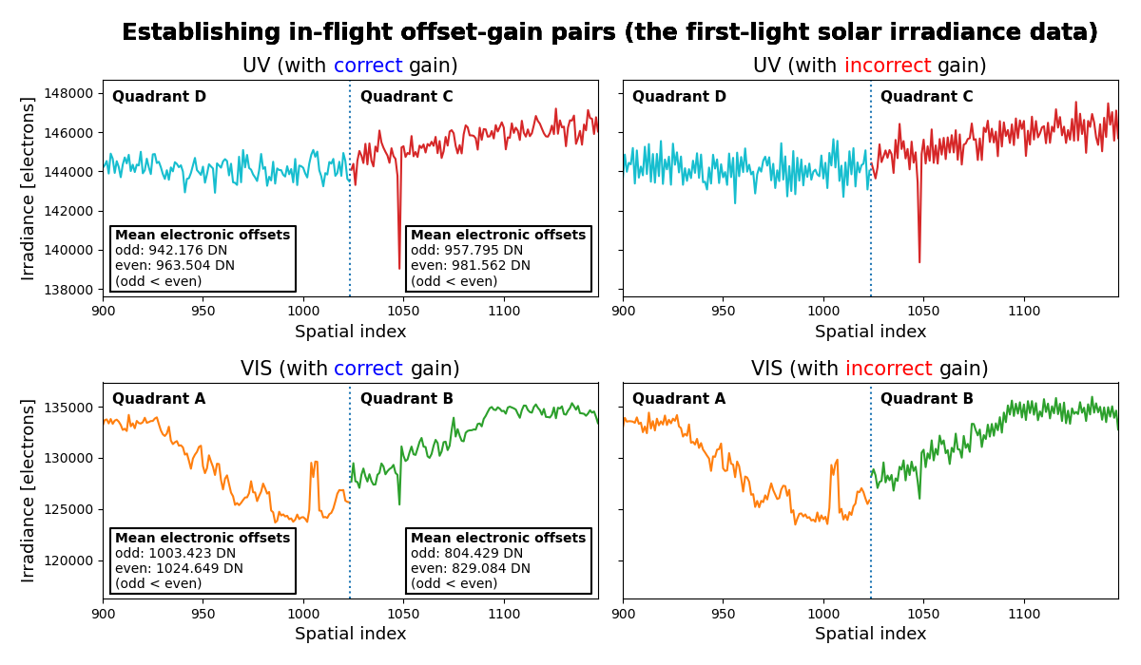
Image processing
Octant phase identification

Slide 9
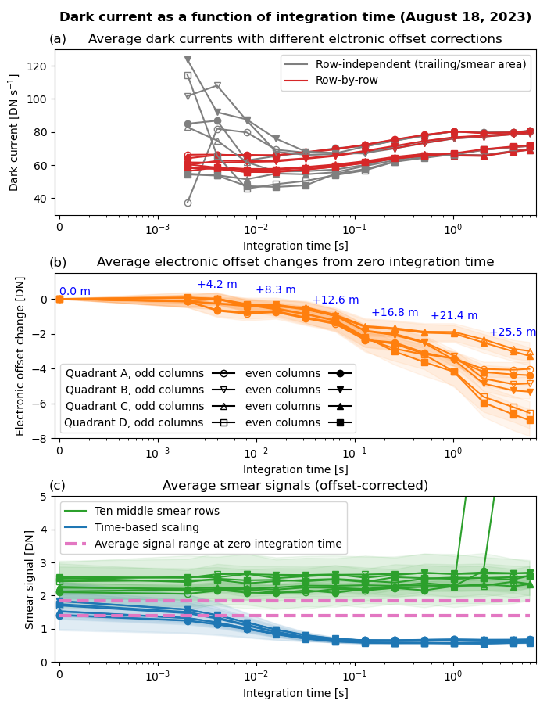
Image processing (takeaways from commissioning)
Electronic offset correction
Row-to-row offset variations → The row-by-row method is preferred.
Visible CCD
UV CCD
Temporal changes in electronic offsets → Frame-by-frame offset correction is desired.

Slide 10
Image processing (takeaways from commissioning)
Smear correction
Time-based scaling: $(smear)=(column\text{−}average photoactive signal)×\frac{(frame transfer time)}{(integration time)}$
Smear from overclocked pixels > Smear from photoactive pixels → Contribution of storage-region dark from read-out → Time-based scaling is preferred.

Slide 11
Image processing (How do we know it’s improved?)
Constant offset + Smear from overclocked pixels
Row-by-row offset + Smear from overclocked pixels
Row-by-row offset + Smear from photoactive pixels
The dependence of dark current on the FPA temperature finally appears.

Slide 12
Image processing
Dark current correction
The CCDs can’t measure (ir)radiance and dark current simultaneously in the image regions.
Dark estimation approaches
Using FPA temperature - the Arrhenius equation - Applied for Earth and Sun exposure
Using storage-region dark summations - Proxy for FPA temperature - Applied for twilight Earth exposure

Slide 13
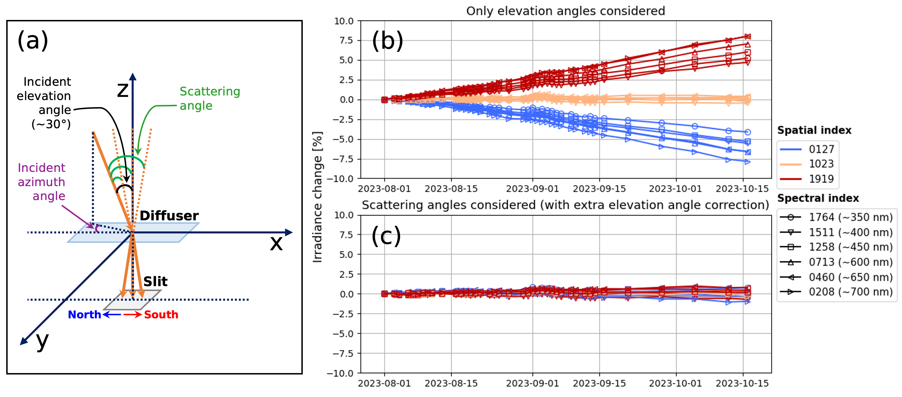
Image processing
BTDF correction
[Credit: David E. Flittner]
Original equation
Updated equation
$T=T_{LUT}∙\left(1+e\right)$
Elevation angle correction
$T=T_{LUT}∙\left(1+e\right)/(1+m)/(1+s)$
Corrected BTDF
BTDF obtained by interpolating look-up-table values
minor (extra) elevation angle correction
scattering angle correction

Slide 14
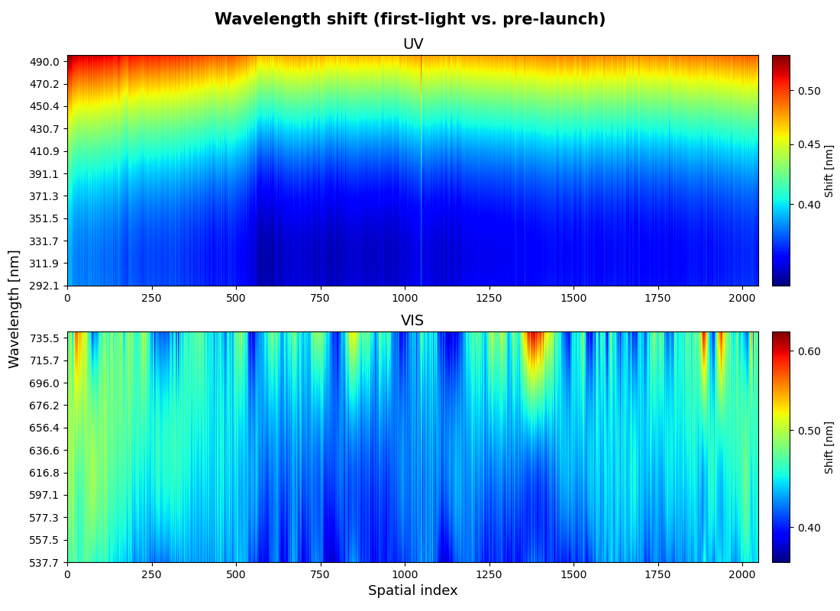
Spectral calibration
First-light vs. Pre-launch: Wavelength shifts equivalent to ~2 spectral pixels

Slide 15
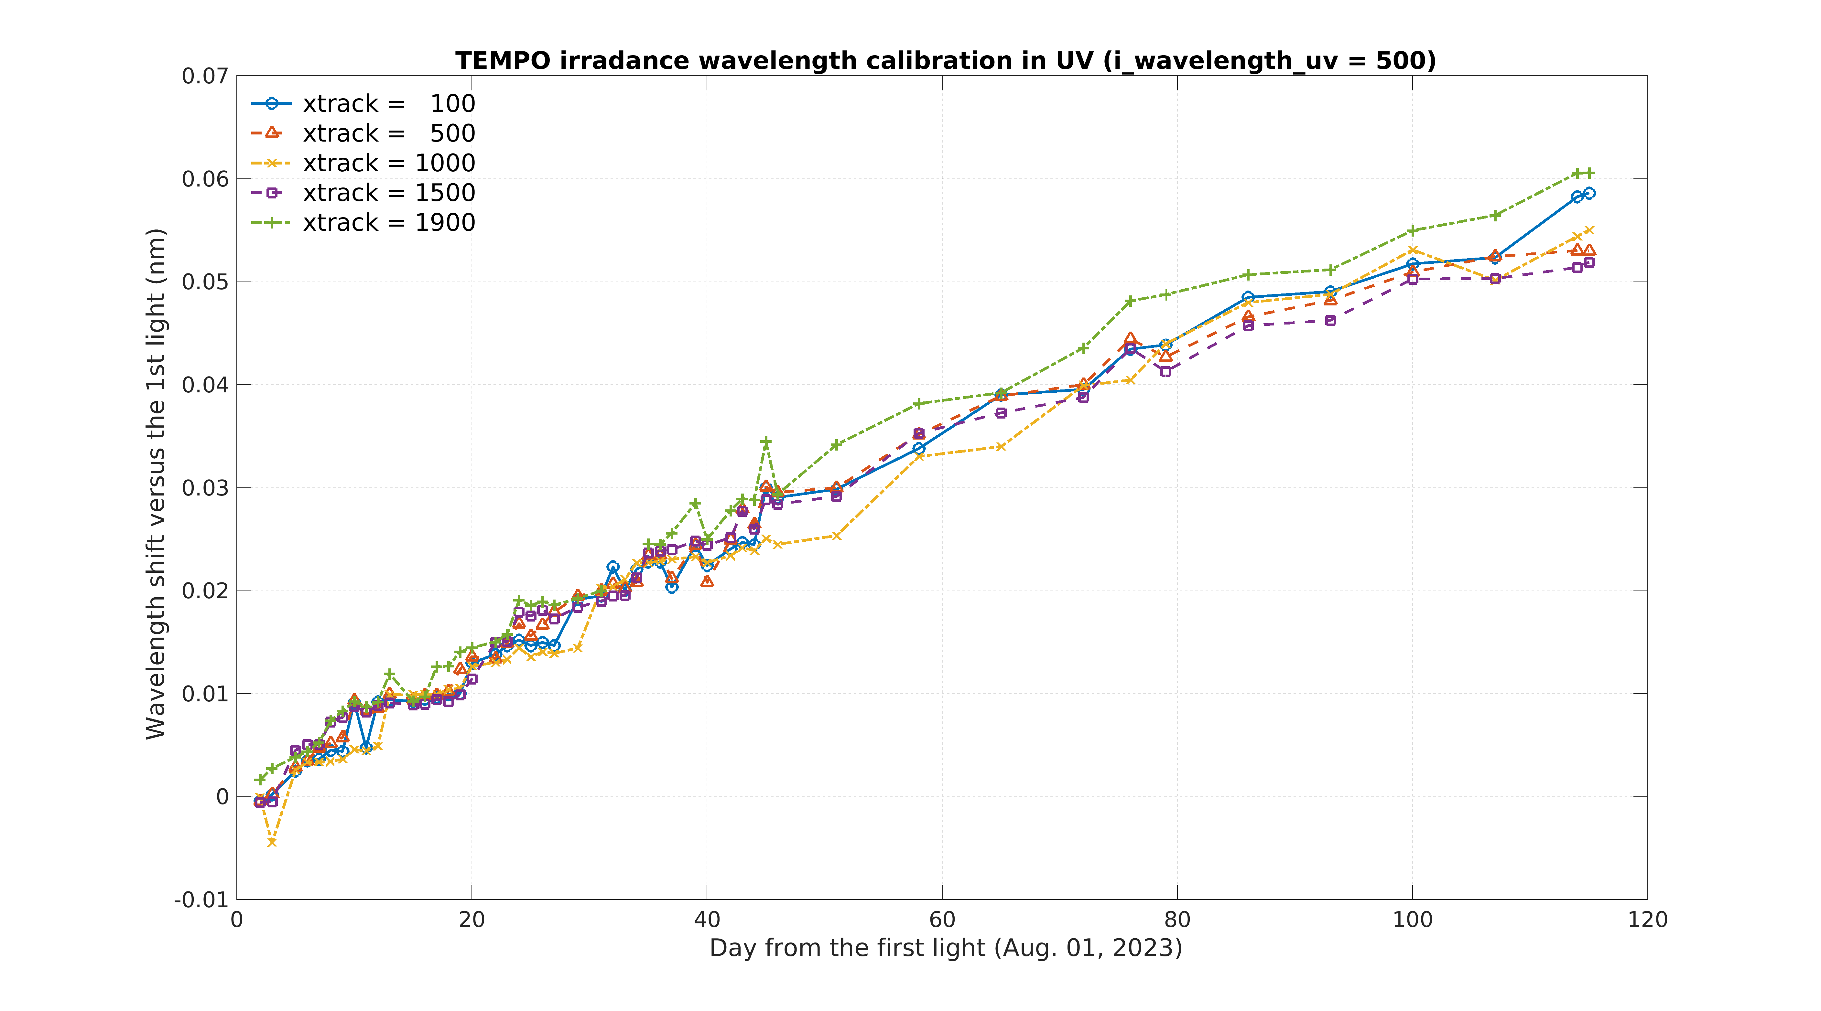
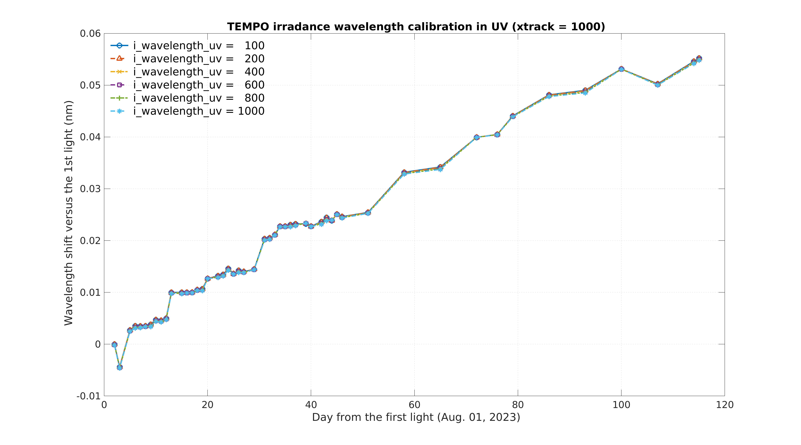
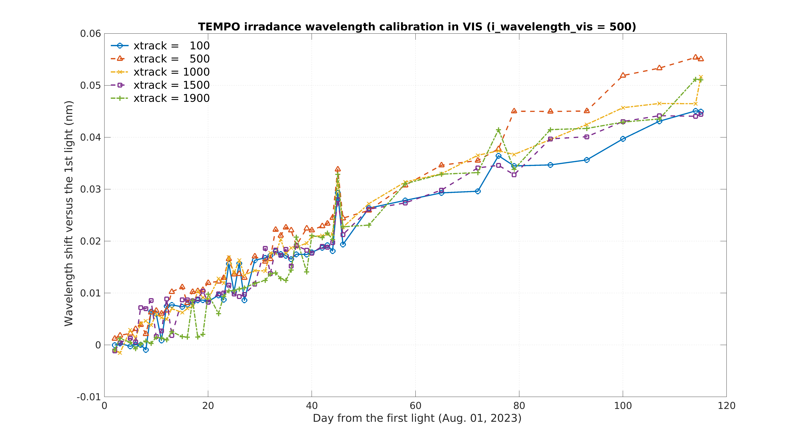
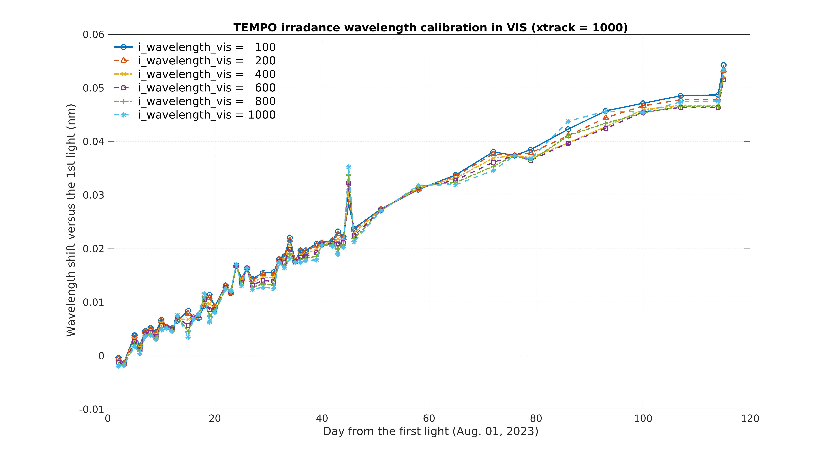
Spectral calibration (trending wavelength shifts)
Different spatial indices
Different spectral indices
UV
UV
Wavelength shift [nm]
Wavelength shift [nm]
VIS
VIS
Wavelength shift [nm]
Wavelength shift [nm]
[Credit: Weizhen Hou]
Days since the first-light (August 1, 2023)
Days since the first-light (August 1, 2023)
Increasing wavelength shifts in solar irradiance measurements since the first-light

Slide 16
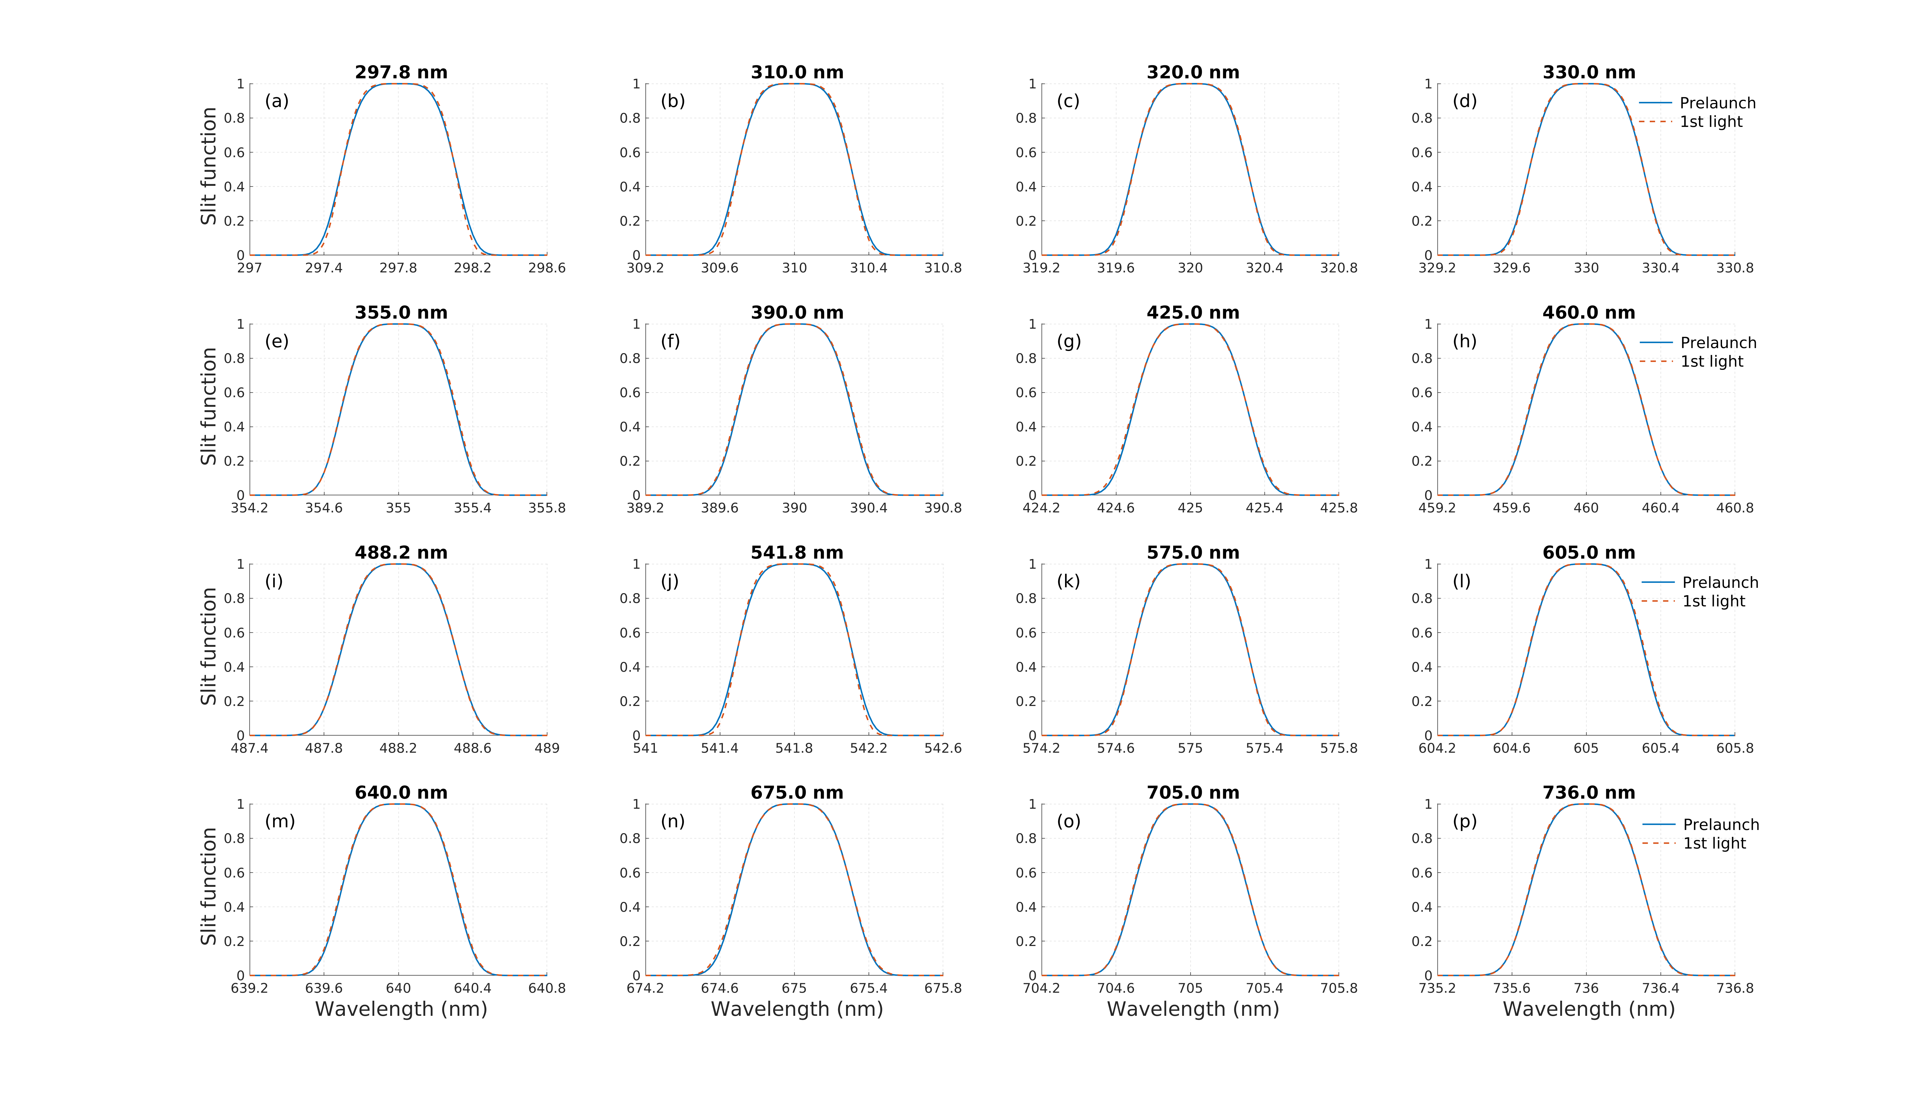
Spectral calibration (trending slit functions)
[Credit: Weizhen Hou]
Spectral calibration on narrow fitting windows enables slit function monitoring.

Slide 17
Update plans
Dark current correction → Update the coefficients for the Arrhenius equation.
Stray light correction → Employ spectral (1-dimensional) point spread functions.
Update the BTDF table for the reference diffuser.
Mitigate the impact of the “burr” on radiometric calibration coefficients.
Include the twilight measurements in the data collection.
Update bad pixel map dynamically using dark current.
Stabilize radiance wavelength calibration.
(Offline) Monitor temporal changes in key calibration data, including slit functions.

Slide 19
Backup slides

Slide 20
Image processing (takeaways from commissioning)
Electronic offset correction
Row-to-row offset variations → The row-by-row method is preferred.
Electronic offset correction
Temporal changes in electronic offsets → Frame-by-frame offset correction is desired.
Smear correction
Time-based scaling: $(smear)=(column\text{−}average photoactive signal)×\frac{(frame transfer time)}{(integration time)}$
Smear from overclocked pixels > Smear from photoactive pixels → Contribution of storage-region dark from read-out → Time-based scaling is preferred.

Slide 21
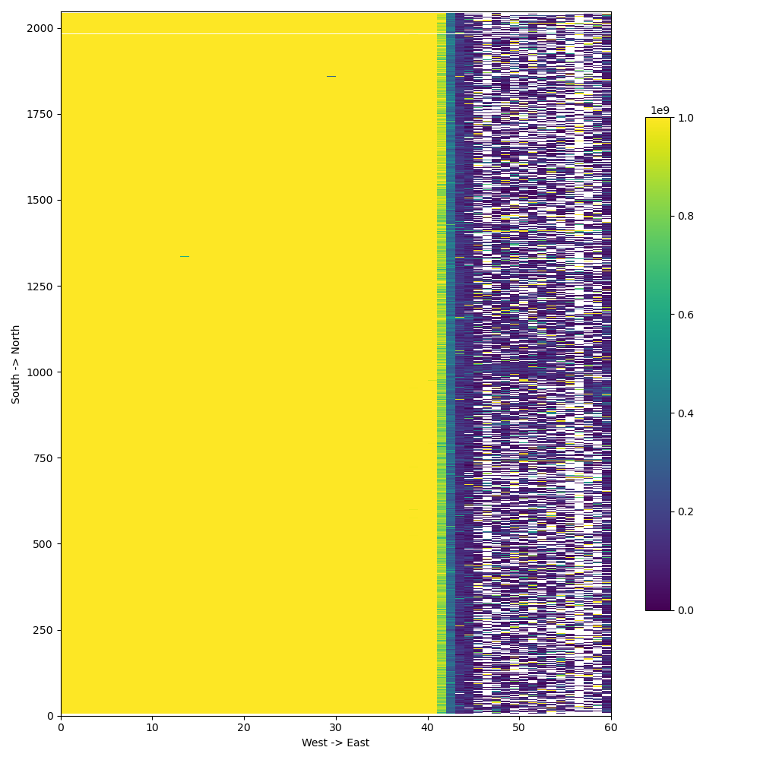
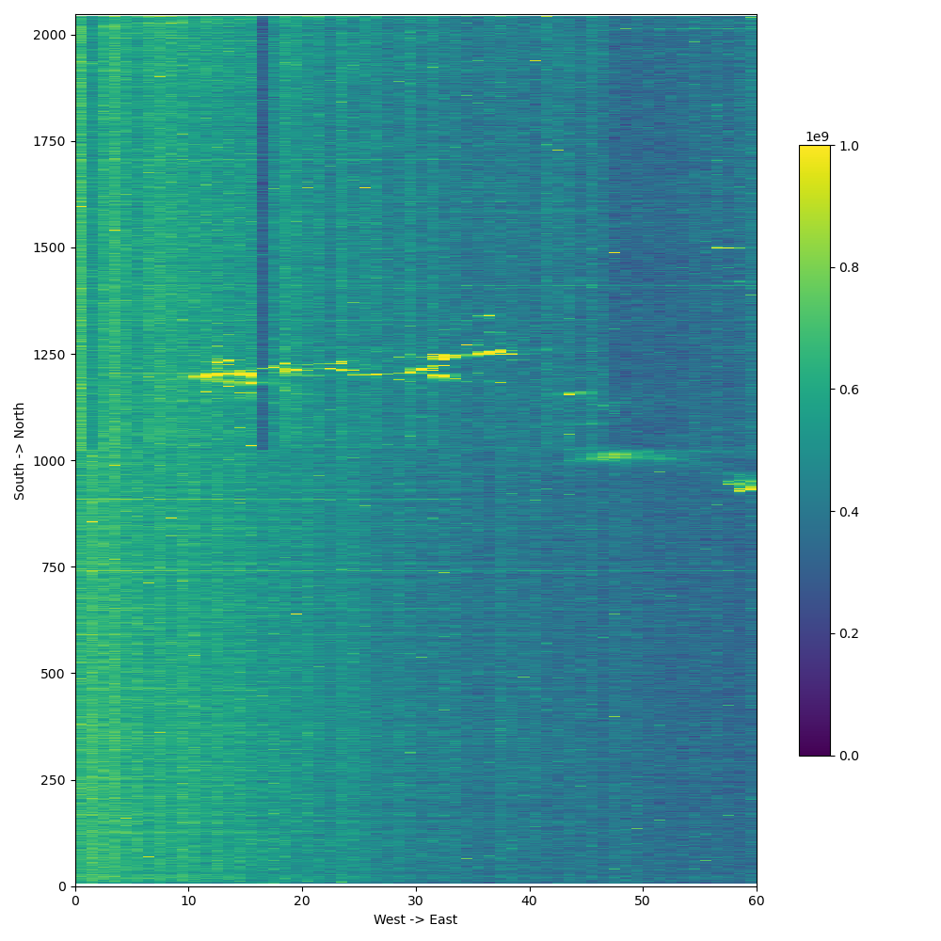
Image processing (How do we know it’s improved?)
Twilight measurements over the West Coast on December 22, 2023 (88-s exposure time)
Constant offset + Smear from overclocked pixels + FPA-temperature-based dark scaling
Row-by-row offset + Smear from photoactive pixels + storage-region-based dark scaling

