Slide 1
Assessment of OMPS Nadir Mapper SDR
Reflectance Using Deep Convective Clouds As Calibration Targets
Dr. Ding Liang^{1*},
Co-Authors: Banghua Yan², Trevor Beck², Lawrence Flynn², Ninghai Sun¹,
Affiliation: 1 Global Science and Technology, College Park, MD, USA
2 NOAA Center for Satellite Applications and Research, College Park, MD, USA

Slide 2
Outline
Background
OMPS-NM* instrument, Deep Convective Cloud (DCC)
Development of the DCC Method for OMPS-NM
OMPS-NM DCC pixels identification
Validation of using DCCs as calibration targets to study OMPS-NM reflectance stability using reprocessed long-term S-NPP OMPS-NM observations
Results and Discussions
NOAA-21 and S-NPP OMPS-NM DCC reflectance time-series
NOAA-21 and S-NPP OMPS-NM reflectance difference: comparison between DCC method and 32-day running mean method
Summary and Path Forward
*OMPS-NM Ozone Mapping and Profiler Suite Nadir Mapper

Slide 3
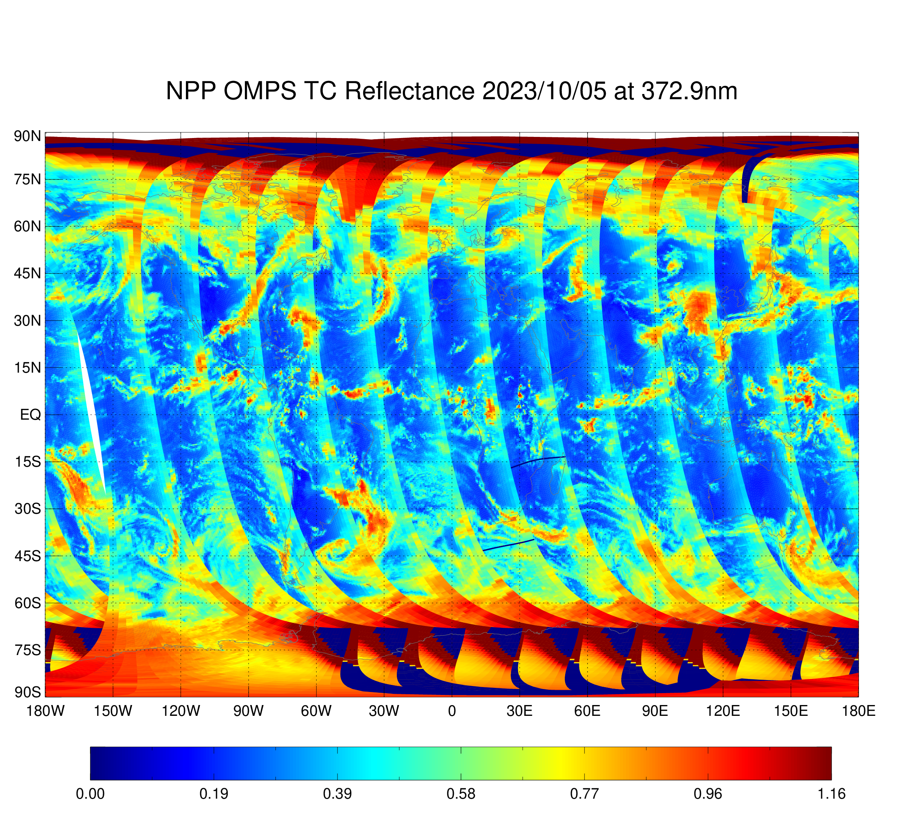
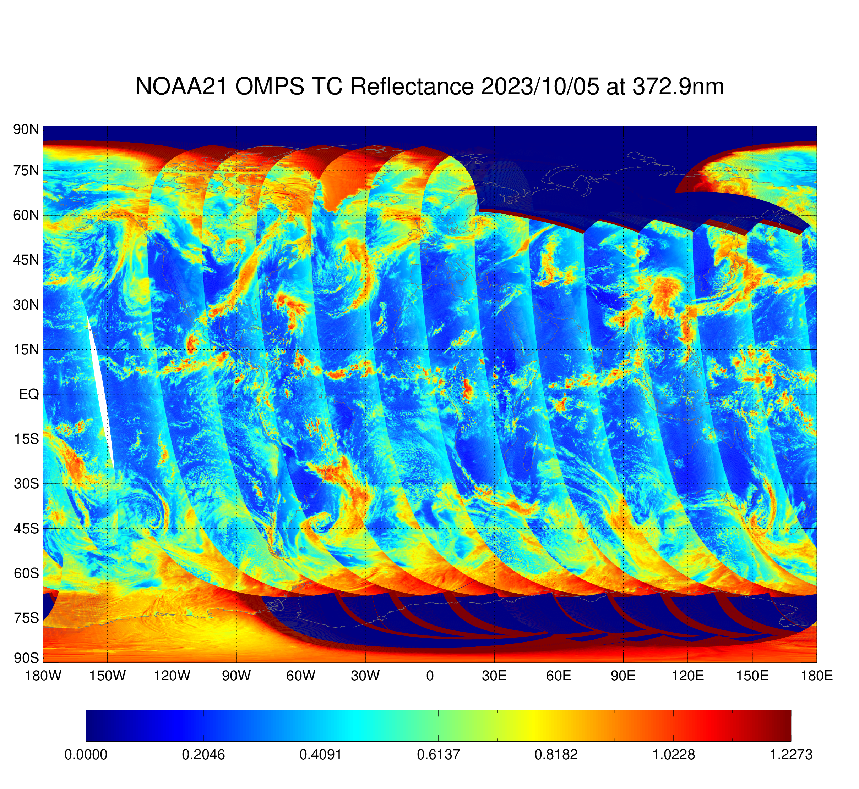
Introduction
Settings of OMPS-NM Science SDR
OMPS provides ozone total column and vertical ozone profile records that continue ozone daily global records;
OMPS-Nadir Mapper(NM) is one of the two nadir sensors for OMPS;
OMPS instruments are flying on the Suomi National Polar-orbiting Partnership (S-NPP) launched on 28 Oct. 2011 and Joint Polar Satellite Systems (JPSS)-1 (alias NOAA-20) launched on18 Nov. 2017, JPSS-2 (alias NOAA-21) launched on 9 Nov. 2022 ;
    DCCs are the brightest tropical Earth targets that located in a thin band near the equator;
    DCCs are ideal visible calibration targets with nearly a Lambertian reflectance;
    DCCs have been used to evaluate calibration stability of several sensors in visible to infrared band.
Parameter | NOAA-21 OMPS NM | S-NPP OMPS NM
Wavelength range | 300-381 nm (198 chs) | 300-380 nm (196 chs)
Spectral Sampling interval | 0.42 nm | 0.42 nm
Cross-track pixels | 177 | 35
Nadir pixel size | 8 km x 10km | 50 km x 50km
Bandwidth | 1.0 nm | 1.0 nm
Figure 1. S-NPP OMPS-NM daily reflectance (left), NOAA-21 OMPS-NM daily reflectance(right) for 05Oct2023.
Pictures are from NOAA Integrated Calibration and Validation System
(ICVS, https://www.star.nesdis.noaa.gov/icvs)

Slide 4
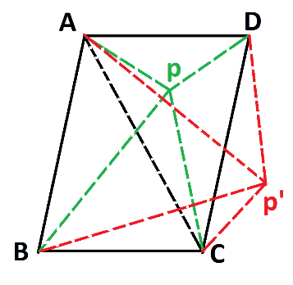
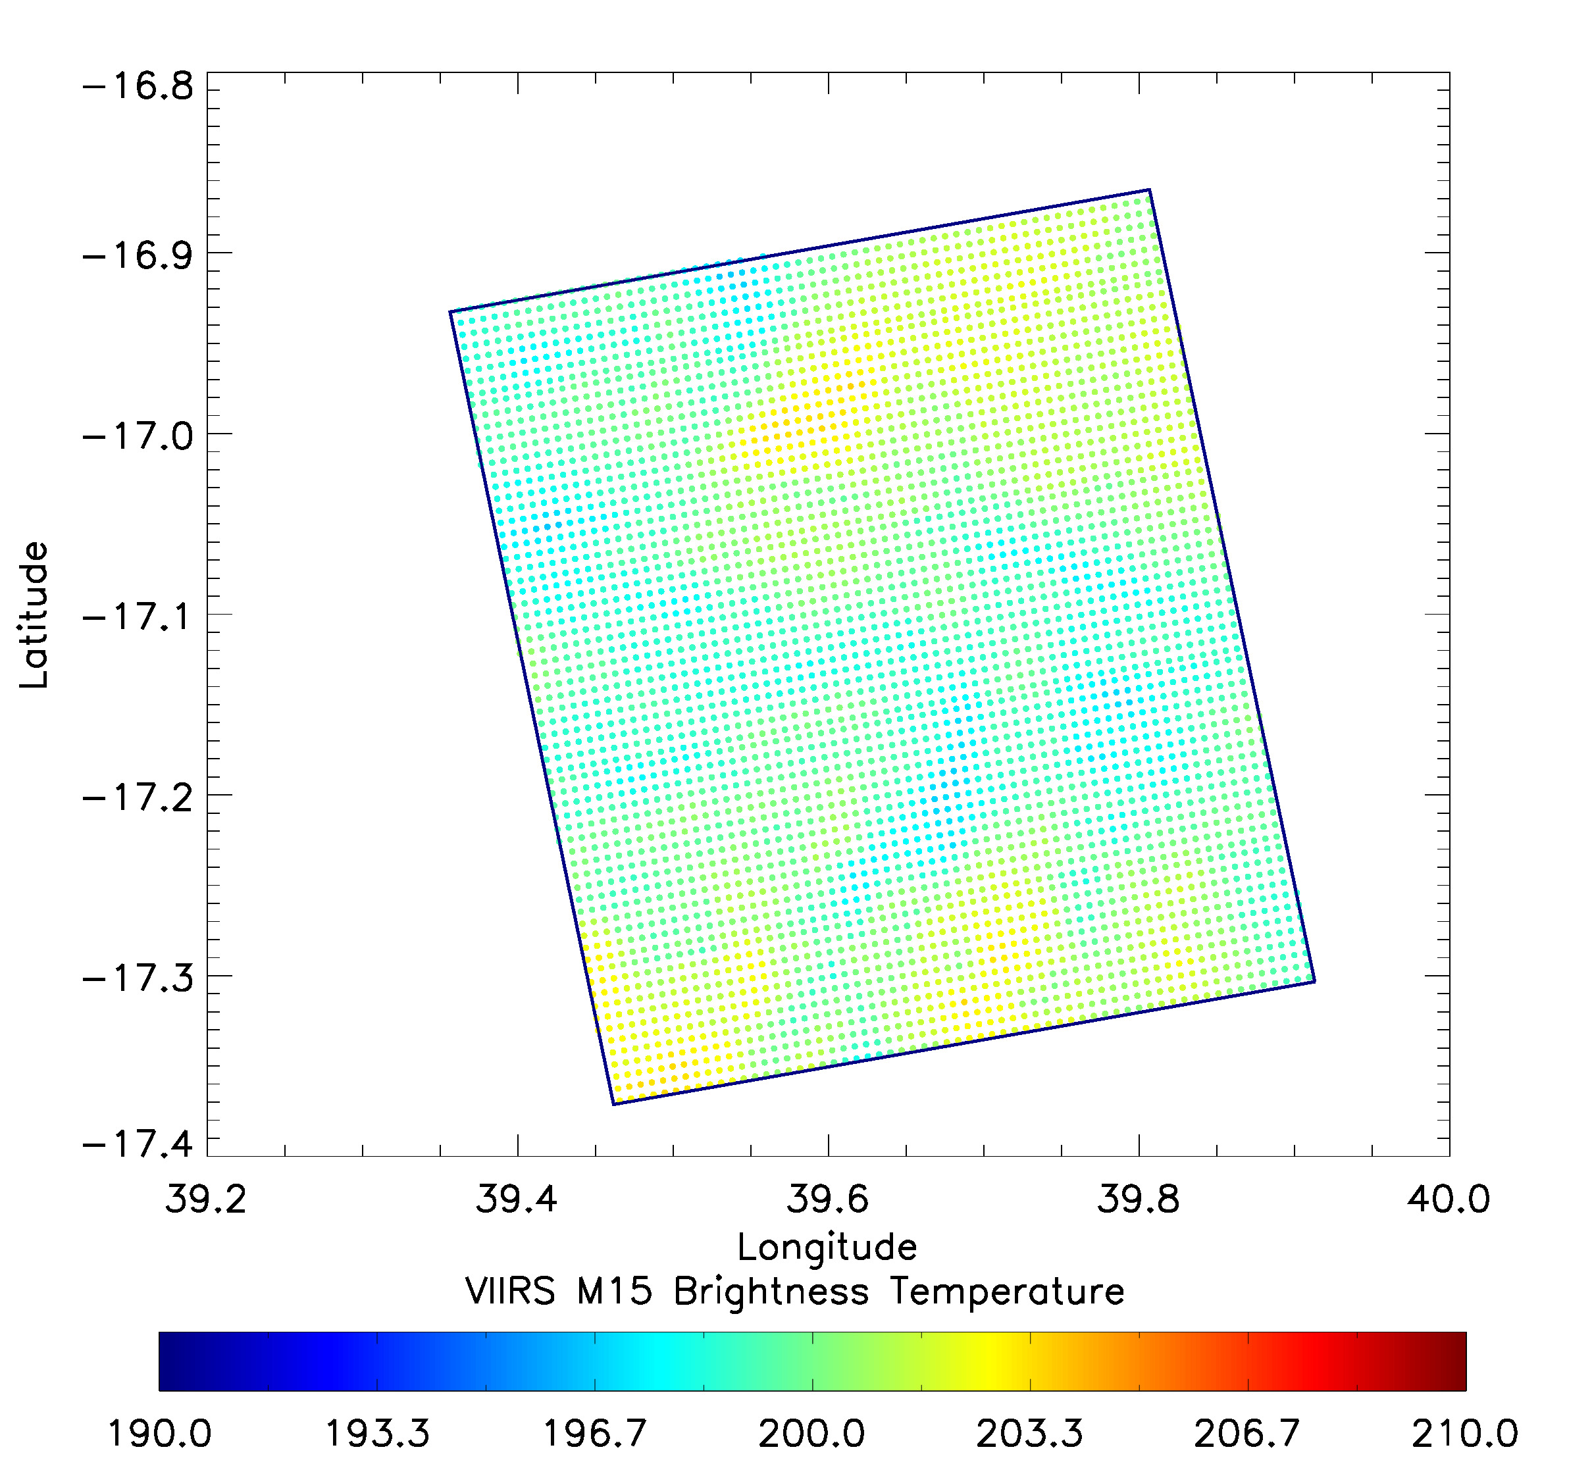
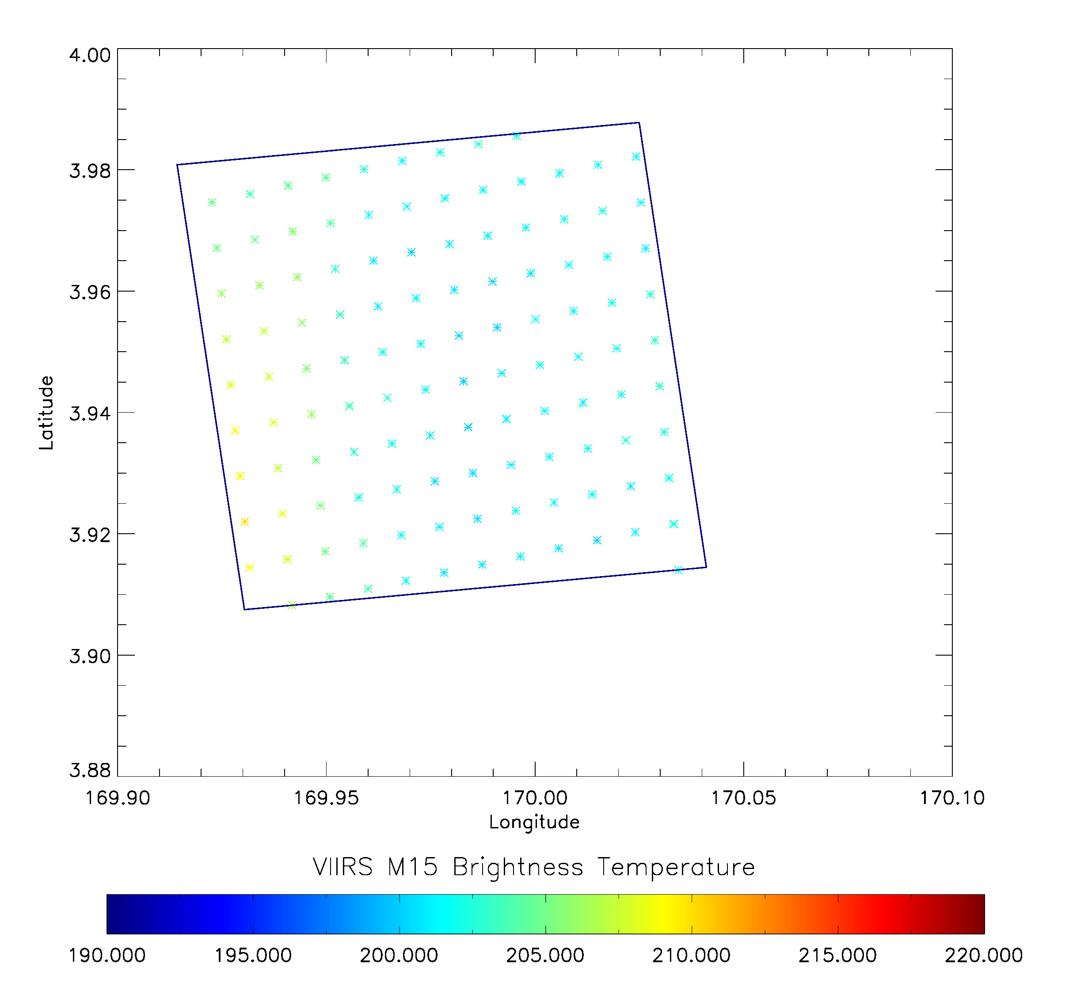
OMPS-NM DCC Pixels Identification
Collocation method:
Quadrilateral ABCD is an OMPS-NM pixel, p and p’ are VIIRS pixels. VIIRS pixel and four corners of OMPS pixel form four triangles.
Pixel p is considered inside ABCD when this equation is satisfied:
|(∆ABP+∆BCP+∆CDP+∆ADP) -(∆ABC+∆ACD) | < threshold
In this study, the threshold is set as 0.1% of the area of ABCD.
  OMPS-NM DCC pixels are identified by the following criteria:
    1. Solar zenith angles < 40 degrees;
    2. Sensor view zenith angles < 35 degrees;
    3. Latitude is between [30S,30N];
    4. 11-µm brightness temperature (TB11) < 210K based on sensitivity study
  OMPS-NM TB11 is from collocated VIIRS Moderate Resolution Band 15 (M15) SDR product.
Figure 2 Illustration of OMPS/NM and VIIRS collocation algorithm
  VIIRS data source: Comprehensive Large Array-data Stewardship System (CLASS) and STAR Central Data Repository (SCDR)
Settings of VIIRS M15 Band:
Parameter | Wavelength | Nadir Pixel Size | Cross-track pixels | Swath Dimensions
VIIRS M15 | 10.729 µm | 750 m | 3200 | 3000 km
Figure 3. Left: One S-NPP OMPS NM pixel overlaid with 4188 collocated VIIRS pixels color coded by VIIRS brightness temperature at M15 band. Right: One NOAA-21 OMPS NM pixel overlaid with 117 collocated VIIRS pixels color coded by VIIRS brightness temperature at M15 band.

Slide 5
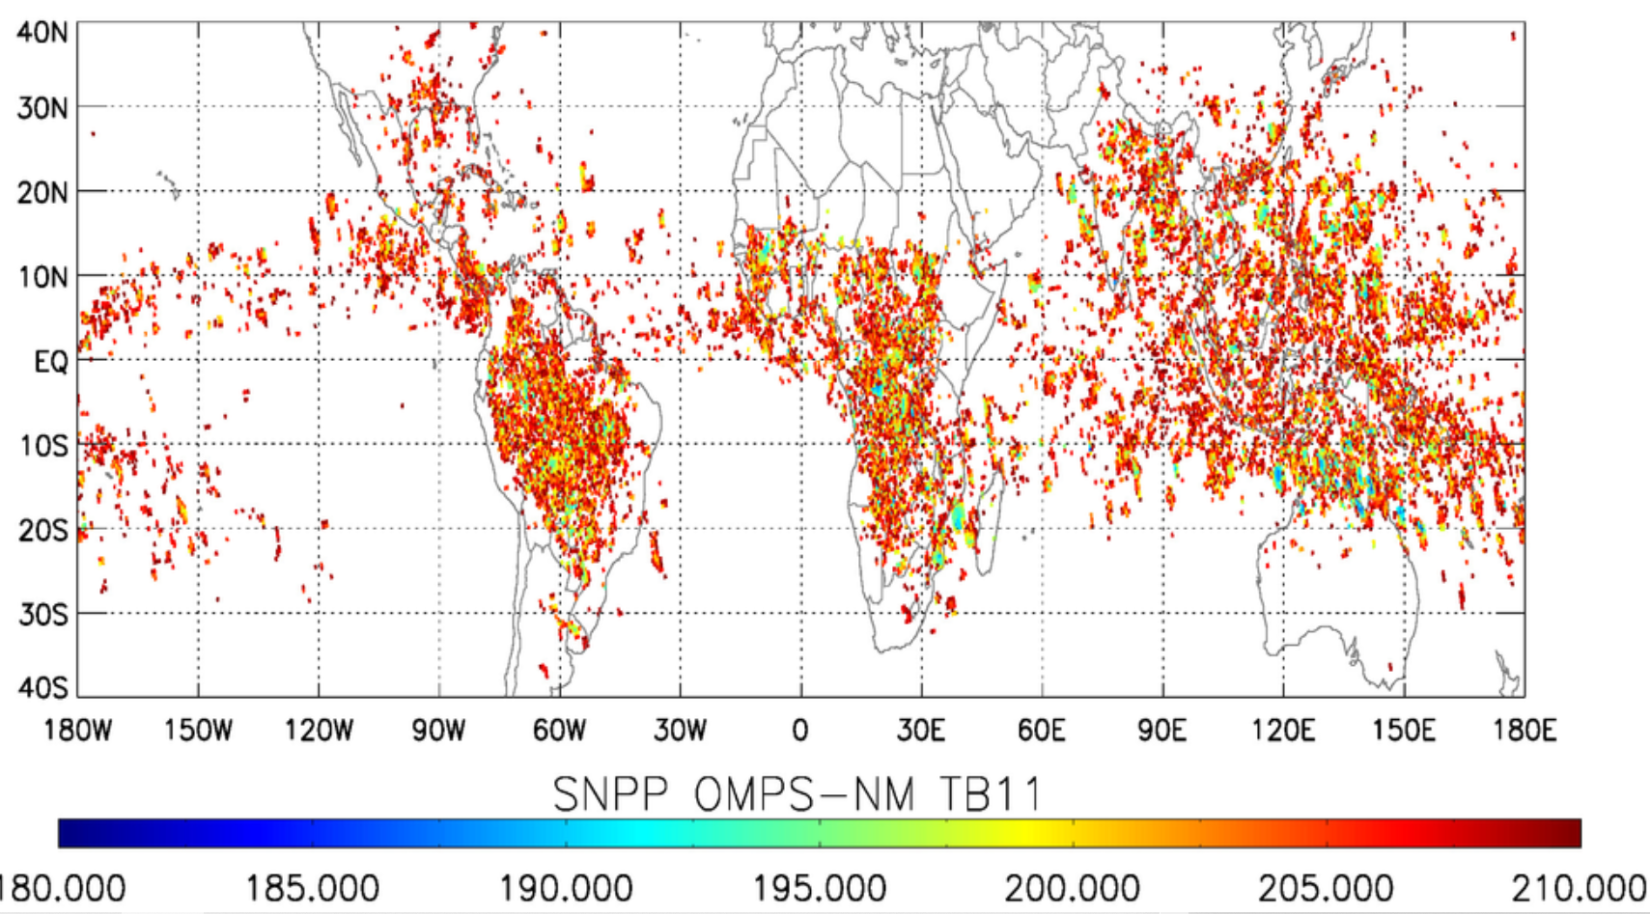
OMPS NM DCC Pixels Distribution in 2021
Figure. 4 S-NPP OMPS-NM DCC pixels in 2021 color coded by TB11 from collocated VIITS pixels.

Slide 6
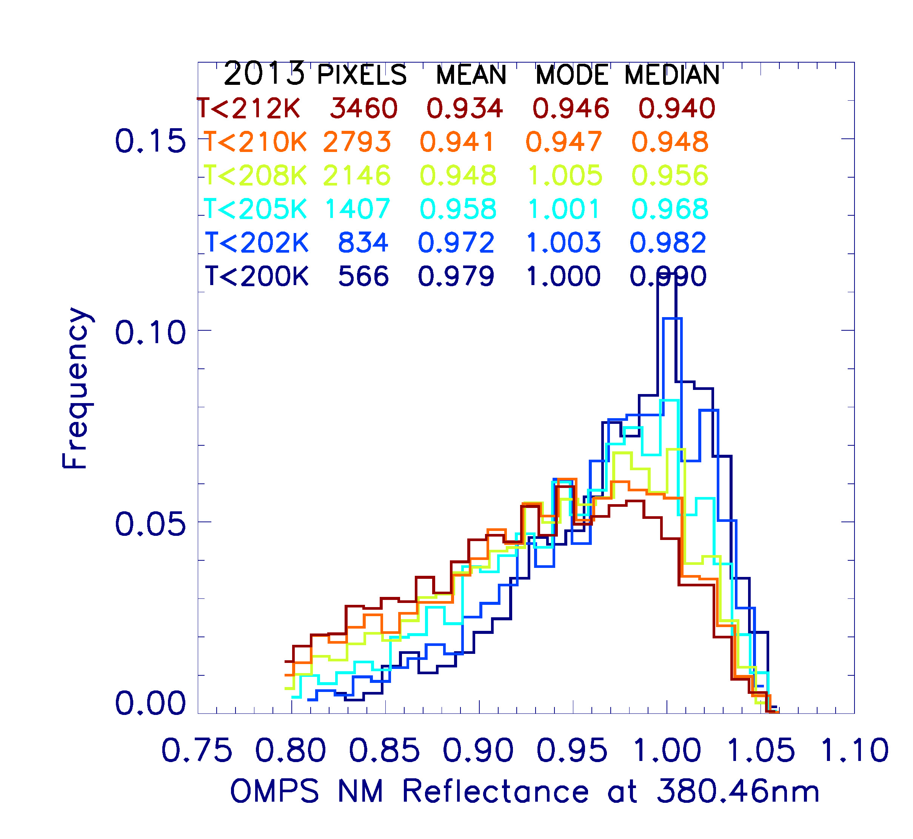
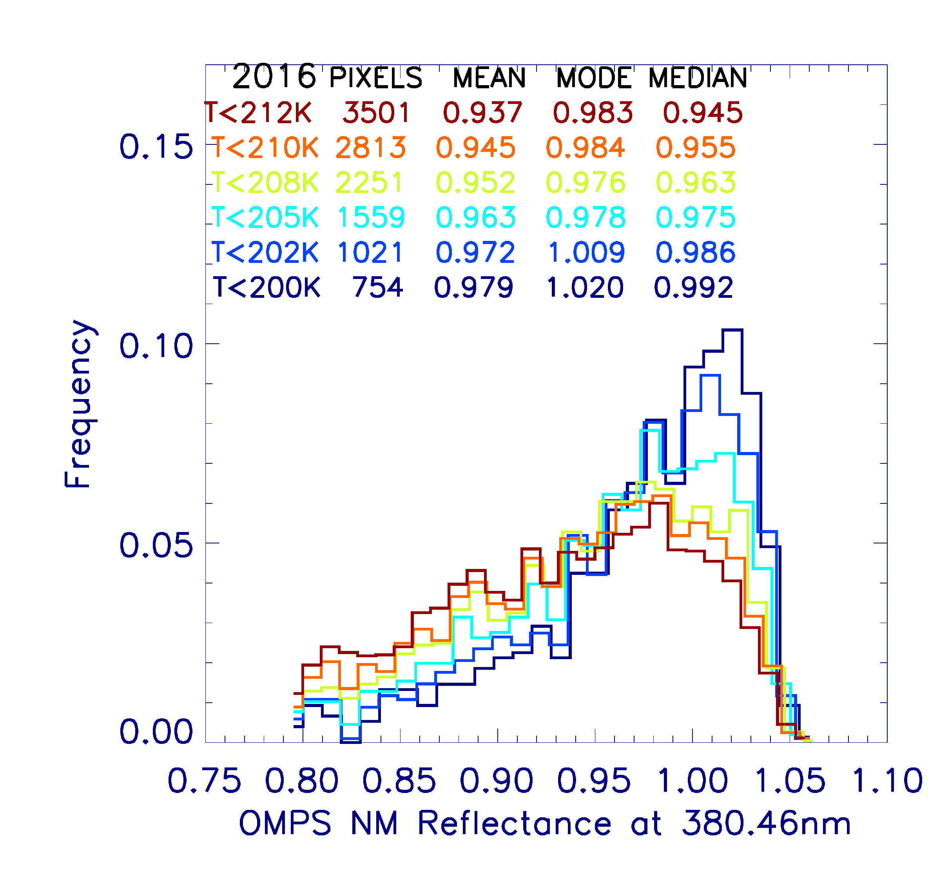
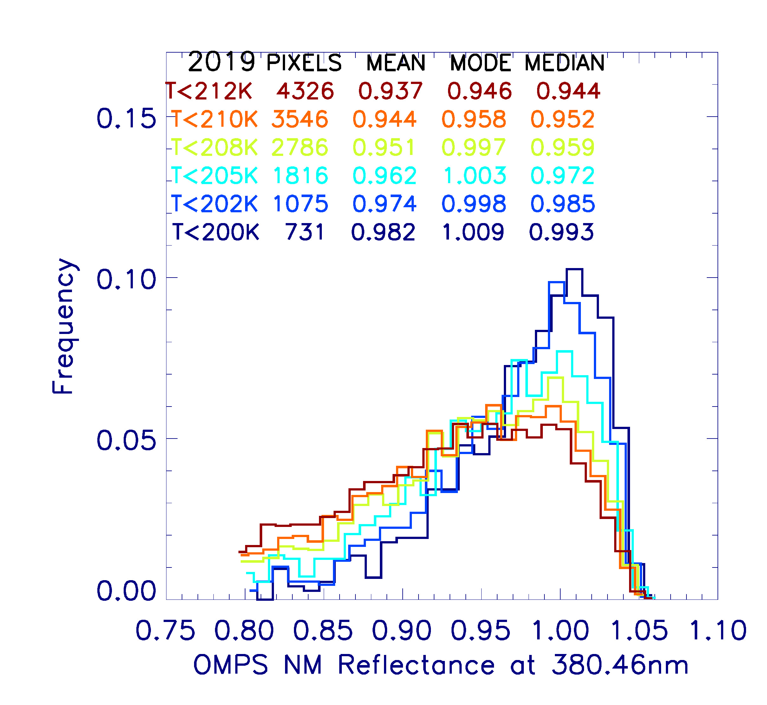
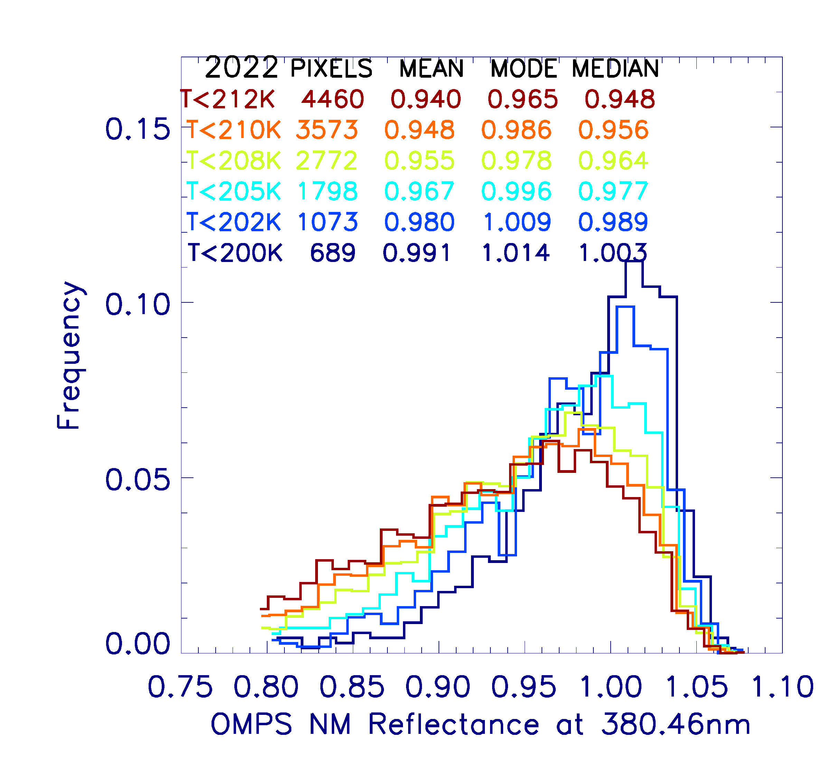
S-NPP OMPS/NM DCC Temperature Threshold Sensitivity Analysis: Part One
DCC reflectance in March and April is used in this study;
When temperature threshold decreases, PDF value decreases in the left side and increases in the right side. This is because warm and dark non-DCC pixels are being screened out;
DCC pixels number decreases by over 20% when temperature threshold decreases by 2K;
Less than 4000 pixels are identified as DCC when temperature threshold is less than 210K;
Fig. 5 Bimonthly PDF of DCC reflectance at 380nm as a function of temperature threshold in 2013,2016,2019, and 2022. Bin size is 1% of averaged reflectance

Slide 7
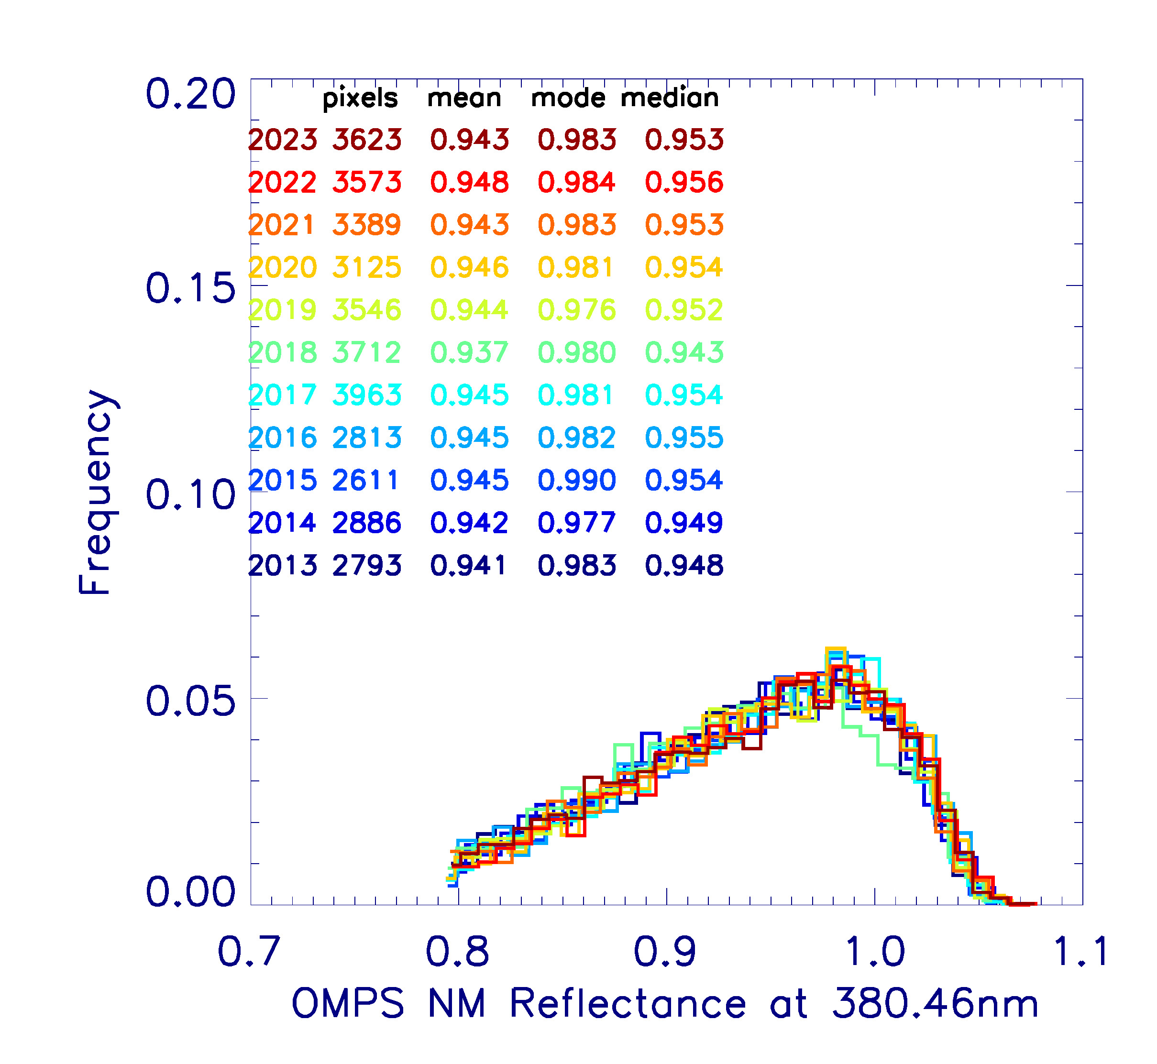
DCC Temperature Threshold Sensitivity Analysis: Part Two
DCC mean 11-year variance is smaller than DCC median and mode
DCC mean is the least sensitive measure to temperature threshold changes;
At 210K threshold, mean trend reaches it minimum value;
PDF of DCC reflectance are generally consistent from month to month at 210K threshold.
Table 3. DCC 380nm reflectance bimonthly PDF mode, mean, and median averaged from 2013 to 2023 for different temperature threshold. The associated 11-year standard deviation and trend are also given.
Temperature Threshold (K) | Mode DCC reflectance | Mean DCC reflectance | Median DCC reflectance | Mode STD (%) | Mean STD (%) | Median STD (%) | Mode trend (%/decade) | Mean trend (%/decade) | Median trend (%/decade)
212 | 0.967 | 0.936 | 0.943 | 1.726 | 0.281 | 0.381 | 0.112 | 0.352 | 0.506
210 | 0.975 | 0.943 | 0.952 | 1.409 | 0.301 | 0.380 | 1.515 | 0.295 | 0.393
208 | 0.983 | 0.951 | 0.960 | 1.335 | 0.312 | 0.379 | -0.823 | 0.401 | 0.437
205 | 0.993 | 0.963 | 0.973 | 0.973 | 0.350 | 0.412 | 1.025 | 0.466 | 0.411
202 | 0.998 | 0.975 | 0.986 | 1.122 | 0.366 | 0.281 | -0.258 | 0.538 | 0.300
Fig. 6 PDF of DCC reflectance at 380nm from 2013 to 2023 at temperature threshold of 210K. Bin size is 1% of averaged reflectance.

Slide 8
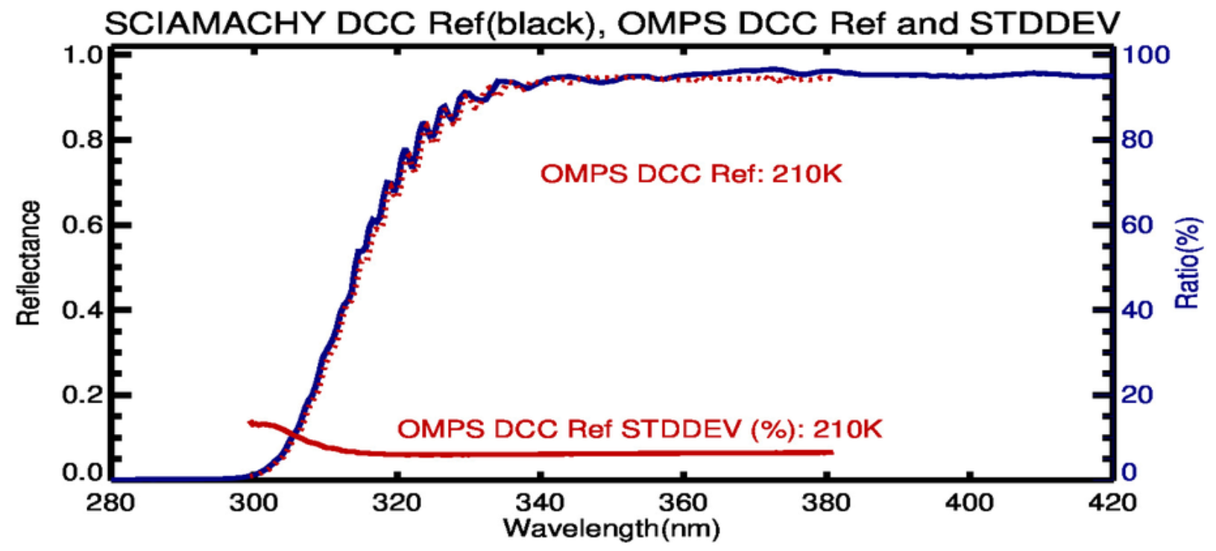
S-NPP OMPS NM DCC Spectra Comparison with SCIAMACHY
SCanning Imaging Absorption spectroMeter for Atmospheric CartograpHY (SCIAMACHY) footprint is classified as DCC when
Center cloud top temperature < 205K
Center optical depth > 70
Cloud fraction >=99% at center
Footprint size: 30km x 240km
Location: [15S,15N]
Time: Aug. 2002 –Dec. 2010
Spectral resolutions: 0.24nm- 0.26nm
S-NPP OMPS-NM DCC reflectance spectrum is similar to SCIAMACHY
Figure. 7 SCIAMACHY DCC reflectance (black) averaged over 22 months with S-NPP OMPS-NM DCC mean reflectance in March and April from 2013 to 2022 and relative standard deviation
The Earth Spectra information was acquired from algorithms and online tools developed at NASA-LaRC with SCIAMACHY V7.01 data obtained from the European Space Agency Envisat program (Scarino et al. 2016, Bovensmann et al. 1999)

Slide 9
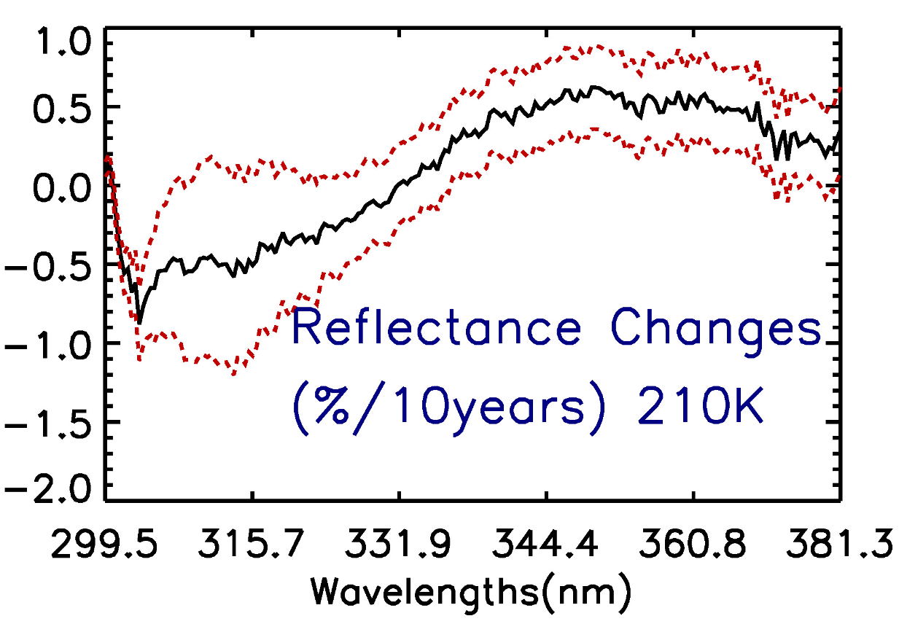
Long-Term Stability of S-NPP Reprocessed OMPS-NM Data:
Reflectance Change over Ten-Year Using the DCC Method
Reflectance changes over ten years with 1-sigma uncertainty vs wavelength:
Mean DCC reflectance is stable with 10-year changes well within 2% requirement;
Positive reflectance changes for wavelength > 330nm;
Reflectance changes increase with wavelength and them decrease with wavelength;
Max reflectance changes is ~0.6%/ 10years.
Figure. 8 S-NPP OMPS-NM DCC mean reflectance changes over ten years with 1-sigma uncertainty vs wavelength when threshold is 210K.

Slide 10
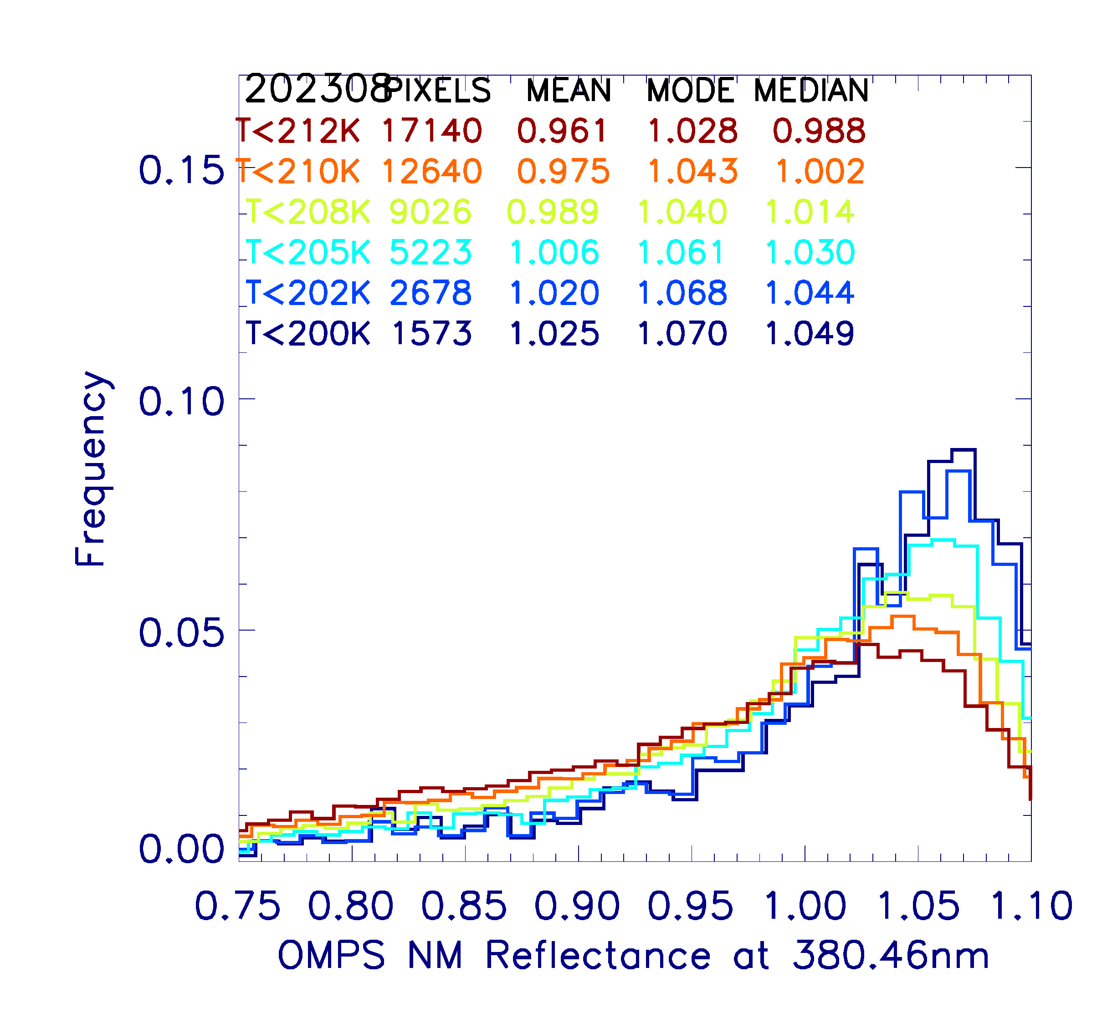
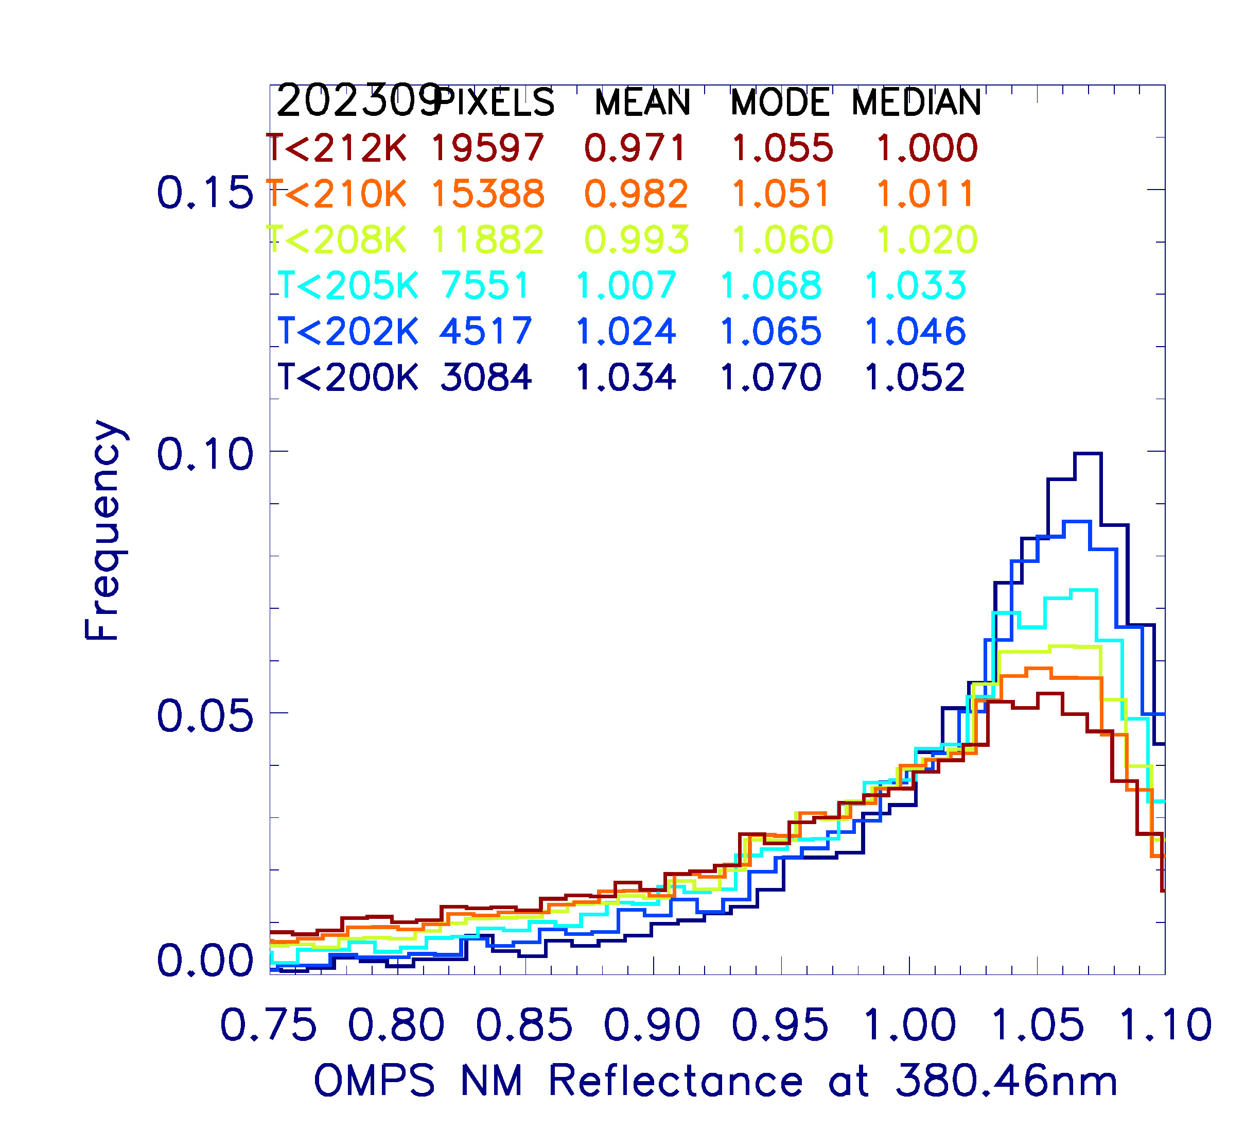
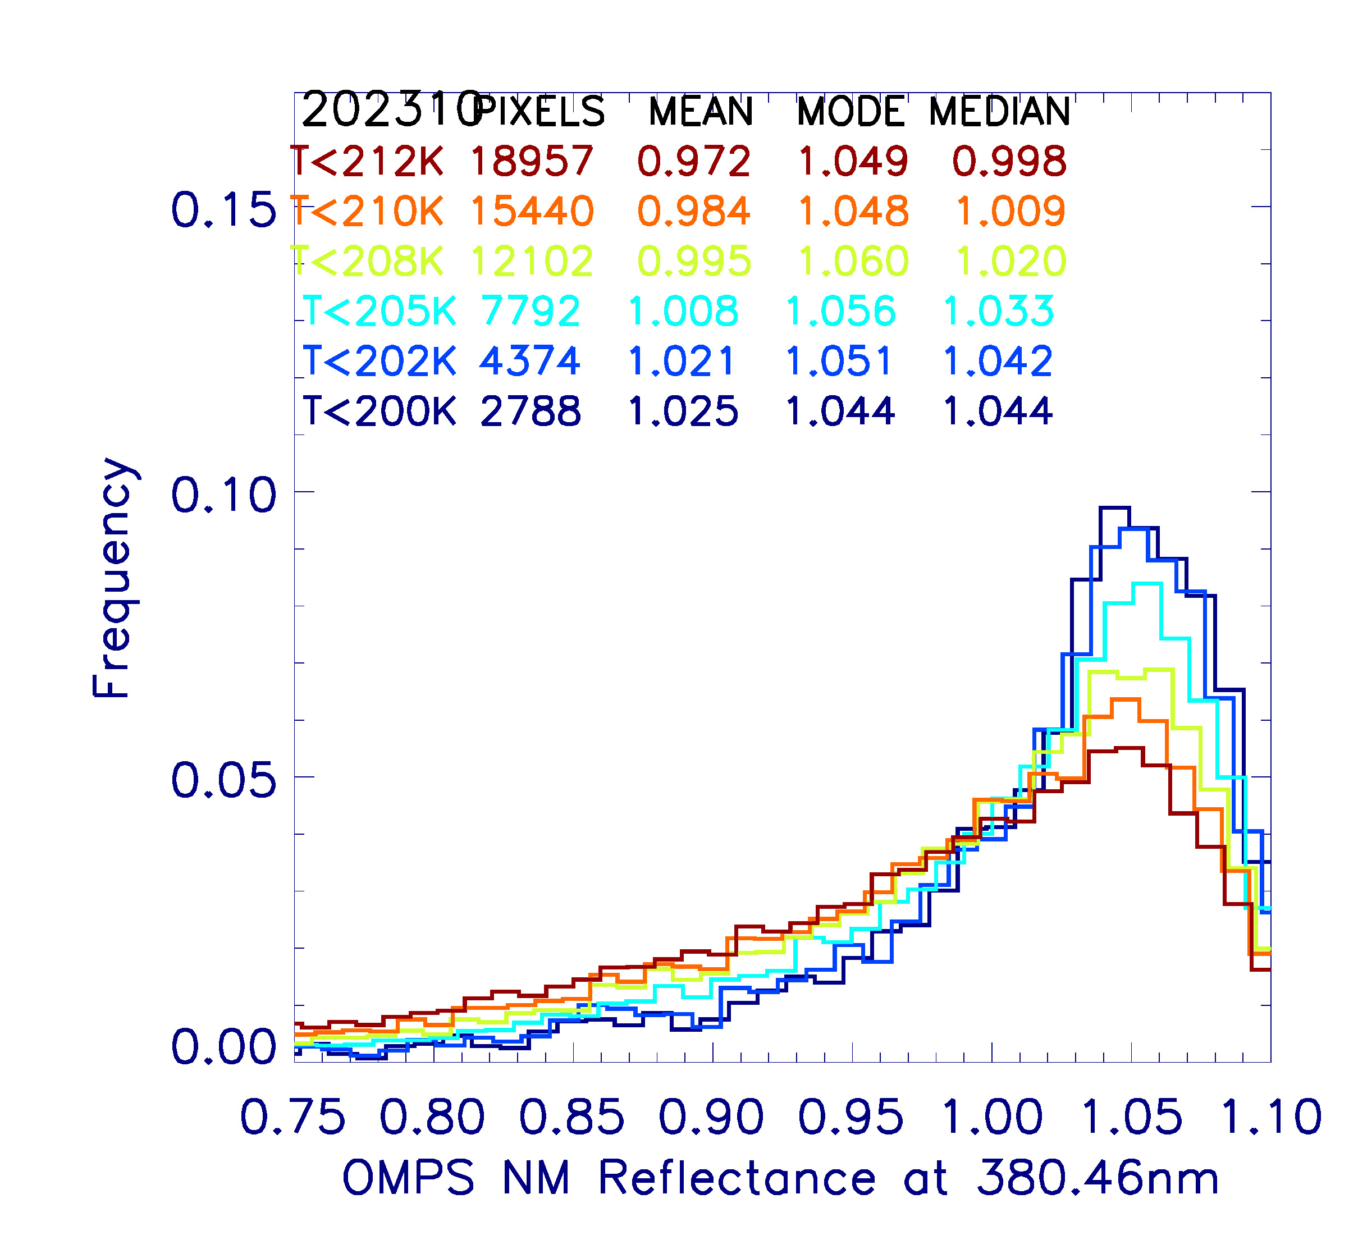
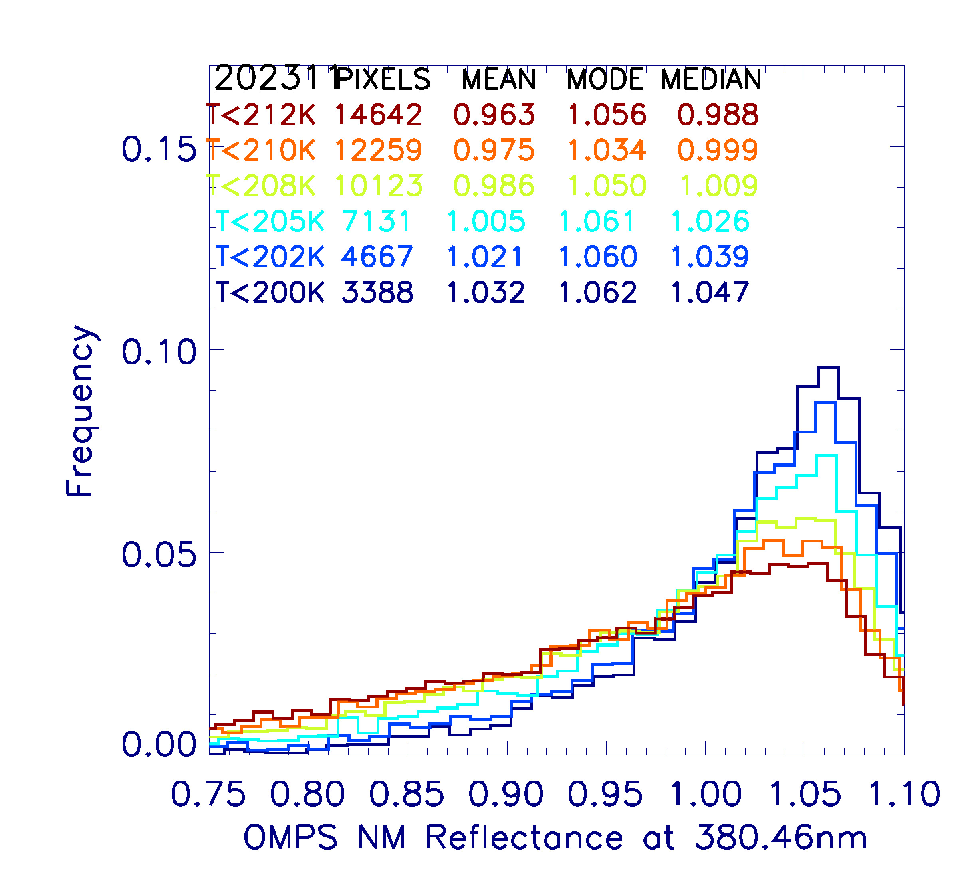
NOAA-21 DCC Temperature Threshold Sensitivity Analysis
NOAA-21 OMPS/NM DCC reflectance in the first week from July to December in 2023 is used in this study;
When temperature threshold decreases, PDF value decreases in the left side and increases in the right side. This is because warm and dark non-DCC pixels are being screened out;
DCC reflectance mean, mode and median increase as temperature threshold decrease;
DCC pixels number decreases by over 20% when temperature threshold decreases by 2K;
Fig. 9 Weekly PDF of DCC reflectance at 380nm as a function of temperature threshold in August to December, 2023. Bin size is 1% of averaged reflectance

Slide 11
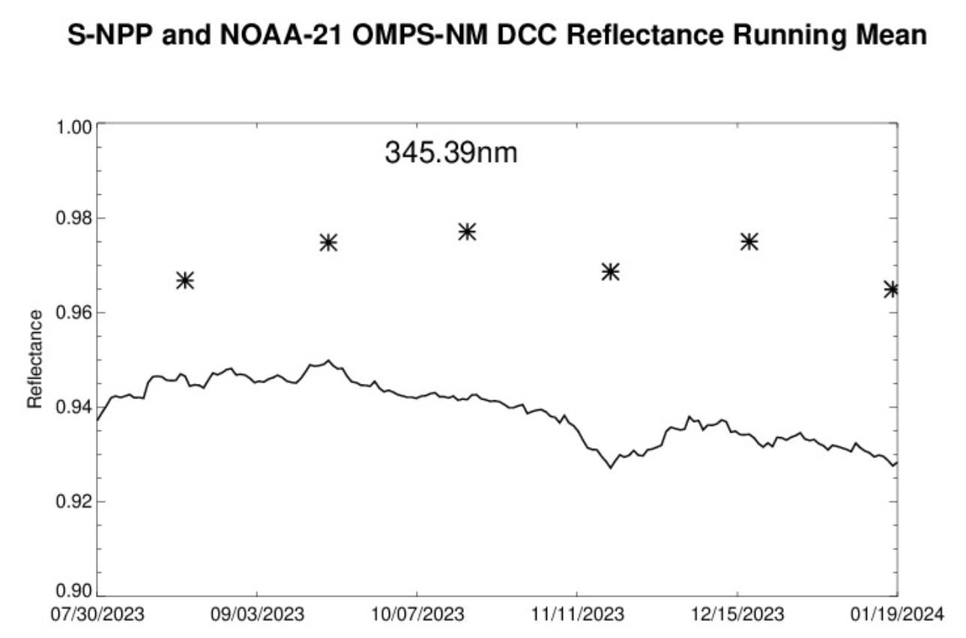
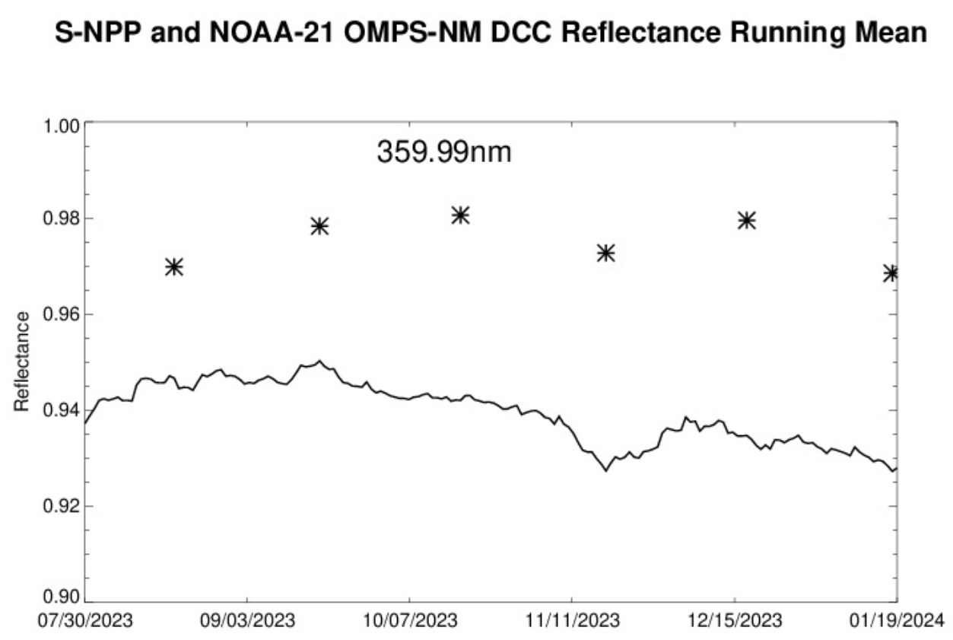
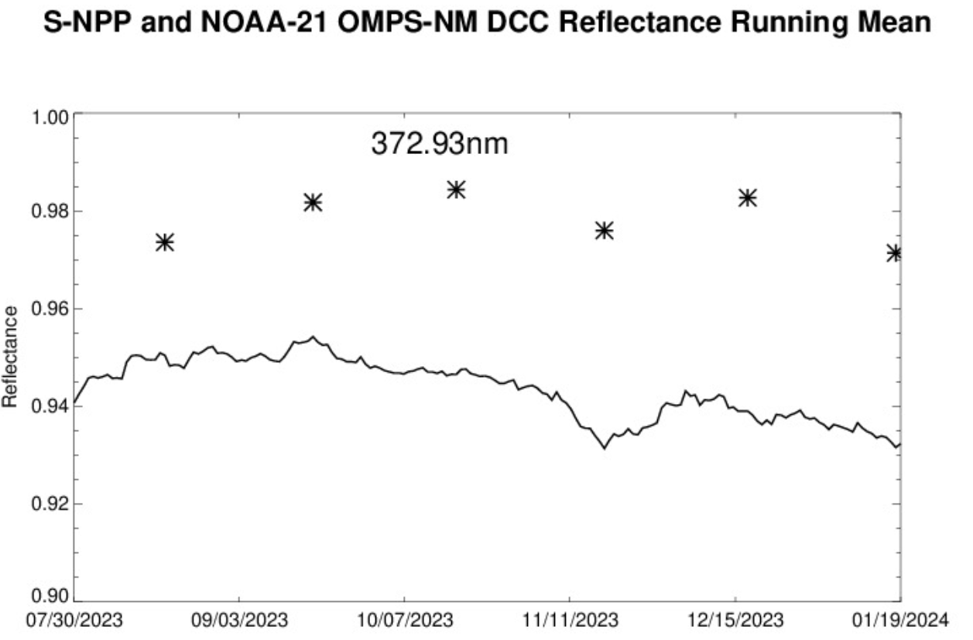
NOAA-21 and S-NPP OMPS NM DCC Reflectance
NOAA-21
NOAA-21
NOAA-21
S-NPP
S-NPP
S-NPP
Figure. 10 S-NPP OMPS-NM DCC reflectance 30 days running mean with NOAA-21 OMPS-NM DCC reflectance 7 days mean.
NOAA-21 OMPS-NM DCC reflectance are larger than S-NPP.
NOAA-21 and S-NPP OMPS-NM mean DCC reflectance have similar seasonal changes.

Slide 12
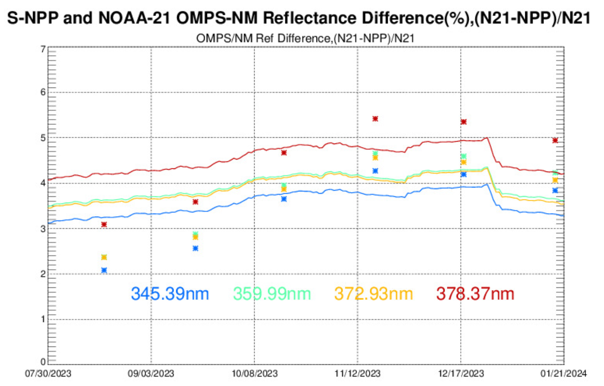
Comparison between NOAA-21 and S-NPP OMPS NM Reflectance:
32-day running mean and DCCs as calibration targets
Stars: differences between NOAA-21 NM DCC 7-day averaged reflectance and S-NPP NM DCC 30-day averaged reflectance.
Solid lines: differences between NOAA-21 NM 32-day averaged global reflectance and S-NPP NM DCC 32-day averaged global reflectance
NOAA-21 and S-NPP OMPS-NM DCC reflectance percentage difference is greater than 2% and increased 2% from August to Jan. 2024.
NOAA-21 and S-NPP OMPS-NM reflectance 32-day mean percentage difference is greater than 3% and increased 1% from August to Jan. 2024.
S-NPP OMPS-NM dark calibration counts were impacted after the Command Data Processor (CDP) reset on 07/26/2023 and 11/01/2023. These anomalies can impact comparison result from 07/26/2023 to 08/27/2023, and 11/01/2023 to 12/03/2023.
NOAA21 OMPS experienced data loss in South Hemisphere from Dec.25 -29, 2023. This impacts 32-day comparison trending results between 12/25/2024 and 1/30/2024.
Figure. 11 Percentage difference between S-NPP and NOAA-21 OMPS-NM reflectance based on 32-day running mean (solid line) and DCC reflectance( stars) .

Slide 13
Summary and Path Forward
Summary
  OMPS-NM pixels TB11 are from collocated VIIRS M15 SDR product;
  NOAA-21 and S-NPP OMPS-NM mean DCC reflectance have similar seasonal changes;
  NOAA-21 and S-NPP OMPS-NM reflectance difference calculated from 32-days method is within 1% from those calculated using DCCs as calibration targets.
Path Forward:
  Further analyses are needed to better understand the difference between S-NPP and NOAA-21;
  Long-term stability monitoring of OMPS-NM on board NOAA-20 and NOAA-21 using DCC technique.

Slide 14
References
Yan, B, and et al., W. New Reprocessing towards Life-Time Quality-Consistent Suomi NPP OMPS Nadir Sensor Data Records (SDR): Calibration Improvements and Impact Assessments on Long-Term Quality Stability of OMPS SDR Data Sets. Remote Sens. 2022, 14, 3125. https://doi.org/10.3390/rs14133125
Doelling, D. and et al., “The Characterization of Deep Convective Clouds as an Invariant Calibration Target and as a Visible Calibration Technique,” Geoscience and Remote Sensing, IEEE Transactions on, 51(3), 1147-1159 (2013).
Gryschka, M., and et al.: Scale analysis of convective clouds. Meteorol. Z. 17(6), 785–791 (2008)
Wenhui Wang, Changyong Cao, "Assessing the VIIRS RSB calibration stability using deep convective clouds," Proc. SPIE 9264, Earth Observing Missions and Sensors: Development, Implementation, and Characterization III, 926410 (19 November 2014); doi: 10.1117/12.2068434
Hu, Y., and et al., “Application of deep convective cloud albedo observation to satellite-based study of the terrestrial atmosphere: monitoring the stability of spaceborne measurements and assessing absorption anomaly,” Geoscience and Remote Sensing, IEEE Transactions on, 42(11), 2594-2599 (2004).
Lee, Y.; Ahn, M.-H.; Kang, M. The New Potential of Deep Convective Clouds as a Calibration Target for a Geostationary UV/VIS Hyperspectral Spectrometer. Remote Sens. 2020, 12, 446. https://doi.org/10.3390/rs12030446
B. R. Scarino, and et al., "A web-based tool for calculating spectral band difference adjustment factors derived from SCIAMACHY hyperspectral data," IEEE Trans. Geosci. Remote Sens., vol. 54, no. 5, pp. 2529-2542, 2016
Zhang, Z., Niu, J., Flynn, L. E., Beach, E., and Beck, T.: An approach to track instrument calibration and produce consistent products with the version-8 total column ozone algorithm (V8TOZ), Atmos. Meas. Tech., 16, 2919–2941, https://doi.org/10.5194/amt-16-2919-2023, 2023.

Slide 15
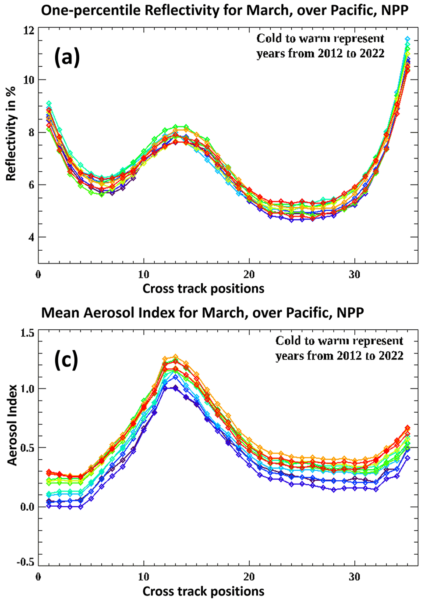
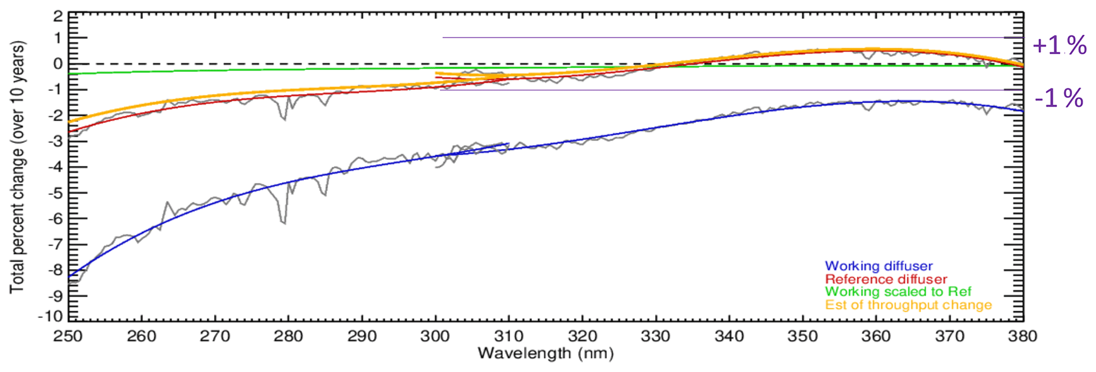
Backup
Figure Estimates of the total wavelength-dependent throughput changes for S-NPP OMPS-NP and OMPS-NM over 10 years (2012 to 2022). The blue curve is from linear fits of the changes in the biweekly solar measurements from the working diffuser. The red curve is from linear fits of the changes in the annual solar measurements from the reference diffuser. The green curve is a scaling of the blue curve accounting for the difference in exposure frequency for the reference versus the working diffusers. The orange curve is the red curve minus the green curve. It gives an estimate of the throughput degradation for the shared optical path for the radiance measurements. Note that the instrument throughput changes for OMPS-NM (300 to 380 nm) are well within the ±1 % level. (This figure was created and provided by Colin Seftor of SSAI for the NASA GSFC Ozone Team.)
Figure Cross-track patterns for the equatorial Pacific for March for all 11 years (2012 to 2022 – cold to warm) of the S-NPP record. Panel (a) shows the cross-track dependence of the 1st percentile reflectivity. Panel (c) shows averages versus cross-track for the aerosol index.

