Slide 1
Calibration of
UV/Vis Spectrometers for
Aerosol Products
L. Flynn (NOAA) drawing upon work by Z. Zhang, J. Niu, D. Liang, C. Seftor, G. Jaross, M. Bali, M. Goldberg, A. Heidinger and C. Cao
GSICS Annual March 13, 2024

Slide 2
Disclaimer
"The scientific results and conclusions, as well as any views or opinions expressed herein, are those of the authors and do not necessarily reflect those of NOAA or the Department of Commerce.“

Slide 3

















Global Space-based Inter-Calibration System https://gsics.wmo.int/en/welcome
What is GSICS?
  Global Space-based Inter-Calibration System
  Initiative of CGMS and WMO
  Effort to produce consistent, well-calibrated data from the international constellation of Earth Observing satellites
What are the basic strategies of GSICS?
  Improve on-orbit calibration by developing an integrated inter-comparison system
        Initially for GEO-LEO Inter-satellite calibration
        Extended to LEO-LEO
        Using external references as necessary
  Best practices for calibration & characterisation
This will allow us to:
  Improve consistency between instruments
  Provide adjustment coefficients if needed.
  Reduce bias in Level 1 and 2 products
  Provide traceability of measurements
  Retrospectively re-calibrate archived data
  Better specify future instruments
  Develop a cadre of experts in calibration
  Easy access to the health of observing systems.
EUMETSAT | CNES | JMA
NOAA | CMA | KMA
ISRO | NASA | WMO
USGS | NIST | JAXA
ROSHYDROMET | IMD | ROSCOSMOS
ESA
Notes:
3
Well, what is GSICS?
The Global Space-based Inter-Calibration System (GSICS) is an initiative of CGMS and WMO, which aims to ensure consistent calibration and inter-calibration of operational meteorological satellite instruments.
One of the basic strategies of GSICS is to develop an integrated on-orbit cal/val system - initially by LEO-GEO Inter-satellite/inter-sensor calibration.
This will then allow us to provide corrections to improve the consistency between instruments, produce less biased level 1, and therefore, level 2 data, and ultimately, retrospectively re-calibrate archive data, which is of great interest in the climate monitoring community

Slide 4
GSICS Activities – GSICS Quarterly Newsletter https://www.star.nesdis.noaa.gov/smcd/GCC/newsletters.php
Over the last year, we published four new Issues of the GSICS Newsletter
  12 Research Articles and seven Topics of News to which
  Approximately 70 Scientists contributed as Authors & Co-Authors.
  Contributions from non-GSICS members has increased.
GSICS Newsletter Editorial Board
Manik Bali, Editor
Lawrence E. Flynn, Reviewer
Lori K. Brown, Tech Support
Fangfang Yu, US Correspondent.
Tim Hewison, European Correspondent
Yuan Li, Asian Correspondent

Slide 5
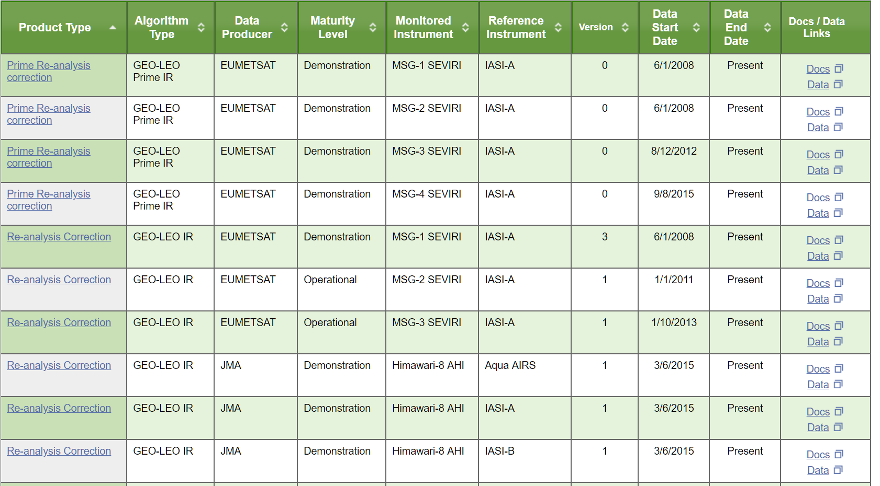
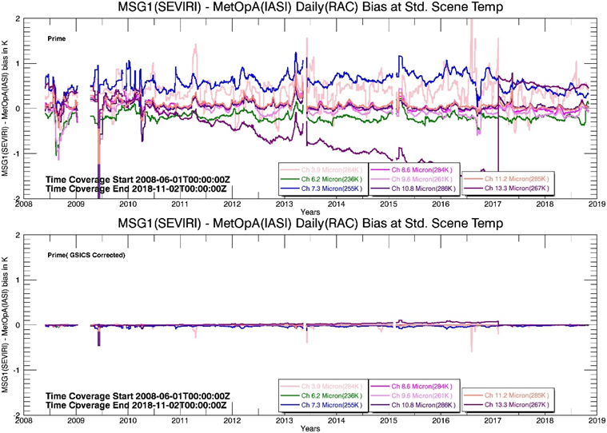
New Visualization Feature on the GSICS Product Catalog more than 70 products have been accepted
https://www.star.nesdis.noaa.gov/smcd/GCC/ProductCatalog.php

Slide 6
GEO versus LEO instruments under-flights has led to a GEO Ring – ISCPP NG is leveraging this set of intercalibrated instruments.
From Status of the Next Generation of the International Satellite Cloud Climatology (ISCCP-NG) , A. Heidinger
  https://earth.esa.int/living-planet-symposium-2022-presentations/27.05.Friday/RhineLobby/1040-1220/02_Heidinger.pdf

Slide 7
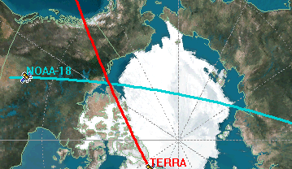
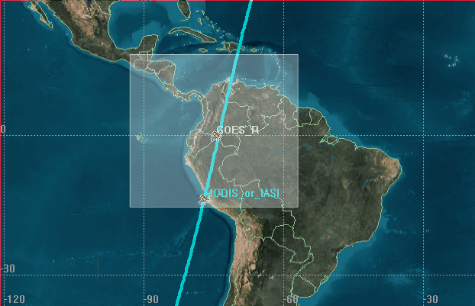
Simultaneous Nadir Overpass (SNO) Method
-a core component in the Integrated Cal/Val System
Slide from a 2006 presentation by C. Cao, NOAA.
These methods have been used extensively by the GSICS Community and are creating bias monitoring products for the IR and Visible sensors on LEO an GEO platforms. The success has created a GEO-Ring of intercalibrated satellite instruments.
There are related efforts for UV spectrometers and EPIC, GEMS and TEMPO are expanding the LEO / GEO studies.
POES intercalibration
Useful for remote sensing scientists, climatologists, as well as calibration and instrument scientists
Support new initiatives (GEOSS and GSICS)
Significant progress are expected in GOES/POES intercal in the near future
Capabilities developed at NESDIS
Has been applied to microwave, vis/nir, and infrared radiometers for on-orbit performance trending and climate calibration support
Capabilities of 0.1 K for sounders and 1% for vis/nir have been demonstrated in pilot studies
Method has been adopted by other agencies
GOES vs. POES
Notes:
Integrated Satellite Instrument Calibration/Validation System Preliminary Design Review
Changyong Cao & Fuzhong Weng
NOAA/NESDIS/STAR STAR Calibration Team
September 20, 2006
https://www.slideserve.com/huyen/changyong-cao-fuzhong-weng-noaa-nesdis-star-star-calibration-team-september-20-2006

Slide 8
To GEO
Match for viewing
geometry
Schematic for GEO & LEO matched viewing
or
LEO Orbital
Track
Equator
LEO Cross
Track FOV
Great Circle aligned
with Cross-track FOV
Sunlit side of
the Earth
Simultaneous View Path (SVP) match up between GEO and LEO. Matches will be present for an instrument on a GEO platform with one in a LEO orbit as the LEO orbital tracks pass near the GEO sub-satellite point, e.g., 1200 at GEO sub-satellite point, 1330 at LEO sub-satellite point.
Notes:
The GEMS instrument with its coverage extending across the Equator will offer the best match ups with EPIC and LEO instruments. The TEMPO and UVN match up geometries will require allowances for differences in scattering or viewing path angles depending on the season cycle of solar angles, although TEMPO at 19ºN is only 3º off nadir.

Slide 9
Figures from “Ice radiance method for BUV
instrument monitoring,” 1993 by G. Jaross & A. Kreuger NASA.
Models have been developed to give estimates of the expected radiances over Antarctica and Greenland. These have be used to estimate calibration biases and maintain calibration consistency over time for reflectivity channels for TOMS, OMI and OMPS instruments.

Slide 10
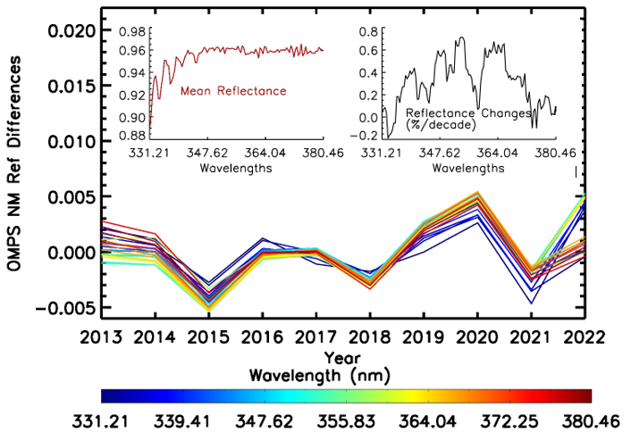
OMPS NM monthly mean Deep Convective Cloud reflectance in March from 2013 to 2022 for wavelengths between 331.21nm and 380.46nm with the long-term average for each wavelength removed. The left insert is long-term mean reflectance for each wavelength. The right insert is estimate of reflectance changes over ten years. 1-Sigma uncertainties on the trend estimates are 0.3%/decade.
Notes:
Ding Liang et al. FEASIBILITY ANALYSIS OF OMPS NM SDR DATA LONG-TERM STABILITY ASSESSMENT USING DEEP CONVECTIVE CLOUD TARGETS (Submitted)
Feasibility aNALYSIS of OMPS NM SDR Data Long-Term Stability aSSESSMENT using Deep Convective Cloud targets
Ding Liang1 , Banghua Yan2 , Lawrence Flynn2 , Ninghai Sun1, Jingfeng Huang3,and Xin Jin3

Slide 11
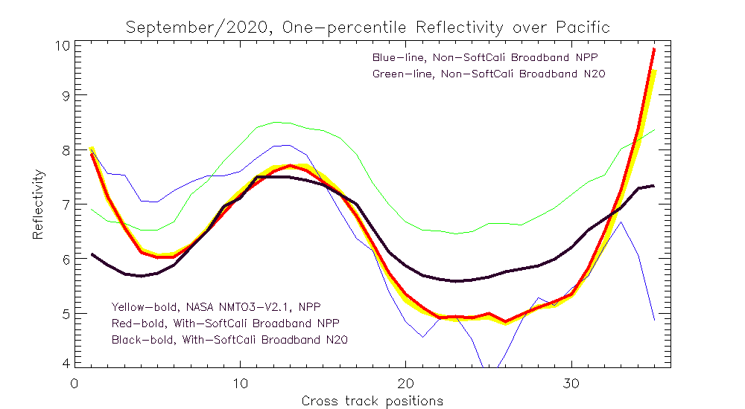
Cross-track Dependence of the One-Percentile Effective Reflectivity from the 331 nm Channel
for September 2020 over a Latitude / Longitude Box in the Equatorial Pacific
Blue Thin Line: S-NPP No Soft Calibration
Green Thin Line: NOAA-20 No Soft Calibration
Z. Zhang, et al., An Approach to Track Instrument Calibration and Produce Consistent Products with the Version-8 Total Column Ozone Algorithm (V8TOZ)
Effective Reflectivity, %
Yellow Bold Line: S-NPP NASA Soft Calibration
Red Bold Line: S-NPP NOAA Soft Calibration
Black Bold Line: NOAA-20 Soft Calibration
Cross-Track Viewing Position # (#18 is Nadir)
Notes:
Z. Zhang, et al., An Approach to Track Instrument Calibration and Produce Consistent Products with the Version-8 Total Column Ozone Algorithm (V8TOZ)

Slide 12
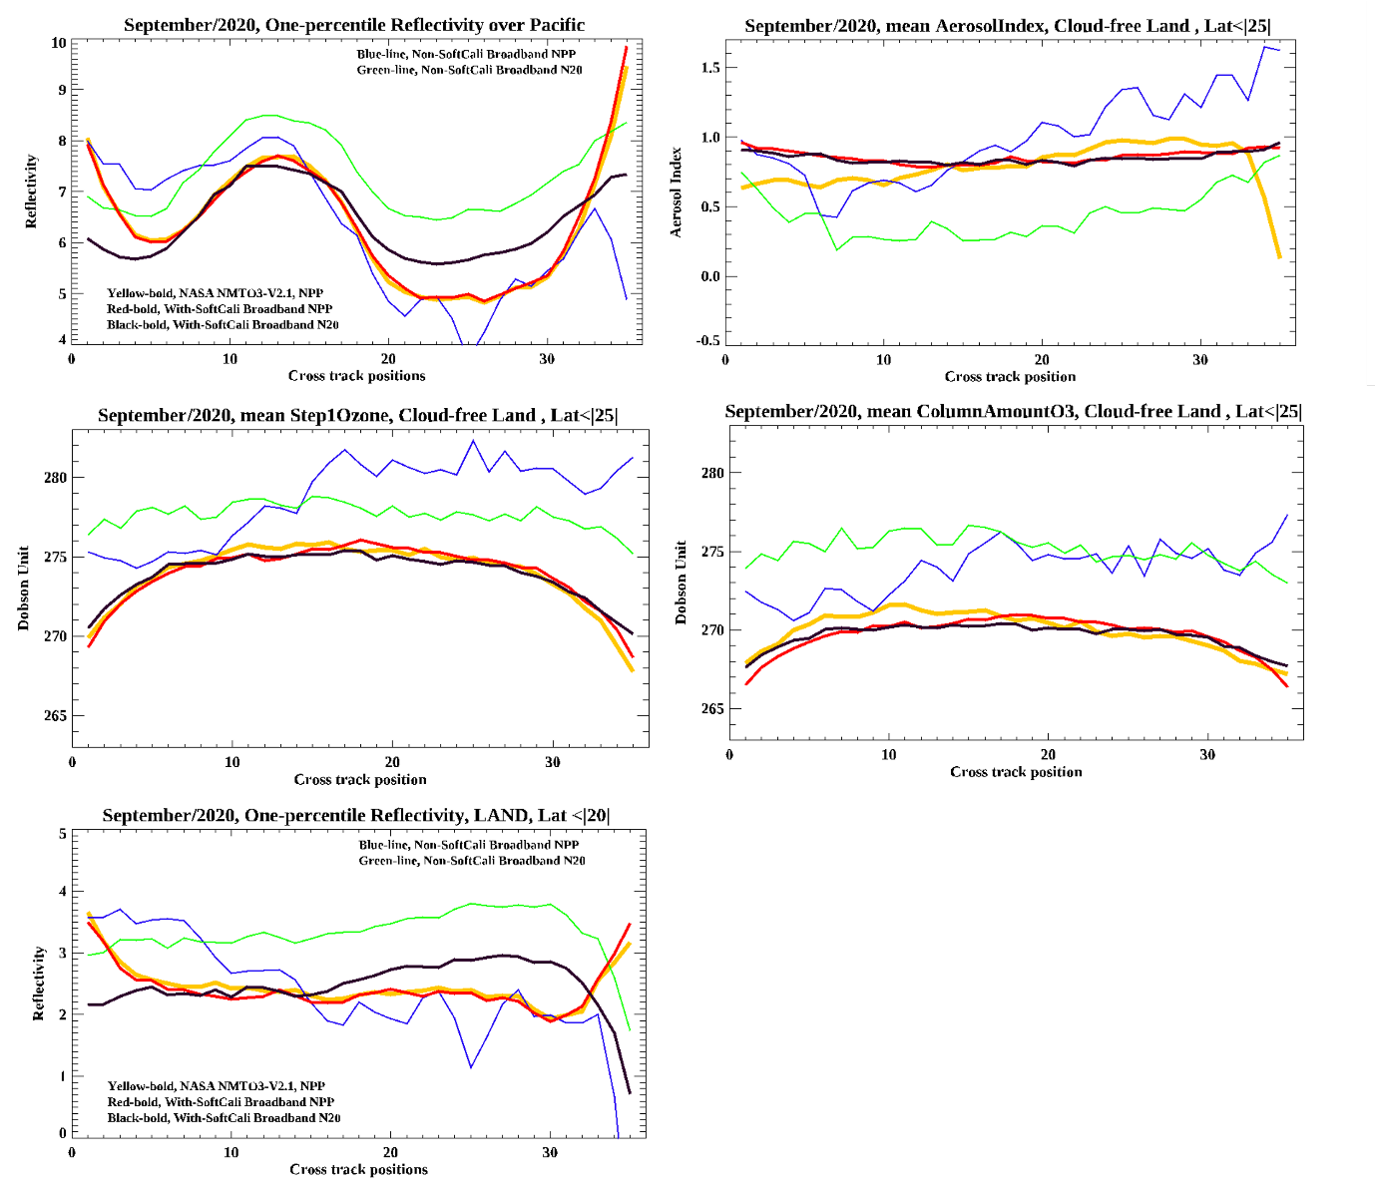
1%-tile Effective Reflectivity
from the 331 nm channel
Cross-track Dependence
Blue Line: NPP No Soft Calibration
Green Line: NOAA-20 No Soft Calibration
Effective Reflectivity, %
Orange Bold Line: NPP NASA Soft Calibration
Red Bold Line: NPP NOAA Soft Calibration
Black Bold Line: NOAA-20 Soft Calibration

Slide 13
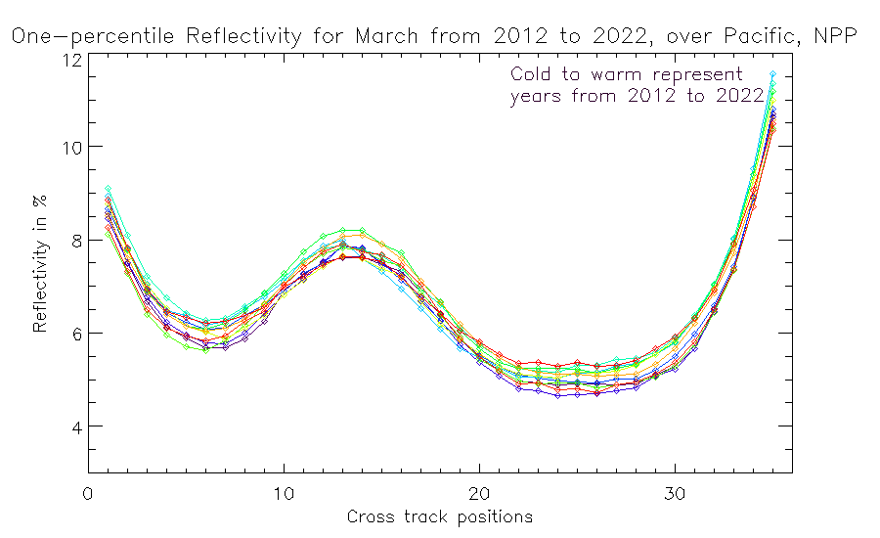
Request for in-situ Measurements of Ocean-Leaving
Radiance in the Ultraviolet versus Solar and Viewing Zenith Angles.
In addition to Sun Glint at reflective angles, is there also “Sky Glint” at high viewing angles?
Persistent cross-track features in 1-percentile
Effective Reflectivity over open ocean –
Not corrected for surface pressure variations.
Effective Reflectivity, %
Sun Glint Geometry
Colors are time-sorted Cold to Warm
2012 2013 2014 2015 2016 2017 2018 2019 2020 2021 2022 2023
Cross-Track Viewing Position # (#17 is Nadir)
Cross-track dependence over the Equatorial Pacific of one-percentile March V8TOz Effective Reflectivity for S-NPP for 11 years. Colors are time-sorted Cold to Warm. The cross-track pattern for one-percentile reflectivity is very stable year-after-year, and the absolute values are stable at the 1% level. While we use Effective Reflectivity values from comparisons over the same time periods to make our soft calibration adjustment estimates, this suggests that there is also value to comparing the absolute results over time as a stability check.

Slide 14
The clouds, Rayleigh scattering and absorbing aerosol signals create the broad wavelength dependence in the radiances as scenes and viewing and solar angles vary.
The small scale features are produced by Ring Effect, trace gas absorption, wavelength scale shifts and stray light.
Normalized Radiance / Irradiance ratios versus wavelength for the S-NPP OMPS Nadir Mapper.

Slide 15
The absorbing aerosol signals are preserved but small scale features are greatly reduced.
For retrievals of some aerosol properties, we can degrade the spectral resolution and treat OMPS and other spectrometer as a filter instruments.
The same as in the previous figure but with a 4-nm moving average applied.

Slide 16
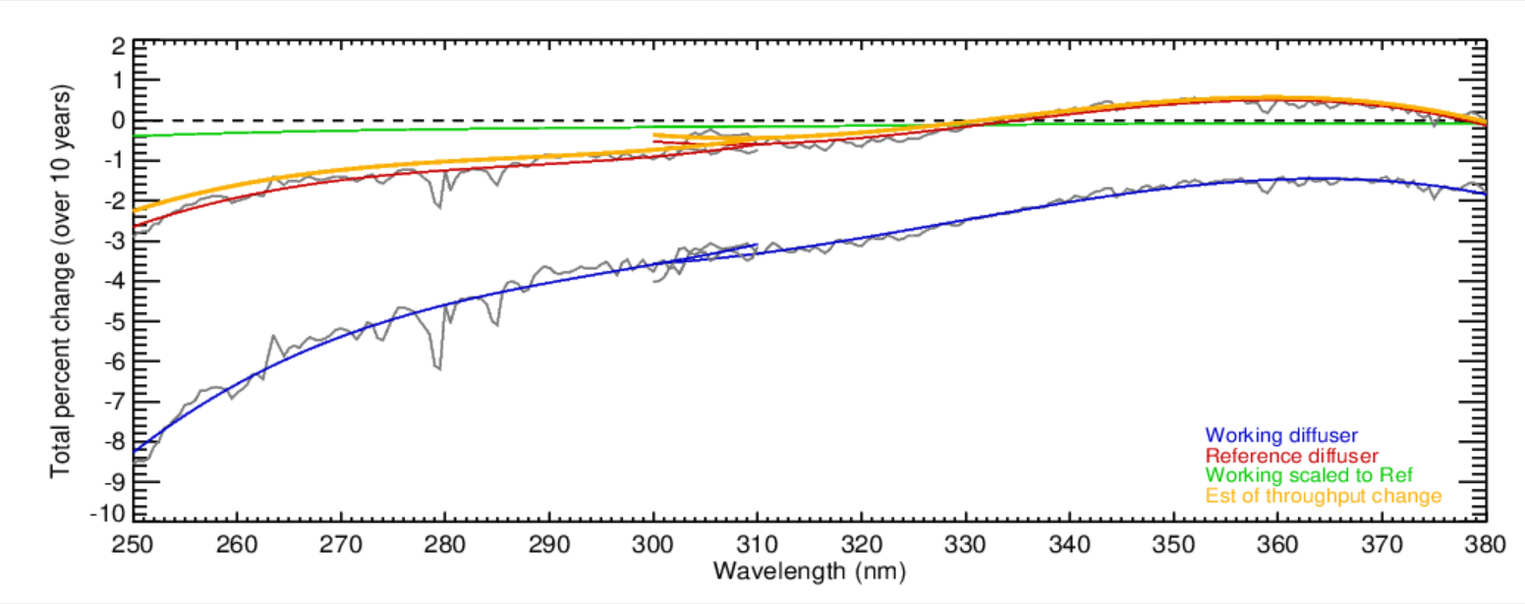
331 nm
360 nm
Relative
trend over
11 years
Monitoring of the OMPS Nadir Mapper
Changes by using on-board dual
Solar diffusers works well
Estimates of the total wavelength-dependent throughput changes for the S-NPP OMPS over ten years (2012 to 2022). The blue curve is from linear fits of the changes of the bi-weekly solar measurements from the working diffuser. The red curve is from linear fits of the changes of the annual solar measurements from the reference diffuser. The green curve is a scaling of the blue curve accounting for the difference in exposure frequency for the reference versus the working diffusers. The orange curve is the red curve minus the green curve. It gives an estimate of the throughput degradation for the shared optical path for the radiance measurements. Notice that the instrument throughput changes for the OMPS NM (300 nm to 380 nm) are well within the +-1% level. (This figure was created and provided by Colin Seftor of SSAI for the NASA GSFC Ozone Team.)

Slide 17
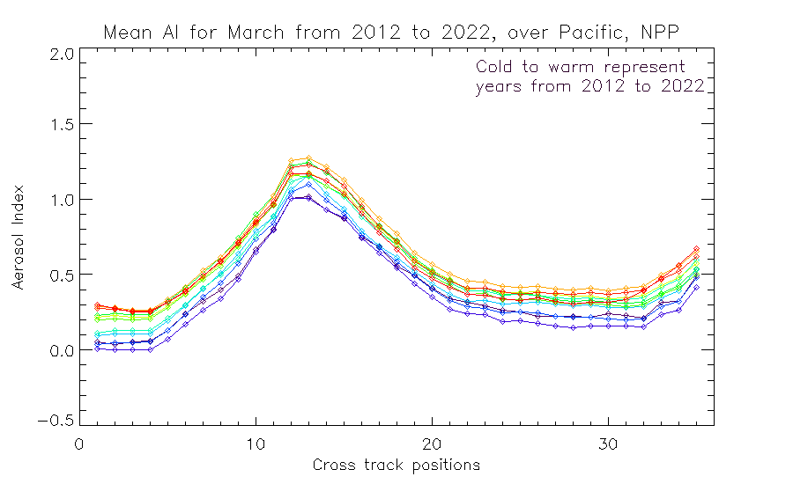
UV Aerosol Index
331/360 nm Pair
Trend over
11 years.
Sun Glint Geometry
Colors are time-sorted Cold to Warm
2012 2013 2014 2015 2016 2017 2018 2019 2020 2021 2022 2023
Cross-Track Viewing Position # (#17 is Nadir)
Cross-track dependence over the Equatorial Pacific of the Aerosol Index for S-NPP for March for 11 years Cold to Warm.
The cross-track pattern for the Aerosol Index is also very stable year-after-year and the absolute values are stable at the 0.4 level. The figure on the slide before does show (two ⃝‘s) a trend in the instrument throughput for the 360 nm channel relative to 331 nm which has not been adjusted in any calibration, so some time dependence in this figure is not unexpected.

Slide 18
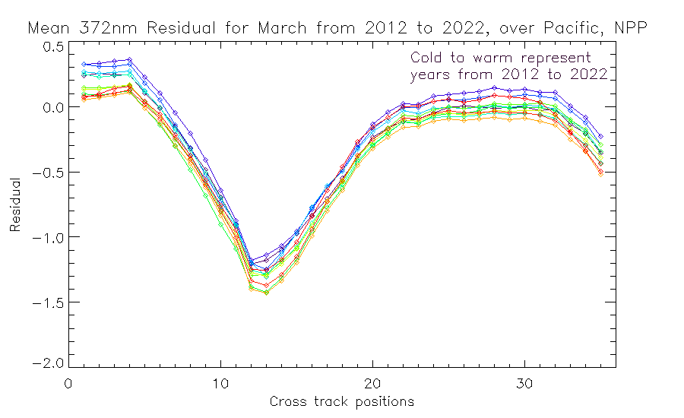
Sun Glint Geometry
Negative of
UV Aerosol Index
331/372 nm Pair
Colors are time-sorted Cold to Warm
2012 2013 2014 2015 2016 2017 2018 2019 2020 2021 2022 2023
Cross-track dependence over the Equatorial Pacific of the 372 nm residual for S-NPP for March for 11 years Cold to Warm. The cross-track pattern for this alternate Aerosol Index is also very stable year-after-year and the absolute values are stable at the 0.4 level.

Slide 19
Here is a comparison of the 372 nm Aerosol Index (Shifted up by 1 unit) plotted over the 360 nm Aerosol Index. They show very similar changes over time. The sun-glint effect is a little larger for the 372 nm channel as expected.
Cross-track dependence over the Equatorial Pacific of the Aerosol Index (Negative of the 360 nm residual using the 331 nm Effective Reflectivity) and the negative of the 370 nm residual for S-NPP for March for 11 years Cold to Warm.

Slide 20
Scatter plot for one day of the two Aerosol Indices
Why not y = 1.41 x + 0.0 ?
(372-331)/(360-331) ≈ 1.41

Slide 21
Possible Topics for Discussion
Calibration
  Absolute versus stability
  Relative
    To another product, e.g., a ground-based network such as AeroNet (aerosol height).
    To another satellite instrument – What is the best choice for a reference?
    Internal consistency, e.g., de-striping. Solar Zenith and Viewing Zenith Angles
    To a retrieval algorithm or forward model and clean atmosphere
  Spectrometers versus broad bandpass measurements – Aerosols are broad signals
Relative Calibration Bias and Adjustments using targets and scenes
  Open Ocean and Sunglint
  Dark Vegetation and Land (PICS)
  Ice Radiances
  Deep Convective Clouds
  Using aerosol-free scenes as zero references
UV Absorbing Aerosol Indices
  Wavelength pair choice
  Cross-track dependence, Satellite Viewing Angle, Solar Zenith Angle.
  Reflectivity model impact
Beyond an Index – Angstrom coefficient, height, phase function
  Polarization information
  Height information
    Oxygen A Band (750-780 nm)
    O2-O2 near 477 nm
    Ring Effect / Inelastic Scattering (Solar features and Solar Activity)
GEO and L1 versus LEO instruments under-flights – leading to a GEO Ring – ISCPP NG
  https://earth.esa.int/living-planet-symposium-2022-presentations/27.05.Friday/RhineLobby/1040-1220/02_Heidinger.pdf

Slide 22
Should we establish a Reference / Transfer Instrument for UV Spectrometers?
OMI
  Pros – Extensive calibration and trending, good spectral resolution and coverage
  Cons – Row Anomaly, nearing end-of-life
OMPS
  Pros – Fully functioning dual diffuser system characterizes small degradation
    Three instruments flying with two more launches scheduled over the next decade
  Cons – Limited wavelength range and 1.0 FWHM resolution
Tropomi
  Pros – Good spectral coverage, large set of validated products
EPIC
  Pros – Everyone flies underneath it with matching LOS possibilities
  Cons – limited number of filter channels
Other LEO or GEO?
Future SITSats? TRUTHS, CLARREO and LIBRA

Slide 23
Summary and Conclusions
GSICS Methods are being applied to characterize instruments used for aerosol retrievals.
More work should be conducted to homogenize UV/Vis instrument records.
The new Geostationary instruments can use the GEO/LEO methods already applied to imagers.
Level 1 calibration can benefit from feedback from Level 2 product validation and adjustments.
Well-maintained Equator Crossing Times greatly simplify long-term stability monitoring.

Slide 24
References
Ice radiance for BUV Instrument Monitoring, G. Jaross & A. Krueger, 1993, https://docserver.gesdisc.eosdis.nasa.gov/repository/Mission/TOMS/3.3_ScienceDataProductDocumentation/3.3.6_ProductApplication/Jaross_Krueger_ice_radiance_method.pdf .
Ding Liang et al., Feasibility Analysis of OMPS NM SDR Data Long-Term Stability Assessment using Deep Convective Cloud targets,” 2023, https://2023.ieeeigarss.org/view_paper.php?PaperNum=3888
J.R. Herman, et al., “A new self-calibration method applied to TOMS and SBUV backscattered ultraviolet data to determine long-term global ozone change”, 1991, JGR Atmospheres, https://agupubs.onlinelibrary.wiley.com/doi/abs/10.1029/90JD02662 .
Weihe Wang et al., “Cross-Calibration of the Total Ozone Unit (TOU) With the Ozone Monitoring Instrument (OMI) and SBUV/2 for Environmental Applications”, 2012, IEEE Transactions on Geoscience and Remote Sensing, Vol. 50, p. 4943-4955, https://api.semanticscholar.org/CorpusID:18682198 .
J.R. Herman, L. Huang, R.D. McPeters, J. Ziemke, A. Cede, and K. Blank, 2018: Synoptic ozone, cloud reflectivity, and erythemal irradiance from sunrise to sunset for the whole Earth as viewed by DSCOVR spacecraft from the earth-sun Lagrange-1, Atmos. Meas. Tech., 11, 1-18, https://avdc.gsfc.nasa.gov/pub/DSCOVR/JayHerman/.
EPIC sites https://epic.gsfc.nasa.gov/science/products/o3, https://epic.gsfc.nasa.gov/science/calibration/uv .
Zhang, Z., Niu, J., Flynn, L. E., Beach, E., & Beck, T.: An approach to track instrument calibration and produce consistent products with the version-8 total column ozone algorithm (V8TOZ), Atmos. Meas. Tech., 16, 2919–2941, https://doi.org/10.5194/amt-16-2919-2023, 2023.
J. Niu, L.E. Flynn, C. Trevor. Beck, Z. Zhang, E. Beach, Z. Zhang & M. Bali (2023) Enterprise version 8 total column ozone algorithm (EV8TOz) development and applications on multiple sensors, Remote Sensing Letters, 14:3, 231-242, DOI: 10.1080/2150704X.2023.2185111.
Notes:
GSICS Meetings http://gsics.atmos.umd.edu/bin/view/Development/MeetingsAndConferences
GSICS Product Catalog https://www.star.nesdis.noaa.gov/smcd/GCC/ProductCatalog.php
GSICS Quarterly Newsletter www.star.nesdis.noaa.gov/smcd/GCC/newsletters.php
Status of the Next Generation of the International Satellite Cloud Climatology (ISCCP-NG), 2022 , A. Heidinger, https://earth.esa.int/living-planet-symposium-2022-presentations/27.05.Friday/RhineLobby/1040-1220/02_Heidinger.pdf

Slide 25
Backup

Slide 26
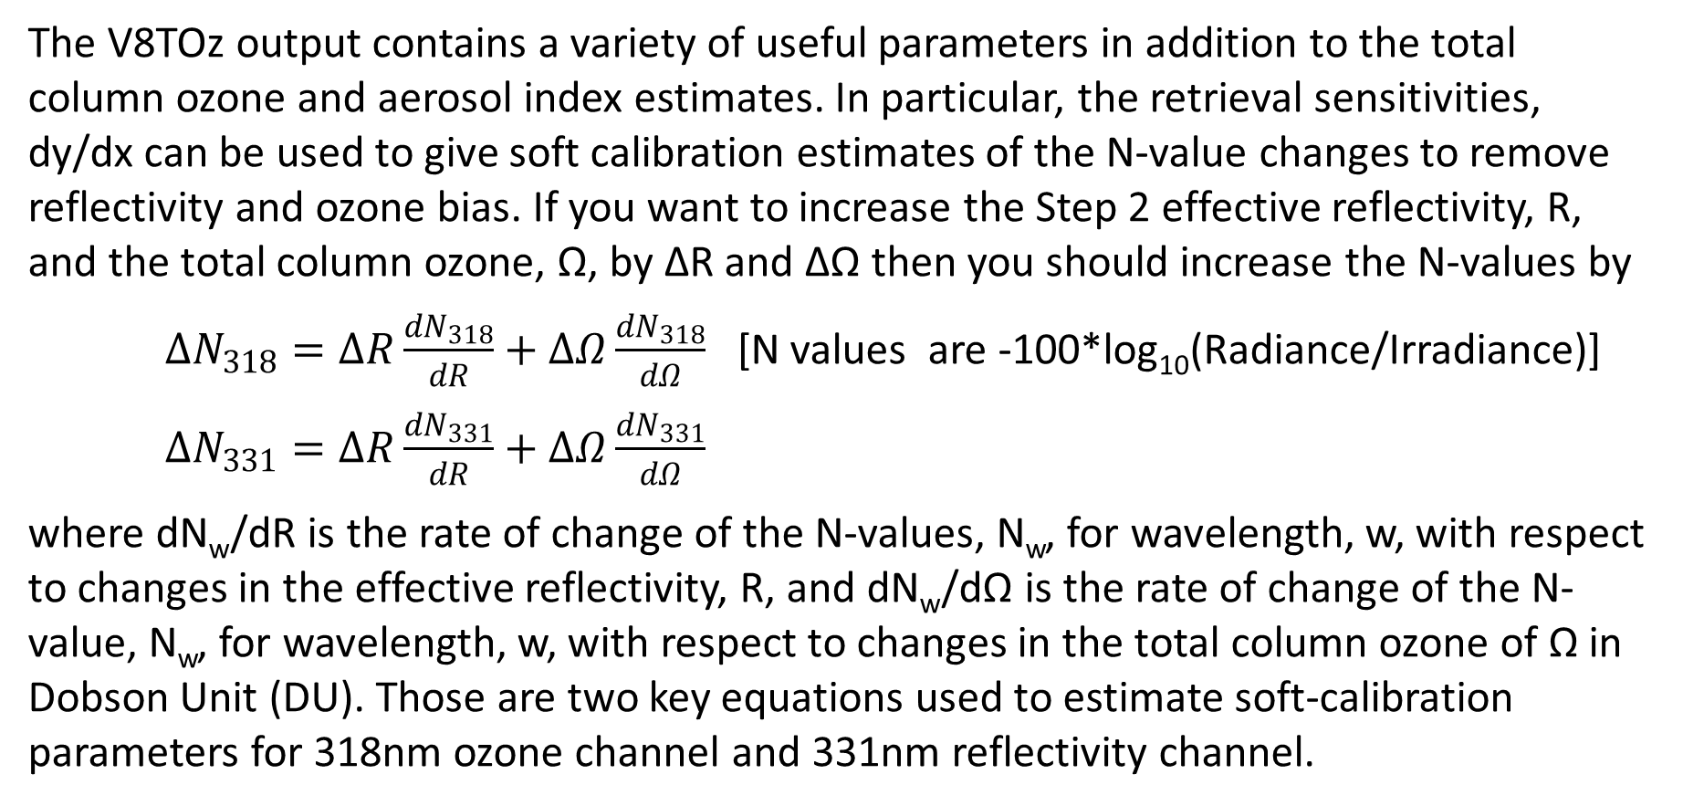
Relationship for Residuals & Adjustments with Ozone & Reflectivity
The V8TOz output contains a variety of useful parameters in addition to the total column ozone and aerosol index estimates. In particular, the retrieval sensitivities, dy/dx can be used to give soft calibration estimates of the N-value changes to remove reflectivity and ozone bias. If you want to increase the Step 2 effective reflectivity, R, and the total column ozone, Ω, by ΔR and ΔΩ then you should increase the N-values by
$∆N_{318}=∆R\frac{{dN}_{318}}{dR}+∆Ω\frac{{dN}_{318}}{dΩ}$ [N values are -100*log₁₀(Radiance/Irradiance)]
$∆N_{331}=∆R\frac{{dN}_{331}}{dR}+∆Ω\frac{{dN}_{331}}{dΩ}$
where dN_{w}/dR is the rate of change of the N-values, N_{w}, for wavelength, w, with respect to changes in the effective reflectivity, R, and dN_{w}/dΩ is the rate of change of the N-value, N_{w}, for wavelength, w, with respect to changes in the total column ozone of Ω in Dobson Unit (DU). Those are two key equations used to estimate soft-calibration parameters for 318nm ozone channel and 331nm reflectivity channel.

Slide 27
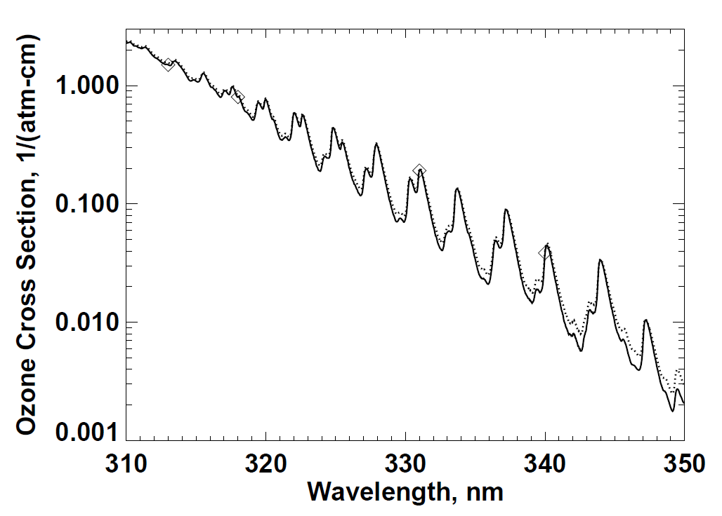
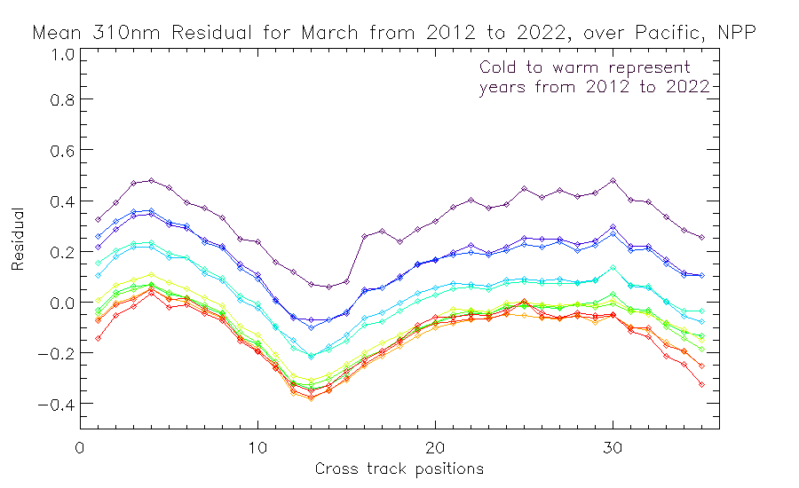
The shorter wavelength residuals are affected by the time dependent calibration drift at 318 nm. The ozone absorption is greater so the error at 318 nm becomes an error in the ozone, and this is magnified by the relative ozone absorption of the shorter channel compared to the 318 nm one.
J.R. Herman, et al., “A new self-calibration method applied to TOMS and SBUV backscattered ultraviolet data to determine long-term global ozone change”, 1991, JGR Atmospheres, https://agupubs.onlinelibrary.wiley.com/doi/abs/10.1029/90JD02662 .

Slide 29
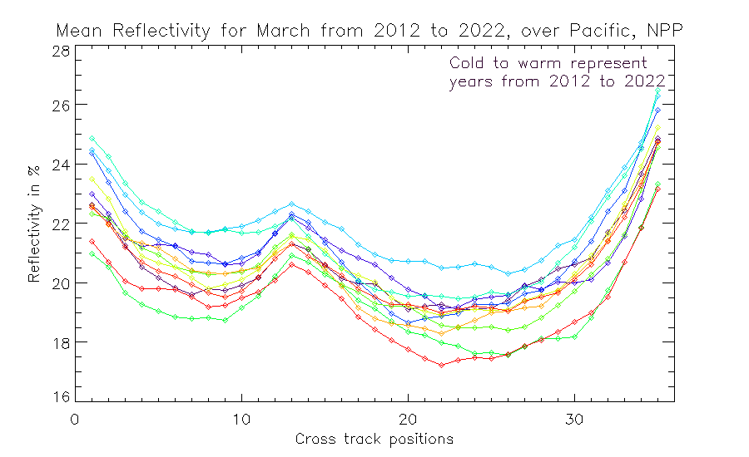
Cross-track dependence over the Equatorial Pacific of average March V8TOz Effective Reflectivity for S-NPP for 11 years. Colors are Cold to Warm. The range of values here is larger than that on the previous slide for the one-percentile reflectivity, and the order of the years from higher to lower values is different.

Slide 30
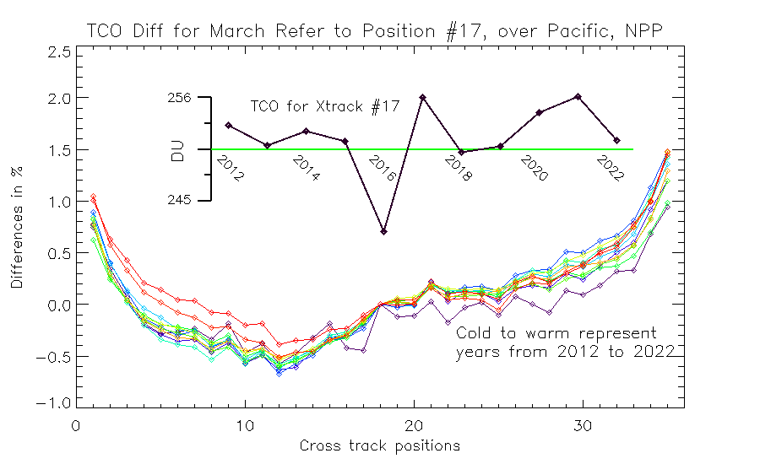
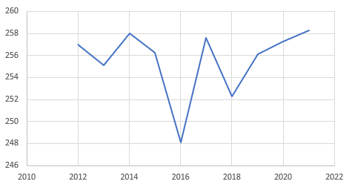
Cross-track dependence over the Equatorial Pacific of the average March V8TOz Total Column Ozone for S-NPP for 11 years Cold to Warm. This figure shows that the cross-track pattern for the total column ozone over the Equatorial Pacific box is also stable year-after-year. The values are given relative to cross-track position 17 for each individual year. The average TCO values for position 17 over the 11 years vary by 7% with no specific trend as shown in the inset time series. One expects variations for this region related to dynamics such as the Quasi-Biennial Oscillation.

Slide 31
Equatorial Pacific of average March total column ozone for S-NPP the Nadir-View for 11 years. Black is the V8TOz product and Red is a V8Pro product.

Slide 32
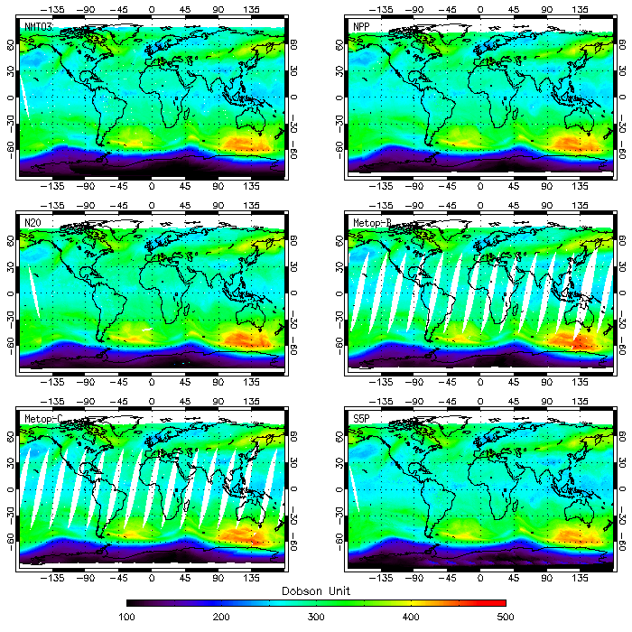
Six maps demonstrate consistent retrievals of baseline products and EV8TOz products from measurements made by OMPS NPP, NOAA-20, GOME-2 on Metop-B and -C, and TROPOMI on the 7th of October 2021.
Notes:
J. Niu, et al., An Enterprise approach for the Version 8 Total Column Ozone Algorithm (EV8TOz)

Slide 33
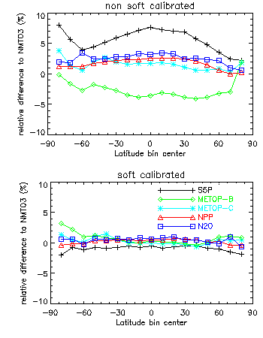
The zonal means of all five TOZ products on 7 October 2021 are computed within ±85° Latitude span. Their differences relative to the baseline are illustrated for the cases without soft calibration (upper), and with soft calibration (lower).

Slide 34
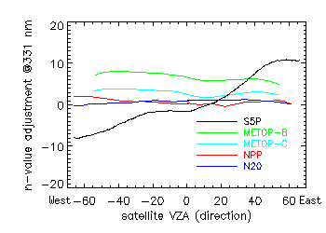
Five sensors’ N-value adjustments in soft calibration tables for 331 nm channel are illustrated as a function of satellite viewing angle (VZA). The VZAs toward West are defined as negative.

Slide 35
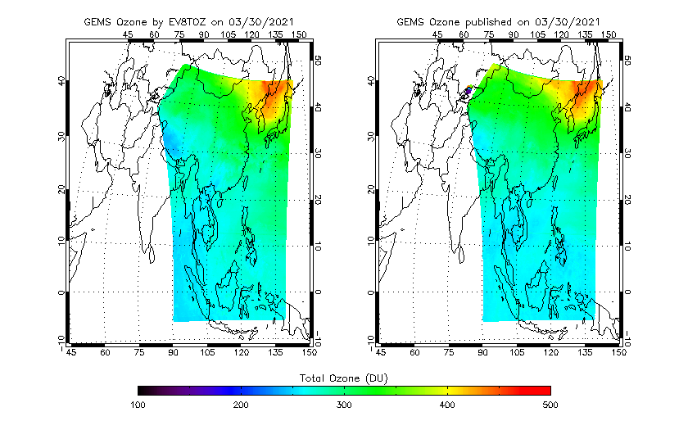
NOAA EV8TOz & GEMS Team V9TOz
Retrieved Total Column Ozone for 20210330_0145
Is the GEMS Team using the latest reflectivity and aerosol version of the V9TOz retrieval algorithm?

Slide 36
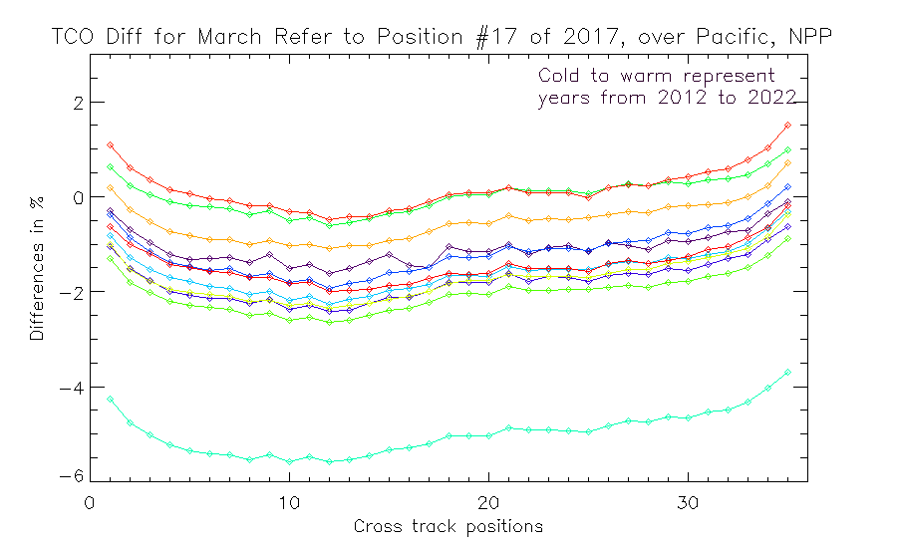

Slide 38
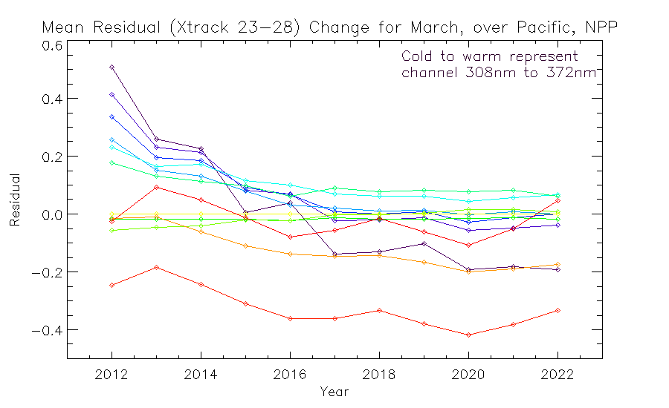

Slide 39
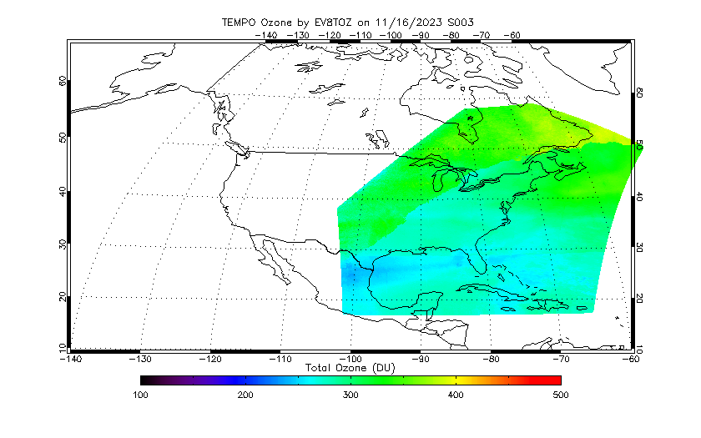
TEMPO S003G01~S003G06

Slide 40
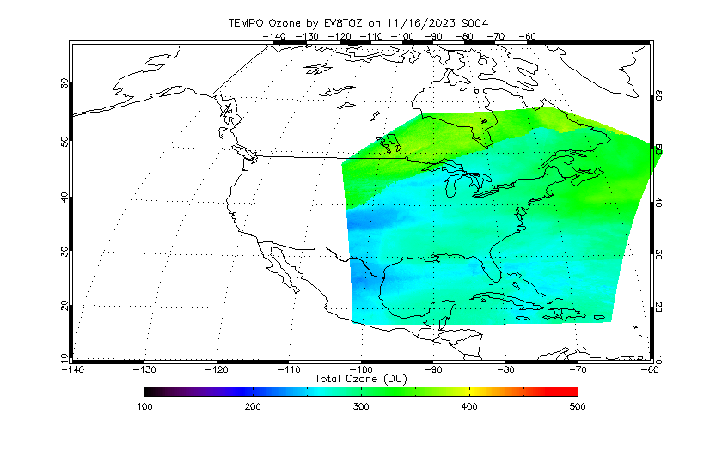
TEMPO S004G01~S004G06

Slide 41
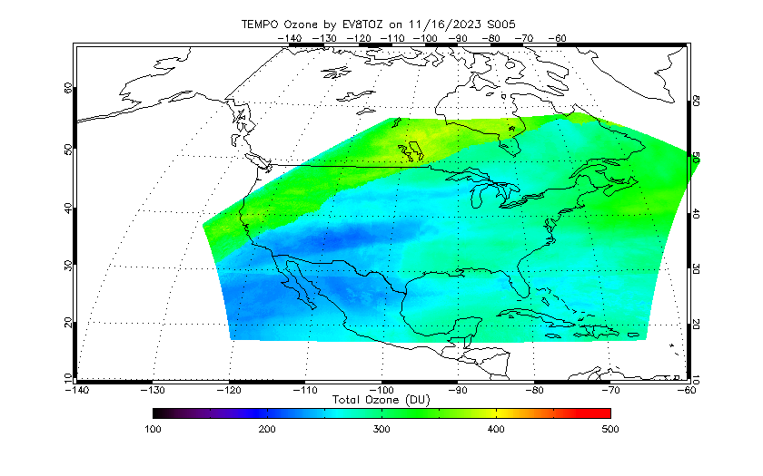
TEMPO S005G01~S005G09

Slide 42
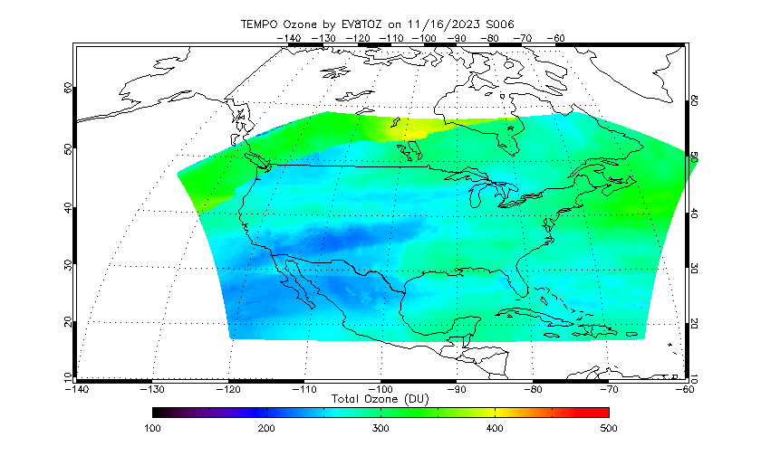
TEMPO S006G01~S006G09

Slide 43
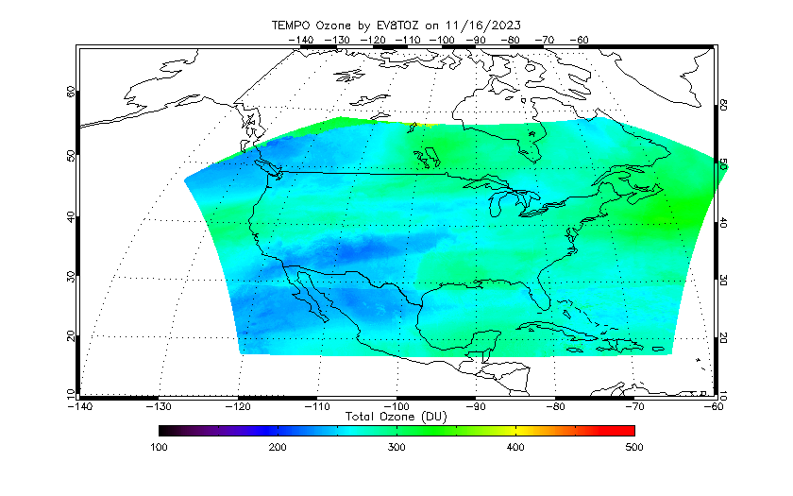
TEMPO S007G01~S007G09

Slide 44
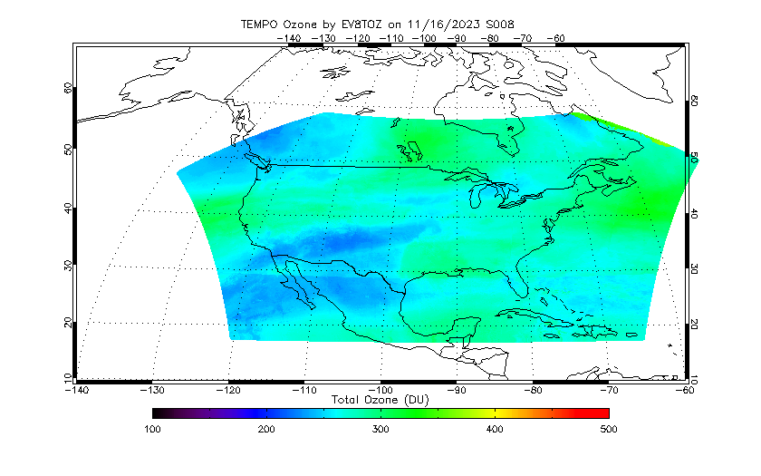
TEMPO S008G01~S008G09

Slide 45
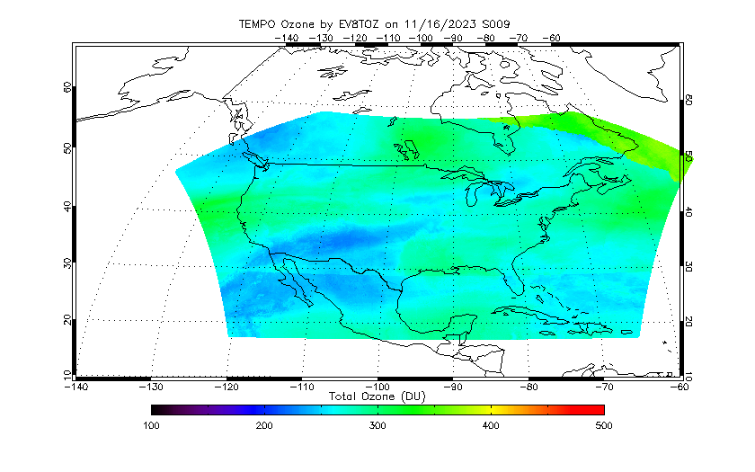
TEMPO S009G01~S009G09

Slide 46
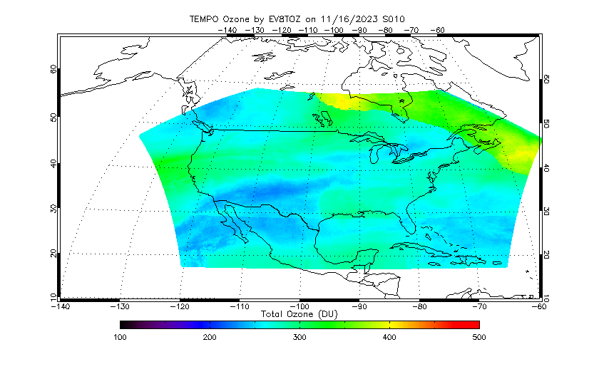
TEMPO S010G01~S010G09

Slide 47
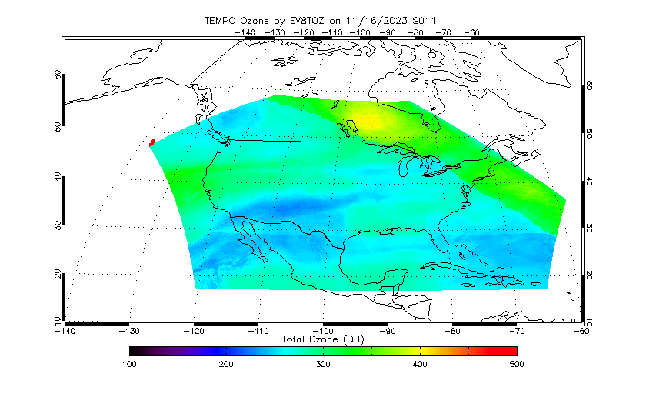
TEMPO S011G01~S011G09

Slide 48
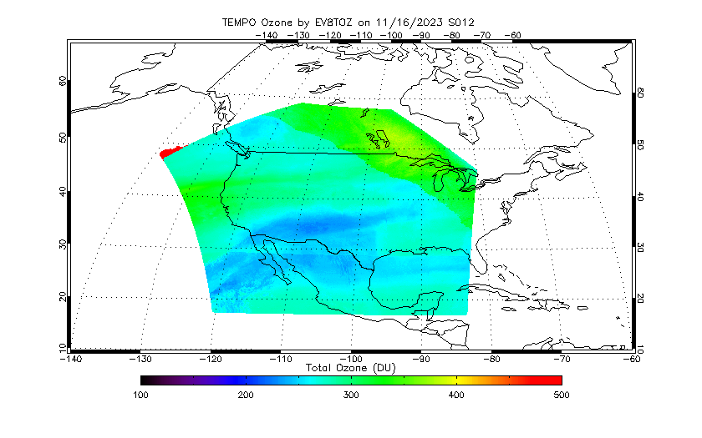
TEMPO S012G01~S012G06

Slide 49
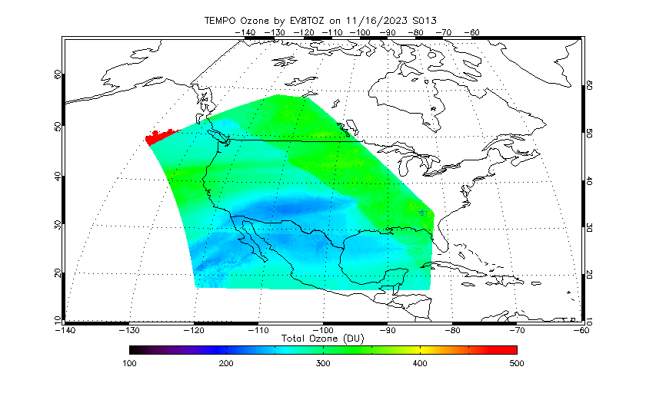
TEMPO S013G01~S013G06

