Slide 1
TROPOMI L1b: UV, VIS, NIR modules: in-flight calibration status
Erwin Loots ^{1 ,} Antje Ludewig ¹, Edward van Amelrooy ¹, Mirna van Hoek ¹, Emiel van der Plas ¹, Nico Rozemeijer ², Simon Spronk ²
¹KNMI, Royal Netherlands Meteorological Institute, De Bilt, The Netherlands,
²TriOpSys B.V., Utrecht, The Netherlands

Slide 2
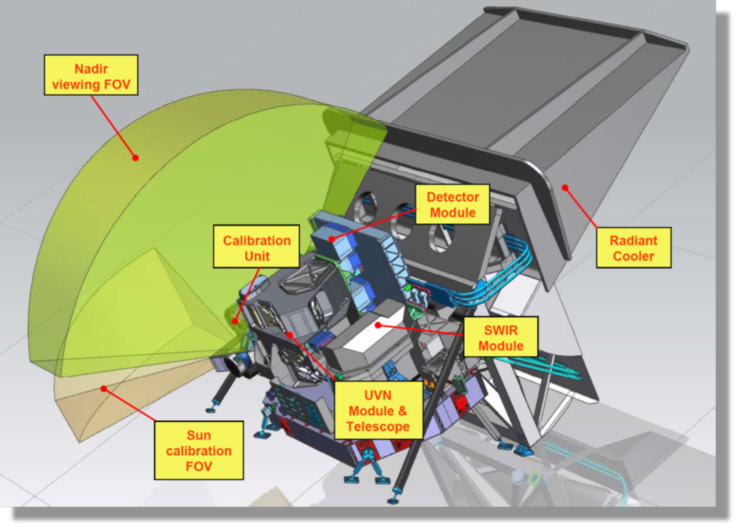
TROPOMI on-board Sentinel-5 Precursor
Single payload
Hyperspectral imager with 4 spectrometers
Sun synchronous orbit (MLTAN 13.30)
Pushbroom with ~ 2600 km swath
High spatial sampling (down to 5.5 km x 3.5 km)
Daily measurements of the Sun via Sun port
Launched 10/2017
Nominal operations since 30/4/2018
TROPOMI spectral bands – based on calibration data
Spectrometer | UV |  | UVIS |  | NIR |  | SWIR
Band ID | 1 | 2 | 3 | 4 | 5 | 6 | 7 | 8
Spectral range [nm] | 267-300 | 300-332 | 305-400 | 400-499 | 661-725 | 725-786 | 2300-2343 | 2343-2389
Spectral resolution [nm] | 0.45 - 0.5 |  | 0.45 - 0.65 |  | 0.34 - 0.35 |  | 0.227 | 0.225
Spectral sampling [nm] | 0.065 |  | 0.195 |  | 0.126 |  | 0.094
Spatial sampling [km²] | 5.5 x 28 | 5.5 x 3.5 | 5.5 x 3.5 |  | 5.5 x 3.5 |  | 5.5 x 7
Detector binning factor | 16 | 2 | 2 | 2 | 2 | 2 | 1 | 1

Slide 3
Current status
Nominal operations (E2) from 2018.04.30
From 2019.08.07: smaller ground pixels
From 2022.07.19: new L01b Processor 2.1
From 2022, autumn: all orbits have been reprocessed (‘collection-3’)
Regular CKD updates to cope with instrument degradation and electronic drifts (last update 2023.07.19)

Slide 4
Calibration developments
Bi-yearly CKD-updates to follow instrument degradation and electronic drift
The updated CKDs affect recent long-term drifts; small jumps in time series at introductions (most recently, 2023.07.19)
→ These corrections are static, i.e. based on off-line analysis, as opposed to dynamic corrections (with either feedback loop from ICAL Processor to L01b Processor, or correction in the L01b Processor itself (viz. dynamic offset correction)
(new!) Currently, we are investigating/preparing additional dynamic in-flight calibration in the UV-detector.
In-flight calibration sources: internal DLED & WLS, but mainly the Sun →

Slide 5
Changes in measured irradiance: related features
What | Where | Magnitude of effect | Estimated residual in data | Corrected in L1b Processor | Remarks
1) Electronic gain drift | All UV, VIS and NIR bands. SWIR not affected | 0.1% | Up to 0.1% during gain jumps | Yes, for almost all orbits. Extrapolation error in recent orbits. | Drifts are per band →spectral jumps at central column
2) Optical degradation | Stronger for short wavelengths, spectral /spatial smooth | 0-12% | <0.7% | Yes, small extrapolation error in recent orbits
3) Day-to-day variation in measurements ‘Hiccups’ | Spat/spec smooth, per detector, UV, VIS, NIR, SWIR | 0.2% UV/SWIR 0.4% VIS/NIR | 0.2% UV/SWIR 0.4% VIS/NIR | No, appear as residuals in the optical degradation derivation | Caused by diffuser or folding mirror mechanism; not deterministic
4) Detector bleaching/ageing | Band 2 (UV) (318-330nm), spatially smooth | 0-14% | <1.5% | Yes, but accidentally also corrects extra SL in band 1 (should be additive not multiplicative) | Correlated with signal magnitude (strongest at 317nm)
5) Changing straylight | Band 1 most affected, spat/spec smooth, also bands 2-4 | 2000e-/s | 30% UV, 6% UVIS of the on-ground straylight | Not yet, testing. Should replace bleaching correction in band 1. | If not corrected: additive error and peaks in FL (280nm)
6) Solar variation | Only around 280,285,288 nm in band 1 | Increasing, now 15% | n/a | No | Correlates with Sun spot counts
7) Spectral stability | All detectors, strongest in SWIR |  | 2-50pm shift | No. L1 does no calibration only annotation | Correlates with grating T for SWIR
8) Detector “scratch” | Band 3, some curved, but only locally | 1% |  | Not yet, testing

Slide 6
Light parts and instrument components (should) determine the correction CKDs
Sun
Earth
irradiance optical path
UV only:
spectral
ageing CKD
- “common” irradiance CKD
- CKD QVD1
- CKD QVD2
Diffusers QVD1 or QVD2
Folding mirror
Telescope + Spectrometers
radiance optical path

Slide 7
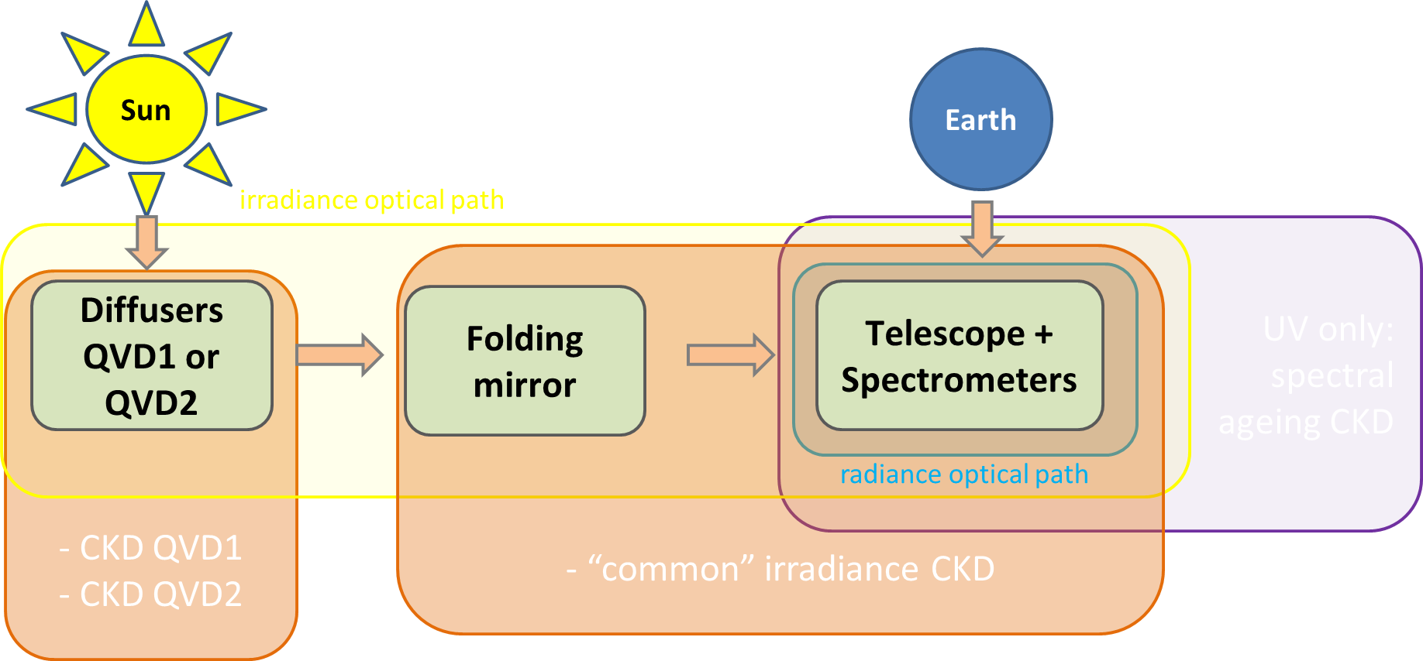
In-flight calibration: degradation flavours
Degradation (long-term drift in signal)
  Multiplicative!
  Smoothness? spectrally/spatially. Pixel position vs pixel wavelength
  Monotonous?
  Cause. Leads to degradation components:
    Diffuser only (IRR)
    Instrument light path w/o diffuser (RAD, IRR)
    Detector bleaching (RAD,IRR, CU)
    Sharp detector features (RAD,IRR, CU)

Slide 8
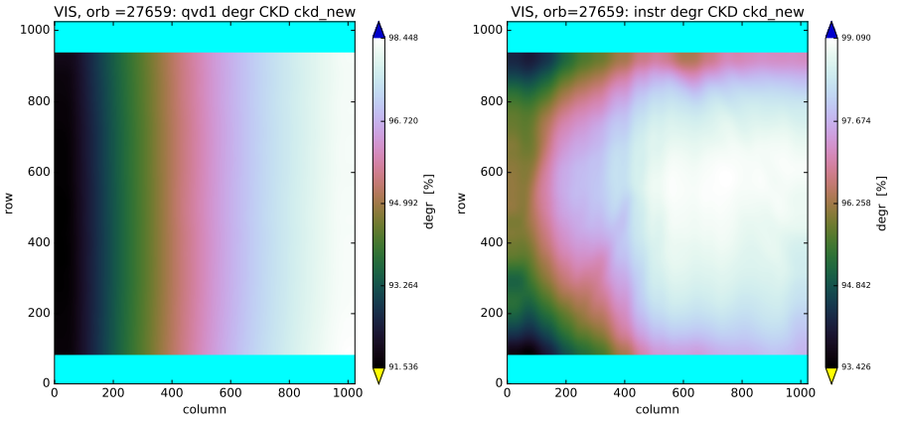
Degradation (1/3): diffuser, common instrument (main flavours)
Diffusers (QVDs) degrade
QVD1 (main) more than QVD2 (backup) (proportional to exposure)
Common/instrument degradation (spectrometer &/ FMM)
Degradation strongest for short wavelengths
NIR and SWIR so far almost or no degradation
Correction applied in v2 L1b since July 2021
Extrapolation in L01b works well
Diffuser CKD Common instrument CKD

Slide 9
Degradation (1/3): diffuser, common instrument (main flavours)
Diffusers (QVDs) degrade
QVD1 (main) more than QVD2 (backup) (proportional to exposure)
Common/instrument degradation (spectrometer &/ FMM)
Degradation strongest for short wavelengths
NIR and SWIR so far almost or no degradation
Correction applied in v2 L1b since July 2021
Extrapolation in L01b works well
Diffuser CKD Common instrument CKD

Slide 10
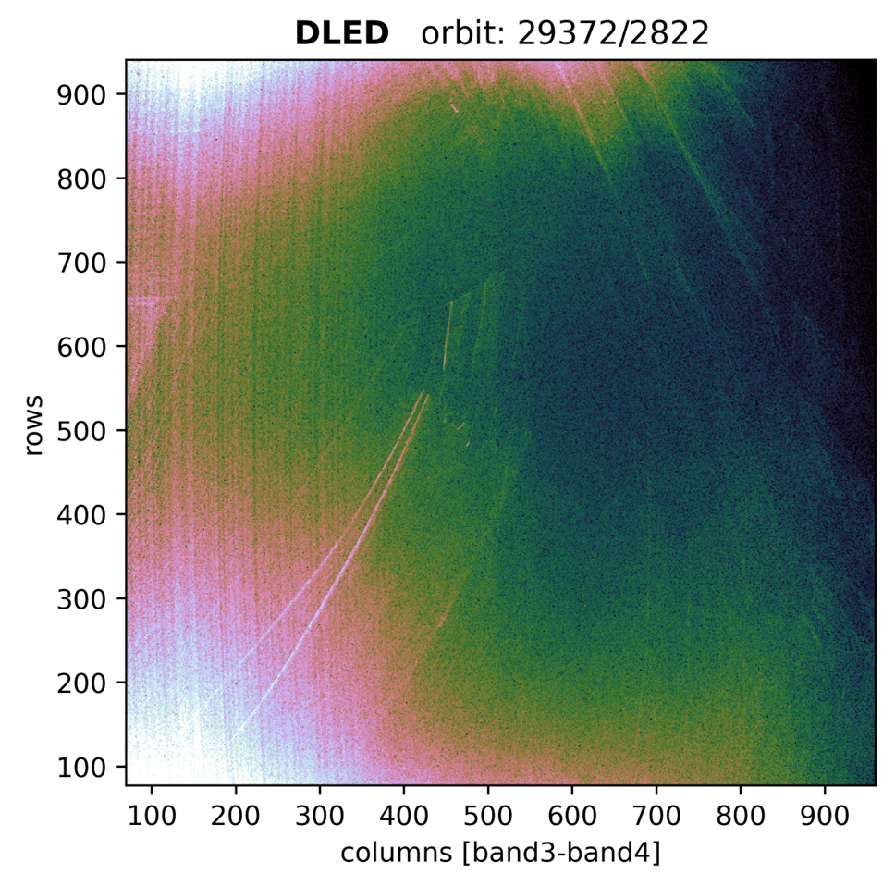
‘New’ flavour: UVIS detector “scratch”
Example of ‘Sharp detector feature’:
In normalized images, ‘scratches’ can be observed, in IRR/WLS/DLED measurements
The two deepest (lower left) features have been analyzed.
Consistent in all measurements, both monotonously and jump-wise growing (to 1-2%) but stabilizing.
This degradation can be separated from (not-sharp, LF) common instrument degradation
→ Separate correction CKD is being tested, will ensure spectral smoothness.
Correction not yet operational (2025?)
GSICS Annual Meeting 2024 - TROPOMI L1b UVN

Slide 11
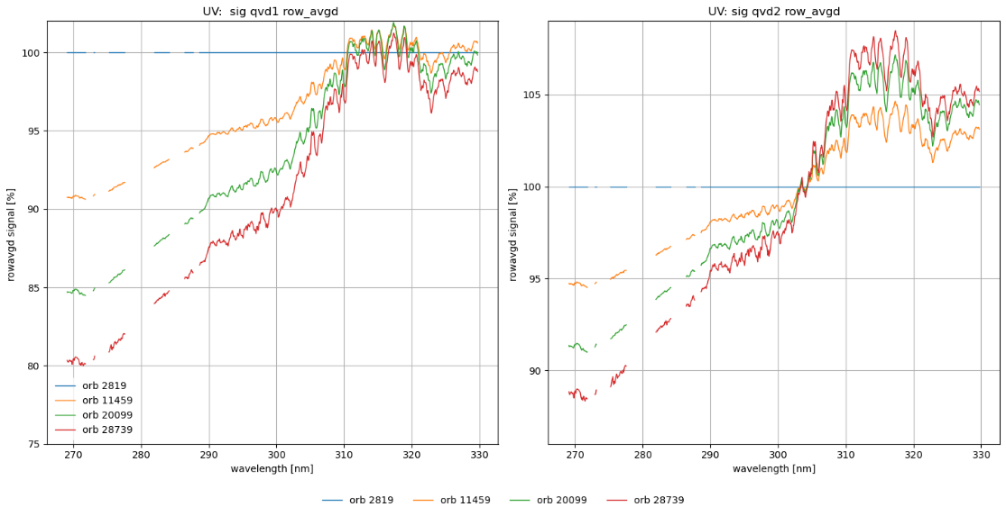
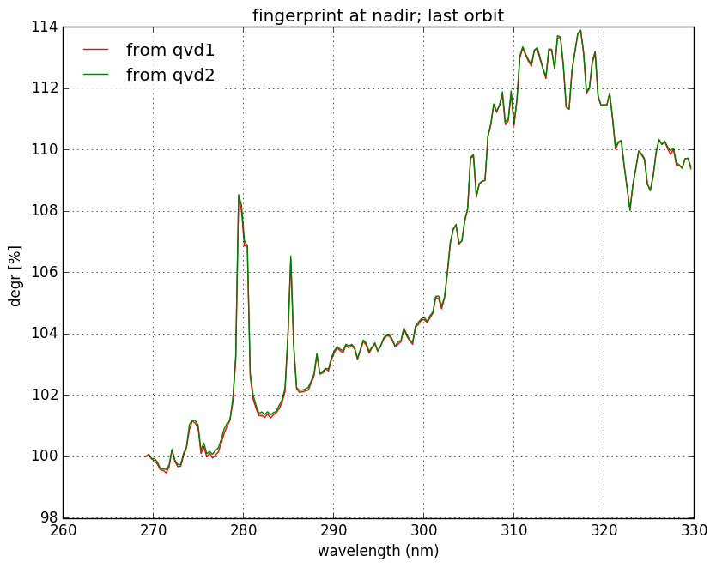
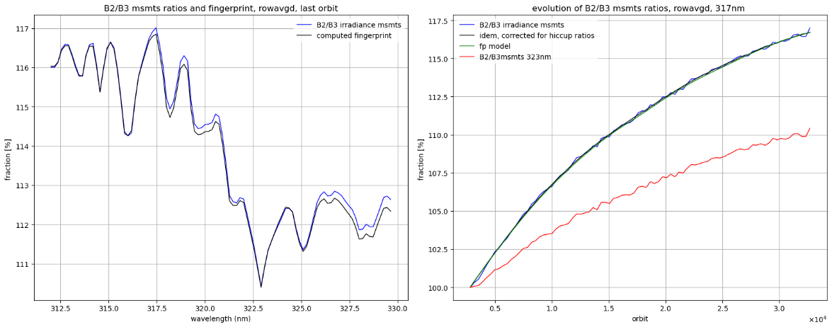
Degradation (2/3): the ‘UV detector bleaching’ flavour
(a)
Measurements (a) show signal increase correlated with solar lines
In region 312-330 nm comparison with band 3 possible (b)
Suspect bleaching close to or on/within the detector
Modeled by separation from instrument CKD: gives extra ‘spectral ageing’ CKD for UV detector (c)
The temporal CKD shows a slowing increase in time ( d)
Thus, modeled from irradiance data and…
…the correction CKD applied to both radiance and irradiance products
2018 2024
(c)
(b) ( d)
10 November 2023

Slide 12
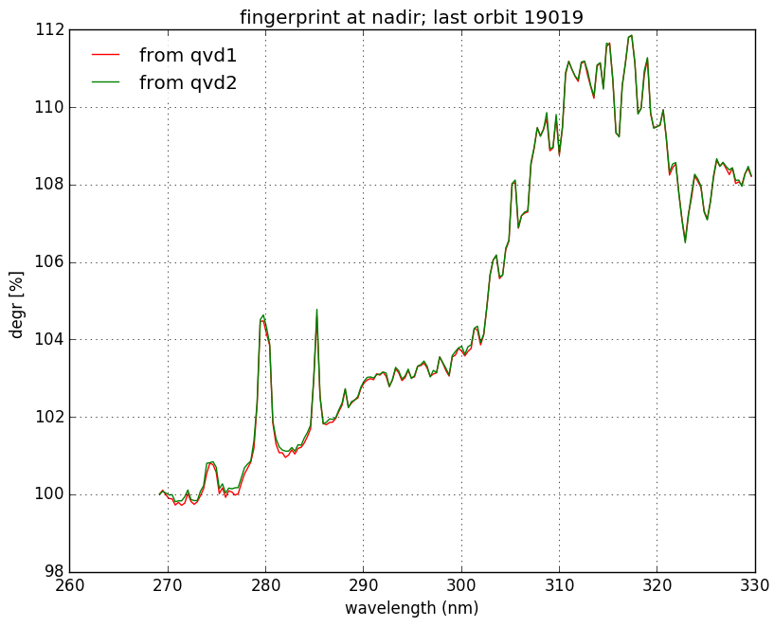
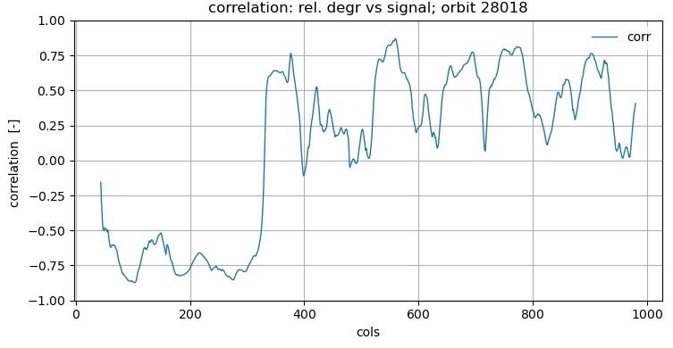

Degradation (3/3): from contradiction in UV to re-assessment
The constructed multiplicative spectral ageing CKD shows increasing positive peaks at 278 and 286 nm (where the absolute signal is minimal), suggesting an additive term, this is also an observation from O3-profile retrievals in UV.
This contradicts the bleaching hypothesis connected to the spectral ageing phenomenon. Bleaching correlates with absolute signal → peaks caused by uncorrected-for offset?
→ main residual offset candidate is (far-field) straylight.
→ Thus starts the Quest for the ‘lost’ UV offset.
Only once it is found (and after repairs!), will the UV degradation make sense again.
Correlation: ageing CKD vs signal
Constructed CKD

Slide 13
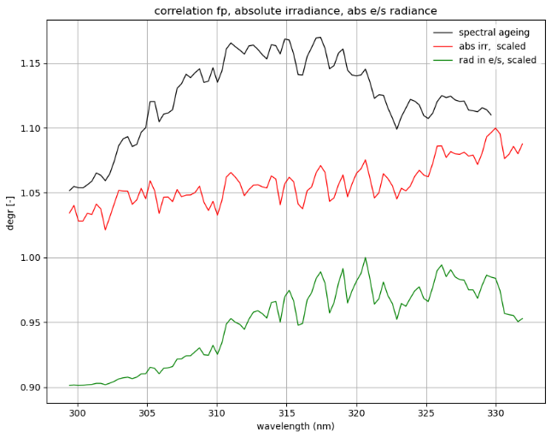
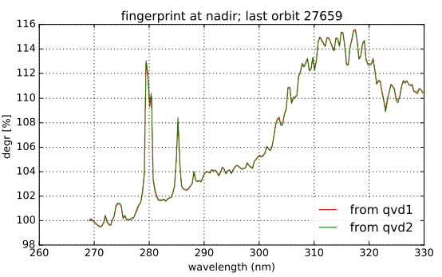
Resume: In-flight calibration: degradation flavours
Degradation (long-term drift in signal)
  Multiplicative!
  Smoothness? spectrally/spatially. Pixel position vs pixel wavelength
  Monotonous?
  Cause. Leads to degradation components:
    Diffuser only (IRR): D = f(lambda), LF
    Instrument light path w/o diffuser (RAD, IRR) D = f(lambda,x), LF
    UV Detector bleaching (RAD,IRR, CU) D = f(S_rad,abs), HF
    Sharp detector features (RAD,IRR, CU) D=f(x), HF
    UV-1 contradictive, D=f(1/S)? →uncorrected additive effect
(Case 3)
Case 1 Case 2 Case 4 Case 5 Case 3

Slide 14
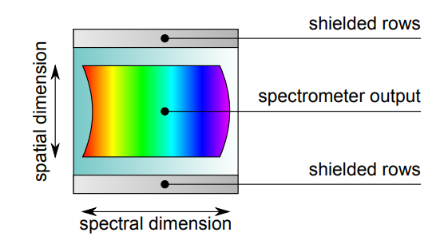
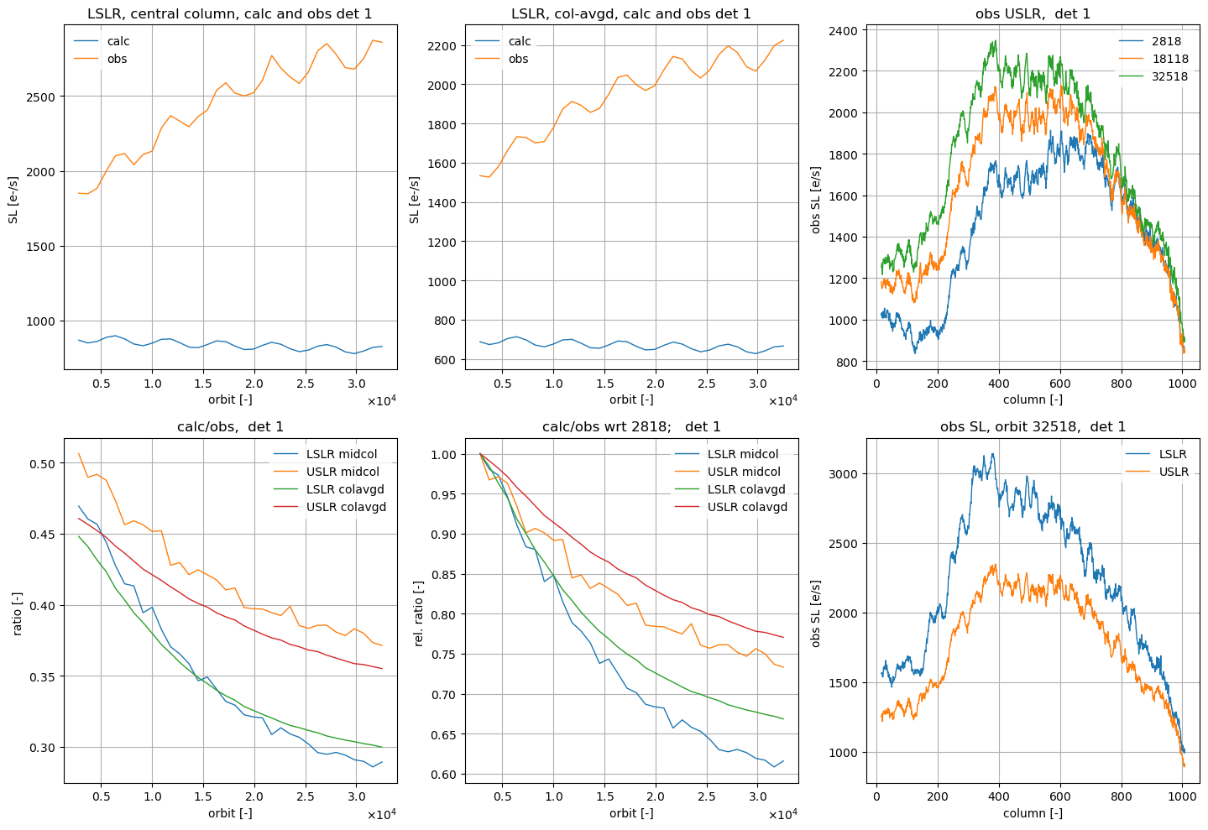
Straylight: modeling and measuring
On each detector there are masked rows (“upper and lower straylight regions”, USLR & LSLR): they do not receive direct light
Signals in these regions are monitored for all (irr)radiance measurements, all scanlines
We monitor calculated (using the straylight convolution kernel CKD) and observed (measured signal before SL correction) signals.
If straylight calibration is perfect, then observed=calculated and signal after correction in these regions is zero. (in practice, we tolerate a slightly positive value: overcorrection is to be avoided)
shielded
masked
masked
shielded
upper straylight region (USLR)
rows
science
lower straylight region (LSLR)
columns (spectral)

Slide 15
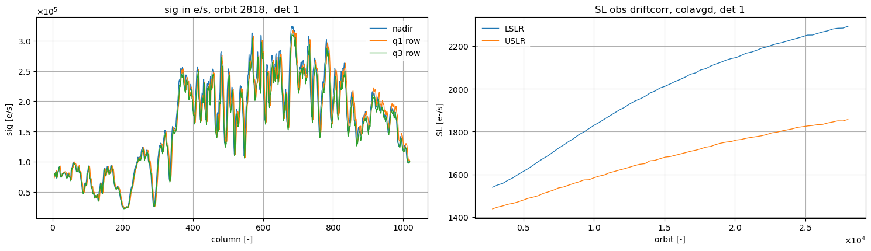
The quest for the lost offset: Straylight in UV
Observations:
  observed straylight is higher than calculated straylight
  this discrepancy increases in time.
(We could reassess the on-ground straylight calibration, leading to a heavier straylight convolution kernel CKD. But the growth in straylight will make such an improvement increasingly worse.)
The straylight arriving in UV-1 (<300nm) part of detector is probably far-field straylight stemming from the much higher absolute signal in the UV-2 (>300nm) part: both smooth and offset-like.
SL increase in USLR/LSLR is well monitored, but not known in science region…
→ … from IF monitoring to IF calibration?
upper straylight region (USLR)
rows
science
lower straylight region (LSLR)
columns (spectral)

Slide 16
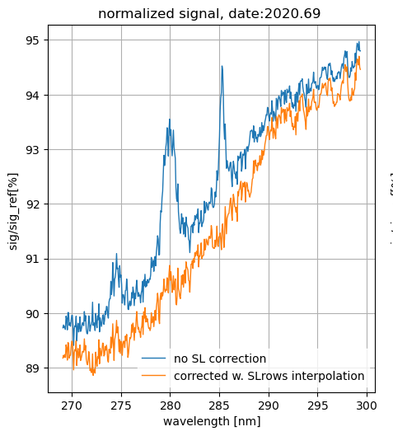
The quest for the lost offset: Toward a dynamic in-flight correction
For all IRR/RAD msmts, we know the observed-calculated straylight difference in the straylight regions
Idea: We can, for each measurement, construct an extra straylight image based on this difference and linear interpolation toward the interior science rows
This extra straylight image signal can be dynamically subtracted from the signal in the L01b Processor
Success criterion: the normalized signal (after this new correction) has no positive peaks, and the multiplicative optical degradation is spectrally smoother, as in the other detectors.
upper straylight region (USLR)
S_obs – S_calc
rows
science
lower straylight region (LSLR)
LSLR science USLR
columns (spectral)
Detector row

Slide 17
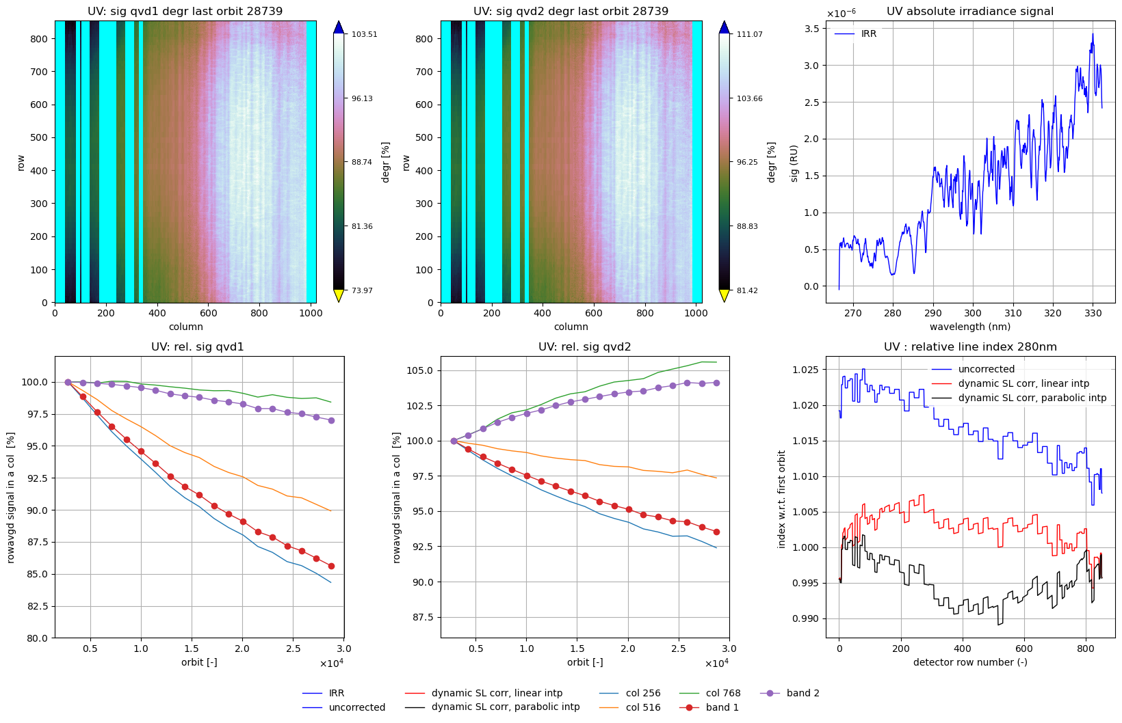
The quest for the lost offset: dynamic straylight correction: line indices
Thus, in principle, a dynamic far-field straylight correction can cope with long term offset-like straylight increases. And without residual offsets, degradation can again be modeled as multiplicative operations, and corrected for.
Robustness of such a dynamic L01b algorithm has to be ensured
Uniqueness of this solution? → Look at solar line indices (*): ratios of throughs and peaks around absorption lines. These indices are stable for all multiplicative (and spatially and spectrally smooth) degradation phenomena.
→ the simple dynamic correction with linear interpolation seems the most stable, for both IRR and RAD measurements.
(*) Marchenko et al, GSICS 2023
←Line index =
2Sb/(Sa+Sc)
Solar line index,
orbit 11459:→
a
c
b

Slide 18
Conclusions and outlook
The Tropomi L01b Processor corrects for optical degradation using in-flight calibration.
  Method: irradiance measurements with two diffusers AND understanding of light paths and instrument components
  The degradation can be divided in several components, with their own CKDs.
  The ‘UVIS detector scratch’ will be such a separate CKD
  UV detector bleaching necessitates another such separated component: the ‘spectral ageing’ CKD
Proper degradation correction requires absence of offsets, both at start of mission and forever after.
The Tropomi L1b Processor corrects for straylight.
Temporal growth of straylight is observed from in-flight monitoring
  Lesson: In-flight monitoring does not imply in-flight calibration.
  UV straylight drift and optical degradation need to be decoupled: first a proper SL removal is needed
  For UV, a robust, simple, additional dynamic straylight correction based on SL monitoring is being tested.
  This correction removes unwanted offset in UV, thereby again enabling proper degradation correction.
Lesson: Applying degradation corrections requires extensive knowledge of complex instrument behaviour (SL growth, detector bleaching,…)

Slide 19
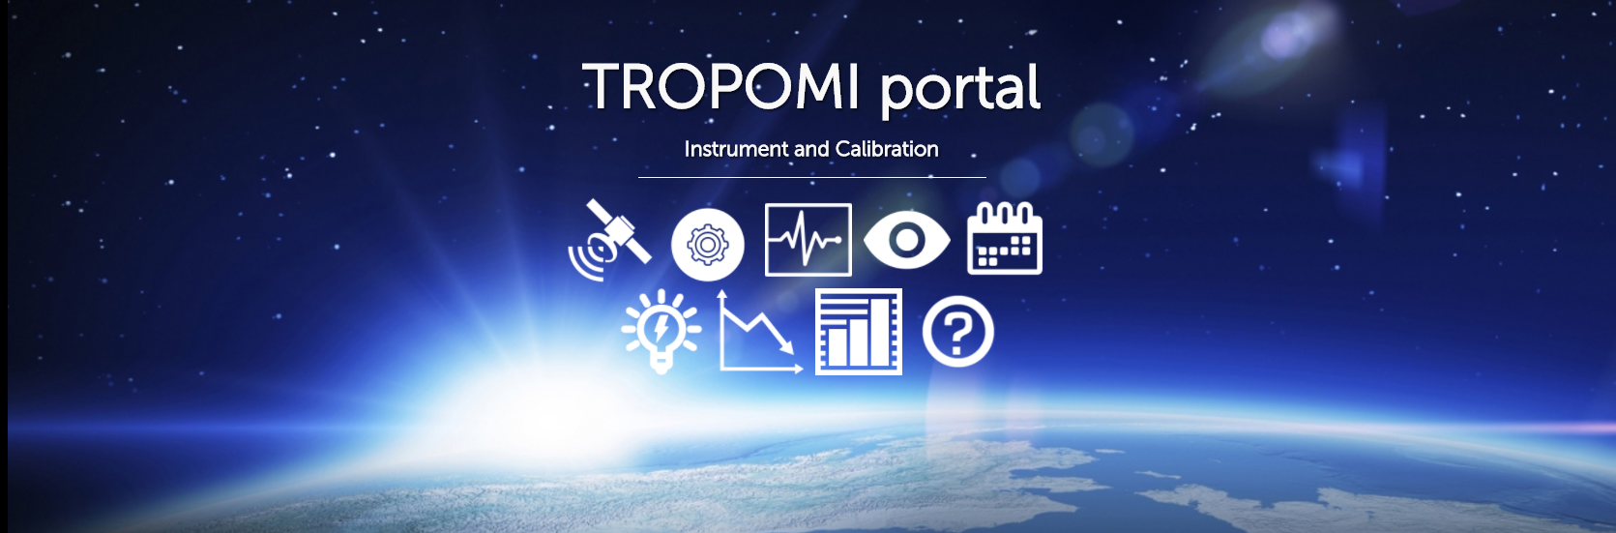
Thank you!
general information: http://www.tropomi.eu/
more on TROPOMI calibration: Kleipool et al. 2018 https://doi.org/10.5194/amt-11-6439-2018
Ludewig et al. 2020 https://doi.org/10.5194/amt-2019-488
Acknowledgement: Sentinel-5 Precursor is a European Space Agency (ESA) mission on behalf of the European Commission (EC). The TROPOMI payload is a joint development by ESA and the Netherlands Space Office (NSO). The Sentinel-5 Precursor ground-segment development has been funded by ESA and with national contributions from The Netherlands, Germany, and Belgium.
GSICS Annual Meeting 2024 - TROPOMI L1b UVN

