Slide 1
GSICS Annual Meeting
UVNS Breakout Session 7L
Darmstadt, Germany (remote)
13 Mar 2024, 17:00-17:10 CET
OCO-2 and OCO-3: Mission Status and Calibration Improvements
Robert Rosenberg, Graziela Keller, Gary Spiers, Junjie Liu, Vivienne Payne, Abhishek Chatterjee
Contact Email: Rob.Rosenberg@jpl.nasa.gov
© 2024 California Institute of Technology. Government sponsorship acknowledged.

Slide 2
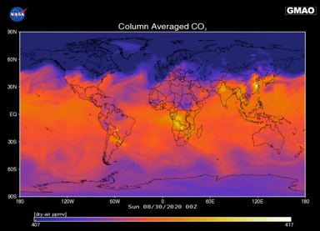
Outline
Orbiting Carbon Observatory
Watching The Earth Breathe…Mapping CO₂ From Space
Instrument & Calibration Approach
Extended Mission Timelines
OCO-2 Solar Record & Lunar Corrections
OCO-3 Pre-Storage Calibration Record
8/30/2020, L3 407-417 ppm
Image Credit: B. Weir & L. Ott

Slide 3
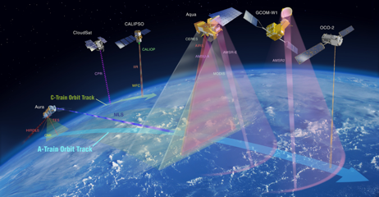
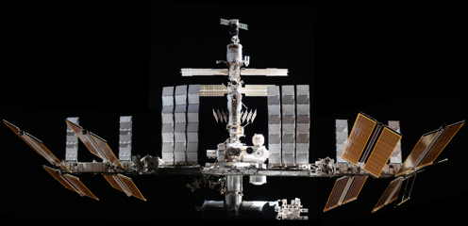
OCO-2 and OCO-3 Provide Complementary Information
Orbiting Carbon Observatory
Key differences include latitude, local time, target acquisition

Slide 4
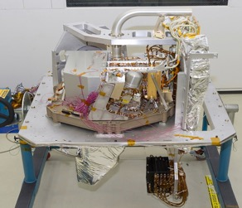
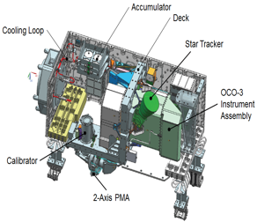
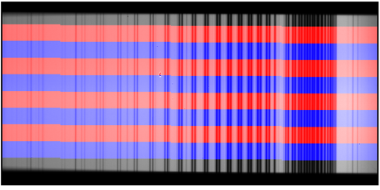
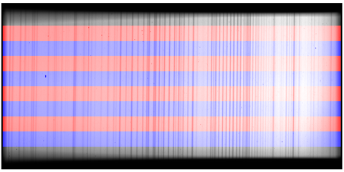
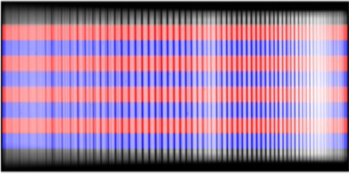
Instrument Basics
Orbiting Carbon Observatory
Three-Channel Grating Spectrometer with Common Entrance Optics
Science goals require X_{CO2} retrievals with precision better than 1 ppm (less than 0.25%), placing strict demands on preflight & inflight calibration
O₂ A 758-772 nm
Weak CO₂ 1591-1621 nm
Strong CO₂ 2043-2082 nm

Slide 5
Calibration Data Flow
Orbiting Carbon Observatory
Some coefficients used to make L1b from L1a, some “pass through” to L2
Level 1A:
Uncalibrated Signal & Temperatures
Level 1B:
Calibrated Radiance & Uncertainty
Level 2:
Modeled Radiance & Retrieved State of Atmosphere
Level 1B Inputs: Radiometric Calibration
Dark Correction | Function of temperature
Stray Light | Function of avg signal
Preflight Gain | Corrects nonlinearity
Gain Degradation | Linear inflight scaling
Level 2 Inputs: Calibration and More
Dispersion | Wavelength vs column
Instrument Line Shape | 200 element lookup table
SNR Model | Background and photon
Bad Sample List | Remove outliers
ABSCO Tables | High resolution spectra
Geolocation | To resample meteorology
Retrieval Config | Prior, covariance, + more
r01 (forward) updated weekly
r02 (retrospective) updated monthly or all at once in major campaigns

Slide 6
Extended Mission Timelines & Selected Key Events
Orbiting Carbon Observatory
Launch
Jul 2
2014
Science
Sep 6
2014
EOPM
Oct 18
2016
Anomaly
Jul 30
2017
Senior Review
2020
Version 11
Mar 1
2022
Senior Review
2023
Senior Review
2026
Recently completed: 249 orbits lost Sep-Dec 2023 to lapsed downlinks
Now: Version 12 prep, intermediate updates for DEM, meteorology
Launch
May 4
2019
Science
Aug 6
2019
Decon
Jan 20
2021
EOPM
Jan 23
2023
Anomaly
Oct 9
2023
Storage
Nov 13
2023
IOC #2
Summer
2024
ISS
End of Life
?
Recently completed: Review & acceptance of V11 calibration coefficients
Now: Eagerly awaiting reinstall, Version 11 L1B & L2 by December 2024

Slide 7
OCO-2 Solar Trend Relative to Aug 2014 (to Orbit 51480)
Orbiting Carbon Observatory
~12 measurements per day, aging much faster than instrument
“Fast” (icing) slowing down
“Slow” (other) also nonlinear

Slide 8
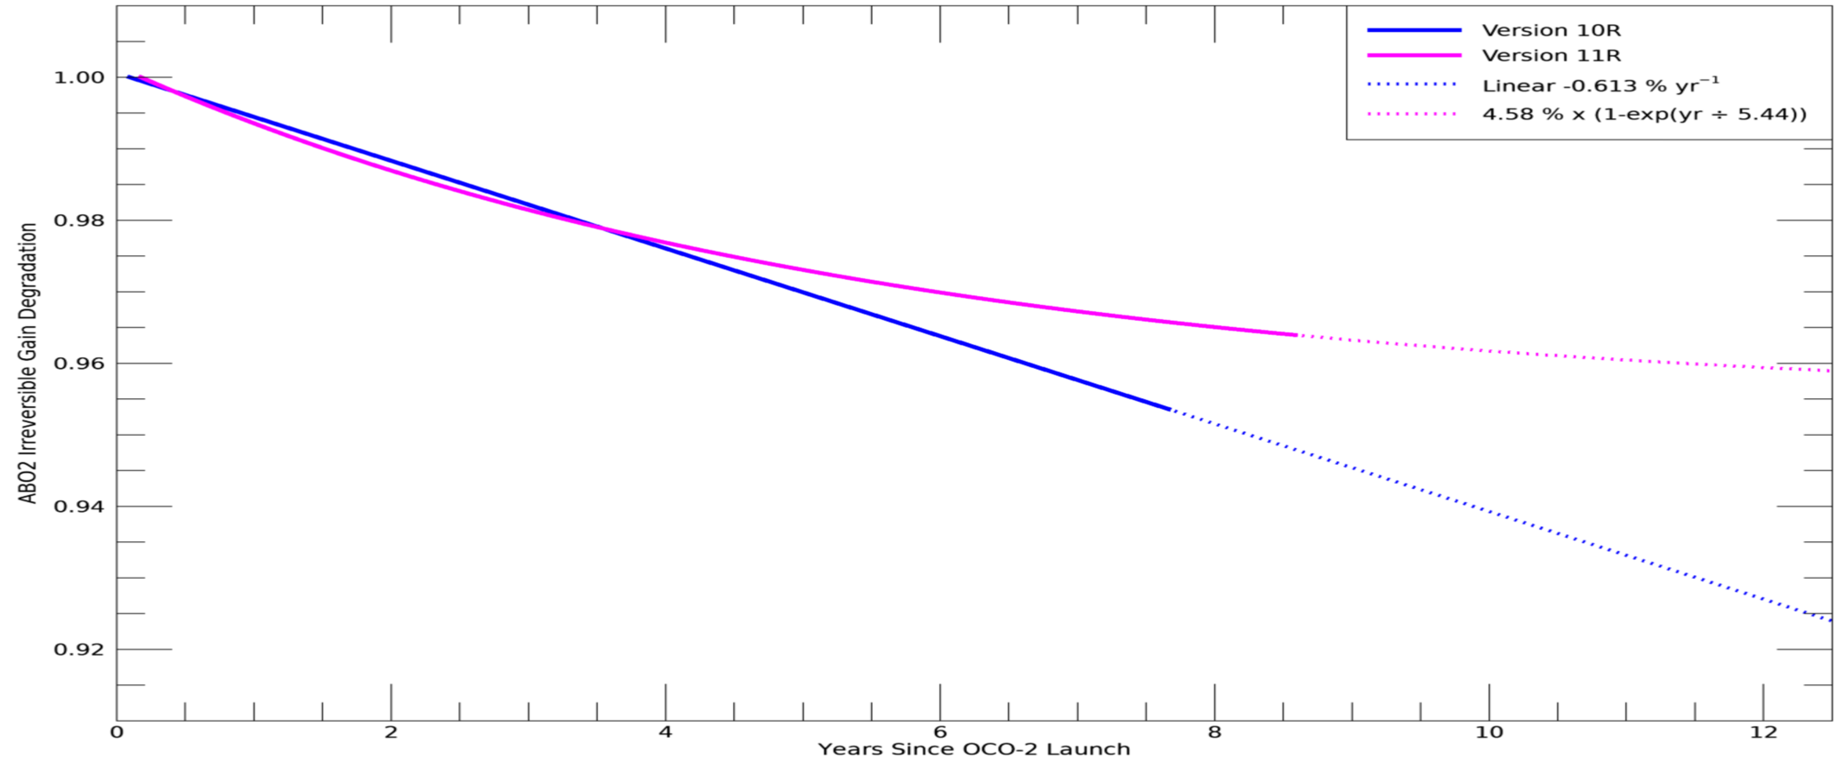
OCO-2 O₂ A-Band Lunar Trend Update for Version 11
Measurements Continue Monthly, Will Update for Version 12

Slide 9
OCO-3 Radiometric Calibration Combined Timeline
Orbiting Carbon Observatory
Symbols above for lunar, vicarious, and OCO-2 crossings indicate times
Symbols below show actual (median) lamp radiance ratios vs Sep 2019
More about this period in next talk by G. Keller

Slide 10
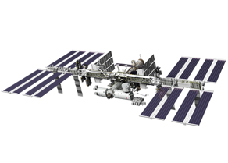
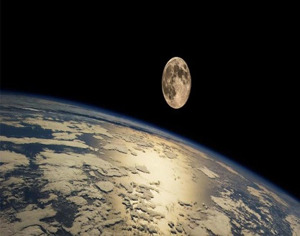
Conclusion
Orbiting Carbon Observatory
Consistently accurate calibration is vital for carbon cycle science
As record lengthens, reprocessing campaigns cost more, take longer, and are less frequent
Continuing to monitor detector health using daily dark & lamp measurements, very stable
Maturing analysis techniques & extending time series for vicarious calibration, simultaneous nadir overpasses, and lunar calibration
Data accessible to the public:
https://disc.gsfc.nasa.gov/
L1B ATBD updated Feb 6. 2024

