Slide 1
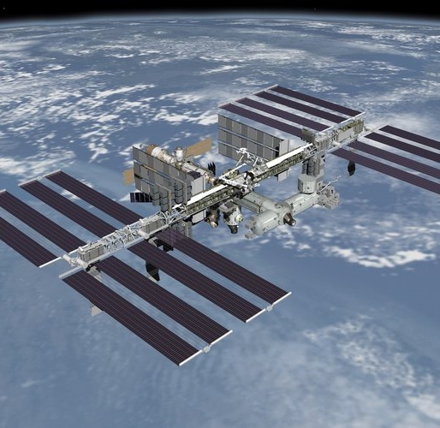


OCO-3 Oxygen A-Band In-Band Spectral Shape Corrections
Graziela R. Keller^{1*}, Rob A. Rosenberg¹, Aronne Merrelli², Christopher W. O'Dell³, Vivienne Payne¹, and Abhishek Chatterjee¹
* OCO-3 Calibration Team Lead
¹ Jet Propulsion Laboratory, Pasadena, CA, USA
² University of Michigan, Ann Arbor, MI,USA
³ Colorado State University, Fort Collins, CO, USA

Slide 2
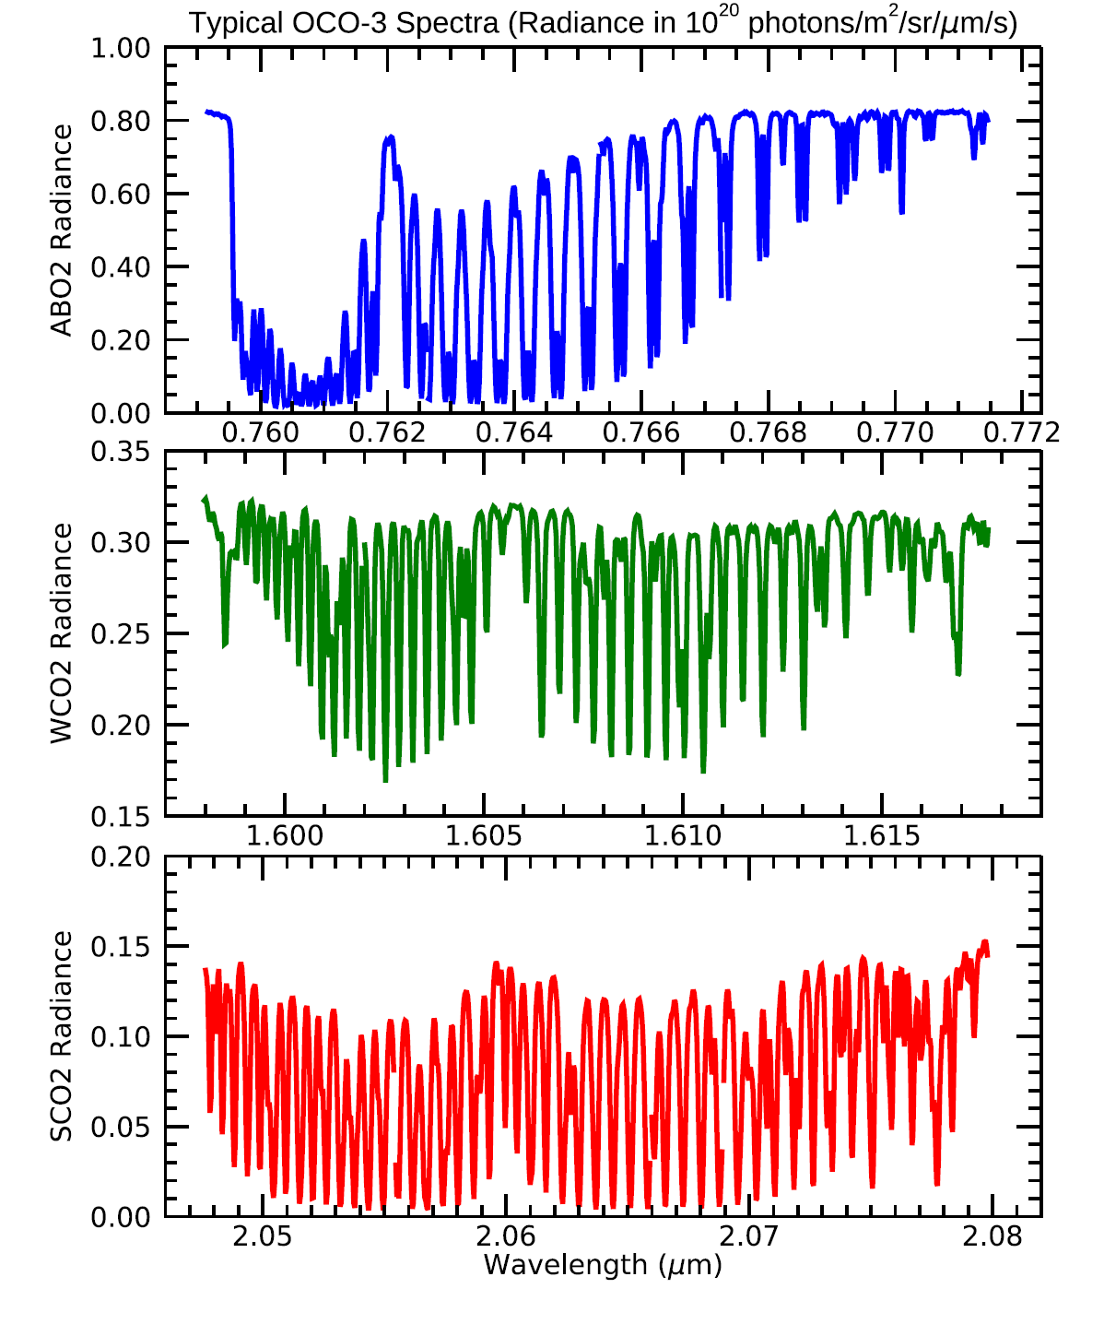
Introduction
OCO-3 launched on May 4th 2019 and is operated from the ISS.
OCO-3 uses the flight spare spectrometers from OCO-2. They are comprised of three long slit grating spectrometers, producing spectral images on three separate CMOS focal plane arrays with a resolving power near 20,000. Calibrated Science data is provided for 1016 spectral samples and 8 spatial footprints.
OCO-3 cannot observe the Sun and lunar observations are severely constrained by limited field of regard. OCO-3 B11 inflight calibration depends on observations of the on-board lamps and of the Earth, besides dark current observations.
Gain degradation coefficients are the main product delivered by the calibration teams through Ancillary Radiometric Products (ARPs).
ABO2
WCO2
SCO2
The Calibration Team for OCO-3 delivers ARPs in two streams
  Forward Stream: Weekly deliveries and typical weekly coverage. Data is extrapolated into the future.
  Retrospective Stream: ARPs cover anywhere from 3 to 7 days. No extrapolation necessary.
    Reprocessing Campaigns
    Rolling Retrospective ARPs delivered monthly.
  OCO-3 currently going through a reprocessing campaign: Build 11.

Slide 3
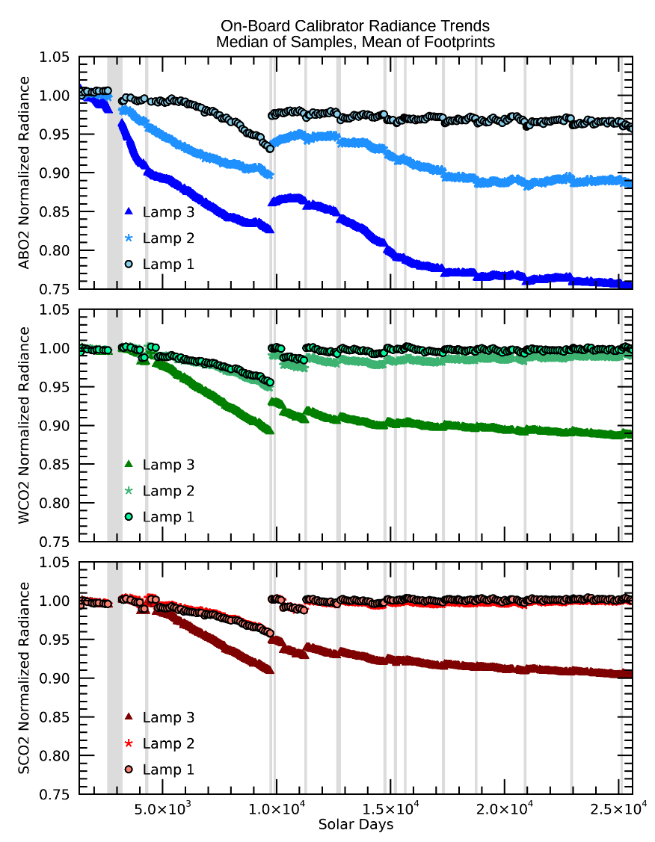
On-Board Calibrator
Three tungsten halogen lamps illuminate a gold coated reflective diffuser.
Comparison between lamp observations inflight and prelaunch are used to assess the degradation of the instrument response, but lamp aging is a confounding factor.
The lamps are observed at different cadences:
L1 – 1% of the time. Every 100 SDs or 6.5 days;
L2 – 19% of the time. Every 5 SDs or 8 hours;
L3 – 80% of the time. Every SD excluding those above.
By assuming we know how L1, the least used, ages, we can use L1 data to constrain aging of lamps 2 and 3 to both mitigate lamp aging and at the same time retain the temporal resolution allowed by lamp 3 observations.
In B10, we made the assumption Lamp 1 did not age.
Details on radiometric calibration of OCO-3 in B10 can be found on
G. R. Keller et al., "Inflight Radiometric Calibration and Performance of the Orbiting Carbon Observatory 3 for Version 10 Products," in IEEE Transactions on Geoscience and Remote Sensing, vol. 60, pp. 1-18, 2022, Art no. 5413518, doi: 10.1109/TGRS.2022.3216825.

Slide 4
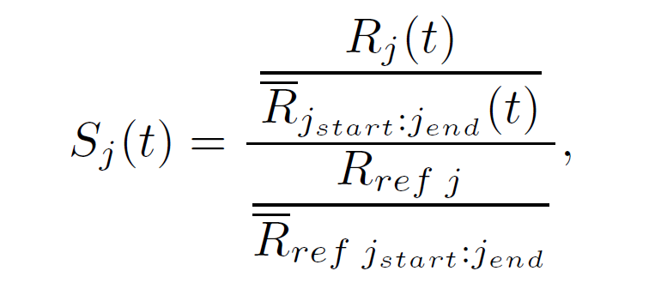
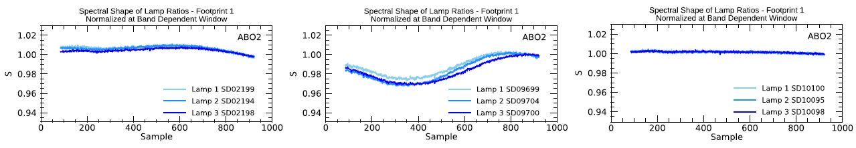
Spectral Profile of Lamp Observations
The spectral shape of lamp ratios with pre-launch in the ABO2 changes during the mission.
We define the Shape parameter S, as on the right, to describe the curvature observed.
Curvature develops gradually in the ABO2 and is abruptly removed by a decontamination event.
The three lamps diverge in terms of ABO2 curvature as contamination builds up.
Early Mission Right before decon event Right after decon event

Slide 5
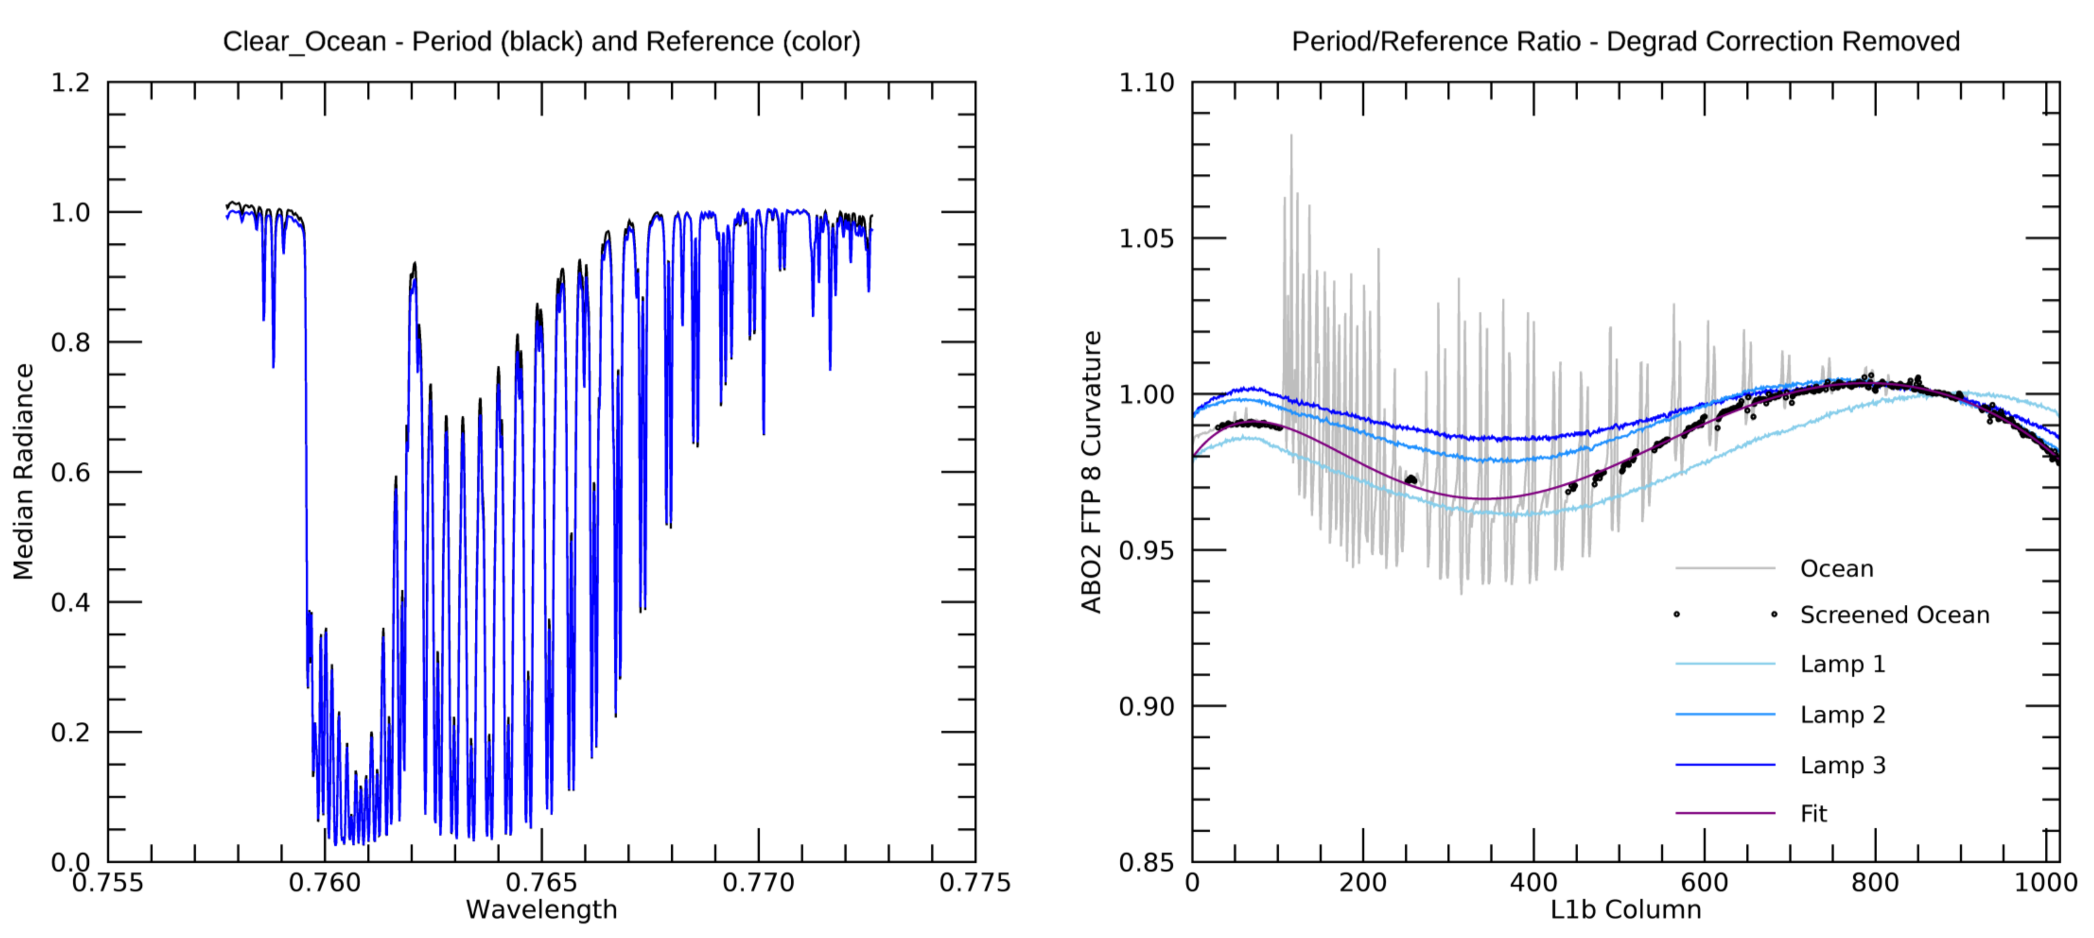
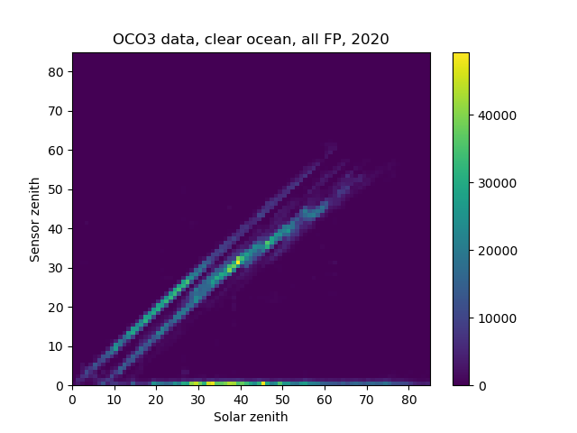
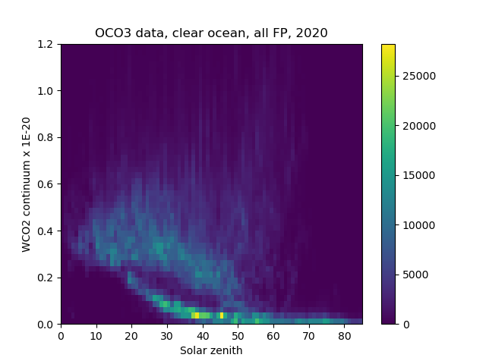
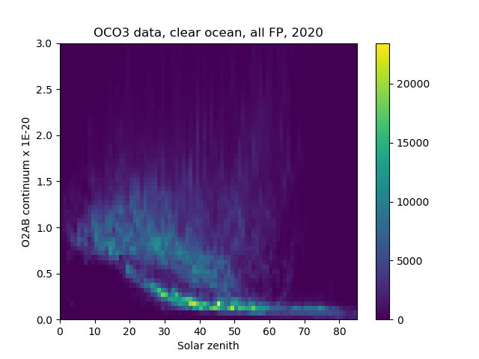
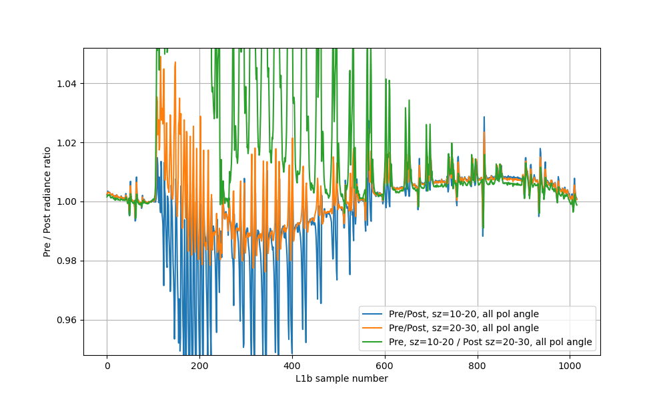
Deriving Curvature from Clear Ocean Scenes
ABO2 FTP 8
ABO2 FTP 8
During periods of high contaminant buildup, the ABO2 spectral curvature imparted to each lamp is different and so is the curvature imparted to clear ocean scenes (right panel). Lamp 2 is a better match to ocean curvature.
Average thousands of clear ocean soundings for low- and high-contaminant periods (blue and black lines on the left panel, respectively).
Before averaging:
  Calibrate with preflight gains
  Apply dispersion correction
  Normalize spectra to median radiance of 771 nm continuum
  Align spectrally using a correlation function
  Screen residual spectral lines
Similarly normalized lamp data were overplotted.
S
Sample
Aronne Merrelli
Aronne Merrelli
Aronne Merrelli
Scene selection criteria
Ocean Glint:
sounding_land_fraction < 1.
sounding_operation_mode = ‘GL’
Air Mass:
Air mass: [2.071,2.128];
sounding_zenith: [5.,50.];
sounding_solar_zenith: [5.,50.];
Continuum Radiances:
WCO2 Continuum Radiance: [2.0E19,6.0E19]
ABO2 Continuum Radiance: [6.0E19,1.6E20]
Clear Sky Check:
dp_abp: [-20,20.]
idp.co2_ratio_idp: [0.99,1.035]
Aronne Merrelli

Slide 6
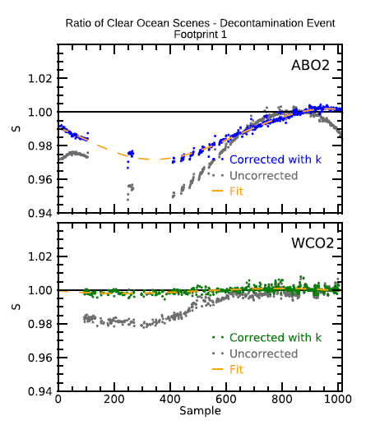
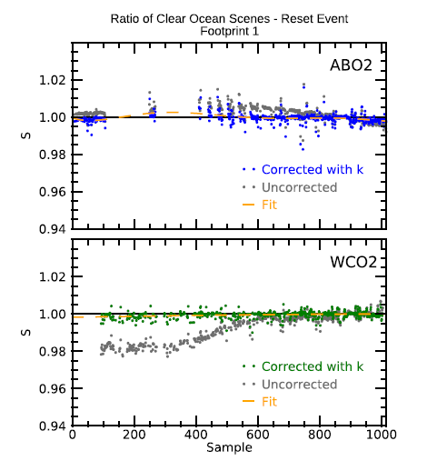
Radiometric Error Incurred in Build 10
In B10, the gain degradation coefficients provide a sample by sample relative on-orbit calibration within the A-band better than 0.5% except during the high contamination periods, when the error will increase with time and reach up to 3% in some wavelengths.
The discrepancy among the lamps occurs during periods of high contamination and challenges our ability to describe the radiometric response of the instrument through lamp observations during this period, which starts around June 2020 and slowly reaches its worst on January 2021.
The decontamination event on SD 9780 resolved this problem and the more frequent decontamination events that follow have avoided reoccurrences.
High Ice, FTP1
Low Ice, FTP1

Slide 7
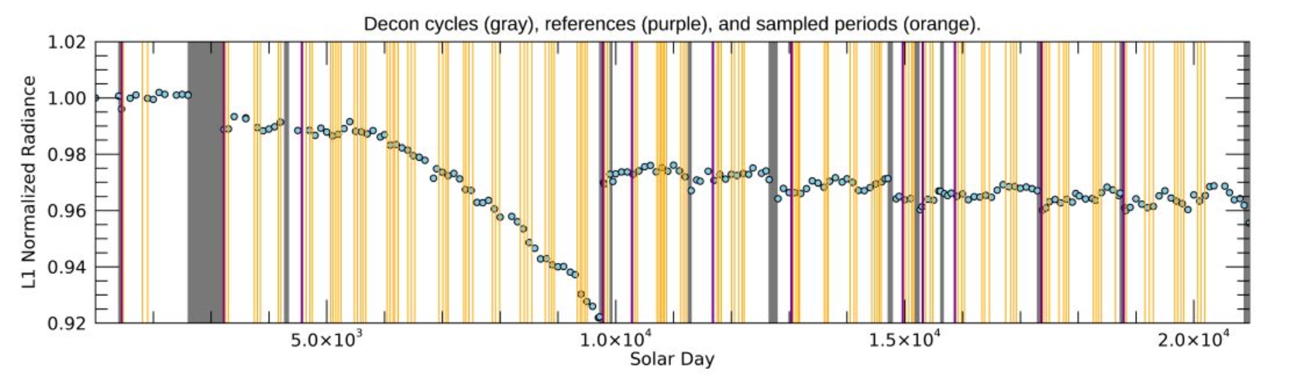
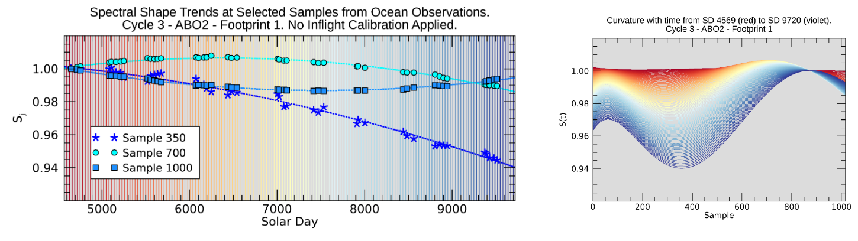
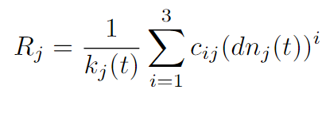

Approach to deriving ABO2 gain degradation in B11.
In B11, we derive the spectral curvature of the gain degradation coefficients directly from ocean scenes, through the fitting of polynomials both across spectral samples and through time, for each decon cycle.
The mean value of gain degradation across the band is still given by the lamp algorithm.
For each decon cycle, a reference period (purple lines) of low contamination is determined, with respect to which curvature is derived.
C1 C2 C3 C4 C5 C6 C7 C8 C9 C10 C11 C12
k – Gain degradation coefficients
c_{i} – Prelaunch gains
dn – Dark subtracted counts
j – Spectral sample index
t_{ref} – Reference time
Curvature
Normalization factor
Gain degradation derived from lamp data at reference period.

Slide 8
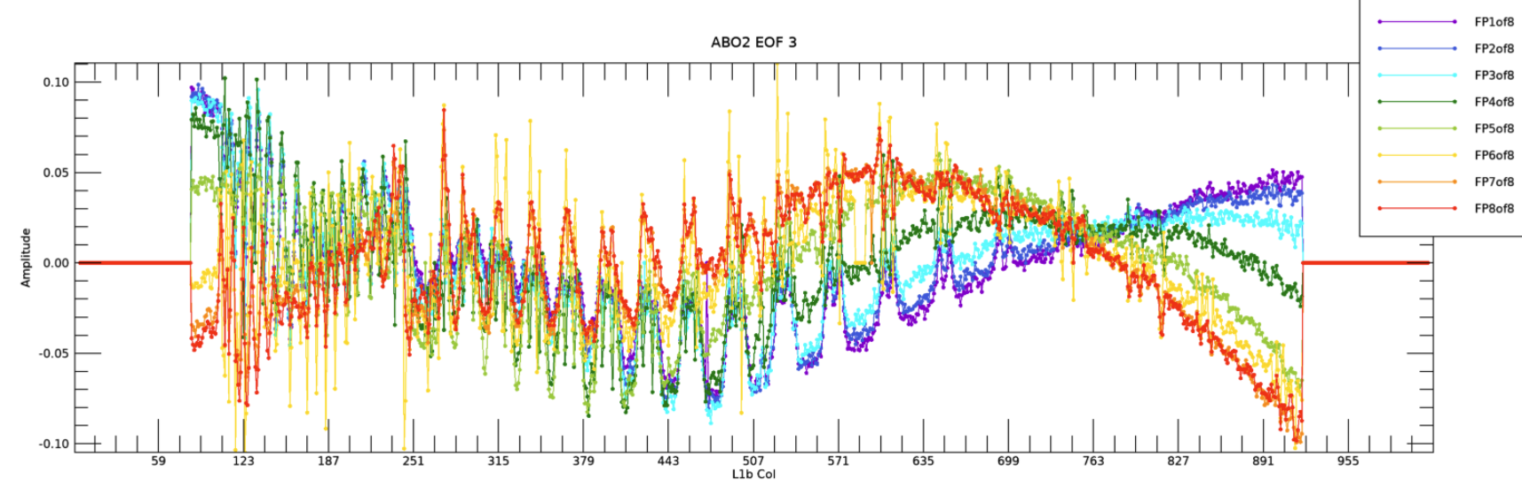
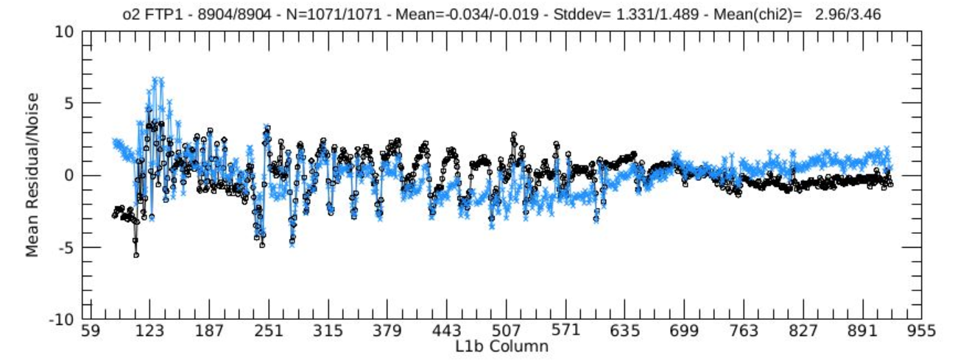
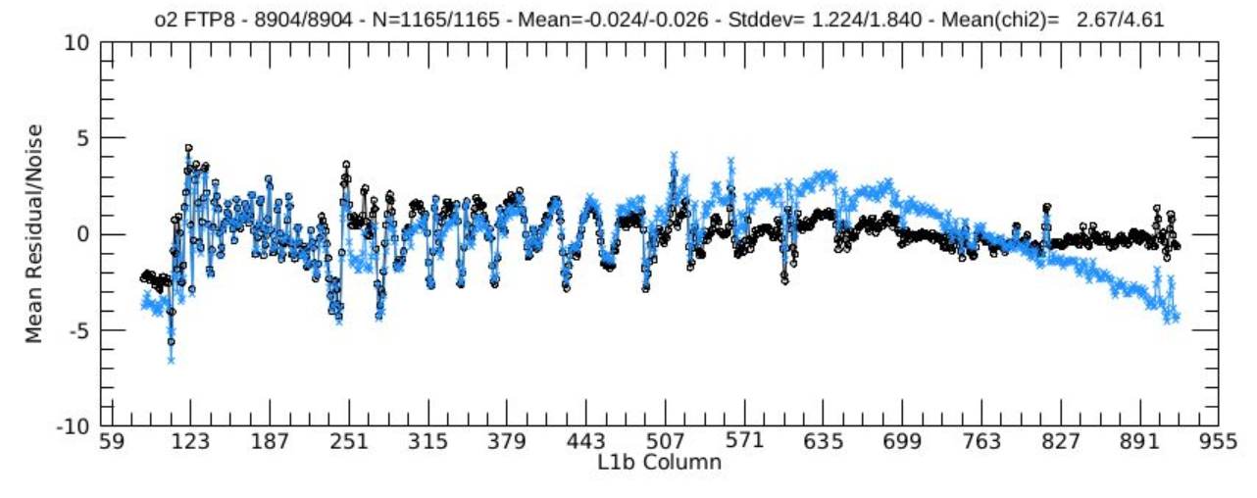
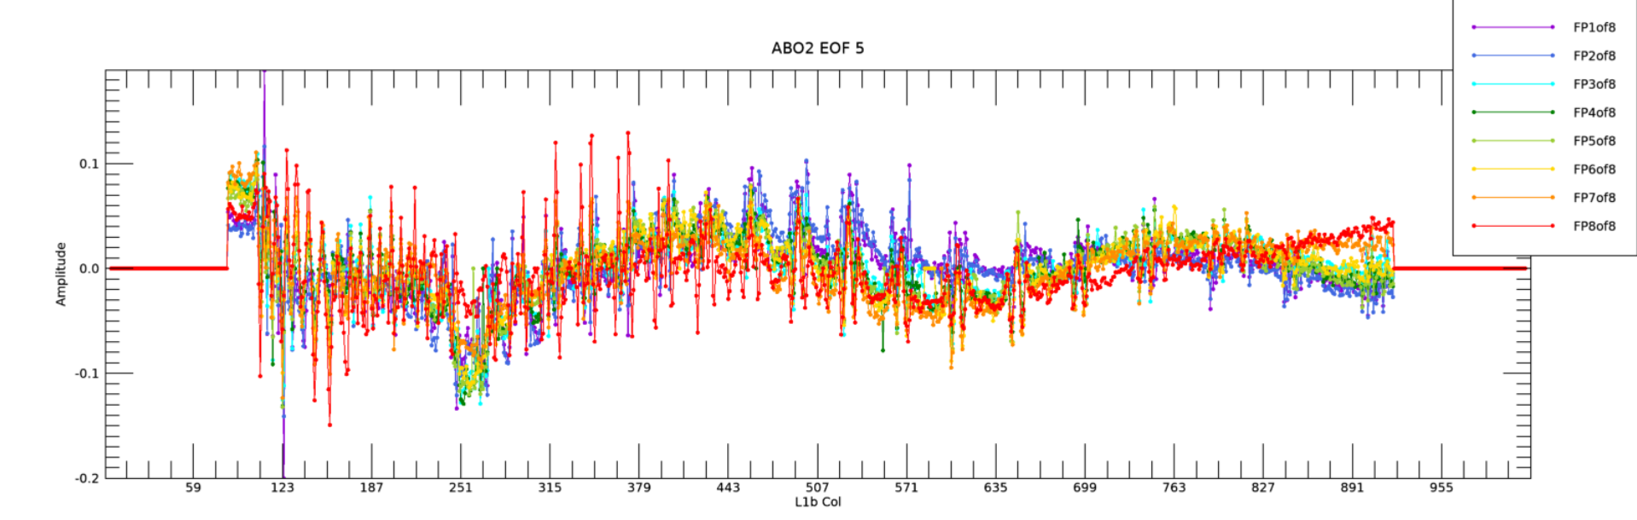
Impact on Product
Empirical Orthogonal Functions (EOFs):
EOFs associated with curvature derived from Build 10 products explained up to 9 % of the variance. This dropped to less than 1 % in Build 11, where curvature related EOFs show less footprint dependency and are no longer subtracted.
Residuals:
The new B11 algorithm positively impacted curvature in all footprints, yielding consistent residuals across all footprints, while v3 OPS ARPs resulted in curved patterns that vary strongly among footprints.
Footprint-dependent effects of icing on ABO2 EOF3 in B10
FTP 1, GL
B103 OPS
Ocean Glint
Footprint-dependent effects of icing on ABO2 EOF5 in B11
FTP 8, GL
Chris O’dell

Slide 9
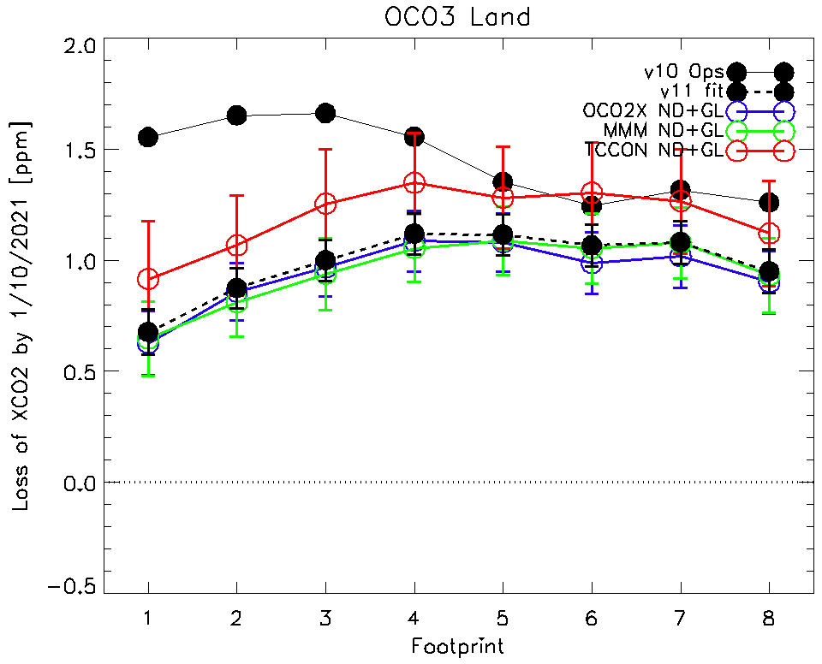
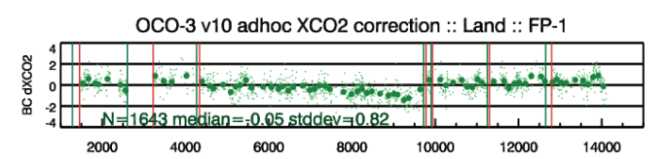
Impact on Product: Slow XCO2 drift
The slow drift in XCO2 was significantly reduced and brought to less than 1 ppm in Build 11.
Build 10 products showed slow XCO2 drift during the longest decontamination cycle, with respect to OCO-2, TCCON and models and required and ad-hoc correction on post processing.
https://docserver.gesdisc.eosdis.nasa.gov/public/project/OCO/OCO3_L2_DQ_Statement_v10_v104.pdf
Chris O’dell

Slide 10
Summary
In OCO-3, contaminant accumulation imparts a S-like shape to the A-Band spectra.
In Build 11, we derive the spectral shape of inflight gain degradation in the A-band directly from observations of clear ocean scenes.
The new calibration of the A-band drastically reduced the curvature of spectral residuals between model and science observations, which previously had a strong footprint dependence.
EOFs associated with curvature derived from Build 10 products explained up to 9 % of the variance. This dropped to less than 1 % in Build 11, where curvature related EOFs are no longer removed.
In Build 10, the curvature artifact manifested itself in the form of a slow drift of XCO₂, from February 2020 to January 2021, with respect to models, TCCON, and OCO-2, which was corrected during the post-processing step.
The slow drift in XCO2 was significantly reduced to less than 1 ppm in Build 11.

Slide 11
Backup Slides

Slide 12
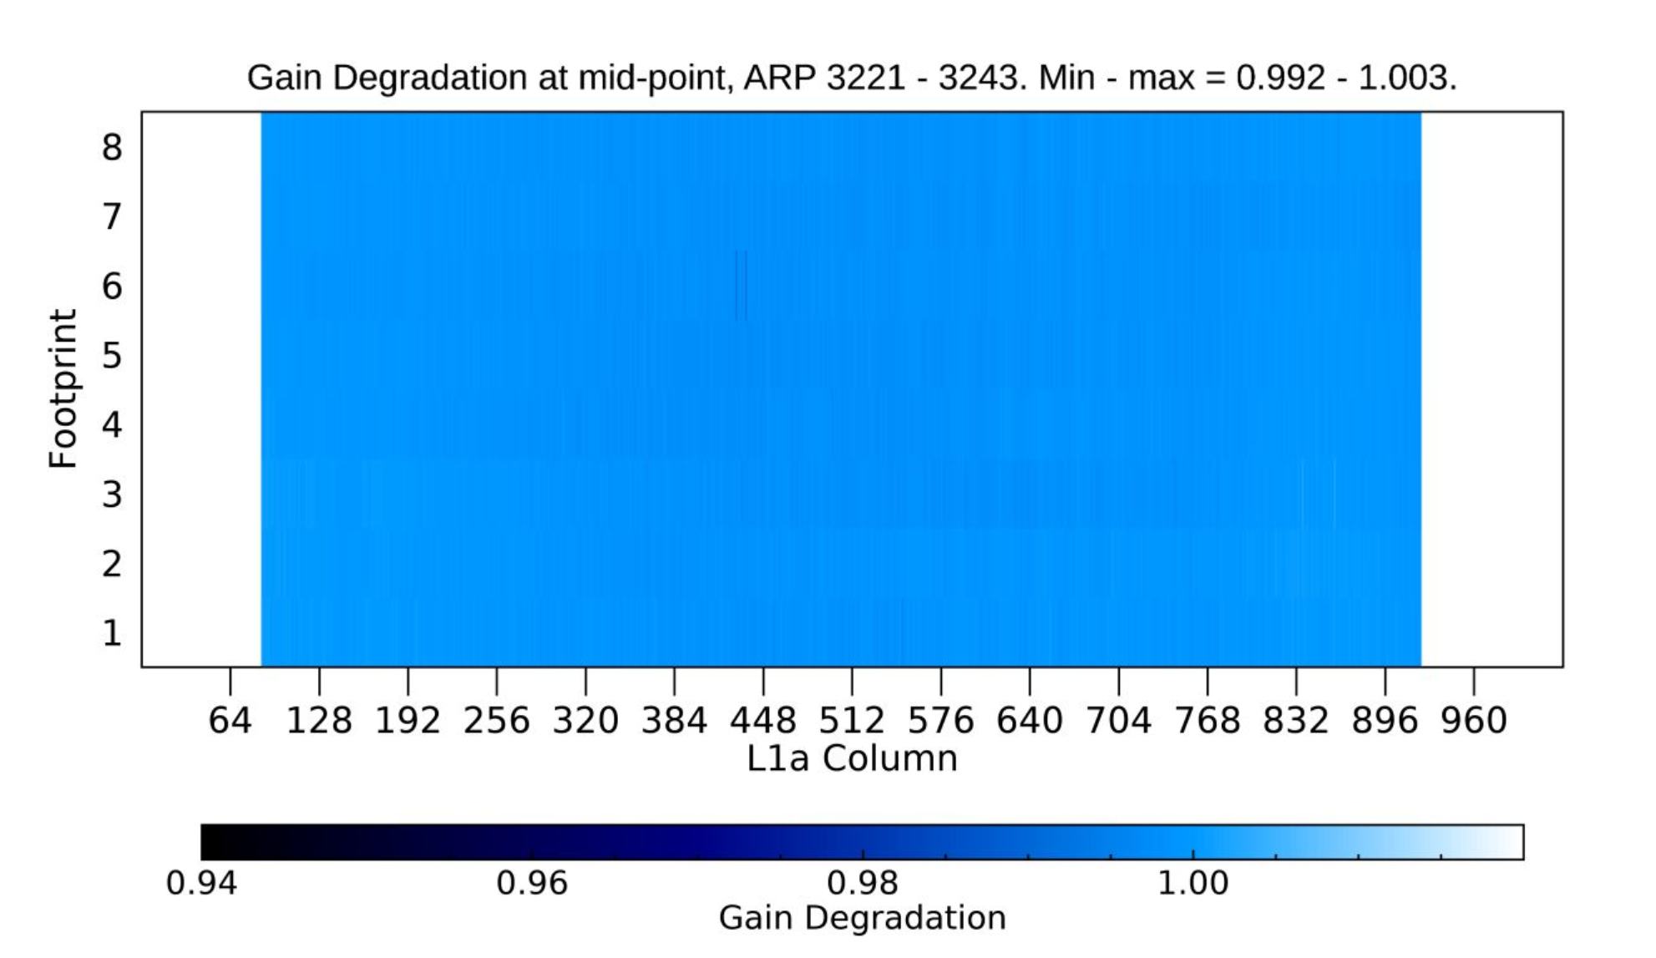
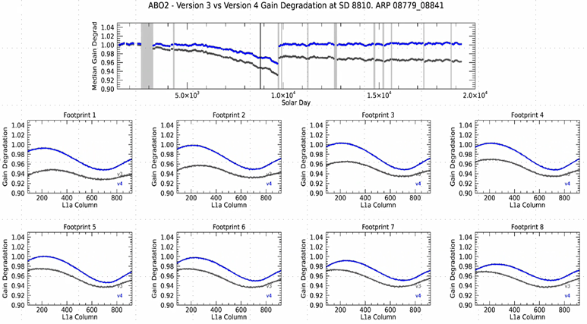
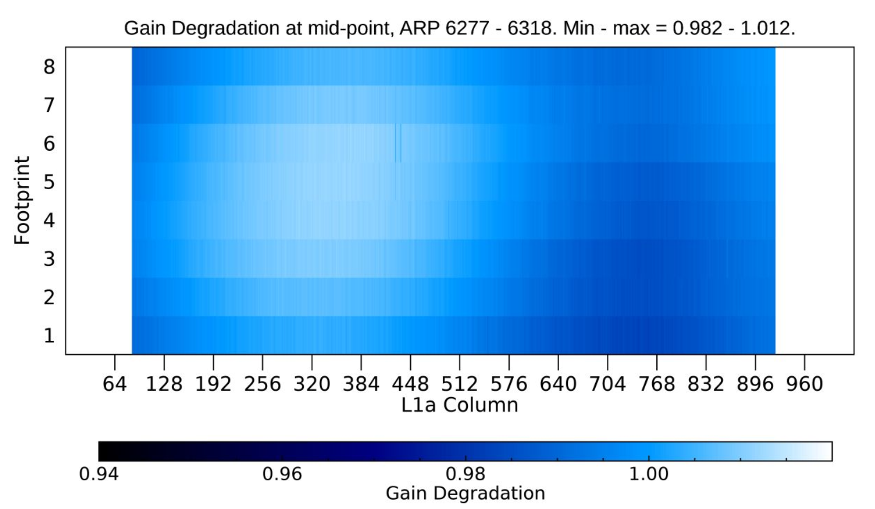
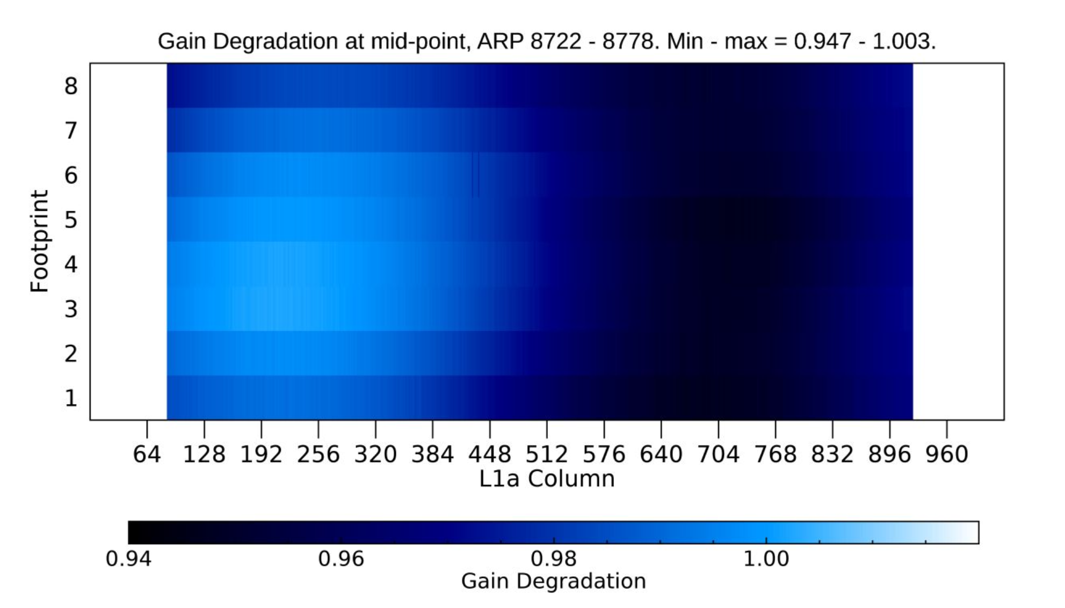
New gain degradation coefficients
B11 - Low Contamination
Build 11 gain degradation coefficients (blue) show more extreme curvature during periods of high ice accumulation. Both B10 and B11 coefficients show footprint dependency.
B11 - High Contamination

Slide 13
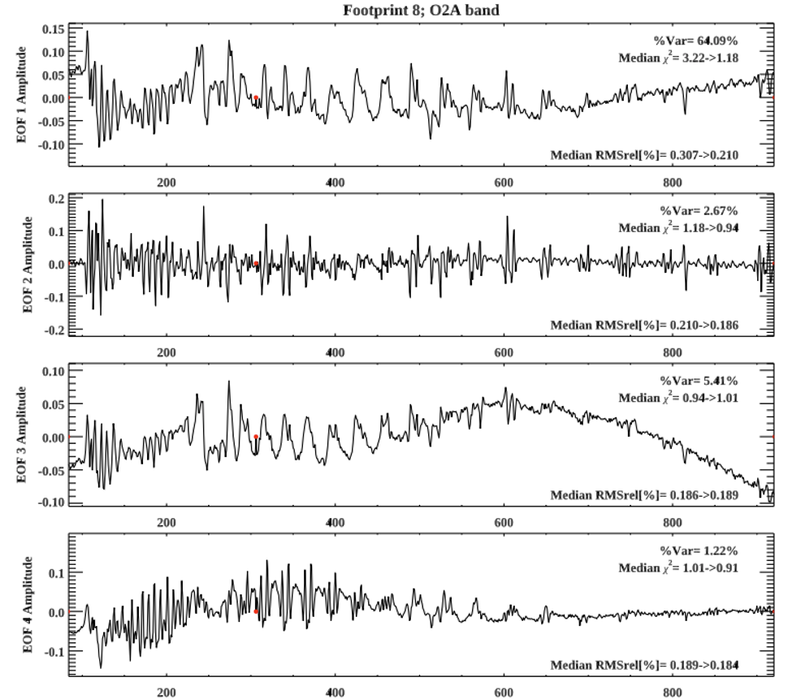
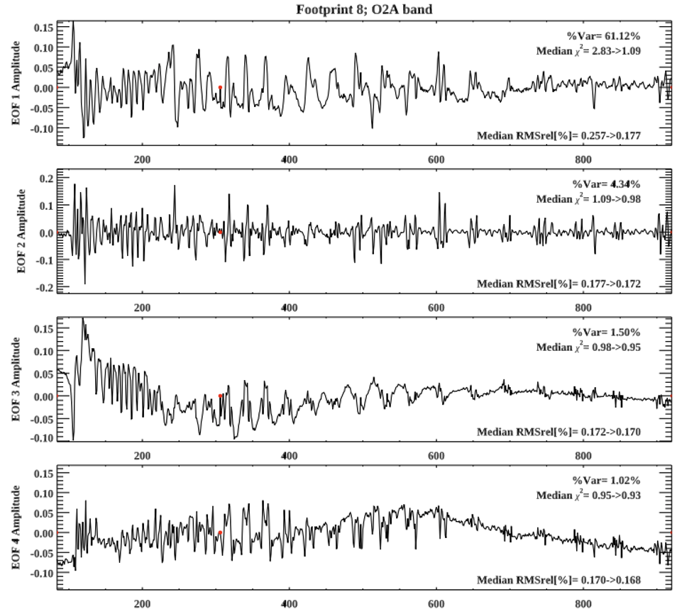
Band 1 in v11…Ice EOF basically gone
OCO3 v10, Footprint 8
OCO3 v11, Footprint 8
Chris O’dell

Slide 14
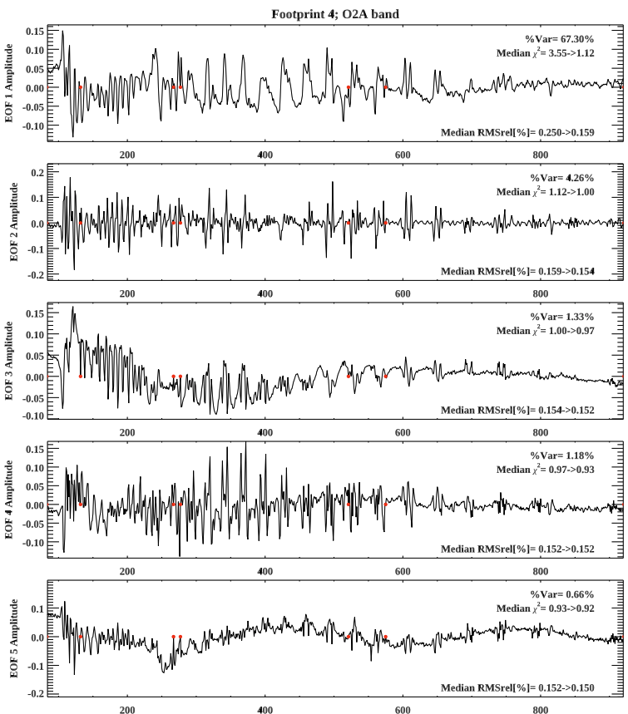
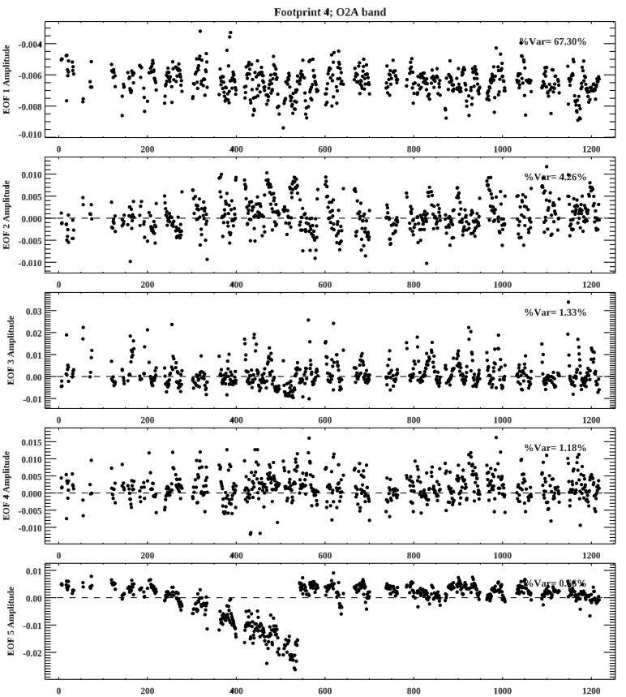
Ice effect relegated to EOF5: many times smaller
OCO3 v11 EOFs, Footprint 4
OCO3 v11 EOF Loadings, Footprint 4
Chris O’dell
Days Since 2019/08/06

Slide 15
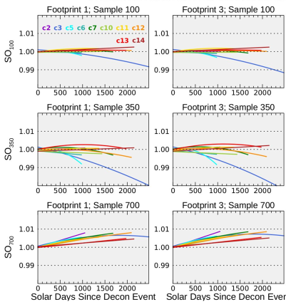
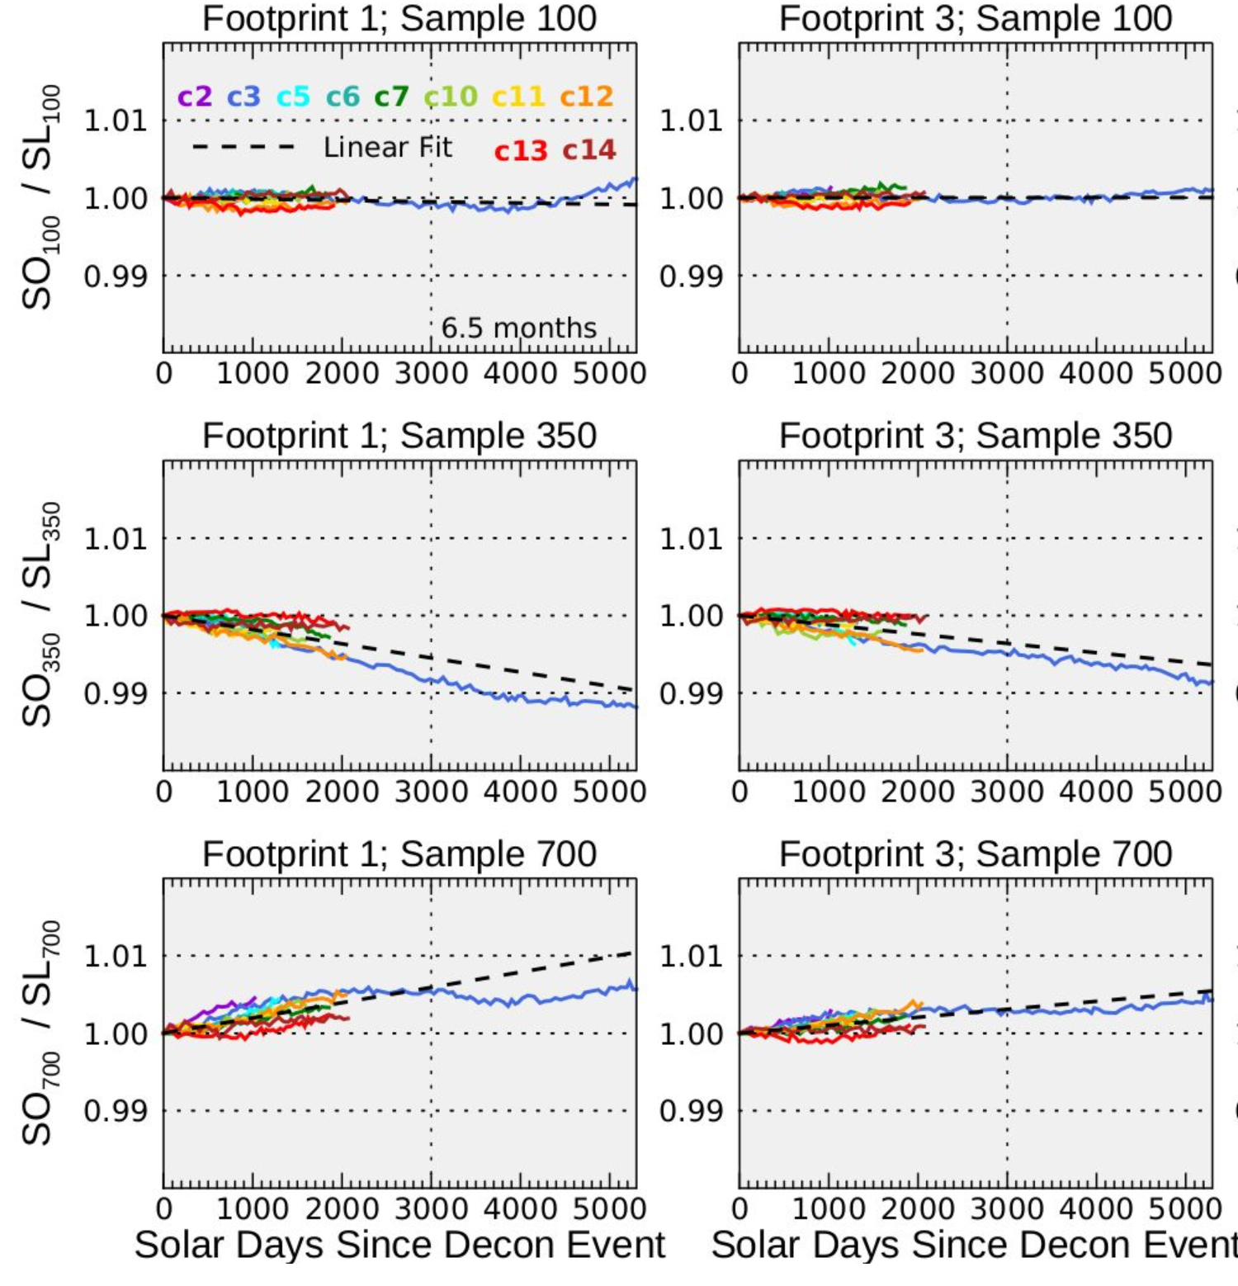
Forward and Rolling Retrospective Streams.
While the Reprocessing calibration algorithm uses data from entire decontamination cycles, this is not possible for the Forward and Rolling Retrospective streams.
Curvature differs considerably between decontamination cycles.
Ratio of gain degradation derived from Ocean and lamp 2 is more consistent and is used to predict the spectral shape of gain degradation.

Slide 16
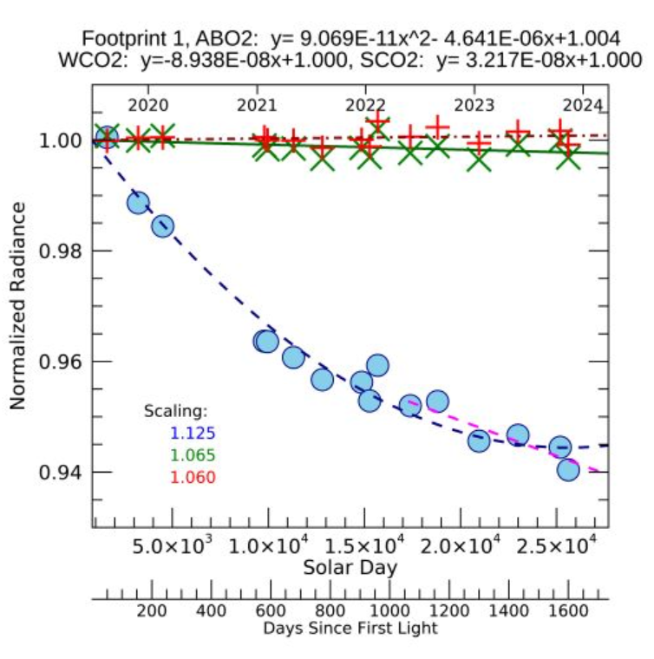
Lamp 1 Aging.
OCO-3 Lamp 1 observations immediately after decontamination events are not impacted by contaminant accumulation.
They can be used to track slow changes in lamp observations that are not related to contamination and may be either due to loss of instrument sensitivity or aging of the calibrator system.

